Slide 1




Coordinating an Effective
Multi-Tiered System of Support for Behavior
Debby Boyer and Sarah Hearn, Center for Disabilities Studies
Sarah Schmittinger-Kashner, Red Clay Consolidated School District
June 20, 2018

Slide 2
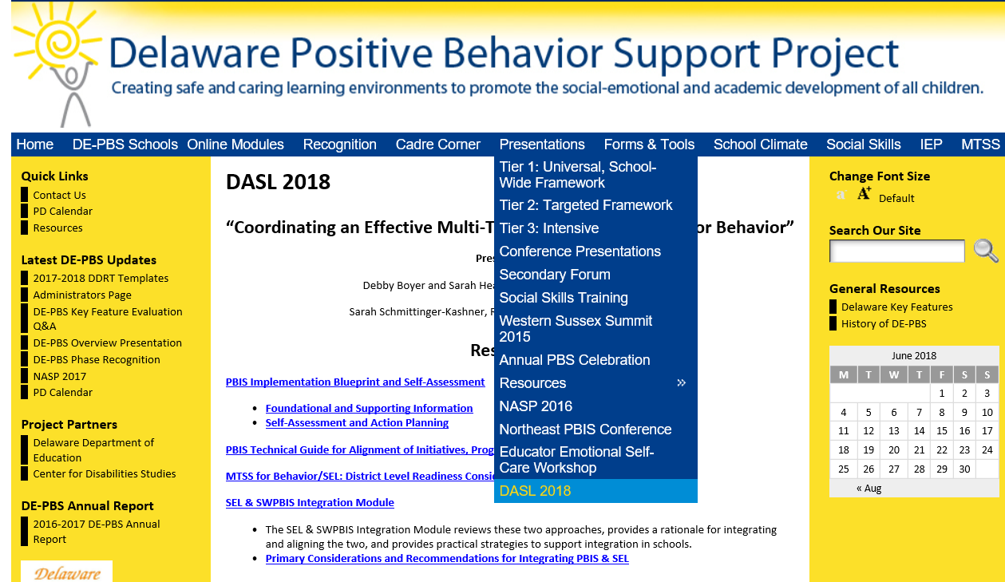
Delawarepbs.org

Slide 3


DASL Session Survey Access
Go to socrative.com
Select “Student Login”
In the “Room Name” box type: SXBVFR8
Answer the questions as they appear on your screen

Slide 4
Overview
Understand best practices for district-level coordination of MTSS for behavior and alignment with other initiatives
Explore tools to support district leadership and integration of new & existing behavior/climate/social-emotional learning (SEL) related initiatives within an MTSS framework
Review implementation process used in Red Clay Consolidated School District

Slide 5
Who is in the room?
District Leaders
School Board Members
School Administrators
Teachers
Specialists: School Psychologists, Counselors, social workers
Others

Slide 6
Which is/are example(s) of a Multi-tiered System of Support (MTSS)?
RTI
Bullying Prevention
PBS
FBA/BIP
Options 1 and 3
All of the above

Slide 7
Effective Organizations
Common Language
“Organizations are groups of individuals whose collective behaviors are directed toward a common goal & maintained by a common outcome”
Skinner, 1953, Science of Human Behavior
Common Practice
Common Vision/Values
Quality
Leadership

Slide 8
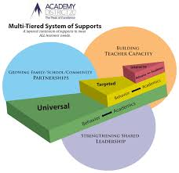
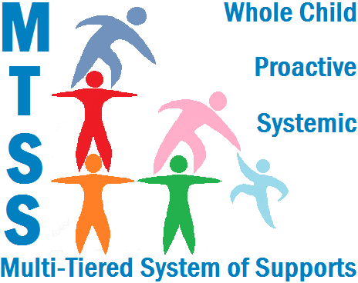
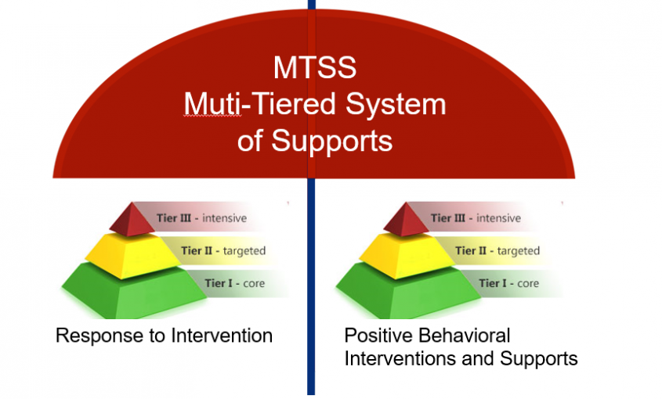
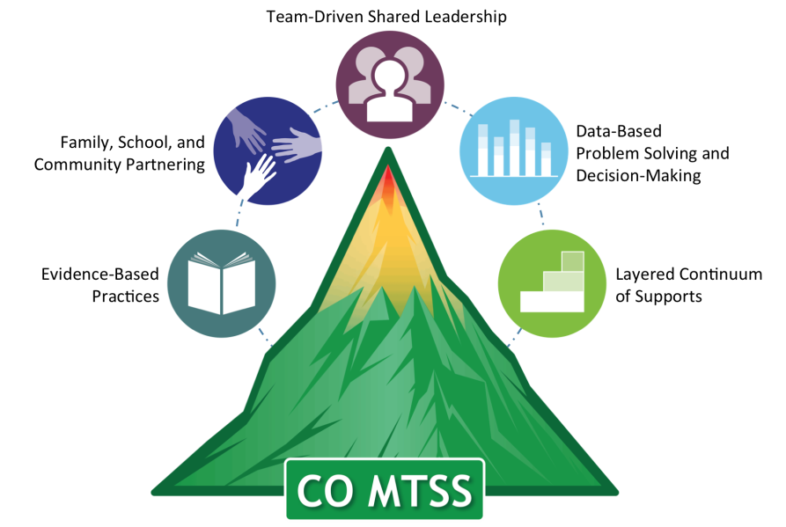
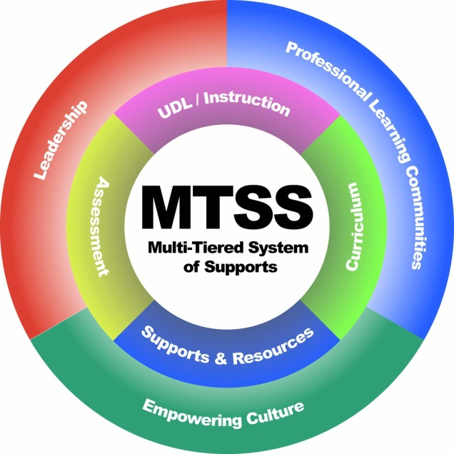
Common Language: What is MTSS?

Slide 9
MTSS for Behavior
Framework for enhancing adoption & implementation of
Continuum of evidence-based interventions to achieve
Academically & behaviorally important outcomes for
All students

Slide 10
IER II: Supplemental, Targeted
TIER III:
Intensive, Individualized
Continuum of Academic & Social Behavior Support
Tier 3 for a Few: Intensive, Individualized
Tier 2 for Some: Targeted for Small Groups
Tier I for All: Core/Universal
10
Notes:
10
10

Slide 11

















Neighborhood Strife
Social Isolation
Family
Set-backs
Disability
Academic Struggles
MTSS
Long-term Traumatic Events
Restorative
Practices
Bullying
Leader in Me
Social Emotional
Learning
Trauma-
Informed
Practices
Responsive
Classrooms
Love
& Logic
Solution
Teams
Students
Staff
Families

Slide 12




MTSS for Social Competence &
Academic Achievement
Outcome data (social behavior, academic achievement), Progress Monitoring, Fidelity
OUTCOMES
SYSTEMS
DATA
What we do to support adults to implement the practices
PRACTICES
What we do to
support students
Notes:
12

Slide 13
Outcomes: Equitable Social and Academic Outcomes
Systems: What we do to support adults
Data: How we determine need and monitor progress
School climate, discipline, academic performance, attendance, nurse visits, counselor contacts
Team-based leadership, coaching support, data-based decision-making protocols, developed procedures and materials for implementing assessment and practices, active supervision protocols
Climate surveys, office disciplinary referrals, academic and behavioral screening information, attendance and tardy data, frequency of nurse/counselor contacts, fidelity checklists and observations
Practices: What we do to support students
3-5 defined school-wide expectations, procedures for teaching and acknowledging expectations, procedures for discouraging problem behaviors, procedures for using data to target needed practices.

Slide 14
Why use the MTSS/PBS framework for trauma-informed schools?
“The fundamental purpose of PBIS is to make schools more effective & equitable learning environments.”
Rob Horner, Co-Director of the OSEP Technical Assistance Center for PBIS
Predictable
Positive
Consistent
Safe

Slide 15
Basic MTSS Implementation Framework
District Behavior Team
SWPBS practices, data, systems
School Behavior Team
2 yr. action plan
School Staff
SWPBS
CWPBS
Data plan
Small group
Individual student
Leadership
Student Benefit
Academic
Social skills
Self-management
Expectations & routines
Policy, funding, leadership, priority, agreement
Team meeting schedule
State Leadership
Internal Coaching Support
External Coaching Support
Team Support

Slide 16
Tier 1 Framework for Positive Behavior Supports and Interventions
School-wide PBS Tier 1: Program Development & Evaluation Systematic Collection & Use of Multiple Data Sources Established Representative Problem-Solving Teams Ongoing Professional Development & Resources to Sustain Implementation | Prevention: Implementing Schoolwide & Classroom Systems Establish Positive Relations (Student, Teacher, Parents) Establish, Teach, and Acknowledge Positive Behavioral Expectations Support a Safe School Environment
Correcting Problem Behavior Establish System to Manage Office Discipline Referrals Support Use of Strong Classroom Management Techniques Systematic Response to Behavior Includes Problem-Solving | Developing Self Discipline Policy Commitment to Goal of Developing Self-Discipline Social Emotional Learning (free standing or integrated within Curriculum) Students Active in Decision-making

Slide 17
3-Tiered System of Support
Necessary Conversations (Teams)
School-wide
Team
Tier 2 Team
Tier 3 Team
Identifies targeted student needs,
Selects and supports implementation of relevant interventions, and
Evaluates interventions’ use
Uses Process data; determines overall intervention effectiveness
Plans SW & Class-wide supports
System
Conversations
Uses process data; evaluates overall effectiveness; does NOT involve discussion of individual students
Problem Solving Conversations
Matches students to interventions and monitors progress, making adjustments as needed
Universal Support through SW Program
FBA/BSP
PTR
Person Centered Planning
CICO
Group interventions
Group w. individual features
Brief FBA/BSP
Adapted from the Illinois PBIS Network
Notes:
17
17

Slide 18
What do you think is the biggest barrier to implementing MTSS?
Lack of Administrator buy-in
Lack of Staff buy-in
No lead person or champion
Limited PD from district or state
Limited funding and/or resource
Competing initiatives

Slide 19
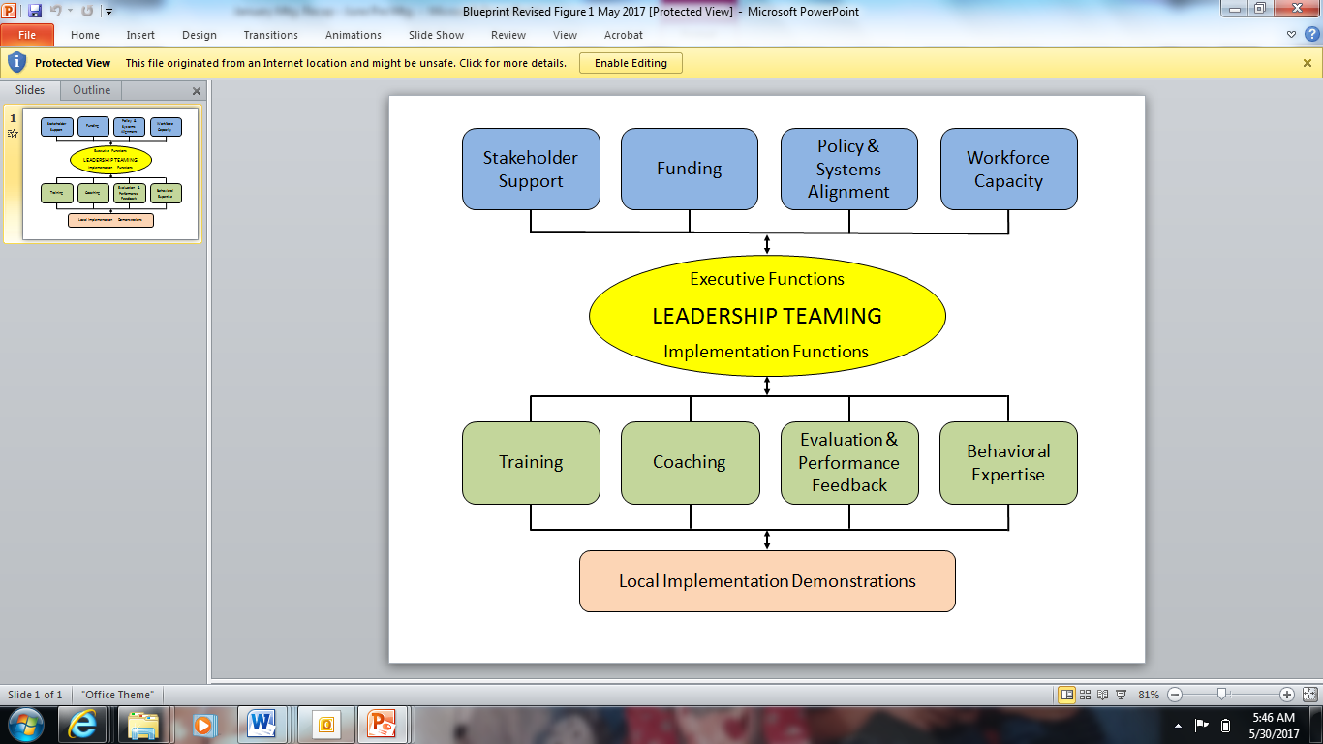

MTSS Capacity Building
State → District →School
PBIS/MTSS Implementation Blueprint

Slide 20
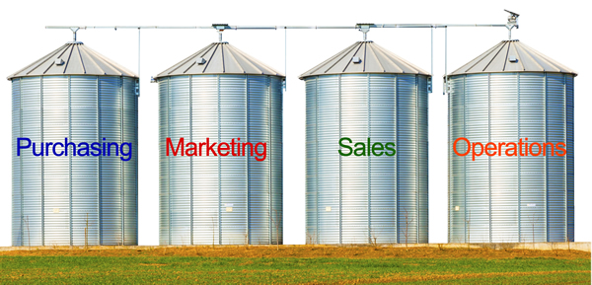
Components for Successful
District Implementation
Leadership Team established to actively coordinate implementation efforts.
Climate
SEL
Academics

Slide 21
Leadership Team Elements
Authority to address state or district implementation (e.g., policy, professional development, evaluation, scheduling, funding).
Representation from the appropriate range of stakeholders from the local community
Completes self-assessment & develops a 3-5 year action plan
Uses formal procedures for securing majority agreements from members of implementation unit for decision-making and policy and procedural approval and problem solving challenges, conflicts, etc.
Informs other leadership personnel on implementation outcomes (e.g., fidelity, student outcomes, professional development).

Slide 22
Who might serve on a district team?
Members should include individuals whose roles, responsibilities, and activities are associated with the
(a) prevention of the development and occurrence of problem behavior,
(b) development and maintenance of behavior, and
(c) management and evaluation of resources related to the provision of behavioral supports.
Examples of district-wide team members include:
District & School administration
Instruction & Curriculum
Character Education
School-wide Discipline
Special Education
Dropout Prevention

Slide 23
What does the leadership team do?
Complete a self-assessment
Create a 3-5 year action plan
Establish regularly scheduled meetings
Identify a coordinator to manage and facilitate
Secure stable funding for efforts
Develop a dissemination strategy to establish visibility (website, newsletter, conferences, TV)
Ensure student social behavior is the top priority of the district
Establish trainers to build and sustain school-wide PBS practices.
Develop a coaching network (each school identifies a team leader to facilitate)
Evaluate school-wide PBS efforts

Slide 24
Working Smarter
Initiative, Project, Committee | Purpose | Outcome | Target Group | Staff Involved | School Improvement Plan
Attendance Committee
SEL Committee
Safety Committee
Discipline Committee
Mental Health Committee
Wellness Committee
Are the same staff serving on multiple committees?
Are outcomes measurable?
Do our committees have a similar purpose?
What committees/teams can you align and integrate to support everyone’s efforts towards the district/school strategic plan and mission?

Slide 25
Developing a Red Clay District’s
MTSS Behavior Leadership Team
Membership
  Cross district-level groups (pulling from silos)
  Strategic school level invitations
    PBIS (training through DE-PBS Project) & Non-PBIS
    Elementary & Secondary
    Successful & Struggling
Meets ~4x per year
District Team Leaders completed Implementation Blueprint Self-assessment initially to inform direction moving forward

Slide 26
Developing a Red Clay District’s
MTSS Behavior Leadership Team
Agenda Topics
  Building MTSS understanding & current district structures
  Discuss desired outcomes for district MTSS efforts
  Current data exploration (fidelity, tier 3 survey, etc.)
  Student case study & problem-solving discussion
  District-wide MTSS expectations: required vs. flexible components

Slide 27
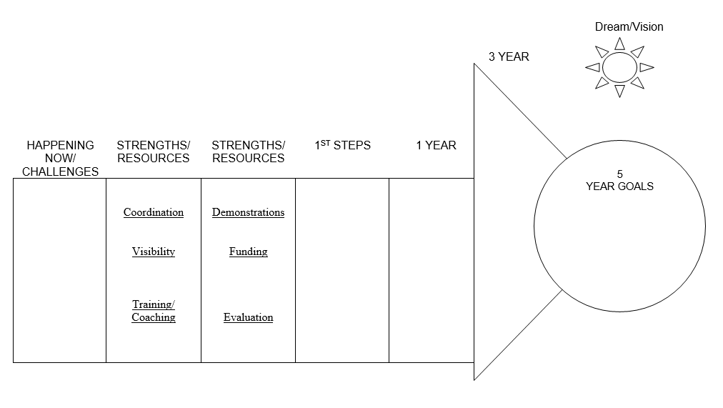
Action Planning/PATHs Process

Slide 28
Components for Successful
District Implementation
An organizational umbrella composed of active and supportive leadership, adequate funding and workforce, and clear vision toward outcomes for aligned initiatives.

Slide 29
Executive Functions – Action Examples
Secure partnership agreements: commitment to 3-5 years for systems change
Establish budget plan: securing short and long-term funding resources
Garner local political support: District Superintendents & Board
Focus on visibility: state & local presentations, multi-media, data sharing
Create clear description of alignment for initiatives with similar goals, outcomes, systems and practices

Slide 30
Red Clay’s Executive Functions Efforts:
Strategic Plan, Workforce, Funding
Behavior Support Coaches – 2 staff
  Attend Bi-monthly Behavior Support Team (BST) problem solving meetings
  Behavior Coaches meet with each building team leader one a month
    Answers building specific questions
    Develops upcoming agendas for Tier 1 or Tier 2/3 meetings
    Action Planning
    Attends building MTSS meetings
  Train on MTSS district wide (tier 1, classroom management, teacher toolbox)
  Provide custom building based faculty training, PLCs, targeted teams
  Classroom management consultation with teachers

Slide 31
Red Clay’s Executive Functions Efforts:
Strategic Plan, Workforce, Funding
Behavior Analyst- 2 staff
  Attend weekly Behavior Support Team (BST) problem solving meetings
  Provide professional development district-wide
  Support monthly psychologist meeting PD- 45 min-1 hr.
      Topics include: FBA,BSP, self-care, internalizing behaviors, developing coping skill goals, how to collect meaningful data.
  Consult on Tier 3 student cases
      Paper review and feedback
      Observation of student
      Consultation with building based psychologist
      Observation, Consultation and development of documents

Slide 32
Red Clay’s Executive Functions Efforts:
Strategic Plan, Workforce, Funding
Building level meetings -
  PBIS (School –wide), one hour per month, 6-8 team members
  PST (Tier 2/3), two meetings per month, one hour each, 6-8 members
      Systems Meeting
      Student Cases
District level team leader meetings
  Substitute coverage for PBIS Team Leader meetings every other month
  Substitute coverage for PST Leader meetings quarterly
  PST and PBS Team leader stipends yearly

Slide 33
Components for Successful
District Implementation
A foundation for sustained and broad-scale implementation established through a cadre of individuals who can provide coaching support for local implementation, a small group of individuals who can train teams on the practices and processes of school-wide behavior support, and a system for on-going evaluation.

Slide 34
Implementation Functions – Action Examples
Establish plan to evaluate for desired outcomes
  Secure data access
  Support collection systems
  Set evaluation schedule & process
Establish district training and coaching plan
  Reflect on school needs
  Reflect on staff capacity
  Assess staff competency/skill level across data, systems & practices

Slide 35
Red Clay’s Implementation Functions Efforts:
Training, Coaching, Evaluation
District wide expectations around MTSS components to be established - “required elements”
Routine Team Leader meetings with embedded training to support “required elements”
Year round coaching provided to Tier 1 and Problem-solving teams
Evaluation Plan
  Delaware School Climate Survey
  Tier 1 monitoring
    Tiered Fidelity Inventory or DE-PBS Key Feature Evaluation
    Office Discipline Referral data
Yearly action planning

Slide 36
MTSS Tier Level | Required Components | Flexible Components
Tier 3: Data, Systems & Practices in place for FEW | Problem-solving Team Data-based Decision Making & Data Collection Functional Behavior Assessment & Behavior Support Plans | Individual Interventions Person centered planning PTR: Prevent-Teach-Reinforce
Tier 2: Data, Systems & Practices in place for SOME | Problem-solving Team Data-based Decision Making & Data Collection Relationship Building Intervention (minimum 1) Skill-based Small Group Intervention (minimum 1) | Additional Relationship Building Interventions Additional Skill-based Small Group Intervention based on building identified needs (may be aligned with re-teaching of social/emotional curriculum)
Tier 1: Data, Systems & Practices in place for ALL | Tier 1 Leadership Team Data-based decision making & Data Collection School-wide Expectations Teaching/Re-teaching of Expectations Major/Minor Flow Chart System for Correcting Problem Behavior Systems Meeting with Special/Student Services staff (minimum monthly) | Home Matrix Use of Incentives Social/Emotional Curriculum Integrated initiatives w/in Tier 1 MTSS Responsive Classrooms Leader in Me Trauma-Informed Practices

Slide 37
Components for Successful
District Implementation
A set of demonstration schools that documents the viability of the approach within the local fiscal, political and social climate of the state/district

Slide 38


Red Clay’s Implementation Highlights
Cooke Elementary
Baltz Elementary
McKean High

Slide 39
Principal’s Role
Maintain standards regarding school innovations
Make public statement of support for selected innovation
Establish representative leadership team to lead implementation
Provide team w/ time & resources
Guide decision-making
Model & reinforce implementation with fidelity
Attend & participate in team meetings
Recognize faculty & team for efforts
Serve as community spokesperson
Monitor & provide feedback on progress & impact
Adapted from Colvin & Sprick, 1999

Slide 40
MTSS for Behavior/Social-Emotional Learning
District Level Readiness Considerations
Is there a need and desire to promote positive school climate, reduce suspensions and behavior referrals, and improve academics?
  Which data sources support this?
Is there desire and commitment from district leadership to support implementation of a multi-tiered system of support (MTSS) for behavior/social-emotional learning (SEL) across all schools?
  How does this connect to your district’s existing strategic plan?
  Does district leadership need additional information on MTSS?

Slide 41
MTSS for Behavior/Social-Emotional Learning
District Level Readiness Considerations
Is there commitment to developing & maintaining a 3-5 year district-wide action plan to build & sustain the MTSS/PBS/SEL framework across all schools?
  What are potential avenues for collaboration/coordination based on existing initiatives and plans within district?
  How will your district work with schools interested in MTSS/PBS/SEL framework development & implementation?
  Considering readiness, buy-in and need, how will schools be identified to receive training and support?
Which district representative(s) will serve as the MTSS District Coordinator(s) (i.e., lead contact, core decision makers) for all behavior/SEL initiatives within your district?
  Who is in the current leadership role for related initiatives, such as school climate & discipline, social-emotional learning, etc.?

Slide 42
MTSS for Behavior/Social-Emotional Learning
District Level Readiness Considerations
Is development of a district team a desired action item for the district and supported by administration? This team of stakeholders would be supported by the DE-PBS Project to lead development of action plan and drive implementation efforts.
  What teaming structure would be a good match for our district context?
  Do we have existing teams with similar goals with which we can integrate?
  Would it make sense for our district to utilize a smaller core implementation/development team with a broader, representative team to support data-based action planning and implementation efforts?
Who are the MTSS for Behavior/SEL Coaches with allocated time & skills identified by the MTSS District Coordinator(s) to receive DE-PBS Project support and provide in-district professional development and technical assistance?

Slide 43
Initiative Alignment

Slide 44

Why Alignment is Important
“One of the major variables affecting sustained implementation of effective practices is the introduction of new initiatives that either (a) compete with resources needed for sustained implementation or (b) contradict existing initiatives.” - McIntosh (2015)

Slide 45


In a randomized controlled group study of SWPBIS in elementary schools in Maryland, Bradshaw et al. (2010) found an average of 5.1 programs were being introduced in each school on “character education and /or development, social-emotional or social skills, bullying prevention, drug prevention (e.g., D.A.R.E.), and conflict resolution and/or peer mediation” (p. 146).

Slide 46
Consistency matters, you can build it
Common
Vision/Expectations
SCHOOL COMMUNITY
Common
Language
Common
Practices
(USDOE OSEP PBIS TA Center, 2010)
Notes:
46

Slide 47
Integration and Alignment Resources
Technical Guide for Alignment of Initiatives, Programs and Practices in School Districts from PBIS.org
  Self-assessment and action planning tools
DE-PBS Module and Resources on SEL and PBS Integration
  Primary Considerations and Recommendations for Integrating PBIS & SEL
MTSS Asset Mapping

Slide 48

Technical Guide for Alignment of Initiatives, Programs and Practices in School Districts
Coordinate and lead process with executive level team
Define valued outcome(s)
Develop inventory of current related initiatives
Identify core systems features for initiatives targeted for alignment
Analyze and make decisions about conflicts and duplicative elements; identify missing fidelity and outcome measures
Design plan for effective alignment including implementation, evaluation and PD
National Technical Assistance Center on Positive Behavior Interventions and Support. (2017). Technical guide for alignment of initiatives, programs, practices in school districts. Eugene, OR: Retrieved from www.pbis.org

Slide 49
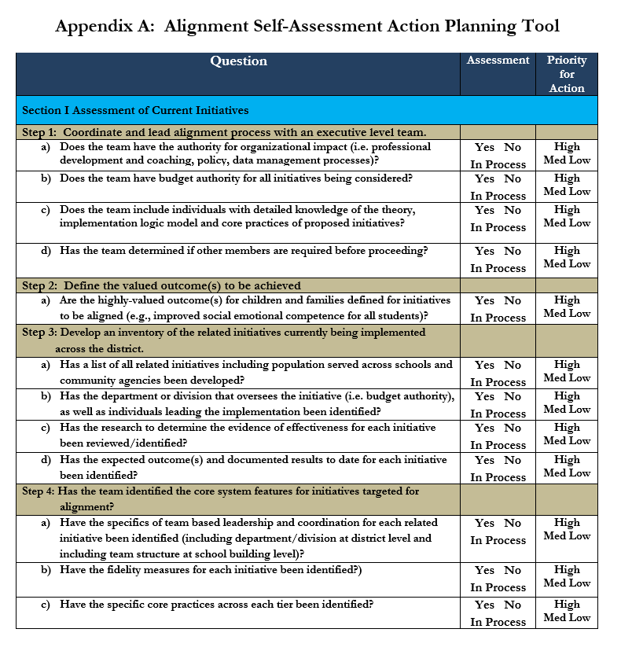
Alignment Self-Assessment Action Planning Tool

Slide 50
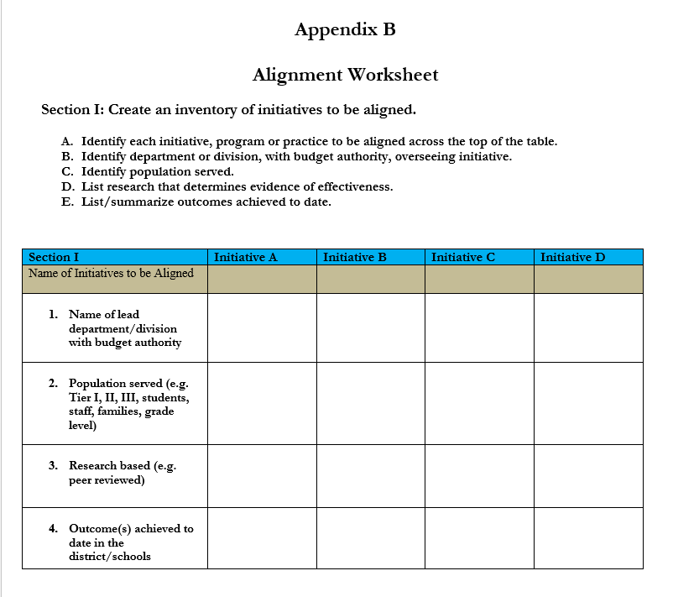

Slide 51
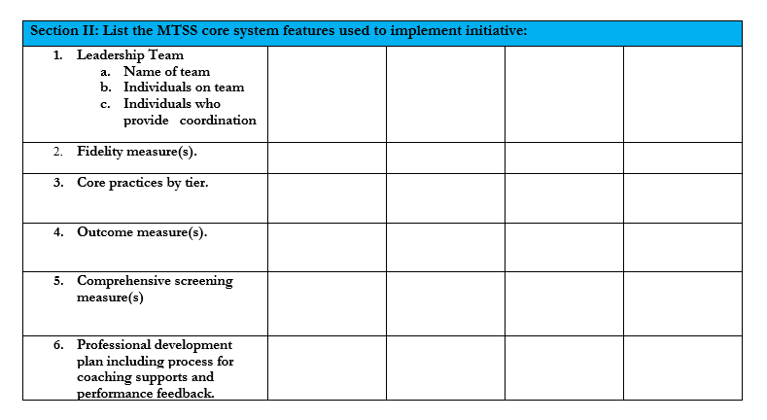
Tool for Identifying MTSS Core Features
Based on 6 core MTSS features (McIntosh & Goodman, 2016)
Organizes information and identifies potential holes
Used to determine “fit” of each initiative

Slide 52
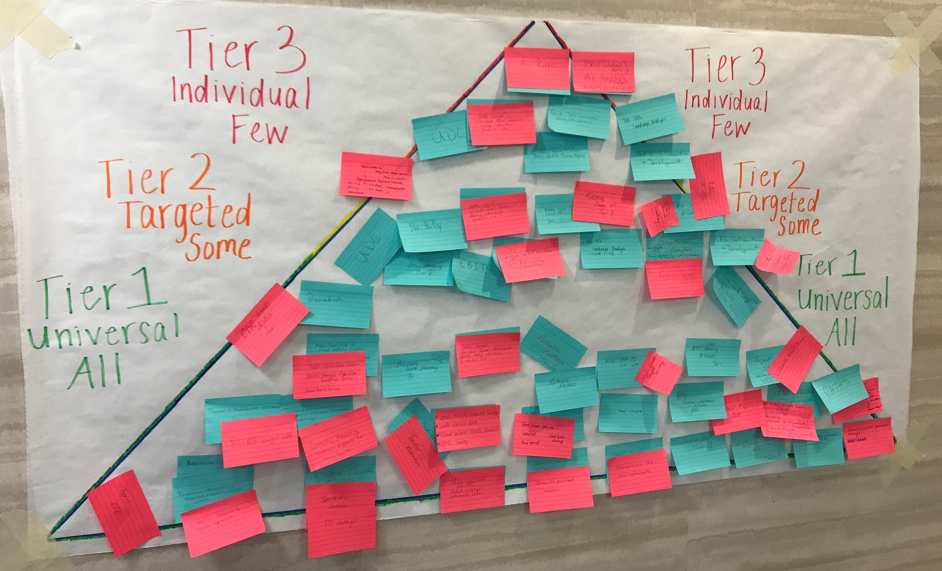
MTSS Asset Mapping: Practices and Outcomes

Slide 53
Behavior/Climate/SEL Initiatives
How do we all fit in?
Example
Name | DE - PBS
Lead organization | DE Department of Education UD Center for Disabilities Studies
Population served | MTSS – Tier 1-2-3
Goals of initiative | Create safe and caring learning environments that promote the social-emotional and academic development of all children Improve school climate Decrease office referrals, suspensions Decrease disproportionality rates
Outcomes & fidelity measures | School climate data ODR Systems fidelity – Tier 1 & Tier 2 Tier 3 – support plan fidelity (TATE)
Type of PD & Coaching | In-person workshops Online PD materials (new) Coaching through district staff
Reflect on initiative on which you work, consult or research
Note the following per initiative:
  Lead organization/person
  Population served – Tier 1, Tier 2, Tier 3
  Goals
  Outcome & fidelity measure(s)
  Types of training & coaching provided

Slide 54
Putting it all together
1. Self-assess
(OUTCOMES)
What practices & systems in place?
What can be enhanced, merged?
3. Establish leadership teaming capacity & readiness
(SYSTEMS)
Organization
What can be continued, added, dropped?
2. Conduct resource mapping (PRACTICES)
Strengths
Challenges
Needs
Features
Functions
4. Develop action plan (IMPLEMENTATION)
Leadership & coordination capacity
5. Monitor & adjust implementation (DATA)
Training & coaching capacity
Policy, funding, visibility, political support
Evaluation
Local behavioral expertise
Implementation fidelity
Progress monitoring
What is level of implementation fidelity?
Successes
Priorities

Slide 55

Thank you!
Questions? Ideas?
Debby Boyer
dboyer@udel.edu
Sarah Hearn
skhearn@udel.edu
Sarah Schmittinger-Kashner
sarah.kashner@redclay.k12.de.us
Delaware PBS Project
Center for Disabilities Studies
University of Delaware
www.delawarepbs.org

