Slide 1
Bullying victimization
Research and recommended interventions
Lead authors: Dr. George Bear, Dr. Lindsey Mantz, and Angela Harris
University of Delaware
Funding and support from:
DE Positive Behavior Support Project – School Climate & Student Success

Slide 2
Module Structure
Module series goal:
Provide information to schools that can lead to improvements in school climate and behavioral outcomes.
Module narratives provide additional information to accompany PowerPoint Presentation.
Endnotes throughout slides correspond to the references in the module narrative.
Gold star = Resource on Delaware PBS website

Slide 3
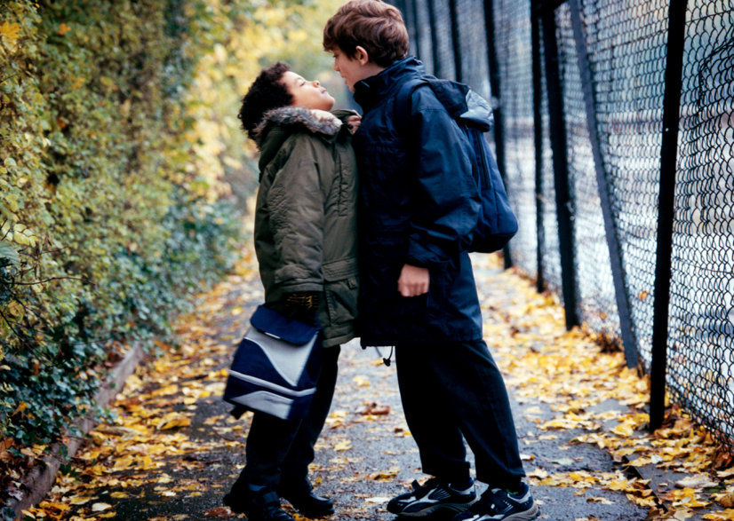
What is Bullying victimization?
Bullying = type of aggression that aims to:
Harm the victim
Is repetitive over time
Involves an imbalance of power
The bully is more powerful than the victim¹

Slide 4
Bullying in Delaware
Delaware law defines bullying as:
Intentional actions that occur in physical, verbal, written, or electronic form towards a student, school employee, or school volunteer that:
cause reasonable fear or substantial harm to the victim’s physical or emotional well-being, or damage to property
are pervasive/persistent or characterized by a power differential that creates a hostile educational environment
interfere with a safe environment
include coercing others to cause the above harmful actions

Slide 5
Delaware School Surveys
Assesses four types of bullying victimization (verbal, physical, social/relational, and cyber)
Delaware Bullying Victimization Scale
Assesses students’ reports of the extent to which they have personally experienced each of the four types of bullying during the current school year
Bullying school-wide subscale on the Delaware School Climate Scale
Assesses bullying in general throughout the school
Items that ask if students bully one another, threaten and bully others, and worry about others bullying them

Slide 6
Negative effects of bullying victimization
Greater internalizing problems
E.g. depression, anxiety, and loneliness¹⁻¹²
Increased risk of suicide ideation, suicide attempts, and self-injury¹³⁻¹⁶
Increased risk of participation in delinquent and problem behaviors
E.g. substance use, stealing, physical fighting, and vandalism¹⁷⁻¹⁸
Greater difficulty making friends and greater risk for social rejection and isolation^{1,15,19-20}
Lower social competence²¹
Lower self-esteem^{11,15,19} and increased levels of self-criticism¹²

Slide 7
Negative effects of bullying victimization
Attachment or connectedness to school^{2,22}
E.g. greater fear, anxiety, and avoidance towards school^{8, 23-25}
Lower
Academic engagement, achievement, and classroom concentration^{8,11,20,26-28}
At risk
For psychosomatic problems
E.g. headaches, stomach pain, sleeping problems⁴
Less

Slide 8
Negative outcomes for bullies
Not only are victims of bullying at increased risk for a number of negative outcomes, but so too are students who bully others. Those risks include:
Involvement in crime, violence, drugs, alcohol, and delinquency^{8,17,29-34}
Greater internalizing problems⁷
Psychosomatic symptoms such as feeling tired or tense³
Suicide attempts and ideation¹⁴
Less school bonding, or connectedness²²
Lower academic achievement^{8,17}
Students who witness bullying and those who
are both victims and perpetrators of bullying
also are at risk for negative outcomes.¹⁰⁹⁻¹¹⁰

Slide 9
Student and Home Characteristics
Bullying Victimization
Contributing Factors
Classroom, School, and Teacher Characteristics

Slide 10
Student & Home Characteristics contributing factors
The following characteristics have been shown to be associated with students who experience the least bullying:
General social and emotional competence. This includes:
Few, if any, behavior problems^{22,35,36}
Good social skills³⁷
Ability to regulate one’s emotions³⁷⁻³⁸
Experiencing and expressing empathy³⁹
Viewing oneself favorably^{15,21,36,38,40-42}
Positive self-perceptions
High self-esteem
Absence of internalizing problems
Overall life satisfaction

Slide 11
Student & Home Characteristics contributing factors
Less Bullying
Good health & physical condition
Parental Support, Engagement & Authoritative Style
Accepted & supported by peers
Not depressed, nervous, or irritable

Slide 12
Student & Home Characteristics contributing factors
Although not malleable, other characteristics of students place them at increased risk of being bullied:
Students with disabilities, especially those with observable behavior problems⁵⁶⁻⁵⁹
Students who identify as lesbian, gay, bisexual, transgender, or questioning^{51,60-61}
Mixed results for race^{7,53,62-66}
Males tend to experience more bullying (and bully others) more than females (verbal and physical bullying)^{1,11,19,21,38,40,44,53,63,67}
Females bully and are bullied with more verbal, relational and social forms of bullying^{9,11,19,53}
Mixed results for age and grade level^{1,9,23,62,68-69,106}
Within the same grade, younger children are bullied more³⁶
Mixed results for religion
Muslim & Jewish students more likely to be victims¹¹⁴⁻¹¹⁶

Slide 13
Classrooms, schools, and teachers contributing factors
Less bullying occurs in schools and classrooms characterized by the following:
Positive teacher-student relationships and teacher support^{27,44,47,65,70-73}
This includes students:
Viewing teachers as disapproving of bullying
Believing teachers will respond to bullying
Believing teachers are aware of peer group interactions
Willing to seek help from teachers for bullying
Believing that teachers encourage them to express points of view

Slide 14
Classrooms, schools, and teachers contributing factors
Positive student-student relationships, especially peer support^{71,77-78}
Student self-determination in the classroom⁸⁰
Greater student respect for diversity and other differences⁷¹
Students perceive behavioral expectations & rules to be clear, fair, and against bullying⁸¹⁻⁸³
Authoritative approach to classroom management and school discipline^{38,70,75,85-86}
Norms that do not support bullying^{23,50,77}

Slide 15
Bullying prevention curricula & programs
Program features associated with more positive outcomes:⁹⁰⁻⁹²
Whole-school, multidisciplinary anti-bullying approach with high intensity
Programs inspired by Dan Olweus
Authoritative approach to classroom management and school discipline
Information/meetings for parents
Use of videos in lessons
Improved playground supervision in elementary school
Teacher training
Counseling for students who bully
Conflict resolution training
When effectiveness of existing programs is found, it is more likely to be in elementary than middle and high school.¹⁰⁶

Slide 16
I. Collect & Examine Data
IV. Classroom management strategies
V. Promote positive teacher-student relationships
VI. Use corrective strategies
VII. Implement a bullying or SEL curriculum
II. Establish common understanding
III. Teach how to respond
Bullying Victimization
Recommended Strategies

Slide 17
Collect & Examine Data Recommended Strategies: Tier 1
Examine data, such as from Delaware School Climate Survey
Are school-wide bullying and individual bullying victimization perceived as occurring infrequently across students, teachers/staff, and parents?
Unfavorable responses would indicate the need for interventions and related staff development.
In addition to examining scale and subscale scores, look at student responses to specific survey items
Responses on the School-wide Bullying subscale (general and school-wide bullying) and Bullying Victimization Scale (individual bullying)
If an area of need:
Gather and examine more data to determine why these relationships are not viewed positively
Office Disciplinary Referrals
Other subscales
Share results of the additional data with focus groups

Slide 18
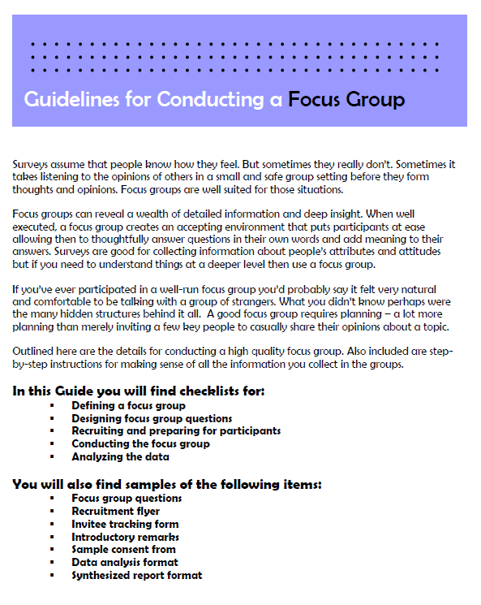
Conducting focus groups
Focus group guide
Information on:
Designing questions
Recruiting participants
Conducting the group
Analyzing data
Provides examples
from Duke University (https://assessment.trinity.duke.edu/documents/How_to_Conduct_a_Focus_Group.pdf)

Slide 19
Establish common understanding of bullying & anti-bullying expectations Recommended Strategies: Tier 1
To do this, schools should…
Have a clear definition & understanding of bullying
Include cyberbullying & the responsibility of the school in such cases
Have teachers & staff reflect upon their own attitudes towards bullying
Teachers, staff, students, and parents should recognize what acts do and do not constitute bullying
Emphasize the consequences of bullying for those who bully and for the victim and school climate

Slide 20
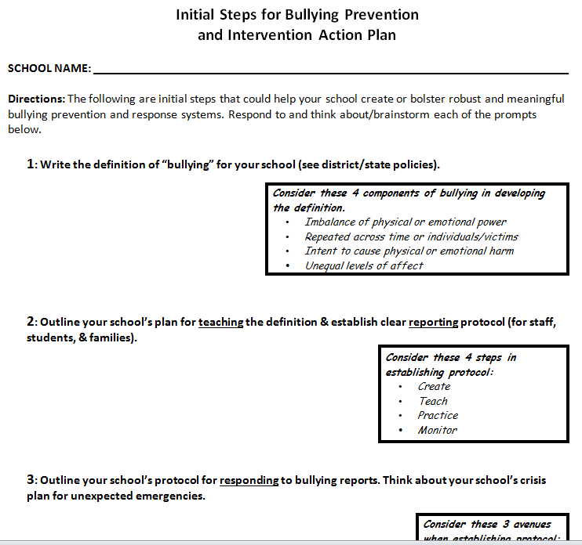
Bullying prevention and intervention action plan
Provides prompts to get staff, administrators, teachers, and other school personnel thinking about the aspects of bullying prevention and intervention that are in place at their school
Includes suggestions about factors/steps to consider when completing the prompts
Courtesy of the DE-PBS Project

Slide 21
Teach students how to respond to bullying Recommended Strategies: Tier 1
Teach students how they might best respond to bullying
Develop an anonymous process by which students can report all forms of bullying, including cyberbullying
Develop school-wide expectations that promote prosocial behavior and prevent bullying, aggression, and peer rejection
Develop clear and consistent consequences for students who bully others
Make families aware of procedures and policies
Identify non-classroom areas where bullying is most likely to occur
Encourage school staff to seek out victims of bullying so they receive help

Slide 22
Classroom management and school-wide strategies Recommended Strategies: Tier 1
Model prosocial behaviors
Use praise and rewards strategically
Ensure there are clear behavioral and academic expectations, routines, and procedures; fair rules & consequences, & monitoring of student behavior
Apply the above to help prevent cyberbullying
Highlight prosocial behavior & the absence of bullying in these expectations
Communicate the importance of social acceptance, the consequences of bullying, and the role of bystanders
Observe peer interactions
Arrange students’ seating to promote opportunities for positive social interactions and social acceptance, and to avoid bullying

Slide 23
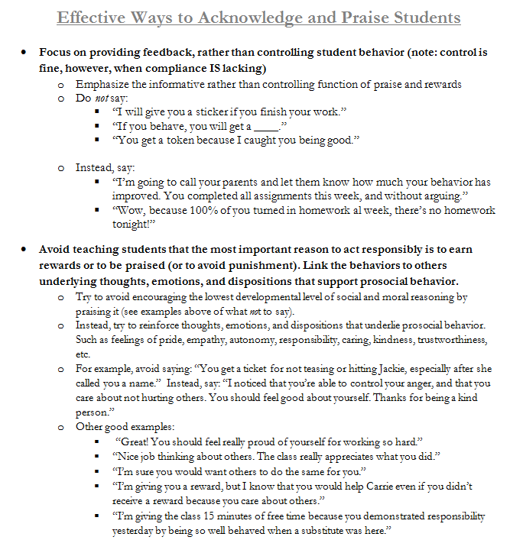
Effective use of praise and acknowledgement
Provides general strategies for how to effectively praise and reward students
Gives specific script examples of what to do or say
Activity for staff practice is available
Courtesy of the DE-PBS Project

Slide 24
Strategies that promote positive teacher-student relationships Recommended Strategies: Tier 1
Spend time with and get to know every student
Greet students when they come into school every day
Notice when students are having difficulties and listen
Treat students equally and do not indicate favorites
Allow your students to get to know you better
Have fun and use humor, when appropriate
Attend sports/extracurricular activities

Slide 25
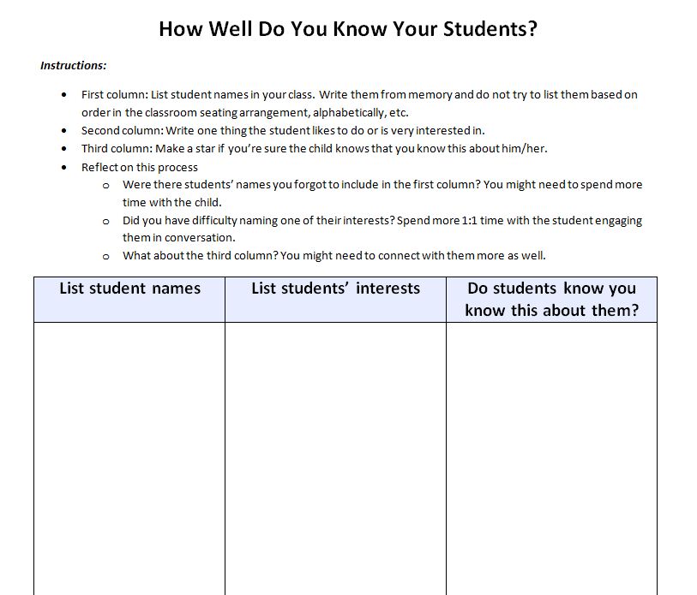
Knowing your students activity
Teacher fills in three columns: 1 = students names in class, 2 = something each student likes or is interested in, 3 = note if the student is aware that the teacher knows this about him/her.
Missing information may indicate that teacher needs to spend more time with child, engage in conversation more often, and/or connect with them more.
Adapted from Responsive Classroom (http://www.responsiveclassroom.org/blog/how-well-do-you-know-your-students)

Slide 26
Use appropriate corrective strategies Recommended Strategies: Tier 1
When minor bullying behaviors are observed…
Correct the behavior immediately
Always combine correction with recognition of positive behaviors
Use inductive discipline
Emphasize impact of the behavior on the victim and relations with others
Communicate that it is the behavior you dislike, not the student
Communicate that it is a shared responsibility to help improve the misbehavior
Communicate optimism that the bullying behavior will not be repeated

Slide 27
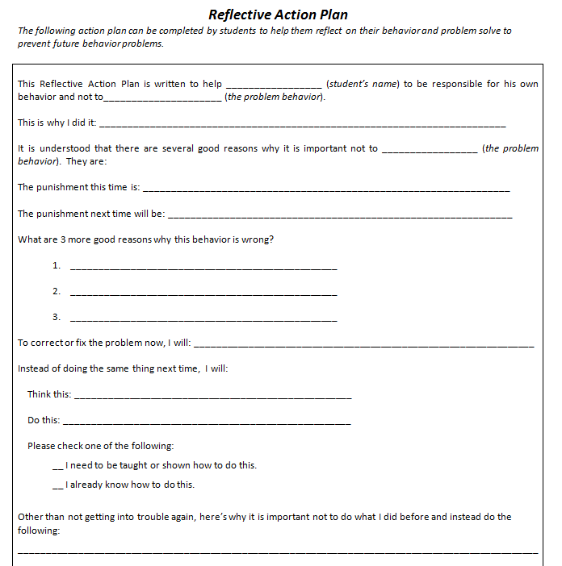
Reflective action plan
Plan completed by students to help them:
Reflect on their behavior
Problem solve to prevent future behavior problems.
Courtesy of G. Bear – DE-PBS: Developing Self Discipline Workshop 2011-12

Slide 28
Implement a universal bullying prevention or sel curriculum Recommended Strategies: Tier 1
Packaged programs available for purchase/training that are supported by research showing they reduce bullying victimization in elementary schools:
KiVa Bullying Prevention Program
Olweus Bullying Prevention Program
Second Step
Focuses on social-emotional skills
Other popular programs (e.g. SWPBIS, Restorative Justice, Bully Proofing Your School, and Second Step: Bullying Prevention Unit) have been shown to lead to positive outcomes but not reduced bullying victimization

Slide 29
KiVA bullying prevention program
For students ages 6-12
Includes training materials and lessons, videos, online games, and parents’ guide
Greater focus on supports for the victims and bullies
Supported by studies showing reduced bullying and victimization⁹³⁻⁹⁶
Now being implemented throughout the U.S., including in DE
From KiVa International: (http://www.kivaprogram.net/program)

Slide 30
Recommended Strategies
Students at Tier 2 & 3

Slide 31
Apply universal interventions Recommended Strategies: Tiers 2 & 3
Interventions should be:
Of greater frequency and intensity
More comprehensive, including multiple components
More individualized and guided by students’ needs and factors that might explain/contribute to bullying and victimization
Social skills deficits
Individual strengths
Social networks in classrooms and school
Classroom management practices
Systems of social support and resources in the school, home, and community

Slide 32
Provide social skills/sel training Recommended Strategies: Tiers 2 & 3
Target specific prosocial skills and antisocial behaviors related to social acceptance, friendships, and bullying victimization
Use lessons from a Tier 1 bullying prevention or SEL curriculum
E.g. Steps to Respect or Second Step
Use evidence-based curriculum lessons designed for use at Tiers 2 and 3
E.g. Incredible Years, Coping Power, and PEERS
Include training for targeted students and their parents
Use caution in grouping students together (i.e. in Tier 2 interventions) who share similar antisocial behaviors. This may result in “deviancy training,” with peers modeling and reinforcing antisocial behavior¹⁰⁴⁻¹⁰⁵

Slide 33
Additional strategies Recommended Strategies: Tiers 2 & 3
Ensure that targeted students have a close, supportive relationship with at least one other student in the school
Individual counseling may be appropriate for bullying victims
Work closely with students’ parents to target social-emotional skills at home

Slide 34
Making a plan
Who is going to do
what actions by
when?

Slide 35
Thank you
Based on areas of need identified by data, check out other resources provided through the School Climate and Student Success Module Series.
www.delawarepbs.org
Questions can be directed to Sarah Hearn
skhearn@udel.edu

Slide 36
Bullying victimization
Lead Authors: Dr. George Bear, Dr. Lindsey Mantz, and Angela Harris, M.A.
University of Delaware & Delaware Positive Behavior Support Project
Research Narrative Reviewed by: Dr. Michelle Demarary
Northern Illinois University
PowerPoint Developed and Reviewed by: Angela Harris, M.A., Sarah Hearn, M.Ed., and Laura Davidson, M.A.
University of Delaware & Delaware Positive Behavior Support Project
Audio Recorded by: Sydney Morales, M.A.
University of Delaware & Delaware Positive Behavior Support Project
Funding and Support from: The Delaware Department of Education through the Delaware Positive Behavior Support Project and the School Climate and Student Success Grant

