Slide 1
Improving Student Engagement
Research and Recommended Interventions
Lead authors: Dr. George Bear and Angela Harris, M.A.
University of Delaware
Funding and support from:
DE Positive Behavior Support Project – School Climate & Student Success

Slide 2
Module Structure
Module series goal:
Provide information to schools that can lead to improvements in school climate and behavioral outcomes.
Module narratives provide additional information to accompany PowerPoint Presentation.
Endnotes throughout slides correspond to the references in the module narrative.
Gold star = Resource on Delaware PBS website

Slide 3
What is Student Engagement?
The extent to which students are actively involved in learning activities in school^{1,2}
Three types:³⁻⁶
Emotional
Feelings towards learning, school, teachers, and classmates (e.g., liking school)
Behavioral
Involvement in academic and school-related activities (e.g., following rules)
Cognitive
Motivation, especially intrinsic, and the desire to exert effort to learn

Slide 4
Delaware School Surveys
The Delaware School Surveys assess school engagement school-wide and engagement of the individual student.
Student Engagement School-wide subscale on the Delaware School Climate Scale:
Items assess teachers/staff’s and students’ perceptions of the extent to which students throughout the school are emotionally, behaviorally, and cognitively engaged
Delaware Student Engagement Scale:
Assesses engagement of the individual student as reported by the student and by his/her parent or other adult at home
Three subscales: Emotional, Behavioral, and Cognitive

Slide 5
Why is Student Engagement Important?
Student Engagement Promotes…
Academics
Prosocial Behavior & Reduces Antisocial Behavior
Student Personal Wellbeing

Slide 6
Importance of Student engagement from a broader lens
Student engagement is commonly viewed as a critical component of school climate¹⁵
It is also viewed as central to democratic education and citizenship in a democratic society
Through active engagement in schooling, students learn the value and skills for future citizenship

Slide 7
Student Characteristics
Student Engagement
Contributing Factors
Teacher, Classroom, and School Characteristics

Slide 8
Student Characteristics Contributing Factors
Students who are emotionally, behaviorally, and/or cognitively engaged in school tend to have:
Social, emotional, and learning competencies^{3,25-30}
Responsible decision making, relationship skills, social awareness, self-management, and self-awareness
Absence of behavioral and emotional problems that interfere with engagement and learning
Antisocial and aggressive behavior,³⁰⁻³³ depression,³⁴ stress³⁵
Positive perceptions of school climate
Including teacher-student relationships,²⁷ student-student relationships,^{27,30,36} fair treatment of students,³⁷ and school safety³⁸
Parent support, and students’ perceptions thereof, including parents being involved in their children’s learning/schooling^{9,27,29,36,39}

Slide 9
Student Characteristics Contributing Factors
Although not malleable, other student factors influence student engagement and should be considered in prevention and intervention efforts:
Age^{11,28,40,41}
As students progress from elementary to middle school, they become less engaged
Gender^{15,28,29,41}
Boys tend to be less engaged than girls
SES^{30,42}
Students from low SES tend to be less engaged

Slide 10
Teacher, classroom, and school characteristics Contributing Factors
Two general characteristics of teaching maximize student engagement in the classroom:⁴³
1. Classroom management
2. Instructional strategies
Additionally, there are school characteristics that promote student engagement

Slide 11
Teacher, classroom, and school characteristics Contributing Factors
Classroom management
Authoritative approach to classroom management, consisting of a balance of structure and social support^{3,11,26-29,43,45-48}
Structure refers to practices such as: having clear routines and procedures, monitoring behavior, holding clear and high expectations, and responding to behavior problems immediately, consistently, and fairly
Social support refers to caring, respect, and responsiveness to students’ psychological needs of competence, relatedness, and autonomy
Support from teachers, administrators, parents, and peers is particularly important in student engagement
The importance of teacher-student, student-student, and home-school relationships, including with respect to engagement, is highlighted in three other modules: Improving Teacher-Student Relationships, Improving Student-Student Relationships, and Improving Home-School Relationships.

Slide 12
Teacher, classroom, and school characteristics Contributing Factors
Instructional methods that have been shown to promote behavioral, cognitive, and emotional engagement in the classroom include:^{3,28,51-59}
Learning activities that, where appropriate and feasible, have the following qualities:
Are matched with students’ ability levels, interests, talents & goals
Are challenging (not too difficult or too easy)
Emphasize higher-order thinking skills, rather than memorization
Are stimulating, often novel & fun
Are quickly paced, with little down time
Allow for choice
Allow for & encourage collaboration with peers
Are authentic, emphasizing real-life applications
Encourage students to assume ownership of the activity’s conception, execution & evaluation

Slide 13
Teacher, classroom, and school characteristics Contributing Factors
Teachers who are most effective in engaging students tend to exhibit the following practices:
Support student autonomy
Use a variety of tasks and activities
Provide peer-assisted activities
Incorporate use of modeling (teacher, student, others) to highlight engagement-related behaviors
Use praise and rewards strategically, providing effective feedback and reinforcing engagement-related behaviors

Slide 14
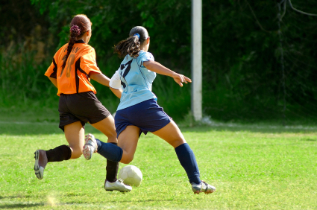
Teacher, classroom, and school characteristics Contributing Factors
School characteristics that help promote engagement include:^{38,51,60,61}
Smaller classes and school size
Multiple opportunities to participate in extracurricular activities, sports, and school governance
An environment that is safe and conducive to learning
Including the absence of bullying
Having a high proportion of teachers of similar race/ethnicity as the students
Particularly in schools with large numbers of racial & ethnic minority students of lower SES

Slide 15
Teacher, classroom, and school characteristics Contributing Factors
The relations between engagement and many of the teacher, classroom, and school characteristics discussed here are reciprocal^{63,64}
For example, positive teacher-student and student-student relationships foster student engagement, but student engagement also fosters positive relationships
Teacher, Classroom, & School Characteristics
Student Engagement

Slide 16
I. Collect & Examine Data
IV. Challenge students to set realistic goals
V. Emphasize effort & persistence in achieving goals
VI. Implement an SEL curriculum
II. Implement authoritative strategies
III. Implement a variety of instructional methods
Student Engagement
Recommended Strategies

Slide 17
Collect and examine data Recommended Strategies: Tier 1
Examine engagement-related data, such as academic achievement, absences, truancies, office disciplinary referrals, suspensions, drop-out rate, & the number of students participating in extracurricular activities
Student, teacher/staff, & parent surveys, such as the Delaware School Surveys, are also valuable data sources
School-wide engagement assessed on the Delaware School Climate Scale
Individual student engagement assessed on the Delaware Student Engagement Scale

Slide 18
Collect and examine data Recommended Strategies: Tier 1
Survey data can help answer:
Do students and teachers/staff view students throughout the school as being engaged, and across grades, racial/ethnic groups and gender?
Are individual students engaged emotionally, behaviorally, and cognitively across grades, racial/ethnic groups and gender?
Reports of low engagement across groups of respondents would indicate need for interventions and related staff development
Examine specific grade, racial/ethnic, and gender groups
Compare responses across the emotional, behavioral, and cognitive subscales
Examine responses to specific items on all subscales
Additional data should be gathered and examined to help determine why low engagement is reported
Share results with focus groups

Slide 19
conducting focus groups
Focus group guide
Information on:
Designing questions
Recruiting participants
Conducting the group
Analyzing data
Provides examples
from Duke University (https://assessment.trinity.duke.edu/documents/How_to_Conduct_a_Focus_Group.pdf)

Slide 20
Implement authoritative strategies Recommended Strategies: Tier 1
An authoritative approach to classroom management consists of a balance of social support and structure.
Ensure social support
Establish and maintain positive relationships in the classroom & school, as well as between school and home
Ensure structure
Use classroom management techniques that help keep students on-task and engaged emotionally, behaviorally, & cognitively
E.g., clear expectations, fair rules, close supervision of behavior, & a variety of instructional methods
Use praise & rewards strategically
Praise and rewards help promote both social support & structure as well as foster engagement
They reinforce engagement-related behaviors and serve as a valuable source of feedback for students

Slide 21
Implement a variety of instructional methods Recommended Strategies: Tier 1
Maximize variety in the use of instructional methods and learning activities, with greatest use of those that require active participation of students
Offer challenging and authentic tasks – those that center on the realistic application of skills learned, and especially higher order thinking skills
Ensure that instructional materials match the abilities of individual students
Offer students choices in activities – in what to do and how to do it
Make learning activities fun by incorporating game-like features
Emphasize the relevance of academic material and activities to the individual lives of students
The methods above are tailored more for behavioral and cognitive engagement, but are likely to enhance emotional engagement as well

Slide 22
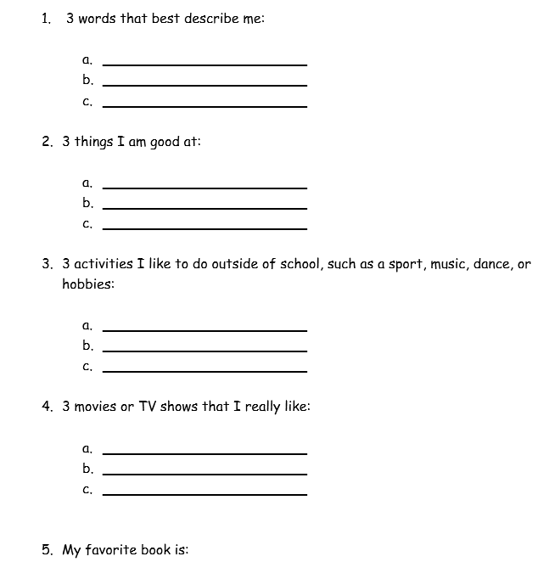
Sample interest survey
For elementary and secondary use
Information gathered can help teachers get to know their students and relate academic material and activities to their interests and preferences

Slide 23
Challenge students to set goals Recommended Strategies: Tier 1
Challenge students to identify and reflect upon their values and goals, and to choose engagement-related behaviors that are consistent with those values and goals
Help students adopt challenging standards and methods for monitoring the progress toward achieving their value-oriented goals
Challenge students to set short-term goals (for all ages), and long-term goals (especially students in higher grades).
Throughout the curriculum, highlight how important values (e.g., altruism, family, etc.) are important and necessary for success in certain subjects/career fields
Emphasize mastery goals over performance goals
Emphasize mastery in external and self-evaluations

Slide 24
Emphasize effort & persistence in achieving goals Recommended Strategies: Tier 1
Emphasize effort and challenge more than ability and adopt a growth mindset
Provide feedback that is frequent, substantive, and constructive
Make grade criteria clear and fair
Promote self-evaluation in meeting one’s goals
Incorporate student self-evaluation into daily tasks and assignments

Slide 25
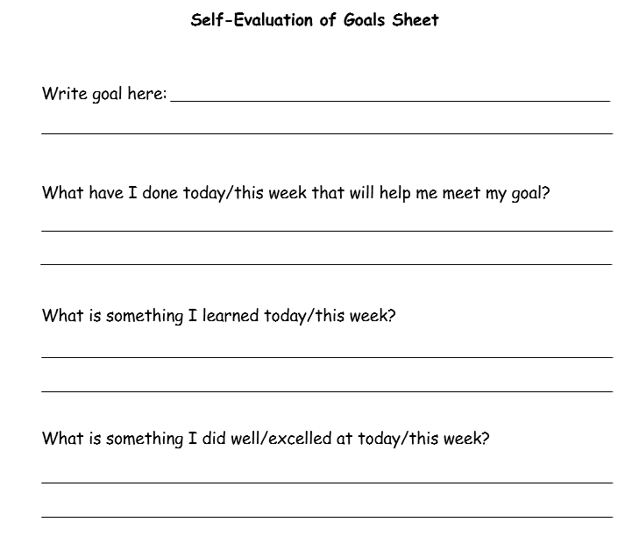
Student Self-evaluation of Goals
Can be used daily or weekly to track progress towards meeting both short-term and long-term goals
Will help encourage students to persist to meet their goals

Slide 26
Implement an evidence-based SEL program Recommended Strategies: Tier 1
Use one that has been shown to strengthen social-emotional competencies, particularly those most related to emotional, behavioral, and cognitive engagement, or have been shown in empirical studies to improve engagement
Responsive Classroom Approach
Second Step
PATHS
RULER
Leader in Me
See CASEL.org for a list of such programs and descriptions of each

Slide 27
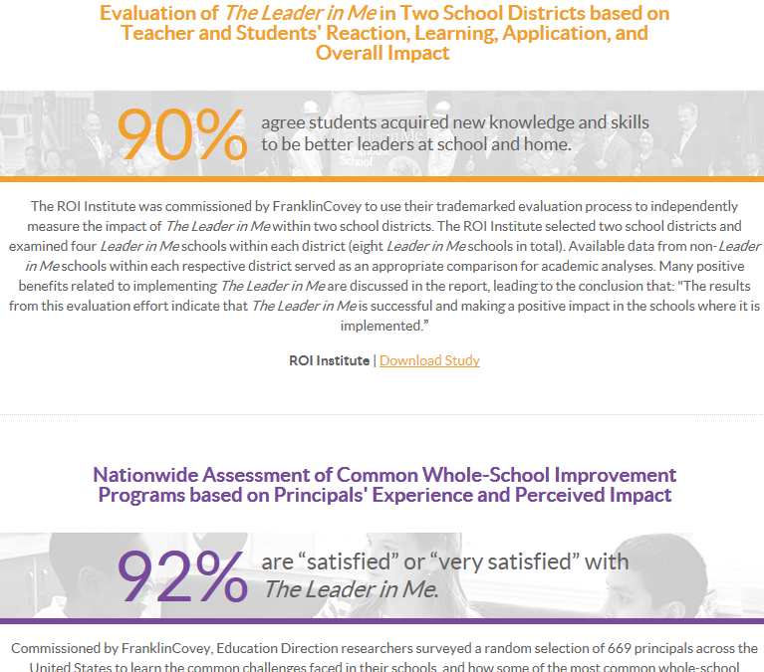
Leader in me
Emphasis on developing students’ leadership and life skills
Principals, teachers, and parents perceive positive impacts of the program:
Increased student leadership skills
Improved school climate
Improved student attendance
Improved satisfaction and engagement
Improvements in behavior
From The Leader in Me (http://www.theleaderinme.org/)

Slide 28
Recommended Strategies & Interventions
Students with Tier 2 & 3 support needs

Slide 29
Students at Tiers 2 & 3 Recommended Strategies
Apply the strategies already mentioned as appropriate at the universal level and for all students
With greater frequency and intensity
More comprehensive
More individualized
Provide additional social skills/SEL training
Targeting specific engagement skills
Universal curriculum or those designed more for Tiers 2 & 3

Slide 30
Students at Tiers 2 & 3 Recommended Strategies
Collaborate with families
E.g., use a daily report card
Where appropriate (e.g., Tier 3), develop a behavioral contract
Targeting specific engagement skills
Consider implementing the Check and Connect intervention, or otherwise provide individual mentoring, especially that which offers support via a positive teacher-student relationship, monitoring, and guidance
Or adopt other programs shown to be effective in preventing dropping out (e.g., FUTURES program⁸⁴)
Arrange or provide additional intensive supports, resources, & changes as needed

Slide 31
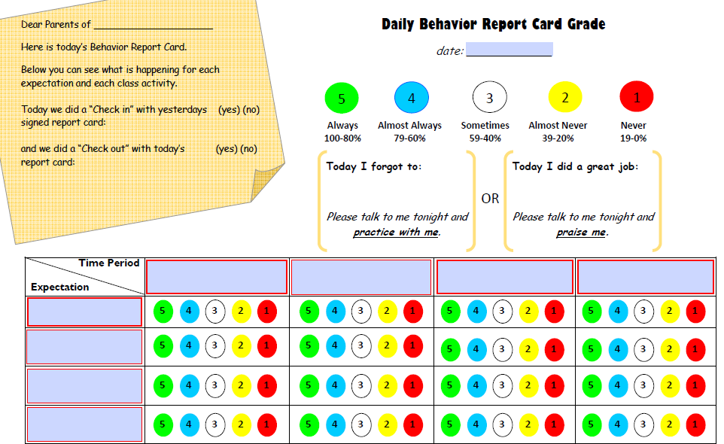
Daily report card
Teacher or teacher & student record how often the expected behavior was met during the specific time period/class activity
Report card is sent home each day highlighting behaviors that need to be practiced and those that should be praised
Teacher, student, and parent signs the report card each day

Slide 32
Making a Plan
Who is going to do
what actions by
when?

Slide 33
Thank you
Based on areas of need identified by data, check out other modules and resources provided through the School Climate and Student Success Module Series.
www.delawarepbs.org
Questions can be directed to Sarah Hearn
skhearn@udel.edu

Slide 34
Improving student engagement
Lead Authors: Dr. George Bear and Angela Harris, M.A.
University of Delaware & Delaware Positive Behavior Support Project
Research Narrative Reviewed by: Dr. Michael Furlong
University of California, Santa Barbara
PowerPoint Developed and Reviewed by: Angela Harris and Shelby Schwing
University of Delaware & Delaware Positive Behavior Support Project
Audio Recorded by: Sydney Morales, M.A.
University of Delaware & Delaware Positive Behavior Support Project
Funding and Support from: The Delaware Department of Education through the Delaware Positive Behavior Support Project and the School Climate and Student Success Grant

