Slide 1
Implementing MTSS to Address Social Emotional Behavioral Needs: Enhancing and Sustaining
Kimberly Yanek, PhD
Mid-Atlantic PBIS Network
kyanek@midatlanticpbis.org

Slide 3
Common Understanding: Language
SWPBIS
MTSS
RTI
VTSS
PBS
PBIS

Slide 4
MTSS Core Defining Features
Team based leadership & coordination
Evaluation of implementation fidelity
Continuum of evidence-based practices
Continuous data-based progress monitoring and decision-making
Comprehensive universal screening
On-going professional development including coaching with local content expertise

Slide 5
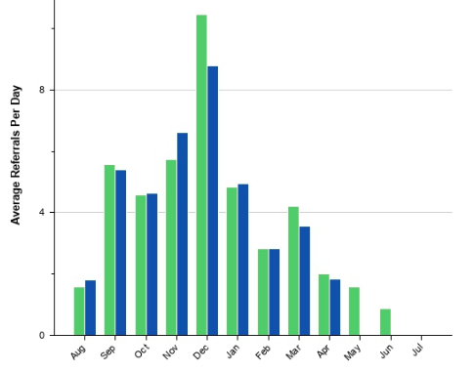
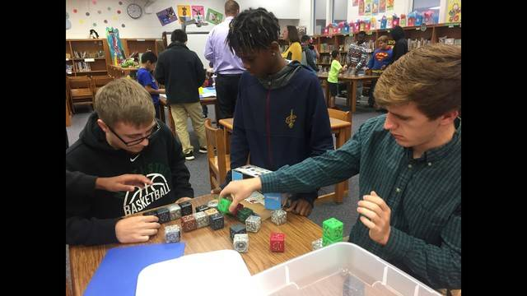
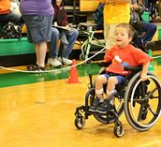
The Foundations of PBIS: What makes PBIS important to us today?
Data-driven decision
making framework
Increases Effectiveness and Efficiency
Improving social
culture, student outcomes
Guide selection & implementation of best practices
Process for Continuous Improvement
for ALL students
(OSEP Center on PBIS, 2010)
Notes:
a data-driven decision making framework for establishing the social culture and behavioral supports needed for a school to be an effective learning environment (academic and behavior) for all students. PBIS represents an integration of behavioral, academic, wellness, cultural and other supports and evidence-based practices.

Slide 6
U.S. Public Health:
Tiered Logic Model
USS Mercy, Drs. Without Borders for people with sustained injury
Natural Disaster: food and water for all
First Aid; Temporary Shelter
A few
Some
All
Walker et al. (1996). Integrated approaches to preventing antisocial behavior patterns among school-age children and youth. JEBD, 4, 194 – 209.

Slide 7
Multi-Tiered Framework
Tertiary Prevention:
Specialized
Individualized
Systems for Students with High-Risk Behavior
FEW
~5%
~15%
SOME
Primary Prevention:
School-/Classroom-
Wide Systems for
All Students,
Staff, & Settings
Secondary Prevention:
Specialized Group
Systems for Students with At-Risk Behavior
ALL
~80% of Students
Notes:
Our language and the ways we communicate with our colleagues, families, and other school community members is important. Sometimes we hear folks referencing T II students or T III students. It's important to communicate that the tiers refer to the layer of support and we use person first language. So, it might be a student needing T II support with math computation or a student needing TIII support with comprehension or a student needing TI support with making friends.
Support is always “layered” onto the previous supports. When a small group of students require a little more support, they continue to receive universal/tier 1 core or instruction. Students receiving secondary supports have increased opportunities for more frequent contingent feedback, additional structure, re-teaching of expectations, etc.
Students in need of intensive, individualized support, continue to receive universal supports. Tier III often builds upon the supports that the student receives with Tier II interventions.

Slide 8
ABCs of Behavior
Traditional Consequence System
Prevention Science:
Instructional Approach
2
Antecedent/
Trigger:
When _____ happens….
1
Behavior:
the student does (what)__
3
Consequence/
Outcome
..because (why) ______
(Loman, Borgmeier, Rodriguez)
Notes:
The traditional approach to discipline has been reactionary. With PBIS, we are shifting from a traditional, reactive response to student behavior to a preventative response.

Slide 9
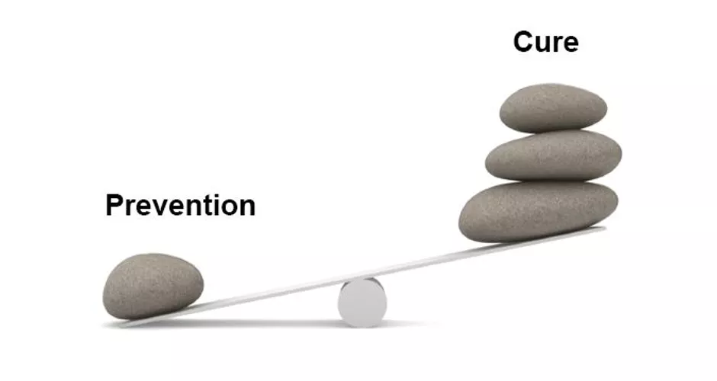
Responding
Lighten the load…

Slide 10
Social Competence & Academic Achievement
OUTCOMES
Information & process for effective decision-making
SYSTEMS
DATA
Supporting staff
PRACTICES
Supporting students
Notes:
10
Student Outcomes: Academic, Social, Attendance, Emotional
Rob Horner PBIS Forum 2018
Practices: PBS and “practices”
Define a practice with operational precision.
What do you see and do
2. Define WHO does WHAT for WHOM
3. Define the outcome(s) (WHY)
A commitment to using what works
Formal research documents that a practice (when used well) results in valued benefits for those receiving support
Recognizing that what works today may be improved tomorrow.

Slide 11
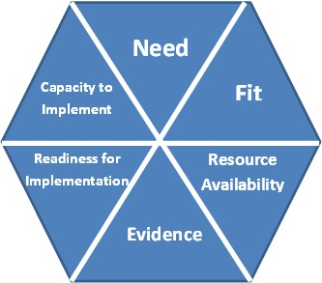
Hexagon Tool
Data informed need
Gap in continuum of supports to address need
Explore options using Hexagon Tool for match & implementation needs

Slide 12
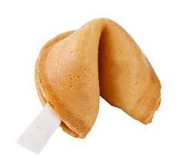
We organize our resources
Multi-Tier Continuum of Supports, Gap Analysis
So kids get help early
Prevention, data formed decision making, increased levels of support
We do stuff that’s likely to work
Evidence-Based interventions; Hexagon Tool
We provide supports to staff to do it right
Fidelity: Tiered Fidelity Inventory
And make sure they’re successful
Coaching and Support
Progress monitor and performance feedback
Problem-Solving process

Slide 13
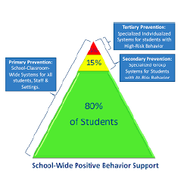
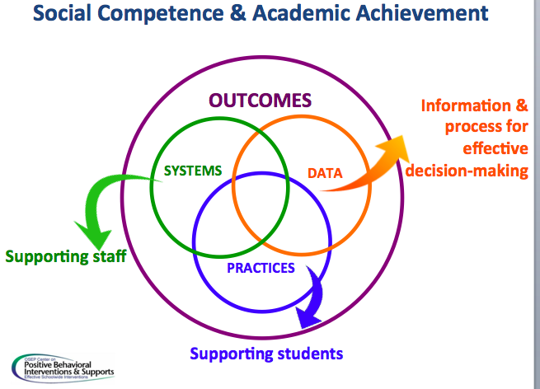
Way of Work Tatoos

Slide 14
Multi-Tiered Framework:
A Way of Work for Tier 1
5%
80%
15%
A few
Some
All
Walker et al. (1996). Integrated approaches to preventing antisocial behavior patterns among school-age children and youth. JEBD, 4, 194 – 209.

Slide 15
What’s in a Precision statement? A sample…
# of staff have observed and reported # of students engaging in problem behavior that is taking place most often problem location or grade levels. This behavior occurs frequency with the highest levels occurring on days/times. We think students may engage in this behavior in order to function of behavior- get/obtain or avoid/escape.

Slide 16
Tier 1 Precision Statement
18 staff members have observed and reported 76 incidents of tardiness from 59 students occurring across grade levels with the highest incidents occurring in 9th and 10th grade with the highest number of incidents on Tuesdays and Thursday with spikes around 9:00 and 2:00. We think students are engaging in this behavior to access peer attention (socialize).
Rule of 10

Slide 17
Craddock High School Resource Map of Supports for Tier 1
Practices/Programs/initiatives | Who receives support? | Provider | How is progress monitored? How are outcomes evaluated? | How do students enter & exit?
SW Expectations defined, taught, acknowledged & appreciated Consistent Instructional Responses Restorative Practices Core Academic Curriculum Second Step | All students | All staff | Office referrals OSS/ISS Attendance,Academic Benchmarks TFI-fidelity, SAS-Fidelity Lesson Plans-fidelity | N/A
Notes:
17
17
might want to insert our resource map...tier definitions that we have given them
have them resource map Tier 1 in one domain...we could differentiate by domains

Slide 18
Prevent | Review on-time behavior defined on matrix with staff & students (consistency) Cooperative Learning Strategies
Teach | Engage student PBIS Leadership Team in video production to illustrate on-time behavior, share sample found on-line- include “why”
Acknowledge & Appreciate | Review Behavior Specific Praise statements with staff- focus on “On-time”; Student led “On-Time Challenge” as grade level group contingency- winning grade level football game tix
Correct | Review using Behavior Specific Correction statements with staff- consistency
Extinction | Student app to post on-time behavior/grade
Safety | Active supervision halls Tues/Thurs at 9:00&2:00

Slide 19
Tier 1 Precision Statement
12 staff members have observed and reported 33 incidents of defiance that looks like students ignoring directions, avoiding tasks, and leaving the classroom from 21 students across grade levels. These behaviors are occurring in classrooms with the majority occurring on Monday morning and Friday afternoon. We think this behavior is escape motivated and we also want to consider that some of our students have been exposed to community violence and may be experiencing chronic stress and/or trauma.

Slide 20
What if we also have this data about our school community?
The population we serve has been impacted by community violence. Community partnerships have shared data that indicate approximately 30% of our families have experienced community violence.
We also want to consider community data that may inform trauma, chronic stress or other factors influencing behavior.

Slide 21
Craddock Middle School Resource Map for Tier 1
Practices/Programs/initiatives | Who receives support? | Provider | How is progress monitored? How are outcomes evaluated? | How do students enter & exit?
SW Expectations defined, taught, acknowledged & appreciated Consistent Instructional Responses Morning Meetings Coping Strategies | All students | All staff | Office referrals OSS/ISS Attendance, TFI-fidelity, SAS-Fidelity Lesson Plans-fidelity | N/A
GAP-SEL skills
(teaching matrix
does not
reflect social
emotional skills
(Hexagon Tool)
Notes:
21
21
might want to insert our resource map...tier definitions that we have given them
have them resource map Tier 1 in one domain...we could differentiate by domains

Slide 22
Prevent | We know some students may have experienced trauma. Add Coping Skills to the school-wide matrix. Review Classroom matrices for rules/routines (structure & predictability). Implement “Calm Zones” in classrooms.
Teach | Explicit instruction for all students on coping skills defined in the matrix. Explicit instruction to teach/review classroom rules/routines. Teach staff and students about use of “Calm Zones”. Include the “why”.
Acknowledge & Appreciate | Review Behavior Specific Praise statements with staff- focus on catching students using Coping Skills and accessing Calm Zone appropriately.

Slide 23
Correct | Review strategies with staff to support (S) use of Coping Skills and Calm Zone (e.g., pre-correction, active supervision, modeling, checking in with students). Move from “what is wrong with you” to “what has happened to you”? Natural conseq.
Extinction | Avoid removal from class for classroom behavioral examples of defiance (those defined by staff that do not pose safety concerns such as refusal to do work, “talking back”, etc.)
Safety | Use active supervision and complete a “Request for Assistance” for any students exhibiting externalizing (e.g., escalating, persistent, increased impulsiveness) or internalizing (e.g., withdrawal, sleeping) behaviors of concerns. Enlist support of admin for immediate concerns.

Slide 24
Classroom Matrix
Pro-social/Social Emotional
Classroom Routines
School-wide Expectations
The Wilson Way | Classroom Rules | Classroom (Attention Signal: 1-2-3 Eyes on Me)
 |  | When you feel upset … | Morning Routine | How to Transition/ Line Up | Small Group Work
Be Responsible | Stay on task Clean up area Apologize for mistakes | Recognize what you’re feeling “I feel…” Stop and take a few deep breaths | Turn in homework Put instructional materials in desk | Put materials away Get materials ready for next activity | Do your fair share Manage time carefully
Be Respectful | Raise hand Listen to speaker Follow directions Use appropriate voice level | Ask for a break if you need a moment Express your feelings appropriately | Say “good morning” to teacher and classmates Talk in soft voices | Listen for direction to next activity Be silent | Listen to understand your peers Take turns speaking Use kind words with feedback Speak only to group members
Be Safe | Walk quietly Keep hands and feet to self | Talk to someone if you need help Talk to someone if it will make you feel better | Put personal belongings in designated areas Take your seat | Stand up Push in chair Wait for group to be called to line up | Clean up area when time is up
Classroom Rules
Notes:
Start with entering your school-wide expectations on the left side and then add your classroom rules.
The School-wide matrix includes the rules for classrooms.
Classrooms then expand their matrix to also include the routines/procedures for common routines (mapped to the school-wide expectations).

Slide 25
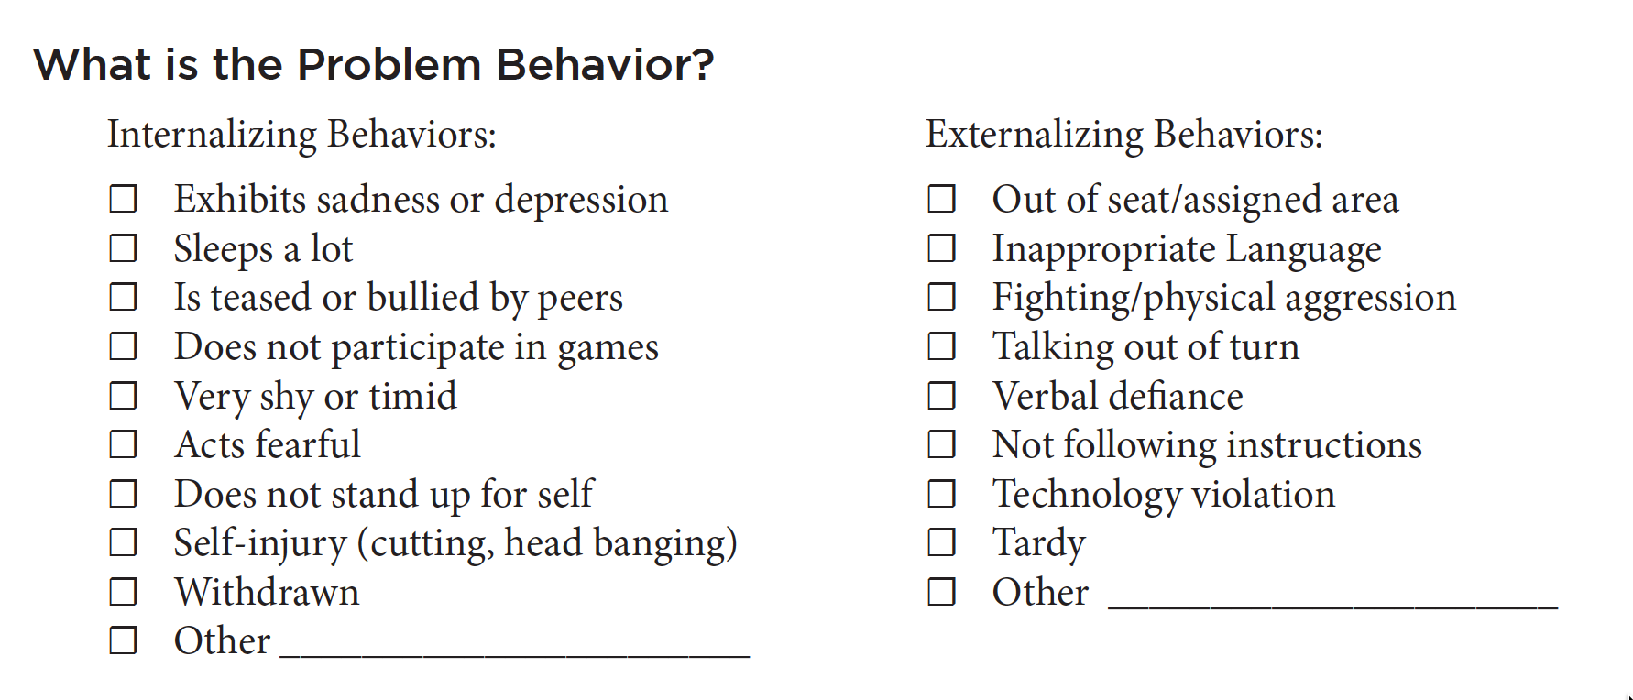
Request for Assistance (submit to school counselor)
When is it most likely to occur?
When is it least likely to occur?

Slide 26
Additional Examples of Alignment using the Teaching Matrix or Social Emotional Behavioral Curriculum

Slide 27
Align Expectation Matrix with Bully Prevention/Intervention
Look for ways to incorporate Bully Prevention strategies into your Expectation Matrix
1. You can incorporate specific behaviors to replace disrespectful behaviors that might commonly occur in School-Wide settings.
For example, to prevent students from being isolated or excluded in the cafeteria or playground, add specific expectations for what a student should do if they see someone alone who might wish to be invited to join in.
See next slide for an example

Slide 28
Teaching Matrix |  | SETTING
 |  | All Settings | Hallways | Playgrounds | Cafeteria | Library/ Computer Lab | Assembly | Bus
 | Respect Ourselves | Be on task. Give your best effort. Be prepared. | Walk. | Have a plan. | Eat all your food. Select healthy foods. | Study, read, compute. | Sit in one spot. | Watch for your stop.
 | Respect Others | Be kind. Hands/feet to self. Help/share with others. | Use normal voice volume. Walk to right. | Share equipment. Include others. | Practice good table manners | Whisper. Return books. | Listen/watch. Use appropriate applause. | Use a quiet voice. Stay in your seat.
 | Respect Property | Recycle. Clean up after self. | Pick up litter. Maintain physical space. | Use equipment properly. Put litter in garbage can. | Replace trays & utensils. Clean up eating area. | Push in chairs. Treat books carefully. | Pick up. Treat chairs carefully. | Wipe your feet.
1. Expectations
NATURAL CONTEXT (Settings/Pro-Social Skills)
Invite people
who are alone
to join in your conversation.
Invite those who are alone to join in.
Expectations
3. Specific Behaviors
Notes:
Replacement behaviors

Slide 29
Align Expectation Matrix with Bully Prevention/Intervention
2. Another option is to add a column to define expectations for what students can do when they see disrespectful behavior in any setting (See next slide)
PBIS research* demonstrates that the most effective expectations to teach can follow the 3-step model of:
STOP
WALK
TALK
“Bully Prevention in Positive Behavior Support”
~Ross, Horner, Stiller (2008)

Slide 30
Teaching Matrix |  | INCORPORATE BULLY PREVENTION / INTERVENTION
 |  | All Settings | Halls | Playgrounds | If you see Disrespect | Library/ Computer Lab | Assembly | Bus
 | Respectful | Be on task. Give your best effort. Be prepared. | Walk. | Have a plan. |  | Study, read, compute. | Sit in one spot. | Watch for your stop.
 | Achieving & Organized | Be kind. Hands/feet to self. Help/share with others. | Use normal voice volume. Walk to right. | Share equipment. Include others. |  | Whisper. Return books. | Listen/watch. Use appropriate applause. | Use a quiet voice. Stay in your seat.
 | Responsible | Recycle. Clean up after self. | Pick up litter. Maintain physical space. | Use equipment properly. Put litter in garbage can. |  | Push in chairs. Treat books carefully. | Pick up. Treat chairs carefully. | Wipe your feet.
1. Expectations
STOP: Interrupt & model respect, rather than watch or join in
NATURAL CONTEXT (Settings/Pro-Social Skills)
WALK: Invite people
who are being disrepected to
to join you and move away.
Invite those who are
alone to
join in.
Expectations
3. Specific Behaviors
Stop: Interrupt,
Say “that’s not ok.”
Walk: Walk away Don’t be an audience
Talk:
REPORT to an adult
Notes:
Replacement behaviors

Slide 31
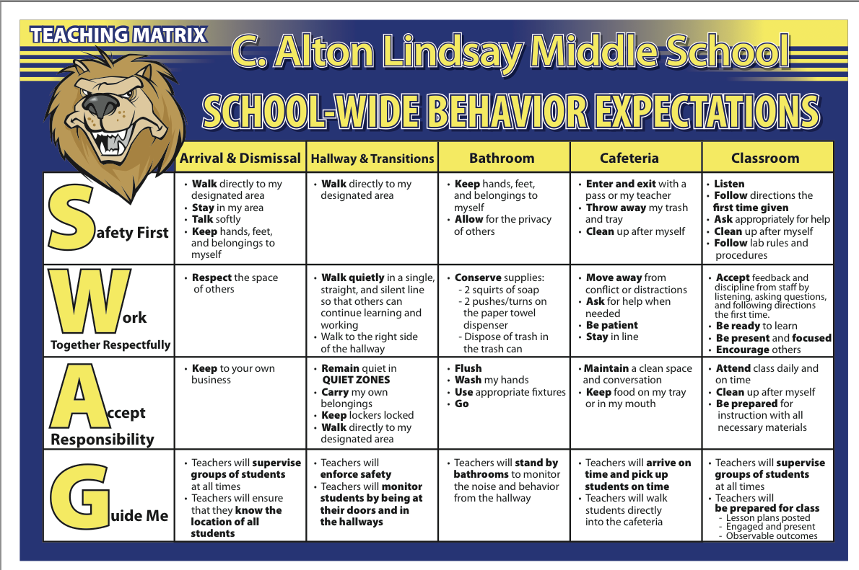
Notes:
What will adults do to create the conditions for learning? This was added after discussion and consensus with teachers.

Slide 32
Supporting Sustained Commitment
Create a culture of safety and transparency to share and engage staff with data
Share Tier 1 outcome and fidelity data with staff at least 4x/year
Share before and after data (precision statements, graphs) with staff whenever a solution is implemented
Share Tier 1 Outcome and Solution Fidelity data with staff

Slide 33
Multi-Tiered Framework:
A Way of Work for Tier 2
5%
80%
15%
A few
Some
All
Walker et al. (1996). Integrated approaches to preventing antisocial behavior patterns among school-age children and youth. JEBD, 4, 194 – 209.

Slide 34
Data Informed Decisions at Tier 2
Informing Need
Decision rules
CICO, same for all
DPR layered for group, anchored to tier 1
Precision Statement and resource map
Solution for progress monitoring groups
Not progressing- then individual minimally using DPR anchored tier 1
Systems data shared with staff- outcomes and fidelity

Slide 35
Sample Precision statement for Tier 2
11 staff members have observed and reported minor disruptive behavior that looks like repeated loud talk, not following directions, and impulsive behavior that is taking place most often in 3rd and 5th grades. This behavior occurs daily across settings, but is most likely to happen during first period and after lunch. Ten 3rd and 5th graders (grade level/group of students) are engaging in this behavior with 2-3 referrals each. We think students may engage in this behavior in order to gain adult attention or escape work.

Slide 36
Craddock Elementary School Resource Map for Tier 2
Practices/Programs/Initiatives | Who receives support-Decision Rules | Provider | Progress monitored? Outcomes evaluated? | How do students enter & exit*?
Check-In Check-Out (CICO) | Students needing extra support with SW Expectations | CICO Facilitators & Teachers | Daily Progress Report (DPR) Student behavior | 2+ ODRs 4+ CR Behavior Incidents *80% goal made over 10 cons days; 0-1 ODRs
Modified CICO | Not making progress with CICO; function-base modifications | CICO Facilitators & Teachers, others as needed | DPR Student Behavior | Same as CICO
 |  |  |  | Same as CICO; Increase on CBM and Summative to cut off
SAIG | CICO+ and academic at risk | CICO Facs & Teachers, Group Leads | DPR, S Behavior, CBM, Summative
Notes:
36
36
might want to insert our resource map...tier definitions that we have given them
have them resource map Tier 1 in one domain...we could differentiate by domains

Slide 37
Prevent | Add another layer of instructional support to teach SW expectations using CICO to students identified needing additional support.
Teach | Re-teach expected behavior and CICO procedures to students. Teach families about CICO. Review CICO procedures with staff involved.
Acknowledge & Appreciate | Review use of Daily Progress Report (DPR) as a tool to prompt teacher feedback and collect data on expected behaviors throughout the day. Inventory students for additional reinforcement obtained by meeting goals.

Slide 38
Correct | Review Behavior Specific Correction statements with staff. Review what a 0, 1, 2 look like when recording data on Daily Progress Report (DPR).
Extinction | Review DPR with student at the end of each day focusing on points earned for engaging in expected behavior. Review & pre-correct for expected behaviors during morning check-in with facilitator and throughout the day with staff.
Safety | CICO Facilitator progress monitors DPR data on a weekly basis to identify any concerns (decreasing trends) in student performance- intervenes as appropriate and reports on-going concerns to tier 2 team. Teacher reports any additional concerns to CICO Facilitator. Enlist support of admin for immediate concerns.

Slide 39
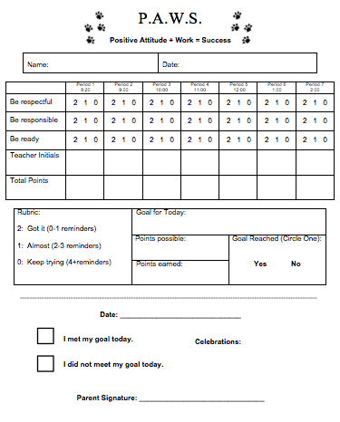
Anchored to SW Expectations
Tier 2 group- Same for all
Increased structure & feedback
Points defined for staff,
student,& families

Slide 41
Tier 2 Progress Monitoring Data:
Currently, 10 students are being supported through CICO. It appears that we are being responsive to 70% of these students through CICO.
5 students are earning at or above 90% of their points and have maintained this over 5 consecutive weeks.
2 out of 10 students are earning between 65% and 75% of their points and have experienced an increase over the past 5 consecutive weeks.

Slide 42
Tier 2 Progress Monitoring Data:
Currently, 10 students are being supported through CICO. It appears that we are being responsive to 70% of these students through CICO.
3 students are not making progress towards earning 80% of their points.
1 of these 3 students has been absent 5 or more days over the past 5 weeks.
1 of these 3 students is experiencing success with CICO in the morning, but not the afternoon.
1 of these 3 students has received 6 minor referrals and 2 major referrals over the past 5 weeks.

Slide 43
Responding to Progress Monitoring Data
1 of these 3 students has been absent 5 or more days over the past 5 weeks. | Continue with CICO Meet with family to engage in problem solving
1 of these 3 students is experiencing success with CICO in the morning, but not the afternoon. | Observe student during morning and afternoon settings. Consider modifications to CICO and staff support based on observation data.
1 of these 3 students has received 6 minor referrals and 2 major referrals over the past 5 weeks. | CICO facilitator observed “on” & “off” times. Staff fidelity at 85%. Collect additional data through informal FBA process to inform function and identify additional supports.

Slide 44
Supporting Sustained Commitment
Create a culture of safety and transparency to share and engage staff with data
Share Tier 2 systems data with staff regularly
Share before and after data (precision statements, graphs) with staff whenever a change in solution is implemented
Share Tier 2 outcome and fidelity data with staff

Slide 45
Leave this here to cover student names
Notes:
This is a sample ticket that was a different color from the other schoolwide tickets. These were given to students for “checking in” and contributed to the class total. They may have counted as double. This ensures that the students enrolled in CICO have a high probably of contributing
45

Slide 46
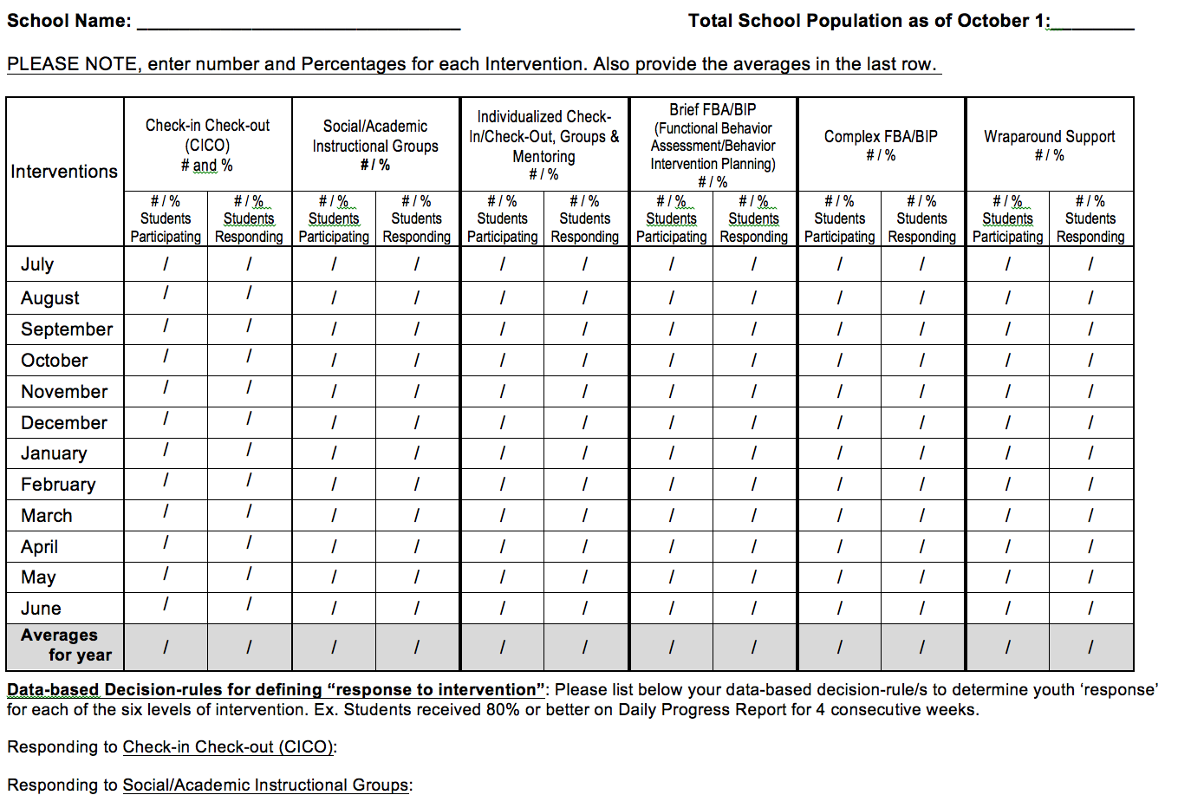
Page 26

Slide 47
Multi-Tiered Framework:
A Way of Work for Tier 3
5%
80%
15%
A few
Some
All
Walker et al. (1996). Integrated approaches to preventing antisocial behavior patterns among school-age children and youth. JEBD, 4, 194 – 209.

Slide 48
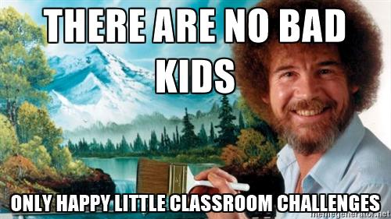

Slide 49
Sample Precision Statement for Tier 3
4 staff members have observed and reported 24 incidents of chronic disruptive behavior that looks like not following directions, engaging in arguments with staff, profanity, and skipping that includes leaving the classroom without permission and not showing up for class with three 8th grade students- JT has 6 referrals, BR has 8 referrals, and SQ has 10 referrals. JT has been receiving support through CICO, BR has been receiving support through CICO-M and SAIG, and SQ has not received any additional support. We think JT and BR are engaging in these behaviors in order to gain staff attention and escape instruction that requires independent reading activities. We are unsure about why SQ is engaging in these behaviors.

Slide 50
Craddock Middle School Resource Map for Tier 3
Practices/Programs/Initiatives | Decision Rules | Provider | Progress monitored? Outcomes evaluated? | How do students enter & exit*?
Informal FBA/ Individual-ized CICO | Students needing extra support with SW Expectations | CICO Facilitators & Teachers | Daily Progress Report (DPR) Student Behavior | 2+ ODRs 4+ CR Behavior Incidents *80% goal made over 10 cons days; 0-1 ODRs
FBA/BIP | Student not responding to T2 or experiencing intense behavioral needs | Team formed around student, staff | Student Behavior data, DPR, academic data Fidelity measure | 6+ ODRs; Referral for Support (Counselor, Teacher, Nurse) *Individualized goals met
JT
BR & SQ
Notes:
50
50
might want to insert our resource map...tier definitions that we have given them
have them resource map Tier 1 in one domain...we could differentiate by domains

Slide 51
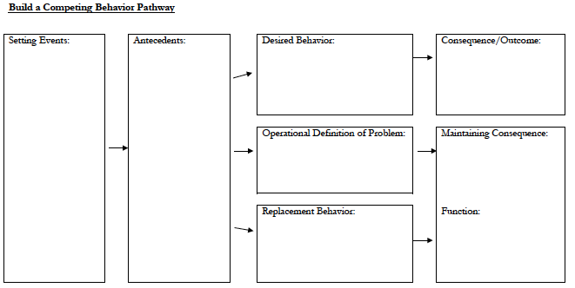
Solution Development at Tier 3
PREVENT & TEACH
ACKNOWLEDGE/APPRECIATE & CORRECT
SAFETY/CRISIS PLAN

Slide 52
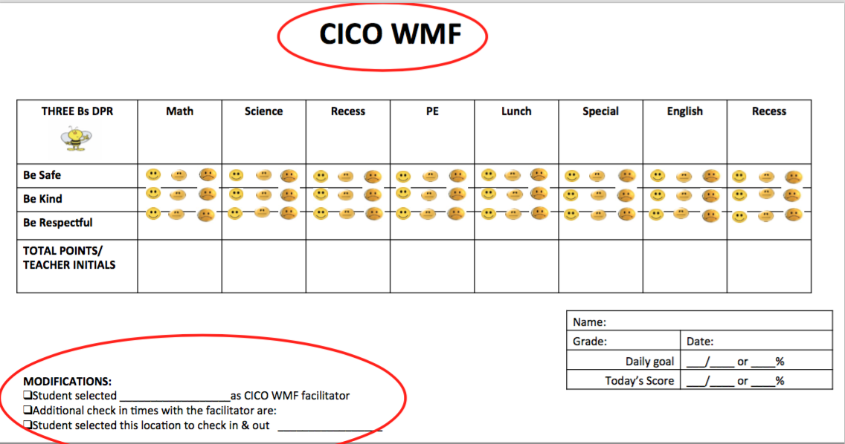
Sample DPR for JT
CICO-M
Sample provided from Iowa DOE PBIS Project

Slide 53
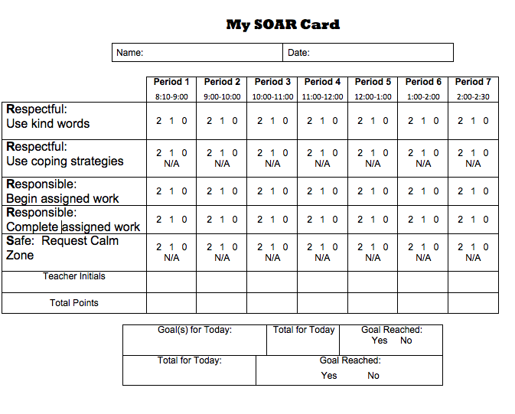
Sample DPR for BR and SQ

Slide 54
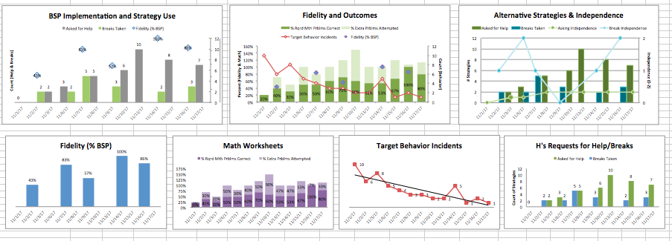
Progress Monitoring at Tier 3

Slide 55
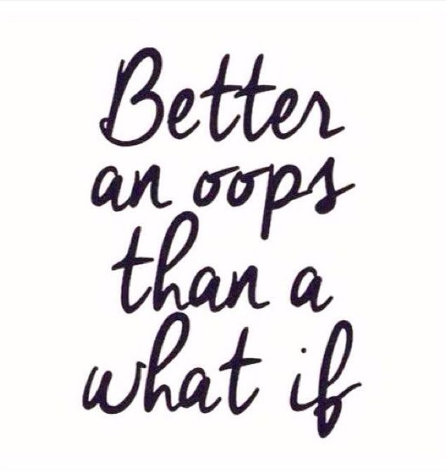
Responding to Progress Monitoring Data
JT | Plan implementation (CICO-M) is low. Staff indicate difficulties implementing morning review of expectations but have been able to review at least 3/days/wk. Observe reading and math periods. Provide staff coaching.
BR | Target goals have been met and staff indicate that student is ready to begin fading to Tier 2 supports (Basic CICO). Continue with Academic Group to support continued growth with writing goals.
SQ | Team indicate that support plan is not a good fit. Disruptive behaviors and truancy remain high across classes. Observe behaviors to identify additional contextual changes are needed. Request meeting with team to identify additional support through Wrap Around Process (newly added to continuum).

Slide 56
Craddock Middle School Resource Map for Tier 3
Practices/Programs/Initiatives | Decision Rules | Provider | Progress monitored? Outcomes evaluated? | How do students enter & exit*?
Informal FBA/ Individual-ized CICO | Students needing extra support with SW Expectations | CICO Facilitators & Teachers | Daily Progress Report (DPR) Student Behavior | 2+ ODRs 4+ CR Behavior Incidents *80% goal made over 10 cons days; 0-1 ODRs
FBA/BIP | Student not responding to T2 or experiencing intense behavioral needs | Team formed around student, staff | Student Behavior data, DPR, academic data Fidelity measure | 6+ ODRs; Referral for Support (Counselor, Teacher, Nurse) *Individualized goals met
GAP… Use Hexagon Tool for FBA/BIP/Wrap Around
JT
BR & SQ
Notes:
56
56
might want to insert our resource map...tier definitions that we have given them
have them resource map Tier 1 in one domain...we could differentiate by domains

Slide 57
Supporting Sustained Commitment
Create a culture of safety and transparency to share and engage staff with data
Share Tier 3 systems data with staff regularly
Share before and after data (precision statements, graphs) with relevant staff whenever a change in solution is implemented
Share Tier 3 outcome and fidelity data with staff

Slide 58
Workbook pg. 33-37
Notes:
More considerations. Have teams talk about these items
58

Slide 59
