Slide 1
Positive Classroom Behavioral Supports: Using Data and Systems to Build Capacity
Kimberly Yanek, PhD
Mid-Atlantic PBIS Network
kyanek@midatlanticpbis.org

Slide 2
Appreciation is given to the following for their
contributions to this Professional Learning

Slide 3
Learning Intentions
Develop shared language and understanding of Positive Classroom Behavioral Supports (PCBS)
Explore data informed approach to support fluency building with Positive Classroom Behavioral Supports
Explore approach to install systems of support for capacity building with Positive Classroom Behavioral Supports

Slide 4
Why … Rationale?
Classroom management continues to be high
priority need
Similarity of practices within classroom and
non-classroom areas
Students spend majority of time in the
classroom
Begin building a system of support for teachers
and what we are asking them to implement…
common language, practices, data
Frequency and intentionality (dosage) of
practices increase as we layer support through
all 3 tiers
Notes:
Research on teachers not prepared during pre-service for classroom
Similarity of practices within classroom, sw/common areas- important to install those skills in classrooms where students spend most of their time
Begins the system of support for teachers and what we are asking them to implement

Slide 5
Do all teachers in your school employ basic classroom evidence based practices?
Behavior Specific Praise statements to error correction is at least 4:1 and classroom system does not promote teacher attention to student errors
OTR rate. Teacher talk should be no more than 40-50% of instructional time
Routines and procedures defined and explicitly taught across year
Social skills explicitly taught in context with behavior examples
Pre-correction is used prior to transitions
Active Supervision used in classroom (and non classroom) areas
How do you know?
(Barrett,S., 2016)
Notes:
Behavior Specific Praise statements to error correction is at least 4:1 and classroom system does not promote teacher attention to student errors
Wait time is 4 seconds
OTR rate. Teacher talk should be no more than 40-50% of instructional time.
New material: a minimum of 4-6 responses per minute with 80% accuracy.
Review of previously learned material: 8-12 responses per minute with 90% accuracy.
Routines and procedures defined and explicitly taught across year
Social skills explicitly taught in context with behavior examples
Pre-correction is used prior to transitions.
Active Supervision used in classroom (and non classroom) areas.

Slide 6
What is your “Why”…
Notes:
Why are you here? Group discussion, share out, talking points.

Slide 7
Consistency Matters
Common
Vision/Expectations
SCHOOL COMMUNITY
Common
Language
Common
Practices
(USDOE OSEP PBIS TA Center, 2010)
Notes:
7
When staff, students and families know the the school’s vision and 3-5 schoolwide expectation, as well as the practices and common language there is consistency among all stakeholders. Consistency matters in developing a safe and predictable environment.

Slide 8
U.S. Public Health: Tiered Logic Model
A few
Cancer treatment; nursing homes; dentures; organ transplants
Some
Medication; medical treatment; fill cavities; vision correction
All
Check-ups; diet; exercise; vaccinations; fluoride; seatbelts
Walker et al. (1996). Integrated approaches to preventing antisocial behavior patterns among school-age children and youth. JEBD, 4, 194 – 209.

Slide 9
Building Capacity through a Continuum of Supports
Support for a Few Staff Members
Support for Some: Small Groups of Staff Members
Data-Informed
Support for All Staff Members
Notes:
9
Our language and the ways we communicate with our colleagues, families, and other school community members is important. Sometimes we hear folks referencing T II students or T III students. It's important to communicate that the tiers refer to the layer of support and we use person first language. So, it might be a student needing T II support with math computation or a student needing TIII support with comprehension or a student needing TI support with making friends.
Support is always “layered” onto the previous supports. When a small group of students require a little more support, they continue to receive universal/tier 1 core or instruction. Students receiving secondary supports have increased opportunities for more frequent contingent feedback, additional structure, re-teaching of expectations, etc.
Students in need of intensive, individualized support, continue to receive universal supports. Tier III often builds upon the supports that the student receives with Tier II interventions.
All that we do is anchored to tier 1 and this is true for social and academic (e.g., literacy, math) instruction.
Going through the stages of learning –acquisition , fluency, maintenance, generalization
I do We do You do
9

Slide 10
Supporting Social Competence & Academic Achievement ...
Culture matters
EQUITABLE
OUTCOMES
Outcome data (social behavior, academic achievement, Progress Monitoring, Fidelity)
SYSTEMS
DATA
What we do to support adults to implement the practices
PRACTICES
What we do to
support students
Notes:
10
For the systems slide…build, communicate to staff, etc. this system which is defined by the data and practices.
For purposes of explanation…the colors matter.
Direct them back to the last triangle… do you see team based implementation? Evidence based practices? Etc. In the next two slides take them through the components.

Slide 11
Leaning into this work
SWPBIS team, including an administrator, leads building system to support implementation of practices in classroom and non-classroom
On-going support with a data-informed spiraling curriculum
Utilize components of coaching throughout system of support

Slide 12
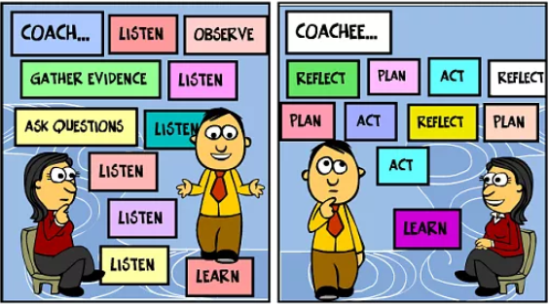
Move from coach as a noun to coach as a verb…
Consider a culture that reflects whole school coaching

Slide 13
Resource Map for Classroom Management
Identify similarities and differences (e.g., theoretical, language) among programs/practices/initiatives supported for classroom management
Work to reconcile differences and make explicit similarities for staff
Align capacity building efforts and fidelity checks

Slide 14
Are there other approaches, practices, programs to consider?
Responsive Classroom
Love and Logic
Teach Like a Champ
RtI
Restorative Practices
Others???
Alignment happens above the level of implementation

Slide 15
Resource Map for Classroom Management
Approach | Theory | Practices | Data | Systems
PBIS | Behavior Science | Expectations are defined with rules & routines. Then, post, teach, reinforce, & correct Explicit Instruction Individual/Group Reinf | Snap-shots | Monthly PD for all every other month; grade level PLCs; 1:1 coaching
Responsive Classroom | Constructivist | Morning Mtgs CR Expectations Group Reinf, some individual | None | 1 PD/year
Conscious Disc | SEL | Explicit teaching, SE regulation | None | 2 PD/yr, coaching

Slide 16
Alignment of Support
Explore current resources for building a system of support
Time (District PD days, Collaborative Planning/PLCs, After School, Staff Meetings, Independent study, etc…)
Content (District Trainers, staff with demonstrated fluency, online resources, MTSS Leadership, etc…)
Continuum of Support (All staff PD, PLCs, Coaching, Staff, etc…)

Slide 17
Multi-tiered Support Framework
Coaching with Performance Feedback
Request for Support
Professional Learning Communities with focused support
Small group professional learning (self selected and data informed)
Data-Informed
All Staff Professional Learning (initial and booster)
Options for Data Collection- Peer/Buddy Observations, Self-Assessment, Surveys
Fluency Building Days
Use outcome data to identify precision statements by grade level
Staff acknowledgement to support PCBS implementation
Notes:
We were intentional about giving options for data collection - some teachers struggled with feedback vs evaluative
First, ask participants to identify tier 2 practices, initiatives, programs. Share out
What are the decision rules for accessing and exiting each of these?
Then ask …What data sources are in place for each tier 2 practices ,initiatives, programs to measure effectiveness and to progress monitor? Share out
Then ask… Who are the service delivery personnel for each of the tier 2 practices, initiatives, programs?

Slide 18
Considerations at Tier 1 to support whole school coaching with data, practices, systems
Notes:
staff development with the eight best practices.; teacher practice documents.

Slide 19
Positive Classroom Behavioral Supports
Define and Teach Rules and Routines aligned with School-wide Expectations (Classroom Matrix)
Identify Continuum of Practices for Responding to Behavior
Arrange physical space to prompt appropriate behavior
Employ Active Supervision
Develop Class-Wide Group Contingencies
Provide Multiple Opportunities to Respond
Notes:
TRAINER NOTES: Note the colored fonts within the list of modules; part of 2 day training reflects the coaching model. We will train the modules in dark blue font, which is “I DO”, our work tomorrow with “mock trainings will be the “We Do” and you doing the training back in your district will be the” You Do”.
These are the 8 Classroom Management Practices that research has shown has a positive impact on students. Each module has the practice bolded in orange font.
We want your teachers to have effective strategies that they are all using consistently. Tier I features are implemented within classrooms and are consistent with school-wide systems.
(The classroom is a critical aspect of Tier I training and includes 8 key components. These strategies maximize classroom management to allow for instructional time and less teacher stress!
**Components 1 & 4 are about setting up the physical environment to minimize distractions for students, to use the physical space of the classroom as an assistant in managing student bodies and behaviors, and also how we can have a positive impact on students engagement by moving around the classroom and having brief interactions with students.
**Components 2, 3, 5, 7 are about efficient teaching of those common classroom routines, how to do it efficiently and not over and over again, and how to provide feedback to encourage students follow those routines. Praise connected to specific behaviors is more powerful than generic praise. Group feedback, and rewards can be powerful motivators too.
**Components #7 and 8 are about providing adequate level of practice for the behaviors you want to see, and how to effectively, quickly redirect these misbehaviors so they are less likely to turn into bigger behaviors.)

Slide 20
Structure of PD for all staff each of the 6 practices
Workshops provided every other month
Follow up task assigned for classroom teachers to build fluency with practices (examples)
Data Collection piece on fluency (lesson plans, feedback ratios)
Coach in all classrooms for fidelity checks
Notes:
BSPS/EC - initial PD and track through to 2017-18 to gender ratios and work to reduce the ratio
Precision statement from Tier I meeting regarding gender, Fall 2017.
Tally sheet by student. Fidelity check (Dayla)

Slide 21
Evolution of Fluency Building with Feedback Ratios
Year 1- introduced and built feedback ratios
Year 2- watched the data to determine staff needing more support
Year 3: 80% of staff had fluency, monitored the student outcome data for equitable use of data. Gender-data to inform equitable use.
Notes:
Pull everything related to BSP.

Slide 22
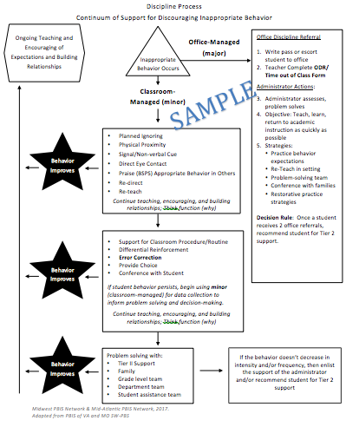
Which practices are currently reflected in your flowchart? Connection to SW Tier 1

Slide 23
Using the Classroom Snapshot to Support Staff
Develop shared understanding (PD for all):
10-20 minutes in grade level or staff meeting
Tell how you will do the following:
How will data be collected?
Teacher self assess
Data Buddy to gather performance feedback
How will you work to ensure teachers feel supported?

Slide 24
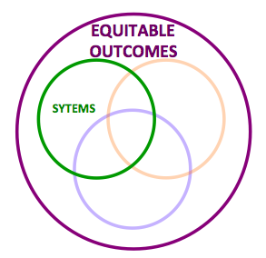
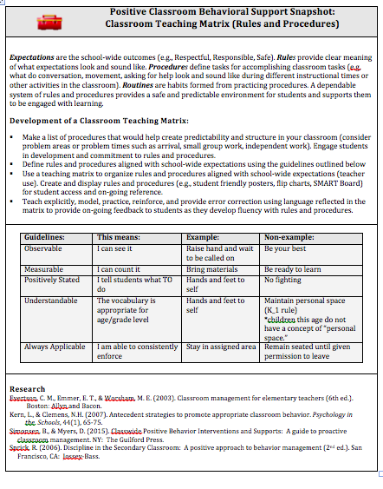
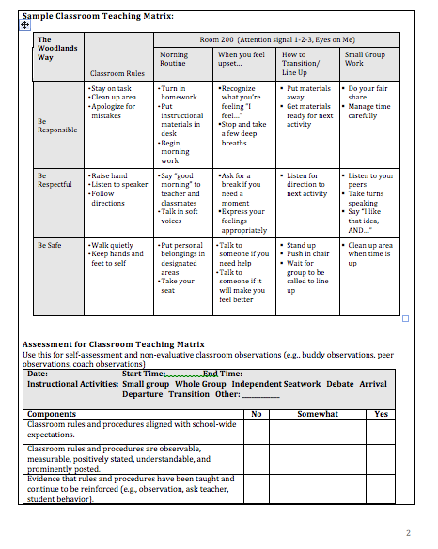
Positive Classroom Behavioral Support Snapshot: Classroom Teaching Matrix

Slide 25
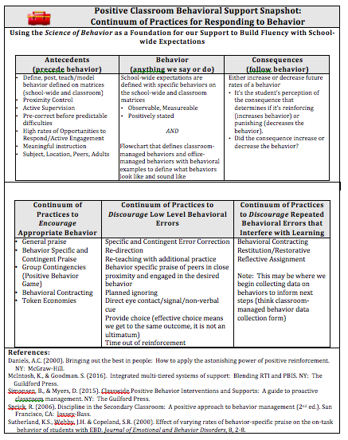
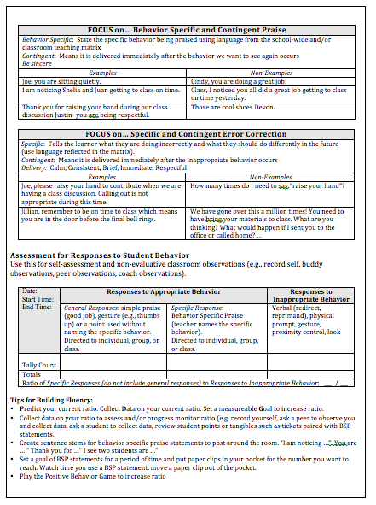
Positive Classroom Behavioral Support Snapshot: Continuum of Responses

Slide 26
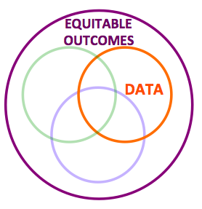
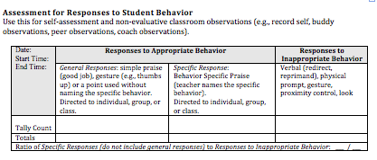
Assessment for Continuum of Responses
Notes:
Use this as a self assessment to determine which teachers may need
extra training or support with this practice.

Slide 27
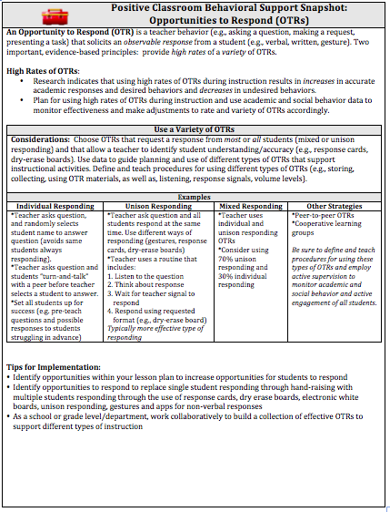
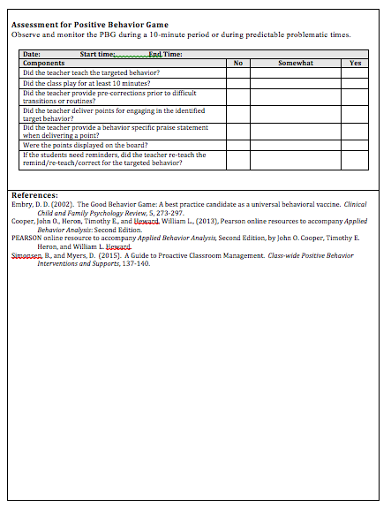
Positive Classroom Behavioral Support Snapshot: Opportunities to Respond

Slide 28
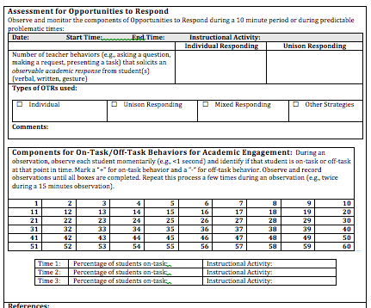
Assessment for OTRs

Slide 29
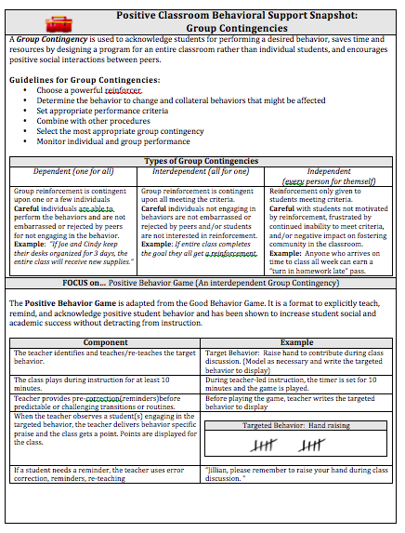
Positive Classroom Behavioral Support Snapshot: Group Contingency

Slide 30
Assessment for Physical Arrangements

Slide 31
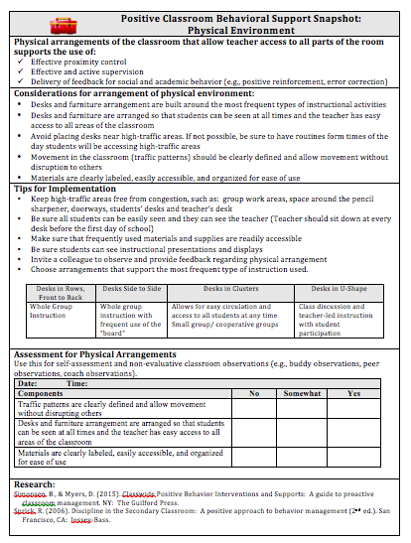
Positive Classroom Behavioral Support Snapshot: Physical Arrangements

Slide 32
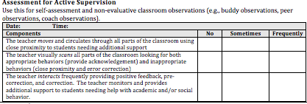
Assessment for Active Supervision

Slide 33
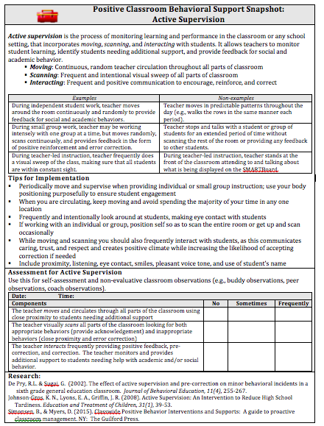
Positive Classroom Behavioral Support Snapshot: Active Supervision

Slide 34
Data Collection and Sharing Options
Options for Data Collection on Fluency:
-Self-Observation via Video
-Peer/Buddy Observations
-Coach Observation
-Self-Assessment/Reflection
-Surveys
Data Sharing on:
-Implementation of 8 Practices
-Anecdotal Teacher and Perception Data
-Precision Statements for Classroom by Grade Level
-Outcome Data (whole staff meetings, PLCs, Celebrations)
Data Informed Decision Making:
-Precision Statements from student outcome data (minor and major) to guide support for implementation
-Teacher generated solutions anchored to the 8 practices
Notes:
Options for Data Collection on Fluency:
-Self-Observation via Video
-Peer/Buddy Observations
-Coach Observation
-Self-Assessment/Rflection
-Surveys
Data Sharing on:
-Implementation of 8 Practices
-Anecdotal Teacher and Perception Data
-Precision Statements for Classroom by Grade Level
-Outcome Data (whole staff meetings, PLCs, Celebrations)
Data Informed Decision Making: Precision Statements (by grade level and school-wide) from student outcome data (minor and major) to guide support for implementation: Teacher generated solutions anchored to the 8 practices

Slide 35
Classroom Observation Data Collection Form
Notes:
Here is part of the data collection form that
can be used to collect data during walk through
visits and observations. This form can also be
used as a self-assessment tool. All the items can
be found on the Classroom Management Snapshot
for each classroom practice.

Slide 36
Using outcome data

Slide 37
SW-PBIS Team … Precision Statement
For the first 2 months of school, staff reports 60 incidents (office and classroom managed) of disrespect and disruption in the classroom across all grade levels (30/50 staff) for 50 distinct students, with the majority of incidents occurring between 1:30 and 3:00 on a daily basis. Staff report that they think students are engaging in this behavior to obtain peer attention and/or escape work.
All, some, or a few?
Notes:
Ask what the focus of support should be- all, some, few

Slide 38
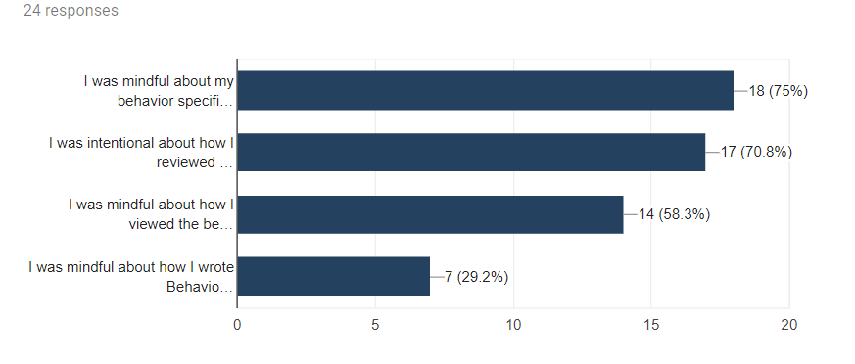
Early in the year, data showed a disproportionately high number of major and minor referrals for boys. The male to female ratio was 11:1. After training and coaching for all staff, and shoulder to shoulder coaching for some, the ratio was reduced to 5:1. In our end of year survey, we asked teachers to indicate all strategies they used to decrease this ratio. Results can be seen below.
Notes:
Training and coaching looked like PD for all, reviewed data which led to shoulder coaching

Slide 39
Notes:
Speaks to reliability of the data

Slide 40
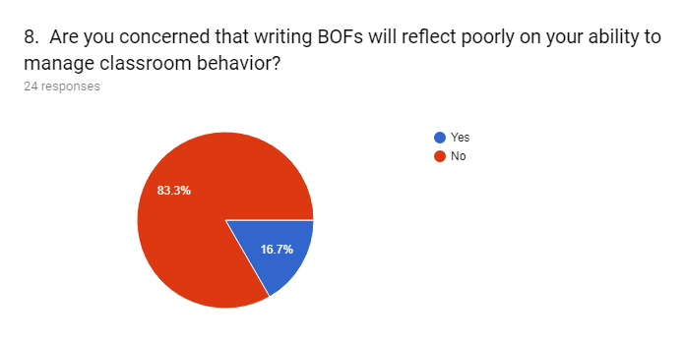
Notes:
The previous slide looks great and some of you may be thinking well maybe staff just stopped writing referrals/collecting data, so we collected data to inform teacher perspectives about collecting data, etc…
This data reflects the culture (safety) created to make data informed decisions (data collection, data sharing, problem solving with data) a part of our whole school approach to coaching.

Slide 41
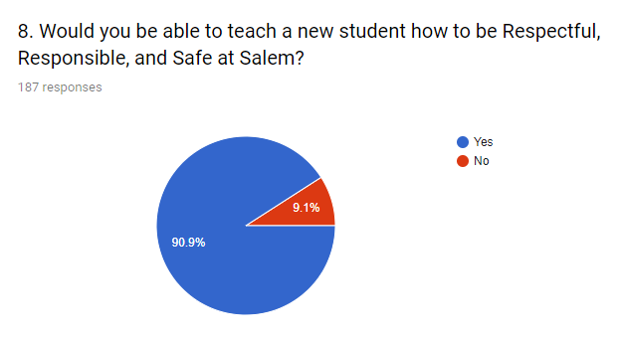

Slide 42
Other System Supports
Newsletters
Here are a few other links of a typical “Growing the Green” messages.
Sharing Data with Staff Regularly
Growing the Green
Fun/Creative Factor (Respect Challenge)

Slide 43
Roles and Responsibilities
Admin
Tier 1 team
External coach, district coach

Slide 44
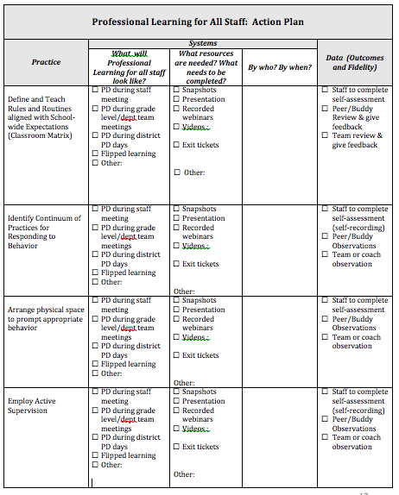
Team Action Planning

Slide 45
Considerations at Tier 2 to support whole school coaching with data, practices, systems
Notes:
staff development with the eight best practices.; teacher practice documents.

Slide 46
Positive Classroom Behavioral Supports
Define and Teach Rules and Routines aligned with School-wide Expectations (Classroom Matrix)
Identify Continuum of Practices for Responding to Behavior
Arrange physical space to prompt appropriate behavior
Employ Active Supervision
Develop Class-Wide Group Contingencies
Provide Multiple Opportunities to Respond
Notes:
TRAINER NOTES: Note the colored fonts within the list of modules; part of 2 day training reflects the coaching model. We will train the modules in dark blue font, which is “I DO”, our work tomorrow with “mock trainings will be the “We Do” and you doing the training back in your district will be the” You Do”.
These are the 8 Classroom Management Practices that research has shown has a positive impact on students. Each module has the practice bolded in orange font.
We want your teachers to have effective strategies that they are all using consistently. Tier I features are implemented within classrooms and are consistent with school-wide systems.
(The classroom is a critical aspect of Tier I training and includes 8 key components. These strategies maximize classroom management to allow for instructional time and less teacher stress!
**Components 1 & 4 are about setting up the physical environment to minimize distractions for students, to use the physical space of the classroom as an assistant in managing student bodies and behaviors, and also how we can have a positive impact on students engagement by moving around the classroom and having brief interactions with students.
**Components 2, 3, 5, 7 are about efficient teaching of those common classroom routines, how to do it efficiently and not over and over again, and how to provide feedback to encourage students follow those routines. Praise connected to specific behaviors is more powerful than generic praise. Group feedback, and rewards can be powerful motivators too.
**Components #7 and 8 are about providing adequate level of practice for the behaviors you want to see, and how to effectively, quickly redirect these misbehaviors so they are less likely to turn into bigger behaviors.)

Slide 47
Decision Rules for T2 Support
Teachers new to the school
Tier 1 team monitoring data and discovered grade levels observing and reporting high levels of problem behaviors- process with precision statement and solution development
Invitation always extended to staff
Admin Observation and Feedback Cycle- aligned with practices and offered additional support
Notes:
Practices, Data, Systems.

Slide 48
Data Informed PD for Small Groups
Tier 1 teams uncovered times of day with spikes in behaviors observed and reported
Tier 1 team drilled down around time of day and realized that the context differed by grade level
Tier 1 team developed precision statements by grade level
Grade levels engaged in solution development during collaborative teams/PLCs
Notes:
Include grade level specific data used to problem solve.

Slide 49
All Staff PD, differentiated by need, led by choice
Retrained all staff on routines and procedures
Within the training, broke into grade level teams with grade level specific data. PBIS grade level team leaders led grade level teams in precision statement development for problems and solution anchored to routines and procedures

Slide 50
Routines and Procedures Specific to Grade Levels
Small group by grade level- same process, but specific to the grade level
Tier 1 team lead for each grade level coached the grade level through solution development
Planned data collection and review on fidelity and outcomes
Notes:
Analysis and problem solving for grade level specific data: Grade 5 data, solution (dismissals), practiced, timeline, data for success.

Slide 51
Best Practices:
Systems of Support Within the Classroom
Opportunities to Respond
Staff Training:
Choice Board for Group Supports
Salem Elementary
March 30, 2018
Notes:
Tier 2 focused PD

Slide 52
Accept the Challenge
Peer Observation: Invite a peer to observe you trying a new or tried and true “opportunity to respond” session of teaching for 10 minutes.
Video of Myself for Reflection: Video yourself while trying a new or tried and true “opportunity to respond” session for 10 minutes. Watch the video and observe yourself.

Slide 53
Roles and Responsibilities
Admin
Tier 1 team
External coach, district coach
Notes:
Ann - how did we make this happen? Scheduling? Meetings?

Slide 54
Considerations at Tier 3 to support whole school coaching with data, practices, systems
Notes:
staff development with the eight best practices.; teacher practice documents.

Slide 55
Positive Classroom Behavioral Supports
Define and Teach Rules and Routines aligned with School-wide Expectations (Classroom Matrix)
Identify Continuum of Practices for Responding to Behavior
Arrange physical space to prompt appropriate behavior
Employ Active Supervision
Develop Class-Wide Group Contingencies
Provide Multiple Opportunities to Respond
Notes:
TRAINER NOTES: Note the colored fonts within the list of modules; part of 2 day training reflects the coaching model. We will train the modules in dark blue font, which is “I DO”, our work tomorrow with “mock trainings will be the “We Do” and you doing the training back in your district will be the” You Do”.
These are the 8 Classroom Management Practices that research has shown has a positive impact on students. Each module has the practice bolded in orange font.
We want your teachers to have effective strategies that they are all using consistently. Tier I features are implemented within classrooms and are consistent with school-wide systems.
(The classroom is a critical aspect of Tier I training and includes 8 key components. These strategies maximize classroom management to allow for instructional time and less teacher stress!
**Components 1 & 4 are about setting up the physical environment to minimize distractions for students, to use the physical space of the classroom as an assistant in managing student bodies and behaviors, and also how we can have a positive impact on students engagement by moving around the classroom and having brief interactions with students.
**Components 2, 3, 5, 7 are about efficient teaching of those common classroom routines, how to do it efficiently and not over and over again, and how to provide feedback to encourage students follow those routines. Praise connected to specific behaviors is more powerful than generic praise. Group feedback, and rewards can be powerful motivators too.
**Components #7 and 8 are about providing adequate level of practice for the behaviors you want to see, and how to effectively, quickly redirect these misbehaviors so they are less likely to turn into bigger behaviors.)

Slide 56
Components of Coaching
Assess the Classroom- Teacher interview & Classroom Learning Walk
Provide Feedback
Provide Choices of Practices and Identify Priorities
Engage in Action Planning
Engage in On-Going Monitoring
(Reinke, et al., 2008)

Slide 57
Teacher Interview
Why?
To establish rapport, learn about the teacher’s classroom management style, and to gain knowledge about the teacher’s past experience.
Notes:
DAYLA
Build connection with what they did at Tier 1 and 2.
Intro the example teacher

Slide 58
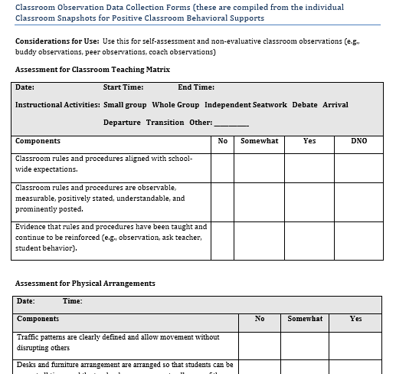
Classroom Observation
Classroom Walkthrough
Tool
October 17 (baseline)
October 23 (fidelity check
as part of sw cr observations)
February 21
April 17 (fidelity check as part of sw cr observations)
8 Classroom
Practices
Notes:
DAYLA

Slide 59
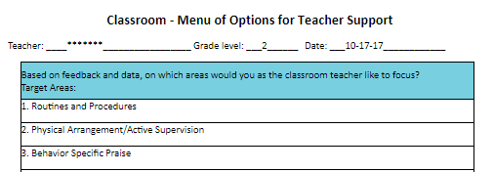
Menu of Options
Notes:
DAYLA

Slide 60
Action Planning & Self-Monitoring
Scheduled follow up observations throughout the year. Used observation data to progress monitor goals.
Teacher also had students in class receiving Tier 2 support through CICO.
Received support from Tier 2 team lead: follow up assistance with DPR goals, reinforcement, and routines.
Notes:
DAYLA
How she self-monitored.

Slide 61
Data Observation & Feedback
 | Overall Ratio | Boys | Girls | Engagement
October 17 | 1:2 | 1:2 | 2:1 | 80%
October 23 | 1:1 | 1:1 | 1:1 | 88%
February 21 | 1:2 | 1:3 | 2:1 | 88%
April 17 | 9:1 | 4:0 | 5:1 | 100%
April 17 SW | 5:1 | 4:1 | 7:1 | 99%
Notes:
DAYLA Possibly share overall school % in CICO and her % in CICO

Slide 62
Decision Rules for T3 Support
All Tier 1 training/systems support (newsletters) included invitation through team leads to connect with coach (Self-selected and not tied to administrator)
Admin offered coach as support through observation cycle (framed as positive offer-student with unique needs)
Notes:
Shufflebarger

Slide 63
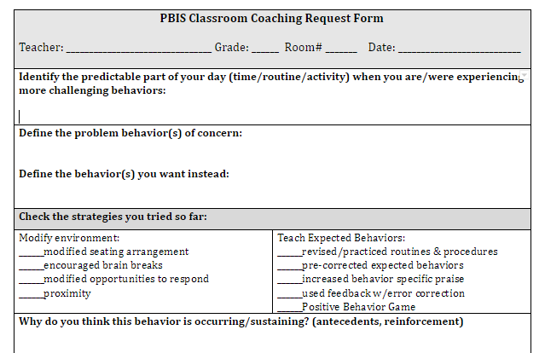
Request for Assistance
Notes:
Complete and send to Tier 1 and Tier 2 team lead

Slide 64
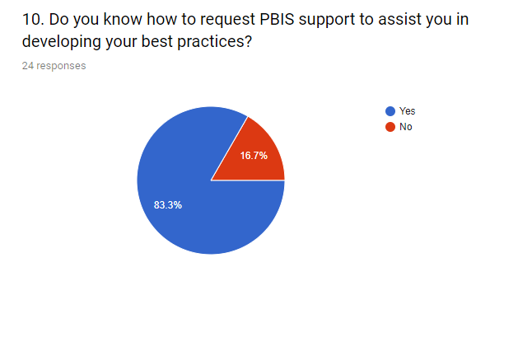
Staff Survey Feedback

Slide 65
Building a Culture of Coaching
Facilitated by a building coach, lead teacher, another trusted teacher, a teacher with fluency with identified practices
Remember… support not evaluation
Data informed or request for assistance
Built on a culture of trust

Slide 66
Roles and Responsibilities
Admin- sub time for staff to engage in coaching relationship
Tier 1 team (leads from each dept/core/grade level)
External coach, district coach
Notes:
DAYLA

Slide 67
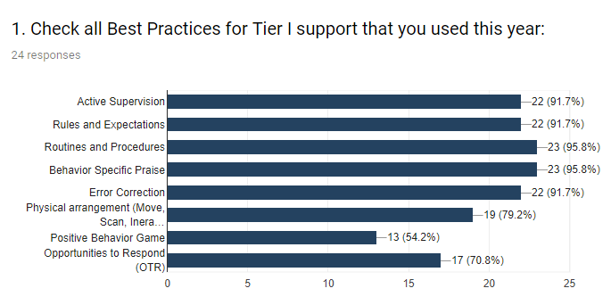
Staff Survey

Slide 68
Lessons Learned
Using student and staff surveys to inform next steps
Collaboration time provided within the master schedule

Slide 69
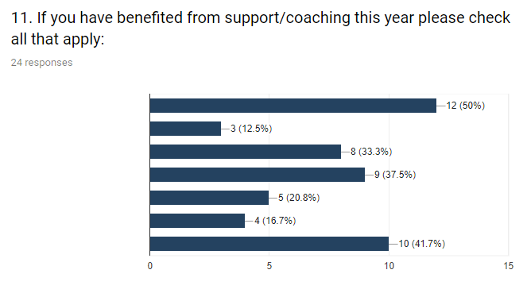
Tier 1 team
Tier 2 team
Admin
Guidance
Coach Dayla Brown
Online Resources
Grade level Reflection

Slide 70
A look beyond classroom … the Ripple Effect

Slide 71
Sustaining the Work
Moving from coach as noun to coach as verb: Inter-rater reliability among staff to collect observation data with coach
-District coach fading support
-Admin support
Notes:
DAYLA and SHUFFLEBARGER
Tier 1 team joined me on fidelity walk

Slide 72
Resources for Defining, Measuring, and Guiding Professional Learning to Build Fluency with Practices (PCBS)

Slide 73
Available at: https://www.pbis.org/Common/Cms/files/pbisresources/PBIS%20Cultural%20Responsiveness%20Field%20Guide.pdf
(Page 14 addresses Classroom)

Slide 74
National Resources Informing 8 Practices

Slide 75
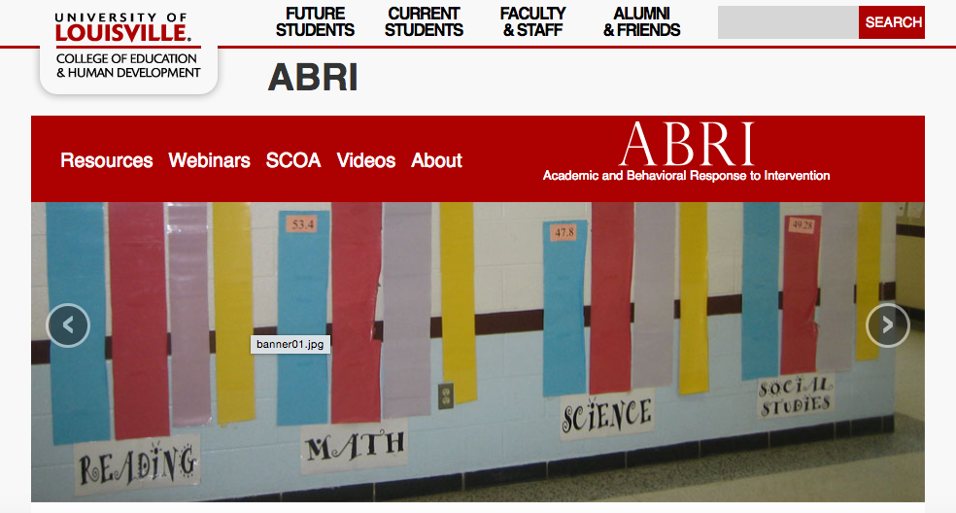
https://louisville.edu/education/abri
Resources for Effective Instruction and Classroom Management

Slide 76
Recorded Webinars

Slide 77
Comprehensive Modules with Assessment Tools

Slide 78
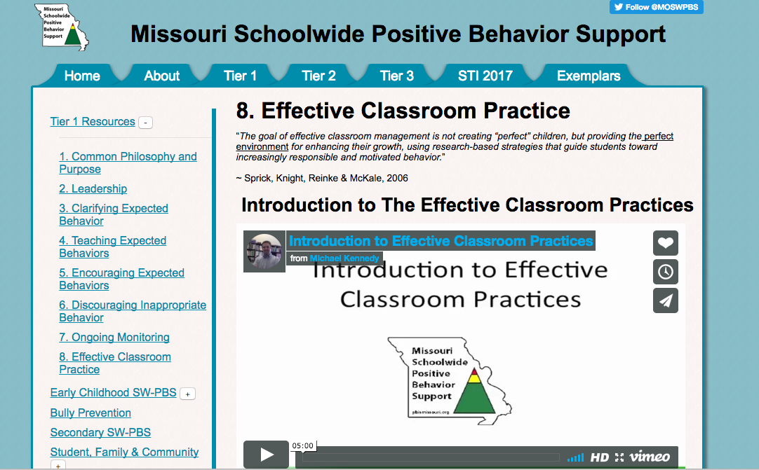
Comprehensive Resources (PD, Assessment)

Slide 79
Available at: https://www.pbis.org/Common/Cms/files/pbisresources/PBIS%20Cultural%20Responsiveness%20Field%20Guide.pdf
(Page 14 addresses Classroom)

