Slide 1
Positive Classroom Behavioral Supports
Kimberly Yanek, PhD
kyanek@midatlanticpbis.org

Slide 2
Appreciation is given to the following
for their contributions to this Professional Learning:

Slide 3
Getting to Know You…

Slide 4
Learning Intentions
Explore the Science of Behavior as our anchor for developing a class-wide plan of support for student behavior
Review a class-wide plan of
preventative practices
Develop a class-wide plan of effective responses to student behavior
anchored to function

Slide 5
Learning Intention
Explore the Science of Behavior as our anchor for developing a class-wide plan of support for student behavior

Slide 6
Prosociality and Social Well Being
“Prosocial individuals contribute to others’ well being through kindness, productive work, improving their community, and supporting family, friends, and coworkers, as well as creative acts of all kinds” (Biglan,2015)
Notes:
Anthony Biglan, PhD, is a senior scientist at Oregon Research Institute and a leading figure in the development of prevention science. His research over the past thirty years has helped to identify effective family, school, and community interventions to prevent all of the most common and costly problems of childhood and adolescence. He is a leader in efforts to use prevention science to build more nurturing families, schools, and communities throughout the world. Biglan lives in Eugene, Oregon.

Slide 7
Why focus on Prosocial and Social Well Being?
Prosocial people…
have more friends,
more meaningful relationships,
fewer behavioral problems
are productive and caring
They excel in school and are healthier.
Behavioral science has taught us how to foster these qualities
(Biglan,2015)
Notes:
We have the tools to help our families and schools to be more nurturing. Rather than addressing each psychological, behavioral, or health problem as though it is unrelated to every other problem, we need to get all of the organizations working on human wellbeing to band together to help make all of our families and schools more nurturing.

Slide 8
ABCs of Behavior
Traditional Consequence System
Prevention Science:
Instructional Approach
2
Antecedent/
Trigger:
When _____ happens….
1
Behavior:
the student does (what)__
3
Consequence/
Outcome
..because (why) ______
(Loman, Borgmeier, Rodriguez)
Notes:
The traditional approach to discipline has been reactionary. With PBIS, we are shifting from a traditional, reactive response to student behavior to a preventative response.

Slide 9
ABCs of Behavior
Antecedents:
Expected behaviors taught,
Classroom practices implemented (routines, supervision), etc.
Behavior:
Expectations defined
Consequences:
Acknowledge-ment/Reinforcement/ Behavior Specific Praise
Effective Responses
Behavior:
“Problem Behaviors” defined
(Loman, Borgmeier, Rodriguez)
Knowing this, helps us with the WHY…
Notes:
The traditional approach to discipline has been reactionary. With PBIS, we are shifting from a traditional, reactive response to student behavior to a preventative response.

Slide 10
Learning Intention
Develop a class-wide plan of preventative practices

Slide 11
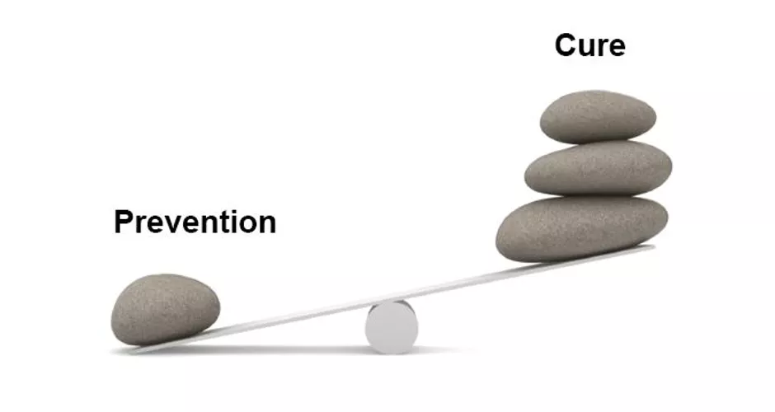
Responding
Lighten the load…

Slide 12
Responding
Practice #1: Define expectations with
specific behaviors/rules and routines

Slide 13
Sample Classroom Matrix
Pro-social/Social Emotional
Classroom Routines
School-wide Expectations
The Wilson Way | Classroom Rules | Classroom (Attention Signal: 1-2-3 Eyes on Me)
 |  | When you feel upset … | Morning Routine | How to Transition/ Line Up | Small Group Work
Be Responsible | Stay on task Clean up area Apologize for mistakes | Recognize what you’re feeling “I feel…” Stop and take a few deep breaths | Turn in homework Put instructional materials in desk | Put materials away Get materials ready for next activity | Do your fair share Manage time carefully
Be Respectful | Raise hand Listen to speaker Follow directions Use appropriate voice level | Ask for a break if you need a moment Express your feelings appropriately | Say “good morning” to teacher and classmates Talk in soft voices | Listen for direction to next activity Be silent | Listen to understand your peers Take turns speaking Use kind words with feedback Speak only to group members
Be Safe | Walk quietly Keep hands and feet to self | Talk to someone if you need help Talk to someone if it will make you feel better | Put personal belongings in designated areas Take your seat | Stand up Push in chair Wait for group to be called to line up | Clean up area when time is up
Classroom Rules
Notes:
Start with entering your school-wide expectations on the left side and then add your classroom rules.
The School-wide matrix includes the rules for classrooms.
Classrooms then expand their matrix to also include the routines/procedures for common routines (mapped to the school-wide expectations).

Slide 14
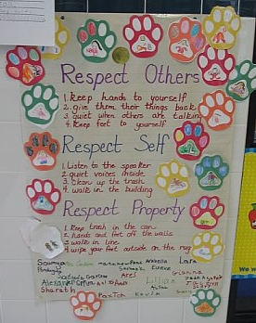
Rosa Lee Carter ES
Notes:
The slide show will stop at the red question mark. Mention that many writers/experts/teachers recommend posting the rules prominently. After taking contributions from the audience, click again to show the two reasons.

Slide 15
Expectation | Pro-Social/ Social Emotional Skill
Be Safe | I tell an adult when I am worried about a friend
Be Respectful | Make sure everyone gets a turn Choose kindness over being right Encourage others; tell peer they did a good job
Be Responsible | Check in with my feelings during the day
Notes:
Consider incorporating pro-social skills within the teaching matrix. Specific behaviors are important and necessary, but we are also addressing social competency with all our students.
Because students spend more time in small cooperative, collaborative work groups, they rely on these prosocial skills for their academic work as well. You can increase content coverage when you precorrect and teach prosocial skills (Anita Archer principle).
Mention behaviors of those being successful or the pro social skills needed by children – intent is to lead the child to be more independent and better quality of life

Slide 16
Conversation: Can students engage in conversation during this activity? If yes, about what? With whom?
Participation: What does it look like and sound like?
Help: How do students get your attention to ask a question? What do they do while they wait?
Movement: Can students get out of their seats for this activity? If so, for what reasons?
Procedures/Routines

Slide 17
Responding
Practice #3: Use explicit instruction to teach
specific behaviors/rules, routines, and signals

Slide 18
We taught the behaviors defined on our classroom matrix using explicit instruction
Behavior Lesson Plan Form
I went over …
Nope
Non-example
Notes:
This is an excellent template teachers and teams can use to organize the instructional process for the desired behavioral skill and can be found on p. 13 in your workbook. This can be used for your lesson planning activity at the end of this module.

Slide 19
Responding
Practices #4-6: Pre-correction,
Active Supervision, Re-teach

Slide 20
Monitor, Reinforce, and Correct
Pre-correct/remind students about expected behaviors
Use active supervision (Move, Scan, Interact)
Provide specific, contingent feedback to reinforce and correct
Reteach and practice throughout the day and school year

Slide 21
Learning Intention
Develop a class-wide plan of effective responses to student behavior anchored to function

Slide 22
Responding
Practices #7: Reinforcement

Slide 23
ABCs of Behavior
Antecedents:
Expected behaviors taught,
Classroom practices implemented (routines, supervision), etc.
Behavior:
Expectations defined
Consequences:
Acknowledge-ment/Reinforcement/ Behavior Specific Praise
Effective Responses
Behavior:
“Problem Behaviors” defined
(Loman, Borgmeier, Rodriguez)
Knowing this, helps us with the WHY…
Notes:
The traditional approach to discipline has been reactionary. With PBIS, we are shifting from a traditional, reactive response to student behavior to a preventative response.

Slide 24
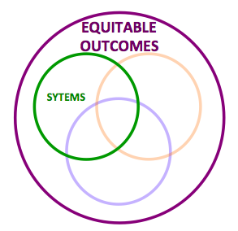
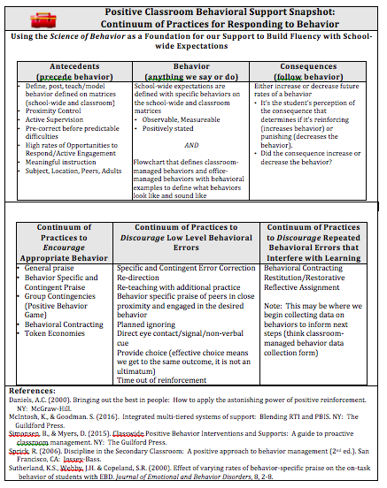
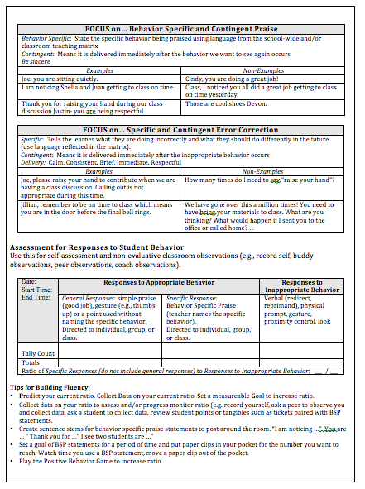
Positive Classroom Behavioral Support Snapshot: Continuum of Responses

Slide 25
Science of Behavior
2
Antecedent/
Trigger:
When _____ happens….
1
Behavior:
the student does (what)__
3
Consequence/
Outcome
..because (why) ______
(Loman, Borgmeier, Rodriguez)
Notes:
The mechanisms behind what we do are important.
Define the what, when, where, how abd why of your expectations
Link you antecedents with consequences- the best antecedents for behavior are those that predict the consequence of preforming the behavior
Shape the behavior your’e looking for through pos reinf. If needed, get the desired behavior going with neg reinf and then immediately and consistently provide pos reinf for the behavior. Avoid getting yourself emotionally worked up tht you’re too upset to post reinf the behavior once it does occur.
Change our behavior- if we same things day in and day out , we can’t expect the outcome to be any different today thatn it was yesterday. You get what you rinforce. Look at the effect your behavior is having on tohers, if you’re not getting the behvioar you want, look for ways to arrange the environment to reinf it and/or directly reinf it yourself.

Slide 26
Antecedents (precede behavior)
Define, Post, Teach/Model, and Reinforce Expected Behavior defined on Matrices (rules, routines)
Proximity Control
Active Supervision
Pre-correct before predictable difficulties
High rates of opportunities to respond/active engagement
Meaningful instruction
Subject, Location, Peers, Adults

Slide 27
Consequences (follow behavior)
Either increase or decrease future rates of a behavior
It’s the student’s perception of the consequence that determines if it’s reinforcing (increases behavior) or punishing (decreases the behavior).
Did the consequence increase or decrease the behavior?
Notes:
Reinf increaes behavior
Pos reinf- get something/stimulus
Neg Reing- avoid something
Punishment decreases
Pos Punishment- something/stimuls is added- after a student misbhaves we call home –we have added something. If the behavior decreases in the future, then we positively punished
Neg Punishment-something /stimulus is removed. If a student misbehaves and we take away recess. If his behavior discontinues that behavior in the fuure, then we have neg punished that behavior

Slide 28
What is acknowledgement/reinforcement?
Acknowledgement/reinforcement are those things and events that follow a behavior and increase the probability that the behavior will be repeated in the future.
One of the most powerful tools for changing behavior.
(Daniels, 2000)

Slide 29
Why should I reinforce students for doing what they should already be doing?
Reinforce behavior, not people
Part of effective instruction
Some students mistrust adult feedback
Larger reach of students

Slide 30
Continuum of Practices to Encourage Appropriate Behavior
General praise
Behavior Specific and Contingent Praise
Group Contingencies (Positive Behavior Game)
Behavioral Contracting
Token Economies

Slide 31
Benefits of Behavior Specific Praise
Helps adults and students focus on positive social behaviors and actions.
It is the most powerful behavior change tool teachers have in their repertoire.
Increases the likelihood students will use the recognized behaviors and skills in the future.
Decreases inappropriate behavior and therefore, reduces the need for correction.
Enhances self-esteem and helps build internal locus of control.
Notes:
Locus of control- you are able to have control over your own destiny

Slide 32
“Whatever you feed,
will grow.”
~Bishop TD Jakes
Notes:
Downloaded from:
http://www.safeandcivilschools.com/research/references/positive-approach-to-behavior.php

Slide 33
General Praise and Non-contingent Attention
Relationship building…
“When a teacher makes the effort to engage with every student individually, students learn and internalize that they are valued … reducing the likelihood that they will misbehave.”
(Sprick et al., 2010)
Time and Place: Upon entry into classroom, greeting students at the door, outside of the classroom, end of class, brief interjections into instructional time

Slide 34
Behavior Specific Contingent Praise
Behavior Specific: state the specific behavior being praised using language from the school-wide and/or classroom teaching matrix
Contingent: means it is delivered immediately after the behavior we want to see again occurs

Slide 35
Additional considerations
Be sincere
Deliver using your natural demeanor
Praise effort
Show benefit of specific behavior
Remove judgment
Too much praise? https://youtu.be/uhiCFdWeQfA

Slide 36
Brian, thank you for raising your hand and letting me know that you need help. You are being responsible for your learning.
Notes:
How will this team support this vision for discipline

Slide 37
Joe, you are sitting quietly.
Specific and Contingent
Cindy, you are doing a great job!
Not Specific
Class, I noticed you all did a great job staying on task yesterday.
Specific, not contingent
William, nice work taking detailed notes.
Specific and contingent
Notes:
Have participants use thumbs up and thumbs down cards

Slide 38
William, those are cool shoes!
This is a compliment ☺
I am noticing Shelia and Juan getting to class on time.
Specific and contingent…can be delivered to more than one person.
Way to go Daniel! Keep up the good work.
Not specific
Notes:
Have participants use thumbs up and thumbs down cards

Slide 39
Justin, you raised your score from the previous assessment by 10 points. You must have spent a lot of time preparing. Well done!
Specific and Contingent …plus effort
Diego, your planner is really organized and you wrote down all of your assignments. This is going to help you with your time management and that is an important skill.
Specific and contingent …plus benefit
Notes:
Have participants use thumbs up and thumbs down cards

Slide 40
What if students do not find praise reinforcing?
They still need feedback (we all do)
Written
Talk privately
Secret signal

Slide 41
How do we use reinforcement to shape pro-social behaviors?
Immediate/High frequency/Predictable/Tangible
Delivered at a high rate for a short period while teaching
new behaviors or responding to problem behavior
Name behavior and tie back to school-wide/class-wide expectation
Intermittent/Unexpected
Brings “surprise” attention to certain behaviors or at scheduled intervals
Use to maintain a taught behavior

Slide 42
Fluency Building
Many adults struggle with acknowledgement
Tokens, tangibles, DOJO points paired with Behavior Specific and contingent praise
Blue Pad/Yellow Pad with expectations
Stems/sentence starters posted around the room, in planner
Paper clip shifting
Tally marks

Slide 43
Planning Considerations
How will you acknowledge and show appreciation to students for using the behaviors defined and taught?
How will you support yourself and colleague(s) to build fluency with behavior specific and contingent praise?
How will you monitor and make decisions about the need to use immediate vs intermittent reinforcement?

Slide 44
Positive Classroom Behavioral Support Snapshot: Continuum of Responses

Slide 45
ABCs of Behavior
Antecedents:
Expected behaviors taught,
Classroom practices implemented (routines, supervision), etc.
Behavior:
Expectations defined
Consequences:
Acknowledge-ment/Reinforcement/ Behavior Specific Praise
Effective Responses
(Loman, Borgmeier, Rodriguez)
Knowing this, helps us with the WHY…
Notes:
The traditional approach to discipline has been reactionary. With PBIS, we are shifting from a traditional, reactive response to student behavior to a preventative response.

Slide 46
Reasons Students Commonly Misbehave
Student(s) don’t know expectations or time and place
Student(s) don’t know how to exhibit expected behavior
Student is unaware he/she is engaged in the misbehavior
Misbehavior is providing student with desired outcome:
Obtaining attention from adults/peers
Escape from difficult task or non-desired activity

Slide 47
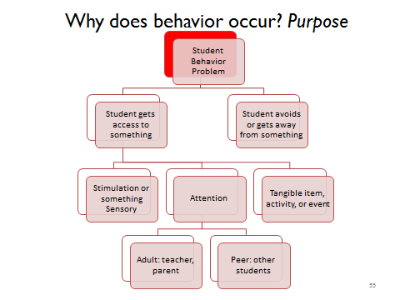

Slide 48
Practices … Making Connections
Balance accountability with an understanding of behavior prompted by trauma
Address behavior issues as learning opportunities and teachable moments
Use natural consequences that are logically related to the misbehavior
Learn student triggers (antecedents) and how to avoid them- recognize early warning signs
Strategies and Resources to Create a Trauma-Sensitive School,
Wisconsin Department of Public Instruction

Slide 49
Practices … Making Connections
Create a “Calm Zone” or safe place for students to seek out by choice to help regulate emotions (possibly escape motivated behavior, teach how to access “Calm Zone”)
Use data to inform need for additional layers of support that are based on function (SAIG, FBA/BIP)
Strategies and Resources to Create a Trauma-Sensitive School,
Wisconsin Department of Public Instruction

Slide 50
We make lots of mistakes in our adult life
Lose keys
Get lost
Forget appointments
Get into car accidents
Overlook paying bills
Neglect to call friends when we said we would
Misplace our phone
Engage in road rage-curse and yell
Drink too much
Eat the wrong foods
“In other words, we do countless things we want our children, in their young state of being, not to do just because we told them these things are wrong.”
(Tsabury, 2010)

Slide 51
Learning from Our Mistakes
Only when they feel free of fear can they extract the lesson they need (safe)
Free them from fear of failure, able to accept that mistakes are an inevitable and even essential aspect of life
(Tsabury, 2010)

Slide 52
Continuum of Practices to Prevent Behavioral Errors
Pre-correction practices
Define, post, teach, model, practice, and reinforce expected behaviors
Prompting or pre-correction, especially right before a challenging time
Active supervision (move, scan, …)
Proximity control
Physical arrangements free of distractions that promote learning and prevent problem behavior
High levels of opportunities to respond, active engagement
Adequate wait time for student responses

Slide 53
Continuum of Practices to Discourage Low Level Behavioral Errors
Low level behavior error practices (in addition to pre-correction practices)
Specific and Contingent Error Correction
Re-directing
Re-teaching with additional practice
Behavior specific praise of peers in close proximity engaged in desired behavior
Planned Ignoring
Direct eye contact/signal/non-verbal cue
Provide choice
Time out from reinforcement

Slide 54
Definitions of Strategies
Planned Ignoring | Ignore student behaviors when their motivation is attention, and continue instruction without stopping.
Physical Proximity | Using teacher proximity to communicate teacher awareness, caring, and concern.
Signal/Non-Verbal Cue | Teacher gestures to prompt a desired behavior, response, or adherence to a classroom procedure and routine.
Direct Eye Contact | The ”teacher look” to get attention and non-verbally prompt a student.
Praise (BSPS) the Appropriate Behavior in Others | Identify the correct behavior in another student or group, and use behavior specific praise to remind all students of the expectation/specific behavior.
Redirect | Restate the desired behavior as described on the teaching matrix.
p. 14

Slide 55
Definitions of Strategies (con’t)
Support for Procedures/ Routines | Identify and install a classroom routine to prevent the problem behavior. Provide a booster for a routine already in place.
Re-teach | State and demonstrate the matrix behavior. Have the student demonstrate. Provide immediate feedback.
Differential Reinforcement | Reinforcing one behavior and not another. For example reinforce the positive behavior while ignoring an inappropriate behavior.
Specific and Content Error Correction | Specific directions that prompt or alert the student to stop the undesired behavior and to engage in the desired behavior.
Provide Choice | Give choice to accomplish task in another location, about the order of task completion, using alternate supplies to complete the task or for a different type of activity that accomplishes the same instructional objective. Choices should lead to the same outcome.
Conference with Student | Describe the problem. Describe the alternative behavior. Tell why the alternative is better. Practice. Provide feedback.
p. 14

Slide 56
Why Focus on Response Strategies & Error Correction?
What is the single most commonly used but least effective method for addressing undesirable behavior?
The single most commonly used but least effective method for addressing undesirable behavior is to verbally scold and berate a student (Albetro & Troutman, 2006).
Notes:
Even when we have clearly defined rules and routines and give high rates of positive feedback we know some students will still demonstrate inappropriate or undesirable behavior.
When misbehavior happens, correcting students is not bad or wrong- in fact, consistently responding to inappropriate behavior is essential. Correctives are a problem only if they exceed the rate of positives.
However….(Read Slide)
The teacher who yells or berates is, in effect, saying to the student this is how an adult reacts and copes with undesirable behaviors in an environment (Alberto & Troutman, 2006).
This is not the model we want to provide for students.

Slide 57
“Negative” interactions are not wrong and are part of feedback… the key is the way in which they are delivered…
Set the Tone
Responses to inappropriate behaviors are always: 1. Calm 2. Consistent 3. Brief 4. Immediate 5. Respectful

Slide 58
Goals of Error Correction
Interrupt the problem behavior and engage the students in the expected behavior- to teach that this is not okay
Ensure the students exhibit the expected behavior in future occurrences of similar situations
Avoid escalation of the problem behavior
(Colvin, 2010)

Slide 59
Consistency is key, not severity
It is less important what the response is, than that something is reliably done.
How we respond or what consequence is used is less important than the certainty that something will be done, even something relatively brief such as redirection or re-teaching.
Notes:
When students passing in the hallways see that all educators consistently stop students to address even small violations of procedures, they will quickly bring their behavior in line.
Give teams time to think of a current problem or a previous problem where staff are not responding consistently or where staff did increase consistency with response and that contributed to a decrease in that behavior.

Slide 60
Specific and Contingent Error Correction Definition
Error correction is an informative statement provided by a teacher or other adult following the occurrence of an undesired behavior.
It is contingent (occurs immediately after the undesired behavior); specific (tells the learner exactly what they are doing incorrectly and what they should do differently in the future); and brief (after redirecting back to appropriate behavior, move on).

Slide 61
Brian, remember to raise your hand to contribute when I we are having a group discussion. Calling out is not appropriate during this time.
Notes:
Use language like this is situational inappropriate- time and place , not wrong, bad remove judgement .Time and place. Remove judgement

Slide 62
Specific and Contingent Error Correction
Examples | Non-Examples
Joe, please raise your hand to contribute when we are having a class discussion. Calling out is not appropriate during this time. | How many times do I need to say “raise your hand”?
Jillian, remember to be on time to class which means you are in the door before the final bell rings. | We have gone over this a million times! You need to bring your materials to class. What are you thinking? What would happen if I sent you to the office or called home? …

Slide 63
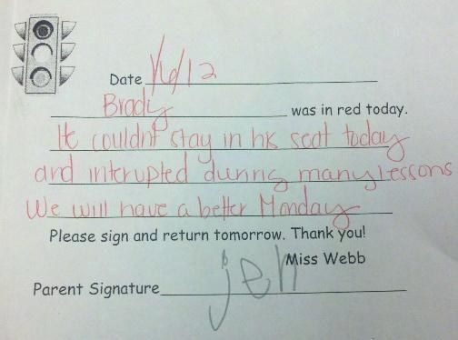
Additional Considerations for Response Systems …
Response Cost Systems

Slide 64
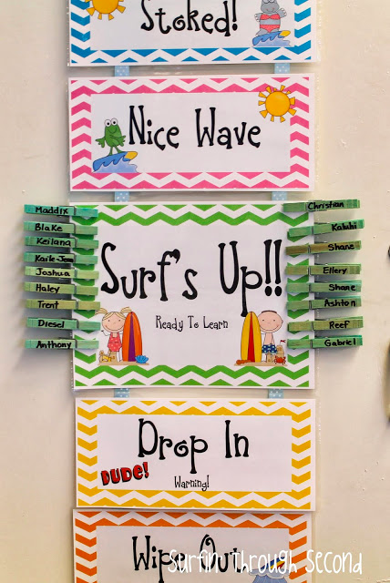
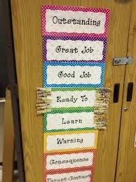
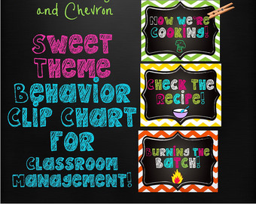
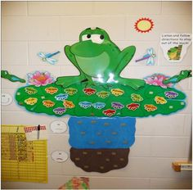
How are we engaging with classroom behavior?
Response cost
How does it show up?
What are the unintended side effects …shaming? blaming?
How does it line up with our valued outcomes?
Notes:
Various theme based response costs …surfs up, cooking, and killing frogs

Slide 65
Cautionary Tales
Response cost does not teach replacement behavior
Response cost is a complex procedure to implement correctly
Requires balance between positive reinforcement (BSPS) and “fines” (punishment) … 4:1 ratios
(Darch, & Kame’enui, 2004; Webber, & Plotts, 2008)
Notes:
Response cost does not teach replacement behavior-
It is not a teaching intervention as students are not
taught appropriate behaviors.
Response cost is a complex procedure to implement
correctly
Requires balance between positive reinforcement (BSPS)
and “fines” (punishment). Can be difficult to apply correctly when teaching.

Slide 66
Considerations with Response Cost
If you use a “response cost” be sure students can earn positives as well (4:1 ratio)
Is it working? Test - are the same students doing well and doing poorly each day? Do students know who is “always on red”?
What do you do when a student has lost everything by 9:30 on Monday morning?
Avoid drawing attention to negative behavior (first response?)
(Anderson, 2008)

Slide 67
Positive Classroom Behavioral Support Snapshot: Continuum of Responses

Slide 68
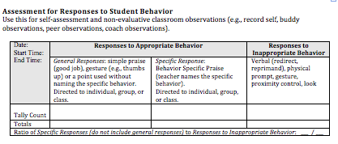
Assessment for Continuum of Responses
The minimum goal is a ratio of 4:1
Notes:
Use this as a self assessment to determine which teachers may need
extra training or support with this practice.

Slide 69
Planning Considerations
How will we respond to students with behavioral errors?
How will we support one another with consistency?

Slide 70
Positive Behavior Game: An Interdependent Group Contingency (All for one) Using a Game to Support Teacher Fluency and Student Behavior
p. 21-22
Notes:
Keep watching group and make tally marks when people have eyes on you. Point out one person (for example---”Mary, I am so glad to see you are following along with what we are doing. You have had your eyes on me and seem very focused today. I am proud of you”). Make sure to put tally marks on the chart and tell the entire group why.

Slide 71
Positive Behavior Game
The Positive Behavior Game is adapted from the Good Behavior Game.
It is a game format used to explicitly teach, remind, and acknowledge positive student behavior and has been shown to increase student social and academic success without detracting from instruction.
The PBG is directly linked to the school-wide/class-wide behavioral expectations

Slide 72
Component | Example
The teacher identifies and teaches/re-teaches the target behavior. | Target Behavior: Raise hand to contribute during class discussion. (Model as necessary and write the targeted behavior to display)
The class plays during instruction for at least 10 minutes. | During teacher-led instruction, the timer is set for 10 minutes and the game is played.

Slide 73
Component | Example
Teacher provides pre-correction(reminders) before predictable or challenging transitions or routines. | Before playing the game, teacher writes the targeted behavior on display

Slide 74
Component | Example
When the teacher observes a student(s) engaging in the targeted behavior, the teacher delivers behavior specific praise and the class gets a point. Points are displayed for the class. | Targeted Behavior: Hand Raising

Slide 75
Component | Example
If a student needs a reminder, the teacher uses error correction, reminders, re-teaching | “Jillian, please remember to raise your hand during class discussion. “

Slide 76
Positive Behavior Game Checklist
Display and teach the targeted behavior
Play for at least 10 minutes
Provide pre-corrections prior to difficult transitions or routines
Deliver points for engaging in the identified target behavior
Provide a behavior specific praise statement when delivering a point
Display points
If the students need reminders, re-teach and remind/re-teach/correct for the targeted behavior

Slide 77
Positive Behavior Game
Teacher sets up the students to “catch” them having positive behaviors
Teacher has to catch the students engaging in the desired behaviors
If students need a reminder, the students do not get a point (do not take points away)
Whole group earning acknowledgement
Based on the overall behavior of the group
Cultivate and reinforce social responsibility

Slide 78
Set Students up for Success
Pre-teaching, and re-teaching the targeted behavior
Pre-correct: provide reminders BEFORE you anticipate the problem behavior
Consider a non-verbal cue to use the desired behavior
EX: Sign, thumb’s up, wink, point to the points on the board
Use proximity by moving near a student needing a prompt. Deliver BSP once the student demonstrates behavior
Make them “special earners” to earn additional points for the class when they demonstrate the desired behaviors

Slide 79
Support ALL Students
Consider how accessible the game is to your learners with special needs:
Do any students need images on the board in addition to words?
EX: PICTURE of students raising their hand.
Do any students have behavioral challenges?
They may need additional practice, reminders, and reinforcement
Do not allow their behaviors to bring down the average for the entire class.

Slide 80
Planning Considerations
How will we use group contingencies to support student behavior?
What might the Positive Behavior Game look like for us?

