Slide 1
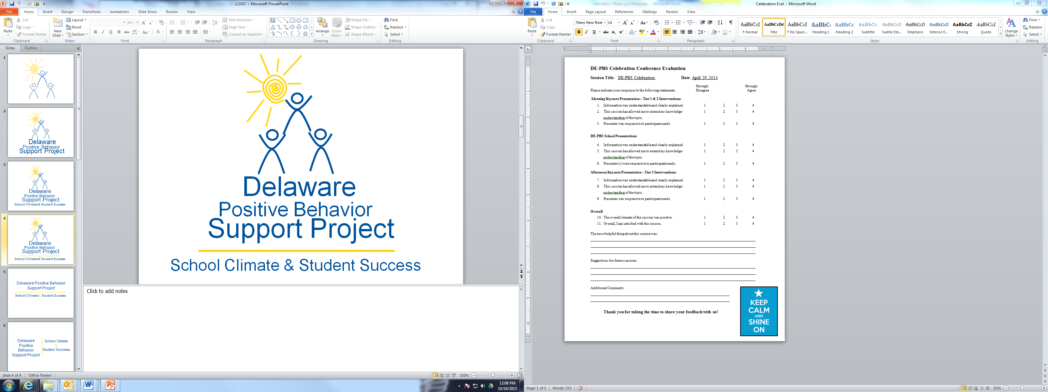
Multi-Tiered System of Support
Tier 3 Practices: DE-PBS Prevent-Teach-Reinforce
October 30, 2018

Slide 2
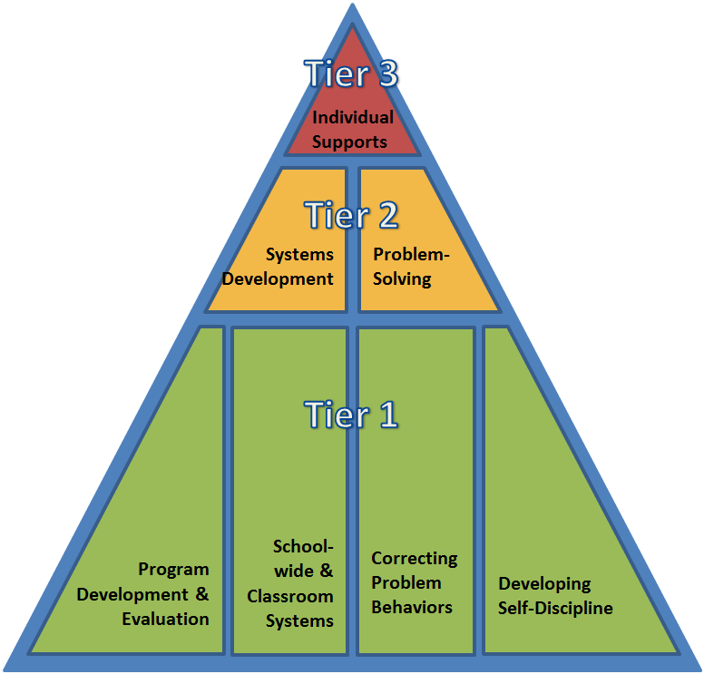


DE-PBS Project is an on going collaboration between the Delaware Department of Education and the UD Center for Disabilities Studies
Notes:
Narrative: The Delaware PBS project is an ongoing collaboration between the Delaware Department of Education and the UD Center for Disabilities Studies.

Slide 3
Today’s Agenda
Time | Topic
9:00 – 10:00 | Welcome & Overview of Tier 3 in MTSS -Key features activity
10:00–10:30 | Critical Elements of an FBA and BIP -TATE activity
10:30-10:45 | Break
10:45 – 11:45 | Teaming -Goal Setting and IBRST Activity
11:45 – 1:00 | Lunch
1:00 – 2:00 | FBA and BIP Development -FBA and BIP activity
2:00-2:30 | Progress Monitoring and Follow Up -Fidelity tool activity
2:30-2:45 | PBS and Special Education
2:45-3:15 | Closing
Notes:
Sarah

Slide 4
Acknowledgements
Dr. Rose Iovannone and FLPBiS Northeast PBIS | Midwest PBIS Network Portland State University: www.basicfba.com
Notes:
Narrative: We would like to thank the individuals and groups on the slide for their contributions to this presentation.

Slide 5
Our Audience & Our Goals
Audience –
Administrators interested in PTR as a Tier 3 Practice
Teams interested in PTR as Tier 3 practice in their building(s)
Individuals interested in PTR as a Tier 3 Practice
Goals-
Provide an in-depth overview of the PTR Framework
Evaluate tools & products to develop and enhance Tier 3: Individualized Positive Behavior Support Plans
Share individual, team, administrative experience with Tier 3 plans to enhance discussion
Notes:
Ask staff to introduce themselves

Slide 6

Why are we here?
High rates of discipline referrals and suspensions
Disproportionality
Student failing to meet proficiency on state test
Attendance and drop out rate concerns
Negative school climate
Need to improve student social and emotional skills
Need to support students exposed to trauma and chronic stress
Notes:
Ask the audience: who are you and why are you here today? These are some of the reasons I am here: (click) What is happening in our schools and with our students that indicates a need for effective supports?

Slide 7
Multi-Tiered Systems of Support
(MTSS) for Student Success
Academic Systems
Behavioral Systems
Tier 3/Tertiary Interventions 1-5%
Individual students
Assessment-based
High intensity
1-5% Tier 3/Tertiary Interventions
        Individual students
        Assessment based
        High intensity
Tier 2/Secondary Interventions 5-15%
Some students (at-risk)
High efficiency
Rapid response
Small group interventions
Some individualizing
5-15% Tier 2/Secondary Interventions
        Some students (at-risk)
        High efficiency
        Rapid response
        Small group interventions
        Some individualizing
Tier 1/Universal Interventions 80-90%
All students
Preventive, proactive
80-90% Tier 1/Universal Interventions
        All settings, all students
        Preventive, proactive
www.delawarepbs.org
Adapted from “What is school-wide PBS?” OSEP Technical Assistance Center on Positive Behavioral Interventions and Supports. Accessed at http://pbis.org/schoolwide.htm, Illinois PBIS Network, Revised May 15, 2008.
Notes:
7
DEBBY

Slide 8

Why use the MTSS/PBS framework for schools?
Predictable
Positive
Consistent
Safe
“The fundamental purpose of PBIS is to make schools more effective & equitable learning environments.”
Rob Horner, Co-Director of the OSEP Technical Assistance Center for PBIS
Notes:
Rob Horner shared this information at the 2014 WI Conference.

Slide 9




MTSS for Social Competence &
Academic Achievement
Outcome data (social behavior, academic achievement), Progress Monitoring, Fidelity
OUTCOMES
SYSTEMS
DATA
What we do to support adults to implement the practices
PRACTICES
What we do to
support students
Notes:
9
Narrative: Within a given MTSS, each of the three tiers we discussed are driven by data, systems and practices to reach desired OUTCOMES.
Outcomes are at the top of this figure, and we cannot lose sight of the fact that schools are in business to support academic achievement, and to provide our students the social and academic skills that they need to be successful in our society.
Under outcomes, we see three interconnected circles that include data, systems, and practices. These three elements are the bread and butter of successful MTSS. Let’s start with data.
Data is your friend. Schools must see value in using data to make decisions, and commit to doing so. We need to know whether or not what we are doing is making a difference, and if it’s not, stop doing it and find another strategy. Ongoing data collection and use of outcome data, such as academic achievement data and behavior data, are key to a strong MTSS.
Next is Systems and processes - To make this work we have SYSTEMS that will support behavior, and here we are talking more about staff behavior and what we do to support staff to implement the practices. Such systems include establishing an effective team with regularly scheduled meetings and an evaluation plan to assess academic and behavioral progress and make decisions based on data. We will talk more about systems specifically to support positive behavior later in the presentation.
Finally, the PRACTICES, and specifically research validated practices, are what are in place to support student academic achievement and behavior, such as the direct teaching of academic content or behavioral expectations. Don’t worry, we’ll talk more about behavior support practices soon.
Debby
Three Components of PBS
1. Systems & processes
Team based problem solving
Data-based decision making
Long term sustainability
2. Data
On going data collection & use
Office Discipline Referrals (# per day, location, infraction, etc.)
Suspension/expulsion
3. Research validated practices
Direct instruction
Social skills instruction
Functional behavioral assessment
PBS is really about changing adult behavior

Slide 10
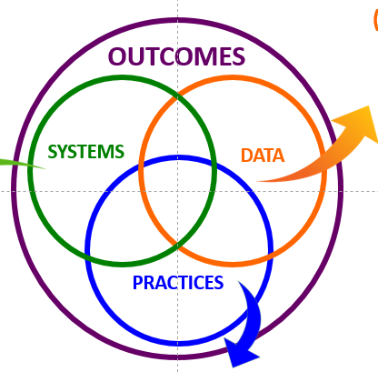
Practices
Data
Systems
3-5 defined school-wide expectations, procedures for teaching and acknowledging expectations, procedures for discouraging problem behaviors, procedures for using data to target needed practices.
Climate surveys, office disciplinary referrals, academic and behavioral screening information, attendance and tardy data, frequency of nurse/counselor/well-ness center contacts, fidelity checklists and observations
Team-based leadership, coaching support, data-based decision-making protocols, developed procedures and materials for implementing assessment and practices
Tier 1
Outcomes
Academic, Self-management, Interpersonal, Career & postsecondary, Mental health
Notes:
Narrative: We saw the circles diagram on the left when talking about MTSS, and it is no surprise that the three elements that comprise MTSS are the same three that encompass PBS. Again, those three components are Systems, Data, and Practices with an overarching aim to reach desired outcomes.
PBS Systems & processes involve those that support staff behavior, such as the establishment of an effective team with regularly scheduled meetings, an evaluation strategy, funding, 3-5 positively stated behavioral expectations, a system to directly teach those behaviors and teach what they look like in the different settings, systems such as tangible acknowledgments for successful completion of the tasks, and coaching. A major key to effective PBS systems and processes is team-based problem solving, data-based decision making, and long-term sustainability.
Effective PBS programs also use Data to support decision making. That is why ongoing data collection and use is a key aspect of PBS. Data such as office discipline referrals broken down by number per day, location, time, and infraction and suspension and expulsion rates can be used to inform decision making about changes that may need to be made to the PBS program and school practices.
Finally, as in MTSS, PBS uses research validated practices to support student behavior. Such practices include direct instruction, social skills instruction, and functional behavior assessment.
In thinking about the three components of systems, data, and practices, it becomes clear that a main focus of PBS is to first change adult behavior, which will result in subsequent improvement in student behavior.

Slide 11
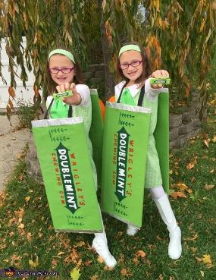
Practices
Systems
Data
All practices from Tier 1 plus:
CICO, group interventions, group interventions with individual features
Team-based leadership, coaching support, data-based decision-making protocols, developed procedures and materials for implementing assessment and practices
All Data from Tier 1 plus:
Daily Progress Monitoring systems, intervention specific monitoring systems, fidelity of tier 2 Implementation
REMEMBER:
Tiers 2 gives students a higher dosage of what we already do at Tier 1
Tier 2
Outcomes
Academic, Self-management, Interpersonal, Career & postsecondary, Mental health

Slide 12

Data
Practices
All Data from Tier 1 and 2 plus:
Systematic direct observation data systems (frequency, duration, rate, etc.), direct behavior rating scales, time sampling data systems, Antecedent, Behavior, Consequence, Observations, Interviews, Surveys, Checklists, Record reviews/Permanent Products, Fidelity of tier 3 Implementation
Systems
All practices from Tier 1 and 2 plus:
Efficient, comprehensive and wrap around individualized positive behavior support plans
Team-based leadership, coaching support, data-based decision-making protocols, developed procedures and materials for implementing assessment and practices
REMEMBER:
Tier 3 gives students a higher dosage of what we already do at Tier 1 and 2
Tier 3
Outcomes
Academic, Self-management, Interpersonal, Career & postsecondary, Mental health

Slide 13
POSITIVE SCHOOL & CLASSROOM CLIMATE
Definition: Shared norms, beliefs, attitudes, experiences, & behaviors that shape nature of interactions between & among students, teachers, & administrators
Outcomes | Data | Practices | Systems
Academic Self-management Interpersonal Career & postsecondary Mental health | Screening Progress monitoring Implementation fidelity | ALL | Leadership MTSS Teaming Professional development Evaluation Policy Exemplars demonstrations
 |  | SOME
 |  | FEW
Sugai, G. 2016 School Climate Transformation Grant meeting
Notes:
Debby
Another way to look at this is to think about the practices you have not just at SW, but for tiers 2 and 3, and how we use the data and systems to impact the same desired outcomes at all levels/tiers
Reference activity resource

Slide 14
Think about the Key Features as they relate to individualized supports…
What is circling around in your head?
What do you have squared away?
what is one really good point to share?

Slide 15
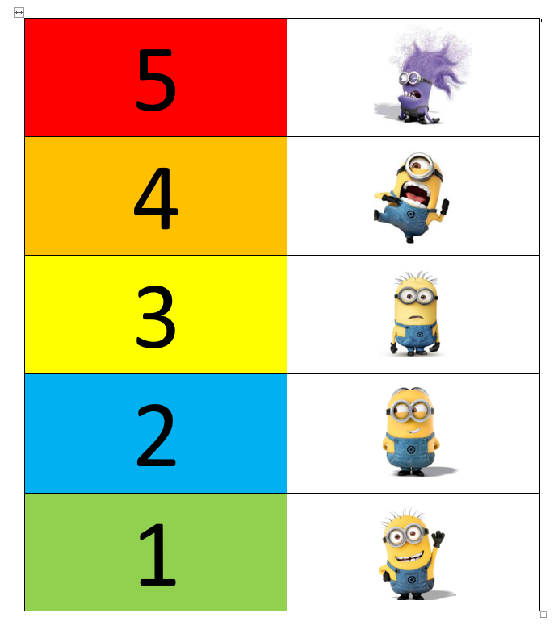
Please answer the following:
When thinking about the FBA and BIP process I feel:
Notes:
Narrative: before we begin, take a moment to think about your experiences as a parent, educator or facilitator involved in the FBA and BIP process. How do you feel? In our experiences, the FBA-BIP process can feel overwhelming, obsolete or frustrating. We hope the information presented here, will help to alleviate some of this frustration by demystifying the process.

Slide 16
Function Across Tiers
The bottom line:
While we understand the need for “formal” FBA-BIP
Understanding the ABCs of behavior is an important tool across all three tiers!
Function-based problem solving is a continuum.
  Teachers can use function-based problem solving in the classroom
  Teams can modify Tier 2 interventions based on function
  Teams can develop simple to complex Individualized Positive Behavior Support Plans based on functional assessment

Slide 17
Does your staff know the “F’ word?
Just using the term “function” may be less effective than saying…
“how behavior meets a student’s needs”
“how behavior helps the student communicate”
“why they’d want to do it”
“purpose” or
“what’s in it for them?”
others?

Slide 18


Functions of Behavior
Notes:
Narrative: Here is a visual of the most commonly cited functions of behavior. Behavior is displayed in order to get something such as stimulation, social interaction or activities/tangibles. OR Behavior is displayed in order to escape or avoid something such as stimulation, social interaction or activities/tangibles.

Slide 19
Basic Behavioral Theory
Do your staff members understand basic behavioral theory?
Setting Event
Antecedent
Behavior
Consequence
Antecedent or event that temporarily alters the value of the consequence.
A “stimulus that precedes a behavior.”
An ”observable and measurable act of an individual (also called a response).”
A “stimulus change that occurs contingent on a behavior.”
What occurs right before the behavior?
What is the observable and measurable behavior?
What occurs right after the behavior?
Guiding Questions
(Alberto & Troutman, 2006)
Notes:
Narrative: here are the textbook definitions of the ABCs of behavior. More on setting events later. Let’s review these in everyday language.
Click: during the FBA process, the team will begin by defining the challenging behavior.
Click: we then ask, “what happened right before the behavior occurred?” this is oftentimes called a trigger or the antecedent.
Click: finally, we are concerned with what occurred in the environment immediately after the behavior. This is called a consequence.

Slide 20
Problem solve using functional thinking at Tier 1…
What is the problem? gather and analyze information; define behavior of concern; do you need any additional information?
Why is it happening? Think about antecedents and function
What can you do? What do you want the students to do instead? How will you prevent problem behavior? When will you implement the strategies?
How will you know if it’s working?
Review the data and answer the questions using functional thinking
  4th grade class
  29 students
  15 discipline referrals (in the classroom)
  Referrals received in October and November
  Referrals for disruptive and disrespectful behavior
  9/15 referrals occurred between 1:00-3:00 pm
Fun with Function at Tier 1
Notes:
At your table, answer the questions by thinking functional about behavior. Remember, function helps us to answer “why” the behaviors are occurring.
Should we do a classroom problem solving sheet of some kind?

Slide 21
Bus Duty
When the teacher is given an extra bus duty on a rainy day, he complains loudly to the principal. The principal covers the bus duty. In the future the teacher is more likely to complain loudly when asked to do an extra duty.
Fun with Function at Tier 3

Slide 22
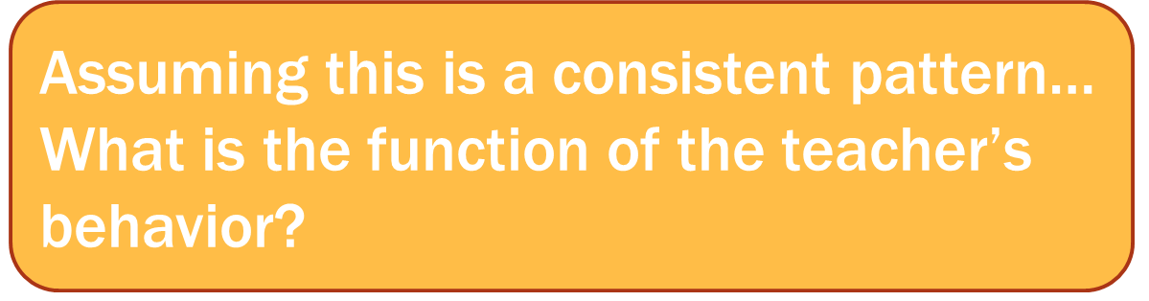
Breakdown of Example: Bus Duty
Antecedent:
Behavior(s):
Consequence:
  Action(+ or -):
  Effect(⬆ or ⬇):
  So it is:
The teacher is given an extra bus duty
He complains loudly to the principal
Fun with Function at Tier 3
The principal takes the bus duty away
The principal…takes the duty away
In the future, the teacher continues to complain
Negative reinforcement

Slide 23
What is an FBA?
Assessing predictable relationships between the environment and behavior
  Involves gathering information from those who know the student
  Predict when/where behavior problems will occur
  Determine why problem behaviors occur
  The FBA is just the information we need in order to build an effective intervention plan
Notes:
Narrative: The FBA is an assessment process. It involves gathering multiple sources of information to make “educated” predictions about how, when, where and why behaviors will occur. In doing so, we can develop the most appropriate plan for our students. From now on, if someone asks you, “what is an FBA”? You can tell them: the FBA is just the information we need in order to build an effective intervention plan!

Slide 24
Tier 3 is a Continuum of Supports
Wraparound or Person Centered Planning
Team Based PTR
Brief PTR
Wrap-Around or Person-Centered Planning Based Supports
  Long-standing, extremely intense behaviors, mental health concerns, complex life events
  Multiple services, agencies or institutions
Team Based PTR
  More intensive FBA/BIP process
  Multiple meetings (2-4) or one long meeting (>2 hours)
  Best for chronic, durable, intense behaviors
Brief PTR (consultant based)
  FBA/BIP developed in one meeting (~60 minutes)
  Best for high frequency/low intensity behaviors
    Noncompliance, minor disruptions
Functional thinking at all levels
Notes:
Tier 3 supports represent a continuum from least complex (Brief FBA/BIP) to most complex (wrap around supports).
As you move up the continuum, the resources required and student needs intensify.
PTR is most appropriate for students who demonstrate chronic, durable and intense behaviors. PTR is time intensive and requires multiple staff members, such as administration, specialists, teachers and family members, unique to the student, to collaborate throughout the process.
When you are at the top, these are students where district resources are also involved. Another part of your system is outlining when and how you involve outside resources.

Slide 25
Critical Features of the FBA
Assessment Includes:
  Student/family input (student strengths and preferences for support options)
  Relevant medical, behavioral (attendance, discipline data), mental health strengths and needs, academic data
  Current Tier 1 and 2 supports for relevant academic and behavioral interventions
  Problem behaviors (academic, social, emotional, etc.) identified and defined in observable and measurable terms
  Baseline data collected for problem behavior(s)
  Identification of antecedents and consequences
  Identification of behavioral function
Notes:
Narrative: An FBA includes several types of information. One type is student and family input, such as student strengths and preferences for support options (for example – what supports might work best with the student). Other essential information includes relevant medical, behavioral (such as attendance and discipline data), mental health strengths and needs, and academic data. Current Tier 1 and Tier 2 supports and relevant academic and behavioral interventions are also critical parts of the FBA.

Slide 26
7 Core Features of a BIP
  Prevention strategies
  Teaching strategies with replacement/alternative behaviors identified and defined in observable and measurable terms
  Strategies for removing rewards for problem behavior
  Specific rewards for desired behavior
  Safety elements when needed
  A systematic process for assessing fidelity and impact
  An action plan for putting the support plan in place
Notes:
Pop quiz… teaching replacement behaviors may occur during what type of tier 2 intervention?
SKILL BUILDING!

Slide 27
Let’s Self-Assess
Technical Adequacy Tool for Evaluation (TATE) and Scoring Rubric developed by national experts (Iovannone, Kincaid & Chistiansen, 2015)
For training purposes, we will use a simplified version of the TATE
Using your own FBA and BIP (or the sample) please complete the checklist

Slide 28
National Trends
FBA Items
  Strengths (highest mean scores)
    More than one source used for FBA
    Identifying functions that are observable (e.g., escape/avoid; get/obtain)
  Challenges (lowest mean scores)
    Considering and identifying setting events
    Identifying contexts in which problem behavior is absent
    Identifying responses (consequences) that immediately follow problem behavior
BIP Items
  Strengths
    BIP completed in timely fashion after FBA
    Hypothesis included or referenced on BIP
    Crisis plan consideration (lack of detail)
  Challenges
    Interventions not linked to hypothesis
    Interventions described in stock lists of strategies
    Interventions to change responses to problem behaviors missing or not linked to function
    Plans for evaluating fidelity of implementation missing
How do we compare?
Iovannone & Romer, 2017

Slide 29
POSITIVE SCHOOL & CLASSROOM CLIMATE
Definition: Shared norms, beliefs, attitudes, experiences, & behaviors that shape nature of interactions between & among students, teachers, & administrators
Outcomes | Data | Practices | Systems
Academic Self-management Interpersonal Career & postsecondary Mental health | Functional Behavioral Assessment Progress monitoring Implementation fidelity Social validity | Efficient Support Plan Comprehensive Support Plans Wrap Around Support Plans | MTSS Teaming Professional development Evaluation Exemplars demonstrations (coaching)
Sugai, G. 2016 School Climate Transformation Grant meeting
Notes:
Today we will be talking, specifically, about the data and systems required to develop comprehensive individualized positive behavior support plans using a model called Prevent-Teach-Reinforce.

Slide 30
Comprehensive Support Plans using the Prevent-Teach-Reinforce Model
Research project funded by U.S. Department of Education, Institute of Education Sciences
  University of South Florida
    Three central Florida school districts
  University of Colorado, Denver
    Two Colorado school districts
Purposes:
  Answer the call for rigorous research
  Evaluate effectiveness of PTR vs. “services as usual” using randomized controlled trial
  Evaluate effectiveness of “standardized “ approach
Aims of the model
  Make available tools that are parsimonious-easy for team/teachers to use
  Use language that is not technical-easy to understand terms
  Use a collaborative approach-not an expert model
  Have consensual team-based processes built within each step
  Provides ongoing support to teacher/team for implementation and making data-based decisions

Slide 31
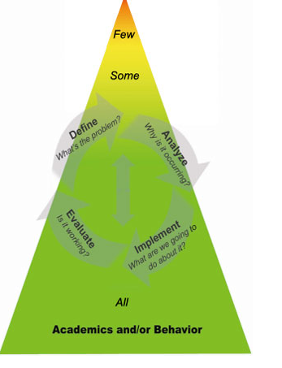
Where is PTR in a Multi-tiered System of Supports (MTSS)?

Slide 32
Who Was in the Original PTR Study?
Disability | N | Percent
Autism | 25 | 9.8
Developmental Delay | 5 | 2.0
Emotional Disturbance | 38 | 14.9
Intellectual Disability | 28 | 11.0
Multiple Disabilities | 4 | 1.6
OHI (not ADD/ADHD) | 1 | .4
OHI (ADD/ADHD) | 8 | 3.1
Specific Learning Disability | 20 | 7.8
Speech/Language Disability | 10 | 3.9
Visual Impairment | 2 | .8
General Education | 99 | 38.8
TOTAL | 245
Notes:
32

Slide 33
Research in PTR
Two randomized controlled trials
  Original for kindergarten through grade 8 (5 years to ~ 14 years of age)
  Young children (3 years to 6 years of age)
Several single subject studies
  General education
  Autism
  Child care settings
  Families
  High school students with emotional disorders

Slide 34
Research Outcomes
RCT-Students receiving PTR significantly improved social skills, problem behaviors and academic engagement compared to those who received services as usual (SAU)
Single subject—multiple baseline designs showed PTR improved the dependent variable in all studies
Teachers implemented the interventions with high (e.g., 80% or greater) fidelity
Teachers found PTR to be socially valid

Slide 35
PTR Model
Start here
Step 1-Develop and use a daily progress monitoring system
Step 2-Analyze the problem by conducting an FBA on each target problem behavior
Step 2-Develop a hypothesis from synthesized information
Step 3-Select and develop a multi-component intervention plan linked to the hypothesis
Step 1-identify, define, and prioritize behaviors
Step 3-Coach the teacher to implement the plan and measure fidelity
Step 4-Within 3 weeks, examine the progress monitoring data and fidelity data and make next-step decisions
Student-Centered Team
Facilitator
Member(s) who know student
Member(s) who know school/district
Notes:
Reference binder of tools –
tab 1: Goal setting
Tab 2: FBA and BIP
Tab 3: Progress Monitoring and Follow Up
Tab 4: Systems Tools

Slide 36
Meeting Schedule
Meeting | Completed Before Meeting | Completed at Meeting
#1 | Record Review | Goal Setting/Progress Monitoring Tool
#2 | FBA Interview Forms Classroom Observation(s) Draft Assessment Summary Table/Hypothesis | Gain Consensus on Hypothesis PTR Menu of Interventions Task Analysis of BIP Coaching/Fidelity Plan
#3+ | Coaching with Teacher and Student In-Class Support from Facilitator Fidelity Observation(s) On-going progress monitoring | Review data and follow data based decision rules
Tab 4: Systems Tools in Binder

Slide 37
The FBA Process is always the same but becomes more complex as the student’s needs increase
More data gathered (including observations of behavior)
Larger problem solving team
More life domains considered
Complexity of FBA
Intensity of Behavior(s)
Less data gathered
Small problem solving team
Fewer settings considered

Slide 38
Resources
Plans developed using the PTR Model of Individualized Positive Behavior Supports require resources!
    Estimated time per student/family team = 2 hours per week initially (during plan development)
    Fading to 1 hour per week as the plan is implemented
Based on MTSS guidance, how many students in your school may require PTR developed plans? (1-5%)
    In a school of 500 students 5-25 students might have Individualized Positive Behavior Support Plans

Slide 39
Teaming
Tab 1 Tools in Binder

Slide 40
Individual Student Support Team Tips
Teaming: A collaborative process
Determine relevant team members
  Can take many formats
  Most effective when: One or two key people assigned to a school are FBA/BIP facilitators
    The facilitator guides student support teams through the FBA/BIP process
Suggestions—3 levels of knowledge represented:
  Members
    Person with knowledge of student (e.g., Classroom teacher, instructional assistant, parent)
    Facilitator—Someone with knowledge of functional assessment, behavioral principles (PTR consultant, school-based consultant)
    Someone with knowledge of context (e.g., administrator or designee)

Slide 41
Tier III Decision Making Teams
Lawanda’s Support Team
Tonya’s Support Team
Shana’s Support Team
What types of systems conversations might happen at Tier 3?
School Wide Tier III Systems Team
Marcie’s Support Team
Jalee’s Support Team
Putnam, 2018
Notes:
Capital: each student will have a unique team who knows them best. Your system team includes a core group who focus on overall outcomes at Tier III vs. individual student problem solving.

Slide 42
Case Study: Joe
Reason for Referral:
Joe has shown an increase in challenging behavior. His data, reviewed at the 9/5/2018 Tier 2/3 problem solving meeting, shows he is not making progress toward behavioral goals despite his current interventions at Tiers 1 and 2 (referenced below). The team would like to collaborate on understanding his challenging behaviors through the PTR process in order to develop an individualized positive behavior support plan.
Tier 3 Decision Rules:
Any student not responding to Tier I and II interventions
Data identifies student as in need (# of ODRs, suspensions, absences, etc…)
Team considering a change of placement for student in special education for disciplinary reasons (during the manifestation process)
Team perceives youth as in urgent need (lower-level of support not seen as adequate)
Student transfers into the school with function based interventions or significant behavioral needs indicated in their records
Tip #1: Define decision rules with systems team

Slide 43
Case Study: Joe
Team Members:
N. Roberts: PTR Facilitator (School Psychologist)
D. Boyer: Primary Implementer (Classroom Teacher)
A. Harris: Data Collection (Para-professional)
M. Pell: Note-Taker (e.g., Educational Diagnostician)
S. Hearn: Administrator
Additional Members
L. Valentine: Guidance Counselor
A. Kendall: Parent
Consider the student (you can include or interview the student)
Tip #2: Assign roles and set agendas before your first meeting!
Notes:
Sample agendas and notes forms available under tab 4

Slide 44
Record Review
Joe’s history with the problem solving team were as follows:
CICO began on 4/15/2017: The team determined that since Joe responded well to adult attention that a CICO mentor was an appropriate intervention.
DATA Review on 5/13/2017: Joe was successful in meeting his daily goals for CICO but continued to demonstrate frustration in class which led to incomplete assignments. The team added a small group skill building intervention to help him with his self-regulation skills.
Counseling began on 5/20/2017: Due to limited groups starting at the end of the school year, Joe began seeing the guidance counselor individually to work on the self-regulation skills taught in the anger management group (such as recognizing triggers and choosing calming strategies).
Modified CICO began on 5/20/2017: The guidance counselor adapted his CICO card to focus on his responsible use of his calming strategies.
Data Review on 8/31/2018: Weekly counseling sessions continued to the end of the school year. Joe began the year with his modified CICO card from the previous year. Joe’s frustration seemed to escalate and his points began to decline at the end of the school year (earning on average 50-60% of points). The team decided to give the plan more time and review again in 6 weeks.
Data Review on 10/12/2018: Joe has had 2 significant discipline referrals. In each incident his classroom teacher reported that his anger led him to tip over a table and walk off school grounds. The team discussed enrolling him in a Tier 2 skill building group to continue to support his frustration management. However, due to the escalation of his behavior the Tier 2 team recommends an Individualized Positive Behavior Support Plan.
Tip #3: Include other information where relevant (e.g. academic)
Notes:
Reference sample FBA/BIP in binder (tab 4)

Slide 45
Support Team Meeting #1: Goal Setting/Data Collection
Purpose:
  Identify behaviors of greatest concern to the team and possible replacement behaviors (teach)
  Prioritize and operationalize behaviors targeted for intervention
  Develop teacher friendly baseline data collection system
Areas that can be targeted:
  Problem behaviors
  Social skills
  Academic behaviors
  Different options/versions under tab 1 of your binder

Slide 46
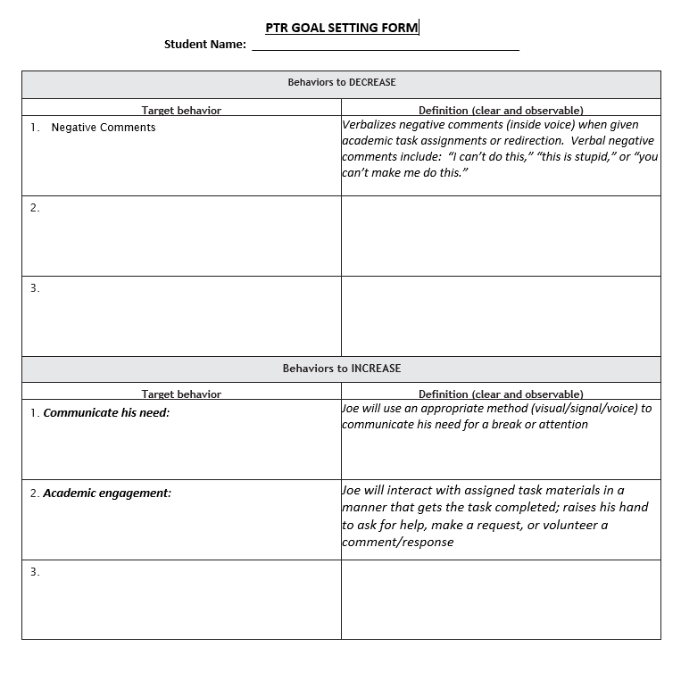
Case Study: Joe
Tip #4: Display forms so everyone can read and agree on definitions

Slide 47
Troubleshooting
IBRST Data Collection
Decide upon a method of prompts to remind teachers/team to:
  Rate the behaviors on the IBRST daily (or frequency determined by the team)
  Have data ready for analysis at ALL meetings related to the student and the plan
  Identify a key person (who likes Excel or other spreadsheet/data chart software) who can transfer the scores into a graph
Too many behaviors identified
Ask teachers/team if they could select one problem behavior that, if reduced, would make each day at least 50% better for everyone (student, school, family)
Defining behaviors
If teachers/team have difficult time using words to define the define the behavior, ask them to demonstrate the student doing the behavior. Write down the motor movements, verbal communication, other key features that define the behavior.

Slide 48
Quiz: is the behavior operationalized?
Gets out of desk and hits other students
Has separation anxiety (from parent)
Spacey
Reads 120 wpm
Says she hears voices
Has an emotional disability
Doesn’t like classmates
Definitions of behaviors need to be:
  OBSERVABLE: the behavior is an action that can be seen
  MEASURABLE: The behavior can be counted or timed
  Defined so clearly that a person unfamiliar with the student could recognize the behavior without any doubts

Slide 49
Operationalized Definitions
Observable/Measurable Definition | Non-observable/measurable Definition
Talks when teacher is lecturing, calling out in a loud voice, singing | Disruptive behaviors
Draws pictures during group work time | Off-task behaviors
Throwing objects, Kicking over chairs | Angry, Hostile Behaviors
Calls peers names | Inappropriate language
Tapping/ drumming on desk, looking around the classroom | Attention problems
Refusal to do work, failure to follow directions | Non-compliance
Yells “No” or “You can’t make me” when given direction | Defiance

Slide 50
Practice!
Select a facilitator and a team member
Using the blank goal setting form: operationalize either one problem behavior or one replacement behavior for a student (you may or may not be working with)

Slide 51
Support Team Meeting #1: Progress Monitoring System
Individualized Behavior Rating Scale Tool – IBRST
  Direct Behavior Rating (DBR)—Hybrid assessment combining features of systematic direct observations and rating scales
  Efficient and feasible for teacher use
  Provides data for decisions
  Prioritized and defined behaviors measured
  Requires minimum of 1 appropriate and 1 inappropriate behavior

Slide 52
Components of IBRST
Scale—5 point foundation
  Can be flexible and add or subtract Likert scale points
  Can be creative and use columns/rows for different time periods/people, etc.
Key—Vital for teacher
  Definition of behavior
  Directions—over what time period of day will they be rating the behavior? What do each of the anchor points represent as perceptual estimates?
Practice
  After setting up, ask teacher to rate student’s behavior from earlier in the day or previous day
  Adjust if necessary
Notes:
Explain where they can find IBRST information in binder (tab 1)

Slide 53
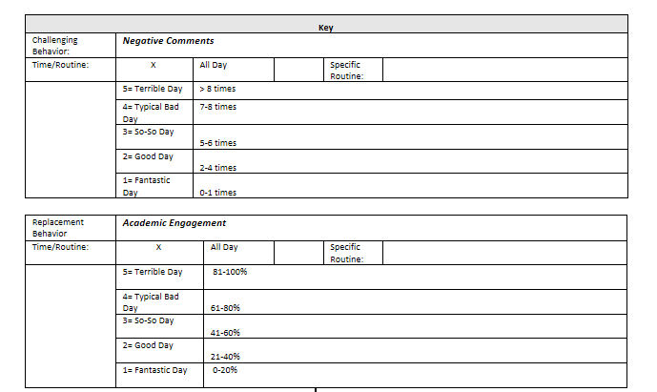
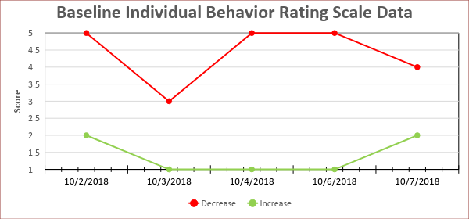
Case Study: Joe

Slide 54
Secondary Level Modifications
Teams with 3 or more members
  Select one team member who will be the primary interventionist
  Behavior identification and IBRST development will be focused on that person’s situation
  Other team members provide input/support
  If desired, other team members can record IBRST data in their settings—rating descriptions can stay the same or minor modifications can be made
    Each row of BRS can represent a different teacher OR
    Each teacher can keep own IBRST
  Facilitator collects all IBRST ratings at specified times

Slide 55
Variations of the Individualized Behavior Rating Scale Tool (IBRST)

Slide 56
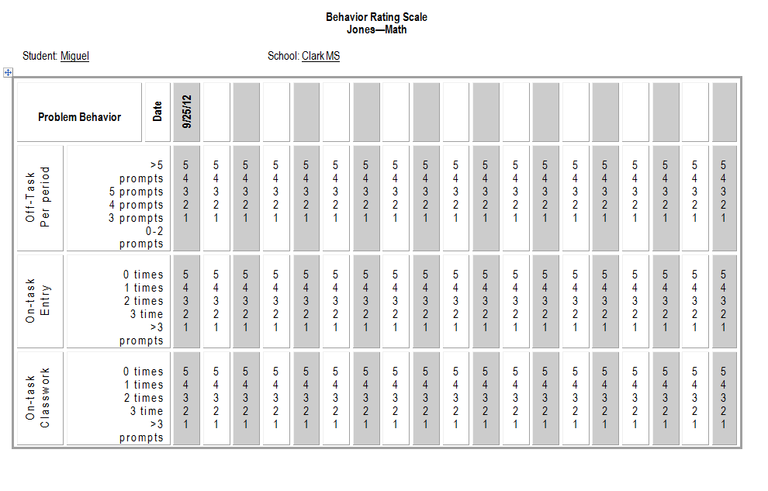

Slide 57
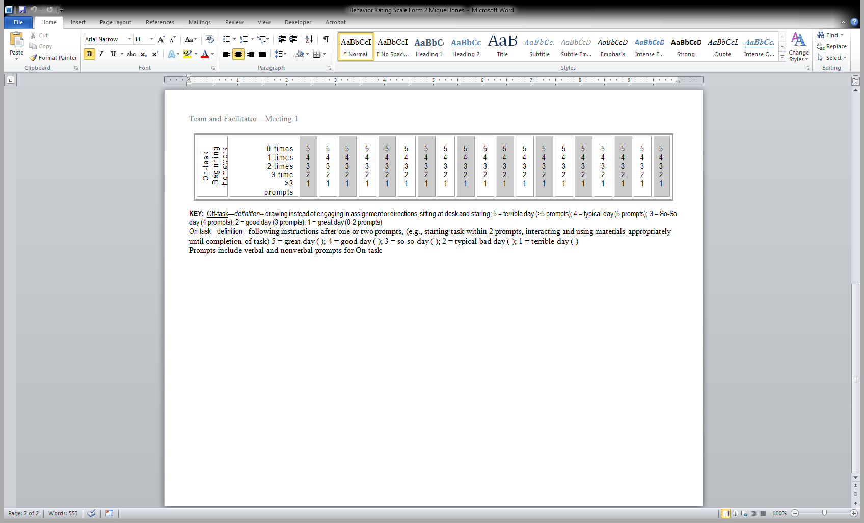

Slide 58
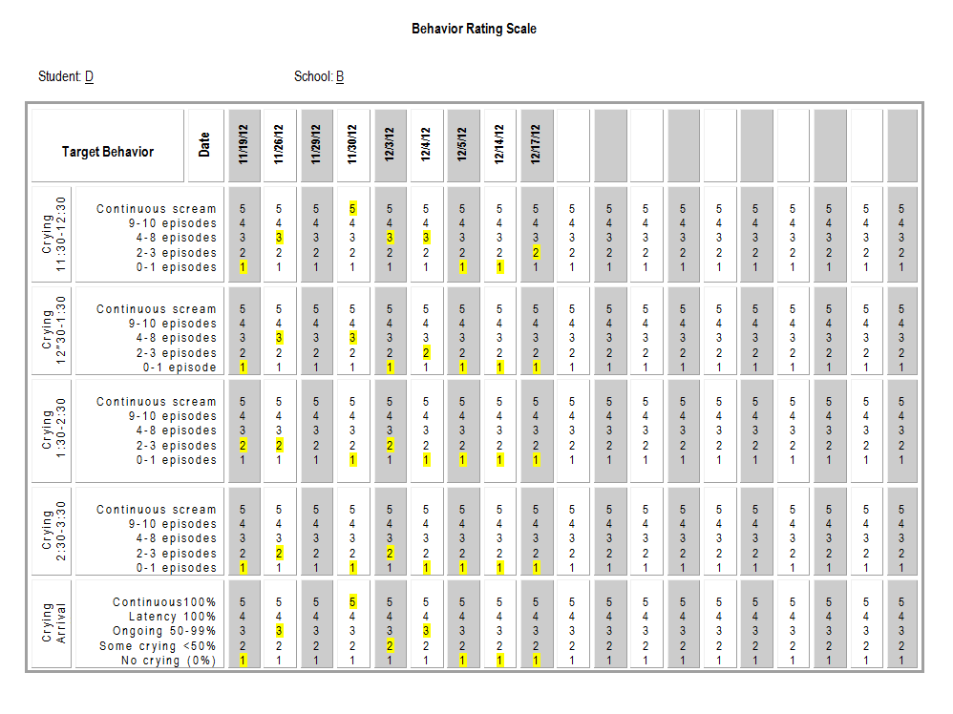

Slide 59
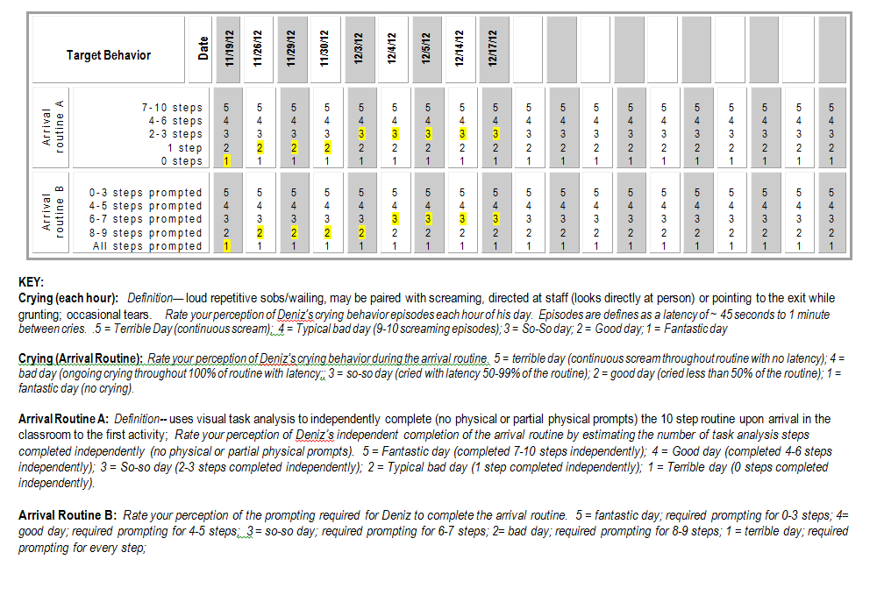

Slide 60
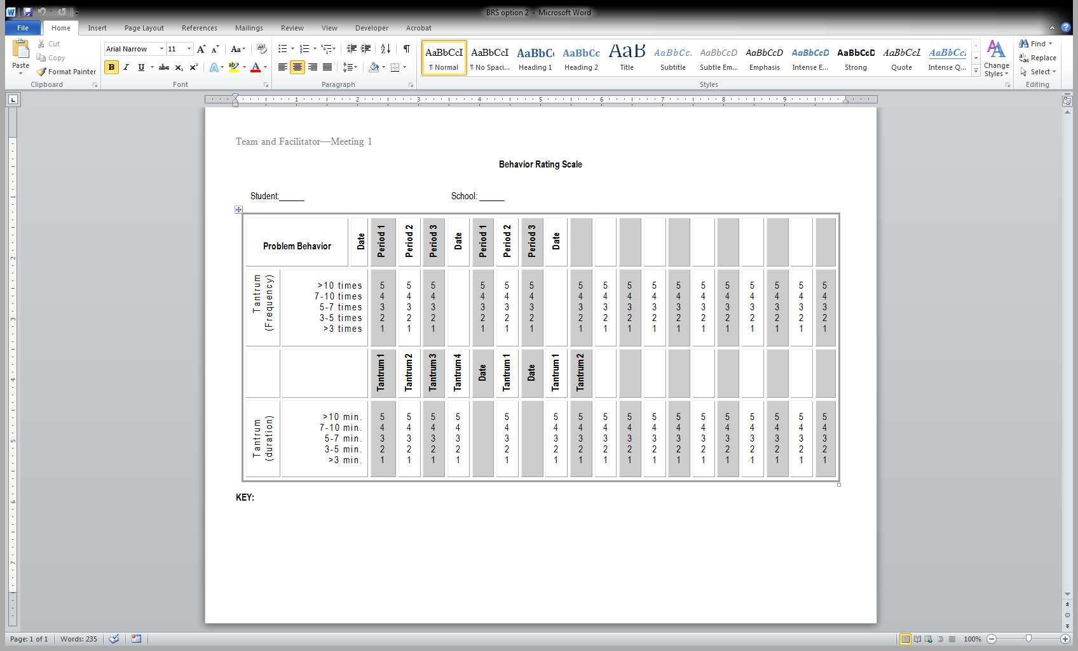

Slide 61
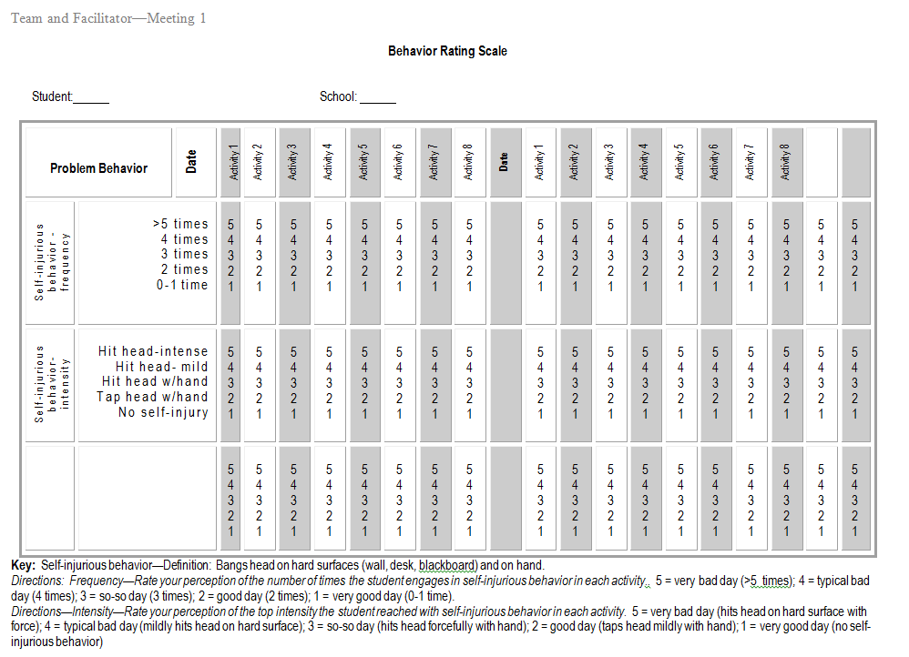

Slide 62
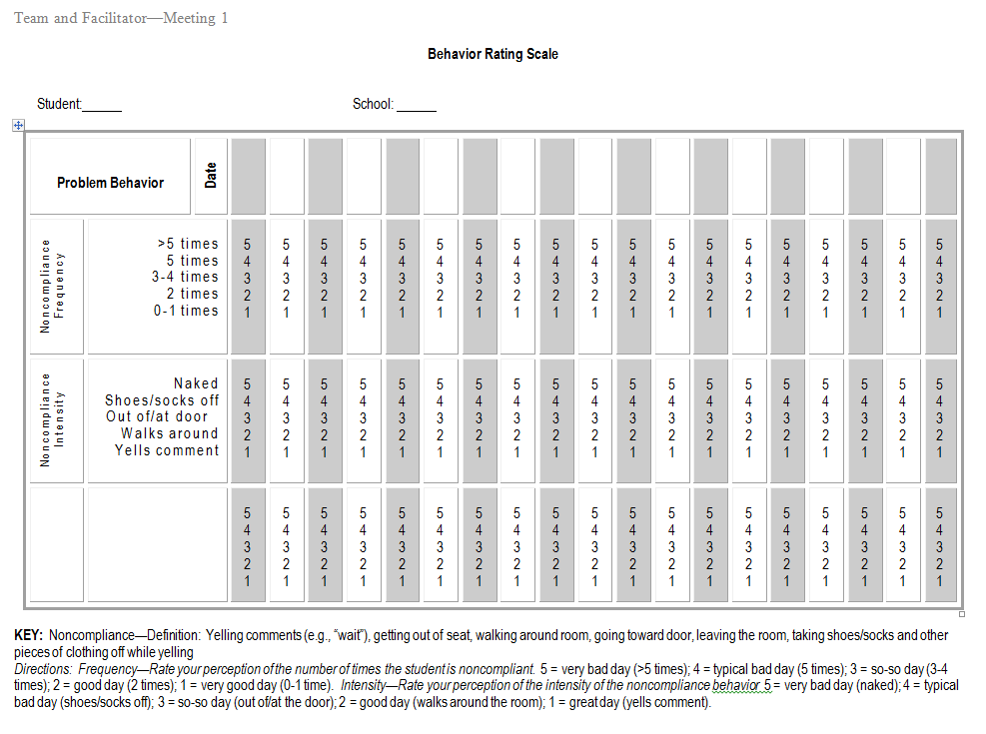

Slide 63
Practice Time
Select a facilitator and a team member
Using the blank goal setting form: operationalize either one problem behavior or one replacement behavior for a student (you may or may not be working with)
Continue with previous practice task…
Set up a behavior rating scale
  As a group, walk through the steps to set up the scale

Slide 64
Lunch: 11:45-1:00

Slide 65
Functional Behavior Assessment
A box to think outside of:
When our typical systems of rewards and consequences try something new!

Slide 66
FBA and BIP Development
Tab 2 Tools in Binder

Slide 67
Behavior Support Team Meeting #2: PTR Assessment (FBA): Problem Analysis
PTR Assessment (FBA)
  Prevent: Antecedents/triggers of problem behavior
  Teach: Function(s) of problem behavior, possible replacement behaviors
  Reinforce: Consequences associated with problem behavior, possible reinforcers
Assessment form completed by each team member
Facilitator summarizes input on Assessment Summary Table and develops draft hypothesis
Team reaches consensus
Facilitator has conducted at least ONE direct observation of student and context prior to this step
67
Notes:
67

Slide 68
Several Versions of PTR Assessment
Located under Tab #2 of Binder
Collected from respondents and summarized by facilitator before meeting #2!

Slide 69
FBA Tips
Team members complete for homework
During meeting, use as an interview
During meeting, give each team member 15 minutes to complete. Give 15 minute break to allow time for facilitator/coach to synthesize information in Assessment Organization Table
Family version of PTR Assessment available
Categorizing/aligning: Ensure that your pathway/table is aligned (e.g., triggers are categorized, function is identified for each set of triggers)

Slide 70
Direct Observation:
  The Facilitator should complete at least one observation of the identified behaviors prior to meeting #2:
    ABC data
    Time Sampling
    Sample Tools under Tab 2
Tip #5: Complete observations during times of day or activities identified as possible antecedents in PTR Interview!

Slide 71
Case Study: Joe
ABC Data:
During independent reading, two incidents of negative comments were observed during the 30 minute observation period. Each occurred in response to teacher redirection: “Joe please get started on your worksheet” and “What do you need to get going on the worksheet?” The teacher was observed to move close to his desk and offer assistance each time he made a negative comment. Although he remained engaged with her help, he quickly stopped working when she walked away. During math, more frequent occurrences of negative comments occurred (a total of 4) and were more intense. Comments occurred quickly after instructions were given to work on problems independently. His comments occurred one after the other (“I am not doing this,” “this is stupid,” “nope not doing it,” and “boring.”). The teacher attempted to ignore his comments but the behavior intensified. She followed up with a private conversation and asked Joe if he would like to take a quick break before beginning the task. He agreed and left the group to read a book in the back of the classroom.

Slide 72
Case Study: Joe
Time on Task Data:
During a 30 minute observation Joe was seen on task 37% of the time. The remaining 63% was spent engaging in off task behaviors. To compare his behavior to that of a peer, a student seated near Joe was on task 87% of the observation period. Off task behaviors included playing with materials in his desk, sharpening his pencil, looking for a book on the shelf and talking to a nearby peer. The observer also noted the number of times Joe was provided reinforcement for demonstrating appropriate behaviors and his reaction. As such, 4 positive interactions were noted (e.g. a hand on his shoulder while passing papers, verbal praise for attempting work, recognition when he raised his hand and a check in to offer help). Joe responded positively to these interactions.

Slide 73
Assessment Organization Table:
Summarize data from interviews, observations and record review in an easy to reference table
Include enough information to generate an intervention
May require additional discussion with respondent or observation prior to meeting #2
Practice: respondent indicates boring tasks as an antecedent, what would you want to know to generate an intervention?

Slide 74
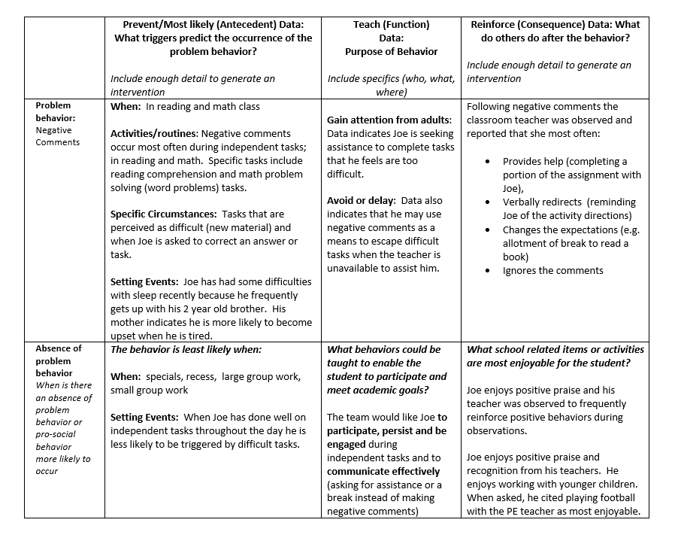
Case Study: Joe
Tip #6: Each problem behavior should have it’s own completed FBA interview and line on the summary table.

Slide 75
Troubleshooting
Team select all options/boxes after question
  Ask them to select the top 3-5 that they have 100% confidence is related to the behavior occurrence
    Example—Prevent Question 4 almost all boxes selected
    Say to the team, “If I came into your classroom tomorrow and would give you $1 million to make Sarah’s behavior happen, which of these would you do first to get the money? Second? Third?
Not sure of function
  First, separate antecedents/triggers by categories (e.g., triggers related to demands to do non-preferred tasks, triggers related to peer interactions, etc.).
  Ask team what function seems to best fit with these categories (e.g., non-preferred tasks—is behavior’s purpose to delay/escape the non-preferred task or to get attention)
  If not sure between escape/attention, probe the team further
    For example, if the child was doing a preferred activity, would the behavior still occur? If yes, it may be attention. If no, it may be escape.

Slide 76
Hypothesis or Summary Statement
Identify chains of behavior in one statement: setting events-antecedent-behaviors-consequence
Each antecedent will likely have a “prevent” intervention – prioritize!
Each identified (challenging) behavior should have it’s own summary statement

Slide 77
Case Study: Joe
Possible Hypotheses
 | When…. | He/she will….. | As a result, he/she ……
Problem Behavior: Negative Comments | During reading and math when Joe is engaged in an independent task (that he perceives as challenging) Setting Events: (These triggers are stronger when he has not slept well) | Make negative comments | Receives attention (assistance from the teacher) and/or (escape) is offered an alternate activity.
Replacement Behavior | Joe is engaged in an independent task (that he perceives as challenging) during reading and math tasks Setting Events: (These triggers are stronger when he has not slept well) | Replacement Behavior: Communicate effectively Desired Behavior: Participate, persist, and be engaged | Receives attention (assistance from the teacher) and/or (escape) is offered an alternate activity. Receives attention (time to play football with the PE teacher, recognition from the teacher, time to work with younger children)
Additional Comments:
The team reached agreement on the hypothesis statement.
The team will focus on teaching Joe to ask for help and/or a break initially with the goal to increase his overall level of engagement to access more enjoyable incentives and complete tasks

Slide 78
Practice Time
Select a facilitator and a team member
Using the blank goal setting form: operationalize either one problem behavior or one replacement behavior for a student (you may or may not be working with)
Set up a behavior rating scale
  As a group, walk through the steps to set up the scale
Continue with previous practice task…
  As a group, use the interview form, to begin developing your Assessment Organization Table and Hypothesis Statement

Slide 79
Behavior Support Team Meeting# 2: Behavior Intervention Plan Development
Tab 2 BIP Tools:
  PTR Menu
  Blank Behavior Intervention Plan Table
  Intervention Descriptions

Slide 80
Behavior Intervention Plan Development: Essential Features
Behavior interventions selected by team from PTR Menu
Team/teacher provides description on how interventions will look in classroom setting
Facilitator guides the team/teacher by using ABA principles to develop most effective intervention that matches the team/teacher context
Each intervention selected is described in detail by task-analyzing steps, providing scripts, describing adult behaviors, NOT student behaviors
After plan developed, time is scheduled to train the team/teacher the strategies prior to implementation
Plans for training students and other relevant individuals
Support provided once plan is implemented

Slide 81
The BIP Process is always the same but becomes more complex as the student’s needs increase
Goals (academic, health, career and social) across life domains (home, school, community)
BIP developed by a unique (larger) team (collaboration across multiple stakeholders)
More individualization
Complexity of BIP
Intensity of Behavior(s)
Fewer settings
BIP (often) developed by a standing team
Less individualization

Slide 82
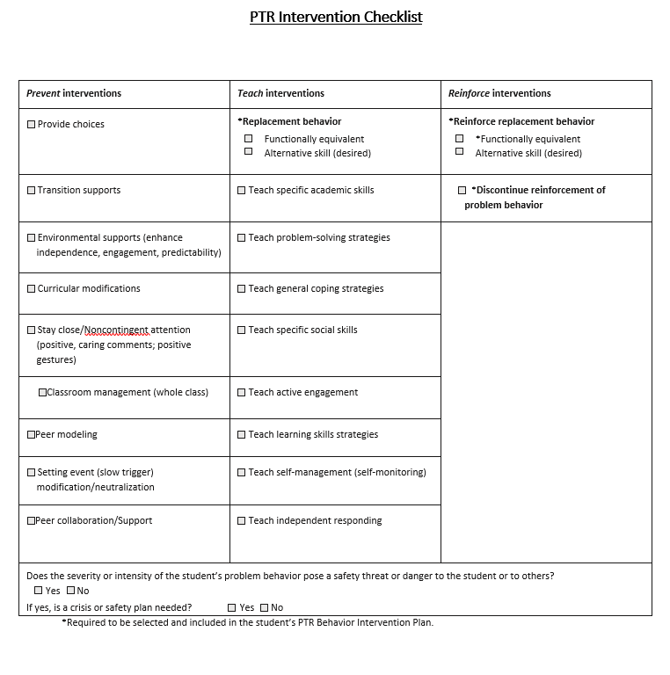

Slide 83
Replacement Behaviors
Functional Equivalent vs. Alternate Skill
Functional Equivalent (examples)
Alternate Skill (examples)
Escape functions
  Ask for a break
  Ask for an alternate task
  Ask to terminate
Access attention functions
  Ask for attention
  Ask for help
Access specific object or activity
  Ask for an object
  Ask for a specific activity
  Ask for one more minute
Raise hand for help or answering questions/participation
Independently complete work
Appropriately transition from point a to point b
Be academically engaged
Initiate social interactions
Make appropriate social comments

Slide 84
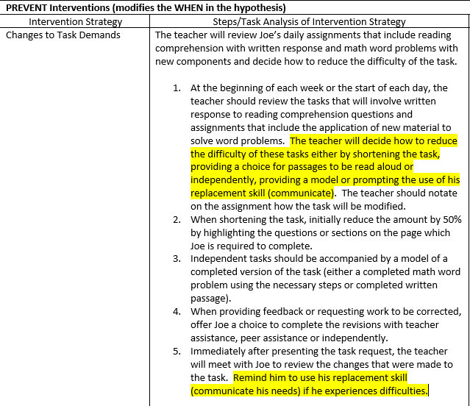
Linking Hypothesis to Intervention
During reading and math when Joe is engaged in an independent task (that he perceives as challenging)
PREVENTION INTERVENTION:
What intervention will modify the independent task so that it is no longer a trigger?
Tip #7: Always prompt the student to use their replacement skill prior to or during presentation of antecedent.

Slide 85
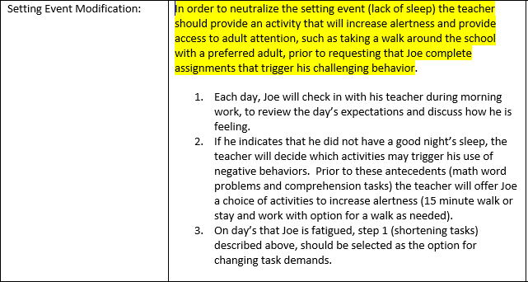
Linking Hypothesis to Intervention
(These triggers are stronger when he has not slept well)
PREVENTION INTERVENTION:
How can we modify the triggers when the setting event is relevant?

Slide 86
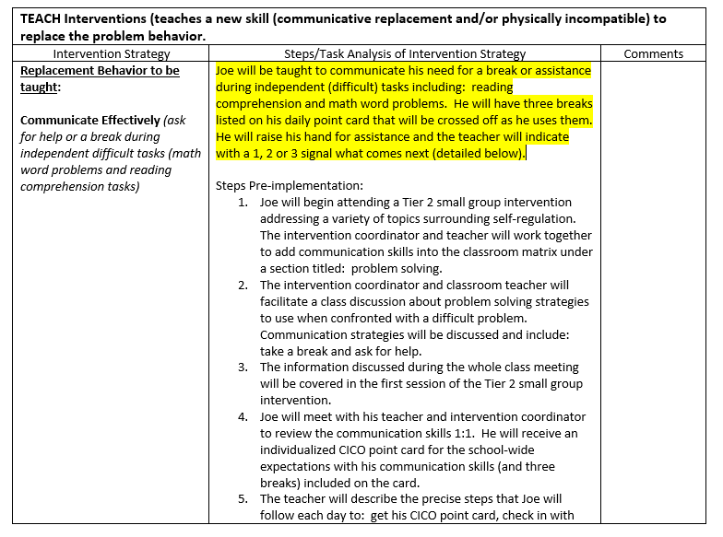
Linking Hypothesis to Intervention
Make negative comments
TEACH INTERVENTION:
What do we want the student to do instead of making negative comments? What is the replacement behavior/skill to be taught to the student?

Slide 87
Reinforcement and Punishment
Give (+)
Take (-)
Action
Effect
Positive
Negative
Inc. ( )*
Increases likelihood of future behaviors
Reinforcement
Reinforcement
Which will help our teams teach NEW behaviors?
Positive
Negative
Dec. ( )*
Decreases likelihood of future behaviors
Punishment
Punishment
* Future probability of behavior
Notes:
Narrative: consequences take the form of reinforcement (which increases the likelihood of future behavior) and punishment (which decreases the likelihood of future behavior). Each can take the form of positive or negative depending on whether the environment is adding or removing some type of stimulus. This can be confusing, let’s look at each one individually.
Click: Positive reinforcement implies you are adding a stimulus to the environment and the effect is to increase the likelihood of future behavior. For example, praising a student (who enjoys adult attention) for demonstrating prosocial behavior will likely increase that behavior in the future.
Click: Positive punishment on the other hand implies your are adding a stimulus to the environment but the effect is to decrease the likelihood of future behavior. For example, correcting a student who makes a behavior error by asking them to move their clip down on a behavior chart, is positive punishment if it decreases that behavior in the future.
Click: Negative reinforcement results when something is removed from the environment which increases the likelihood of future behavior. An example would be: removing

Slide 88
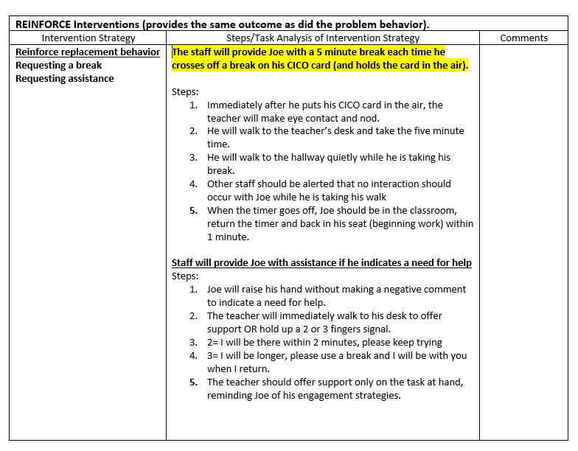
Linking Hypothesis to Intervention
Receives attention (assistance from the teacher) and/or (escape) is offered an alternate activity.
REINFORCE INTERVENTION:
How will we make sure that the replacement behavior gets the same outcome as did the problem behavior (e.g., attention/escape)?

Slide 89
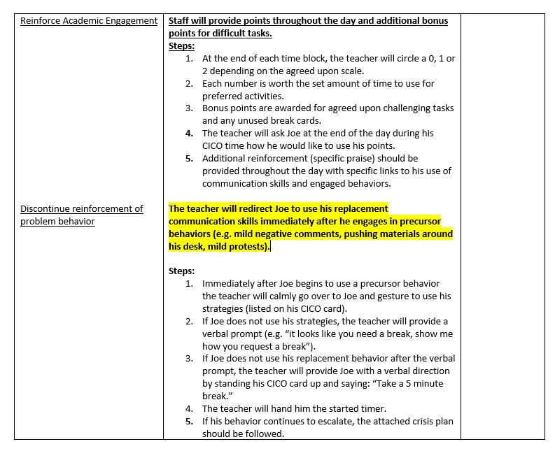
Linking Hypothesis to Intervention
Receives attention (assistance from the teacher) and/or (escape) is offered an alternate activity.
DISCONTINUE REINFORCE INTERVENTION:
How will we minimize the pay-off for the problem behavior?

Slide 90
BIP Development Tips
Task analyze each step of the plan
  Non-Example: Give student choices
  Example:
    Prior to the start of independent reading, tell the student, “We have 2 worksheets today.”
    Show student both worksheets
    Say, “Which worksheet would you like to do first?”
Teachers need to know exactly what to do or the intervention may not be implemented as intended.
Use the PTR menu and description of interventions as guide but individualize for the student
Are there Tier 1 or 2 interventions/accommodations that are provided that can be folded into the plan? (e.g. the student can be taught coping skills during a small group and skills could be embedded into a classroom matrix for all students to use)
Notes:
90

Slide 91
Classroom Matrix to teach coping skills
The Wilson Way | Classroom Rules | Classroom (Attention Signal: 1-2-3 Eyes on Me)
 |  | When you feel upset … | Morning Routine | How to Transition/ Line Up | Small Group Work
Be Responsible | Stay on task Clean up area Apologize for mistakes | Recognize what you’re feeling “I feel…” Stop and take a few deep breaths | Turn in homework Put instructional materials in desk | Put materials away Get materials ready for next activity | Do your fair share Manage time carefully
Be Respectful | Raise hand Listen to speaker Follow directions Use appropriate voice level | Ask for a break if you need a moment Express your feelings appropriately | Say “good morning” to teacher and classmates Talk in soft voices | Listen for direction to next activity Be silent | Listen to understand your peers Take turns speaking Use kind words with feedback Speak only to group members
Be Safe | Walk quietly Keep hands and feet to self | Talk to someone if you need help Talk to someone if it will make you feel better | Put personal belongings in designated areas Take your seat | Stand up Push in chair Wait for group to be called to line up | Clean up area when time is up
Notes:
Start with entering your school-wide expectations on the left side and then add your classroom rules.
The School-wide matrix includes the rules for classrooms.
Classrooms then expand their matrix to also include the routines/procedures for common routines (mapped to the school-wide expectations).

Slide 92
BIP Development Tips
Teams can select interventions for homework or can select during team meeting
Focus on one routine, class, subject for developing intervention
Make sure the facilitator is asking guiding questions-allow the teacher to describe how the intervention will be in their classroom
If meeting time is limited, break up strategies:
  One meeting, focus on full development of Prevent, next meeting develop Teach/Reinforce OR
  First concentrate on Teach/Reinforce; next meeting develop Prevent.

Slide 93
Practice Time
Select a facilitator and a team member
Using the blank goal setting form: operationalize either one problem behavior or one replacement behavior for a student (you may or may not be working with)
Set up a behavior rating scale
  As a group, walk through the steps to set up the scale
As a group, use the interview form, to begin developing your Assessment Organization Table and Hypothesis Statement
Continue with previous practice task…
  Using the PTR menu and intervention descriptions, choose a prevent, teach or reinforce strategy to task analyze

Slide 94
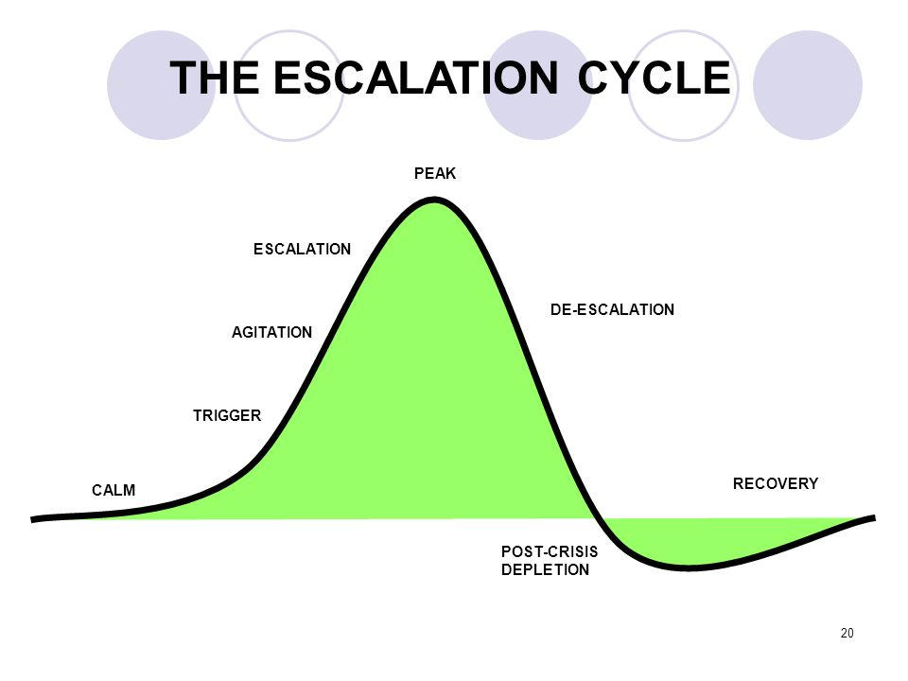
The Safety Plan
Notes:
Prompting happens at the trigger and not during agitation, escalation or peak emotional response.

Slide 95
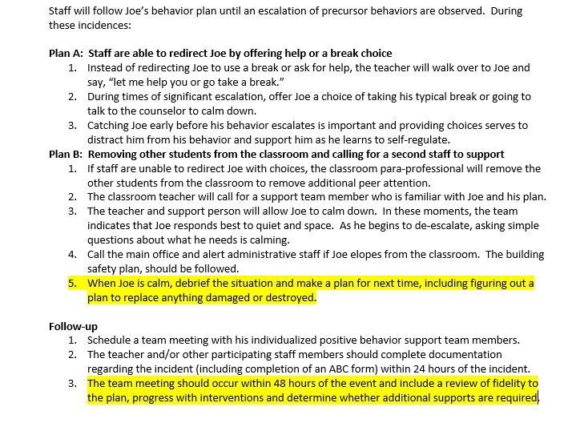
Case Study: Joe
Harmful behaviors escalate when Joe has received verbal corrections in order to escape the tasks and adult.
DISCONTINUE REINFORCE INTERVENTION:
How will we minimize the pay-off for the problem behavior?
Goal is to de-escalate so that you are able to problem solve with the student. Always make a plan for next time.

Slide 96
Behavior Support Team Meeting #3+: Progress Monitoring and Follow Up
Tab 3 Tools in Binder

Slide 97
Teacher Coaching
Teacher and Staff Training
  Initial training with no students present
  Model, Role Play,
  Q & A, Discussion
Fidelity checklist used by PTR Facilitator:
  Evaluate teacher accuracy on each step prior to implementation with student
  Comfort and competence measured
  Can also be used as fidelity measure after intervention is implemented

Slide 98
Coaching Steps
Several methods for coaching the teacher.
Can choose one method, combination of two, or all three
  Discussion—facilitator asks teacher to verbally describe (in his or her own words) each of the interventions.
    Ensures teacher describes each step of the intervention
    Teacher can refer to coaching form to cue core steps
  Q & A—facilitator asks teacher questions about strategies.
    For example, choice-making “When are you going to offer the choices to X?”; “What kind of choices will you offer X?”; etc.
  Role Play (preferred method)-facilitator plays role of student and asks teacher to perform plan steps as they would with student.

Slide 99
Coaching Steps
Successful training:
  Decide who else needs to be trained (e.g., student, other school staff, parent)
  Try to be there when teacher trains student or offer to train student
Determine start date of intervention plan
  Can choose to implement the intervention in phases.
    Prevent first, then teach/reinforce
    Teach/reinforce first, the prevent
Fidelity checklist can be used as fidelity measure rather than developing separate checklist

Slide 100
In-Class Support
Provide support to teacher in implementation
  Be present on first day of implementation
  Determine when to debrief
  Measure fidelity- Fidelity measurements can be done once or twice a week rather than daily
  Discuss and modify if necessary

Slide 101
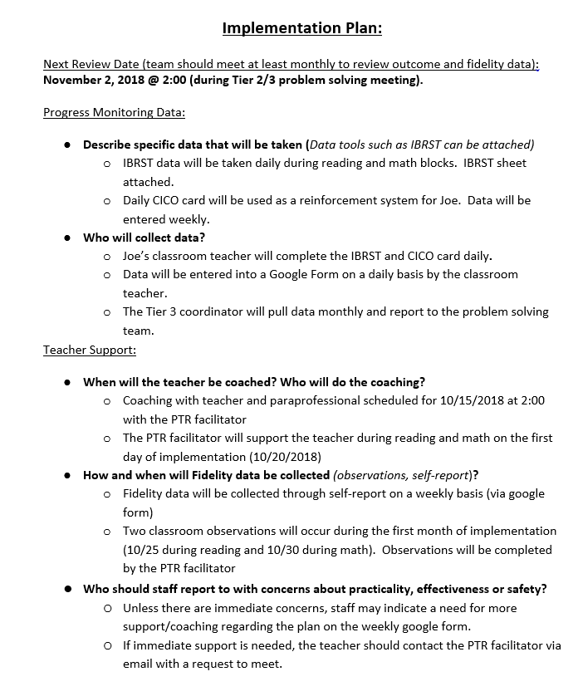
Case Study: Joe
Tip #8: Social Validity is key to a successful plan.

Slide 102
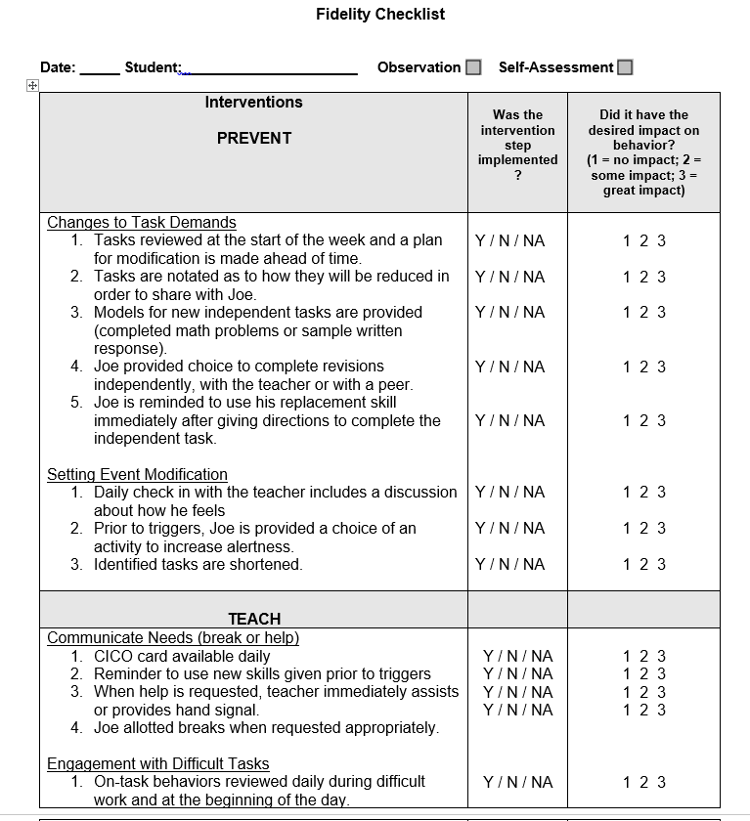
Case Study: Joe

Slide 103
Progress Monitoring
Decision rules
  What constitutes adequate fidelity? 80%, 70%, something else?
  What constitutes adequate student progress? (e.g., 3 or more consecutive ratings at or above goal line?)
Implementation Fidelity Data
  Is the plan being implemented consistently and accurately?
Student outcome data
  Is the problem behavior decreasing? Is the replacement behavior increasing?
Expanding the plan
  Routines, times of day
  Generalize across settings and/or staff

Slide 104
What if Joe needs more support?
  A key to balancing the child find requirements of the IDEA and multi-tiered systems is the appropriate use of progress monitoring data.

Slide 105
What Does the Data Indicate?
When the data indicates that a student is continuing to struggle academically or behaviorally that is a strong indication that a student may need to be referred to special education.
See the Tier 3 flowchart under tab 4 for sample decision rules for increased support

Slide 106
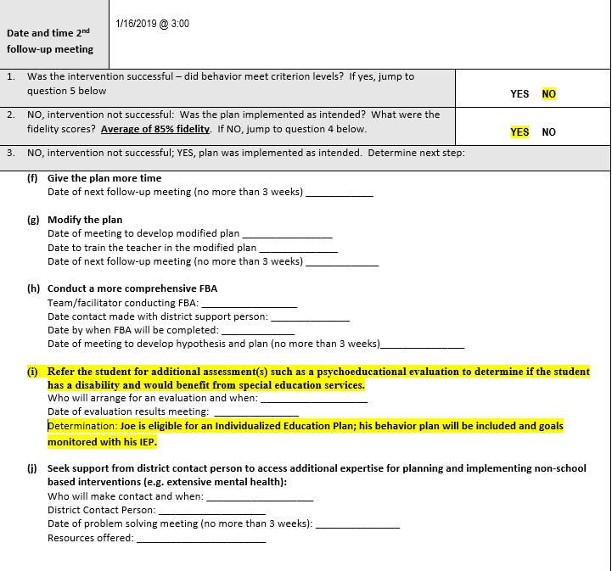
Case Study: Joe
The IEP will include goals for behavior and expand across identified areas of need.

Slide 107
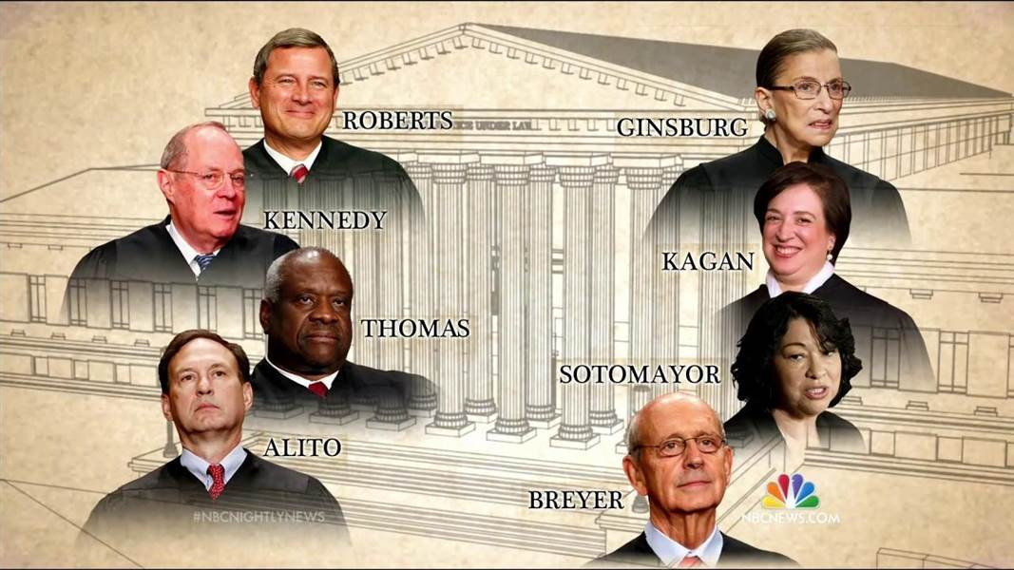

The Rowley/Endrew Test
Yell & Lewis, 2018

Slide 108
Board of Education v. Rowley, 1982
“We therefore conclude that the ‘basic floor of opportunity’ consists of access to specialized instruction and related services which are individually designed to provide educational benefit to the handicapped child.”
Yell & Lewis, 2018
Notes:
Justice Rehnguist noted the statutory definition of FAPE was cryptic rather than comprehensive
“Congresses intent was more to open the door of public education-to offer a floor of opportunity
The High Court developed a two-part test to determine if a school district had provided a student with a FAPE

Slide 109
The Rowley Two-Part Test
Has the state complied with the procedures set forth in the law?
Is the resulting IEP reasonably calculated to enable the student to receive educational benefit?
Limited definition of “educational benefit”
Yell & Lewis, 2018
Notes:
The Court applied the two-part to the case of Amy
The school district had complied with the procedures of the law , thus meeting part 1 of the test
Also, the court held that Amy had received educational benefit because she was passing from grade to grade, thus meeting part 2 of the test benefit-Footnote
Herein lay the problem-Amy had a IQ of 125 and was academically very able-The Supreme Court was essentially able to sidestep the 2nd part of the test
When applying the FAPE test to individual cases, courts began to have different interpretations of the 2nd or substantive part of the Rowley test

Slide 110
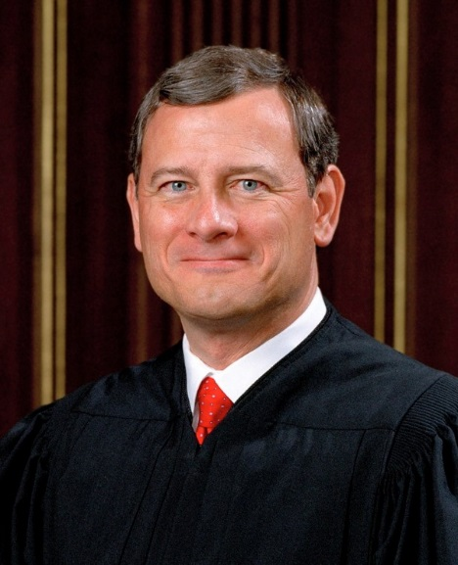
Endrews Supreme Court Ruling: March 22, 2017
In Rowley, “we declined…to endorse any one standard for determining when (students with disabilities) are receiving sufficient educational benefit to satisfy the requirements of the Act.”
“That more difficult problem is before us today.”
Yell & Lewis, 2018

Slide 111
“The IEP must aim to enable the child to make progress. After all, the essential function of an IEP is to set out a plan for pursuing academic and functional advancement”
-Endrew F., 2017, p. 11-
11
Yell & Lewis, 2018
Notes:
progress monitoring will need to be supported by user-friendly and efficient data analytics and technology. The student’s record of progress across a year of instruction, such as can be provided by formative assessments and benchmarking assessments, (Abrams, McMillan, & Wetzel, 2015; Crawford, 2014), will also be vitally important

Slide 112
The Tenth Circuit’s Educational Benefit Standard
Endrew F. v. Douglas County School District R1, 798 F.3d 1329, (10th Cir. 2014)
“The educational benefit mandated by the IDEA must merely be more than de minimis”
Yell & Lewis, 2018
Notes:
Now famous quotation from the decisions was that the educational benefit offered Drew had to be “merely more than de minimis”

Slide 113
The Rowley/Endrew Test
In the development of an IEP, has the school agency complied with the procedures set forth in the IDEA?
2. Is the IEP developed through the IDEA’s procedures reasonably calculated to enable the child to make progress that is appropriate in light of his or her circumstances?
33
Yell & Lewis, 2018

Slide 114
Simple Starting Point
Students with disabilities are first and foremost, students who attend your school
Student IEP behavior goals should use parallel language to the schools universal expectations
Students with disabilities can participate in Tier II supports, when appropriate
Adopt and use research-based progress monitoring systems.
Ensure that a school’s PBS system does not inadvertently violate the child find or evaluation requirements of the IDEA
When PBS supports are used in a students IEP or behavior intervention plan, ensure that such supports are clearly specified and implemented as written
Yell & Lewis, 2018

Slide 115
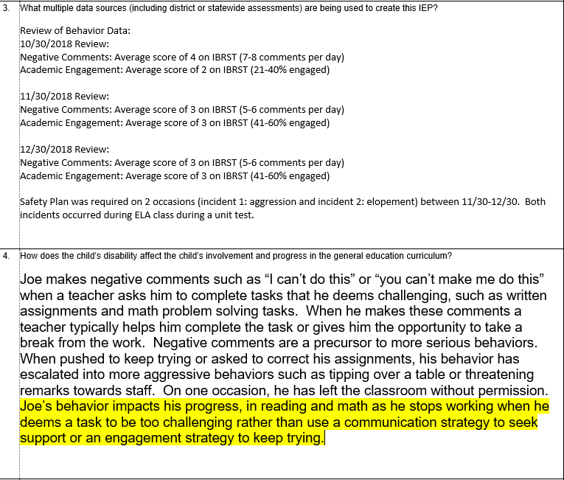
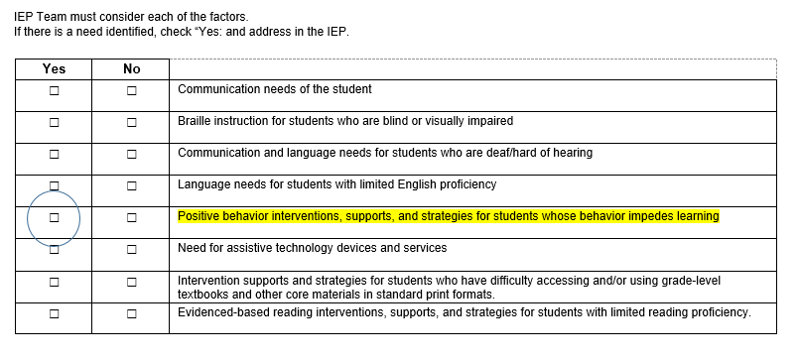
Case Study
Endrews Test: The IEP is reasonably calculated based on data from the FBA and BIP process.
Endrews Test: Learning new behaviors will enable him to make appropriate progress

Slide 116
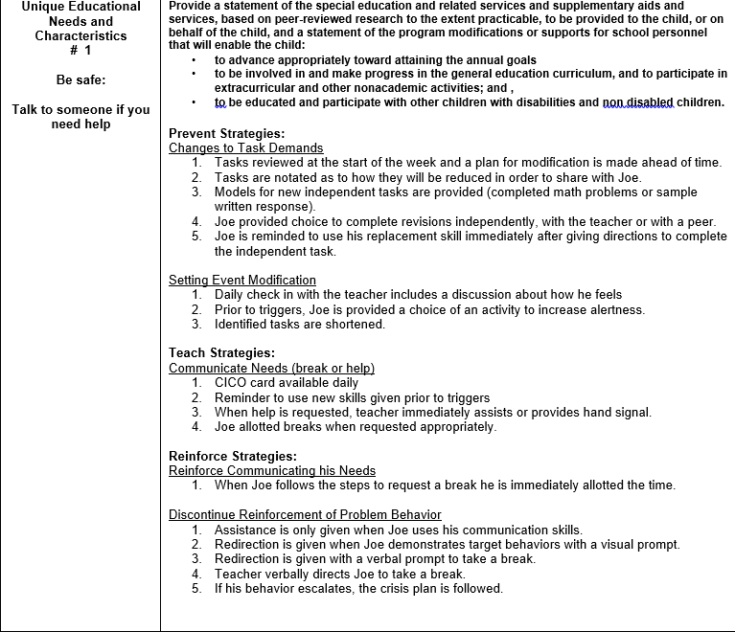
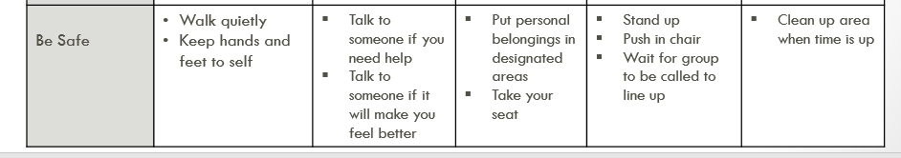
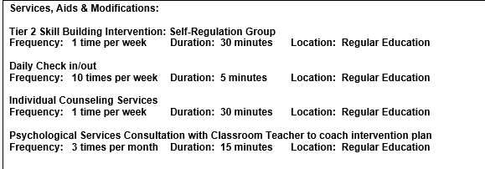
Case Study: Joe
Linked to Tier 1 Classroom Expectations
Linked to Tier 2 Practices
Increased Individualized Supports

Slide 117
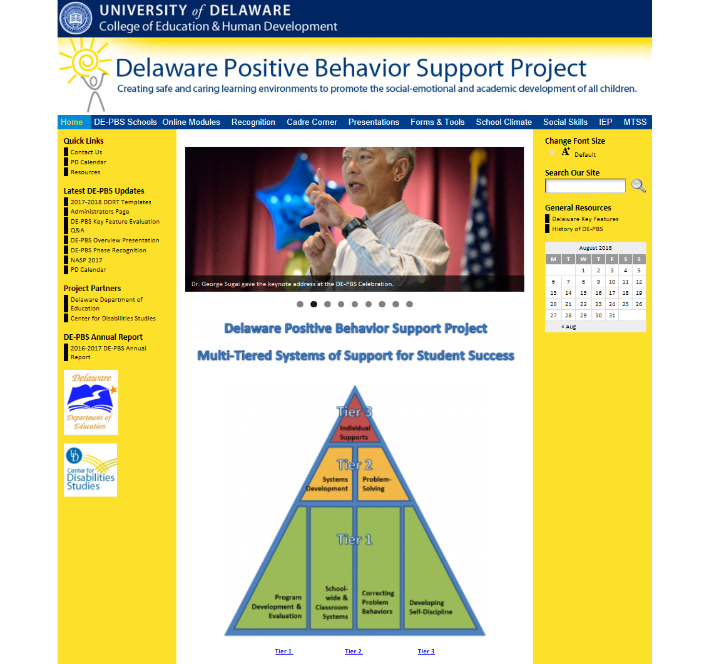
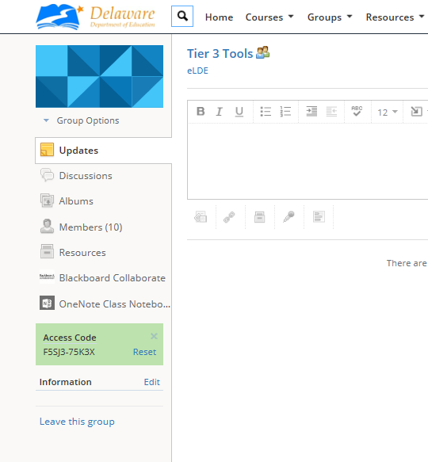
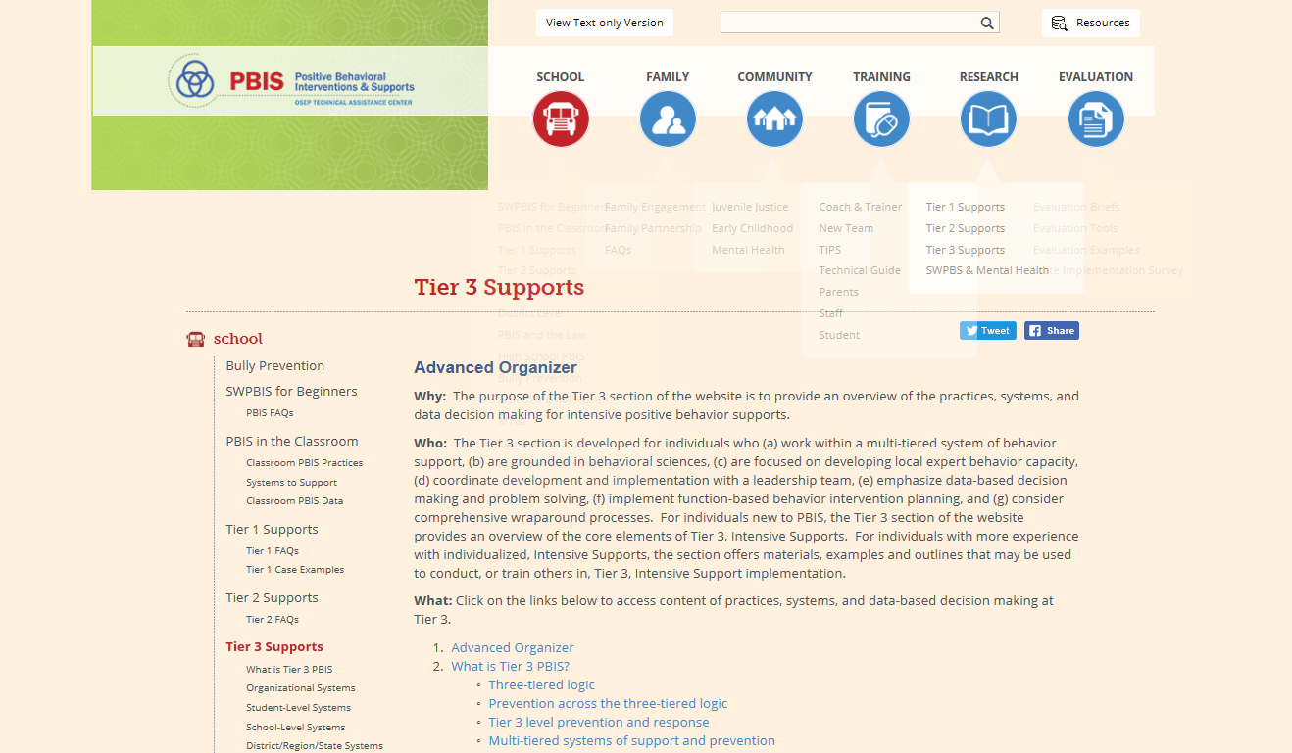
Resources
Delawarepbs.org
Schoology
Access Code:
F5SJ3-75K3X
Pbis.org
Notes:
Narrative: There are several resources for FBAs and BIPs as well as Tier 3 in general available for your use. See the Delaware PBS website, the Delaware PBS Tier 3 Tools Schoology page, and the PBIS.org Tier 3 supports webpage for more information.

Slide 118
Questions?
robertsn@udel.edu

Slide 119
References:
Iovannone, R., Romer, N. (2017). The FBA/BIP technical adequacy tool for evaluation (TATE): applications for improving practice. [PowerPoint slides]. Retrieved from: https://new.apbs.org/conference/presentations/fbabip-technical-adequacy-tool-evaluation-tate-applications-improving.
Yell, M. & Lewis, T. (2018). Positive behavioral interventions & supports: implications for supporting students with disabilities [PowerPoint slides]. Retrieved from https://sites.google.com/a/midwestpbis.org/pbis-leadership-forum-2018/sessions.

Slide 120
PTR Publications
PTR Manuals
  Dunlap, G., Iovannone, R., Kincaid, D., Wilson, K., Christiansen, K., Strain, P., & English, C., 2018. Prevent-Teach-Reinforce: The school-based model of individualized positive behavior support (2nd ed.). Baltimore, MD: Paul H. Brookes. (Second edition coming soon)
  Dunlap, G., Wilson, K., Strain, P., & Lee, J. K. (2013). Prevent-Teach-Reinforce for young children: The early childhood model of individualized positive behavior support. Baltimore, MD: Paul H. Brookes.
Journal Articles
  Barnes, S., Iovannone, R., Blair, K. S. W., Crosland, K., & Peshak-George, H. (under review). An evaluation of the Prevent-Teach-Reinforce model within a multi-tiered intervention system. Journal of Positive Behavior Interventions.
  DeJager, B. W., & Filter, K. J. (2015). Effects of Prevent-Teach-Reinforce on academic engagement and disruptive behavior. Journal of Applied School Psychology, 31, 369-391.
  Dunlap, G., Iovannone, R., Wilson, K., Kincaid, D., & Strain, P. (2010). Prevent-Teach-Reinforce: A standardized model of school-based intervention. Journal of Positive Behavior Interventions, 12, 9-22.
  Dunlap, G., Lee, J. K., Joseph, J. D., & Strain, P. (2015). A model for increasing the fidelity and effectiveness of interventions for challenging behaviors: Prevent-Teach-Reinforce for young children. Infants & Young Children, 28, 3-17.
  Iovannone, R., Anderson, C. M., & Scott, T. M. (2013). Power and control: Useful functions or explanatory fictions? Beyond Behavior,
  Iovannone, R., Greenbaum, P., Wei, W., Kincaid, D., & Dunlap, G. (2014). Interrater agreement of the Individualized Behavior Rating Scale Tool. Assessment for Effective Intervention, 39, 195-207.
  Iovannone, R., Greenbaum, P., Wei, W., Kincaid, D., Dunlap, G., & Strain, P. (2009). Randomized controlled trial of a tertiary behavior intervention for students with problem behaviors: Preliminary outcomes. Journal of Emotional and Behavioral Disorders, 17, 213-225.
  Kulikowski, L. L., Blair, K. S. C., Iovannone, R., & Crosland (2015). An evaluation of the Prevent-Teach-Reinforce (PTR) model in a community preschool classroom. Journal of Behavior Analysis and Supports, 2, 1-22.
  Sears, K. M., Blair, K. S. C., Iovannone, R. & Crosland, K., (in press). Using the Prevent-Teach-Reinforce model with families of young children with ASD. Journal of Autism and Developmental Disabilities.
  Strain, P. S., Wilson, K., & Dunlap, G. (2011). Prevent-Teach-Reinforce: Addressing problem behaviors of students with autism in general education classroom. Behavior Disorders, 36, 160-171.

