Slide 1
DE-PBS Cadre Meeting
Thursday, December 6, 2018

Slide 2
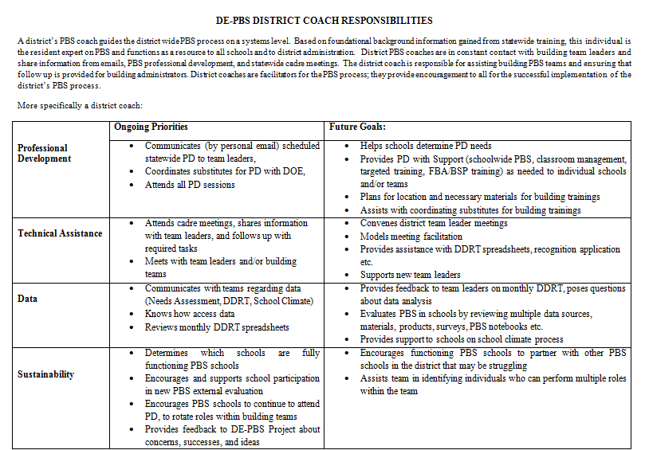

Slide 3
What is a Multi-Tiered System of Support (MTSS)
an evidence-based framework for effectively integrating multiple systems and services to address students’ academic achievement, behavior, and social–emotional well-being.
a strategy for improving outcomes for all students and for creating safe and supportive learning environments free of bullying, harassment, and discrimination.
includes school-wide strategies, targeted supports and individualized student supports.
www.nasp.org

Slide 4




MTSS for Social Competence &
Academic Achievement
Outcome data (social behavior, academic achievement), Progress Monitoring, Fidelity
OUTCOMES
SYSTEMS
DATA
What we do to support adults to implement the practices
PRACTICES
What we do to
support students

Slide 5
DE-PBS Annual Report - 2017-2018
Tier 3: PD & Data
Tier 2: PD & Data
Tier 1: PD & Data

Slide 6

DE-PBS Phase Recognition

Slide 7
2017- 18 Phase 1 Recipients
School District | School Name
Brandywine | Talley Middle
Caesar Rodney | Postlethwait Middle
Cape Henlopen | HO Brittingham Elementary
Cape Henlopen | Rehoboth Elementary
Capital | East Dover Elementary

Slide 8
2017- 18 Phase 1 Recipients
School District | School Name
Lake Forest | Lake Forest High School
Milford | Morris Early Childhood Center
Red Clay | McKean High School
Red Clay | Shortlidge Elementary

Slide 9
2017-18 Phase 2 Recipients
School District | School Name
Red Clay | Highlands Elementary
Christina | Pulaski Elementary

Slide 10
2017-18 Phase 3 Recipients
School District | School Name
Christina | Shue-Medill Middle
Lake Forest | East Elementary
Red Clay | Cooke Elementary

Slide 11
2017-18 Phase 4 Recipients
School District | School Name
Appoquinimink | Brick Mill Elementary
Appoquinimink | Bunker Hill Elementary
Cape Henlopen | Milton Elementary
Christina | Gallaher Elementary
Christina | Keene Elementary
Christina | Wilson Elementary
Red Clay | Marbrook Elementary

Slide 12
Public Notices
Letters to district superintendents and board presidents,
Website posting
Twitter

Slide 13

What’s new?
Revamp: Phase 4 - Tier 2 Targeted Systems
Pilot: Phase 5 – Tier 3

Slide 14
18-19 SY Phase Recognition Reminders
Distribution typically in February
Application entails end of the year program reflection
Recognition reflects CURRENT year effort; schools maintaining or advancing levels should apply yearly
Process should be a team effort
Application review – May
http://wh1.oet.udel.edu/pbs/recognition/applications/

Slide 15
It’s a Conversation
Do you have district conversations encouraging folks to apply for recognition?
Do you have time available to provide TA in completing the application process?
How do you use the recognition application or process as a tool with your teams?

Slide 16


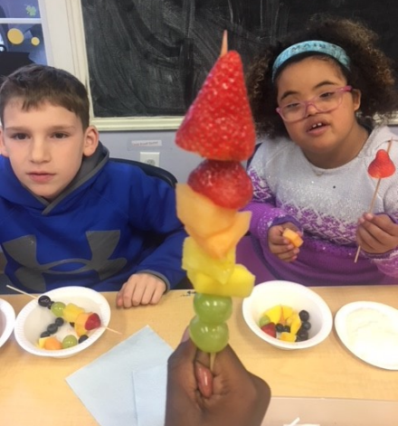



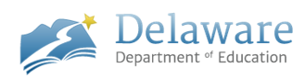
Indicators 4A & 4B
Rates of Long-term Suspension & Expulsion
Identification of Significant Discrepancy
Tracy Neugebauer
December 6, 2018
PBS Cadre

Slide 17

Indicator 4A
Rates of Suspension and Expulsion
4A
Percent of Local Education Agencies (LEAs) identified by the State as having a significant discrepancy in the rates of suspensions and expulsions of children with disabilities for greater than 10 days in the school year.
Considered a results driven indicator with stakeholders setting targets.
Current Annual Performance Report (APR) or SEA Target is 0%.

Slide 18
Indicator 4B
Rates of Suspension and Expulsion
4B
Percent of LEAs identified by the State as having a significant discrepancy in the rates of suspensions and expulsions for greater than 10 days in a school year of children with disabilities by race and ethnicity.
Considered a Compliance Driven indicator with OSEP setting the target.
Current Annual Performance Report (APR) or SEA Target is 0%.

Slide 19
Indicator 4B
Rates of Suspension and Expulsion
4B- Measurable and Rigorous Target:
Percent of districts that have: (a) a significant discrepancy, by race or ethnicity, in the rate of suspensions and expulsions of greater than 10 days in a school year for children with IEPs; and
(b) policies, procedures or practices that contribute to the significant discrepancy and do not comply with requirements relating to the development and implementation of IEPs, the use of positive behavioral interventions and supports, and procedural safeguards.

Slide 20
Significant Discrepancy Definition
Rate Ratio Method
  An LEA has a significant discrepancy when the
  rate of long term suspension/ expulsions
  for students with disabilities compared to
  the rate for students without disabilities is greater than the “state bar.”

Slide 21
Significant Discrepancy Definition
Rate Ratio Method – State Bar
Current Definition of Significant Discrepancy:
4A - LEAs with Rate Ratio above “Bar” and 15 or more students in cell
4B - LEAs with Rate Ratio above “Bar” and 10 or more students in cell
Both 4A & 4B:
Rate Ratio is 1.16 with a .02 reduction per year.
One year of data reviewed.

Slide 22
Significant Discrepancy Definition
Rate Ratio Method
In FFY17 OSEP changed the methodology in which
SEA’s reports data.
Prior to FFY17-
4A. Percent = [(# of districts that have a significant discrepancy in the rates of suspensions and expulsions for greater than 10 days in a school year for children with IEPs) divided by the (# of districts in the State)] times 100.

Slide 23
Significant Discrepancy Definition
Rate Ratio Method
In FFY17 OSEP changed the methodology in which
SEA’s reports data.
Prior to FFY17-
4B. Percent = [(# of districts that have: (a) a significant discrepancy, by race or ethnicity, in the rates of suspensions and expulsions of greater than 10 days in a school year for children with IEPs; and (b) policies, procedures or practices that contribute to the significant discrepancy and do not comply with requirements relating to the development and implementation of IEPs, the use of positive behavioral interventions
and supports, and procedural safeguards) divided by the
(# of districts in the State)]

Slide 24
Significant Discrepancy Definition
Rate Ratio Method
New methodology (FFY17) in which SEA’s reports data:
4A. Percent = [(# of districts that meet the State- established n size
(if applicable) that have a significant discrepancy in the rates of suspensions and expulsions for greater than 10 days in a
school year of children with IEPs) divided by the (# of districts
in the State that meet the State- established n size (if applicable))]
times 100.

Slide 25
Significant Discrepancy Definition
Rate Ratio Method
New methodology (FFY17) in which SEA’s reports data:
4B. Percent = [(# of districts that meet the State- established n size
(if applicable) for one or more racial/ethnic groups that have: (a) a significant discrepancy, by race or ethnicity, in the rates of suspensions and expulsions of greater than 10 days in a school year of children
with IEPs; and (b) policies, procedures or practices that contribute
to the significant discrepancy and do not comply with requirements relating to the development and implementation of IEPs, the use of positive behavioral interventions and supports, and procedural safeguards) divided by the (# of districts in the State that meet the State- established n size (if applicable) for one or more racial/ethnic groups)] times 100.

Slide 26
Significant Discrepancy Definition
Rate Ratio Method
New methodology (FFY17) in which SEA’s reports data:
4B. Percent = [(# of districts that meet the State- established n size
(if applicable) for one or more racial/ethnic groups that have: (a) a significant discrepancy, by race or ethnicity, in the rates of suspensions and expulsions of greater than 10 days in a school year of children
with IEPs; and (b) policies, procedures or practices that contribute
to the significant discrepancy and do not comply with requirements relating to the development and implementation of IEPs, the use of positive behavioral interventions and supports, and procedural safeguards) divided by the (# of districts in the State that meet the State- established n size (if applicable) for one or more racial/ethnic groups)] times 100.

Slide 27
Communication
DE data: 4A
FFY | 2012 | 2013 | 2014 | 2015 | 2016* | 2017
Target | 0% | 0% | 0% | 0% | 0% | 0%
Data | 9.75% | 2.56% | 0% | 4.65% | 66.70% | 100%
Number of LEAs that met the N Size (15) | 15 | 3 | 4 | 12 | 6 | 6
State Bar rate ratio | 1.28 | 1.26 | 1.24 | 1.22 | 1.20 | 1.18
Number of LEAs with Significant Discrepancy ( N size of 10 plus exceeded state bar rate ratio) | 4 | 1 | 0 | 2 | 4 | 6
Total Number of LEAs | 39 | 39 | 42 | 43 | 46 | 46
Number of LEAs Noncompliant | 4 | 1 | 0 | 2 | 4 | 3
*calculation methodology required to change to only include those LEAs that met the minimum cell size.

Slide 28
DE data: 4B
FFY | 2012 | 2013 | 2014 | 2015 | 2016* | 2017
Target | 0% | 0% | 0% | 0% | 0% | 0%
Data | 9.75% | 12.82% | 0% | 4.65% | 100% | 50%
Number of LEAs that met the N Size (10) | 17 | 5 | 7 | 12 | 6 | 6
State Bar Rate Ratio | 1.28 | 1.26 | 1.24 | 1.22 | 1.20 | 1.18
Number of LEAs with Significant Descrepancy ( N size of 15 plus exceeded Rate ratio) | 4 | 5 | 0 | 2 | 6 | 6
Total Number of LEAs | 39 | 39 | 42 | 43 | NA | NA
Number of LEAs Noncompliant | 4 | 5 | 0 | 2 | 6 | 3
*calculation methodology required to change to only include those LEAs that met the minimum cell size

Slide 29
Opportunities due to
Methodology changes
New baseline data was automatically set due to these changes.
Opportunity to bring stakeholders together to discuss changing Delaware’s definition of Significant Discrepancy.
  Rate Ratio
  Number of years data review
  Cell Sizes
  4A Target
Stakeholder group met 2 times and reviewed data and came up with recommendations

Slide 30
Stakeholder Recommendations
Static Rate Ratio of either 1.80 or 2.0 versus yearly reduction.
Compare data over 3 years versus 1 year.
Cell Sizes of 15 for 4A and 10 for 4B (no changes)
4A Target of 50% with a reduction every 2 years.
Any LEA with a cell size of 5 and a rate ratio of 5.0 or greater for one year will be considered to have a discrepancy.

Slide 31

Questions?
Tracy Neugebauer
tracy.neugebauer@doe.k12.de.us

Slide 32
Professional Development
Review of Fall 2018 & Looking Ahead

Slide 33
Tier 1: School-wide (SW) PBS Team Workshop
10/17/2018
New & revamping representative teams in attendance
Deep overview on SWPBS framework components
  Program Development & Evaluation
  Prevention: Implementing SW & CR Systems
  Correcting Problem Behavior
  Developing Self-Discipline

Slide 34
Looking Ahead…Tier 1: Secondary Forum
Collaborative meeting of secondary schools implementing DE-PBS at varying levels
Members of secondary school PBS teams will meet and share resources and ideas to support implementation in middle and high school settings
2/14/2019
More coaching information can be found at:
http://wh1.oet.udel.edu/pbs/secondary-forum/

Slide 35
Looking Ahead…Tier 1: DE School Climate Survey Workshop
Overview of the DE School Climate Survey and it’s importance
Summary of statewide survey results
Time to review and interpret their own school climate reports for use in action planning
5/13/2019
9am-3:30pm

Slide 36
Looking Ahead…Tier 1: School-wide PBS Team Series
SWPBS Team Training Series
  Typically 3 session series (2 summer, 1 fall)
Think of potential teams based on interest and need
Support Readiness
  Plan with administration; Administrator team buy-in is key!
  Discuss team structure
  Provide overview of MTSS & Tier 1 efforts

Slide 37
Tier 1: SWPBS Team Training Discussion
What is the current interest level for Tier 1 Team PD in your district?
Are teams revamping or brand new to DE-PBS?
Is anyone planning to run an in-district Tier 1 Team PD this summer?

Slide 38
Tier 2: Targeted Team Training
9/25/2018
Tier 2 problem-solving team members worked to extend current Tier 2 programming for students by establishing a sound system.
Provided an in-depth overview of the recommended features for effective Tier 2 behavior teams, programming, and interventions.
Focused on how to identify and secure appropriate Tier 2 interventions that match demonstrated student needs.
More coaching tools can be found at:
http://wh1.oet.udel.edu/pbs/forms-and-tools/tier-2-targeted-tools/

Slide 39
Looking Ahead…Tier 2: Networking
This session is open to schools that previously participated in the DE-PBS Project Tier 2: Targeted Team Training.
Topics and activities include reviewing Tier 2 systems & problem-solving concepts, examining evaluation methods and networking with other implementing teams.
3/26/2019
More coaching tools can be found at:
http://wh1.oet.udel.edu/pbs/forms-and-tools/tier-2-targeted-tools/

Slide 40
Tier 3: Prevent-Teach-Reinforce Training
10/30/18
For those who facilitate Tier 3 interventions with school based teams or those looking to gain a better understanding of PTR process
Tier 3 team based (FBA/BIP) process for developing individualized positive behavior plans
Focused on the 5 steps of the process and how to facilitate with teams
Updated forms can be found at: http://wh1.oet.udel.edu/pbs/ptr-forms/!

Slide 41
Tier 3: Coaching
For those coordinating tier 3 interventions (e.g. school psychologist, behavioral specialist) through facilitating, coaching and/or training school teams in the PTR process (or any team-based model of individualized positive behavioral supports)
Tools for coaches to improve FBA/BIP Facilitation
  TATE
Tools for coaching teachers to implement behavior strategies
  Coaching Sequence
  Performance Feedback
11/15/2017
More coaching tools can be found at: http://wh1.oet.udel.edu/pbs/tier-3-forms-and-tools/ !

Slide 42
Looking Ahead…Tier 3: FBA/BIP Workshop
For new educators or those who want to learn more about process of using a function based approach to develop behavior intervention plans
  Understand the ABC’s of behavior
  Recognize the role of function based thinking across all tiers
  Identify the steps of conduction an FBA
  Understand the critical components of function based BIPs
  Identify who needs an FBA/BIP and the role of problem solving team
Part 1: 2/28/19 and Part 2: 3/7/19
Training materials available to use within your district can be found at: http://wh1.oet.udel.edu/pbs/tier-3-forms-and-tools/!

Slide 43
Resource Sharing
Keeping Track of the Goods

Slide 44
Platform Inventory
DE-PBS Project
District/Schools
Delwarepbs.org
Google Drives
Schoology
What district structures are being used?
School structures?

Slide 45
Activity
TA Brainstorm

Slide 46
Data

Slide 47
Discipline Data Reporting Tool (DDRT)
  Templates available on website
    Tier 1: Forms & Tools / Program Development & Evaluation
  Submission 2x per year
    January 11th & June 21st
NEW – Cost benefit calculations & graphs tab

Slide 48
School Climate Survey 2018-2019
Timeline
Logistics
Enrollment: open through 10/26/18
Survey window:
  Staff: 11/12/18 - 12/14/18
  Student and Home: 1/7/19 - 2/22/19
Results: May 2019
Workshop: May 13, 2019
Student, Staff, Home Versions
Paper & Online Options
  Staff ONLINE
  Student PAPER & ONLINE
  Home PAPER & ONLINE
Survey Contact per school
  Coordinator Checklist

Slide 49
DE PBS Key Feature Evaluation
Statewide Summary
From 2011-2018, 156 KFEs (36 re-evaluations) have been conducted.
53% of schools evaluated received a Proficient or Exemplary level of Tier 1 PBS implementation!

Slide 50
DE PBS Key Feature Evaluation Plan
2018 – 2019 School
Winter/Spring 2019
KFE visits with SCSS partnership schools
Accept requests for new & re-evaluations for Phase Recognition

Slide 51
Key Feature Evaluation Process
On-site Evaluation (approx. 3-4 hours)
Sources of Information:
  Interviews with administrator, DE-PBS team leader, teachers/staff, students
  Review of documents
  Schoolwide observations
DE-PBS Key Feature Evaluation Structure
SW PBS Tier 1: Program Development & Evaluation | Prevention: Implementing SW & CR Systems
Correcting Problem Behavior | Developing Self Discipline

Slide 52
Key Feature Evaluation Review Guide
Tool to be used after receiving evaluation feedback
Review noted strengths for each evaluation section
  Identify strategies for maintaining strengths and develop an action plan
Review noted recommendations for each section
  Prioritize recommendations and develop an action plan
This tool supports continued implementation planning

Slide 53
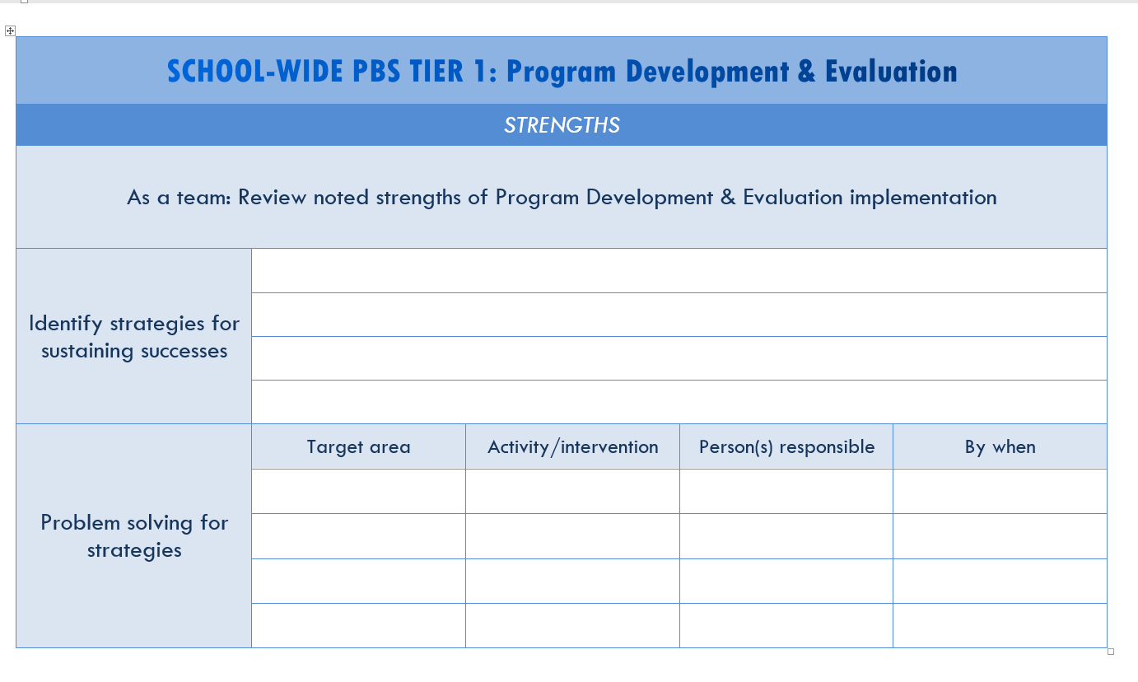
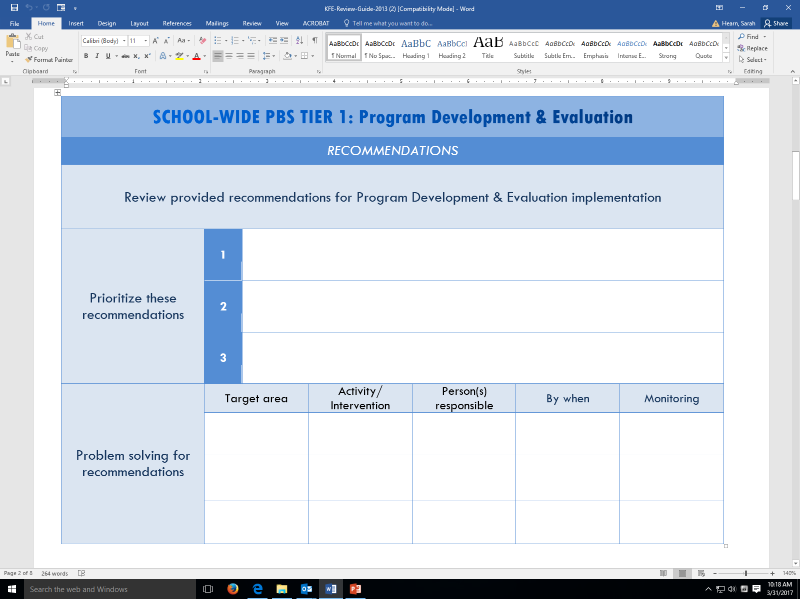
KFE Action Plan Guide

Slide 54
Reminder: DE-PBS Key Feature Status Tracker Tool
Purpose: To support teams to assess implementation in four main program categories & plan next steps
Broken into four evaluation sections
  SWPBS Tier 1, Prevention, Correcting Problem Behaviors, and Developing Self-Discipline
Tracker includes:
  Key program components for each section
    Teams can use these to assess their program and identify areas to modify or build upon
  Action plan to develop steps towards improving or modifying program components
Used for ongoing monitoring

Slide 55

The Tiered Fidelity Inventory (TFI)
Tier 2 Planning Tool
TEAM 2.1 Team Composition 2.2 Team Operating Procedures 2.3 Screening 2.4 Request for Assistance 2.5 Options for Tier II INTERVENTIONS 2.6 Tier II Critical Features 2.7 Practice Matched to Student Need 2.8 Access to Tier 1 Supports 2.9 Professional Development | EVALUATION 2.10 Level of Use 2.11 Student Performance Data 2.12 Fidelity Data 2.13 Annual Evaluation

Slide 56
PBS/MTSS related initiatives/Events
What’s the scoop?

Slide 57
Project DelAWARE
Federal Grant from Substance Abuse and Health Services Administration (SAMHSA)
$1.8 million per year for 5 years

Slide 58
Primary Goals
There are four primary goals of this grant:
  By 9/29/23, all staff in each partnering school will demonstrate knowledge of the school’s Multi-Tiered Systems of Support (MTSS) related to mental health;
  By 9/29/23, FTEs are added to in-school clinical staff and appropriate school staff are knowledgeable on addressing mental health of their students;
  By 9/29/19, mental health awareness promotion is widespread across the partnering LEA; and
  By 9/29/23, mental health services (e.g., screening, assessment and treatment) including at least two evidence-based interventions are delivered to at least 742 students.

Slide 59
Delaware’s Social-Emotional Learning Commitment
Goal: The Delaware SEL Collaborative will work to develop a Strategic Plan that includes advancing three initial target areas.
Guiding Principles
Communications
Competencies

Slide 60
Strategic Plan: Guiding Principles
Define what SEL means and what SEL encompasses.
Define common language.
Define how SEL supports Equity.
Define statewide collaboration and cohesion while maintaining local flexibility.

Slide 61
Strategic Plan: Communications
How to listen to communities and build on existing assets?
How to communicate the purpose and "why" of the work?
How to seek feedback on SEL Strategic Plan & progress?

Slide 62
Strategic Plan: Competencies
What should students be able to know and do at different stages of social and emotional development?
How do competencies include specific goals and benchmarks?

Slide 63
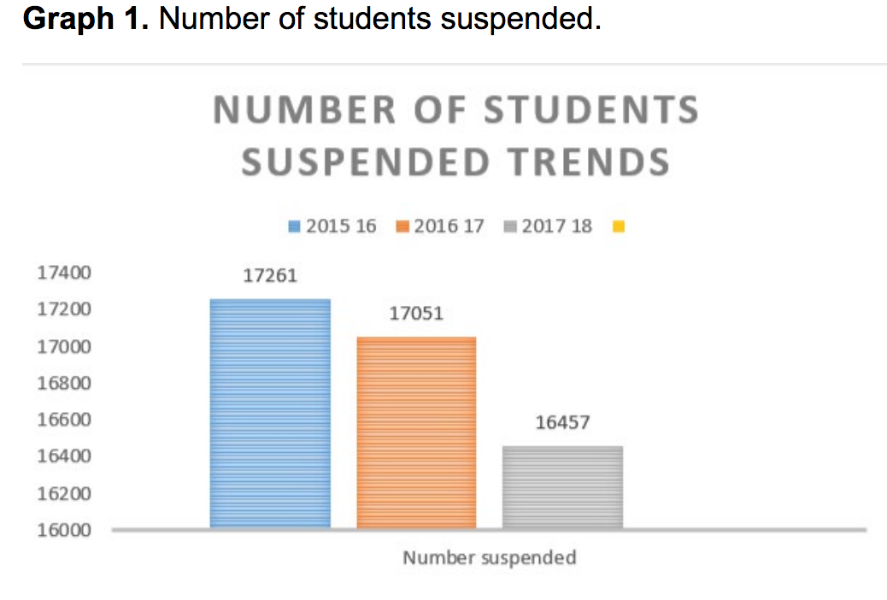
School Discipline Improvement Program (HB 85)
2018 DOE Report: https://www.doe.k12.de.us/cms/lib/DE01922744/Centricity/Domain/470/PDF%202018%20SDIP%20Report.pdf
Approved Bill:
  https://legis.delaware.gov/json/BillDetail/GenerateHtmlDocumentEngrossment?engrossmentId=13013&docTypeId=6
20% rate threshold applied to 2017-2018 school year data:
  20 schools exceeded the threshold in 1 subgroup
  Additional 39 schools exceeding the threshold +1 subgroups
Delaware Department of Education

Slide 64
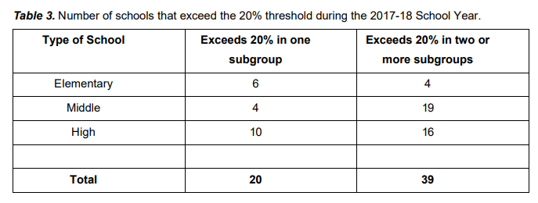
Delaware Department of Education

Slide 65
School Discipline Improvement Program (HB 85)
Identified schools are required to
  [1] evaluate their disciplinary practices and
  [2] develop a corrective action plan
Recommended strategies:
  Restorative Practices
  Trauma Informed Care
  Implicit Bias Awareness
  Cultural Competency
  Classroom Management
  Other appropriate programming
OUTCOMES
SYSTEMS
DATA
PRACTICES
https://www.pbis.org/school/equity-pbis

Slide 66
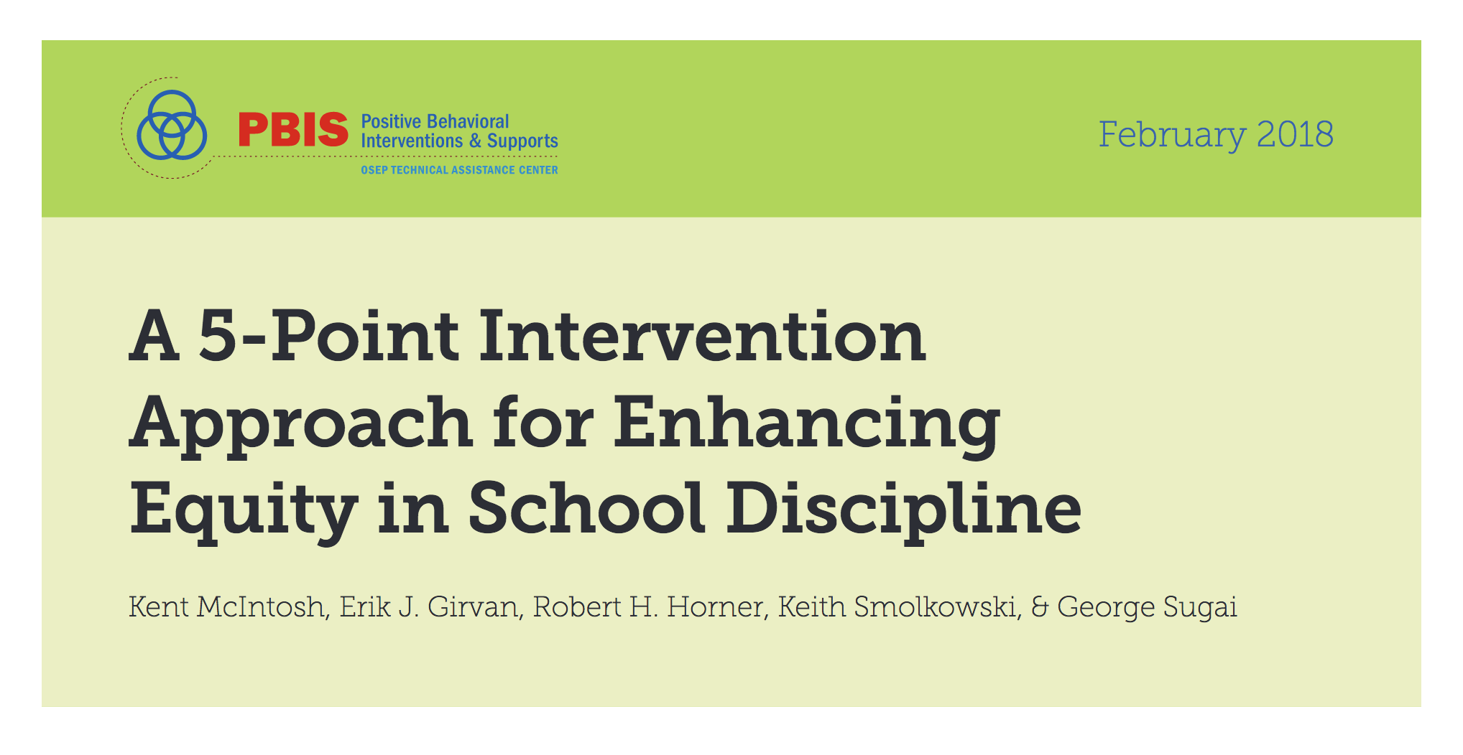
Components of Effective Intervention to Prevent and Reduce Discipline Disproportionality
Collect, Use, and Report Disaggregated Discipline Data
Implement a Behavior Framework that is Preventive, Multi-Tiered, and Culturally Responsive
Use Engaging Instruction to Reduce the Opportunity (Achievement) Gap
Develop Policies with Accountability for Disciplinary Equity
Teach Strategies for Neutralizing Implicit Bias in Discipline Decisions
https://www.pbis.org/Common/Cms/files/pbisresources/A%205-Point%20Intervention%20Approach%20for%20Enhancing%20Equity%20in%20School%20Discipline.pdf

Slide 67
DE Inclusion Conference 2019
March 13, 2019 – Dover Downs
Keynote: Technical Solutions for Equitable Access – Liz Berquist
  Coordinator of Professional Learning for the Baltimore County Public School District
  Research focus largely on UDL implementation and related professional development
Workshop strands (3.5 hours)
  Trauma Responsive Approaches Across the Tiers, Lynn DeSousa

Slide 68
Housekeeping

Slide 69
Substitute Reimbursement Reminder
The Department of Education will provide substitute reimbursement for REGISTERED participants.
Please request your Business Office to forward substitute PFAs electronically within 30 days of the training event to Linda Smith at linda.smith@doe.k12.de.us.
All PD confirmation emails will contain PFA information.

Slide 70

Contact Info Updates
Team Leader & Administrator contacts across tiers
School Climate Contacts

Slide 71


Twitter
@DelawarePBS
#Depbs
#PBIS (national)

Slide 72
Thank you &
Happy Holidays
Please complete evaluations
Mark your calendars….
February 26, 2019
April, 11, 2019

