Slide 1
Delaware PBS Cadre
Tuesday, February 16, 2019

Slide 2
Today’s Topics
Professional Development Updates
DE-PBS Phase Recognition
Data Reminders
District Planning & Coaching

Slide 3
Professional Development

Slide 4
Substitute Reimbursement Reminder
The Department of Education will provide substitute reimbursement for REGISTERED participants.
Please request your Business Office to forward substitute PFAs electronically within 30 days of the training event to Linda Smith at linda.smith@doe.k12.de.us.
All PD confirmation emails will contain PFA information.

Slide 5
Secondary Forum Debrief – 2/14/19
Welcomed 87 participants from 30 schools in 12 districts
Topics included:
Using School-wide Expectations
Student Voice in PBS Programming
Student & Staff Recognition
Resources shared around:
Trauma-Informed Interventions
Emotional Regulations
Executive Functioning
State & Nation PBS/PBIS Community

Slide 6
Tier 3: FBA/BIP Workshop
For new educators or those who want to learn more about process of using a function based approach to develop behavior intervention plans
Understand the ABC’s of behavior
Recognize the role of function based thinking across all tiers
Identify the steps of conduction an FBA
Understand the critical components of function based BIPs
Identify who needs an FBA/BIP and the role of problem solving team
Part 1: 2/28/19 and Part 2: 3/7/19
4:30 – 7:30

Slide 7
DE Inclusion Conference 2019
March 13, 2019 – Dover Downs
Keynote: Technical Solutions for Equitable Access – Liz Berquist
Coordinator of Professional Learning for the Baltimore County Public School District
Research focus largely on UDL implementation and related professional development
Workshop strands (3.5 hours)
Trauma Responsive Approaches Across the Tiers, Lynn DeSousa

Slide 8
Tier 2: Networking
This session is open to schools that previously participated in the DE-PBS Project Tier 2: Targeted Team Training.
Topics and activities include reviewing Tier 2 systems & problem-solving concepts, examining evaluation methods and networking with other implementing teams.
3/26/2019
Del-tech, Dover
Morning workshop/Afternoon planning

Slide 9
Tier 1: DE School Climate Survey Workshop
Overview of the DE School Climate Survey and it’s importance
Summary of statewide survey results
Time to review and interpret their own school climate reports for use in action planning
5/13/2019
Dover Downs, Dover
Morning workshop/Afternoon planning

Slide 10
Tier 1: School-wide PBS Team Series
SWPBS Team Training Series
Summer workshop, Summer team work, Fall workshop
Think of potential teams based on interest and need
Support Readiness
Plan with administration; Administrator team buy-in is key!
Discuss team structure
Provide overview of MTSS & Tier 1 efforts

Slide 11
Association for Positive Behavior Support Conference Sharing
THANK YOU to our coaches for sharing their APBS Conference take-aways with us today!
LaWanda – Capital School District
Laura, Jen and Melanie – Colonial School District
Sarah – Red Clay
http://apbs.org

Slide 12
The Intersection of MTSS and Special Education: Addressing Myths, Facts and Misconceptions
Take-a-ways from APBS 2019
Sarah Schmittinger Kashner- District Coach, RCCSD

Slide 13
Myth #1 – All students who don’t succeed at T2 MUST move to T3.
Schools should have multiple tier 2 interventions in place.
Identify best match
Consider whether a student would benefit from more than one intervention
T2 interventions can be adapted
Modification/adaptations to standard protocol. (increase or decrease, modify core components, add supplemental supports).
Timing of adaptions (at onset, due to nonresponsiveness)

Slide 14
Myth #2- Tier 3 data collection is difficult, if not, impossible, to accomplish….
How to you coordinate data across many plans?
How do you manage it?
Use easy data collection tools
NCII website—tools chart- examples of screening and progress monitoring.
Behavior progress monitoring tool (vetted by experts in the field)
Keep it simple--- on implementation and kid outcomes. Counting—rates of praise or opportunities to respond. Pick 15 minutes (when implementation is critical)
The question is—do we need to increase adult behavior supports or increase student supports?
SCOA app (Scott & Him 2011)—collecting data and imports to graph
Dbr.education.uconn.edu- you can swap in adult or kid behavior.

Slide 15
Myth #3 All staff should become experts in T3 assessments, intervention and implementation.
Everyone is an expert—in their area. (academics-gen ed teachers, kids-family/child, intervention experts). They need to be able to do their piece well.
Education experts- Make T1 strong enough to support ALL students—differentiated for most kids, most of the time.
Education experts- Enhance communication with home to support T2.
Education experts- implement T3 strategies.
Kid experts- support T1 (classroom instructions and intervention).
Kid Experts- - Enhance communication with home to support T2.
Kid experts- at the table—inform and support T3.
Intervention experts - Support T1 (classroom and instruction intervention).
Intervention experts Support education and kid experts in T2.
Intervention experts- at the table0 to collaborate and develop T3.

Slide 16
Myth #4- Most T3 interventions are too complex and difficult to implement. We just need an easy menu of interventions to choose from.
T3 must be based on data
Does intervention address function(s) of behavior?
Does intervention fit home, school, classroom and community context?
Picking 1 or more interventions from an array of options WITHOUT assessment data is unlikely to be successful.

Slide 17
Myth 4- continues…
Cover 4 areas:
1- Antecedents (what happened before problem behavior that makes it more or less likely and allow you to PREVENT problem behavior from occurring)
2- Behavior (define clearly the problem behavior and TEACH appropriate behavior to replace problem behavior)
3- Consequences (reinforce appropriate behavior you want to see and increase reinforcement for problem behavior)
4- LIFESTYLE context (understanding what you learn fits into the context of the student’s life, classroom, school, etc.. Using person centered planning techniques to understand the student’s life goals, strengths, need, support networks, etc..

Slide 18
Myth #5 Wraparound supports including the home and community are not the responsibility of the school.
Developing an effective comprehensive support system is a joint effort.
Effective problem solving through wrap around process necessitates the involvement of the students educators.
Students spend a significant amount of time in school.

Slide 19
Phase Recognition

Slide 20
Phases 1 & 2 – Focus on Tier 1: School-wide PBS
Phase I- Developing a SWPBS System
Products Submitted:
Behavior Matrix
Status Tracker (2 sections)
Reflection Question:
Status Tracker Action Plan
Phase II- Establishing an Advanced SWPBS System
Products Submitted:
DDRT – Data for 2017-18 & 2018-19 SYs
Status Tracker (4 sections)

Slide 21
Phases 3 & 4 – Tier 2: Targeted PBS
Phase III- Developing a Targeted Team (Problem Solving Conversations)
Program Components
Reflection Prompt - Reflect on list of current interventions used at Tier 2. Select one student successfully supported through a Tier 2 level intervention this year.
Phase IV- Establishing a Targeted Team (Systems Conversations)
Program Components
Reflection Prompt – Select Tier 2 behavioral support intervention and examine it from a systems perspective.

Slide 22
Phase 3&4 Thoughts
Do you feel there is clarity between problem-solving & systems conversations?
Reflecting on Tier 2 professional development, do these applications align?
Thinking about your teams’ Tier 2 data, systems and practices, have we captured them in the applications?
Do these applications provide prompts we want our teams to utilize as they wrap up their year and plan for next?

Slide 23
Phase 5 – Tier 3: Individual PBS Problem-solving & Systems - PILOT
Program Components:
Teams, Resources, Support Plans, Evaluation
Products for Submission:
Team members
Meeting schedule
Tier 3 overall data tracking
Tier 3 support plan review (TATE or TFI worksheet)
Reflection Prompt
Tier 3 case study
Tier 3 system review
Who’s interested?
Coach review & feedback
Pilot sites for Phase 5 – schools working to improve Tier 3 practices, data & systems

Slide 24
Phase Related Timeline
Application finalized and shared with DE-PBS contacts – March 2019
If a KFE is required or wanted, please contact Sarah Hearn (skhearn@udel.edu) no later than April 5, 2019
District Coaches or Project Staff can review applications beforehand if received by May 1, 2019
Applications due Friday, June 28, 2019
If confirmation is not received by July 15, 2019 please contact Sarah Hearn.
Notifications sent the week of September 16, 2019

Slide 25
18-19 SY Phase Recognition Reminders
Distribution typically in February
Application entails end of the year program reflection
Recognition reflects CURRENT year effort; schools maintaining or advancing levels should apply yearly
Process should be a team effort
Application review – May
http://wh1.oet.udel.edu/pbs/recognition/applications/

Slide 26
It’s a Conversation
Do you have district conversations encouraging folks to apply for recognition?
Do you have time available to provide TA in completing the application process?
How do you use the recognition application or process as a tool with your teams?

Slide 27
Data

Slide 28
Discipline Data Reporting Tool (DDRT)
Templates available on website
Tier 1: Forms & Tools / Program Development & Evaluation
Submission 2x per year
January 11th & June 21st

Slide 29
School Climate Survey 2018-2019
Student and Home Survey window updates:
Paper mailing by 2/25
Online open through Friday 3/1/19
Workshop: May 13, 2019
Encourage representative(s) from participating schools
Coaches needed
Survey app update

Slide 30
Key Feature Evaluation Plan 2018 – 2019 School
Winter/Spring 2019
KFE visits with SCSS partnership schools
Accepting requests for new & re-evaluations for Phase Recognition

Slide 31
Key Feature Evaluation Process
On-site Evaluation (approx. 4-5 hours)
Sources of Information:
Interviews with administrator, DE-PBS team leader, teachers/staff, students
Review of documents
Schoolwide observations
DE-PBS Key Feature Evaluation Structure
SW PBS Tier 1: Program Development & Evaluation | Prevention: Implementing SW & CR Systems
Correcting Problem Behavior | Developing Self Discipline

Slide 32
Key Feature Evaluation Review Guide
Tool to be used after receiving evaluation feedback
Review noted strengths for each evaluation section
Identify strategies for maintaining strengths and develop an action plan
Review noted recommendations for each section
Prioritize recommendations and develop an action plan
This tool supports continued implementation planning

Slide 33
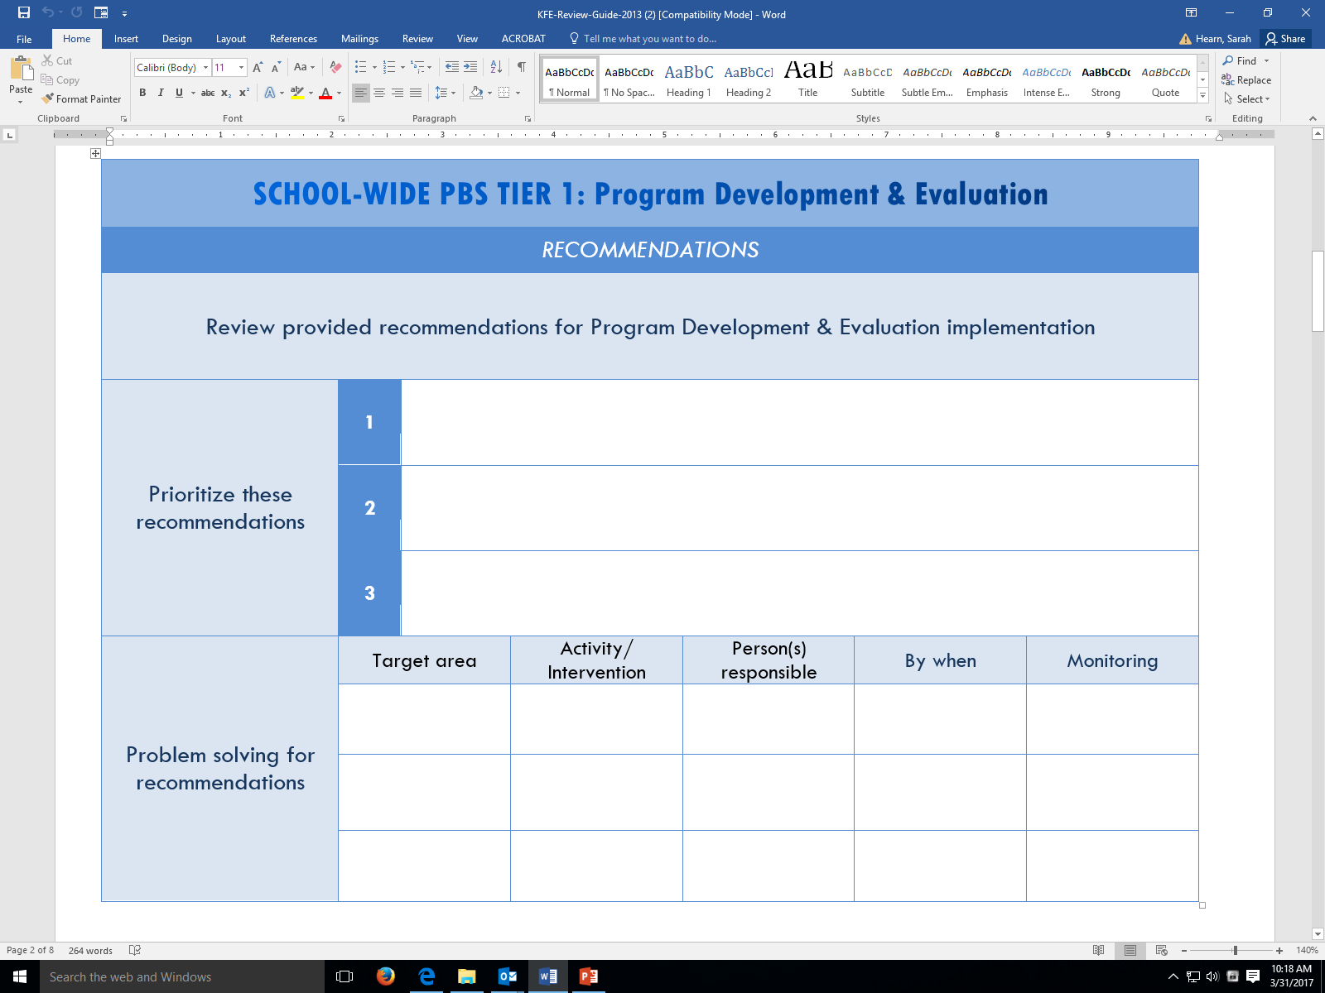
KFE Action Plan Guide

Slide 34
Reminder: DE-PBS Key Feature Status Tracker Tool
Purpose: To support teams to assess implementation in four main program categories & plan next steps
Broken into four evaluation sections
SWPBS Tier 1, Prevention, Correcting Problem Behaviors, and Developing Self-Discipline
Tracker includes:
Key program components for each section
Teams can use these to assess their program and identify areas to modify or build upon
Action plan to develop steps towards improving or modifying program components
Used for ongoing monitoring

Slide 35
DE Assessment of Strengths & Needs for PBS - DASNPBS
DE Assessment of Strengths and Needs
Four sections:
Tier 1: Program Development & Evaluation
Prevention: School-wide & Classroom Systems
Correcting Problem Behaviors
Developing Self-Discipline
10 question survey per implementation area
Staff perspective on program strength/weakness for use in planning

Slide 36
The Tiered Fidelity Inventory (TFI) Tier 2 Planning Tool
TEAM 2.1 Team Composition 2.2 Team Operating Procedures 2.3 Screening 2.4 Request for Assistance 2.5 Options for Tier II INTERVENTIONS 2.6 Tier II Critical Features 2.7 Practice Matched to Student Need 2.8 Access to Tier 1 Supports 2.9 Professional Development | EVALUATION 2.10 Level of Use 2.11 Student Performance Data 2.12 Fidelity Data 2.13 Annual Evaluation

Slide 37
District MTSS/PBS Planning

Slide 38
Components for Successful District Implementation
Leadership Team to actively coordinate implementation efforts
An organizational umbrella composed of adequate funding, broad visibility, and consistent political support
A foundation for sustained and broad-scale implementation established through a cadre of individuals who can provide coaching support for local implementation, a small group of individuals who can train teams on the practices and processes of school-wide PBIS, and a system for on-going evaluation
A small group of demonstration schools that documents the viability of the approach within the local fiscal, political and social climate of the state/district

Slide 39
MTSS for Behavior/SEL District Readiness Considerations
In the district, is there a need and desire to promote positive school climate, reduce suspensions and behavior referrals, and improve academics?
Is there desire and commitment from district leadership to support implementation of a MTSS for behavior/social-emotional learning (SEL) across all schools?
With support from district administration, is there commitment to developing & maintaining a 3-5 year district-wide action plan to build & sustain the MTSS/PBS/SEL framework across all schools?

Slide 40
MTSS for Behavior/SEL District Readiness Considerations
Which district representative(s) will serve as the MTSS District Coordinator(s) (i.e., lead contact, core decision makers) for all behavior/SEL initiatives within your district?
Is development of a district team a desired action item for the district and supported by administration?
Who are the MTSS for Behavior/SEL Coaches with allocated time & skills identified by the MTSS District Coordinator(s) to receive DE-PBS Project support and provide in-district professional development and technical assistance?

Slide 41
MTSS for Social Competence &
Academic Achievement
Outcome data (social behavior, academic achievement), Progress Monitoring, Fidelity
OUTCOMES
SYSTEMS
DATA
What we do to support adults to implement the practices
PRACTICES
What we do to
support students

Slide 42
Practices
Systems
Data
3-5 defined school-wide expectations, procedures for teaching and acknowledging expectations, procedures for discouraging problem behaviors, procedures for using data to target needed practices.
Team-based leadership, coaching support, data-based decision-making protocols, developed procedures and materials for implementing assessment and practices, active supervision protocols
Climate surveys, office disciplinary referrals, academic and behavioral screening information, attendance and tardy data, frequency of nurse/counselor/well-ness center contacts, fidelity checklists and observations
Outcomes
School climate, discipline, academic performance, attendance, nurse visits, counselor contacts

Slide 43
MTSS Implementation Snapshot

Slide 44
WWW.Delawarepbs.org
Next DE-PBS Cadre Meeting on April 11, 2019

