Slide 1
Appoquinimink
Brandywine
Caesar Rodney
Cape Henlopen
CAPITAL
CHRISTINA
COLONIAL
LAKE FOREST
MILFORD
RED CLAY
SMYRNA
WOODBRIDGE
Welcome!

Slide 2
today
The Why & Important Considerations
The How
  Existing Tools
  Sample Interventions

Slide 3
EXPECTATIONS FOR TODAY
 | WHYs & IMPORTANT CONSIDERATIONS | EXISTING TOOLS & SAMPLE INTERVENTIONS
BE ENGAGED | - Compare the ideas to your current understandings | Share what has/hasn’t worked and how
BE REFLECTIVE | - Compare the ideas presented to your current messaging | - Engage in problem-solving
BE STRATEGIC | - Consider who needs to hear these messages next and how | - Write notes down about next steps/questions

Slide 4
MTSS
MTSS is defined as "the practice of providing high-quality instruction and interventions matched to student need, monitoring progress frequently to make decisions about changes in instruction or goals, and applying child response data to important educational decisions" (Batsche et al., 2005).

Slide 5
PBIS
Social Competence & Academic Achievement
OUTCOMES
Supporting
Decision Making
Supporting
Staff Behavior
SYSTEMS
DATA
PRACTICES
Supporting Student Behavior

Slide 6
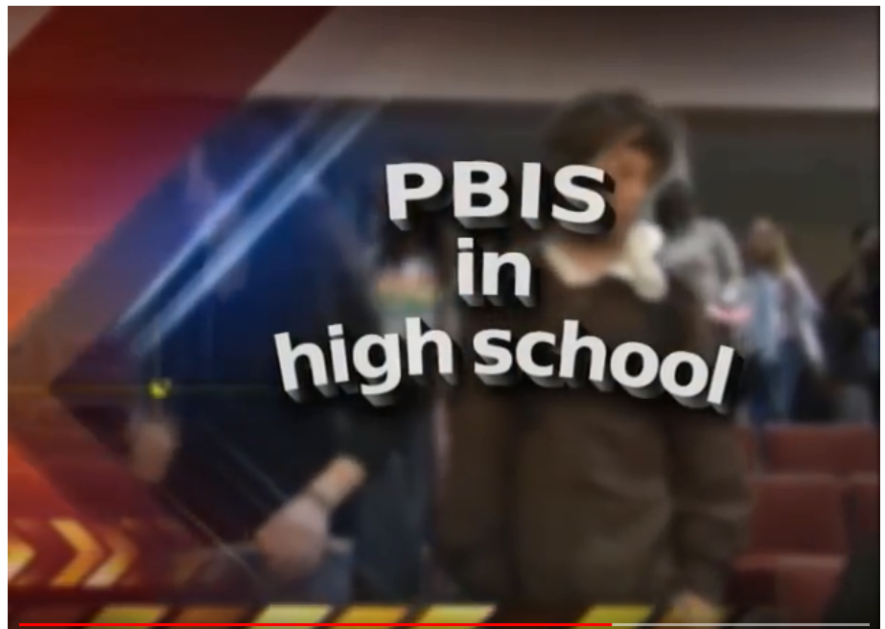

Slide 7
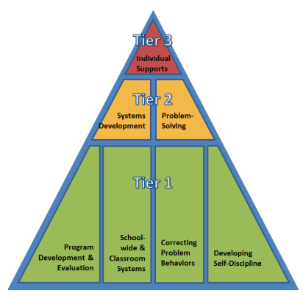
MTSS PBS framework in DElaware
See the 10
DE-PBS Key Features

Slide 8
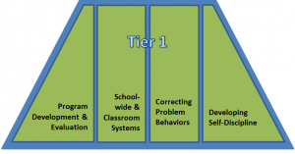
Tier 1 PBS in DElaware
See the DE-PBS Key Feature Status Tracker

Slide 9
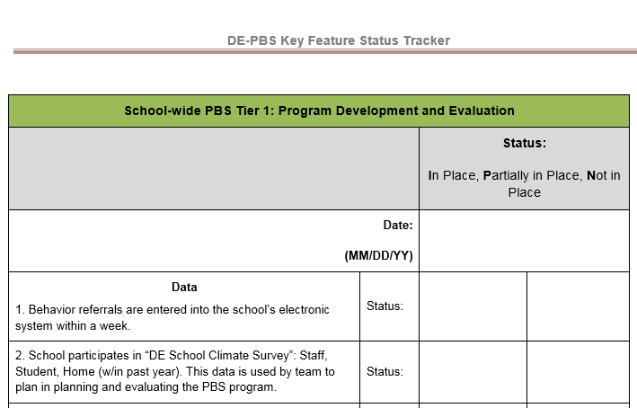
See the DE-PBS Key Feature Status Tracker

Slide 10
pBS
DE-PBS
Project
SCHOOLWIDE EXPECTATIONS

Slide 11
Welcome!
SchoolS & School-Wide Expectations

Slide 12
Tell us a bit about yourselves and your relationship with PBS and/or a MTSS for behavior
A
NEW
CRUSH
WE’RE RECONCILING
WE ARE ENGAGED
WE’RE MARRIED

Slide 13
Meredith Middle
Appoquinimink
“Be Kind. Be Courteous. Be Safe. Be Strong.”
Keep Crusaders Strong
Be Kind
Be Committed
Be Safe

Slide 14
Middletown High
Appoquinimink
C- Character: we prepare students to be global
A- Attitude: we cultivate pride by promoting positive behavior
V- Vision: We inspire students to accomplish postsecondary goals
S- Success: we believe students can achieve excellence

Slide 15
Redding Middle
Appoquinimink
Good Citizenship
Responsible
Empathy
Accountability
Trustworthy

Slide 16
Waters Middle School
Appoquinimink
Respect yourself, others, and the environment.

Slide 17
Brandywine High
Brandywine
Be Safe
Be Supportive
Be Successful

Slide 18
Concord High
Brandywine
The Concord Way
Respect
Responsibility
Resilience

Slide 19
PS DuPont Middle
Brandywine
Be Respectful, Be Responsible, Be Engaged

Slide 20
Mt. Pleasant High
Brandywine
Performance
Respect
Integrity
Determination
Excellence

Slide 21
Springer Middle
Brandywine
Best Effort
Academic Achievement
Responsible Actions
Kind Gestures

Slide 22
Talley Middle
Brandywine
Be Respectful
Be Responsible
Be Focused

Slide 23
Postlethwait Middle
Caesar Rodney
Rider 5:
Respect
Integrity
Discipline
Effort
Responsibility

Slide 24
Mariner Middle
Cape Henlopen
Mature
Motivated
Successful

Slide 25
Central Middle
Capital
R- Respectful
A- Accountable
P- Productive

Slide 26
Dover High
Capital
Be Respectful
Be Accountable
Be Productive

Slide 27
William Henry Middle
Capital
Be Proactive
Begin with the End in Mind
Put First Things First
Think Win-Win
Seek First to Understand, then to Be
Understood
Synergize
Sharpen the Saw

Slide 28
Bayard Middle
Christina
Be Respectful Achievers who are Responsible and Kind

Slide 29
Gauger-Cobbs Middle
Christina
Be Respectful, Responsible and Ready

Slide 30
Kirk Middle
Christina
Be Ready, Responsible and Respectful

Slide 31
Shue-Medill Middle
Christina
I pledge to respect school policies, rules, staff members, and students.
I pledge to show outstanding effort in school.
I pledge to attend school daily and be on time.
I pledge to be responsible in all school settings.
We are Tigers and we "ROAR to Achieve!"
R- Respect
O-Outstanding Effort
A-Attendance
R- Responsibility

Slide 32
McCullough Middle
Colonial
Be Responsible
Be Safe
Be Respectful

Slide 33
Lake Forest High
Lake Forest
Take PRIDE:
Positivity
Respect
Integrity
Determination
Excellence

Slide 34
Milford Central Academy
Milford
Be Positive.
Be Productive.
Be Respectful.
Be Responsible.

Slide 35
Milford Senior High
Milford
Be Responsible, Be Respectful, Be Safe

Slide 36
McKean High
Red Clay
We A.R.E. McKean
Achievement
Responsibility
Empathy

Slide 37
Skyline Middle
Red Clay
Person/Self
Action Toward Others
Work in Academics
School & Community

Slide 38
Stanton Middle
Red Clay
Safety
Ownership
Achievement
Respect
Soar with the Falcon Four

Slide 39
Smyrna High
Smyrna
"Making Connections and Building Dreams," while living our
District Core Values of
Respect, Responsibility, Integrity, Compassion, and Perseverance.

Slide 40
Woodbridge Middle
Woodbridge
Preparation
Respect
Integrity
Dedication
Excellence
PRIDE

Slide 41
Woodbridge High
Woodbridge
Respect Ourselves and Others
Act with Integrity
Dedicate Ourselves to Excellence
Make Responsible Choices.

Slide 42
Other folks and district coaches
Thank you for joining us!

Slide 43
THEMES
SAFETY and RELATIONSHIPS and ACHEIVEMENT

Slide 44
THEMES
SAFETY and RELATIONSHIPS and ACHEIVEMENT
Physical
Emotional
Psychological
Of Self
Of Others
Of Community

Slide 45
THEMES
SAFETY and RELATIONSHIPS and ACHEIVEMENT
Physical
Emotional
Psychological
With Self
With Others
With Community

Slide 46
THEMES
SAFETY and RELATIONSHIPS and ACHEIVEMENT
Physical
Emotional
Psychological
Through Self
For Others
Within Community

Slide 47
SCHOOLWIDE EXPECTATIONS MATTER

Slide 48
THEMES
SAFETY and RELATIONSHIPS and ACHEIVEMENT

Slide 49
The really good news
An MTSS for Behavior focuses on:
SAFETY & RELATIONSHIPS
STRUCTURE & SUPPORT
THE RESEARCH IS CONSISTENTLY ON OUR SIDE!

Slide 50
What is at risk?
SAFETY & RELATIONSHIPS
STRUCTURE & SUPPORT
School Climate
Academic Performance
Disengaged Students, Staff and Families
Negative Behaviors

Slide 51
How do we do this?
SAFETY & RELATIONSHIPS
STRUCTURE & SUPPORT

Slide 52
How do we do this?
SAFETY & RELATIONSHIPS
STRUCTURE & SUPPORT

Slide 53
How do we do this?
RETHINK TRADITIONAL SCHOOLING methods
Ideas from Senate Bill 85
Legislation was passed to reduce Delaware schools’ use of “exclusionary” discipline models, such as out-of-school suspensions and expulsions, in favor of other models, which emphasize discussion, mediation and community involvement as ways to address problematic behavior. The bill’s supporters contended that out-of-school suspensions do not address the fundamental reasons for misbehavior and cause students to fall behind in class.

Slide 54
How do we do this?
RETHINK TRADITIONAL SCHOOLING methods
Ideas from Senate Bill 85
Legislation was passed to reduce Delaware schools’ use of “exclusionary” discipline models, such as out-of-school suspensions and expulsions, in favor of other models, which emphasize discussion, mediation and community involvement as ways to address problematic behavior. The bill’s supporters contended that out-of-school suspensions do not address the fundamental reasons for misbehavior and cause students to fall behind in class.

Slide 55
SAFETY & RELATIONSHIPS
STRUCTURE & SUPPORT

Slide 56
How do we do this?
SAFETY & RELATIONSHIPS
STRUCTURE & SUPPORT

Slide 57
How do we do this?
Ideas from Senate Bill 85
Restorative Practices
Trauma Informed Care
Implicit Bias Awareness
Classroom Management
Cultural Competency
Insert the URL for the report here

Slide 58
POLL with names
SHARING YOUR EFFORTS
Restorative Practices
Trauma Informed Care
Implicit Bias Awareness
Classroom Management
Cultural Competency

Slide 59
POLL with names
SHARING YOUR EFFORTS
Restorative Practices
Trauma Informed Care
Implicit Bias Awareness
Classroom Management
Cultural Competency

Slide 60
CULTURAL COMPETENCY
…entails developing certain personal and interpersonal awareness and sensitivities, developing certain bodies of cultural knowledge, and mastering a set of skills that, taken together, underlie effective cross-cultural teaching.
(Diller and Moule, 2005)

Slide 61
CULTURAL COMPETENCY
Valuing diversity:
Being culturally self-aware:
Understanding the dynamics of cultural interactions:
Institutionalizing cultural knowledge and adapting to diversity:
(NEA, 2008)

Slide 62
CULTURAL COMPETENCY
Valuing diversity:
Being culturally self-aware:
Understanding the dynamics of cultural interactions:
Institutionalizing cultural knowledge and adapting to diversity:
#&*^$BD)@#$!
(NEA, 2008)

Slide 63
CULTURAL COMPETENCY
Valuing diversity:
Being culturally self-aware:
Understanding the dynamics of cultural interactions:
Institutionalizing cultural knowledge and adapting to diversity:
Student Voice!
(NEA, 2008)

Slide 64
Alignment with
DE-PBS Key Features
Recognize that ALL students benefit from positive behavioral supports. This includes students with and without behavior problems or disabilities, and requires sensitivity to individual and cultural differences.
Student Voice!
(DE-PBS, 2011)

Slide 65
Welcome!
Dover High School RAP CLUB

Slide 66
SHARING YOUR EFFORTS

Slide 67

SHARING YOUR EFFORTS

Slide 68
aCKNOWLEDGEMENT
The Why & Important Considerations
The How
  Existing Tools
  Activities in School

Slide 69
Prevention: Implementing schoolwide & Classroom Systems
DE-PBS Tier 1 Key Features | Acknowledgement System:
 | Recognition system is documented using matrix (frequent, unpredictable, long-term, relationship building, contacts home, staff)
 | Staff systematically recognize students for good behavior (e.g. verbal praise, DE-PBS ticket, privilege) and convey reason for recognition given
 | System in place to recognize staff for their efforts to support students’ positive behavior

Slide 70
Getting to the Heart of Recognition
Structure to teach and recognize prosocial behaviors
Social Support through teacher and student relationships
Engagement

Slide 71
What is acknowledgement/reinforcement?
Acknowledgement/reinforcement are those things and events that follow a behavior and increase the probability that the behavior will be repeated in the future.
One of the most powerful tools for changing behavior.
(Daniels, 2000)

Slide 72
Structure and relationships
Purpose of recognition/reinforcement
Create frequent positive interactions between staff and students
Recognizing desired behavior is a strategy to prevent problem behaviors
Use strategically to support teaching of a school-wide expectations
Strengthen replacement behaviors that compete with habitual undesirable behavior
Use strategically to reinforce social and emotional learning competencies and effort that underlie prosocial behavior

Slide 73
Rewards can negatively impact interest and performance:
Considerations:
  If reward is used as bribery
  If rewards are delivered ambiguously (not clearly tied to performance of expectation)
  If what we deliver is not a “reward” from the student’s perspective
  If partial rewards are delivered when full reward is expected
  If large rewards are delivered briefly and then withdrawn completely
Horner & Goodman, Using Rewards within
School-wide PBIS, www.pbis.org
For more information see:
Cameron, Banko & Pierce, 2001

Slide 74
motivation
Considerations:
What systems of positive reinforcement are in place in your school?
  Do they affect all students?
  Do they affect all staff?
  Who is resistant to participate?
The most recent School Climate surveys of students and staff indicate that at the secondary level what is most important to students is the genuineness and meaningfulness of the acknowledgement from teachers.

Slide 75
5: 1 Ratio, It’s not Just for Kids
  Business Teams:
  High Performance = 5.6 positives to 1 negative
  Medium Performance = 1.9 positives to 1 negative
  Low Performance = 1 positive to 2.7 negatives
  (Losada, 1999; Losada & Heaphy, 2004)
  Successful Marriages:
  5.1 positives to 1 negative (speech acts) and
  4.7 positives to 1 negative (observed emotions)
    (Gottoman, 1994)
Slide from Dewhirst and Davis, 2011

Slide 76
relationships
Intervention: General Praise and Non-contingent Attention
“When a teacher makes the effort to engage with every student individually, students learn and internalize that they are valued … reducing the likelihood that they will misbehave.” (Sprick et al., 2010)
How: Upon entry into classroom, greeting students at the door, outside of the classroom, end of class, brief interjections into instructional time
Yanek, 2018

Slide 77
Structure
Intervention: Behavior Specific Contingent Praise
Behavior Specific: state the specific behavior being praised using language from the school-wide and/or classroom teaching matrix
Contingent: means it is delivered immediately after the behavior we want to see again occurs
How:
  “You really showed how to be cooperative in science lab today by working together to create the model.”
  “Thanks to everyone for being so responsible and caring by bringing in canned goods for the PBS food drive.”

Slide 78
The Wilson Way | Classroom Rules | Classroom (Attention Signal: 1-2-3 Eyes on Me)
 |  | When you feel upset … | Morning Routine | How to Transition/ Line Up | Small Group Work
Be Responsible | Stay on task Clean up area Apologize for mistakes | Recognize what you’re feeling “I feel…” Stop and take a few deep breaths | Turn in homework Put instructional materials in desk | Put materials away Get materials ready for next activity | Do your fair share Manage time carefully
Be Respectful | Raise hand Listen to speaker Follow directions Use appropriate voice level | Ask for a break if you need a moment Express your feelings appropriately | Say “good morning” to teacher and classmates Talk in soft voices | Listen for direction to next activity Be silent | Listen to understand your peers Take turns speaking Use kind words with feedback Speak only to group members
Be Safe | Walk quietly | Talk to someone if you need help Talk to someone if it will make you feel better | Put personal belongings in designated areas Take your seat | Stand up Push in chair Wait for group to be called to line up | Clean up area when time is up
Pro-social/Social Emotional
Classroom Routines
School-wide Expectations
Classroom Rules

Slide 79
Effective Ways to Praise and Acknowledge:
Highlight future usefulness of behavior
Linking the behavior to underlying thoughts, emotions, and dispositions
Encouraging the student to take pride in her own behavior
Focusing on student’s specific achievement toward the achievement
Linking behavior to underlying thoughts, emotions, and dispositions to support prosocial behavior
Highlighting the future value of the behavior
Encouraging the student to self evaluate their prosocial behavior

Slide 80
Practicing Effective praise
Go to socrative.com
Select “Student Login”
In the “Room Name” box type: SXBVFR8
Answer the questions as they appear on your screen

Slide 81

Acknowledgement of implementation practices
Universal Support | Supplemental Support | Individualized Support
All educators are acknowledged for developing classroom climates | Selected or participating educators are acknowledged with greater frequency for implementing climate practices | Individual educators are acknowledged at high rates for implementing specific classroom PBIS practices

Slide 82
PBIS School-wide Acknowledgement Matrix (Student and Staff!)
TYPE | WHAT | WHEN | WHERE | WHO
Immediate/High Frequency In the moment, predictable (e.g., Gotchas, Paws, High Fives) | KIDS: ADULTS: | High frequency for a short time when first teaching desired behavior or re-teaching identified problem behavior from data |  | ALL KIDS, ALL STAFF
Redemption of high frequency (e.g., school store, drawings) | KIDS: ADULTS: | At least monthly |  | ALL KIDS. ALL STAFF
Intermittent/Unpredictable (e.g., surprise homework completion treat, random use of gotchas in hallway) | KIDS: ADULTS: | Maintaining a taught behavior (fading) |  | ALL KIDS, ALL STAFF
Long-term School-wide Celebrations (school-wide not individually based) FOR: Ex: ODR reduction, school-wide target met for certain setting/behavior area ACTIVITY: (e.g., ice cream social, dance, game day) | BOTH TOGETHER: | At least quarterly |  | ALL KIDS, ALL STAFF
Slide from Dewhirst and Davis, 2010

Slide 83
Brag
STUDENTS
ADULTS
Road-block
?!

Slide 84

BREAK
Let’s Take a Break …

Slide 85
Brag
STUDENTS
ADULTS
Road-block
?!

Slide 86
INTERVENTIONS
The Why & Important Considerations
The How
  Existing Tools
  Sample Interventions

Slide 87
EXPECTATIONS FOR TODAY
 | WHYs & IMPORTANT CONSIDERATIONS | EXISTING TOOLS & SAMPLE INTERVENTIONS
BE ENGAGED | - Compare the ideas to your current understandings | Share what has/hasn’t worked and how
BE REFLECTIVE | - Compare the ideas presented to your current messaging | - Engage in problem-solving
BE STRATEGIC | - Consider who needs to hear these messages next and how | - Write notes down about next steps/questions

Slide 88
Moving on…
DE-PBS Key Feature #9
In translating [DE-PBS beliefs and MTSS methods] into practice, schools value the importance of data-based decision making, as reflected in the on-going evaluation of program effectiveness and modification of program components, interventions and supports based on multiple sources of data.

Slide 89
Interventions…the other topic of high interest
Trauma Informed Interventions
Tier 2 Interventions

Slide 90
Interventions
Implementation Science tells us that we need to think integration and think strategically about any intervention.

Slide 91
PBS
Social Competence & Academic Achievement
OUTCOMES
Supporting
Decision Making
Supporting
Staff Behavior
SYSTEMS
DATA
PRACTICES
Supporting Student Behavior

Slide 92
OUTCOMES
SYSTEMS
DATA
Supporting
Staff Behavior
Supporting
Decision Making
PRACTICES
(Lewis, 2009)
Supporting Student Behavior

Slide 93
OUTCOMES
SYSTEMS
DATA
Supporting
Staff Behavior
Supporting
Decision Making
PRACTICES
(Lewis, 2009)
Supporting Student Behavior

Slide 94
OUTCOMES
SYSTEMS
DATA
Supporting
Staff Behavior
Supporting
Decision Making
PRACTICES
(Lewis, 2009)
Supporting Student Behavior

Slide 95
OUTCOMES
SYSTEMS
DATA
Supporting
Staff Behavior
Supporting
Decision Making
PRACTICES
(Lewis, 2009)
Supporting Student Behavior

Slide 96
THE HEXAGON TOOL
Blase, K., Kiser, L. and Van Dyke, M. (2013)

Slide 97
Table talk
Take 3 minutes to locate and look at the Hexagon Tool
Talk to others at your table about the tool:
  Why and how have you used it before?
  In your experience, what are the implications if one of these components was not addressed?
  How could you use this tool now or in the future?

Slide 98
Interventions
Trauma Informed Interventions
Tier 2

Slide 99
Interventions
Trauma Informed Interventions
  Tier 1
  Tier 2
  Tier 3

Slide 100


Book StudIES
  Tier 1: Trauma Informed Interventions

Slide 101
Book StudIES
  Tier 1: Trauma Informed Interventions
POLYTECH High School 2017-2018
Book-Study Coordinators: Karen Clifton and Ryan Fuller
Building Leadership Team
Staff-wide Kick-Off Event
Assigned Readings and Reflection Assignments via Schoology
On-Going Staff-wide PD and Discussions

Slide 102
Book StudIES
  Tier 1: Trauma Informed Intervention
P.S. DuPont Middle School 2018-2019
Book-Study Coordinators: Focus Advisory Team
Staff-wide Discussions and PD
Tier 1 Strategies:
  Change how we are approaching students

Slide 103
Book Study
Considerations?
Blase, K., Kiser, L. and Van Dyke, M. (2013)

Slide 104

Book StudIES

Slide 105

Cognitive-Behavioral Intervention for Trauma in Schools (CBITS)
Tier 2 & 3:
Trauma Informed Intervention

Slide 106
Interventions
Trauma Informed Interventions: CBITS (Cognitive Behavioral Intervention for Trauma in Schools)
See https://cbitsprogram.org/
Consider SSETS (Support for Students Exposed to Trauma)

Slide 107
CBITS
school-based, group and individual intervention.
designed to reduce symptoms of post-traumatic stress disorder (PTSD), depression, and behavioral problems
designed to improve functioning, grades and attendance, peer and parent support, and coping skills.
CBITS uses cognitive-behavioral techniques (e.g., psychoeducation, relaxation, social problem solving, cognitive restructuring, and exposure).
5-12th grade.

Slide 108
SAMPLE session
https://vimeo.com/channels/unitedwaydanecounty/28408793

Slide 109
CBITS
Considerations?

Slide 110
CBITS

Slide 111
Interventions
Other Tier 2 Interventions
  Emotional Regulation
  Executive Thinking
May also be
trauma-related

Slide 112
Anger or aggression management emotional-regulation

Slide 113
Interventions
Other Tier 2 Interventions
  Emotional Regulation
  Executive Thinking
May also be
trauma-related

Slide 114
Anger or aggression management
emotional-regulation
Students who engage in proactive aggression initiate aggressive behavior to obtain some goal or outcome. Conversely, students who engage in reactive aggression are responding to perceived threats around them.
(NASP, 2008, p.12)

Slide 115
Anger or aggression management
emotional-regulation

Slide 116
Anger or aggression management
emotional-regulation

Slide 117
Think first
School-based group intervention designed to be used in the high school setting for students in grades 9-12.
Facilitated by clinicians.
[Equips] students with the social processing and behavioral skills needed to reduce impulsive and reactive aggressive responses to anger.

Slide 118
Small Intervention Group
Considerations?

Slide 119

CBITS
Anger or aggression management
emotional-regulation

Slide 120
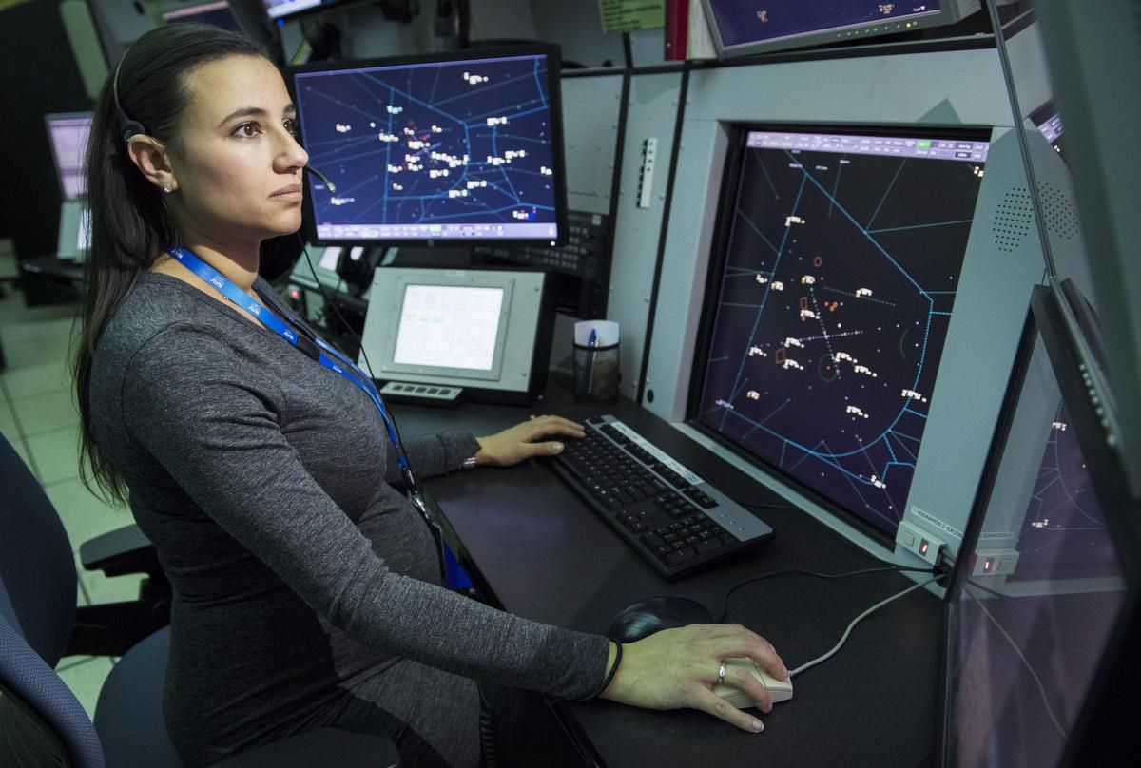
Executive Function and
Self-regulation Skills:
“These are the mental processes that enable us to plan, focus attention, remember instructions, and juggle multiple tasks successfully. “
“Just as an air traffic control system at a busy airport safely manages the arrivals and departures of many aircraft on multiple runways, the brain needs this skill set to filter distractions, prioritize tasks, set and achieve goals, and control impulses.”
From https://developingchild.harvard.edu/

Slide 121
Exposure to trauma and chronic stress can delay and impair these skills
BUT like all skills, they will improve with practice and more practice makes them less effortful
Executive Function and
Self-regulation Skills:

Slide 122
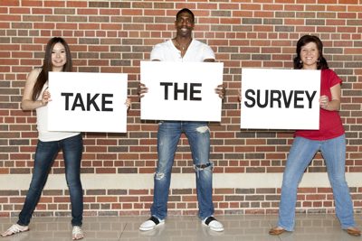
Executive Skills Questionnaire —
Peg Dawson & Richard Guare
Complete the questions on pages 1 and 2
Use the key to identify which sets of questions you had the highest total for and which had your lowest total
Review the Executive Skills definitions on page 3 for your areas of strength and weakness and see if you agree

Slide 123

EXISTING CURRICULUM
P.S. DuPont Middle School
2017-2019
Coordinators: Tier 2 Team Members and Classroom Teachers
7th Grade Academy
8th Grade Academy
Combined with SEL Skills and Experiential Activities

Slide 124
Exposure to trauma and chronic stress can delay and impair these skills
BUT like all skills, they will improve with practice and more practice makes them less effortful
Executive Function and
Self-regulation Skills:
Is this just a Tier 2 concern?

Slide 125
Implementation
Considerations?

Slide 126
https://developingchild.harvard.edu/

Slide 127

What are your experiences?

Slide 128
Help tools beyond today
Delawarepbs.org
Presentations
Secondary Forum

Slide 129
Delawarepbs.org

Slide 130
Help tools beyond today
Pbis.org
High School PBIS

Slide 131
Pbis.org

Slide 132
Pbis.org

Slide 133
EXPECTATIONS BEYOND TODAY
STAY ENGAGED
STAY REFLECTIVE
STAY STRATEGIC

Slide 134
Thank you!
Happy Valentines Day 😍
Your feedback matters – please complete the evaluation.
Make sure you signed in.
Notes from today will be sent out via a follow-up email. That email will include links to our Secondary Forum webpage on delawarepbs.org and secondary school resources on the national pbis.org website.
This room is open until 3pm. Project staff are on-hand to support you.

