Slide 1
TIER 2 presentation
Milton Elementary School
TIER 2 Presentation, Positive Behavior Support

Slide 2
POSITIVE BEHAVIOR AT MES
Kindness is the theme of the year!
  Greetings at the Door
  Kindness Journals
  Kick Off Kindness Assembly
  Kindness Champions
  Each grade level takes the theme and
  runs with it
  Second Step Curriculum
  Restorative Circles (TIER 1 and TIER 2)
  PBS Recharge in January to reteach expectations
  Child Study meetings for behavior

Slide 3
What TIER 2 looks like at MES
Daily Greeting by teachers and staff
Check in Check out Program
Social Thinking Groups
Emotional Regulation Group (Zones of Regulation)
TIER 2 BIPS
Mentoring
Mental Health Partnerships

Slide 4
CHECK IN/CHECK OUT (CICO)
Referred through Office Discipline Referrals, Child Study, Teacher Referral, Administrator Consult, Self Referred, Parent Referral
Step 1 - Identify staff member for each student - make connections
Step 2 - Pre and post staff member meeting
Step 3- Track data and monitor progress
Step 4- Fading out if successful; continue/move onto Tier 3 interventions if behaviors continue or escalate.
Duration- Approx. 6-8 weeks
Check In Check Out Tools POINT CARD
  Self monitoring
  Teacher ratings

Slide 5
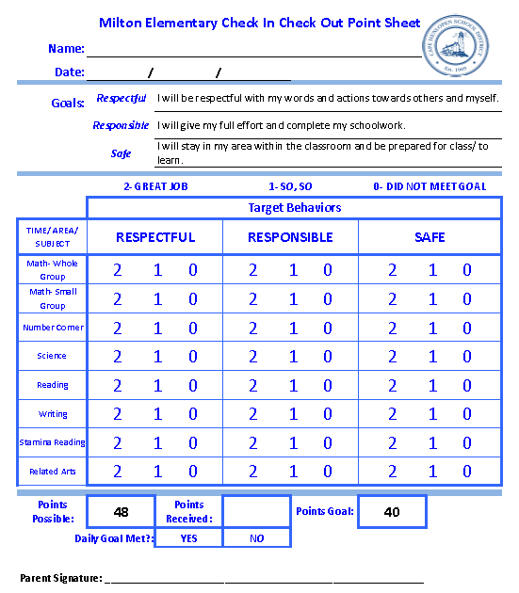

Slide 6
CHECK IN/CHECK OUT (CICO) Progress Monitoring Example
Week | Week 1 | Week 2 | Week 3 | Week 4 | Week 5 | Week 6 | Week 7 | Week 8
Weekly Averages | 70 | 86.5 | 92 | 96.66667 | 91.66667 | Holidays | 94 | 96
Goal of 80%

Slide 7
Road Blocks
Students forgetting to fill out the sheet
Students losing the sheet
Students not meeting with check in person
Parents not signing the point card
Parents discussing the point card with the student in a more negative manner than positively reframing the issues and working on solutions

Slide 8
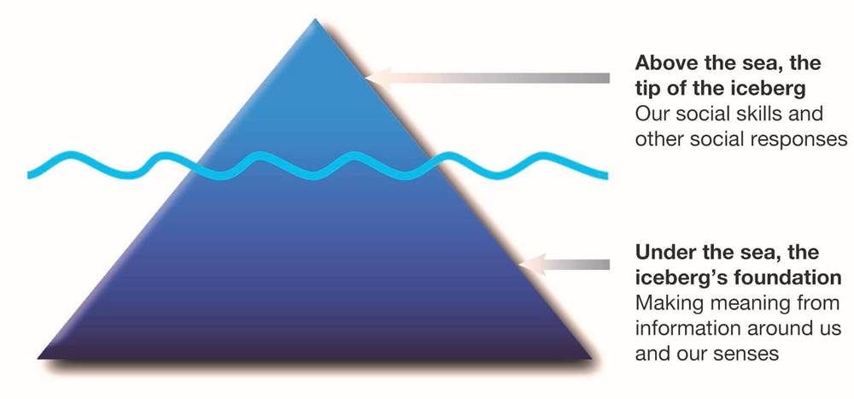
The Social Thinking® Social Competency Model – Iceberg Analogy

Slide 9
SOCIAL THINKING GROUP
Referrals – Child Study, teacher referral, office discipline referrals
Weekly meetings with the School Social Worker
Exit and Entry Criteria for the group
Social Thinking Group Data Collection
  Behavior Rating Scale Likert Like Scale
  1-5 (well below expectations, below expectations, at expectations, at expectations, above expectations, well above expectations)

Slide 10


SOCIAL THINKING GROUP TOOLS
Social Thinking Curriculum
  Superflex
  Michelle Garcia Winner
  Social Detectives

Slide 11
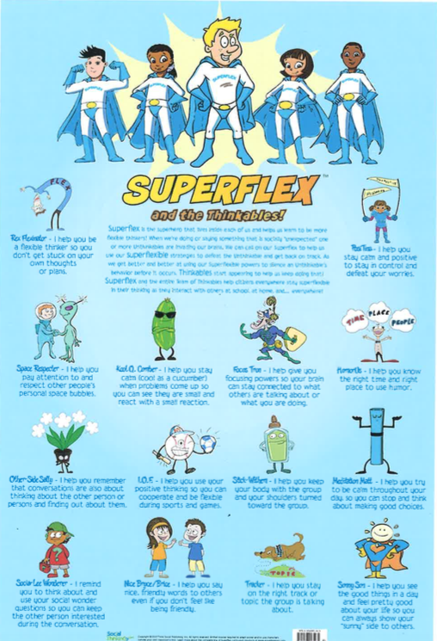
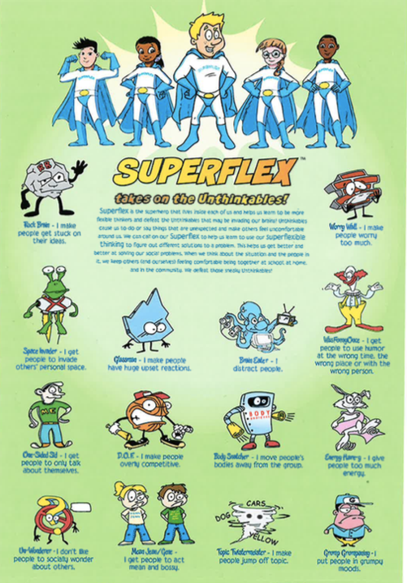
Super
Flex

Slide 12
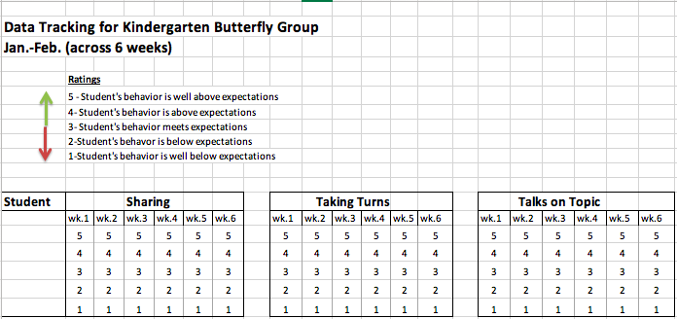
Data Tracking for Social Thinking Group

Slide 13
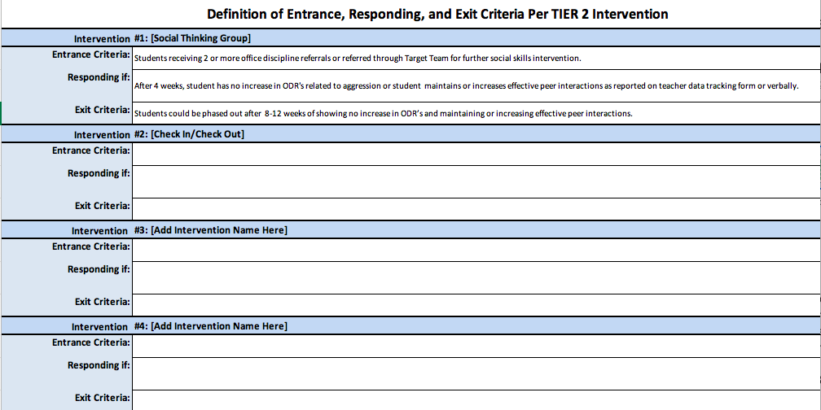
Criteria for tier 2 Intervention

Slide 14
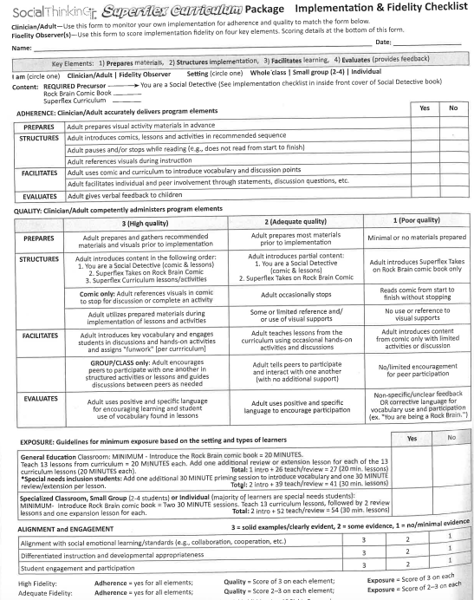
Superflex
Implementation and Fidelity
Checklist

Slide 15
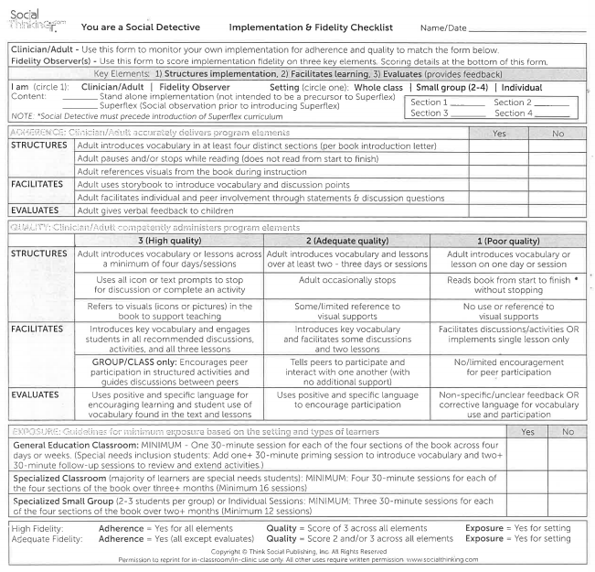
Social Detective
Implementation and Fidelity Checklist

Slide 16

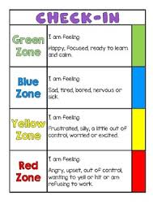
EMOTIONAL REGULATION GROUP
Teacher referrals, pre-k readiness information from preschool, parent referrals
Meeting: weekly
Run by: School Psychologist Intern
Participants: 4 Kindergarten students with behavioral regulation difficulties
Materials: Zones of Regulation materials and curriculum
Tracking Data:
  Intervention Tracking Tool

Slide 18
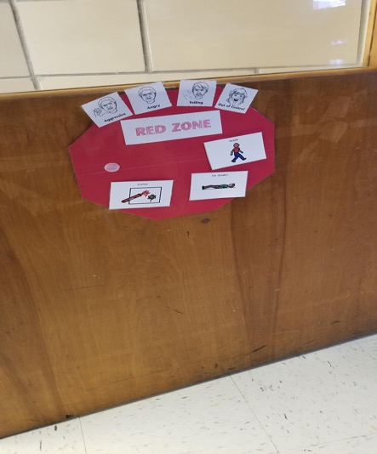
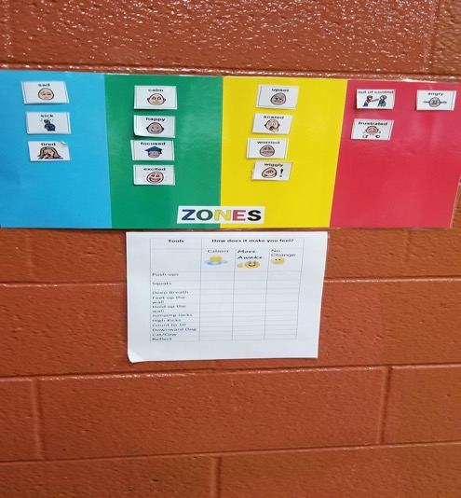
Examples in the classroom

Slide 19
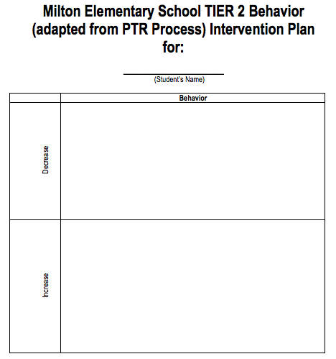
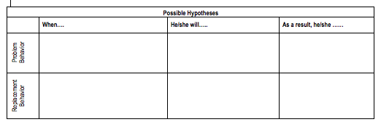
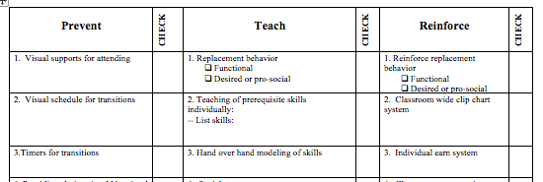
TIER 2 Behavior intervention plan
We developed a TIER 2 BIP for students that need extra support but are not TIER 3

Slide 20
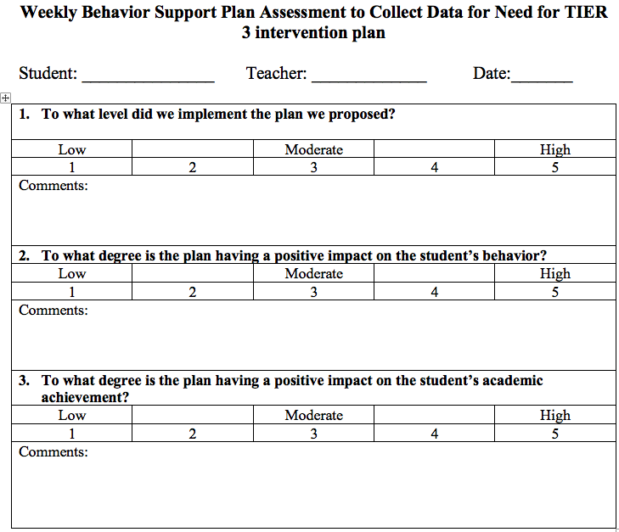
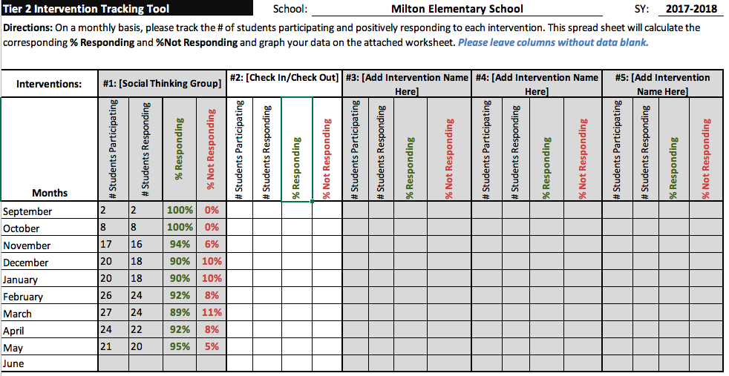
TIER 2 INTERVENTION TRACKING
SUPPORT PLAN ASSESSMENT
TIER 2 INTERVENTION TRACKING TOOL
EXIT CRITERIA

