Slide 1

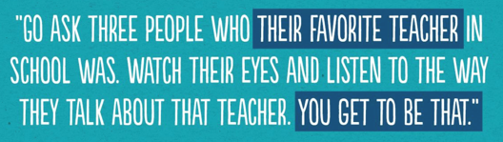
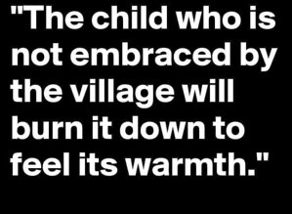


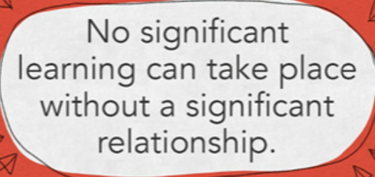
BE SOMEONE’S CHAMPION
Every Opportunity
https://vimeo.com/179818336
and Red Folder
https://vimeo.com/139254033

Slide 2
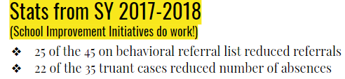
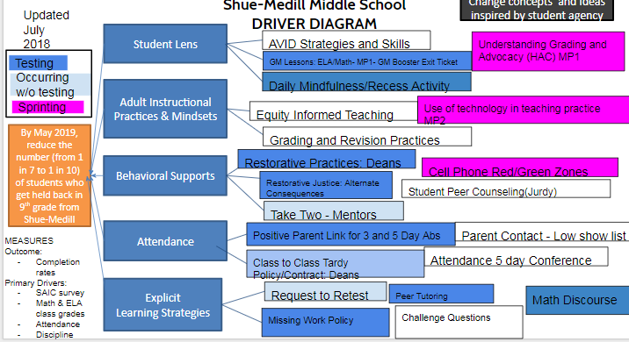
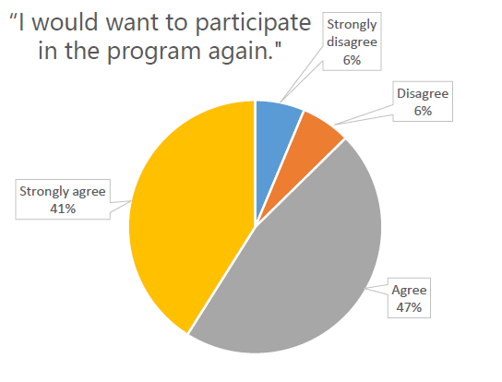
IMPROVEMENT SCIENCE ROOTS

Slide 3
TAKE TWO, OWN TWO: A Tier 2 approach to managing behavior in any school setting
Shue-Medill Middle School: Newark, DE

Slide 4
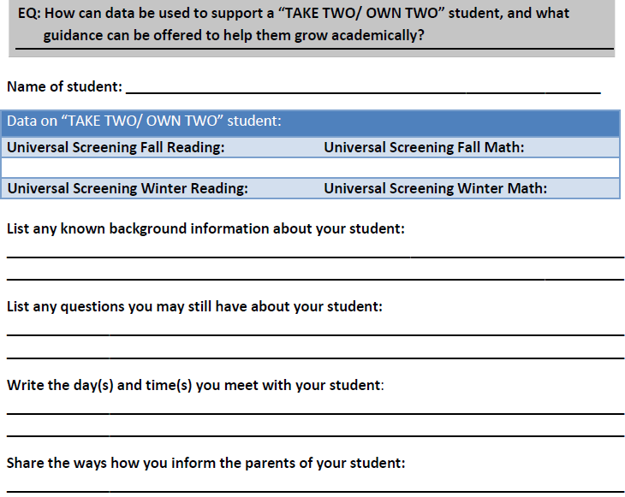
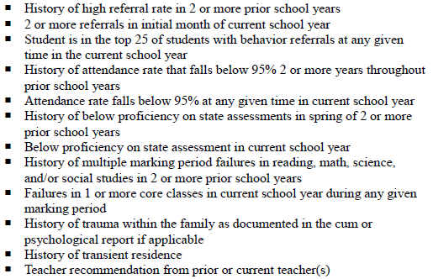
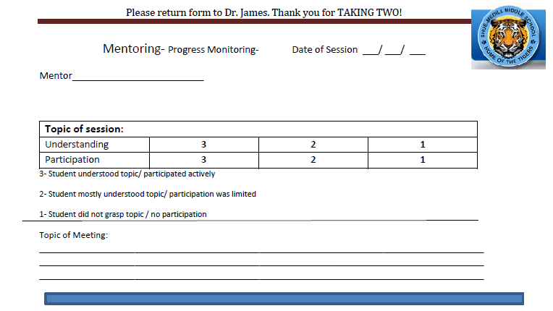
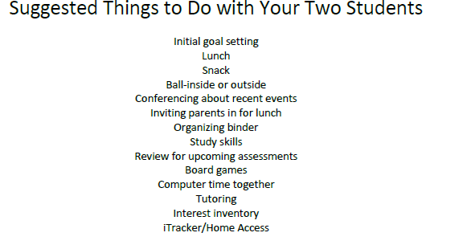
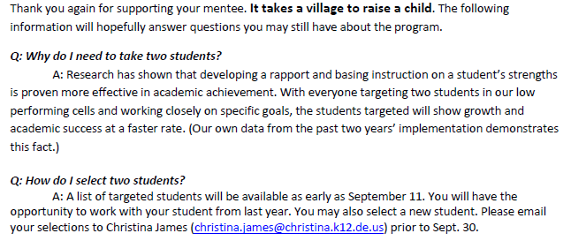
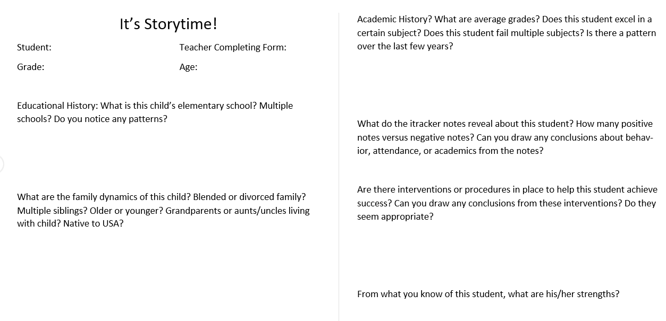
Process:
Create watchlist
Communicate to staff
Introduce tools
Provide time to meet/celebrate
Continual follow up

Slide 5
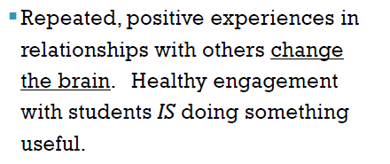
*Restorative circles (academic and non-academic) (show clip?)
*Anti-anxiety groups
*Social skills groups
*Basketball incentive
*Wise Boys mentoring
*Girl Scouts
*4H
*Lunch Bunch
*You Matter wall
*Positive postcards
Notes:
Show first three min of restorative circle

Slide 6
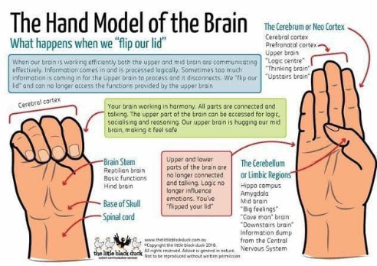
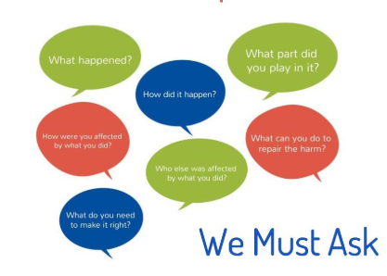
Tier 1 leading into Tier 2 (Trauma-Informed Teaching of SEL Competencies):
*Small Restorative Circles
*Upstairs vs Downstairs Brain
*Roster Comparison

