Slide 1
Delaware PBS Cadre
Thursday, April 11, 2019

Slide 2
Today’s Topics
Professional Development Updates
DDOE Indicator 4 Update
District Planning & Coaching
DE-PBS Phase Recognition
Data Reminders

Slide 3
Professional Development

Slide 4
Substitute Reimbursement Reminder
The Department of Education will provide substitute reimbursement for REGISTERED participants.
Please request your Business Office to forward substitute PFAs electronically within 30 days of the training event to Alicia Balcerak at Alicia.Balcerak@doe.k12.de.us..
All PD confirmation emails will contain PFA information.

Slide 5
Tier 2: Networking Workshop (3/26)
Open to schools that previously participated in the DE-PBS Project Tier 2: Targeted Team PD
AM presentations/PM team planning time
Topics and activities included:
reviewing Tier 2 systems & problem-solving concepts
networking with other implementing teams
completing action planning around the TFI

Slide 7
 | “I prefer this model because it highlights the specifics of each Tier.” “I prefer this model because it seems to have more information pictured with it. The others still seem like they need to be thought out. Also, we call the Tier 3 students our “high flyers”, so it makes sense for us to have them at the top,”
 | “This visual shows the importance of Tier 1” “I like this because you need a strong Tier 1, which is the foundation of Tier 2.” “This model has a strong emphasis on building out Tier 1”
 | “I like this triangle because of how it shows that all kids are accessing Tier 1 and then additional supports for those who need it. Those kids don’t get limped into their own group.” “I really love this model, as it is important to remind people that everyone accesses Tier 1 and that you layer those additional supports on for Tier 2 and 3.

Slide 8
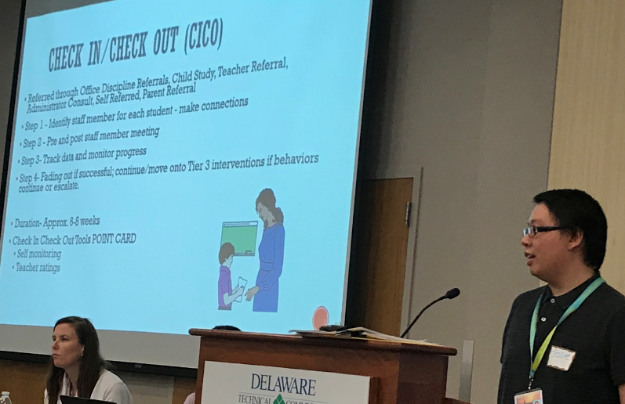
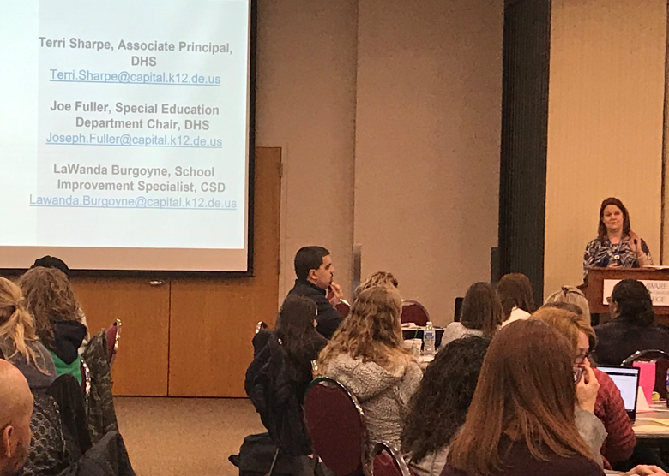
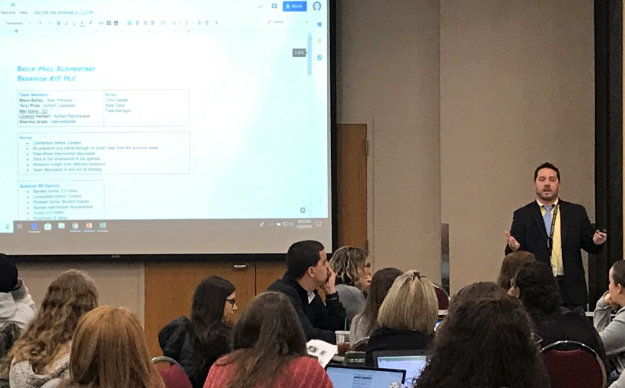
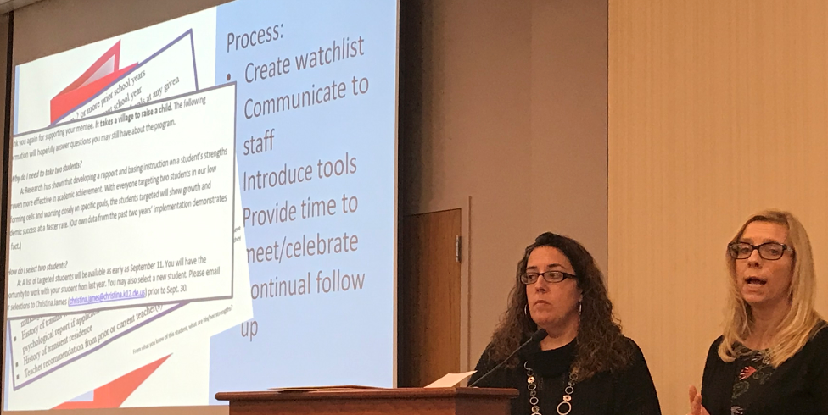
Tier 2: Networking Workshop (3/26)
Guest Presentations
Shue-Medill MS
Brick Mill ES
Milton ES
Capital SD/Dover HS

Slide 9
The Tiered Fidelity Inventory (TFI) Tier 2 Planning Tool
TEAM 2.1 Team Composition 2.2 Team Operating Procedures 2.3 Screening 2.4 Request for Assistance 2.5 Options for Tier II INTERVENTIONS 2.6 Tier II Critical Features 2.7 Practice Matched to Student Need 2.8 Access to Tier 1 Supports 2.9 Professional Development | EVALUATION 2.10 Level of Use 2.11 Student Performance Data 2.12 Fidelity Data 2.13 Annual Evaluation

Slide 10
TFI (Tiered Fidelity Inventory) Summary

Slide 11
Tier 3 Systems Webinar
Materials accessible on our website: http://wh1.oet.udel.edu/pbs/tier-3-forms-and-tools/
Recorded Webinar and Transcribed Power Point Available for Download
Focus on Tier 3 Myths, Teaming and Five Guidelines for Developing a Tier 3 System
Who Participated? Thoughts?

Slide 12
Tier 1: DE School Climate Survey Workshop - 5/13/2019
Overview of the DE School Climate Survey and it’s importance
Summary of statewide survey results
Time to review and interpret their own school climate reports for use in action planning
RSVP by 5/1/19
Dover Downs, Dover
Morning workshop/Afternoon planning

Slide 13
Tier 1: School-wide PBS Team Series
SWPBS Team Training Series
Summer workshop, Summer team work, Fall workshop
Think of potential teams based on interest and need
Support Readiness
Plan with administration; Administrator team buy-in is key!
Discuss team structure
Provide overview of MTSS & Tier 1 efforts

Slide 14
DOE Equity Update Discipline
April 11, 2019

Slide 15
DDOE Updates IDEA Equity Requirements related to Discipline
Significant Discrepancy (indicators 4a and 4b)
Significant Disproportionality (not an indicator)

Slide 16
Significant Discrepancy
Indicator 4a- RESULTS Indicator
Suspension and Expulsion of Students with Disabilities as compared to students without disabilities
Description
Percent of districts that have a significant discrepancy in the rate of suspensions and expulsions of greater than 10 days in a school year for children with IEPs
FFY 17 Reporting
Number of LEAs that were identified with significant discrepancy ÷ the number of LEAs that met the state established “n” size of 15
6 LEAs were identified with Significant Discrepancy (Exceeded the “n” size of 15 and exceeded rate ratio of 1.18)
6 LEAs met the State established ‘N” size of 15.

Slide 17
Significant Discrepancy
Indicator 4b – COMPLIANCE Indicator
Suspension and Expulsion of Students with Disabilities as compared to students without disabilities
Description
Percent of districts that have: (a) a significant discrepancy, by race or ethnicity, in the rate of suspensions and expulsions of greater than 10 days in a school year for children with IEPs; and (b) policies, procedures or practices that contribute to the significant discrepancy and do not comply with requirements relating to the development and implementation of IEPs, the use of positive behavioral interventions and supports, and procedural safeguards
FFY 17 Reporting
Number of LEAs that were identified with Significant Discrepancy and found to be noncompliant ÷ Number of LEAs who met the state established “n” size
6 LEAs were identified with Significant Discrepancy and conducted a self-assessment of polices, procedures and practices as well as a review of contributory individual student records (Exceeded “n” size of 10 and rate ratio of 1.18)
3 LEAs were found to be noncompliant
6 LEAs met the state established “n” size of 10.

Slide 18
Significant Discrepancy-Opportunity for change
FFY 16 OSEP changed methodology for reporting Indicator 4 on the Annual Performance Report
With Technical Assistance from National TA providers, DDOE engaged stakeholders to review discipline data, Delaware trends as well as National trends to in order to make recommendations for changes
Advocates, DOE personnel, school personnel, local TA and PD providers, etc.

Slide 19
Significant Discrepancy DE’s new definition
Static rate ratio of 2.0 for both 4a & 4b
Review 3 years of data
4a “n” size will remain 15
4b “n” size will remain 10
Exception: Any LEA that exceeds a rate ratio of 5.0 with an “n” size of 5 will also be identified

Slide 20
Indicator 4 Data using new Thresholds
Preliminary run of data shows 0 LEAs being identified.
Final run of data next week.

Slide 21
Significant Disproportionality
Determine whether significant disproportionality based on race/ethnicity is occurring with respect to:
20 U.S.C. 1418(d) and 34 CFR §300.646
The identification of children as children with disabilities, including identification as children with particular impairments;
The placement of children in particular educational settings;
The incidence, duration, and type of disciplinary actions, including suspensions and expulsions.

Slide 22
Other considerations
First letters of findings using new regulations--May of 2019 using 2017-2018 data
7 Racial/Ethnicity Categories in 14 of the following areas:
Identification (6 Classifications)
Intellectual Disability
Learning Disability
Emotional Disability
Autism
Other Health Impairment
Speech & Language Impairments
Placement (3 categories)
79%-40% of day
Less than 40%
Separate Schools and residential facilities
Discipline (5 categories)
OSS < 10 days
ISS < 10 days
OSS > 10 days
ISS > 10 days
Total removals
98 ways to be identified

Slide 23
Significant Disproportionality update
Identification based on DE’s new definition will be out on April 15, 2019
If identified LEA will go through the self-assessment process which includes determining root causes using a variety of data (triangulation of data) and developing a plan that needs to be a part of the consolidated grant application for next year
Mandatory 15% combined IDEA 611 & 619 funds reserved for Comprehensive Coordinator Early Intervening Services (CCEIS)
Students receiving CCEIS services need to be track and reported for two years
Will include business rules for data when LEA receives their Significant Disproportionality report card
*** See handouts for Delaware’s definitions for Significant
Disproportionality

Slide 24
Significant Disproportionality Data
LEA | Area | Subgroup | Race/Ethnicity
A | Discipline | Total Removals | African American
B | Discipline | Total Removals | African American
 | Discipline | OSS | African American
C | Identification | Mild Intellectual Disability | African American
D | Placement | Residential & Separate | African American
 | Discipline | ISS > 10 days | African American
 | Discipline | Total Removals | African American
E | Identification | Emotional Disability | African American

Slide 25
What does the data say? What can you do?
Understand that there is an equity issue
is your LEA suspending/expelling a particular race/ethnicity?
is your LEA raising awareness of the impact of trauma on students?
is your LEA reviewing SEL standards and their approach, is it evidence-based, is it effective, is it being implemented with fidelity?

Slide 26
What can you do?
What can you do to support your LEA with these requirements?
Continue to implement a positive behavior support framework to enhance academic and social behavior outcomes for students.
Continue to work with District Administration and schools to review and include discipline data as a norm.
Use data to make informed decisions about selection, implementation and progress monitoring of evidence-based behavioral practices that are integrated into an MTSS system.
Find ways to improve and support implementation fidelity.

Slide 27
Data
What data sources can use do to support your LEA with these requirements and decision making?
School Climate data
Office referrals, types of incidents, grade levels, same teachers?
Suspension/expulsion data
Academic data
Low Income data
ESL data

Slide 28
Questions?

Slide 29
District MTSS/PBS Planning

Slide 30
Components for Successful District Implementation
Leadership Team to actively coordinate implementation efforts
An organizational umbrella composed of adequate funding, broad visibility, and consistent political support
A foundation for sustained and broad-scale implementation established through a cadre of individuals who can provide coaching support for local implementation, a small group of individuals who can train teams on the practices and processes of school-wide PBIS, and a system for on-going evaluation
A small group of demonstration schools that documents the viability of the approach within the local fiscal, political and social climate of the state/district

Slide 31
Coaching
“Coaching” helps people work well together and use practices effectively. It reflects a relationship where everyone has an equal say in what takes place, and everyone plays a role in supporting the decisions. The goal of coaching in schools is to enhance PBIS fidelity and student outcomes.
Educators use coaching to:
Identify and reduce/eliminate barriers to effective practices
Achieve desired goals at the student, classroom, school, district, and/or community level
Help those involved to increase their expertise and skills
Adapted from FLPBIS Project

Slide 32
Coaching Reflection
Where are we NOW? |  | What are our GOALS?
Review Functions of a District-based PBIS Coach
Review Functions of a District PBIS Coordinator
Engage in Coaching Reflection Sheet
How does your role align?
Where do you align with district leadership roles?
What goals do you have for our coaching role? What’s needed to meet those goals?

Slide 33
Phase Recognition

Slide 34
Phases 1 & 2 – Focus on Tier 1: School-wide PBS
Phase I- Developing a SWPBS System
Products Submitted:
Behavior Matrix
Status Tracker (2 sections)
Reflection Question:
Status Tracker Action Plan
Phase II- Establishing an Advanced SWPBS System
Products Submitted:
DDRT – Data for 2017-18 & 2018-19 SYs
Status Tracker (4 sections)

Slide 35
Phases 3 & 4 – Tier 2: Targeted PBS
Phase III- Developing a Targeted Team (Problem Solving Conversations)
Section I: Program Components
Section II: Products for Submission
Section III: Reflection Promptv-vReflect on list of current interventions used at Tier 2. Select one student successfully supported through a Tier 2 level intervention this year.
Phase IV- Establishing a Targeted Team (Systems Conversations)
Section I: Products for Submission
Section II: Reflection Prompt - Based on review of overall Tier 2 data from the 2018-2019 school year, what are your proposed next steps for the 2019-2020 school year?

Slide 36
Phase 4- Establishing a Targeted Team (Systems Conversations)
Products for Submission
1) Completed Tier 2 section of the Tiered Fidelity Inventory (TFI)
2) Completed Tier 2 Intervention Tracking Tool (Tabs 1&2) reflective of at least two Tier 2 interventions used during the 2018-2019 SY.
3) Completed “Tier 2 Intervention Table” for one Tier 2 Intervention represented in the Tier 2 Intervention Tracking Tool.

Slide 37
Phase Related Timeline
Application finalized and shared with DE-PBS contacts – April 2019
If a KFE is required or wanted, please contact Sarah Hearn (skhearn@udel.edu) in April 2019.
As District Coaches be a resource to review applications before submission
Applications due Friday, June 28, 2019
If confirmation is not received by July 15, 2019 please contact Sarah Hearn.
Notifications sent the week of September 16, 2019

Slide 38
Data

Slide 39
Collecting Recognition Data
Benefits
show where recognition consistency is a strength (or not)
recognize teachers
help you look at equity
identify trends/patterns in recognition
Challenges
Tracking can take time and more energy than expected (you have to plan ahead)

Slide 40
PBIS Rewards More information for your decision-making
School Size (# of students) | Estimated cost for Base Features = $500 Yr | Estimated cost With Teacher Workplace Addon | Estimated cost With Advanced Referral System $350 yr | Student Fee $1.75 each | COST ESTIMATE
50 | $500 Yr | Included in Base | 175 | 0 - Small School Discount | $675
250 | $500 Yr | Included in Base | 350 | $437.50 | $1287.50
500 | $500 Yr | Included in Base | 350 | $775 | $1625
1000 | $500 Yr | Included in Base | 350 | $1750 | $2600
2500 | $500 Yr | Included in Base | 350 | $4375 | $5225

Slide 41
PBIS Rewards Considerations for your decision-making
10% District discount is available
Timing of photos/badges
Current functioning of SW systems
Other considerations?

Slide 42
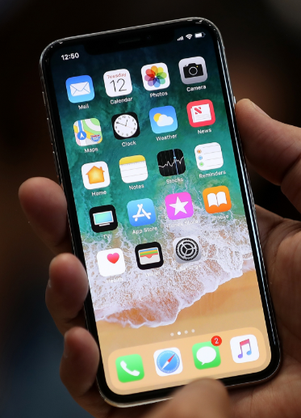
https://www.pbisrewards.com/about/demo-video-v5/
Demonstration & Video Resources:

Slide 43
Discipline Data Reporting Tool (DDRT)
Templates available on website
Tier 1: Forms & Tools / Program Development & Evaluation
Submission 2x per year
January 11th & June 21st

Slide 44
DE Assessment of Strengths & Needs for PBS - DASNPBS
DE Assessment of Strengths and Needs
Four sections:
Tier 1: Program Development & Evaluation
Prevention: School-wide & Classroom Systems
Correcting Problem Behaviors
Developing Self-Discipline
10 question survey per implementation area
Staff perspective on program strength/weakness for use in planning

Slide 45
The Tiered Fidelity Inventory (TFI) Tier 3 Planning Tool
TEAMS 3.1 Team Composition 3.2 Team Operating Procedures 3.3 Screening 3.4 Student Support Team RESOURCES 3.5 Staffing 3.6 Student/Family/Community Involvement 3.7 Professional Development | SUPPPORT PLANS 3.8 Quality of Life Indicators 3.9 Academic, Social and Physical Indicators 3.10 Hypothesis Statement 3.11 Comprehensive Support 3.12 Formal and Natural Supports 3.13 Access to Tier 1 and Tier 2 Supports EVALUATION 3.14 Data System 3.15 Data Based Decision Making 3.16 Level of Use 3.17 Annual Evaluation

Slide 46
MTSS for Social Competence &
Academic Achievement
Outcome data (social behavior, academic achievement), Progress Monitoring, Fidelity
OUTCOMES
SYSTEMS
DATA
What we do to support adults to implement the practices
PRACTICES
What we do to
support students

Slide 47
Practices
Systems
Data
3-5 defined school-wide expectations, procedures for teaching and acknowledging expectations, procedures for discouraging problem behaviors, procedures for using data to target needed practices.
Team-based leadership, coaching support, data-based decision-making protocols, developed procedures and materials for implementing assessment and practices, active supervision protocols
Climate surveys, office disciplinary referrals, academic and behavioral screening information, attendance and tardy data, frequency of nurse/counselor/well-ness center contacts, fidelity checklists and observations
Outcomes
School climate, discipline, academic performance, attendance, nurse visits, counselor contacts

Slide 48
MTSS Implementation Snapshot

Slide 50
Thank you!
WWW.Delawarepbs.org

