Slide 1
Establishing a Results-Driven Tier 3 Support System
Rose Iovannone, Ph.D., BCBA-D, iovannone@usf.edu
University of South Florida
Live Webinar: 3/29/2019

Slide 2
Objectives
Participants will:
Discuss the Tier 3 Myths and how they impact their setting’s implementation of Tier 3 processes
Discuss the five guidelines for developing a Tier 3 for Behavior Results-Driven System
Notes:
So we're going to talk today about doing Tier three as a system. Tier 3 behavioral supports as a system, as opposed to just one person at a time.
So here are our objectives, we're going to talk about some myths at Tier three and some guidelines for how we develop Tier 3 systems. We'll go ahead and talk about the challenges of Tier three as a system as well.

Slide 3
Tier 3 Support Systems
Increase in graduation,
Decrease in dropouts,
Reduced restraint and seclusion,
Reduced suspension and expulsion
Reduced disproportionality
Effective data collection and behavioral assessment
Evidence-based practices and implementation fidelity
1. Decreases in problem behavior
2. Increases in social skills
3. Academic engaged time
FBA
BIP
Proximal Outcomes
Effective
Distal Outcomes
Ineffective
Poor post secondary outcomes:
unemployment, incarceration, mental health issues, poor social relationships
Professional development, data based problem solving, systems restructuring. etc.
Notes:
This slide talks mainly about what we want to do when we have a Tier three support system. This focused on FBA and BIP. However at Tier three, I want to make sure that we understand Tier three goes beyond the FBA/BIP. We do consider it the core practice, and the core behavioral support in a Tier three system, but you may have some students who need individualized supports for which an FBA and a BIP would not help.
So, for example, someone who has some significant mental health needs or significant needs in terms of just basic life events such as economics (e.g. a student doesn’t have a place to stay at night or they don't have enough food in their home). You don't need an FBA or BIP to figure out what supports might need to be wrapped around that student for his or her family. Supports are individualized for that one student to be able to help him or her be effective.
So just wanted to clear that up that we're not saying all Tier three is an FBA/BIP, because that's where sometimes we get in trouble. A lot of districts, say, “well, we're already doing FBA/BIP, therefore, we don't have a need to do anything else at Tier three.”
But whatever we do, whether we're doing an FBA/BIP, which is probably the most frequent support you're going to be providing or some other support, we are really looking at are these near outcomes or what we call proximal outcomes, which are what's going to happen immediately after we do our support.
We should see a decrease in that behavior that brought the student to our attention. We should see an increase in skills such as social skills, academic skills, replacement behaviors, and academic engaged time.
This is why we want to think about Tier 3 as a system instead of just one kid at a time and looking at it not only school wide, but also district wide and possibly statewide. We should see this in the green circle at the top of the graphic.
These are long term outcomes. So by providing better and more effective Tier 3 support, we should have an increase in graduation rate, you should see reduced use of restraint and seclusion and reduced suspensions, especially if you're doing multi tiered systems of support. Your high flyers are probably the ones getting the most incidence of suspension and expulsion and those kids may actually need more individualized supports. We may also see reduced disproportionality.
So by doing really good individual supports on top of everything else you're doing and having a system in place to be able to put supports in place, you should be able to get long term outcome effectiveness.
If we don't do this, we're going to be where we sometimes see we are right now. These kids who don't receive support and are unsuccessful in school, when they leave, their outcomes are dismal. They have higher unemployment rates, higher incarceration rates, and they're at risk for more mental health needs and issues as well as poor social relationships.

Slide 4
Tier 3-System
Tier 3, overall, not systemic in most schools
Primarily consists of specific strategies-not a system
Often, Tier 3 supports seen as a special education specific activity
Often viewed as a compliance exercise
Notes:
We know, first of all, most districts and schools are not looking at Tier 3 as a system, they're looking at it as a case by case. In some cases, a Tier three system is considered as special education or this is something special education does.
And sometimes people look Tier 3 as only the FBA and BIP. They only are looking at it as a compliance issue, “did we do the FBA and BIP, and can we find it because we have a site visit next week?”

Slide 5
Tier 3 Myths
Compliance is all we need to be concerned about
Focuses on completing forms correctly
Site visits (monitoring)
Step to move students to more restricted placement
We cannot do Tier 3 until we have Tiers 1 and 2 implemented with fidelity
All three tiers can and should be worked on concurrently
All districts already have students needing Tier 3 behavior supports
For some in special education, this is the only Tier mandated
Special education is a Tier 3 intervention
Special education is not an intervention, practice, or strategy
Implies that the only way a student can get an individualized behavior support is to identify for IEP eligibility
Notes:
Myth #1: So the first myth is all we really need to be concerned about is compliance, because no one's making us do this. All we need is to make sure the forms are filled out and they're filled out correctly. People see this FBA BIP compliance as a step to move kids to more restrictive placement. So it's not really a system, but basically this is a little practice we do to get kids out of our classroom or to make sure we're compliant.
Myth #2: We hear this a whole lot and it's somewhat disturbing because actually people in our world of PBS support this myth. And so there is a discussion around this, but we do think we're moving towards understanding that we do not have to have Tiers one and two in place and implemented with fidelity before we even start looking at Tier Three systems. We do feel that all three tiered systems can be worked on concurrently, and by working on Tier 3 often you end up strengthening your Tier 1 and 2 because you're seeing that there are some gaps in how kids are being identified as needing Tier three supports.
And at times, you're saying, well, if we had a stronger Tier 2 system in place or we were doing Tier 1 with more fidelity, maybe some of those kids would not need individualized supports. But the reality is, you already have kids that need individualized supports regardless of your Tier one supports.
But it's not quite a mandate, to have all three Tiers in place. You have kids, especially kids who are in special education, whom you have to provide supports based on their IEP. And you have a smaller number of kids, who are taking up most of the school personnel time in terms of trying to figure out what we're going to do about the behavior. So it doesn't make sense to wait until you have a perfect Tier 1 and 2 system in place before you start Tier three as a system.
And in addition, if you wait to you have Tiers 1 and 2 in place, you may never address Tier 3 because we have witnessed that some schools/districts will do Tier 1 and get a new principal, a new Director, or a new superintendent and all of a sudden they no longer want to do this practice or approach. They want to do a different approach. So if you wait until your entire district or school is perfect, it's never going to happen. So you might as well just go ahead and start thinking about Tier three
Myth #3: Special education is a Tier three intervention. Special education is not an intervention or a strategy; special education is a placement or eligibility condition. It is not in and of itself an intervention. Some people could say they are going to specially educate a kid but that doesn't tell you what you're doing. So just by giving an eligibility placement within special education, still means you have kids accessing Tiers one, two, and three. Some kids go into special education and may not even have behavioral problems, so they should have access to only tier three academic support. So it's really more of thinking of this all as a system that 100% of students in your school and in your district have access to, at the level of need.

Slide 6
Tier 3 Myths
General education students do not get functional behavior assessments
Emerging research base supporting effectiveness of FBA/BIPs for students in general education
All we need for Tier 3 is a list of strategies to use
Encyclopedias or names of strategies for typographical behaviors
These have not been shown to be effective
Everyone needs to learn how to do FBA/BIPs
FBA/BIPs based on applied analysis principles
Not all educators have, nor need to have, the skills
Only behavior analysts can do FBAs/BIPs
Not a role specific process
Key feature-person facilitating FBA/BIPs have knowledge of ABA principles and has communication/interactive skills to facilitate teams through the process
Notes:
Myth #4:
Some people think that general education kids don't get FBA’s. So I don't know if that means they have to be identified as special ed before they get FBA or if they're using the FBA term as more of an eligibility term that one only receives under an IEP. However, we can think functionally about everyone's behaviors. If we have a really good Tier three system, we're looking at general education students who have problem behaviors and are trying to intervene so they don't need a child referral or a referral to student services to see whether or not they need to be considered for special ed services.
Myth #5:
“We don't need a system. We just need a bunch of strategies.” Those that are working in more of a coaching/consultant facilitator role, probably hear that often. However, at this individualized level, we really need to consider having a list of strategies to figure out what is going on with this behavior. For example, where is it happening, why is it happening, what is the function, what are the triggers, what might we put into place individually, that would increase this child’s success and make things better?
Myth #6:
We do think that FBA/BIP may be too tough for teachers to do on their own. They're based on behavior analytic principles and a lot of general education teachers, for example, don't get that training, even some teachers who work in special education. It's not as simple as filling out a form; it requires one to think functionally about behaviors so that you come up with interventions that include the function and the triggers.
Myth #7:
Lastly, only certain people can do FBA’s/BIP’s. They say it should only be a behavior analyst doing this FBA/BIP. Unfortunately, most school districts don't employ behavior analysts and that would put a stop to all FBA’s/BIP’s. Not all behavior analysts, just like not all school psychologist or not all teachers or not all counselors necessarily have this depth of skill in everything. So that's why we just say it's not a role specific process. You just have to have the principles and the understanding and also good communication skills to get through the process.

Slide 7
Tier 3 Systems in Schools
Effective evidence-based processes exist to support students with serious problem behaviors
Overall, not being implemented with fidelity
Improved student outcomes not being realized
Ineffective tier 3 systems may impact district performance on special education indicators:
Restraint/Seclusion
Suspensions/Expulsions
Disproportionality
Drop out/Graduation Rates
Systemic issues contributing to problem
Notes:
Now we're going to talk about systems and schools. We already know the systems that are effective and evidence based, but what we don’t know is if they are being implemented with fidelity in schools because we don’t see good student outcomes. We already talked about how ineffective Tier three systems can lead to these unimpressive outcomes. We also know there's systemic issues that are impacting this.

Slide 8
What We Know About Tier 3 in Florida Schools (and probably others)
Source—initial interview conducted with districts prior to receiving technical assistance to improve practices
Most districts did not have a Tier 3 leadership team prior to interview
District training primarily consist of traditional FBA/BIP PPT presentations
Job-embedded approaches non-existent
Process within district inconsistent (general vs. special education; quality contingent upon skills of people on campus)
Notes:
So this is what we have found out about Tier three systems in Florida, because we're doing a lot of work with Florida and we're thinking that maybe this is the same in some other states. This information came from Florida through an interview with the district team to try to figure out where they currently are in establishing a Tier three behavior system. This is a kind of a synthesis of most of the comments.
First of all, when we do the interview, we find out that most districts didn't even have a team to begin with that really concentrated on Tier three supports district-wide, so the team that usually came to us was a new team that was just created to start off in this process. Most of the training around any Tier three support tends to be PowerPoint presentations including FBA/BIP trainings. They might put some case studies in it, but there's not very much coaching or job embedded approaches, they mostly focus on mental health issues and mental health. Mental health is also a multi-tiered issue as well. You need to establish a Tier one system of how you're going to embed mental health within your MTSS or the integrated systems framework. Then you want to have a process where you're going to be able to identify students with mental health needs who need individualized mental health support. So not every student with a mental health issue may need an individualized therapeutic approach; but you do have to have a system integrated into your problem solving MTSS framework that allows you to look at your data and make some decisions and then have the resources available to support this kids.
Now with the push for mental health, a lot of districts are getting training and trauma-informed care practices or in first aid mental health training, which are more awareness presentations. That's not going to make an expert out of anyone to be able to provide individualized support to students who have those intensive needs. That’s what districts do because they often only have so many days to do professional development and they just look for something to fill those days. We have to get them away from that practice of thinking of professional development as being these PowerPoints, and instead maintain and generalize the trainings and try doing some job embedded practice-based coaching or professional learning so that the information continues to expand.
There seems to be inconsistent Tier three processes at this level. So they have different forms, different paths different outcomes, we want to look at an integrated system.

Slide 9
What We Know About Tier 3 in Florida Schools (and probably others)
Inconsistent procedures for identifying students needing T3 supports
Districts do not routinely have procedures to measure fidelity of the FBA/BIP process
Districts do not routinely have processes/procedures to measure BIP implementation
Few districts have data systems that
identify students receiving tier 3 supports
describe progress of those students
Notes:
We don't have a good process in Florida for identifying kids who actually need Tier two or three supports; it comes about in various ways. That doesn't seem to be built into the multi tiered process this common path for how we identify kids who truly need Tier three support and then be able to evaluate the supports. This may be helped through a universal screening, which is usually implemented between Tiers one and two and within those tiers to be able to start identifying kids who may be at risk for supports.
We find the districts don't have any procedures to measure whether the FBA/BIP process is being done with fidelity. So it's not just the teacher implementing the interventions, but the person or the people who are doing and engaging in the FBA/BIP process, are they actually doing it with fidelity. And we don't have in our schools ways to measure whether or not the behavior intervention plans are being implemented with fidelity. For those of you doing PTR, that fidelity piece is built in. In some cases, some people don't do the fidelity measure part of how effective interventions are and what we do next, including the data systems. We have not yet come to a district where they've developed a data system that includes Tier three supports and that makes sense because Tier three is not thought of as a system. No one is trying to identify what are the system variables we need to have regarding Tier three, and what kind of data do we need, how would that data look, how do we enter data, and how do we build that on into our current system.
It’s important to get something in place and then maybe figure out how to customize it; or if you have a data system in your district that your districts pay for, see what is customizable. They might be able to help you build a Tier three system that will meet your needs. I'm going to show you an example of a Tier three system that will give you some ideas.

Slide 10
What We Know About Tier 3 in Florida Schools
9. FBAs have multiple problems including:
Missing or non-functional baseline data
Minimal detail about setting events and antecedents
Missing consequences (i.e., actual responses of others following problem behavior)
Link of hypothesis components to FBA assessment
10. BIPs have multiple problems including:
Missing linkage of interventions to hypothesis
Description of interventions vague
Over-reliance on consequential interventions
Missing follow-up plans
No plan for fidelity measurement
Notes:
Back to FBA’s/BIP’s and some of the problems that we are seeing. Many are doing a wonderful job with FBA’s/BIP’s but we know overall most are not. They are not done with technical adequacy, they're done mainly filling out forms and sticking them in folders and nobody doing anything differently. So we're not going to go through all the multiple problems of FBA’s because I'm sure most of you have heard about it before.

Slide 11
Challenges Facing Schools
Three-fold
There is an absence of clear guidelines for developing a results-driven tier 3 system that is conceptually systematic yet practical and efficient for school application.
There is a shortage of trained personnel who can implement the practices with fidelity
There is a lack of ongoing supports provided to districts that will ensure implementation and sustainability of evidence-based processes that improve outcomes for all students with serious problem behaviors
These are impacted by the challenges in teaming for systems change
Notes:
So why are we having these problems? Those of you not administrators or in a leadership role know you don't hold power to change your system but you can be a force in promoting and getting people to think about changing the system.
There are no guidelines for Tier 3. I know the national PBS center is now going to work on getting the schools to address Tiers two and three. We also know that if you can get a system that you're always going to have a shortage of people who have the skills at this advanced level and would be able to support students, teachers, principals, and administrators to be able to do effective Tier three interventions. Not only is there a lack of the personnel, but there’s limited resources for support. Trying to figure out how to coach somebody is sometimes very challenging for schools if they if they don't carve out a position, for example, school psychologists. They want to work with teachers to help them implement behavior interventions; however, they are limited to how often they can go in and help that teacher because the district may have a shortage. It is a challenge for districts to figure out job roles and responsibilities and to be able to have enough commitment to doing behavioral support that functional behavior assessments and plans are a job duty.
Another challenge that schools face in regards to FBA’s/BIP’s is the difficulty in making systematic change.

Slide 12
Teaming (Higgins, Weiner, & Young, 2012)
Implementation teams
Purpose
Planning, creating, and implementing an organization-wide change strategy based on a strategic vision
Responsibilities
Gain buy-in
Increase likelihood of implementation fidelity
Notes:
Higgins, Weiner, and Young looked at teaming for systems change. The purpose of the Tier 3 team is related to systematic change because a major aspect is to create and implement an organization-wide change strategy based on a vision that's strategic. During action planning, one of the first steps is to develop a team’s strategic vision to what this team is going to do. At times, what we need to do is revisit that vision, and remind people of that vision because everything that you do should then contribute toward achieving your vision.
The team also is responsible for gaining buy-in from the organization or the district. On this vision and on this plan that you have, you're going to have to do various activities to get that buy-in the same ways for gaining buy-in for Tier 1 services in your schools. For example, you may need to conduct surveys with your teachers to find out the problem behaviors. You’re going to want to get buy-in from the people who are really invested in Tier 3 and are going to be implementing the changes. Receiving buy-in from the right teachers will increase the amount that people actually participate with fidelity.

Slide 13
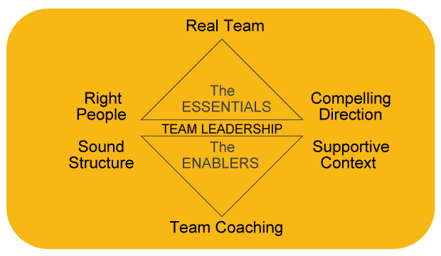
Ruth Wageman
Notes:
Higgins et al. (2012) also discusses the enablers of a team. Not only does the team need to be able to coach others but people on the team need to be a coach. By interacting with one another as well as the organization, this increases competency and builds skills, allowing the organization as a whole to grow. This framework is in the conceptual stages, but it emphasizes the necessity of having the right people on your team. An important aspect of the framework and structure for this team to operate as a supportive context is that your administration and leadership at the top need to recognize a commitment to this team. This ensures that everyone is on the same page about the responsibilities of the team.

Slide 14
Teaming Considerations (for systems change)
Context
Factor 1—Team is a “real” team
Team operationalizes team members
Work requires interdependency—collaborating for specific purpose
Membership can come and go but the roles are stable
Factor 2—Compelling direction with clear and impactful purpose
Factor 3—Structure of teaming includes
Clearly defined tasks
Established norms
Team size and skills are aligned
Factor 4—Supportive organizational context that
Recognizes and reinforces superior team performance
Provides valuable feedback
Supports professional development of team members
Has sufficient resources to execute the work
Factor 5—Access to coaching from team leader and members
Notes:
There are several factors for the context of the teaming considerations. These factors are borrowed from the Higgins et al. (2012) article.
Factor 1:
Want to make sure that the Team is a “real” team, meaning when you create a team, you define your team members and their purpose/role they serve on the team. The team cannot just be a bunch of experts; instead they are people who have a specific area of knowledge and experience that is beneficial for the team. The team must be inter-dependent upon each other because that's how you're all going to learn from each other. There should also be a specific purpose of your collaboration, not to just sit on the team. Higgins encouraged us to think about roles on the team instead of people because in schools, people come and go. It happens too often where one individual holds the team together and when they leave, the entire team dissolves. You want to ensure that the roles on the team are stable so that if a person leaves the role is still there.
Factor 2:
Next, teams must have that compelling direction with a clear purpose. One compelling reason for creating a team may be due to failures at Tier 2 and 3 levels; for example, a school may not be successful with children at the individualized levels and not able to successfully reduce problem behavior due to too much use of restraints, seclusion incidents, or suspensions. With these examples, there is definitely an impactful purpose of this team to decide how to assess Tier 3 support as a system, so the team can get to the root of the issue. The team can discuss what is going well and what isn’t in regards to interventions and strategies as well as assessing fidelity of implementation. Again, all of those things that you look at when you evaluate your Tier 1 data can also apply to Tier 3 data.
Factor 3:
The next factor is structure which include the importance of clearly defining tasks when creating an action plan. For example, not simply stating that someone will send email…go more in depth and state who will put together the resources in the email and who will send it and who will receive it. It is also important for teams to have good norms established, including the norms of their behavior and their expectations. How are you going to behave as a team? How are you going to come to consensus? How are you going to have discussions? How are you going to be able to respect and honor everyone? Establish clear norms of your behaviors and in your expected outcomes and your commitments so that everybody's accountable on your team. Also, teams need to have an adequate size and skills that are aligned. For example, when putting a team together, you might want to think about the necessary roles first because sometimes, one person can fill multiple roles but you want to ensure there are enough members on your team to cover all the roles that you've defined.
Factor 4:
Lastly, teams need supportive organizational context which means your superiors and the district or the principal really recognizes and reinforces this team and acknowledges superior team performance. To assess the levels of team performance within your team feedback to each other on team performance, there should be a section for practices and protocol. Feedback from outside of the organization and the organization context, preferably outside of your team should also be given. The team also need sufficient resources to execute their work, so members themselves should have access to professional supports that enable them to be more competent and more skilled team members.
Factor 5:
We talked about factor 5, access to coaching from the team leader and members. So people need to be coached to become more competent to get to that mastery level

Slide 15
Teaming Considerations
Composition
Diverse membership
Positions across the organization (district to school level)
Representative of the constituencies that will be required to change
Time in organization
Different years/tenure bring different perceptions about barriers to change and gaining buy-in of key stakeholders
Role representation on implementation teams
Team’s task is to implement actions beyond the boundaries of the team (i.e., across school system)
Selection of team membership indicates that each is representing the perspective of the role
https://www.teamdiagnosticsurvey.com/
Notes:
Another teaming consideration is the composition of the team members. One suggestion is that the team has positions across the organization. For example, at the school level, you should have people that represent both the district level, as well as the school level. The district level has the benefit of knowing the big picture, but they may not know necessarily how policies and processes are really impacting schools because they don't live and breathe in the schools. School level members know the daily life of the school and what aspects are important but they may lack the grand picture knowledge.
Another important consideration of teams is managing people's time in the organization and not just bringing in people who have been there a long time, or people that are new. It is important to have diversity in experiences because different years of experience bring about very different perspectives and input for training and ideas. It can also help develop buy-in from stakeholders, by having diversity across tenure in the team.
Then the team's task is to implement the actions across the school system. Teams will meet and create an action plan and come back together and assess how the team is doing beyond the team into the school system as well. A link to a diagnostic teaming survey was provided from the internet. However, it is a paid service and you will have to pay to take that survey because you have to register. This is just another resource for teams to consider using if they want.

Slide 16
Prior to Addressing Tier 3 as a System…
Do you have a Tier 3 District Team?
Do you have a Tier 3 School Team for Systems Conversations?

Slide 17
Tier 3 Systems Conversations…
District Tier 3 Team
Meets consistently to guide development, implementation, and sustainability of Tier 3 systems at school level
Provide support for implementation of procedures, protocols, and practices.
Provide input and support (COACHING) to staff
Make data-based decisions related to Tier 3 systems at school level
Leaders
Family & Community
Educators
District
School
Administrators
District Staff
School Staff
Parents
Agency staff (wrap around)
Notes:
These next few slides are different versions of Tier three systems team. You can have a district level Tier 3 team in which you have the leaders from the district in the school as well as educators. This is where you start doing some of the integrated system framework and start bringing in not only parents who can help inform and have a role on this team, but agency staff as well. This team meets consistently to guide the development and implementation sustainability, provide support for the practices and procedures, and provide coaching. This team is not just looking at one kid but looking at your system as a whole.

Slide 18


Tier 3 Systems Conversations…
Meets consistently to guide development, implementation, and sustainability of Tier 3 systems at school level
Provide support for implementation of procedures, protocols, and practices.
Provide input and support (COACHING) to staff
Make data-based decisions related to Tier 3 systems at school level
School Tier 3 Team
Leaders
Educators
Community
Administrator
Tier 3 Systems Coordinator
Teachers
Specialists
Tier 3 Facilitator
Social Workers
Outside Agency Staff
Notes:
This is an example of a school Tier 3 team now. The school teams look at their individual school for Tier 3. For the school teams, you want to have diversity of people and roles to fill to ensure the team has interdependency on each other. Another important point to consider is the inclusion of the community; for example, if you're a title one school do you need to have a social worker on the team? The team should meet consistently and make sure the school is implementing the Tier 3 practices and supports as a system by referencing Tier 2 and 3 data as well as individual student data. The team should also assess the consistency of implementation of Tier 3 supports; for example, is it the same as the last time we met? Are we seeing a decrease or increase in behavior problems? How are the kids that are receiving Tier 3 supports actually doing? Are there any that have been on Tier 3 supports for years?

Slide 19
School Student-Centered
T3 Team
Meets less frequently
Provide input and support to teacher implementing intervention
Make broader data-based decisions (tiered support, needs expanding/generalizing plan
Referring Teacher
Student
Other Teachers
Coach
Other Staff
Family
Meets frequently with the coach
Is the focus of the what, where, how
Is the recipient of direct active coaching
Makes immediate data-based decisions about plan
Core Team
Referring Teacher
Student
Coach
Notes:
So this is another way of looking at FBA kinds of processes or ad hoc teams where now you have identified a student who requires two or three supports and the top would be that school student-centered Tier 3 team that could include teachers, students, and the coach. The other staff and the family might be more your FBA/BIP team. That whole team is not going to be engaged in the FBA/BIP process; you will have a core team as well as the referring teacher, the student, and the coach who should be on the school team. They will then work with whoever else needs to be on that core team to develop and implement a function linked behavior support plan. So in this concept of school-centered teams, they aren’t going to meet as often as that core team. The core team is going to have a lot of meetings because they're going to develop the FBA and the hypothesis, discuss and coach the interventions, and look at tweaking interventions, while observing and providing feedback. So that core team meets a lot, but the school-centered team that's going to look at how to come back together to look at the data will meet every once in three weeks or four weeks.

Slide 20
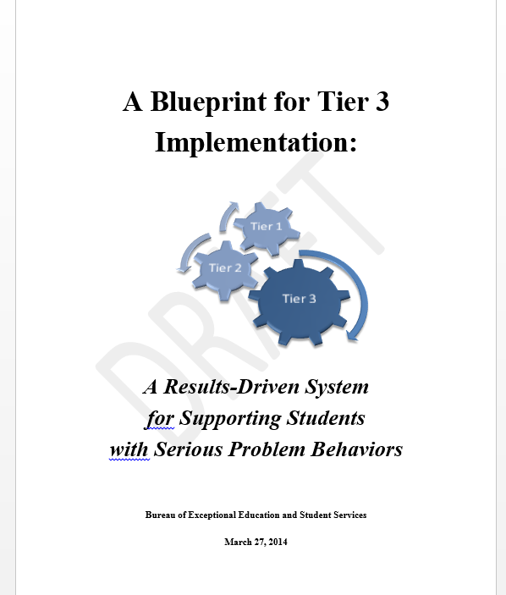
http://www.fldoe.org/academics/exceptional-student-edu/
Notes:
In Florida, we go through various iterations of what do we, and we’re deciding if we are going to add information or make a brand new blueprint. This link may not work anymore because the Florida Department of Education keeps on moving it around the site. So you can email Dr. Rose Iovannone if you can't find it, or go into The Exceptional Student part of Florida Department of Ed and just put “blueprint for Tier three” in the search. It should come up as a PDF and it's a free download (it's about 80 pages). So it's not an easy read. We will be going through the important highlights of the document.

Slide 21
Tier 3 Blueprint Rationale
Tier 3 extends beyond special education
Includes externalizing and internalizing behaviors (trauma, crisis, psychiatric, substance abuse, etc.)
The FBA and BIP process is the foundation of Tier 3 (but may not be sufficient for many students with complex issues)
Notes:
In the summary of the report, it states the rationale for the Tier 3 blueprint and how it extends beyond special education. We really wanted to make that clear that this is for 100% of the kids who need Tier three individualized support. So it's not just for special education, it is for general education students as well. The FBA/BIP process is important for Tier 3 services and is the foundation but it is not the sole practice in Tier 3. Here are the broad recommendations that are included in the Blueprint:

Slide 22
Broad Recommendations:
Results based Tier 3
Comprehension
Skills
Professional Supports
Aligned infrastructures
Policies & procedures
All educators understand a Tier 3 system of behavior supports.
Educators have beliefs, knowledge and skills to implement and sustain Tier 3.
Sufficient professional supports at school level to implement Tier 3.
Sufficient district & school infrastructure alignment to evidence-based practices
Polices, procedures, and practices align between state, district, and schools.
Notes:
These recommendations are not sequential; it's not necessary that you have to do the first one to get to number five. These are all the principles that we believe are necessary to have a really good Tier 3 system.
So first of all, you, the educators in your district, need to understand what our Tier 3 support includes. For example:
How do you identify students or Tier 3 support
What kind of supports are needed?
What was the process?
What are they not?
Tier three is not special education it is individualized customizable supports for academics and behavior.
The second guideline is that educators need to have beliefs and the knowledge and the skills to implement a sustained Tier 3 belief system. This is where we get the most pushback. You may have educators out there who do not think behavior is part of their responsibility, that they should not be teaching behavior. You also have people who think that some students cannot behave and they should be sent to other schools. That philosophy can be a big barrier to Tier 3 buy-in. We have some who may be scared of the kids. If you do have that kind of overall philosophy in your district, especially if it's coming from leadership, you might have a hard time.
In the third guideline, you are going to want a way to address that philosophy in your Tier 3 system. It’s important to address that not everyone on the team may have the same skill level. Not everybody needs to be an expert, but maybe administrators need to have an awareness level of what the Tier 3 supports look like for a counselor, a school psychologist, or behavior interventionist. It is also important to have sufficient professional supports to implement Tier 3 services which involves a lot of coaching. In this chapter of the blueprint, they discuss the necessary supports and how to allocate those resources.
Chapter four talks about the guidelines for infrastructure. We need to have alignment across the school and the district so that there's an understanding of what our goals are for data, systems and practices.
Lastly, chapter five discuses the importance of alignment with what the state goals are, so policies and procedures of the district are in line with the schools.

Slide 23
Ensure 1: All Educators Understand Tier 3 Systems
Wraparound based (Person-centered plans, functional analysis, multiple expertise)
Team based (PTR)
Consultant-based (Brief PTR)
One big idea:
Multiple levels of tier 3
Not a one-size fits all
Slice of Tier 3-tip of triangle
All levels use functional thinking: (Scott, Alter, Rosenberg, & Borgmeier, 2010)
Notes:
Tier 3 systems are not just a “one size fits all” process. Tier 3 is not just about FBA’s/BIP’s so we wouldn’t say that an FBA/BIP looks the same for every single kid, necessarily. Those that have come to prior trainings know that there could possibly be a three tiered model within Tier 3. This allows educators to have prevention techniques to catch children earlier before they need the most intensive types of Tier 3 support. This is illustrated as that bottom level consultant-based efficient prevent-teach-reinforce method. The student behaviors are still mild in this portion of Tier 3. The behaviors not happening with high frequency and you might only have one problem behavior that's happening in one routine or one situation that you can clearly predict and identify and you are really clear on what the function is. You don't need to spend the resources, time, and observations to try to figure out and collect a lot of data. For example, a student may shout out the question instead of raising his hand because he wants attention. A ton of data is not necessary to come up with that hypothesis. This “tier” is one where just a coach or a facilitator and a teacher work together or just the immediate people who are very close to the student who will be implementing an intervention.
This removed many time limits, making it an efficient process for some cases. However, it is not as effective if the behaviors are intense or if the behaviors happen in more than one environment for different functions with different triggers. For example, if the student is non-verbal and has a intellectual disability or Autism- their behaviors can have many different communicative intents. An efficient FBA is not going to be effective because you're going to have to get a lot of people's input and a lot of observations to figure out what is going on with the behaviors. It would have to be determined whether the behaviors serve as functions of escape, attention, or access. So, that won't work for some of those kids who have more in depth needs, but this can work for the lot of the kids who might have very minor problems.
Then the second level would include a more comprehensive FBA/BIP approach, very similar to something like PTR. You would have a full team that meets several times and each time, you have a specific purpose for what you're doing with your FBA/BIP process to develop interventions and multi-component intervention plans and making data-based decisions.
The top “tier” for wrap-around services are supports that seem to be much more of a need recently. These wraparound supports are not going to help the students who are already successful in school. This is why person-centered planning approaches are important. At the University of South Florida, the first step of our FBA/BIP process was to do a person-centered plan. For some students, you don't need to actually get to the FBA/BIP because you're wrapping around so many supports and you’re creating your action plan for this student, you might not need to go any further. It’s important that the student has a big voice in the plan. So we see these as different levels in Tier 3 and one of the things you're going to have to do is to make sure that your staff and your schools in the district understand that Tier 3 is complex.

Slide 24
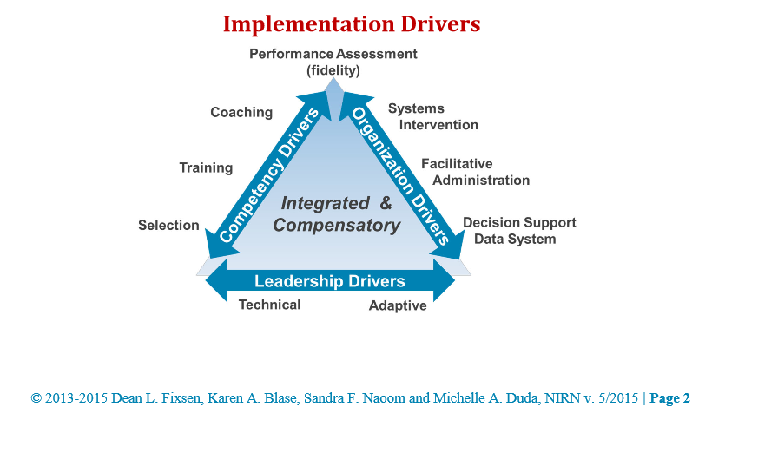
Ensure 2: Educators have beliefs, knowledge and skills to implement and sustain tier 3
One big idea:
Competent in strategies that promote systems change as well as behavioral principles
Much of tier 3 requires adult behavior change-more than student behavior change
Knowledge of implementation science and variables impacting implementation
Knowledge of adult-behavior change theories
Notes:
Educators have beliefs and knowledge and skills to sustain Tier 3. In this big idea, for systems to change, this means that adults need to change, not just kids because adult behavior will result in the behavior of the child changing.
Educators need to understand what are the necessary drivers that are needed to implement systems and systemic change. One researcher who does a lot of work with this idea is Sanetti (on next slide). She does a lot of teacher implementation fidelity systems change work. Her model includes ways to motivate adults to change and to move them from being interested in changing, to actually being the change and being involved in the change process.

Slide 25

Example of Supports to Enhance Adult Change-Task analyzed behavior plans (manualized)-Sanetti et al.
Hypothesis: When given a demand to do a non-preferred academic task that involves independent writing for more than 5 minutes, Don will shout out negative comments (e.g., I hate this, you can’t make me do this). As a result, he gets to avoid/delay the non-preferred task and obtains assistance from an adult.
BIP Prevention Strategy:
Provide Choices: The teacher will provide Don with a choice after assigning him independent math work in class. Choice options are: (a) materials to use for assignment; choice of leadership activities; (b) where to sit; (c) who to do the assignment with
Steps to implement strategy:
Each morning, the teacher will decide which choice option to present to Don.
Immediately after giving the class the independent math assignment, the teacher will walk over to Don and present him with the choice option.
Verbally state the choice; e.g., “Don, where do you want to sit? X or X?”
Immediately after Don makes his choice, say, “Thanks for making a great choice” and release him to his selection.
BIP Prevention Strategy:
Provide choices of where to sit
Notes:
Sanetti’s model emphasizes the importance of having manual processes that are really well defined, especially when you're implementing evidence-based interventions. It’s important for teachers to do this. Teachers need to feel that they have self-efficacy in doing their work and they DON’T feel like they don’t have the skills or the knowledge to implement interventions. Teachers should be empowered to implement interventions and feel competent that they can do it.

Slide 26
Ensure 3: Sufficient professional supports
One Big Idea:
We need to shift the focus of professional development from primarily workshops, presentations, institutes to job-embedded PD and coaching that will build competencies of professionals within authentic environments
Not every professional needs the same level of competencies.
Notes:
This is another big idea about implementation drivers and sufficient professional supports which the audience already knows.

Slide 27
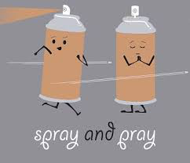
Move From Overreliance on:
Spray and pray workshops

Slide 28
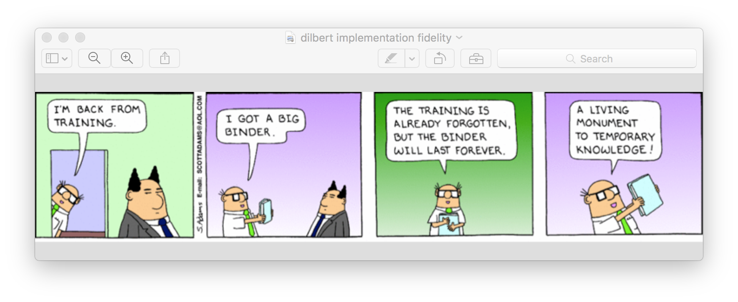
Notes:
The comic says, “I'm back from training. I got a big binder, the training is already forgotten, but the binder will last forever. A living monument to temporary knowledge!”
“I don't know about you, but I have a lot of binders on my bookshelf that I haven't looked at for years and years.” –Dr. Iovannone
So we want to get away from going to trainings and coming back with a big binder full of nice hand outs that won’t be used. Everybody loves getting resources and teachers want to reference what they learned immediately. However, half the time, these binders and useful handouts sit there. Now we start putting things online so people can have more easy access to resources but sometimes you read the information online and wish you had gone to the session.

Slide 29

To Matching Supports to Competency Needs
Coaching
Performance feedback
Job-embedded implementation
Practice-Based Coaching (PBC)
Behavioral Skills Training (BST)
Notes:
We really need to think about coaching again and start doing the coaching model job embedded practice not just in case studies, but actually getting in and helping an adult set goals regarding what they want to learn to do through this process. It’s important to support them by modeling, role playing, practicing, and doing performance feedback and reflection.

Slide 30
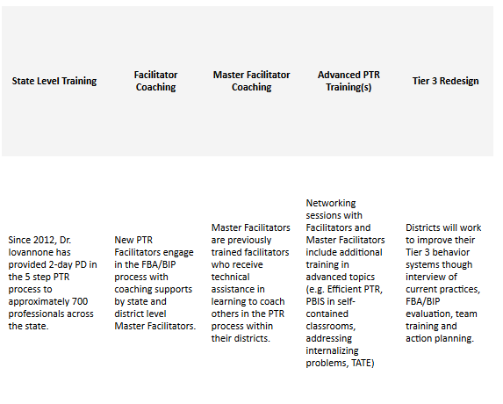
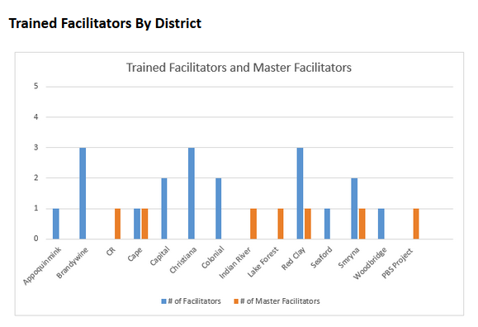
Delaware-PBS PTR Coaching Model
Job Embedded Coaching
Notes:
Delaware has a PBS PTR coaching model that we continue to try to implement every year. Both Dr. Iovannone and Niki Kendall have led trainings on PTR about what must be accomplished to become a facilitator or a coach. To be a coach, you must be able to not only increase your own skills, but then to be able to eventually coach others if you are interested and have the skills and the time to do that.

Slide 31
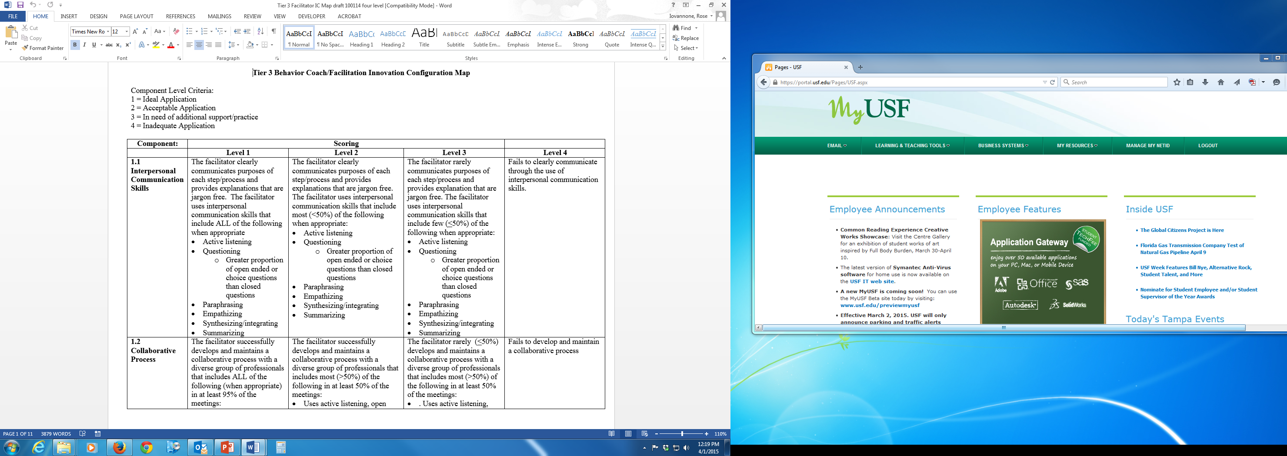
Tier 3 IC Map
Tool used to:
Identify professional development needs for FBA/BIP Facilitators
Establish baseline and ongoing improvement
Can be used as self-assessment, external assessment or combination
Notes:
We have provided some tools that you can use to be a coach to others. These will be touched on briefly but they are on the Delaware PBS website under the Tier 3 tools and forms tab. This first document is a basic configuration map which helps a coachee do FBA/BIPs when they feel like they're in need of a lot more support. For example, where do they think they're doing it with adequacy, where do they think they're at master level, where do they think that maybe they aren’t doing these things at all.
We should feel safe to say, “I know I'm not doing this adequately and I need to have more support.” This sets the baseline and also helps set a place to start for training and coaching. Some districts use this systemically by gathering personnel in a meeting who are the individuals responsible in the district for facilitating FBA/BIP and have them complete this document and discuss how they feel the district operates with this as a whole, not just individually.
One district actually used it as an activity at one of their school psychologist meetings and school site social worker/behavior analyst meeting. They're all the facilitators of FBA’s/BIP’s in their district and they broke into small groups with all the disciplines represented in each group. They went through this IC Map document and mapped where they thought they were most strong and where they needed the most help. It ended up setting the map for their professional development plan for the district. This document can be used beyond just one person. It can be used as a district level planning form to improve systems.

Slide 32
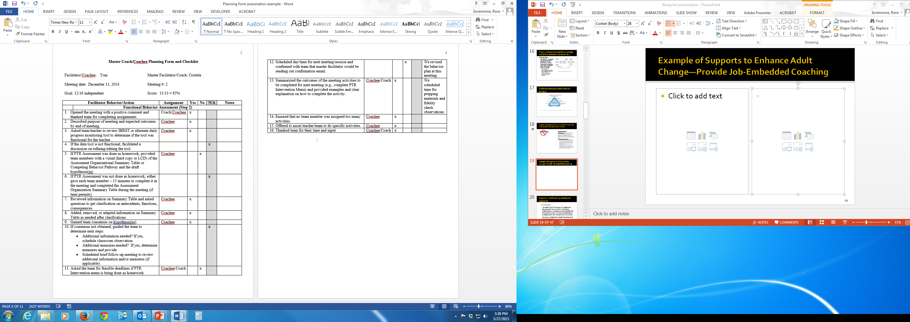
Coach-Coachee Pre-Planning Form
Notes:
This document is a task analysis of all the steps of an FBA process. This is based on PTR, but any FBA/BIP process could actually use this if you just modify some of the steps. It allows the coach to work with the person they're coaching to model, role-play, and practice the steps of the meeting. It allows you to have something for debriefing later on. You can keep notes about how the person did if you modeled them or did it without any observation, but did a self-assessment. Afterwards, there can be a debriefing meeting between the coach and the person being coached and you can then talk about some of the steps that were done really well and some of the steps that were challenging and difficult. Then the team can action plan for what strategies to try for the next time.

Slide 33
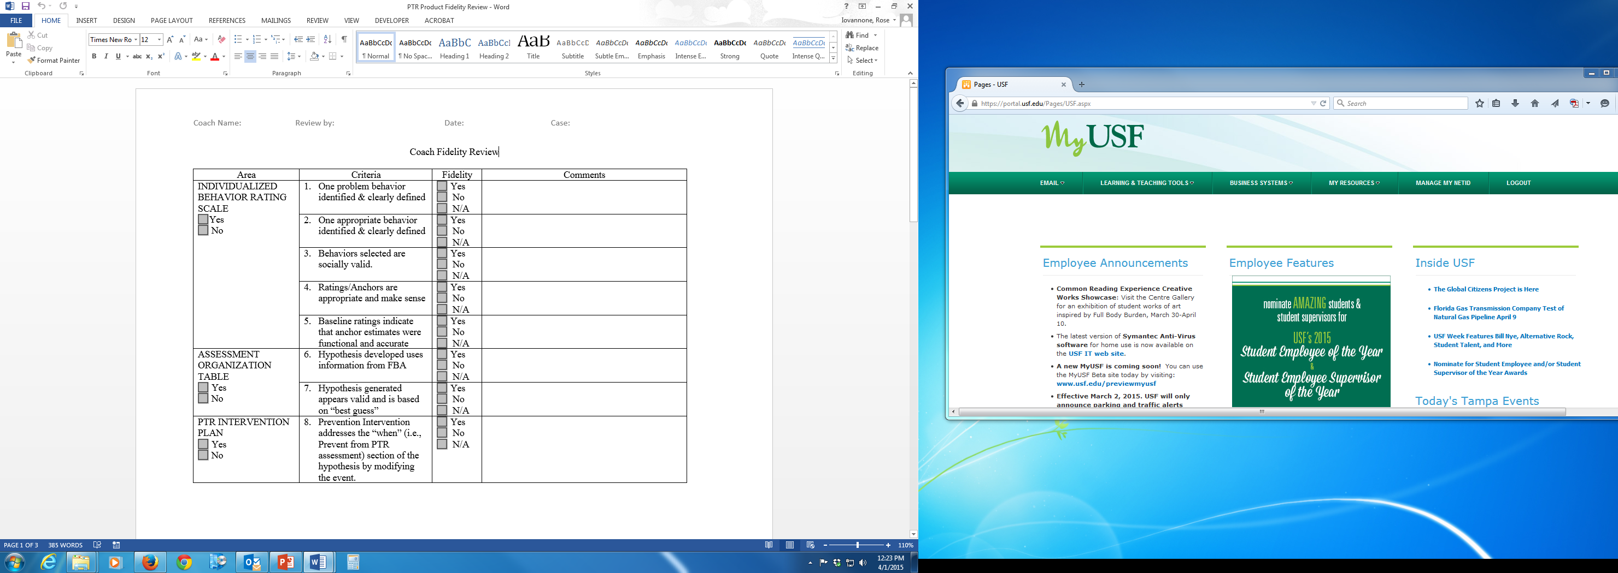
Systematic Review of Products
Provides structured ongoing feedback to facilitators on the quality of products
Can be used as an ongoing progress monitoring tool
Notes:
We also have resources for systemic reviews of processes where you have a forum in which you can look at specific products. For example, did they have a progress monitoring system that seems to be a good measurement of the problem behavior as well as the appropriate behavior? People can self-assess and then you can also do an assessment and see where you agree and disagree and then use that for debriefing as well.

Slide 34
Ensure 4: Sufficient district & school infrastructure
Tier 1 | Tier 2 | Tier 3
Office discipline referrals Attendance In-school suspensions Out-of-school suspensions Restraint\seclusion Fidelity of tier 1 implementation Classroom management system (minors incidents) SESIR Climate surveys Social, Emotional and Behavior Screening Tools | Daily Progress Monitoring systems Intervention specific monitoring systems Fidelity of tier 2 Implementation | Systematic direct observation data systems (frequency, duration, rate, etc.) Direct behavior rating scales Time sampling data systems Antecedent, Behavior, Consequence Observations Interviews Surveys Checklists Record reviews/Permanent Products Fidelity of tier 3 Implementation
One Big Idea:
If a district does not have a functional data system that can review data at multiple levels (e.g., student, teacher, school, district) across all three tiers of support, the district will be unable to implement an effective tier 3 process.
Table 8: Possible Data Sources to Support MTSS for Behavior
Notes:
Now let's look at sufficient districts and school infrastructure. If you don't have a data system that can review your data at a Tier 3 level, then you're not going to be able to sustain Tier 3 because you don't have system level data to make decisions. This big idea and table is from the Blueprint document. This actually talks about what are some possible data sources that you can use to inform your system.

Slide 35
Data Systems
Do you have a data system that does the following:
Identify students needing tier 3 supports
Provide baseline (pre-intervention) data that lets you know how all students needing t3 are doing before intervention and post (after intervention)-how all students are doing after intervention
Drill into data by looking at students in specific schools, grade levels, categories, classrooms
Provide fidelity data
Identify the specific problem and replacement behaviors
Identifies the interventions being implemented
Data are required for making data-based decisions
Notes:
This is what you want to have your data system do for a Tier two or three data system. We want you to have a system that can give you in your district or in your school a report on the students who are receiving Tier three supports. If the only way you can do that is by going into file cabinets, and piecing together different reports. You need a Tier three system that can streamline that for you. Your system also needs to let you know how you're doing with your supports, so you need baseline data and you need post-intervention data. Then you can see how many students are still on baseline, those who haven’t gotten into Tier 2 or 3 support, and why they are still at baseline after a whole year. How are we doing with our kids who have Autism? How about the kids who are on high indicators of disproportionality for discipline referrals? How well are we doing with those kids and are there effective Tier 3 supports for them?
You have to be a detective with your data to figure out where problems exist and where more support is needed as well as celebrating the successes. It is important to have a data system that's going to give fidelity data. In other words, how well are people implementing their interventions? How are we doing our processes as a whole? You want to know what your specific problem behaviors are in Tier 1 so you have an idea of what kinds of behaviors are happening at Tier 3. Are there some behaviors that we're just not addressing well as a district or as a school or as a group? We also want to know which interventions are being implemented; for example, prevention interventions and whether a data system is established that lists behavior interventions. That can give you a sense on, are we over relying on doing one intervention, no matter what the function is or what the triggers are, but that's the one people are comfortable doing? It can also inform on which interventions are not working for the kids. Your data system will lead you to make really important decisions on where your systems need to be and supports need to be strengthened and where you're doing excellent jobs already.

Slide 36
Case Study 1- Mike: Behavior Rating Scale
Behavior
Screaming | 9+ times 7-8 times 5-6 times 3-4 times 0-2 times | 5 4 3 2 1 | 5 4 3 2 1 | 5 4 3 2 1 | 5 4 3 2 1 | 5 4 3 2 1 | 5 4 3 2 1 | 5 4 3 2 1 | 5 4 3 2 1 | 5 4 3 2 1 | 5 4 3 2 1 | 5 4 3 2 1 | 5 4 3 2 1
Hitting | 8+ times 6-7 times 4-5 times 2-3 times 0-1 times | 5 4 3 2 1 | 5 4 3 2 1 | 5 4 3 2 1 | 5 4 3 2 1 | 5 4 3 2 1 | 5 4 3 2 1 | 5 4 3 2 1 | 5 4 3 2 1 | 5 4 3 2 1 | 5 4 3 2 1 | 5 4 3 2 1 | 5 4 3 2 1
Expressing Frustration | 40%+ 30-40% 20-30% 10-20% 0-10% | 5 4 3 2 1 | 5 4 3 2 1 | 5 4 3 2 1 | 5 4 3 2 1 | 5 4 3 2 1 | 5 4 3 2 1 | 5 4 3 2 1 | 5 4 3 2 1 | 5 4 3 2 1 | 5 4 3 2 1 | 5 4 3 2 1 | 5 4 3 2 1
Transition to Non-preferred | Whimper or squeal Louder than indoor voice Outdoor play voice Louder than outdoor play Ear penetrating | 5 4 3 2 1 | 5 4 3 2 1 | 5 4 3 2 1 | 5 4 3 2 1 | 5 4 3 2 1 | 5 4 3 2 1 | 5 4 3 2 1 | 5 4 3 2 1 | 5 4 3 2 1 | 5 4 3 2 1 | 5 4 3 2 1 | 5 4 3 2 1
01/15
Notes:
The South Florida Tier 3 databases using the IBRST PTR rating scale that most are probably familiar with. It provides a way to compare a system across children who may have different behaviors. A problem behavior of five always means that the behavior still there, a lot. It doesn't matter who the kid is, what the behavior is, what the disability is, or what the intervention is; we just know that if we have ratings of five from post-intervention for problem behavior that something is not working. A score of one means that things are working, things are great that day. The goal is to have a lot of ones. On the last two rows, the scale is switched or flipped because we want to see appropriate behavior at high level. So again, a five means we're seeing a lot of behavior. So if you think of it in terms of we're seeing a lot of the behavior, it's a five. Then it's good when it's appropriate behavior because we do want to see a lot of appropriate behavior. It's not good when it's a problem behavior. We don't want to see a lot of problem behavior and ones mean we don't see too much of it. So we use that as a way to build our Tier 3 system.

Slide 37
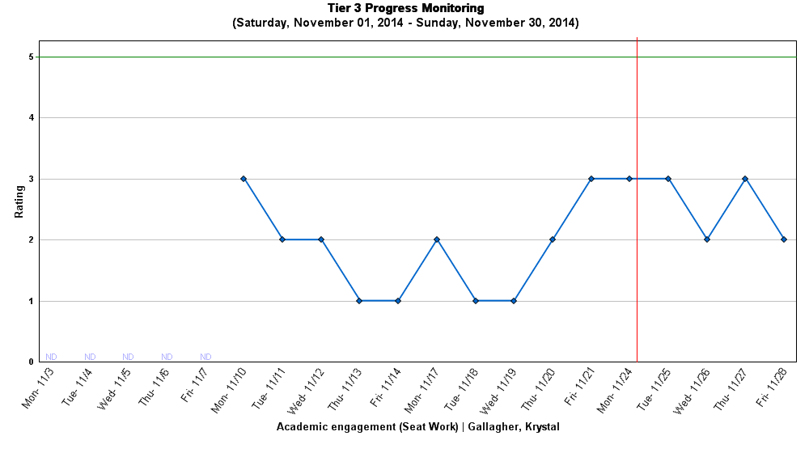
Appropriate Behavior: Academic engagement (Seat Work) - Incompatible
Monitoring Unit: Afternoon Functions: Obtain peer attention
Monitoring Tool: BRS
5(BEST day): On-task all afternoon
4: On-task most of afternoon
3(AVG. day): On-task some of afternoon
2: Rarely on task in afternoon
1(WORST day): Not on-task all afternoon
Individual
Intervention begins
Notes:
If you wanted to go into Google and search the RTI database and put Florida in there, you’ll see a demonstration site. You can play around with the database because it's not just Tier 3, it includes Tiers 1 and 2 as well. You can get an individual rating system similar to this that would be what an individual rating might look like. The red line is where the intervention began, you can make decisions, then you could pull that report.

Slide 38
Delaware PBS Example:
Data Tracking Tool (SYSTEMS Level Data)
Tier 2 Intervention Tracking Tool |  |  |  |  |  | School: |  |  |  |  |  |  |  |  |  |  |  | SY:
Directions: On a monthly basis, please track the # of students participating and positively responding to each intervention. This spread sheet will calculate the corresponding % Responding and %Not Responding and graph your data on the attached worksheet. Please leave columns without data blank.
Interventions: | #1: Check In/Out |  |  |  | #2: Mentoring Program A |  |  |  | #3: Mentoring Program B |  |  |  | #4: Lunch Bunch |  |  |  | #5: PEERS Group
Months | # Students Participating | # Students Responding | % Responding | % Not Responding | # Students Participating | # Students Responding | % Responding | % Not Responding | # Students Participating | # Students Responding | % Responding | % Not Responding | # Students Participating | # Students Responding | % Responding | % Not Responding | # Students Participating | # Students Responding | % Responding | % Not Responding
September
October
November
December
January
February
March
April
May
June
Interventions: | #7: Brief FBA/BIP |  |  |  | #8: Complex FBA/BIP |  |  |  | #9: Wrap Around Support
Months | # Students Participating | # Students Responding | % Responding | % Not Responding | # Students Participating | # Students Responding | % Responding | % Not Responding | # Students Participating | # Students Responding | % Responding | % Not Responding
September
October
November
December
January
February
March
April
May
June
Responding to Brief Function Based Interventions: After four weeks, youth has no new office discipline referrals and a 50% reduction in the identified problem behavior. In addition, student earns 80% of DPR points, and increase grades and attendance by 75%.
Systems
Notes:
Delaware has their own tracking system that can be used by any district. This is the Tier two tracking tool that we've presented in a lot of professional development sessions. Its an excel spreadsheet that has recently been expanded. It now includes your Tier 3 interventions. So this is a might be a simple starting point, it has both the tracking of the overall intervention and there's another tab that asks you to set decision points so that this would inform your decisions as to whether or not students are responding to your Tier 3 interventions.

Slide 39
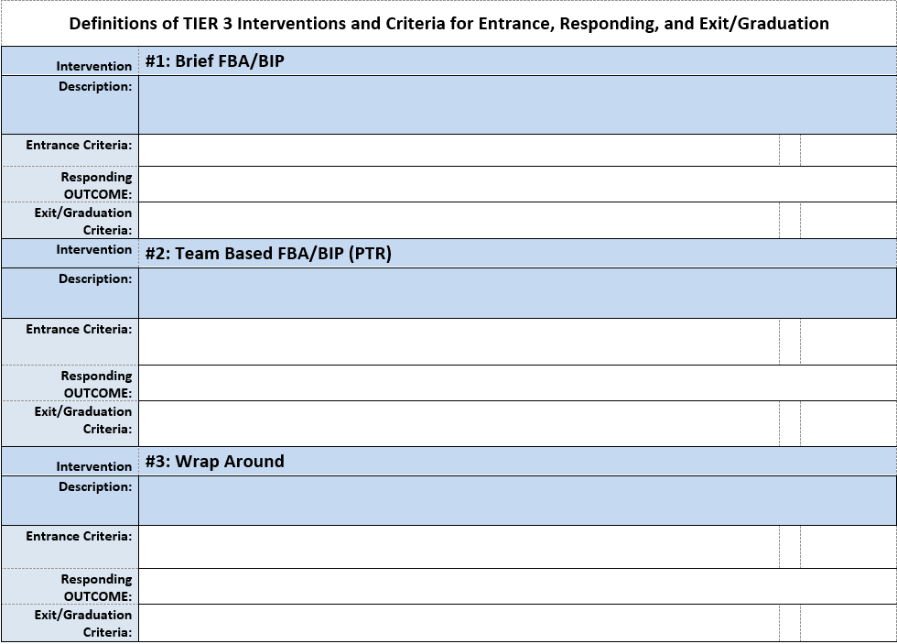
Delaware PBS Example:
Data Tracking Tool (Intervention Criteria)
Notes:
This is a very basic, simple starting point.

Slide 40
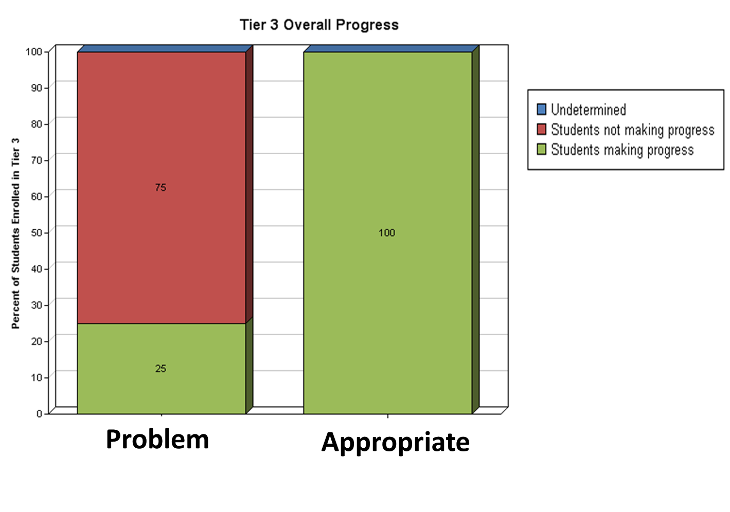
School-Wide
Notes:
Going back to that Tier 3 database in Florida, this is school wide data for Tier three. This is an example of one report you could have to look at your Tier 3 overall progress. First of all, these are fake data just for demonstration purposes and the person who put in the fake data didn't understand Tier 3 at all so when it doesn't make sense, please don't hold it against the presenters. It’s just demonstrating what you can pull from this data system. So you can look at how well your school is doing on progress or problem behavior being decreased and appropriate behavior being increased. You can pull a report to let you know overall how your school is doing.

Slide 41
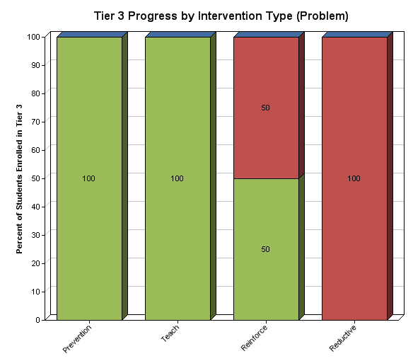

School-Wide
Notes:
You can also pull it by intervention type and what kind of progress or students on the intervention types. The PTR menu of intervention was included, so that people can select the interventions that they are using in their intervention plan with the student. Then there's the teach interventions and reinforce that were added. This shows you where our students are making progress and what type of interventions are being used. Sometimes the hardest part for people is to ensure they are implementing their interventions with fidelity and acknowledging that reactive processes are not actually changing behavior.

Slide 42
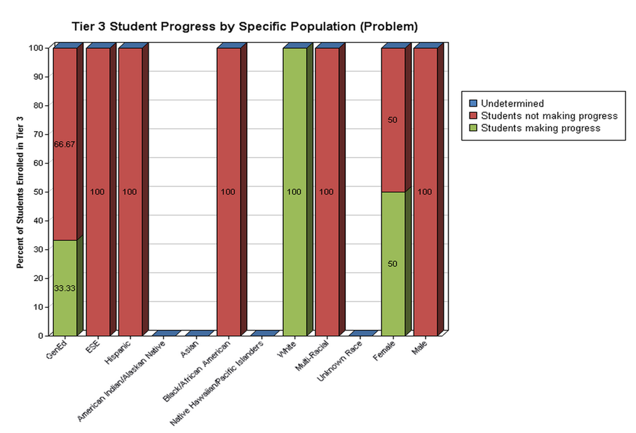
Notes:
This graph is again looking at a school-wide one. Now you're looking at student progress on their intervention plan based upon the specific population they're in. So you could look at if they're special education or by race/ethnicity. You can look at male or female as well. You can pull those out and really delve deep into the data and this is Tier 3 enrollment by intervention strategy.

Slide 43
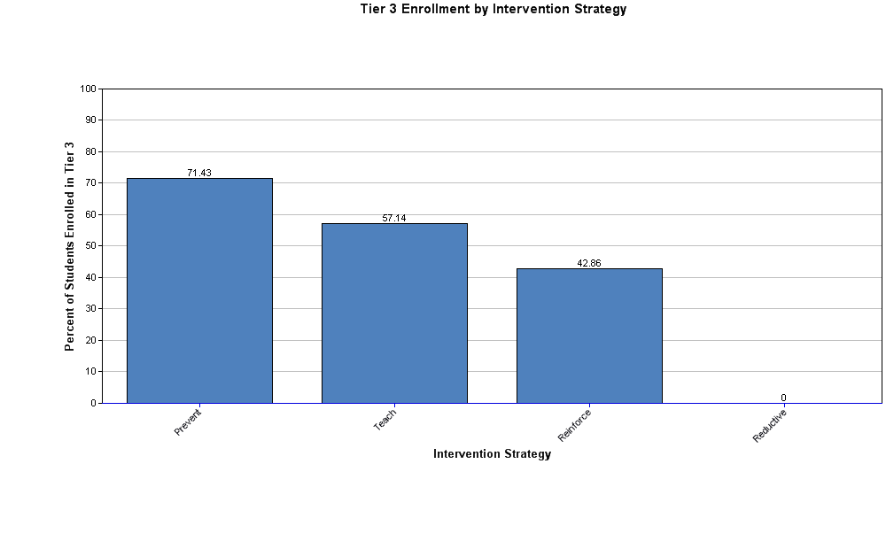
Notes:
This is now not looking at progress, but how many students are receiving these types of supports. This is for school wide or district wide data.

Slide 44
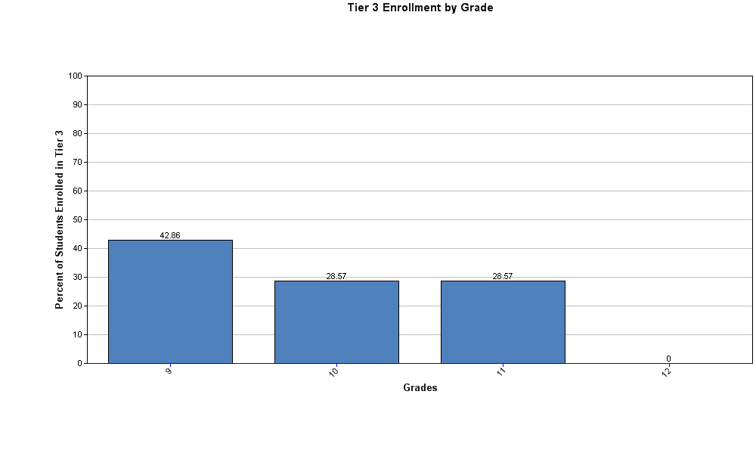
Notes:
Then, how many students are receiving Tier 3 supports based on grade levels. For example, this is a middle school for six, seventh, and eighth grade. This is just a little snapshot of what a data system can do. If you can, you can go to RTI Florida RTB database. On the right side it will display the demonstration. You just click on that and you can practice entering data and practice pulling down reports. There's already some data in it so you can practice pulling reports and seeing what kind of reports you can get if you are a district thinking of doing Tier three.

Slide 45
Ensure 5: Polices, procedures, and practices align
One big Idea:
Districts will need to establish a consistent process/procedures for tier 3 supports across all schools for both general and special education.
Process/practices need to be reflected in manuals, communication, and data

Slide 46
District-Wide Tier 3 Process
District-Level
Tier 3 process development and monitoring
Monitoring individual student progress (data collection and analysis)
FBA/BIP development and training
Professional development
School-Level
Referral process for students needing Tier 3 supports
Timeline for students accessing Tier 3 supports
FBA/BIP development and implementation
Coaching/training and on-going teacher support
Monitoring student progress
Criteria (decision points) for increasing or decreasing levels of support
Fidelity of implementation

Slide 47
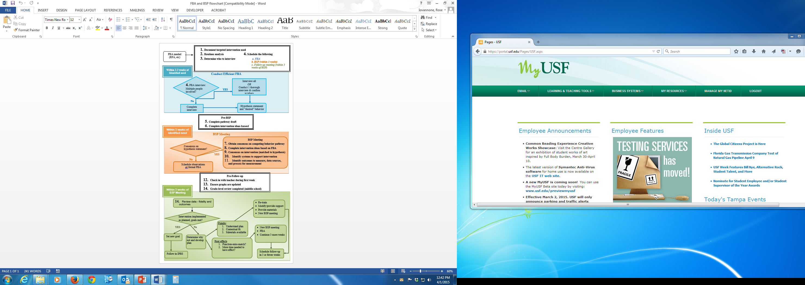
Example of a Consistent Tier 3 Process
Notes:
It’s important to have a consistent process. This flow chart is from Dr. Iovannone’s colleague, Cynthia Anderson, who works in Illinois. This chart shows how you get an FBA/BIP process consistent across everybody and it actually describes how a student gets brought to the school team. Who is looking at advanced tiered support and how it gets to them that the student needs individualized support are illustrated. The very first section in the black and white squares is the pre-meeting process and what information they receive (referral from the teachers). They actually have a little form where a teacher can submit to the team. The blue section is what they do first. First they conduct an “efficient” FBA, they do an interview, and figure out if they can come up with a hypothesis. And if not, then they do a full blown FBA. The second part just talks about how they develop their behavior interventions with that process. The process of making sure the teachers are supported and the third, the green section, is when they come back in three or four weeks, their decision making process based on the data.

Slide 48
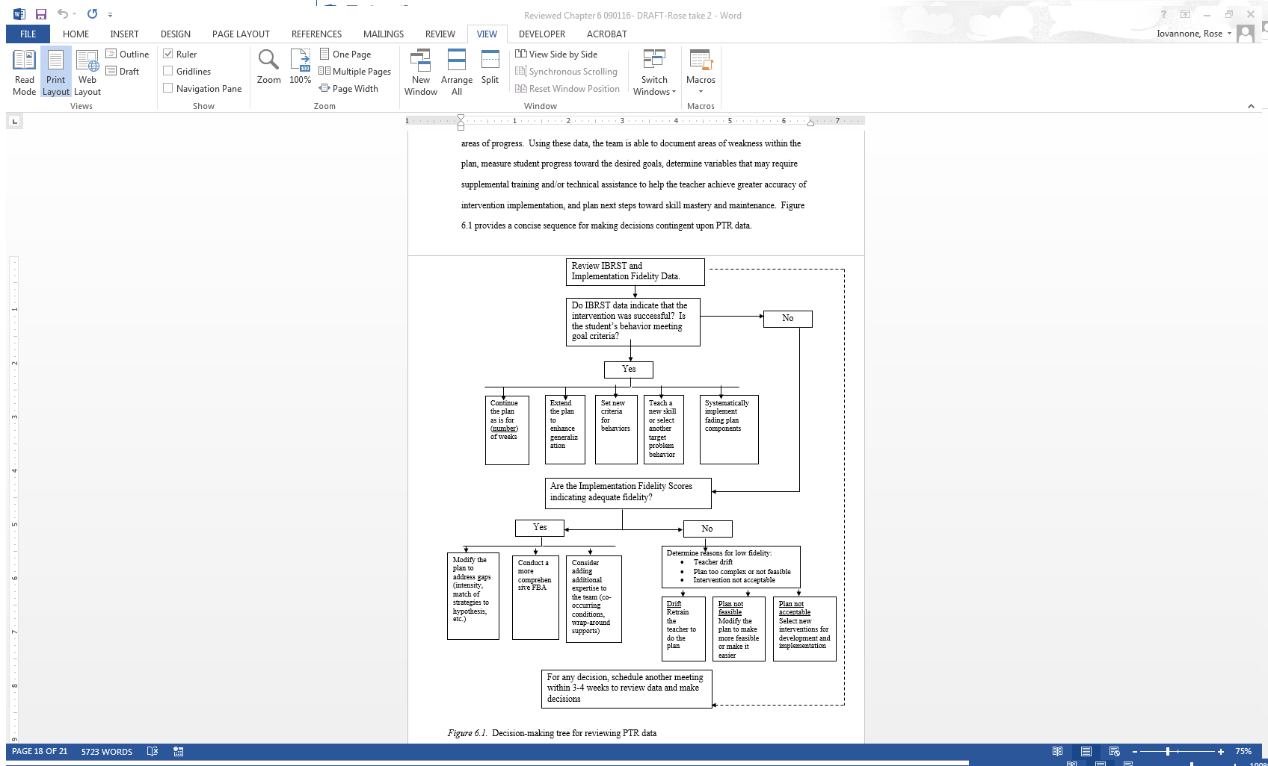
Notes:
In our PTR book, there is a database decision making flow chart for how you look at your fidelity data and you look at your student outcome data, which in our case is the IBRST. Based on answering these questions, the first step is to look at your status. Are your students behaviors improving, are they going the right direction? If that's a yes, then it will take you directly below, where there are five boxes. There are five things you might use to make decisions. One decision you may make is to extend the plan or you might start fading the plan. One might be that you're going to shape behavior to have material of that behavior. There's multiple options. If things are going well, then you're going to ask the question, do we have high fidelity from the teacher? If we have, then something is probably wrong with the plan. If we say no, the teachers not implementing it with fidelity, then we have to figure out why that is happening. So it guides you to make decisions.

Slide 49
Considerations for Additional Expertise
To have an effective tier 3 system, districts will have a coherent process for determining when and how to obtain additional supports and expertise
General guidelines for developing a plan:
Identify situations in which there is a need for additional expertise
Identify skills or specific expertise required
Describe methods/process for accessing additional expertise
Develop procedures for coordinating and collaborating with internal and/or external professions
Procedures include integration of activities within the continuum of school-based behavioral support
Develop guidelines for requesting more in-depth functional assessment procedures
Note: FBA/BIP process is a foundation; however, the FBA/BIP process may look different for individuals who present with behaviors that are internalizing or characteristics of conditions (e.g., anxiety, depression)
Notes:
Finally, there are people who are experts in more extreme behaviors (i.e. cutting) that others may be more experienced in working with. Those are the people you need to collaborate with if you are doing an FBA/BIP and you can't figure out the hypothesis after implementing with high fidelity. This might be for those who are working with students who might have very significant cognitive deficits in which they're doing a lot of self injurious automatic behaviors. You may need to get somebody who knows how to do a functional analysis for those behaviors. Also, you may need to have somebody who understands borderline personality disorder or understands how to work with students who might be using Alcohol/drugs or abusing substances. So you have to have a plan for when you identify that you need additional expertise as a team and how are you going to access that, so that you don't have everybody going off rogue and bringing in people. It's a process that may not be implemented at the district or school.

Slide 50
Examples Of Conditions Or Behaviors That May Require Additional, Expertise.
Intense Behavioral Problems | Psychological/Mental Health | Medical | Life Situations
Extreme self-injurious behavior endangering health/well-being Intensive physical aggression acts toward peers and/or adults and/or property causing bodily harm or significant property destruction Behavioral problems are so intense and resistant to interventions and student is at risk for more segregated placements and/or being incarcerated | Suicidal ideation and/or suicidal attempts Engaging in seriously threatening behaviors that are unlawful and may result in incarceration Personality and/or psychotic disorders High risk sexual behavior Post-traumatic stress Significant substance abuse related disorders (e.g., alcohol, drug) | Psychosomatic illnesses (e.g., extreme headaches or stomach problems due to stress) that contribute to or exacerbate internalizing or externalizing Sleep disorders Frontal lobe damage Seizure disorders Enuresis Encopresis | Homelessness Food deprivation Traumatic situations (e.g., abuse-sexual, physical, psychological Exposure to savage acts (e.g., war, murder, rape) Extreme poverty Foster care placements and/or unstable home placement
*Note some of these example may fall under multiple domains (e.g., encopresis may involve behavioral health and/or medical intervention)
Notes:
In our blueprint, we give some examples of behaviors or conditions that may require expertise. They might be things that we don't see often, such as mental health issues for people following the hurricane in Puerto Rico for those in Florida. We got a big influx of students in Florida who were pretty traumatized after they lost their homes, and they went through a lot of really scary things, including deaths and injuries. We’re not all equipped to deal with that and even if we have been through a lot of counseling courses. How to respond to crises and traumatic events requires additional mental health endorsement or credentials or training in order to support those.
Those are some other things to think about. Schools need to assess if they have some of these issues in the school or district and do not have personnel with expertise available, and whether they want to contract or purchase time of others or start training personnel on how to respond to crises. Some individuals have the basic credentials. School psychologists, for example, have a lot of the credentials where they can go ahead and get more training and support to be able to do some of these more advanced kinds of interventions for kids who have very intense needs, which again goes into Tier 3 planning.

Slide 51
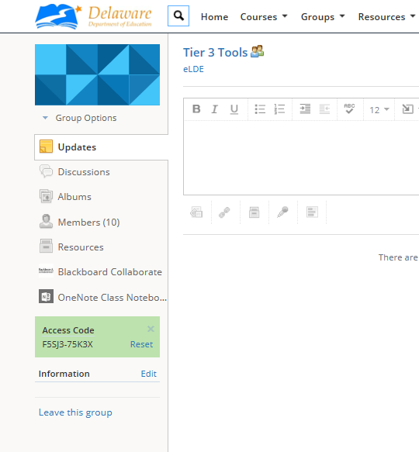
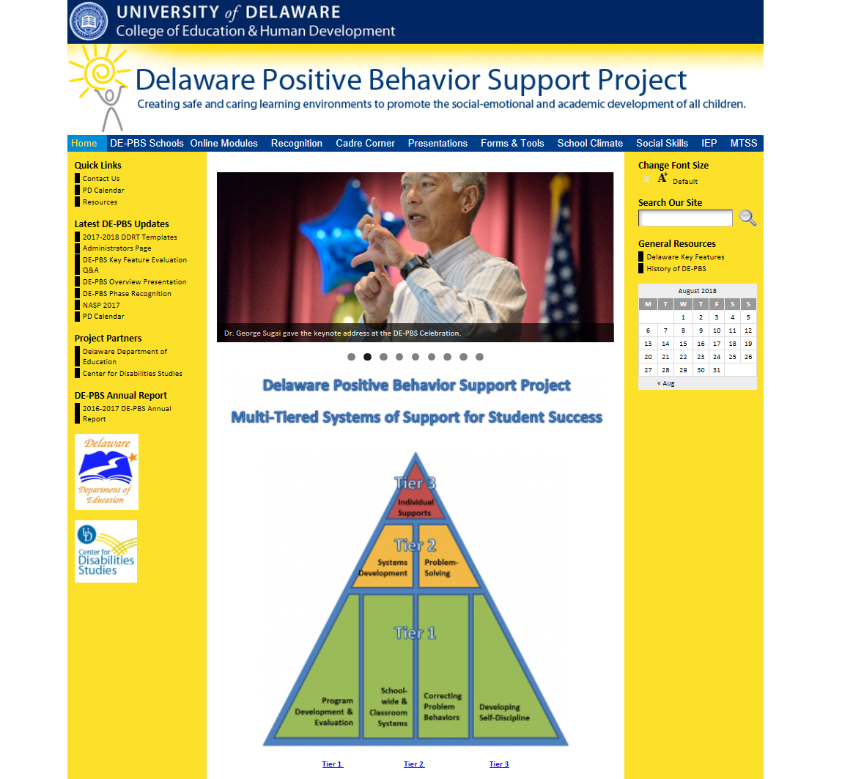
Delaware Resources
Schoology
Delawarepbs.org
Access Code:
F5SJ3-75K3X
Notes:
Narrative: There are several resources for FBAs and BIPs as well as Tier 3 in general available for your use. See the Delaware PBS website, the Delaware PBS Tier 3 Tools Schoology page, and the PBIS.org Tier 3 supports webpage for more information.

Slide 52

Questions? Please Contact:
Dr. Rose Iovannone
iovannone@usf.edu
Niki Kendall, DE-PBS
Robertsn@udel.edu
Debby Boyer, DE-PBS
dboyer@udel.edu

