Slide 1
2019 NEPBIS Leadership Forum
Defusing High School Student Fights Through Tier 1 and 2 Innovations

Slide 2
We are excited to meet you..
Dr. Courtney Voshell (courtney.voshell@capital.k12.de.us)
Ms. Melissa Butz-Miller (melissa.butz@capital.k12.de.us)
Ms. Caroline Green (caroline.green@capital.k12.de.us)
Dr. Megan Pell
(mpell@udel.edu)

Slide 3
Please tell us about you..
Educators or Professionals
in the Classroom
Administrators
District or State-Level Personnel
Team Members – Tier 1, 2 and 3

Slide 4
Presentation Objectives
Share how a 1,700+ student school created and implemented a MTSS approach to address and decrease incidents of student fighting.
Provide the logistics of implementing new preventive and responsive initiatives related to decreasing student fighting.

Slide 5
WELCOME! and please... | Considerations Shared | Tools and Models Shared
Be Engaged | Use Padlet (or your hand) to let presenters know your questions. | Use Padlet to list additional related and recommended tools and models.
Be Reflective | Determine what makes sense for your context. | Share what has worked for your context (or hasn’t).
Be Strategic | Identify who you want to talk to about this presentation on Monday. | Employ the handouts to support your note-taking.

Slide 6
Padlet Information
https://padlet.com/mpell2/dq9m0eo8lplk
Questions for Presenters
&
Related Methods/
Tools to Share with Others

Slide 8
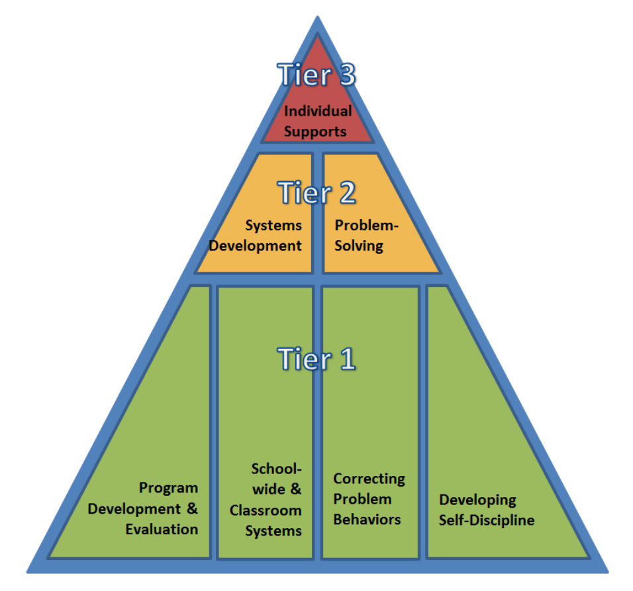
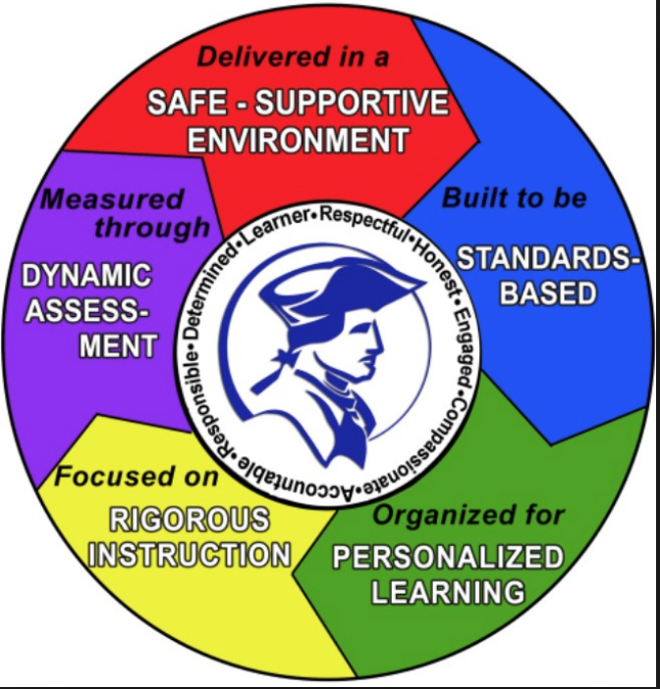
Presentation Overview
The CONTEXT
DE-PBS Project and School Climate Transformation Grant
Dover High School
The INNOVATIONS at Tier 1 and 2
The Why, The What, The How
The DATA
Additional RESOURCES
Q & A Time

Slide 9
The DE-PBS Project serves as a technical assistance center for the Delaware DOE to actualize the vision to create safe and caring learning environments that promote the social-emotional and academic development of all children.
The statewide initiative is designed to build the knowledge and skills of Delaware educators in the concepts and evidence-based practices of Positive Behavior Support (PBS) as a Multi-tiered System of Support (MTSS).

Slide 10
Tier 1 Foundation
School-wide PBS Tier 1: Program Development & Evaluation | Prevention: Implementing Schoolwide & Classroom Systems
Correcting Problem Behavior | Developing Self Discipline

Slide 11
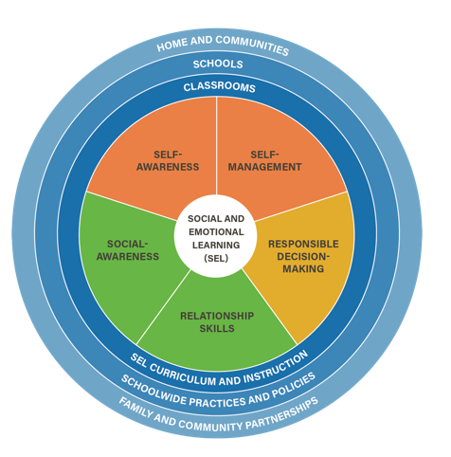
The CASEL
SEL Model
https://casel.org/what-is-sel/

Slide 12
Tier 2 Foundation
Systems
Development
&
Problem-Solving
Conversations
Guiding Document:
Tiered Fidelity Inventory (TFI)

Slide 13
5 year grant
4 years of one-to-one coaching at Tier 1, 2, 3 level for school and district personnel
Additional professional development opportunities and support and funds

Slide 14
Dover High MTSS Innovations
Between March 2017-August 2017:
Tier 1 Team Members and Tier 2/3 Team Members met to:
- determine new Tier 1 Schoolwide SEL programming
- shape a new Tier 2/3 “reintegration from fighting” program
Since August 2017:
Both teams have worked to:
support each other in the implementation of both interventions
maintain programming fidelity
continue cross-tier collaboration & discussions
It takes
time!

Slide 15
Between March 2017-August 2017:
School-In-Session Conversations
Tier 1 team looked at data and talked
although small, fighting was impacting climate
student-student relationships were a concern
a need for research-based character education
Tier 1 approached Tier 2 for All Tiers collaboration
What evidence-based secondary SEL can help?

Slide 16
Between March 2017-August 2017:
Summer Conversations
All Tiers Detective Work and Discussions
SEL research via rubric use
Big Take-Aways:
= 1 focus area for Tier 1: School Connect
goal: map of priorities/lessons
= 1 focus area for Tier 2: Reintegration
goal: find the root cause and prevent from happening it again
(decrease the 5 day penalty using a process)
It takes
time!

Slide 17
And then it all began!
Big Questions
the All Tiers Group Kept in Mind
How?
Who?
When?
The
Reintegration
Process
is Born!

Slide 18
Between Fall 2017:
Back-t0-School Activities
MTSS Roll-Out - Faculty Presentations/Discussions
Tier 1: SW implementation of School Connect via Senator Up!
Tier 2: Reintegration for select fighting incidents

Slide 19
Administrative Perspective: Supporting This Work
Resource allocation
Ensuring the “right people” were connected to the process
Research based curriculum: School Connect
Flexibility with our School Success Guide Standards
Autonomy to our teacher leaders
Recognizing this is not always appropriate (typically because it was unsupported by parents)

Slide 20
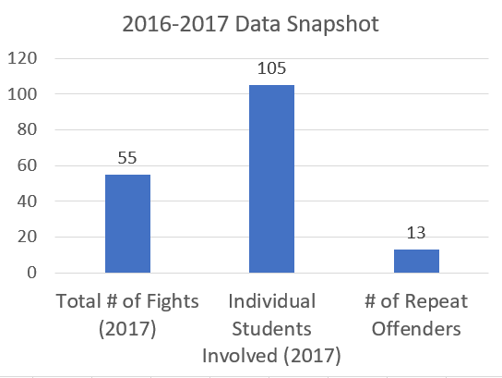
Baseline Data
The Top 5 Offenses
Skipping Class
Safety Violation
Disruption
Leaving assigned area
Fighting

Slide 21
Padlet Reminder
https://padlet.com/mpell2/dq9m0eo8lplk
Questions for Presenters
&
Related Methods/
Tools to Share with Others

Slide 22
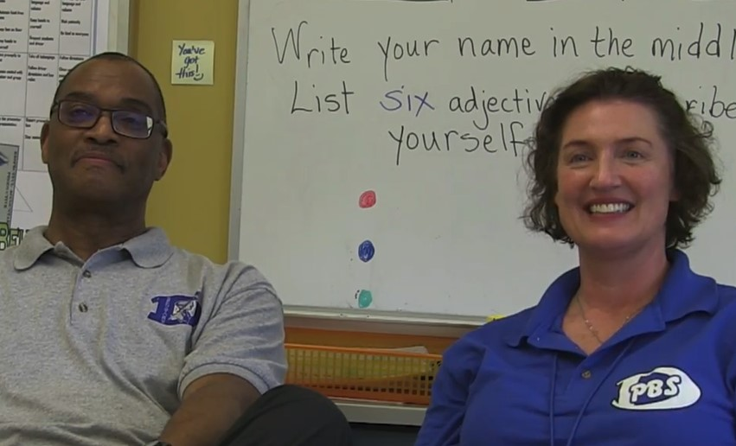
How It Started...
Dover High
Tier 1 Team Leaders
Jim Bailey & Lane Carter
Notes:
HOW IT STARTED

Slide 23
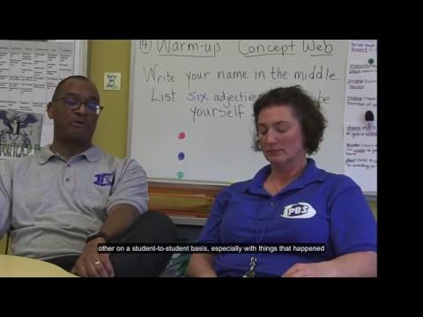
Steps Taken to Move It Forward - Teaching Skills
Dover High
Tier 1 Team Leaders
Jim Bailey & Lane Carter
Notes:
Teaching Skills

Slide 24
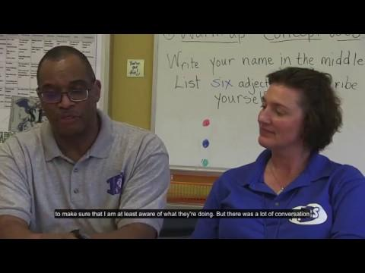
Tier 1 Team Leader Reflections
Dover High
Tier 1 Team Leaders
Jim Bailey & Lane Carter
Notes:
THINKING BACK All Tiers Team coming together & the process in coming up with this plan

Slide 25
2017-18 School Year: | The Logistics
Tier 1 Implementation - How? Who? When?
Tier 2/3 Implementation - How? Who? When?
The Tools
The Timelines

Slide 26
2017-18 School Year
Tier 1 Implementation - How? Who? When?
Analyzed the School Connect curriculum for best lessons based on recommendations from UDel, Dr. Pell
Reviewed calendar dates for Senator Up! (advisory classes)
aligned selected lessons
published on the PBS webpage (DHS website)
rolled out to staff during faculty meetings (twice) and had PD
coordinated with librarian for book tracking through Destiny Discover
provided access to class sets for advisory teachers
coordinated pre-printed materials for all lessons (delivered every week to teacher boxes)

Slide 27
2017-18 School Year
Tier 2/3 Implementation
Rolled out to staff at start of 2017-18 school year through staff meetings, PBS breakout sessions, Tier II meetings
Tier II leads and ISS Coordinator met at start of school year to review and select appropriate School Connect Lessons, created a Reintegration Form, Student Reflection Sheet, Google Doc Tracking Form, and process for “What Happens After a Fight”
Reintegrations are completed the day they return to school - some may return a day early to complete the process
Reintegrations are assigned based on staff availability

Slide 28
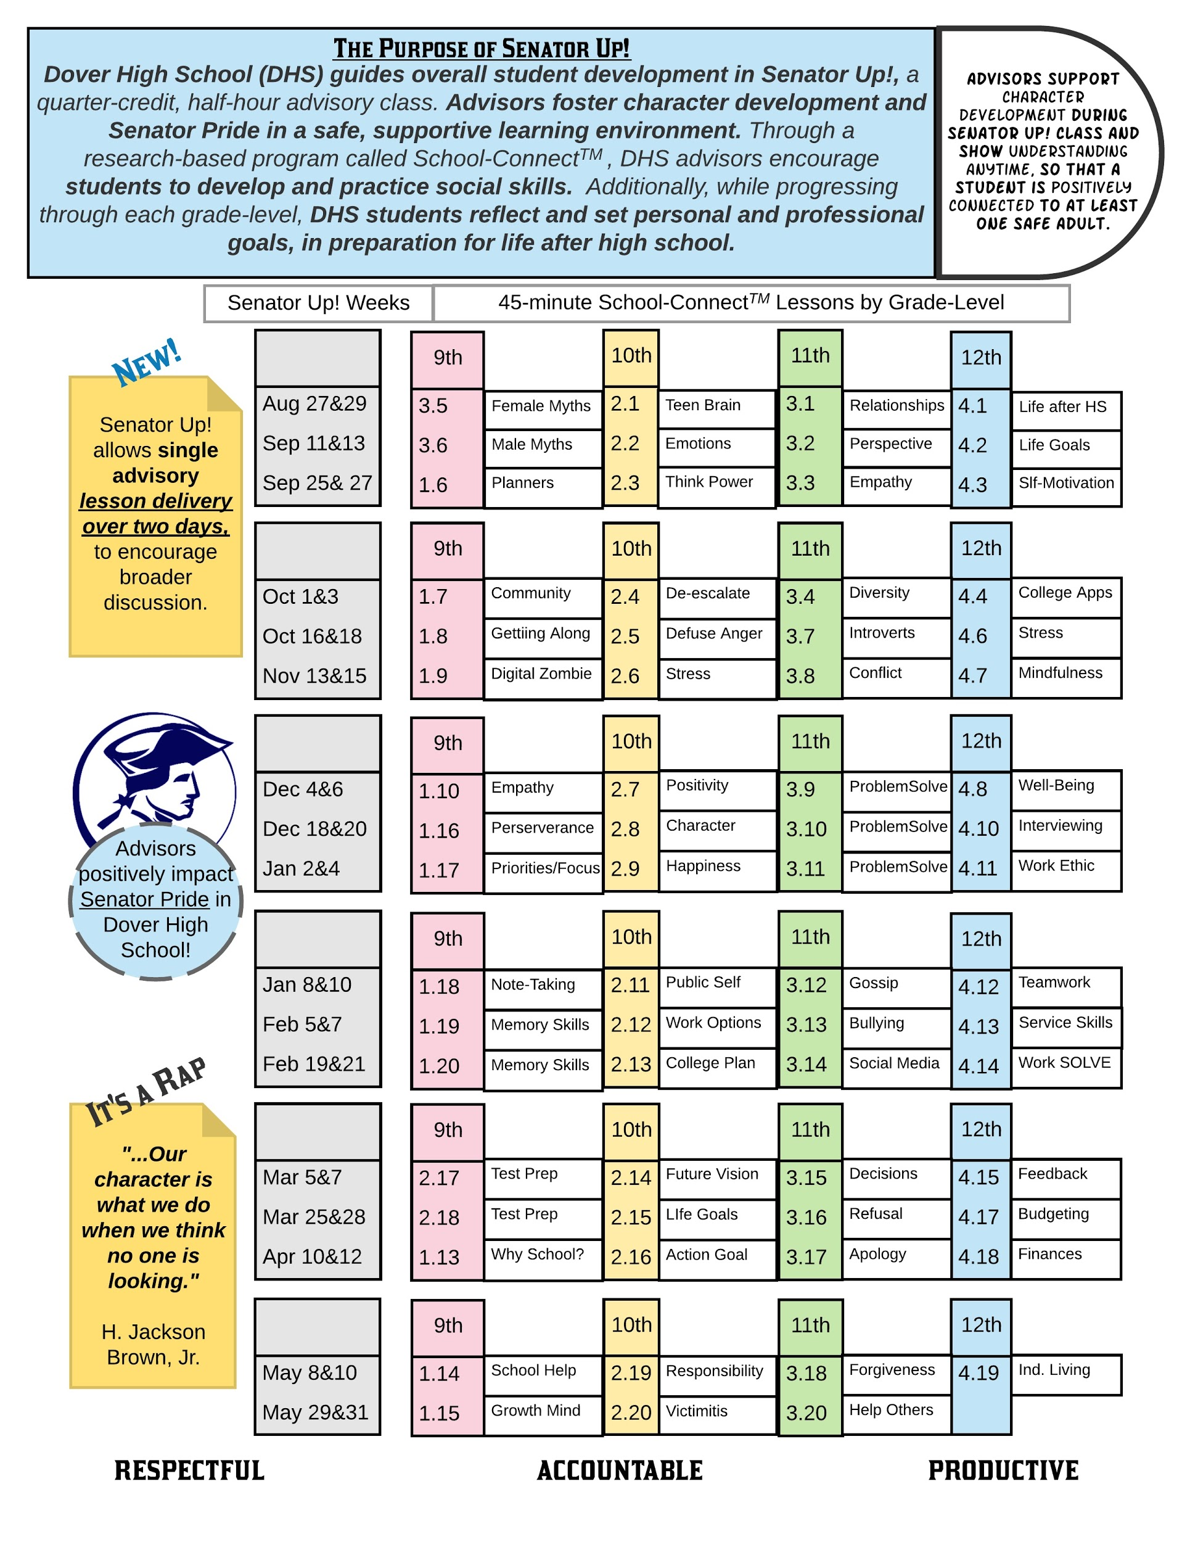
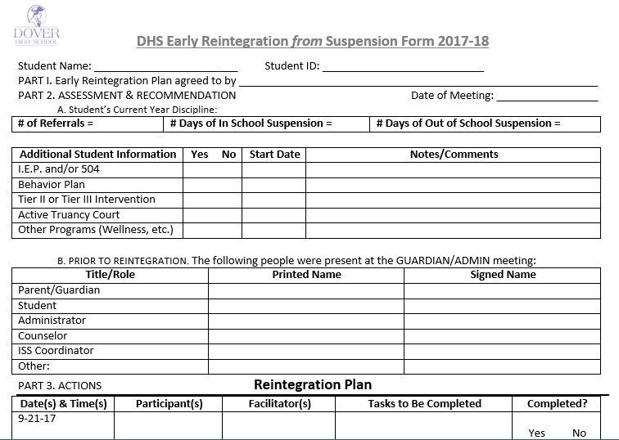
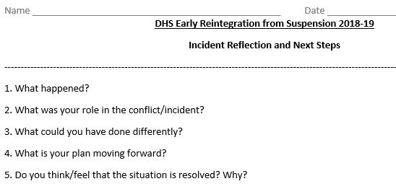
The Tools | Tier I and II leaders work together as each team creates their plans for implementation - the overall purpose is to make sure each plan supports the other and improves building climate
Tier II - Reintegration Process
The goal is to decrease days of OSS while providing students with the skills to avoid fighting in the future while promoting a positive school climate
Tier I - Senator Up! (Advisory)
Created a schedule for School Connect Curriculum
Notes:
Butz-Miller (Voshell jump in)

Slide 29
Summer 2017
Tier I - Senator Up! (Advisory)
Created a schedule for School Connect Curriculum
Notes:
Close -up of handout

Slide 30
Summer 2017
Tier II - Reintegration Process
The goal is to decrease days of OSS while providing students with the skills to avoid fighting in the future while promoting a positive school climate
Notes:
Close -up of handout: The reintegration forms - Plan Page

Slide 31
Summer 2017
Tier II - Reintegration Process
The goal is to decrease days of OSS while providing students with the skills to avoid fighting in the future while promoting a positive school climate
Notes:
Close -up of handout: The reintegration forms - Reflection Sheet

Slide 32
How did it look in practice with students, family and staffing?

Slide 33
Reintegration Anticipated/Sample Timeline
Monday 18th | Tuesday 19th | Wednesday 20th | Thursday 21st | Friday 22nd
 |  | Fight occurs during lunch between Student A and Student B. First fight for both students; both receive 3 days OSS. Both parties and parents review and sign Reintegration Agreement form prior to leaving school grounds. | Parents are contacted again to reinsure all parents agree to Reintegration Process and will bring students to school 1 day early. Students are not to ride the bus - must be brought to school via own transportation.
Monday 25th | Tuesday 26th | Wednesday 27th | Thursday 28th | Friday 29th
Both students return to school 1 day early from OSS to complete Reintegration and missed coursework due to suspension. Reintegration Process is completed and students are permitted to return to classes.

Slide 34
Reintegration Anticipated/Sample Timeline
Monday 18th | Tuesday 19th | Wednesday 20th | Thursday 21st | Friday 22nd | Monday 25th
 |  | Fight occurs during lunch between Student A and Student B. First fight for both students; both receive 3 days OSS. Both parties and parents review and sign Reintegration Agreement form prior to leaving school grounds. | Parents are contacted again to reinsure all parents agree to Reintegration Process and will bring students to school 1 day early. Students are not to ride the bus - must be brought to school via own transportation. |  | Both students return to school 1 day early from OSS to complete Reintegration and missed coursework due to suspension. Reintegration Process is completed and students are permitted to return to classes.
Notes:
Taking a closer look with a condensed work week visual.

Slide 35
Reintegration Actual Timeline
Monday 18th | Tuesday 19th | Wednesday 20th | Thursday 21st | Friday 22nd
 |  | Fight occurs during lunch between Student A and Student B. First fight for both students; both receive 3 days OSS. One student is permitted to walk home the other is picked up by emergency contact. | Parents are contacted again to discuss the Reintegration Process. Neither party can be reached and messages are not returned. Paperwork is mailed home (includes Reintegration Information). | Parents are contacted again to discuss the Reintegration Process. Only parent of Student B is reached.
Monday 25th | Tuesday 26th | Wednesday 27th | Thursday 28th | Friday 29th
Student B returns a day early (parent was contacted); student A is still on suspension. Student B completes Reflection Piece of Reintegration only and returns to classes. | Student A returns to school. Both students complete Reintegration Process and return to classes.

Slide 36
Reintegration Actual Timeline (Days# 1-3)
Monday 18th | Tuesday 19th | Wednesday 20th | Thursday 21st | Friday 22nd
 |  | Fight occurs during lunch between Student A and Student B. First fight for both students; both receive 3 days OSS. One student is permitted to walk home the other is picked up by emergency contact. | Parents are contacted again to discuss the Reintegration Process. Neither party can be reached and messages are not returned. Paperwork is mailed home (includes Reintegration Information). | Parents are contacted again to discuss the Reintegration Process. Only parent of Student B is reached.
Notes:
Taking a closer look at the first 3 days of the intervention – really how it looks .

Slide 37
Reintegration Actual Timeline (Days # 4-5)
Monday 25th | Tuesday 26th | Wednesday 27th | Thursday 28th | Friday 29th
Student B returns a day early (parent was contacted); student A is still on suspension. Student B completes Reflection Piece of Reintegration only and returns to classes. | Student A returns to school. Both students complete Reintegration Process and return to classes.
Notes:
Taking a closer look at the last 2days of the intervention.

Slide 38
Case Studies:
What did it look like on the ground
for students?

Slide 39
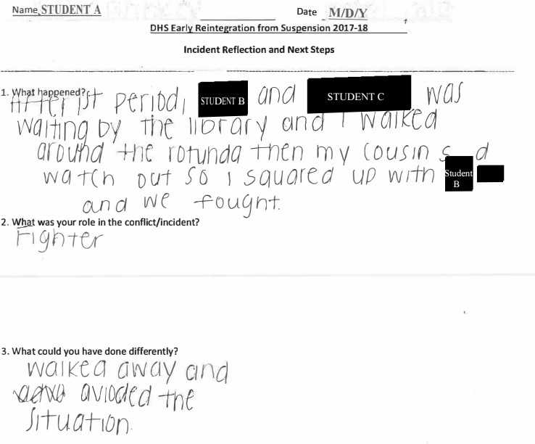
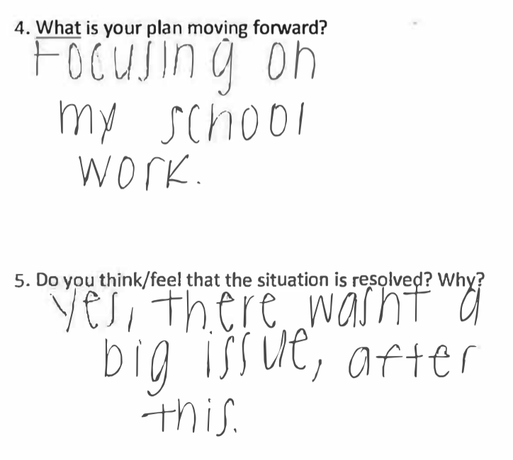
Student
Example
# 1
See handout
Notes:
See handout

Slide 40
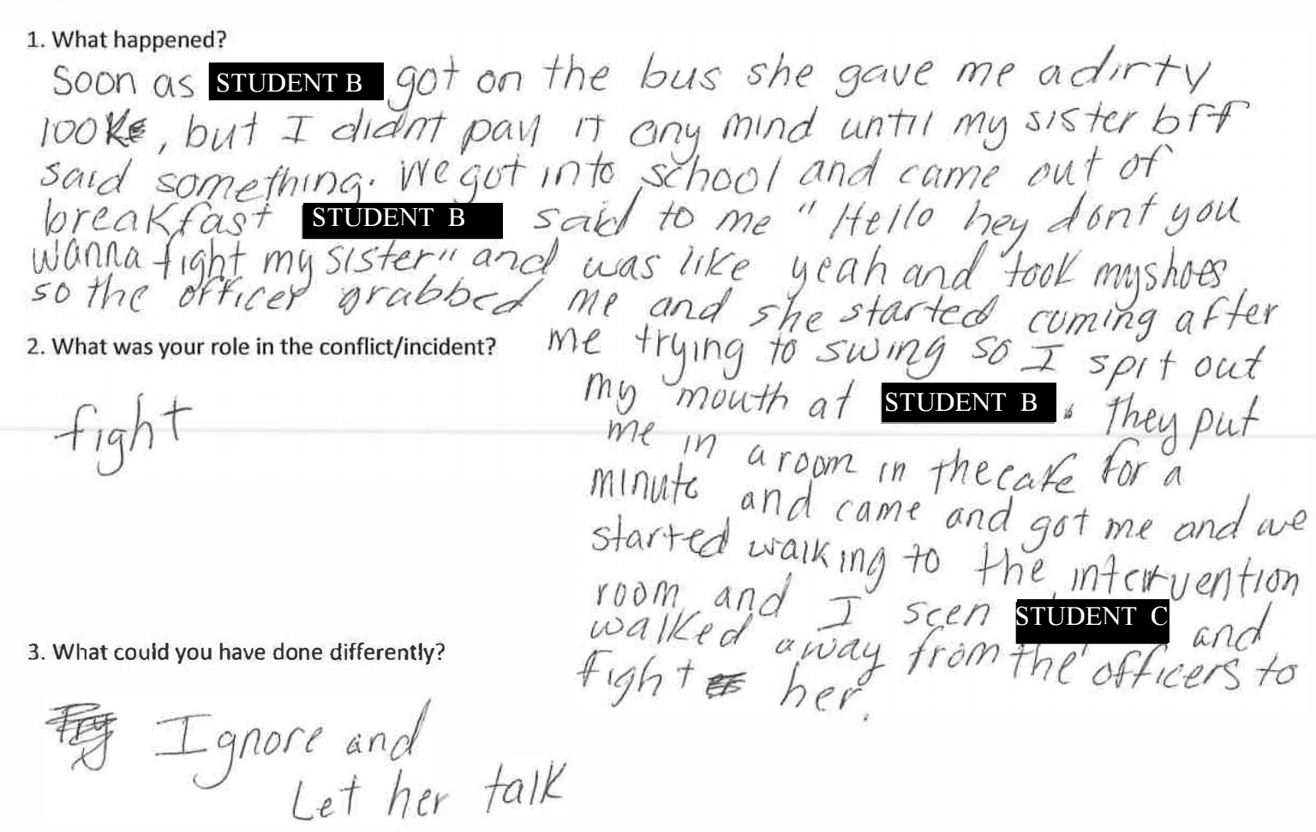
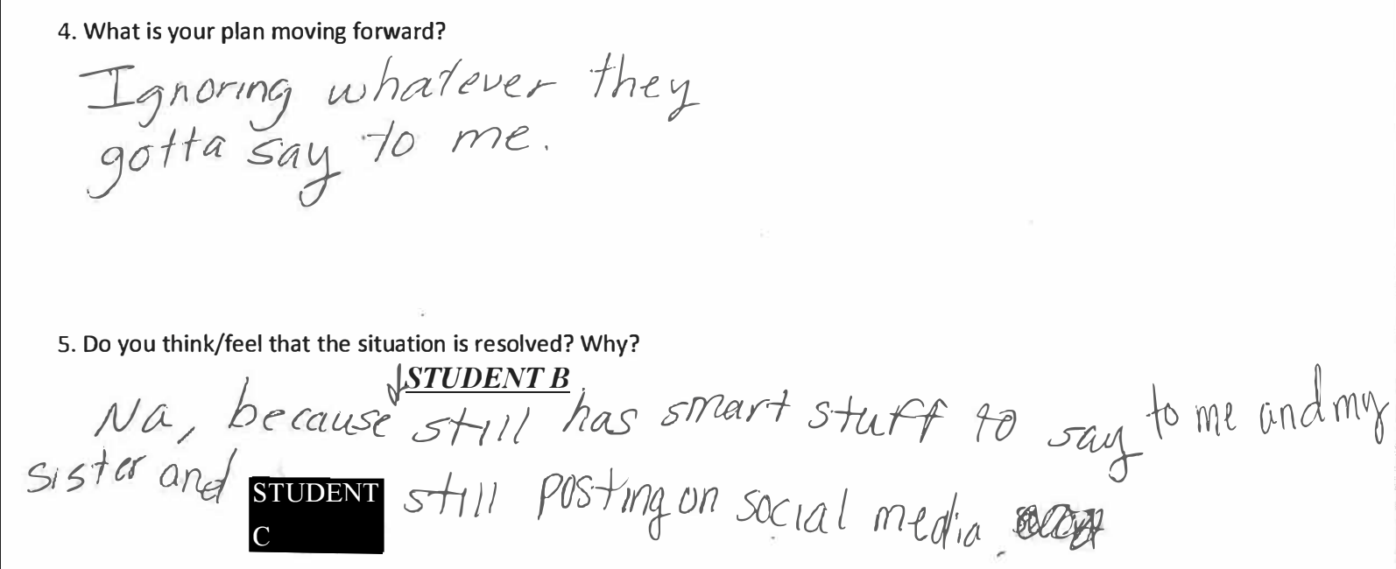
Student
Example
# 2
See handout
Notes:
See handout

Slide 41
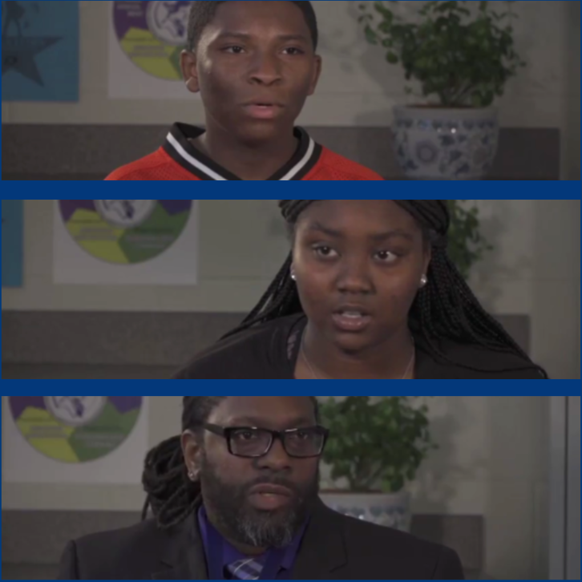
Video Excerpt
Mr. Johnson and Students
Delaware Parent
Information Center

Slide 42
What does the numeric data seem to tell us about the reintegration intervention?

Slide 43
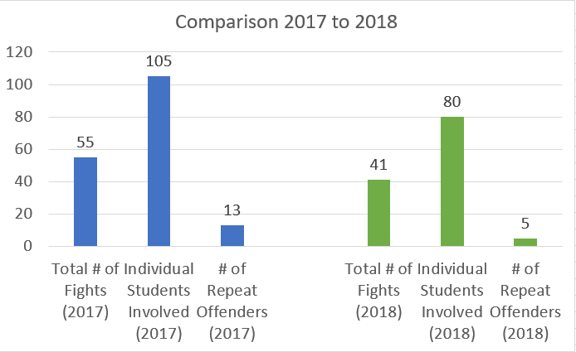
Current Data
Top Offenses (YTD 2019)
Leaving assigned area
Skipping Class
Disrespect towards a staff member
Disruption of the Ed Process
Fighting*

Slide 44
2017-18 Reintegration Data Breakdown
 | # Students Referred | # Students Completed | SE | RE | 9th | 10th | 11th | 12th
Q1 | 15 (7 M) (8 F) | 13 | 1 | 14 | 4 | 5 | 4 | 2
Q2 | 19 (13 M) (6 F) | 17 | 5 | 14 | 10 | 4 | 4 | 0
Q3 | 39 (11 M) (28 F) | 36 | 6 | 33 | 19 | 14 | 3 | 3
Q4 | 13 (5 M) (8 F) | 12 | 2 | 11 | 5 | 4 | 3 | 1
Overall | 86 | 78 | 14 | 72 | 38 | 27 | 14 | 6

Slide 45
2017-18 School Year | First Reintegration (Sept. 13, 2017) What we learned from the process
On-going Tier I and II communication and support via meetings and mid-year
check ins!
(CRUCIAL is an understatement!)
# of repeat offenders = 3
# of repeat fights between same 2 people = 0
staff climate change with regards to returning students
word of the Reintegration Process spreading amongst students

Slide 46
2017-18 School Year | First Reintegration (Sept. 13, 2017) What we learned from the process
amount of time the Reintegration Process takes
scheduling and supporting reintegrations
location(s) for reintegrations
maintaining fidelity with regards to each pair/group
COMMUNICATION
On-going Tier I and II communication and support via meetings and mid-year
check ins!
(CRUCIAL is an understatement!)

Slide 47
Summer 2018 | Data and systems review Review implementation of School-Connect curriculum
2018-19 School Year | Our data so far and what it tells us Summer work and next steps Tier I and II Goals for 2019-2020 school year
 | # Students Referred | # Students Completed | 9th | 10th | 11th | 12th
Q1 | 23 (12 M) (11 F) | 22 | 14 | 3 | 4 | 2
Q2 | 26 (13 M) (13 F) | 26 | 16 | 2 | 5 | 3
Q3 | 47 (34 M) (13 F) | 44 | 29 | 11 | 2 | 5
Q3
spike
needs
Tier 1
proactivity

Slide 48
Where are we now and which directions might we (and you!) be heading?

Slide 49
Where we are now
Current conversations among the adults...
MTSS (All Team) Communication
Careful about Fidelity (Including Follow-Up)
Flexible Schedule at All Times
Be Seen As Neutral Ally
Two People at All Times and Strong Working Relationships
Significant Background in Behavior and Interventions
Knowledge About Existing Interventions in School
Positive Relationships with Staff in the Building

Slide 50
Additional Administrative Reflections...
Self-Reflection
How can we be more proactive versus reactive?
Stay Supportive and Engaged
Gathering more support for our co-leads
How do we maintain fidelity without causing burnout?
Streamlined
How do we support this at our middle grades?

Slide 51
Existing Supportive Tools...
School Climate Surveying
The HEXAGON Tool
CASEL Program Guide for Secondary Schools
Delaware PBS Project and PBIS.org

Slide 52
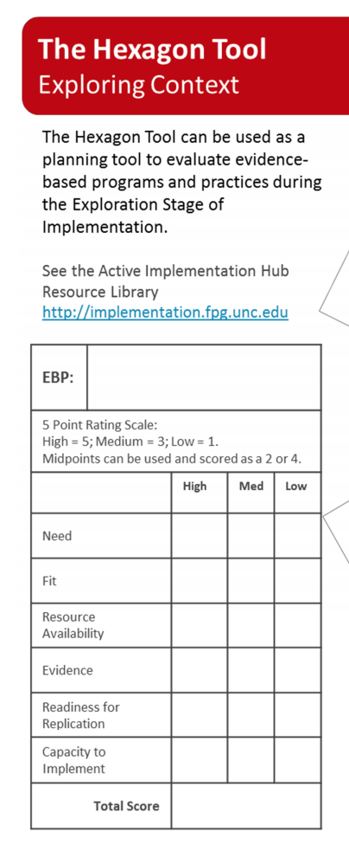
Existing
Supportive
Tools...
https://www.pbis.org/Common/Cms/files/pbisresources/NIRN-Education- TheHexagonTool.pdf
http://secondaryguide.casel.org/casel-secondary-guide.pdf

Slide 53
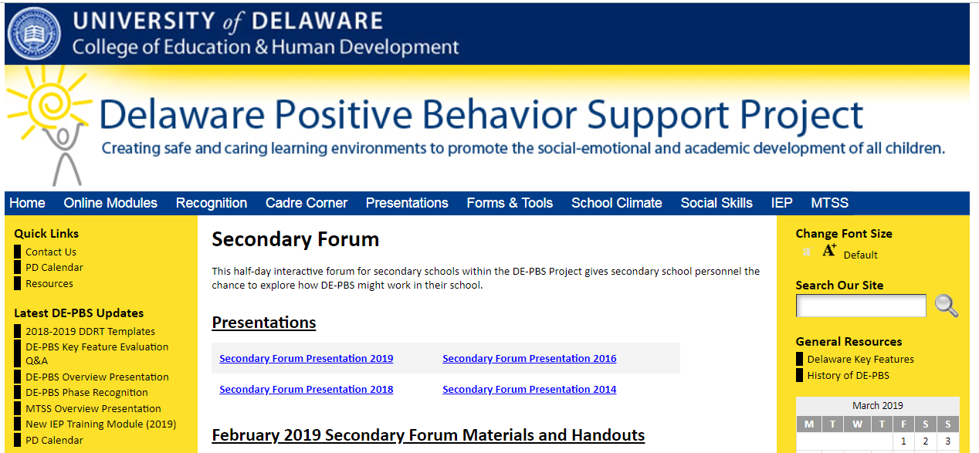
Delaware PBS Project delawarepbs.org

Slide 54
PBIS.org

Slide 55
https://padlet.com/mpell2/dq9m0eo8lplk
Thank You - Q & A!
Dr. Courtney Voshell (courtney.voshell@capital.k12.de.us)
Ms. Melissa Butz-Miller (melissa.butz@capital.k12.de.us)
Ms. Caroline Green (caroline.green@capital.k12.de.us)
Dr. Megan Pell (mpell@udel.edu)
Notes:
Review of Padlet

