Slide 1
School Climate Data Workshop
Delaware Positive Behavior Support Project
May 12, 2015
George Bear, Ph.D.
Jessica Kradjel
Sarah Hearn
University of Delaware

Slide 2
Agenda
Time: | Topic:
9:00 – 9:45 | Overview of School Climate & Delaware State-wide Results
9:45 – 10:15 | School Climate Data Sharing & Use
10:15 – 10:30 | Break
10:30 – 10:50 | Understanding Data Reports & Interpretation Worksheets
10:50 – 12:00 | Group Work on Interpreting your school’s scores.

Slide 3
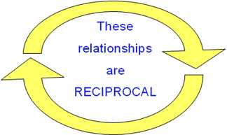
Why is school climate important?
School Climate is linked to a wide range of academic, behavioral, and socio-emotional outcomes for students:
Academic achievement
Student academic, social, and personal attitudes and motives
Attendance and school avoidance
Behavior problems, delinquency, victimization
Emotional well-being

Slide 4
School climate is also linked to outcomes for teachers:
Less burnout and greater retention in the profession
Greater implementation fidelity of new curriculum and interventions
Greater levels of job satisfaction

Slide 5
DE School Climate Survey Participation
Number of Schools
School Years

Slide 6
2015 Survey Sample
 |  | Student Survey | Teacher Survey | Home Survey
Elementary | Schools | 79 | 80 | 76
 | Respondents | 15751 | 2913 | 13049
Middle | Schools | 28 | 28 | 24
 | Respondents | 11181 | 1249 | 3914
High | Schools | 21 | 21 | 16
 | Respondents | 6906 | 1137 | 1514
Alternative | Schools | 5 | 5 | 3
 | Respondents | 149 | 97 | 32
Special | Schools | 4 | 8 | 7
 | Respondents | 200 | 460 | 284
Early Childhood | Schools | N/A | 7 | 7
 | Respondents | N/A | 226 | 733
Other | Schools | 3 | 4 | 4
 | Respondents | 2150 | 183 | 832

Slide 7
Delaware School Climate Surveys 2015 Subscales
Part I : School Climate
Student Survey | Teacher/Staff Survey | Home Survey
Teacher-Student Relations | Teacher-Student Relations | Teacher-Student Relations
Student-Student Relations | Student-Student Relations | Student-Student Relations
Respect for Diversity | Respect for Diversity | Respect for Diversity
Clarity of Expectations | Clarity of Expectations | Clarity of Expectations
Fairness of Rules | Fairness of Rules | Fairness of Rules
School Safety | School Safety | School Safety
Student Engagement School-wide | Student Engagement School-wide
Bullying School-wide | Bullying School-wide
 | Teacher-Home Communications | Teacher-Home Communications
 | Staff Relations
Total School Climate | Total School Climate | Total School Climate
 |  | Parent Satisfaction

Slide 8
Part I: School Climate Item Examples
Teacher-Student Relations
“Teachers care about their students.”
Student-Student Relations
“Students are friendly with each other.”
Respect for Diversity
“Adults care about students of all races.”
Student Engagement School-wide
“Most students try their best.”
Clarity of Expectations
“Students know what the rules are.”
Fairness of Rules
“The school rules are fair.”

Slide 9
Part I: School Climate Item Examples (continued)
School Safety
“Students feel safe.”
Bullying School-wide
(Note: A high score for this subscale is unfavorable)
“Students threaten and bully others.”
Teacher-Home Communications
“Teachers listen to the concerns of parents.”
Staff Relations
“Teachers, staff, and administrators work well together.”
Satisfaction with School
“I like this school.”

Slide 10
PART II: Techniques
Student Survey | Teacher/Staff Survey | Home Survey
Positive Behavior Techniques | Positive Behavior Techniques
Punitive Techniques | Punitive Techniques
Social Emotional Learning Techniques | Social Emotional Learning Techniques

Slide 11
Part II: Techniques Item Examples
Use of Positive Techniques
“Students are praised often.”
“Classes get rewards for good behavior.”
Use of Punitive Techniques (Note: A high score for this subscale is unfavorable)
“Students are punished a lot.”
“Students are often sent out of class for breaking rules.”
Use of Social Emotional Learning (SEL) Techniques
“Students are taught to feel responsible for how they act.”
“Students are taught to understand how others think and feel.”

Slide 12
Part III: Bullying & IV: Engagement (Individual Level)
Student Survey |  | Teacher/Staff Survey | Home Survey
Bullying Victimization¹ | Physical Bullying |  | Physical Bullying
 | Verbal Bullying |  | Verbal Bullying
 | Social/Relational Bullying |  | Social/Relational Bullying
 | Cyberbullying²
Student Engagement | Cognitive & Behavioral |  | Cognitive & Behavioral
 | Emotional |  | Emotional
¹ Grades 6-12 only for the printed version. Optional for grades 4-5 with computer version. ² Grades 6-12 only.

Slide 13
Part III: Bullying Victimization
Item Examples
Verbal Bullying
“A student said mean things to me.”
Physical Bullying
“I was pushed or shoved on purpose.”
Social/Relational Bullying
“A student told or got others to not like me.”
Cyberbullying (grades 6-12)
“A student sent me a mean or hurtful message about me using email, text messaging, instant messaging, or similar electronic messaging.”

Slide 14
Part IV: Student Engagement
Item Examples
Cognitive and Behavioral Engagement
“I pay attention in class.”
“I try my best in school.”
Emotional Engagement
“I feel happy in school.”
“My school is a fun place to be.”

Slide 15
Evidence of Reliability and Validity
Reliability:
Are the scores consistent or stable?
Validity:
Does the test yield the factors predicted?
Are the scores related to other variables as one might predict (e.g., grade level, sex and race, academic achievement, suspensions)?

Slide 16
They’re reliable!

Slide 17
Climate Surveys: Reliability (alpha coefficients)
Subscale | Student | Teacher/Staff | Home
Teacher-Student Relations | .87 | .87 | .90
Student-Student Relations | .86 | .91 | .93
School Safety | .79 | .89 | .91
Clarity of Expectations | .77 | .90 | .92
Fairness of Rules | .80 | .83 | .90
Respect for Diversity | .79 | .85 | .87
Student Engagement School-wide | .76 | .84 | N/A
Bullying School-wide | .77 | .89 | N/A
Teacher-Home Communications | N/A | .82 | .90
Staff Relations | N/A | .95 | N/A
Total Climate | .93 | .96 | .98
Parent Satisfaction | N/A | N/A | .87
Use of Positive Behavioral Techniques | .82 | .84 | N/A
Use of Punitive Techniques | .72 | .78 | N/A
Use of Social Emotional Learning Techniques | .82 | .91 | N/A

Slide 18
Climate Surveys: Reliability (alpha coefficients)
Subscale | Student | Home
Cognitive and Behavioral Engagement | .84 | .88
Emotional Engagement | .88 | .91
Verbal Bullying | .92 | .92
Physical Bullying | .87 | .81
Social/Relational Bullying | .91 | .90
Total Bullying | .95 | .94
Cyberbullying | .91 | N/A

Slide 19
Evidence of Validity?

Slide 20
See Technical Manual on Delaware PBS website
Bear, G. G., Yang, C., Mantz, L., Pasipanodya, E., Boyer, D., & Hearn, S. (2014). Technical manual for Delaware surveys of school climate, bullying victimization, student engagement, and positive, punitive, and social emotional learning techniques.
http://wordpress.oet.udel.edu/pbs/technical-manual-for-school-climate-surveys

Slide 21
Peer-Reviewed Journals:
Bear, G. G., Gaskins, C., Blank, J. , & Chen, F. F. (2011). Delaware School Climate Survey-Student: Its factor structure, concurrent validity, and reliability. Journal of School Psychology.
Bear, G., Yang, C., Pell, M., & Gaskin, C. (2014).Validation of a brief measure of teachers' perceptions of school climate: Relations to student achievement and suspensions. Learning Environments Research.
Bear, G.G., Yang, C., & Pasipanodya, E. (2015). Assessing school climate: Validation of a brief measure of the perceptions of parents. Journal of Psychoeducational Assessment.
Yang, C., Bear, G. G., Chen, F.F., Zhang, W., Blank, J.C., & Huang, X.S. (2013). Students‘perceptions of school climate in the U.S. and China. School Psychology Quarterly.
Bear, G.G., Mantz, L., Glutting, J., Yang, C., & Boyer, D. (2015). Differences in bullying victimization between students with and without disabilities. School Psychology Review.

Slide 22
Validity Screening Items on Student Survey
Items:
“I am telling the truth in this survey.”
“I answered all items truthfully on this survey.”
Results:
6.4% (2,665) disagreed to one or both items and thus were deleted
5.8% (2,388) did not respond to one or both items
“Liars” scored significantly lower, but their removal had very little impact on overall scores (about 1 tenth of a point)

Slide 23
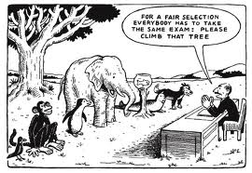
2015 State-wide Results

Slide 24
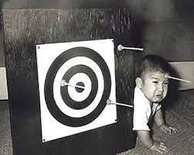
Might not be the scores you aimed for, but most were quite good.

Slide 25
For example: “I like this school.” | Percent who Agreed or Agreed a lot
 | Elem School | Middle School | High School
Teachers/Staff | 96% | 91% | 89%
Home | 96% | 87% | 82%
Students | 88% | 71% | 67%

Slide 26
Part I: School Climate Subscales
Student Survey Results

Slide 27
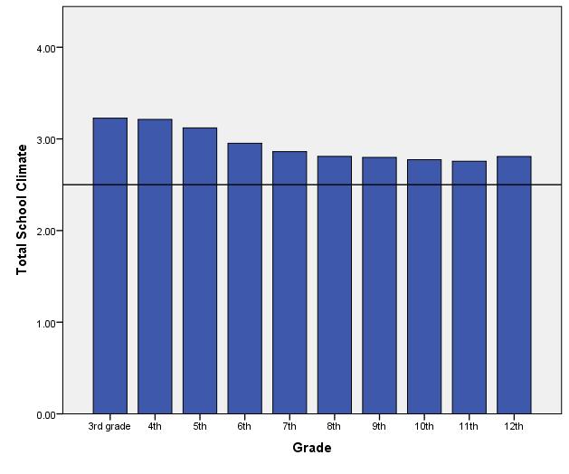
Total School Climate by Student Grade
Student perceptions tend to decrease, especially from elementary to middle school

Slide 28
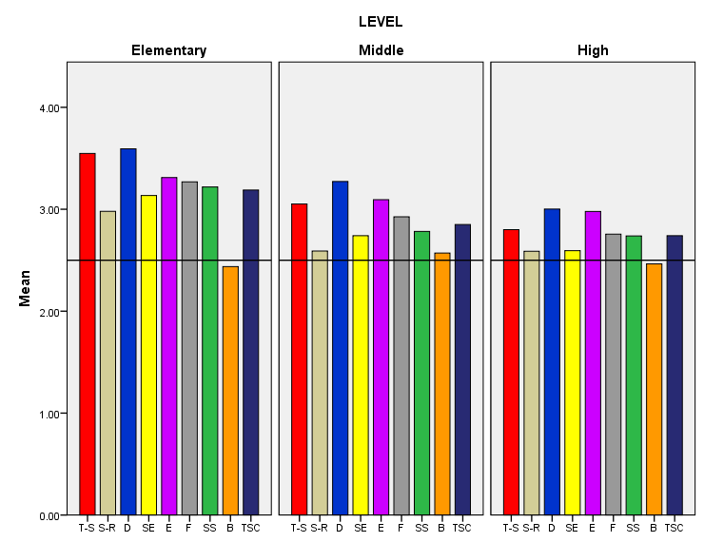
Grade Level Differences: Student Survey 2015
Teacher-Student Relations
Respect for Diversity
Clarity of Expectations
School Safety
Total School Climate
Student Engagement
School-wide
Bullying School-wide
Student Relations
Fairness of Rules
Fairness of Rules

Slide 29
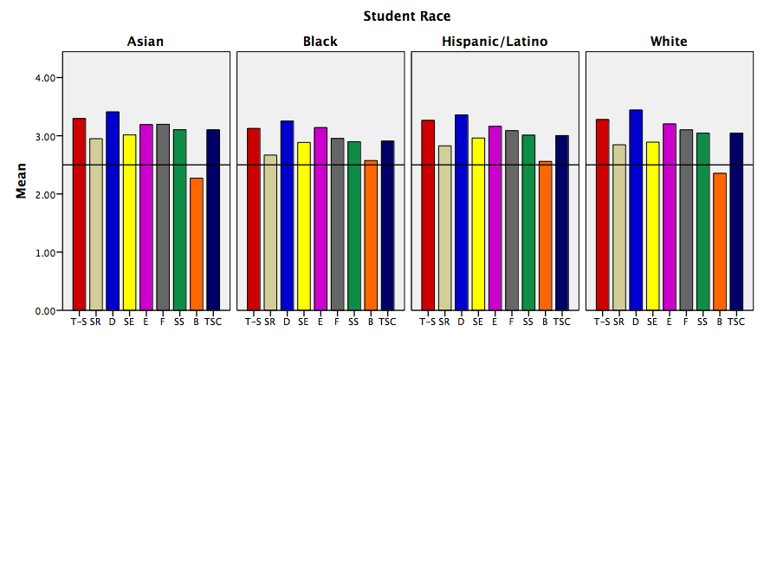
Racial Differences: Student Survey 2015
Teacher-Student Relations
Respect for Diversity
Clarity of Expectations
School Safety
Total School Climate
Student Engagement
School-wide
Bullying School-wide
Student Relations
Fairness of Rules
Fairness of Rules

Slide 30
Sample subscale responses associated with student scores (Part I: School Climate) | Percent who Agreed or Agreed a lot
 | Elem School | Middle School | High School
Teacher-Student Relations 7. Teachers care about their students. | 95.6 | 85.8 | 76.4
Student–Student Relations 11. Students are friendly with each other. | 75.8 | 59.7 | 62.5
Student Engagement School-wide 29. Most students work hard to get good grades. | 91.6 | 75.9 | 66.8
Clarity of Expectations 10. Students know how they are expected to act. | 88.2 | 82.7 | 82.6
Bullying School-wide* 9. Students threaten and bully others. | 36.9 | 52.8 | 50.4
School Safety 13. Students feel safe. | 89.4 | 75.8 | 72.2
* = A high score on this subscale is negative because items are negatively worded.

Slide 31
Sample subscale responses associated with student scores (Part I: School Climate) | Percent who Agreed or Agreed a lot
 | Elem School | Middle School | High School
Respect for Diversity 2. Teachers treat students of all races with respect. | 94.0 | 86.0 | 80.4
Fairness of Rules 18. The school’s Code of Conduct is fair. | 89.9 | 77.0 | 70.9

Slide 32
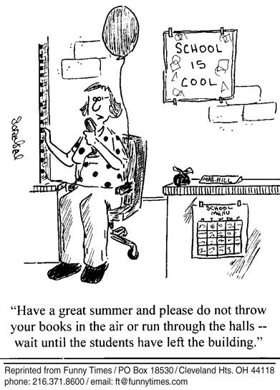
Part I: School Climate Subscales Teacher/Staff Survey Results

Slide 33
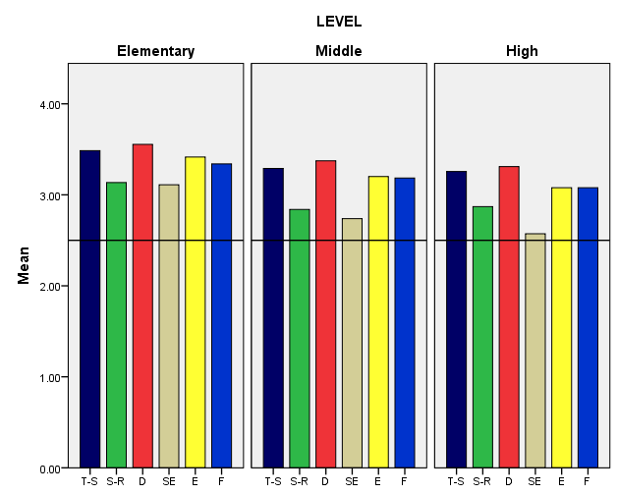
2015 Teacher Survey Results, K-12
Teacher-Student Relations
Respect for Diversity
Clarity of Expectations
Student Relations
Student Engagement
School-wide
Fairness of Rules

Slide 34
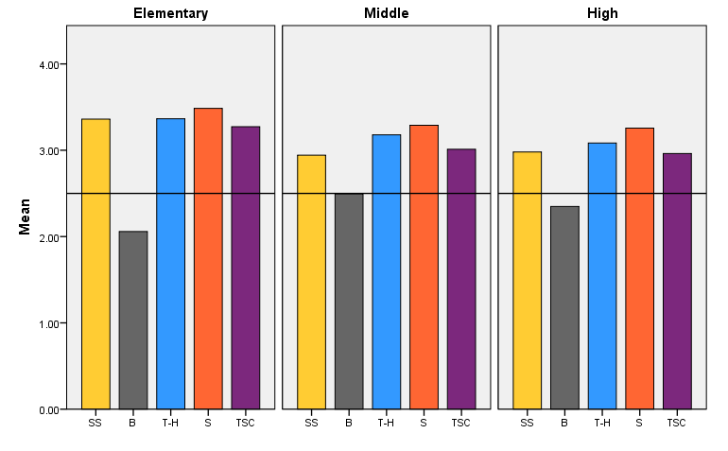
2015 Teacher Survey Results, K-12
School Safety
Teacher-Home
Communication
Total School Climate
Bullying School-wide
Staff Relations

Slide 35
Sample subscale responses associated with teacher/staff scores (Part I: School Climate) | Percent who Agreed or Agreed a lot
 | Elem School | Middle School | High School
Teacher-Student Relations 7. Teachers care about their students. | 99.2 | 97.8 | 98.2
Student–Student Relations 11. Students are friendly with each other. | 93.8 | 81.7 | 84.4
Student Engagement School-wide 29. Most students work hard to get good grades. | 89.1 | 66.8 | 55.8
Clarity of Expectations 10. Students know how they are expected to act. | 97.0 | 92.0 | 86.6
Bullying School-wide* 9. Students threaten and bully others. | 30.1 | 57.6 | 48.0
School Safety 13. Students feel safe. | 97.0 | 82.8 | 84.4
* = A high score on this subscale is negative because items are negatively worded.

Slide 36
Sample subscale responses associated with teacher/staff scores (Part I: School Climate) | Percent who Agreed or Agreed a lot
 | Elem School | Middle School | High School
Respect for Diversity 2. Teachers treat students of all races with respect. | 97.3 | 95.5 | 94.6
Fairness of Rules 18. The school’s Code of Conduct is fair. | 92.5 | 88.8 | 88.1
Teacher-Home Communications 37. Teachers do a good job communicating with parents. | 96.5 | 89.3 | 85.5
Staff Relations 36. Teachers, staff, and administrators function as a good team in this school. | 85.3 | 77.7 | 73.3

Slide 37
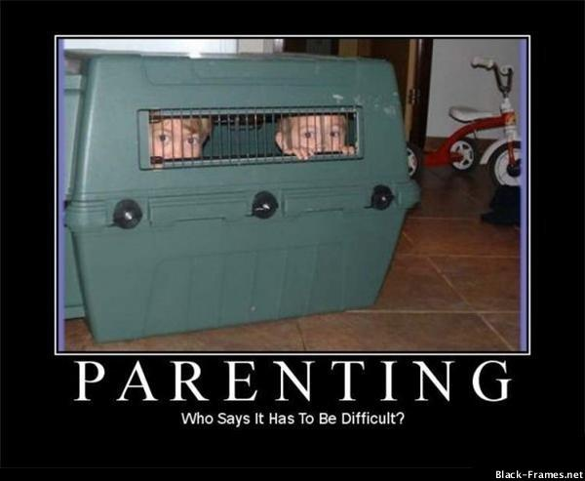
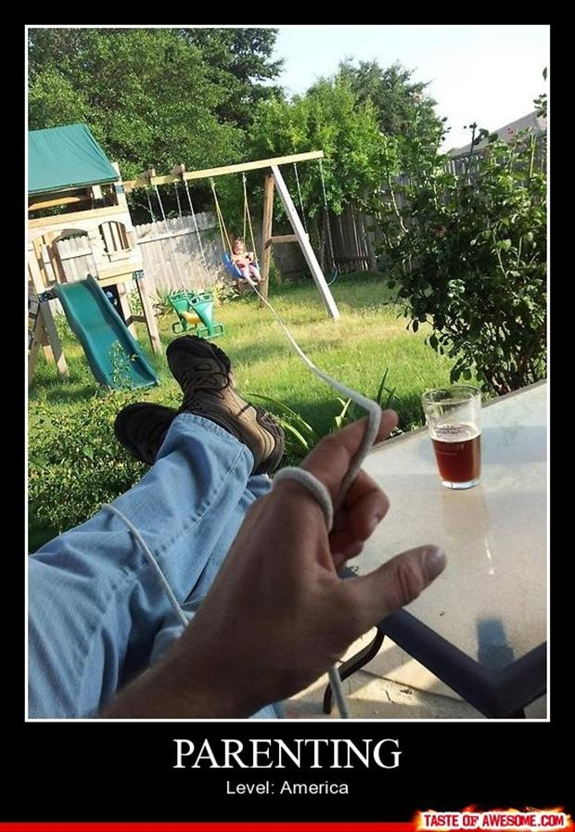
Part I: School Climate Subscales Home Survey Results

Slide 38
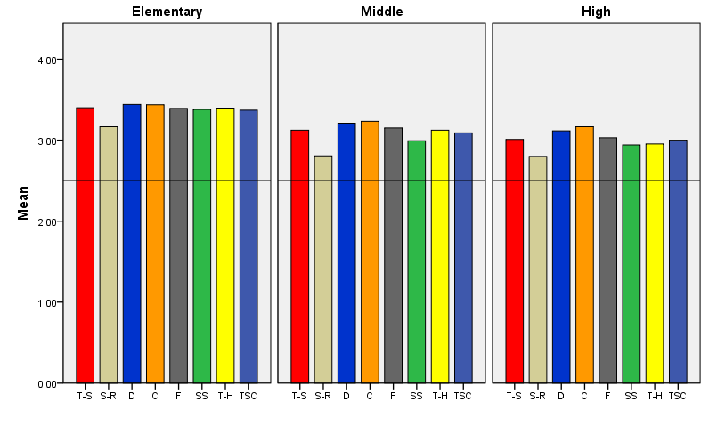
Grade Level Differences: Home Survey 2015
Teacher-Student Relations
Respect for Diversity
Fairness of Rules
Teacher-Home Communication
Student Relations
Clarity of Expectations
School Safety
Total School Climate
Fairness of Rules

Slide 39
Sample subscale responses associated with home scores (Part I: School Climate) | Percent who Agreed or Agreed a lot
 | Elem School | Middle School | High School
Teacher-Student Relations 7. Teachers care about their students. | 97.9 | 92.6 | 88.0
Student–Student Relations 11. Students are friendly with each other. | 89.1 | 72.3 | 73.6
Clarity of Expectations 10. Students know how they are expected to act. | 98.1 | 94.6 | 92.0
Teacher-Home Communication 24. Teachers work closely with parents to help students when they have problems. | 94.1 | 85.7 | 75.3

Slide 40
Sample subscale responses associated with home scores (Part I: School Climate) | Percent who Agreed or Agreed a lot
 | Elem School | Middle School | High School
School Safety 13. Students feel safe. | 96.6 | 84.5 | 80.3
Respect for Diversity 2. Teachers treat students of all races with respect. | 98.0 | 92.6 | 88.4
Fairness of Rules 18. The school’s Code of Conduct is fair. | 97.7 | 92.8 | 86.2
Parent Satisfaction 9. I am satisfied with the education students get in this school. | 93.5 | 87.7 | 81.3

Slide 41
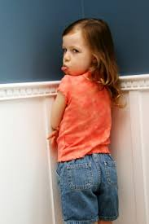
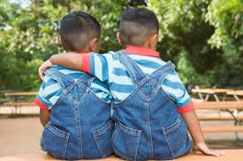
Part II: Techniques Positive, Punitive and Social-Emotional Learning Techniques

Slide 42
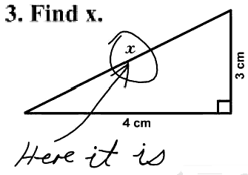
Part II: Techniques Student Responses

Slide 43
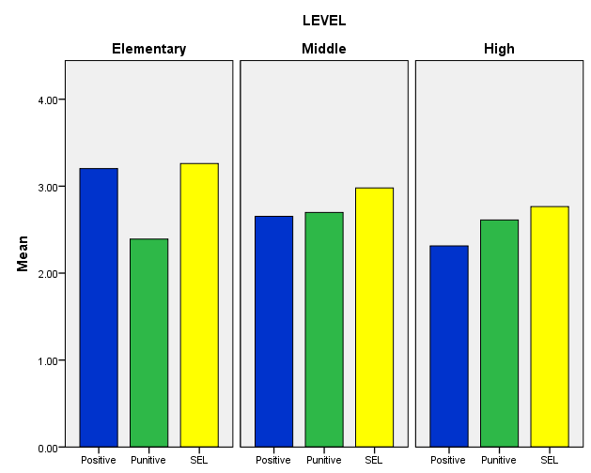
Disciplinary Techniques by Student Grade Level
Positive
Techniques
Punitive
Techniques
SEL
Techniques

Slide 44
Sample subscale responses associated with student scores (Part II: Techniques) | Percent who Agreed or Agreed a lot
 | Elem School | Middle School | High School
Use of Positive Behavioral Techniques 2. Students are praised often. 5. Students are often given rewards for being good. | 82.5 82.9 | 59.6 59.5 | 43.2 35.0
Use of Punitive Techniques* 4. Students are often sent out of class for breaking rules. 13. Students are punished too much for minor things. | 55.8 35.5 | 73.7 52.3 | 64.8 58.1
Use of SEL Techniques 3. Students are taught to understand how others think and feel. 12. Students are taught how to solve conflicts with others. | 91.5 87.4 | 83.0 66.2 | 77.8 50.9
* = A high score on this subscale is negative because items are negatively worded.

Slide 45
Part II: Techniques Teacher/Staff Results

Slide 46
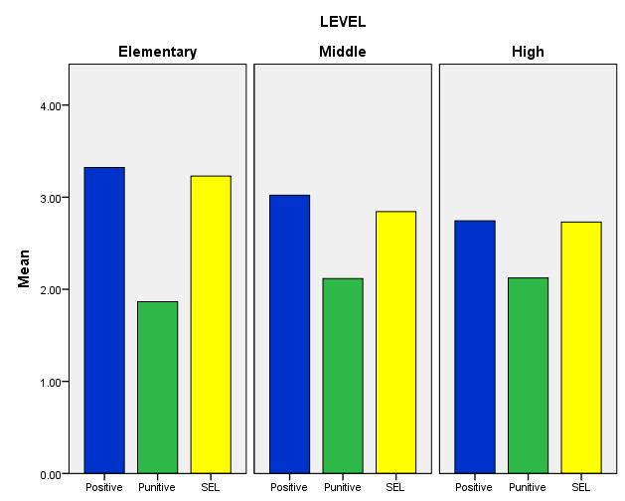
Disciplinary Techniques by Teacher Grade Level
Positive
Techniques
Punitive
Techniques
SEL
Techniques
In contrast to reports of students, teachers/staff consistently report low use of punitive techniques and high use of positive and SEL techniques.

Slide 47
Sample subscale responses associated with staff/teacher scores (Part II: Techniques) | Percent who Agreed or Agreed a lot
 | Elem School | Middle School | High School
Use of Positive Behavioral Techniques 2. Students are praised often. 11. Classes get rewards for good behavior | 97.6 92.8 | 91.0 76.6 | 83.7 50.6
Use of Punitive Techniques* 7. Students are often yelled at by adults. 10. Many students are sent to the office for breaking rules. | 9.8 14.0 | 16.9 24.1 | 12.8 31.3
Use of SEL Techniques 3. Students are taught to feel responsible for how they act. 15. Students are taught they should care about how others feel. | 93.4 95.5 | 78.3 77.0 | 70.4 71.9
* = A high score on this subscale is negative because items are negatively worded.

Slide 48
Part III: Bullying Student Results

Slide 49
Bullying Scale
Students asked to respond to 12 statements about the extent to which he/she was bullied, including:
4 physical statements
4 verbal statements
4 social bullying statements
Students in grades 6-12 also given 4 statements about cyberbullying
Students responded on a 6-point scale:
1 = Never
2 = Less than once a month (replaced “Sometimes”)
3 = Once or twice a month
4 = Once a week
5 = Several times a month
6 = Every day

Slide 50
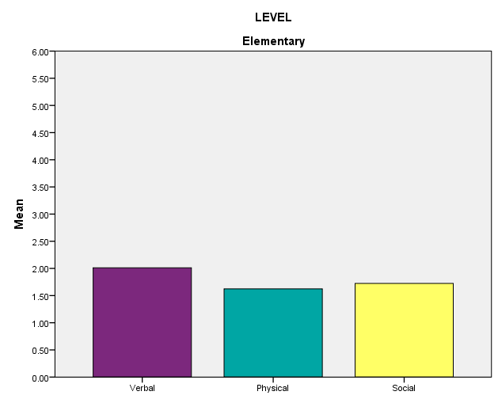
Bullying by Student Grade Level
Verbal Bullying
Physical Bullying
Social/
Relational Bullying

Slide 51
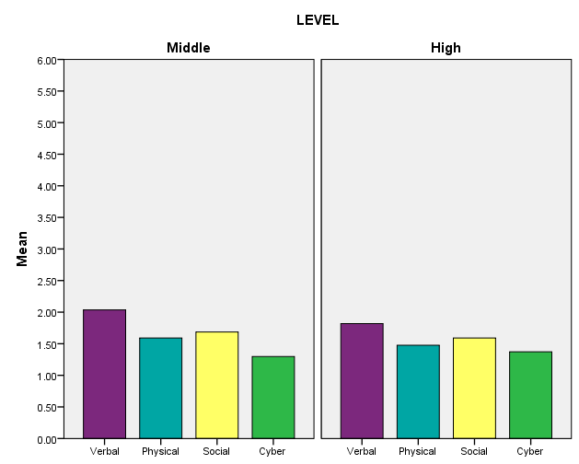
Bullying by Student Grade Level
Verbal Bullying
Physical Bullying
Social/
Relational Bullying
Cyber-bullying

Slide 52
Sample subscale responses associated with student scores (Part III: Bullying*) | Percent who are bullied once a month or more
 | Elem School | Middle School | High School
Verbal Bullying 4. A student said mean things to me. | 29.0 | 29.2 | 23.5
Physical Bullying 5. I was hit or kicked and it hurt. | 14.0 | 12.5 | 10.0
Social/Relational Bullying 6. A student told/got others not to like me. | 17.5 | 18.0 | 16.0
Cyberbullying 14. A student sent me a mean or hurtful message about me using email, text messaging, instant messaging, or similar electronic messaging. | N/A | 7.9 | 9.2
* = A high score on this subscale is negative because items are negatively worded.

Slide 53
Part III: Bullying Home Results

Slide 54
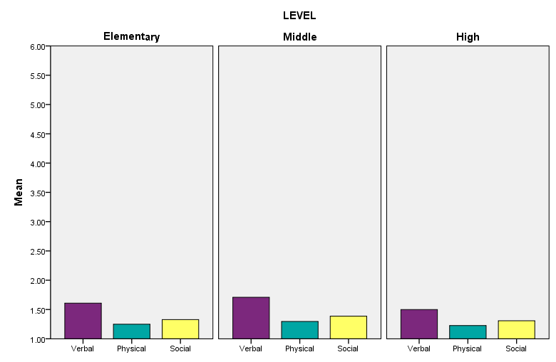
Bullying by Student Grade Level
Verbal Bullying
Physical Bullying
Social/
Relational Bullying

Slide 55
Sample subscale responses associated with home scores (Part III: Bullying*) | Percent who are bullied once a month or more
 | Elem School | Middle School | High School
Verbal Bullying 7. My child was called names he/she didn’t like. | 12.7 | 16.5 | 11.9
Physical Bullying 11. A student threatened to harm my child. | 3.7 | 6.7 | 5.4
Social/Relational Bullying 9. A student got others to say mean things about my child. | 7.2 | 10.6 | 7.9
* = A high score on this subscale is negative because items are negatively worded.

Slide 56
Part IV: Engagement Student Results

Slide 57
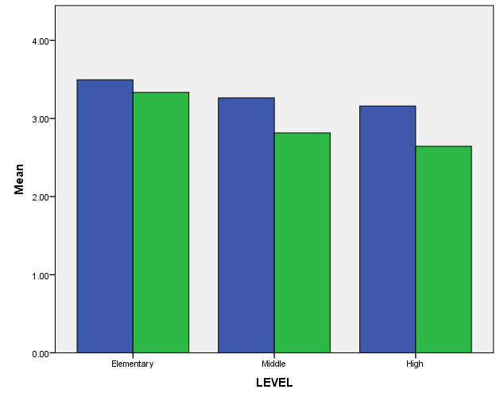
Student Engagement Grade Level Differences: Student Survey
Cognitive and Behavioral Engagement
Emotional Engagement

Slide 58
Sample subscale responses associated with student scores (Part IV: Engagement ) | Percent who Agreed or Agreed a lot
 | Elem School | Middle School | High School
Cognitive 1. I pay attention in class. 4. I follow the rules at school. | 93.5 95.3 | 92.6 91.4 | 93.0 92.0
Emotional 3. I feel happy in this school 9. I like students who go to this school | 85.9 90.6 | 69.4 79.7 | 63.2 70.7

Slide 59
Part IV: Engagement Home Results

Slide 60
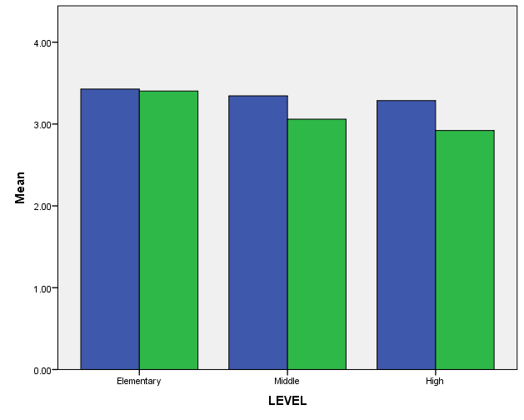
Student Engagement Grade Level Differences: Home Survey
Cognitive and Behavioral Engagement
Emotional Engagement

Slide 61
Sample subscale responses associated with home scores (Part IV: Engagement ) | Percent who Agreed or Agreed a lot
 | Elem School | Middle School | High School
Cognitive 2. My child tries his/her best in school. | 96.8 | 93.4 | 91.3
Emotional 3. My child feels happy in this school | 94.4 | 84.7 | 78.6

Slide 62
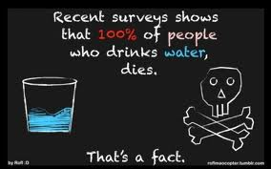
How do school climate scores relate to other measures?
Caution: Correlation does not mean causation. ☺ Direction of influence is likely to be bidirectional.

Slide 63
Evidence of Concurrent Validity Student Survey and School-level Data
Subscales | % Students Suspended/Expelled |  | % Passing ELA |  | % Passing Math
 | Elementary | Middle/High | Elementary | Middle/High | Elementary | Middle/High
Teacher-Student Relations | -.48*** | -.41** | .42*** | .26 | .49*** | .29*
Student-Student Relations | -.68*** | -.62*** | .55*** | .61*** | .654*** | .69***
Respect for Diversity | -.52*** | -.36* | .58*** | .27 | .58*** | .28*
School Safety | -.55*** | -.59*** | .47*** | .54*** | .53*** | .60***
Clarity of Expectations | -.42*** | -49*** | .32*** | .39** | .40*** | .44**
Fairness of Rules | -.49*** | -.52*** | .38*** | .26 | .43*** | .34*
Engagement | -.51*** | -.35* | .32*** | .33* | .44*** | .42**
Schoolwide Bullying | .54*** | .44** | -.71*** | -.52*** | -.71*** | -.54***
Total Climate | -.61*** | -.57** | .57*** | .50*** | .64*** | .56***
N= 77 Elementary schools; 37 Middle and High Schools. *p < .05; **p < .01, ***p < .001; one-tailed

Slide 64
Evidence of Concurrent Validity Teacher Survey and School-level Data
Teacher Survey | % Students Suspended/Expelled |  | % Passing ELA |  | % Passing Math
 | Elementary | Middle/High | Elementary | Middle/High | Elementary | Middle/High
Teacher-Student Relations | -.55*** | -.48** | .64*** | .27* | .67*** | .28*
Student-Student Relations | -.73*** | -.64*** | .74*** | .76*** | .78*** | .79***
Respect for Diversity | -.47*** | -.40* | .60*** | .28* | .61*** | .32*
School Safety | -.65*** | -.57*** | .68*** | .58*** | .74*** | .63***
Clarity of Expectations | -.49*** | -.47* | .60*** | .29* | .66*** | .33*
Fairness of Rules | -.48*** | -.46* | .56*** | .35* | .61*** | .39*
Engagement | -.68*** | -.69*** | .73*** | .72*** | .79*** | .78***
Bullying Schoolwide | .66*** | .36* | -.69*** | -.54*8* | -.79*** | -.54**
Teacher-Home Communication | -.59*** | -.54*** | .66*** | .27 | .70*** | .32*
Staff Relations | -.36** | -.34* | .40*** | .05 | .48*** | .15
Total Climate | -.64*** | -.60*** | .70*** | .48*** | .77*** | .54***
N= 77 Elementary schools; 37 Middle and High Schools. *p <.05, **p < .01, **p < .001; one-tailed

Slide 65
Evidence of Concurrent Validity Student Survey: Positive, Punitive, SEL Techniques
 | Positive |  | Punitive |  | SEL
 | Elementary | Middle/High | Elementary | Middle/High | Elementary | Middle/High
Teacher-Student Relations | .62*** | .79*** | -.68*** | -.20 | .85*** | .90***
Student-Student Relations | .38*** | .18 | -.84*** | -.75*** | .71*** | .51***
Respect for Diversity | .32** | .77*** | -.80*** | -.16 | .74*** | .88***
School Safety | .46*** | .33* | -.75*** | -.53*** | .76*** | .69***
Clarity of Expectations | .67*** | .59*** | -.63** | -.25 | .89*** | .87***
Fairness of Rules | .60*** | .71*** | -.65*** | -.32* | .84*** | .79***
Engagement | .62*** | .71*** | -.63*** | -.26 | .81*** | .91***
Bullying School-wide | -.11 | .16 | .94*** | .81*** | -.58*** | -.15
Total Climate | .48*** | .54*** | -.87*** | -.52*** | .84*** | .82***
% Suspensions | -.19* | -.01 | .57*** | .57*** | -.48*** | -.35*
% Passing ELA | -.03 | -.16 | -.71*** | -.63*** | .41*** | .25
% Passing Math | .11 | -.09 | -.73*** | -.64*** | .50*** | .30*
N= 77 Elementary schools; 37 Middle and High Schools. *p <.05, **p < .01, ***p < .01; one-tailed

Slide 66
Evidence of Concurrent Validity Teacher Survey: Positive, Punitive, SEL Techniques
 | Positive |  | Punitive |  | SEL
 | Elementary | Middle | Elementary | Middle | Elementary | Middle
Teacher-Student Relations | .64*** | .53*** | -.77*** | -.60*** | .82*** | .74***
Student-Student Relations | .54*** | .34* | -.88*** | -.78*** | .74*** | .61***
Respect for Diversity | .56*** | .52*** | -.73*** | -.62*** | .77*** | .67***
School Safety | .62*** | .39** | -.84*** | -.65*** | .81*** | .77***
Clarity of Expectations | .71*** | .51*** | -.75*** | -.48*** | .84*** | .90***
Fairness of Rules | .63*** | .47** | -.64*** | -.43** | .77*** | .83***
N= 77 Elementary schools; 37 Middle and High Schools *p <.05,** p < .01, ***p < .0; one-tailed

Slide 67
Evidence of Concurrent Validity Teacher Survey: Positive, Punitive, SEL Techniques
 | Positive |  | Punitive |  | SEL
 | Elementary | Middle | Elementary | Middle | Elementary | Middle
Engagement | .58*** | .55*** | -.86*** | -.81*** | .76*** | .70***
Bullying | -.50*** | -.01 | .89*** | .51*** | -.74*** | -.34*
Home-School Communication | .65*** | .59*** | -.77*** | -.60*** | .86*** | .76***
Total Score | .66*** | .53*** | -.87*** | -.71*** | .87*** | .87***
% Suspensions | -.30*** | -.31* | .68*** | .65** | -.45*** | -.46*
% Passing ELA | .40*** | .05 | -.73*** | -.70** | .62*** | .30*
% Passing Math | .44*** | .14 | -.79*** | -.75*** | .64*** | .35*
N= 89 Elementary schools; 46 Middle and High Schools *p <.05, **p < .01, ***p < .001; one-tailed

Slide 68
Elementary Students
 | Verbal Bullying | Physical Bullying | Social Bullying
Total School Climate | -.75*** | -.75*** | -.71***
Engagement: Cog. & Behav. | -.60*** | -.63*** | -.62***
Engagement: Emotional | -.63*** | -.65*** | -.60***
Punitive Techniques | .75*** | .77*** | .75***
Positive Techniques | -.16 | -.15 | -.13
SEL Techniques | -.56*** | -.55*** | -.53***
N= 66 Elementary schools. *p <.05, **p < .01, ***p < .001; one-tailed

Slide 69
Middle School and High School Students
 | Verbal Bullying | Physical Bullying | Social Bullying
Total School Climate | -.18 | -.28 | -.37*
Engagement: Cog. & Behav. | .29 | .23 | .11
Engagement: Emotional | .07 | .02 | -.12
Punitive Techniques | .62*** | .59*** | .55**
Positive Techniques | .47* | .44* | .32*
SEL Techniques | .20 | .09 | -.03
N= 37 Middle and High Schools *p <.05, **p < .01, ***p < .001; one-tailed

Slide 70
Changes in Scales
Examining several new items on Respect for Diversity Scale
Students respect others who are different.
Students of different races get along.
Teachers expect the best from students of all races.
(Replaced items about “color of a person’s skin doesn’t matter” to teachers or students)

Slide 71
Examining several new items on
Positive, Punitive, and SEL Techniques Scale
2 new positive items:
Teachers use just enough praise and rewards; not too much or too little.
All student receive rewards for doing a good job.
2 new punitive items:
Students are punished too much for minor things.
Teachers use just enough punishment; not too much or too little.

Slide 72
Examining several new items on
Cognitive and Behavioral Engagement Subscales
of the Student Engagement Scale
When I don’t do well, I work harder.
I stay out of trouble at school.
I have plans for after high school (college, service, trade school).

Slide 73
Examining New Scale: Student Social Emotional Learning Scale
12 items assessing 4 core dimensions of SEL
Self-management of emotions and behavior
e.g., “I can control how I behave”
Relationship skills
e.g., “I get along well with others.”
Social awareness
e.g., “I care about how others feel.”
Responsible decision making
e.g., “I am good at deciding right from wrong.”
Students respond on 4-point scale:
1 = Not like me at all, 4 = Very much like me

Slide 74
Summary
Delaware has developed a reliable and valid measure of school climate.
Scores on the surveys are reliable and related to important outcomes, particularly academic achievement and suspensions/expulsions.
Improvements continue to be made.

