Slide 1
School Climate
Data Workshop
Delaware Positive Behavior Support Project
May 10, 2016
George Bear
University of Delaware

Slide 2
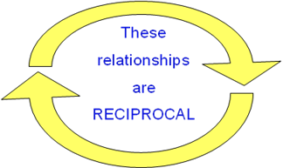
Why is school climate important?
School Climate is linked to a wide range of academic, behavioral, and socio-emotional outcomes for students:
          Academic achievement
          Student academic, social, and personal attitudes and motives
          Attendance and school avoidance
          Behavior problems, delinquency, victimization
          Emotional well-being
          Note: we recently found that improvements
          In school climate preceded reduced suspensions

Slide 3
School climate is also linked to outcomes for teachers:
          Less burnout and greater retention in the profession
          Greater implementation fidelity of new curriculum and interventions
          Greater levels of job satisfaction

Slide 4
DE School Climate Survey Participation
Number of Schools
School Years

Slide 5
2016 Survey Sample
 |  | Student Survey | Teacher Survey | Home Survey
Elementary | Schools | 79 | 82 | 79
 | Respondents | 16941 | 2942 | 12119
Middle | Schools | 26 | 27 | 27
 | Respondents | 13601 | 1250 | 3409
High | Schools | 20 | 21 | 21
 | Respondents | 9139 | 1163 | 996
Alternative | Schools | 5 | 5 | 5
 | Respondents | 198 | 78 | 56
Special | Schools | 2 | 6 | 6
 | Respondents | 74 | 340 | 188
Early Childhood | Schools | N/A | 7 | 7
 | Respondents | N/A | 235 | 591
Other | Schools | 4 | 5 | 4
 | Respondents | 2699 | 182 | 255
 |  | 42,652 | 6,190 | 17,614

Slide 6
Delaware School Surveys Scales per Population
Student Scales
School Climate
Techniques
Teacher/Staff Scales
School Climate
Home Scales
School Climate
Bullying
Engagement
Student Social Emotional Competence
Techniques
Bullying
Engagement

Slide 7
Delaware School Climate Surveys 2016 Subscales
Part I : School Climate
Student Survey | Teacher/Staff Survey | Home Survey
Teacher-Student Relations | Teacher-Student Relations | Teacher-Student Relations
Student-Student Relations | Student-Student Relations | Student-Student Relations
Clarity of Expectations | Clarity of Expectations | Clarity of Expectations
Fairness of Rules | Fairness of Rules | Fairness of Rules
School Safety | School Safety | School Safety
Student Engagement School-wide | Student Engagement School-wide
Bullying School-wide | Bullying School-wide
 | Teacher-Home Communications | Teacher-Home Communications
 | Staff Relations
Total School Climate | Total School Climate | Total School Climate
 |  | Satisfaction with School

Slide 8
Part I: School Climate
Item Examples
  Teacher-Student Relations
    “Teachers care about their students.”
  Student-Student Relations
    “Students are friendly with each other.”
  Student Engagement School-wide
    “Most students try their best.”
  Clarity of Expectations
    “Students know what the rules are.”
Fairness of Rules
    “The school rules are fair.”

Slide 9
Part I: School Climate
Item Examples (continued)
School Safety
  “Students know they are safe in this school.”
Bullying School-wide
(Note: A high score for this subscale is unfavorable)
  “Students threaten and bully others.”
Teacher-Home Communications
  “Teachers listen to the concerns of parents.”
Staff Relations
  “Teachers, staff, and administrators work well together.”
  Satisfaction with School
  “I like this school.”

Slide 10
One Change in Scale
Respect for Diversity subscale was deleted.
Two of the 4 items are now on the Teacher-Student Relations and Student-Student Relations subscales:
Teachers treat students of all races with respect.
Students respect others who are different

Slide 11
PART II: Techniques (Students and Teacher/Staff)
Student Survey | Teacher/Staff Survey | Home Survey
Positive Behavior Techniques | Positive Behavior Techniques
Punitive Techniques | Punitive Techniques
Social Emotional Learning Techniques | Social Emotional Learning Techniques

Slide 12
Part II: Techniques
Item Examples
Use of Positive Techniques
  “Students are praised often.”
  New item: “Teachers use just enough praise and rewards; not too much or too little.”
Use of Punitive Techniques
(Note: A high score for this subscale is unfavorable)
  “Students are punished a lot.”
  New item: “Students are punished too much for minor things.”
Use of Social Emotional Learning (SEL) Techniques
  “Students are taught to feel responsible for how they act.”
  New item: “Students are often asked to help decide what is best for the class or school.”

Slide 13
Part III: Bullying & IV: Engagement (Individual Level) (Students and Home)
Student Survey |  | Teacher/Staff Survey | Home Survey
Bullying Victimization¹ | Verbal Bullying |  | Verbal Bullying
 | Physical Bullying |  | Physical Bullying
 | Social/Relational Bullying |  | Social/Relational Bullying
 | Cyberbullying²
Student Engagement | Behavioral |  | Behavioral
 | Cognitive |  | Cognitive
 | Emotional |  | Emotional
¹ Grades 6-12 only for the printed version. Optional for grades 4-5 with computer version. ² Grades 6-12 only.

Slide 14
Part III: Bullying Victimization
Item Examples
Verbal Bullying
  “A student said mean things to me.”
Physical Bullying
  “I was pushed or shoved on purpose.”
Social/Relational Bullying
  “A student told or got others to not like me.”
Cyberbullying (grades 6-12)
  “A student sent me a mean or hurtful message about me using email, text messaging, instant messaging, or similar electronic messaging.”

Slide 15
Part IV: Student Engagement
(Students and Home)
  Last Year: 2 subscales (Cognitive/Behavioral and Emotional).
  This year: 3 subscales:
  Behavioral Engagement
    “I pay attention in class.”
    “I follow the rules at school.”
  Cognitive Engagement
    “I try my best in school.”
    “I turn in my homework on time.”
  Emotional Engagement
    “I feel happy in school.”
    “My school is a fun place to be.”

Slide 16
NEW THIS YEAR! PART V: Student Social Emotional Competencies Scale (Students only)
Student Survey | Teacher/Staff Survey | Home Survey
Responsible Decision-making/Responsibility
Understanding how others Think and Feel/Social Awareness
Self-management of Emotions and Behavior
Relationship Skills

Slide 17
Part V: Student Social Emotional Competencies Scale
Item Examples
Responsible Decision-making/Responsibility
  “I feel responsible for how I act.”
Understanding how others think and feel/Social Awareness
  “I think about how others feel.”
Self-management of emotions and behavior
  “I can control how I behave.”
Relationship skills
  “I am good at solving conflicts with others.”

Slide 18
Evidence of Reliability and Validity
Reliability:
Are the scores consistent or stable?
Validity:
Does the test yield the factors predicted?
Are the scores related to other variables as one might predict (e.g., grade level, sex and race, academic achievement, suspensions)?

Slide 19
School Climate and Techniques: Reliability (alpha coefficients)
Subscale | Student | Teacher/Staff | Home
Teacher-Student Relations | .88 | .88 | .91
Student-Student Relations | .87 | .91 | .93
School Safety | .79 | .89 | .91
Clarity of Expectations | .77 | .90 | .92
Fairness of Rules | .80 | .82 | .90
Student Engagement School-wide | .82 | .88 | N/A
Bullying School-wide | .77 | .89 | N/A
Teacher-Home Communications | N/A | .90 | .90
Staff Relations | N/A | .95 | N/A
Total Climate | .90 | .94 | .97
Parent Satisfaction | N/A | N/A | .86
Use of Positive Behavioral Techniques | .85 | .83 | N/A
Use of Punitive Techniques | .75 | .79 | N/A
Use of Social Emotional Learning Techniques | .80 | .90 | N/A

Slide 20

But, some scores are not very reliable with 3rd graders:
USE CAUTION!

Slide 21
School Climate: Reliability (alpha coefficients) by Grade
Grade | Teacher Student Relations | Student Relations | School Safety | Clarity of Expect-ations | Fairness of Rules | Student Engagement School-wide | Bullying School-wide | Total Score
Third | .73 | .84 | .65 | .67 | .62 | .73 | .65 | .85
Fourth | .80 | .85 | .71 | .72 | .72 | .74 | .75 | .85
Fifth | .84 | .87 | .75 | .76 | .79 | .76 | .80 | .87
Sixth | .87 | .87 | .79 | .77 | .82 | .79 | .81 | .89
Seventh | .86 | .87 | .80 | .80 | .82 | .80 | .84 | .89
Eighth | .87 | .87 | .82 | .79 | .81 | .81 | .83 | .90
Ninth | .87 | .86 | .84 | .82 | .84 | .81 | .82 | .90
Tenth | .86 | .86 | .83 | .79 | .82 | .80 | .82 | .90
Eleventh | .85 | .87 | .84 | .79 | .82 | .81 | .86 | .89
Twelfth | .84 | .87 | .86 | .81 | .82 | .82 | .85 | .89

Slide 22
Engagement and Bullying: Reliability (alpha coefficients)
Subscale | Student | Home
Behavioral Engagement | .81 | .85
Cognitive Engagement | .75 | .82
Emotional Engagement | .88 | .84
Verbal Bullying | .92 | .91
Physical Bullying | .86 | .80
Social/Relational Bullying | .91 | .90
Total Bullying | .95 | .94
Cyberbullying | .90 | N/A

Slide 23
Evidence of Validity?
See Technical Manual on Delaware PBS website
Bear, G., Yang, C., Harris, A., Mantz, L., Hearn, S., & Boyer, D. (2016). Technical Manual for 2016 Delaware School Survey: Scales of School Climate; Bullying Victimization; Student Engagement; Positive, Punitive, and Social Emotional Learning Techniques; and the Delaware Social and Emotional Competencies Scale. Newark, DE: Center for Disabilities Studies.
http://wordpress.oet.udel.edu/pbs/technical-manual-for-school-climate-surveys

Slide 24
Peer-Reviewed Journals:
Bear, G. G., Gaskins, C., Blank, J. , & Chen, F. F. (2011). Delaware School Climate Survey-Student: Its factor structure, concurrent validity, and reliability. Journal of School Psychology.
Bear, G., Yang, C., Pell, M., & Gaskin, C. (2014).Validation of a brief measure of teachers' perceptions of school climate: Relations to student achievement and suspensions. Learning Environments Research.
Bear, G.G., Yang, C., & Pasipanodya, E. (2015). Assessing school climate: Validation of a brief measure of the perceptions of parents. Journal of Psychoeducational Assessment.
Yang, C., Bear, G. G., Chen, F.F., Zhang, W., Blank, J.C., & Huang, X.S. (2013). Students‘perceptions of school climate in the U.S. and China. School Psychology Quarterly.
Bear, G.G., Mantz, L., Glutting, J., Yang, C., & Boyer, D. (2015). Differences in bullying victimization between students with and without disabilities. School Psychology Review.

Slide 25
Peer-Reviewed Journals:
Bear, G.G., Holst, B., Lisboa, C., Chen, D., Yang, C., & Chen, F.F. (in press). A Brazilian Portuguese survey of school climate: Evidence of validity and reliability. International Journal of School and Educational Psychology.
Bear, G.G., Chen, D.D., Mantz, L., Yang, C., Huang, X., & Shiomi, K. (2016). Differences in classroom removals and use of praise and rewards in American, Chinese, and Japanese schools. Teaching and Teacher Education, 53(1), 41-50.
Mantz, L.S., Bear, G.G., Yang, C., & Harris, A. (submitted for publication). A school-wide tool for assessing CASEL’s social-emotional competencies: Evidence of validity and reliability.

Slide 26
Validity Screening Items on Student Survey
Items:
“I am telling the truth in this survey.”
“I answered all items truthfully on this survey.”
Results:
10.2% (4,562) disagreed to one or both items and thus were deleted
5.4% (2,434) did not respond to one or both items

Slide 27
2016 State-wide Results

Slide 28
For example: “I like this school.” | Percent who Agreed or Agreed a lot
 | Elem School | Middle School | High School
Teachers/Staff | 96% | 90% | 91%
Home | 96% | 87% | 82%
Students | 95% | 72% | 68%

Slide 29
Part I: School Climate Subscales
Student Survey Results

Slide 30
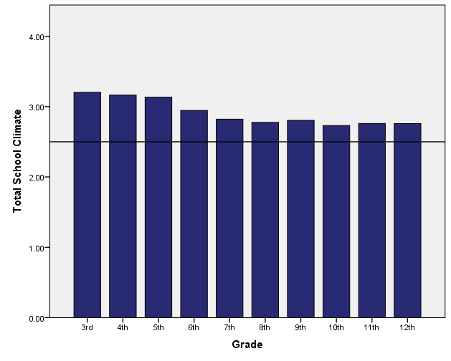
Total School Climate by Student Grade
  Student perceptions tend to decrease, especially from elementary to middle school

Slide 31
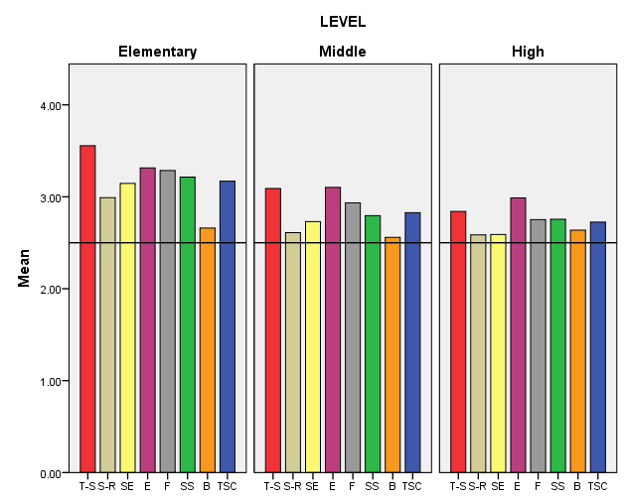
Grade Level Differences: Student Survey 2016
Teacher-Student
Relations
Student Engagement
School-wide
Fairness of Rules
Bullying School-wide
Student Relations
Clarity of Expectations
School Safety
Total School Climate
Fairness of Rules

Slide 32
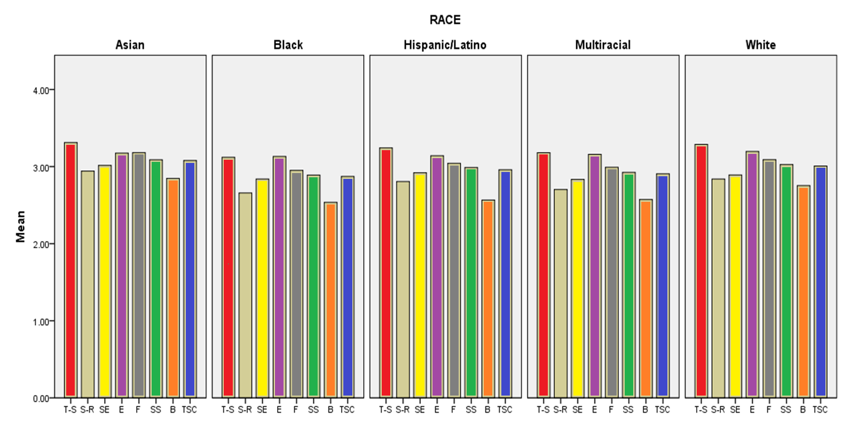
Race Differences: Student Survey 2016
Teacher-Student
Relations
Student Engagement
School-wide
Fairness of Rules
Bullying School-wide
Student Relations
Clarity of Expectations
School Safety
Total School Climate

Slide 33
Sample subscale responses associated with student scores (Part I: School Climate) | Percent who Agreed or Agreed a lot
 | Elem School | Middle School | High School
Teacher-Student Relations 7. Teachers care about their students. | 95.6 | 86.6 | 77.4
Student–Student Relations 11. Students are friendly with each other. | 75.6 | 61.3 | 64.9
Student Engagement School-wide 29. Most students work hard to get good grades. | 91.9 | 77.5 | 69.9
Clarity of Expectations 10. Students know how they are expected to act. | 88.2 | 83.5 | 84.6
Bullying School-wide* 9. Students threaten and bully others. | 36.4 | 50.4 | 48.4
Fairness of Rules 18. The school’s Code of Conduct is fair. | 90.4 | 78.3 | 70.0
School Safety 13. Students feel safe. | 89.4 | 76.1 | 74.7
* = A high score on this subscale is negative because items are negatively worded.

Slide 34
Part I: School Climate Subscales
Teacher/Staff Survey Results

Slide 35
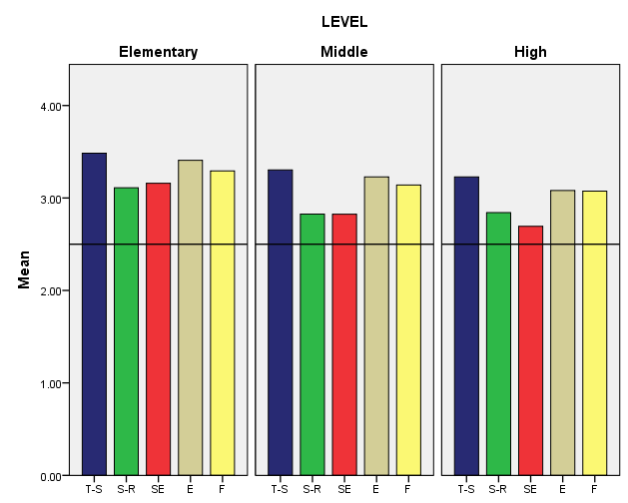
2016 Teacher Survey Results, K-12
Teacher-Student
Relations
Clarity of Expectations
Student Relations
Student Engagement
School-wide
Fairness of Rules

Slide 36
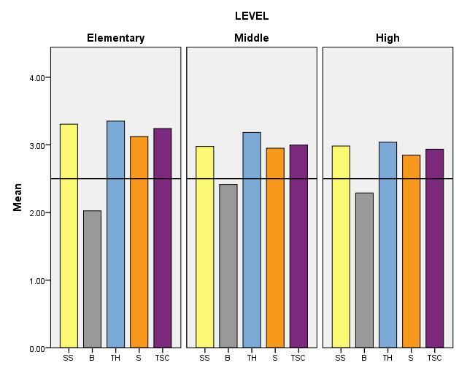
2016 Teacher Survey Results, K-12
School Safety
Teacher-Home
Communication
Total School Climate
Bullying School-wide
Staff Relations

Slide 37
Sample subscale responses associated with teacher/staff scores (Part I: School Climate) | Percent who Agreed or Agreed a lot
 | Elem School | Middle School | High School
Teacher-Student Relations 7. Teachers care about their students. | 99.2 | 97.8 | 97.0
Student–Student Relations 11. Students are friendly with each other. | 93.1 | 83.4 | 85.1
Student Engagement School-wide 29. Most students work hard to get good grades. | 88.3 | 70.5 | 58.3
Clarity of Expectations 10. Students know how they are expected to act. | 96.1 | 93.3 | 87.4
Bullying School-wide* 9. Students threaten and bully others. | 27.7 | 52.0 | 43.7
School Safety 13. Students feel safe. | 96.1 | 86.6 | 88.6
* = A high score on this subscale is negative because items are negatively worded.

Slide 38
Sample subscale responses associated with teacher/staff scores (Part I: School Climate) | Percent who Agreed or Agreed a lot
 | Elem School | Middle School | High School
Fairness of Rules 18. The school’s Code of Conduct is fair. | 92.1 | 86.7 | 88.7
Teacher-Home Communications 34. Teachers do a good job communicating with parents. | 96.5 | 91.6 | 84.8
Staff Relations 33. Teachers, staff, and administrators function as a good team. | 85.2 | 78.8 | 75.9

Slide 39
Part I: School Climate Subscales
Home Survey Results

Slide 40
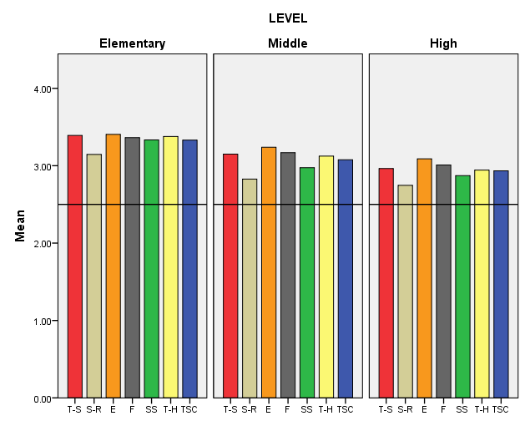
Grade Level Differences: Home Survey 2016
Teacher-Student
Relations
Clarity of Expectations
School Safety
Total School Climate
Student Relations
Fairness of Rules
Teacher-Home Communication
Fairness of Rules

Slide 41
Sample subscale responses associated with home scores (Part I: School Climate) | Percent who Agreed or Agreed a lot
 | Elem School | Middle School | High School
Teacher-Student Relations 7. Teachers care about their students. | 97.6 | 92.6 | 84.8
Student–Student Relations 11. Students are friendly with each other. | 89.8 | 74.8 | 71.9
Clarity of Expectations 10. Students know how they are expected to act. | 98.0 | 94.9 | 91.3
Teacher-Home Communication 24. Teachers work closely with parents to help students when they have problems. | 93.9 | 85.3 | 77.5

Slide 42
Sample subscale responses associated with home scores (Part I: School Climate) | Percent who Agreed or Agreed a lot
 | Elem School | Middle School | High School
School Safety 13. Students feel safe. | 95.8 | 82.3 | 78.9
Fairness of Rules 18. The school’s Code of Conduct is fair. | 97.3 | 93.1 | 89.0
Parent Satisfaction 9. I am satisfied with the education students get in this school. | 93.1 | 87.4 | 81.0

Slide 43
Part II: Techniques
Positive, Punitive and
Social-Emotional Learning Techniques
Student Responses

Slide 44
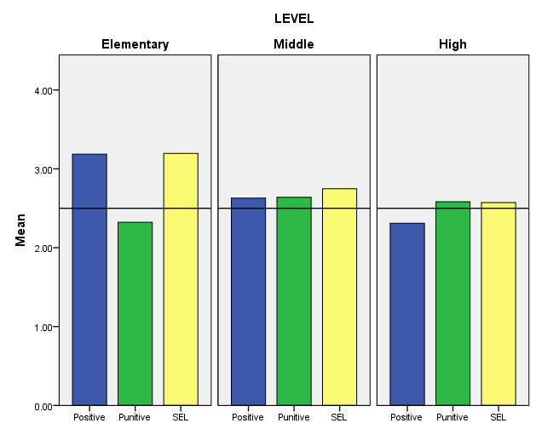
Disciplinary Techniques by Student Grade Level
Positive
Techniques
Punitive
Techniques
SEL
Techniques

Slide 45
Sample subscale responses associated with student scores (Part II: Techniques) | Percent who Agreed or Agreed a lot
 | Elem School | Middle School | High School
Use of Positive Behavioral Techniques 2. Students are praised often. 5. Students are often given rewards for being good. | 82.8 82.3 | 58.2 57.0 | 42.5 34.0
Use of Punitive Techniques* 4. Students are often sent out of class for breaking rules. 13. Students are punished too much for minor things. | 53.0 34.8 | 71.2 51.0 | 62.4 56.2
Use of SEL Techniques 3. Students are taught to feel responsible for how they act. 12. Students are taught how to solve conflicts with others. | 90.8 86.9 | 82.4 63.8 | 76.6 50.4
* = A high score on this subscale is negative because items are negatively worded.

Slide 46
Part II: Techniques
Teacher/Staff Results

Slide 47
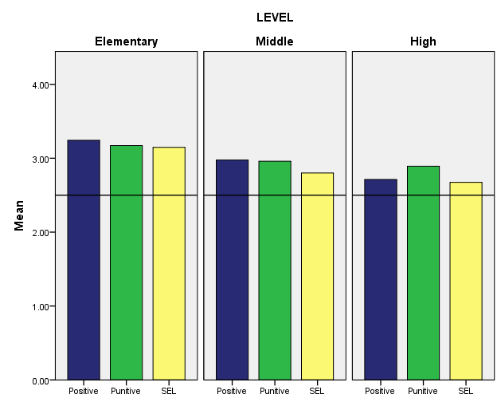
Disciplinary Techniques by Teacher Grade Level
Positive
Techniques
Punitive
Techniques
SEL
Techniques
In contrast to reports of students, teachers/staff consistently report low use of punitive techniques and high use of positive and SEL techniques.

Slide 48
Sample subscale responses associated with staff/teacher scores (Part II: Techniques) | Percent who Agreed or Agreed a lot
 | Elem School | Middle School | High School
Use of Positive Behavioral Techniques 2. Students are praised often. 11. Classes get rewards for good behavior | 96.8 90.0 | 90.3 75.2 | 80.2 49.9
Use of Punitive Techniques* 7. Students are often yelled at by adults. 10. Many students are sent to the office for breaking rules. | 9.5 14.9 | 16.1 25.2 | 13.4 32.4
Use of SEL Techniques 3. Students are taught to feel responsible for how they act. 15. Students are taught they should care about how others feel. | 91.6 95.3 | 79.6 78.3 | 69.7 72.1
* = A high score on this subscale is negative because items are negatively worded.

Slide 49
Part III: Bullying
Student Results

Slide 50
Bullying Scale
Students asked to respond to 12 statements about the extent to which he/she was bullied, including:
  4 physical statements
  4 verbal statements
  4 social bullying statements
Students in grades 6-12 also given 4 statements about cyber bullying
Students responded on a 6-point scale:
  1 = Never
  2 = Less than once a month
  3 = Once or twice a month
  4 = Once a week
  5 = Several times a month
  6 = Every day

Slide 51
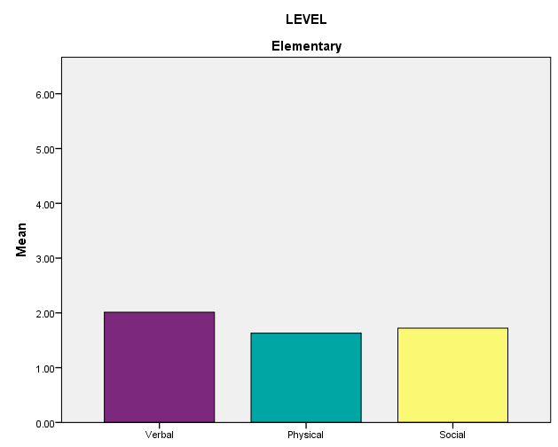
Bullying by Student Grade Level
Verbal Bullying
Physical Bullying
Social/
Relational Bullying

Slide 52
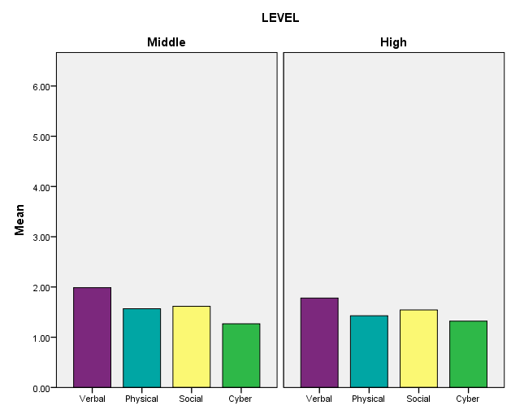
Bullying by Student Grade Level
Verbal Bullying
Physical Bullying
Social/
Relational Bullying
Cyber bullying

Slide 53
Sample subscale responses associated with student scores (Part III: Bullying*) | Percent who are bullied once a month or more
 | Elem School | Middle School | High School
Verbal Bullying 4. A student said mean things to me. | 28.2 | 27.4 | 22.4
Physical Bullying 5. I was hit or kicked and it hurt. | 14.7 | 11.4 | 8.8
Social/Relational Bullying 6. A student told/got others not to like me. | 17.1 | 15.8 | 14.5
Cyberbullying 14. A student sent me a mean or hurtful message about me using email, text messaging, instant messaging, or similar electronic messaging. | N/A | 2.1 | 2.8
* = A high score on this subscale is negative because items are negatively worded.

Slide 54
Part III: Bullying
Home Results

Slide 55
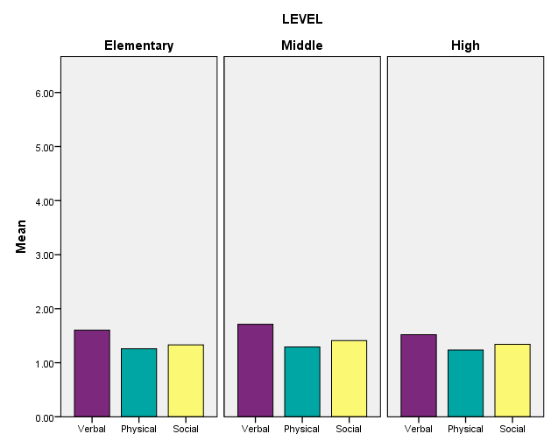
Bullying by Student Grade Level
Verbal Bullying
Physical Bullying
Social/
Relational Bullying

Slide 56
Sample subscale responses associated with home scores (Part III: Bullying*) | Percent who are bullied once a month or more
 | Elem School | Middle School | High School
Verbal Bullying 7. My child was called names he/she didn’t like. | 11.7 | 15.4 | 11.2
Physical Bullying 11. A student threatened to harm my child. | 3.8 | 6.5 | 6.0
Social/Relational Bullying 9. A student got others to say mean things about my child. | 6.6 | 10.3 | 8.6
* = A high score on this subscale is negative because items are negatively worded.

Slide 57
Part IV: Engagement
Student Results

Slide 58
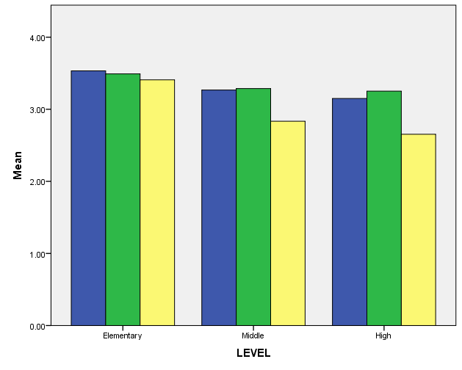
Student Engagement Grade Level Differences: Student Survey
Behavioral Engagement
Cognitive Engagement
Emotional Engagement

Slide 59
Sample subscale responses associated with student scores (Part IV: Engagement ) | Percent who Agreed or Agreed a lot
 | Elem School | Middle School | High School
Behavioral 1. I pay attention in class. 4. I follow the rules at school. | 94.0 95.4 | 92.7 92.2 | 93.2 92.9
Cognitive 2. I try my best in school. 5. I turn in my homework on time. | 97.9 89.8 | 95.1 79.1 | 91.1 78.0
Emotional 3. I feel happy in school 9. I like students who go to this school | 86.5 90.5 | 71.0 79.8 | 63.5 71.0

Slide 60
Part IV: Engagement
Home Results

Slide 61
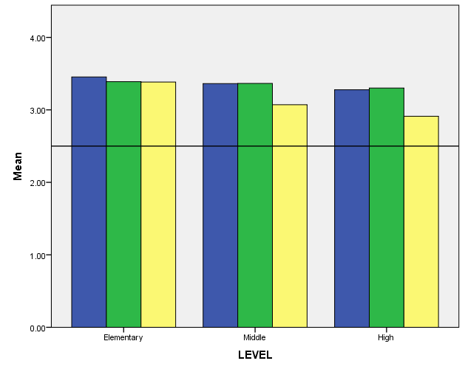
Student Engagement Grade Level Differences: Home Survey
Behavioral Engagement
Cognitive Engagement
Emotional Engagement

Slide 62
Sample subscale responses associated with home scores (Part IV: Engagement ) | Percent who Agreed or Agreed a lot
 | Elem School | Middle School | High School
Behavioral 4. My child follows the rules at school. | 97.4 | 96.4 | 94.8
Cognitive 2. My child tries his/her best in school. | 96.9 | 92.3 | 89.4
Emotional 3. My child feels happy in this school | 94.0 | 84.0 | 76.8

Slide 63
Part V: Student Social Emotional Competence Scale
Student Results

Slide 64
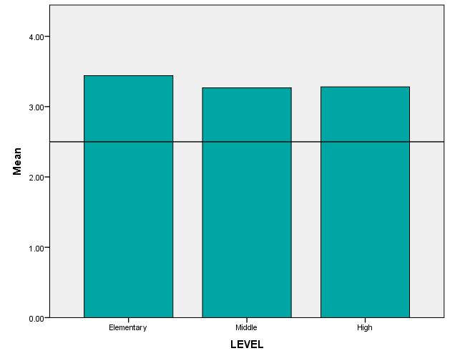
Total Social Emotional Competence Scores by Student Grade Level

Slide 65
Sample subscale responses associated with student scores (Part V: Student SEL Scale) | Percent who indicated this was somewhat or very much like them
 | Elem School | Middle School | High School
Responsible Decision-making/Responsibility 5. I feel responsible for how I act. | 93.9 | 92.2 | 94.5
Understanding how others think and feel/Social Awareness 6. I care about how others feel. | 92.6 | 86.7 | 85.5
Self-management of emotions and behavior 7. I think before I act. | 86.6 | 81.3 | 86.5
Relationship Skills 4. I am good at solving conflicts with others. | 83.0 | 78.6 | 84.8

Slide 66
How do school climate scores relate to other measures?
Caution: Correlation does not mean causation. ☺ Direction of influence is likely to be bidirectional.

Slide 67
Evidence of Concurrent Validity
Student Survey and School-level Data: School Climate Scale
Subscales | Elementary Schools |  |  | Middle Schools |  |  | High Schools
 | ELA | Math | S/E | ELA | Math | S/E | ELA | Math | S/E
Teacher–Student Relations | .540** | .485** | -.420** | .714** | .715** | -.583** | -.041 | .108 | -.565*
Student–Student Relations | .691** | .649** | -.682** | .751** | .755** | -.740** | .286 | .526* | -.837**
Engagement School-wide | .531** | .530** | -.585** | .663** | .644** | -.623** | .355 | .546** | -.819**
Clarity of Expectations | .463** | .445** | -.316** | .605** | .614** | -.408* | -.021 | .077 | -.432*
Fairness of Rules | .500** | .463** | -.366** | .690** | .616** | -.772** | -.431* | -.296 | -.135
School Safety | .558** | .500** | -.512** | .657** | .669** | -.579** | .451* | .528* | -.691**
Bullying School-wide | -.782** | -.687** | .574** | -.708** | -.760** | .676** | -.381 | -.510* | -.686**
Total School Climate | .694** | .639** | -.598** | .746* | .743** | -.698** | .223 | .393 | -.749**
Note. ELA= English–Language Arts. S/E = Suspensions and Expulsions. ELA = % passing ELA. Math = % passing math. 77 Elementary Schools, 28 Middle Schools, 17 High Schools. *p < .05. **p < .01, ***p < .001 One tailed.

Slide 68
Evidence of Concurrent Validity
Teacher Survey and School-level Data: School Climate Scale
Subscale | Elementary Schools |  |  | Middle Schools |  |  | High Schools
 | ELA | Math | S/E | ELA | Math | S/E | ELA | Math | S/E
Teacher–Student Relations | .522** | .648** | -.574** | .577** | .590** | -.463** | .353 | .431* | -.661**
Student–Student Relations | .716** | .746** | -.753** | .683** | .635** | -.586** | .629** | .704** | -.668**
Schoolwide Engagement | .743** | .816** | -.734** | .727** | .746** | -.683** | .731** | .775** | -.774**
Clarity of Expectations | .498** | .624** | -.541** | .444* | .396* | -.246 | .420* | .397* | -.424*
Fairness of Rules | .559** | .611** | -.566** | .506** | .468** | -.400* | .559** | .461* | -.419*
School Safety | .591** | .683** | -.696** | .590** | .543** | -.486** | .574** | .590** | -.580**
Bullying Schoolwide | -.687** | -.700** | .690** | -.660** | -.612** | .463* | -.534** | -.547** | .500*
Teacher-Home Communications | .604** | .698** | -.555** | .551** | .614** | -.530** | .330 | .547** | -.700**
Staff Relations | .307** | .270** | -.211* | .214 | .259 | -.198 | .230 | .222 | -.360
Total School Climate | .655** | .622** | -.527** | .617** | .603** | -.508** | .587** | .613** | -.676*
Note. ELA= English–Language Arts. S/E = Suspensions and Expulsions. ELA = % passing ELA. Math = % passing math. 75 Elementary Schools, 27 Middle Schools, 20 High Schools. *p < .05. **p < .01, One tailed.

Slide 69
Evidence of Concurrent Validity
Student Survey: Positive, Punitive, SEL Techniques
Subscale | Elementary Schools |  |  | Middle Schools |  |  | High Schools
 | ELA | Math | S/E | ELA | Math | S/E | ELA | Math | S/E
Punitive Techniques | -.764** | -.714** | .634** | -.790** | -.822** | .735** | -.147* | -.473* | .726**
Positive Techniques | -.033 | -.030 | -.016 | .113 | .102 | -.118 | -.460 | -.332 | -.262
SEL Techniques | .374** | .325** | -.325** | .580** | .610** | -.619** | -.199 | -.181 | -.151
Note. ELA= English–Language Arts. S/E = Suspensions and Expulsions. ELA = % passing ELA. Math = % passing math. 76 Elementary Schools, 28 Middle Schools, 18 High Schools. *p < .05. **p < .01, **p <.001. One tailed.

Slide 70
Evidence of Concurrent Validity
Teacher Survey: Positive, Punitive, SEL Techniques
 | Elementary Schools |  |  | Middle Schools |  |  | High Schools
 | ELA | Math | S/E | ELA | Math | S/E | ELA | Math | S/E
Positive Techniques | .319** | .347** | -.244* | .258 | .278 | -.234 | .137 | .261 | -.542**
Punitive Techniques | .692** | .688** | -.672** | .655** | .649** | -.674** | .396* | .483* | -.627**
SEL Techniques | .544** | .540** | -.415** | .390* | .386* | -.288 | .607** | .529** | -.619**
Note. ELA= English–Language Arts. S/E = Suspensions and Expulsions. ELA = % passing ELA. Math = % passing math. 75 Elementary Schools, 27 Middle Schools, 20 High Schools. *p < .05. **p < .01, One tailed.

Slide 71
Summary
Delaware has developed a reliable and valid measure of school climate.
Scores on the surveys are reliable and related to important outcomes, particularly academic achievement and suspensions/expulsions.
Improvements continue to be made.

