Slide 1
School Climate Data Workshop
Delaware Positive Behavior Support Project
May 14, 2018

Slide 2
Delaware School Survey Foundation Resource
School Climate and the Delaware School Surveys: Review of importance of school climate and overview of tools used to measure it plus more
Answers the following questions:
Why is school climate importance?
How are we doing in Delaware?
What do I need to know about the DE School Surveys?
review the 5 scales included in the survey
list the subscales included in each of the 5 scales per population
provide item examples from each scale and subscale
Are the DE School Surveys reliable and valid?
review evidence of survey reliability
review evidence of survey validity
provide references to peer-reviewed journal studies

Slide 3
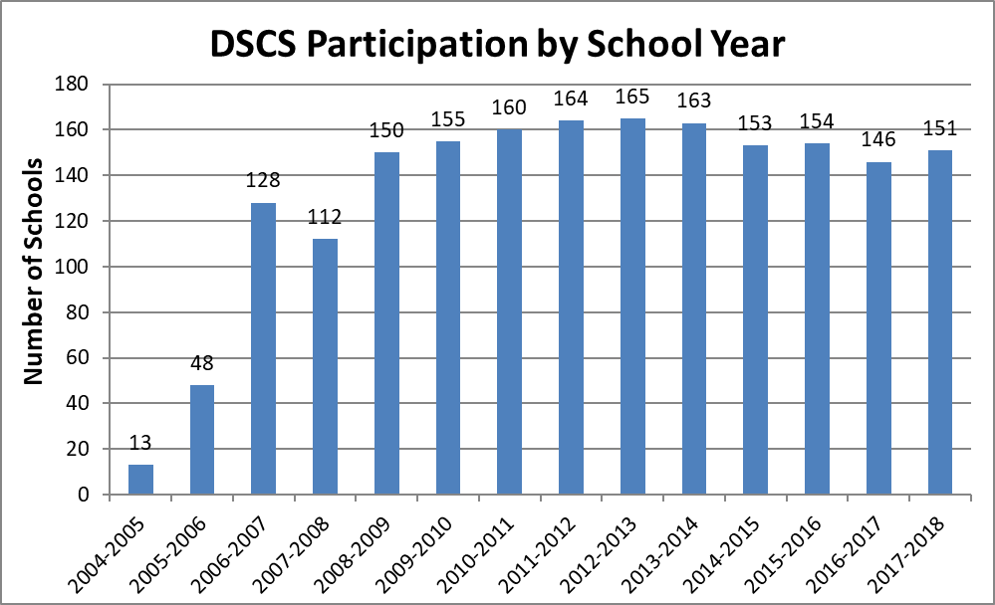
Participation Continues To Be High
Number of Participating Schools
School Years

Slide 4
2017-18 Survey Sample
 |  | Student Survey | Teacher Survey | Home Survey
Elementary | Schools | 79 | 81 | 72
 | Respondents | 15194 | 3077 | 9186
Middle | Schools | 26 | 26 | 24
 | Respondents | 11582 | 1200 | 2731
High | Schools | 18 | 18 | 15
 | Respondents | 7606 | 1104 | 834
Alternative | Schools | 3 | 4 | 1
 | Respondents | 75 | 66 | 11
Special | Schools | 2 | 9 | 5
 | Respondents | 58 | 547 | 223
Early Childhood | Schools | N/A | 5 | 6
 | Respondents | N/A | 206 | 688
Other | Schools | 7 | 7 | 5
 | Respondents | 4243 | 362 | 953
 |  | 38,758 | 6,592 | 14,626

Slide 5
Delaware School Survey Scales (Note: School Climate is 1 of the 5 Scales)
Student Scales
School Climate
Techniques (School Discipline)
Teacher/Staff Scales
School Climate
Home Scales
School Climate
Bullying Victimization
Student Engagement
Student Social and Emotional Competencies
Techniques (School Discipline)
Bullying Victimization
Student Engagement

Slide 6
Validity Screening Items on Student Survey
Items:
SC-31. “I am lying on this survey.”
E-13. “I am telling the truth in this survey.”
Results:
13.7% (5,232) noted lying on item SC-31 and/or E-13 and thus were deleted
8.3% (3,826) did not respond to either or both items SC-31 and E-13 and were deleted

Slide 7
2018 State-wide Results Caution in Comparisons: Schools (and Students) Differ

Slide 8
For example: “I like this school.” | Percent who Agreed or Agreed a lot
 | Elem School | Middle School | High School
Teachers/Staff | 96% | 89% | 93%
Home | 96% | 89% | 82%
Students | 97% | 70% | 64%

Slide 9
School Climate Scale
2018 Student Survey Results

Slide 10
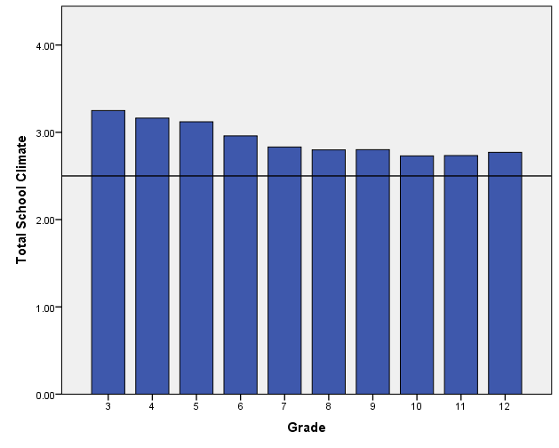
Total School Climate by Student Grade
Student perceptions tend to decrease, especially from elementary to middle school

Slide 11
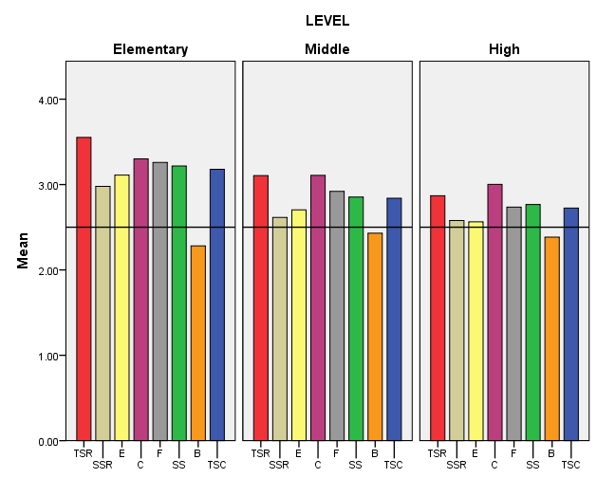
Grade Level Differences: Student Survey 2018
Scores tend to decrease as students get older, especially from ES to MS
Bullying SW is seen as a problem, especially in MS and HS
Student-student relations and student engagement SW tend to be low compared to other scores across all levels
Teacher-student relations and clarity of expectations tend to be high compared to other scores across all levels
Teacher-Student Relations
Student Engagement
School-wide
Fairness of Rules
Bullying School-wide
Student Relations
Clarity of Expectations
School Safety
Total School Climate
Fairness of Rules

Slide 12
Sample subscale responses associated with student scores (School Climate) | Percent who Agreed or Agreed a lot
 | Elem School | Middle School | High School
Teacher-Student Relations 7. Teachers care about their students. | 95.8 | 86.5 | 78.9
Student–Student Relations 11. Students are friendly with each other. | 75.8 | 61.2 | 64.7
Student Engagement School-wide 28. Most students work hard to get good grades. | 92.0 | 75.8 | 68.9
Clarity of Expectations 10. Students know how they are expected to act. | 88.1 | 82.3 | 83.8
Bullying School-wide* 9. Students threaten and bully others. | 35.3 | 53.9 | 44.3
Fairness of Rules 18. The school’s Code of Conduct is fair. | 90.1 | 76.6 | 69.6
School Safety 13. Students feel safe. | 90.3 | 80.1 | 75.1
* = A high score on this subscale is negative because items are negatively worded.

Slide 13
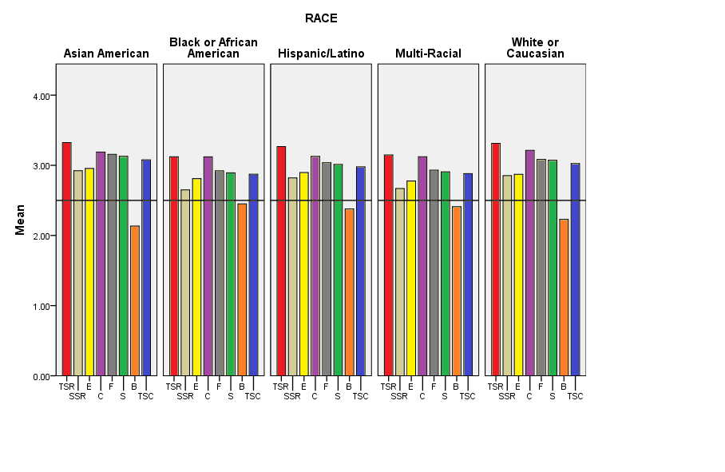
Race Differences: Student Survey 2018
Teacher-Student Relations
Student Engagement
School-wide
Fairness of Rules
Bullying School-wide
Student Relations
Clarity of Expectations
School Safety
Total School Climate

Slide 14
School Climate Scale 2018 Teacher/Staff Survey Results

Slide 15
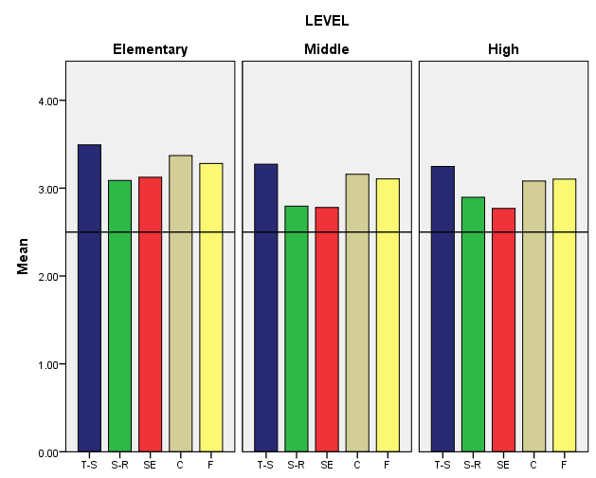
2018 Teacher Survey Results, K-12
Teachers/staff across grade levels tend to perceive student engagement SW and student relations least favorably and teacher-student relations most favorably.
Generally, perceptions decrease from elementary to middle school
Teacher-Student Relations
Student Engagement
School-wide
Student Relations
Clarity of Expectations
Fairness of Rules

Slide 16
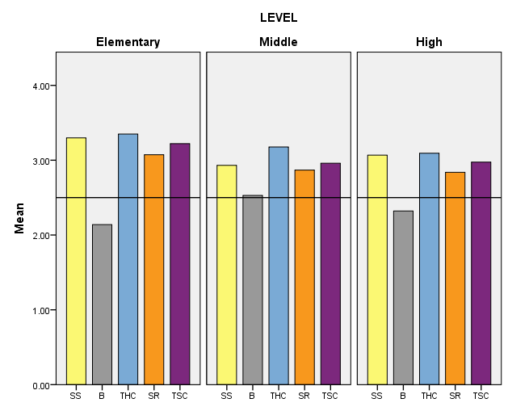
2018 Teacher Survey Results, K-12
Teacher-home communications tend to be viewed favorably across grade levels
Bullying SW tends to be viewed least favorably by middle school teachers/staff
School Safety
Teacher-Home
Communication
Total School Climate
Bullying School-wide
Staff Relations

Slide 17
Sample subscale responses associated with teacher/staff scores (School Climate) | Percent who Agreed or Agreed a lot
 | Elem School | Middle School | High School
Teacher-Student Relations 7. Teachers care about their students. | 99.1 | 97.2 | 98.1
Student–Student Relations 11. Students are friendly with each other. | 92.3 | 81.3 | 88.6
Student Engagement School-wide 28. Most students work hard to get good grades. | 87.0 | 67.4 | 63.5
Clarity of Expectations 10. Students know how they are expected to act. | 95.5 | 88.0 | 87.6
Bullying School-wide* 9. Students threaten and bully others. | 31.0 | 56.4 | 42.9
School Safety 13. Students feel safe. | 95.4 | 84.3 | 90.9
* = A high score on this subscale is negative because items are negatively worded.

Slide 18
Sample subscale responses associated with teacher/staff scores (School Climate) | Percent who Agreed or Agreed a lot
 | Elem School | Middle School | High School
Fairness of Rules 18. The school’s Code of Conduct is fair. | 93.7 | 88.0 | 92.3
Teacher-Home Communications 33. Teachers do a good job communicating with parents. | 97.0 | 92.2 | 87.2
Staff Relations 32. Teachers, staff, and administrators function as a good team. | 83.4 | 75.0 | 75.5

Slide 19
School Climate Scale 2018 Home Survey Results

Slide 20
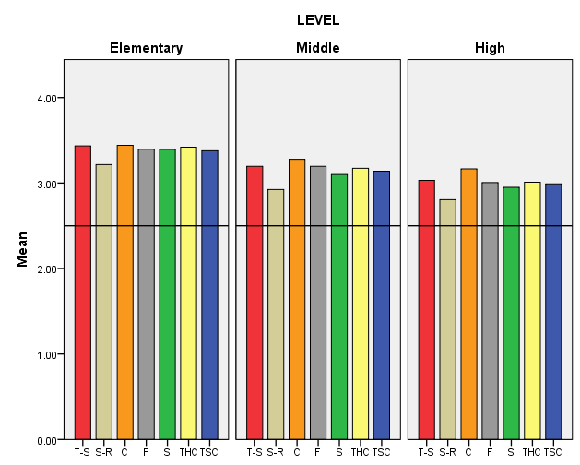
Grade Level Differences: Home Survey 2017-18
Clarity of expectations tends to be viewed most favorably across grade levels, while student relations is viewed least favorably.
Generally, perceptions decrease from elementary to high school, but positive perceptions overall.
Clarity of Expectations
School Safety
Total School Climate
Teacher-Student Relations
Student Relations
Fairness of Rules
Teacher-Home Communication
Fairness of Rules

Slide 21
Sample subscale responses associated with home scores (School Climate) | Percent who Agreed or Agreed a lot
 | Elem School | Middle School | High School
Teacher-Student Relations 7. Teachers care about their students. | 97.4 | 93.2 | 87.3
Student–Student Relations 11. Students are friendly with each other. | 91.0 | 79.6 | 76.0
Clarity of Expectations 10. Students know how they are expected to act. | 98.3 | 95.6 | 91.5
Teacher-Home Communication 24. Teachers work closely with parents to help students when they have problems. | 94.5 | 86.7 | 78.3

Slide 22
Sample subscale responses associated with home scores (School Climate) | Percent who Agreed or Agreed a lot
 | Elem School | Middle School | High School
School Safety 13. Students feel safe. | 96.9 | 88.8 | 82.3
Fairness of Rules 18. The school’s Code of Conduct is fair. | 97.8 | 94.5 | 85.2
Parent Satisfaction 9. I am satisfied with the education students get in this school. | 94.2 | 89.6 | 80.6

Slide 23
Positive, Punitive and Social-Emotional Learning Techniques Scale

Slide 24
Techniques 2018 Student Responses

Slide 25
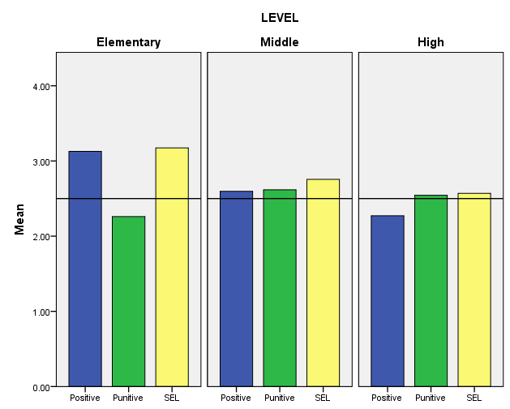
Disciplinary Techniques by Student Grade Level
Students in middle and high school tend to perceive less use of positive and SEL techniques and greater use of punitive techniques than elementary students.
Positive Techniques Punitive Techniques SEL Techniques

Slide 26
Sample subscale responses associated with student scores (Techniques) | Percent who Agreed or Agreed a lot
 | Elem School | Middle School | High School
Use of Positive Behavioral Techniques 2. Students are praised often. 5. Students are often given rewards for being good. | 81.0 80.1 | 54.8 54.3 | 40.9 30.8
Use of Punitive Techniques* 4. Students are often sent out of class for breaking rules. 13. Students are punished too much for minor things. | 51.3 30.2 | 72.1 49.8 | 58.6 55.3
Use of SEL Techniques 3. Students are taught to feel responsible for how they act. 12. Students are taught how to solve conflicts with others. | 90.9 87.0 | 82.3 64.3 | 76.0 49.4
* = A high score on this subscale is negative because items are negatively worded.

Slide 27
Techniques 2018 Teacher/Staff Results

Slide 28
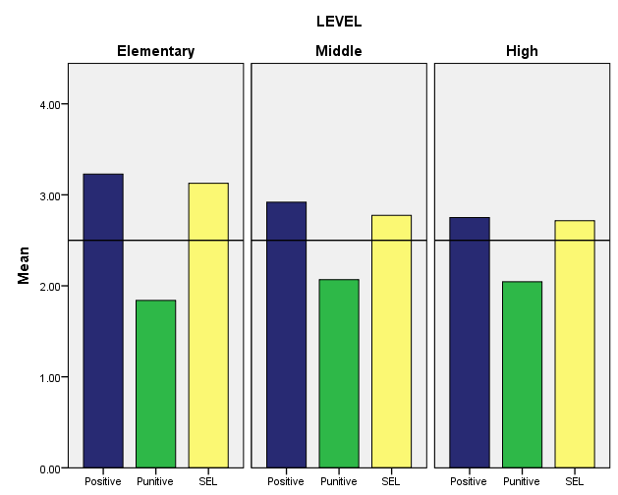
Techniques by Teacher Grade Level
In contrast to students, teachers/staff consistently report low use of punitive techniques & high use of positive and SEL techniques.
Use of positive techniques decreases from elementary to high school.
Positive Techniques Punitive Techniques SEL Techniques

Slide 29
Sample subscale responses associated with staff/teacher scores (Techniques) | Percent who Agreed or Agreed a lot
 | Elem School | Middle School | High School
Use of Positive Behavioral Techniques 2. Students are praised often. 11. Classes get rewards for good behavior | 96.9 89.8 | 89.8 70.1 | 83.3 50.3
Use of Punitive Techniques* 7. Students are often yelled at by adults. 10. Many students are sent to the office for breaking rules. | 10.1 16.8 | 20.7 30.7 | 12.3 27.1
Use of SEL Techniques 3. Students are taught to feel responsible for how they act. 15. Students are taught they should care about how others feel. | 90.4 94.4 | 74.6 80.2 | 70.0 74.6
* = A high score on this subscale is negative because items are negatively worded.

Slide 30
Bullying Victimization Scale 2018 Student Results

Slide 31
Bullying Victimization Scale
Students asked to respond to 12 statements about the extent to which he/she was bullied, including:
4 physical statements
4 verbal statements
4 social bullying statements
Students in grades 6-12 also given 4 statements about cyber bullying
Students responded on a 6-point scale:
1 = Never
2 = Less than once a month
3 = Once or twice a month
4 = Once a week
5 = Several times a month
6 = Every day

Slide 32
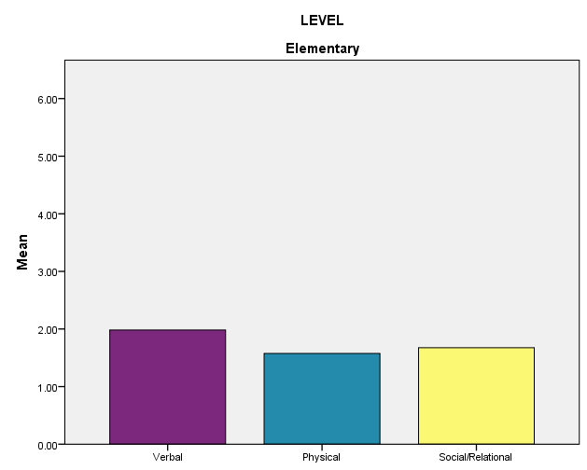
Bullying Victimization by Student Grade Level
Elementary students tend to view verbal bullying as occurring more frequently than other types of bullying.
Overall, students perceive little bullying occurring in elementary school.
Verbal Bullying Physical Bullying Social/Relational Bullying

Slide 33
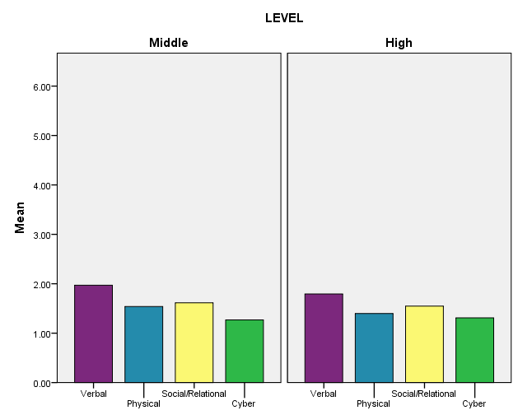
Bullying Victimization by Student Grade Level
As in elementary school, students tend to view verbal bullying as occurring most frequently in middle and high school.
Overall, students view bullying as occurring rather infrequently (never – less than once a month range).
Verbal Bullying Physical Bullying Social/Relational Bullying Cyberbullying

Slide 34
Sample subscale responses associated with student scores (Bullying Victimization*) | Percent who are bullied once a month or more
 | Elem School | Middle School | High School
Verbal Bullying 4. A student said mean things to me. | 28.3 | 28.2 | 23.0
Physical Bullying 5. I was hit or kicked and it hurt. | 12.6 | 11.1 | 7.8
Social/Relational Bullying 6. A student told/got others not to like me. | 16.1 | 15.5 | 14.5
Cyberbullying 14. A student sent me a mean or hurtful message about me using email, text messaging, instant messaging, or similar electronic messaging. | N/A | 7.2 | 8.1
* = A high score on this subscale is negative because items are negatively worded.

Slide 35
Bullying Victimization Scale 2018 Home Results

Slide 36
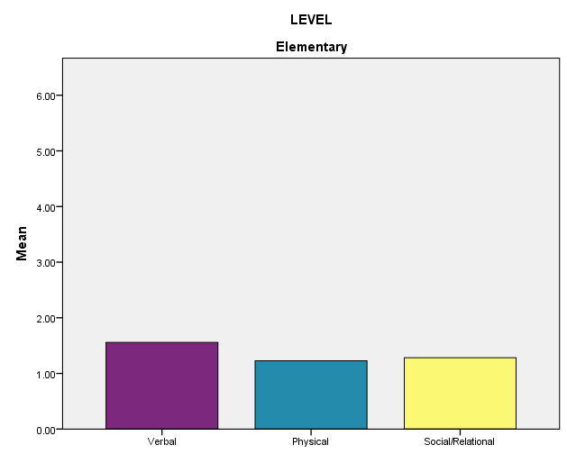
Bullying Victimization by Student Grade Level
Parents tend to view verbal bullying as occurring more frequently than other types of bullying in elementary school.
Overall, parents perceive little bullying occurring in elementary school.
Verbal Bullying Physical Bullying Social/Relational Bullying

Slide 37
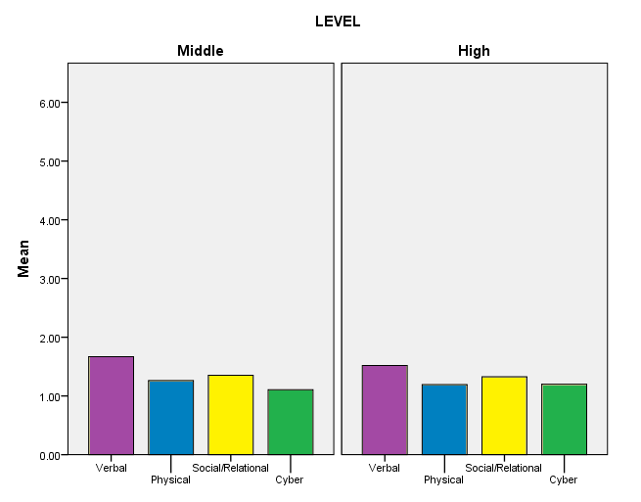
Bullying Victimization by Student Grade Level
As in elementary school, parents tend to view verbal bullying as occurring most frequently in middle and high school.
Overall, parents view bullying as occurring rather infrequently (never – less than once a month range).
Verbal Bullying Physical Bullying Social/Relational Bullying Cyberbullying

Slide 38
Sample subscale responses associated with home scores (Bullying Victimization*) | Percent who are bullied once a month or more
 | Elem School | Middle School | High School
Verbal Bullying 7. My child was called names he/she didn’t like. | 10.6 | 14.7 | 10.4
Physical Bullying 11. A student threatened to harm my child. | 2.6 | 4.5 | 4.1
Social/Relational Bullying 9. A student got others to say mean things about my child. | 5.3 | 8.5 | 6.8
Cyberbullying* 13. Another student sent my child a mean or hurtful message about him/her using email, text messaging, or other electronic messaging. | N/A | 3.0 | 5.1
A high score on this subscale is negative because items are negatively worded. *For grades 6-12 only

Slide 39
Student Engagement Scale 2018 Student Results

Slide 40
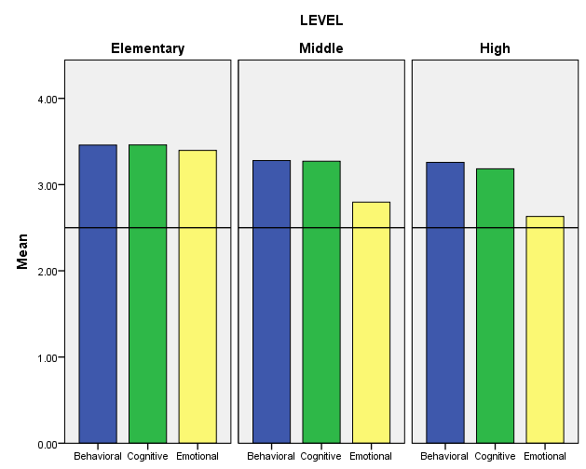
Student Engagement Grade Level Differences: Student Survey
In middle school and high school, students tend to view themselves as being less emotionally engaged than in elementary school.
Overall, across grade levels students tend to perceive themselves as being engaged in school.
Behavioral Engagement Cognitive Engagement Emotional Engagement

Slide 41
Sample subscale responses associated with student scores (Student Engagement ) | Percent who Agreed or Agreed a lot
 | Elem School | Middle School | High School
Behavioral 1. I pay attention in class. 4. I follow the rules at school. | 94.4 96.0 | 92.1 91.9 | 92.6 92.8
Cognitive 2. I try my best in school. 5. I turn in my homework on time. | 98.3 85.7 | 94.7 77.8 | 90.1 76.2
Emotional 3. I feel happy in school 9. I like students who go to this school | 84.5 90.3 | 67.7 78.9 | 60.7 70.9

Slide 42
Student Engagement Scale 2018 Home Results

Slide 43
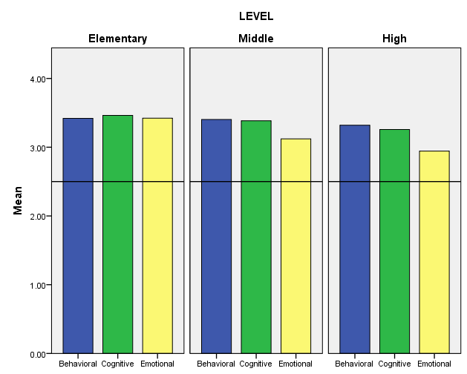
Student Engagement Grade Level Differences: Home Survey
In middle school and high school, parents tend to view their children as being less emotionally engaged than in elementary school.
Overall, across grade levels, parents perceive their children as being engaged in school.
Behavioral Engagement Cognitive Engagement Emotional Engagement

Slide 44
Sample subscale responses associated with home scores (Student Engagement ) | Percent who Agreed or Agreed a lot
 | Elem School | Middle School | High School
Behavioral 4. My child follows the rules at school. | 97.8 | 97.3 | 95.2
Cognitive 2. My child tries his/her best in school. | 97.0 | 94.0 | 88.9
Emotional 3. My child feels happy in this school | 94.7 | 86.2 | 78.4

Slide 45
Student Social and Emotional Competencies Scale 2018 Student Results

Slide 46
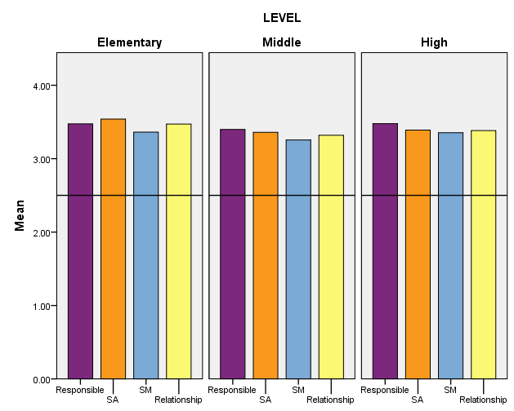
Student Social and Emotional Competencies Scores by Student Grade Level
Students across grade levels tend to perceive themselves as possessing social and emotional competence in all 4 areas.
Responsible Decision Making Social Awareness Self-Management Relationship Skills

Slide 47
Sample subscale responses associated with student scores (Student Social and Emotional Competencies Scale) | Percent who indicated this was somewhat or very much like them
 | Elem School | Middle School | High School
Responsible Decision-making/Responsibility 1. I feel responsible for how I act. | 95.2 | 94.8 | 96.3
Understanding how others think and feel/Social Awareness 6. I care about how others feel. | 93.5 | 88.1 | 87.0
Self-management of emotions and behavior 7. I think before I act. | 85.8 | 81.2 | 87.1
Relationship Skills 4. I am good at solving conflicts with others. | 80.9 | 77.6 | 85.5

Slide 48
Summary
Delaware has developed a reliable and valid measure of school climate and more.
Scores on the surveys are reliable and related to important outcomes, particularly academic achievement and suspensions/expulsions.
Improvements continue to be made.
For additional information & resources visit
www.delawarepbs.org

