Slide 1
School Climate Data Workshop
Delaware Positive Behavior
Support Project
May 13, 2019

Slide 2
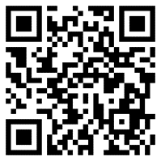
Join Us on Padlet
How to use Padlet: Log in using the QR code or provided link. You can post from your computer or smart phone. Posts will be displayed in the order they are received.
https://padlet.com/robertsn2/oi4g8ec9dh48

Slide 3


Delaware Department of Education
Teaching & Learning Branch
Exceptional Children Resources Group

Slide 4
Our DE-PBS Staff Team
Project Directors – Linda Smith & Debby Boyer
SCSS & Survey Coordinator – Sarah Hearn
Project Coaches – Megan Pell, Niki Kendall
Database Manager – Erin Konrad
Graduate Assistants – Angela Harris, Shelby Schwing, Jenna Leary, Natali Munoz
Faculty Partner & Lead Survey Developer – George Bear

Slide 5
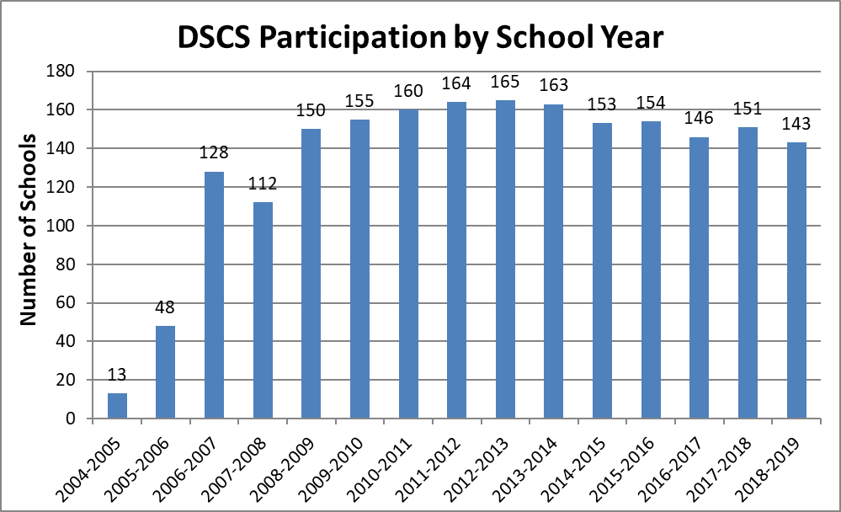
Participation Continues To Be High
Number of Participating Schools
School Years

Slide 6
2018-19 Survey Sample
 |  | Student | Teacher | Home
Elementary | Schools | 71 | 73 | 70
 | Respondents | 14104 | 3084 | 8725
Middle | Schools | 26 | 26 | 19
 | Respondents | 11470 | 1381 | 2391
High | Schools | 15 | 16 | 6
 | Respondents | 6331 | 1173 | 535
Alternative | Schools | 4 | 5 | 2
 | Respondents | 124 | 109 | 29
Special | Schools | 2 | 9 | 5
 | Respondents | 54 | 660 | 227
Early Childhood | Schools | N/A | 8 | 6
 | Respondents | N/A | 282 | 677
Other | Schools | 6 | 6 | 5
 | Respondents | 2734 | 375 | 794
 |  | 34,817 | 7,064 | 13,378

Slide 7
Delaware School Survey Scales
(Note: School Climate is 1 of the 5 Scales)
Student Scales
School Climate
Techniques (School Discipline)
Teacher/Staff Scales
School Climate
Home Scales
School Climate
Bullying Victimization
Student Engagement
Student Social and Emotional Competencies
Techniques (School Discipline)
Bullying Victimization
Student Engagement

Slide 8
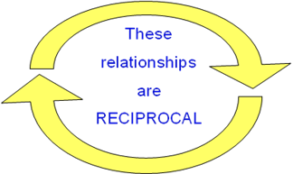
Why is school climate important?
School Climate is linked to a wide range of academic, behavioral, and socio-emotional outcomes for students and teachers:
          Academic achievement
          Student academic, social, and personal attitudes and motives
          Student attendance and school avoidance
          Student behavior problems, delinquency, victimization
          Student and teacher emotional well-being
          Teachers’ greater implementation fidelity
          of new curriculum and interventions

Slide 9
Correlates of School Climate in Delaware Schools
 | Elementary School (n=71) | Middle School (n = 26) | High School (n = 15)
Academics
English Language Arts | .69* | .75* | .22
Math | .64* | .74* | .39
Student Engagement | .77* | .90* | .83*
Behavior
Suspensions | -.60* | -.70* | -.75*
Bullying Victimization | -.47* | -.66* | -.15
Social and Emotional Competencies | .74* | .82* | .58*
Classroom Management Techniques
Punitive | -.87* | -.93* | -.54*
Positive | .46* | .43* | .22
SEL | .83* | .86* | .77*

Slide 10
Side Note: Other Research Tidbits
Among recent Findings by UD/CDS researchers.
International Research:
Chinese students perceive school climate more favorably than American students and are more emotionally engaged, particularly beyond elementary school. However, among Chinese students (but not American students), perceptions of school climate are unrelated to their engagement in school (Bear, Yang, Chen, He, Xie, & Huang, 2018).
Retained students in private schools report greater verbal and social/relational bullying, and bullying in general, than in public schools in Brazil. There are no differences in bullying victimization between promoted, once-retained, and multiple-retained students in public schools (Harris, Bear, Chen, Lisboa, & Holst, 2018).

Slide 11
Side Note: Other Research Tidbits
Delaware Schools:
Teaching SEL (more so in elementary school), Teacher-Student Relationships (more so in MS and HS), and Student-Student Relationships are strong predictors of student engagement (Yang, Bear, & May, 2018).
Effects of teaching social and emotional competencies are nearly twice that of the use of praise and rewards (Bear, Yang, Mantz, & Harris, 2017).
Frequent use of praise and rewards does not appear to harm intrinsic motivation (but is associated with greater extrinsic motivation) (Bear, Slaughter, Mantz, Farley-Ripple, 2017).

Slide 12
Improvements in DE Continue!
DE School Climate Longitudinal Study 2012-2017
Examined changes in students’ perceptions of school climate using the DE School Climate Scale -Student version
Guiding question:
  Did students’ perceptions of school climate improve from 2012 to 2017 in elementary, middle, and high schools?
  If so, were improvements found across all seven aspects of school climate measured by the Delaware School Climate Scale-Student?

Slide 13
Major Findings
Total school climate score:
  Students’ perceptions quite favorable; especially in elementary schools
  Improved significantly from 2012 to 2017
All seven subscales:
  Scores improved significantly (elementary, middle, and high schools)
  Exception: Bullying School-wide subscale scores in middle schools.
Most impressive:
  Improvements in School Safety and Bullying (elementary & high schools)

Slide 14
State-wide Data Highlights and Application

Slide 15
School Climate Scale
Notable Trends
Student, Staff, and Home Survey Trends

Slide 16
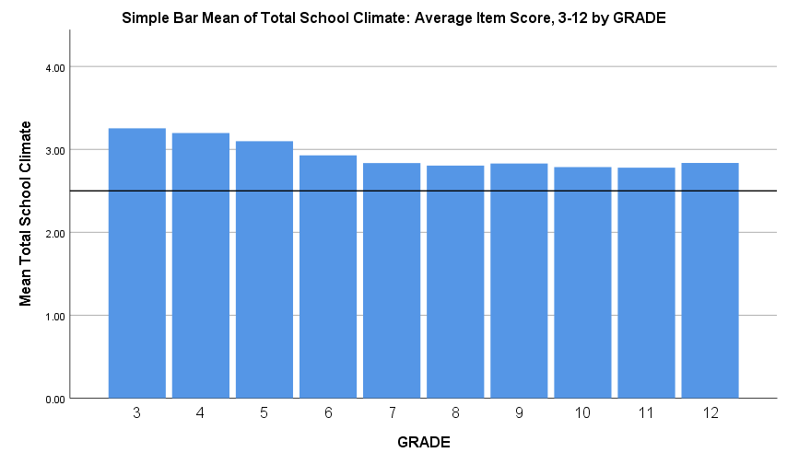
Total School Climate by Student Grade
  Student perceptions tend to decrease, especially from elementary to middle school

Slide 17
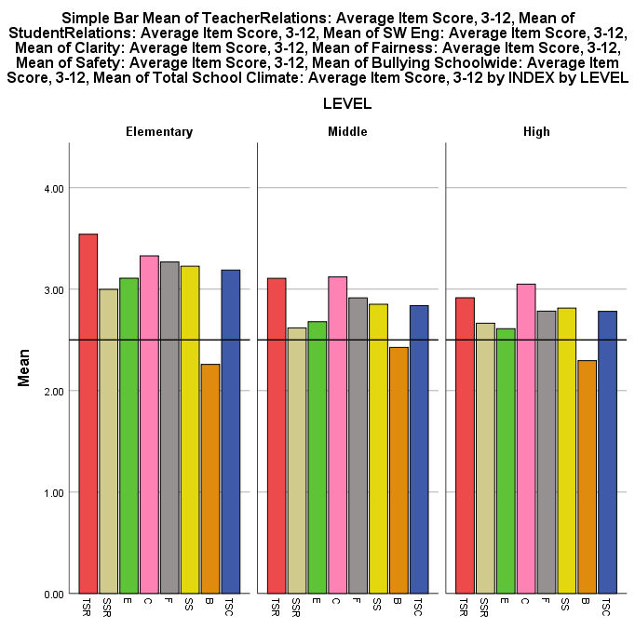
Grade Level Differences: Student Survey 2019
Scores tend to decrease as students get older, especially from ES to MS
Bullying SW is seen as a problem, especially in MS
Student-student relations and student engagement SW tend to be low compared to other scores across all levels
Teacher-student relations and clarity of expectations tend to be high compared to other scores across all levels
Teacher-Student
Relations
Student Engagement
School-wide
Fairness of Rules
Bullying School-wide
Student Relations
Clarity of Expectations
School Safety
Total School Climate
Fairness of Rules

Slide 18
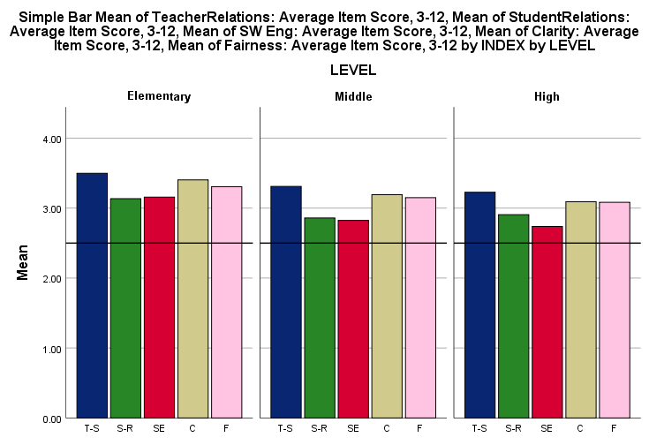
2019 Teacher Survey Results, K-12
Similar to students, teachers/staff across grade levels tend to perceive student engagement SW and student relations least favorably and teacher-student relations most favorably.
Teacher-Student
Relations
Student Engagement
School-wide
Student Relations
Clarity of Expectations
Fairness of Rules

Slide 19
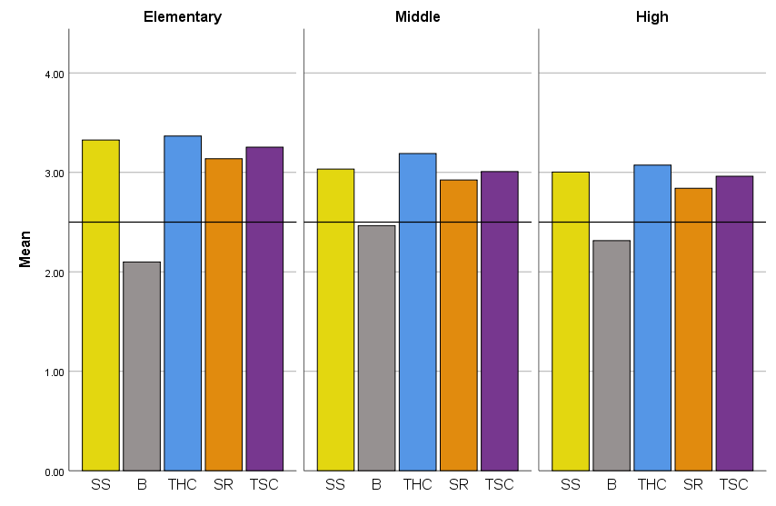
2019 Teacher Survey Results, K-12
Also similar to students, Bullying SW tends to be viewed least favorably by middle school teachers/ staff
School Safety
Teacher-Home
Communication
Total School Climate
Bullying School-wide
Staff Relations

Slide 20
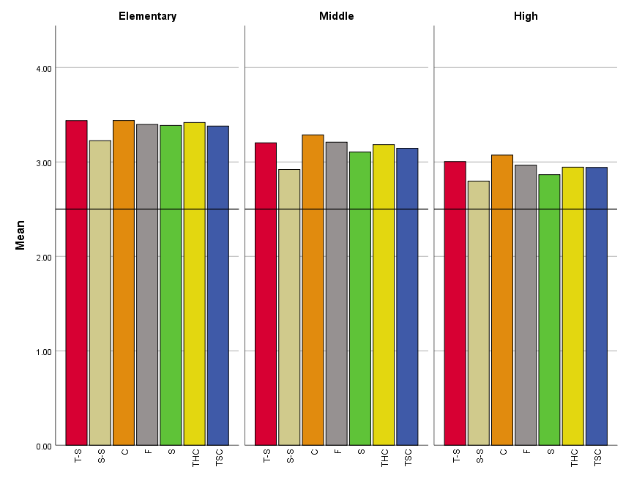
Grade Level Differences: Home Survey 2018-19
Home data also reveals that student relations is viewed least favorably across grade levels
Clarity of expectations tends to be viewed most favorably across grade levels
Clarity of Expectations
School Safety
Total School Climate
Teacher-Student
Relations
Student Relations
Fairness of Rules
Teacher-Home Communication
Fairness of Rules

Slide 21
Summary: School Climate Scale
Notable Trends
Student-student relationships scores tend to be low across students, teachers/staff, and families across grade levels
Student engagement schoolwide is also perceived less favorably across students and teachers/staff across grade levels
Bullying schoolwide is seen as a problem by students and teachers/staff, particularly in middle schools
Teacher-student relationships and clarity of expectations tend to be viewed most favorably across populations and grade levels

Slide 22
Student Engagement Scale
NOTABLE TRENDS
Student and Home Survey Trends

Slide 23
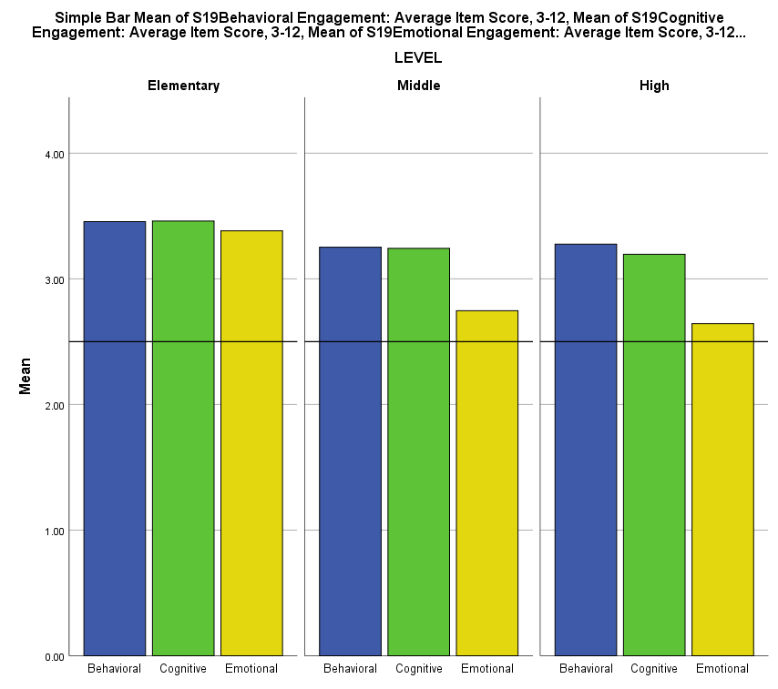
Student Engagement Grade Level Differences: Student Survey
In middle school and high school, students tend to view themselves as being less emotionally engaged than in elementary school.
Overall, across grade levels students tend to perceive themselves as being engaged in school.
Behavioral Engagement Cognitive Engagement Emotional Engagement

Slide 24
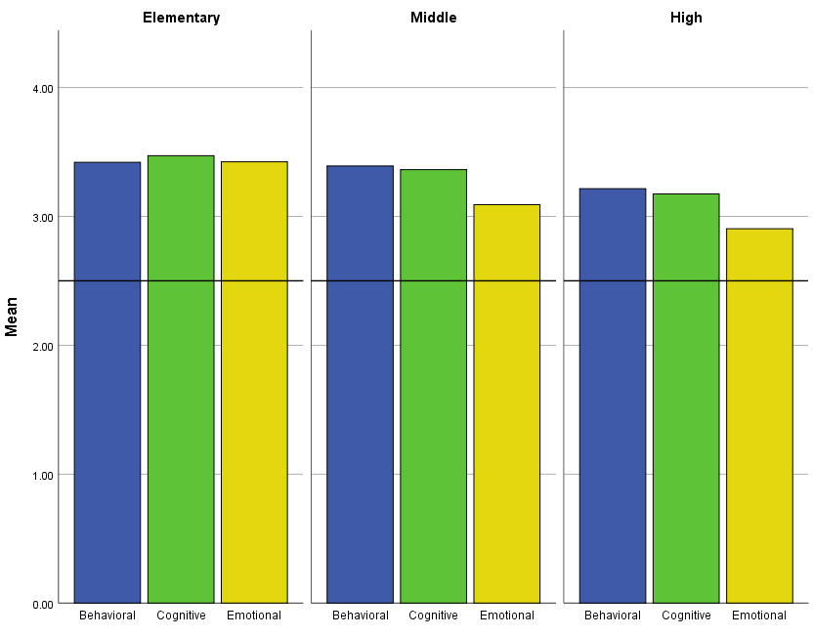
Student Engagement Grade Level Differences: Home Survey
A similar trend emerges in the home data: In middle school and high school, parents tend to view their children as being less emotionally engaged than in elementary school.
Overall, across grade levels, parents perceive their children as being engaged in school.
Behavioral Engagement Cognitive Engagement Emotional Engagement

Slide 25
Summary: Student Engagement Scale
Notable Trends
In middle school and high school, students tend to view themselves as being less emotionally engaged than in elementary school
Overall, across grade levels, students and parents perceive themselves or their children as being engaged in school

Slide 26
Now what?
What do we see?: Most prominent and universal data trend is low student-student relationships scores across students, teachers/staff, and families across grade levels
  Student engagement schoolwide, emotional engagement (in MS and HS) and bullying schoolwide (in MS) are also areas of concern
What do we do now?: Action plan by digging into available resources
*This reflective process can be used when examining your school’s data

Slide 27
Resource: School Climate PD Online Module Series
Supported by the School Climate and Student Success Grant (SCSS)
Goal of the PD is to provide information to schools that can lead to improvements in school climate and behavioral outcomes
Each module is approximately hour-long PowerPoint sessions with captioned audio
Potential uses:
  In-house professional development
  Materials can be accessed for use as:
    A whole staff
    In professional learning communities
    Leadership teams
    Individuals

Slide 28
School Climate PD Series, cont.
The modules provide educators with:
  An overview of the topic, its importance, and factors that contribute to both negative and positive aspects of the topic
  Recommended research-based strategies to improve the topic
  Resources and tools (available to download) to support the positive development of the topic
  Research-based module in-depth narratives (that serve as the basis for the PowerPoint presentations) that focus on each topic in great detail

Slide 29
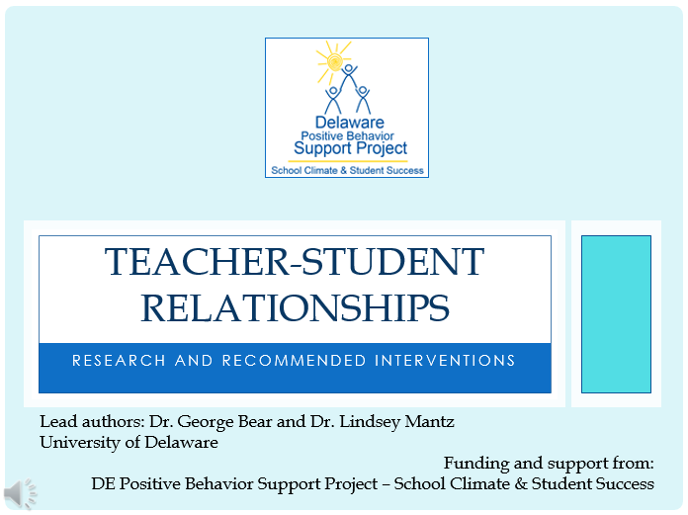
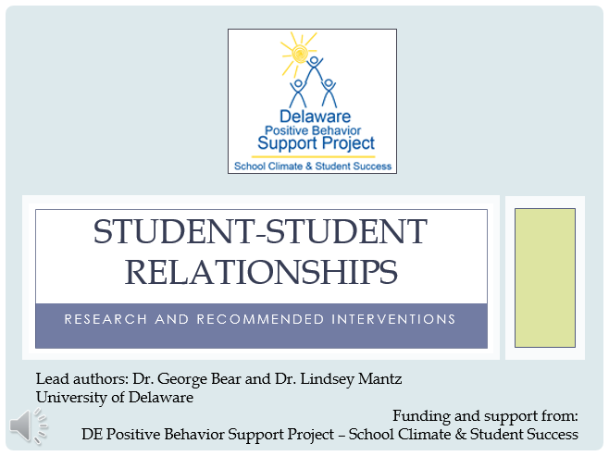
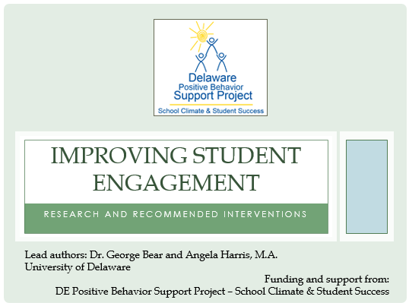

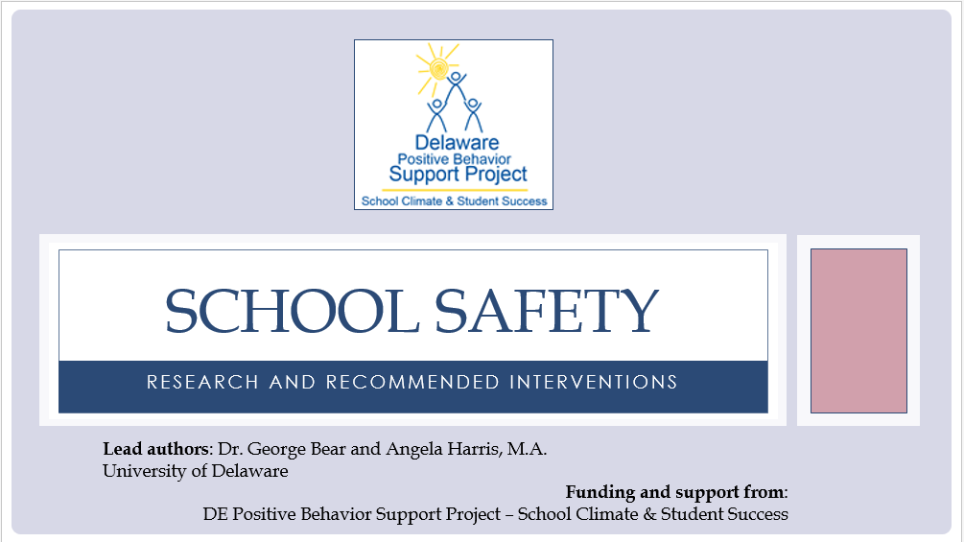
Available Modules
Note: School Safety Module presentation does not currently include captioned audio

Slide 30
Reflect & Share
For those of you that have already accessed the School Climate modules…..
  how are you using the modules (e.g., shared with staff, presented to all staff, used resource guide, facilitate discussion during PLC, etc.?

Slide 31
Action Planning: Student-Student Relationships Module

Slide 32
Why Are Student-Student Relationships Important?
Impact
Mental health & emotional wellbeing
Social & Academic develop-ment
School & Classroom Climate
Buffer life stressors

Slide 33
Student Characteristics
Student-Student Relationship Contributing Factors
Classroom
Management
&
School-wide
Discipline

Slide 34
Examine School Climate Data
Classroom Management & School-wide Discipline
Student-Student Relationship Recommended Strategies
Student-student Relationship Building Activities
Curriculum-based Lessons

Slide 35

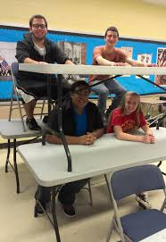
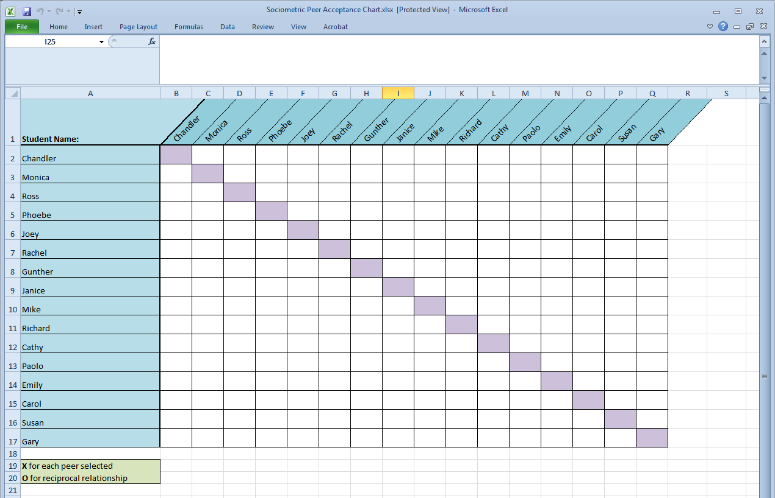
SOCIOMETRIC SEATING TOOL
Excel spreadsheet and instruction guide
Students list 3 peers with whom they would like sit
Track students’ responses in Excel to see who is (and who is not) nominated by one another

Slide 36
Reflect & Share
What student relationship building activities have you engaged in?

Slide 37
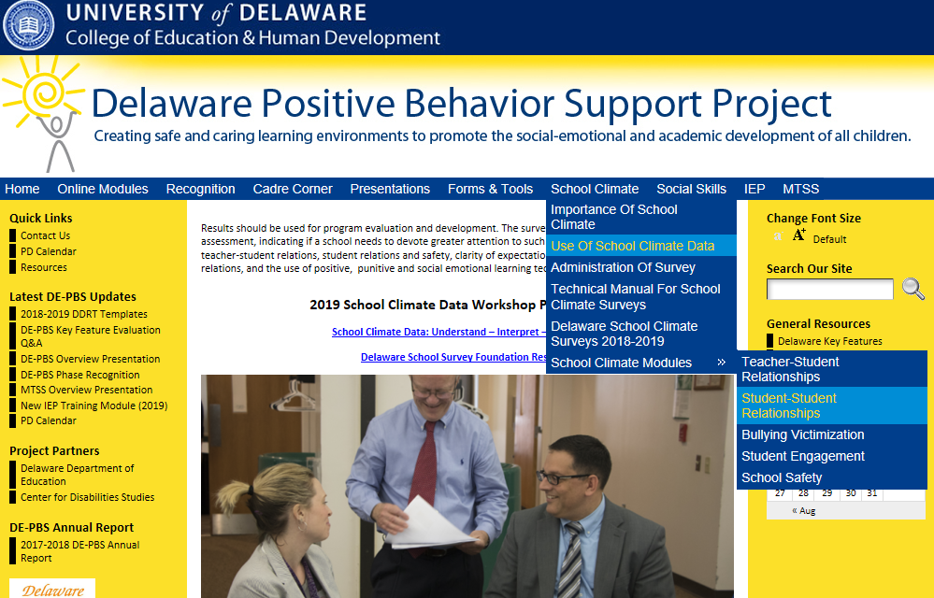
Resource Access

Slide 38
Reflect & Share
In what ways have you used survey data?

Slide 39
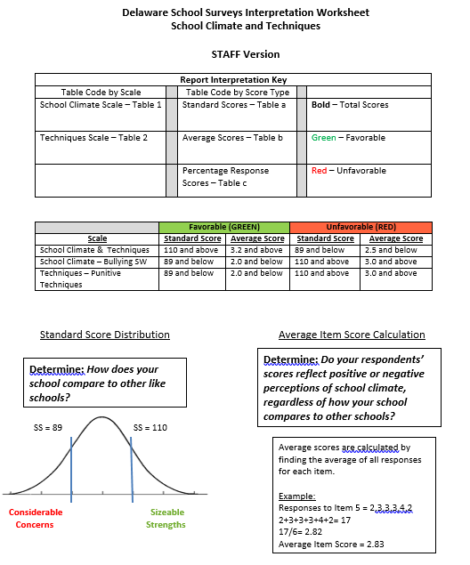
Interpretation Worksheets & Action Plan Overview

Slide 40
Interpretation Worksheet Structure
Worksheet per survey population
  (Student, Staff, Home)
Guides you through each survey scale
  (School Climate, Techniques, Bullying, Engagement, Social Emotional Competencies)
Prompts review of graphs & 3 types of scores
Consider strengths, concerns, general notes such as significant differences
Information gathered then used to complete action planning template

Slide 41
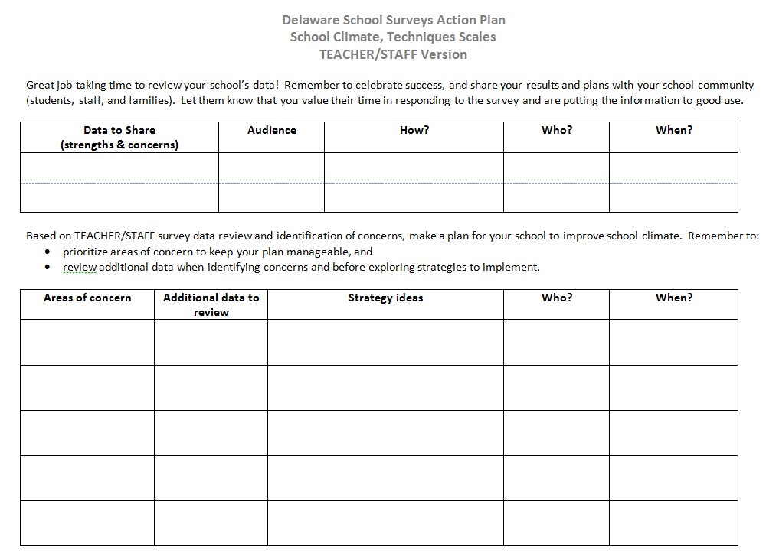

Slide 42

Recommended next steps for today:
Review student report (if applicable)
Your next steps in the coming weeks:
Determine how and when to share!
Start action planning

Slide 43
Data Review

