Slide 1
Welcome to Tier 2 Planning

Slide 2
Today’s Agenda
Welcome & Big Picture
Complete Tier 2 TFI
Action Planning
Plan initial next steps for each section of TFI
Identify longer term items to address

Slide 4
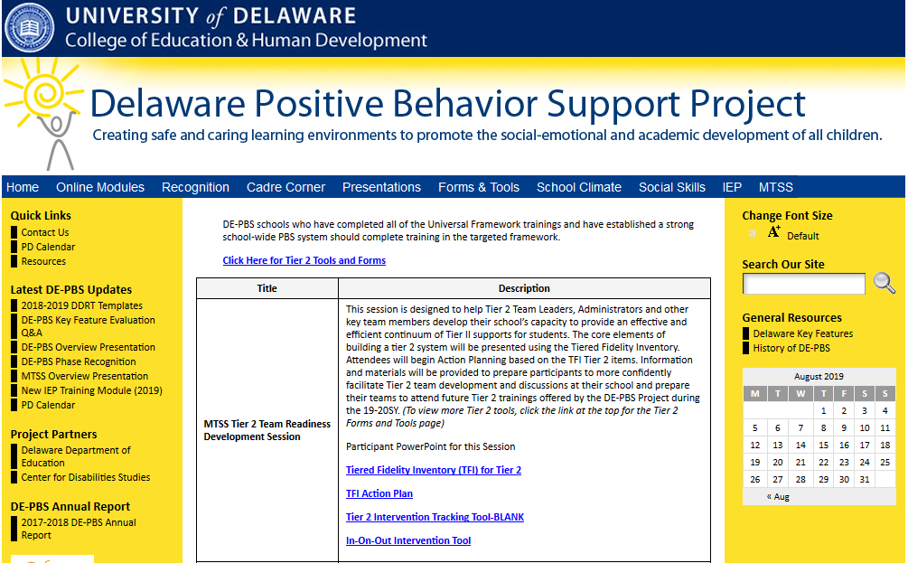

Slide 5
The Delaware Positive Behavior Support Project is a collaboration with the DE Department of Education, the UD Center for Disabilities Studies, and Delaware Public Schools. Vision: Create safe and caring learning environments to promote the social-emotional and academic development of all children.

Slide 6
Expectations for today
BE ENGAGED | Share what has worked in your school Ask questions Connect with others
BE REFLECTIVE | Consider each TFI item and score as accurately as possible Have a growth mindset
BE STRATEGIC | Focus on items you can address quickly Use parking lot for off topic issues or barriers Leave with a plan

Slide 7
The MTSS/PBS Big Picture

Slide 8
Continuum of Academic & Social Behavior Support
Tier 3 for a Few: Intensive, Individualized
Tier 2 for Some: Targeted for Small Groups
Tier I for All: Core/Universal

Slide 9
REMEMBER Tiers 2 gives students a higher dosage of what we already do at Tier 1.
Teach
Prompt
Reinforce
Monitor
Communicate

Slide 10
3-Tiered System of Support
Necessary Conversations (Teams)
SW-Team
Tier 2 Team
Tier 3 Team
Plans SW & Class-wide supports
System
Conversations
Uses process data; evaluates overall effectiveness; does not involve discussion of individual students
Problem Solving Conversations
Matches students to interventions and monitors progress, making adjustments as needed
System
Conversations
Uses process data; evaluates overall effectiveness; does not involve discussion of individual students
Universal Support through SW Program
CICO
Brief FBA/BIP (Consultant Based)
Group interventions
FBA/BIP or PTR (Team Based)
Group w. individual
features
FBA/BIP or PCP (Wrap Around Based)
Relationship-Building Interventions
Skill-Building Interventions
Adapted from the Illinois PBIS Network

Slide 11
MTSS – Tiers 2 & 3
Tier 2
Tier 3
Targeted
Team
Student Support Team
System
Conversations
Uses process data; evaluates overall effectiveness; does NOT involve discussion of individual students
Problem Solving Conversations
Matches students to interventions and monitors progress, making adjustments as needed
Tier 2
Tier 3
Problem-Solving Team / IST Teams

Slide 12
Teams Lead the Systems within a MTSS
Tier 2 Team(s)
Identifies targeted student needs, selects relevant interventions; implements & evaluates interventions’ use
System Conversations
Uses process data; evaluates overall effectiveness; does NOT involve discussion of individual students
Problem Solving Conversations
Matches students to interventions and monitors progress, making adjustments as needed
Problem-Solving
Systems

Slide 13
Tiered Fidelity Inventory (TFI): Tier II Individual Items Slide Deck

Slide 14
TFI Tier II Items
Subscale: Teams
Item 2.1: Team Composition
Item 2.2: Team Operating Procedures
Item 2.3: Screening
Item 2.4: Request for Assistance
Subscale: Interventions
Item 2.5: Options for Tier II Interventions
Item 2.6: Tier II Critical Features
Item 2.7: Practices Matched to Student Need
Item 2.8: Access to Tier I Supports
Item 2.9: Professional Development
Subscale: Evaluation
Item 2.10: Level of Use
Item 2.11: Student Performance Data
Item 2.12: Fidelity Data
Item 2.13: Annual Evaluation

Slide 15
TFI Item: 2.1 Team Composition
Feature | Possible Data Sources | Scoring Criteria
Team Composition: Tier II (or combined Tier II/III ) team includes a Tier II systems coordinator and individuals able to provide (1) applied behavioral expertise, (2) administrative authority, (3) knowledge of students, and (4) knowledge about operation of school across grade levels and programs. | School organizational chart Tier II team meeting minutes | 0 = Tier II team does not include coordinator or all 4 core areas of Tier II team expertise 1 = Team identified, but without coordinator and all 4 core areas of Tier II team expertise OR attendance of these members below 80% 2 = Tier II team is composed of coordinator and individuals with all 4 areas of expertise with attendance of these members at or above 80%
Main Idea:
Tier II team needs individuals with specific skills and perspectives to implement Tier II supports.

Slide 16
Quick Check: Team Composition
Are all necessary roles/functions represented on the team?
Team Assessment:
Coordinator
Applied behavioral expertise
Administrative authority
Knowledge about students
Knowledge about school
Scoring:
0= Tier II team does not include coordinator or all four core areas of Tier II team expertise.
1= Team identified, but without coordinator and all four core areas of Tier II team expertise, OR attendance of these members is below 80%.
2 = Tier II team is composed of coordinator and individuals with all four areas of expertise with attendance of these members at or above 80%.

Slide 17
2.2 Team Operating Procedures
Feature | Possible Data Sources | Scoring Criteria
Team Operating Procedures: Tier II team meets at least monthly and has (a) regular meeting format/agenda, (b) minutes, (c) defined meeting roles, and (d) a current action plan. | Tier II team meeting agendas and minutes Tier II meeting role descriptions Tier II action plan | 0 = Description of feature not being implemented. 1 = Description of feature being partially implemented. 2 = Description of the feature being fully implemented
Main Idea:
Tier II teams need meeting foundations in order operate efficiently and to implement effective supports.

Slide 18
Quick Check: Team Operating Procedures
What meeting procedures are currently in place at the Tier II level?:
Team Assessment:
Regular, monthly meetings
Consistently followed meeting format
Minutes taken during meeting
Participant roles are clearly defined
Action plan current to the school year
Scoring:
0 = Tier II team does not use regular meeting format/agenda, minutes, defined roles, or a current action plan.
1 = Tier II team has at least two but not all four features.
2 = Tier II team meets at least monthly and uses regular meeting format/agenda, minutes, defined roles, AND has a current action plan.

Slide 19
2.3 Screening
Feature | Possible Data Sources | Scoring Criteria
Screening: Tier II team uses decision rules and multiple sources of data (e.g., ODRs, academic progress, screening tools, attendance, teacher/family/student nominations) to identify students who require Tier II supports. | Multiple data sources used (ODRs, Time out of instruction, Attendance, Academic performance) Team decision rubric Team meeting minutes School policy | 0 = No specific rules for identifying students who qualify for Tier II supports. 1 = Data decision rules established but not consistently followed or are gathered from only one data source. 2 = Written policy exists that (a) uses multiple data sources for identifying students, and (b) ensures that families are notified when a student enters Tier II supports.
Main Idea:
Timely selection of students for Tier II supports improves the effectiveness of Tier II implementation.

Slide 20
Quick Check: Screening
What is the process for identifying students who may need Tier II supports?:
Team Assessment:
Written policy or rubric for documentation identifying students in need of assistance
Use of multiple data sources
Process for notifying and including families
Scoring:
0 = No specific rules for identifying students who qualify for Tier II supports.
1 = Data decision rules established but not consistently followed or are gathered from only one data source.
2 = Written policy exists that (a) uses multiple data sources for identifying students, and (b) ensures that families are notified when a student enters Tier II supports.
Back to ALL ITEMS

Slide 21
2.4 Request for Assistance
Feature | Possible Data Sources | Scoring Criteria
Request for Assistance: Tier II planning team uses written request for assistance form and process that are available to all staff, families, and students. | School handbook Request for Assistance form Family handbook | 0 = No formal process exists. 1 = Informal process in place for staff and families to request behavioral assistance. 2 = Written request for assistance process is in place, and team responds to request within three days.
Main Idea:
Faculty, staff, families, and students should have a highly predictable and low-effort strategy for requesting behavior assistance.

Slide 22
Quick Check: Request for Assistance
What is the process for requesting assistance with behavior support?:
Team Assessment:
Written policy or rubric for documentation identifying students in need of assistance
Use of multiple data sources
Process for notifying and including families
Scoring:
0 = No formal process exists.
1 = Informal process in place for staff and families to request behavioral assistance.
2 = Written request for assistance process is in place, and team responds to request within three days.

Slide 23
2.5 Options for Tier II Interventions
Feature | Possible Data Sources | Scoring Criteria
Options for Tier II Interventions: Tier II team has multiple ongoing behavior support interventions with documented evidence of effectiveness matched to student need. | School Tier II handbook Targeted Interventions Reference Guide | 0 = No Tier II interventions with documented evidence of effectiveness are in use. 1 = Only 1 Tier II intervention with documented evidence of effectiveness is in use. 2 = Multiple Tier II interventions with documented evidence of effectiveness matched to student need are in use.
Main Idea:
A wide array of intervention options increases the likelihood that student
needs are met and done so in a timely way..

Slide 24
Quick Check: Options for Tier II Interventions
What intervention options are available at the Tier II level?:
Team Assessment:
Are there multiple Tier II interventions readily available?
Do they have an evidence base of effectiveness with students?
Scoring:
0 = No Tier II interventions with documented evidence of effectiveness are in use.
1 = Only one Tier II intervention with documented evidence of effectiveness is in use.
2 = A sufficient array of Tier II interventions with documented evidence of effectiveness matched to student need are in use.

Slide 25
2.6 Tier II Critical Features
Feature | Possible Data Sources | Scoring Criteria
Tier II Critical Features: Tier II interventions provide (a) additional instruction/time for student skill development, (b) additional structure/ predictability, and/or (c) increased opportunity for feedback (e.g., Daily Progress Report). | Universal lesson plans Tier II lesson plans Daily/Weekly Progress Report School schedule School Tier II handbook | 0 = Tier II interventions do not promote additional instruction/time, improved structure, or increased feedback. 1 = All Tier II interventions provide some but not all three core Tier II features. 2 = All Tier II interventions include all three core Tier II features.
Main Idea:
Tier II supports should focus on improving the skills and context needed for student success.

Slide 26
Quick Check: Tier II Critical Features
What critical features are embedded in Tier II supports?:
Team Assessment:
Do all Tier II interventions include additional instruction/time for student skill development?
Do all Tier II interventions include additional structure/predictability?
Do all Tier II interventions include increased opportunities for feedback?
Scoring:
0 = Tier II interventions do not promote additional instruction/time, improved structure, or increased feedback.
1 = The array of Tier II interventions provide some but not all three core Tier II features.
2 = The array of Tier II interventions include all 3 core Tier II features.
Back to ALL ITEMS

Slide 27
2.7 Practices Matched to Student Need
Feature | Possible Data Sources | Scoring Criteria
Practices Matched to Student Need: A formal process is in place for efficient selection of Tier II interventions that are matched to student need (e.g., behavioral function), and have contextual fit (e.g., culture, developmental level). | Data sources used to identify interventions School policy Tier II handbook Needs assessment Targeted Interventions Reference Guide | 0 = No process is in place. 1 = Process for selecting Tier II interventions does not include documentation that interventions are matched to student need . 2 = Formal process is in place to select practices that match student need and have contextual fit (e.g., developmentally and culturally appropriate).
Main Idea:
Tier II support strategies are
evidence-based and designed with
preliminary assessment information (or assumptions) about student need.

Slide 28
Quick Check: Practices Matched to Student Need
What is the process for identifying appropriate Tier II supports?:
Team Assessment:
Is there a formalized process to select Tier II supports?
Does the process take into account student need and contextual fit?
Scoring:
0 = No process is in place.
1 = Process for selecting Tier II interventions does not include documentation that interventions are matched to student need.
2 = Formal process is in place to select practices that match student need and have contextual fit (e.g., developmentally and culturally
appropriate).
Back to ALL ITEMS

Slide 29
2.8 Access to Tier I Supports
Feature | Possible Data Sources | Scoring Criteria
Access to Tier I Supports: Tier II supports are explicitly linked to Tier I supports, and students receiving Tier II supports have access to and are included in Tier I supports. | Universal lesson plans & teaching schedule Tier II lesson plans Acknowledgement system Student of the month documentation Family communication | 0 = There is no evidence that students receiving Tier II interventions have access to Tier I supports. 1 = Tier II supports are not explicitly linked to Tier I supports, and/or students receiving Tier II interventions have some but not full access to Tier I supports. 2 = Tier II supports are explicitly linked to Tier I supports, and students receiving Tier II interventions have full access to and receive all Tier I supports.
Main Idea:
Tier II supports are more effective when layered within Tier I.

Slide 30
Quick Check: Access to Tier I Supports
How do students receiving Tier II supports benefit from the Tier I system?
Team Assessment:
Are the school’s Tier II supports linked/layered/ aligned with the school-wide universal system?
Do students receiving Tier II supports still receive full access to Tier I systems?
Scoring:
0 = There is no evidence that students receiving Tier II interventions have access to Tier I supports.
1 = Tier II supports are not explicitly linked to Tier I supports, and/or students receiving Tier II interventions have some but not full access to Tier I supports.
2 = Tier II supports are explicitly linked to Tier I supports, and students receiving Tier II interventions have full access to all Tier I supports.
Back to ALL ITEMS

Slide 31
2.9 Professional Development
Feature | Possible Data Sources | Scoring Criteria
Professional Development: A written process is followed for teaching all relevant staff the process for and how to implement each Tier II intervention that is in place. | Professional development calendar Staff handbook Lesson plans for teacher trainings School policy | 0 = No process for teaching staff is in place. 1 = Professional development and orientation process is informal. 2 = Written process is used to teach and coach all relevant staff in all aspects of intervention delivery, including request for assistance process, using progress report as an instructional prompt, delivering feedback, and monitoring student progress.
Main Idea:
Effective Tier II supports require participation of many adults in the school.

Slide 32
Quick Check: Professional Development
What is the process for training staff members providing Tier II supports?
Team Assessment:
Are there scheduled trainings for school team members?
Is there a faculty-wide orientation led by the Tier II team?
Is there a scheduled, annual orientation for new faculty?
Are there documented strategies for orienting substitutes or volunteers?
Is the process for requesting assistance around behavioral concerns known by all, easy to follow, and encouraged?
Scoring:
0 = No process for teaching staff is in place.
1 = Professional development and orientation process is informal.
2 = Written process is used to teach and coach all relevant staff in all aspects of intervention delivery, including request for assistance process, using progress report as an instructional prompt, delivering feedback, and monitoring student progress.
Back to ALL ITEMS

Slide 33
2.10 Level of Use
Feature | Possible Data Sources | Scoring Criteria
Level of Use: Team follows a written process to track proportion of students participating in Tier II supports, and access is proportionate. | Tier II enrollment data Tier II team meeting minutes Progress monitoring tool | 0 = Team does not track number of students responding to Tier II interventions. 1 = Team defines criteria for responding to each Tier II intervention, but fewer than 5% of students are enrolled. 2 = Team defines criteria and tracks proportion, with at least 5% of students in the school receiving Tier II supports.
Main Idea:
Tier II supports that are used by
too few students (e.g., 1% of enrollment)
or by too many students (e.g., 20% of
enrollment) are not sustainable.

Slide 34
Quick Check: Level of Use
What proportion of students are receiving Tier II supports?
Team Assessment:
Is between 5% and 15% of the total student population receiving Tier II supports?
Does the school have the capacity to sustain effective supports for this proportion of students?
Scoring:
0 = Team does not track number of students responding to Tier II interventions.
1 = Team defines criteria for responding to each Tier II intervention, but fewer than 5% of students are enrolled.
2 = Team defines criteria and tracks proportion, with at least 5% of students in the school receiving Tier II supports.

Slide 35
2.11 Student Performance Data
Feature | Possible Data Sources | Scoring Criteria
2.11 Student Performance Data: Tier II team tracks proportion of students experiencing success (% of participating students being successful) and uses Tier II intervention outcomes data and decision rules for progress monitoring and modification. | Student progress data (e.g., % of students meeting goals) Intervention Tracking Tool Daily/Weekly Progress Report sheets Family communication | 0 = Student data are not monitored. 1 = Student data monitored but no data decision rules are established to alter (e.g., intensify or fade). support 2 = Student data (% of students being successful) are monitored and used at least monthly, with data decision rules established to alter (e.g., intensify or fade) support and shared with stakeholders.
Main Idea:
Tier II team needs regular access
to information about student success to be
able to adapt and improve Tier II supports.

Slide 36
Quick Check: Student Performance Data
How is Tier II outcome data used to provide effective supports?
Team Assessment:
Is there a system to collect and organize intervention outcome data?
Does the Tier II team have access to reports summarizing intervention outcome data?
Does the Tier II team have a system with data decision rules to identify how Tier II supports should be altered?
Scoring:
0 = Student data are not monitored.
1 = Student data are monitored, but no data decision rules are established to alter (e.g., intensify or fade) support.
2 = Student data (% of students being successful) are monitored and used at least monthly, with data decision rule established to alter (e.g., intensify or fade) support, and are shared with stakeholders.

Slide 37
2.12 Fidelity Data
Feature | Possible Data Sources | Scoring Criteria
Fidelity Data: Tier II team has a protocol for ongoing review of fidelity for each Tier II practice. | Tier II coordinator training District technical assistance Fidelity probes taken monthly by a Tier II team member | 0 = Fidelity data are not collected for any practice. 1 = Fidelity data (e.g., direct, self report) collected for some but not all Tier II interventions. 2 = Periodic, direct assessments of fidelity are collected by Tier II team for all Tier II interventions.
Main Idea:
Fidelity assessments should
always be included as part of
implementation practice.

Slide 38
Quick Check: Fidelity Data
What role does fidelity data play in the actions of the Tier II team?
Team Assessment:
Is the team assessing fidelity of implementation at Tier II?
Is there regular assessment of fidelity?
Scoring:
0 = Fidelity data are not collected for any Tier II intervention.
1 = Fidelity data (e.g., direct, self report) are collected for some but not all Tier II interventions.
2 = Periodic, direct assessments of fidelity collected by Tier II team for all Tier II interventions.
Back to ALL ITEMS

Slide 39
2.13 Annual Evaluation
Feature | Possible Data Sources | Scoring Criteria
2.13 Annual Evaluation: At least annually, Tier II team assesses overall effectiveness and efficiency of strategies, including data decision rules to identify students, range of interventions available, fidelity of implementation, and ongoing support to implementers; and evaluations are shared with staff and district leadership. | Staff and student surveys Tier II handbook Fidelity tools School policy Student outcomes District reports | 0 = No data-based evaluation takes place. 1 = Evaluation is conducted, but outcomes are not used to shape the Tier II process. 2 = Evaluation is conducted at least annually, outcomes are shared with staff and district leadership, and clear alterations in process are proposed based upon evaluation.
Main Idea:
Any strategy or procedure needs to be reviewed at least annually and revised to remain current and match changes in the school.

Slide 40
Quick Check: Annual Evaluation
What is the process for regularly examining Tier II systems?
Team Assessment:
Is there an evaluation conducted for Tier II systems?
Does this happen annually?
Are the outcomes shared with all stakeholders (faculty, students, family, board members, superintendent, etc.)?
Are the outcomes clearly linked to a Tier II action plan?
Scoring:
0 = No data-based evaluation takes place.
1 = Evaluation is conducted, but outcomes are not used to shape the Tier II process.
2 = Evaluation is conducted at least annually, outcomes are shared with staff and district leadership, and clear alterations in process are proposed based upon evaluation.

Slide 41
Using TFI for Action Planning

Slide 42
TFI Section 1: Teams
2.1 Team Composition
2.2 Team Operating Procedures
2.3 Screening
2.4 Request for Assistance

Slide 43
2.1 Team Composition Considerations
Tier II team does not need to be large. Even 2-5 people may be sufficient.
The key is to ensure that the authority to make decisions exists, and the behavioral expertise is present to guide adaptations.

Slide 44
2.2 Team Operating Procedures Considerations
Tier II team may be part of Tier I team, but a regular meeting is typically needed to review Tier II data and is needed for new students nominated for Tier II.
Clarify with teams if and how the decision is made to transition from Tier I meeting items to Tier II meeting items.

Slide 45
TFI 2.3 & 2.4 Purpose & Outcomes
Purpose:
Develop a process to identify students in need of Tier II supports, including a system for staff, families, and students to specifically ask for support.
Outcomes:
2.3 Screening: Tier II team uses decision rules and multiple sources of data (e.g., ODRs, academic progress, screening tools, attendance, teacher/ family/student nominations) to identify students who require Tier II supports.
2.4 Request for Assistance: Tier II planning team uses written request for assistance form and process that are timely and available to all staff, families, and students.

Slide 46
Screening Process
Minimum of two data sources to accurately identify students with
Externalizing and/or internalizing social, emotional or behavioral risk factors
Request for Assistance
Existing School Data
Does the student data meet our decision rule?
Universal Screening
What other sources of data do we need?
Team Collects and Reviews Data

Slide 47
Data-Based Decision Making Numbers to Keep in Mind
80-90%: Percent of total population whose needs will be met by Tier I alone
5-15%: Percent of total population expected to need and be supported by Tier II interventions
7 -12% supported in CICO
1-5%: Percent of total population expected to need and be supported by Tier III interventions

Slide 48
Let’s Work it Out
What is your total student enrollment?
What is 10% of your total school enrollment?
Do the math at your table, share out with the larger group

Slide 49
Data-Based Decision Making Requires Decision Rules
70% Percent of students (receiving CICO) should be responding to the intervention (if it’s done with fidelity)
Data-based Decision-Rules for “determining response” must be clearly defined
Data sources defining response should be efficient
For example, student maintains an 80% average on DPR for 4 weeks

Slide 50
Considerations for Creating Decision Rules
Utilize naturally occurring data sources (academic, behavior, other)
Multiple avenues to access support (may not show up as a data point, could be a recommendation - teacher, family, student)
Decision rules are guidelines for determining access: allow for flexibility

Slide 51
Possible Decision Rules: Academic If it’s predictable, it’s preventable…
Student experiences more than ? minutes out of instruction
Student drops GPA by more than ?_
Benchmark testing
Student- incomplete classwork/homework
Other indicators

Slide 52
Possible Decision Rules: Behavior If it’s predictable, it’s preventable…
Student has ? consecutive minor classroom reports
Student has 2-5 ODR’s
Student has 1Suspension
Student experiences more than ? minutes out of instruction
Student misses more than ? days unexcused absences
Student- incomplete classwork/homework
Tardies
Other indicators:

Slide 53
Possible Decision Rules: Other If it’s predictable, it’s preventable…
What data could you use for Internalizing Behavior?

Slide 54
Data-Based Decision-Rules: Sample to Consider
a) Identification for CICO (IN):
Student is identified by 2 or more ODRs, 2 unexcused absences, 2 incomplete homework assignments, referral from family or school staff, etc.
b) Progress-monitoring (ON):
DPR data is collected daily & reviewed every other week. Data is collected for 4-6 weeks (individual buildings decide whether 4 or 6 weeks will be better for their students).
c) Exiting/transitioning (OUT):
Student received a total of 80% of DPR points averaged per day/week for 4 weeks and has had no new ODRs or attendance or homework concern. Student may be transitioned into being a CICO student mentor.

Slide 55
Sample Decision Rules

Slide 56
Activity: Decision Rules for Interventions
List your current interventions on Intervention tool provided
Creating Decision Rules for:
IN
ON
OUT (Graduating!)

Slide 57
2.4 Request for Assistance Considerations
The process for nominating a student should be easily understood and easily accessed by all.
Families, staff, and students should know how to nominate a student and know the process when a student is nominated.
Emphasis should be given on having quick access to needed supports.

Slide 58
Tier 2 Action Plan
Tiered Fidelity Inventory – Tier II Action Plan
Tier II Subscale and Feature | Definition | Possible Data Sources | Description How does this feature currently look at your school?
TEAMS
2.1 Team Composition | Tier II (or combined Tier II/III) team includes a Tier II systems coordinator and individuals able to provide (a) applied behavioral expertise, (b) administrative authority, (c) knowledge of students, and (d) knowledge about operation of schools across grade levels and programs. | School organizational chart Tier II team meeting minutes
2.1 Action Steps: |  |  | By Who: | By When:
2.2 Team Operating Procedures | Tier II team meets at least monthly and has (a) regular meeting format/agenda, (b) minutes, (c) defined meeting roles, and (d) a current action plan. | Tier II team meeting agendas and minutes Tier II meeting roles descriptions Tier II action plan
2.2 Action Steps: |  |  | By Who: | By When:

Slide 59
TFI (Tier II) Interventions

Slide 60
TFI (Tier II) Section 2: Interventions
2.5 Options for Tier II Interventions
2.6 Tier II Critical Features
2.7 Practice Matched to Student Need
2.8 Access to Tier 1 Supports
2.9 Professional Development

Slide 61
2.5 Options for Tier II Interventions Considerations
Standard modifications of existing interventions meet criteria for multiple interventions.
CICO for peer attention
CICO for academic task avoidance
Multiple approaches for Tier II support exist.
Focus on Tier II supports that improve student success (e.g., do more than simply remove or control the student).
Combinations of support strategies may be very appropriate and efficient.
It is okay to start small and then build options

Slide 62
How is academic success being addressed?
Relationship-Building Interventions
For students:
whose behavior is a function of seeking adult attention
who “can do” appropriate behavior but typically “don’t do”
Goal: To provide greater reinforcement for desired behaviors than is currently provided for undesired behavior
If the student does not experience the interactions as positive and supportive, the intervention will not work!

Slide 63
How is academic success being addressed?
Skill-Building Interventions
Skill Building Interventions
For students:
whose behavior is a function of not having appropriate behaviors in their repertoire
need to be taught appropriate replacement behaviors
Goal: To provide more opportunities for the student to learn and practice behavior.

Slide 64
Ideally, the skills being taught in intervention groups should be a re-boost of the skills already learned at Tier 1

Slide 65
2.9 Professional Development
TEACHERS ARE CRITICAL FOR SUCCESS!
“A common misperception is that these strategies will “fix” the student and the classroom teacher does not need to be an active participant since “specialists” or outside staff are often involved in the intervention…

Slide 66
2.9 Professional Development
TEACHERS ARE CRITICAL FOR SUCCESS!
“…it is important to stress that these interventions will require high level of involvement among ALL staff within the school building” (Lewis, 2009).

Slide 67
Tier 2 Action Plan
Tiered Fidelity Inventory – Tier II Action Plan
Tier II Subscale and Feature | Definition | Possible Data Sources | Description How does this feature currently look at your school?
TEAMS
2.1 Team Composition | Tier II (or combined Tier II/III) team includes a Tier II systems coordinator and individuals able to provide (a) applied behavioral expertise, (b) administrative authority, (c) knowledge of students, and (d) knowledge about operation of schools across grade levels and programs. | School organizational chart Tier II team meeting minutes
2.1 Action Steps: |  |  | By Who: | By When:
2.2 Team Operating Procedures | Tier II team meets at least monthly and has (a) regular meeting format/agenda, (b) minutes, (c) defined meeting roles, and (d) a current action plan. | Tier II team meeting agendas and minutes Tier II meeting roles descriptions Tier II action plan
2.2 Action Steps: |  |  | By Who: | By When:

Slide 68
TFI Section 3: Evaluation
2.10 Level of Use
2.11 Student Performance Data
2.12 Fidelity Data
2.13 Annual Evaluation

Slide 69
2.10 Level of Use Considerations
Tier II team and administration should know the proportion of students on Tier II supports.
The level of Tier II supports should be between 5% and 15% to be effective and worth the organizational costs.

Slide 70
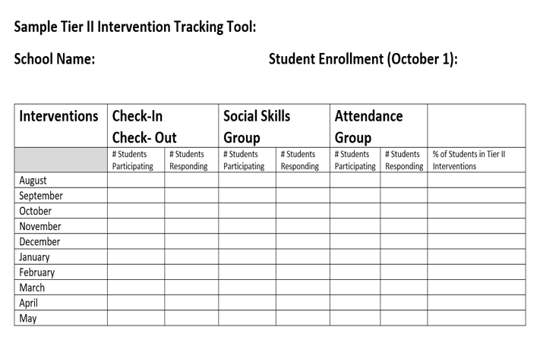
2.11 Student Performance Data Considerations
Having an efficient way to track student data will make the data more likely to be reviewed monthly.
Possible documentation includes an Intervention Tracking Tool. Here is one example. (There are many ways to track data: Excel, Word or Google Docs)

Slide 71
Intervention Tracking Tool
All Data Screenshot (Blank)

Slide 72
Intervention Tracking Tool
All Data Screenshot (with Sample Data)

Slide 73
Intervention Tracking Tool
Intervention Decision Rules

Slide 74
Intervention Tracking Tool & Effectiveness
Tier 2: Systems Level Data
Discussions
How often are you looking at trends?
What trends do you see?
Celebrations to share?
Intervention-level concerns?
Threshold for possible intervention revamp?
Fidelity concerns or mismatch to student needs?
What are you sharing with staff?

Slide 75
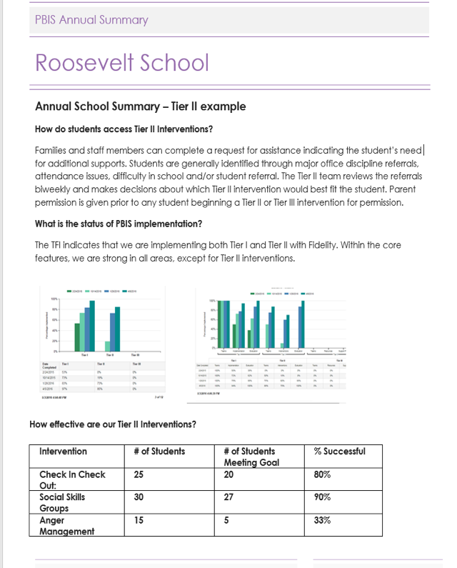
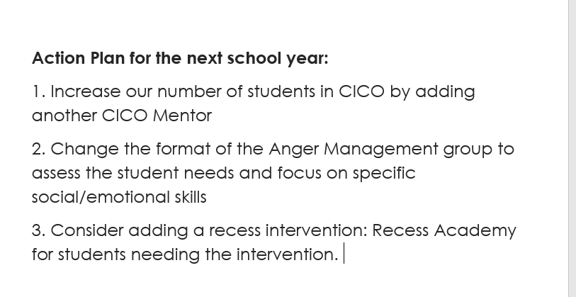
Example Tier II Annual Evaluation

Slide 76
Tier 2 Action Plan
Tiered Fidelity Inventory – Tier II Action Plan
Tier II Subscale and Feature | Definition | Possible Data Sources | Description How does this feature currently look at your school?
TEAMS
2.1 Team Composition | Tier II (or combined Tier II/III) team includes a Tier II systems coordinator and individuals able to provide (a) applied behavioral expertise, (b) administrative authority, (c) knowledge of students, and (d) knowledge about operation of schools across grade levels and programs. | School organizational chart Tier II team meeting minutes
2.1 Action Steps: |  |  | By Who: | By When:
2.2 Team Operating Procedures | Tier II team meets at least monthly and has (a) regular meeting format/agenda, (b) minutes, (c) defined meeting roles, and (d) a current action plan. | Tier II team meeting agendas and minutes Tier II meeting roles descriptions Tier II action plan
2.2 Action Steps: |  |  | By Who: | By When:

Slide 77
Thank you for your participation!
Please see our website for additional resources:
www.delawarepbs.org
For any questions or concerns please contact us:
Debby Boyer: dboyer@udel.edu
Megan Pell: mpell@udel.edu
Niki Kendall: robertsn@udel.edu

