Slide 1

Welcome
DE-PBS Cadre
October 7, 2019

Slide 2

The Day
LOGISTICS
Updated contact info needed
for you and your schools
Logistics
Phase Recognition
Professional Development Review and Preview
What’s New?
Tackling Integration
Tool Sharing
Coaching Activities
Data
Wrap-Up

Slide 3

DE-PBS Phase Recognition
2018-2019 School Year

Slide 4
2018- 19 Phase 1 Recipients
School District | School Name
Cape Henlopen | Love Creek Elementary
Cape Henlopen | Rehoboth Elementary
Lake Forest | Lake Forest Central Elementary
Red Clay | Anna P. Mote Elementary
Red Clay | Warner Elementary

Slide 5
2018- 19 Phase 2 Recipients
School District | School Name
Appoquinimink | Alfred G. Waters Middle
Brandywine | Carrcroft Elementary
Brandywine | Talley Middle
Red Clay | Marbrook Elementary

Slide 6
2018-19 Phase 3 Recipients
School District | School Name
Lake Forest | Lake Forest East Elementary
Red Clay | Austin D. Baltz Elementary
Red Clay | Shortlidge Academy

Slide 7
2018-19 Phase 4 Recipients
School District | School Name
Appoquinimink | Brick Mill Elementary
Christina | Robert S. Gallaher Elementary
Christina | Shue-Medill Middle
Christina | William B. Keene Elementary

Slide 8
2018-19 Phase 5 Recipient
School District | School Name
Cape Henlopen | Milton Elementary

Slide 9
Public Notices
School level messages
Letters to district superintendents and board presidents
Website posting
Twitter

Slide 10

19-20 SY
Phase Recognition Reminders
Distribution typically in February
Application entails end of the year program reflection
Recognition reflects CURRENT year effort; schools maintaining or advancing levels should apply yearly
Process should be a team effort
http://wh1.oet.udel.edu/pbs/recognition/applications/

Slide 11
Professional Development
Review of Summer 2019 & Looking Ahead

Slide 12
Summer – New Team Training Sessions
Welcome to New Tier 1: PBS Schools
Brandywine
Brandywine High School
Springer Middle
Red Clay
Brandywine Springs
First State School
Richey Elementary
Charters
Las Americas ASPIRA Academy
East Side Charter
Providence Creek Academy
Colonial
Colonial Early Education Program
Wilbur Elementary
William Penn High
Indian River
Long Neck Elementary
Millsboro Middle
Sussex Central High
Terry Center

Slide 13
Tier 3: FBA/BIP Workshop
This workshop is for new educators or those who want to learn more about the process of using a function based approach to develop behavioral intervention plans.
The steps for conducting an FBA will be reviewed along with the critical components of function based BIPs.
10/11/2019 (9:00am-4:00pm)

Slide 14
Tier 3: Prevent-Teach-Reinforce Training
For those who facilitate Tier 3 interventions with school based teams or those looking to gain a better understanding of PTR process
Tier 3 team based (FBA/BIP) process for developing individualized positive behavior plans
Focused on the 5 steps of the process and how to facilitate with teams
10/24/2019 (9:00am-3:30pm)
Updated forms can be found at: http://wh1.oet.udel.edu/pbs/ptr-forms/

Slide 15
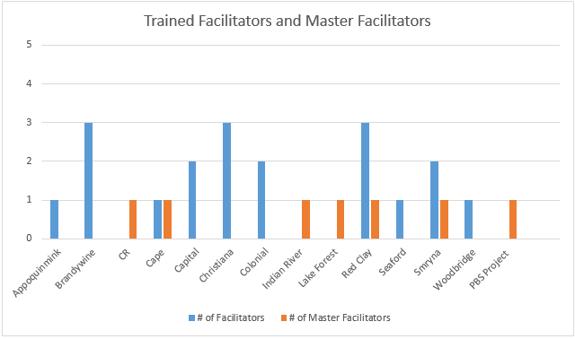
PTR Facilitator Coaching Process
Dr. Iovannone Provides Coaching to:
Master Facilitators (including DE-PBS Staff) who Provide Coaching to:
Building Facilitators who Provide Coaching to:
Individual Student Level Teams

Slide 16
Building Based Tier 3 PTR “Facilitator”
Technical Assistance
What is it?
Practice Based Coaching from DE-PBS Project in using the PTR process
3 Slots Available for 2019-20 SY
What is expected?
Participants will be expected to attend a full day PD, complete two student PTR cases using PTR model, participate in three (in face or by phone) TA sessions (per case), and submit PTR process fidelity data and case outcome data.
Who should be considered?
Individuals with expertise in applied behavior analysis and coaching competencies (e.g. facilitating team meetings and communicating effectively).
Individuals with building level support and time to participate in PD and TA opportunities throughout the year.
How do we sign up?
Please invite and support attendance for all potential candidates to attend the PTR workshop on 10/24/2019
After the PTR workshop, interested attendees will meet with project staff to assess readiness
A listing of interested and eligible participants will be forwarded to the appropriate district staff (special education director/DE-PBS MTSS contacts) who will make a final determination about participation

Slide 17
District-Level Tier 3 Coach/PTR “Master Facilitator” Technical Assistance
What is it?
Practice Based Coaching from DE-PBS Project in Coaching Others in the PTR process
0 Slots Available for 2019-20 SY; Plan ahead for next year.
What is expected?
District Level Tier 3 Coaches will receive support in delivering TA to a new PTR facilitator through two student cases, participate in three (in face or by phone) technical assistance sessions (per case) with the DE-PBS Project, and submit PTR process fidelity data, and student/facilitator outcome data.
What are the qualifications?
Experience and expertise in applied behavior analysis techniques evidenced by technically adequate FBA/BIP development leading to successful student outcomes.
Effective coaching competencies (e.g. meeting facilitation, positive staff relationships and effective communication)
May work in an assigned building but must have the ability (and time) to support district’s new or in-need Tier 3 PTR facilitators through the FBA/BIP process
Experience developing, coordinating, and facilitating staff development activities
How do we sign up?
Please contact Niki Kendall (robertsn@udel.edu) if interested in learning more about District Level Tier 3 Coach/PTR Master Facilitator Technical Assistance

Slide 18
Tier 1: School-wide (SW) PBS Framework Overview
New & revamping representative teams in attendance
Deep overview on SWPBS framework components
  Program Development & Evaluation
  Prevention: Implementing SW & CR Systems
  Correcting Problem Behavior
  Developing Self-Discipline
10/29/2019 (9:00am-3:30pm)
More coaching information can be found at:
http://wh1.oet.udel.edu/pbs/forms-and-tools/tier-1-universal-tools/

Slide 19
Tier 3: FBA/BIP Workshop
For new educators or those who want to learn more about process of using a function based approach to develop behavior intervention plans
  Understand the ABC’s of behavior
  Recognize the role of function based thinking across all tiers
  Identify the steps of conduction an FBA
  Understand the critical components of function based BIPs
  Identify who needs an FBA/BIP and the role of problem solving team
Part 1: 11/14/19 and Part 2: 11/21/19
5:00pm-7:30pm
Training materials available to use within your district can be found at: http://wh1.oet.udel.edu/pbs/tier-3-forms-and-tools/

Slide 20
Tier 2: Targeted New Team Training
Tier 2 problem-solving team members worked to extend current Tier 2 programming for students by establishing a sound system.
Provided an in-depth overview of the recommended features for effective Tier 2 behavior teams, programming, and interventions.
Focused on how to identify and secure appropriate Tier 2 interventions that match demonstrated student needs.
12/10/2019 (9:00am-3:30pm)
More coaching tools can be found at:
http://wh1.oet.udel.edu/pbs/forms-and-tools/tier-2-targeted-tools/

Slide 21
Tier 1: SWPBS New Team Training Part 2
For new School-wide PBS Teams, this workshop focuses on systems to support correction of problem behaviors and developing self-discipline as part of the Tier 1 PBS framework.
Participants will:
  explore components of their behavior tracking system
  discuss how disciplinary encounters can routinely be used as learning opportunities
  explore social-emotional learning curriculum and student involvement
1/10/20 (9:00am-3:30pm)

Slide 22
Tier 2 & 3 School System
This workshop is for problem solving teams working to develop systems that support students in need of advanced interventions.
Tier 2 linkages will be explored and an overview of Tier 3 system features will be provided to include teaming, resources, support plans and evaluation.
Teams will leave with tools to evaluate their current practices to support in action planning.
1/22/2020 (9:00am-12:00pm)

Slide 23
Tier 1: Secondary Forum
Collaborative meeting of secondary schools implementing DE-PBS at varying levels
Members of secondary school PBS teams will meet and share resources and ideas to support implementation in middle and high school settings
2/12/2020 (9am-3:30pm)
More coaching information can be found at:
http://wh1.oet.udel.edu/pbs/secondary-forum/

Slide 24
Tier 2: Networking
This session is open to schools that previously participated in the DE-PBS Project Tier 2: Targeted Team Training.
Topics and activities include reviewing Tier 2 systems & problem-solving concepts, examining evaluation methods and networking with other implementing teams.
3/25/2020 (9:00am-3:30pm)
More coaching tools can be found at:
http://wh1.oet.udel.edu/pbs/forms-and-tools/tier-2-targeted-tools/

Slide 25
Big Picture – What’s new?
Project DelAWARE
State Personnel Development Grant – MTSS A & B
School Climate & Student Success Grant Debrief

Slide 26

Project DelAWARE is a collaborative effort between the Department of Education (DOE), The Division of Prevention and Behavioral Health Services (DPBHS), the UD Center for Disabilities Studies (CDS), the UD Center for Drug and Health Studies (CDHS), and three local school districts – Capital School District, Colonial School District, and Indian River School District. Funding for the project is provided through a 5 year federal SAMHSA (Substance Abuse and Mental Health Services Administration) grant.
The overarching purpose of Project DelAWARE is to implement evidence-based mental health services in school settings within the context of the Multi-Tiered System of Support (MTSS) in order to promote wellness and resilience for school-age youth and to improve access to mental health services.

Slide 27
Colonial School District
Wilbur Elementary School
Capital School District
William Henry Middle School
Indian River School District
Long Neck Elementary School
William Penn High School
Central Middle School
Dover High School
Millsboro Middle School
Sussex Central High School

Slide 28
Project Goals
Goal 1: School staff will recognize the principles of MTSS and will understand the referral process to access mental health services for students.
Goal 2: Each school district will receive a mental health support team comprised of a Mental Health Professional and a Community Project Manager to assist the district with identifying students with mental health needs, addressing the needs within the each school, coordinating the mental health services within the school setting, and connecting students with resources in the community.
Goal 3: Launch a mental health awareness campaign to eliminate the stigma around mental health.
Goal 4: Each school will implement a mental health screening process for students and provide mental health services that are evidence-based and proven effective.

Slide 29
Key Features
Additional Human Resources
Youth Mental Health First Aid
Multi-Tier System of Support
Interconnected System Framework
“Reducing the Stigma” Social Marketing Campaign
Functional Family Therapy
Strengthen School Referral Process
Identify Coordinated Resources
Universal Screening Process
Cognitive Behavioral Intervention for Trauma in Schools

Slide 30
ISF Definition and MTSS/ISF Core Features
  Structure and process for education and mental health systems to interact in most effective and efficient way
  Guided by key stakeholders in education and mental health/community systems who have the authority to reallocate resources, change role and function of staff, and change policy
  Effective teams that include community mental health providers
  Data-based decision making
  Formal processes for the selection & implementation of evidence-based practices (EBP)
  Early access through use of comprehensive screening
  Rigorous progress-monitoring for both fidelity & effectiveness
  Ongoing coaching at both the systems & practices level

Slide 31

DDOE’s MTSS Framework
Multi-Tiered System of Supports (MTSS)
Academic
Student’s response to academic instruction and tiered supports.
MTSS is a framework that aligns academic and behavioral supports to serve
the whole child
Behavior
Student’s response to positive behavior tiered supports.

Slide 32
Multi-Tiered System of Support
Academic
Student’s response to academic instruction and tiered supports.
Behavior
Student’s response to positive behavior tiered supports.
Focus on instruction in the general education classroom. Provides tiered, data-driven, instructional supports to individual students who are struggling academically. | Focus on school-wide system that supports emotional and behavioral learning. Provides tiered, evidence-based supports which lead to an increase in student engagement and a decrease in problematic behavior.

Slide 33

School Climate and Student Success Grant
2014-2019
Goal 1: Increase the State’s capacity to provide training and technical assistance to enhance the capacity of LEAs to support schools’ implementation of multi-tiered behavioral frameworks (MTBF).
Goal 2: Improving school climate and behavioral outcomes for all students through MTBFs.

Slide 34
Final Evaluation Report Coming Soon!
School Climate Data Longitudinal Study
  Guiding question:
    Did students’ perceptions of school climate improve in elementary, middle, and high schools?
    If so, were improvements found across all seven aspects of school climate measured by the Delaware School Climate Scale-Student?
Case Study
  To examine critical aspects of Multi-tiered Systems of Support implementation
  Determine the critical implementation supports and/or barriers for partnering districts

Slide 35
Case Study
8 schools
  4 Elementary, 3 Middle, and 1 High School
Interviews with:
  CDS staff
  District coaches
  Principals
  Lead disciplinary staff
  PBS team leaders
  Classroom teachers
Focus groups with:
  3-6 students in two of the three school districts
  One school included focus group with school staff
Total of 58 interviews and 6 focus groups.

Slide 36

SCSS Partners
Brandywine
Carrcroft Elementary
PS duPont Middle
Talley Middle
Capital
East Dover Elementary
Central Middle
Dover High
Red Clay
AI duPont Middle
Baltz Elementary
Richardson Park Elementary

Slide 37

Alignment and Integration Activity
Identify places where alignment is happening. Note each one on a post-it note.
Consider places where there are “sticking points” impeding alignment or integration. Write each of these on a post-it note.
Place your post-it notes on the appropriate flip chart papers on the wall.

Slide 38
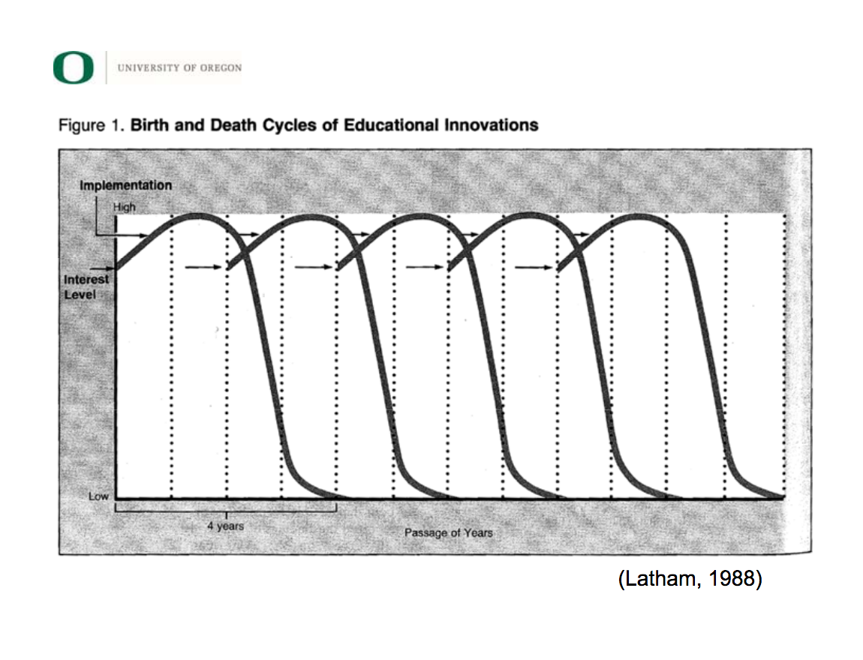
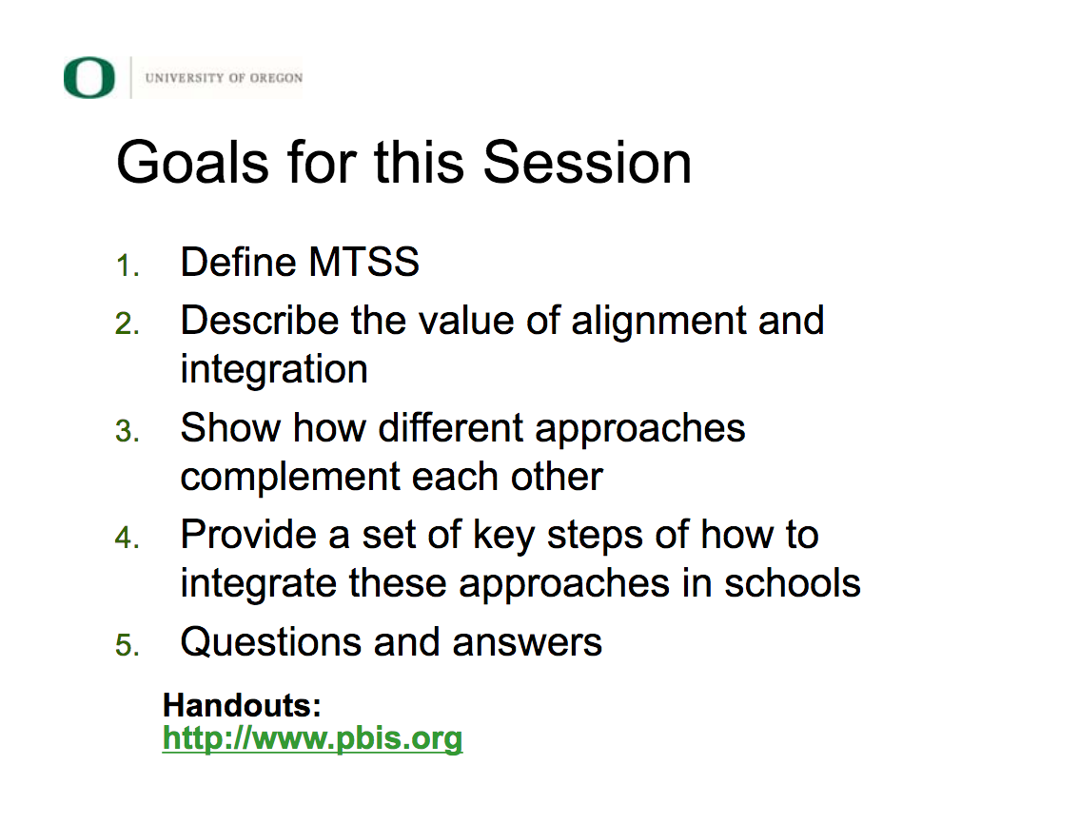
Integrated Multi-Tiered Systems of Support
Kent McIntosh, University of Oregon
https://assets-global.website-files.com/5d3725188825e071f1670246/5d7bd8a446d296b53108ea52_integrated%20mtss%20overview%202017-5-19.pdf

Slide 39





Slide 40
The Hexagon Tool (s)
A tool for teams to make effective decisions
about initiatives and evidence-based practices.

Slide 41
Implementation Science

Slide 42

6 Dimensions of any initiative or tool for team consideration and discussion:
1. Meets Needs of Students
2. Fit with Current Initiatives
3. Resource/Supports Availability
4. Existing Evidence
5. Usability/Readiness for Replication
6. Capacity to Implement

Slide 43
3 Versions
C
B
A

Slide 44
Using the Tools
Completing the tools and discussions are team-based activities.
2 tools use a scoring rubric (A & B).
Each tool includes investigative and reflective questions.
It takes time to complete the tools.
Questions/sections can be split up for homework.
You want to start with evidence-based practices.

Slide 45
B
A

Slide 46
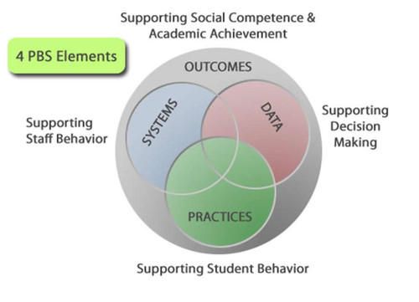
Data, Systems & Practices
Selection of Evidence Based Practices for Reading, Math, and Behavior: Is it the right thing to do? Do we think we can do it the right way?
Evaluation of Evidence Based Practices: Did we do it the right way? Did it work the way we planned?

Slide 47
C

Slide 48
1. Need
…of students; how well the program or practice might meet identified needs.
A | B | C
1. Was an analysis of data (e.g., student outcome) conducted to identify specific area of need(s)? | 4. How do affected individuals and community members perceive their need? What do they believe will be helpful? How were community members engaged to assess their perception of need? | Do we have data that supports the need?

Slide 49
2. Fit
…with current initiatives, priorities, structures and supports, and parent/community values.
A | B | C
3. How does it fit with priorities of the state/region/district? | 2. How does the program or practice fit with family and community values in the impacted community, including the values of culturally and linguistically specific populations? | Are there competing initiatives?

Slide 50
3. Resources/Supports
…availability for training, staffing, technology supports, curricula, data systems and administration..
A | B | C
4. Are staffing resources available for this innovation? | 3. Are there curricula and other resources related to the program or practice readily available? If so, list publisher or links. What is the cost of these materials? | Is the technology department able to support the EBP if needed?

Slide 51
4. Evidence
…indicating the outcomes that might be expected if the program or practices are implemented well.
A | B | C
3. If research data are not available, are there evaluation data to indicate effectiveness (e.g. pre/post data, testing results, action research)? If yes, provide citations or links to evaluation reports. | 3. What outcomes are expected when the program or practice is implemented as intended? How much of a change can be expected? | Is there research to support its use with a particular population

Slide 52
5. Readiness/Usability
…for replication of the program, including expert assistance available, number of replications accomplished, exemplars available for observation, and how well the program is operationalized
A | B | C
1. Is there a qualified “expert”, TA provider, purveyor who can help Regional Teams and Districts with implementation over time and across schools (e.g. training, coaching methods, progress monitoring, data)? If yes, list names and/or organization (e.g. Center, University) and contacts. | 3. Is each core feature well operationalized (e.g., staff know what to do and say, how to prepare, how to assess progress)? | Have committed staff members to been selected to implement?

Slide 53
6. Capacity
…to Implement as intended and to sustain and improve implementation over time.
A | B | C
5. Does the innovation foster and encourage teacher leadership? | 1. Typically, how much does it cost to run the program or practice each year? Are there resources to support this cost? If the current budget cannot support this format, outline a resource development strategy. | Can families be shown how to support the EBP?

Slide 54
C
B
A

Slide 55
1 Version includes post-implementation reflection
C

Slide 56
Process for Any Tools You Select:
Step1: Before adding an initiative, consider all of the mapping current initiatives, resources and staff utilization . What is currently working? What can you eliminate? Does everyone need it?
Step 2: Evaluate current EBPs and select new EPBs
Step 3: Utilize common implementation framework to install systems required to train, support and evaluate how EBPs to be used at school and district level.

Slide 57
Resources for EBPs:
Positive Behavioral Interventions and Supports, http://www.pbis.org
Collaborative for Academic, Social, and Emotional Learning (CASEL) http://https://casel.org/
Evidence Based Intervention Network: http://ebi.missouri.edu/
Evidence-Based Behavioral Practices: http://www.ebbp.org/
National Center on Intensive Interventions http://www.intensiveintervention.org/
Promising Practices http://www.promisingpractices.net/
SAMHSA Registry of Evidence-Based Program and Practices: http://nrepp.samhsa.gov/Index.aspx
RTI Action Network http://www.rtinetwork.org/
What Works Clearinghouse by the USDOE Institute of Education Sciences: https://ies.ed.gov/ncee/wwc/

Slide 58
Coaching Activities
Foundations for District & School Success

Slide 59
Information Collection on PBS/MTSS Schools per District
Information collected by district coaches per active PBS school:
  Team Leader(s) per tier
  Administrator lead/support per tier
  Data contact/lead
  Team membership
    Depending on school structures: Tier 1, Tier 2, Tier 2/3, Tier 3
  Monthly meeting schedule per team
  Other?

Slide 60
Team Leader Meetings
Sample Meeting Structures
Benefits of Routine Team Leader Meetings:
Tier 1 team leaders
Tier 2/3 team leaders
MTSS team leaders (with or w/out administrators)
New teams vs. veteran implementing schools
Elementary vs. secondary team leaders
Chance to share unified district messaging
Focus on professional development content
Opportunity for team leader networking
Creates group sharing of successes; structured and informal
Promotes group problem solving

Slide 61
Routine Correspondence
Follow up from DE-PBS messages to Team Leaders and/or Administrators
  Encourage PD attendance as applicable
  Offers of support for data tools
  Being available for questions

Slide 62
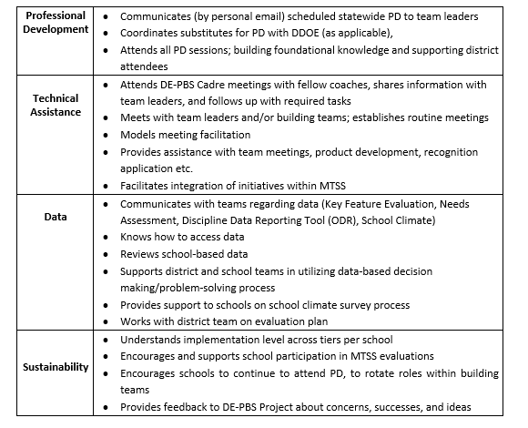
DE-PBS/MTSS District Coach Responsibilities

Slide 63
Data

Slide 64
Discipline Data Reporting Tool (DDRT)
Cost Benefit
Average Referral Rate per Month & Year, ISS/OSS Referrals
Single year graphs
Multi-year graphs
Referrals by Student (Triangle)
National & Delaware data comparison

Slide 65
Discipline Data Reporting Tool (DDRT)
  Templates available on website
    Tier 1: Forms & Tools / Program Development & Evaluation
  Submission 2x per year
    January 10th & June 19th 2020

Slide 66
School Climate Survey 2019-2020
Timeline
Logistics
Enrollment: Following invite distribution, open through 11/1/19
Survey window:
  Staff, Student and Home: 12/1/19 - 3/3/20
  New: School selects window within this timeframe
Student, Staff, Home Versions available online through App
Paper Options
  New: HOME ONLY
Survey Contact per School
  Contact is lead for communication with DE-PBS Project and Mosaic

Slide 67
Tier 1 Fidelity - Key Feature Evaluation Process
On-site Evaluation (approx. 4 hours)
Sources of Information:
  Interviews with administrator, DE-PBS team leader, teachers/staff, students
  Review of documents
  Schoolwide observations
DE-PBS Key Feature Evaluation Structure
SW PBS Tier 1: Program Development & Evaluation | Prevention: Implementing SW & CR Systems
Correcting Problem Behavior | Developing Self Discipline

Slide 68
Key Feature Evaluation Review Guide
Tool to be used after receiving evaluation feedback
Review noted strengths for each evaluation section
  Identify strategies for maintaining strengths and develop an action plan
Review noted recommendations for each section
  Prioritize recommendations and develop an action plan
This tool supports continued implementation planning

Slide 69
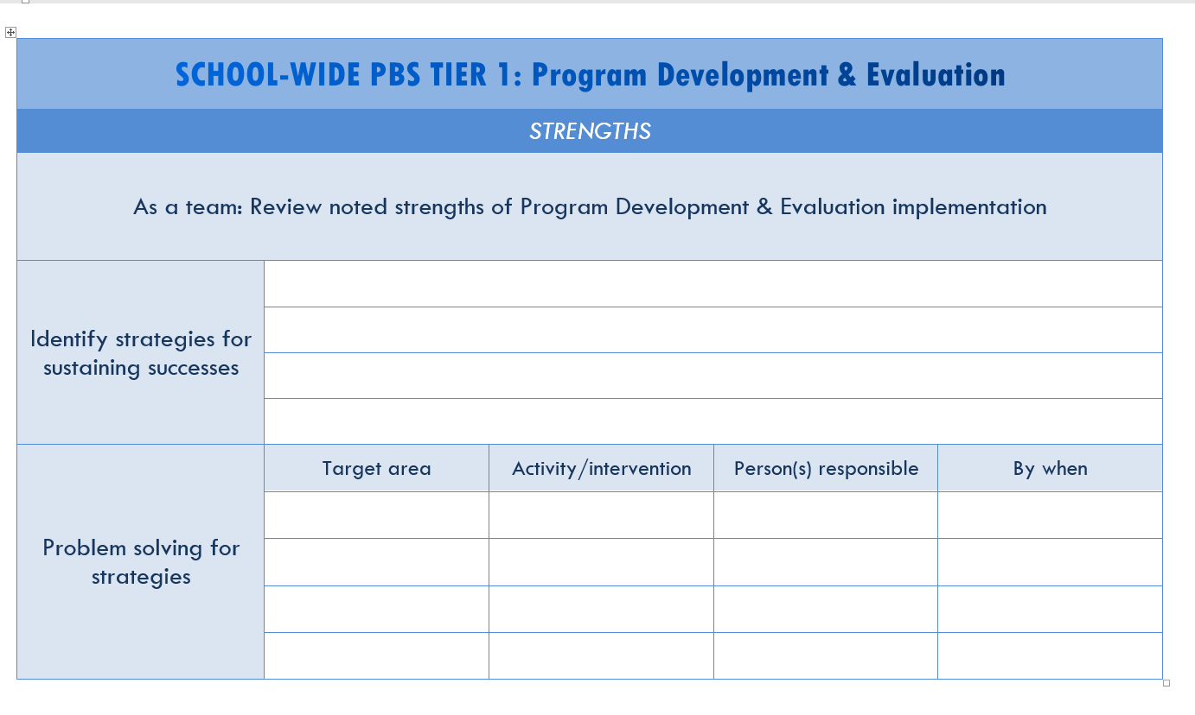
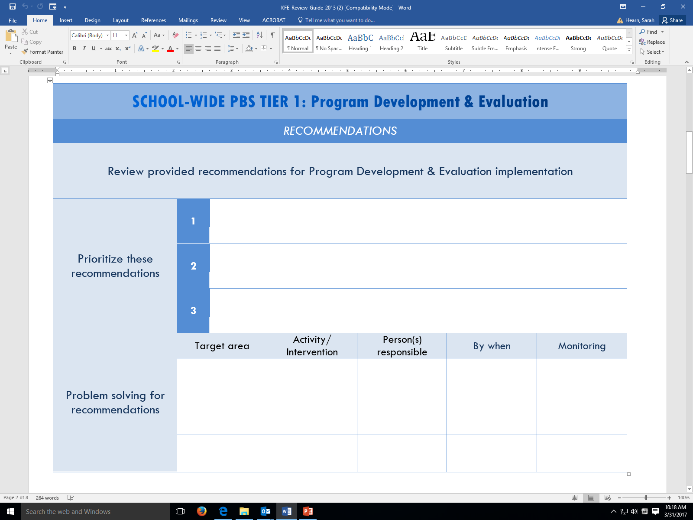
KFE Action Plan Guide

Slide 70
Tier 1: Team Self-Assessment
DE-PBS Key Feature Status Tracker Tool
Purpose: To support teams to assess implementation in four main program categories & plan next steps
Broken into four evaluation sections
  SWPBS Tier 1, Prevention, Correcting Problem Behaviors, and Developing Self-Discipline
Tracker includes:
  Key program components for each section
    Teams can use these to assess their program and identify areas to modify or build upon
  Action plan to develop steps towards improving or modifying program components
Used for ongoing monitoring

Slide 71
Tier 2: Team Self-Assessment
The Tiered Fidelity Inventory (TFI)
TEAM
2.1 Team Composition
2.2 Team Operating Procedures
2.3 Screening
2.4 Request for Assistance
2.5 Options for Tier II
INTERVENTIONS
2.6 Tier II Critical Features
2.7 Practice Matched to Student Need
2.8 Access to Tier 1 Supports
2.9 Professional Development
EVALUATION
2.10 Level of Use
2.11 Student Performance Data
2.12 Fidelity Data
2.13 Annual Evaluation

Slide 72


Mark Your Calendars!
2019-20
DE-PBS Cadre Meeting Dates:
Wednesday, December 4, 2019
Wednesday, February 5, 2020
Wednesday, April 8, 2020

Slide 73

Thank you for your time today and your coaching efforts everyday!

