Slide 1
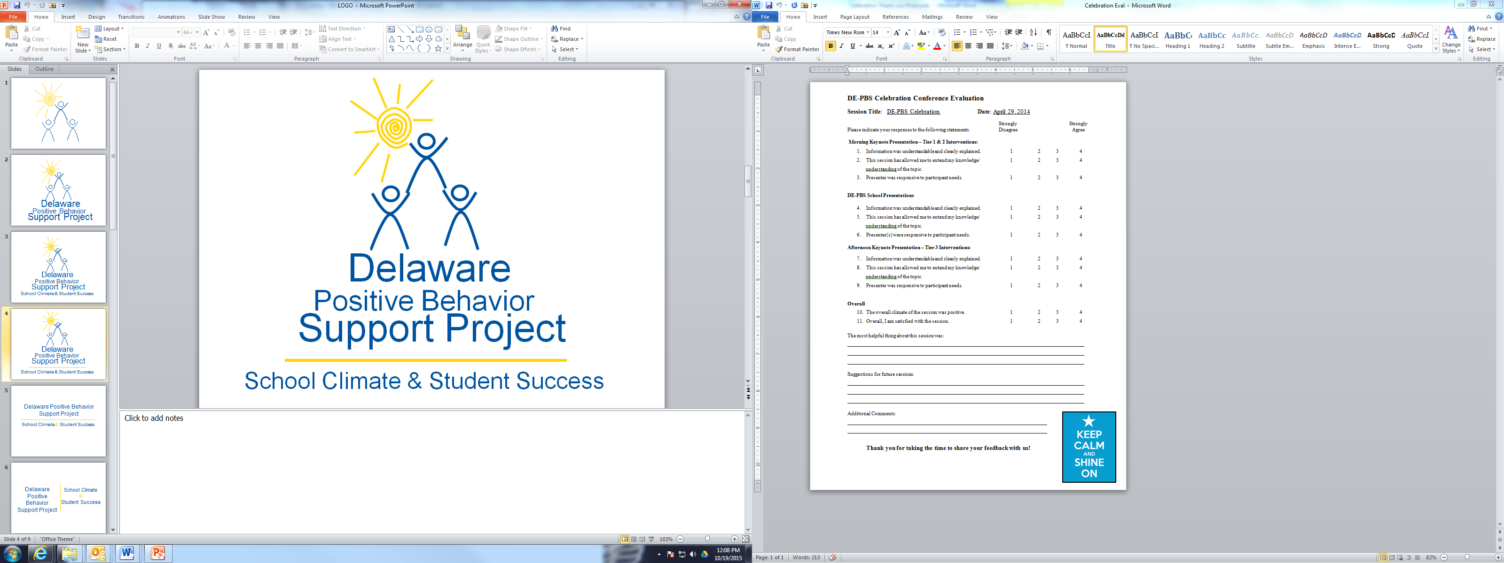
MTSS Tier 1:
School-wide PBS Leadership Workshop
Fall 2019

Slide 2


Welcome!
Please open Padlet on your phone or laptop using the QR code or link on card on your table.
Answer one of the prompts:
What do you want to achieve as a result implementation of PBS/MTSS ?
What is something important to you in your ideal school?
http://bit.ly/schoolwidePD

Slide 3
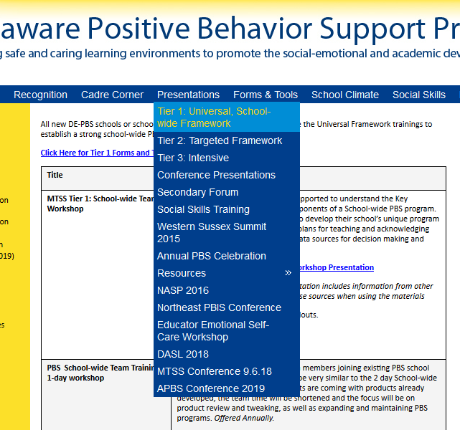
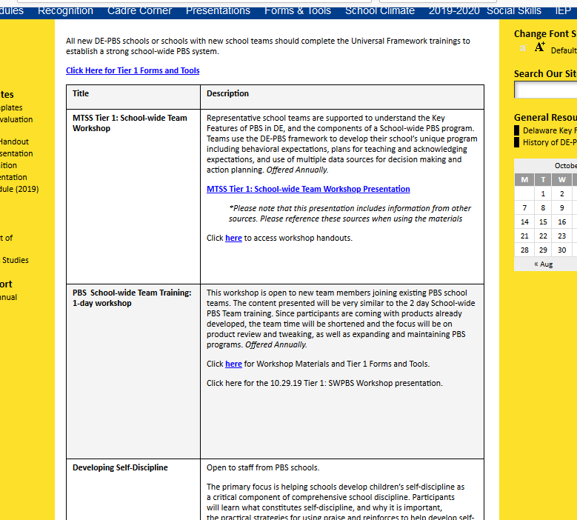

Slide 4
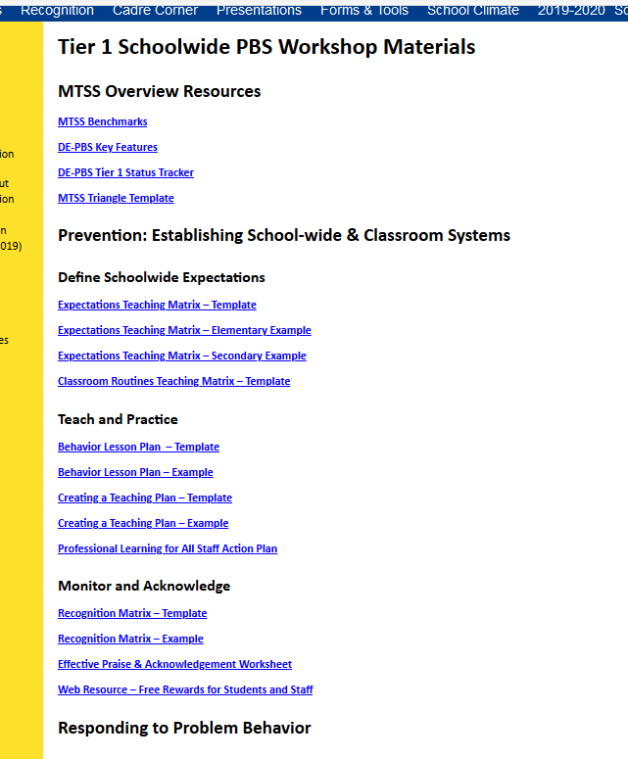

Slide 5
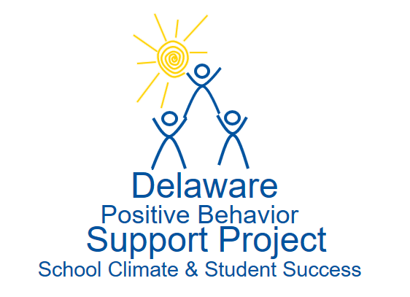


The DE-PBS Project serves as a technical assistance center for the Delaware DOE to actualize the vision to create safe and caring learning environments that promote the social-emotional and academic development of all children.
The statewide initiative is designed to build the knowledge and skills of Delaware educators in the concepts and evidence-based practices of Positive Behavior Support (PBS) as a Multi-tiered System of Support (MTSS).

Slide 6

Who’s here today?
Cedar Lane Elementary
Lorewood Grove Elementary
Redding Middle
Silver Lake Elementary
Townsend Elementary
Claymont Elementary
Concord High
PS DuPont Middle
Hanby Elementary
Brandywine ECAP
Lombardy
Mount Pleasant Elementary
Mount Pleasant High
Tally Middle School
McIlvaine ECC
Postlethwait Middle

Slide 7
Who’s here today?
Star Hill Elementary
Central Middle
Early College High School at Del State
Bancroft Elementary
Gauger Cobbs Middle
Oberle Elementary
Shue-Medill Middle
William Penn High
Wilbur Elementary
Howard T. Ennis School
Millsboro Middle
Morris Early Childhood Center
Brandywine Springs School
Cooke Elementary
Highlands Elementary

Slide 8

Who’s here today?
Lewis Dual Language Elementary
Shortlidge Academy
Skyline Middle
Stanton Middle
John Bassett Moore School
Sunnyside Elementary
Phillis Wheatley Elementary
Woodbridge High

Slide 9
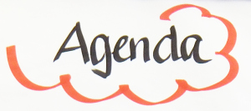
Morning
  MTSS Overview
  Establishing/updating Behavior Expectations
  Teaching and Practicing
Lunch 11:45 – 12:00
Afternoon
  Responding with Instructional consequences
  Making decisions using Data Sources & Problem Solving
  Team Action Planning

Slide 10
Expectations
 | During the day…
BE ENGAGED | Share your experiences related to the topics presented Ask questions Wait until team time to talk with colleagues at your table
BE REFLECTIVE | Compare the ideas shared to your current context and experiences Assess your current school practices Monitor your own reactions to content
BE STRATEGIC | Use the team time to work on school products Stay on task and use parking lot for issues you can’t address today

Slide 11

How to Participate Using Padlet
Respond to group polls
Ask questions
Respond to other participant questions
Make comments
Please share your name and school name if you want to offer resources to others

Slide 12

Burning Questions
Structures to support positive classroom culture
  Consistency across classrooms
  How does MTSS apply to classrooms
  Implement restorative practices in classrooms
How does PBS integrate with SEL and other initiatives
More strategies related to supporting students impacted by trauma
When to refer a student, how do you know when student needs a higher tier?
Simple school-wide incentive systems and budget friendly rewards
High school/middle school specific concerns
  Interventions
  Rewards and motivation
  Buy in
Special populations

Slide 13

What is MTSS?
Multi-Tiered System of Supports (MTSS)
Academic
Student’s response to academic instruction and tiered supports.
MTSS is a framework that aligns academic and behavioral supports to serve
the whole child
Behavior
Student’s response to positive behavior tiered supports.

Slide 14
What is MTSS?
MTSS is a framework that:
Supports high expectations for all students through intentional instruction and tiered supports that are based on standards-aligned classroom instruction.
Utilizes a data-driven problem-solving process to identify concerns, determine level of supports needed and evaluate the effectiveness of the support.
Requires a balanced assessment system that includes universal screening, diagnostic and progress monitoring tools.

Slide 15
Multi-Tiered System of Support
Academic
Student’s response to academic instruction and tiered supports.
Behavior
Student’s response to positive behavior tiered supports.
Focus on instruction in the general education classroom. Provides tiered, data-driven, instructional supports to individual students who are struggling academically. | Focus on school-wide system that supports emotional and behavioral learning. Provides tiered, evidence-based supports which lead to an increase in student engagement and a decrease in problematic behavior.

Slide 16
MTSS simplified
for enhancing adoption & implementation of
of evidence-based interventions to achieve
& behaviorally important outcomes for
students
Framework
Continuum
Academically
All

Slide 17

Positive Behavioral Interventions & Supports (PBIS) is…
  a data-driven decision making framework for establishing the social culture and multi-tiered behavioral supports needed for an organization to be an effective learning environment for all youth and staff.
  Increase Effectiveness and Efficiency
  Supports Consistent Adult Behavior
  Process for Continuous Improvement
  Framework for Aligning Initiatives
Adapted from: USDOE OSEP PBIS TA Center, 2010 Midwest PBIS Network 1-15-19

Slide 18
Multi-Tiered Systems of Support
(MTSS) for Student Success
MODEL A
Academic Systems
Behavioral Systems
Tier 3/Tertiary Interventions 1-5%
Individual students
Assessment-based
High intensity
1-5% Tier 3/Tertiary Interventions
        FBS/BSP
Tier 2/Secondary Interventions 5-15%
Some students (at-risk)
High efficiency
Rapid response
Small group interventions
Some individualizing
5-15% Tier 2/Secondary Interventions
        Some students (at-risk)
        High efficiency
        Rapid response
        Small group interventions
        Some individualizing
Tier 1/Universal Interventions 80-90%
All students
Preventive, proactive
80-90% Tier 1/Universal Interventions
        All settings, all students
        Preventive, proactive
www.delawarepbs.org
Adapted from “What is school-wide PBS?” OSEP Technical Assistance Center on Positive Behavioral Interventions and Supports. Accessed at http://pbis.org/schoolwide.htm, Illinois PBIS Network, Revised May 15, 2008.

Slide 19
Positive Behavior Support
as Your MTSS
MODEL B
ODRs, Credits, Attendance,
Grades, etc.
Tier 1/Universal
School-Wide Assessment
School-Wide Prevention Systems
Classroom Practices
Tier 2/
Secondary
Tier 3/
Tertiary
Daily Progress Report (DPR)
Assessment
Intervention
Check-in/ Check-out (CICO)
Targeted screening tools, interviews, questionnaires.
Continuum of
Groups
Functional Behavior Assessment (direct and indirect methods)
Individual Behavior Intervention Plan

Slide 20
MODEL C
Layered Continuum of Academic &
Social Behavior Support
Tier 3 for a Few: Intensive, Individualized
Tier 2 for Some: Targeted for Small Groups
Tier I for All: Core/Universal

Slide 21
Positive Behavioral Interventions and Supports (PBIS) for Continuous Improvement and Alignment of Initiatives
is a Multi-Tiered System of Supports (MTSS) Framework
Supporting culturally equitable Targets including
social/emotional competence & academic achievement
OUTCOMES
Supporting culturally knowledgeable Staff Behavior
team-based leadership and coordination
professional development, coaching, and content expertise
Supporting culturally valid Data-based Decision Making
universal screening
progress monitoring
evaluation of fidelity
SYSTEMS
DATA
PRACTICES
Midwest PBIS Network 2/7/19. Adapted from:
“What is a systems Approach in school-wide PBIS?” OSEP Technical Assistance on Positive Behavioral Interventions and Supports. https://www.pbis.org/school
McIntosh, K.& Goodman, S. (2016). Integrated Multi-Tiered Systems of Support: Blending RTI and PBIS. New York: Guilford Press.
Supporting Student Behavior
three-tiered continuum of culturally relevant evidence-based interventions

Slide 22
Outcomes
Identify measurable targets connected to your organization’s priorities and needs
For example:
Social and Emotional Competence
Academic Achievement
Organizational Climate and Culture
Student College and Career Readiness
Student Community Readiness
Behavior
Mental Wellness
Relationship Building
Building protective factors for students who experienced trauma
etc.

Slide 23
DATA
Establish comprehensive universal screening measures (entry and exit criteria) for internalizing and externalizing needs
Select which evidence-based practices to install
Team data-based problem solving for decision-making
Continuous data-based progress monitoring of organizational and student outcomes (grades, attendance, referrals, perception, equity, etc.)
Process for layering up supports
Evaluation of implementation fidelity
Items in bold denote core features of MTSS
McIntosh, K.& Goodman, S. (2016). Integrated Multi-Tiered
Systems of Support: Blending RTI and PBIS. New York: Guilford Press.

Slide 24
SYSTEMS
Team-based leadership and coordination (District and School)
District and School Administrator Commitment
Ongoing professional development including coaching and performance feedback
Support for staff in Implementing practices
Communication/input from stakeholders
Documentation and Policies
Items in bold denote core features of MTSS
McIntosh, K.& Goodman, S. (2016). Integrated Multi-Tiered
Systems of Support: Blending RTI and PBIS. New York: Guilford Press.

Slide 25
PRACTICES
Three-tiered continuum of evidence-based practices and lessons to support community members
Interventions to match level of need
Practices implemented with fidelity
Practices result in improved outcomes
Tier 3 Individualized Prevention for high need behaviors
~ 5%
~ 15%
Tier 2 Group-based Prevention for at-risk behaviors
Tier 1 Prevention for all community members in all settings
~ 80% Responding
Items in bold denote core features of MTSS
McIntosh, K.& Goodman, S. (2016). Integrated Multi-Tiered
Systems of Support: Blending RTI and PBIS. New York: Guilford Press.

Slide 26
3-Tiered System of Support
Necessary Conversations (Teams)
SW-Team
Tier 2 Team
Tier 3 Team
Plans SW & Class-wide supports
System
Conversations
Uses process data; evaluates overall effectiveness; does not involve discussion of individual students
Problem Solving Conversations
Matches students to interventions and monitors progress, making adjustments as needed
System
Conversations
Uses process data; evaluates overall effectiveness; does not involve discussion of individual students
Universal Support through SW Program
CICO
Brief FBA/BIP (Consultant Based)
Group interventions
FBA/BIP or PTR (Team Based)
Group w. individual
features
FBA/BIP or PCP (Wrap Around Based)
Adapted from the Illinois PBIS Network

Slide 27
At the school-wide level: Tier 1
  Problem-solving leadership team with administration established
  Ongoing data-collection, analysis and action planning
  Prevention through established SW & Classroom systems
  Positive social expectations defined, actively taught, and recognized
  Focus on relationship building (students, staff, home)
  Arrange consistent consequences for problem behavior
  Focus on developing self-discipline

Slide 28
At the small group level: Tier 2
  Interventions are efficient
    Continuously available so students can receive support quickly (optimally-within 2-3 days)
  Minimal time commitment required from classroom teachers
  Required skill sets needed by teachers easily learned
  Aligned with school-wide expectations
  Emphasis on intervention designed to support multiple students simultaneously (e.g. Check-In/Check-Out, Social Skills Groups, etc.)
    Consistently implemented with most students, some flexibility
  Intervention selected matched to function of student behavior
Adapted from Rose Iovannone, Brief PTR

Slide 29
At the individual level: Tier 3
Team formed which include those who have knowledge of the student
Systematic problem solving process is foundation
Target behaviors identified and defined
Antecedents (predictors) of problem behavior occurrence
Consequences/responses of others following problem behavior
Hypothesis generated by data
Function-based understanding of behavior
Multi-component intervention plan built and linked with hypothesis
Progress monitoring plan established
Fidelity measurement of intervention implementation developed and scheduled
Follow-up meeting to make data-based decisions

Slide 30
Reflecting on your school PRACTICES
Intervention Names Coordinators Intent/Outcome Goal
Tier 3
Tier 2
Tier 1

Slide 31

















Neighborhood Strife
Academic Struggles
Family
Set-backs
Disability
Social Isolation
SW-PBS
Long-term Traumatic Events
Leader in Me
Trauma-Informed
Practices
Restorative Practices
Compassionate Schools
Love
& Logic
Responsive Classrooms
Solution Teams
Staff
Students
Families

Slide 32
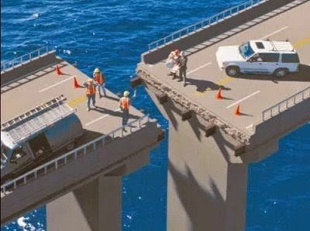
Where are you with Alignment?
“One of the major variables affecting sustained implementation of effective practices is the introduction of new initiatives that either (a) compete with resources needed for sustained implementation or (b) contradict existing initiatives.”
  McIntosh (2015)

Slide 33
How Do We Integrate/Align with other Key Initiatives?
Identify key components of each intervention or approach
Identify areas that share common aims, goals, and practices
Identify differences in key components and decide if these can enhance one another or should be modified or negotiated

Slide 34
Impact of Trauma in Our Schools
Children ages 3 to 5 who have had 2 or more ACEs are over 4 times more likely to
  have trouble calming themselves down
  be easily distracted
  have a hard time making and keeping friends.
Students with 3 or more ACEs are
2.5 times more likely to fail a grade.
Students with 3 or more ACEs are significantly more likely to be unable to perform at grade level, receive special education services, be suspended, be expelled, or
drop out of school.
The Illinois ACEs Response Collaborative

Slide 35
Why use the MTSS/PBS framework for trauma-informed schools?
“The fundamental purpose of PBIS is to make schools more effective & equitable learning environments.”
Rob Horner, Co-Director of the OSEP Technical Assistance Center for PBIS
Predictable
Positive
Consistent
Safe

Slide 36
Expectation | Mindfulness Skill
Be Safe | I use 4x4 breathing when I sense strong emotions
 | I label the size of the problem before I act
Be Respectful | I listen to others before I react or respond
 | I find multiple ways to solve a problem
 | I look for ways to demonstrate kindness
 | I care about how others feel and think
Be Responsible | I observe my thoughts and emotions when I am learning
 | I learn from my mistakes
 | I use my tools to stay tuned-in during class

Slide 37
School-wide Expectations | Classroom Rules | Classroom Routines/Procedures, Socio Emotional Skills
 |  | Entering Classroom | Resolving Conflict | Making Friends | Cooperative Learning Groups
 | Attention Signal : 4 fingers = 4x4 breathing
Be Respectful | Use kind words & actions Use appropriate voice level | Enter/exit classroom prepared Use inside voice | Think of multiple ways to solve the problem |  | Listen to others Accept differences Encourage others Wait your turn to speak
Be Responsible | Follow adult directions Take care of materials/equipment | Place materials in correct area Begin warm-up promptly | Give an “I” Statement Think about how others feel |  | Use Time Wisely Contribute Complete your part
Be Safe | Keep hands, feet & objects to self Use all equipment & materials appropriately | Walk | Use 4x4 breathing in a safe space Label the size of the problem before acting |  | Use Materials Carefully Stay in your designated area
SEL Skill
Specific Behaviors

Slide 38
Model for PREVENTION: Structure & Support
PBIS
(Structure)
SEL
(Support)
Positive School Climate
Internalizing Problems
Externalizing Problems

Slide 39
CASEL Model for SEL

Slide 40
What does the research say regarding integrating the two approaches?
For school discipline, classroom management, and childrearing: Authoritative Discipline (combination of structure and support), which blends strategies of SEL and SWPBIS is the best approach.
  Best for achieving compliance
  Best for promoting self-discipline and resilience
  Best for effective prevention and correction
  Best for school climate
  Best for preventing bullying

Slide 41
Which SWPBIS Features are Most Related to Equity?
(Tobin & Vincent, 2011)
Examined change in Black-White Relative Risk Index for suspensions in 46 schools
Two key predictors of decreased disproportionality:
  Regular use of data for decision making
  Implementation of classroom SWPBIS systems

Slide 42
It is a Process…Not a Curriculum
You decide…
what is important to your school community
how to measure improvement
what strategies are effective, efficient & relevant
how to obtain input & feedback from all

Slide 43

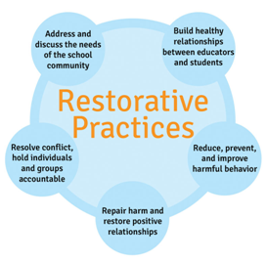



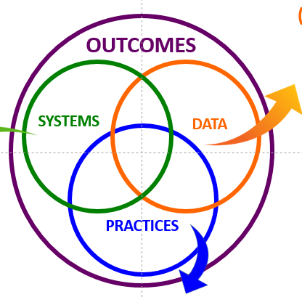
Keep in Mind…
MTSS/PBS provides the structure that increases likelihood that specific practices/interventions (e.g., Restorative Practices, Leader in Me, Trauma Informed Pracitices) will be implemented with fidelity.

Slide 44
Tier 1 Framework for Delaware Positive Behavior Supports and Interventions
School-wide PBS Tier 1: Program Development & Evaluation Systematic Collection & Use of Multiple Data Sources Established Representative Problem-Solving Teams Ongoing Professional Development & Resources to Sustain Implementation | Prevention: Implementing Schoolwide & Classroom Systems Establish Positive Relations (Student, Teacher, Parents) Establish, Teach, and Acknowledge Positive Behavioral Expectations Support a Safe School Environment Ensure classroom management practices for encouraging appropriate behavior
Correcting Problem Behavior Establish System to Manage Office Discipline Referrals Support Use of Strong Classroom Management Techniques and use of continuum of responses to inappropriate behavior Systematic Response to Behavior Includes Problem-Solving | Developing Self Discipline Policy Commitment to Goal of Developing Self-Discipline Social Emotional Learning (free standing or integrated within Curriculum) Students Active in Decision-making

Slide 45
CORE FEATURES
of School-Wide PBS
5 ways we can use systems to support every student to be successful in school
1
DEFINE
School-wide expectations (i.e. social competencies)
2
TEACH & PRACTICE
Prosocial behaviors
MONITOR & ACKNOWLEDGE
Prosocial behaviors
3
4
PROVIDE INSTRUCTIONAL CONSEQUENCES
for unwanted behavior
5
MAKE DECISIONS
Based on information collected
Courtesy of K. McIntosh; U of Oregon

Slide 46

Rethinking Discipline Behavior Change… as an instructional process
This work is not about changing kids.
This work is about changing the environment to make it more likely that kids will succeed (both academically and socially/emotionally).
We change STUDENT behavior by
changing ADULT behavior
INVERVENTIONS = changes in staff procedures & practices

Slide 47

A “Shift” in our Thinking
What is your WHY for pursuing an educational approach to discipline?
Impact of Relationships?
Impact of Trauma?
Growth Mindset?
Approaching Behavior like Academics?
Treat students like adults want to be treated?
Punishment vs Teaching
Impact of shaming and other Response Cost strategies (e.g. clip-charts, demerits, three-minors equals a major, etc.)
Skill deficit/function vs defiance
Restorative Practices?
All humans have performance deficits, and need tiered supports
High expectations, High Patience
Others?
How are you
“Rethinking” Discipline?

Slide 48

Padlet
What is one big idea you want to share with your Tier 1 Team and/or the staff at your school?

Slide 49
CORE FEATURES
of School-Wide PBS
Critical Features of Effective School-Wide Expectations
Small number (2-5)
Memorable
Broad (cover all expected behaviors)
Positively stated
1
DEFINE
School-wide expectations (i.e. social competencies)
Courtesy of K. McIntosh; U of Oregon

Slide 50

School-wide Expectations Guidelines
Expectations are the umbrella for more specific rules:
Identify 3 – 5 positively stated expectations
Use data to determine expectations
Choose positive actions and terms
Keep them simple, broadly stated and easy to remember
Remember to be age appropriate
Overall goal to promote self-discipline, positive social and academic outcomes

Slide 51
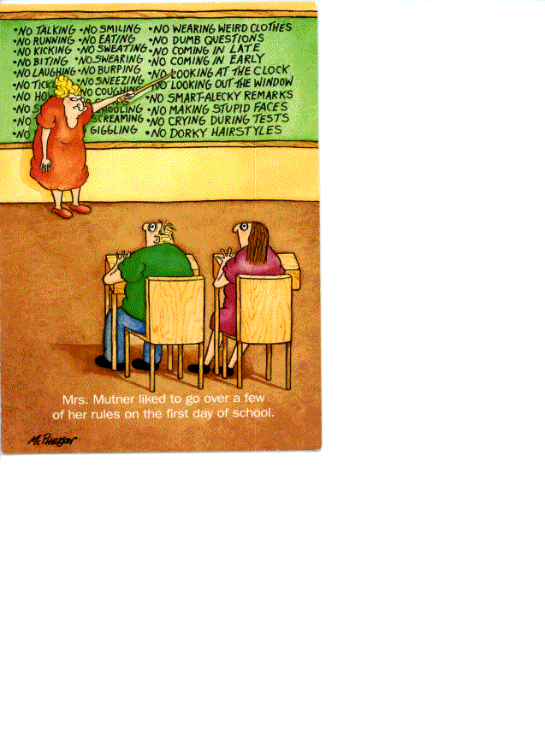
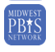
T H E DO NOTs
(A Non-Example)

Slide 52
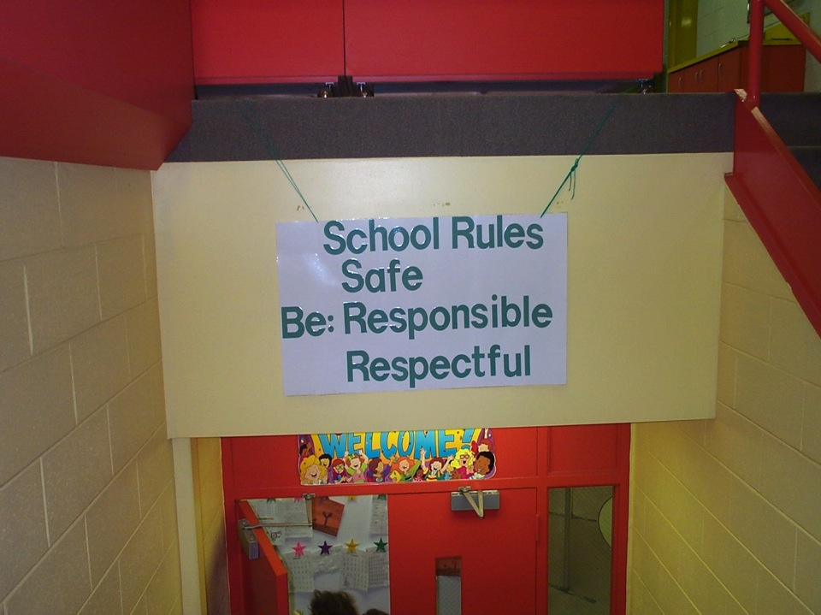
Redesign the Learning Environment
School Rules
NO Food
NO Weapons
NO Backpacks
NO Drugs/Smoking
NO Bullying
School Expectations

Slide 53
Expectation Example
Dover High and Central Middle
RAP Expectations
Respect
Accountable
Productive
Other Thoughts…
Where "Koalaty" Counts
Distinct Expectations
Acronym that works well
Continuity within district
Connect to school mottos
Connect with other behavior initiatives

Slide 54

Our Goal!
Select three to five schoolwide expectations that define success for all students and are applicable in all settings.
    Examples:
    Respectful
    Cooperative
    Safe
    Kind

Slide 55
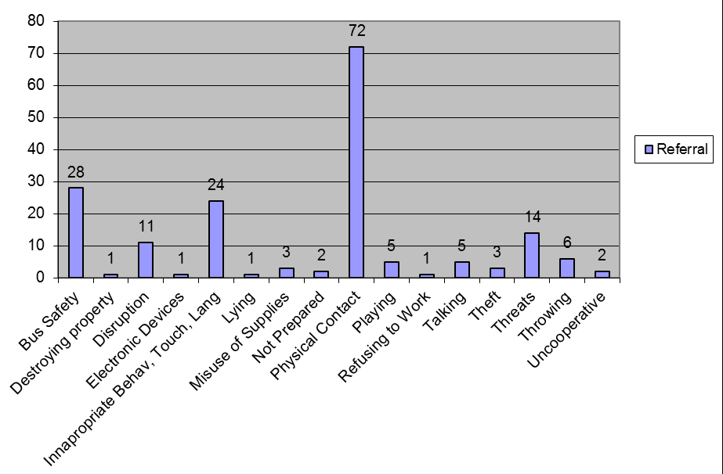
What are the behaviors to target? Got Data?

Slide 56
CORE FEATURES
of School-Wide PBS
The Way it Works
They become the common language of the school:
School personnel
Students
Families
1
DEFINE
School-wide expectations (i.e. social competencies)
Courtesy of K. McIntosh; U of Oregon

Slide 57
Why? … Consistency Matters
Common
Vision/Expectations
SCHOOL COMMUNITY
Common
Language
Common
Practices
(USDOE OSEP PBIS TA Center, 2010)

Slide 58
School-wide Expectations & Rules
Expectations
Rules/Examples
A list of specific, positively stated behaviors that are desired of all faculty and students
These expectations should be in line with the school’s mission statement and should be taught to all faculty, students, and families
Specific skills you want students to exhibit and the procedures you want students to follow in specific settings
www.pbis.org

Slide 59

Our Goal!
Create a teaching matrix of specific pro-social behaviors/rules to further clarify each schoolwide expectation for every setting.

Slide 60
Why Develop a School-wide Teaching Matrix?
Defines the expected behaviors for specific settings:
  hallways, classrooms, gym, cafeteria, bus loading, bathrooms, assemblies
    State definitions positively
    Use a few common words
    Show what the behavior “looks like”
Creates the “Curriculum” that will guide the teaching of expected behaviors across settings & programs.
Enhances communication among staff, students and parents/community.

Slide 61
Teaching Matrix Guidelines
Remember our behaviors/rules are specific tasks students are to do to demonstrate the schoolwide expectations
When defining specific behaviors/rules they should be:
Observable – behaviors that we can see,
Measureable – we could actually count the occurrence of the behavior,
Positively Stated – things to do to be successful,
Understandable – student-friendly language, and
Always Applicable.
http://pbismissouri.org

Slide 62
Example of Rules Following Guidelines
Guidelines | This Means | Example | Non-Example
Observable | I can see it. | Raise hand and wait to be called on. | Be your best.
Measurable | I can count it. | Bring materials. | Be ready to learn.
Positively Stated | I tell students what TO do. | Hands and feet to self. | No fighting.
Understandable | The vocabulary is age and grade appropriate. | Hands and feet to self. | Maintain personal space (K-1 rule)
Always Applicable | I am to consistently enforce. | Stay in assigned area. | Remain seated until given permission to leave.
http://www.midatlanticpbis.org

Slide 63
Including Pro-social skills on your matrix
What modifications can be made to your matrix to increase the effectiveness of school-wide PBS supports for students in your building who exhibit internalizing behaviors?
  Not talking with other children
  Being shy
  Timid and/or unassertive
  Avoiding or withdrawing from social situations
  Not standing up for one’s self
  Source: Walker and Severson, 1992

Slide 64
Specific Behaviors + Social-Emotional Skills
Expectation | Specific Behavior or Social Emotional Skill
Be Safe | Keep hands and feet to self
 | I tell an adult when I am worried about a friend.
Be Respectful | Use the signal to ask a public or private question.
 | Make sure everyone gets a turn.
Be Responsible | Turn in all work on time
 | Check in with my feelings during the day
http://www.midatlanticpbis.org

Slide 65
Specific Behaviors + Pro-Social Skills
Specific Behaviors
Pro-Social Skills
Throw paper in the waste can
Use the right side of the stairway
Bring all materials to class
Keep hands, feet, and other objects to yourself
Do an act of kindness
Pick up trash even if it isn’t yours
Use encouraging words with others
Tell peer they did a good job

Slide 66
Teaching Matrix |  | SETTING
 |  | Hallways | Cafeteria | Library/ Computer Lab | Bus | Classroom
 | Be Respectful | Keep hands feet and other objects to self | Eat only your food | Study, read, compute | Watch for your stop
 | Be Responsible | Use quiet voice | Replace trays & utensils | Push in chairs. Treat books carefully. | Wipe your feet Sit appropriately
 | Be Safe | Maintain your own physical space Stay to the right | Clean up your eating area | Whisper. Return books | Use a quiet voice Stay in your seat
Rules (specific behaviors) operationally define your expectations
Expectations

Slide 67
CORE FEATURES
of School-Wide PBS
Supporting Every Student
Get and use meaningful input from:
Staff
Families
Students
1
DEFINE
School-wide expectations (i.e. social competencies)
Courtesy of K. McIntosh; U of Oregon

Slide 68
Matrix Review Activity
Are current expectations still meeting needs & context of our school?
Does our teaching matrix need refinement based on the guidelines?
Are prosocial skills embedded in our matrix?
If a Social-Emotional Learning (SEL) curriculum is used in our school, how are skills embedded in our matrix?
Predictable
Positive
Consistent
Safe

Slide 69
Teaching Matrix |  | SETTING
 |  | Hallways | Cafeteria | Library/ Computer Lab | Bus | Classroom
 | Be Respectful | Keep hands feet and other objects to self | Eat only your food | Study, read, compute | Watch for your stop
 | Be Responsible | Use quiet voice | Replace trays & utensils | Push in chairs. Treat books carefully. | Wipe your feet Sit appropriately
 | Be Safe | Maintain your own physical space Stay to the right | Clean up your eating area | Whisper. Return books | Use a quiet voice Stay in your seat
What about the classroom?
Expectations

Slide 70
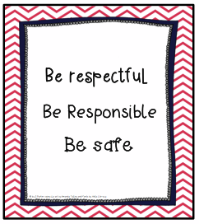
Creating Classroom Expectations
Staff members should use the School-wide Expectations as the foundation for their classroom expectations.
It will be less confusing for the students and should be easy for the teachers to show the connection from the expected school-wide behavior to what is expected in the classroom at all times.

Slide 71
Classroom Specific Matrix
The School-wide matrix includes the rules for classrooms.
Classrooms then expand their matrix to also include the routines/procedures for common routines (mapped to the school-wide expectations).
What are three routines used daily in your classroom?

Slide 72
What Are Procedures & Routines?
Procedures explain the accepted process for carrying out a specific activity such as
    walking in the hallway
    using lockers
    sharpening pencils
    attending an assembly
    setting up chemistry lab stations
    going to the restroom
Classroom procedures are patterns for accomplishing classroom tasks
Procedures form routines when practiced and help students meet expectations stated in the rules

Slide 73
Research Studies Found…
Having Procedures and Routines in place will:
  Increase instructional time by preventing problem behavior
  Free teachers from correcting misbehavior
  Improve classroom climate
  Create shared ownership of the classroom
  Develop self-discipline
Effective teaching includes teaching functional routines and procedures to students at the beginning of the year and using these routines to efficiently move through the school day.
(Leinhardt, Weidman, & Hammond, 1987)
As students become more familiar with classroom routines and procedures, additional instructional formats and more challenging work can be incorporated
(Evertson, Emmer, & Worsham, 2003; Good & Brophy, 2003)

Slide 74
Conversation: Can students engage in conversation during this activity? If yes, about what? With whom?
Participation: What does it look like and sound like?
Help: How do students get your attention to ask a question? What do they do while they wait?
Movement: Can students get out of their seats for this activity? If so, for what reasons?
Routines and Procedures
http://www.midatlanticpbis.org

Slide 75
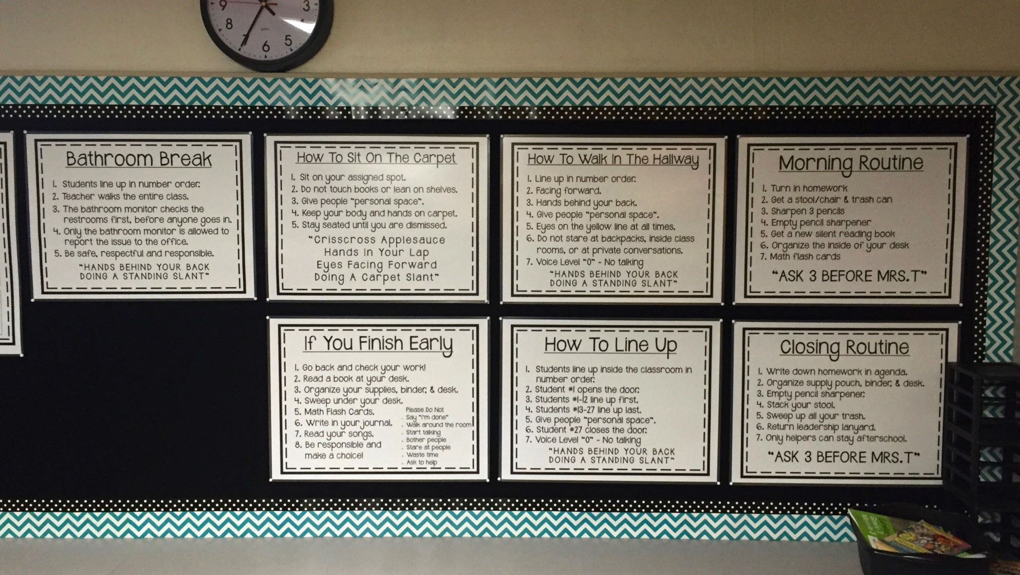
Classroom Routines
Respectful
Ready
Respectful
Ready
Responsible
Respectful
Responsible
Be Respectful
Responsible
Ready

Slide 76
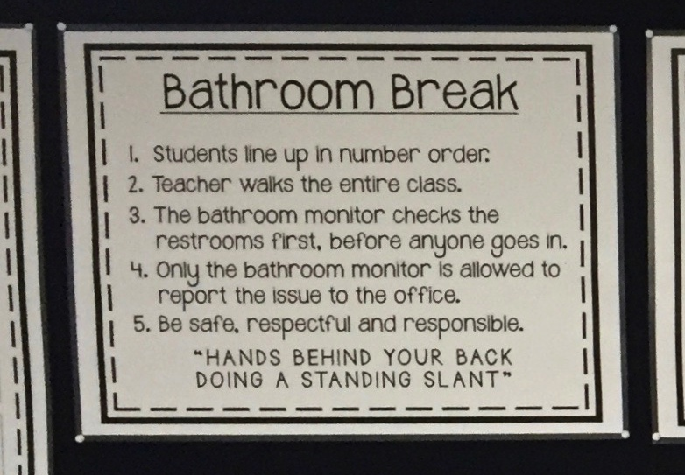
Classroom Routines
Respectful

Slide 77
Example of a Classroom Teaching Matrix
The Winhall Way | Classroom Examples (Rules) | Winhall HS – Classroom 214 Routines rev4-16-19
 |  | Welcome | Group Work | Online | When you feel upset… | How to Transition
Be Responsible | Stay on task Offer to help Apologize for mistakes | Turn in homework Put materials in desk Begin work | Do your fair share Manage time carefully | Double check sources before I post Think before I forward | Stop and take a few deep breaths Recognize what you’re feeling “I feel…” | Clean up your area
Be Respectful | Raise hand Track the speaker Follow directions | Say “good morning” to teacher and classmates Talk in soft voices | Listen to your peers Take turns speaking Say “I like that idea, AND…” | Consider feelings of others before I post Upstanders speak for others | Ask for a break if you need a moment Express your feelings appropriately | Stand and Push in your Chair OR Listen for direction to next activity
Be Safe | Walk quietly Keep hands and feet to self | Put personal belongings in designated areas Take your seat | Clean up area when time is up | Turn on privacy controls | Talk to someone if you need help Talk to someone if it will make you feel better | Eye’s on me Wait to be called
Have any of your schools engaged in supporting teachers to establish a classroom teaching matrix?

Slide 78

Invest in Building a Strong Foundation
The teaching matrix is foundation for
  TEACHING behavior & social skills
  ACKNOWLEDGING/REINFORCING skills
  PRE-CORRECTING for desired behaviors, and
  CORRECTING behavioral missteps through re-teaching.

Slide 79

They’re Alive!
Think of your School-wide and Classroom Teaching Matrices as living, fluid documents. If being responsive to your data and needs of your school & community, then teams and schools need to be flexible and willing to revisit expectations and rules.

Slide 80
CORE FEATURES of School-Wide PBS
The Way it Works
Explicit instruction ensures everyone is clear on what is desired, without assuming everyone knows what to do
1
DEFINE
School-wide expectations (i.e. social competencies)
2
TEACH & PRACTICE
Prosocial behaviors
Courtesy of K. McIntosh; U of Oregon

Slide 81

Purpose & Outcomes
Purpose:
Prepare and plan for facilitating implementation
of teaching the school-wide and classroom-wide
expectations
Outcomes and Fidelity:
Teaching Expectations
  Expected academic and social behaviors are taught
  directly to all students in classrooms
  across all settings/locations

Slide 82
Why Develop a System for Teaching Behavior?
Behaviors are prerequisites for academics
Procedures and routines create structure
Repetition is key to learning new skills
For a youth to learn something new, it needs to be repeated on average of times (Joyce and Showers, 2006)
Adults average (Joyce and Showers, 2006)
For youth to unlearn an old behavior and replace with a new behavior, the new behavior must be repeated on average times (Harry Wong)
8
25
28
www.pbis.org

Slide 83
“If a child doesn’t know how to read, we teach.”
“If a child doesn’t know how to swim, we teach.”
“If a child doesn’t know how to multiply, we teach.”
“If a child doesn’t know how to drive, we teach.”
“If a child doesn’t know how to behave, we…
...teach? …punish?”
“Why can’t we finish the last sentence as automatically as we do the others?”
Tom Herner (NASDE President ) Counterpoint 1998, p.2

Slide 84
Once you have developed school-wide expectations, it is not enough to just post the words on the walls of the classroom, or simply tell students what they are…
YOU MUST TEACH THEM!
I taught the behaviors defined on my classroom matrix using explicit instruction
I went over the behaviors defined on my classroom matrix using explicit instruction

Slide 85
Teaching Academics
DEFINE
(TELL)
Simplify
MODEL
(SHOW)
PRACTICE
In setting
MONITOR
ADJUST
(RETEACH)
For
efficiency
BE CONSISTENT

Slide 86
Teaching Behavior
DEFINE
(TELL)
Simplify
MODEL
(SHOW)
PRACTICE
In setting
MONITOR
ADJUST
(RETEACH)
For
efficiency
BE CONSISTENT

Slide 87
Teaching social behaviors like academic skills
“You got it. Tomorrow let’s figure out how to handle cyber-teasing.”
“If someone won’t stop teasing your friend, you should look cool & walk away w/ your friend…”
ADJUST for
Efficiency
DEFINE
Simply
“That was great. What would that look like if you were stuck on the bus? In the classroom?”
MONITOR &
ACKNOWLEDGE
Continuously
“Watch. This is how I would do it at a concert.”
MODEL
“Tell me how you would do it if you were in hallway.” “At school dance.”
PRACTICE
In Setting

Slide 88
How do you teach behavioral expectations?
  Teach in the actual settings where behaviors are to occur
  Teach the words by demonstrating the actions using examples and non-examples.
  Model and practice to fluency
  Build a social culture that is predictable and focused on student success
Respect Ourselves
Respect Our Community
Respect Our Environment

Slide 89
Creating Behavior Lesson Plans
Teachers create lesson plans for each desired behavior from the matrix
Students are taught the expectations, rules and routines for both the school-wide system and the classroom-wide system.
Remember… If you are seeing problematic behavior, ask, “Have I taught the desired and acknowledged the behavior I want to see?”

Slide 90
Teaching Matrix |  | SETTING
 |  | All Settings | Hallways | Playgrounds | Cafeteria | Library/ Computer Lab | Assembly | Bus
 | Respect Ourselves | Be on task. Give your best effort. Be prepared. | Walk. | Have a plan. | Eat all your healthy food first. | Study, read, compute. | Sit in one spot. | Watch for your stop.
 | Respect Others | Be kind. Hands/feet to self. Help/share with others. | Use normal voice volume. Walk to right. | Play safe. Include others. Share equipment. | Invite those sitting alone to join you. | Whisper. Return books. | Listen/watch. Use appropriate applause. | Use a quiet voice. Stay in your seat.
 | Respect Property | Recycle. Clean up after self. | Pick up litter. Maintain physical space. | Use equipment properly. Put litter in garbage can. | Replace trays & utensils. Clean up eating area. | Push in chairs. Treat books carefully. | Pick up. Treat chairs appropriately. | Wipe your feet. Sit appropriately.
Teach in one location
Teach one expectation
Expectations

Slide 91
Designing a Behavior Lesson Plan (Cool Tool)
  Step one: Select the skill to be taught
  Skills are taken directly from the behavioral matrix
  Select skills based on the trends in your data
  Step two: Write the lesson plan
  Name the skill & align to school-wide expectation
  Also align with SEL standards
  Responsibility is the expectation
  Name the expectation: Be Responsible
  Name the location: Hallway
  Name the skills: Students who are responsible:
    Move silently
    Walk with hands at your sides
    Stay to the right

Slide 92
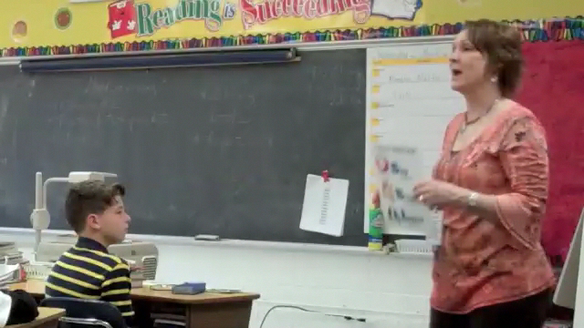
Example: Teaching students how stop their behavior when asked (showing respect)

Slide 93
CORE FEATURES of School-Wide PBS
1
DEFINE
School-wide expectations (i.e. social competencies)
Supporting Every Student
Empower students to design and teach PBIS lessons
2
TEACH & PRACTICE
Prosocial behaviors
Courtesy of K. McIntosh; U of Oregon

Slide 94
Behavior Lesson Plan Form
Expectation:
Location:
Establish/Define Expectation: Introduce the skill(s) and why is important. Be sure to list when the behavior is expected:
Teach: Teacher demonstrates or models the appropriate behavior. Discuss non-examples and examples.
Monitor and Reinforce: Increase the likelihood that students will demonstrate the skill. Provide examples if appropriate.
Pre-Correct/Remind: Provide anticipated time of day/activities to pre-correct.
Feedback: Observe student performance and give positive, specific feedback to students. Provide an example or specific praise and error correction.
Reteach: Provide examples of times throughout the day and school year to provide booster lessons.
Supervise: Don’t forget to move, scan and interact with students!

Slide 95
Expectation: Respect Others |  | Location: Cafeteria
Establish/Define Skill or Procedure: Define the behavior and why it is important. Be sure to list when the behavior is expected
Definition: we respect others in the cafeteria by making sure everyone feels comfortable and has someone to sit with. Why Important: Being respectful of others in the cafeteria helps everyone feel like they belong. When Expected: If you notice a student is sitting alone, you can ask a teacher to sit with them or invite them to sit with you and your friends.
Teach: Teacher demonstrates or models the appropriate behavior. Provide non-examples and examples.
Example: Debby notices that Niki, a student in her class is sitting alone. She notices because Niki is not talking to any of the other students sitting near her. She raises her hand to ask the teacher if she can invite Niki to sit at their table. If Niki agrees, the two sit together. Non-Example: Debby notices that Niki is not talking to anyone at her table. She whispers to her friend that it looks like Niki doesn’t have any friends, the two laugh.
Practice: Give students opportunities to role-play the appropriate behaviors across all relevant settings.
All students have the opportunity to role play inviting a student to join them in the cafeteria. Repeat several times so that everyone has different roles to role-play. Make sure all students understand the expectation and behavior.
Monitor and Reinforce: Increase the likelihood that students will demonstrate the skill. Provide examples if appropriate.
Pre-Correct/Remind: Provide anticipated time of day/activities to pre-correct. | Provide prompts right before lunch.
Feedback: Observe student performance and give positive, specific feedback to students. Provide an example or specific praise and error correction. | Privately (to Debby) say: “I noticed that you invited a new friend, Niki, to sit with you at lunch. Way to respect your classmate!”
Reteach: Provide examples of times throughout the day and school year to provide booster lessons. | In the beginning of the year when students are first getting to know each other
Supervise: Don’t forget to move, scan and interact with students!
Sample Behavior Lesson Plan

Slide 96

Lesson Plan Activity
Choose one expectation in one location.
Work with your shoulder partner and complete the behavior lesson plan template.
Be ready to describe your lesson to the group, describe the non-example if needed, and role play the correct example.

Slide 97
Develop a Plan for Teaching Expectations
Once the behavior lesson plans are created it is important to take time to decide how and when the lessons will be taught
Provide initial lesson plans to begin teaching behavior
Build on what you have (i.e. character ed.)
Develop a system for expanding behavior lesson plan ideas throughout the year
  Skill of the month, Booster Sessions
Determine the minimum requirements for teaching behavior (i.e. how often)

Slide 98
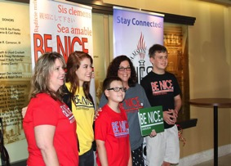

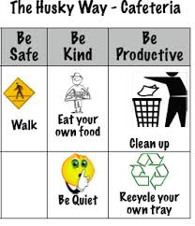
When and How will we teach behavior?
Kick-off events
  Teaching staff, students, and families the
  expectations and rules
  Beginning and mid-year; more often as needed
  Teach rules for all areas of school, including individual classrooms
On-going Direct Instruction
  Daily or Weekly schedule?
  Data-driven and scheduled designed lessons
  Pre-correction
  Re-teaching immediately after behavioral errors
Embedding into curriculum
Booster trainings
  Scheduled and data-driven
Continued visibility
  Visual Displays – posters, agenda covers
  Daily announcements
  Newsletters

Slide 99

Introductory Events/Kick off
All faculty and students participate
Decide on method that will be most effective for your school
Consider Importance/Impact - Activity/event should be a high priority… not given a few minutes in some other activity

Slide 100
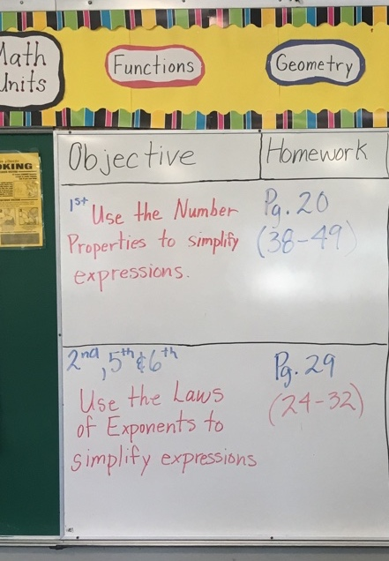
Embed into Daily Curriculum
Objective for the Subject Matter Lesson
Objective for a paired Behavioral/Social/emotional skill (taken from the school’s teaching matrix)
Today’s
Wilson Way Be Responsible
* Focus on your own work

Slide 101
Will you teach through Videos?
Important Considerations When Making Teaching Videos
Matching the climate of your building
Making sure they are data driven
Pairing them with follow up activities (Discussion, etc.)
Do not roll-play non-examples. Video’s should demonstrate the positive examples only.
Involve students in the process
Ensure students involved are representative of your student body

Slide 102
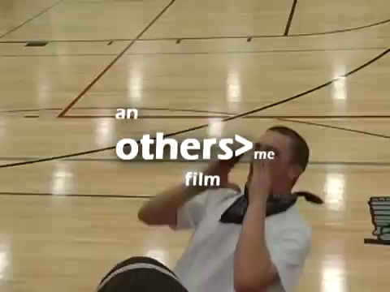
Using Instructional Videos-
Arrive on Time
https://youtu.be/5C-Wyy_lPNk

Slide 103
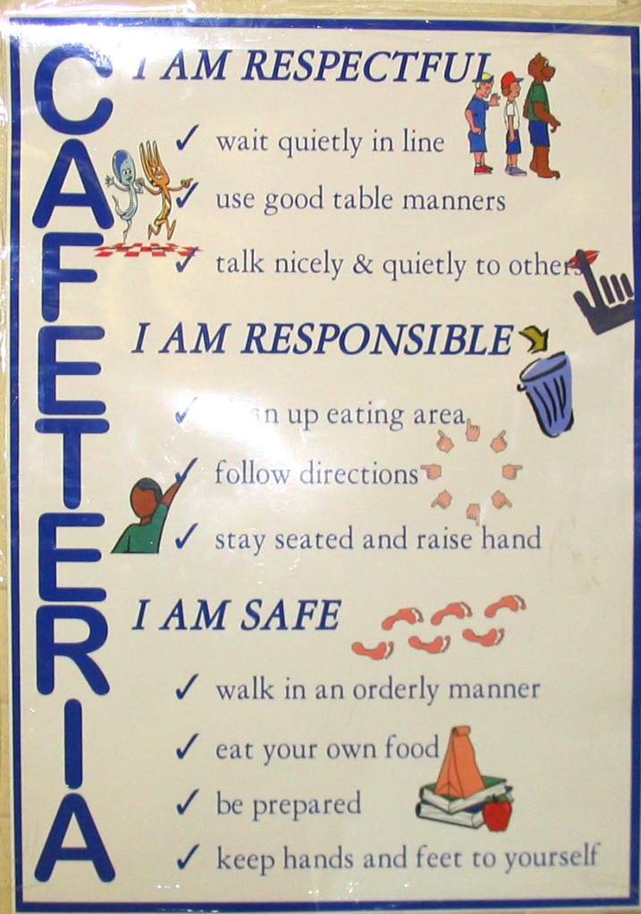
School-wide Expectation Visibility
Promote joint ownership and responsibility for meeting expectations among staff, students and community
Posting expectations & matrix components per location provide reference tools for pre-correction & correction of misbehavior
Include expectation language in school-based materials: agenda books, code of conduct, school promotional items (pencils, t-shirts, etc.)
Represent expectations in various ways to support understanding (pictures/art, words)

Slide 104
Remember…
Behavior change is an instructional process
We change STUDENT behavior
by changing
ADULT behavior
Interventions = changes in staff procedures & practices

Slide 105
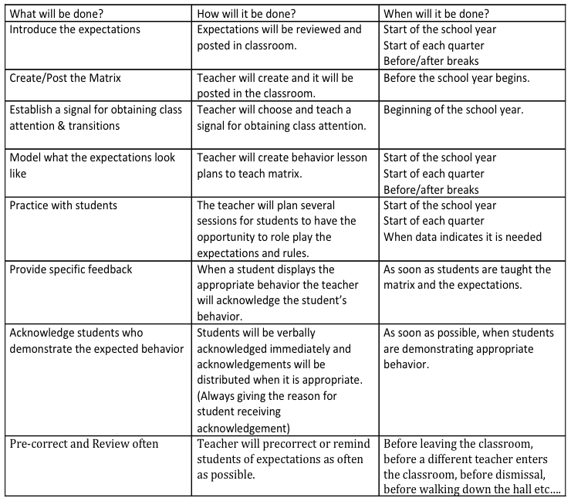
Sample Plan for Teaching Expectations

Slide 106
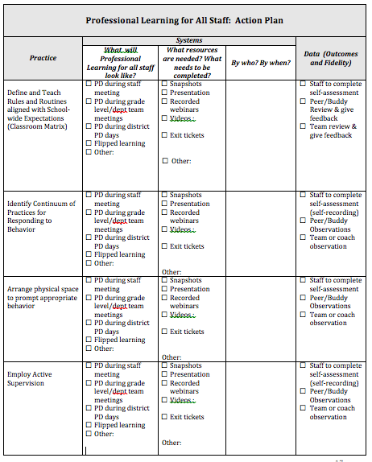
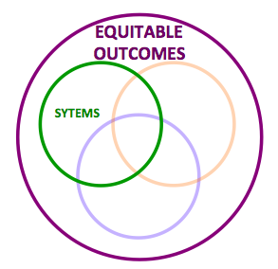
Professional Learning Action Plan
Systems to support consistent practices across classrooms

Slide 107
CORE FEATURES
of School-Wide PBS
On-Going Acknowledgement of Prosocial Behavior
Every faculty and staff member acknowledges PROSOCIAL behavior
5+:1-
1
DEFINE
School-wide expectations (i.e. social competencies)
2
TEACH & PRACTICE
Prosocial behaviors
MONITOR & ACKNOWLEDGE
Prosocial behaviors
3
Courtesy of K. McIntosh; U of Oregon

Slide 108
CORE FEATURES
of School-Wide PBS
The Way it Works
“Whatever you feed, will grow”
- Bishop TD Jakes
1
DEFINE
School-wide expectations (i.e. social competencies)
2
TEACH & PRACTICE
Prosocial behaviors
MONITOR & ACKNOWLEDGE
Prosocial behaviors
3
Courtesy of K. McIntosh; U of Oregon

Slide 109

Growing our our relationship-building intents…recognition is one method.

Slide 110
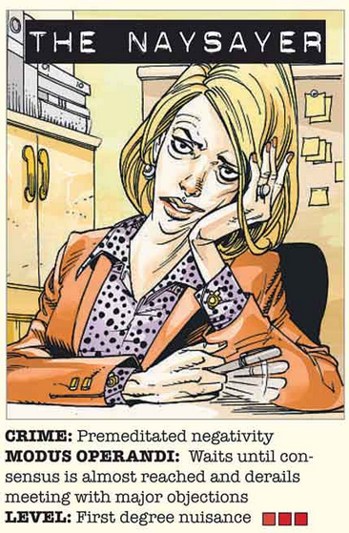
Reality check please…

Slide 111

Reality Check…You Got It!
Positive approaches to behaviors provide real, meaningful results for schools, teachers and students:
Increased academic engagement
Decreased disruptive behavior
Increased intrinsic motivation
Increase peer social acceptance
(Rodgriguez & Sprick, n.d.)

Slide 112

Purpose of Reinforcers/ Acknowledgement Systems
Create frequent positive interactions between staff and students
Recognizing desired behavior is a strategy to prevent behavior problems.
Teach new behavior
Strengthen replacement behaviors that compete with habitual undesirable behavior
Repeated review of your SW systems can also identify areas for improved equity

Slide 113
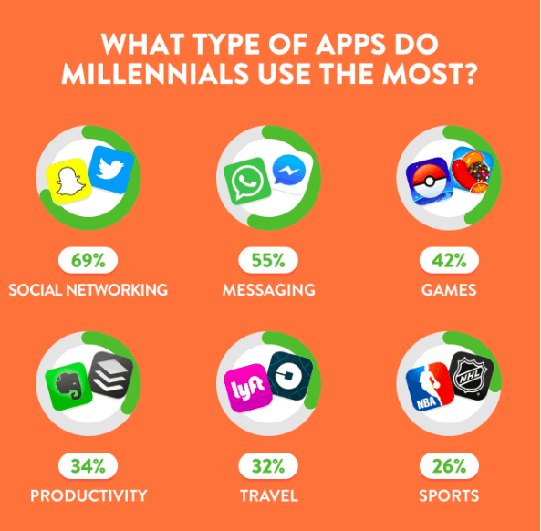
Feedback (Still) Matters
Mobile apps are projected to hit $188.9 billion in revenue by 2020. (Statista)
Nearly 70 percent of millennials say social networking apps are among their most commonly used. (MindSea)

Slide 114
A Debate As Old As Time…
  “In terms of the overall effects of reward, our meta-analysis indicates no evidence for detrimental effects of reward on measures of intrinsic motivation.”
        (Cameron, Banko & Pierce, 2001 p.21)

Slide 115
How to avoid rewards negatively impacting interest and performance:
  If reward is used as bribery
  If rewards are delivered ambiguously (not clearly tied to performance of expectation)
  If what we deliver is not a “reward” from the student’s perspective
  If partial rewards are delivered when full reward is expected
  If large rewards are delivered briefly and then withdrawn completely
Horner & Goodman, Using Rewards within
School-wide PBIS, www.pbis.org
Considerations &
Cautions:
For more information see:
Cameron, Banko & Pierce, 2001

Slide 116
TOOLS ARE OUT THERE
for implementation and reflection:
Construct a Reinforcement Matrix
Use strategic praise practice and non-contingent attention.
Develop a ratio and growth mindset.
Check off your classroom matrix and routines.

Slide 117
PBS School-wide Acknowledgement Matrix (Student & Staff!)
TYPE | WHAT | WHEN | WHERE | WHO
Immediate/High Frequency In the moment, predictable |  |  |  | ALL KIDS, ALL STAFF
Redemption of high frequency |  |  |  | ALL KIDS. ALL STAFF
Intermittent/Unpredictable |  |  |  | ALL KIDS, ALL STAFF
Long-term School-wide Celebrations (school-wide not individually based) FOR ACTIVITY |  |  |  | ALL KIDS, ALL STAFF

Slide 118
PBS School-wide Acknowledgement Matrix (Student & Staff!)
TYPE | WHAT | WHEN | WHERE | WHO
Immediate/High Frequency In the moment, predictable |  |  |  | ALL KIDS, ALL STAFF
Redemption of high frequency |  |  |  | ALL KIDS. ALL STAFF
Intermittent/Unpredictable |  |  |  | ALL KIDS, ALL STAFF
Long-term School-wide Celebrations (school-wide not individually based) FOR ACTIVITY |  |  |  | ALL KIDS, ALL STAFF

Slide 119
PBS School-wide Acknowledgement Matrix (Student & Staff!)
TYPE | WHAT | WHEN | WHERE | WHO
Immediate/High Frequency In the moment, predictable |  |  |  | ALL KIDS, ALL STAFF
Redemption of high frequency |  |  |  | ALL KIDS. ALL STAFF
Intermittent/Unpredictable |  |  |  | ALL KIDS, ALL STAFF
Long-term School-wide Celebrations (school-wide not individually based) FOR ACTIVITY |  |  |  | ALL KIDS, ALL STAFF

Slide 120
PBS School-wide Acknowledgement Matrix (Student & Staff!)
TYPE
Immediate/High Frequency In the moment, predictable (e.g., Gotchas, Paws, High Fives)
Redemption of High Frequency (e.g., school store, drawings)
Intermittent/Unpredictable (e.g., surprise HW completion treat, random use of gotchas in hallway)
Long-term School-wide Celebrations (school-wide not individually based) FOR: Ex: ODR reduction, school-wide target met for certain setting/behavior area ACTIVITY: (e.g., ice cream social, dance, game day)

Slide 121
PBS School-wide Acknowledgement Matrix (Student & Staff!)
TYPE
Immediate/High Frequency In the moment, predictable (e.g., Gotchas, Paws, High Fives)
Redemption of High Frequency (e.g., school store, drawings)
Intermittent/Unpredictable (e.g., surprise HW completion treat, random use of gotchas in hallway)
Long-term School-wide Celebrations (school-wide not individually based) FOR: Ex: ODR reduction, school-wide target met for certain setting/behavior area ACTIVITY: (e.g., ice cream social, dance, game day)

Slide 122
High Frequency Acknowledgements
Way to quickly and easily reinforce when students meet the SW expectations
Delivery explicitly connects to SW expectation
Keep the system simple
Build in opportunities for data collection
Start Small

Slide 123
High Frequency Acknowledgements
Way to quickly and easily reinforce when students meet the SW expectations
Delivery explicitly connects to SW expectation
Keep the system simple
Build in opportunities for data collection
Start Small
Suggested Additions:
Activities that build staff and student relationships while recognizing good behavior
Promoting positive contacts home

Slide 124
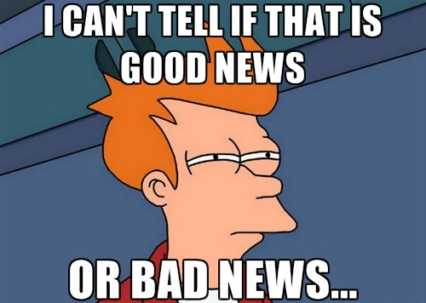
Delivery Matters…

Slide 125
Strategic Use of Praise
Opportunity to provide feedback on positive behavior
Connecting it to social-emotional competencies (e.g., empathy, caring, responsibility, respect, and autonomy)
Highlight the usefulness of the behavior (e.g., academic connection)
Be sincere and credible

Slide 126
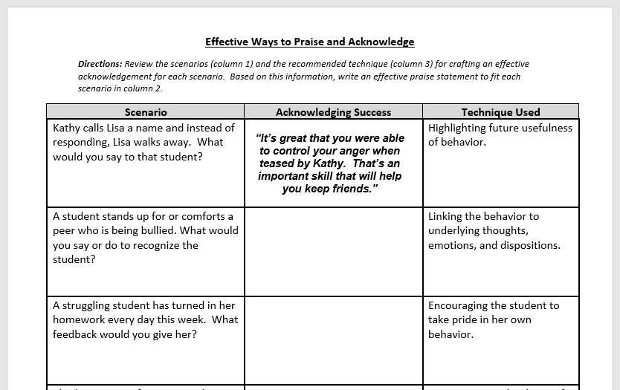
Sample Teaching Tool for Teachers

Slide 127
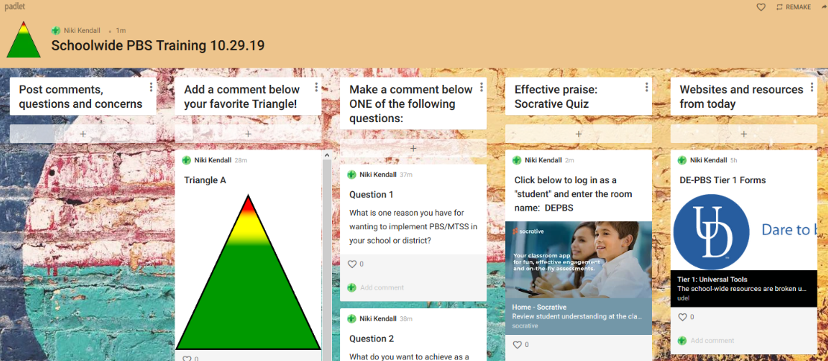

Slide 128
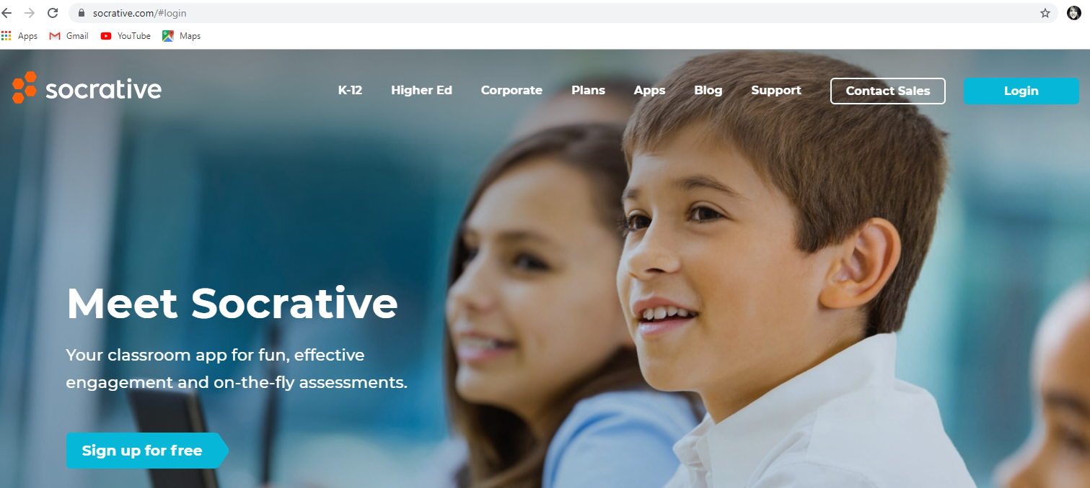

Slide 129
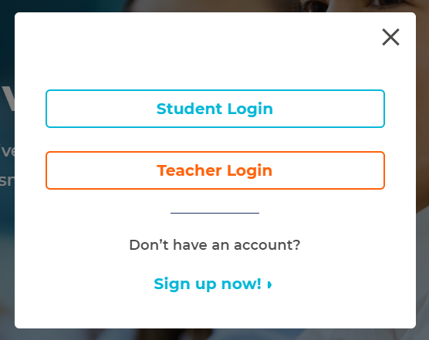
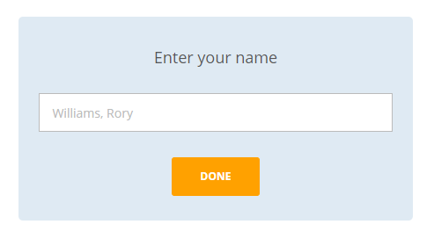
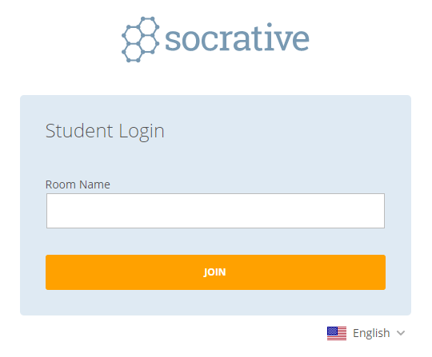
1
3
2
DEPBS

Slide 130
PBIS School-wide Acknowledgement Matrix (Student & Staff!)
TYPE
Immediate/High Frequency In the moment, predictable (e.g., Gotchas, Paws, High Fives)
Redemption of High Frequency (e.g., school store, drawings)
Intermittent/Unpredictable (e.g., surprise HW completion treat, random use of gotchas in hallway)
Long-term School-wide Celebrations (school-wide not individually based) FOR: Ex: ODR reduction, school-wide target met for certain setting/behavior area ACTIVITY: (e.g., ice cream social, dance, game day)

Slide 131

Recognition Systems - Redemption
Your intents and student needs
INFORM
the mechanics.

Slide 132
CORE FEATURES
of School-Wide PBS
Supporting Every Student
Ensure acknowledgement systems are:
Used equitably
Actually reinforcing
1
DEFINE
School-wide expectations (i.e. social competencies)
2
TEACH & PRACTICE
Prosocial behaviors
MONITOR & ACKNOWLEDGE
Prosocial behaviors
3
Courtesy of K. McIntosh; U of Oregon

Slide 133

CORE FEATURES
of School-Wide PBS
1
DEFINE
School-wide expectations (i.e. social competencies)
2
TEACH & PRACTICE
Prosocial behaviors
MONITOR & ACKNOWLEDGE
Prosocial behaviors
3
4
PROVIDE INSTRUCTIONAL CONSEQUENCES
for unwanted behavior
Courtesy of K. McIntosh; U of Oregon

Slide 134
System for Responding to/
Correcting Problem Behaviors
Responding to Problem Behavior
Referral System
Clear & Consistent Procedures
Disciplinary Learning Opportunities

Slide 135
Consistent & Clear Procedures:
Classroom vs. Office Managed
Staff need to know what problem behaviors are major vs. minor (office-managed vs classroom–managed)
This process must be defined, taught/re-taught, and agreed upon with all staff, and must include definitions for:
  major discipline incidents
  minor discipline incidents
  a continuum of discipline procedures

Slide 136
Learning Opportunities: Response to Problem Behaviors include problem solving/skill building
Observe problem
behavior
No
Yes
Find a place to talk
with student(s)
Is the behavior
major?
Ensure safety
Write referral &
Escort student to
office
Problem Solve
Determine
consequence
Problem solve
Follow procedure
documented
Determine
consequence
Etc.
Follow documented
procedure
Adapted from procedure 2.0 A. Todd U of Oregon
Etc.

Slide 137
CORE FEATURES
of School-Wide PBS
Discourage Unwanted Behaviors
Do not ignore unwanted behavior
1
DEFINE
School-wide expectations (i.e. social competencies)
2
TEACH & PRACTICE
Prosocial behaviors
CAUTION
MONITOR & ACKNOWLEDGE
Prosocial behaviors
3
4
PROVIDE INSTRUCTIONAL CONSEQUENCES
for unwanted behavior
Courtesy of K. McIntosh; U of Oregon

Slide 138
Discourage Unwanted Behaviors
CORE FEATURES
of School-Wide PBS
1
DEFINE
School-wide expectations (i.e. social competencies)
2
TEACH & PRACTICE
Prosocial behaviors
QUICK REDIRECTS
MONITOR & ACKNOWLEDGE
Prosocial behaviors
3
4
PROVIDE INSTRUCTIONAL CONSEQUENCES
for unwanted behavior
Courtesy of K. McIntosh; U of Oregon

Slide 139
The Way it Works
Don’t assume that punishment teaches the right way
“When everyone handles infractions with instructional correction procedures, students learn that what happens when they misbehave is procedure not personal.” - Bob Algozzine
CORE FEATURES
of School-Wide PBS
1
DEFINE
School-wide expectations (i.e. social competencies)
2
TEACH & PRACTICE
Prosocial behaviors
MONITOR & ACKNOWLEDGE
Prosocial behaviors
3
4
PROVIDE INSTRUCTIONAL CONSEQUENCES
for unwanted behavior
Courtesy of K. McIntosh; U of Oregon

Slide 140
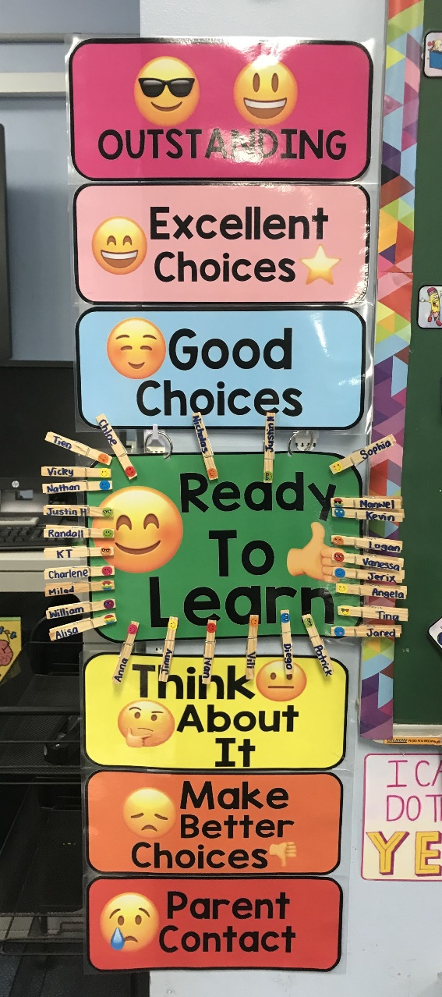

Praise can be public……
….. Corrections should be private.
Courtesy of K. McIntosh; U of Oregon

Slide 141

Classwide “Reset” Routine
TRY for students
  Take three deep breaths
  Reflect on your feelings
  You got this!
Social-emotional Theme
  Mistakes are part of the learning process
  We won’t always do it right the first time
  We can’t succeed unless we TRY
Courtesy of K. McIntosh; U of Oregon

Slide 142
CORE FEATURES
of School-Wide PBS
Supporting Every Student
Find ways to coach to desired behavior, instead of exclude
1
DEFINE
School-wide expectations (i.e. social competencies)
2
TEACH & PRACTICE
Prosocial behaviors
MONITOR & ACKNOWLEDGE
Prosocial behaviors
3
4
PROVIDE INSTRUCTIONAL CONSEQUENCES
for unwanted behavior
Courtesy of K. McIntosh; U of Oregon

Slide 143
Recommendation to eradicate disparities in school discipline
Problem-solving approach to discipline
  Understanding the context
  Why the student is engaging in behavior and understanding the teachers response
  Providing opportunity for reflection and restoration
  Providing additional interventions or services for students with complex support needs
Russell J. Skiba, director of Discipline Disparities Research-to-Practice Collaborative

Slide 144
Disciplinary encounters: 2-part problem solving process
Part 1 focuses how the student might think & act differently. How they can monitor their behavior.
  Student centered: Guided by problem solving & skill building with student.
Part 2 focuses on what the teacher or school should do, beyond punishment, to prevent the problem behavior from recurring and to foster self-discipline, perseverance, and resilience.
  Teacher (or school) centered: Guided by changes in the student’s environment.

Slide 145
Problem Solving with Students
Goal is to help students:
  Determine possible solutions to solve the problem
  Evaluate the options and select the best one
  Develop a plan to follow through with the solution
    How can they self-monitor to ensure they are following the plan?
    How can they continue following this plan over time?
  Consider obstacles that may develop
    How can they be resilient and bounce back from obstacles?
  Are there skills they are lacking that need to be taught in order to solve the problem?

Slide 146
Example Problem Solving Questions
What is the problem in this situation? How do you know that there is a problem?
What should you do? What is the right thing to do?
What did you do the last time there was a problem like this one?
What do you do when what you want to do is not the same as what you ought to do?
Do you need a plan to do what you decided to do? If so, what might it look like?
How will you keep track of this plan and how you’re following it?
What obstacles might get in the way of your doing what you ought to do and intend to do? What might you do to avoid or overcome these obstacles?

Slide 147
Strategies to Support Consistency
Clearly defined major vs. minor behaviors
Clearly/operationally defined response process for minor and major behaviors
Staff feedback loop
Communication through:
  PLC discussions (cross grade-level discussions – what works?)
  Full staff presentation
  Flow chart in classrooms
  Handbooks
Administrator & Staff monitoring and conversations (preventative & corrective)

Slide 148
Behavior Response Reflection
What are the ways in which your school (administrative team, Tier 1 team) promotes problem-solving/skill-building as part of correcting problem behavior?
  Are Office-managed vs. Classroom-managed procedures established? Are staff supported to follow procedures?
Are instructional consequences for unwanted behavior part of procedural response?
  How can the admin and Tier 1 team help build/enhance these procedures? At the school-wide level? At the classroom level?

Slide 149
CORE FEATURES
of School-Wide PBS
The Way it Works
Collect it, use it (for decision making), share it!
1
DEFINE
School-wide expectations (i.e. social competencies)
2
TEACH & PRACTICE
Prosocial behaviors
MONITOR & ACKNOWLEDGE
Prosocial behaviors
3
4
PROVIDE INSTRUCTIONAL CONSEQUENCES
for unwanted behavior
5
MAKE DECISIONS
Based on information collected
Courtesy of K. McIntosh; U of Oregon

Slide 150
Understanding & Using Data
DATA
Sources
Analysis
Action Planning

Slide 151
Definition
Data are the many sources of information we use to make decisions about how to allocate our resources of time and attention for teaching, redirecting, prompting, and reinforcing behaviors.
Data come in many forms such as office referrals, attendance records, grades, surveys, verbal feedback, and observations.
Data must be documented, and shared to be most effective in action planning.

Slide 152
Why Use Data For Decision Making?
Data helps us ask the right questions…it does not provide the answers.
Use data to:
  Identify problems
  Refine problems
  Define the questions that lead to solutions
Data helps place the “problem” in the context
rather than in the students.

Slide 153

Office Discipline Referral Data (ODR)
The Big 5 – Organizing ODR Data Source
  Average Referral/Day/Month (DDRT)
  # of Referrals by Location
  # of Referrals by Behavior
  # of Referrals by Time of Day
  # of Referrals by Student (DDRT)

Slide 154
Multiple Data Sources
Examining multiple data sources will provide you with most comprehensive picture
Examples:
  Staff & Student Attendance
  Retention, Dropout, Graduation Data
  Supported through DE-PBS Project
    School Climate Surveys (staff, student, families)
    DE-PBS Key Feature Evaluation
    Delaware Assessment of Strengths and Needs for PBS (DASNPBS)

Slide 155
CORE FEATURES
of School-Wide PBS
Supporting Every Student
Disaggregate your data to assess your system’s effectiveness for every student
1
DEFINE
School-wide expectations (i.e. social competencies)
2
TEACH & PRACTICE
Prosocial behaviors
MONITOR & ACKNOWLEDGE
Prosocial behaviors
3
4
PROVIDE INSTRUCTIONAL CONSEQUENCES
for unwanted behavior
5
MAKE DECISIONS
Based on information collected
Courtesy of K. McIntosh; U of Oregon

Slide 156
Improving Decision-Making
Solution
From
Problem

Slide 157
Improving Decision-Making
Solution
From
Problem
Information
Problem
Solving
To
Problem
Solution
Information

Slide 158
Improving Decision-Making
Information
Problem
Solving
To
Problem
Solution
Information

Slide 159
Improving Decision-Making
Precision Problem Statement
Monitor Outcome vs Goal
Set Measurable Goal
Use
Data
Problem
Solving
Monitor Fidelity of Plan
Develop Solution and Action Plan

Slide 160
Data-based Decision Making
Decisions are more likely to be effective and efficient when they are based on data.
The quality of decision making depends most on the first step—defining the problem to be solved.
Big Ideas:
Define problems with precision and clarity.
Data help place the “problem” in the context rather than on the students.

Slide 161
Primary to Precise (Disaggregating with Purpose):
Disaggregating student data into subpopulations can help schools and communities…
  plan appropriate programs,
  decide which evidence-based interventions to select (i.e. have they been evaluated with the target population),
  use limited resources where they are needed most, and
  see [and celebrate] important trends in behavior and achievement.
National Center for Mental Health Promotion and Youth Violence Prevention (2012)

Slide 162
Going from Primary to Precise:
Ask the Right Questions…
What are the data we need for a decision?
Precise problem statements include information about the following:
  What is the problem behavior?
  How often is the problem happening?
  Where is the problem happening?
  Who is engaged in the behavior?
  When is the problem most likely to occur?
  Why is the problem sustaining?

Slide 163
The data to move from a Primary to a Precise Statement?
What problem behaviors are most common?
  ODR per Problem Behavior
Where are problem behaviors most likely?
  ODR per Location
When are problem behaviors most likely?
  ODR per time of day
Who is engaged in problem behavior?
  ODR per student
Why are problem behaviors sustaining?

Slide 164
Primary vs. Precision Statements
How do we go from here to here?
Primary Statements | Precision Statement
Too many referrals | There are 25% more ODRs for aggression on the playground this month than last year. These are most likely to occur during first recess, with a large number of students, and the aggression is related to getting access to the new playground equipment.
September has more suspensions than last year
Gang behavior is increasing
The cafeteria is out of control
Student disrespect is rampant

Slide 165
Primary vs. Precision Statements
What?
25% More ODRs for aggression
Precision Statement
There are 25% more ODRs for aggression on the playground this month than last year. These are most likely to occur during first recess, with a large number of students, and the aggression is related to getting access to the new playground equipment.
Where?
On the playground
Who?
A large number of students
When?
First recess
Why?
To get new playground equipment

Slide 166
Primary vs. Precision Statements
What?
25% More ODRs for aggression
Precision Statement
There are 25% more ODRs for aggression on the playground this month than last year. These are most likely to occur during first recess, with a large number of students, and the aggression is related to getting access to the new playground equipment.
Where?
On the playground
Who?
A large number of students
When?
First recess
Why?
To get new playground equipment

Slide 167
Next Steps…
Precision Problem Statement
Monitor Outcome vs Goal
Set Measurable Goal
Use
Data
Monitor Fidelity of Plan
Develop Solution and Action Plan

Slide 168
Team Problem Solving:
From primary to Precision Problem Statement
Example Precision Problem Statement:
Minor disrespect and disruption are increasing and are most likely to occur during the last 15-minutes of classes when students are engaged in independent seat work. This pattern is most common in 7th and 8th grades, involve many students, and appears to be maintained by work avoidance/escape. Attention may also be a function of the behavior- we’re not sure.
Primary statement:
  “ODRs during December were higher than any month.”

Slide 169
Next Step…
Precision Problem Statement
Monitor Outcome vs Goal
Set Measurable Goal
Use
Data
Monitor Fidelity of Plan
Develop Solution and Action Plan

Slide 170
Team Problem Solving:
Set a Measurable Goal
Goals allow you to analyze, monitor, and adjust professional practice.
  Example: By December 18 (school-wide PBS team meeting), there will be a 5% decrease in minor disrespect and disruption behavior referrals for students in 7th & 8th grades as measured by ODR data.
Is it:
  Specific?
  Measurable?
  Achievable?
  Relevant?
  Timely?

Slide 171
Next Step…
Precision Problem Statement
Monitor Outcome vs Goal
Set Measurable Goal
Use
Data
Monitor Fidelity of Plan
Develop Solution and Action Plan

Slide 172
Team Problem Solving: :
Develop a Solution & Action Plan
What efficient & effective strategies does the team propose be done to meet the goal?
Example Plan of Action:
During 7th & 8th grade advisory periods during the week of November 3-5, staff will review “Be Respectful” lessons. Examples discussed will reflect current scenario.
Team member representatives from 7&8th grade teams will discuss & brainstorm with their teams classroom management strategies to keep students engaged during the last 15 minutes of class at next PLC meeting on November 6th.

Slide 173
Next Step…
Precision Problem Statement
Monitor Outcome vs Goal
Set Measurable Goal
Use
Data
Monitor Fidelity of Plan
Develop Solution and Action Plan

Slide 174
Team Problem Solving:
Monitor Fidelity of Plan
How will you ensure the plan is being implemented as designed? Are you doing what you say you will do?
  Examples:
    School counselors will divide classrooms and do at least 4 brief observations to note if “Be Respectful” lessons are utilized.
    Team members commit to ask 2 7th & 2 8th graders what was the focus of a given day’s advisory lesson.
    Create a shared document for PLCs to report out engagement strategy brainstorm after PLC mtg.

Slide 175
Next Step…
Precision Problem Statement
Monitor Outcome vs Goal
Set Measurable Goal
Use
Data
Monitor Fidelity of Plan
Develop Solution and Action Plan

Slide 176
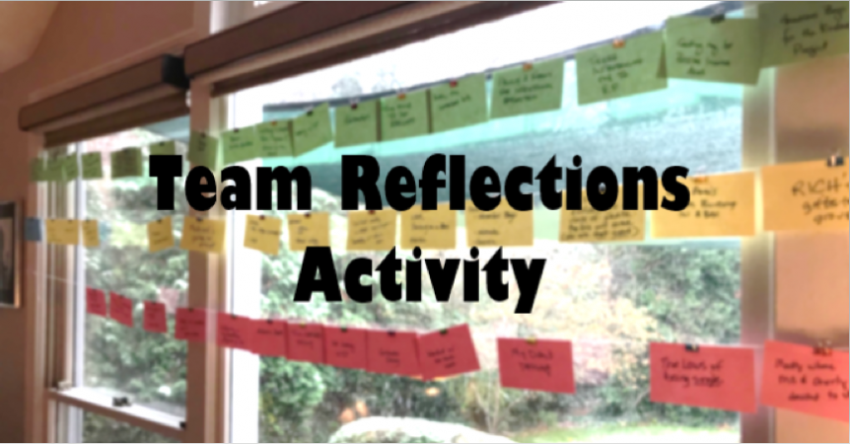
Team Problem Solving:
Monitor Outcome Data vs Goal
Was your problem-solving a success?
As a team, review data to see if the plan was successful.
Do you need to change the precision problem statement, goal, action plan, or fidelity measure?

Slide 177
What do we do with all this data?
Data Summaries reviewed monthly with team & used to make decisions
  Designate a data person
  Utilize a subgroup to review & present summary
Share data with staff at least 3-4 times/year
  Staff Meetings
  Content/grade level team meetings
  PLC meetings
Share highlights with parents & community
  School & district newsletters
  Community news

Slide 178
Something to consider in regard to
Who?
Multiple strategies can be used to identify students for Tier 2 supports.
For example,
Office discipline referrals
Screening instrument scores
Teacher nominations
Parent and support service recommendations
Formative assessments.
https://www.pbis.org/pbis/tier-2

Slide 179

Something to consider in regard to
HOW
Team-Oriented Process
Can help ensure equity across
  Student populations
  Student needs
Can help determine when a need is really Tier 1 or 2 or 3
Mark Your Calendars:
12/10/19 (New Teams)
1/22/20 (Tier 2/3 Systems)
3/25/20 (Networking)

Slide 180
CORE FEATURES
of School-Wide PBS
5 ways we can use systems to support every student to be successful in school
1
DEFINE
School-wide expectations (i.e. social competencies)
2
TEACH & PRACTICE
Prosocial behaviors
MONITOR & ACKNOWLEDGE
Prosocial behaviors
3
4
PROVIDE INSTRUCTIONAL CONSEQUENCES
for unwanted behavior
5
MAKE DECISIONS
Based on information collected
Courtesy of K. McIntosh; U of Oregon

Slide 181
3 Big Ideas
to support every
student to be successful
Courtesy of K. McIntosh; U of Oregon

Slide 182

Leaders and advocates are important and inspire...

Slide 183
...but they are human, too.

Slide 184
1. Focus on Systems
Creating safe, predictable, and positive environments comes from consistent interactions, not one-time superhero moments
Courtesy of K. McIntosh; U of Oregon

Slide 185

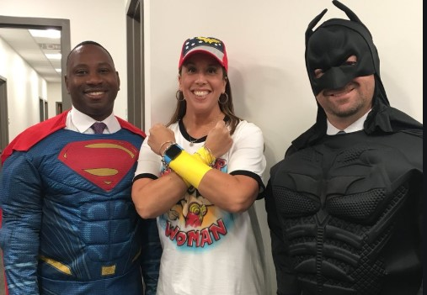
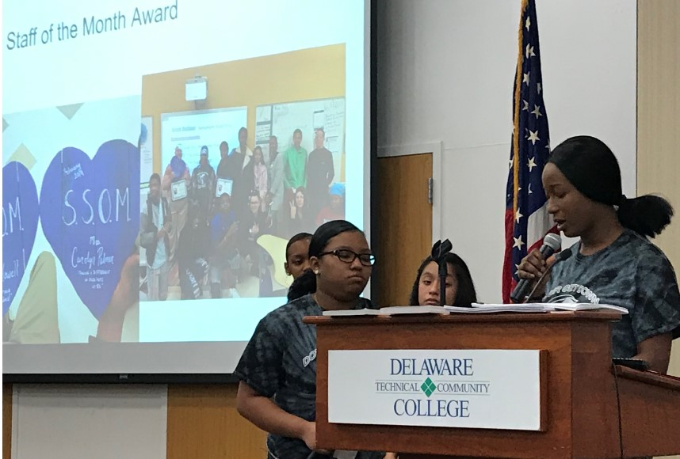
...and create supportive and colloborative teams and communities!
Courtesy of K. McIntosh; U of Oregon

Slide 186
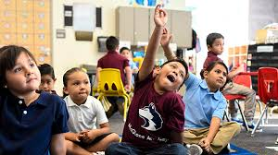
2. Our systems cannot be considered effective until they are effective for every student
Courtesy of K. McIntosh; U of Oregon

Slide 187
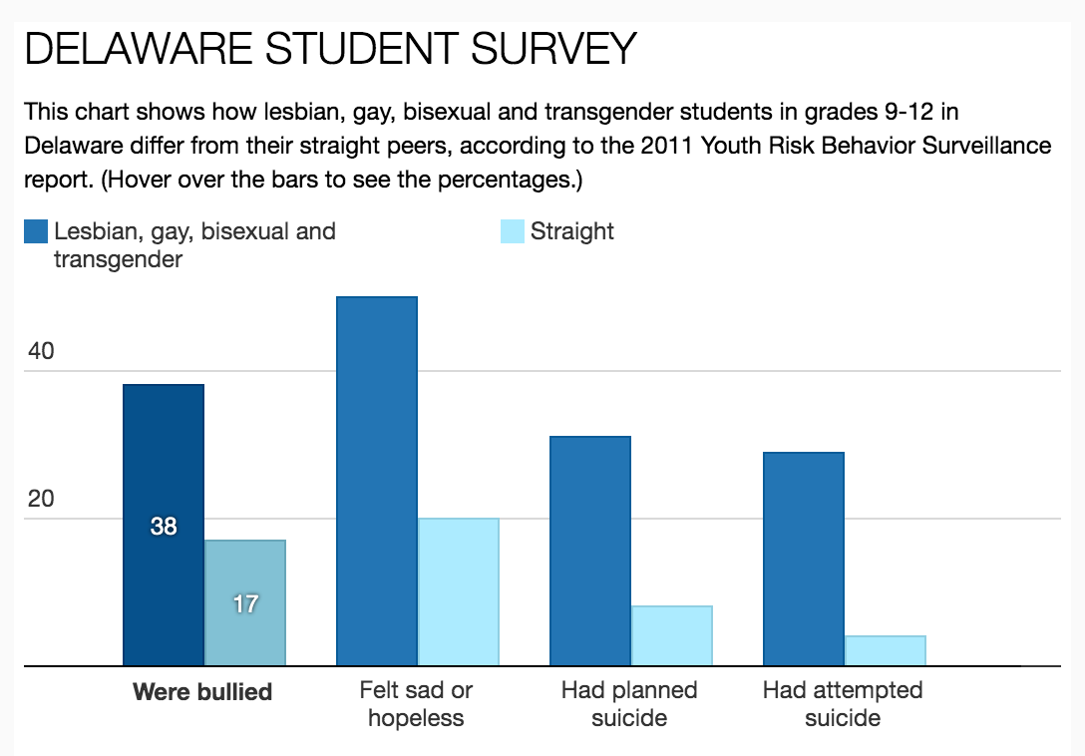
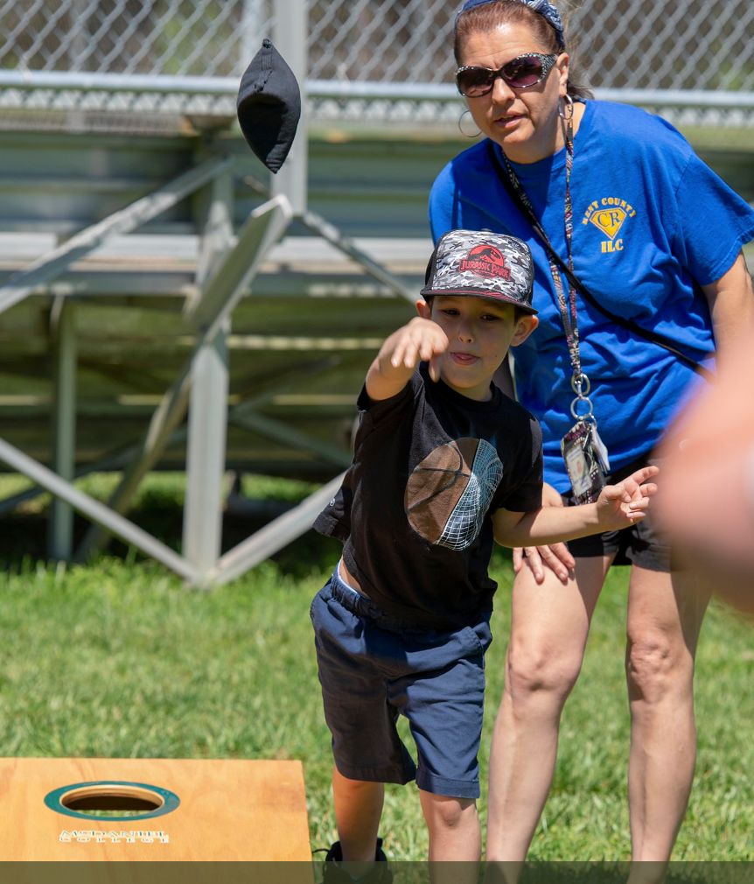
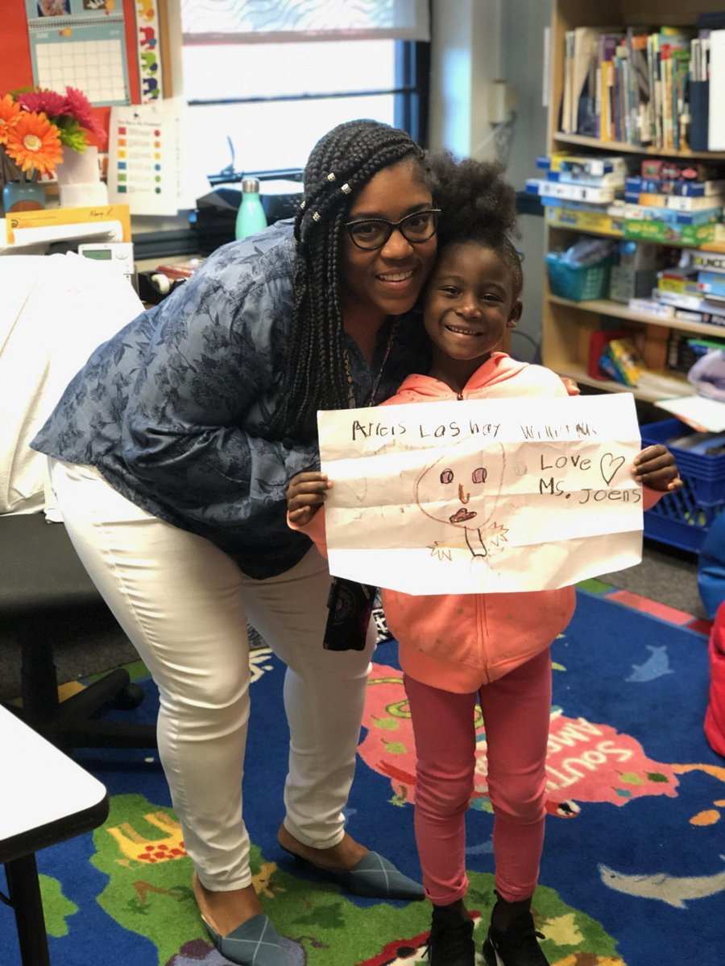
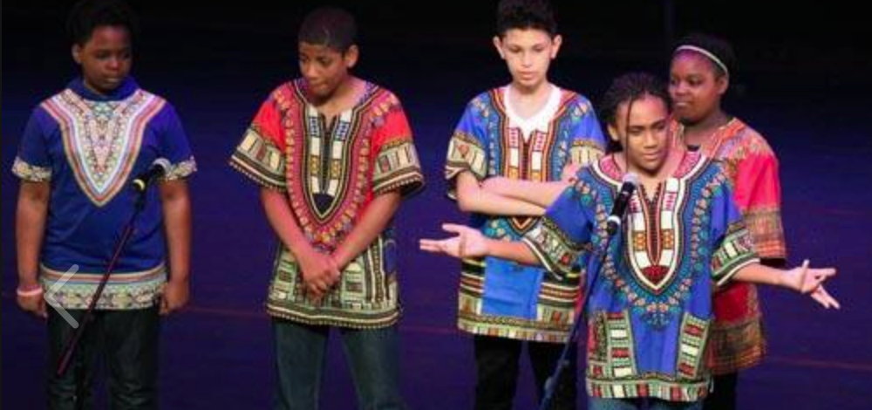

Slide 188
3. Address challenges with a framework, not isolated, standalone programs
Standalone programs are unlikely to provide the consistent support needed to improve outcomes
Courtesy of K. McIntosh; U of Oregon

Slide 189
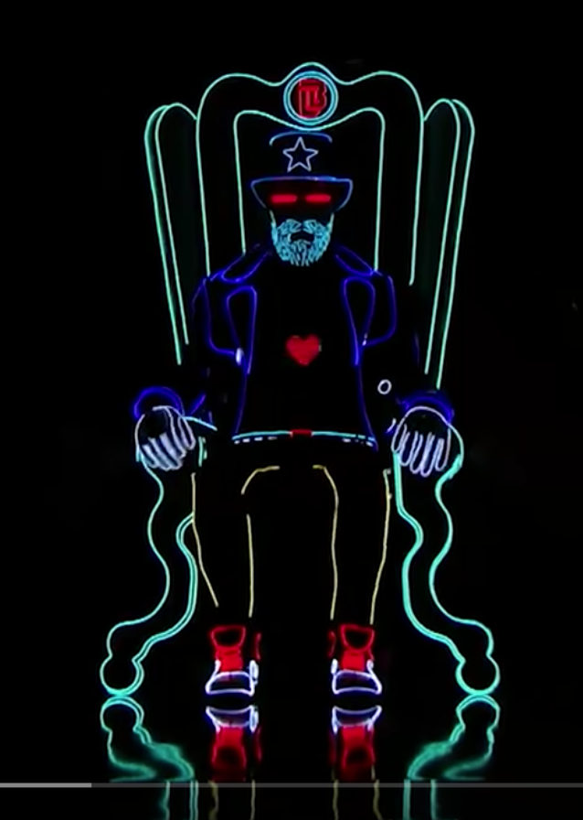
Standalone programs can be impressive...

Slide 190
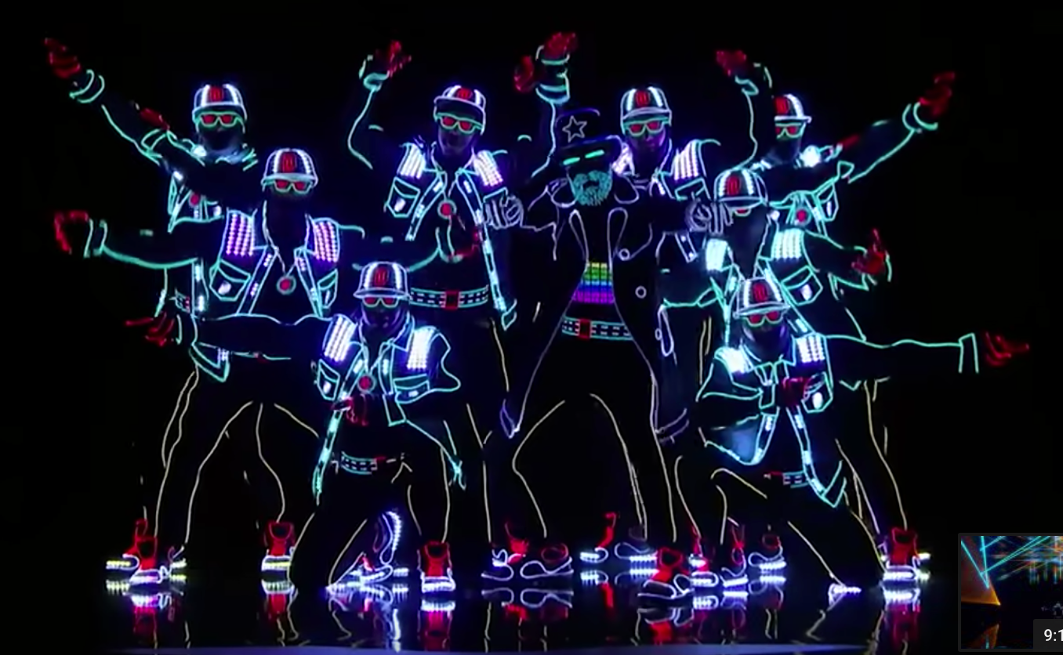
...but coordinated frameworks are amazing!

Slide 191
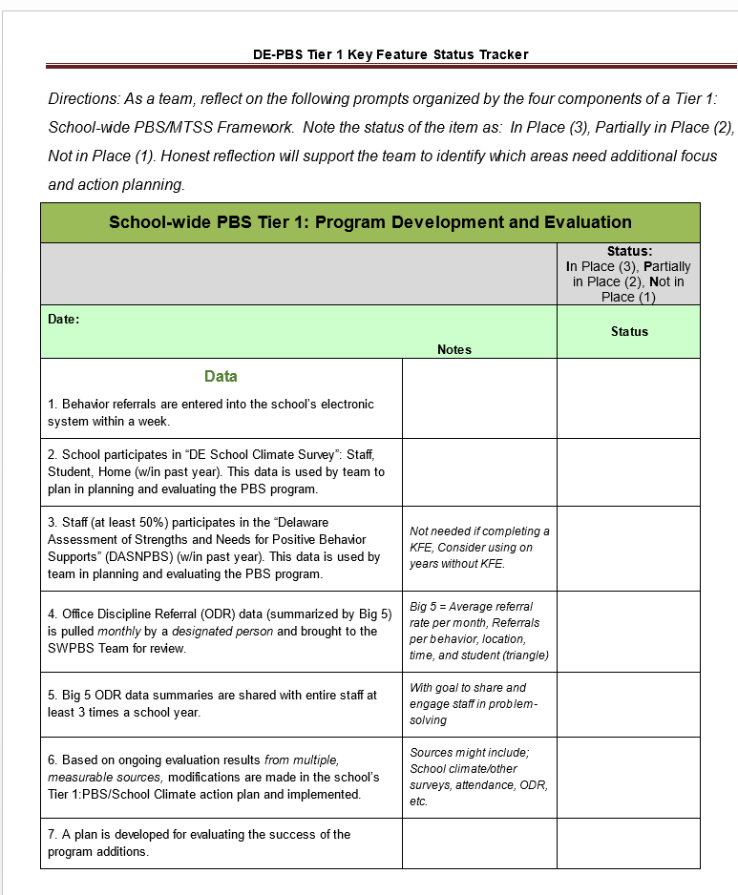
Key Feature Status Tracker –
Putting it all together!
A team resource.

Slide 192
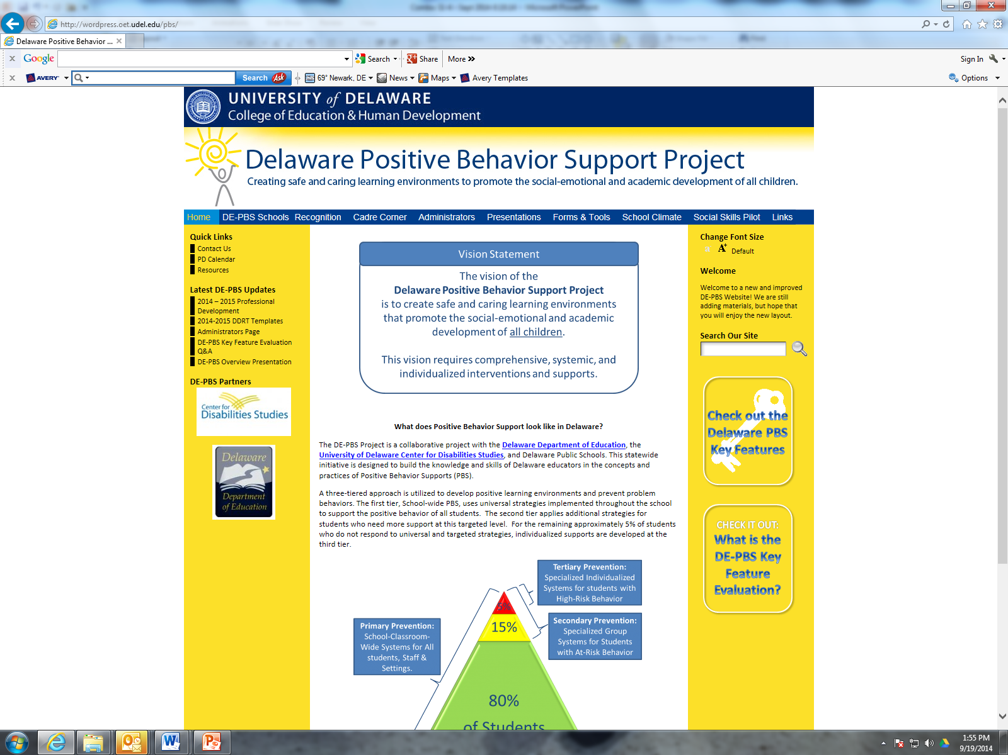
Thank you!
WWW.DELAWAREPBS.ORG
Schoology Groups:
  School Climate
  DE-PBS resources

