Slide 1
DE-PBS Cadre Meeting
December 4, 2019

Slide 2
Fall PD Recap

Slide 3
Tier 3 Focused PD
FBA & BIP Workshops
Prevent-Teach-Reinforce
Welcome New PTR Coachees!
New Facilitators | New Master Facilitators
Tawanda Morgan (CR) | Gabi Koury (Red Clay)
Reserved Spot for Appoquinimink | Christina MacKerchar (Colonial)
Susie Smathers (Colonial)

Slide 4
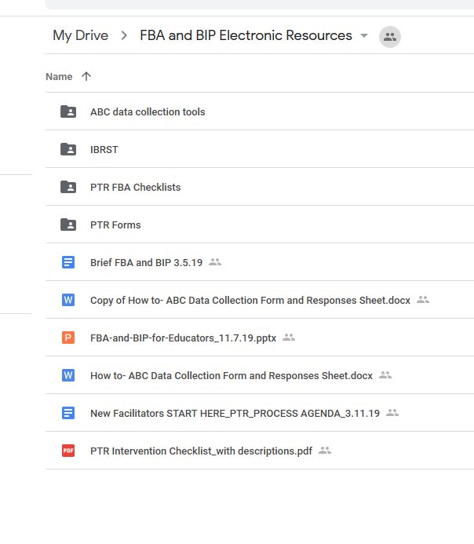
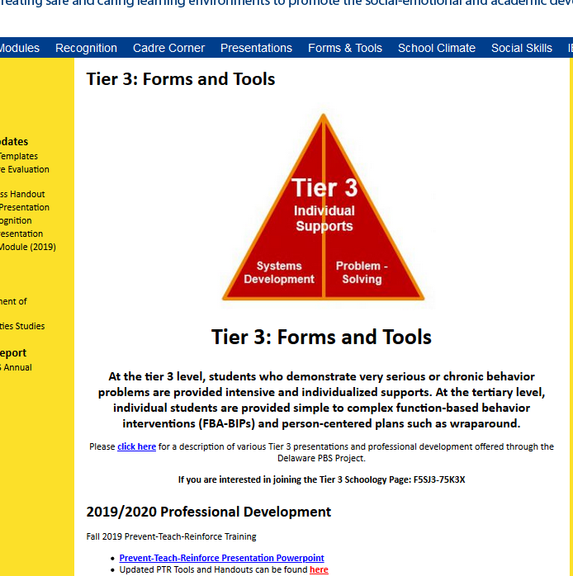
Electronic Resources!
Website!
Google Drive
NCII at AIR

Slide 5
Tier 1: School-wide PBS Framework Overview
CORE FEATURES of School-Wide PBS
1
DEFINE
School-wide expectations (i.e. social competencies)
5 ways we can use systems to support every student to be successful in school
2
TEACH & PRACTICE
Prosocial behaviors
MONITOR & ACKNOWLEDGE
Prosocial behaviors
3
4
PROVIDE INSTRUCTIONAL CONSEQUENCES
for unwanted behavior
5
MAKE DECISIONS
Based on information collected
Courtesy of K. McIntosh; U of Oregon

Slide 6
Matrix Review Activity
Are current expectations still meeting needs & context of our school?
Does our teaching matrix need refinement based on the guidelines?
Are prosocial skills embedded in our matrix?
If a Social-Emotional Learning (SEL) curriculum is used in our school, how are skills embedded in our matrix?
Predictable
Positive
Consistent
Safe

Slide 7
Example of a Classroom Teaching Matrix
The Winhall Way | Classroom Examples (Rules) | Winhall HS – Classroom 214 Routines rev4-16-19
 |  | Welcome | Group Work | Online | When you feel upset… | How to Transition
Be Responsible | Stay on task Offer to help Apologize for mistakes | Turn in homework Put materials in desk Begin work | Do your fair share Manage time carefully | Double check sources before I post Think before I forward | Stop and take a few deep breaths Recognize what you’re feeling “I feel…” | Clean up your area
Be Respectful | Raise hand Track the speaker Follow directions | Say “good morning” to teacher and classmates Talk in soft voices | Listen to your peers Take turns speaking Say “I like that idea, AND…” | Consider feelings of others before I post Upstanders speak for others | Ask for a break if you need a moment Express your feelings appropriately | Stand and Push in your Chair OR Listen for direction to next activity
Be Safe | Walk quietly Keep hands and feet to self | Put personal belongings in designated areas Take your seat | Clean up area when time is up | Turn on privacy controls | Talk to someone if you need help Talk to someone if it will make you feel better | Eye’s on me Wait to be called

Slide 8
Data

Slide 9
Discipline Data Reporting Tool (DDRT)
Cost Benefit
Average Referral Rate per Month & Year, ISS/OSS Referrals
Single year graphs
Multi-year graphs
Referrals by Student (Triangle)
National & Delaware data comparison

Slide 10
Discipline Data Reporting Tool (DDRT)
Templates available on website
Tier 1: Forms & Tools / Program Development & Evaluation
Submission 2x per year
January 10th & June 19th 2020

Slide 11
School Climate Survey 2019-2020
Logistics
Timeline
Survey window:
ONLINE Staff, Student and Home: 12/1/19 - 3/6/20
PAPER Home: January delivery
New: School selects window within this timeframe
School Climate Survey
2019-20
Student, Staff, Home Versions available online through App
Paper Options
New: HOME ONLY
Survey Contact per School
Contact is lead for communication with DE-PBS Project and Mosaic

Slide 12
Planning for Paper Surveys
District Coordinators &/or Coaches:
Plan for arrival of paper surveys to D.O. for in-district mailing
Early January; Updates to come
Building Coordinators to consider the following questions:
How will you send the paper Home surveys to families?
When will you plan to distribute?
What is the completion deadline?
How will the completed surveys be collected??
Who is responsible for collecting and mailing the surveys back to University of Delaware?

Slide 13
DE Assessment of Strengths & Needs for PBS - DASNPBS
DE Assessment of Strengths and Needs
Four sections:
Tier 1: Program Development & Evaluation
Prevention: School-wide & Classroom Systems
Correcting Problem Behaviors
Developing Self-Discipline
Staff survey
10 question survey per implementation area
Staff perspective on program strength/weakness for use in planning

Slide 14
Tier 1: Team Self-Assessment DE-PBS Key Feature Status Tracker Tool
Purpose: To support teams to assess implementation in four main program categories & plan next steps
Broken into four evaluation sections
SWPBS Tier 1, Prevention, Correcting Problem Behaviors, and Developing Self-Discipline
Tracker includes:
Key program components for each section
Teams can use these to assess their program and identify areas to modify or build upon
Action plan to develop steps towards improving or modifying program components
Used for ongoing monitoring

Slide 15
Tier 1 Fidelity - Key Feature Evaluation Process
On-site Evaluation (approx. 4 hours)
Sources of Information:
Interviews with administrator, DE-PBS team leader, teachers/staff, students
Review of documents
Schoolwide observations
Tier 1 Fidelity: Key Feature Evaluation Process
DE-PBS Key Feature Evaluation Structure
SW PBS Tier 1: Program Development & Evaluation | Prevention: Implementing SW & CR Systems
Correcting Problem Behavior | Developing Self Discipline

Slide 16
Key Feature Evaluation Review Guide
Tool to be used after receiving evaluation feedback
Review noted strengths for each evaluation section
Identify strategies for maintaining strengths and develop an action plan
Review noted recommendations for each section
Prioritize recommendations and develop an action plan
This tool supports continued implementation planning

Slide 17
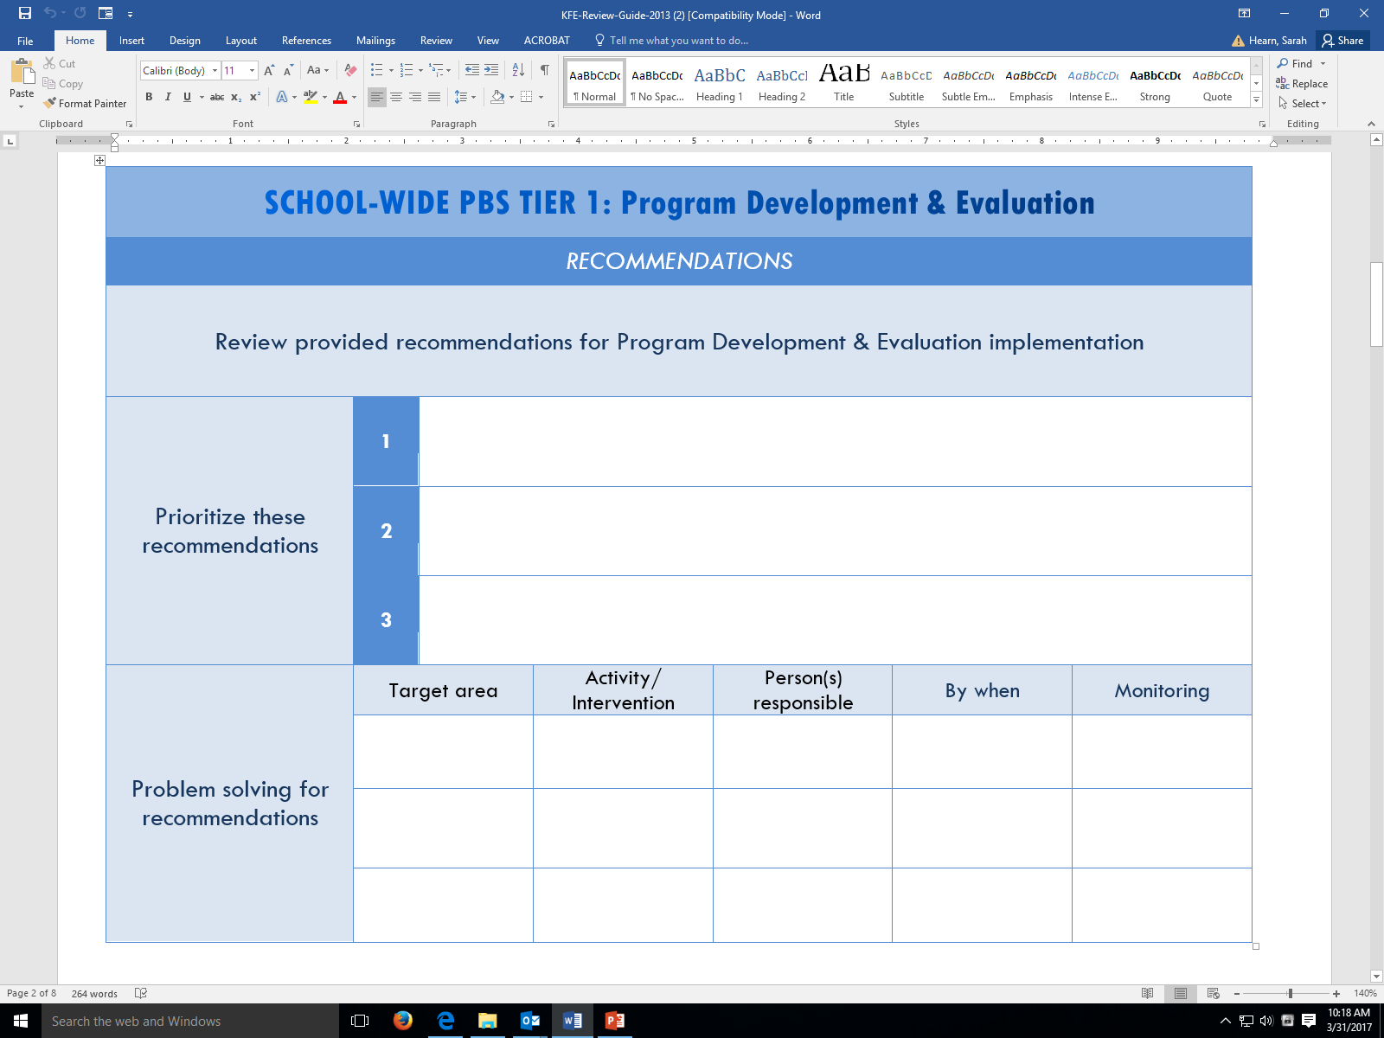
KFE Action Plan Guide

Slide 18
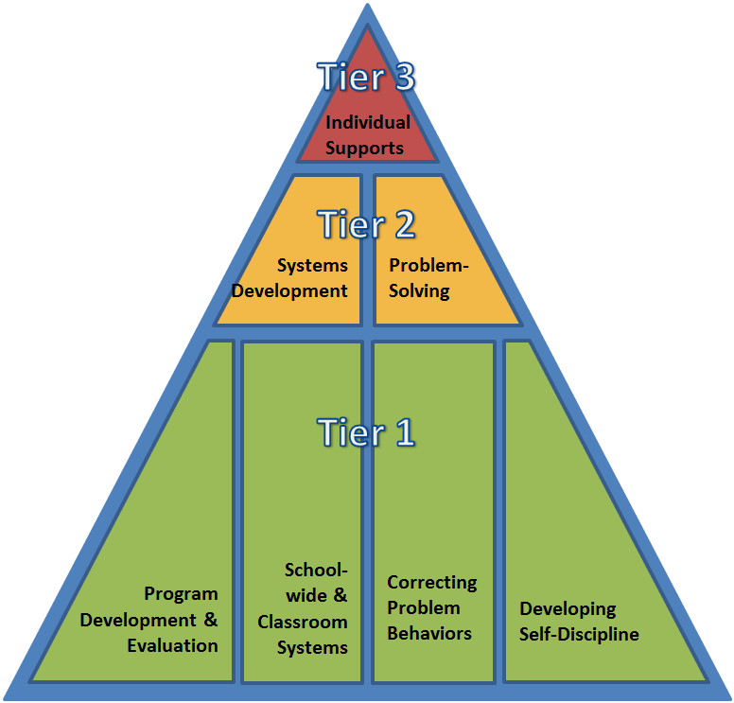
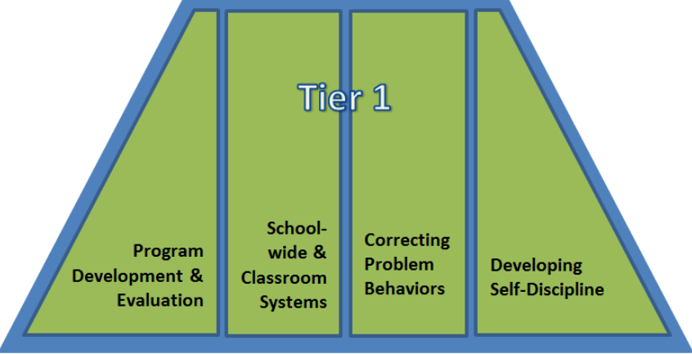
3 Tools to Measure & Reflect On the 4 Components of Tier 1
Handout: KFE, KF-ST, DASN-PBS
What They Are
Description
Structure
Format

Slide 19
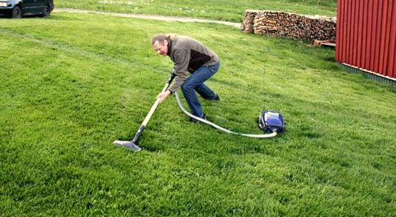
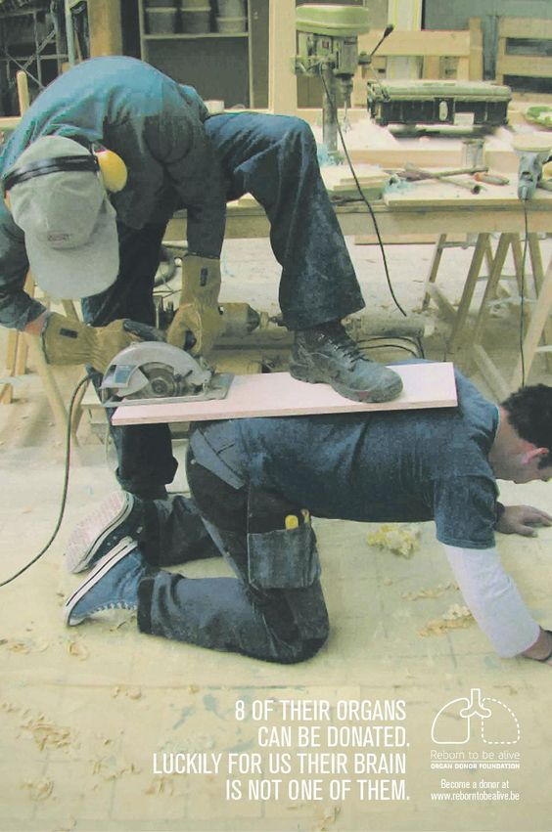
Hmm.. What is going on here?

Slide 20
How to Make a the Best Match
Considerations When Using
When to Use It
People Directly Involved in Completing It
Length of Time Needed to Complete It
School Gets Results
Helpful URLS to Check Out

Slide 21
Universal Screening Exploration and Installation

Slide 22
What Is Universal Screening?
Purpose: to identify youth who have high risk for developing behavioral or mental health problems to match/develop appropriate interventions
Typically involves several levels of assessment to avoid over- or under-identification of students

Slide 23
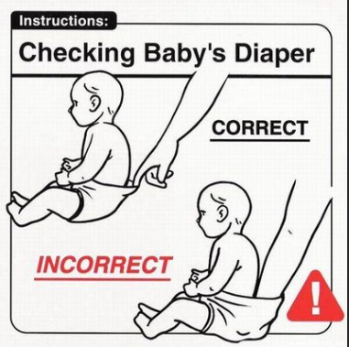
Universal Screening Data…
Simply indicates there might be an issue
Not intended to be:
Prescriptive
Evaluative

Slide 24
Universal Screening Data Informs Decisions across the Tiers
Universal Mental Health/SEL/Behavior Screening Tool | Teacher Referrals | Existing Universal Screening Data (grades, attendance, behavior referrals)
Collected/Reviewed 2 or 3 times per year | On-going review | Quarterly/On-going review
Identifies Student’s Needs
Tier 1 | Tier 2 | Tier 3
Inform universal prevention efforts (e.g. lessons to create/revise/revisit) | Match students to existing interventions based on data based decision rules (problem solving conversations) Inform the development of new group interventions (systems conversations) | Collect additional data to understand the behavior and identify appropriate supports (e.g. risk assessment, secondary screening tool, FBA, observations, interviews)

Slide 25
Multiple Gating Procedures
Gate 1: cast a wide net
Brief screening tool (e.g. self report, teacher nominations)
Gate 2: refine the “catch”
Review of existing data sources
Gate 3: (as needed) identify those most at risk
Secondary Screening Tool, Observations, interviews, other assessments

Slide 26
Our Task for the District: Exploration Phase
Establish a representative district team and purpose
Explore existing school-wide data and data plans to identify gaps in matching students to interventions and addressing the whole child.
Based on gaps, research available universal screening tools to address needs.
Develop a method to get stakeholder support (e.g. teachers, parents etc.)

Slide 27
Explore School Wide Data Sources
Early Warning Indicators (attendance, academics, discipline referrals)
School Climate Data, Delaware School Survey

Slide 28
Data Tool
Tier 1 Data Blueprint A data blueprint provides an overview and systemic approach to identify students in need and evaluate the effects of various practice and policy initiatives. It also helps teams determine the extent to which their data plan is being implemented properly.
Data | Source | Definition | Purpose | Schedule | Person Responsible
Student Grades | Student | Student grades refer to the proficiency and quality level for student work in a given area. | Universal Screening data to inform delivery of academic supports | Reviewed each quarter and in response to teacher request for assistance
Attendance | Student | The regular attendance of students to class including whether they are tardy. | Universal Screening data to inform delivery of academic/behavioral/SEL supports | Reviewed each quarter and in response to teacher request for assistance
Discipline Referrals | Student | ODRs are the number of times a student has been referred to the office for disciplinary reasons | Universal Screening data for Externalizing Behavior Problems to inform delivery of behavioral supports | Reviewed each quarter and in response to teacher request for assistance
DESSA | Teacher | Strength-based behavior rating scale to measure the social-emotional competence for children in grades K-8 | Universal Screening tool data for Socio Emotional Skills to inform delivery of SEL supports | Administered and reviewed in fall and spring
Strengths and Difficulties Questionnaire | Student | SDQ will be used to screen for psychiatric disorder and/or impairment | Secondary Screening tool data to inform delivery of Tier 2/3 mental health/behavioral supports | Administered and reviewed in fall and spring
Delaware School Climate Surveys (DSCS) | Student Teacher/Staff Hom | The DSCSs provide schools with a free, brief, useful measure of school climate assessing how students, teachers/staff, and parents perceive the school environment. | Program Development | Reviewed annually
DE-PBS Key Features Evaluation | School Team | Tier 1 fidelity tool completed via external evaluation | Implementation Fidelity | Administered and reviewed (as indicated)
Key Feature Status Tracker | School Team | Tier 1 fidelity tool completed via team self-assessment | Program development | Administered and reviewed in fall and spring
Delaware School Survey | Community | An annual survey of 5th, 8th, and 11th grade public school students in Delaware. The survey is used to estimate student attitudes and experiences with tobacco, drugs, alcohol, bullying, depression, and a variety of issues facing Delaware's youth. | Program development | Reviewed annually

Slide 29
What is Missing in Our Data Plans?
After reviewing current data plans across schools, we noticed that we do not have enough information about….
After reviewing current data plans across schools, we noticed that we do not have enough information from….

Slide 30
What concerns us about our data?
The data indicates the following concerning trends (this will inform screening tool selection):
Consider reviewing other sources of existing data, not always considered in data plans (aggregated):
Family/Teacher Requests for assistance
Nurses visits
Risk assessments
Restraint

Slide 31
Universal screening for what?
Behavior problems?
Social-emotional problems?
Mental illness? Mental health?
Social-emotional strengths?
Choose a tool based on your concerns from the data review!

Slide 32
What concerns us about our data?
The data indicates the following concerning trends (this will inform the type of screening tool):
These problems are particularly concerning for (this will inform the screener demographic):

Slide 33
Universal = All?
All kindergartners
All transfers into school
All students during transition year to middle school or high school
Choose a demographic based on your concerns from the data review!

Slide 34
Engaging Stakeholders
Explore/Share the research
Teacher report and early warning indicators are not sensitive to internalizing behaviors
Adding a universal mental health screening tool will increase identified students particularly:
Females
Students with higher grades
Older students
Students with internalizing symptoms
Elevated but less extreme impairment
Explore/Share district and community data
Develop/Communicate an installation plan
Samantha, M., Evans, S.W., & Owens, J.S. (2019) Universal screening in middle and high schools: Who falls through the cracks? School Psychology, 34(6), 591-602
Splett, J., Trainor, K., Raborn, A., Halliday-Boykins, C., Garzona, M., Dongo, M., & Weist, M. (2018) Comparison of universal mental health screening to students already receiving intervention in a multitiered system of support. Behavioral Disorders, 43, 3, 344-356.

Slide 35
Next meeting… Installation: Preparing to Implement
Outline school level readiness criteria required to adopt (the district approved) universal screener
Establish team operating procedures to review data
Develop a protocol for data based decision making (e.g. multi-gating with data based decision rules)
Create a professional development plan for teachers, testing coordinators and MTSS teams
Establish a system for gaining consent
Develop a protocol for sharing results with other teams, staff and families
Create a calendar of critical dates for training, screener administration, data review and results sharing

Slide 36
Tiered Fidelity Inventory (TFI) Orientation
Coaching for Tier 2 Success

Slide 37
Tiered Fidelity Inventory (TFI) for Tier 2
Coming Your Way
Via Email…

Slide 42
Our Tier II TFI Action Plan
Subscale | Item | Current Score | Action(s) | Person(s) Responsible | Timeline(s)
Teams | 2.1 Team Composition
 | 2.2 Team Operating Procedures
 | 2.3 Screening
 | 2.4 Request for Assistance

Slide 43
SAMPLE
ACTION PLAN

Slide 44
State TFI Trends 114 TFIs on file since 2015 58 schools 11 districts

Slide 45
Supporting Your Schools
Attend the 12/10/19 and/or 3/25/20 Trainings
-TFI is embedded within the training
Facilitate your teams use for action planning outside of training
Mid-year check
End of year
1-2 hours
Tier 2 Website
http://wh1.oet.udel.edu/pbs/forms-and-tools/tier-2-targeted-tools/

Slide 46
Supporting Your Schools
Coaches-to-Coaches
Any Additional Ideas?

Slide 47
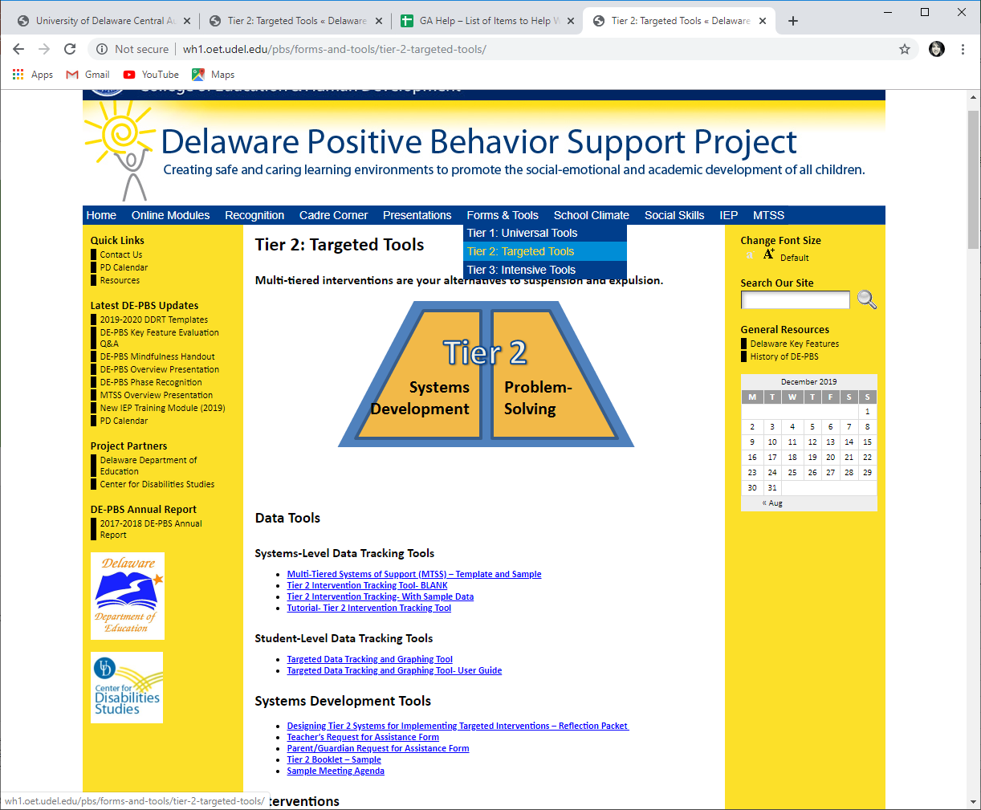
Tier 2: Targeted Team Website Presentations & Tools

Slide 48
Upcoming Professional Development

Slide 49
Tier 2: Targeted New Team Training
Tier 2 problem-solving team members worked to extend current Tier 2 programming for students by establishing a sound system.
Provided an in-depth overview of the recommended features for effective Tier 2 behavior teams, programming, and interventions.
Focused on how to identify and secure appropriate Tier 2 interventions that match demonstrated student needs.
12/10/2019 (9:00am-3:30pm)

Slide 50
Tier 1: SWPBS New Team Training Part 2
For new School-wide PBS Teams, this workshop focuses on systems to support correction of problem behaviors and developing self-discipline as part of the Tier 1 PBS framework.
Participants will:
explore components of their behavior tracking system
discuss how disciplinary encounters can routinely be used as learning opportunities
explore social-emotional learning curriculum and student involvement
1/10/20 (9:00am-3:30pm)

Slide 51
Tier 2 & 3 School System
This workshop is for problem solving teams working to develop systems that support students in need of advanced interventions.
Tier 2 linkages will be explored and an overview of Tier 3 system features will be provided to include teaming, resources, support plans and evaluation.
Teams will leave with tools to evaluate their current practices to support in action planning.
1/22/2020 (9:00am-12:00pm)

Slide 52
Tier 1: Secondary Forum
Collaborative meeting of secondary schools implementing DE-PBS at varying levels
Members of secondary school PBS teams will meet and share resources and ideas to support implementation in middle and high school settings
2/12/2020 (9am-3:30pm)

Slide 53
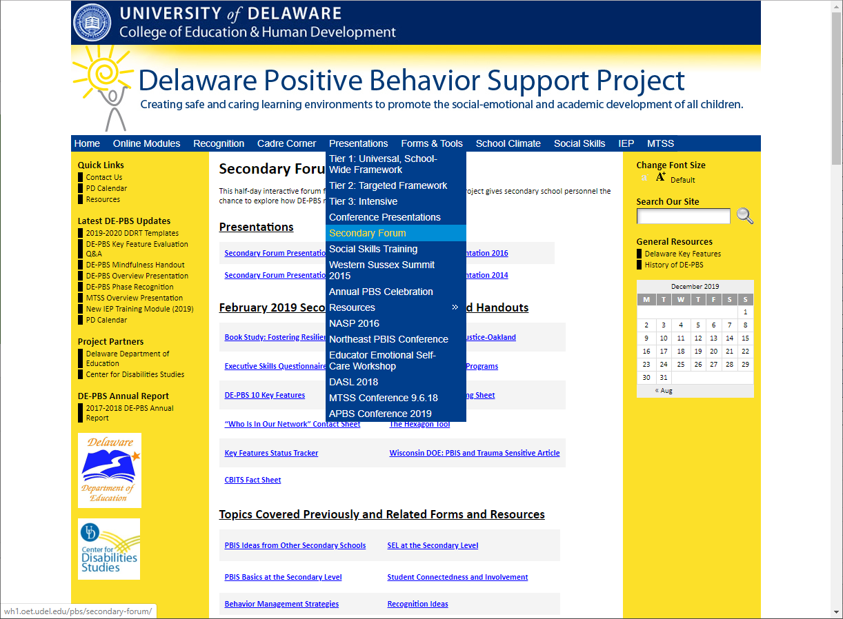
Sample Archived Topics: - Recognition Ideas - 10 DE-PBS Key Features - Hexagon Tool - Student RAP Club - School Connectedness - Anger Management Strategies - Reintegration Programming

Slide 54
Tier 2: Networking
This session is open to schools that previously participated in the DE-PBS Project Tier 2: Targeted Team Training.
Topics and activities include reviewing Tier 2 systems & problem-solving concepts, examining evaluation methods and networking with other implementing teams.
3/25/2020 (9:00am-3:30pm)

Slide 55
Taking Your Recommendations TOPICS SCHOOLS/PEOPLE
Let’s Share the LOVE in February!
Nominations for the FEB 12th PBS SECONDARY FORUM
Let’s Make it Happen in March!
Nominations for the March 25th Tier 2: Networking
Project support is always available for presentation preparation.

Slide 56
Alignment & Integration
Updates & Activity

Slide 57
MTSS & Statewide Integration Efforts
Multi-Tiered System of Supports (MTSS)
Academic
Student’s response to academic instruction and tiered supports.
MTSS is a framework that aligns academic and behavioral supports to serve
the whole child
Behavior
Student’s response to positive behavior tiered supports.

Slide 58
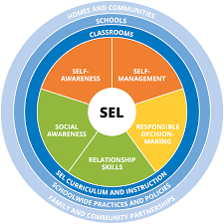
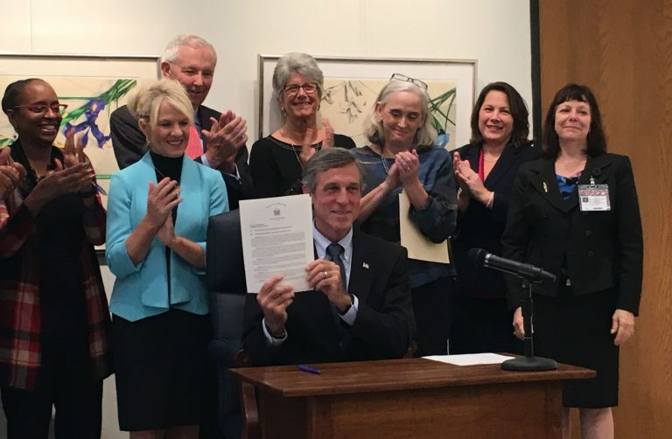
Other State Activities
SEL Collaborative
Trauma-Informed Practices

Slide 59
Why Invest in Alignment?
Unaligned efforts are ineffective and inefficient
Doing many things, but none of them well
Assumption that New is better… More is better
Political value (“we have _______ in our school”)
Assumption that if we train individuals in many things THEY will do the alignment and integration on their own and placing burden on them
Adapted from Steve Goodman, MIBLSI

Slide 60
Alignment and Integration
Alignment
Correct positioning for effective/efficient performance
Core features of practices and support of these practices are aligned across the system
Integration
Different parts of a system are made a functional and structural whole
Resources are leveraged to build upon each other
Integration:
Cross Content
Cross Department
Cross Agencies

Slide 61
Effective Alignment begins with Outcomes

Slide 62
Effective Alignment of Initiatives
Every initiative within a district should have a fidelity and outcome measure and the core features summarized. A single professional development plan should guide the work that the Organization Unit oversees.
Rob Horner

Slide 63
Social Competence & Academic Achievement
OUTCOMES
Information & process for effective decision-making
SYSTEMS
DATA
Supporting staff
PRACTICES
Supporting students

Slide 64
Components for meaningful and durable outcomes
Meaningful student outcomes from effective practices implemented with fidelity in efficient and sustainable educational organizations
Systems
Practices
Data
Decreased likelihood of implementation fidelity, efficiency, and sustainability
Systems
Practices
Data
Decreased likelihood of selecting and utilizing most effective interventions
Courtesy of S. Goodman
Systems
Practices
Data
Decreased likelihood of intervention adjustments and continuous improvement
Systems
Practices
Data

Slide 65
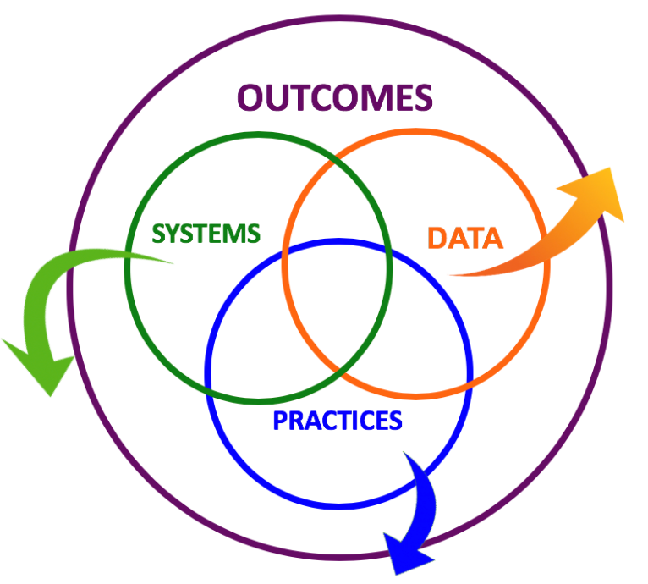
Initiative Framework Activity
Top 3 from initiatives from last cadre:
Restorative Practices
Trauma Informed Practices
Leader in Me
Others?
Select one to focus on

Slide 66
MTSS/PBS
Outcomes
Practices
Systems
Data
School climate, discipline data,
academic performance, attendance, nurse visits,
3-5 defined school-wide expectations, procedures for teaching and acknowledging expectations, procedures for discouraging problem behaviors, procedures for using data to target needed practices.
Team-based leadership, ongoing coaching support, data-based decision-making protocols, procedures and materials for implementing assessment and practices
Climate surveys, office disciplinary referrals, academic and behavioral screening information, attendance data, frequency of nurse/well-ness center contacts, fidelity checklists and observations

Slide 67
Initiative Framework Activity
On your own, take notes on the framework handout
Meet with your group to share responses
Post on chart paper

Slide 68
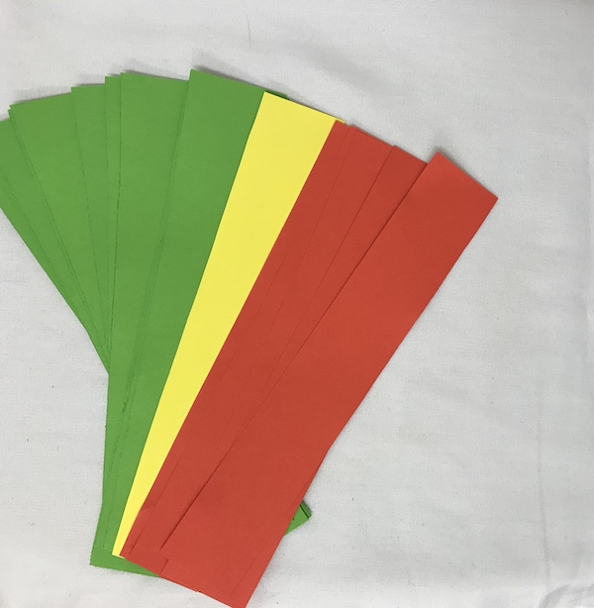
Next Steps
Look at alignment with PBS/MTSS in our district
Is your goal alignment or integration?

Slide 69
Recognition Check in

Slide 70
19-20 SY Phase Recognition Reminders & Discussion
Distribution typically in February
Application entails end of the year program reflection
Recognition reflects CURRENT year effort; schools maintaining or advancing levels should apply yearly
Process should be a team effort
http://wh1.oet.udel.edu/pbs/recognition/applications/

Slide 71
General Updates
12/12/19 PBIS Secondary Leadership Academy Community of Practice (12-1:30pm)
Webinar Zoom Meeting with Dover High Presentation
Join from PC, Mac, Linux, iOS or Android: https://unh.zoom.us/j/564311672
Or call in by dialing: +1 646 876 9923 (US Toll), Meeting ID: 564 311 672

Slide 72
Mark Your Calendars!
2019-20
DE-PBS Cadre Meeting Dates:
Wednesday, February 5, 2020
Wednesday, April 8, 2020

Slide 73
Thank you!

