Slide 1

FBA and BIP for Educators
Friday, October 11, 2019 –
8:45 a.m. to 3:30 p.m.
Niki Kendall, Delaware PBS Project

Slide 2
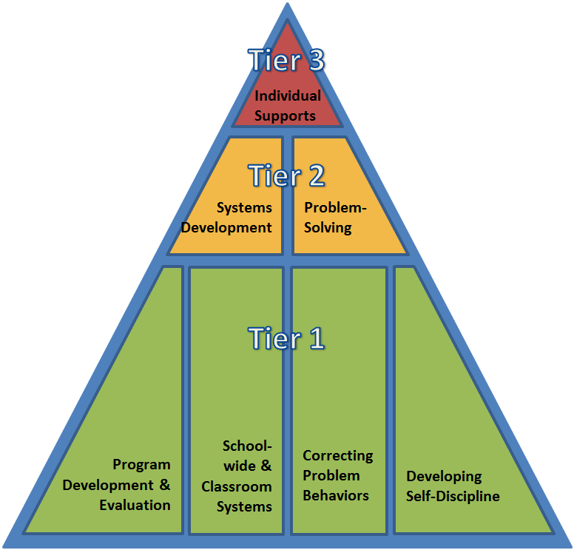


DE-PBS Project is on going collaboration between the Delaware Department of Education and the UD Center for Disabilities Studies

Slide 3
Objectives
Understand the Science of Behavior (ABCs)
Apply the science of behavior across all tiers of support
Identify the steps for conducting an FBA
Understand the critical components of function based BIPs
Identify who needs an FBA/BIP and the role of the problem solving team in the process

Slide 4
Acknowledgements
Dr. Rose Iovannone and FLPBiS Northeast PBIS National Center on Intensive Interventions | Midwest PBIS Network Portland State University: www.basicfba.com
Notes:
Add citations from behavior bootcamp

Slide 5
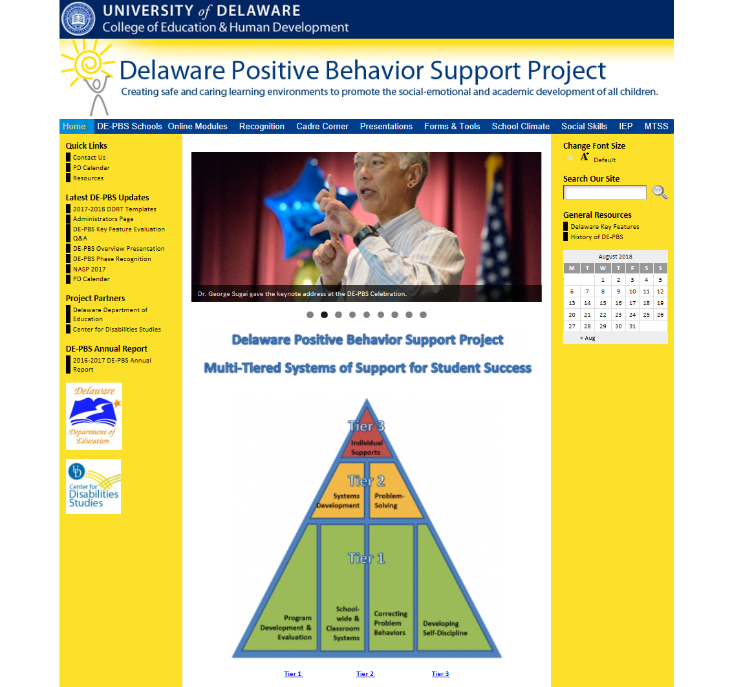
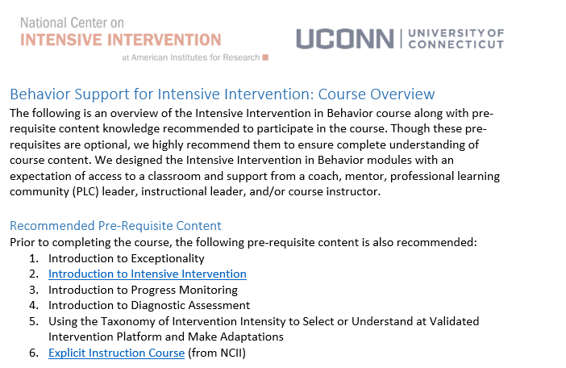
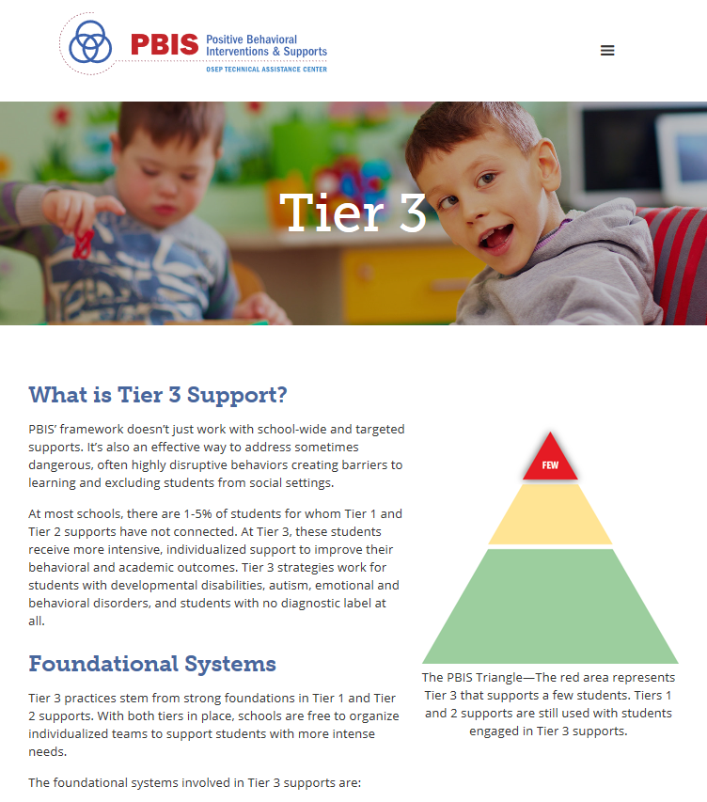
Resources
NCII at AIR
Delawarepbs.org
Pbis.org

Slide 6
Getting the Most Out of Today…
Focus on moving from knowledge to practice
Set implementation goals and either self-monitor or ask for peer/coach feedback on your use of key skills
When a practice isn’t working, use your understanding of theory to help you modify or intensify a practice to improve outcomes

Slide 7
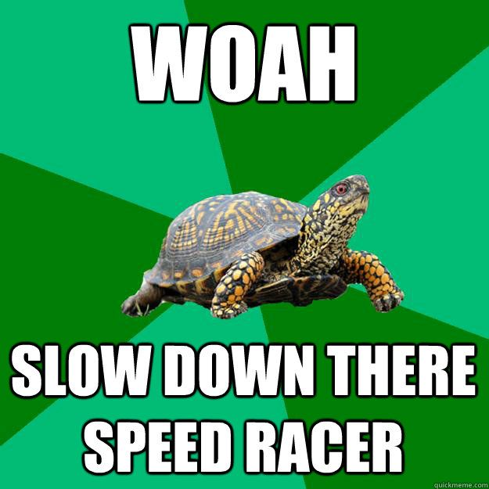
Throughout today consider…
What questions are still circling?
What do you have squared away?
What was one good point made?

Slide 8
Who is in the Room?
General education teacher
Special education teacher
School psychologist
School counselor
Student services (OT, PT, Speech, etc.)
Administrator
Paraprofessional
Other?
Notes:
Poll created

Slide 9
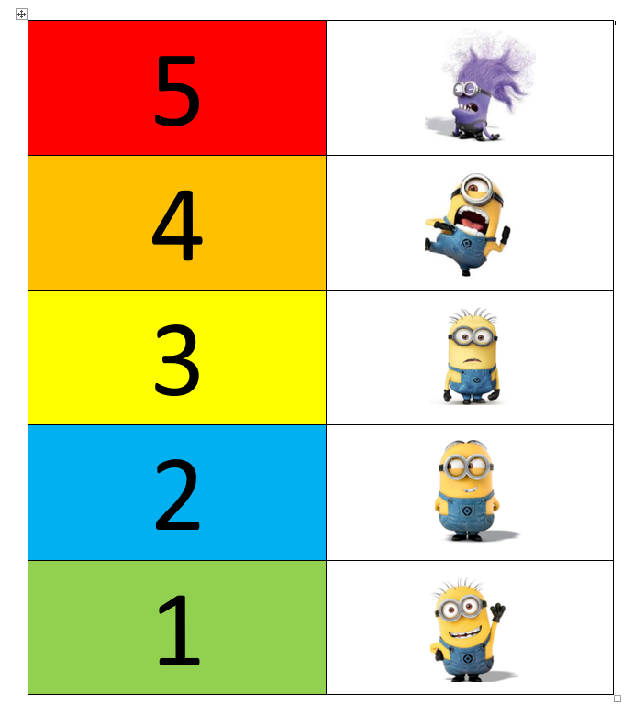
Please answer the following:
When thinking about individualizing behavioral interventions I feel:
Notes:
Poll created

Slide 10
Understanding Behavioral Theory:
Why Do We/You Care?

Slide 11
United States, we have a problem!
12% of beginning public school teachers leave within their first 2 years
50% leave within their first 5 years
(Boyd, Grossman, Ing, Lankford, Loeb, & Wyckoff, 2011; DeAngelis, & Presley, 2011; Feng, 2006; Henke, Zahn, & Carroll, 2001; Ingersoll, 2001; Ingersol, Merril, May, 2012; Johnson & Birkeland, 2003; Ingersoll & Smith, 2003; Kaiser & National Center for Educational Statistics, 2011; Kukla-Acevedo, 2009; Luekens, Lyter, Fox, & Changler, 2004; Smith & Ingersoll, 2004; Torres, 2012; Zabel & Zabel, 2002)

Slide 12
Why do teachers leave?
Most consistently listed factors:
  Lack of pedagogical training
  School environment
  Poor student behavior and motivation
  Inadequate pre-service training on classroom management
  Lack of support and training for handling student behaviors
(Boyd, Grossman, Ing, Lankford, Loeb, & Wyckoff, 2011; Chesley & Jordan, 2012; Feng, 2006; Halford, 1998; Henke, Zahn, & Carroll, 2001; Ingersoll, 2001; Ingersol, Merril, May, 2012; Johnson & Birkeland, 2003; Kukla-Acevedo, 2009; Lane, Wehby, & Barton-Arwood, 2005; Luekens, Lyter, Fox, & Changler, 2004; Stough, 2006; Torres, 2012; Zabel & Zabel, 2002)
Notes:
Teachers often cite – low engagement, student discipline and lack of motivation
Teachers stay when they feel included in decision making and problem solving process.

Slide 13

So teaching is hard….
…why do you do it?

Slide 14

Stop and Jot
Effective teacher behaviors
What 3 words would you use to describe the classroom environment of the most effective teacher you’ve had?
Notes:
https://youtu.be/jTs88SdbBYc

Slide 15

Our job in this PD is to boil down some of these big concepts into concrete skills, which when implemented translate back into great teaching

Slide 16
Research-Based Classroom Management
Maximize structure in your classroom.
Post, teach, review, monitor, and reinforce a small number of positively stated expectations.
Actively engage students in observable ways.
Establish a continuum of strategies to acknowledge appropriate behavior.
Establish a continuum of strategies to respond to inappropriate behavior.
(Simonsen, Fairbanks, Briesch, Myers, & Sugai, 2008)

Slide 17
Get tough slide doesn’t work
“Get Tough” Doesn’t Work
So why do we keep doing it?
Student Acts Out
Teacher says no and gives initial consequence
Student becomes disrespectful
Teacher sends student to office
Student escapes class
What did the student learn?
What did the teacher learn?

Slide 18

Science of behavior has taught us that students….
The power of PBIS is not in the rewards;
it is in the teaching!
…are NOT born with “bad behaviors”
…do NOT learn when presented contingent aversive consequences
...DO LEARN better ways of behaving by being taught directly & receiving positive feedback

Slide 19
Why does this matter?
A basic understanding of the science of behavior change gives us tools to observe, measure, teach, and correct behaviors effectively and efficiently.
Moves us away from perceptions, opinions, and assumptions about motivations or intentions to a conversation that recognizes that
  Behavior is communication, and
  Behavior occurs in the context of an antecedent and consequence.

Slide 20
What questions are still circling?
What do you have squared away?
What was one good point made?

Slide 21
Understanding the Science of Behavior

Slide 22
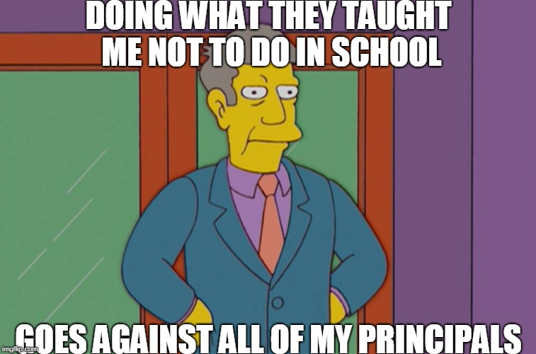
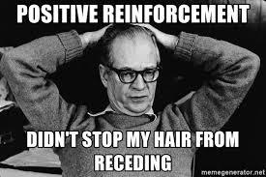
Let’s explore the science behind behavior to help us better understand why students and teachers behave the way they do.

Slide 23
Just using the term “function” may be less effective than saying…
“how behavior meets a student’s needs” or “how behavior helps the student communicate” or “why they’d want to do it” or “purpose” or “what’s in it for them?” others?

Slide 24
Examples of functions in schools…
To obtain:
I shout out because it takes the attention off the task and onto me
I disagree with the teacher to get access to an activity or prevent a transition
I wander because I am bored and I can stimulate myself somewhere else
Escape:
I will take a walk around the room because someone will tell me to get to work and help me
I ask to go to the nurse because I can get a break from class
Notes:
Others??

Slide 25
Building Blocks of Behavior
Setting Event
Antecedent
Behavior
Consequence
Antecedent condition or event that temporarily alters the value of the consequence.
A “stimulus that precedes a behavior.”
An ”observable and measurable act of an individual (also called a response).”
A “stimulus change that occurs contingent on a behavior.”
(Alberto & Troutman, 2006)

Slide 26
Say it together…
OBSERVABLE AND MEASURABLE
  Antecedents are typically observable and measurable stimuli that precede a behavior
  Behaviors are typically observable and measurable acts
  Consequences are typically observable and measurable stimuli that contingently follow a behavior
So, the key questions to ask are:
  Can you see (or sense) it?
  Can you measure it?

Slide 27
Antecedents: Questions to Answer
Where, when and whom is the problem behavior more likely?
Notes:
The key is to pin point what is setting the behavior in motion!

Slide 28
Common Antecedents:
Routines/activities (e.g. transitions, recess, independent work, bathroom, discussions etc.)
Circumstances (e.g. reprimanded or corrected, task is too difficult, end of preferred activity, specific adults or peers)

Slide 29
What’s the “antecedent”?
Antecedent
The teacher said, “line up,” and the students pushed in their chairs and made a line at the door.
The teacher said, “put your books away,” and the students put their books back in their backpacks.
When he was given a difficult math assignment, he put is head down and refused to begin the work.
The principal entered the room to observe math instruction, and the teacher provided more opportunities to respond.
She felt mad, so she hit.

Slide 30
Consequences: Questions to Answer
What do others (adults, peers) most often do or say immediately after the behavior occurs (e.g. what interventions have been attempted)?

Slide 31
Reinforcement and Punishment
Give (+)
Take (-)
Action
Effect
Positive
Negative
Inc. ( )*
Reinforcement
Reinforcement
Positive
Negative
Dec. ( )*
Punishment
Punishment
* Future probability of behavior
Notes:
Negative reinforcement example= nagging son to clean room and will stop nagging contingent on her son cleaning the room (takes nagging away – but increases the behavior)
Positive punishment example= praising a student who doesn’t want to be praised – student stops working

Slide 32
What type of consequence?
Provide specific praise to a student who enjoys attention following a behavior
Assign a quiz at the end of every week; for students who turn in their homework, the quiz is cancelled
Provide specific and immediate feedback following unwanted behavior
Ask a student to stay in from recess to finish a homework assignment

Slide 33
“Adam”
When Adam is told that he must wait for a favorite activity, he screams, hits, kicks, head-butts, and destroys property. After this behavior, staff immediately allow him to do his favorite activity. In the future, Adam continues to scream, hit, etc., whenever he is told to wait.

Slide 34
Breakdown of Example: Adam
Antecedent:
Behavior(s):
Consequence:
  Action(+ or -):
  Effect(⬆ or ⬇):
  So it is:
When Adam is told to wait
he screams, kicks, head-butts, and destroys property
Adam’s staff allow him to access his favorite activity
Adam’s staff…give him access to the activity
In the future, Adam continues to “tantrum””
Positive reinforcement

Slide 35
Bus Duty
When the teacher is given an extra bus duty on a rainy day, he complains loudly to the principal. The principal covers the bus duty. In the future the teacher is more likely to complain loudly when asked to do an extra duty.

Slide 36
Breakdown of Example: Bus Duty
Antecedent:
Behavior(s):
Consequence:
  Action(+ or -):
  Effect(⬆ or ⬇):
  So it is:
The teacher is given an extra bus duty
He complains loudly to the principal
The principal takes the bus duty away
The principal…takes the duty away
In the future, the teacher continues to complain
Negative reinforcement

Slide 37
“Adam”
When Adam is told that he must wait for a favorite activity, he screams, hits, kicks, head-butts, and destroys property. After this behavior, staff immediately allow him to do his favorite activity. In the future, Adam continues to scream, hit, etc., whenever he is told to wait.
Get/Obtain Activity
Assuming this is a consistent pattern…
What is the function of Adam’s behavior?

Slide 38
Bus Duty
When the teacher is presented with bus duty, he complains loudly. In the past, the principal gets frustrated and takes the duty away. In the future, the teacher continues to complain whenever he is presented with a duty.
Escape/Avoid Activity
Assuming this is a consistent pattern…
What is the function of the teacher’s behavior?

Slide 39
Setting Events: Questions to Answer
Are there specific circumstances unrelated to the school setting (or happen outside of the immediate routine) that occur some days but not on other days that may make problem behavior more likely or worse?

Slide 40
Focus on Setting Events
Setting Event
Antecedent
Behavior
Consequence
Antecedent condition or event that temporarily alters the value of the consequence.
Can occur at the same time and/or same place
Setting events may be environmental, physiological, or social
Setting events help explain variations in behavior
You may be sick or tired in school when given a task, which may decrease the value of typical reinforcers for task completion (and increase value of nap)
Can occur earlier and/or in a different location
If you fight with a family member before school, it may decrease the value of adult attention for appropriate social skills (and increase value of escape)

Slide 41
Common Setting Events:
Lack of sleep or food
Illness
Having a fight on the way to school
Bad grade on a test / reprimands
Forgetting to take medication
Substitute teacher / changes in routine
Lack of rapport with staff
History of bad grades in a subject area
Non-examples:
Diagnosis of autism or ADHD
“Bad” home life
* Note: Setting Events can be difficult to identify, are often unknown.
Notes:
41
Highlight lack of rapport → student does not have positive relationship with staff giving the task demand, it makes the task demand MORE aversive and the extent to which negative behavior results in escape will make it more likely to occur.
41

Slide 42
What questions are still circling?
What do you have squared away?
What was one good point made?

Slide 43
Recognize the role of function based thinking across all tiers of support

Slide 44
Understanding and Influencing Behavior
…and leading others to do the same
https://www.youtube.com/watch?v=SByymar3bds
Notes:
We can use the same logic to encourage and teach NEW and more positive behaviors to help students get their needs met. This is a Tier 1 application of the “Science of behavior”

Slide 45
MULTI-TIERED SYSTEM
OF SUPPORTS FOR BEHAVIOR
Tertiary Prevention:
Specialized
Individualized
Systems for Students with High-Risk Behavior
~5%
Secondary Prevention:
Specialized Group
Systems for Students with At-Risk Behavior
~15%
Primary Prevention:
School-/Classroom-
Wide Systems for
All Students,
Staff, & Settings
PBiS is not a program but a problem solving model based on a foundation of behavioral science
Students
Staff
Parents
Families
~80% of Students
Notes:
Within a multi-tiered system we embed best practices at Tier 1 and intensify as student need dictates.
Understanding function is important for our teachers and support staff, not just those of us that facilitate the formal FBA-BIP process.

Slide 46
Across all Tiers of Support Behavior Science Helps us…
Take a best guess about function & choose strategies that are function based to prevent problem behavior and increase positive behaviors!

Slide 47
When we find ourselves frequently searching for interventions – that is a key indication we should focus on prevention.
Classroom Management Strategies
Function-based Problem Solving
Boyd, Grossman, Ing, Lankford, Loeb, & Wyckoff, 2011

Slide 48
5 Positive Classroom Behavioral Supports for ALL
Which of these will increase the likelihood of positive behavior?
Maximize structure in your classroom.
Post, teach, review, monitor, and reinforce a small number of positively stated expectations.
Actively engage students in observable ways.
Establish a continuum of strategies to acknowledge appropriate behavior.
Establish a continuum of strategies to respond to inappropriate behavior.
Which of these will decrease the likelihood of problem behavior?
ALL
Notes:
When choosing supports for classrooms- refer to positive classroom behavior supports. Can we layer, individualize or intensify these supports as move move up the continuum?

Slide 49
Problem solve using the science of behavior at Tier 1…
What is the problem?
Diagnose the problem, why is it happening? Think about antecedents and consequences
In what ways can you:
Increase the frequency, duration, or precision of 5 Critical Features of Classroom Management to address the problem?
Review the Tier 1 classroom progress monitoring data and answer the questions using behavior science logic:
  4th grade class
  29 students
  15 discipline referrals (in the classroom)
  Referrals received in October and November
  Referrals for disruptive and disrespectful behavior
  9/15 referrals occurred between 1:00-3:00 pm
In other words, go back to the basics (practices and structures to increase positive and decrease undesirable behavior!)
Notes:
At your table, answer the questions by thinking functional about behavior. Remember, function helps us to answer “why” the behaviors are occurring.
Should we do a classroom problem solving sheet of some kind?

Slide 50
Functional thinking across all tiers
Small group interventions
Function-based Problem Solving

Slide 51
Remember…
As the needs of the student increase:
  The process involves more adults for problem solving
  The data collection increases and becomes more specific
  Individualization of the interventions increase

Slide 52
Tier II Interventions Based on the Science of Behavior
Tier I supports are explicitly linked to Tier II supports
Tier II behavior interventions should be ongoing, evidence-based (supported by research), and address attention seeking and escape maintained behaviors (i.e., function).
Interventions provide:
  Additional instruction/time for student skill development
  Additional structure/predictability (focus on prevention)
  Increased opportunity for feedback (e.g., daily progress report)
  Include additional progress monitoring
  May involve community: parents, teachers, school staff
Notes:
Students receiving Tier 2 have access to Tier 1

Slide 53
Tier II Interventions Based on the Science of Behavior
Example (CICO):
Research study found that for students with attention-maintained behavior, participating in the Check-In/Check-Out intervention was associated with improvements in ratings of problem behavior, prosocial behavior, and office discipline referrals.
*For students with escape-maintained behavior, no effects or improvements were found.
Notes:
Shows the importance of matching Tier 2 interventions to function.

Slide 54
What questions are still circling?
What do you have squared away?
What was one good point made?

Slide 55
Identify the steps for conducting an FBA

Slide 56
The FBA/BIP process supports students by working to change adult practices
FBA/BIP

Slide 57
Tier 3 Continuum of Supports
Wrap-Around
  Long-standing, extremely intense behaviors, mental health concerns, complex life events
  Multiple services, agencies or institutions
    Person-Centered-Planning
Comprehensive FBA – (Prevent Teach Reinforce)
  More intensive FBA/BIP process
  Multiple meetings (2-4) or one long meeting (>2 hours)
  Additional data collection (e.g. behavioral observations)
  Best for chronic, durable, intense behaviors
Efficient FBA
  FBA/BIP developed in one meeting (~60 minutes)
  Indirect data collection (e.g. interviews, record review)
  Best for high frequency/low intensity behaviors
    Noncompliance, minor disruptions
Wraparound based (Person-centered plans, functional analysis, multiple expertise)
Comprehensive FBA and BIP
Efficient FBA and BIP
Notes:
Narrative: The FBA/BIP process represents a continuum from (efficient FBA/BIP) to most complex (wrap around supports). As you move up the continuum, the resources required and student needs intensify. More on this later… for now, it is important to remember that not all FBA’s will or should look exactly the same. Remember, the FBA is an assessment and requires the gathering of student data from (sometimes) multiple sources to understand student behavior. That being said, the process will look differently depending on the nature of the student’s behavior. Sometimes, you may use data that already exists such as interviews or school discipline data and other times you may need to also collect additional data such as student observations.

Slide 58
When do we consider a Tier 3 approach?
Any student not responding adequately to Tier I/II interventions
Request for Assistance made by teacher, parent, or student
Adult perceives youth as in urgent need (lower-level support not seen as adequate)
Data identifies student as in need (# of ODRs, suspensions, absences, etc..).
Student comes into the district with function-based or behavioral needs indicated in their records
IDEA requires an FBA whenever a child with a disability has his or her current placement changed for disciplinary reasons and during the manifestation process, if needed.
ALL students in both general and special education are eligible for the FBA-BIP process and supports!

Slide 59

#1 Critical Feature of the FBA-BIP
Unique STUDENT- CENTERED
Notes:
The assessment should include student/family input about strengths and intervention preference
You want to know another reason teachers STAY at schools? Positive staff relations. When staff feel included in the problem solving process and able to develop trusting, working relationships – they feel comfortable seeking advice.

Slide 60
The FBA Process is always the same but becomes more complex as the student’s needs increase
More data gathered (including observations of behavior)
Larger problem solving team
More life domains considered
Complexity of FBA
Intensity of Behavior(s)
Less data gathered
Small problem solving team
Fewer settings considered

Slide 61
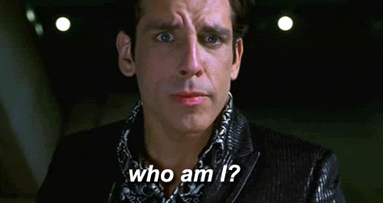
FBA-BIP Team Roles and Responsibilities
 | Facilitator | Team Members | Student and Family
Who | Team member with: expertise in facilitating problem solving process, knowledge of behavioral principles, supervised experience in conducting FBA/BIPs in schools | Unique to student (e.g. teacher, specialist, paraprofessional, counselor etc.) | Unique to student (provides input on who is a member of the team)
FBA | Ensures relevant information is gathered by team Ensures the team comes to consensus on a hypothesis that includes operational definition of problem behavior, antecedents and function | Provides and gathers information (data) Ask questions for clarification Using data available, problem solve unclear components of the hypothesis statement Brainstorm additional sources of data that may clarify the process | Provide input about strengths, preferences and goals Provides additional sources of data as appropriate
BIP | Leads the team in creating a BIP Ensures all stakeholders give input Keeps team focused on the hypothesized function Ensures the identified function-based strategies are a good fit for the classroom / implementation setting Ensures all stakeholders agree with aspects of the plan that require their action Ensures there are follow-up procedures in place (coaching, progress monitoring) | Work with Facilitator in creating the BIP Identify function based interventions matched to hypothesis Provide feedback on feasibility of the proposed function-based strategies Implement interventions Support the collection of progress monitoring data | Work with Facilitator in creating the BIP Provide preferences/input for individual support options to meet their stated needs and goals across life domains (e.g. academics, health, career and social)

Slide 62
Critical Features of the FBA
Assessment Includes:
  Problem behaviors (academic, social, emotional, etc.) identified and defined in observable and measurable terms
  Relevant medical, behavioral (attendance, discipline data), mental health strengths and needs, academic data
  Response to current/previous academic and behavioral interventions
  Baseline data collected for problem behavior(s)
  Identification of antecedents and consequences
  Identification of behavioral function

Slide 63
1. Define the Problem Behavior in Observable and Measurable Terms
2. Conduct assessment for behavior support planning (Functional Behavioral Assessment)
Collect Baseline Data
Ask staff, student and family about where, when, & why behavior occur AND what interventions have already been attempted
Hypothesize a final summary of where, when, & why behavior occurs
See the behavior during specified routines (to confirm hypothesis)
3. Design an individualized behavior intervention plan (BIP)
• Ensure technical adequacy
• Ensure contextual fit
The FBA to BIP Process
4. Ensure Fidelity of Implementation
5. Monitor Plan Impact on Student Behavior
Adapt BIP and implementation as needed based on on-going monitoring
Adapted from Horner, Albin, Todd, Newton & Sprague, 2011
Notes:
All of our systems support this technical process.
Think about baseline data and where it can go…

Slide 64


1. Define the Problem Behavior
Definitions of behaviors need to be:
  OBSERVABLE: the behavior is an action that can be seen
  MEASURABLE: The behavior can be counted or timed
  Defined so clearly that a person unfamiliar with the student could recognize the behavior without any doubts
Notes:
Basic fba

Slide 65
Are these observable, & measurable?
Gets out of desk and hits other students
Has separation anxiety (from parent)
Spacey
Reads 120 wpm
Says she hears voices
Emotionally disturbed
Doesn’t like classmates
Notes:
Basic fba

Slide 66
What information do you already collect that can be compiled to begin forming a picture of the student?
Regularly Collected Data | Other Helpful Information
Data Considerations: What information do you already collect that can be compiled to begin forming a picture of the student? What do you see in the existing student data that can begin forming a picture of the student?
Regularly Collected Data Sources | Other Helpful Data Sources
Office discipline referrals Classroom discipline data ISS/OSS Attendance/Tardy Grades Assessment Performance (CBM, STAR, DIBELS etc.) IEP Data (IEP Plus, Student Record) | Nurse visits Counselor visits Current or previous classroom supports for student behavior or academic performance Current or previous participation in behavior or academic interventions

Slide 67
1. Define the Problem Behavior in Observable and Measurable Terms
2. Conduct assessment for behavior support planning (Functional Behavioral Assessment)
Collect Baseline Data
Ask staff, student and family about where, when, & why behavior occur AND what interventions have already been attempted
Hypothesize a final summary of where, when, & why behavior occurs
See the behavior during specified routines (to confirm hypothesis)
3. Design an individualized behavior intervention plan (BIP)
• Ensure technical adequacy
• Ensure contextual fit
The FBA to BIP Process
4. Ensure Fidelity of Implementation
5. Monitor Plan Impact on Student Behavior
Adapt BIP and implementation as needed based on on-going monitoring
Adapted from Horner, Albin, Todd, Newton & Sprague, 2011
Notes:
All of our systems support this technical process.
Think about baseline data and where it can go…

Slide 68
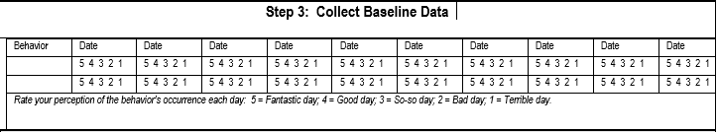
Collect Baseline Data on Problem Behavior
Notes:
The key is to begin collecting data to determine the severity and establish baseline for change

Slide 69
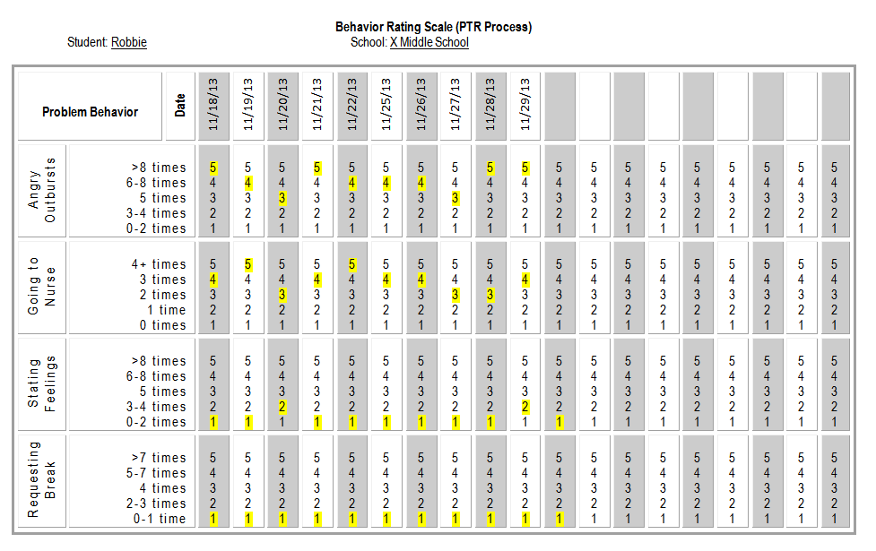
Individualized Behavior Rating Scale (IBRST)
Angry Outbursts – any behavior defined as yelling, talking back, angry words directed at teacher – measured in times of occurrence per day
Going to the nurse – times that Robbie requests to go to the nurse per day
Stating feelings – anytime that Robbie expresses how he feels (i.e. nervous, scared, worried, anxious, angry, mad) either using picture cues or words. This is also measured in times per day.
Requesting a break – the number of times Robbie requests a break either by words or picture
Notes:
NIKI

Slide 70
CICO Card Front
John’s Tier 2 CICO Card
Goals | AM to Lunch | Lunch to Recess | Recess to PM
Be Responsible | J K L | J K L | J K L
Be Respectful | J K L | J K L | J K L
Be Ready | J K L | J K L | J K L
Total Points
Teacher Initials
Also Baseline Data

Slide 71
2. Conduct assessment for behavior support planning (Functional Behavioral Assessment)
Ask staff, student and family about where, when, & why behavior occur AND what interventions have already been attempted

Slide 72
ANALYZE the Nature of the Behavior– Questions to keep in mind
When is the behavior more likely to occur?
  Consider time of day, day of week
Where is the target behavior more likely to occur?
  Consider location, subject, activity
What is happening before the behavior occurs? (Antecedents)
How often is the behavior occurring? (Behavior)
What is happening after the behavior occurs? (Consequence)
Notes:
Add some additional questions to ensure all areas covered. Perhaps a sample interview?

Slide 73
2. Conduct assessment for behavior support planning (Functional Behavioral Assessment)
Hypothesize a final summary of where, when, & why behavior occurs

Slide 74
Put it all together…
Develop a summary statement…otherwise known as a hypothesis statement

Slide 75
What started the behavior in motion?
Antecedent
This is known as the Antecedent.
Riffel, 2017

Slide 76
Defined behavior in measurable and observable terms
Antecedent | Behavior
This is known as the Behavior.
Riffel, 2017

Slide 77
We then determine what is reinforcing the behavior.
Antecedent | Behavior | Consequence
This is known as the Consequence.
Riffel, 2017

Slide 78
And what the student is gaining or escaping.
Antecedent | Behavior | Consequence
This is known as the Function.
Riffel, 2017

Slide 79
As needed…consider what makes the behavior more likely
Setting Event | Antecedent | Behavior | Consequence
This is known as the Setting Event
Riffel, 2017

Slide 80
Once we have all this- we have the summary statement
Setting Event (more likely when) | Antecedent (when) | Behavior (The student) | Consequence (and as a result)
On days Scout’s mother visits the school for lunch | When there is a transition | Scout has a disruptive outburst | His teacher holds his hand Function to: get adult attention
Riffel, 2017

Slide 81
2. Conduct assessment for behavior support planning (Functional Behavioral Assessment)
See the behavior during specified routines; update information based on observations
Notes:
Observations may or may not occur depending on whether or not the hypothesis is confirmed by the team

Slide 82
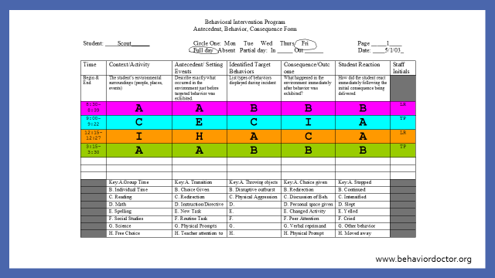
ABC Observation Collection Tool

Slide 83
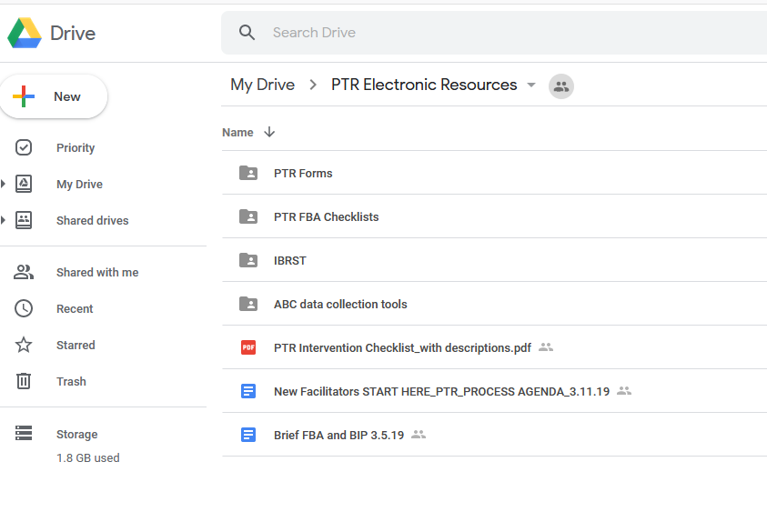
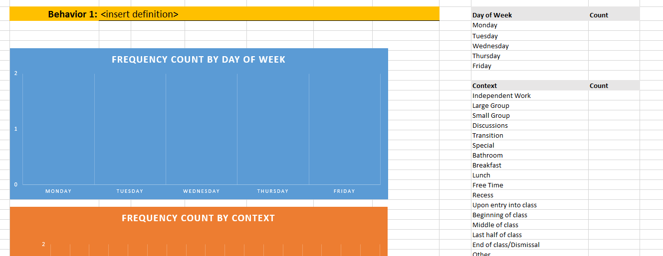
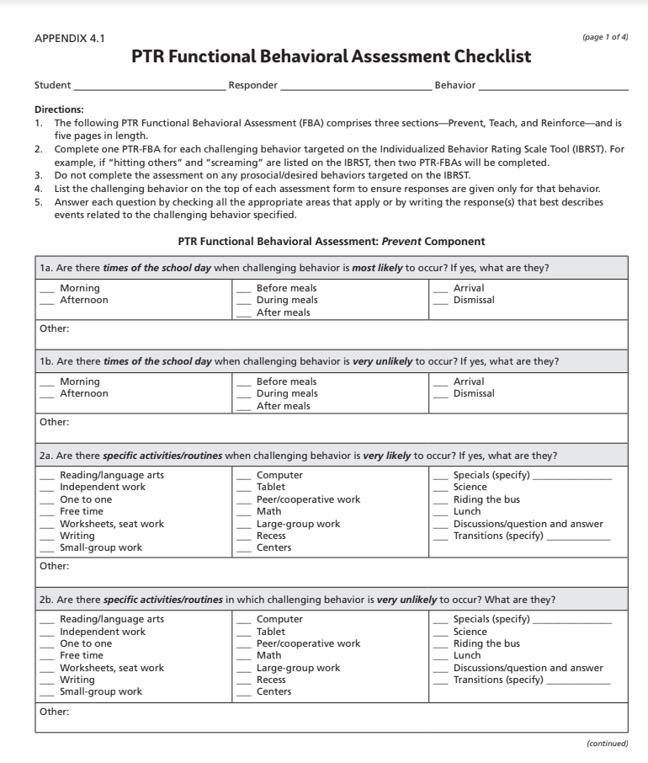
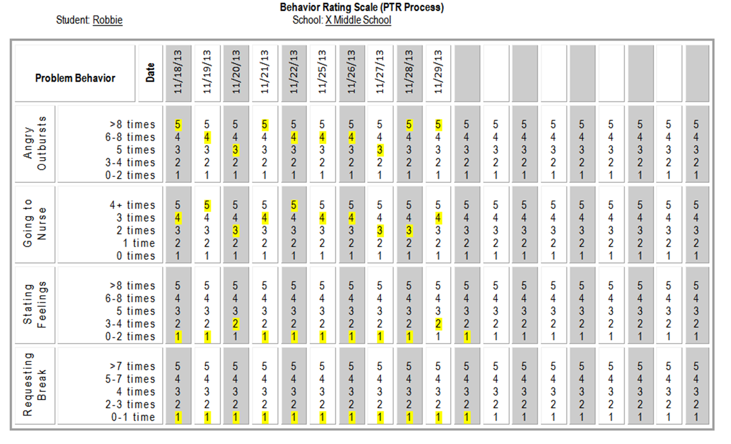

Slide 84
Practice!
Evaluate sample FBA
Notes:
And also take a break

Slide 85
What questions are still circling?
What do you have squared away?
What was one good point made?

Slide 86
Understand the critical components of function based BIPs

Slide 87
True or False?
A BIP is a list of strategies to address problem behavior?
Notes:
FALSE! A BIP is: a behavior intervention plan designed by a team that includes interventions based on student function…. Rifel’s defintion

Slide 88
FALSE!
A BIP defines how an educational setting will be changed to improve the behavioral success of one or more students based on information gathered through an FBA process.
Horner, Sugai, Tim Lewis (2008)

Slide 89
1. Define the Problem Behavior
2. Conduct assessment for behavior support planning (Functional Behavioral Assessment)
Defining behavior in observable & measureable terms
Ask staff, student and family about where, when, & why behavior occur AND what interventions have already been attempted
Hypothesize a final summary of where, when, & why behavior occurs
See the behavior during specified routines (to confirm hypothesis)
3. Design an individualized behavior intervention plan (BIP)
• Ensure social validity
• Ensure technical adequacy
The FBA to BIP Process
4. Ensure Fidelity of Implementation
5. Monitor Plan Impact on Student Behavior
Adapt BIP and implementation as needed based on on-going monitoring
Adapted from Horner, Albin, Todd, Newton & Sprague, 2011
Notes:
All of our systems support this technical process.

Slide 90
Why consider social validity?
Notes:
Pose the question to the audience. As a teacher, what would interfere with your ability to implement an intervention as planned?

Slide 91
If you are implementing the intervention…
Be an active participant in selecting interventions
Provide description on how interventions will look in the classroom setting
Task analyze each step: describe what adults will do!
Develop a daily checklist of implementer steps
Participate in coaching and ensure all relevant staff are coached
Frequently check in with the team
Seek on-going support
Notes:
Don’t forget to coach the student!

Slide 92
1. Define the Problem Behavior
2. Conduct assessment for behavior support planning (Functional Behavioral Assessment)
Defining behavior in observable & measureable terms
Ask staff, student and family about where, when, & why behavior occur AND what interventions have already been attempted
Hypothesize a final summary of where, when, & why behavior occurs
See the behavior during specified routines (to confirm hypothesis)
3. Design an individualized behavior intervention plan (BIP)
• Ensure social validity
• Ensure technical adequacy
The FBA to BIP Process
4. Ensure Fidelity of Implementation
5. Monitor Plan Impact on Student Behavior
Adapt BIP and implementation as needed based on on-going monitoring
Adapted from Horner, Albin, Todd, Newton & Sprague, 2011
Notes:
All of our systems support this technical process.

Slide 93
Ensure Technical Adequacy
  Prevention strategies
  Teaching strategies with replacement/alternative behaviors identified and defined in observable and measurable terms
  Strategies for removing rewards for problem behavior
  Specific rewards for desired behavior
  Safety elements when needed
  A systematic process for assessing fidelity and impact
  An action plan for putting the support plan in place
7 Core Features of a BIP
Notes:
How are these the same or different?

Slide 94
Building Blocks of Behavior
Setting Event
Antecedent
Behavior
Consequence
Prevention Strategies
Prevention Strategies
TEACH Strategies
Reinforcement Strategies
Understanding Function Helps Guide Our BIP Design!
(Alberto & Troutman, 2006)
Notes:
Technical adequacy is ensured if the science of behavior is applied to the problem solving process.

Slide 95

Prevention Strategies address the function the problem behavior serves
When asked to read aloud in class, Kyle makes inappropriate comments and pushes his book off his desk to avoid public speaking (not related to reading difficulty; related to extreme social anxiety).
    Does the Prevent Intervention address the Function of Behavior
      Give student passage in advance to practice pre-reading
      Do not ask student to read aloud in class (or respond publicly)
      Let student read 1 sentence directions they are familiar with, instead of entire paragraphs from the text

Slide 96

Prevention Strategies address the function the problem behavior serves:
When participating in large group activities, Angela often interrupts the teacher to ask questions during instruction to gain adult attention.
Does the Prevent Intervention address the function of behavior?
Give the student a job to complete during large group instruction (e.g. write the answers on the board)
Allow the student to write comments on a post-it to share later
Let the student choose a preferred seat during large group instruction
Increase the ratio of positive to negative comments during large group instruction
Antecedent

Slide 97
Prevention Strategies
After the Replacement behavior has been taught, Prompts and Pre-corrections are used to support and help remind the student to use taught behaviors.
  Example:
  Niki’s problem behavior is maintained by escape from difficult math assignments.
  When handing out assignments, Niki’s teacher will remind her that she can ask for a break (Replacement behavior) if she gets frustrated.
Antecedent

Slide 98
“Replacement” or “Alternative” Behavior(s)
Replacement behaviors must maintain the same function for the student with the same accuracy and efficiency as the problem behavior.
** Replacement behaviors are NOT the Desired Behavior!
Behavior
Notes:
Identifying Replacement behaviors are closely tied to the FBA as well as the BIP process. We are going to cover this in both training days;

Slide 99
Which of the Following are Appropriate Replacement Behaviors?
Jason is nine and cries when asked to write in his journal. The crying is maintained by avoiding or escaping difficult tasks.
Possible Replacement Behaviors:
  More rewards for doing tasks
  Ask for an easier task/ worksheet
  Ask to play w/ his Gameboy
  Appropriately request adult attention
  Ask to have soda after tasks are done
2. Is behavior easier to do than problem behavior?
1. Serve same Function? Does it provide escape from difficult task?
Behavior
3. Is Behavior socially acceptable?
Basic FBA to BIP
Notes:
99

Slide 100
Reinforce the Replacement Behavior
    When the student engages in the replacement behavior, quickly provide the student with an outcome that matches the outcome/ function of the problem behavior
    E.g. if student raises hand to request an easier, substitute assignment; in order to escape difficult tasks → then quickly provide the student with the easier assignment
Consequence

Slide 101
Reinforce Desired Behaviors
    The ultimate plan is to have the student move beyond the replacement behavior to using the desired behavior (e.g. following typical classroom expectations)
    Reinforcing this progression should start from the beginning of the intervention
Consequence

Slide 102
John’s Tier 2 CICO Card
Goals | AM to Lunch | Lunch to Recess | Recess to PM
Be Responsible | J K L | J K L | J K L
Be Respectful | J K L | J K L | J K L
Be Ready | J K L | J K L | J K L
Total Points
John’s updated Tier 3 CICO Card
Goals | AM to Lunch | Lunch to Recess | Recess to PM
Be Responsible Ask for help | J K L | J K L | J K L
Be Respectful Ask for 2 more minutes | J K L | J K L | J K L
Be Ready | J K L | J K L | J K L
Total Points
Behavior
Replacement Behaviors that Support the Development of Desired Behaviors
Desired Behaviors
Notes:
AH
Example of a data sheet for the CICO intervention
At Tier 3, added the use of strategies (replacement behaviors) to John’s card

Slide 103

Strategies for Removing Reinforcement for Problem Behavior
  Redirect to the Replacement Behavior
  Minimize the pay-off the student has been receiving for the problem behavior
Consequence

Slide 104

Error Correction Example…
Niki
you are not completing your math job,
Remember: Praise can be public, correction should be private
if you need a break don’t forget to use your break card,
working on our math and taking breaks is responsible,
Consequence
thanks for starting your math work!

Slide 105
1. Define the Problem Behavior
2. Conduct assessment for behavior support planning (Functional Behavioral Assessment)
• Defining behavior in observable & measureable terms
• Ask staff, student and family about where, when, & why behavior occur AND what interventions have already been attempted
• See the behavior during specified routines
• Hypothesize a final summary of where, when, & why behavior occurs
3. Design an individualized behavior intervention plan (BIP)
• Ensure technical adequacy
• Ensure contextual fit
The FBA to BIP Process
4. Ensure Fidelity of Implementation
5. Monitor Plan Impact on Student Behavior
Adapt BIP and implementation as needed based on on-going monitoring
Adapted from Horner, Albin, Todd, Newton & Sprague, 2011
Notes:
All of our systems support this technical process.

Slide 106
Possible sources of progress monitoring data:
  Daily Behavior Ratings (DBRs): https://www.interventioncentral.org/teacher-resources/behavior-rating-scales-report-card-maker
  Individual Behavior Rating Scale (IBRST)
  Formal observations
Set Decision Points: how will you know if the intervention was successful?

Slide 107
Without fidelity…
We cannot draw conclusions and plan next steps for interventions that don’t seem to be working.
We cannot say that a student is resistant to intervention without showing that the intervention happened as designed.

Slide 108
Writing the Intervention Plan
Task analyze each step of the plan
  Non-Example: Give student choices
  Example:
    Prior to the start of independent reading, tell the student, “We have 2 worksheets today.”
    Show student both worksheets
    Say, “Which worksheet would you like to do first?”
Teachers need to know exactly what to do or the intervention may not be implemented as intended.
Notes:
108

Slide 109
Which One Will More Likely be Consistently Implemented?
BIP-Prevention Strategies
OR
BIP-Prevention Strategies
Provide Choices: The teacher will provide Don with a choice prior to assigning him independent work in class. Choice options are: (a) materials to use for assignment; choice of leadership activities; (b) where to sit; (c) who to do the assignment with
Steps:
Immediately after giving the class the independent math assignment, go over to Don and present him with a choice option.
When presenting him with a choice, say “Don, where do you want to sit? X or X?”
After Don makes his choice, say, “Thanks for making a great choice” and release him to his choice.
Provide choices of where to sit

Slide 110
Practice!
Evaluate sample BIP
Notes:
And also take a break

Slide 111
What questions are still circling?
What do you have squared away?
What was one good point made?

Slide 112
Please answer the following:
When thinking about individualizing behavior interventions I feel:
Notes:
Poll created

Slide 113

Questions, Comments, Concerns?

