Slide 1
Administrators Meeting
Plan for our time together:
MTSS and Phases of Implementation
What’s my Role?
Alignment of Programs and Interventions
Alignment with Expectations for Administrators
Time for Questions and Sharing Ideas

Slide 2
Material in this presentation was adapted from:
Building Administrator Support Across Implementation Stages: Using Implementation Science to Support Administrators at PBIS Schools
By Catherine Rossi, Ph.D. May Institute
Presented at 2017 NEPBIS Conference

Slide 3
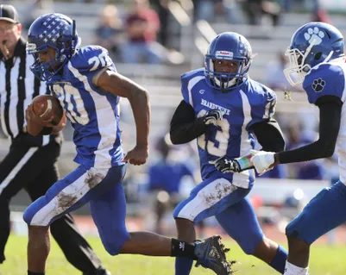
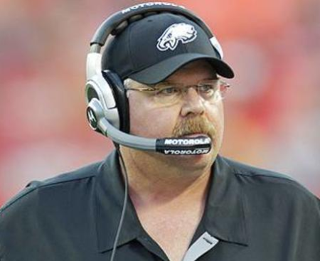
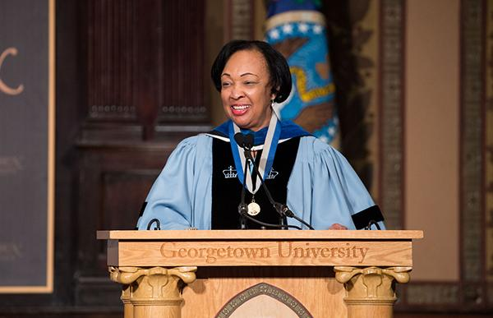
COUNSELOR
CHEER
LEADER
TEAM MEMBER
TYRANT
EXPERT
COACH

Slide 4
Layered Continuum of Academic &
Social, Emotional and Behavior Support
Tier 3 for a Few: Intensive, Individualized
Tier 2 for Some: Targeted for Small Groups
Tier I for All: Core/Universal

Slide 5
PBS is a Multi-Tiered System of Supports (MTSS) Framework
Supporting culturally equitable Targets including social/emotional competence & academic achievement
OUTCOMES
Supporting culturally knowledgeable Staff Behavior
team-based leadership and coordination
professional development, coaching, and content expertise
Supporting culturally valid Data-based Decision Making
universal screening
progress monitoring
evaluation of fidelity
SYSTEMS
DATA
PRACTICES
Midwest PBIS Network 2/7/19. Adapted from:
“What is a systems Approach in school-wide PBIS?” OSEP Technical Assistance on Positive Behavioral Interventions and Supports. https://www.pbis.org/school
McIntosh, K.& Goodman, S. (2016). Integrated Multi-Tiered Systems of Support: Blending RTI and PBIS. New York: Guilford Press.
Supporting Student Behavior
three-tiered continuum of culturally relevant evidence-based interventions

Slide 6
Where are you in the implementation process?
EXPLORATION/ADOPTION
INSTALLATION
Develop
Commitment
INITIAL IMPLEMENTATION
Establish
Leadership
Teams,
Setup Data
Systems
FULL IMPLEMENATION
Provide Significant Support to Implementers
SUSTAINING
Embed as Standard Practice/
Add
Schools
Increase Efficiency & Effectiveness
Adapted by Rossi (2017) from Fixsen, D. L., Naoom, S. F., Blase, K. A., Friedman, R. M. & Wallace, F. (2005). Implementation Research: A Synthesis of the Literature.Kinkade, Don Florida PBIS

Slide 7
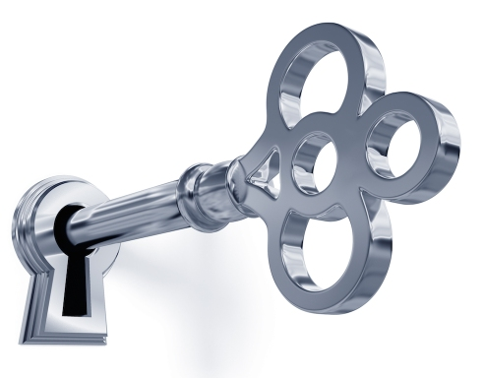
Key Roles for Administrators
Developing Buy-In through your Vision
Supporting Team Implementation
Fostering Communication
Facilitating Leadership and Policy
(Adapted from Rossi and May Institute, 2017)

Slide 8
Exploration Phase – Developing Buy-In
Administrator Role:
Build a case for the need for change
Provide data/evidence
Demonstrate enthusiasm and optimism
Build on existing capacity and strengths
Build ownership
Build a shared vision
(Adapted from Rossi and May Institute, 2017)

Slide 9
Building the need for change
Use survey data related to perceptions from staff, students and family
Share behavior/discipline data and gather feedback
Consider other data sources that show need
Identify specific areas of strength in current practices
Identify areas for growth
(Adapted from Rossi and May Institute, 2017)

Slide 10
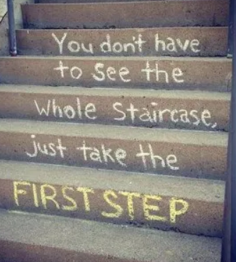
Demonstrating enthusiasm
Highlight good things in place
Point out strengths
Emphasize this is a team effort
Start with small steps you can celebrate
Share that you believe it is possible
(Adapted from Rossi and May Institute, 2017)

Slide 11
Installation Phase
Enact the Vision
Determine how implementation will address:
Needs identified by data analysis
Goals in your school success plan
Improve academic success of students
(Adapted from Rossi and May Institute, 2017)

Slide 12
Key Roles for Administrators
Developing Buy-In through your Vision
Supporting Team Implementation
Fostering Communication
Facilitating Leadership and Policy
(Adapted from Rossi and May Institute, 2017)

Slide 13
Initial Implementation - Supporting Team Implementation
Identify resources needed
Develop long term plan based on data
(Adapted from Rossi and May Institute, 2017)

Slide 14
Installation – Supporting Team Implementation
Attend training with school team
Attend team meetings on regular basis
Model behaviors expected of staff
Recognize staff efforts to meet expectations
(Adapted from Rossi and May Institute, 2017)

Slide 15
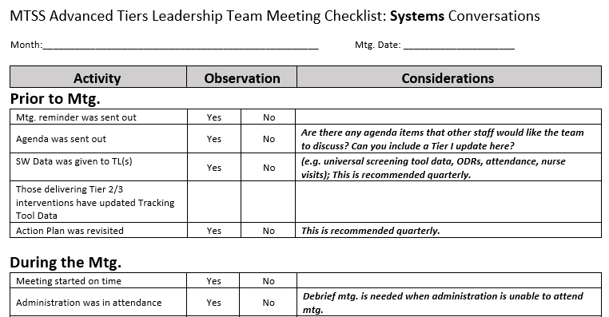
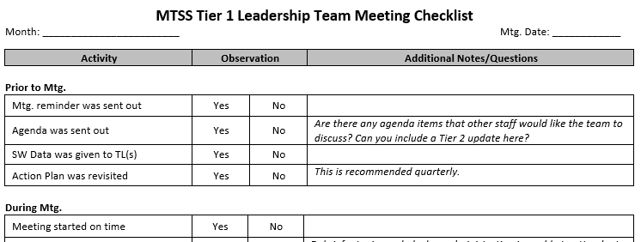
(Adapted from Rossi and May Institute, 2017)

Slide 16
Full Implementation - Supporting Team Implementation
Maintain Vision
Support team to use data ongoing
Support team to use evaluation results to action plan, not as a “score”
Clearly define major/minor behaviors and train staff on consistent reporting
(Adapted from Rossi and May Institute, 2017)

Slide 17
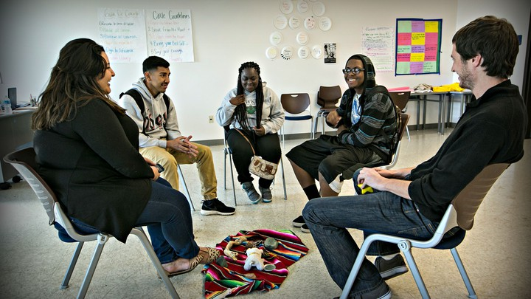
Full Implementation - Supporting Staff Implementation
Re-thinking Discipline
Focus on teaching expectations and acknowledging students
Move from focus on punitive system of consequences to tiered interventions and supports
(Adapted from Rossi and May Institute, 2017)

Slide 18
Rethinking Discipline Behavior Change… as an instructional process
This work is not about changing kids.
This work is about changing the environment to make it more likely that kids will succeed (both academically and socially/emotionally).
We change STUDENT behavior by
changing ADULT behavior
INVERVENTIONS = changes in staff procedures & practices
(Adapted from Rossi and May Institute, 2017)

Slide 19
A “Shift” in our Thinking
What is your WHY for pursuing an educational approach to discipline?
Impact of Relationships?
Impact of Trauma?
Growth Mindset?
Approaching Behavior like Academics?
Treat students like adults want to be treated?
Punishment vs Teaching
Impact of shaming and other Response Cost strategies (e.g. clip-charts, demerits, three-minors equals a major, etc.)
Skill deficit/function vs defiance
Restorative Practices?
All humans have performance deficits, and need tiered supports
High expectations, High Patience
Others?
How are you
“Rethinking” Discipline?
(Adapted from Rossi and May Institute, 2017)

Slide 20
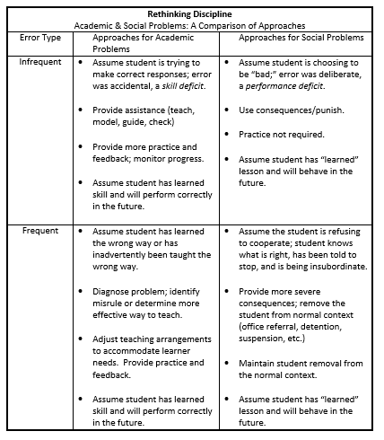
Activity: Rethinking Discipline
Read the following information in the “Rethinking Discipline” chart. Record your thoughts.
Share your thoughts with another person in your large group (e.g., inside-outside circle).
What did you hear from others that give you pause to rethink your understanding of discipline?
Share the key ideas that may restructure your view of discipline with your team.
Positive Classroom Behavioral Supports Implementation Workbook (Excerpt)
Yanek/Mid-Atlantic PBIS
(Adapted from Rossi and May Institute, 2017)

Slide 21
Turn and Talk
How do you communicate with your team and staff about your beliefs regarding discipline and MTSS/PBS?
How active are you in implementation?
Attend trainings
Attend team meetings
Time to share at faculty meetings
Gather feedback from staff
How do you support staff to change discipline practices?
(Adapted from Rossi and May Institute, 2017)

Slide 22
Key Roles for Administrators
Developing Buy-In through your Vision
Supporting Team Implementation
Fostering Communication
Facilitating Leadership and Policy
(Adapted from Rossi and May Institute, 2017)

Slide 23
Exploration - Fostering Communication
Communicate the importance of implementation with all stakeholders
Regularly share implementation actions and plan with all staff
Ensure team members are part of communication
(Adapted from Rossi and May Institute, 2017)

Slide 24
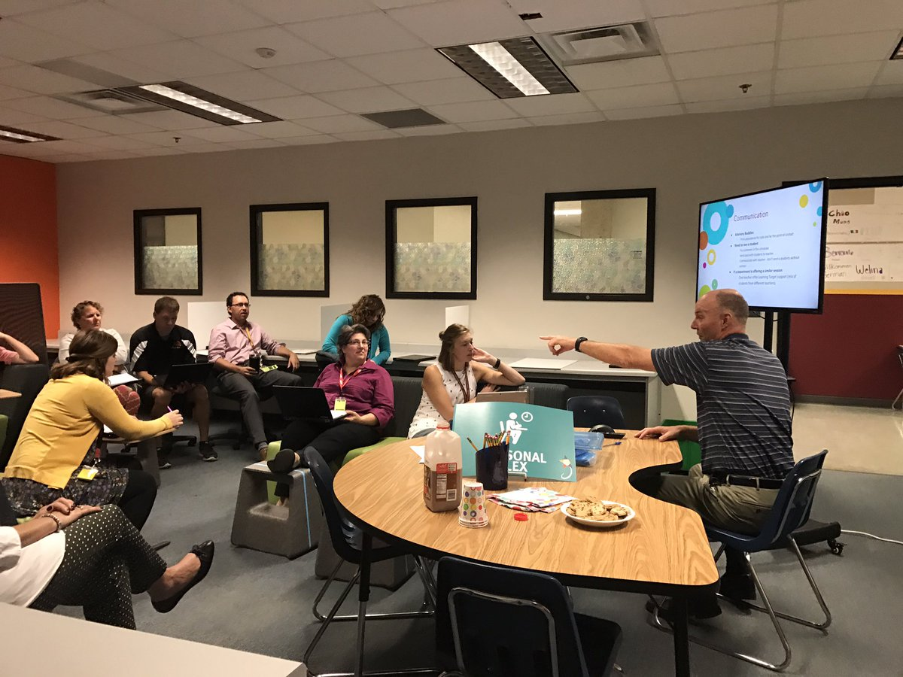
Initial Implementation - Fostering Communication
Build in 2-way communication opportunities about implementation with staff
Grade level meetings, PLCs
Communicate team decisions with all staff
Provide opportunities for all staff to learn
Provide feedback and recognition to staff regarding implementation efforts
(Adapted from Rossi and May Institute, 2017)

Slide 25
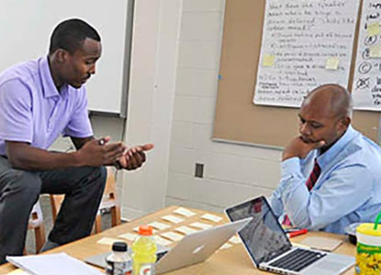
Full Implementation - Fostering Communication
Provide clear expectations for staff role in implementation
Continue 2 way communication and feedback and recognition regarding implementation
(Adapted from Rossi and May Institute, 2017)

Slide 26
Example of Clear Staff Expectations
 | Be Safe | Be Responsible | Be Respectful
Cafeteria | Scan and circulate in your zone Calmly address low levels of misbehavior Notify another supervisor to alert security/administration if unsafe situation arises | Arrive for your duty on time Stay engaged and focused on supervision throughout the lunch period | Engage with students positively (non-contingent reinforcement) Quietly and privately correct misbehavior Give frequent positive reinforcement (tickets, golden tray awards, etc)
Hallways | Be in the hallway (near your classroom) between classes to supervise students Calmly address low levels of misbehavior Alert security/administration if an unsafe situation arises | Be alert and engaged When the bell rings to signify the beginning of class, close your door and begin class | Engage with students positively (smiles, greetings, etc) Respectfully correct misbehavior (quietly, privately, brief one liners) Greet your students upon entering your room (glad your are here today, get started on….)
Classroom | Teach and post classroom rules Monitor student behavior and performance by actively circulating among students while students are working in groups or independently Use de-escalation strategies (reflective responses, active listening, behavior support techniques) to support students demonstrating low level agitation | Teach, monitor, and feedback your attention signal Teach, monitor, and feedback your expectations (CHAMPS) Keep unstructured time to a minimum (establish routines and classroom procedures) | Maintain at least a 3:1 ratio of positive to negative consequences Use frequent non-contingent reinforcement (interacting positively with students because they exist) Correct misbehavior non-emotionally
(Adapted from Rossi and May Institute, 2017)

Slide 27
Turn and Talk
How do you enable your team to communicate with staff?
Roll out and annual orientation
Ongoing updates throughout school year
Communication with all staff (e.g. bus drivers, paraprofessionals, cafeteria staff)
Communication with families
(Adapted from Rossi and May Institute, 2017)

Slide 28
Key Roles for Administrators
Developing Buy-In through your Vision
Supporting Team Implementation
Fostering Communication
Facilitating Leadership and Policy
(Adapted from Rossi and May Institute, 2017)

Slide 29
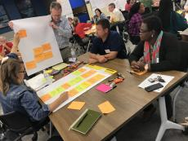
Installation - Facilitating Leadership
Support team leaders on the team
Provide team with resources
Support teams to identify priorities for PD in the building and plan for related activities
Map out decisions the team has authority to make
(Adapted from Rossi and May Institute, 2017)

Slide 30
Implementation - Facilitating Leadership
Guide rather than dictate
Empower leadership in others
Recognize staff for higher levels of implementation
(Adapted from Rossi and May Institute, 2017)

Slide 31
Alignment
Picture not
included
(Adapted from Rossi and May Institute, 2017)

Slide 32
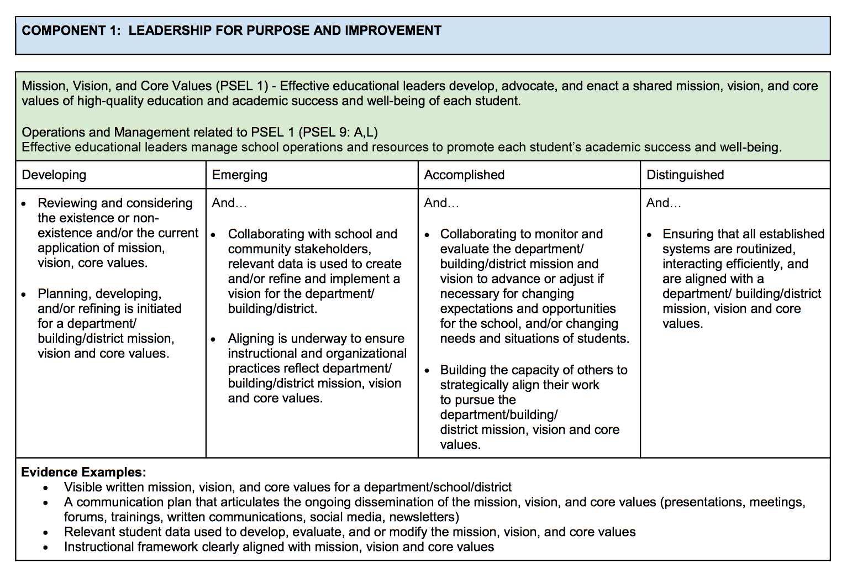
Alignment with Expectations for Administrators
District MTSS Expectations
DPAS II
Tier 1 systems, data, and practices consistently in place
Director of Climate, Culture, Equity will meet 3 x per year with School-wide PBS Team to discuss progress
PBS Coach will provide ongoing support to solidify Tier 1
Professional Development will be incorporated into Principals’ Meetings
PBS Team must attend DE-PBS Tier 1 Professional Development (within the last 2 years)
District will establish PBS Leadership Team
PBS Key Features Evaluation will be conducted by end-of-year (U of D)
Participate in DE School Climate Survey annually (students, staff, families)
Share results with staff
Complete DE Discipline Data Reporting Tool (DDRT) in January & June
Share results with staff

Slide 33
DPAS II for Administrators
Component 1: Leadership for Purpose and Improvement
Distinguished: Ensuring that all established systems are routinized, interacting efficiently, and are aligned with a department/building/district mission, vision and core values.
Evidence Examples:
DATA |  | SYSTEMS |  | PRACTICES
Relevant student data used to develop, evaluate, and or modify the mission, vision, and core values |  | A communication plan that articulates the ongoing dissemination of the mission, vision, and core values (presentations, meetings, forums, trainings, written communications, social media, newsletters) |  | Documented community partnerships that align to mission, vision and core values

Slide 34
DPAS II for Administrators
Component 2: Leadership for Self and Others
Distinguished: Ensuring that all established systems are routinized, interacting efficiently, and are aligned with professional norms and ethical and legal principles resulting in democracy, equity, social justice, and diversity.
Evidence Examples:
DATA |  | SYSTEMS |  | PRACTICES
Climate surveys include questions related to student success and well-being; interaction with staff; cultural responsiveness |  | Documented meetings with all new staff hires to review policies, procedures and expectations |  | Written policies and procedures articulate an alignment to the mission, vision, and core values of the department/school/district

Slide 35
Why Invest in Alignment?
Unaligned efforts are ineffective and inefficient
Doing many things, but none of them well
Assumption that New is better… More is better
Political value (“we have _______ in our school”)
Assumption that if we train individuals in many things THEY will do the alignment and integration on their own and placing burden on them
Adapted from Steve Goodman, MIBLSI

Slide 36
Alignment and Integration
Alignment
Correct positioning for effective/efficient performance
Core features of practices and support of these practices are aligned across the system
Integration
Different parts of a system are made a functional and structural whole
Resources are leveraged to build upon each other
Integration:
Cross Content
Cross Department
Cross Agencies

Slide 37
Effective Alignment begins with Outcomes
Are you filling silos or making bread?

Slide 38
Every initiative within a district should have a fidelity and outcome measure and the core features summarized. A single professional development plan should guide the work that the Organization Unit oversees.
Rob Horner

Slide 39
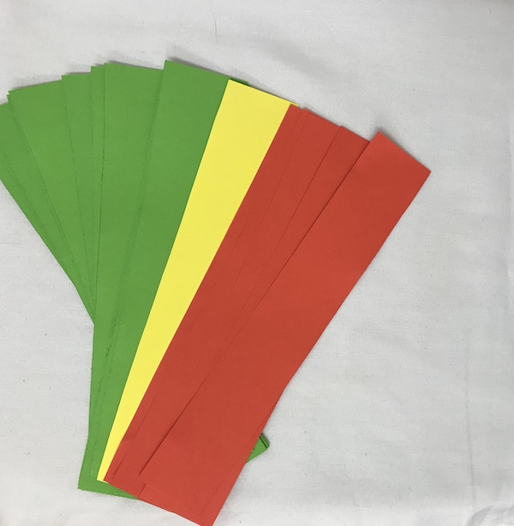
Next Steps
Intervention or committee inventory
Is your goal alignment or integration?

Slide 40
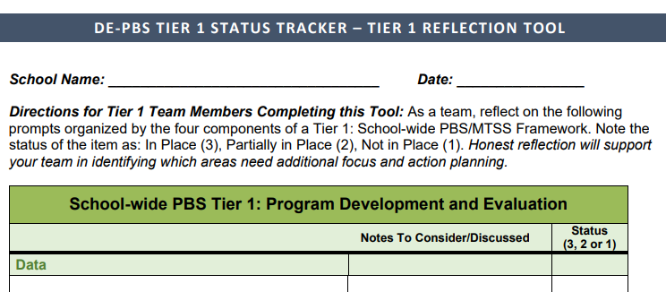
Tool for Picking Next Steps: Status Tracker

Slide 41
Self-Care for Administrators

Slide 42
MetLife Survey of the American Teacher Survey of 1,000 K-12 public school teachers in 2012
About half (51%) of teachers reported being under great stress several days a week or more.
This was an increase of 15 percentage points over the 36% of teachers reporting this in 1985.
27% reported being under great stress almost every day
Half of principals (48%) also reported being under great stress several days a week or more

Slide 43
Mindfulness
Think of a challenging situation
What were you feeling?
What was your internal state (body awareness)?
What was your awareness of the environment?
How did you respond?
cc: RelaxingMusic - https://www.flickr.com/photos/83905817@N08

Slide 44
What to do with known patterns
Uncover the reason for response
Plan ahead for response
Create plan to debrief
cc: erink_photography - https://www.flickr.com/photos/49268016@N04

Slide 45
Reducing Stress and coping during stress
Develop proactive coping strategies when you feel your emotions rising
Map out your day and identify times or tasks that make you feel the most stressed and develop a plan to address
Establish coming home rituals to create clear boundary
Talk to colleague to process difficult day
Write about before you leave
Create to do list
Listen to audiobook or call friend on way home
Play uplifting music
Sit in silence to decompress

Slide 46
Final Thoughts
PARTNERS

