Slide 1
DE-PBS Cadre Meeting
February 5, 2020

Slide 2
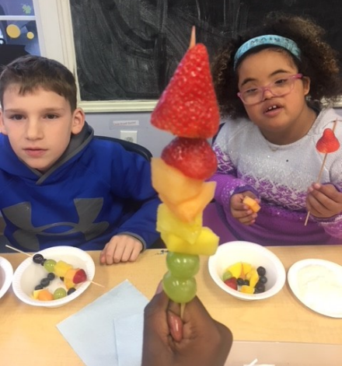
State Performance Plan/ Annual Performance Report FFY 2018
Presented to GACEC
January 21, 2020
Exceptional Children Resources
Delaware Department of Education

Slide 3
Compliance Indicators
Indicator 4B:
Suspension and Expulsion of Students with Disabilities as compared to students without disabilities
Description:
Percent of districts that have: (a) a significant discrepancy, by race or ethnicity, in the rate of suspensions and expulsions of greater than 10 days in a school year for children with IEPs; and (b) policies, procedures or practices that contribute to the significant discrepancy and do not comply with requirements relating to the development and implementation of IEPs, the use of positive behavioral interventions and supports, and procedural safeguards.
FFY 2018 Target | FFY 2018 Data | Status | FFY 2019 Target
0% | 0% | Met Target | 0%

Slide 4
Results Indicators
Indicator 4A:
Suspension and Expulsion of Students with Disabilities as compared to students without disabilities
Description:
Percent of districts that have a significant discrepancy in the rate of suspensions and expulsions of greater than 10 days in a school year for children with IEPs
FFY 2018 Target | FFY 2018 Data | Status | FFY 2019 Target
50% | 0% | Met Target | 40%

Slide 5
508, 922, and 925 Regulations Update

Slide 6
Where We Came From
2015 - Advisory Council developed to provide input into the SSIP
Early 2017 - Added representation from and aligned efforts with the DE RTI Coalition and the DE SPDG
Fall 2017 - Becomes MTSS Advisory Council with the purpose of continued exploration of topics related to instructional and assessment within DE’s MTSS structures and stakeholder engagement
Spring 2017 RtI Guiding Coalition Final Report

Slide 7
Where We Came From
January 8, 2018 Stakeholders reviewed and revised Regulation 925
Review and revise eligibility criteria
Review and revise other sections of 925 including Parental Consent, Evaluations, IEP, IEP Team, Private School Placements, LRE, Alternative Means of Participation, High School Graduation
12 Stakeholder groups: GACEC, Special Education Strategic Planning Committee, Autism Delaware, Division of the Visually Impaired, LEAs, Statewide Programs, Parents, Community Members, Nemours, Center for Disabilities Studies, Parent Information Center
2019-2020 MTSS Reboot Stakeholder Committee

Slide 8
Where We Came From
Regulation 925 addresses evaluations, eligibility determination, and individualized education programs.
In collaboration with stakeholders, the Department gathered input and revised the eligibility criteria for each disability category in Regulation 925.
The revised eligibility criteria for some disability categories references Multi-Tiered System of Supports (MTSS).
Regulation 508 details MTSS.
Since the disability eligibility criteria were revised in Regulation 925, the corresponding definitions and other relevant definitions were revised in Regulation 922.

Slide 9
What’s Happening Now
Regulations 508, 922, and 925 have officially been sent to the registrar’s office and will be posted by February 3rd for public comment at:
Delaware regulation site at: http://regulations.delaware.gov/register/january2020/index.shtml
DDOE website:
https://www.doe.k12.de.us/domain/89

Slide 10
MTSS/ DE-PBS Implementation

Slide 11
MTSS Integration
WHY?
Academic and Behavior MTSS systems share elements of quality instruction and effective systems change principles (McIntosh, Goodman, & Bohanon, 2010; Stollar, Poth, Curtis, & Cohen, 2006)
Use these shared elements to make a more cohesive system
Integrated approaches may be more sustainable
Less competition cross content area initiatives
Capacity building of educator skills in one MTSS area can be applied in other areas of MTSS (data analysis, problem solving, etc.)

Slide 12
MTSS Integration
Focus: Academic and Non-Academic Systems
Scientifically-based interventions
Instruction as prevention
Tiered continuum of supports with increasing intensity based on need
Regular screening for early intervention
Use of a problem-solving model and data-based decision rules
Focus on teaming
Emphasis on improving quality of implementation
Embedded into school improvement plan

Slide 13
MTSS Integration
Focus: Academic and Non-Academic
State-Wide
Increase statewide knowledge and implementation of MTSS
Integrating Academic and Non-Academic supports under one system
Develop and sustain the capacity of state and LEAs to support MTSS practices
LEAs - Supported by State Personnel Development Grant
Las Americas ASPIRA Academy
Eastside Charter School
Christina School District
Smyrna School District

Slide 14
MTSS Integration
MTSS Reboot Stakeholder Advisory Committee
Combined membership of SSIP, RTI, MTSS,
School Climate Transformation Grant,
DE-PBS MTSS Advisory Groups
Increase statewide knowledge and implementation of MTSS
Integrate Academic and Non-Academic supports under one system
Develop and sustain the capacity of state and LEAs to support MTSS practices

Slide 15
MTSS Integration
MTSS Reboot Stakeholder Advisory Committee
Provide input to the development of Delaware’s MTSS framework
Inform Delaware’s MTSS Definition and Essential Components
Next Steps!
Please review the MTSS Regulations and provide comments!

Slide 16
MTSS Integration
DE-PBS Project – Technical Assistance Center
Tiered Behavior Support – MTSS-B
Annual cycle of training and technical assistance beginning each summer
Opportunities to receive training in Schoolwide – Tier 1 Behavior Support to assist LEAs/ Schools to design and implement systems matched to schools’ context
Integration of Academic and Non-Academic supports under one system – focus on whole child
Integration across social-emotional learning efforts

Slide 17
MTSS Integration
DE-PBS Project – Technical Assistance Center
Tiered Behavior Support – MTSS-B
Progression to Tier 2 and Tier 3 systems and interventions
Tier 1 Secondary PBS Forum – February 12
Opportunity to explore for middle and high schools
Technical Assistance and Coaching - partnership between District Coaches and DE-PBS Project staff
For more information: www.delawarepbs.org
Linda.Smith@doe.k12.de.us
Jalee.Pernol@doe.k12.de.us
Susan.Veenema@doe.k12.de.us

Slide 18
Winter PD Recap

Slide 19
Tier 2: Targeted PBS New Team Training
Thank you! 81 people from 16 schools from 11 districts plus partners
Team-based workshop to extend current Tier 2 programming for via a sound system
Structured to align with Tiered Fidelity Inventory (TFI-Tier 2):
Teams
Interventions
Evaluation

Slide 20
Tier 2: Targeted PBS New Team Training
Content and Tools
Focused on helping them to develop their team-based framework for:
Constructing an asset map of current Tier 2 resources
Creating effective Tier 2 systems-level conversations
Evaluating current Tier 2 programming
Developing next step action items

Slide 21
CICO
Content and Tools
Reminding teams to start with the basic format
Matching intervention to function of behavior
Immediate implementation
Focus on school-wide behavior expectations
Determining when to build-up towards more individualized features

Slide 22
CICO Support Needs
Is their a need basic Check in/Check out PD in your district?
What has worked for you to support the use CICO with fidelity in your schools?
If there is a need for CICO PD, what format would be most beneficial:
In person half day session
Webinar
Set of materials for district and building staff to lead PD
Other?

Slide 23
Tier 1: School-wide PBS Team Training Part 2
1/10/2020
In attendance: 66 people from 14 schools, representing 7 districts,.
For this year’s new School-wide PBS Teams, this workshop focused on systems to support correction of problem behaviors and developing self-discipline as part of the Tier 1 PBS framework.
Structure of sharing activities for use in full-team and/or staff engagement.

Slide 24
Tier 2 & 3 School System Workshop
Workshop Objectives
Identify common vocabulary and background knowledge of basic behavioral modification to share with entire staff
Answer the question, “what is Tier 3” and address data, systems and practice misrules
Understand roles and functions of the Tier 2/3 Systems Team and Student Support Teams
Begin to action planning to develop a Tier 3 process
Held on 1/22,20. 74 people from 23 schools and agencies, representing 12 districts, and 2 collaborative partners attended

Slide 25
Teaming Activity
Count off by 4’s
Read the section of the Tier 2/3 Systems Team document assigned to you, summarize in a sentence or two, and take turns reporting out to your team
“Systems Team Responsibilities” & “Team Membership”
“Systems Team Member Roles”
“Considerations for Scheduling Systems Team Meetings”
“System to Elicit Participation of Student Support Team Members”

Slide 26
Teaming Structures:
Lawanda’s Student Support Team
Marcie’s Student Support Team
Tier 2/3 Team
Niki’s Student Support Team
Putnam, 2018

Slide 27
3-Tiered System of Support: Necessary Conversations by Teams
SW- Tier 1 Team
Tier 2 Team
Tier 3 Team
Tier 3 Individual Student Support Teams
Tier 2/3 Team
System
Conversations
Uses process data; evaluates overall effectiveness; does not involve discussion of individual students
Problem Solving Conversations
Matches students to interventions and monitors progress, making adjustments as needed
Relationship-Building & Skill-Building Interventions
Adapted from the Illinois PBIS Network

Slide 28
Action Plan Review:
Survey says….
Work with team to increase staff knowledge of behavior principles (#1)
Ensure staff are “part” of student support teams and we collaborate for each individual student (#5)
Identify current students receiving Tier 3 BIP supports (#6)
Identify students in need of Tier 3 interventions based on discipline data (#9)

Slide 29
Upcoming Professional Development

Slide 30
Secondary Forum
2/12/2020: Content
Focus: Helping attendees feel capable to implement a thoughtful MTSS framework for behavior
Topics this year include:
Rolling out a new Tier 1 cell phone policy (Brandywine)
Utilizing School Resource Officers to promote positive school climate (Colonial)
Utilizing student voice (Red Clay)
Self-care methods and considerations (UD, Colonial)
Cognitive Behavioral Intervention for Trauma in Schools (CBITS, Project DelAWARE)
Recognition systems (Red Clay)

Slide 31
Secondary Forum
2/12/2020: Format
8:30 – 12:30: Guest presentations and facilitated discussions
12:30-1:30: “Administrators and MTSS-B/PBS” working lunch
12:30-3:30: Open working space with access to project coaches
https://delaware.ca1.qualtrics.com/jfe/form/SV_26lHNtGPa47KhO5

Slide 32
Tier 2: Networking
3/25/2020: Content
Reviewing Tier 2 systems & problem-solving concepts
Examining data-collection methods in detail
Networking with other implementing schools
Participants will complete the TFI-Tier 2
Invitations go to previously trained Tier 2 teams

Slide 33
Tier 2: Networking
3/25/2020: Format
8:30 – 12: Guest presentations and facilitated discussions
Topics/Guests suggested:
Social skills (Milton ES)
Think First (Talley MS)
Attendance support (Carrcroft ES)
Sustainability (Baltz)
Data-based decision-making (Shortlidge)
12-3:30: Open working space with access to project coaches

Slide 34
Data

Slide 35
School Climate Survey 2019-2020
Logistics
Timeline
Survey window:
ONLINE Staff, Student and Home: Dec. 2019 - 3/6/20
PAPER Home: January delivery
New: School selects window within this timeframe
School Climate Survey
2019-20
Reminders
Student, Staff, Home Versions available online through App
Paper Options
New: HOME ONLY
Survey Contact per School
Contact is lead for communication with DE-PBS Project and Mosaic

Slide 36
Prompts for Planning Paper Surveys
Building Coordinators prompted to consider the following questions:
How will you send the paper Home surveys to families?
When will you plan to distribute?
What is the completion deadline?
How will the completed surveys be collected??
Who is responsible for collecting and mailing the surveys back to University of Delaware?

Slide 37
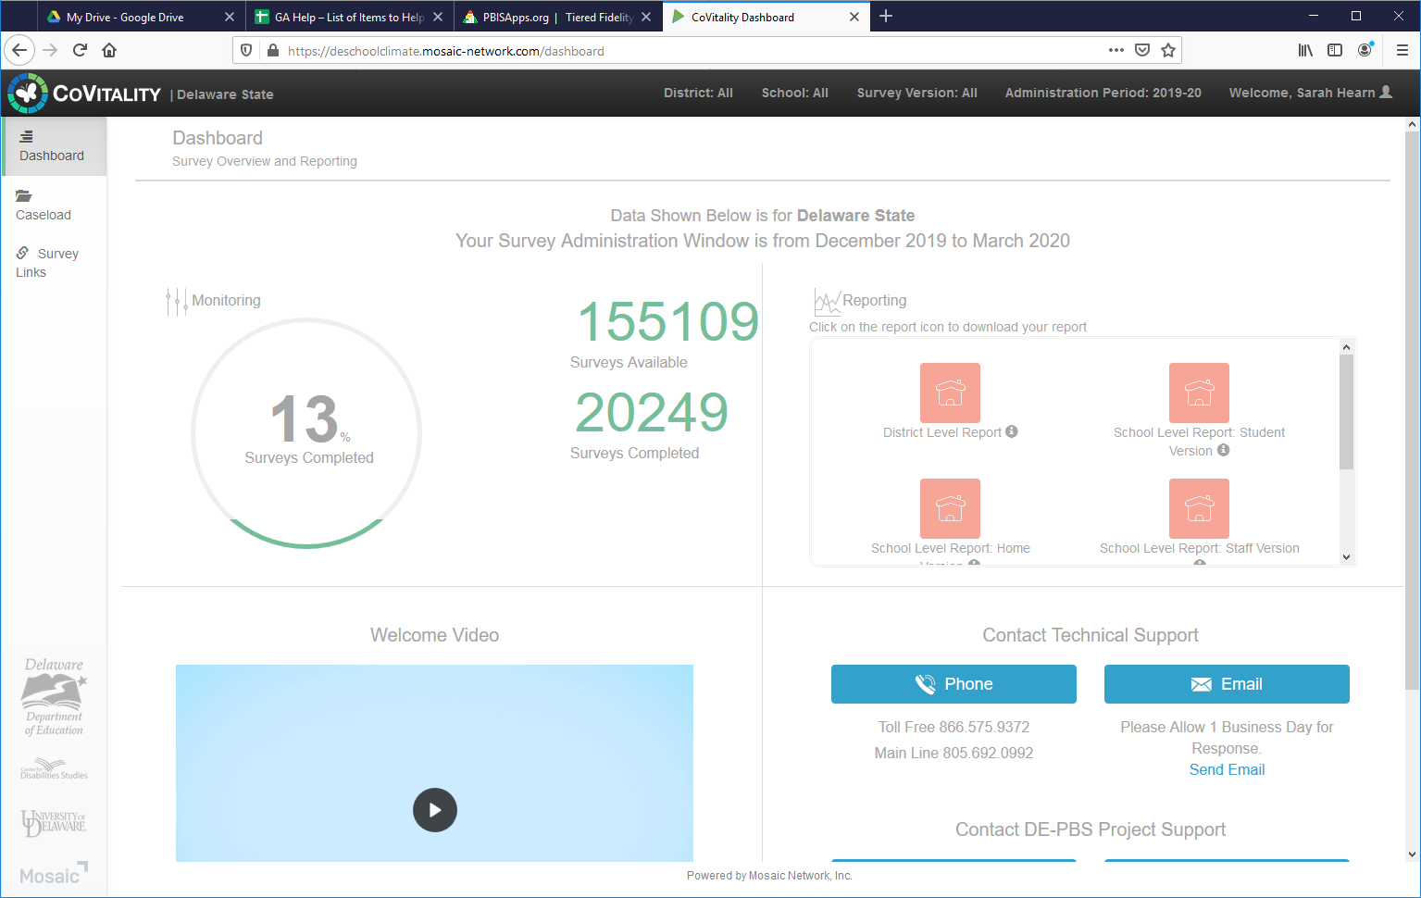
All Surveys 13% Completed

Slide 38
Staff Surveys 33% Completed

Slide 39
Home Surveys 1% Completed

Slide 40
Student Surveys 46% 3-5 Completed & 15% 6-12 Completed

Slide 41
Brainstorm & Idea Sharing
What outreach strategies have you utilized with survey coordinators?
Prompts with general reminders? Prompts for those not yet engaged? Those not reaching sampling goals?
What strategies have you used to acknowledge schools that are on target with completion?

Slide 42
Climate Data Workshop
Typical Agendas include:
State-wide data highlights/trends for current year’s data
Orientation to report interpretation worksheets & action planning / data-sharing tools
Team data time with Project staff available
Distribution of school data reports
Year-Specific Agendas include:
District/School-based presentations
Climate Module resource presentation
Break out session for newbies ☺

Slide 43
Discipline Data Reporting Tool (DDRT)
Templates available on website
Tier 1: Forms & Tools / Program Development & Evaluation
Submission 2x per year
January 17th & June 19th 2020

Slide 44
DE Assessment of Strengths & Needs for PBS - DASNPBS
DE Assessment of Strengths and Needs
Four sections:
Tier 1: Program Development & Evaluation
Prevention: School-wide & Classroom Systems
Correcting Problem Behaviors
Developing Self-Discipline
Staff survey
10 question survey per implementation area
Staff perspective on program strength/weakness for use in planning

Slide 45
Tier 1: Team Self-Assessment DE-PBS Key Feature Status Tracker Tool
Purpose: To support teams to assess implementation in four main program categories & plan next steps
Broken into four evaluation sections
SWPBS Tier 1, Prevention, Correcting Problem Behaviors, and Developing Self-Discipline
Tracker includes:
Key program components for each section
Teams can use these to assess their program and identify areas to modify or build upon
Action plan to develop steps towards improving or modifying program components
Used for ongoing monitoring

Slide 46
Tier 1 Fidelity - Key Feature Evaluation Process
On-site Evaluation (approx. 4 hours)
Sources of Information:
Interviews with administrator, DE-PBS team leader, teachers/staff, students
Review of documents
Schoolwide observations
Tier 1 Fidelity: Key Feature Evaluation Process
DE-PBS Key Feature Evaluation Structure
SW PBS Tier 1: Program Development & Evaluation | Prevention: Implementing SW & CR Systems
Correcting Problem Behavior | Developing Self Discipline

Slide 47
TFI
Monitoring School Intentions and Actions
Tier 2 Workshops embed activities for schools to complete the TFI-Tier2
Tier 2 is always a work in progress so we want to track the progress
Our goal: Participating schools complete Tier 2 TFI 1-2 times per year

Slide 48
Phase Recognition
2019-2020 SY

Slide 49
Phases 1 & 2 – Focus on Tier 1: School-wide PBS
Phase I- Developing a SWPBS System
Products Submitted:
Behavior Matrix
Status Tracker (2 sections)
Reflection Question:
Status Tracker Action Plan
Phase II- Establishing an Advanced SWPBS System
Products Submitted:
DDRT – Data for 2017-18 & 2018-19 SYs
Status Tracker (4 sections)

Slide 50
Phases 3 & 4 – Tier 2: Targeted PBS
Phase III- Developing a Targeted Team (Problem Solving Conversations)
Program Components
Products for Submission
Reflection Prompt - Reflection Prompt - Reflect on list of current interventions used at Tier 2. Select one student successfully supported through a Tier 2 level intervention this year.
Phase IV- Establishing a Targeted Team (Systems Conversations)
Products for Submission
Reflection Prompt – Based on review of overall Tier 2 data from the 2019-2020 school year, what are your proposed next steps for the 2020-2021 school year?

Slide 51
Phase 4- Establishing a Targeted Team (Systems Conversations)
Products for Submission
1) Completed Tier 2 section of the Tiered Fidelity Inventory (TFI)
2) Completed Tier 2 Intervention Tracking Tool (Tabs 1&2) reflective of at least two Tier 2 interventions used during the 2018-2019 SY.
3) Completed “Tier 2 Intervention Table” for one Tier 2 Intervention represented in the Tier 2 Intervention Tracking Tool.

Slide 52
Phase 5 – Tier 3: Individual PBS Problem-solving & Systems
Phase 5 Pilot Pause for 2019-20
Project aligning Tier 2/3 Systems workshop with goals of Phase 5
Planning for strategic outreach to Phase 4 schools in preparation for 2020-2021 SY

Slide 53
Phase Related Timeline
Application finalized and shared with DE-PBS contacts – February 2020
Teams encouraged to begin review & reflection process
If a KFE is needed for application, schools need to connect with coaches for KF Status Tracker & contact Sarah Hearn (skhearn@udel.edu) no later than March 27, 2020
Applications due Friday, June 26, 2020
If confirmation is not received by July 17, 2020 please contact Sarah Hearn.
Notifications sent the week of September 14, 2020

Slide 54
2019-2020 SY Phase Recognition Reminders
Application entails end of the year program reflection; however no need to wait until EoY to begin
Recognition reflects CURRENT year effort; schools maintaining or advancing levels should apply yearly
Note: a school’s current implementation might differ from year prior
Process should be a team effort

Slide 55
Successful applicants have …
Reached out to district coaches & Project staff
Taken time to answer the questions as a team
Been proactive and not waisted until the last minute. Note applications have been designed so that if a team if following MTSS process, the information only needs to be organized
Not waiting until the due date/end of June to complete application and products for submission
NOTE! DE-PBS project wants to award all! We are definitely in favor of recognizing teams for the effort put forth.

Slide 56
Coaching Supports
Do you have district conversations encouraging folks to apply for recognition?
Do you have time available to provide TA in completing the application process?
How do you use the recognition application or process as a tool with your teams?

Slide 57
Universal Screening From Exploration to Installation (Content not covered due to time. Planned for April mtg.)
Screening Resource Guide:
https://sites.google.com/udel.edu/delaware-umhs/home

Slide 58
Mark Your Calendars!
2019-20
DE-PBS Cadre Meeting Dates:
Wednesday, April 8, 2020

Slide 59
Thank you!
WWW.Delawarepbs.org

