Slide 1

Welcome
DE-PBS Cadre
April 8, 2020
Spring will come and so will happiness. Hold on. Life will get warmer.
Writer Anita Krizzan

Slide 2
Meeting Expectations
 | Virtual Meetings
BE ENGAGED | Use of video is encouraged Use Zoom features (polls, reactions, raise hand, etc.) Minimize distractions when possible
BE REFLECTIVE | Share questions you have for full group Note follow up questions for PBS team or other cadre members
BE STRATEGIC | Use time to problem solve with others Share successes, ideas, useful resources Unmute at anytime to ask a question or use raise hand function

Slide 3

Set the Stage & Goals
Connect with each other
Opportunity to share needs and ideas
Share some resources we have gathered
Our focus is addressing the social, emotional and behavioral needs of students, families and staff through MTSS both in the immediate and the long term

Slide 4
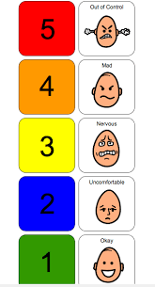

Group Check In: How are you feeling?

Slide 5

Sharing
How are you thinking about social/emotional/behavioral supports?

Slide 6

Agenda for Today
Resource Review
Coach Supports for Team Leaders
Recognition
School Climate
Summer Planning

Slide 7

DE-PBS Resource Review

Slide 8

Family Resources
Have you shared information on family and virtual learning resources with building contacts?
Poll Question

Slide 9
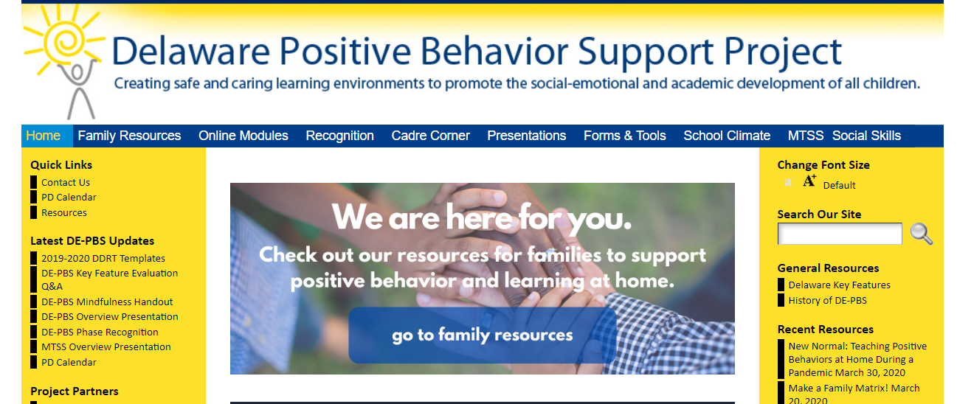
DE-PBS Family Resources
Family Resources Link

Slide 10
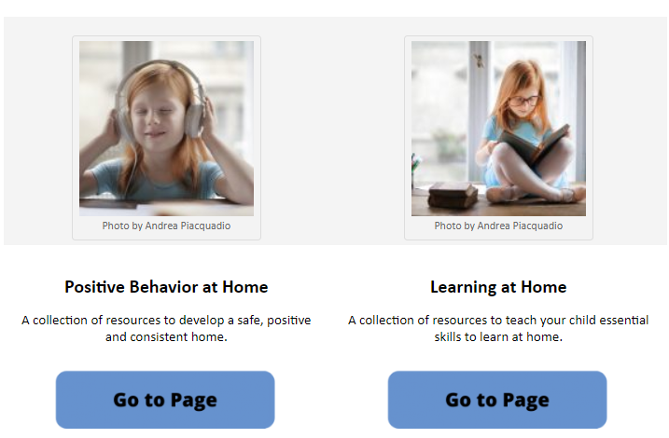
Positive Behavior at Home Link
Learning at Home Link

Slide 11

DE-PBS Family Resources
Supporting Positive Behavior at Home:
Handouts
Helpful Websites
Videos
Supporting Learning at Home:
Links to resources from our friends and partners in Delaware
Delaware DOE
UD ACCESS Project
Handouts
Helpful Websites

Slide 12
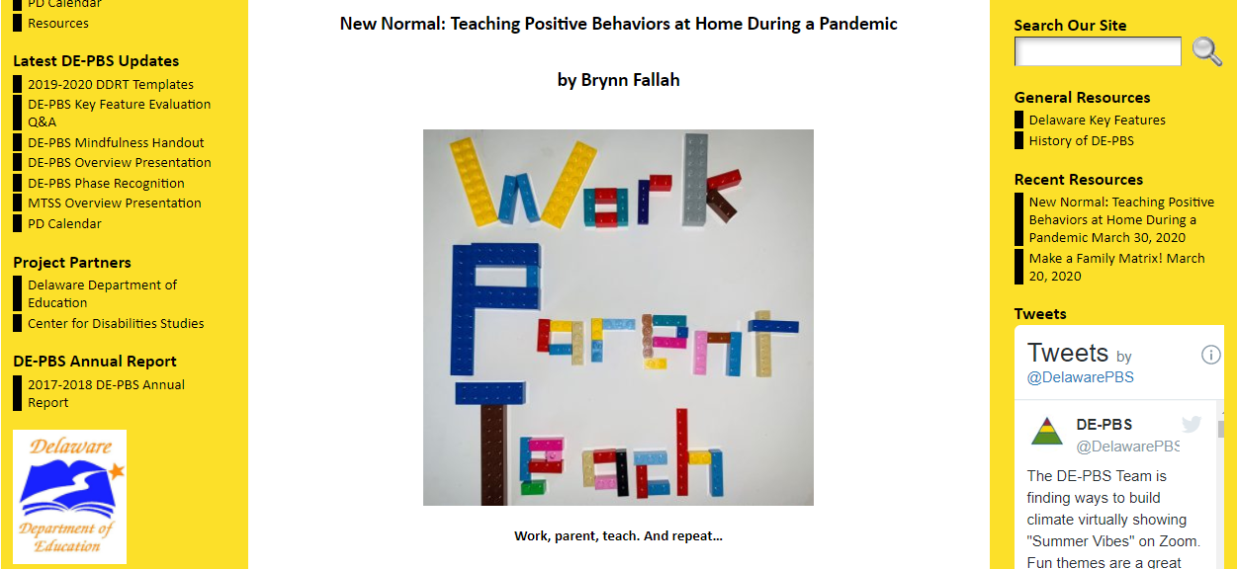
Recent Resources

Slide 13
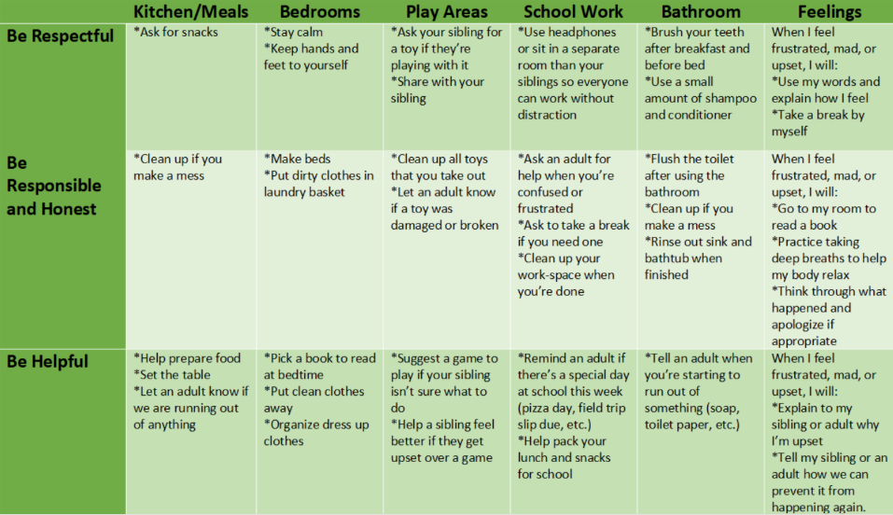
Supporting Positive Behavior at Home - Tool Highlight
Home Matrix

Slide 14
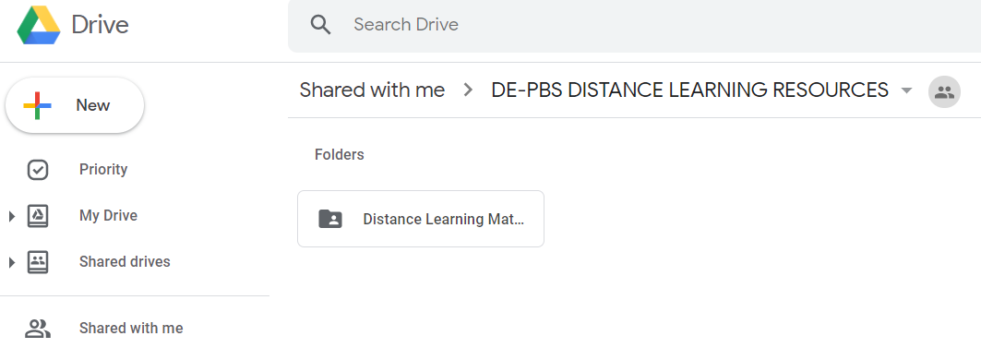
Distance Learning Resources on Google Drive
Distance Learning Google Drive

Slide 15
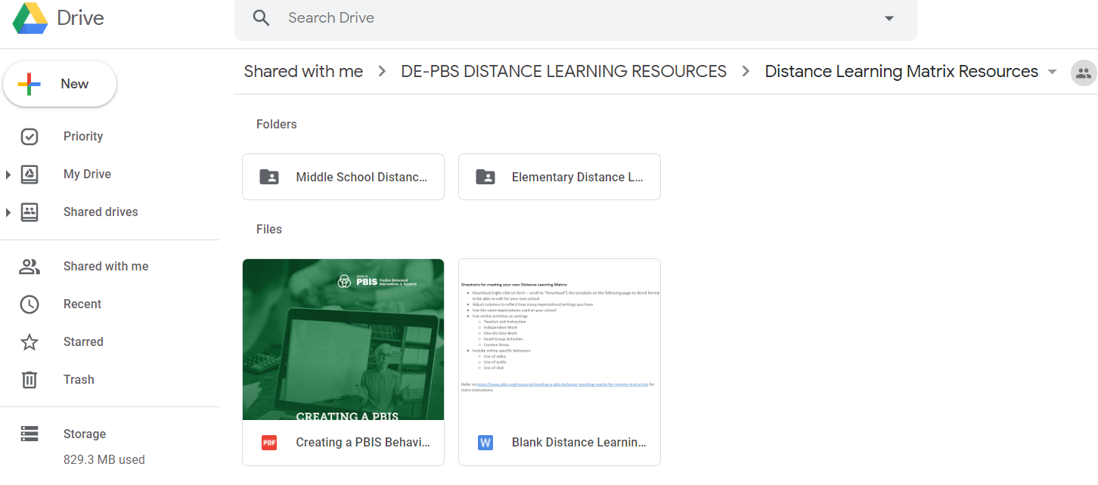
Distance Learning Behavior Matrices

Slide 16
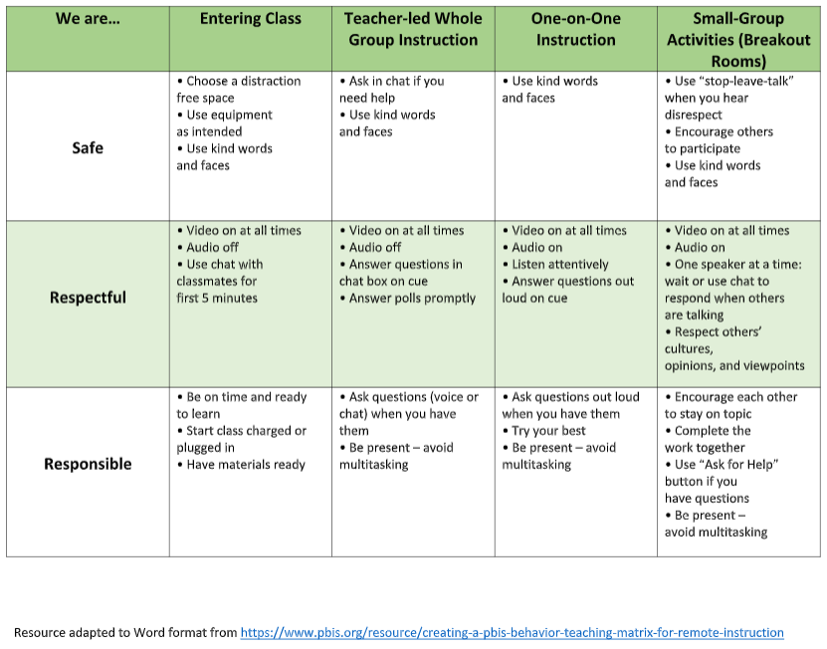
Distance Learning Behavior Matrix Example

Slide 17

Twitter
Follow us and we will follow you back!
@delawarepbs
Communication
Tools
Resources

Slide 18
Professional Development Resources
MTSS/PBS Online Professional Development:
MTSS/PBS Overview
Team Leader Supports
SEL & PBIS Integration
ABCs of IEPs
School Climate Professional Development Resources:
Student Relations & Teacher-Student Relations
School Safety
Bullying Prevention
Student Engagement

Slide 19
Telehealth During Remote Learning
What’s Currently Happening:
Project DelAWARE
Cognitive Behavior Intervention for Trauma in Schools (CBITS) & Functional Family Therapy (FFT)
SAMHSA
Safety Precautions
Privacy/HIPAA
Threat to Cause Harm
Virtual Crisis Response

Slide 20

Coach Supports
for Team Leaders
Tier 1 Team Leaders
Tier 2/3 Team Leaders

Slide 21
Coach Supports
In what ways are you able to connect with your MTSS Team Leaders at this time?
Poll Question

Slide 22

Coach Supports for Team Leaders
Maintaining & Adapting
Best Practices
within the
COVID-19 / Virtual context

Slide 23
Coach Supports for Team Leaders
Best Practices
Systems:
Collaborative team meetings are held
Meeting agendas are used & notes are shared out
Data:
Collect discipline, climate, safety & programming data
Review that data to find specific trends to celebrate & address
Practices:
SW Expectations continue being taught and reinforced
Relevant professional development is determined/provided
Tier 1, 2 & 3
Team Leaders

Slide 24

Maintaining Best Practices
Suggested Tier 1 TL tools
Systems:
Flow of Monthly Team Meeting
SWPBS Team Meeting Minutes Form
Data:
Tier 1 Team Monthly Data Analysis Guide
School-wide Data Review Prompts
Collect Status Tracker data and start action planning
Practices:
SW Matrix for Virtual Learning
Professional development tools for Tier 1
Modules: Climate-related modules, Team Leaders module, SEL/PBS

Slide 25
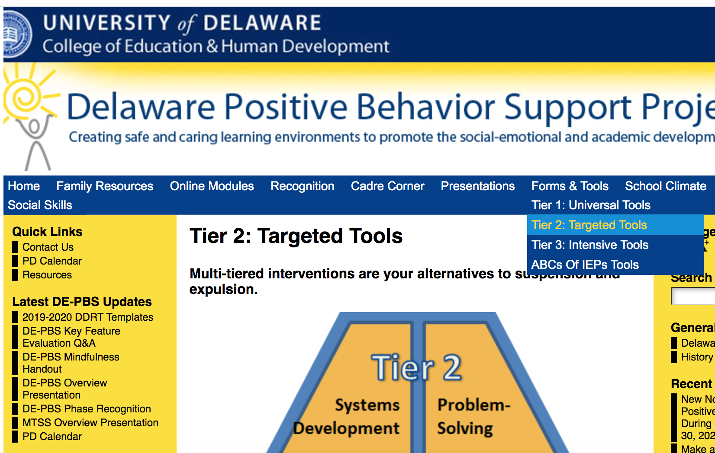
Maintaining Best Practices
Suggested Advanced Tiers TL tools
Systems:
Tier 2 Handbook development
Tier 3: TATE Review
Data:
Review/Update Tier 2 Tracker Tracker
Review referrals for Tier 2/3 services
Practices:
Consider need for additional Tier 2 intervention groups (Hexagon?)
Professional development tools for Advanced Tiers
ABCs of IEPs

Slide 26
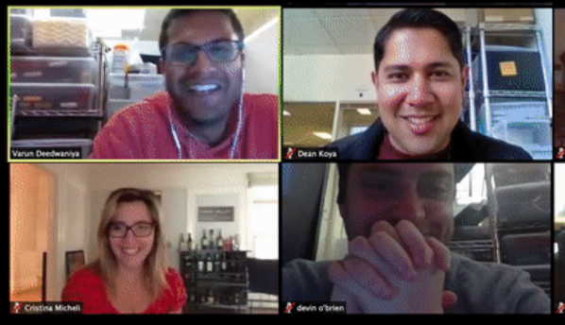
Coach Supports for Team Leaders
How are you adapting MTSS best practices strategies for virtual environment?

Slide 27
What Maintaining & Responding strategies are you trying?
Coaching ideas you loved or would love to share

Slide 28
Coach Supports for Team Leaders
Responding in the virtual context - Tier 1
Systems
Help TLs to determine new team meeting dates/times, if needed
Build a support network for Tier 1 TLs - community counts
Encourage TLs to update Tier 1 communication re; community, family supports
Data
Help TLs to support their school collecting & reviewing additional data
Practices
Helping TLs to work with team to build online learning expectation
Help TLs to consider adapted recognition systems

Slide 29
Coach Supports for Team Leaders
Responding in the virtual context - Tier 2/3
Systems
Help them to determine new team meeting dates/times, if needed
Build a supportive team leader network - community counts
Encourage them to update Tier 2/3 information with community, family supports
Update referral system to address online disengagement
Data
Help them to review new additional referral data
Practices
Help TLs to work with intervention coordinators to adapted interventions for online
Help TLs to work with team to plan ahead for Tier 2/3 needs when school restarts

Slide 30

Thank you for ALL of your coaching...
...and please remember to keep up that self-care!

Slide 31

Recognition
Highlighting
2019-2020 MTSS achievements
&
Providing reflection
and action planning for
2020-2021 MTSS activities

Slide 32
Recognition
Do you feel your schools will want to pursue recognition for their 2019-2020 MTSS efforts?
Poll Question

Slide 33

Recognition
The big picture:
Phase 1 and 2...focus on Tier 1
Phase 3 and 4...focus on Tier 2
Tier 1 and 2 teams in a school can both apply for 2019-2020 Recognition
Your input, the FAQs & the Word versions of the online application questions will help teams decide which phase to go for
All application materials include opportunities for team reflections

Slide 34

Recognition
For more details - check out the guidance tools online:

Slide 35

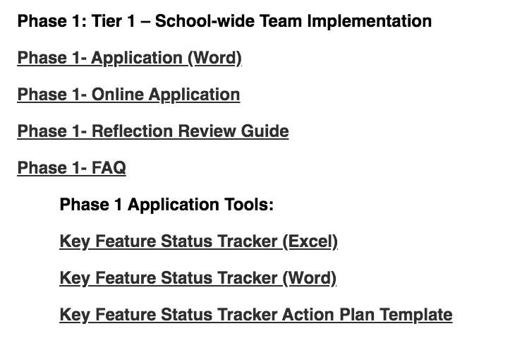
Recognition
The Applications

Slide 36
Recognition
The Guidance

Slide 37
Recognition
Copies of Tools
Needed to Complete the Application

Slide 38
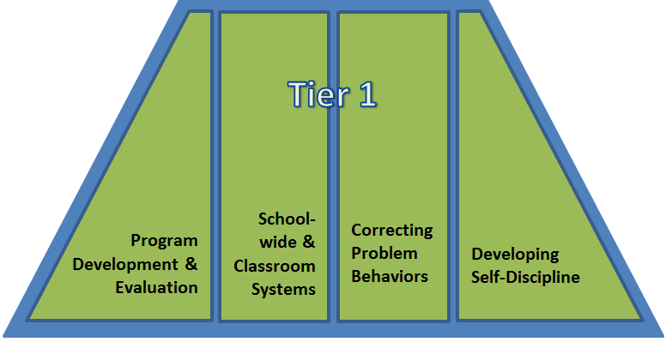
Recognition
More specifically:
Phase 1: Team outlines how team addresses some fundamental components of Tier 1 programming
Phase 2: Team outlines SW reflections/action plans and submits DDRT.

Slide 39
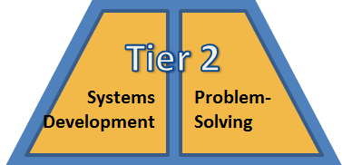
Recognition
More specifically:
Phase 3: Team outlines existing problem solving conversations for individual students
Phase 4: Team outlines their systems-level conversations for evaluating overall Tier 2 effectiveness

Slide 40

Recognition
Dates To Keep in Mind:
Recognition process reflects = 2019-2020 SY
Online submission due date: Friday, 6/26/20
DE-PBS Project receipt sent: Friday, 7/17/20
Notification of recognition phase earned sent: Week of 9/14/20

Slide 41

School Climate
[Add text, Calabri 18]
Poll Question

Slide 42
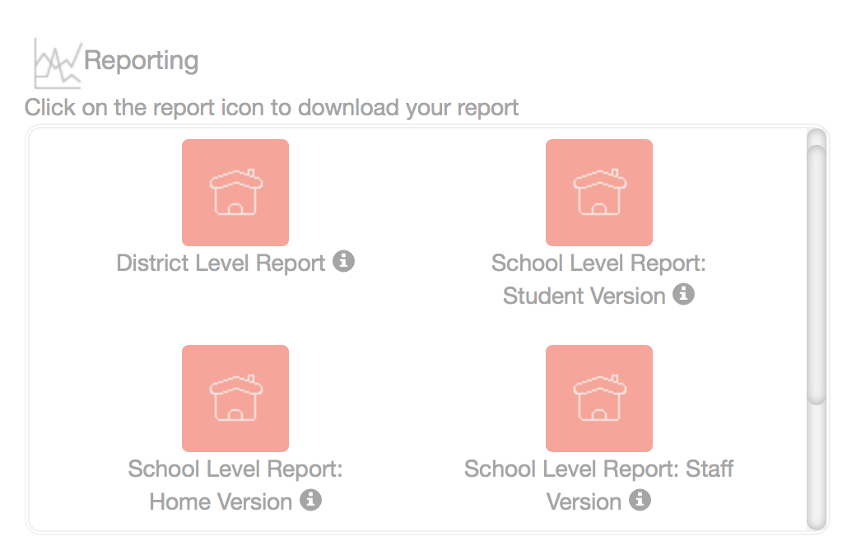
School Climate - Student & Staff - Where do we stand?
Survey window closed March 6th
Reports NOW AVAILABLE! Student & Staff reports can be downloaded as PDF files from the Dashboard

Slide 43
School Climate - HOME - Where do we stand?
Online only - Reports NOW AVAILABLE!
Round 1 - Paper surveys from 75 schools returned to UD for processing
Currently being scanned; data will be cleaned and uploaded into CoVitality
Round 2 - 14 schools received paper surveys, but completed surveys not back to UD before closing
If mailed, these are in state mail system OR UD central mailing. Once open surveys will be scanned & data uploaded into CoVitality

Slide 44
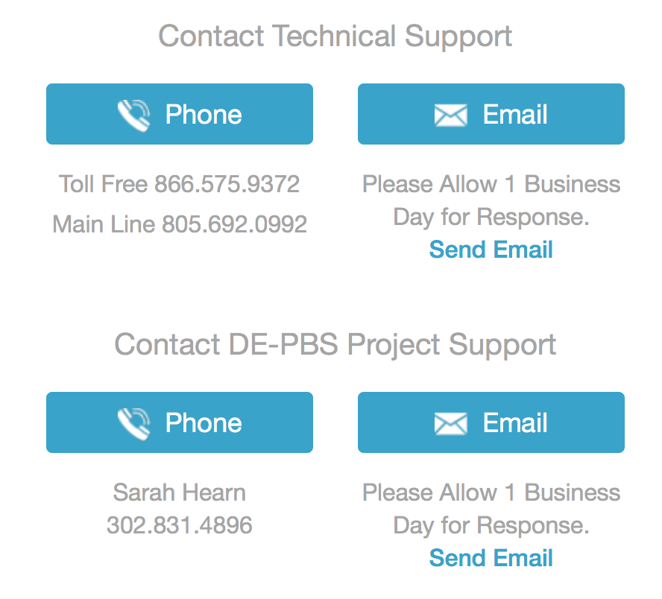
Mosaic - CoVitality App Tech Support

Slide 45
Report Review Resources
IN THE IMMEDIATE WORKS
Review guidance presentation
Interpretation worksheets (aligned with new reports)
Action plan templates
Data sharing templates

Slide 46

Summer Planning
[Add text, Calabri 18]

Slide 47

Self-care Plans
Breathing
Walking
Appreciate all that you are doing
Reading for pleasure
Video call with friend or family
Making something you enjoy

Slide 48
Wrap UP
Reminder to connect with DE-PBS Project Staff as helpful to discuss district-specific ideas, needs, concern, next steps, etc.
Please take a minute to complete the Cadre Evaluation: https://bit.ly/2RgoVkx

Slide 49
Thank you!

