Slide 1
Sharing Your 19-20 School Climate Data with YOUR FAMILIES
Directions for PowerPoint users:
The following is a sample template for sharing your 19-20 DSCS results.
Please read the “notes” section for each slide to help you understand what information we recommend you include per slide.
Please edit this template to meet your needs and the needs of your families. It is okay to add and cut slides to this template.
Recommendations for using this template:
Using screen shots from your DSCS report and notes from interpretation worksheets will save you time in creating informative slides.
Consider giving families time immediately after your presentation to:
share how staff at the school have made them and/or their child feel welcomed in your school
brainstorm ways to improve any areas of concern
CUSTOMIZE ME
Notes:
[Please read the above bullet points in detail. The bottom line is that this template is yours to customize to your school’s needs. We also have a PowerPoint template for sharing DSCS data with staff at delawarepbs.org ]

Slide 2
Our School’s
2019-2020
School Climate Data
____________________________________________________________
[Add Your School Name Here]
Notes:
[Important reminder: The slides and notes included in this template are for your use in sharing school climate data with your families. Feel free to uses this template as is or adapt it according to your needs.]

Slide 3
Your Thoughts and Opinions Matter to Us…
We asked ____ families/parents/guardians to complete this survey so that we could learn what you think about our school.
We received ___ completed surveys – many thanks to those of you who returned your survey!
Your experiences and opinions will be included in our plans as we build on our strengths and work to make improvements.
Notes:
[Important reminder: The slides and notes included in this template are for your use in sharing school climate data with your families. Feel free to uses this template as is or adapt it according to your needs.]

Slide 4
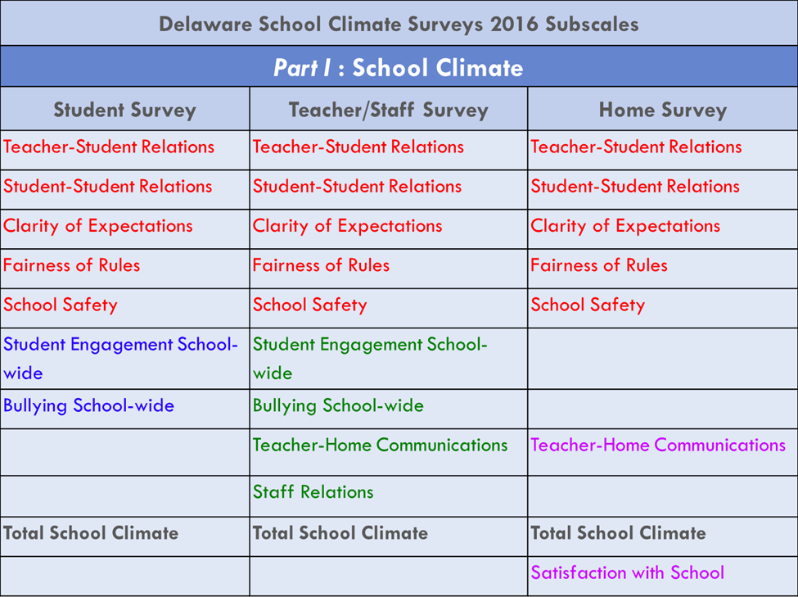
These are the topics covered in Part 1
Notes:
[Use this slide to share what are the subscales on the DSCS. Below is an overview table from the workshop if you want to use it.]
[Important reminder: The slides and notes included in this template are for your use in sharing school climate data with your families. Feel free to uses this template as is or adapt it according to your needs.]

Slide 5
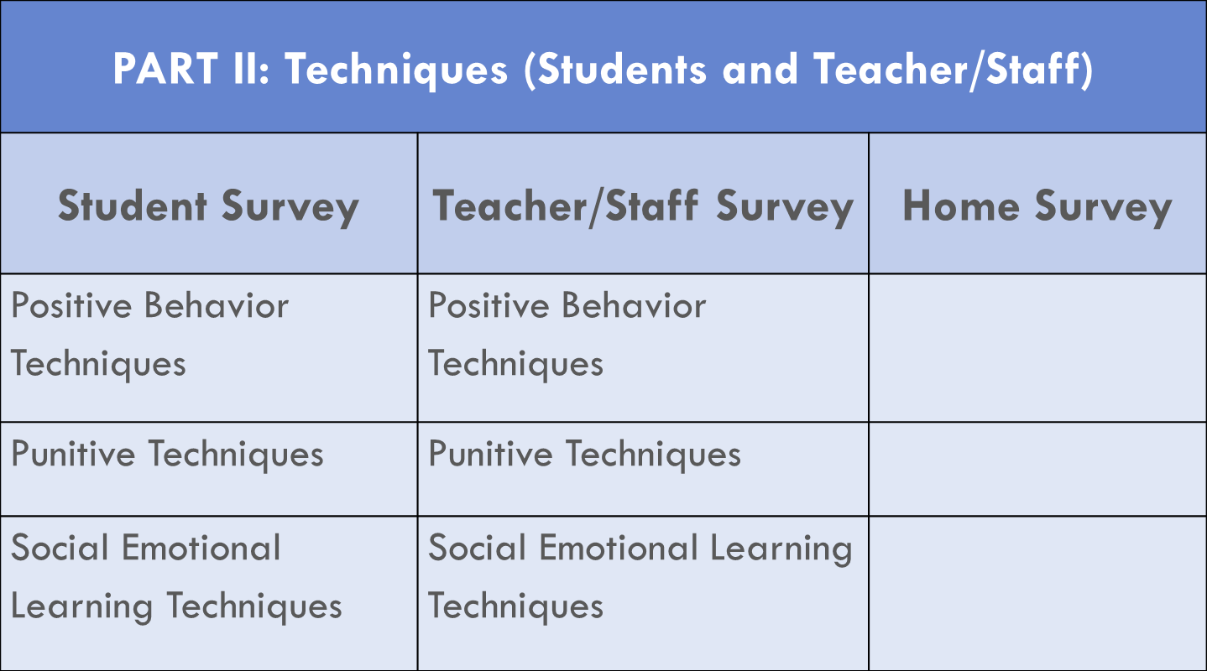
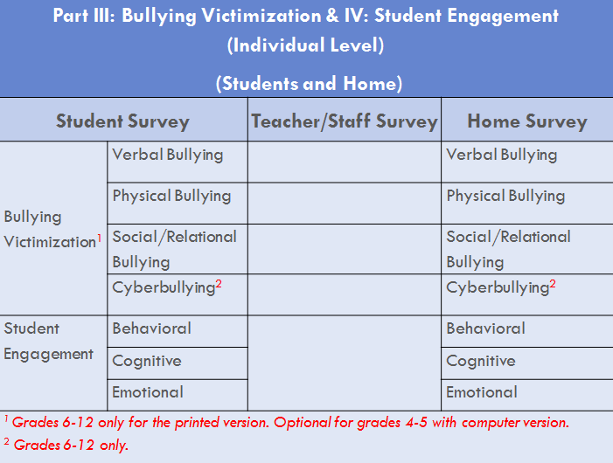
These are the topics covered in Parts 2-5:
Part V: Social Emotional Competencies
Student Survey
Responsible Decision-Making
Social Awareness
Self-Management
Relationship Skills
Notes:
[Use this slide to share what are the subscales on the DSCS. Below are more overview tables from the workshop if you want to use them.]
[Important reminder: The slides and notes included in this template are for your use in sharing school climate data with your families. Feel free to use this template as is or adapt it according to your needs.]

Slide 6
What is the Delaware School Climate Survey?
Has 3 versions:
Student, Staff , and Home
Includes 5 sections:
School Climate
How students, staff, and families feel when in this school.
Techniques
What techniques our staff uses to help manage student behaviors.
Bullying Victimization
How often behaviors related to bullying occur.
Student Engagement
How students are emotionally, cognitively and behaviorally engaged in our school.
Social and Emotional Competencies
To what extent students demonstrate social-emotional skills.
Notes:
[Use this slide to explain how the DSCS is organized.]
[Important reminder: The slides and notes included in this template are for your use in sharing school climate data with your families. Feel free to use this template as is or adapt it according to your needs.]

Slide 7
How People Could Respond to Survey Items
For School Climate, Techniques, Student Engagement:
1 = Disagree a lot
2 = Disagree,
3 = Agree
4 = Agree a lot
For Bullying Victimization:
1 = Never,
2 = Less than once a month,
3 = Once or twice a month,
4 = Once a week,
5 = Several times a week,
6 = Every day
For Social and Emotional Competencies Scale:
1= Not like me at all,
2= Not much like me,
3= Somewhat like me,
4= Very much like me
Notes:
[Use this slide to explain response types on the DSCS.]
[Important reminder: The slides and notes included in this template are for your use in sharing school climate data with your families. Feel free to use this template as is or adapt it according to your needs.]

Slide 8
The Delaware School Climate Survey
Is it a good tool to help us understand and build positive school climate here?
Yes! Thank you (and your child) for completing it ☺
Notes:
[Use this slide to explain that the DSCS is a valid and reliable tool for measuring school climate in your school. Notes from the data workshop are copied below if you want to use them.]
[Important reminder: The slides and notes included in this template are for your use in sharing school climate data with your families. Feel free to use this template as is or adapt it according to your needs.]

Slide 9
Our Results
OUR COMMUNITY MEMBERS COMPLETED…
Part 1: School Climate
Part 2: Techniques
Part 3: Bullying Victimization
Part 4: Student Engagement
Part 5: Social and Emotional Competencies
Notes:
[Use this slide to explain what you are going to share today. We recommend that you cover as much as you can but focus on the average item scores and individual item responses that most pertain to your school. Please delete any parts you didn’t ask staff, students and/or families to respond to.]
[Important reminder: The slides and notes included in this template are for your use in sharing school climate data with your families. Feel free to use this template as is or adapt it according to your needs.]

Slide 10
Important Results
PART 1: School Climate
How we feel when in this school
Notes:
[Use this slide to start discussing Part 1 survey results on the DSCS. Important reminder: The slides and notes included in this template are for your use in sharing school climate data with your families. Feel free to use this template as is or adapt it according to your needs.]
Listed in the slide and below are the SUB-SCALES for students, staff and/or families Part 1 surveys:
When sharing sub-scale trends with your school, we recommend focusing on Total AVERAGE ITEM scores and trends
Teacher-student relationships
Student-student relationships
Student engagement
Clarity of expectations
Fairness of rules
School safety
Bullying school-wide *
Total school climate
✷ A higher score represents an unfavorable response to items on the Bullying School-Wide subscale and the Use of Punitive Techniques subscale.

Slide 11
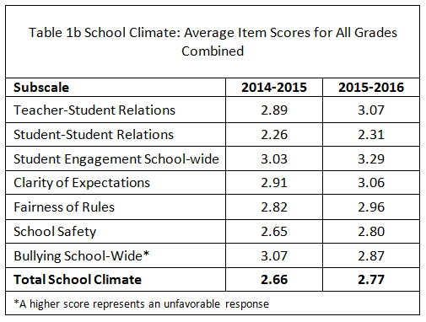
Important Results
PART 1: School Climate
How we feel when in this school…
SAMPLE SCHOOL SLIDE
This is great news folks overall!
What should we keep next year?
Notes:
[This is an example of an adapted slide for this section of the Part 1 data results on the DSCS. Important reminder: The slides and notes included in this template are for your use in sharing school climate data with your families. Feel free to use this template as is or adapt it according to your needs.]
Listed in the slide and below are the SUB-SCALES for students, staff and/or families:
When sharing sub-scale trends with your school, we recommend focusing on Total AVERAGE ITEM scores and trends
Teacher-student relationships
Student relationships
Student engagement
Clarity of expectations
Fairness of rules
School safety
Bullying school-wide *
Total school climate
✷ A higher score represents an unfavorable response to items on the Bullying School-Wide subscale and the Use of Punitive Techniques subscale.

Slide 12
Important Results
PART 2: Techniques
What our staff uses to help manage student behaviors
Notes:
[Use this slide to start discussing Part 2 survey results on the DSCS. Important reminder: The slides and notes included in this template are for your use in sharing school climate data with your families. Feel free to use this template as is or adapt it according to your needs.]
Listed in the slide and below are the SUB-SCALES for students and staff Part 2 surveys (items were not on the family survey) :
When sharing sub-scale trends with your school, we recommend focusing on Total AVERAGE ITEM scores and trends
Positive behavior techniques
Punitive techniques*
Social emotional learning techniques
✷ A higher score represents an unfavorable response to items on the Bullying School-Wide subscale and the Use of Punitive Techniques subscale.

Slide 13
Important Results
PART 3: Bullying
How often behaviors related to bullying occur
Notes:
[Use this slide to start discussing Part 3 survey results on the DSCS. Important reminder: The slides and notes included in this template are for your use in sharing school climate data with your families. Feel free to use this template as is or adapt it according to your needs.]
Listed in the slide and below are the SUB-SCALES for student and family Part 3 surveys (items were not on the staff survey) :
When sharing sub-scale trends with your school, we recommend focusing on Total AVERAGE ITEM scores and trends
Physical bullying
Verbal bullying
Social/relational bullying
Cyberbullying

Slide 14
Important Results
PART 4: Student Engagement
How students are emotionally, cognitively and
behaviorally engaged in our school
Notes:
[Use this slide to start discussing Part 4 survey results on the DSCS. Important reminder: The slides and notes included in this template are for your use in sharing school climate data with your families. Feel free to use this template as is or adapt it according to your needs.]
Listed in the slide and below are the SUB-SCALES for students and family Part 4 surveys (items were not on the staff survey) :
When sharing sub-scale trends with your school, we recommend focusing on Total AVERAGE ITEM scores and trends
Cognitive engagement
Behavioral Engagement
Emotional engagement

Slide 15
Important Results
PART 5: Social and Emotional Competencies
To what extent students demonstrate social-emotional skills
Notes:
[Use this slide to start discussing Part 4 survey results on the DSCS. Important reminder: The slides and notes included in this template are for your use in sharing school climate data with your families. Feel free to use this template as is or adapt it according to your needs.]
Listed in the slide and below are the SUB-SCALES for students and family Part 4 surveys (items were not on the staff survey) :
When sharing sub-scale trends with your school, we recommend focusing on Total AVERAGE ITEM scores and trends
Cognitive engagement
Behavioral Engagement
Emotional engagement

Slide 16
DISCUSSION
What were our strengths?
What surprises were there?
What are our next steps in regard to improving school climate, techniques, bullying, student engagement and/or social and emotional competencies?
School Climate Workshop, 5/7/13
Notes:
[Use this slide to debrief the presentation and start any additional action planning for next year. If you have the Positive Behavior Support project in your school, your school-wide team members could be a great resource for leading or facilitating this conversation.]
[Important reminder: The slides and notes included in this template are for your use in sharing school climate data with your staff. Feel free to use this template as is or adapt it according to your needs.]

Slide 17
Looking for More Information?
Find out how we are working on positive school climate at our school at our school’s website: [insert website here] .
Find out more about our district bullying-related policies at [insert website here].
Find out more about the Delaware School Climate Survey at http://delawarepbs.org .
Find out about parent resources through the Delaware Parent Information Center website at http://www.picofdel.org/
Notes:
[Use this slide to share important resources with families. Add as many as you think you need and/or your families want. Sharing a contact name and number regarding the DSCS at your school might be appropriate, as would any PTA/PTO information.]
Important reminder: The slides and notes included in this template are for your use in sharing school climate data with your families. Feel free to use this template as is or adapt it according to your needs.]

Slide 18
for your support
now and in the future
to build positive school climate
at our school!
School Climate Workshop, 5/7/13
Notes:
Important reminder: The slides and notes included in this template are for your use in sharing school climate data with your families. Feel free to use this template as is or adapt it according to your needs.]

