Slide 1

Sharing Your 19-20 School Climate Data with STAFF
Directions for PowerPoint users:
The following is a sample template for sharing your 19-20 DSCS results.
Please read the “notes” section for each slide to help you finalize what goes where in your presentation ☺
Please edit this template to meet your needs and the needs of your staff. It is okay to add and cut slides to this template.
Recommendations for using this template:
Using screen shots from your DSCS report and notes from interpretation worksheets will save you time in creating informative slides.
Consider having your SWPBS Team help to create and lead your final PowerPoint presentation
Consider giving staff time immediately after your presentation to:
  brainstorm ways to improve any areas of concern (Action Planning)
  share strategies that they feel help to address any identified areas of strength or concerns
CUSTOMIZE ME
Notes:
[Please read the above bullet points in detail. The bottom line is that this template is yours to customize to your school’s needs. We also have a PowerPoint template for sharing DSCS data with families at delawarepbs.org ]

Slide 2
Our School’s
2019-2020
School Climate Data
____________________________________________________________
[Add Your School Name Here]
Notes:
[Important reminder: The slides and notes included in this template are for your use in sharing school climate data with your staff. Feel free to use this template as is or adapt it according to your needs.]

Slide 3
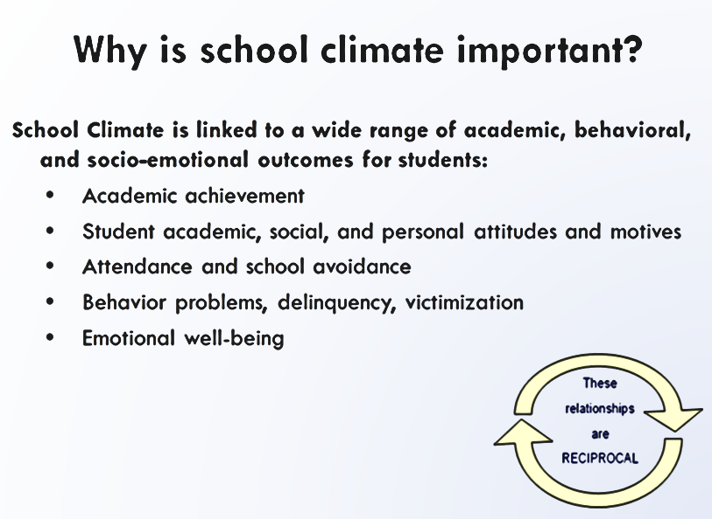
Notes:
[Use this slide to share research findings related to why it was important for your school to collect school climate data. Notes from the data workshop are copied below if you want to use them.]
“We know from the literature that School climate is important because it is linked to a wide range of academic, behavioral, and social-emotional outcomes:
Academic achievement
(Battistich, Solomon, Kim, Watson, & Schaps, 1995; Brookover et al., 1978; Brand, Felner, Shim, Seitsinger, & Dumas, 2003; Griffith, 1999)
Student attitudes
(Battistich et al., 1995)
Attendance and school avoidance
(Brand, 2003; Welsh, 2000)
Delinquency
(Gottfredson, 2005; Welsh, 2000, Way, 2007)
Attitudes toward and use of illegal substances
(Brand, 2003)
Victimization
(Gottfredson, 2005; Welsh, 2000)
Behavior problems
(Battistich & Horn, 1997; Battistich, Solomon, Kim, Watson, & Schaps, 1995; Kuperminc, Leadbeater, & Blatt, 2001; Kuperminc et al., 1997; Loukas & Robinson, 2004; Shochet, Dadds, Ham, & Montague, 2006; Welsh, 2000; Wilson, 2004).”
[Important reminder: The slides and notes included in this template are for your use in sharing school climate data with your staff. Feel free to use this template as is or adapt it according to your needs.]

Slide 4
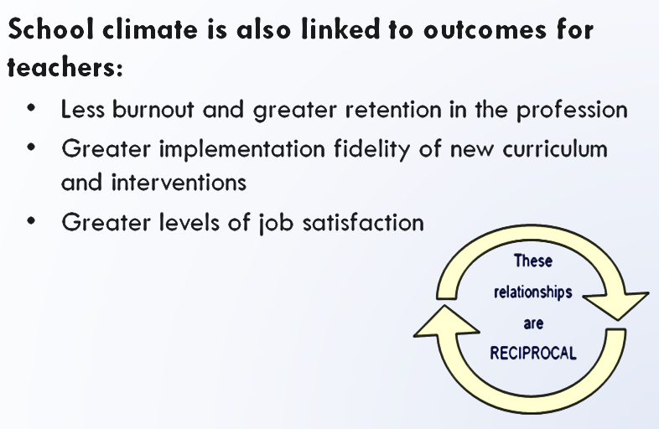
Notes:
[Use this slide to share research findings related to why it was important for your school to collect school climate data. Notes from the data workshop are copied below if you want to use them.]
“We know from the literature that School climate is important because it is linked to a wide range of academic, behavioral, and social-emotional outcomes:
Academic achievement
(Battistich, Solomon, Kim, Watson, & Schaps, 1995; Brookover et al., 1978; Brand, Felner, Shim, Seitsinger, & Dumas, 2003; Griffith, 1999)
Student attitudes
(Battistich et al., 1995)
Attendance and school avoidance
(Brand, 2003; Welsh, 2000)
Delinquency
(Gottfredson, 2005; Welsh, 2000, Way, 2007)
Attitudes toward and use of illegal substances
(Brand, 2003)
Victimization
(Gottfredson, 2005; Welsh, 2000)
Behavior problems
(Battistich & Horn, 1997; Battistich, Solomon, Kim, Watson, & Schaps, 1995; Kuperminc, Leadbeater, & Blatt, 2001; Kuperminc et al., 1997; Loukas & Robinson, 2004; Shochet, Dadds, Ham, & Montague, 2006; Welsh, 2000; Wilson, 2004).”
[Important reminder: The slides and notes included in this template are for your use in sharing school climate data with your staff. Feel free to use this template as is or adapt it according to your needs.]

Slide 5
The Delaware School Climate Survey
Is the DSCS
valid and reliable?
Notes:
[Use this slide to proactively address staff questions regarding whether or not the DSCS is even a valid and reliable tool for measuring school climate in your school. Notes from the data workshop are copied in subsequent slides if you want to use them.]
[Important reminder: The slides and notes included in this template are for your use in sharing school climate data with your staff. Feel free to use this template as is or adapt it according to your needs.]

Slide 6

Yes…
Please check out it out for yourself if you have more questions…
http://wh1.oet.udel.edu/pbs/technical-manual-for-school-climate-surveys/
Notes:
[Use this slide to explain that the DSCS is a valid and reliable tool for measuring school climate in your school. Notes from the data workshop are copied below if you want to use them.]
[Important reminder: The slides and notes included in this template are for your use in sharing school climate data with your staff. Feel free to use this template as is or adapt it according to your needs.]

Slide 7
Yes…
Please check out it out for yourself if you have more questions…
Bear, G. G., Gaskins, C., Blank, J. , & Chen, F. F. (2011). Delaware School Climate Survey-Student: Its factor structure, concurrent
validity, and reliability. Journal of School Psychology.
Bear, G., Yang, C., Pell, M., & Gaskin, C. (2014).Validation of a brief measure of teachers' perceptions of school climate: Relations
to student achievement and suspensions. Learning Environments Research.
Bear, G.G., Yang, C., & Pasipanodya, E. (2015). Assessing school climate: Validation of a brief measure of the perceptions of
parents. Journal of Psychoeducational Assessment.
Yang, C., Bear, G. G., Chen, F.F., Zhang, W., Blank, J.C., & Huang, X.S. (2013). Students‘perceptions of school climate in the U.S. and China. School Psychology Quarterly.
Bear, G.G., Mantz, L., Glutting, J., Yang, C., & Boyer, D. (2015). Differences in bullying victimization between students with and
without disabilities. School Psychology Review.
Bear, G.G., Holst, B., Lisboa, C., Chen, D., Yang, C., & Chen, F.F. (in press). A Brazilian Portuguese survey of school climate: Evidence of validity and reliability. International Journal of School and Educational Psychology.
Bear, G.G., Chen, D.D., Mantz, L., Yang, C., Huang, X., & Shiomi, K. (2016). Differences in classroom removals and use of praise and rewards in American, Chinese, and Japanese schools. Teaching and Teacher Education, 53(1), 41-50.
Mantz, L. S., Bear, G. G., Yang, C., & Harris, A. (2016). The Delaware Social-Emotional Competency Scale (DSECS-S): Evidence of Validity and Reliability. Child Indicators Research, 1-21.
Notes:
[Use this slide to explain that the DSCS is a valid and reliable tool for measuring school climate in your school. Notes from the data workshop are copied below if you want to use them.]
[Important reminder: The slides and notes included in this template are for your use in sharing school climate data with your staff. Feel free to use this template as is or adapt it according to your needs.]

Slide 8
The Delaware School Surveys
Has 3 versions: Student, Staff and Home
Includes 5 sections:
  School Climate (Students, Staff and Families share their perceptions regarding school features that are link to components of positive school climate.)
  Techniques (Students and Staff share their perceptions of the extent to staff use positive behavior, punitive/corrective and social emotional learning techniques.)
  Bullying Victimization (Students are asked to report their own experience of victimization, and families are asked to report the experience of their child.)
  Student Engagement (Students and families share their perceptions of student cognitive/behavioral and emotional engagement in school and school tasks.)
  Social and Emotional Competencies (Students share to what extent they demonstrate social emotional competency skills.)
Notes:
[Use this slide to explain how the DSCS is organized in general. You can delete the name of any versions or sections that were not completed at your school this year.]
[Important reminder: The slides and notes included in this template are for your use in sharing school climate data with your staff. Feel free to use this template as is or adapt it according to your needs.]

Slide 9
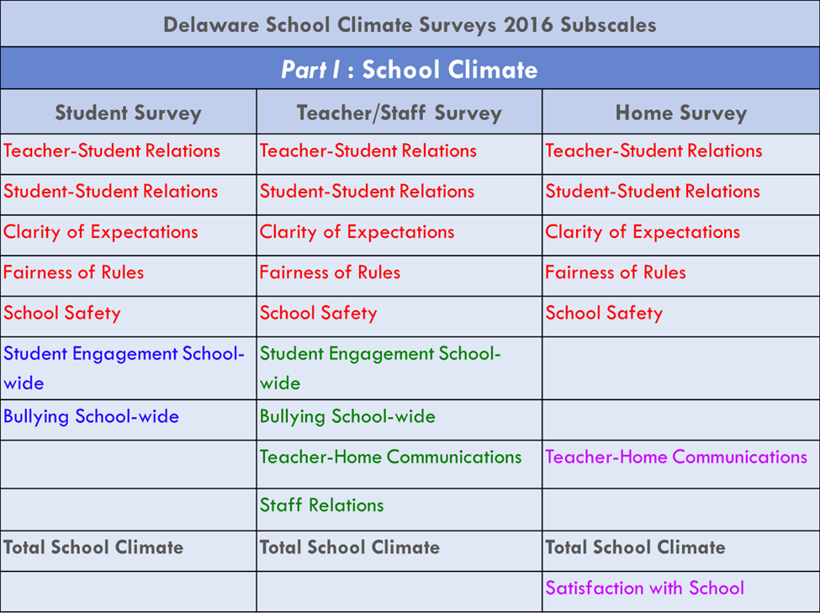
Delaware School Surveys Subscales: Part 1
Notes:
[Use this slide to share what are the subscales on Part 1 of the DSCS.]
[Important reminder: The slides and notes included in this template are for your use in sharing school climate data with your staff. Feel free to use this template as is or adapt it according to your needs.]

Slide 10
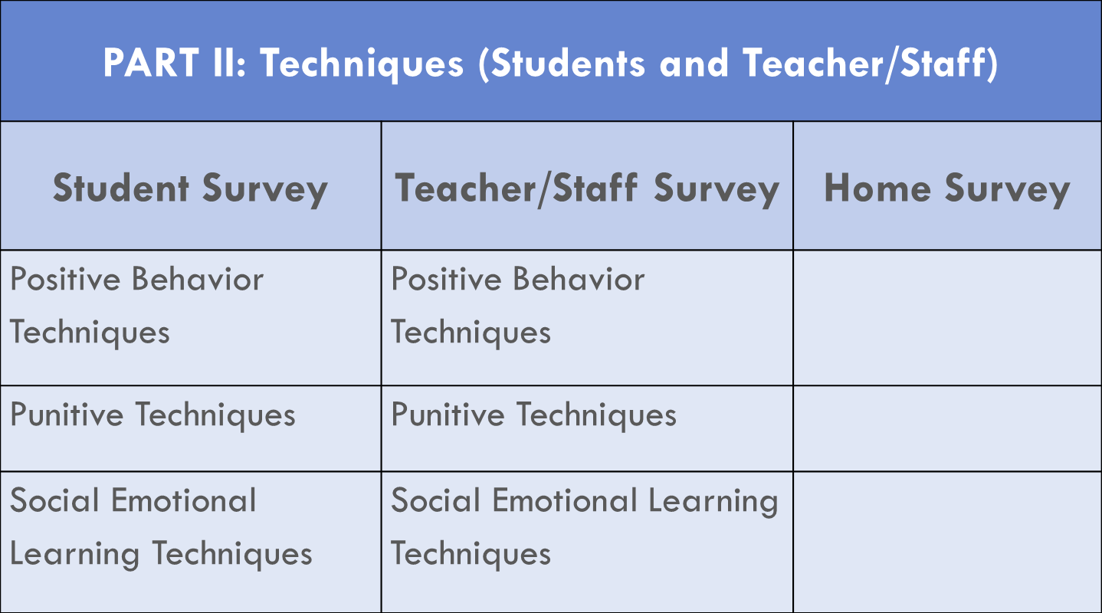
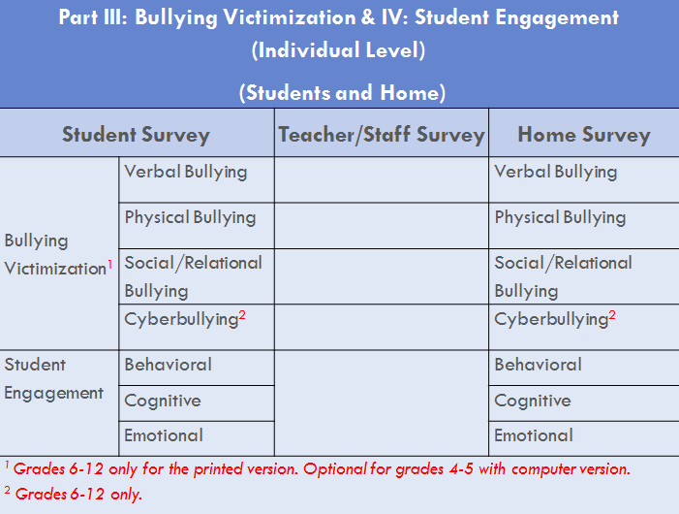
Delaware School Surveys Subscales: Parts 2-5
Part V: Social Emotional Competencies
Student Survey
Responsible Decision-Making
Social Awareness
Self-Management
Relationship Skills
Notes:
[Use this slide to share what are the subscales on Part 2, 3, and 4 of the DSCS.]
[Important reminder: The slides and notes included in this template are for your use in sharing school climate data with your staff. Feel free to use this template as is or adapt it according to your needs.]

Slide 11
Response Codes
  For School Climate, Techniques, Student Engagement:
  1 = Disagree a lot
  2 = Disagree,
  3 = Agree
  4 = Agree a lot
  For Bullying Victimization:
  1 = Never,
  2 = Less than once a month,
  3 = Once or twice a month,
  4 = Once a week,
  5 = Several times a week,
  6 = Every day
  For Social and Emotional Competencies Scale:
  1= Not like me at all,
  2= Not much like me,
  3= Somewhat like me,
  4= Very much like me
Notes:
[Use this slide to explain response types on the DSCS.]
[Important reminder: The slides and notes included in this template are for your use in sharing school climate data with your staff. Feel free to use this template as is or adapt it according to your needs.]

Slide 12
The Final Report
REPORTS AVAILABLE:
  Student responses (if collected)
  Staff responses (if collected)
  Home responses (if collected)
INCLUDES THE FOLLOWING DATA:
  Average Item Score (year-to –year comparison & current year) = what was our school’s average score for each subscale
  Individual Item Responses = shows how our students, staff and/or families responded to individual survey items
  Standard Scores = comparison to other schools like our school
COVERS UP TO FIVE SCALES
  School Climate
  Techniques
  Bullying Victimization
  Student Engagement
  Social and Emotional Competencies
Notes:
[Use this slide to explain what you are going to share today. We recommend that you cover as much as you can but focus on the average item scores and individual item responses that most pertain to your school.]
[Important reminder: The slides and notes included in this template are for your use in sharing school climate data with your staff. Feel free to use this template as is or adapt it according to your needs.]

Slide 13

The Final Report
REPORTS AVAILABLE:
  Student responses (if collected)
  Staff responses (if collected)
  Home responses (if collected)
COVERS UP TO FIVE SCALES
  School Climate (up to 11 subscales)
  Techniques (staff uses to manage/instruct students)
  Bullying Victimization (up to 4 different types)
  Student Engagement (at individual level)
  Social and Emotional Competencies (taught to students)
INCLUDES THE FOLLOWING DATA:
  Average Item Score = what was the average score for each subscale
  Individual Item Responses = shows how our students, staff and/or families responded to individual survey statements
  Standard Scores = comparison to other schools like our school
Notes:
[Use this slide to explain what average item scores (AIS) and individual item responses (IIR) are, if you share them. The analogy is that AISs and IIRs look at your school’s data only (the averages are based only on survey results from your school).]
[We understand that you want cover as much data with your staff as possible but please note, the DE-PBS Project recommends that you focus on the average item scores and/or individual item responses that most pertain to your school.]
[Important reminder: The slides and notes included in this template are for your use in sharing school climate data with your staff. Feel free to use this template as is or adapt it according to your needs.]

Slide 14

The Final Report
REPORTS AVAILABLE:
  Student responses (if collected)
  Staff responses (if collected)
  Home responses (if collected)
COVERS UP TO FIVE SCALES
  School Climate
  Techniques
  Bullying
  Engagement of Students
  Social and Emotional Competencies
INCLUDES THE FOLLOWING DATA:
  Average Item Score (year-to –year comparison & current year) = what was our school’s average score for each subscale
  Individual Item Responses = shows how our students, staff and/or families responded to individual survey items
  Standard Scores = comparison to other schools like our school
Notes:
[Use this slide to explain what standard scores (SS) are, if you share them. The analogy here is that this scores shows how your staff, student and home perceptions compared to the perceptions of staff, students and families across all schools like your school (for example, if you are a middle school, your SS show how your school results compare to other middle schools that completed the DSCS).]
[Important reminder: The slides and notes included in this template are for your use in sharing school climate data with your staff. Feel free to use this template as is or adapt it according to your needs.]

Slide 15
CAUTIONS:
  To Middle and High Schools:
  In general, perceptions of school climate become lower with increasing grades (not shown in standard scores, but shown in other two scores).
  ALL Grade Levels:
  Scores tend to be lowest for Student Relations
  Lower for African Americans
  Lower if your school has high free and reduced lunch count
Notes:
[You can use this slide to proactively address common teacher questions regarding negative data trends.]
[Important reminder: The slides and notes included in this template are for your use in sharing school climate data with your staff. Feel free to use this template as is or adapt it according to your needs.]

Slide 16
Our Results
  OUR COMMUNITY MEMBERS COMPLETED…
    Part 1: School Climate Scale
    Part 2: Techniques Scale
    Part 3: Bullying Victimization Scale
    Part 4: Student Engagement Scale
    Part 5: Social and Emotional Competencies Scale
Notes:
[Use this slide to explain what you are going to share in the rest of the PowerPoint.]
[We understand that you want cover as much data with your staff as possible but please note, the DE-PBS Project recommends that you focus on the average item scores and/or individual item responses that most pertain to your school.]
[Important reminder: The slides and notes included in this template are for your use in sharing school climate data with your staff. Feel free to use this template as is or adapt it according to your needs.]

Slide 17

PART 1: School Climate
Our STUDENT Survey Results
7 SUB-SCALES | Notable scores and/or trends
Teacher-student relationships
Student-student relationships
Student engagement school-wide
Clarity of expectations
Fairness of rules
School safety
Bullying school-wide *
Total school climate
✷ A higher score represents an unfavorable response.
Notes:
[Use this slide to start discussing student survey results on the DSCS. Feel free to delete the existing tables on this slide and replace them with other tables or graphs from your original report (cutting and pasting will save time! ☺).When sharing sub-scale trends with your school, we recommend focusing on Total AVERAGE ITEM scores and trends]
[Listed in the slide and below are the SUB-SCALES for students.
Teacher-student relationships
Student-student relationships
Student engagement school-wide
Clarity of expectations
Fairness of rules
School safety
Bullying school-wide *
Total school climate
✷ A higher score represents an unfavorable response to items on the Bullying School-Wide subscale and the Use of Punitive Techniques subscale.
[Important reminder: The slides and notes included in this template are for your use in sharing school climate data with your staff. Feel free to use this template as is or adapt it according to your needs. For example, go ahead and delete any slides relating to parts you didn’t ask staff, students and/or families to respond to.]

Slide 18
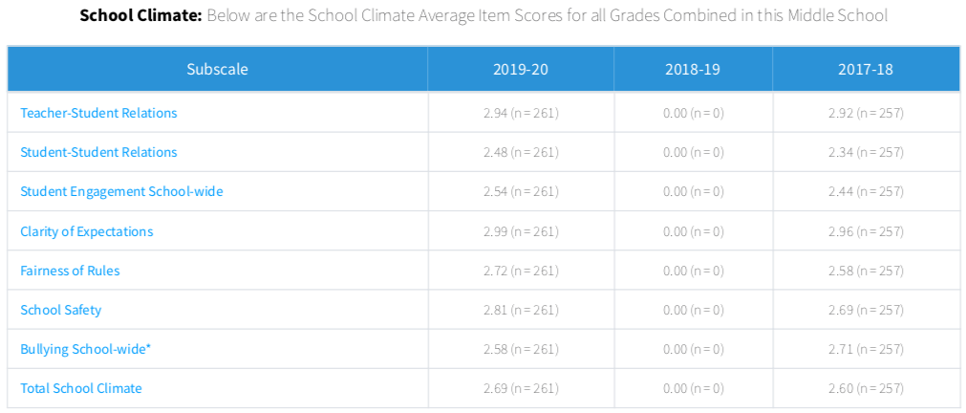
PART 1: School Climate
Our STUDENT Survey Results
SAMPLE SCHOOL SLIDE
This is great news folks overall ! How do you think our 3 climate-focused events this year influenced this?☺ What should we keep next year?
Notes:
[Important reminder: The slides and notes included in this template are for your use in sharing school climate data with your staff. Feel free to use this template as is or adapt it according to your needs. For example, above is a sample of how you can could edit this PowerPoint template by adding a table cut directly out of your DSCS report. This “new” slide highlights positive climate trends with staff (instead of the table originally included in this template).]
[We recommend that your school administration and/or SWPBS team use or create slides that will prompt your staff to use your climate data to action plan around that success the next year.]

Slide 19
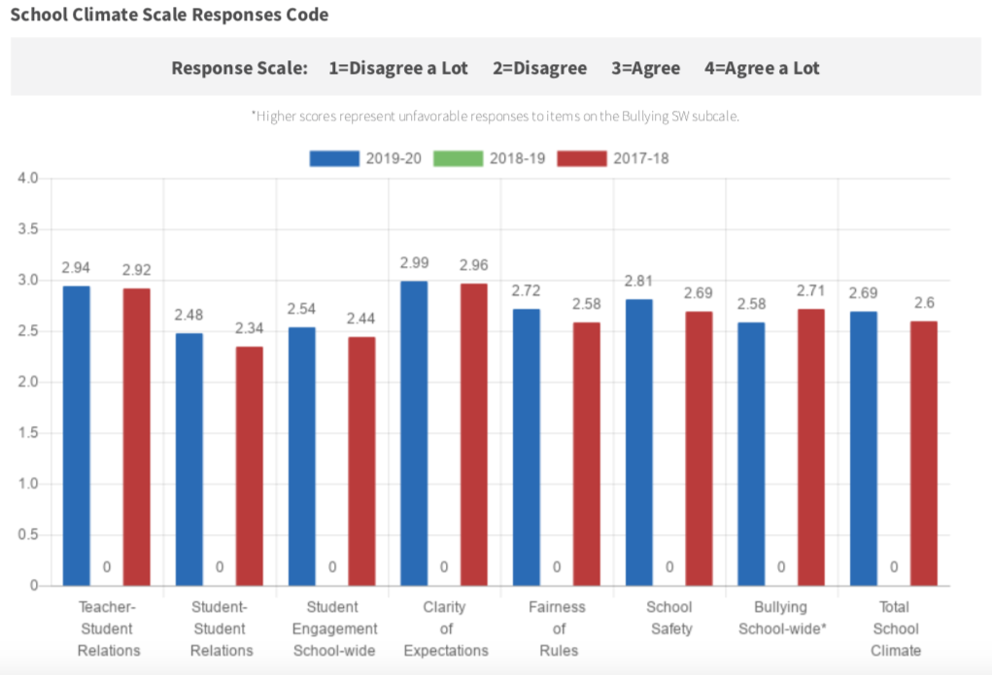
PART 1: School Climate
Our STUDENT Survey Results
SAMPLE SCHOOL SLIDE
So, it looks like we have a little work to do on building student relationships. Where do you want to start on this? When can we ask our students for their ideas?
Notes:
[Important reminder: The slides and notes included in this template are for your use in sharing school climate data with your staff. Feel free to use this template as is or adapt it according to your needs. For example, above is a sample of how you can could edit this PowerPoint template by adding a table cut directly out of your DSCS report. This “new” slide highlights problematic climate trends with staff (instead of the table originally included in this template).]
[We recommend that your school administration and/or SWPBS team use or create slides that will prompt your staff to use your climate data to action plan around that success the next year.]

Slide 20

PART 1: School Climate
Our STAFF Survey Results
9 SUB-SCALES (see next slide too) | Notable scores and/or trends
Teacher-student relationships
Student-student relationships
Student engagement schoolwide
Clarity of expectations
Fairness of rules
Notes:
[Use this slide to start discussing teacher survey results on the DSCS. Feel free to delete the existing tables on this slide and replace them with other tables or graphs from your original report (cutting and pasting will save time! ☺).When sharing sub-scale trends with your school, we recommend focusing on Total AVERAGE ITEM scores and trends]
[Listed in the slide and below are five of the SUB-SCALES for staff:
Teacher-student relationships
Student-student relationships
Student engagement school-wide
Clarity of expectations
Fairness of rules
[Important reminder: The slides and notes included in this template are for your use in sharing school climate data with your staff. Feel free to use this template as is or adapt it according to your needs.]

Slide 21
PART 1: School Climate
Our STAFF Survey Results
9 SUB-SCALES (continued) | Notable scores and/or trends
School safety
Bullying school-wide*
Teacher-home communication
Staff relations
Total school climate
✷ A higher score represents an unfavorable response to items on the Bullying School-Wide subscale and the Use of Punitive Techniques subscale.
Notes:
[Use this slide to start discussing teacher survey results on the DSCS. Feel free to delete the existing tables on this slide and replace them with other tables or graphs from your original report (cutting and pasting will save time! ☺). When sharing sub-scale trends with your school, we recommend focusing on Total AVERAGE ITEM scores and trends]
[Listed in the slide and below are five more SUB-SCALES for staff:
School safety
Bullying school-wide*
Teacher-home communication
Staff relations
Total school climate
✷ A higher score represents an unfavorable response to items on the Bullying School-Wide subscale and the Use of Punitive Techniques subscale.]
[Important reminder: The slides and notes included in this template are for your use in sharing school climate data with your staff. Feel free to use this template as is or adapt it according to your needs.]

Slide 22

PART 1: School Climate
Our HOME Survey Results
7 SUB-SCALES | Notable scores and/or trends
Teacher-student relationships
Student-student relationships
Clarity of expectations
Fairness of rules
School safety
Teacher-home communications
Satisfaction with school
Total school climate
Parent satisfaction
Notes:
[Use this slide to start discussing home survey results on the DSCS. Feel free to delete the existing tables on this slide and replace them with other tables or graphs from your original report (cutting and pasting will save time! ☺). When sharing sub-scale trends with your school, we recommend focusing on Total AVERAGE ITEM scores and trends]
[Listed in the slide and below are the 7 SUB-SCALES for home:
Teacher-student relationships
Student-student relationships
Clarity of expectations
Fairness of rules
School safety
Teacher-home communication
Satisfaction with school
Total school climate
Parent satisfaction (subscale not included in total school climate score, but should be reviewed separately)
[Important reminder: The slides and notes included in this template are for your use in sharing school climate data with your staff. Feel free to use this template as is or adapt it according to your needs.]

Slide 23
Our Results
  OUR COMMUNITY MEMBERS COMPLETED…
    Part 1: School Climate Scale
    Part 2: Techniques Scale
    Part 3: Bullying Victimization Scale
    Part 4: Student Engagement Scale
    Part 5: Social and Emotional Competencies Scale
Notes:
[Use this slide to explain what you are going to share today. We recommend that you cover as much as you can but focus on the average item scores and individual item responses that most pertain to your school.]
[Important reminder: The slides and notes included in this template are for your use in sharing school climate data with your staff. Feel free to use this template as is or adapt it according to your needs. For example, please delete any parts you didn’t ask staff, students and/or families to respond to.]

Slide 24
PART 2: Techniques
Our STUDENT Survey Results
3 SUB-SCALES | Notable scores and/or trends
Positive techniques
Punitive techniques*
Social emotional learning techniques
✷ A higher score represents an unfavorable response.
Notes:
[Use this slide to start discussing student survey results on the DSCS. Feel free to delete the existing tables on this slide and replace them with other tables or graphs from your original report (cutting and pasting will save time! ☺). When sharing sub-scale trends with your school, we recommend focusing on Total AVERAGE ITEM scores and trends]
Listed in the slide and below are the SUB-SCALES for students:
Positive techniques
Punitive techniques*
Social emotional learning techniques
✷ A higher score represents an unfavorable response to items on the Use of Punitive Techniques subscale.
[Important reminder: The slides and notes included in this template are for your use in sharing school climate data with your staff. Feel free to use this template as is or adapt it according to your needs.]

Slide 25
PART 2: Techniques
Our STAFF Survey Results
3 SUB-SCALES | Notable scores and/or trends
Positive techniques
Punitive techniques*
Social emotional learning techniques
✷ A higher score represents an unfavorable response.
Notes:
[Use this slide to start discussing staff survey results on the DSCS. Feel free to delete the existing tables on this slide and replace them with other tables or graphs from your original report (cutting and pasting will save time! ☺). When sharing sub-scale trends with your school, we recommend focusing on Total AVERAGE ITEM scores and trends]
[Listed in the slide and below are the SUB-SCALES for students:
Positive techniques
Punitive techniques*
Social emotional learning techniques
✷ A higher score represents an unfavorable response to items on the Use of Punitive Techniques subscale.]
[Important reminder: The slides and notes included in this template are for your use in sharing school climate data with your staff. Feel free to use this template as is or adapt it according to your needs.]

Slide 26
Our Results
  OUR COMMUNITY MEMBERS COMPLETED…
    Part 1: School Climate Scale
    Part 2: Techniques Scale
    Part 3: Bullying Victimization Scale
    Part 4: Student Engagement Scale
    Part 5: Social and Emotional Competencies Scale
Notes:
[Use this slide to explain what you are going to share today. We recommend that you cover as much as you can but focus on the average item scores and individual item responses that most pertain to your school. Go ahead and delete any parts you didn’t ask staff, students and/or families to respond to.]
[Important reminder: The slides and notes included in this template are for your use in sharing school climate data with your staff. Feel free to use this template as is or adapt it according to your needs.]

Slide 27
PART 3: Bullying Victimization
Our STUDENT Survey Results
Up to 4 SUB-SCALES | Notable scores and/or trends
Physical bullying
Verbal bullying
Social/relational bullying
Cyberbullying (6-12 grade only)
Notes:
[Use this slide to start discussing student survey results on the DSCS.]
Listed in the slide and below are the SUB-SCALES for students:
Physical bullying
Verbal bullying
Social/relational bullying
Cyberbullying
[Important reminder: The slides and notes included in this template are for your use in sharing school climate data with your staff. Feel free to use this template as is or adapt it according to your needs.]

Slide 28
PART 3: Bullying Victimization
Our HOME Survey Results
Up to 3 SUB-SCALES | Notable scores and/or trends
Physical bullying
Verbal bullying
Social/relational bullying
Cyberbullying
Notes:
[Use this slide to start discussing home survey results on the DSCS.]
Listed in the slide and below are the SUB-SCALES for home:
Physical bullying
Verbal bullying
Social/relational bullying
[Important reminder: The slides and notes included in this template are for your use in sharing school climate data with your staff. Feel free to use this template as is or adapt it according to your needs.]

Slide 29
Our Results
  OUR COMMUNITY MEMBERS COMPLETED…
    Part 1: School Climate Scale
    Part 2: Techniques Scale
    Part 3: Bullying Victimization Scale
    Part 4: Student Engagement Scale
    Part 5: Social and Emotional Competencies Scale
Notes:
[Use this slide to explain what you are going to share today. We recommend that you cover as much as you can but focus on the average item scores and individual item responses that most pertain to your school. Go ahead and delete any parts you didn’t ask staff, students and/or families to respond to.]
[Important reminder: The slides and notes included in this template are for your use in sharing school climate data with your staff. Feel free to use this template as is or adapt it according to your needs.]

Slide 30
PART 4: Student Engagement
Our STUDENT Survey Results
3 SUB-SCALES | Notable scores and/or trends
Cognitive
Behavioral
Emotional
Notes:
[Use this slide to start discussing student survey results on the DSCS.]
Listed in the slide and below are the SUB-SCALES for students:
Cognitive
Behavioral
Emotional
[Important reminder: The slides and notes included in this template are for your use in sharing school climate data with your staff. Feel free to use this template as is or adapt it according to your needs.]

Slide 31
PART 4: Student Engagement
Our HOME Survey Results
3 SUB-SCALES | Notable scores and/or trends
Cognitive
Behavioral
Emotional
Notes:
[Use this slide to start discussing home survey results on the DSCS.]
Listed in the slide and below are the SUB-SCALES for home:
Cognitive
Behavioral
Emotional
[Important reminder: The slides and notes included in this template are for your use in sharing school climate data with your staff. Feel free to use this template as is or adapt it according to your needs.]

Slide 32
Our Results
  OUR COMMUNITY MEMBERS COMPLETED…
    Part 1: School Climate
    Part 2: Techniques
    Part 3: Bullying Victimization
    Part 4: Student Engagement
    Part 5: Social and Emotional Competencies
Notes:
[Use this slide to explain what you are going to share today. We recommend that you cover as much as you can but focus on the average item scores and individual item responses that most pertain to your school. Go ahead and delete any parts you didn’t ask staff, students and/or families to respond to.]
[Important reminder: The slides and notes included in this template are for your use in sharing school climate data with your staff. Feel free to use this template as is or adapt it according to your needs.]

Slide 33
PART 5: Social Emotional Competencies
Our STUDENT Survey Results
4 SUB-SCALES | Notable scores and/or trends
Responsible Decision Making
Social Awareness
Self- Management
Relationship Skills
Notes:
[Use this slide to start discussing student survey results on the DSCS.]
[Use this slide to start discussing student survey results on the DSCS.]
Listed in the slide and below are the SUB-SCALES for students:
Responsible Decision Making
Social Awareness
Self- Management
Relationship Skills
[Important reminder: The slides and notes included in this template are for your use in sharing school climate data with your staff. Feel free to use this template as is or adapt it according to your needs.]

Slide 34
    DISCUSSION
  What were our strengths?
  What surprises were there?
  What are our next steps in regard to improving school climate, techniques, bullying and/or student engagement?
School Climate Workshop, 5/7/13
Notes:
[Use this slide to debrief the presentation and start any additional action planning for next year. If you have the Positive Behavior Support project in your school, your school-wide team could be a great resource for leading or facilitating this conversation.]
[Important reminder: The slides and notes included in this template are for your use in sharing school climate data with your staff. Feel free to use this template as is or adapt it according to your needs.]

Slide 35
    Action Planning
School Climate Focus Areas of concern | Additional data to review | Strategy Ideas/ Immediate Steps | Who is responsible? | When? Timeline Notes
School Climate Workshop, 5/7/13
Notes:
[Use this slide to debrief the presentation and start any additional action planning for next year. If you have the Positive Behavior Support project in your school, your school-wide team could be a great resource for leading or facilitating this conversation.]
[Important reminder: The slides and notes included in this template are for your use in sharing school climate data with your staff. Feel free to use this template as is or adapt it according to your needs.]

Slide 36
SAMPLE SCHOOL SLIDE
    Action Planning
School Climate Focus Areas of concern | Additional data to review | Strategy Ideas/ Immediate Steps | Who is responsible? | When? Timeline Notes
All areas |  | Share DSCS results with families: 1) In newsletter through SWPBS article and 2) At back-to-school night Draft up 2 paragraphs and pick 2 graphs from the report for the article | Ms. Hearn | June newsletter & Aug. event
Student-Staff Relationships | Strengths & Needs Assessment for PBS (Prevention area) | Try to improve how students perceive staff caring about their problems. Ask SGA students for feedback before summer break (student task force?) | SWPBS Team | Aug-Sept – get feedback from students and staff; Sept-Nov. try at least 1 improvement activity
School Climate Workshop, 5/7/13
Notes:
[Above is a sample action plan generated by a staff discussion of school climate data. Again, if you have the Positive Behavior Support project in your school, your school-wide team could be a great resource for leading or facilitating this conversation.]
[Important reminder: The slides and notes included in this template are for your use in sharing school climate data with your staff. Feel free to use this template as is or adapt it according to your needs.]

Slide 37

for your efforts
now and in the future
to build positive school climate
in our school!
School Climate Workshop, 5/7/13
Notes:
[Important reminder: The slides and notes included in this template are for your use in sharing school climate data with your staff. Feel free to use this template or adopt it according to your needs.]

