Slide 1
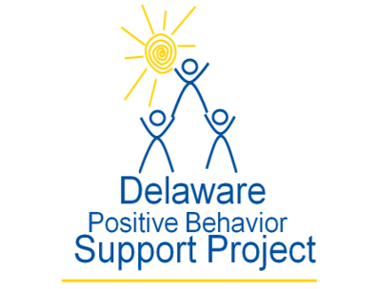
Crisis Response During COVID-19: System and Practice Considerations for School and District Crisis Team Members
May 5, 2020
Hosted by DE-PBS Project
www.delawarepbs.org

Slide 2
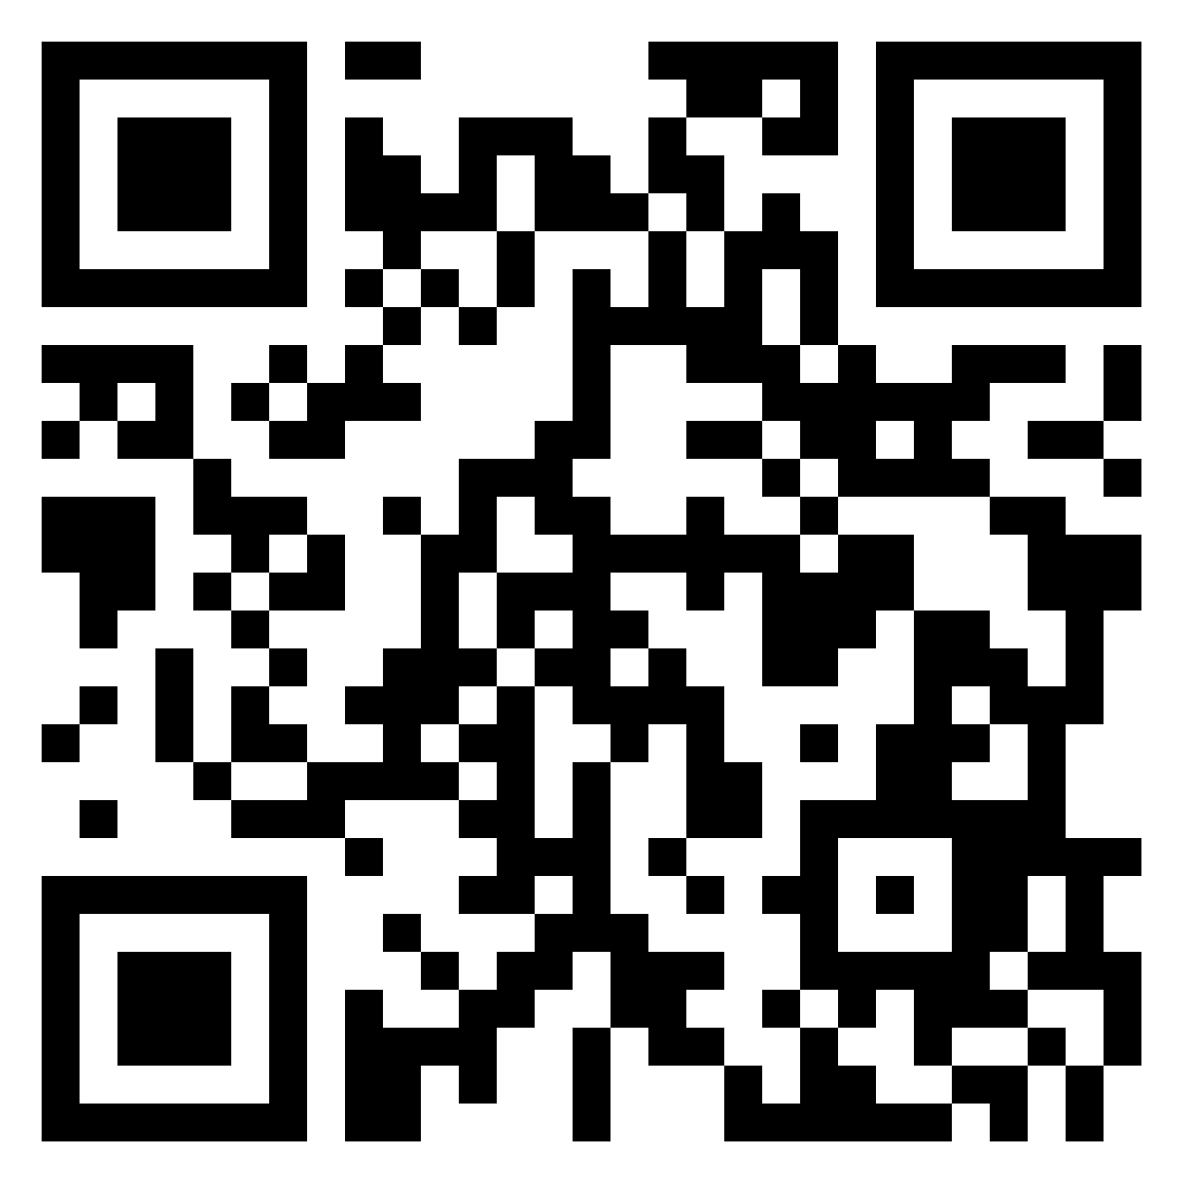
WEBINAR LOGISTICS
Scan QR Code for Padlet Access
KEEP YOUR VIDEO OFF
COMPLETE SURVEY FOR PDMS HOURS
USE THE CHAT BOX TO ASK QUESTIONS
USE PADLET TO SHARE RESOURCES AND IDEAS

Slide 3
www.delawarepbs.org

Slide 4
The DE-PBS Project serves as a technical assistance center for the Delaware DOE to actualize the vision to create safe and caring learning environments that promote the social-emotional and academic development of all children.
The statewide initiative is designed to build the knowledge and skills of Delaware educators in the concepts and evidence-based practices of Positive Behavior Support (PBS) as a Multi-tiered System of Support (MTSS).

Slide 5
 | Virtual Meetings
BE ENGAGED | Use Zoom features (reactions, chat box) Use Padlet to find and share resources/ideas Minimize distractions when possible
BE REFLECTIVE | Share questions you have for presenters via chat Note follow up questions for presenters & DE-PBS team
BE SUPPORTIVE | Share successes, ideas, useful resources via Padlet Be patient with technology issues Understand we are learning together

Slide 6
How deep is the mud? Depends who you ask. We all go through the same stuff differently.

Slide 7
A few things to ground us in MTSS thinking

Slide 8
Intensive
Few
Continuum of Support Logic for ALL
Targeted
Some
More important now than ever
Universal
All

Slide 9
BASELINE PHASE
On-going supports for fidelity implementation of evidence-based practices
CONTEXT FOR ACTION
PHASE CHANGE
Covid-19 pandemic: illness, death, disruption & trauma
Achievement & opportunity gaps
Reactive discipline
Discrimination by race, ethnicity, disability, etc.
Bullying & harassment
Antisocial behavior
School, family, & community gun violence
Non-scientific decision making
Negative classroom & school climate
Mental illness
Substance abuse & addiction
Organizational inefficiency
“NEW NORMAL” PHASE
Re-calibration & renovation of school organization & functioning
Unemployment
Homelessness
Hunger & poverty
Mental & physical illness
Discrimination & harassment
Domestic violence & child abuse
Family disruption & change
Achievement loss
EDUCATION
Employment
Business & commerce
Family structure & functioning
Recreation leisure
Housing & transportation
Medical & mental health care
Public assistance
Federal & state leadership
Can’t turn on broken light switch
From George Sugai Keynote for the OSPI Virtual MTSS Fest, April 22, 2020

Slide 10
Reactive Ineffective Responses to Crisis
Subjective decision making
Train & hope
1-time training events
Non-evidence-based practices
Numerous and siloed practices
Low quality implementation of evidence-based practices
Adapted from George Sugai Keynote for the OSPI Virtual MTSS Fest, April 22, 2020

Slide 11
Effective Responses
All things you already know and do
Trauma-informed decision making
Prevention-based behavioral sciences
Tiered support systems
Data-based decision-making teaming
Continuous coached professional development
High fidelity implementation
Proactive, competent, informed leadership and team leadership
Adapted from George Sugai’s Keynote for the OSPI Virtual MTSS Fest, April 22, 2020

Slide 12
Positive Behavioral Interventions and Supports (PBIS) for Continuous Improvement and Alignment of Initiatives
is a Multi-Tiered System of Supports (MTSS) Framework
Supporting culturally equitable Targets including social/emotional competence & academic achievement
OUTCOMES
Supporting culturally knowledgeable Staff Behavior
team-based leadership and coordination
professional development, coaching, and content expertise
Supporting culturally valid Data-based Decision Making
universal screening
progress monitoring
evaluation of fidelity
SYSTEMS
DATA
PRACTICES
Midwest PBIS Network 2/7/19. Adapted from:
“What is a systems Approach in school-wide PBIS?” OSEP Technical Assistance on Positive Behavioral Interventions and Supports. https://www.pbis.org/school
McIntosh, K.& Goodman, S. (2016). Integrated Multi-Tiered Systems of Support: Blending RTI and PBIS. New York: Guilford Press.
Supporting Student Behavior
three-tiered continuum of culturally relevant evidence-based interventions
Notes:
12

