Slide 1

Using MTSS to Keep SEL a Priority When Reopening Schools
June 25, 2020

Slide 2
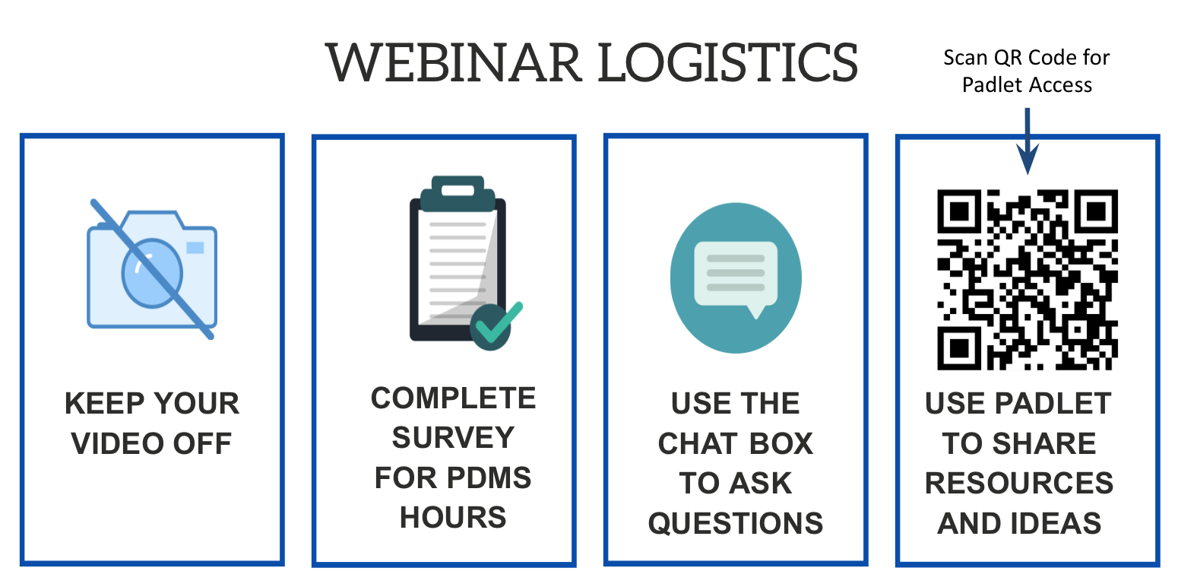

Slide 3
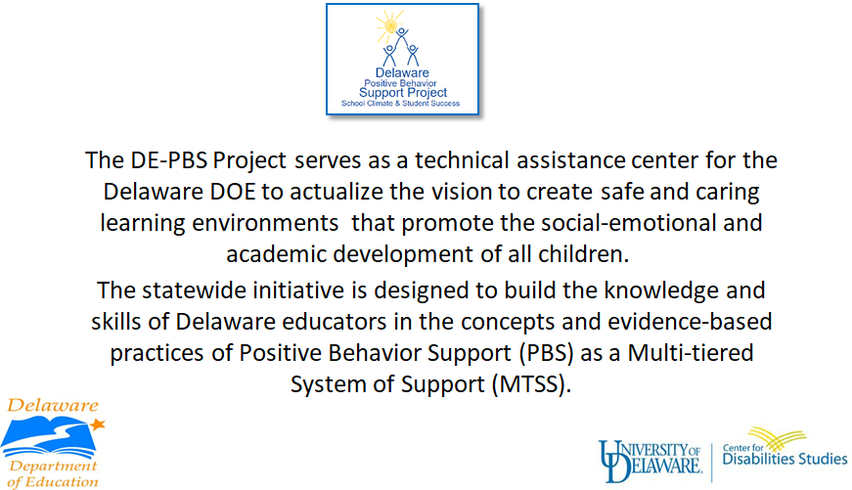

Slide 4




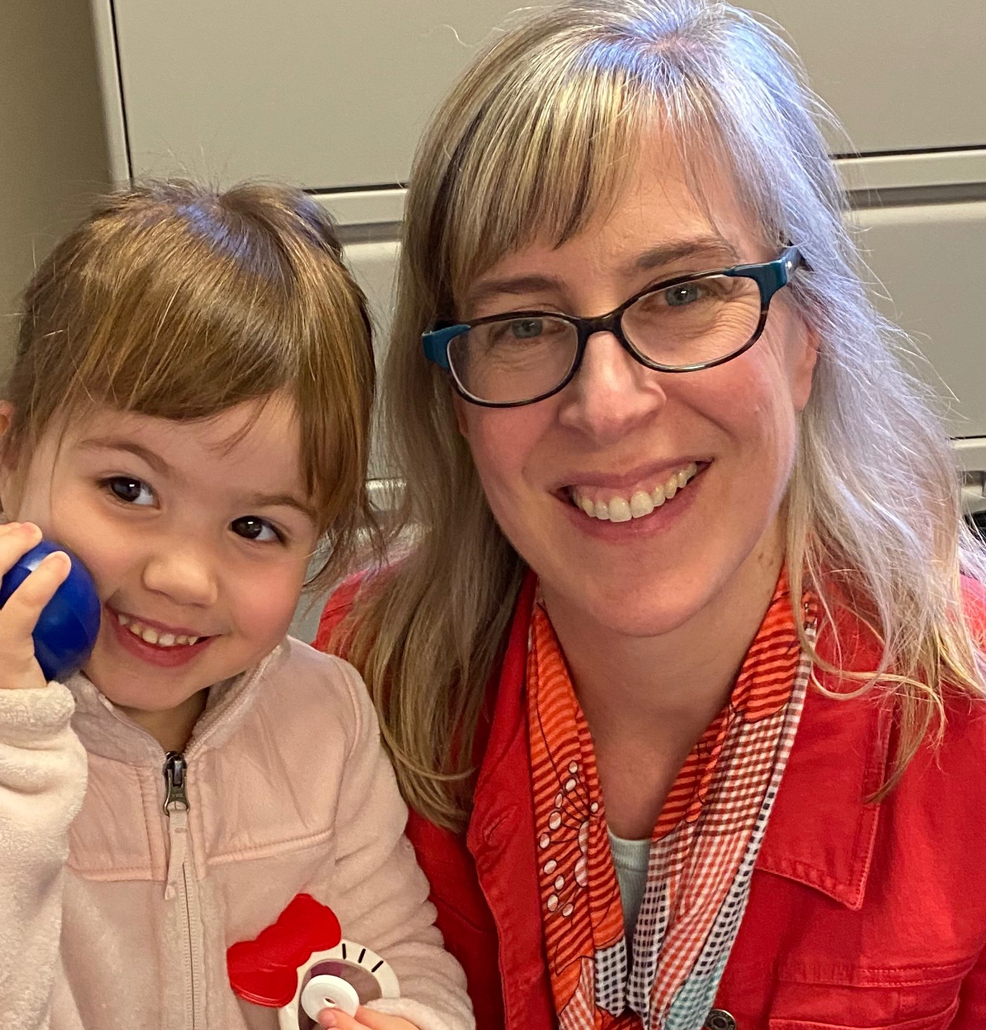

Slide 5
Making the most of our time
BE ENGAGED | Share your experiences related to the topics presented Ask questions via the chat box
BE REFLECTIVE | Compare the ideas shared to your current context and experiences Recognize areas of glow and growth
BE STRATEGIC | Engage in note-taking, individual or shared

Slide 6

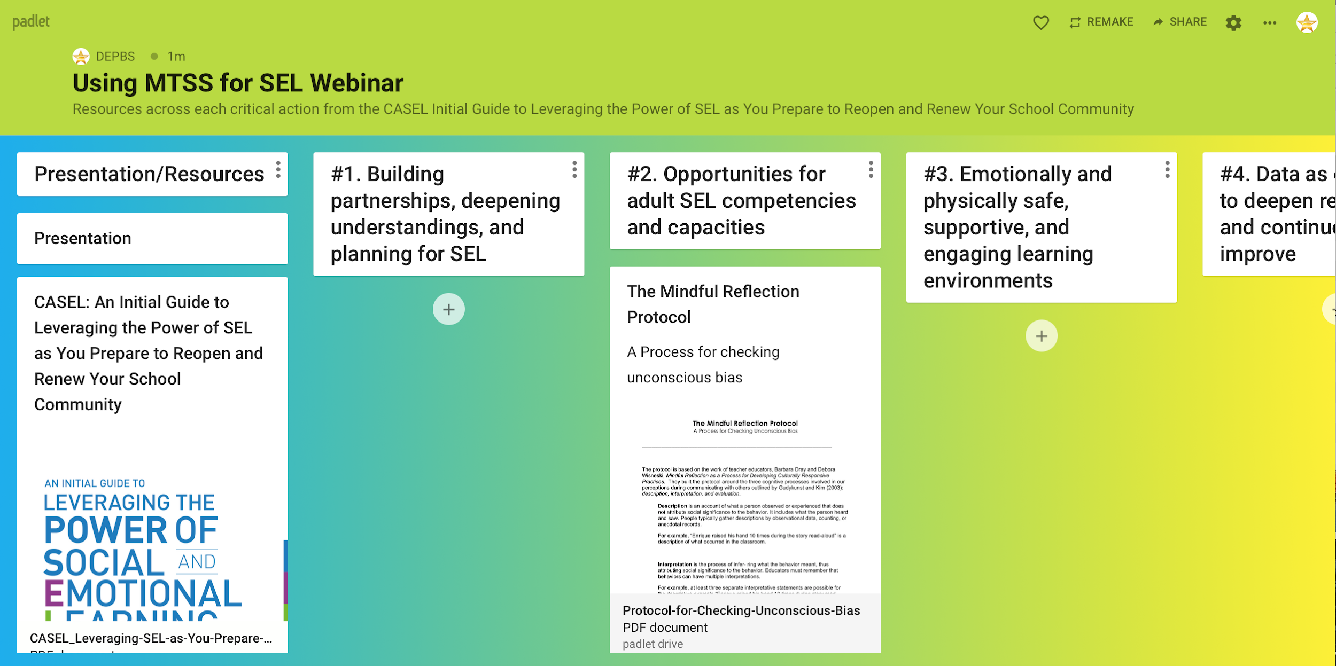
Padlet Resource
https://padlet.com/DEPBS/fi39uqxz4c1keqfd

Slide 7


Red Clay School District Resource
Gabrielle Koury
Lauren Messick
Ashlynn Guptill
Adriane Simpson

Slide 8

Webinar Purpose
Introduce the CASEL Tool and how it can be used by school and district teams
Align the 4 Critical Actions with the MTSS Framework to enhance planning and ensure equity
Empower teams with tools to use for reopening plans that address their community needs

Slide 9
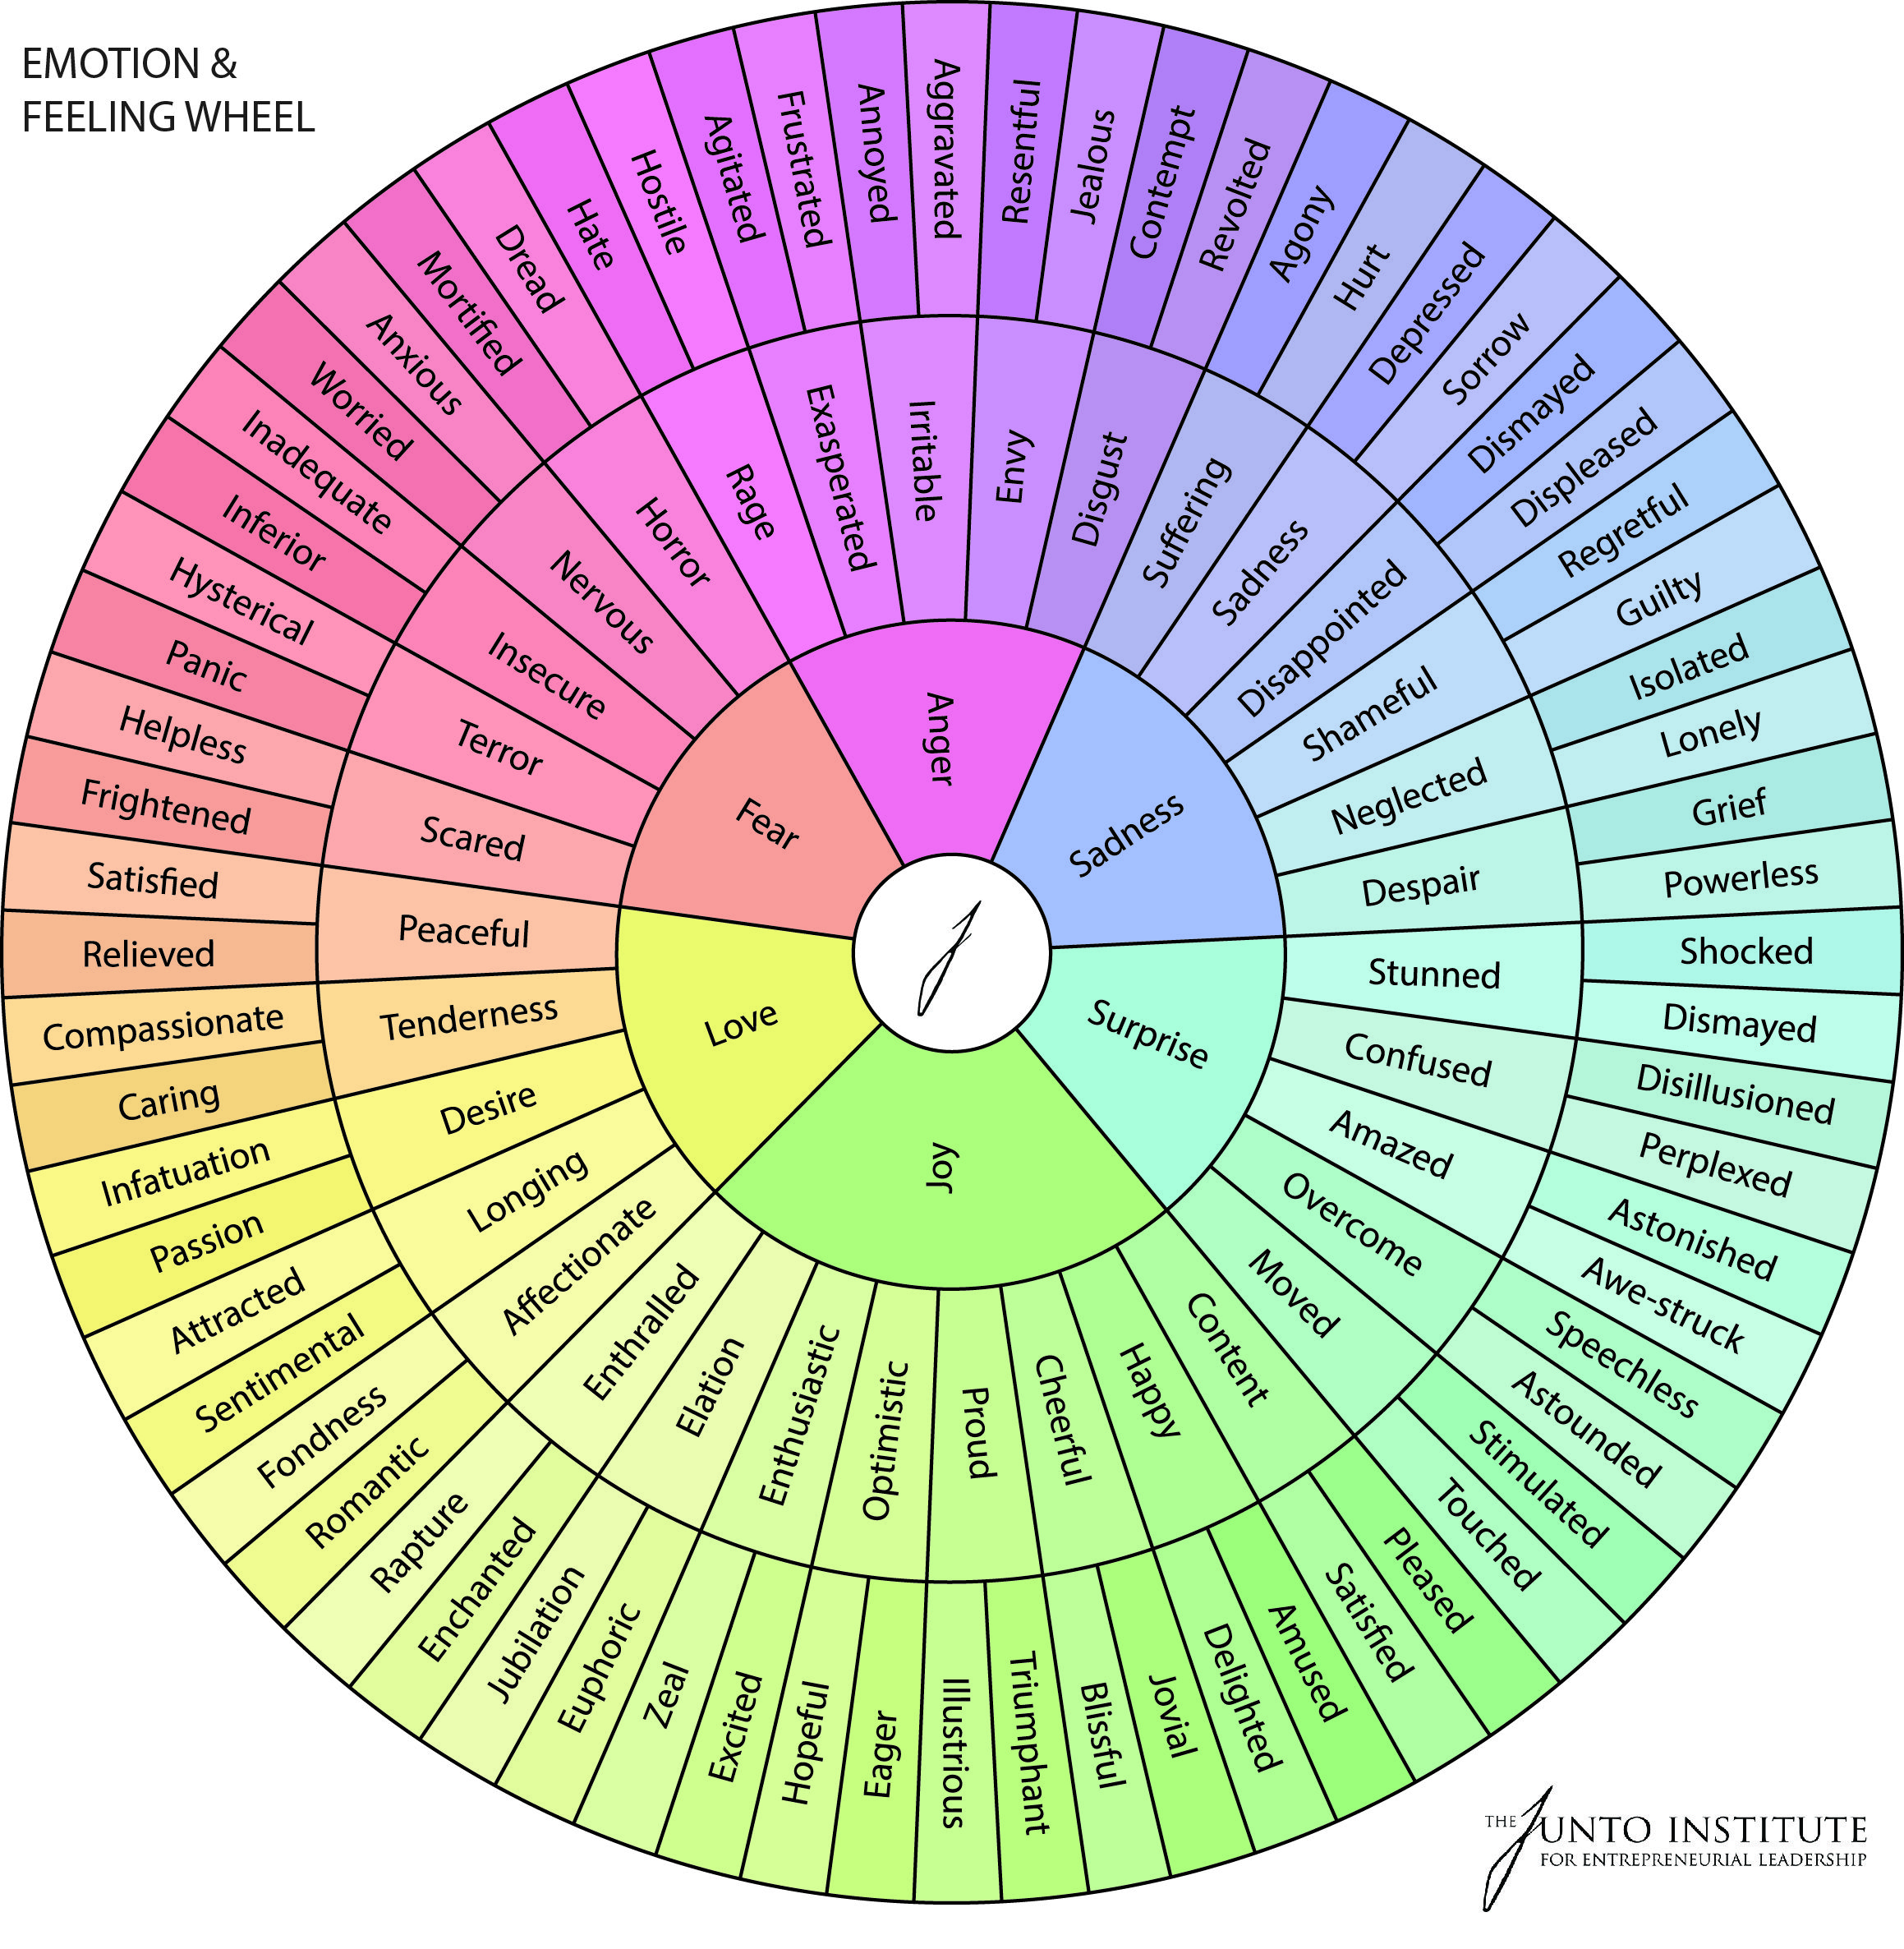
When you think about planning for reopening schools, how do you feel?

Slide 10
Multi-Tiered System of Supports (MTSS) Framework
Supporting culturally equitable Targets including
social/emotional competence & academic achievement
OUTCOMES
Supporting culturally knowledgeable Staff Behavior
team-based leadership and coordination
professional development, coaching, and content expertise
Supporting culturally valid Data-based Decision Making
universal screening
progress monitoring
evaluation of fidelity
SYSTEMS
DATA
PRACTICES
Midwest PBIS Network 2/7/19. Adapted from:
“What is a systems Approach in school-wide PBIS?” OSEP Technical Assistance on Positive Behavioral Interventions and Supports. https://www.pbis.org/school
McIntosh, K.& Goodman, S. (2016). Integrated Multi-Tiered Systems of Support: Blending RTI and PBIS. New York: Guilford Press.
Supporting Student Behavior
three-tiered continuum of culturally relevant evidence-based interventions
Notes:
10

Slide 11
MTSS Three-tiered Continuum of Evidence-based Practices
Tier III Prevention:
Specialized, Individualized
Data, Systems, Practices for High-Need and Complex Behaviors
~5%
Students
Staff
Families
Community
~15%
Tier II Prevention:
Group-based Data, Systems, Practices Targeting At-Risk Behaviors
Tier I Prevention:
School/Classroom-wide Data, Systems, Practices
for all Students, Staff, Settings
~80% responding
Midwest PBIS Network 1-15-19
Adapted from: USDOE OSEP PBIS TA Center

Slide 12
Tiered Supports
Determining who is making decisions and how are they making them
FEW Tier 3 | Practices in place for students, staff, families needing intense, individualized support (1-5%)
SOME Tier 2 | Practices in place for students, staff, families needing some additional support (15-20%)
ALL Tier 1 | Practices in place for 100% students, staff, families

Slide 13
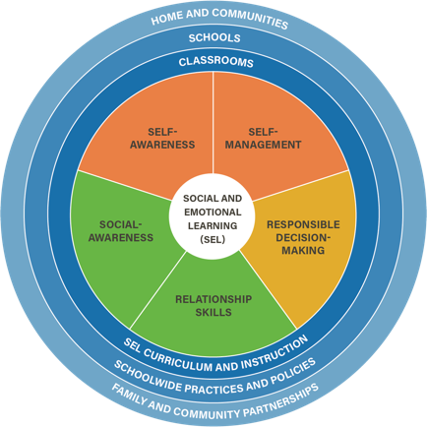
CASEL Foundation for SEL
Shared Language

Slide 14
About CASEL’s Guide
It’s initial - guidance to support and sustain SEL coming soon
Actionable recommendations
SEL is “critical underpinning”
Highlights need for more inclusive and equitable learning environments

Slide 15

SEL as Equity Lever
“Systemic implementation of SEL fosters and depends on an equitable learning environment where all students and adults feel respected, valued, and affirmed in their individual interests, talents, social identities, cultural values, and backgrounds.
…requires that SEL be implemented with an explicit goal of promoting educational equity.”

Slide 16


Depth of this presentation related to SEL, MTSS and all reopening considerations...
There are many other resources to get here
We are here

Slide 17

Professional Learning
Differentiated Book Studies
DDOE offerings from Office of Equity and Innovation
Trauma-Informed Practices Intro Training for Trainers
Neurologic Trauma-Informed Classrooms
Action Data Series
Trauma Responsive Schools Implementation Assessment
School Health Assessment and Performance Evaluation System
Beyond Consequences Classroom 180: Advanced Trauma Bootcamp
Trauma-Informed Practices
Social and Emotional Learning
Restorative Practices
Mindfulness
Equitable and Just Schools
Culture of Care
Assessment

Slide 18
DELAWARE RESTART AND RECOVERY RESPONSE
PDMS Course# 29140 Section# 54409
Beyond Consequences Classroom 180: Advanced Trauma Bootcamp – EVERY EDUCATOR
This intensive course hosted by Beyond Consequences Institute (BCI) is a deep-dive into the groundbreaking new book, Classroom180: A Framework for Creating, Sustaining, and Assessing the Trauma-Informed Classroom. The Classroom180 Framework is a comprehensive roadmap of what it means to fully create, implement, and sustain a trauma-informed classroom from kindergarten through the twelfth grade. Additionally, Classroom180 includes an assessment tool, the Classroom180 Rubric, which can be used by administrators and other specialists who support teachers on the journey of becoming trauma-informed. In response to the COVID-19 pandemic, this training will be virtual and will provide a blended training with the majority of the sessions conducted LIVE on the BCI Zoom platform with some course work being done through our Trauma-Informed Online Academy (TIOA). Each participant will receive a book as well as log-in and password to access the TIOA during the training. This 16.5 hour course will include the following the Pre-requisite online course (1.75 hours), 3- day, LIVE training (11.75 hours), and Online Coursework & Exercises (3 hours).

Slide 19
DELAWARE RESTART AND RECOVERY RESPONSE
PDMS Course# 29145 Section# 54414
Neurologic Trauma-Informed Classrooms – EVERY EDUCATOR
The Neuro Logic Trauma-Informed Classroom Training is a 4-hour, pre-recorded, and advanced training for those who have participated in previous trauma awareness level learning sessions, particularly including the BRAIN ARCHITECTURE GAME simulation. Participants will go through a process that begins with an understanding of basic brain science and the recognition of the impact of stress, trauma, and neglect on the brain. Through examples and application of current brain research, participants will gain hope and practical strategies for overcoming this negative impact, as well as a recognition of how these strategies will help all students improve learning, behavior and emotional health. Participants will leave this training equipped with newfound hope and practical interventions that can be applied immediately in their roles within the school community.

Slide 20
NEW ADDITIONS:
Trauma Responsive Schools Implementation Assessment (TRS-IA)
PDMS Course #29187 Section #54523
The TRS-IA is a free, easy to use quality improvement tool developed by the National Child Traumatic Stress Network and the National Center for School Mental Health. The TRS-IA is an evidence-informed self-assessment that comprises eight key domains of trauma-responsive schools and districts. Upon completion of the assessment, feedback reports are generated to support schools and districts to enhance their trauma responsiveness. This session will review how to access and effectively use the TRS-IA.

Slide 21
The School Health Assessment and Performance Evaluation System (SHAPE)
PDMS Course #29188 Section #54524
The School Health Assessment and Performance Evaluation System (SHAPE) offers a no-cost, user-friendly online platform for individuals, schools, districts, and states to use to assess and improve their school mental health systems. SHAPE offers the tools needed to improve school mental health programming and sustainability. This session will highlight the many features and resources available as part of the SHAPE System and will walk participants through how to best use the system to inform quality improvement in school mental health.

Slide 22
CASEL’S 4 Critical Actions:
 | Take time to building partnerships, deepen your understanding, and plan for SEL.
 | Design opportunities for adults to connect, heal, and cultivate their own SEL competencies and capacities.
 | Create emotionally and physically safe, supportive, and engaging learning environments that promote all students students’ social and emotional development.
 | Use data as an opportunity to deepen relationships and continuously improve support for students, families, and staff.
1
2
3
4

Slide 23
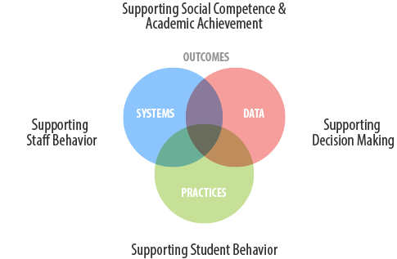
1. Take time to build partnerships, deepen your understanding, and plan for SEL.
4. Use data as an opportunity to deepen relationships and continuously improve support for students, families, and staff.
2. Design opportunities for adults to connect, heal, and cultivate their own SEL competencies and capacities.
3. Create emotionally and physically safe, supportive, and engaging learning environments that promote all students’ social and emotional development.

Slide 24
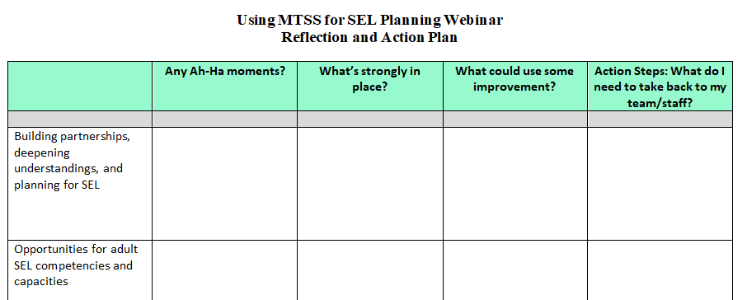
Reflection and Action Plan Tool

Slide 25
CASEL’S 4 Critical Actions:
 | Take time to building partnerships, deepen your understanding, and plan for SEL.
 | Design opportunities for adults to connect, heal, and cultivate their own SEL competencies and capacities.
 | Create emotionally and physically safe, supportive, and engaging learning environments that promote all students students’ social and emotional development.
 | Use data as an opportunity to deepen relationships and continuously improve support for students, families, and staff.
1
2
3
4

Slide 26
Build student, staff, family and community understanding of SEL.
Utilize voices of student, staff, family, and community to plan for SEL.
Communicate value of SEL and your school/ district’s goals to integrate SEL.

Slide 27

Starting Your SEL Program
The CASEL Guide to Schoolwide Social and Emotional Learning
Build awareness, commitment, ownership - and create a plan.
Strengthen adult SEL.
Promote SEL for students.
Practice continuous improvement.
https://schoolguide.casel.org/

Slide 28

Build Transition Teams
Great news...
Most of you already have!

Slide 29

Teams should have representation from:
Administration
Teachers
Support Staff
Family
Student
Community partners

Slide 30




Voices

Slide 31
Community Partners
Mental health agencies
Community-based mental health providers
Mentoring programs
After-school programs
Extracurricular activities
Sports programs

Slide 32
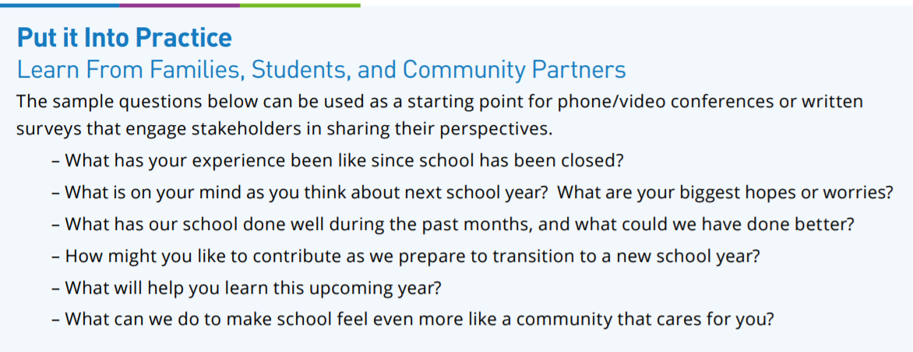
CASEL Survey Example

Slide 33

https://pdkintl.org/COVID19-Resources/
What are some methods you use to cope with stress?
If you are a classroom teacher/support staff, what support do you need from admin right now?
What do you feel you can do to make sure the students you work with feel connected to their classmates while they are not physically at school?
What can your teachers and administrators do to make sure you feel connected to your classmates while you are not physically at school?
In going through this experience, did you find your school was prepared for distance learning?

Slide 34

Identify Areas That Need Support
Barriers in distance learning for students
Staff who need more support to teach SEL virtually
Students and staff who have been sick, lost a loved one, experienced housing or employment instability

Slide 35

Identify Areas of Impact
Students and families who have received personal outreach
Students who were engaged in distance learning
Staff who felt comfortable teaching SEL virtually
Existing SEL program
Positive relationships between staff and students

Slide 36

Use identified strengths as a basis for your transition plan and build on them!

Slide 37
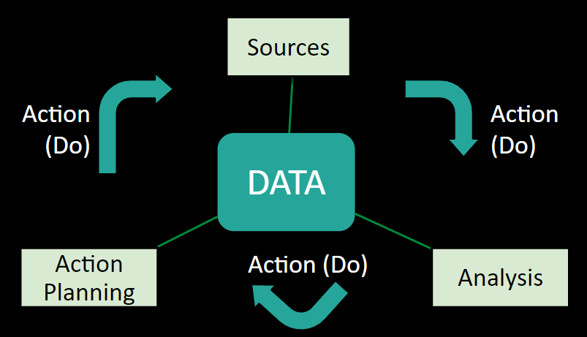
Continuity in Planning
How are you engaging families throughout the year?
How are you re-engaging vulnerable students?

Slide 38
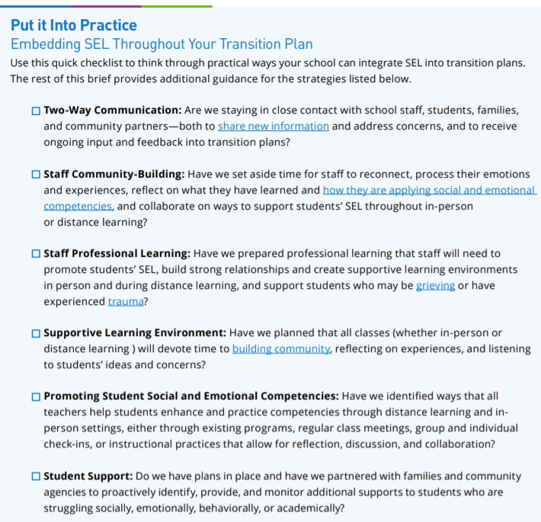
Embedding SEL Throughout Your Transition Plan
Two-Way Communication
Staff Community-Building
Staff Professional Learning
Supportive Learning Environment
Promoting Student Social and Emotional Competencies
Student Support

Slide 39

Equity in Critical Action #1
Are your teams culturally and racially representative?
Is your school-wide SEL curriculum equitable?
Are the voices you’re valuing from student, staff, family, and community racially and culturally representative?
Are your survey results from one population more than another? Why do you think?
Do the results show disparities?

Slide 40
Critical Action #1: Take time to build partnerships, deepen your understanding, and plan for SEL.
 | Student | Staff | Family | Community
FEW Tier 3 | Identify individual needs for layered support
SOME Tier 2 | Include in teams Utilize focus groups
ALL Tier 1 | Communicate importance of SEL Build relationships through direct outreach Use surveys to gain insight into personal experiences Communication is ongoing

Slide 41
CASEL’S 4 Critical Actions:
 | Take time to building partnerships, deepen your understanding, and plan for SEL.
 | Design opportunities for adults to connect, heal, and cultivate their own SEL competencies and capacities.
 | Create emotionally and physically safe, supportive, and engaging learning environments that promote all students students’ social and emotional development.
 | Use data as an opportunity to deepen relationships and continuously improve support for students, families, and staff.
1
2
3
4

Slide 42
Over 5,000 teachers responded to a survey performed by CASEL and the Yale Center for Emotional Intelligence at the end of March 2020. The five feelings that teachers mentioned most were:
The two main causes at that time were:
A general fear that someone in their family would contract COVID-19
Managing the needs of their families and themselves while working full time from home and adapting to new technology.
Anxious, Fearful, Worried, Overwhelmed, and Sad
https://www.edsurge.com/news/2020-04-07-teachers-are-anxious-and-overwhelmed-they-need-sel-now-more-than-ever

Slide 43

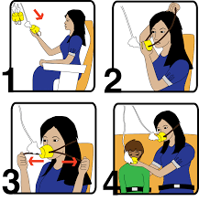

Slide 44

Allow space for connection, listening, and healing among all leaders and staff in the school building
Community Building
Regulate Your Emotions
Become Informed
Reframe Your Outlook
Monitor Self-Talk
Distance Yourself
Parry
Building Your Resilience
Build Your Connections
Foster Wellness
Find Purpose
Embrace Healthy Thoughts
Seek Help
jl
https://elemental.medium.com/how-to-regulate-your-stir-crazy-emotions-de432d6410ad
https://www.apa.org/topics/resilience

Slide 45
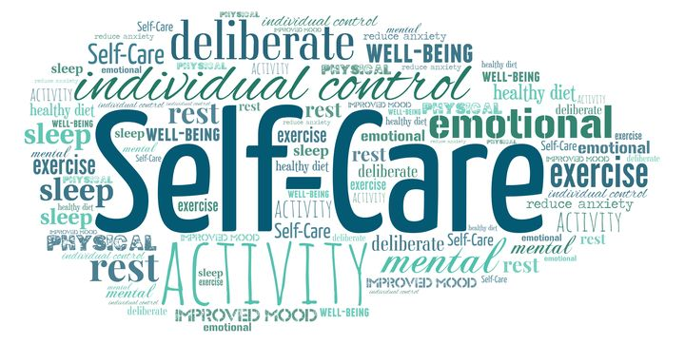

Slide 46
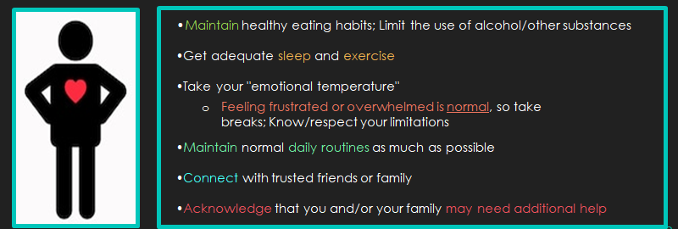
Self-Care for Staff
Red Clay Consolidated School District (2020) Trauma Informed Re-entry.

Slide 47
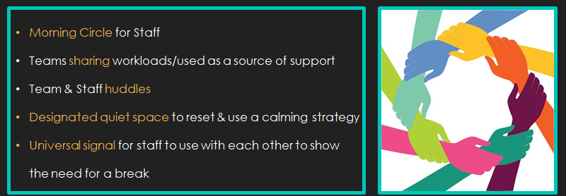
Assisting Staff with Coping with Stress
Red Clay Consolidated School District (2020) Trauma Informed Re-entry.

Slide 48
Capture this Moment to Identify New Opportunities
Reflect on what you have learned from the past few months.
Reflect on how this experience will shape the coming years.
Offer ongoing opportunities for staff to collaborate on ideas to inform a collective path forward.
Engage Staff
Disruption
New Strengths
Disengagement
Inequity
Partnering with Families
Provide Time for Staff Discussions

Slide 49
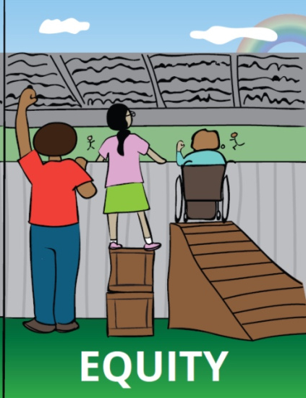
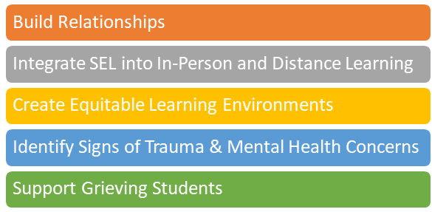
Provide professional learning to build educators’ capacity to support students’ SEL

Slide 50
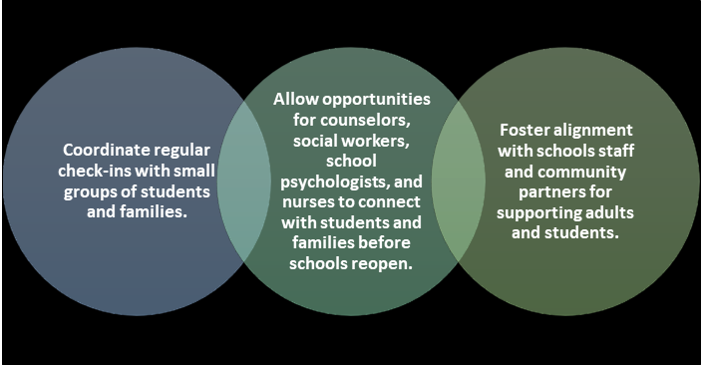
Maximize staff members’ abilities to connect with students, families, and community partners

Slide 51
Ensure access to mental health and trauma supports for adults
Mental Health Issues
Secondary Traumatic Stress
Compassion Fatigue
Trauma

Slide 52

Secondary Traumatic Stress & Compassion Fatigue
Secondary traumatic stress (STS) is the emotional distress that results when an individual hears about the traumatic experiences of another individual. Distress may result from hearing someone’s trauma stories, seeing high levels of distress in the aftermath of a traumatic event, needing to retell a student’s story, and/or seeing photos or images related to the trauma.
https://safesupportivelearning.ed.gov/sites/default/files/TSS_Building_Handout_2secondary_trauma.pdf

Slide 53
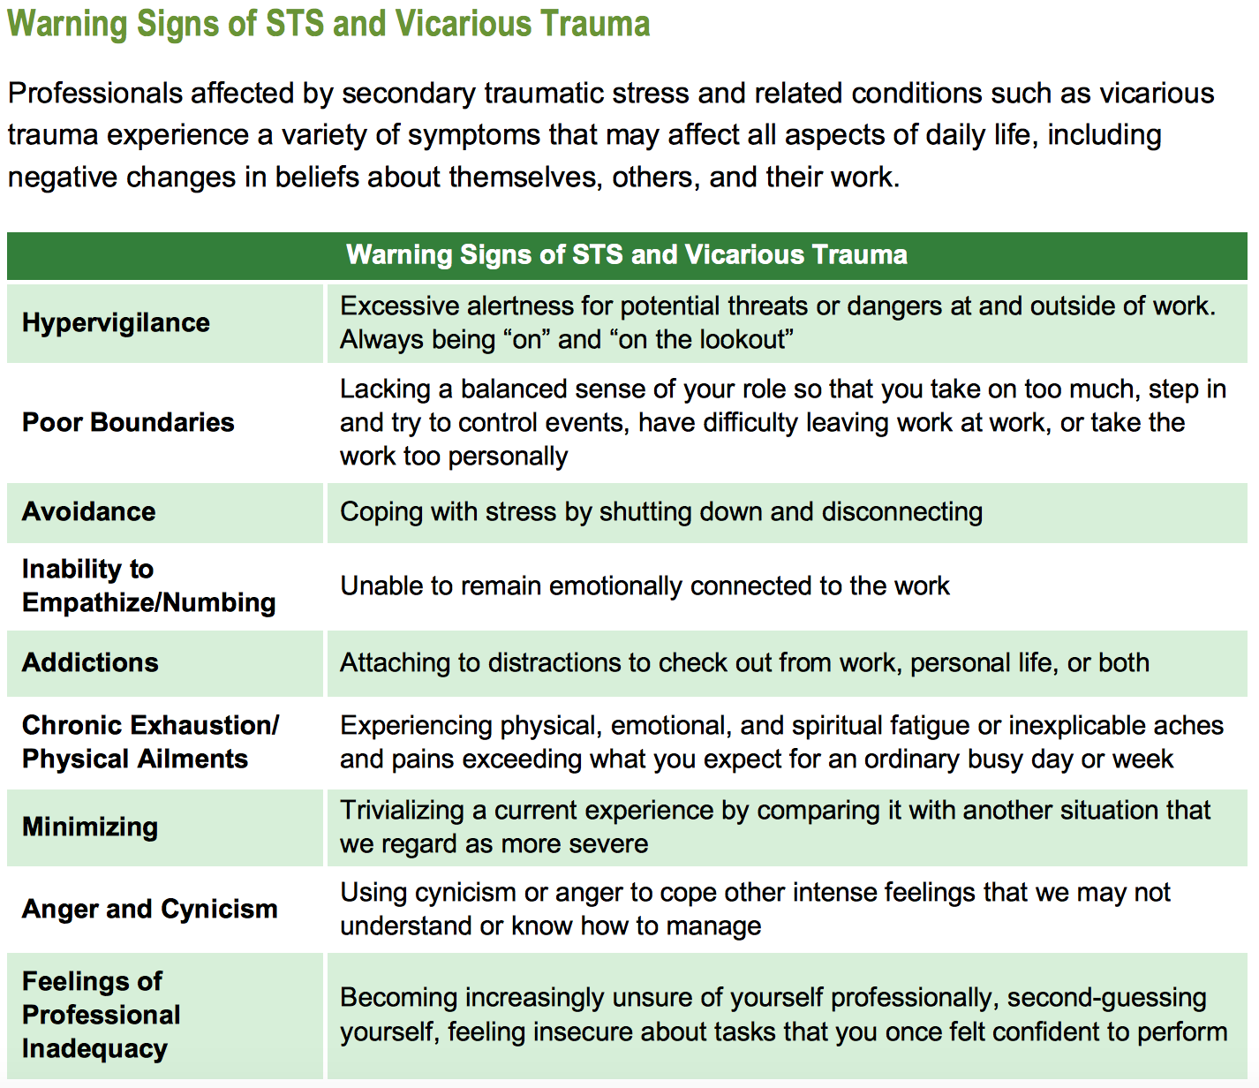
https://safesupportivelearning.ed.gov/sites/default/files/TSS_Building_Handout_2secondary_trauma.pdf

Slide 54
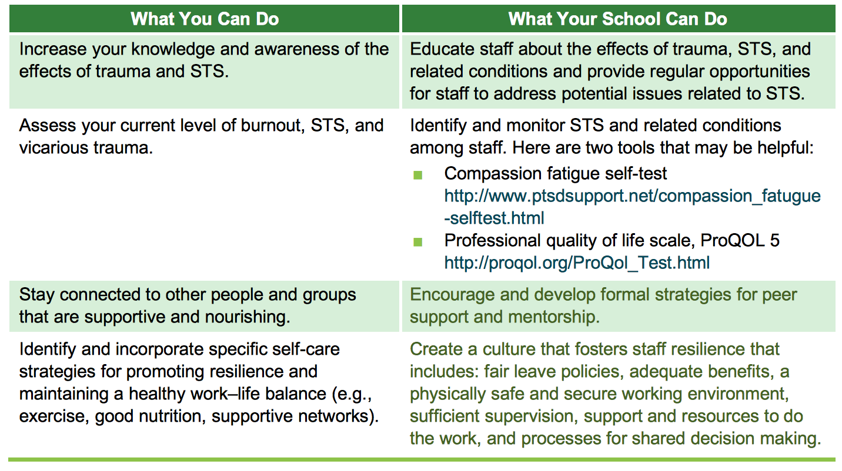
https://safesupportivelearning.ed.gov/sites/default/files/TSS_Building_Handout_2secondary_trauma.pdf

Slide 55



Pass Your Umbrella...
http://www.ascd.org/ascd-express/vol15/num13/5-strategies-for-teacher-self-care.aspx

Slide 56
Critical Action #2: Design opportunities for adults to connect, heal, and cultivate their own SEL
 | Student | Staff | Family | Community
FEW Tier 3 |  | Individual needs identified Provide Community Resources
SOME Tier 2 |  | Organize small groups focusing on anxiety, secondary trauma, and other data-driven topics
ALL Tier 1 |  | Provide space/tools for reflection Give staff a self-rating test Train staff in self-care opportunities

Slide 57
CASEL’S 4 Critical Actions:
 | Take time to building partnerships, deepen your understanding, and plan for SEL.
 | Design opportunities for adults to connect, heal, and cultivate their own SEL competencies and capacities.
 | Create emotionally and physically safe, supportive, and engaging learning environments that promote all students students’ social and emotional development.
 | Use data as an opportunity to deepen relationships and continuously improve support for students, families, and staff.
1
2
3
4

Slide 58
CASEL Key Point #1
Intentionally build structures that promote supportive adult-student relationships and a sense of belonging.

Slide 59
“Predictable structures promote a sense of safety that helps students, especially those who have experienced trauma or struggle behaviorally, regulate emotions and take on new challenges and developmental tasks.”

Slide 60

One Caring Adult
How will you create greater opportunities for meaningful teacher- student relationships?

Slide 61

Ideas to Build Connections
Minimize transitions betweens classrooms
Create or extend homeroom/advisory
Looping
Small group and individual check-ins (in person and/or virtually)
Consistent and predictable routines and procedures

Slide 62
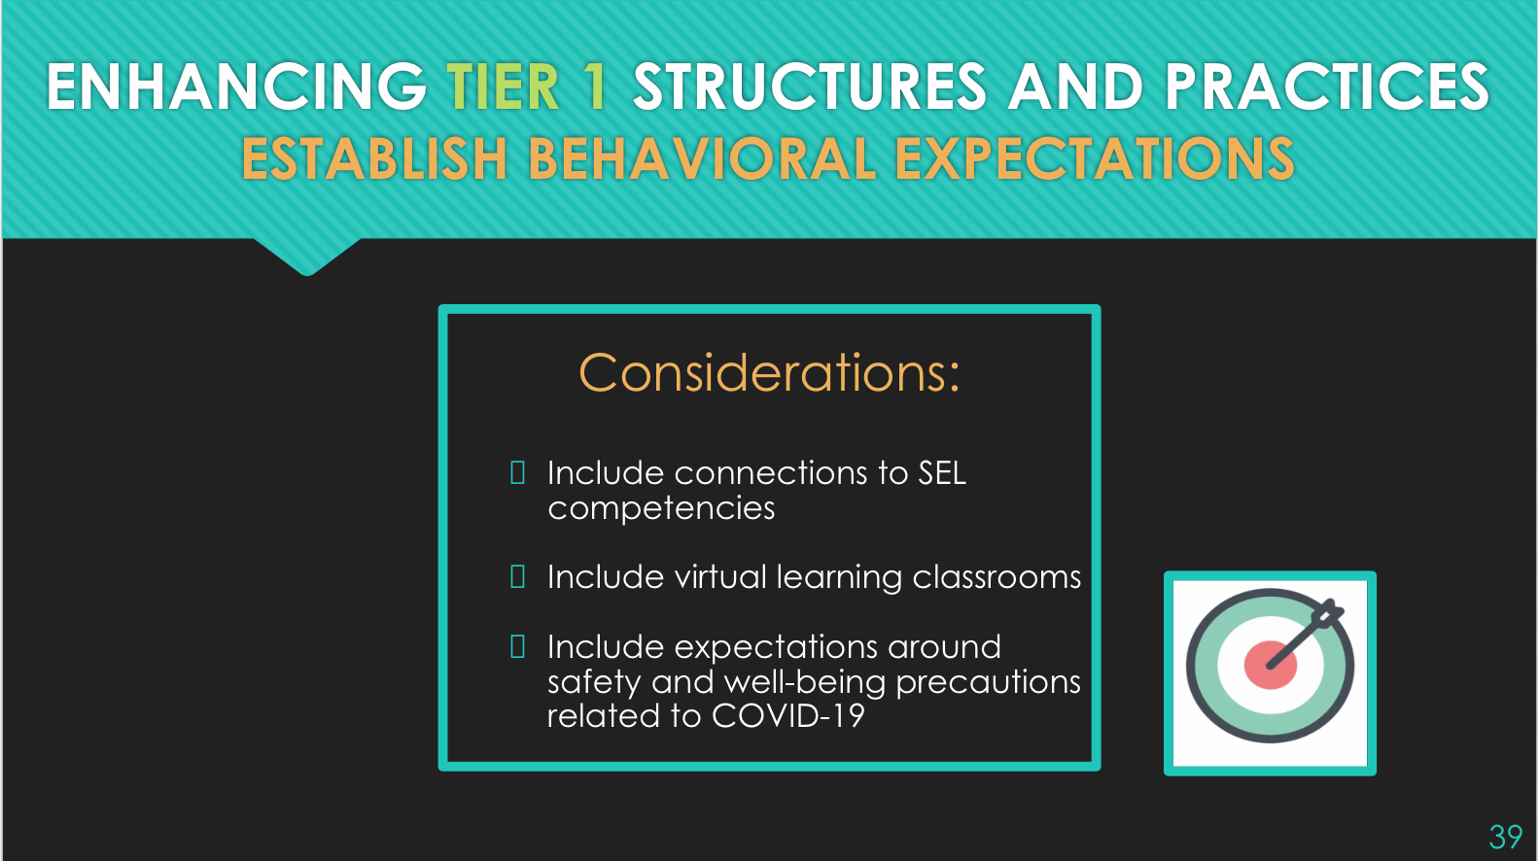


Slide 63
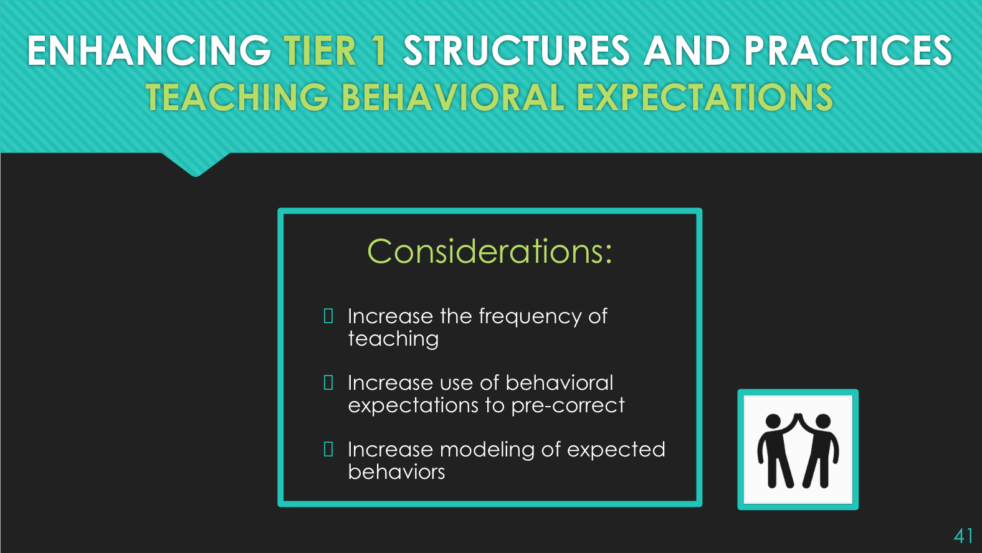

Slide 64
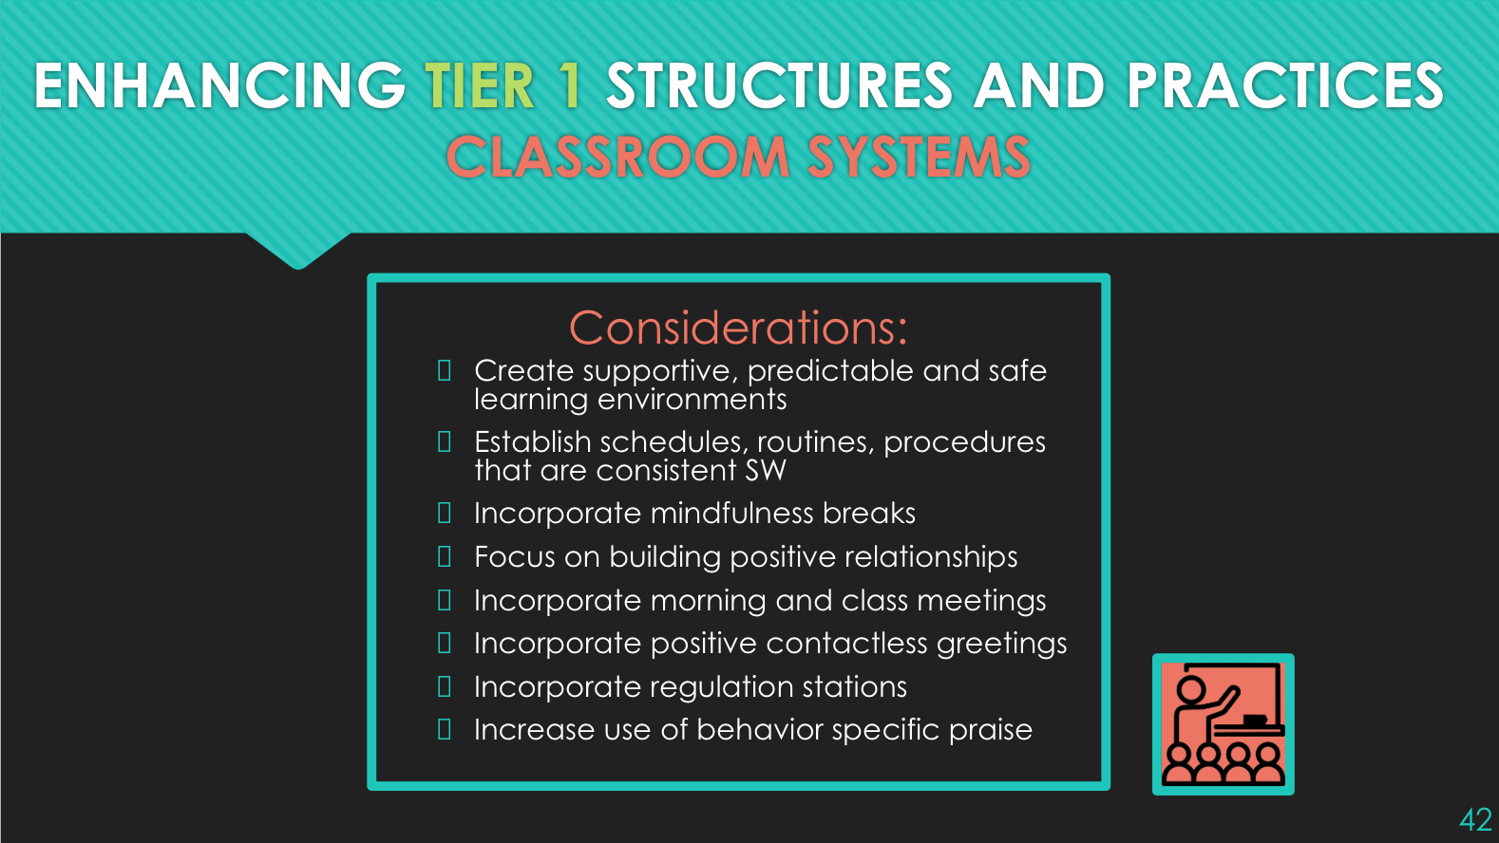

Slide 65
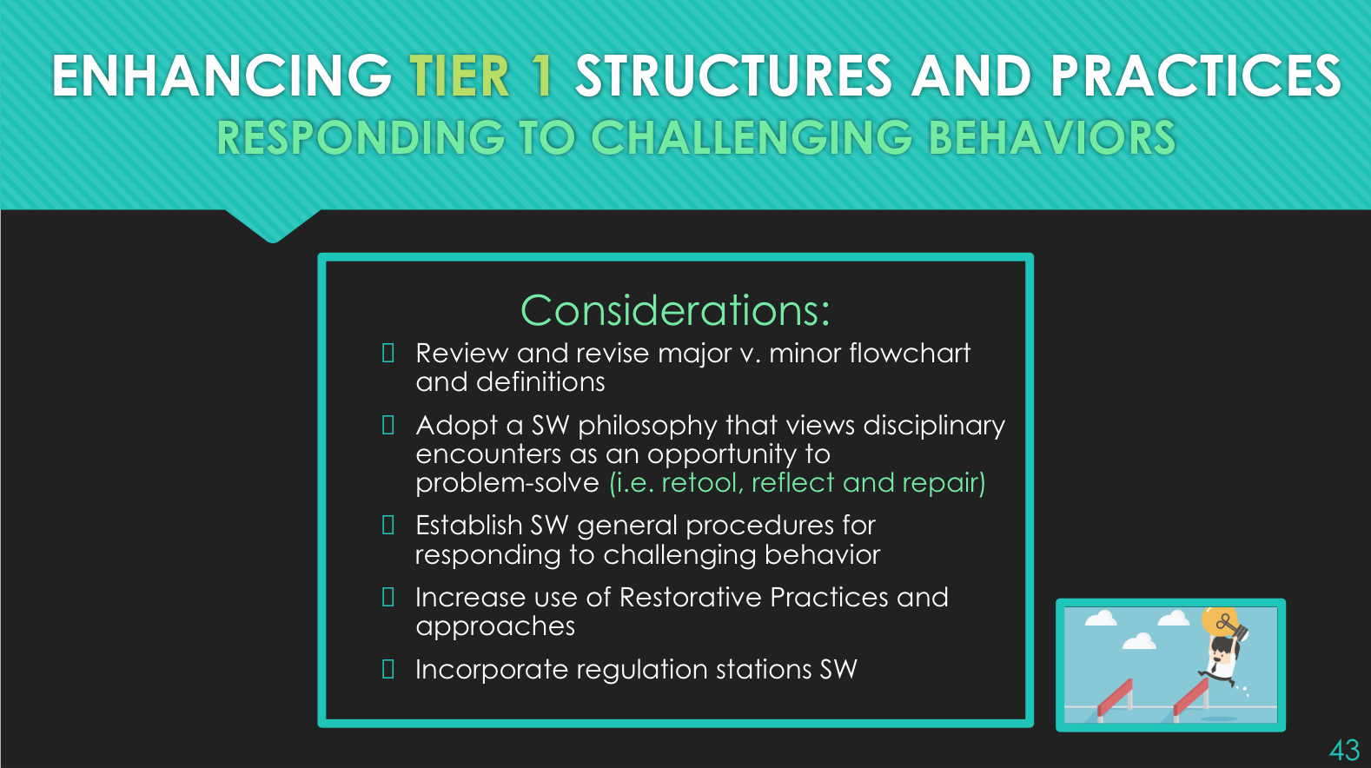

Slide 66
CASEL Key Point #2
Weave opportunities for students to practice and reflect upon social emotional competencies throughout the day.

Slide 67

Student SEL Skills Highlighted by the Pandemic
Students coping with challenges
Managing stress
Practicing empathy
Creating social bonds across distance
Taking collective action
Managing loss and grief

Slide 68

Weave in SEL Throughout the Day
Use developmentally appropriate SEL competencies and standards
  DE SEL Collaborative has developed draft Competencies
Continue any existing evidence-based SEL program
Classroom community meetings
Small mentoring groups

Slide 69

Academic Opportunities for SEL
Reflections
Interaction
Cross-age peer tutoring
Group discussions
Brain breaks
More intentional opportunities to weave SEL into academics:
AIR’s Teaching the Whole Child: Instructional Practices That Support Social Emotional Learning

Slide 70
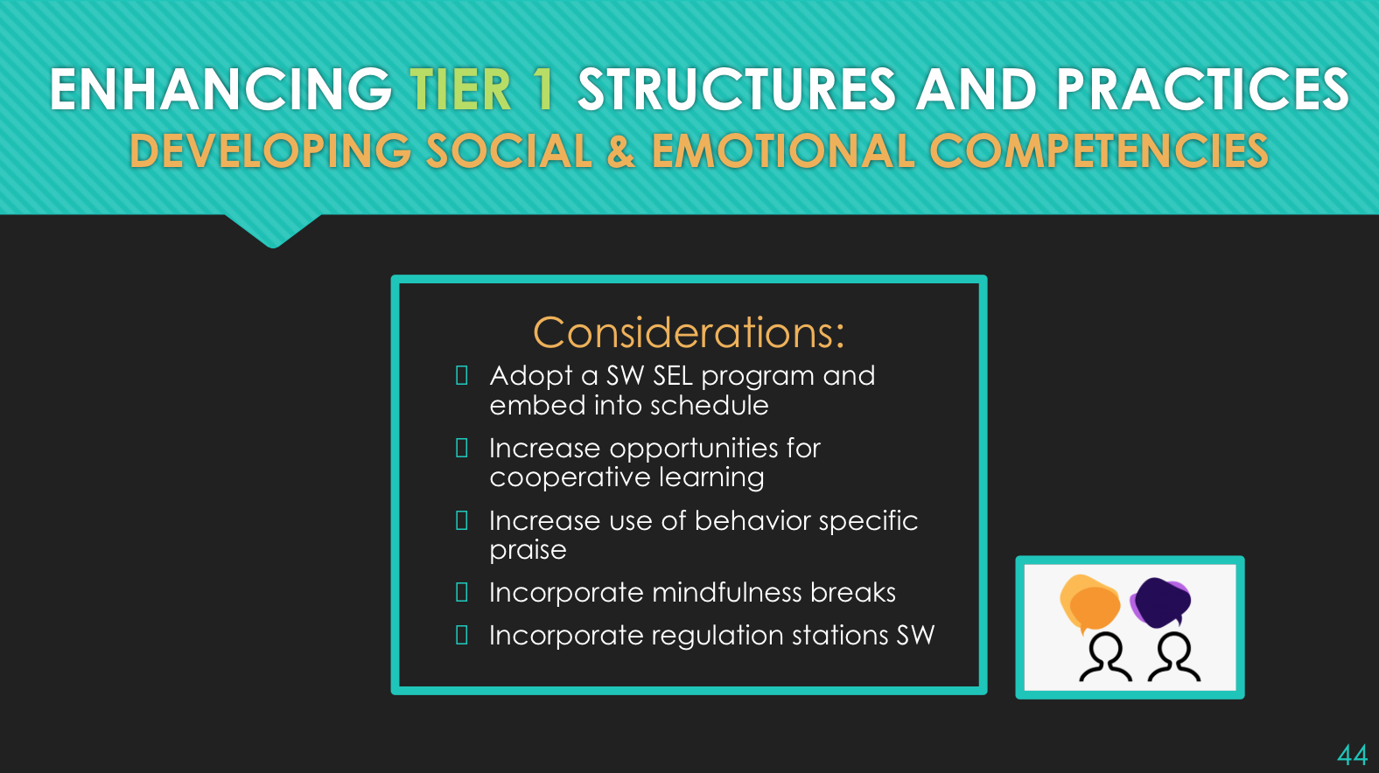

Slide 71
CASEL Key Point #3
Engage students in developmentally appropriate conversations and lessons to discuss past, current, and future impacts of the pandemic on themselves, their families, their communities, and the broader world.

Slide 72

Talk About The Pandemic Directly
Students have the opportunity to talk about their feelings about the pandemic and its impact on them
Distinguish fact from fiction
Students get to hear others’ experience and relate
Students can support one another
….Just make sure to support your teachers and staff by teaching them how to have these conversations.

Slide 73
CASEL Key Point #4
Collaborate with families and community partners to align on strategies for supporting students’ SEL at home and during extended learning.

Slide 74
Family and Community Collaboration
Family
Community
Invite family to participate in MTSS team(s) meetings Identify SEL strategies that can be used at school and at home Invite families to participate in school SEL activities Share SEL supports that kids need with families | Identify key community stakeholders that provide opportunities for students to create positive adult relationships Identify out-of-school community programs, sports, extracurricular activities

Slide 75
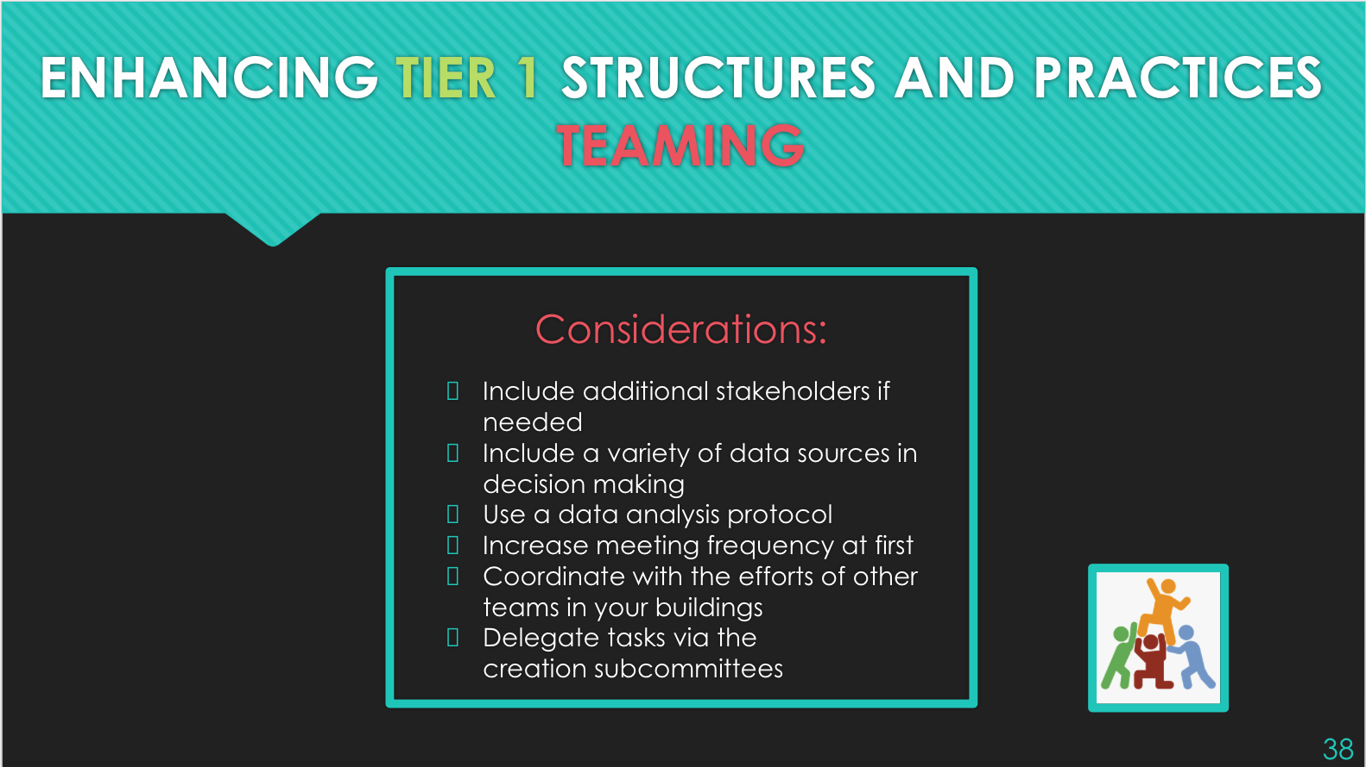

Slide 76
CASEL Key Point #5
Identify support for students who are struggling.

Slide 77
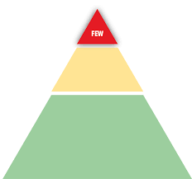
Support for Students Who Are Struggling
Consider staff training in Trauma-Informed/Sensitive Schools
Work with staff to proactively identify students who may be struggling
Work with family and community to identify a plan for additional mental health and trauma support
Seek connections to support needs for food, shelter, technology, transportation, and others

Slide 78
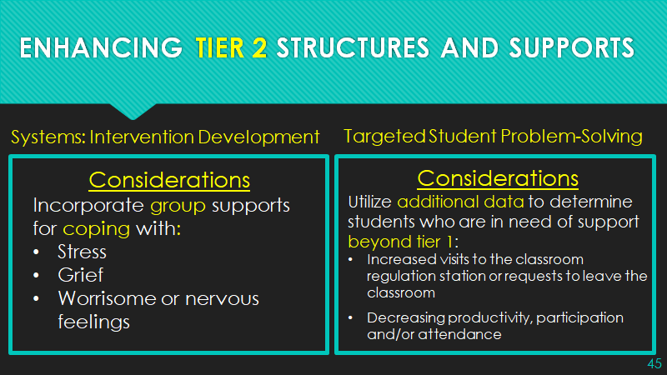

Slide 79
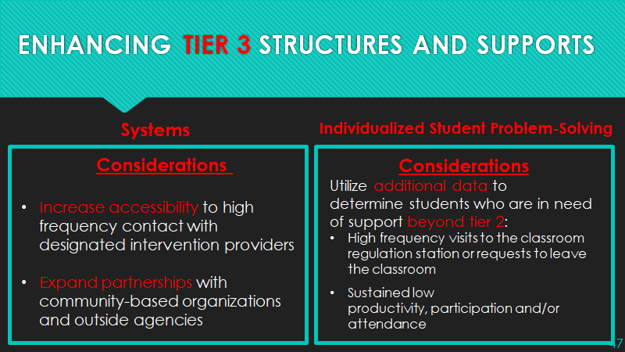

Slide 80
Critical Action #3: Create emotionally and physically safe, supportive, and engaging learning environments that promote all students students’ social and emotional development.
 | Student | Staff | Family | Community
FEW Tier 3 |  |  |  | Designate team member(s) to develop relationship with food pantries coordinators in local area and provide updates to share with families.
SOME Tier 2 |  | With Tier 1 team during 5*10 professional learning, provide overview of mentoring program & recruit for small group mentoring professional learning. | Provide 2 additional outreach calls/texts to families with students with decrease in academic engagement (1 letter grade drop pre/post-COVID) - ask about supports they may need.
ALL Tier 1 | Implement a Connections Survey with all students to identify one caring adult to welcome them back to school. | Provide professional learning for staff regarding 5*10 strategy. Provide funds and time for staff to develop welcome back message. | Staff are provided with culturally responsive outreach protocols to family and all families have 2 contacts with school personnel over the summer.

Slide 81
CASEL’S 4 Critical Actions:
 | Take time to building partnerships, deepen your understanding, and plan for SEL.
 | Design opportunities for adults to connect, heal, and cultivate their own SEL competencies and capacities.
 | Create emotionally and physically safe, supportive, and engaging learning environments that promote all students students’ social and emotional development.
 | Use data as an opportunity to deepen relationships and continuously improve support for students, families, & staff.
1
2
3
4

Slide 82
Responses to Data
A Self-Awareness Question
Data Denial | Data Indifferent | Data Informed | Data Driven
You distrust data and avoid using it | You don’t care about data and have no need for it | You use it only when it supports your opinions or decisions | You use it to shape and inform all your decisions
Cooper & Monzingo (2014) for North Carolina Association for Middle Level Education

Slide 83
Continuous Data-Based Decision-Making
Sources
Action
(Do)
Action
(Do)
DATA
Action Planning
Action (Do)
Analysis

Slide 84


Consider SEL Skills and Related Initiatives Data in the Same Way...
How much does SEL influence the outcomes mentioned?
Graduation
Academic success
Student growth
Why does the transparency of data impact how students, staff & families can use the data?
https://www.moedu-sail.org

Slide 85



CASEL Key Points
Engage staff, students, and families in sharing ongoing feedback and partnering on continuous improvement.
Support educators in reflecting on data around their own instructional practices and classroom climate, especially when trying out new strategies or modes of teaching.
Collect and act on data around students who are disengaged or chronically absent.

Slide 86
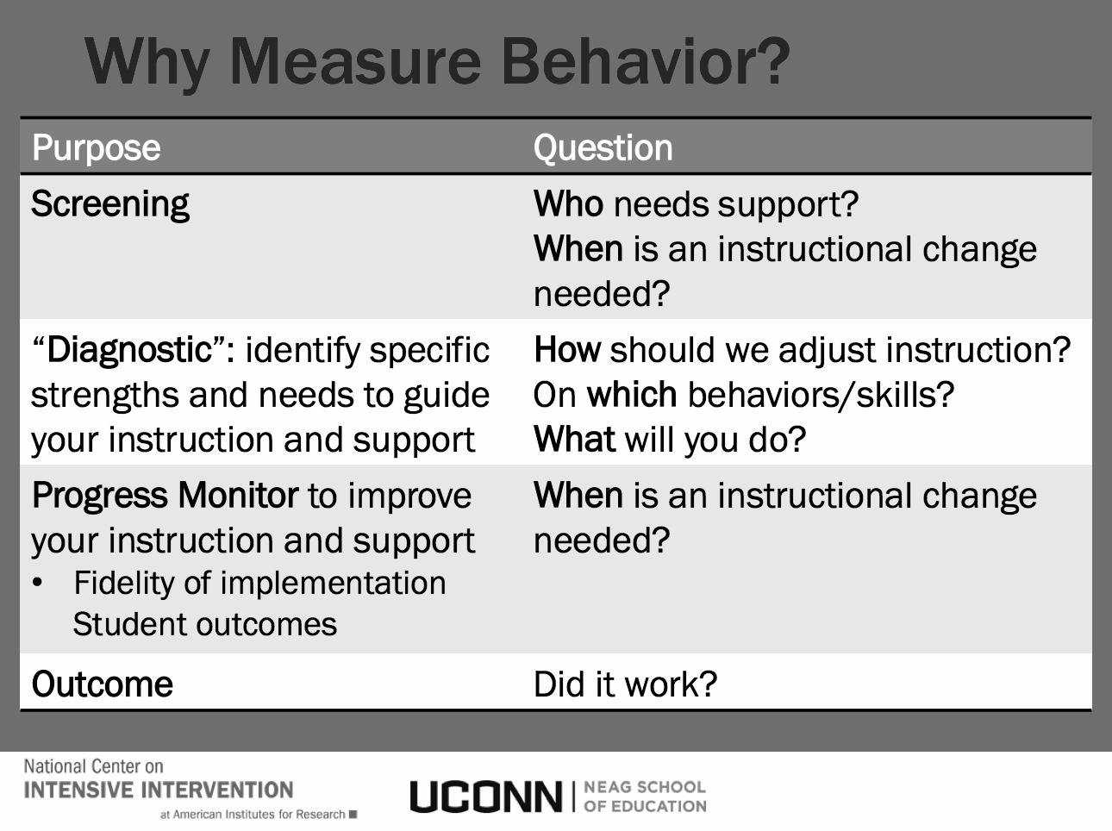
EXPANDING Your Existing Data
Self-Awareness
Self- Management
Responsible Decision-
Making
Social Awareness
Relationship Skills

Slide 87
EXPANDING Your Existing Data
Self-Awareness
Self- Management
Responsible Decision-
Making
Social Awareness
Relationship Skills

Slide 88



Sample Tool: Tier 1
Delaware School Climate Data Existing Data
Engage staff, students, and families in sharing ongoing feedback and partnering on continuous improvement.

Slide 89
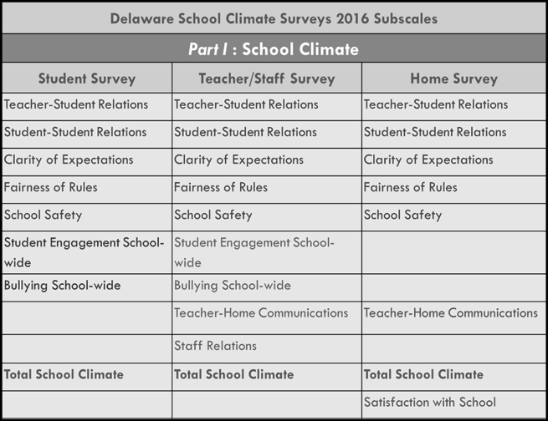
Relationship Skills
Self- Management
Responsible Decision-
Making
Social Awareness

Slide 90
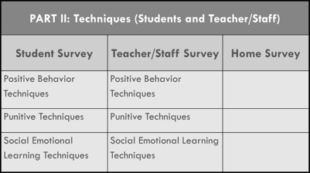
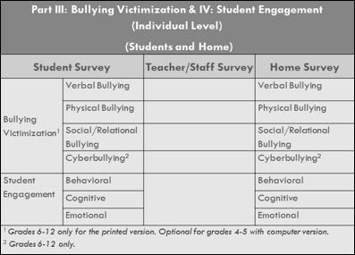
Responsible Decision-
Making
Social Awareness
Self- Management
Relationship Skills
Part V: Social Emotional Competencies
Student Survey
Responsible Decision-Making
Social Awareness
Self-Management
Relationship Skills

Slide 91
CASEL Key Points
Support educators in reflecting on data around their own instructional practices and classroom climate, especially when trying out new strategies or modes of teaching.

Slide 92
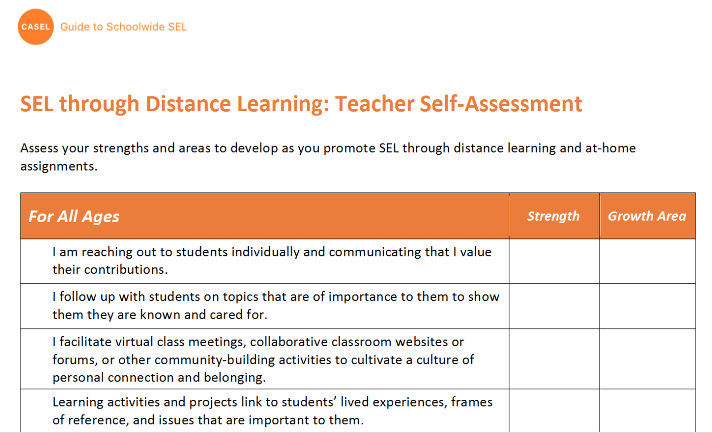
CASEL Put into Practice Idea (Distance)
https://schoolguide.casel.org/resource/sel-through-distance-learning-teacher-self-assessment/
For All Ages
Especially for Upper Elementary and Secondary Students
11 items total

Slide 93

Sample Tool: Tier 1
Positive Online Behavior Supports
1. Build an engaging online environment.
2. Build community.
3. Curate answers in an organized way.
4. Be present.
5. Establish norms for office hours & video conferencing.
6. Group purposefully
7. Teach about plagiarism.
8. Don’t shy away from difficult conversations.
9. Use various means to contact participants.
https://www.edutopia.org/article/extending-classroom-management-online

Slide 94
Sample Tool: Tier 1
Positive Online Behavior Supports
1. Build an engaging online environment.
2. Build community.
3. Curate answers in an organized way.
4. Be present.
5. Establish norms for office hours & video conferencing.
6. Group purposefully
7. Teach about plagiarism.
8. Don’t shy away from difficult conversations.
9. Use various means to contact participants.
https://www.edutopia.org/article/extending-classroom-management-online

Slide 95
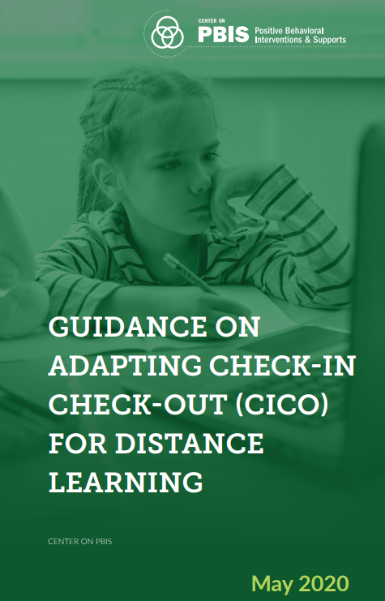
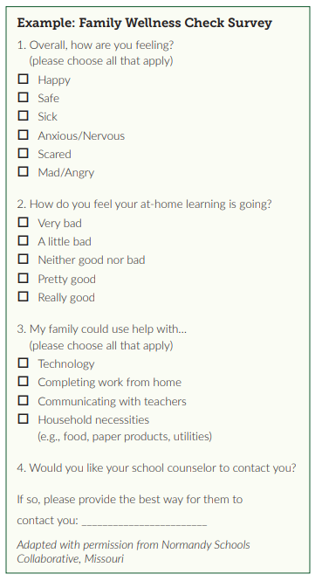
Sample Tool: Tier 1
Adapting CICO
https://www.pbis.org/resource/guidance-on-adapting-check-in-check-out-cico-for-distance-learning

Slide 96
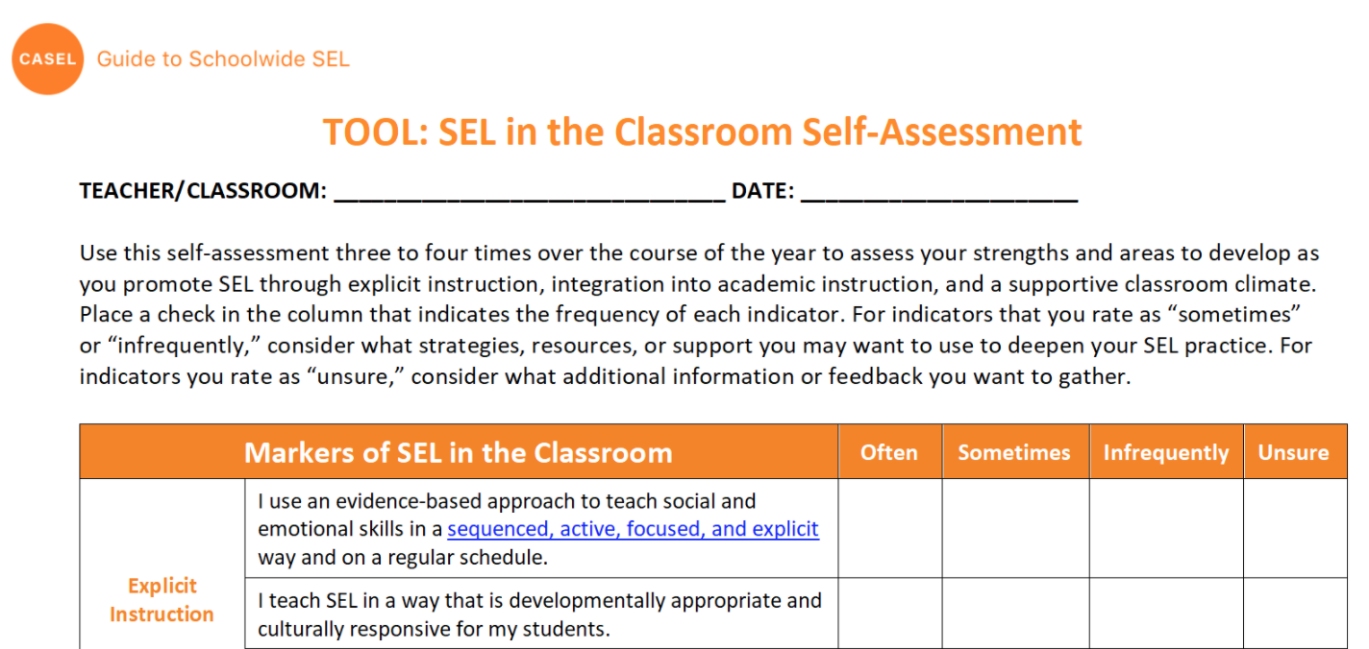
Another CASEL Related Tool (Classroom)
https://schoolguide.casel.org/resource/sel-in-the-classroom-self-assessment//
Explicit Instruction
Integration of SEL into Academic instruction
Supportive Classroom Climate
22 items

Slide 97

Sample Tool: Tier 1
Positive Classroom Behavior Supports
https://osepideasthatwork.org/sites/default/files/ClassroomPBIS_508.pdf

Slide 98
Tier 1 Team: Sample coordination of related activities
 | Student | Staff | Family
ALL Tier 1 Team | - Decide & provide staff PD for daily SEL temperature check-ins with students | - Determine need for & provide staff with self-assessment to gauge ratios of + to - classroom statements | - Determine need & structure for culturally responsive home resilience and needs survey

Slide 99
Tier 1 Team: Sample coordination of related activities
 | Student | Staff | Family
ALL Tier 1 Team | - Decide & provide staff PD for daily SEL temperature check-ins with students - Track and share data for students celebrations & additional support | - Determine need for & provide staff with self-assessment to gauge ratios of + to - classroom statements - Track and share data for staff peer modeling & additional support | - Determine need & structure for culturally responsive home resilience and needs survey - Sharing of data and development of home tips & mini-strategy lessons

Slide 100

CASEL Key Points
Collect and act on data around students who are disengaged or chronically absent.

Slide 101
Looking students’ attendance trends before and during COVID-19, teams can “develop a plan that addresses the root causes of their absences and leverages family and community partners to double-down on individual outreach and relationship-building.”

Slide 102


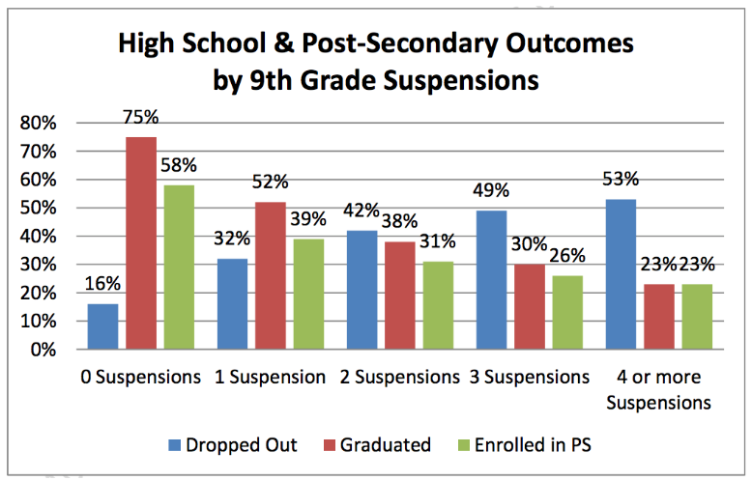
The Link Between Suspensions, Expulsions, and Dropout Rates
https://www.americaspromise.org/opinion/link-between-suspensions-expulsions-and-dropout-rates

Slide 103


When Schools Cause Trauma
Trauma in the Curriculum
Trauma in Policies
Toward Schools as Healing Spaces
https://www.tolerance.org/magazine/summer-2019/when-schools-cause-trauma

Slide 104

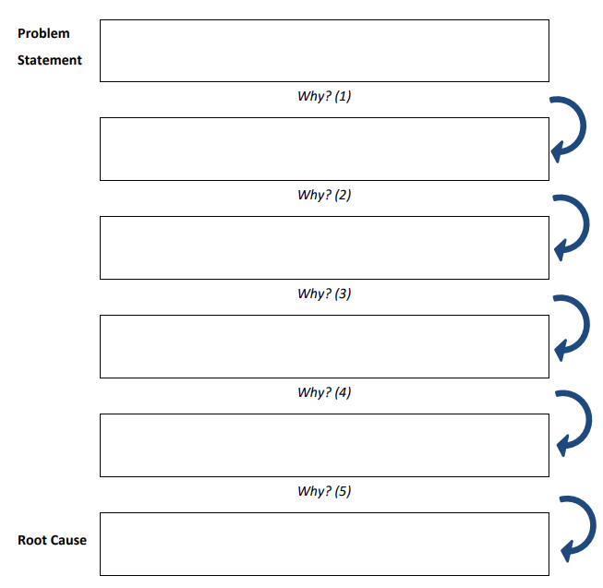
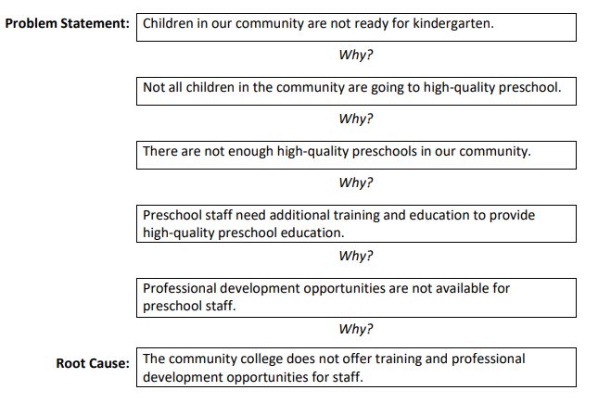
https://nirn.fpg.unc.edu/resources/lesson-1-hexagon-tool

Slide 105
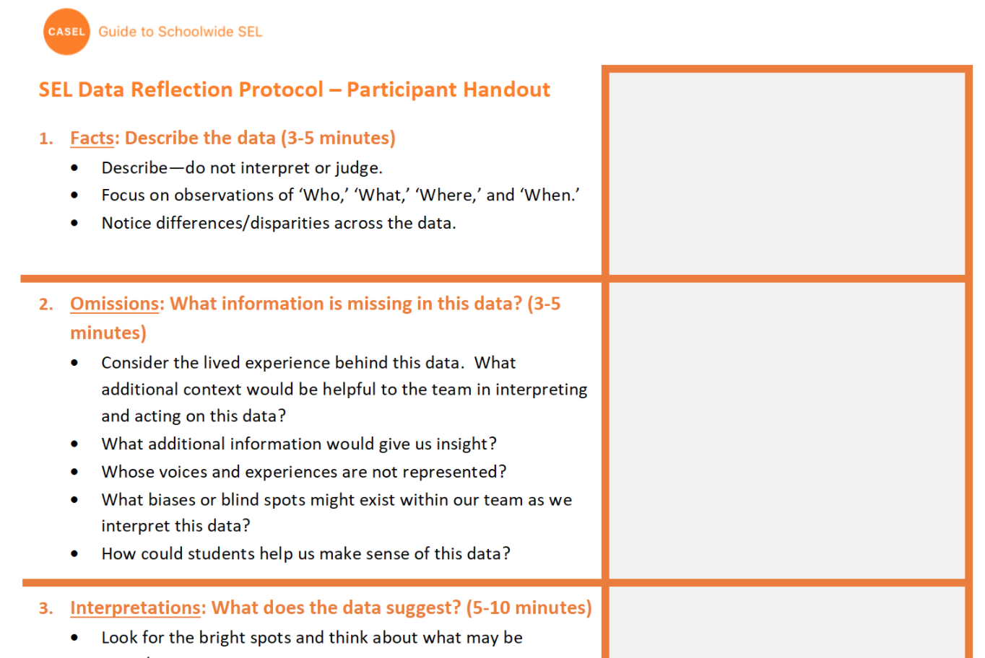
CASEL Putting in Into Practice : Equity
“Data reflection should inform decision-making that promotes equitable outcomes for all members of the school community.”

Slide 106


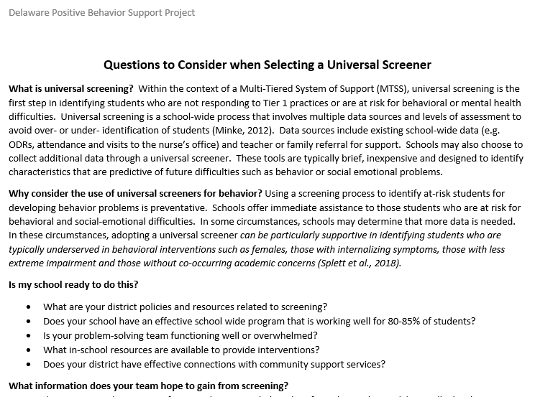
SCHOOL MENTAL HEALTH COLLABORATIVE

Slide 107


Adopting a SEB Screening Tool During & After COVID
Assume base rates of SEB risk will be elevated during and after disruptions to academic schedules
Eklund & von der Embrose (2020)

Slide 108
Adopting a SEB Screening Tool During & After COVID
Assume base rates of SEB risk will be elevated during and after disruptions to academic schedules
Screening can inform type and prevalence of risk, but should not be solely used to determine individual student services
Universal considerations of SEL/Mental Health are KEY to success
Consider additional referral pathways
Eklund & von der Embrose (2020)

Slide 109
Tier 2/3 Team: Sample coordination of related activities
 | Student | Staff | Family | Community
FEW Tier 3 Team SOME Tier 2 Team | - Using Tier 1 team’s implementation of IM40 survey to identify unique gaps in students assets - Work to update CICO procedures for virtual school setting. (Pbis.org) | - Further analyze ProQOL data collected by Tier 1 team to identify specific staff “burn-out” needs and identify resources. | - Tier 2 team coordinates follow-up check-in calls with Connect the Dots survey for families of students with 10+ Zoom absences. | - Work with community agencies to collect and share quarterly community stats in District MTSS Leadership meetings.

Slide 110
Critical Action #4: Use data as an opportunity to deepen relationships and continuously improve support for students, families, and staff.
 | Student | Staff | Family | Community
FEW Tier 3 | Continue to review data via screening processes & tools Progress monitor students’ engagement in Tier 3 interventions and the impact on students’ outcomes Adjust intervention programming as needed (fade, continue, modify)
SOME Tier 2 | Review data via screening processes & tools Progress monitor students’ engagement in Tier 2 interventions and their impact on students’ outcomes Adjust intervention programming as needed (fade, continue, modify)
ALL Tier 1 | Collect data on schoolwide and classroom-wide practices to promote SEL Collect screening data from across the population (all or equitably rep. group) Share results and facilitate group problem-solving Develop action plans and progress monitor process and outcomes

Slide 111
Analysis to Action Data Use Training Series
PDMS Course# 29142 Section# 54411
This 6-hour learning opportunity is designed to improve your ability to translate data into action. Activities will help participants craft a data-driven strategy to achieve and monitor results at the school, classroom, and student levels that can be applied to all areas of practice. No statistical expertise is required. NO willing educator will be left behind!
Session 1: The Data Story Session 2: Universal Screening Session 3: Strategies for Multi-Tiered Systems | Dr. Heidi Sweetman Nicole Kendall UD, CDS MJ Scales UD, CDHS | Day 1: July 1 Day 2: July 8 Day 3: July 15 | 10 a.m. – 12 10 a.m. – 12 10 a.m. – 12

Slide 112
Putting It Together
 | Take time to building partnerships, deepen your understanding, and plan for SEL.
 | Design opportunities for adults to connect, heal, and cultivate their own SEL competencies and capacities.
 | Create emotionally and physically safe, supportive, and engaging learning environments that promote all students students’ social and emotional development.
 | Use data as an opportunity to deepen relationships and continuously improve support for students, families, & staff.
1
2
3
4

Slide 113

Thank You and Time for Q & A
Thanks

Slide 114
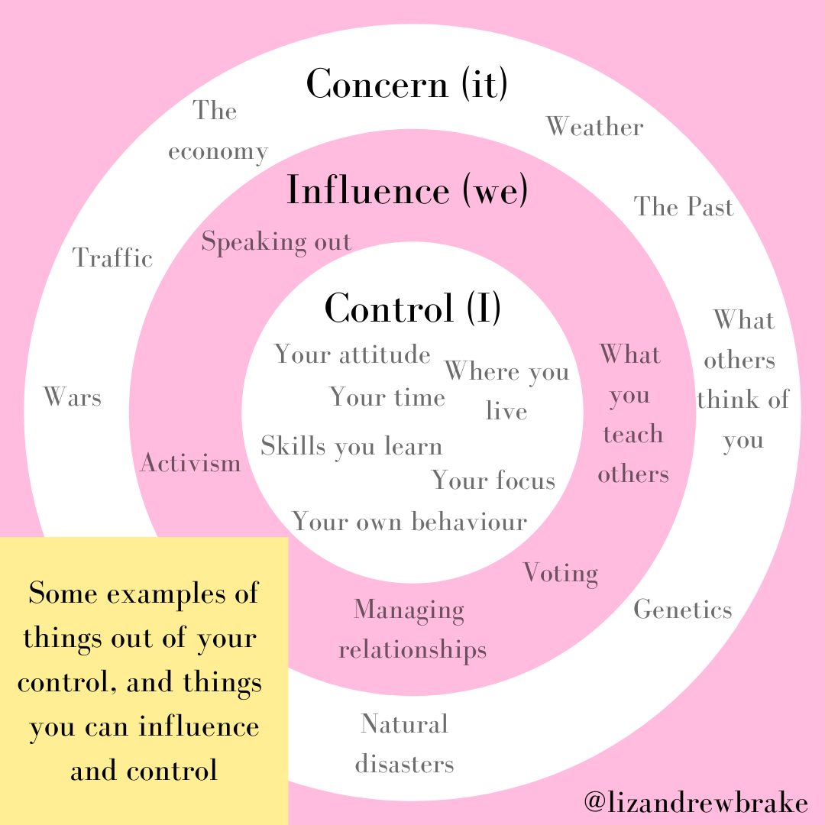
What is one thing that is in your control that you can do

