Slide 1
Welcome DE-PBS Cadre
June 5, 2020

Slide 2
Today’s Agenda
Welcome & addressing the current context, needs and concerns
School Climate Survey Resources
MTSS - Proactively Shaping for the “New Normal”
School Year-end Reminders & Supports
Upcoming Events
Wrap Up & Community Conversation

Slide 3
Today’s Materials - Cadre Corner -> Cadre Meetings-> 2019-20

Slide 4
Meeting Expectations
 | Virtual Meetings
BE ENGAGED | Unmute yourself or use chat box to ask questions Participate in polls and breakout rooms Use video when possible, especially when speaking
BE REFLECTIVE | Share questions you have for full group Note follow up questions for PBS team and/or individuals Focus on problem solving around areas of concern
BE SUPPORTIVE | Share successes, ideas, useful resources Listen with openness and understanding Attend to your own needs

Slide 5
Readiness
Introspection
Outreach
Professional Development
School-wide Support
Small Group Support
Individual Support
Sustainable Change
School Climate and Culture
Subject Area Curricula
Ongoing, Multilevel Advocacy and System Evaluation

Slide 6
Please silently respond to the following
Introspection:
What am I feeling? Why am I moved in this way? What have I experienced that contributes to these feelings?
Outreach:
Who can I call that I know well to talk about this with? Who else can I share with that may not have the same experiences or perspective?
PD
How can I continue my own learning?
What action do I commit to take?

Slide 7
School Climate Data Reports & Resources

Slide 8
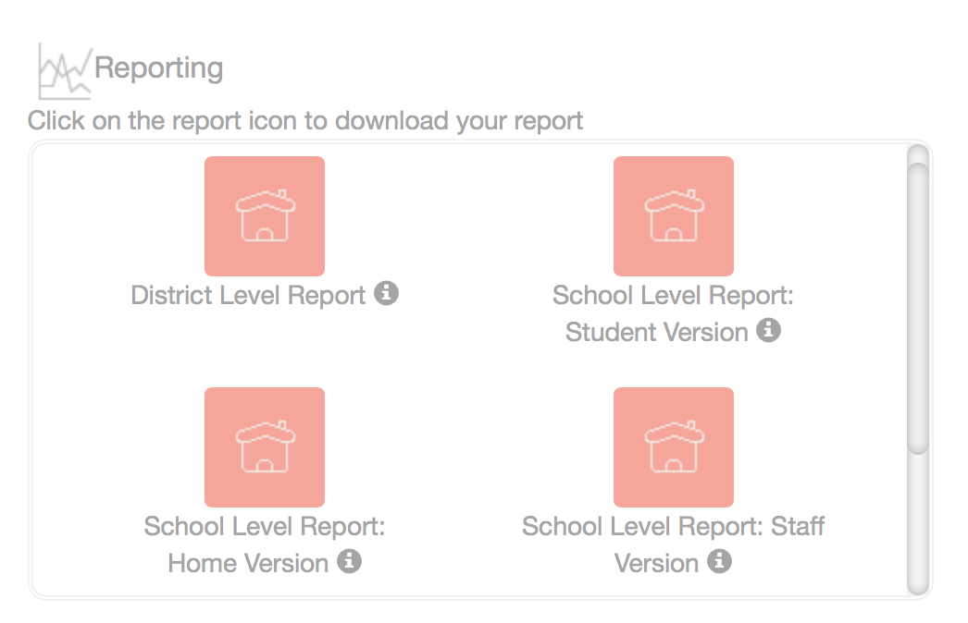
School Climate - Student & Staff - Where do we stand?
School-based reports NOW AVAILABLE! Student & Staff reports can be downloaded as PDF files from the Dashboard

Slide 9
School Climate - HOME - Where do we stand?
Online only - Reports NOW AVAILABLE!
Round 1 - Paper surveys from 75 schools returned to UD for processing
Currently being scanned; data will be cleaned and uploaded into CoVitality
Round 2 - 14 schools received paper surveys, but completed surveys not back to UD before closing
If mailed, these are in state mail system OR UD central mailing. Once open surveys will be scanned & data uploaded into CoVitality

Slide 10
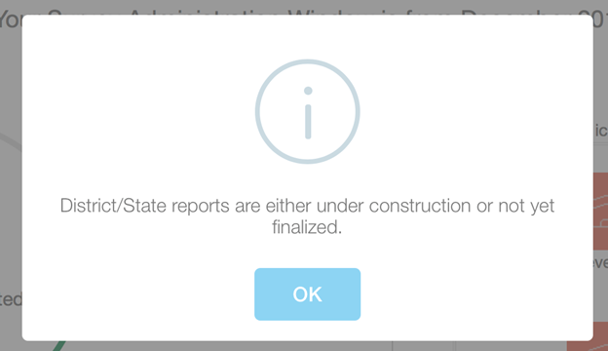
District Level Report
Currently under construction
Note: Previously available to download
District raw data files include addition of code information

Slide 11
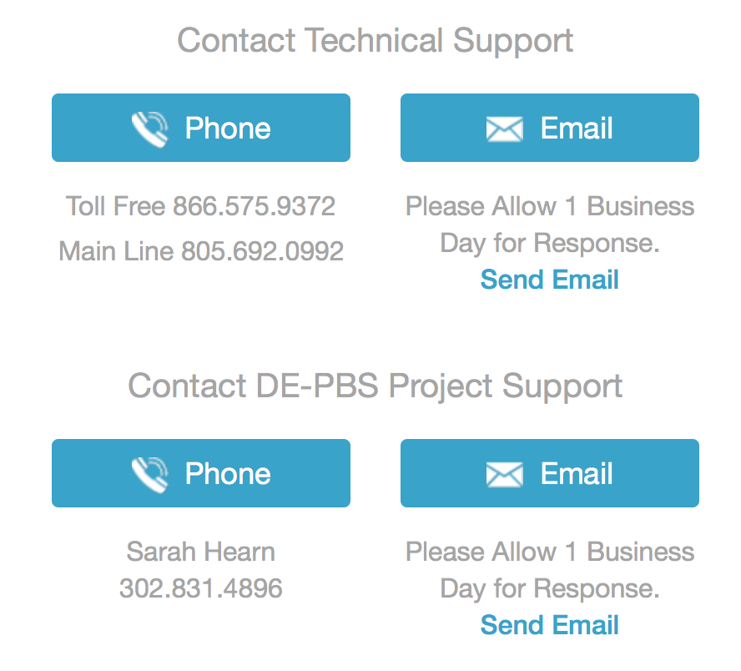
Mosaic - CoVitality App Tech Support

Slide 12
Important Review Resources
Review guidance presentation
2020 DSCS Data Report Download Instructions
Interpretation worksheets (aligned with new reports)
Action plan templates
Data sharing templates

Slide 13
DSCS Online Module Series
From: School Climate and Student Success Grant (SCSS)
Goal: Info schools can use to lead to improvements in school climate and behavioral outcomes
Structure: Each module is ~1 hr, CC
Potential uses:
In-house PD
For use with:
Whole staff and/or Individuals
PLCs and/or Leadership teams

Slide 14
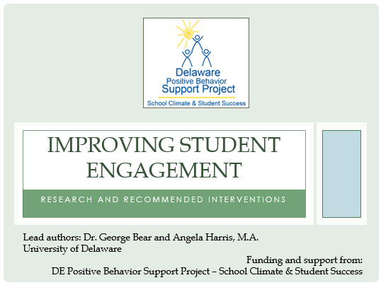
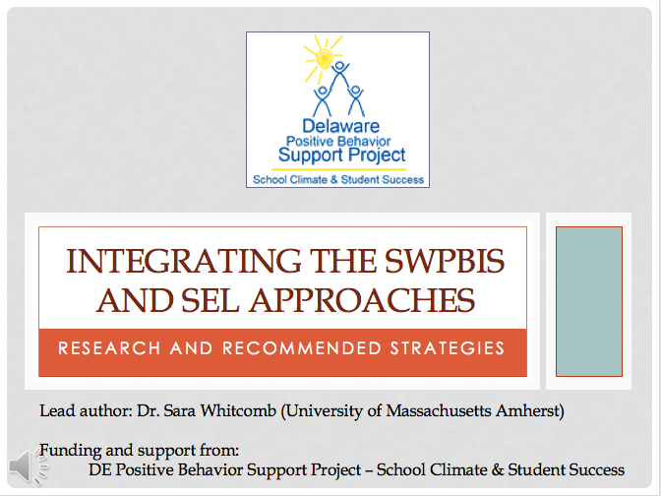
Available Professional Learning
Subscale-Related DSCS Modules

Slide 15
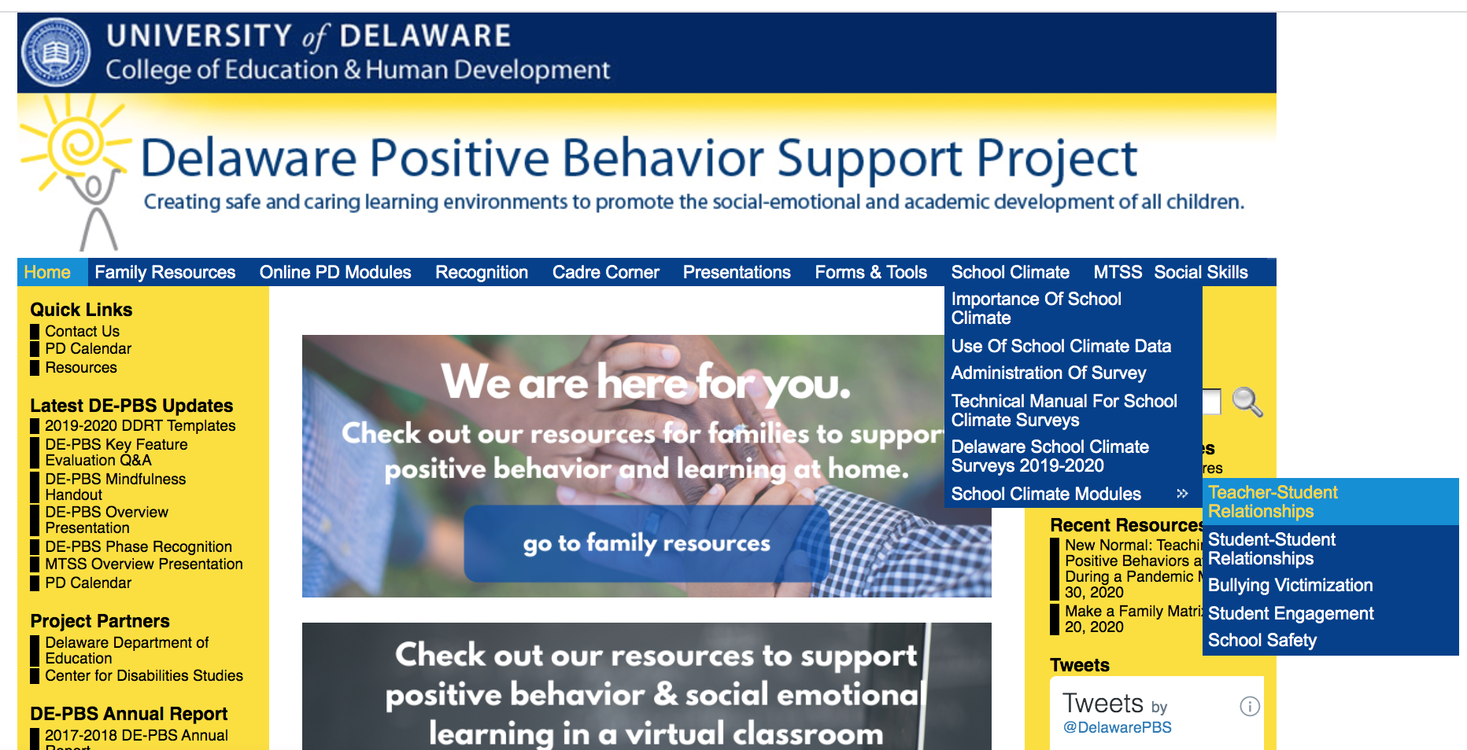

Slide 16
Understanding Your Climate Data
Utilizing Data to Inform Goals

Slide 17
Intents
Ensure that school teams understand how to read and interpret school climate data
Provide teams an opportunity to reflect upon current year School Success Plan goals
Provide teams access to a variety of data sources
Provide support to teams as they utilize data to align goals and action steps
Provide opportunities for teams to share feedback and support during School Success Plan writing process
Develop a plan for ongoing progress monitoring

Slide 18
Agenda
Icebreaker
Breakout #1 (ES and MS/HS)
Understanding your Climate Data
Reflections on this year’s School Success Plans
Planning for Next Year
Making Connections between the Data and School Success Plans
Breakout #2 (School Teams)
Student Voice Considerations
Next Steps

Slide 19
Breakout #1
Take a moment to to reflect upon your School Success Plan, take a moment to discuss the following within your small group:
What goals from your 2019-20 School Success Plan addressed climate?
How will you celebrate an area of success related to your goals around climate?
Identify additional areas around climate that you will explore for the upcoming school year.

Slide 20
Breakout #2
As a school team, take another look at your data. Discuss with your team the following:
What story is your data telling?
What additional data sources do you need in order to tell the whole story?
Identify a sub scale to explore more deeply. As you drill down more deeply into those questions, what additional questions surface?
Are there other initiatives that you are currently using in your building that may help to address the findings in the subscale, if altered or enhanced?

Slide 21
Task
Create 1 Climate and Culture goal based upon relevant data (Climate Survey, Discipline Data, Leader in Me data, etc.)
Create 2-3 Action Steps that align with the goal
Be prepared to share and provide/receive feedback
Take advantage of District Support Sessions

Slide 22
Day 2 Agenda
Icebreaker
Temperature check
Comfort level with utilizing data to create goals
Breakout #1
Share out
Exit Poll
What questions do you still have?
In what areas do you need additional support?
District School Success Plan Calendar

Slide 23
Breakout #1
How comfortable did you feel using data to identify a goal related to school climate?
What data sources did you utilize to identify a goal? What data sources will you utilize to measure progress toward your goal?
Share action steps within your group and receive feedback

Slide 24
Next Steps
Support for School Teams
School Success Plan Feedback Sessions
Calendar for district quarterly progress/data review meetings
Ongoing coaching and support

Slide 25
DDOE MTSS Update
MTSS Definition:
Delaware MTSS is a framework designed to meet the needs of the whole child through an integrated multi-level prevention system that optimizes team-based leadership and data-driven decision making to meet the academic and non-academic needs of all students. High quality core academic instruction and non-academic practices are provided as universal supports. Evidence-based intervention and supports are matched to student needs and informed by ongoing progress monitoring and additional formative assessments.
Regulation Process
Implementation Guide & Supporting Documentation In Development

Slide 26
MTSS: Proactively Shaping for
“New Normal”

Slide 27
The Mid-Atlantic PBIS Network
Is an educational organization housed at Sheppard Pratt Health System that supports implementation of Positive Behavioral Interventions and Supports in state, local, and community agencies throughout the Mid Atlantic.
A partner with the OSEP funded National PBIS Technical Assistance Center, the Network develops the capacity of schools to prevent problem behaviors, promote positive school culture, and to evaluate the impact on both social and academic success of all youth, including those with the highest level of need.
http://www.midatlanticpbis.org/home

Slide 28
Dr. George Sugai
Is a national expert in positive behavioral interventions and supports (PBIS) and before retiring, he was the co-director of the National Center on Positive Behavioral Interventions and Supports.
Is Emeritus Professor in the Neag School of Education at the University of Connecticut. In 2019 he retired as the Endowed Chair and Professor with tenure in School of Education at University of Connecticut.
His research and practice interests include school-wide positive behavior support, behavioral disorders, applied behavior analysis, organizational management, and classroom and behavior management, and school discipline.

Slide 29
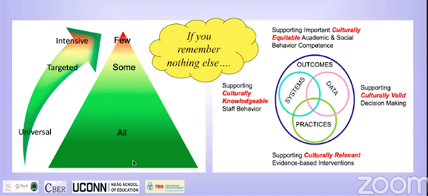
MTSS: Proactively Shaping for “New Normal”

Slide 30
Companion Guide - MTSS: Proactively Shaping for “New Normal”
Suggestions for Use
What’s Needed
Team MTSS Action Plan
Additional Notes

Slide 31
MTSS for "New Normal" - Notes
Directions: As you watch and listen, you are welcome to use this worksheet to capture key ideas and messages. The prompts provided, follow along with Dr. Sugai’s presentation. Be on the lookout for the red hands or “high fives” on certain slides.

Slide 32
MTSS Planning Matrix Template & Example
Work as a team with common vision, values, language, and routine.
Use DATA on risk-screening, student outcome & progress, and implementation fidelity to guide decision making.
Consider ALL students (All, Some, Few)
Commit to a small number of measurable, achievable, observable student OUTCOMES for each group.
Prioritize selection of PRACTICES that are (a) evidence-validated/-based and conceptually defendable (b) aligned with important outcomes.
Develop durable, doable, and competent SYSTEMS SUPPORTS for accurate, fluent, and sustainable implementation.

Slide 33
Being Strategic: Breakout Room Discussions
Which audiences would you want to share this with?
How might you share the presentation?
Are you involved in district planning for the return to the school?
What resources or ideas have been useful that you can share with others?
If not yet, how might you connect & share this information with those that are.

Slide 34
School Year-end Reminders & Supports

Slide 35
Substitute Reimbursement Reminder
Substitute Reimbursement requests via PFAs/IVs must be submitted by Tuesday, June 9. Please direct reimbursement requests to Beth.Draper@doe.k12.de.us

Slide 36
Recognition
Phase 1 and 2...focus on Tier 1
Phase 3 and 4...focus on Tier 2
Tier 1 and 2 teams in a school can both apply for 2019-2020 Recognition
Your input, the FAQs & the Word versions of the online application questions will help teams decide which phase to go for
All application materials include opportunities for team reflections

Slide 37
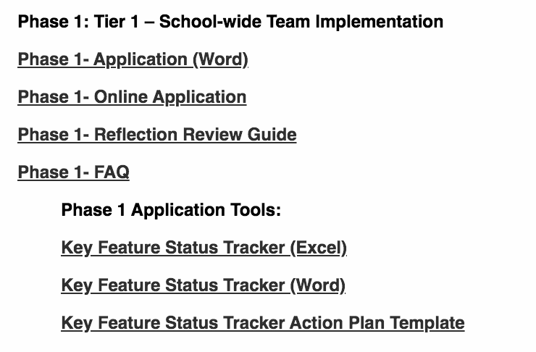
Recognition
For more details - check out the guidance tools online:

Slide 38
Recognition
Dates To Keep in Mind:
Recognition process reflects = 2019-2020 SY
Online submission due date: Friday, 6/26/20
DE-PBS Project receipt sent: Friday, 7/17/20
Notification of recognition phase earned sent: Week of 9/14/20

Slide 39
Discipline Data Reporting Tool (DDRT)
Templates available on website & shared via email
Tier 1: Forms & Tools / Program Development & Evaluation
2nd submission August 2019 - March 13th, 2020
Due Jenna Leary at jenleary@udel.edu by June 26th.

Slide 40
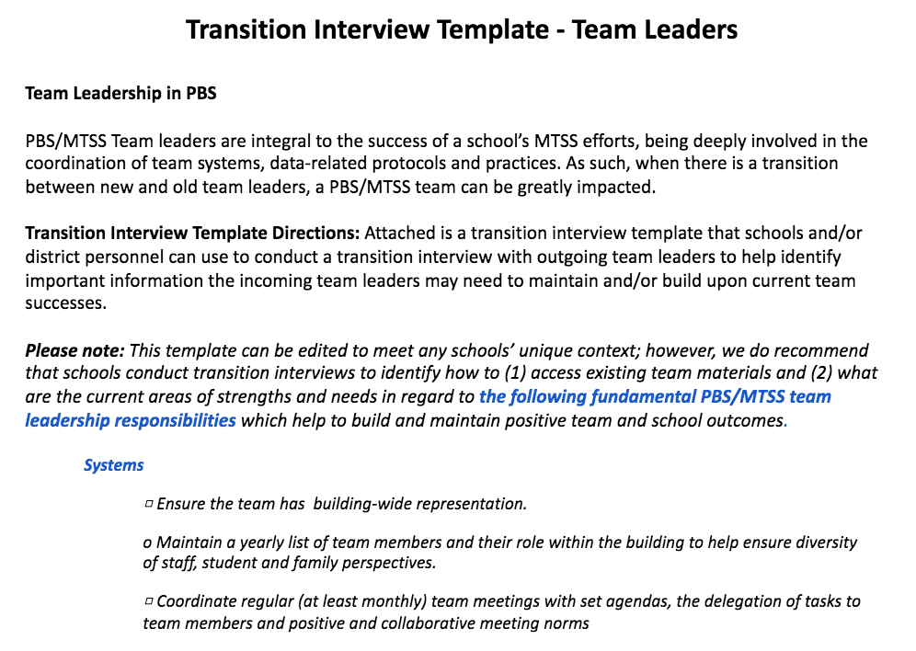
Team Leader
Transitions

Slide 41
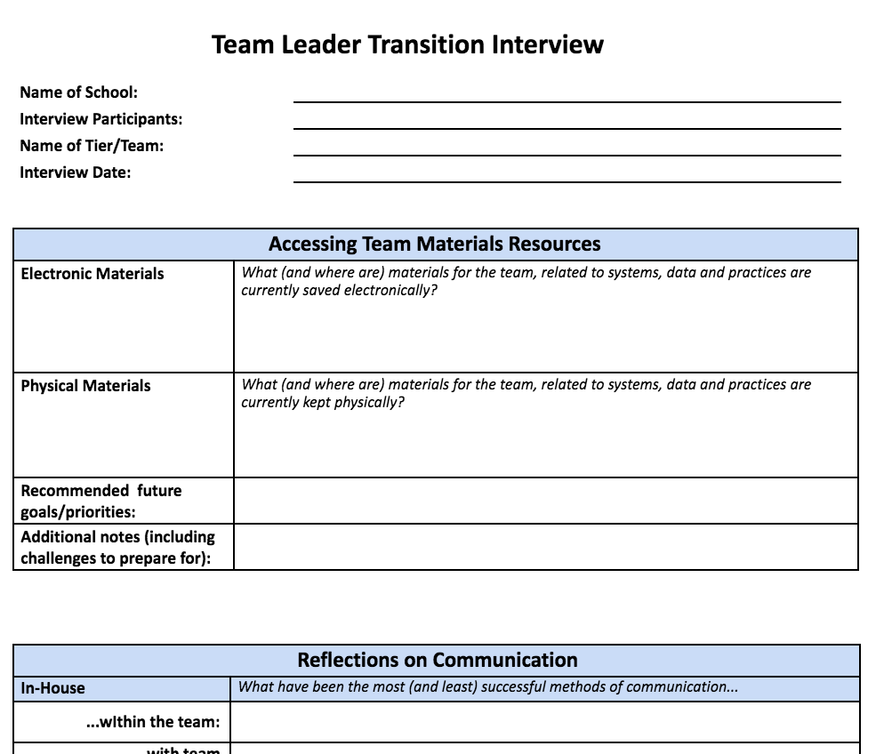
Team Leader
Transition
Interview

Slide 42
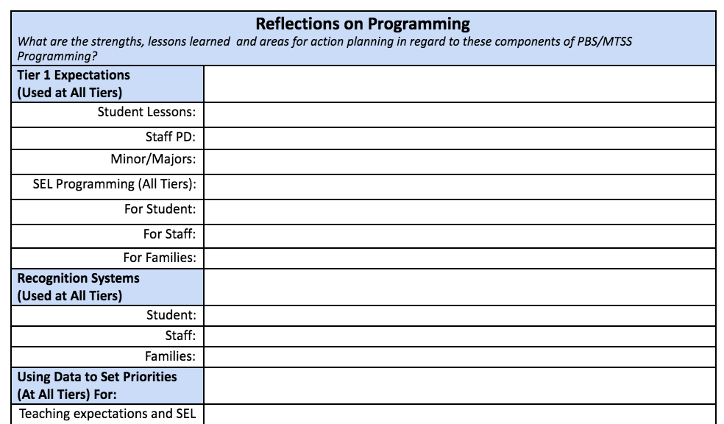
Team Leader Transition Interview

Slide 43
Other Transitions?

Slide 44
Upcoming Events

Slide 45
When: June 17th from 1:30-3:00pm.
What: Dr. Rose Iovannone, from the University of South Florida, will share information about universal parenting practices including ways to implement and individualize these for families.
Who:
Most relevant to those providing behavioral consultation with families such as school psychologists and behavioral interventionists.
Others are welcome to attend, but some prior exposure to PTR is recommended.
For those unfamiliar with PTR, share this brief overview prior to the webinar: http://wh1.oet.udel.edu/pbs/ptr-forms/

Slide 46
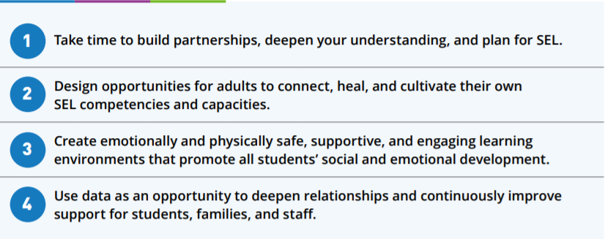
Self-Care Webinar Idea sharing
https://casel.org/wp-content/uploads/2020/05/CASEL_Leveraging-SEL-as-You-Prepare-to-Reopen-and-Renew.pdf

Slide 47
Toni Morrison
We appreciate your time with us today and value your feedback
“When you get these jobs that you have been so brilliantly trained for, just remember that your real job is that if you are free, you need to free somebody else. If you have some power, then your job is to empower somebody else.”

Slide 48
Creating a Space for Sharing
Join us for an unscripted, safe space for:
Sharing
Listening
Support
Action Planning

Slide 49
Please silently respond to the following
Introspection:
What am I feeling? Why am I moved in this way? What have I experienced that contributes to these feelings?
Outreach:
Who can I call that I know well to talk about this with? Who else can I share with that may not have the same experiences or perspective?
PD
How can I continue my own learning?
What action do I commit to take?

