Slide 1
Improving the Decision-Making Process
Solution
From
Problem
Information
Problem
Solving
To
Problem
Solution
Information
Excerpt from DE-PBS MTSS Tier 1: School-wide PBS Leadership Workshop

Slide 2
Improving the Decision-Making Process
Precision Problem Statement
Monitor Outcome vs Goal
Set Measurable Goal
Use Data
Problem
Solving
Monitor Fidelity of Plan
Develop Solution and Action Plan

Slide 3
Data-based Decision Making
Decisions are more likely to be effective and efficient when they are based on data.
The quality of decision making depends most on the first step—defining the problem to be solved.
Big Ideas:
Define problems with precision and clarity.
Data help place the “problem” in the context rather than on the students.

Slide 4
Going from Primary to Precise: Ask the Right Questions
What are the data we need for a decision?
Precise problem statements include information about the following:
What is the concern (e.g. problem behavior)?
How often is the concern happening?
Where is the concern happening?
Who is engaged in the concern?
When is the concern most likely to occur?
Why is the concern sustaining?

Slide 5
Primary vs. Precision Statements
How do we go from here to here?
Primary Statements | Precision Statement
Too many referrals | There are 25% more office discipline referrals for aggression on the playground this month than last year. These are most likely to occur during first recess, with a large number of students, and the aggression is related to getting access to the new playground equipment.
September has more suspensions than last year
Gang behavior is increasing
The cafeteria is out of control
Student disrespect is rampant

Slide 6
Example Precision Statements
There are 25% more office discipline referrals (ODRs) for aggression on the playground this month than last year. These are most likely to occur during first recess, with a large number of students, and the aggression is related to getting access to the new playground equipment.
What?
25% More ODRs for aggression
When?
First recess
Where?
Why?
To get new playground equipment
On the playground
Who?
A large number of students

Slide 7
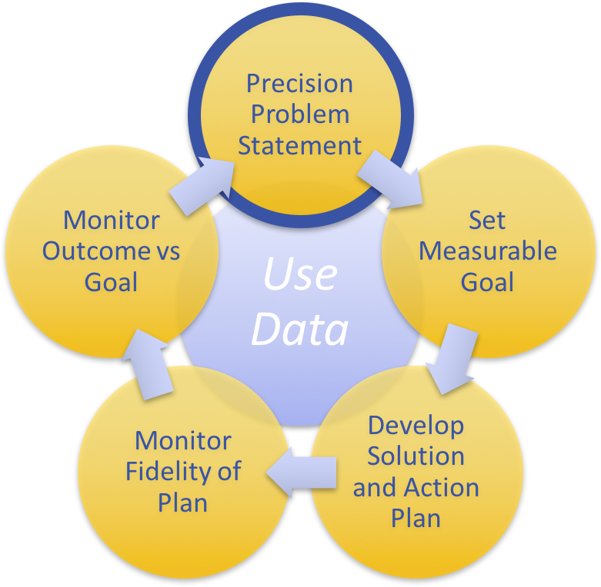
Team Problem Solving: From primary to Precision Problem Statement
Primary statement:
“ODRs during December were higher than any month.”
Example Precision Problem Statement:
Minor disrespect and disruption are increasing and are most likely to occur during the last 15-minutes of classes when students are engaged in independent seat work. This pattern is most common in 7th and 8th grades, involve many students, and appears to be maintained by work avoidance/escape. Attention may also be a function of the behavior- we’re not sure.

Slide 8
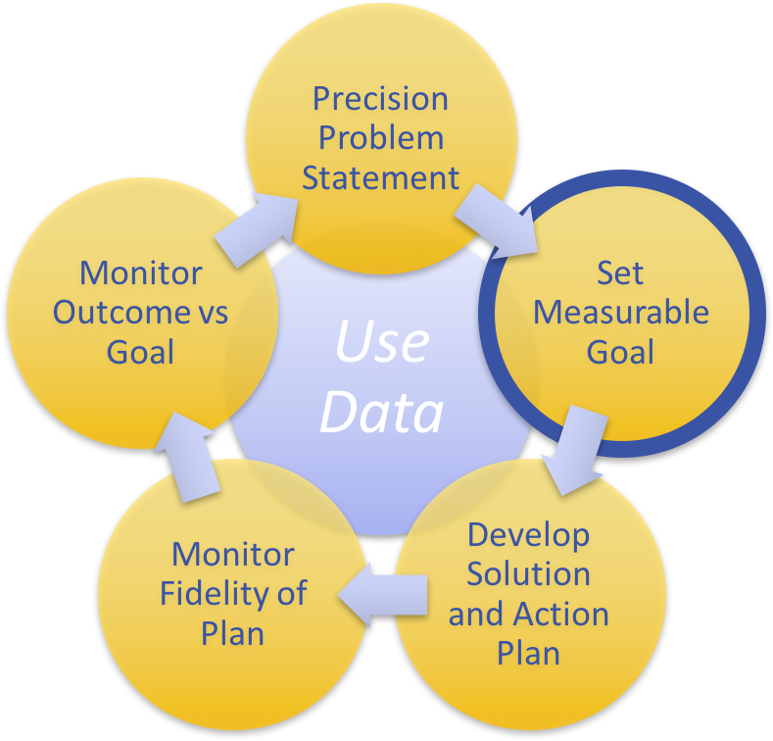
Team Problem Solving: Set a Measurable Goal
Goals allow you to analyze, monitor, and adjust professional practice.
Example: By December 18 (Tier 1 MTSS/PBS team meeting), there will be a 5% decrease in minor disrespect and disruption behavior referrals for students in 7th & 8th grades as measured by ODR data.
Is it:
Specific?
Measurable?
Achievable?
Relevant?
Timely?

Slide 9
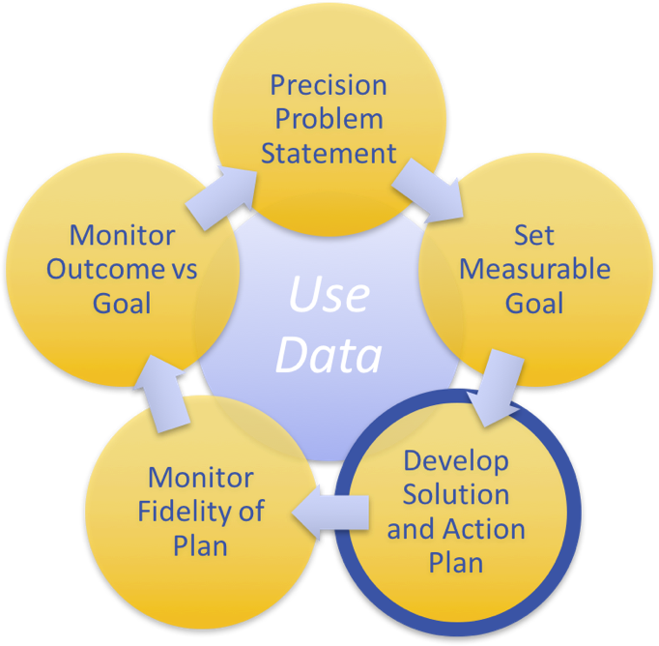
Team Problem Solving: : Develop a Solution & Action Plan
What efficient & effective strategies does the team propose be done to meet the goal?
Example Plan of Action:
During 7th & 8th grade advisory periods during the week of November 3-5, staff will review “Be Respectful” lessons. Examples discussed will reflect current scenario.
Team member representatives from 7&8th grade teams will discuss & brainstorm with their teams classroom management strategies to keep students engaged during the last 15 minutes of class at next PLC meeting on November 6th.

Slide 10
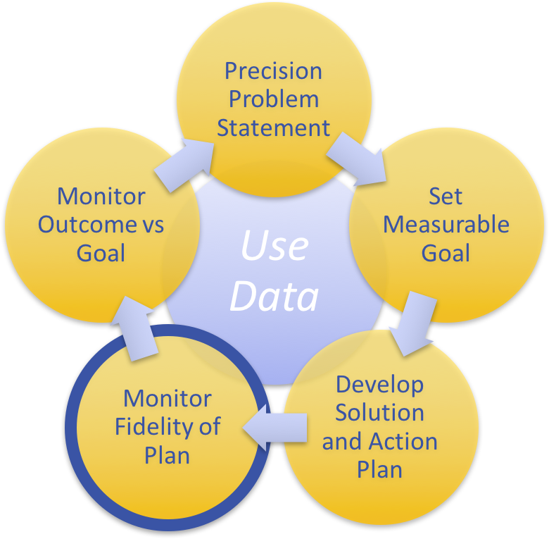
Team Problem Solving: Monitor Fidelity of Plan
How will you ensure the plan is being implemented as designed? Are you doing what you say you will do?
Examples:
School counselors will divide classrooms and do at least 4 brief observations to note if “Be Respectful” lessons are utilized.
Team members commit to ask 2 7th & 2 8th graders what was the focus of a given day’s advisory lesson.
Create a shared document for PLCs to report out engagement strategy brainstorm after PLC mtg.

Slide 11
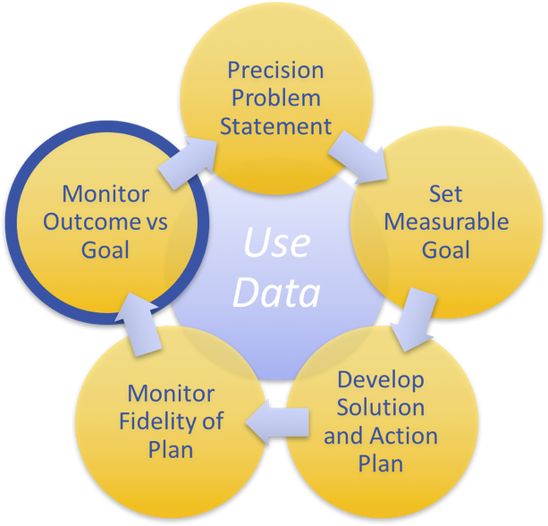
Team Problem Solving: Monitor Outcome Data vs Goal
As a team, review data to see if the problem- solving plan was successful.
Revisit the precision problem statement. Update the data used to create the precision problem statement and compare results.
What other data sources can also inform the impact of the intervention?
Do you need to change the precision problem statement, goal, action plan, or fidelity measure?

Slide 12
Problem Solving & Planning Template & Example
Both available for team use.
www.delawarepbs.org

