Slide 1




WELCOME!
Tier 2: New Tier 2 Teams Workshop
Wifi: Special Events
PW: 20191209DgfE

Slide 2
WELCOME!
Tier 2: New Tier 2 Teams Workshop
Designing Tier 2 Systems for Implementing Targeted Interventions

Slide 3
Agenda
Welcome!
Overview of Tier 2 Conversations: Systems and Problem-Solving
Effective Tier 2 Teaming
Interventions at the Tier 2 Level
Evaluation and Monitoring of Tier 2 Interventions
We will be engaged in activities throughout the day, including team self-reflections and action planning.

Slide 4
Expectations
 | During the day, please…
BE ENGAGED | Share effective strategies you have used related to the topics presented Know that team time is the best time for colleague discussions
BE REFLECTIVE | Compare the ideas shared to your current context and experiences Assess your current school practices
BE STRATEGIC | Use this time together to work together Take notes in a way that you can share out with others not attending today.

Slide 5
Meeting Roles Help
Required for Today:
  Recorder/Note taker – Completes Forms; takes notes; keeps track of decisions made, on paper or via Google
  Reporter - Uses recorder’s notes to share with the group
Optional:
  Facilitator - Guides team back to activities and the intent of those activities; remains objective
  Timekeeper - Keeps track of time spent on issue; prompts group when allotted time is up

Slide 6

Logistics Re: Materials
Paper Copies – Individual & Team folders
Google Drives – 1 Per School (check your email)
Shout out to Our Attending Administrators
Evaluation Forms (2 mins)
http://udlguidelines.cast.org/

Slide 7
What your Google Drive looks like:

Slide 8

Administrators – Your Support = Sustainability of Systems
A balcony view of MTSS in your school:
  The existing Schoolwide (Tier 1) foundation(s)
  The recruitment of staff members who are, can or will be involved in Tier 2 interventions
Ways you have committed to support a team working on Tier 2 interventions & systems:
  Allocated Meeting Time
  Supported Data Collection & Use of Data by Team
  Active Leadership Within Team & Implementation Support

Slide 9
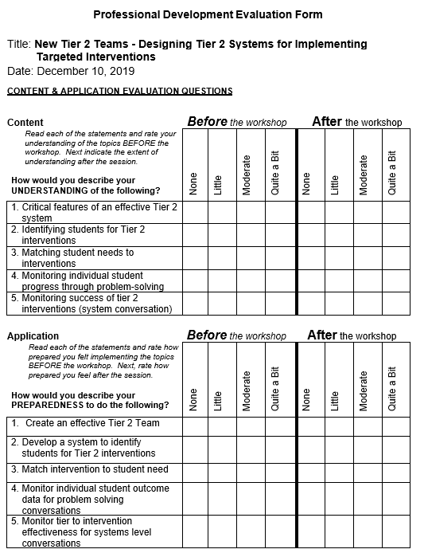
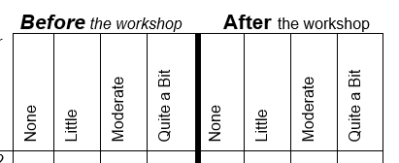
At this time, please take 2 minutes to complete the BEFORE items on today’s evaluation sheet. Thanks!

Slide 10

Activity 1: Asset Mapping by People
Who are the people in your school?
Step 1:
List the people in your building currently providing interventions
Include staff who work regularly in your building as well as outside providers who routinely come to your school.
Step 2:
Identify areas of expertise and current interventions provided.

Slide 11
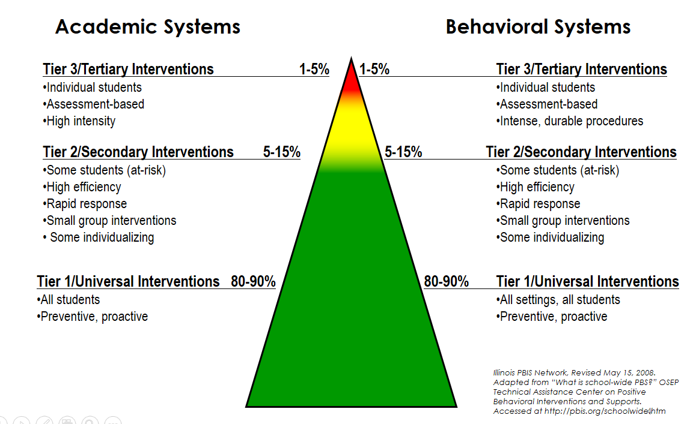
School-Wide Systems for Student Success:
A Multi-Tiered System of Support

Slide 12
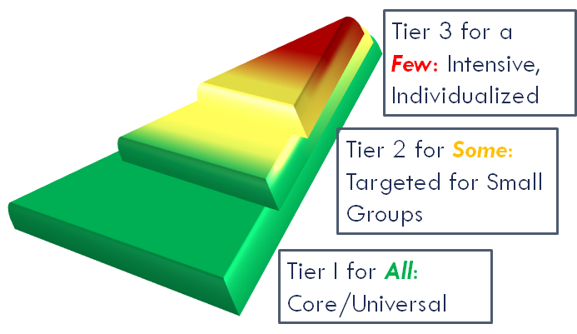
Layers that build, not dividers that separate

Slide 13
Tier 1 & 2 Comparisons
Similarities
Systematic problem solving process is foundation
Supports put in place are based on the function of student behaviors
Data are used for determining & monitoring interventions
Data used for monitoring students at both tiers are often existing data sources, such as ODRs,
Differences
Tier 1 focuses on schoolwide interventions
Tier 2 interventions are oriented to address the specific demonstrated needs of a particular sub-group of students.

Slide 14
Tier 2 & 3 Comparisons
Similarities
Systematic problem solving process is foundation
Supports put in place are based on the function of the student behavior
Data are used for determining & monitoring interventions
Differences
Tier 2 focuses on group-based interventions rather than highly individualized supports
Tier 2 interventions can be determined without pulling together a team formed specifically for the student
Data used for monitoring students at Tier 2 are often existing data sources, such as ODRs, rather than observation data taken on specifically defined behaviors

Slide 15
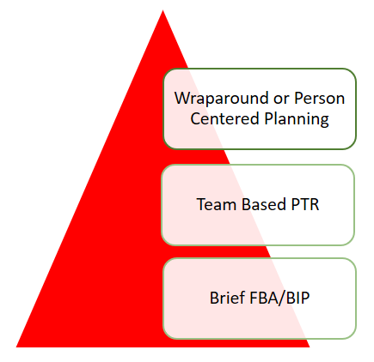
Tier 3 is a Continuum of Supports
Wrap-Around or Person-Centered Planning Based Supports
Long-standing, extremely intense behaviors, mental health concerns, complex life events
Multiple services, agencies or institutions
Team Based FBA/BIP (e.g. PTR)
More intensive FBA/BIP process
Multiple meetings (2-4) or one long meeting (>2 hours)
Best for chronic, durable, intense behaviors
Brief FBA/BIP (consultant based)
FBA/BIP developed in one meeting (~60 minutes)
Best for high frequency/low intensity behaviors
Noncompliance, minor disruptions
Functional thinking at all levels

Slide 16
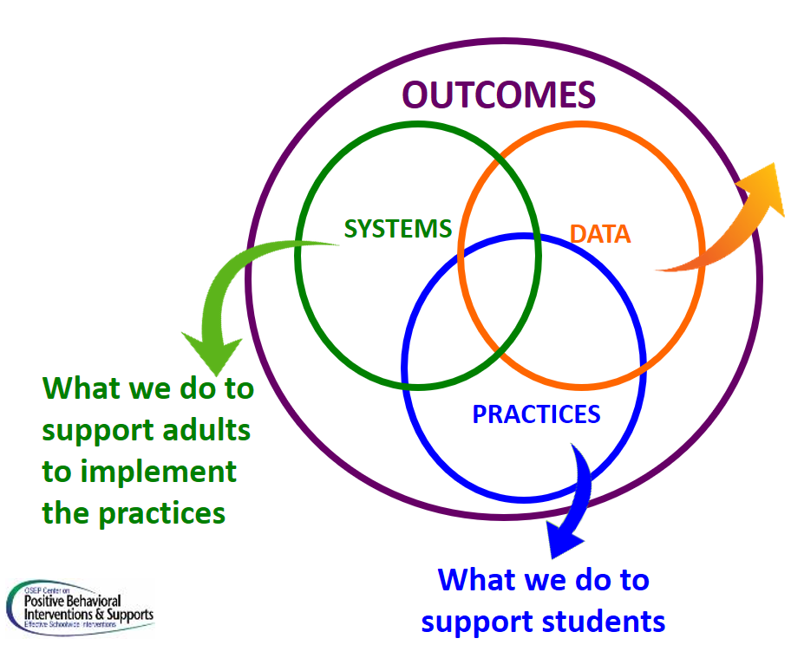
MTSS for Social Competence & Academic Achievement
Outcome data (social, behavior, academic achievement), Progress Monitoring, Fidelity

Slide 17


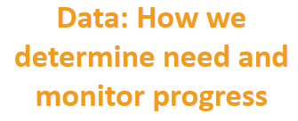
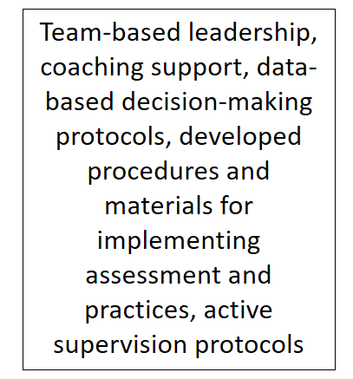
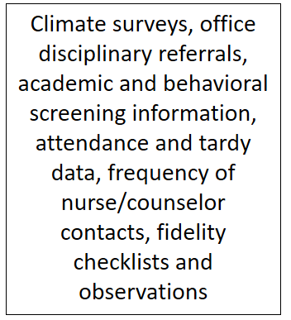

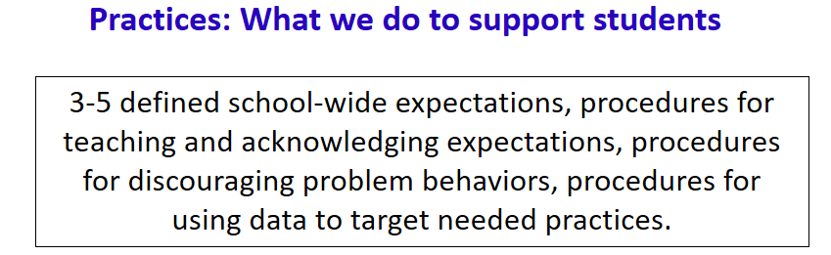

Slide 18
System Development is Key!
  To scale up interventions we must first scale up implementation capacity
  Building implementation capacity is essential to maximizing the use of Positive Behavior Support and other innovations
Dean Fixsen, Karen Blase, Robert Horner, George Sugai, (2008)
Adapted from the Illinois PBIS Network

Slide 19


“When a school implements an intervention without careful consideration of the systems features necessary to guide implementation, the intervention is likely to disappear quickly, be implemented with poor fidelity, or becomes part of a hodgepodge of interventions, none of which have documented effects.”
(Anderson &
Borgmeier 2010)

Slide 20
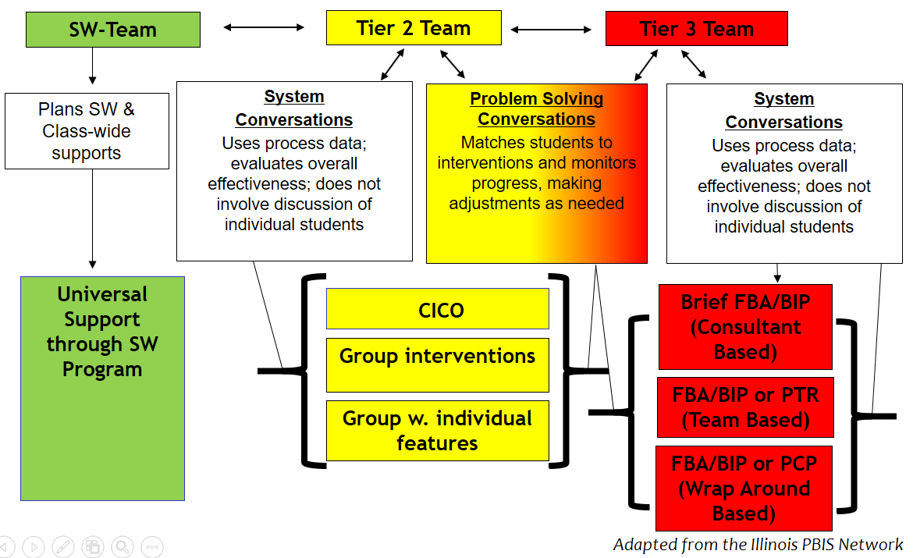
3-Tiered System of Support Necessary Conversation (Teams)

Slide 21
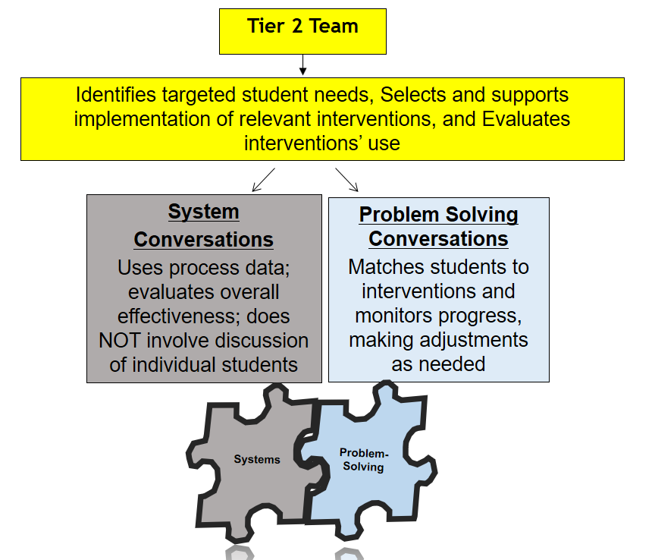
3-Tiered System of Support Necessary Conversations (Teams)

Slide 22
What is the mission of your Tier 2 team?
“Teams exist to uphold an organization’s mission, to fulfill its vision and to meet its goals. For a team to do this it needs a clear and articulated reason for existing -- an explicit articulation of the connection between the team’s work and the organization’s big picture goals” (Aguilar, 2016, p. 65)
Teams need their own mission and vision so they know where they are headed, how they fit, and why they exist...

Slide 23
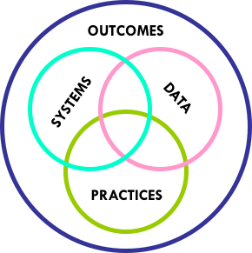
Why does your Tier 2 team exist?
Outcomes: What student needs are we addressing?
Data: What evidence do we have that students have that need?
Systems: How do we engage and support all staff to address that need?
Practices: How do we interact with and support our students to address that need?

Slide 24

Activity: Your Tier 2 Team Mission
Review the questions on the Mission Handout and make notes
Discuss as a Team and formulate your Tier 2 Mission

Slide 25

School-wide Systems for Student Success:
A Multi-Tiered System of Support
Everyone’s System Looks Different
How many students do you expect to serve at Tier 2?
What is 10% and 15% of your population

Slide 26
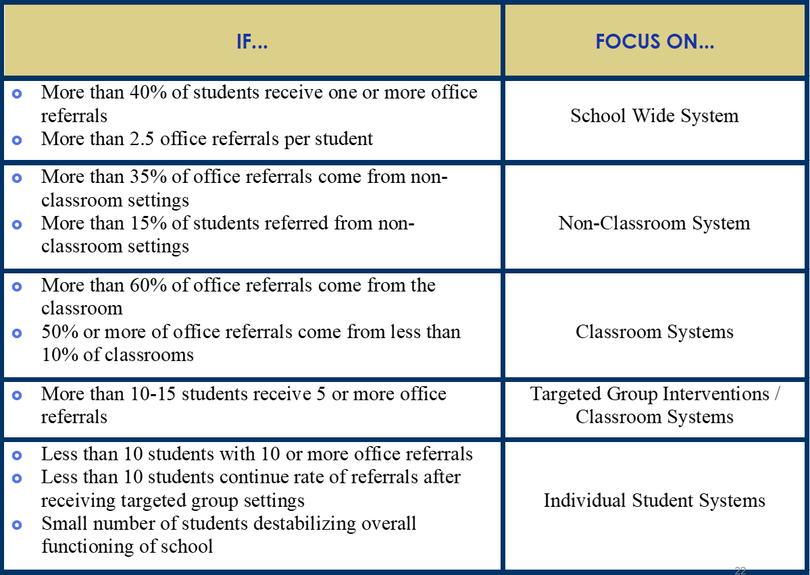

Slide 27
Looking at your SW data in detail
Drilling down can reveal opportunities for SW and/or CR interventions
Your team reviews the September data and notice that there are a couple of students with 5+ referrals for being late to class. You begin using daily report cards with them. Which Tier?
Your Tier 2 team reviews the October student data. From this data, over 50 students have been referred to the team for 5+ referrals for being late to class. What would you do?

Slide 28
Looking at your SW data in detail
Drilling down can reveal opportunities for SW and/or CR interventions
Your Tier 2 team reviews the referrals for November. There are 26 students with 4+ referrals for fighting in the hallway, hallway disruption, late to class, and offensive touching (location: hallway). What would you do?

Slide 29
Communicate and Connect within MTSS

Slide 30
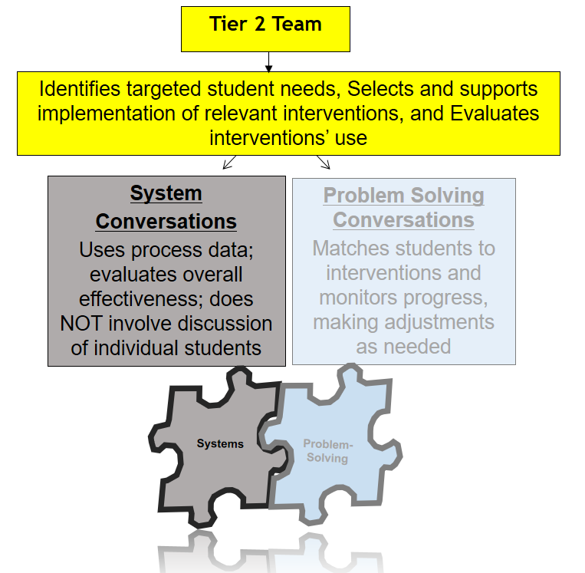
3-Tiered System of Support Necessary Conversations (Teams)

Slide 31

Tiered Fidelity Inventory (TFI):
Tier II Individual Items Slide Deck
Access the audio on the slides by clicking on the audio icon

Slide 32

Subscale: Teams
  Item 2.1: Team Composition
  Item 2.2: Team Operating Procedures
  Item 2.3: Screening
  Item 2.4: Request for Assistance
Subscale: Interventions
  Item 2.5: Options for Tier II Interventions
  Item 2.6: Tier II Critical Features
  Item 2.7: Practices Matched to Student Need
  Item 2.8: Access to Tier I Supports
  Item 2.9: Professional Development
Subscale: Evaluation
  Item 2.10: Level of Use
  Item 2.11: Student Performance Data
  Item 2.12: Fidelity Data
  Item 2.13: Annual Evaluation

Slide 33


Creating an Effective Tier 2 Team
to support all of your important Tier 2 efforts…

Slide 34

Outcomes
Examining & addressing gaps in available Tier 2 interventions
Identifying interventions for implementation and that need refinement *
Determining percent of students successful in group interventions*
Identifying students for problem solving conversations*
* Data will guide yours systems team in these activities.

Slide 35
The Logistics and Set-up
Team Operating Procedures (Logistics)
Monthly meeting schedule
Agenda, minutes, and use of meeting roles
System Set up Activities
Develop process for identifying students for Tier 2 support
Request for assistance
Forms & data rules
Staffing
Identification of coordinators & facilitators of existing interventions
Identification of coordinators & facilitators of new interventions
Communication:
with staff, student, families

Slide 36

Additional Tier 2 System Conversations
Your Interventions
Relationship- and Skill-Building
Measurement and Evaluation:
Of the Intervention’s Use and Fidelity

Slide 37
Determine Team Operating Procedures...
Monthly meeting schedule
Agenda & minutes
Use of meeting roles
Current Action Plan

Slide 38
Sample Mtg. Agenda
Review summary data for current tier 2 intervention: (record on Tracking Tool for each intervention)
Provide %age of students responding, not responding, graduating
Determine if changes are needed*
Decide how to share this summary info with staff
Determine how to roll-out a new intervention
Discuss possible new interventions for behaviors of concern

Slide 39
Develop Processes for:
Identifying students for Tier 2 support
Forms & data rules
Request for assistance

Slide 40
Universal Mental Health/SEL/Behavior Screening Tool | Teacher Referrals | Existing Universal Screening Data (grades, attendance, behavior referrals)
Collected/Reviewed 2 or 3 times per year | On-going review | Quarterly/On-going review
Identifies Student’s Needs
Tier 1 | Tier 2 | Tier 3
Inform universal prevention efforts (e.g. lessons to create/revise/revisit) | Match students to existing interventions based on data based decision rules (problem solving conversations) Inform the development of new group interventions (systems conversations) | Collect additional data to understand the behavior and identify appropriate supports (e.g. risk assessment, secondary screening tool, FBA, observations, interviews)

Slide 41
Develop Data Rules for...
Identifying Students for Tier 2 Interventions (IN)
Office Discipline Referrals
Suspensions
Attendance/Tardies
Additional Sources:
Universal Screening Tool (SDQ, BESS etc.)
Requests for Assistance made by teachers, family members and/or students
Nursing/Wellness Visits
Multiple data sources
Decision rules in place

Slide 42
Identifying Students for Tier 2 support...
Why Use Early Warning Indicators?
GPA is among the strongest predictors of high school graduation (even beyond attendance); indicative of academic difficulties and/or disengagement from school
Chronic absenteeism (18 days/year; 2 days/month) is strongly correlated with high school dropout probability; can also indicate a student is struggling with health, family, or other issues distracting them from their studies
ODRs are strongly correlated to future outcomes such as increased suspension and drop out probability; indicative of externalizing behavior problems
Balfanz, Herzog & Mac Iver (2007) (followed 13,000 students) and demonstrated early warning indicators can be used to identify 60% of the students who will not graduate from high school… who are we missing?

Slide 43

Create or Improve Request for Tier 2 Assistance...
Request Form Data
Should be brief
One form whether concern is academic, behavioral or both
Should contain name of person requesting assistance and the dates/times they are available to meet, if needed
You may have one already for teachers but do you have one for families and students?
TIP: Show your staff a model completed form

Slide 44

Pull Together Effective tier 2 Team (PST/IST/? Team)...
Knowledge of students
Knowledge about operation of school across grade levels and programs
Required:
Administration
School Psychologist
Staff with RTI experience
Tier 1 – School-wide Team Representative
Intervention Coordinators of each intervention
Consider:
Counselors, Social Workers, Family Crisis Therapists, Community representatives
Administrative authority
Applied behavioral expertise

Slide 45
Team Leader vs. Coordinator vs. Facilitator
Tier 2 Team Leader
Schedules monthly meetings
Collect & review data to share during team meetings
Provide general staff updates
Intervention Coordinators
Organizes and/or oversees the specific interventions such as CICO or group interventions with & without individual features
Communicates with intervention facilitators
May also be a facilitator of group interventions
Facilitators-Trained Staff
Directly provides intervention support services to youth/families
Roles include: meeting with students for CICO, running groups, not necessarily members of systems team
Report student progress

Slide 46
Set-up Your Communication Methods
Support communication with staff, students, and families
Inform all about how students are eligible for the intervention
Share types of interventions available
Share the process to request assistance for a student
Plan to share updates on overall intervention success

Slide 47
Communication Methods
Example ideas:
Email
Newsletters
Website
Parent Meetings
Open House/Back-to-School

Slide 48
Develop Your Professional Development
Written process for:
Teaching staff how to refer students to Tier 2 services
Implement each Tier 2 intervention in place

Slide 49

Tiered Fidelity Inventory (TFI):
For Tier 2

Slide 56
TFI Tier II Items
Subscale: Teams
  Item 2.1: Team Composition
  Item 2.2: Team Operating Procedures
  Item 2.3: Screening
  Item 2.4: Request for Assistance
Subscale: Interventions
Subscale: Evaluation

Slide 57
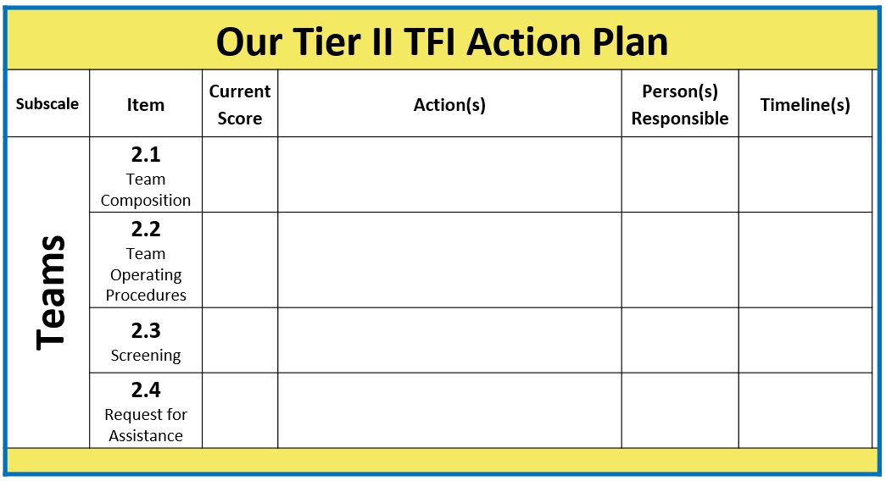

Slide 58
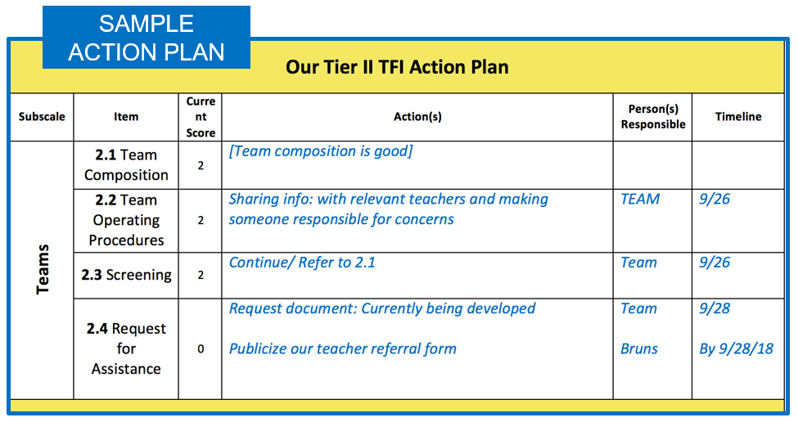

Slide 59
TFI Item: 2.1 Team Composition
Feature | Possible Data Sources | Scoring Criteria
Team Composition: Tier II (or combined Tier II/III ) team includes a Tier II systems coordinator and individuals able to provide (1) applied behavioral expertise, (2) administrative authority, (3) knowledge of students, and (4) knowledge about operation of school across grade levels and programs. | School organizational chart Tier II team meeting minutes | 0 = Tier II team does not include coordinator or all 4 core areas of Tier II team expertise 1 = Team identified, but without coordinator and all 4 core areas of Tier II team expertise OR attendance of these members below 80% 2 = Tier II team is composed of coordinator and individuals with all 4 areas of expertise with attendance of these members at or above 80%

Slide 60
TFI Item: 2.1 Team Composition
Feature | Possible Data Sources | Scoring Criteria
Team Composition: Tier II (or combined Tier II/III ) team includes a Tier II systems coordinator and individuals able to provide (1) applied behavioral expertise, (2) administrative authority, (3) knowledge of students, and (4) knowledge about operation of school across grade levels and programs. | School organizational chart Tier II team meeting minutes | 0 = Tier II team does not include coordinator or all 4 core areas of Tier II team expertise 1 = Team identified, but without coordinator and all 4 core areas of Tier II team expertise OR attendance of these members below 80% 2 = Tier II team is composed of coordinator and individuals with all 4 areas of expertise with attendance of these members at or above 80%
Main Idea:
Tier II team needs individuals with specific skills and perspectives to implement Tier II supports.

Slide 61
Quick Check: Team Composition
Are all necessary roles/functions represented on the team?
Team Assessment:
Coordinator
Applied behavioral expertise
Administrative authority
Knowledge about students
Knowledge about school
Scoring:
0= Tier II team does not include coordinator or all four core areas of Tier II team expertise.
1= Team identified, but without coordinator and all four core areas of Tier II team expertise, OR attendance of these members is below 80%.
2 = Tier II team is composed of coordinator and individuals with all four areas of expertise with attendance of these members at or above 80%.

Slide 62
2.2 Team Operating Procedures
Feature | Possible Data Sources | Scoring Criteria
Team Operating Procedures: Tier II team meets at least monthly and has (a) regular meeting format/agenda, (b) minutes, (c) defined meeting roles, and (d) a current action plan. | Tier II team meeting agendas and minutes Tier II meeting role descriptions Tier II action plan | 0 = Description of feature not being implemented. 1 = Description of feature being partially implemented. 2 = Description of the feature being fully implemented

Slide 63
2.2 Team Operating Procedures
Feature | Possible Data Sources | Scoring Criteria
Team Operating Procedures: Tier II team meets at least monthly and has (a) regular meeting format/agenda, (b) minutes, (c) defined meeting roles, and (d) a current action plan. | Tier II team meeting agendas and minutes Tier II meeting role descriptions Tier II action plan | 0 = Description of feature not being implemented. 1 = Description of feature being partially implemented. 2 = Description of the feature being fully implemented
Main Idea:
Tier II teams need meeting foundations in order operate efficiently and to implement effective supports.

Slide 64
Quick Check: Team Operating Procedures
What meeting procedures are currently in place at the Tier II level?:
Scoring:
0 = Tier II team does not use regular meeting format/agenda, minutes, defined roles, or a current action plan.
1 = Tier II team has at least two but not all four features.
2 = Tier II team meets at least monthly and uses regular meeting format/agenda, minutes, defined roles, AND has a current action plan.
Team Assessment:
Regular, monthly meetings
Consistently followed meeting format
Minutes taken during meeting
Participant roles are clearly defined
Action plan current to the school year

Slide 65
2.3 Screening
Feature | Possible Data Sources | Scoring Criteria
Screening: Tier II team uses decision rules and multiple sources of data (e.g., ODRs, academic progress, screening tools, attendance, teacher/family/student nominations) to identify students who require Tier II supports. | Multiple data sources used (ODRs, Time out of instruction, Attendance, Academic performance) Team decision rubric Team meeting minutes School policy | 0 = No specific rules for identifying students who qualify for Tier II supports. 1 = Data decision rules established but not consistently followed or are gathered from only one data source. 2 = Written policy exists that (a) uses multiple data sources for identifying students, and (b) ensures that families are notified when a student enters Tier II supports.

Slide 66
2.3 Screening
Feature | Possible Data Sources | Scoring Criteria
Screening: Tier II team uses decision rules and multiple sources of data (e.g., ODRs, academic progress, screening tools, attendance, teacher/family/student nominations) to identify students who require Tier II supports. | Multiple data sources used (ODRs, Time out of instruction, Attendance, Academic performance) Team decision rubric Team meeting minutes School policy | 0 = No specific rules for identifying students who qualify for Tier II supports. 1 = Data decision rules established but not consistently followed or are gathered from only one data source. 2 = Written policy exists that (a) uses multiple data sources for identifying students, and (b) ensures that families are notified when a student enters Tier II supports.
Main Idea:
Timely selection of students for Tier II supports improves the effectiveness of Tier II implementation.

Slide 67
Quick Check: Screening
What is the process for identifying students who may need Tier II supports?:
Team Assessment:
Written policy or rubric for documentation identifying students in need of assistance
Use of multiple data sources
Process for notifying and including families
Scoring:
0 = No specific rules for identifying students who qualify for Tier II supports.
1 = Data decision rules established but not consistently followed or are gathered from only one data source.
2 = Written policy exists that (a) uses multiple data sources for identifying students, and (b) ensures that families are notified when a student enters Tier II supports.
Back to ALL ITEMS

Slide 68
2.4 Request for Assistance
Feature | Possible Data Sources | Scoring Criteria
Request for Assistance: Tier II planning team uses written request for assistance form and process that are available to all staff, families, and students. | School handbook Request for Assistance form Family handbook | 0 = No formal process exists. 1 = Informal process in place for staff and families to request behavioral assistance. 2 = Written request for assistance process is in place, and team responds to request within three days.

Slide 69
2.4 Request for Assistance
Feature | Possible Data Sources | Scoring Criteria
Request for Assistance: Tier II planning team uses written request for assistance form and process that are available to all staff, families, and students. | School handbook Request for Assistance form Family handbook | 0 = No formal process exists. 1 = Informal process in place for staff and families to request behavioral assistance. 2 = Written request for assistance process is in place, and team responds to request within three days.
Main Idea:
Faculty, staff, families, and students should have a highly predictable and low-effort strategy for requesting behavior assistance.

Slide 70
Quick Check: Request for Assistance
What is the process for requesting assistance with behavior support?:
Team Assessment:
Written policy or rubric for documentation identifying students in need of assistance
Use of multiple data sources
Process for notifying and including families
Scoring:
0 = No formal process exists.
1 = Informal process in place for staff and families to request behavioral assistance.
2 = Written request for assistance process is in place, and team responds to request within three days.

Slide 71


Having Effective Tier 2 Interventions
to support the current needs of your students and community …

Slide 72


Your Interventions
Tier II supports are explicitly linked to Tier I supports.
Students receiving Tier II supports have access to Tier I supports.
We do not take away Tier 1 levels of support when a student starts to receive Tier 2 supports

Slide 73

Remember:
Tier 2 gives students a higher dosage of
what we already do at Tier 1
Teach Skills
Prompt use
Reinforce the use of skills
Monitor effectiveness
Communicate

Slide 74
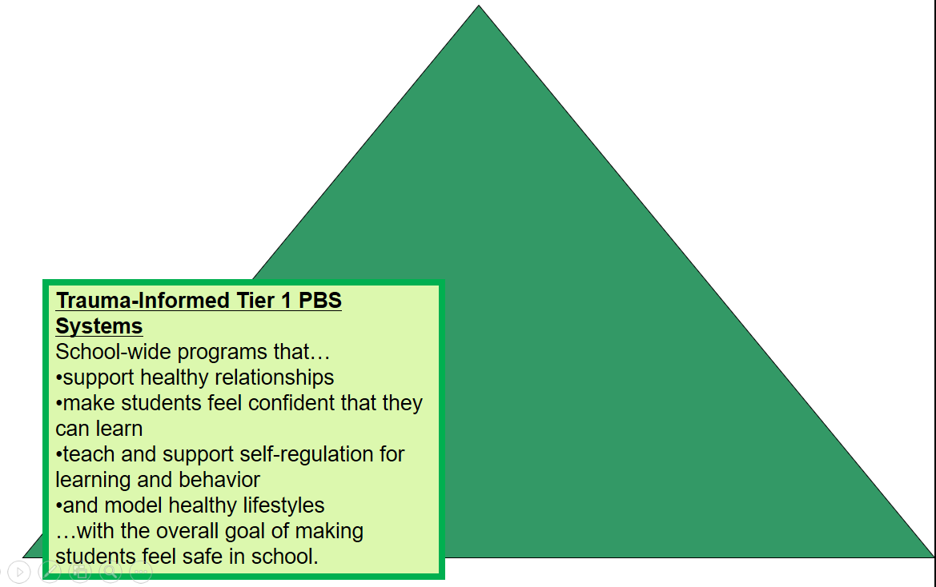
Develop Trauma-Informed Tier 1 Policies and Practices

Slide 75
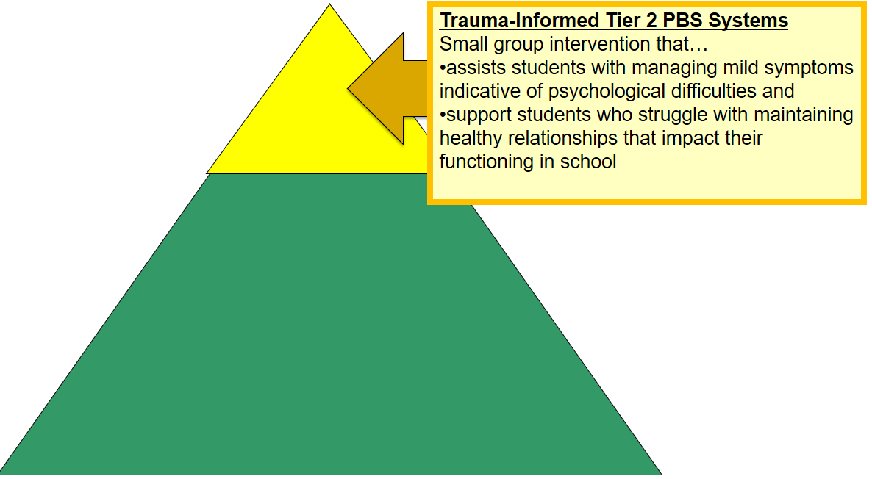
Develop Trauma-Informed Tier 2 Interventions

Slide 76
Activity 3: Triangle Intervention Assets
List Tier 1 practices provided to ALL students
List Tier 2 interventions provided to SOME students
List Tier 3 interventions provided to a FEW students
Notes:
76

Slide 77



Your Interventions
Multiple ongoing, evidence-based behavior support interventions are available for skill-building and relationship-building.
Interventions provide:
additional instruction/time for student skill development,
additional structure/predictability, and/or
increased opportunity for feedback (e.g., daily progress report).

Slide 78
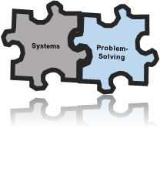
Best Practices for Interventions
Interventions are efficient
Continuously available so students can receive support quickly (within 2-3 days optimally)
Minimal time commitment required from classroom teachers
Required skill sets needed by teachers easily learned
Aligned with school-wide expectations
Intervention designed to support multiple students simultaneously (e.g. Check-In/Check-Out, Social Skills Groups, etc.)
Consistently implemented with most students, some flexibility
Intervention selected matched to function of student behavior
Adapted from Rose Iovannone, Brief PTR

Slide 79
Tier 2 System Conversation
Your Interventions - Selections
A formal process is in place to select Tier II interventions that:
Match student need (e.g., behavioral function) and
Adapt to improve contextual fit (e.g., culture, developmental level).

Slide 80



More Information about Interventions

Slide 81

Relationship-Building Interventions
Relationship-Building Interventions
For students whose behavior is a function of seeking adult attention
For students who “can do” appropriate behavior but typically “don’t do”
Goal: Provide greater reinforcement for desired behaviors than is currently provided for undesired behavior
If the student does not experience the interactions as positive and supportive, the intervention will not work!

Slide 82
Research shows function matters
Study of CICO based on function:
Results indicated that, for students with attention-maintained behavior, implementation of Check-In/Check-Out was associated with statistically and clinically significant improvements in ratings of problem behavior, ratings of prosocial behavior, and office discipline referrals.
However, for students with escape-maintained behavior, no statistically significant effects were found.
There exists the need for multiple tier two interventions in both academic and behavior support. McIntosh et al., 2009

Slide 83
Relationship-Building Interventions
What mentoring opportunities are available
to your students?
Big Brothers/Big Sisters?
Other community-based mentor programs?
School-based mentor programs? As part of before/after school programming?
Key features of successful mentoring programs:
Ongoing mentor training with structured activities
Clear expectations regarding contact frequency
Involvement of parents by communicating student goals (DuBois et al, 2002; cited in Hawken et al.)

Slide 84
Relationship-Building Interventions
How will you monitor the effectiveness of
existing mentoring programs?
Track fidelity
  Frequency of mentoring
  Frequency of parent contact
  Student and/or parent satisfaction with match
Track outcomes using existing data as much as possible
Reduction in ODR’s
Improvements in attendance, tardies, skips
Improvements in Daily Report Card of school expectations
(ON/OUT CONSIDERATIONS)

Slide 85
Relationship-Building Interventions
How will you monitor the effectiveness of
existing mentoring programs?
Summarize these individual data for use in tracking the success of the system
If the student does not experience the interactions as positive and supportive, the intervention will not work!

Slide 86
Skill Building Interventions
Skill Building Interventions
For students who do not have appropriate behaviors in their repertoire to communicate needs and meet expectations
Students need to be taught desired behaviors and/or appropriate replacement behaviors
Goal: Provide more opportunities than currently provided for students to learn, practice, receive feedback and generalize behaviors

Slide 87
Skill Building Interventions
Key features of successful skill-building Interventions:
Implemented in small groups, typically outside of the classroom
Specific challenging behaviors are replaced with socially acceptable behaviors
Take place in a natural environment (i.e. in school, with other students)
Include progress monitoring
Focus on prevention and generalization
Consider both internalizing vs. externalizing behaviors
May involve community: parents, teachers, school staff

Slide 88
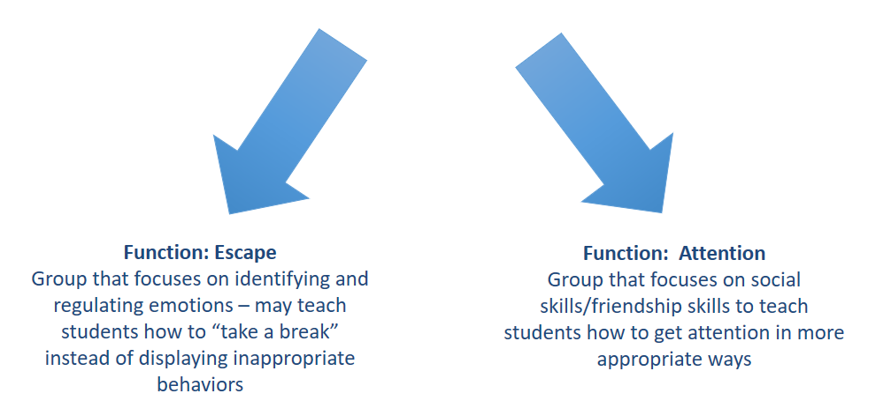
Skill Building Interventions:
Teach Replacement Behaviors

Slide 89
Skill Building Interventions
How will you monitor the success of skill-building interventions?
Daily Progress Reports (DPRs)
Absences & tardies
Academic performance
Reduction in referrals for behavior problems
Teacher rating scales
(ON/OUT CONSIDERATIONS)

Slide 90
Skill Building Interventions
3 Evidence Based SEL Intervention Handouts
Skill Building Interventions: General
Skill Building Strategies: Internalizing Behaviors
Skill Building Strategies: Externalizing Behaviors

Slide 91
Activity 5: Coding Intervention Type
Review your Tier 2 interventions and as a team code the type of intervention
  Bonus, if you want to narrow down the type of skill building (e.g. internalizing, externalizing)
Discuss as a team: what types of interventions are we missing? What types of interventions are we doing really well with?
Coding KEY:
RB: Relationship Building
SB: Skill Building
Notes:
91

Slide 92
Check-in Check-out
Overview:
An extension of Tier 1 through increased positive adult-student interaction
Most likely to benefit students who desire increased positive adult attention
Minimal time required from teacher
Can be a first stop intervention
Having 7-12% students accessing CICO supports routine establishment of intervention
If you only have 1-2% on CICO, you may be waiting for kids who will likely need more….
Adapted from Illinois PBIS Network

Slide 93

Middle School Example of CICO
•https://www.youtube.com/watch?v=tjixn5i4rqk

Slide 94
What does it look like? CICO Example of Daily Cycle (March & Horner, 1998)
1. Check-in with assigned adult upon arrival to school
* Adult positively greets student
* Review School-wide expectations (daily goals)
* Students pick up new Daily Progress Report card
* Provide materials (pencil etc.) if needed
* Turn in previous day’s signed form (optional)
* Provide reinforcer for check-in (optional)
Illinois PBIS Network

Slide 95
CICO Daily Cycle continued...
2. At each class:
Teacher provides positive feedback and, if needed, corrective behavioral feedback
Teacher completes DPR or
Student completes self-monitoring
DPR/teacher checks and initials card (self-monitoring normally happens as students begin to successfully exit the intervention)
3. Check-out at end of day:
Review points & goals
Reinforce youth for checking-out (token/recognition optional, think beyond school-wide token)
Receive reinforcer if goal met (optional, but good idea)
Take DPR card home (optional)
Illinois PBIS Network

Slide 96
CICO Daily Cycle continued...
4. Share DPR with parent (optional)
Talk with parents about intervention and invite them to participate
Students may receive reinforcer from parent
Invite parents to sign card
No consequence to students if not signed by parent
5. Return signed card next day
Celebrate and prepare for the next day
Illinois PBIS Network

Slide 97
Which students could benefit from CICO?
New students entering building mid-year (like orientation to the building)
Students with low-level problem behavior (identified by # of ODRs, teacher referral based on classroom management charts, etc.)
Children who are internalizers (identified by visits to nurses office, sits alone at lunch, etc.)
As one part of an individual support plan for a student (another layer of intervention)
Illinois PBIS Network

Slide 98
Data-Based Decision Rules:
How will we identify students for CICO?
Student is identified by 3 or more ODRs in a month.
Request for assistance
Parent Request
What will we use to monitor progress?
DPR data are collected daily & reviewed every other week. Data are collected for 4-6 weeks
What are our exiting/transitioning rules?
Student received a total of 80% of DPR points averaged per day/week for 4 weeks and has had no new ODRs. Student may be transitioned to self-monitoring for additional cycle or graduated.
  “Interventions Change”: If student is not making progress, what to do next

Slide 99
Can we staff CICO?
Who will be our coordinator?
Think about our facilitators:
Who would make good facilitators?
  Flexibility to meet with students
  Students would enjoy meeting with
  Positive orientation
How will they would be prepared to participate?
  Training
  Materials
  Preserving time
  Back up plan when not available

Slide 100
Systems for Reinforcing
Students
Will students receive “ticket” or other type of reinforcement for checking in/out? Daily? Weekly?
Unexpected or Intermittent reinforcement for “being brave” and handing in a DPR with low scores
Intermittent reinforcement for checking out with DPR ('catch kids' doing the right thing, look for other opportunities to provide intermittent reinforcement)
Staff
How will you acknowledge staff for participating in CICO?
What intermittent unexpected reinforcement will be offered to staff?
Illinois PBIS Network

Slide 101


Communicating about CICO Intervention with School Community
Share information about both the procedures and the outcomes (data) of CICO
Provide explicit teaching of CICO procedures

Slide 102

Share information regarding program and procedures with all staff and families
Provide an overview of CICO
Post on school website
Through school newsletter
At staff meeting
During open house
Share “Request for Assistance”
For staff
For families

Slide 103

Staff Training and Overview
Rolling out Tier 2 Systems and CICO Training for ALL staff
Share how the Tier 2 system will operate
Data used to identify students
Referral/Request for Assistance
Introduce your CICO DPR and detailed explanation of how the intervention will work
Emphasis on increased positive interaction and relationship building
Corrective vs. negative feedback
Provide other prompts for teachers, based on common student reactions (e.g., “What to do when a student is unhappy with their score”)

Slide 104
Student Orientation
For all students, provide information about the intervention.
  Regarding CICO: “Some kids may have a card sometimes”
For students participating in intervention, explain the who, what, when, & where
  Regarding CICO: Pre-correct: Teach students what to do when they disagree with a score
Take the student perspective: “Is this intervention a punishment or a support?”

Slide 105
Family Orientation
For all families, provide information about the intervention:
  Inform during registration process
  Share at open house, through newsletters, newspaper and other…
    Regarding CICO: Describe “What CICO Is”
For families of kids participating in intervention, communicate often:
  Best if phone call is made directly to family
  Followed by letter
  Consent: check with your district’s decision makers
    Regarding CICO: “Here is the process for enrolling in this intervention and consenting to your child’s participation…”
  Provide updates about progress

Slide 106
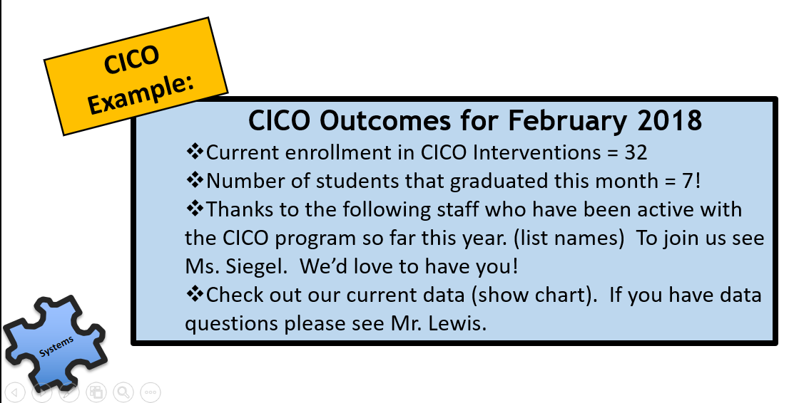
Staff Intervention Updates
Provide information about enrollment, graduation, staff participation, and resources.
Give opportunity for questions or discussion.

Slide 107

CICO Systems Conversation: Initial Training Questions
If you currently use CICO, complete the Tier 2 Initial Training Checklists with this intervention in mind to find out how routine your CICO system currently is.
If you currently don’t use CICO, please think about another Tier 2 intervention at your school and complete the Tier 2 Intervention Initial Training Checklists to start your systems conversation about this intervention.

Slide 108

CICO Problem-solving Conversation Questions:
If Johnny is not responding to CICO…
Does Johnny like his mentor?
Can we add an individual feature to support Johnny?
Could his behavior have an escape function?
Does he need more academic supports?
Is our CICO tool meaningful to Johnny?
If Johnny is responding to CICO…
What is the exit requirement?
Can we build in a self-monitoring piece?

Slide 113
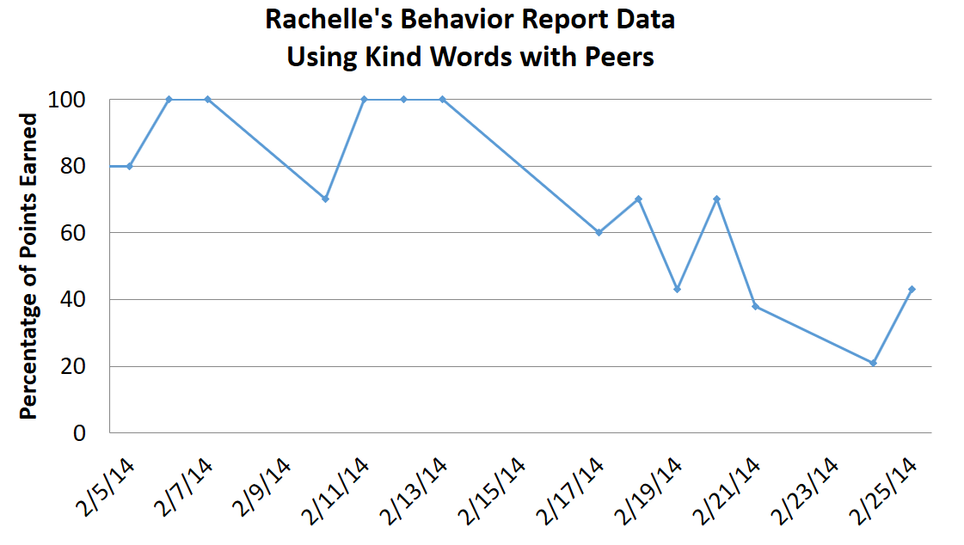
DPR data used for decision-making

Slide 114

Example of update to families of kids participating
Provide information on a regular basis.
Give opportunity for questions or discussion

Slide 115
Check-in Check-out
More Resources – General Information and Fidelity Checking Resources:
PBIS.ORG APPS: https://www.pbisapps.org/Resources/Pages/CICO-SWIS-Publications.aspx
MICHIGAN IBLS INITIATIVE : http://miblsi.cenmi.org/MiBLSiModel/Implementation/ElementarySchools/TierIISupports/Behavior/TargetBehaviorInterventions/CheckInCheckOut/AdditionalCICOResources.aspx
PBIS WORLD:
http://www.pbisworld.com/tier-2/check-in-check-out-cico/
NEW: CICO INITIATIVE Google Drive https://drive.google.com/drive/folders/0B0OPEEkD2dOgclYwTmdPLVJDaUE

Slide 116
Team CICO Reflection Time
If you are school with the CICO intervention currently in place:
  Discuss how your CICO compares to the CICO discussed in the video – what is in alignment and what is out of alignment with evidence-based CICO practices? What might be a good tweak/change for the future?
  Look at the Examples and Resources packet (in your yellow folder white packet, pgs. 19-21 OR Google drive file – “Tier 2 Targeted Team Examples Resources Packet”) and fill out the pages according to your current training for CICO implementation.
If you are a school with no CICO intervention in place currently:
  Use the HEAXAGON TOOL to help determine the “fit” for CICO.
  Check out the CICO Initiative Google Drive and identify 1 folder of most interest: https://drive.google.com/drive/folders/0B0OPEEkD2dOgclYwTmdPLVJDaUE)

Slide 117

The HEAXAGON TOOL

Slide 118
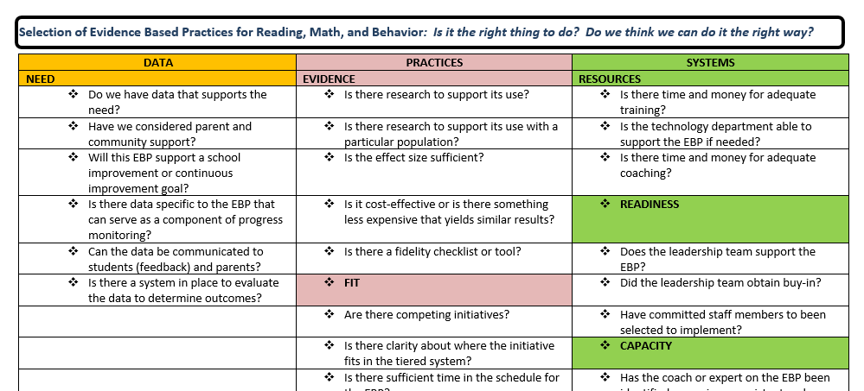
Hexagon Tool Screenshot
Tool can be found at - http://wh1.oet.udel.edu/pbs/cadre-2019-2020/

Slide 119
TFI Tier II Items
Subscale: Teams
Subscale: Interventions
  Item 2.5: Options for Tier II Interventions
  Item 2.6: Tier II Critical Features
  Item 2.7: Practices Matched to Student Need
  Item 2.8: Access to Tier I Supports
  Item 2.9: Professional Development
Subscale: Evaluation

Slide 120
2.5 Options for Tier II Interventions
Feature | Possible Data Sources | Scoring Criteria
Options for Tier II Interventions: Tier II team has multiple ongoing behavior support interventions with documented evidence of effectiveness matched to student need. | School Tier II handbook Targeted Interventions Reference Guide | 0 = No Tier II interventions with documented evidence of effectiveness are in use. 1 = Only 1 Tier II intervention with documented evidence of effectiveness is in use. 2 = Multiple Tier II interventions with documented evidence of effectiveness matched to student need are in use.

Slide 121
2.5 Options for Tier II Interventions
Feature | Possible Data Sources | Scoring Criteria
Options for Tier II Interventions: Tier II team has multiple ongoing behavior support interventions with documented evidence of effectiveness matched to student need. | School Tier II handbook Targeted Interventions Reference Guide | 0 = No Tier II interventions with documented evidence of effectiveness are in use. 1 = Only 1 Tier II intervention with documented evidence of effectiveness is in use. 2 = Multiple Tier II interventions with documented evidence of effectiveness matched to student need are in use.
Main Idea:
A wide array of intervention options increases the likelihood that student
needs are met and done so in a timely way..

Slide 122
Quick Check: Options for Tier II Interventions
What intervention options are available at the Tier II level?:
Team Assessment:
Are there multiple Tier II interventions readily available?
Do they have an evidence base of effectiveness with students?
Scoring:
0 = No Tier II interventions with documented evidence of effectiveness are in use.
1 = Only one Tier II intervention with documented evidence of effectiveness is in use.
2 = A sufficient array of Tier II interventions with documented evidence of effectiveness matched to student need are in use.

Slide 123
2.6 Tier II Critical Features
Feature | Possible Data Sources | Scoring Criteria
Tier II Critical Features: Tier II interventions provide (a) additional instruction/time for student skill development, (b) additional structure/ predictability, and/or (c) increased opportunity for feedback (e.g., Daily Progress Report). | Universal lesson plans Tier II lesson plans Daily/Weekly Progress Report School schedule School Tier II handbook | 0 = Tier II interventions do not promote additional instruction/time, improved structure, or increased feedback. 1 = All Tier II interventions provide some but not all three core Tier II features. 2 = All Tier II interventions include all three core Tier II features.

Slide 124
2.6 Tier II Critical Features
Feature | Possible Data Sources | Scoring Criteria
Tier II Critical Features: Tier II interventions provide (a) additional instruction/time for student skill development, (b) additional structure/ predictability, and/or (c) increased opportunity for feedback (e.g., Daily Progress Report). | Universal lesson plans Tier II lesson plans Daily/Weekly Progress Report School schedule School Tier II handbook | 0 = Tier II interventions do not promote additional instruction/time, improved structure, or increased feedback. 1 = All Tier II interventions provide some but not all three core Tier II features. 2 = All Tier II interventions include all three core Tier II features.
Main Idea:
Tier II supports should focus on improving the skills and context needed for student success.

Slide 125
Quick Check: Tier II Critical Features
What critical features are embedded in Tier II supports?:
Team Assessment:
Do all Tier II interventions include additional instruction/time for student skill development?
Do all Tier II interventions include additional structure/predictability?
Do all Tier II interventions include increased opportunities for feedback?
Scoring:
0 = Tier II interventions do not promote additional instruction/time, improved structure, or increased feedback.
1 = The array of Tier II interventions provide some but not all three core Tier II features.
2 = The array of Tier II interventions include all 3 core Tier II features.
Back to ALL ITEMS

Slide 126
2.7 Practices Matched to Student Need
Feature | Possible Data Sources | Scoring Criteria
Practices Matched to Student Need: A formal process is in place for efficient selection of Tier II interventions that are matched to student need (e.g., behavioral function), and have contextual fit (e.g., culture, developmental level). | Data sources used to identify interventions School policy Tier II handbook Needs assessment Targeted Interventions Reference Guide | 0 = No process is in place. 1 = Process for selecting Tier II interventions does not include documentation that interventions are matched to student need . 2 = Formal process is in place to select practices that match student need and have contextual fit (e.g., developmentally and culturally appropriate).

Slide 127
2.7 Practices Matched to Student Need
Feature | Possible Data Sources | Scoring Criteria
Practices Matched to Student Need: A formal process is in place for efficient selection of Tier II interventions that are matched to student need (e.g., behavioral function), and have contextual fit (e.g., culture, developmental level). | Data sources used to identify interventions School policy Tier II handbook Needs assessment Targeted Interventions Reference Guide | 0 = No process is in place. 1 = Process for selecting Tier II interventions does not include documentation that interventions are matched to student need . 2 = Formal process is in place to select practices that match student need and have contextual fit (e.g., developmentally and culturally appropriate).
Main Idea:
Tier II support strategies are
evidence-based and designed with
preliminary assessment information (or assumptions) about student need.

Slide 128
Quick Check: Practices Matched to Student Need
What is the process for identifying appropriate Tier II supports?:
Team Assessment:
Is there a formalized process to select Tier II supports?
Does the process take into account student need and contextual fit?
Scoring:
0 = No process is in place.
1 = Process for selecting Tier II interventions does not include documentation that interventions are matched to student need.
2 = Formal process is in place to select practices that match student need and have contextual fit (e.g., developmentally and culturally
appropriate).
Back to ALL ITEMS

Slide 129
2.8 Access to Tier I Supports
Feature | Possible Data Sources | Scoring Criteria
Access to Tier I Supports: Tier II supports are explicitly linked to Tier I supports, and students receiving Tier II supports have access to and are included in Tier I supports. | Universal lesson plans & teaching schedule Tier II lesson plans Acknowledgement system Student of the month documentation Family communication | 0 = There is no evidence that students receiving Tier II interventions have access to Tier I supports. 1 = Tier II supports are not explicitly linked to Tier I supports, and/or students receiving Tier II interventions have some but not full access to Tier I supports. 2 = Tier II supports are explicitly linked to Tier I supports, and students receiving Tier II interventions have full access to and receive all Tier I supports.

Slide 130
2.8 Access to Tier I Supports
Feature | Possible Data Sources | Scoring Criteria
Access to Tier I Supports: Tier II supports are explicitly linked to Tier I supports, and students receiving Tier II supports have access to and are included in Tier I supports. | Universal lesson plans & teaching schedule Tier II lesson plans Acknowledgement system Student of the month documentation Family communication | 0 = There is no evidence that students receiving Tier II interventions have access to Tier I supports. 1 = Tier II supports are not explicitly linked to Tier I supports, and/or students receiving Tier II interventions have some but not full access to Tier I supports. 2 = Tier II supports are explicitly linked to Tier I supports, and students receiving Tier II interventions have full access to and receive all Tier I supports.
Main Idea:
Tier II supports are more effective when layered within Tier I.

Slide 131
Quick Check: Access to Tier I Supports
How do students receiving Tier II supports benefit from the Tier I system?
Team Assessment:
Are the school’s Tier II supports linked/layered/ aligned with the school-wide universal system?
Do students receiving Tier II supports still receive full access to Tier I systems?
Scoring:
0 = There is no evidence that students receiving Tier II interventions have access to Tier I supports.
1 = Tier II supports are not explicitly linked to Tier I supports, and/or students receiving Tier II interventions have some but not full access to Tier I supports.
2 = Tier II supports are explicitly linked to Tier I supports, and students receiving Tier II interventions have full access to all Tier I supports.
Back to ALL ITEMS

Slide 132
2.9 Professional Development
Feature | Possible Data Sources | Scoring Criteria
Professional Development: A written process is followed for teaching all relevant staff the process for and how to implement each Tier II intervention that is in place. | Professional development calendar Staff handbook Lesson plans for teacher trainings School policy | 0 = No process for teaching staff is in place. 1 = Professional development and orientation process is informal. 2 = Written process is used to teach and coach all relevant staff in all aspects of intervention delivery, including request for assistance process, using progress report as an instructional prompt, delivering feedback, and monitoring student progress.

Slide 133
2.9 Professional Development
Feature | Possible Data Sources | Scoring Criteria
Professional Development: A written process is followed for teaching all relevant staff the process for and how to implement each Tier II intervention that is in place. | Professional development calendar Staff handbook Lesson plans for teacher trainings School policy | 0 = No process for teaching staff is in place. 1 = Professional development and orientation process is informal. 2 = Written process is used to teach and coach all relevant staff in all aspects of intervention delivery, including request for assistance process, using progress report as an instructional prompt, delivering feedback, and monitoring student progress.
Main Idea:
Effective Tier II supports require participation of many adults in the school.

Slide 134
Quick Check: Professional Development
What is the process for training staff members providing Tier II supports?
Team Assessment:
Are there scheduled trainings for school team members?
Is there a faculty-wide orientation led by the Tier II team?
Is there a scheduled, annual orientation for new faculty?
Are there documented strategies for orienting substitutes or volunteers?
Is the process for requesting assistance around behavioral concerns known by all, easy to follow, and encouraged?
Scoring:
0 = No process for teaching staff is in place.
1 = Professional development and orientation process is informal.
2 = Written process is used to teach and coach all relevant staff in all aspects of intervention delivery, including request for assistance process, using progress report as an instructional prompt, delivering feedback, and monitoring student progress.
Back to ALL ITEMS

Slide 135
TFI Tier II Items
Subscale: Teams
Subscale: Interventions
  Item 2.5: Options for Tier II Interventions
  Item 2.6: Tier II Critical Features
  Item 2.7: Practices Matched to Student Need
  Item 2.8: Access to Tier I Supports
  Item 2.9: Professional Development
Subscale: Evaluation

Slide 136
Monitoring Tier 2 Interventions Effectively
to help make important programming decisions for students & staff.

Slide 137
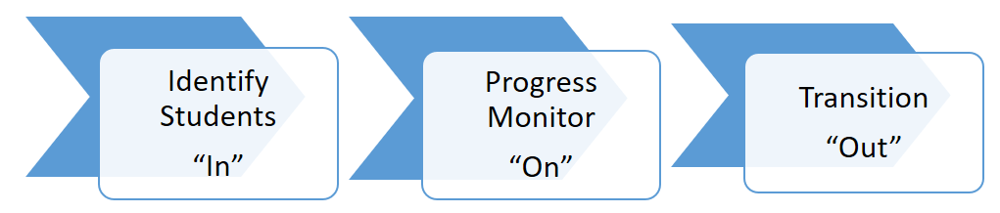
Setting up Decision Rules to allow conversation based on data

Slide 138
Monitoring (Annually)
Meet to review/determine overall effectiveness and efficiency of strategies:
Data-decision rules for student selection
Interventions available
Fidelity of implementation
(On-going) support for implementers
Evaluation/data sharing

Slide 139
Monitoring (On-Going, Big Picture)
Per intervention determine:
  Types of student progress data used
  Rules of effectiveness (ON)
  Rules for intervention fading & transition (OUT)
Identify how student progress data will be recorded and brought to system meeting
Develop system to monitor overall intervention effectiveness
Based on data identify gaps in types of interventions needed to support student body

Slide 140
Intervention Tracking Tool & Effectiveness
Monitoring
Based on data sources identified to monitor progress for a given intervention, the team will define how they measure student success (ON).
Example ON Rule for Check-in Check-out:
  After 4 weeks, student has earned 80% or more of their Daily Progress Report (DPR) points.
Example ON Rule for to Anger Management Group:
  After 4 weeks, student has no major office discipline
referrals for aggression related behaviors (e.g., fighting,
offensive touching).

Slide 141
Overall Intervention Effectiveness
For each intervention a plan for progress monitoring will be established.
As part of a system conversation, the team will collect and summarize intervention data to assess overall response.

Slide 142

Overall Intervention Effectiveness
Example: If after a month, less than 70% of students are responding to an interventions, the Tier 2 Team should have a systems conversation to review the fidelity of that intervention and make adjustments as needed.

Slide 143
Monitoring at the SYSTEMS LEVEL
The Intervention Tracking Tool
# of total students participating = add together all students participating in a particular group intervention and record. If there are multiple groups of a given intervention, add those students together.
# of students responding = Based on pre-determined definition of response, record number of students responding to given intervention.
% of students responding = Calculate the # of students responding divided by # of students responding and record.

Slide 144
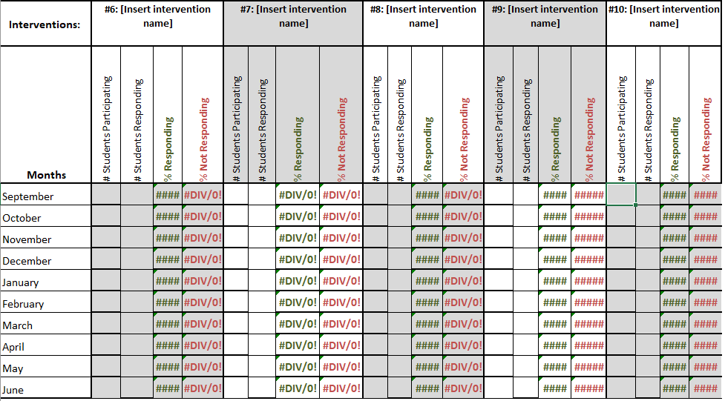
Tier 2 Intervention Tracking Tool – Paper or Google Drive

Slide 145
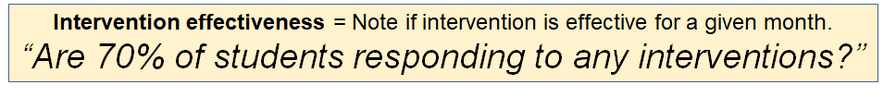
Monitoring at the SYSTEMS LEVEL : Progress Monitoring
If NO, the Tier 2 Systems team should review the fidelity of the intervention and make adjustments as needed.
Example: Mentoring Program
Ask “Are mentors and mentees meeting regularly?”
If not – Is there an issue regarding the schedule? – This a systems conversation
If so but seems isolated to a particular mentor – This is a problem-solving conversation
Ask “Do mentor, student and teacher(s) know what the behavior definitions mean?”

Slide 146

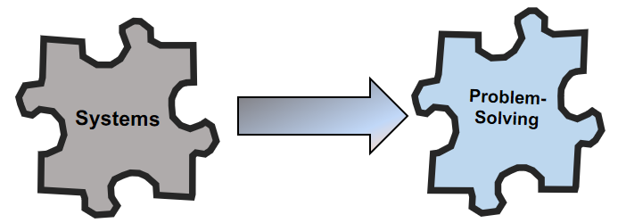
Monitoring at the SYSTEMS LEVEL : Progress Monitoring
If YES, flag for problem-solving discussion for individual students… this is now a problem-solving discussion.

Slide 147
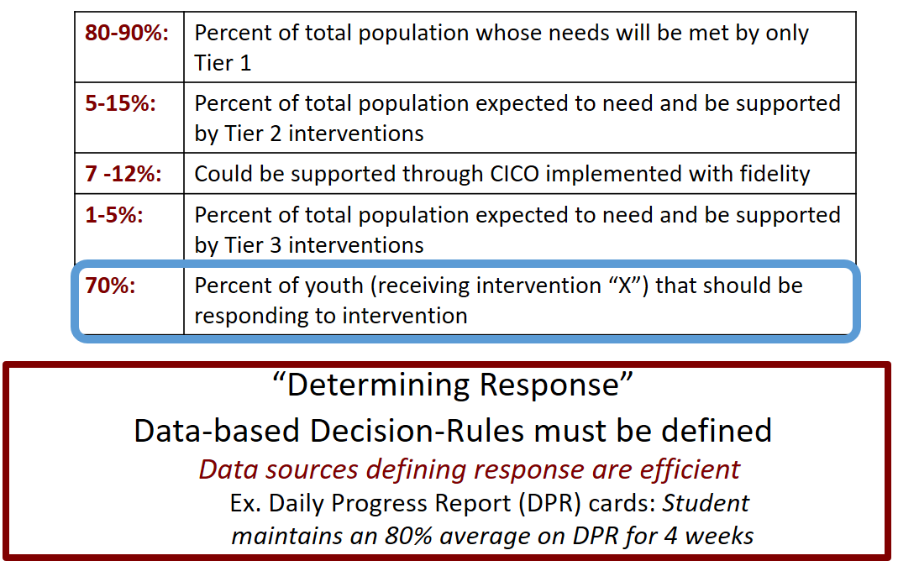
Tier 2 System Conversation: Numbers to Keep in Mind

Slide 148
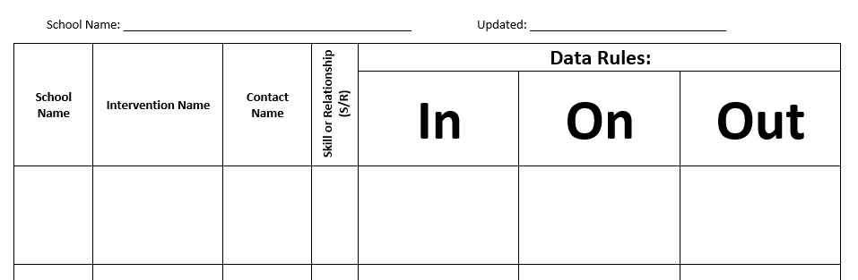
Putting it all together…

Slide 149
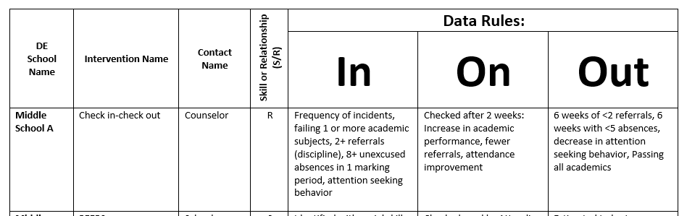
Where the rubber meets the road…
…is where a team’s intent becomes more apparent.

Slide 150
Activity 7: Let’s get started…
…on your team IN/ON/OUT worksheet.

Slide 151
Communication at the Individual Level
Support communication with staff, students, and families about individual student progress
Facilitate intervention-specific information sharing
  Staff, student, parent training
  Progress monitoring directions & guidance
  Process for fading and exiting an intervention

Slide 152
Data Review at the Individual Level
Team to review currently data regarding specific students and intervention effectiveness and problem solve as needed
•
Identify need for increased supports
Identify need for use of different supports
Identify readiness for decreased supports
Identify readiness for graduating from intervention

Slide 153
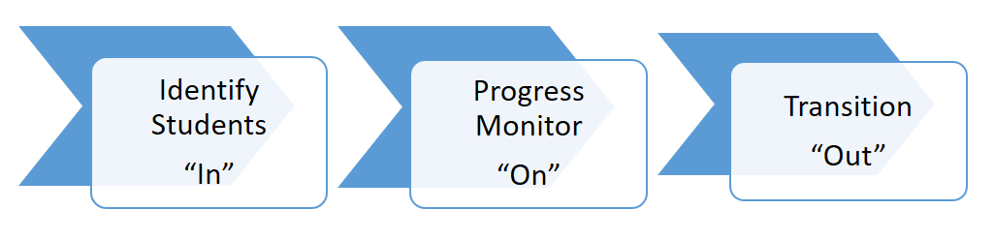
Data-Based Decision Making
Conversation is based on data!

Slide 154
Individual Data Tracking
Points earned on Daily Progress Report (DPR)
Reduction in ODRs
Attendance improvement
Reduction in In School Suspensions
Improvement in grades
Reduction of tardies
Improved homework completion
Group specific skill tracking

Slide 155
Recommended Time-Frames for Data Review
Student outcome data (student effectiveness)
Consider every 2 weeks:
Intervention facilitator/coordinator to review individual student data
Multiple data points to consider. For example, DPR percentage AND reduction in ODRs.
Intervention Integrity data (Intervention effectiveness)
Consider at least once a month:
Student aggregate data should be reviewed by Tier 2 Team for Systems Conversation Illinois PBIS Network

Slide 156
Subscale: Teams
Subscale: Interventions
Subscale: Evaluation
  Item 2.10: Level of Use
  Item 2.11: Student Performance Data
  Item 2.12: Fidelity Data
  Item 2.13: Annual Evaluation

Slide 157
2.10 Level of Use
Feature | Possible Data Sources | Scoring Criteria
Level of Use: Team follows a written process to track proportion of students participating in Tier II supports, and access is proportionate. | Tier II enrollment data Tier II team meeting minutes Progress monitoring tool | 0 = Team does not track number of students responding to Tier II interventions. 1 = Team defines criteria for responding to each Tier II intervention, but fewer than 5% of students are enrolled. 2 = Team defines criteria and tracks proportion, with at least 5% of students in the school receiving Tier II supports.

Slide 158
2.10 Level of Use
Feature | Possible Data Sources | Scoring Criteria
Level of Use: Team follows a written process to track proportion of students participating in Tier II supports, and access is proportionate. | Tier II enrollment data Tier II team meeting minutes Progress monitoring tool | 0 = Team does not track number of students responding to Tier II interventions. 1 = Team defines criteria for responding to each Tier II intervention, but fewer than 5% of students are enrolled. 2 = Team defines criteria and tracks proportion, with at least 5% of students in the school receiving Tier II supports.
Main Idea:
Tier II supports that are used by
too few students (e.g., 1% of enrollment)
or by too many students (e.g., 20% of
enrollment) are not sustainable.

Slide 159
Quick Check: Level of Use
What proportion of students are receiving Tier II supports?
Team Assessment:
Is between 5% and 15% of the total student population receiving Tier II supports?
Does the school have the capacity to sustain effective supports for this proportion of students?
Scoring:
0 = Team does not track number of students responding to Tier II interventions.
1 = Team defines criteria for responding to each Tier II intervention, but fewer than 5% of students are enrolled.
2 = Team defines criteria and tracks proportion, with at least 5% of students in the school receiving Tier II supports.

Slide 160
2.11 Student Performance Data
Feature | Possible Data Sources | Scoring Criteria
2.11 Student Performance Data: Tier II team tracks proportion of students experiencing success (% of participating students being successful) and uses Tier II intervention outcomes data and decision rules for progress monitoring and modification. | Student progress data (e.g., % of students meeting goals) Intervention Tracking Tool Daily/Weekly Progress Report sheets Family communication | 0 = Student data are not monitored. 1 = Student data monitored but no data decision rules are established to alter (e.g., intensify or fade). support 2 = Student data (% of students being successful) are monitored and used at least monthly, with data decision rules established to alter (e.g., intensify or fade) support and shared with stakeholders.

Slide 161
2.11 Student Performance Data
Feature | Possible Data Sources | Scoring Criteria
2.11 Student Performance Data: Tier II team tracks proportion of students experiencing success (% of participating students being successful) and uses Tier II intervention outcomes data and decision rules for progress monitoring and modification. | Student progress data (e.g., % of students meeting goals) Intervention Tracking Tool Daily/Weekly Progress Report sheets Family communication | 0 = Student data are not monitored. 1 = Student data monitored but no data decision rules are established to alter (e.g., intensify or fade). support 2 = Student data (% of students being successful) are monitored and used at least monthly, with data decision rules established to alter (e.g., intensify or fade) support and shared with stakeholders.
Main Idea:
Tier II team needs regular access
to information about student success to be
able to adapt and improve Tier II supports.

Slide 162
Quick Check: Student Performance Data
How is Tier II outcome data used to provide effective supports?
Team Assessment:
Is there a system to collect and organize intervention outcome data?
Does the Tier II team have access to reports summarizing intervention outcome data?
Does the Tier II team have a system with data decision rules to identify how Tier II supports should be altered?
Scoring:
0 = Student data are not monitored.
1 = Student data are monitored, but no data decision rules are established to alter (e.g., intensify or fade) support.
2 = Student data (% of students being successful) are monitored and used at least monthly, with data decision rule established to alter (e.g., intensify or fade) support, and are shared with stakeholders.

Slide 163
2.12 Fidelity Data
Feature | Possible Data Sources | Scoring Criteria
Fidelity Data: Tier II team has a protocol for ongoing review of fidelity for each Tier II practice. | Tier II coordinator training District technical assistance Fidelity probes taken monthly by a Tier II team member | 0 = Fidelity data are not collected for any practice. 1 = Fidelity data (e.g., direct, self report) collected for some but not all Tier II interventions. 2 = Periodic, direct assessments of fidelity are collected by Tier II team for all Tier II interventions.

Slide 164
2.12 Fidelity Data
Feature | Possible Data Sources | Scoring Criteria
Fidelity Data: Tier II team has a protocol for ongoing review of fidelity for each Tier II practice. | Tier II coordinator training District technical assistance Fidelity probes taken monthly by a Tier II team member | 0 = Fidelity data are not collected for any practice. 1 = Fidelity data (e.g., direct, self report) collected for some but not all Tier II interventions. 2 = Periodic, direct assessments of fidelity are collected by Tier II team for all Tier II interventions.
Main Idea:
Fidelity assessments should
always be included as part of
implementation practice.

Slide 165
Quick Check: Fidelity Data
What role does fidelity data play in the actions of the Tier II team?
Team Assessment:
Is the team assessing fidelity of implementation at Tier II?
Is there regular assessment of fidelity?
Scoring:
0 = Fidelity data are not collected for any Tier II intervention.
1 = Fidelity data (e.g., direct, self report) are collected for some but not all Tier II interventions.
2 = Periodic, direct assessments of fidelity collected by Tier II team for all Tier II interventions.
Back to ALL ITEMS

Slide 166
2.13 Annual Evaluation
Feature | Possible Data Sources | Scoring Criteria
2.13 Annual Evaluation: At least annually, Tier II team assesses overall effectiveness and efficiency of strategies, including data decision rules to identify students, range of interventions available, fidelity of implementation, and ongoing support to implementers; and evaluations are shared with staff and district leadership. | Staff and student surveys Tier II handbook Fidelity tools School policy Student outcomes District reports | 0 = No data-based evaluation takes place. 1 = Evaluation is conducted, but outcomes are not used to shape the Tier II process. 2 = Evaluation is conducted at least annually, outcomes are shared with staff and district leadership, and clear alterations in process are proposed based upon evaluation.

Slide 167
2.13 Annual Evaluation
Feature | Possible Data Sources | Scoring Criteria
2.13 Annual Evaluation: At least annually, Tier II team assesses overall effectiveness and efficiency of strategies, including data decision rules to identify students, range of interventions available, fidelity of implementation, and ongoing support to implementers; and evaluations are shared with staff and district leadership. | Staff and student surveys Tier II handbook Fidelity tools School policy Student outcomes District reports | 0 = No data-based evaluation takes place. 1 = Evaluation is conducted, but outcomes are not used to shape the Tier II process. 2 = Evaluation is conducted at least annually, outcomes are shared with staff and district leadership, and clear alterations in process are proposed based upon evaluation.
Main Idea:
Any strategy or procedure needs to be reviewed at least annually and revised to remain current and match changes in the school.

Slide 168
Quick Check: Annual Evaluation
What is the process for regularly examining Tier II systems?
Team Assessment:
Is there an evaluation conducted for Tier II systems?
Does this happen annually?
Are the outcomes shared with all stakeholders (faculty, students, family, board members, superintendent, etc.)?
Are the outcomes clearly linked to a Tier II action plan?
Scoring:
0 = No data-based evaluation takes place.
1 = Evaluation is conducted, but outcomes are not used to shape the Tier II process.
2 = Evaluation is conducted at least annually, outcomes are shared with staff and district leadership, and clear alterations in process are proposed based upon evaluation.

Slide 169
Subscale: Teams
Subscale: Interventions
Subscale: Evaluation
  Item 2.10: Level of Use
  Item 2.11: Student Performance Data
  Item 2.12: Fidelity Data
  Item 2.13: Annual Evaluation

Slide 170



Application beyond your team...
...to maximize your assets!

Slide 171


We are moving from clinicians being the only response to identified social emotional/mental health needs,
What magic can you share across the Tiers?
TO
being social emotional/mental health leaders who help build the capacity of the rest of the staff
Overview: Tier II Systems

Slide 172

Activity 9: Maximize your Assets (Magic) Part 2
3. Notice anyone proving support that is not part of your Tier 2 team and anyone you are unfamiliar with their areas of expertise. If unfamiliar, how can you engage them in your Tier 2 System?
4. Consider any unmet needs identified in your data and potential interventions. Identify a person or people who could offer this intervention. Beyond providing interventions how else can you leverage the expertise in your building to support MTSS at all tiers?

Slide 173
Developing a Vision and Mission Statement
The purpose of our team is to:
I know we are effective when…
I hope that as a result of Tier 2 Team, this will be true:
Our Tier 2 Team Mission is:
Any updates before leaving?

Slide 174

Next Steps
Resources to support you:
Your documents (TFI, AP, Assets)
The DE-PBS Tier 2 website
Your district-level MTSS/PBS Coaches
Upcoming PD
  1/22/20 - Tier 2 & 3
  3/25/20 - Tier 2 Networking
What else?

Slide 175
Thank You!
for your team’s time
& engagement today!
Your work & feedback matter
… please make sure to share
both before leaving!

Slide 176
Early Warning Screeners and Decision Points
Helpful indicators of student achievement and future outcomes:
  GPA
  Course grades
  Attendance
  Office Discipline Referrals
Use these as early warning screeners to inform on behavior and academic interventions (ex: missing 18 days a year considered chronic absentee)
Chronic absentees are at a higher risk of dropping out and lower risk of graduating
  Students with emotional/behavioral disorders (EBD) and learning disabilities are higher risk for missing school
  If student has an emotional/behavioral disorder (EBD) can try using a behavioral intervention targeted to the reason they are absent (ex: Check-in/Check-out)

