Slide 1
Developing Expectations and a Behavior Matrix for Return to School
August 6, 2020

Slide 3
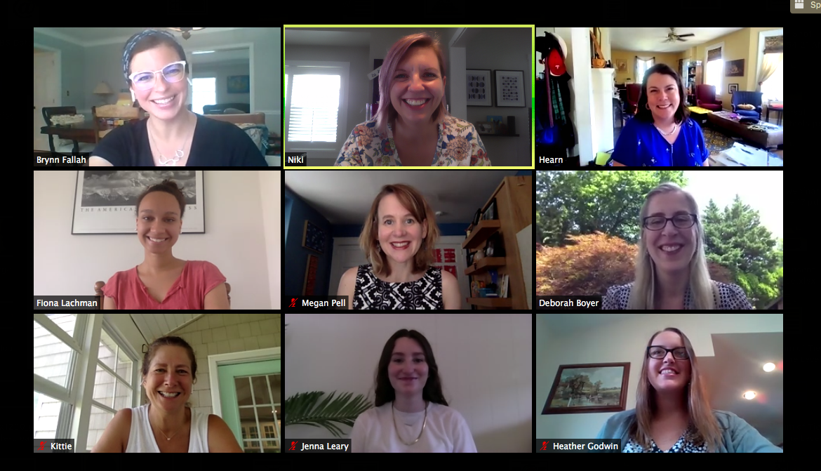
Meet the DE-PBS Team!

Slide 4
Making the most of our time
BE ENGAGED | Share ideas and respond to prompts in chat box Ask questions via the chat box Turn video on for breakout rooms
BE REFLECTIVE | Compare the ideas shared to your current context and experiences Recognize areas of glow and growth
BE STRATEGIC | Engage in note-taking, individual or shared with team Identify next steps

Slide 5
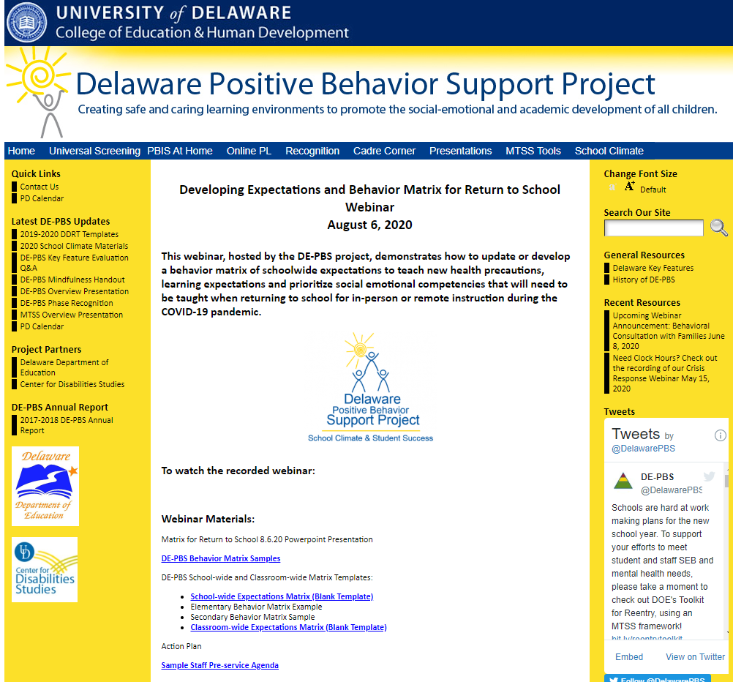
DE-PBS Website:
Today’s content & much more...
http://wh1.oet.udel.edu/pbs/matrix-for-return-to-school/

Slide 6
Overarching Goal
Create a safe, positive, predictable environment for ALL.

Slide 7
Presentation Objectives
Enhance efforts to create safe, positive and predictable learning environments
Leverage your student behavior matrix to support learning and social emotional needs during COVID-specific context whether virtual, hybrid or in-person
Update your matrix to address physical and mental health safety needs
Expand supports and expectations for staff
Review an action plan for supporting and preparing for returning to school

Slide 8
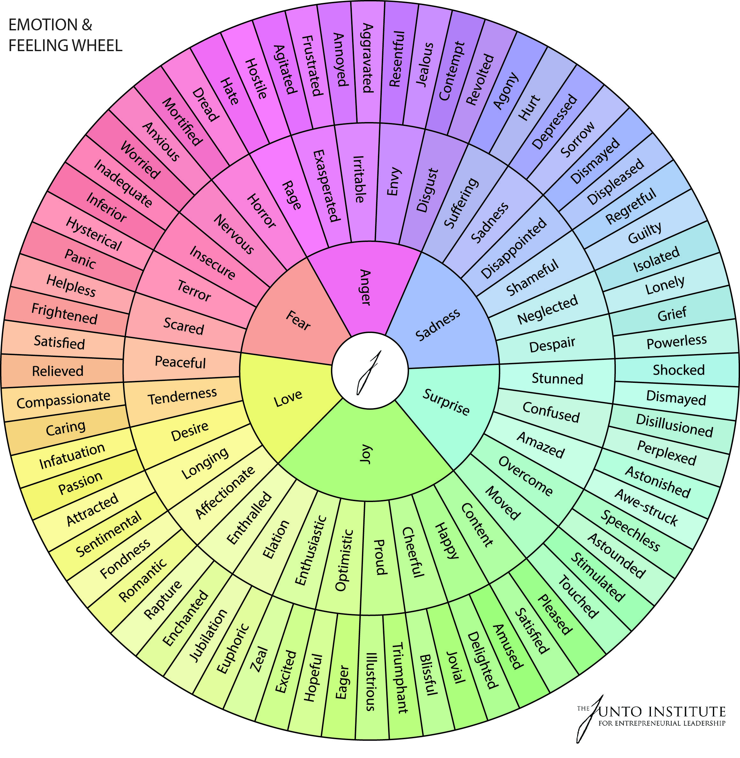
When you think about planning for reopening schools, how do you feel?

Slide 9
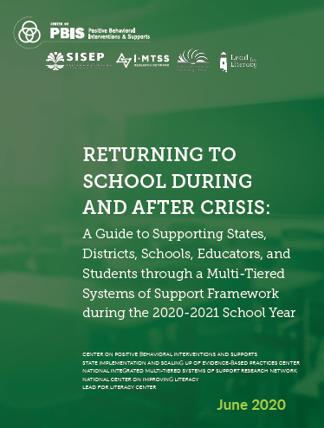
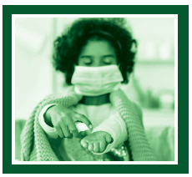
Center on PBIS State Implementation and Scaling-up of Evidence-based Practices Center (SISEP) National Integrated MTSS Research Network National Center on Improving Literacy Lead for Literacy Center
https://www.pbis.org/resource/returning-to-school-during-and-after-crisis

Slide 10
Reentry Guide and Toolkit Contents
Guidance for Reentry through a Multi-Tiered Approach
District Level Quick Start Guide
School Level Quick Start Guide
Quick Start Toolkit
Leadership Teams
Evaluation Plans
Universal (Tier 1) Socio-Emotional and Behavioral Health Supports
Targeted and Individual (Tier 2 and 3) Socio-Emotional and Behavioral Health Supports
Supporting Staff Wellness
Additional Resources

Slide 12
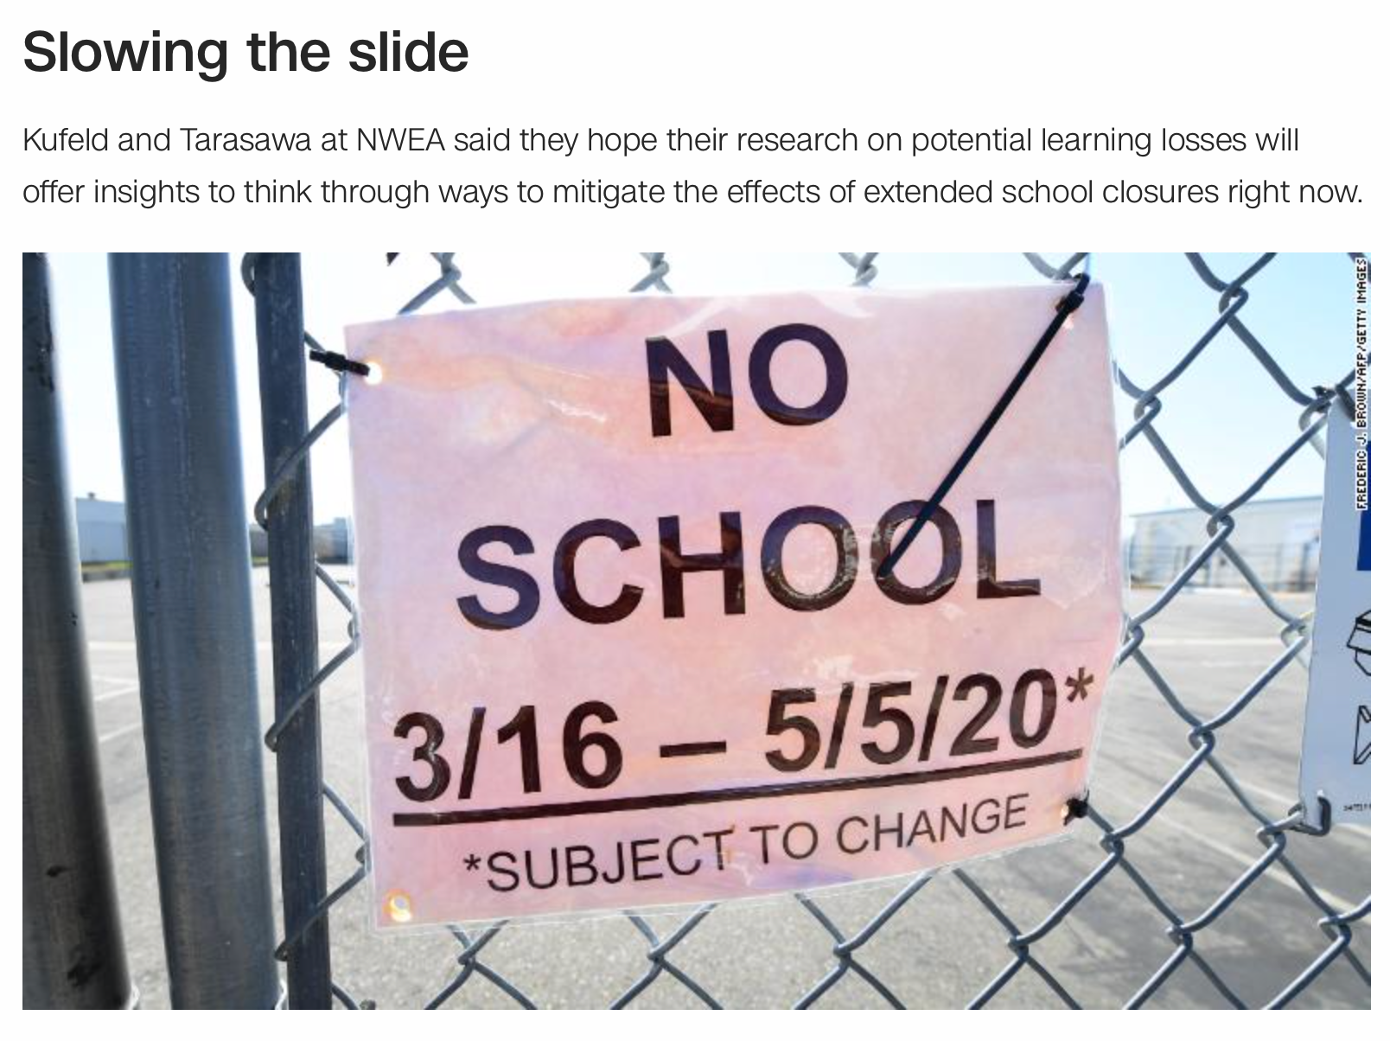
Context: Challenges

Slide 13
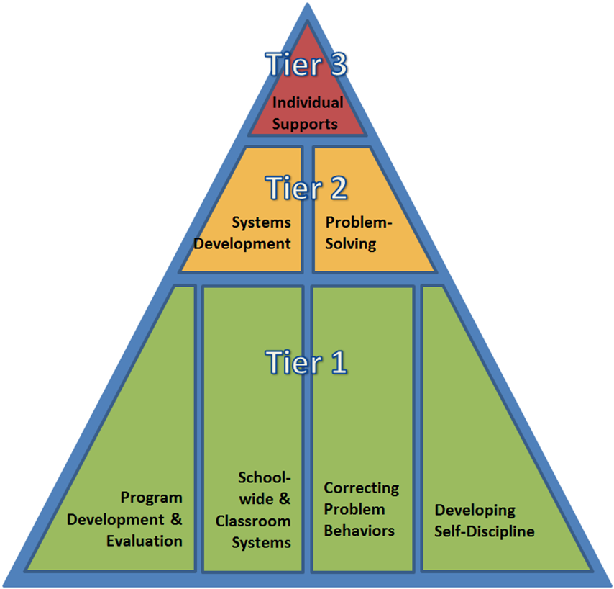
Continuum of Support Logic for ALL is Critical Now
Build on Current Systems and Practices

Slide 14
Social-Emotional Learning: Always essential but especially key in current context
SEL has been a consistent focus of DE-PBS Framework to improve school climate
Developing Self-Discipline focus of Tier 1
Focus on:
Policy Commitment to Goal of Developing Self-Discipline
Social Emotional Learning (free standing or integrated within Curriculum)
Students Active in Decision-making
MTSS/PBS
Internalizing Problems
Positive School Climate
SEL
Externalizing Problems

Slide 15
Positive Behavioral Interventions and Supports (PBIS) for Continuous Improvement and Alignment of Initiatives
is a Multi-Tiered System of Supports (MTSS) Framework
Supporting culturally equitable Targets including social/emotional competence & academic achievement
OUTCOMES
Supporting culturally knowledgeable Staff Behavior
team-based leadership and coordination
professional development, coaching, and content expertise
Supporting culturally valid Data-based Decision Making
universal screening
progress monitoring
evaluation of fidelity
SYSTEMS
DATA
PRACTICES
Midwest PBIS Network 2/7/19. Adapted from:
“What is a systems Approach in school-wide PBIS?” OSEP Technical Assistance on Positive Behavioral Interventions and Supports. https://www.pbis.org/school
McIntosh, K.& Goodman, S. (2016). Integrated Multi-Tiered Systems of Support: Blending RTI and PBIS. New York: Guilford Press.
Supporting Student Behavior
three-tiered continuum of culturally relevant evidence-based interventions
Notes:
15

Slide 16
Guiding Principles
Make student growth and benefit central to all decisions.
MTSS is for all students, families, and educators.
OUTCOMES
Continue to invest in systems to support high-fidelity implementation across time.
Use data to inform all decisions (screening, progress monitoring, equitable outcomes, & fidelity).
SYSTEMS
DATA
EQUITY
Prioritize equity.
PRACTICES
Implement a small number of effective, culturally-relevant practices well.
Integrate, align, & connect practices.
Use the MTSS framework to differentiate supports & monitor to ensure equity.

Slide 17
What Is Gained by Identifying Expectations & Rules?
Establishes common, unifying language for staff, students and families
Supports social behavioral curriculum design; supports alignment of varying initiatives
Promotes uniform instruction across multiple settings within the school (and outside)
Provides reassurance and predictability
Adapted from: www.pbis.org

Slide 18
Step 1
Identify 3-5 developmentally appropriate behavioral expectations that reflect your school’s values. Consider using input from staff, students, family, and community to identify these values (e.g. Be Responsible, Be Respectful, Be Safe).
Use your existing behavioral expectations if your school has already established them.
Step 2
Use back to school model chosen by district/school (in-person, virtual, hybrid)
Pick up to 6 specific locations/routines to focus on
Examples: classroom, bathroom, break out rooms, hallway, playground, etc.
Use data to determine priority areas
Step 3
Define what each expectation looks/sounds like in each area for your school.
State each expectation in a positive way (avoid words like “no” and “don’t”)
Examples: “Wear your mask over your nose and mouth”, “Wash hands with soap and water for 20 seconds”

Slide 19
Step 1
Identify 3-5 positively stated, easy to remember, and developmentally appropriate behavioral expectations that reflect your school’s values.
Use input from staff, students, family, and community to identify these values (e.g. Be Responsible, Be Respectful, Be Safe).
Expectations define success for all students and are applicable in all settings (in person and virtual).
Use data to prioritize.
Use your existing behavioral expectations if your school has already established them.

Slide 20
A note about updating/developing your matrix with a team...
Utilize existing teams
Representation from staff, students, family, community
Now more than ever it is essential to have individuals with physical and mental health knowledge…

Slide 21
Voices at the “Table”
Administrator
Teachers
School Nurse
School Counselor
School Psychologist
School-Based Wellness Center (when applicable)
Student
Family
Community
COVID School Coordinator

Slide 22
Behavior Matrix: Template
 |  | SETTING/ROUTINE
RULE/ EXPECTATION | Be Safe
 | Be Responsible
 | Be Respectful
http://pbismissouri.org

Slide 23
Step 2
Use back to school model chosen by district/school (in-person, virtual, hybrid)
Pick a set of specific locations/routines to focus on
Examples: classroom, bathroom, bus, hallway, playground, etc.
Use data to determine priority areas
SEL/Self-Care can be a separate column or embedded throughout

Slide 24
In-Person Behavior Matrix: Template
 |  | ROUTINE/SETTING
 |  | Classroom | Hallways | Playground/ Outside | Bus | Bathroom | Self-Care or SEL
RULE/ EXPECTATION | Be Safe
 | Be Responsible
 | Be Respectful
http://pbismissouri.org

Slide 25
Virtual Behavior Matrix: Classroom Template
We are… | Entering Class | Teacher-led Whole Group Instruction | One-on-One Instruction | Small-Group Activities (Breakout Rooms)
Safe
Respectful
Responsible
https://www.pbis.org/resource/creating-a-pbis-behavior-teaching-matrix-for-remote-instruction

Slide 26
Step 3
Define what each expectation looks/sounds like in each area (physical or virtual)
State each expectation in a positive way (avoid words like “no” and “don’t”)
Examples: “Wear your mask over your nose and mouth”, “Keep your video on at all times”
SEL/self-care can be embedded throughout

Slide 28
Teaching Matrix Guidelines
Remember our behaviors/rules are specific tasks students are to do to achieve the schoolwide expectations
When defining specific behaviors/rules they should be:
Observable – behaviors that we can see,
Measurable – we can actually count the occurrence of the behavior,
Positively Stated – things to do to be successful,
Understandable – student-friendly language, and
Always Applicable.
http://pbismissouri.org

Slide 29
Example of Rules Following Guidelines
What does that even mean?
Guidelines | This Means | Example | Non-Example
Observable | I can see it. | Raise hand and wait to be called on. | Be your best.
Measurable | I can count it. | Bring materials. | Be ready to learn.
Positively Stated | I tell students what TO do. | Hands and feet to self. | No fighting.
Understandable | The vocabulary is age and grade appropriate. | Hands and feet to self. | Maintain personal space (K-1 rule)
Always Applicable | I am to consistently enforce. | Stay in assigned area. | Remain seated until given permission to leave.
http://www.midatlanticpbis.org

Slide 30
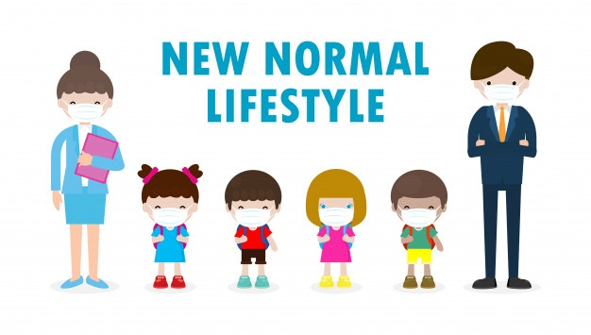
It’s our job as adults and educators to teach, normalize and model new expectations....

Slide 31
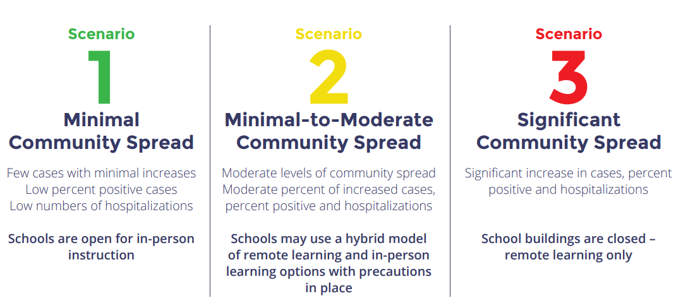
https://www.doe.k12.de.us/cms/lib/DE01922744/Centricity/Domain/599/ddoe_returningtoschool_guidance_final.pdf

Slide 32
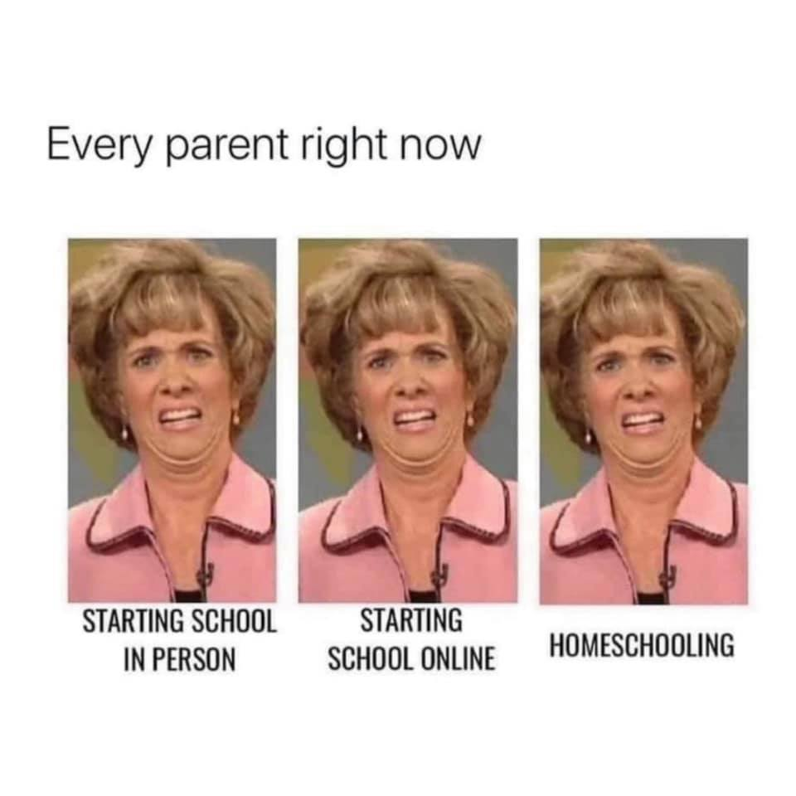
...and educator...

Slide 33
Cautions For Use
These are examples. DE-PBS Project is not recommending actions to prevent spread of COVID-19, but rather sharing a tool to help organize and teach these new expectations.
Your version should reflect your school’s expectations, circumstances, and specific state/district/school’s requirements regarding COVID-related protocols.
Consider including social, emotional, behavioral, and physical health needs that have been highlighted by COVID-19.
The matrix is a tool to organize expectations for behaviors. Many of these behaviors are new and need to be taught through daily lessons and frequent, positively stated reminders.

Slide 34
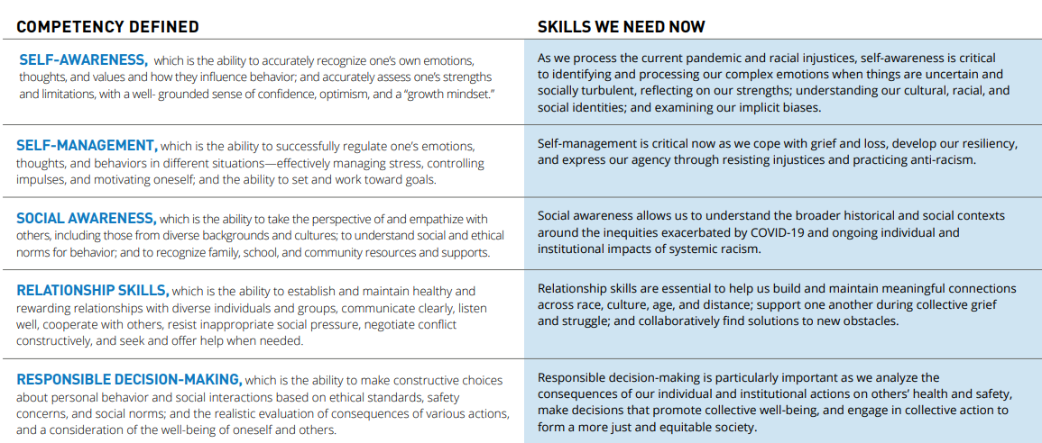
SEL Skills During COVID-19
https://casel.org/wp-content/uploads/2020/07/SEL-ROADMAP.pdf

Slide 35
SEL in Delaware’s Return to School Guidance
“Every student’s academic and social-emotional needs will be recognized and addressed through the integration of Social Emotional Learning (SEL), the strengthening of relationships, and culturally responsive teaching.”
“Restorative supports and professional learning offerings for educators around equity and implicit bias, SEL, and culturally responsive education to support student learning and engagement.”
“Support the integration of SEL into instruction, with an emphasis on strengthening connections with students and implementing practices for culturally responsive teaching.”
“Leverage collective staff support, including non-teaching staff (i.e. school counselors) to support SEL, engage community partners, and strengthen connections and relationships with families and students.”

Slide 36
Specific Behaviors + Pro-Social Skills
Specific Behaviors
Pro-Social Skills
Wash your hands with soap and water for at least 20 seconds
Follow one-way direction arrows
Wipe down any shared materials before/after use
Keep hands, feet, and other objects to yourself
Respect when friends are ready or not ready to share experiences
Check in on friends to see how they are handling changes.
Give “air high fives” to encourage others
http://www.midatlanticpbis.org

Slide 37
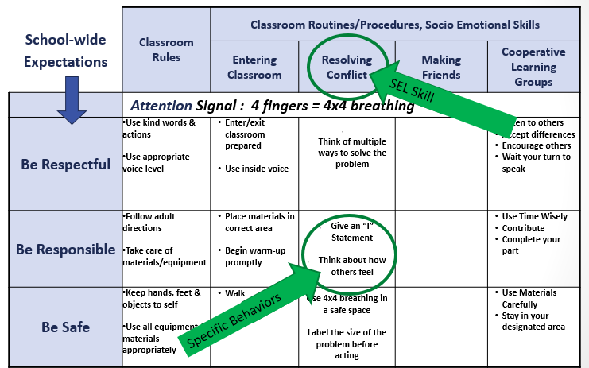

Slide 38
https://www.doe.k12.de.us/cms/lib/DE01922744/Centricity/Domain/599/ddoe_returningtoschool_guidance_final.pdf

Slide 39
Teaching Matrix: Example
 |  | SETTING
 |  | All Settings | Hallways | Playgrounds | Cafeteria | Library/ Computer Lab | Assembly | Bus
EXPECTATION | Respect Ourselves | Be on task. Give your best effort. Be prepared. | Walk. | Have a plan for play. | Eat all your food. Select healthy foods. | Study, read, compute. | Sit in one spot. | Watch for your stop.
 | Respect Others | Hands/feet to self. Help/share with others. | Use normal voice volume. Walk to right. | Play safe. Include others. Share equipment. | Practice good table manners | Whisper. Return books. | Listen/watch. Use appropriate applause. | Use a quiet voice. Stay in your seat.
 | Respect Property | Recycle. Clean up after self. | Pick up litter. Maintain physical space. | Use equipment properly. Put litter in garbage can. | Replace trays & utensils. Clean up eating area. | Push in chairs. Treat books carefully. | Pick up. Treat chairs appropriately. | Wipe your feet. Sit appropriately.
http://pbismissouri.org

Slide 40
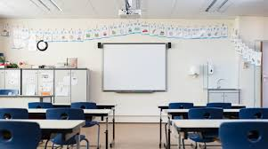
Classroom Matrix
Extend School-wide expectation to the classroom
Classroom teachers & students define those expectations across their routines together
Definitions can look different across classrooms & routines
In-person learning vs. virtual learning
Science lab vs. homeroom

Slide 41
Classroom Considerations
Examples
Non-Examples
Turn in completed assignments on time
Walk at all times in the classroom
Keep hands, feet, and objects to yourself
Raise your hand and wait for permission to speak
Use only your personal materials and label them
Wipe down desk and seat before and after use
Wear your mask over your nose and mouth
Be responsible
Be a good citizen
Respect authority
Pay attention
Be ready to learn
Do your best
Be kind to others
Be polite
Be safe
adapted from http://www.midatlanticpbis.org

Slide 42
CDC Considerations
School-wide expectations | All settings | Computer lab/library | Masks | Lunchtime
Be Safe | Maintain physical distance Sneeze/cough into your elbow Air high 5/hug your friends | Wipe down computers/ materials before and after use | Ask for help if you aren’t sure how to wear your mask Wash your hands (according to protocol) | Eat only your own food Leave your mask in your….(cubby/next to you…)
Be Respectful | Wear your mask to protect yourself and others Maintain social distancing guidelines | Use hand sanitizer before and after use (leave a sticky note for the next user) | Think about others by covering your nose and your mouth with your mask | Follow school guidelines???? Honor social distance markers Throw your food in the trash (according to school routine)
Be Responsible | Wash your hands for >20 seconds Let an adult know if you feel feverish, have a cough, ….. | Learn more about CDC guidelines (HS) (persuasive writing, science) | Take care of one another: wear your mask when not eating or drinking | Take care of one another: wear your mask when not eating or drinking
http://www.midatlanticpbis.org

Slide 43
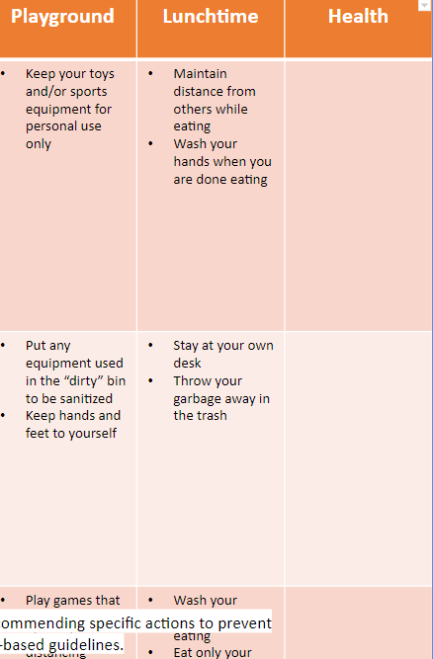
Including Physical Health Requirements
https://www.doe.k12.de.us/cms/lib/DE01922744/Centricity/Domain/599/ddoe_returningtoschool_guidance_final.pdf

Slide 44
Walk through the health assessment with students. How do you access it? What do you need to report? Will schools require it to be completed for every student? What happens if they don’t?
What exact symptoms does this include? Where is the “COVID room”?
What happens when you get there?
What exact symptoms does this include? Do they have to report symptoms?

Slide 45
Elementary Example | Classroom | Bathroom | Bus | Hallway | Playground | Lunchtime
Responsible | Use only your personal materials and label them Keep your personal materials in your own caddy Clean up your workspace everyday Tell an adult if you see a classmate having a hard time | Use one pump of soap to wash your hands and one paper towel to dry your hands | Stay in your assigned seat for the entire ride Let bus driver know if unsafe behavior seen | Follow 1-way direction arrows | Keep your toys and/or sports equipment for personal use only | Maintain distance from others while eating Wash your hands when you are done eating
Respectful | Wear your mask to respect others and yourself by keeping you all healthy Kindly remind others of rules, if needed Identify how to help others | Throw your paper towel in the trash can | Wait turn to board/exit Remind other of expectations kindly Keep hands and feet to yourself | Use kind language Smile with your eyes and wave to acknowledge adults & peers | Put any equipment used in the “dirty” bin to be sanitized Keep hands and feet to yourself | Stay at your own desk Throw your garbage away in the trash
Safe | Wear your mask over your nose and mouth to protect yourself and others Sneeze and cough into your elbow Keep hands and items out of your mouth Tell someone if you need help | Wash your hands with soap and water for at least 20 seconds | Sit in every other seat Wear your mask over your nose and mouth Keep windows open if possible | Maintain 6’ (big) personal space bubble Wear your mask over your nose and mouth to protect others in the hallway and yourself | Play games that allow for physical distancing | Wash your hands before eating Eat only your own food Keep your mask close to you when you aren’t wearing it
DRAFT: These are examples. DE-PBS Project is not recommending specific actions to prevent spread of COVID-19. Schools should develop/revise based on district/school-based guidelines.

Slide 46
Secondary Example | Classroom | Bathroom | Lunchtime | Hallway | Sports | SEL/ Student Self-Care
Responsible | Use only your personal materials and label them Keep your personal materials in your backpack | Use one pump of soap to wash your hands and one paper towel to dry your hands | Maintain distance from others while eating Wash your hands when you are done eating | Follow one-way direction arrows | Keep personal items to yourself | Tell an adult if you observe someone struggling Stand up for others if you observe COVID stigmatization or inequities Avoid risky situations that could expose you to the virus
Respectful | Wipe down your desk and chair before/after use Wipe down any shared materials before/after use | Keep the bathroom tidy and clear of personal items | Stay at your own desk Throw your garbage away in the trash | Elbow bump friends to greet them | Put any equipment in the “dirty” bin to allow for sanitization | Give “air high fives” to encourage others Check in on friends Practice reflective listening when others are sharing their COVID experiences
Safe | Wear your mask over your nose and mouth | Wash your hands with soap and water for at least 20 seconds | Wash your hands before eating Eat only your own food Keep your mask close to your when you aren’t wearing it | Move to your next class quickly to reduce contact outside of the classroom | Limit activity to contact- minimum sports | Tell someone if you are struggling Share what you are going through and have gone through
DRAFT: These are examples. DE-PBS Project is not recommending specific actions to prevent spread of COVID-19. Schools should develop/revise based on district/school-based guidelines.

Slide 47
https://www.doe.k12.de.us/cms/lib/DE01922744/Centricity/Domain/599/ddoe_returningtoschool_guidance_final.pdf

Slide 48
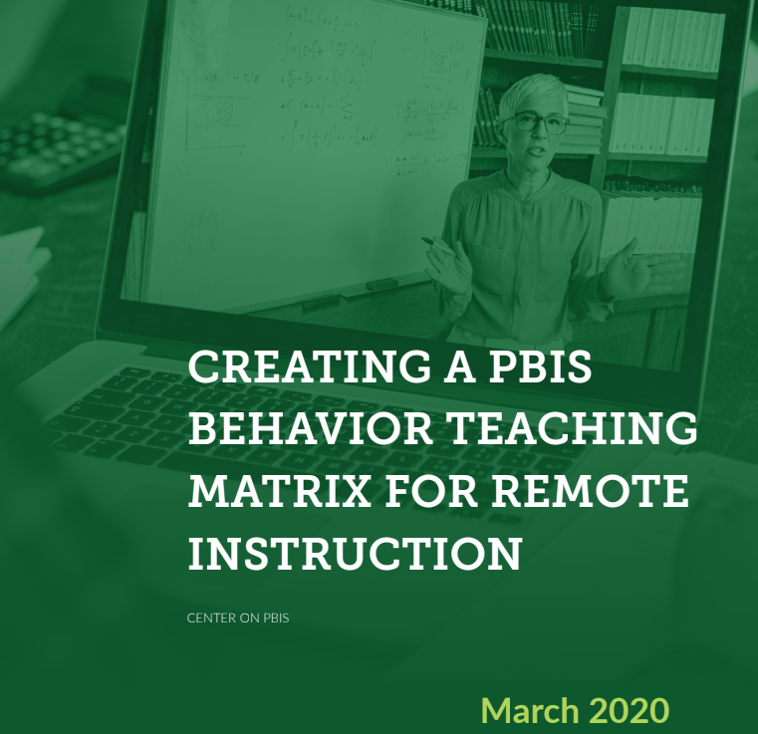
Distance Learning Matrix
Practices used in the physical classroom can be used in the virtual classroom
Online interactions are just like real-life interactions, with the same positive and negative social consequences for behavior
Creating a PBIS Behavior Matrix for Remote Instruction

Slide 49
Steps for Developing a Remote Instruction Teaching Matrix
Keep the same school-wide behavior expectations
Use online activities as your settings
Activities: ie Online (all activities), Teacher-Led Instruction, Independent Work, One-On-One Work, and Small Group Activities
App or subject-specific activities: content areas
Modified physical routines: re-imagine what the physical routines looked like to apply them virtually (ie entering the classroom, greeting students, sharing a positive comment, planned unstructured time)
Consider online-specific behaviors that need to be taught (ie use of video, audio, chat, and technology explicitly taught as a lesson)
Teach directly (ongoing explicit teaching and practice)
https://assets-global.website-files.com/5d3725188825e071f1670246/5e7e5a79378fc458723ddf4f_Creating%20a%20PBIS%20Behavior%20Teaching%20Matrix%20for%20Remote%20Instruction.pdf

Slide 50
Elementary Virtual Example
We are… | Entering Class | Teacher-led Whole Group Instruction | One-on-One Instruction | Small-Group Activities (Breakout Rooms)
Safe | • Choose a distraction free space • Use equipment as intended • Use kind words and faces | • Ask in chat if you need help • Use kind words and faces | • Use kind words and faces | • Use “stop-leave-talk” when you hear disrespect • Encourage others to participate • Use kind words and faces
Respectful | • Video on at all times • Audio off • Use chat with classmates for first 5 minutes | • Video on at all times • Audio off • Answer questions in chat box on cue • Answer polls promptly | • Video on at all times • Audio on • Listen attentively • Answer questions out loud on cue | • Video on at all times • Audio on • One speaker at a time: wait or use chat to respond when others are talking • Respect others’ cultures, opinions, and viewpoints
Responsible | • Be on time and ready to learn • Start class charged or plugged in • Have materials ready | • Ask questions (voice or chat) when you have them • Be present – avoid multitasking | • Ask questions out loud when you have them • Try your best • Be present – avoid multitasking | • Encourage each other to stay on topic • Complete the work together • Use “Ask for Help” button if you have questions • Be present – avoid multitasking
https://www.pbis.org/resource/creating-a-pbis-behavior-teaching-matrix-for-remote-instruction

Slide 51
Laketown Elementary Distance Learning Expectations
 | Learning Zone | Playing Zone | Using Technology | Supporting Family
Peaceful | Be aware of your body and voice. Use whole body listening. | Control your body and voice. Compromise. | Keep volume low. Take breaks. | Discuss expectations daily. Focus your attention when others talk.
Respectful | Be aware of other’s learning. Follow directions and complete work. | Be respectful of equipment. Find a fair way to play Take turns Trade Share | Be safe online. Keep devices charged and use with care. | Allow parents to work and siblings to learn. Use Stop-Name Your Feeling-Calm Down.
Inclusive | Share resources and supplies. Help each other learn. | Be accepting of different ways to play. Agree on rules before playing. | Share devices so all can learn. Be kind to others when posting. | Use S-T-E-P to find solutions during conflict. Show empathy.
Determined | Stay focused on your task. Try your best and use positive self-talk. | Clean up. Follow directions. | Be a courageous learner. Be patient. | Develop positive new routines. Be assertive and ask for help.
Engaged | Be prepared to learn. Keep relationships with classmates. | Participate fully. Be active and have fun. | Check communication daily. Focus your attention on educational work. | Encourage each other. Acknowledge successes.
Laketown Elementary is a community of learners where every child matters and every moment counts.
We show Laketown PRIDE by being Peaceful, Respectful, Inclusive, Determined, and Engaged.

Slide 52
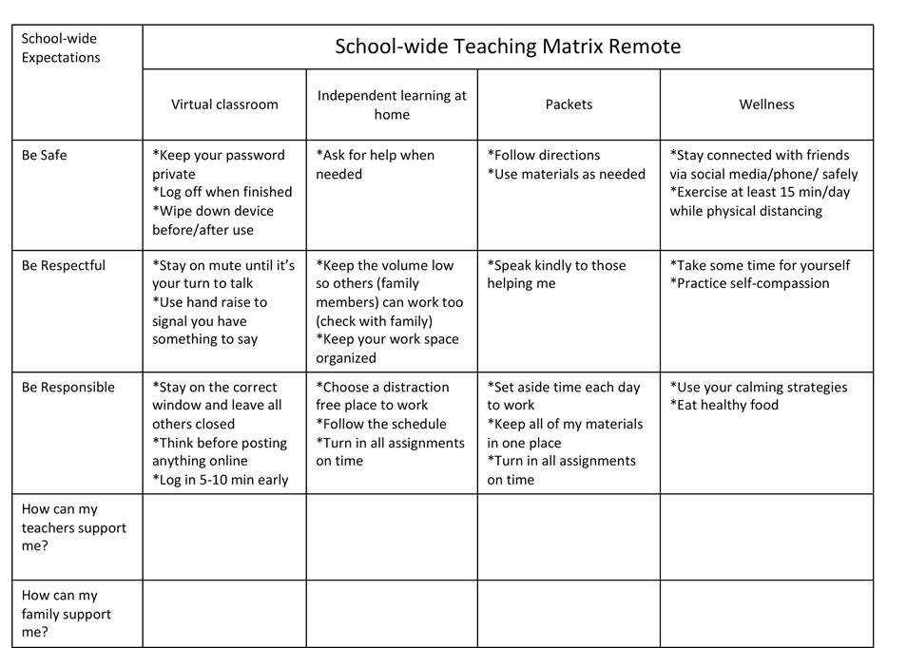

Slide 53
Dstance Learning Behavior Matrix | Preparation How ready are you? | Respect How do you treat others? | Integrity Who are you when no one is looking? | Discipline Are you following the rules? | Effort Are you being your best you?
Distance Learning | I am: Have all the materials I need Attend Zoom/online Meetings on time. Completing and turning in assignments on time. | I am: Taking turns to comment during on-line/zoom lessons. Honoring one voice. Making respectful comments on-line/zoom Respectful facial expressions online/zoom. Valuing school property. Wash hands and maintain social distances. | I am: Turning in my own work. Helping younger siblings if needed. Using Zoom for school use only. Always THINKing before posting. (Is it True, is it Helpful, is it Inspiring, is it Necessary is it Kind?) Supportive of my classmates and opinions. | I am: Attending all my classes, every day. Following class procedures. Checking my calendar. Completing my homework each day. Spending time helping my family. | I am: Always persevering and trying my best. Asking for help when I need it. Actively participating. Creating thoughtful and neat work. Checking over my work. Helping others who might need assistance.
Technology | I am: Coming to class with Chromebook charged. Using technology appropriately. Taking good care of my Chromebook. | I am: Respectful of myself and others online. Keeping login, passwords, and private information private. Avoiding eating or drinking while using Chromebook. | I am: Always citing sources of pictures & information used. Always THINKing before posting. (Is it True, is it Helpful, is it Inspiring, is it Necessary is it Kind?) | I am: Staying on task when using technology. Avoiding and reporting inappropriate sites and unsafe use. | I am: Using Chromebooks for school use only. Taking PRIDE in completing my best work.
Courtesy of Grandview Middle School, Westonka Public Schools ISD 277, Minnesota
Report students and staff who are showing PRIDE during our Distance Learning! Click this link to the online form to report PRIDE!

Slide 54
Prioritize Equity
MTSS (and your matrix) is for all students, families, and educators
A matrix needs to be representative of the population it is designed for
Development of expectations and matrix is done with stakeholders (students, family, community) - including input from them is culturally responsive
Having input from marginalized groups, not only easily reached groups, is especially important
Teams examine expectations and matrices for implicit bias and ensure that they are universal
Ongoing feedback is used to make improvements
Communication about your matrices is widespread and multi-modal
https://assets-global.website-files.com/5d3725188825e071f1670246/5d70468ef10ca28bb416e7b0_pbis%20cultural%20responsiveness%20field%20guide.pdf

Slide 55
Share Your Ideas For Equity Considerations
How will your matrix be culturally responsive?

Slide 56
“When hybrid models occur, prioritize actions from each context that maximize strengths of that mode of instruction.”

Slide 57
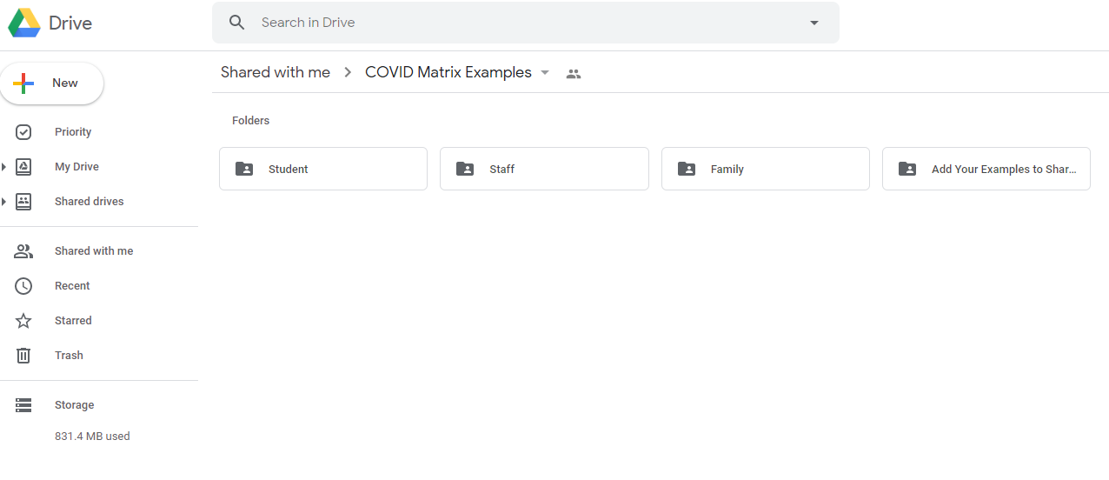
COVID Matrix Examples

Slide 58
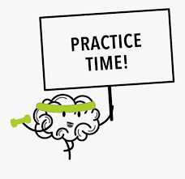
Let’s Pause & Brainstorm: Student Supports
Prior to and upon return, what are the most important things to teach students related to behavior/SEL?
How will they connect with your current expectations & teaching matrix?
Workgroup time: Pause and take 2 minutes to brainstorm. Take 8 minutes to share priorities & connections with your workgroup.

Slide 59
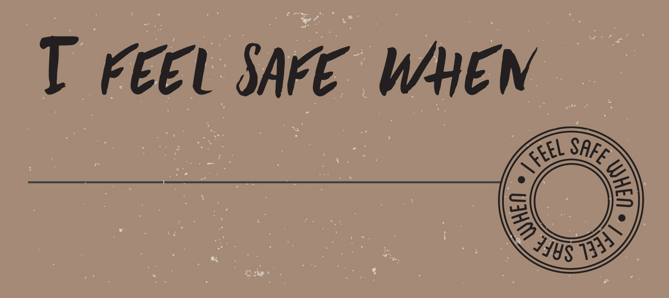
What is something that is important to you to know your safety (emotional or physical) is being addressed? Write in the chat box

Slide 60
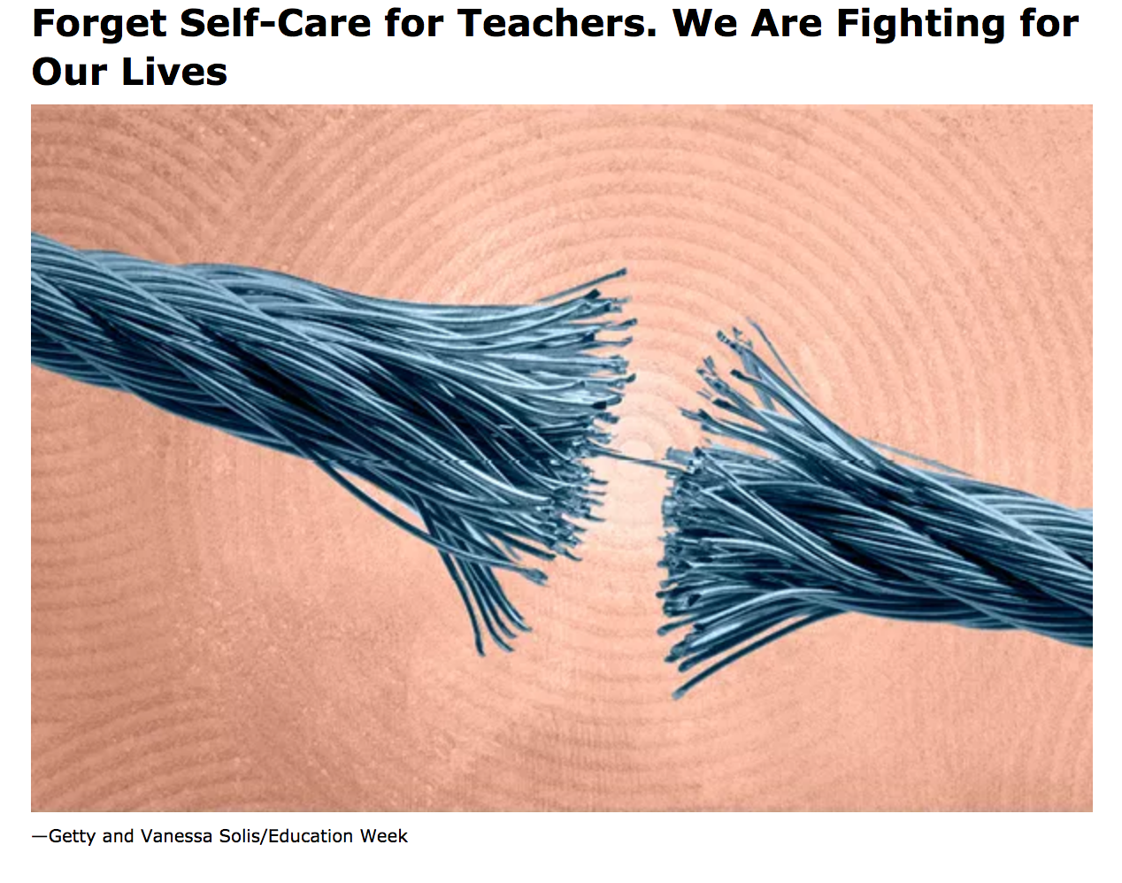
https://www.edweek.org/ew/articles/2020/07/22/forget-self-care-for-teachers-we-are-fighting.htm
l

Slide 61
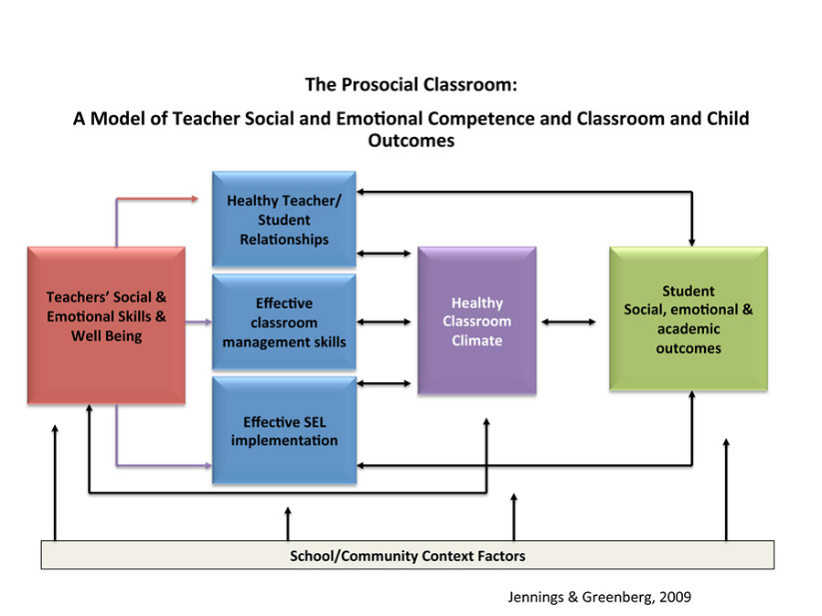
The Importance of Teacher Social and Emotional Skills and Well Being

Slide 62
Use our MTSS Structures to Support Social Emotional Skills and Teacher Well Being
MTSS/PBS
Teachers’ Social & Emotional Skills & Well Being
Internalizing Problems
Positive School Climate
SEL
Externalizing Problems

Slide 63
Create a safe, positive, predictable environment for ALL.
Be proactive
Empower teachers
Create clear expectations for staff
in person and virtual
Build social and emotional supports for staff
Identify and respond to inequities
https://www.nycleadershipacademy.org/wp-content/uploads/2020/04/Leading-for-Equity-and-Access-Amid-COVID-4.23.20-2.pdf

Slide 64
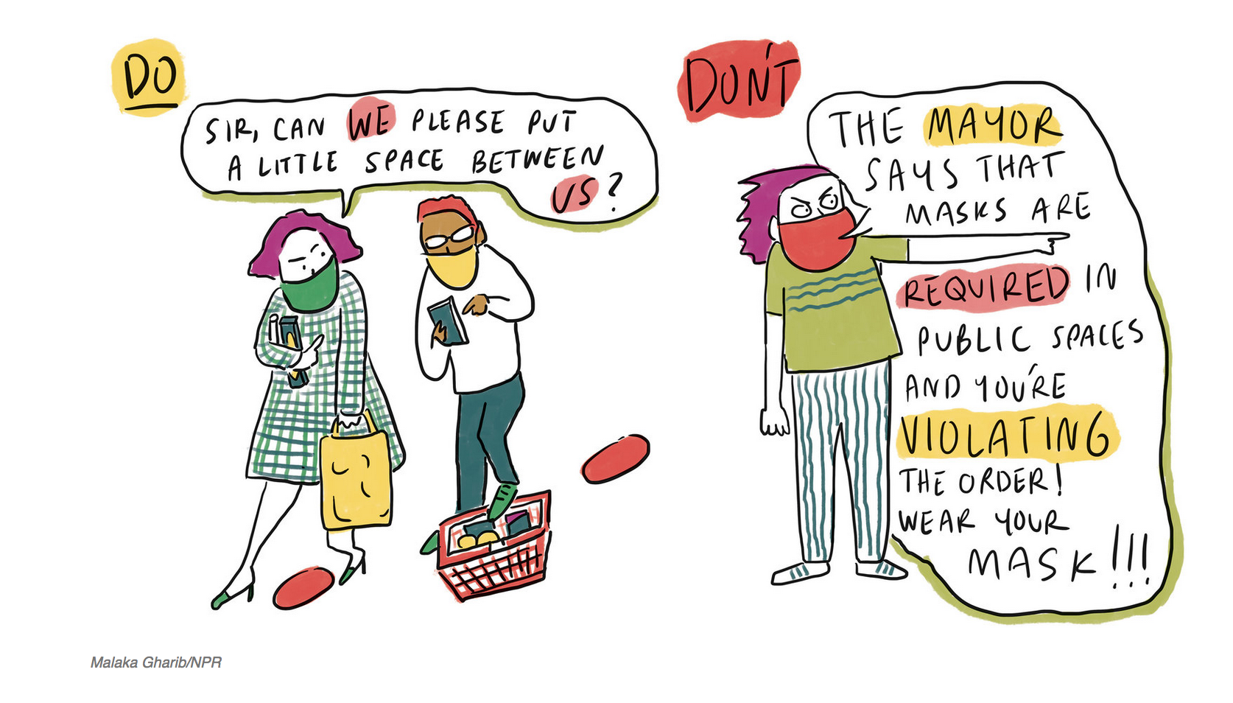
PBS is for Adults too
https://www.npr.org/2020/07/28/896134292/covid-19-etiquette-6-common-conundrums-and-a-printable-pocket-guide?utm_source=npr_newsletter&utm_medium=email&utm_content=20200804&utm_term=4725246&utm_campaign=the-new-normal&utm_id=43719143&orgid=433

Slide 65
What to do Now
Design a System of Support for Staff
Focus on de-stressing staff
Clear, concrete health expectations, procedures and routines
Direct instruction
Opportunity to practice, plan and build fluency
Get feedback and input from staff, adjust, improve
5:1 feedback ratio

Slide 66
Staff Days – Preparing for In person (prior to students returning)
Check in
Expect to be emotional , exhausted
Track your “triggers”
Common experience will increase connection and sense of belonging, allow yourself to be vulnerable, honest and compassionate
Opportunity to practice new procedures
Walk every inch of the building in small groups, physically distanced –learn about new routines
Important for you to feel comfortable and model calm when kids get back

Slide 67
What to do when…
Out of soap
Student is refusing to wear mask
Person within community tests positive
I need a break
I recognize someone needs help
Design the system so we can…
Practice, practice, practice
Huddle and debrief
Reflect and improve

Slide 68
Sample Agenda for Staff First Day Back
Day | 1 OUTSIDE: Welcome and Check in /morning circle opener (music, time to just be together – outside using new protocol for entering and exiting building. (e.g. temperature checks, sanitizer station) District and school leaders model for teachers how to welcome students back. Review revised school-wide matrix (shared in advance) and explicitly discuss SW expectations and new routines. Break into small teams and take a tour (using distancing protocols) of the school- School Tour- practice line up routine, new traffic flow and become familiar with prompts (posters, floor signs) Provide direct instruction to all staff…Teach routines and procedures across all contexts, have staff take notes, be aware of things that “trigger” them throughout the first day. Self-reflection worksheet and huddles/check in across each day will be important Other Considerations: ** Use same process for orientation days with families and students coming back- ** Do we ask staff and students to wear something (similar to a medical bracelet) that lets us know they are exempt from wearing a mask?- VARIES based on local safety procedures
 | Break

Slide 69
Staff Example | Classroom | Bathroom | Outdoors | Staff Lounge | Staff Self-Care | Supporting Families
Responsible | Use only your personal materials, label them, and keep in your classroom/ workspace Provide a space for sharing and compassionate listening to process COVID experiences. | One person in the bathroom at a time | Remind students to put any used equipment in the “dirty” bin after use | Wipe down surfaces before and after eating Clean up any personal items/ food when leaving | “Tap out” with team teacher when needed Know your own calming strategies and use them when needed Complete health assessment every morning | Communicate with families 1:1 every week Keep a communication log Respond to caregiver requests within 48 hours
Respectful | Exercise patience with students who are still learning these new expectations Remind students of rules by pre-teaching them and using friendly reminders throughout the day | Leave the bathroom clear of personal items, paper towels, and shared items Limit use of time in the bathroom to allow time for others | Limit time on the playground to class time only to allow for the next group to transition in and out smoothly | Gently remind co-workers of rules when needed | Check in with others’ mental health Foster a culture of normalizing talking about mental health needs by talking about your own and respecting the needs of others | Use requested means of communication Recognize caregiver workload
Safe | Wear your mask over your nose and mouth unless eating lunch Remind students to wipe down computers, desks, shared materials before and after use Keep windows open as often as possible | Wash your hands with soap and water for at least 20 seconds | Maintain 6 feet distance from other staff even when outdoors | Sit staggered to maintain distance Wash hands before and after eating | Communicate to team, admin, and/or counselors if you are struggling | Stay informed of family food, shelter, and employment instability
DRAFT: These are examples. DE-PBS Project is not recommending specific actions to prevent spread of COVID-19. Schools should develop/revise based on district/school-based guidelines.

Slide 70
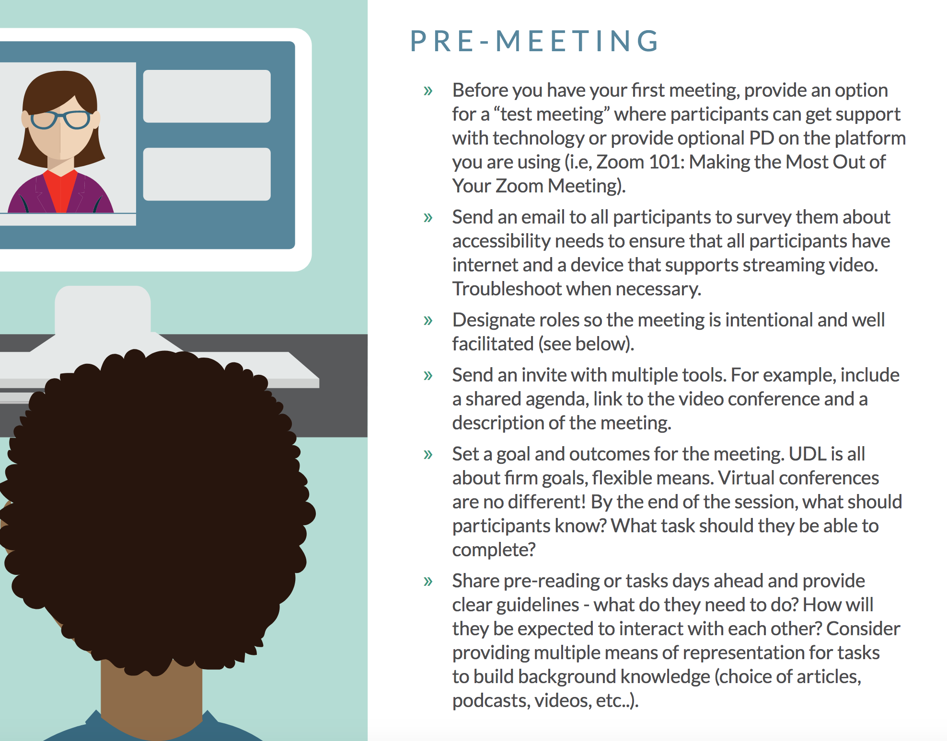
Universally designing your meetings and PLCs in the virtual world
Share goals
Create and share meeting norms
Utilize virtual meeting roles
Get feedback
https://www.novakeducation.com/wp-content/uploads/2020/04/Video_Conferencing_PLC_Guide_REV.pdf

Slide 71
Brainstorm: Staff Supports
What are the most important things to put in place now to support staff?
How will they connect with your current expectations & routines for staff?
Workgroup time: Take a minute to identify your priority. Have each group member share priorities. Identify common priorities and share ideas for how to support.

Slide 72
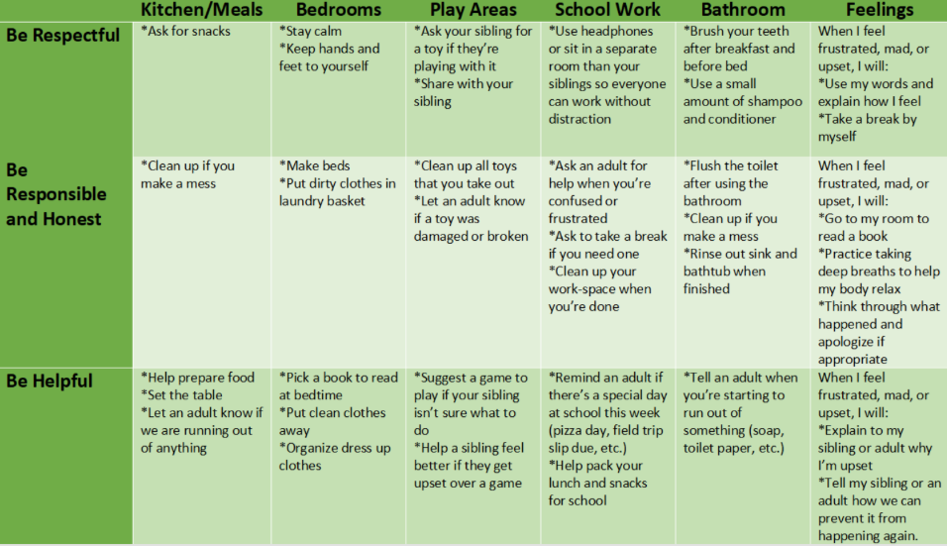
At-Home Behavior Support
Supporting Positive Behavior at Home
Supporting Learning at Home
Developing an At-Home Behavior Matrix

Slide 73
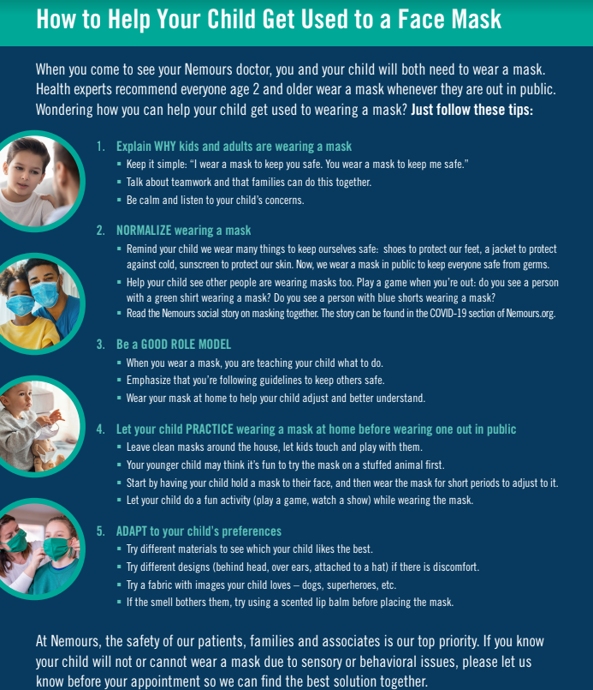
Communicating with Families
Teach positive health behaviors including hygiene, wear mask (varying fabrics/styles), social distancing
Keep children home if exhibiting any symptoms
Communicate regularly with teacher/counselor/nurse regarding any physical or mental health needs
De-stigmatization of COVID-19

Slide 74
They’re Alive!
Think of your School-wide and Classroom Matrices as living, fluid documents. If being responsive to your data and needs of your school and community, then teams and schools need to be flexible and willing to revisit expectations and rules.

Slide 75
Return to School Action Planning - Matrix Focus
DDOE’s Reentry Guide & Toolkit: Guidance for Supporting Student & Staff Socio-Emotional and Behavioral Health When Reopening Schools Reentry Guidance Action Plan
Includes Quick Start Guidelines with Critical Actions to consider at the district and school level; Action plan templates included
School Level Action Plan:
Leadership Teaming, Evaluation Plan, Universal SEB Practices Plan

Slide 76
Reentry Toolkit - School Level Critical Action
Leadership
Teaming

Slide 77
Reentry Toolkit - School Level Critical Action
Evaluation Plan

Slide 78
Reentry Toolkit - School Level Critical Actions
Universal SEB
Practices

Slide 79
Reentry Toolkit - School Level Critical Actions
Universal SEB
Practices

Slide 80
Resources & References
“In order to carry a positive action we must develop here a positive vision.”
- Dalai Lama
www.delwarepbs.org
http://pbismissouri.org/
www.pbis.org
http://www.midatlanticpbis.org
Centers for Disease Control and Prevention. (2020). Considerations for Schools. https://www.cdc.gov/coronavirus/2019-ncov/community/schools-childcare/schools.html
Center on PBIS. (2020). Responding to the Novel Coronavirus (COVID-19) Outbreak Through PBIS. https://assets-global.website-files.com/5d3725188825e071f1670246/5e713cc6a814d74f2453520c_Responding%20to%20the%20Novel%20Coronavirus%20(COVID-19)%20Outbreak%20through%20PBIS.pdf
Center on Positive Behavioral Interventions and Supports, State Implementation and Scaling Up of Evidence-Based Practices Center, National Integrated Multi-Tiered Systems of Support Research Network, National Center on Improving Literacy, & Lead for Literacy Center. (2020). Returning to School During and After Crisis: A Guide to Supporting States, Districts, Schools, Educators, and Students through a Multi-Tiered Systems of Support Framework During the 2020-2021 School Year. https://assets-global.website-files.com/5d3725188825e071f1670246/5eece8935e4d8010fea193d9_Returning%20to%20School%20During%20and%20After%20Crisis.pdf
Leverson, M., Smith, K., McIntosh, K., Rose, J., & Pinkelman, S. (2019). PBIS cultural responsiveness field guide: Resources for trainers and coaches. OSEP Technical Assistance Center. https://assets-global.website-files.com/5d3725188825e071f1670246/5d70468ef10ca28bb416e7b0_pbis%20cultural%20responsiveness%20field%20guide.pdf
Delaware Department of Education. (2020). Returning to School: Planning a Safe, Efficient, and Equitable Return to School for Students and Staff. https://www.doe.k12.de.us/cms/lib/DE01922744/Centricity/Domain/599/ddoe_returningtoschool_guidance_final.pdf
CASEL. (2020). Reunite, Renew, and Thrive: Social and Emotional Learning (SEL) Roadmap for Opening School. https://casel.org/wp-content/uploads/2020/07/SEL-ROADMAP.pdf
Delaware Health and Social Services Division of Public Health. (2020). COVID-19 Guidance Face Coverings for Children. https://coronavirus.delaware.gov/wp-content/uploads/sites/177/2020/06/Guidance-Face-Coverings-for-Children-6.2.20.pdf
Delaware Health and Social Services Division of Public Health. (2020). Essential Services Screening Recommendations for the COVID-19 Pandemic. https://coronavirus.delaware.gov/wp-content/uploads/sites/177/2020/06/6.18-Essential-Services-Screening-Policy.pdf
Delaware Health and Social Services Division of Public Health. (2020). Coronavirus Disease 2019 (COVID-19). https://coronavirus.delaware.gov/wp-content/uploads/sites/177/2020/04/Covid-19-Awareness-scaled.jpg
Delaware SEL Competencies Draft. (2020) https://files.constantcontact.com/f6736190301/066c0cc8-f7a7-4c7a-b8cb-9349a49de217.pdf

Slide 81
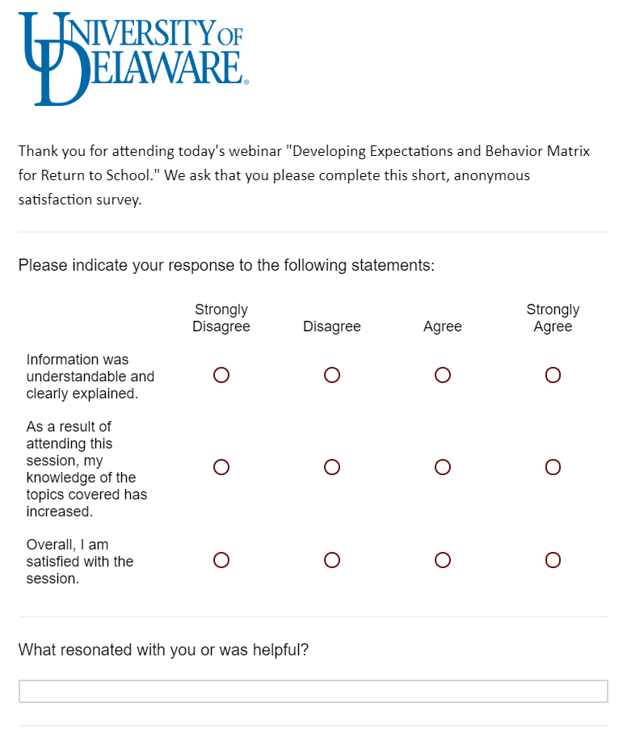
Please take a moment to fill out our evaluation form
We appreciate your hard work and dedication to the students of Delaware….
THANK YOU!

