Slide 1
DE-PBS Cadre Meeting
October 30, 2020

Slide 2
Meeting Expectations
 | Virtual Meetings
BE ENGAGED | Unmute yourself or use chat box to ask questions Participate in polls and breakout rooms Use video when possible, especially when speaking
BE REFLECTIVE | Share questions you have for full group Note follow up questions for PBS team and/or individuals Focus on problem solving around areas of concern
BE SUPPORTIVE | Share successes, ideas, useful resources Listen with openness and understanding Attend to your own needs

Slide 3
Welcome & Agenda
Cadre Goals:
Support district MTSS/PBS Coaches in their role
Project updates & resource sharing
Conduit between state to district to schools
Networking among districts
Feedback on Project activities/resources
Today’s Agenda:
DE-MTSS Regulations Update
MTSS & Equity Orientation
Reorient to DDOE Reentry Guide & Toolkit - Focus on Critical Action resources

Slide 4
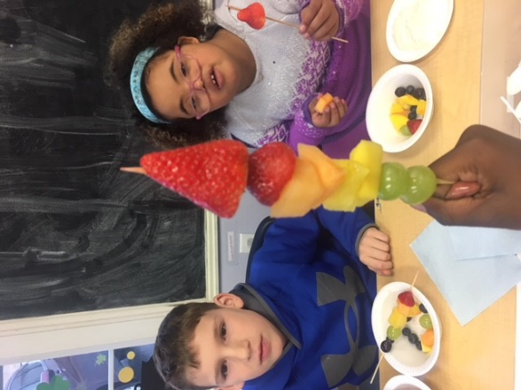
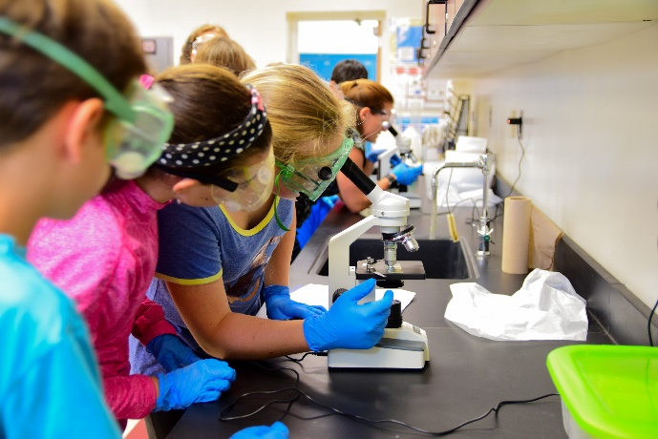
DE-MTSS Regulations Update

Slide 5
DE MTSS Regulations Update
In collaboration with stakeholders, the Department gathered input and revised the eligibility criteria for each disability category in Regulation 925.
The revised eligibility criteria for some disability categories references Multi-Tiered System of Support (MTSS). Regulation 508 details MTSS.
While Regulation 925 references MTSS, Regulation 508 is a general education regulation. MTSS is only one component of determining eligibility criteria
SBE voted to approve 508, 922, and 925 on October 15, 2020. These regulations will replace the current ones on July 1, 2021.
Until the new regulations go into effect, schools will continue to operate under the current version of Regulation 925, including section 12-RTI Procedures

Slide 6
DE-MTSS Website & Support Documents
Delaware’s MTSS Website – www.doe.k12.de.us/mtss
Info on the MTSS process, data systems and technical assistance designed to meet the needs of various stakeholders (e.g. LEAs, families, community organizations and SEA)
Evidence-based research and resources to support MSS implementation at the district and building level
Events, partnerships, professional learning and other related activities to help develop and build capacity to implement and sustain a strong MTSS system
Creation Process:
Format designed by Core Team with DOE technical guidance
Advisory and Leadership will review for feedback
Will continue to modify and update as needed

Slide 7
DE-MTSS Website & Support Documents
Support Documents : Implementation Guide, Quick Guides
Assist with implementation of MTSS as outlined in regulations
Delaware specific with related tools for application
Various audiences will be addressed
Creation Process:
Based on Regulations
Created by Core Team
Input from DOE Cross Workgroup Review Team
Reviewed by MTSS Advisory
Finalized by Leadership Team

Slide 8
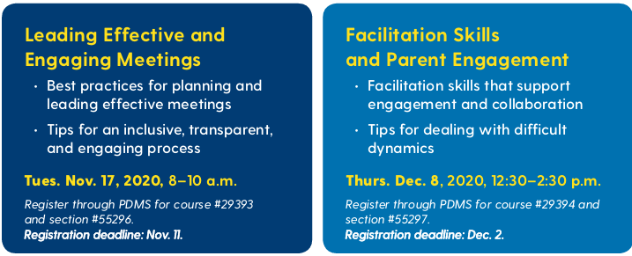
Tips and Skills for Effective IEP Meetings

Slide 9
MTSS & Equity
OUTCOMES
SYSTEMS
DATA
EQUITY
PRACTICES

Slide 10
Guiding Principles
Make student growth & benefit
of all students central to all decisions.
Prioritize equity.
OUTCOMES
Use data to inform all decisions (screening,
progress monitoring,
equitable outcomes,
& fidelity).
Continue to invest in systems to support high-fidelity implementation across time.
SYSTEMS
DATA
EQUITY
PRACTICES
Implement a small
number of effective,
culturally-relevant practices well.
Integrate, align, & connect practices.

Slide 11
Guiding Principles
Make student growth & benefit
of all students central to all decisions.
Prioritize equity.
OUTCOMES
Use data to inform all decisions (screening,
progress monitoring,
equitable outcomes,
& fidelity).
Continue to invest in systems to support high-fidelity implementation across time.
Use the MTSS framework to differentiate supports & monitor to ensure equity
for all students.
SYSTEMS
DATA
EQUITY
PRACTICES
Implement a small
number of effective,
culturally-relevant practices well.
Integrate, align, & connect practices.

Slide 12
5 Core Components
to ensure a culturally responsive lens & equitable outcomes, systems, practices
Identity
Voice
Supportive Environment
Situational Appropriateness
Data for Equity

Slide 13
5 Core Components
Identity
Race & ethnicity plus ability, gender identity, language, marital status, religion, sexual identity, socio-economic status, and more
Practitioners need to understand their own identity and how that impacts their practice and classroom, as well as the identity of their students, families and community.
Voice
Authentic family and community engagement include providing families, students and community members with meaningful opportunities to be heard, and voice their opinion, and exercise leadership within the school system.

Slide 14
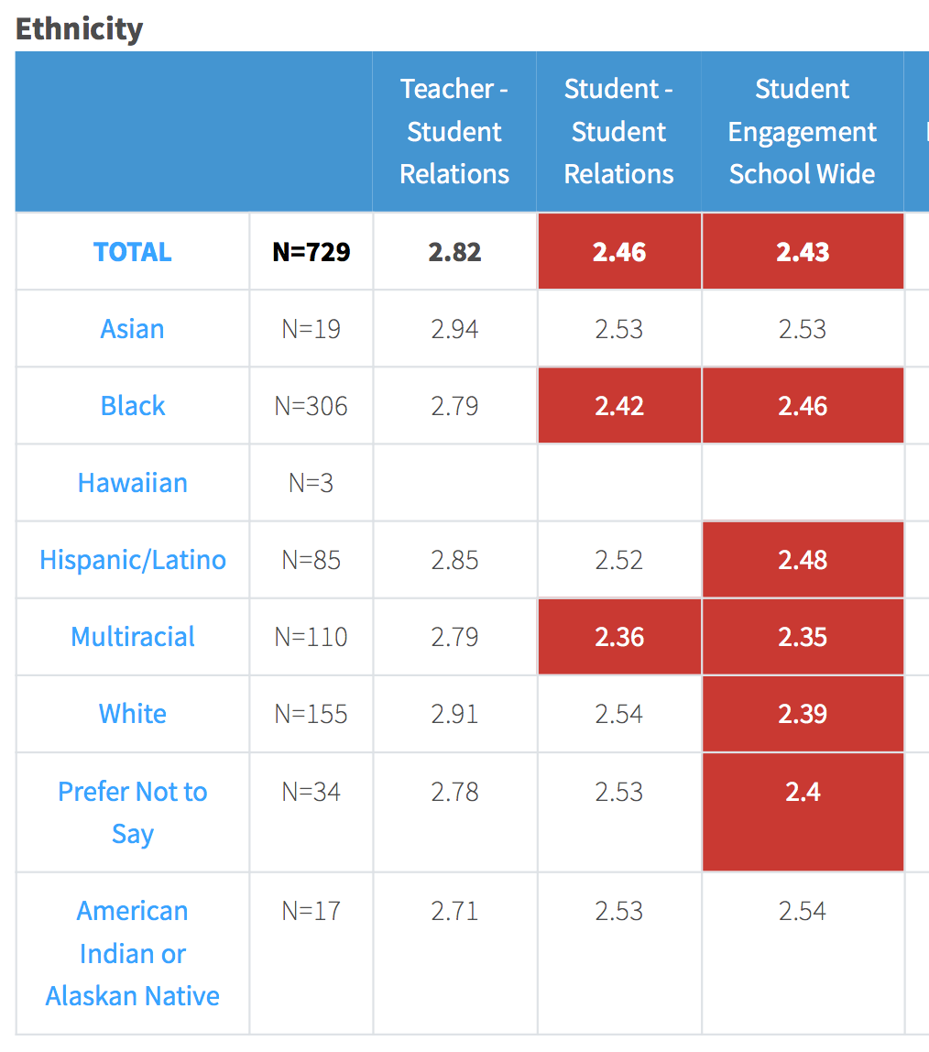
Supportive Environment
Students feel valued and see themselves and their experiences on display.
Staff must understand that school expectations exist as a framework to teach desired behaviors to fluency, rather than a system for delivering infractions
Staff must understand that the acknowledgment system is intended as a tool to encourage the learning and generalization of desired behaviors.
Situational Appropriateness
Go beyond Code Switching and speak to the strengths-based aspects of student home and community norms and systems.
Data for Equity
It is imperative to disaggregate data for analysis and action planning and openly discuss trends in data regarding equity.
It is critical to address issues of disparate impact at the systems level (i.e. operationally defining subjective behaviors.)

Slide 15
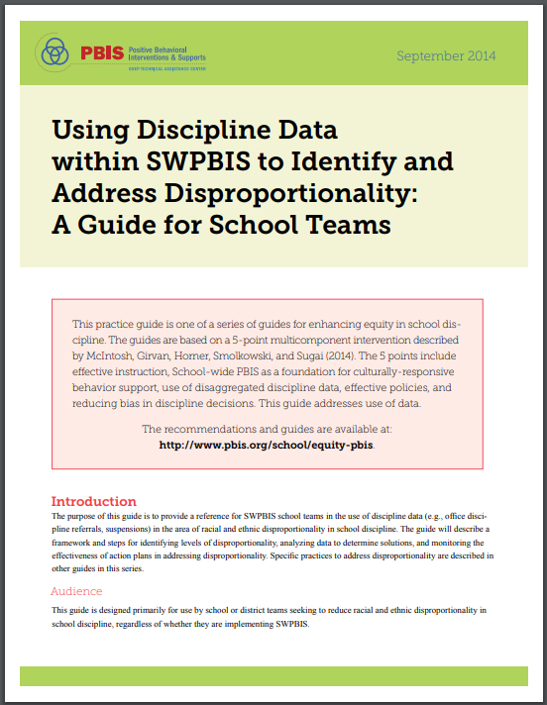
Moving Forward

Slide 16
How familiar are you with these PBIS tools ?
PBIS Cultural Responsiveness Field Guide
A 5-Point Intervention Approach for Enhancing Equity in School Discipline
Using Discipline Data within SWPBIS
to Identify and Address Disproportionality

Slide 17
If we had a web session looking through how to use this field guide, would you be interested?
This would be for coaches, district partners or team leads that could support roll out.

Slide 18
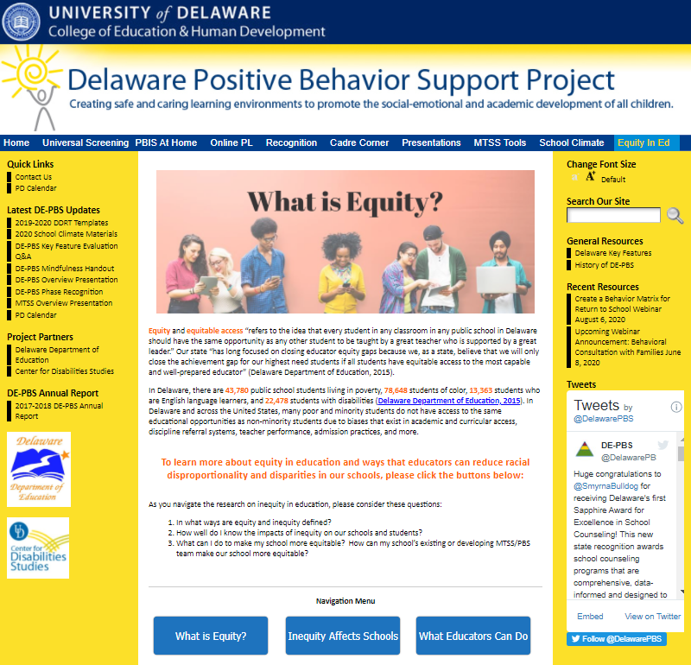
Delawarepbs.org
Equity in Ed
What is Equity?
Inequity Affects Schools
What Educators Can Do

Slide 19
Equity in Ed
In what ways are equity and inequity defined?
How well do I know the impacts of inequity on our schools and students?
What can I do to make my school more equitable? How can my school’s existing or developing MTSS/PBS team make our school more equitable?
Existing equity-related research
how racial inequity in our schools can affect students of color in many ways.
Recommended equity-promoting practices
ways to address racial discipline disproportionality and build equity in our schools.

Slide 22
Resources Informing DE-PBS Efforts

Slide 23
How familiar are you with the the DDOE Reentry Guide & Toolkit?

Slide 24
District Action Plan Template

Slide 25
“Leadership teams should avoid the inclination to respond with new tools (e.g. adding a new SEL curriculum) or collecting new data (e.g. universal screening surveys and tools) without deliberate team-based problem solving and establishing systems to support their use.”
DDOE Guidance for Supporting Student & Staff SEB Health When Returning to School

Slide 26
District Critical Action #1: Leadership Teaming
Revist leadership team membership. Ensure the team includes members with expertise in data science, school and community mental health staff and school nurses.

Slide 27
Teaming Structure
Administrator
Teachers
School Nurse
School Counselor
School Psychologist
School-Based Wellness Center (when applicable)
Student
Family
Community
COVID School Coordinator

Slide 28
Teaming Considerations
District and School:
Are teams established with necessary voices?
Are meeting times pre-determined?
Is there a consistent meeting schedule?
Are problem-solving teams established?
If return to school teams/committees were formed, are they the same team or is coordination needed?

Slide 29
District Critical Action #2: Aligned Communication
Revisit mission and vision and ensure messages are cohesive across the district.
Develop a clear communication plan and strengthen communication routines (update contacts at district, school, community levels)
Clearly communicate how school professionals should access district crisis response supports

Slide 30
Communication with Families
What proactive strategies has your district used to provide clear, positive communication with families?
What strategies have been successful in responding to frustrated families?

Slide 31
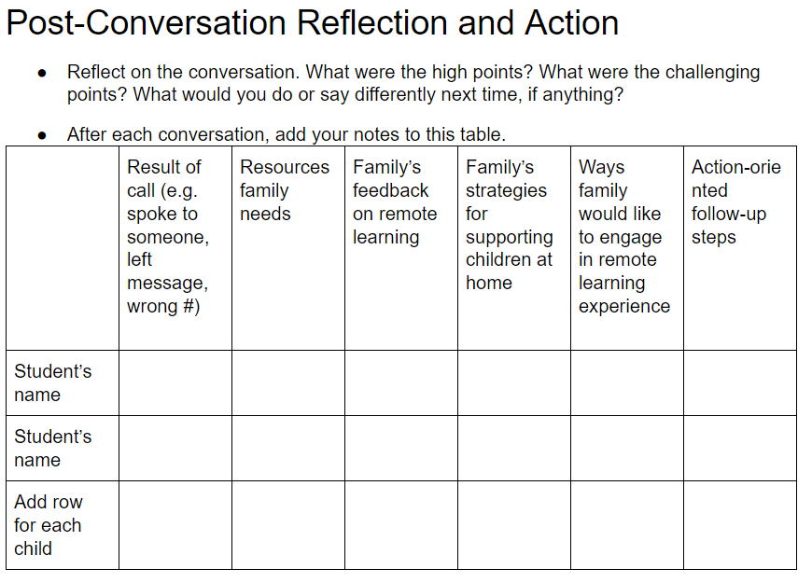
Highlighted Resource

Slide 32
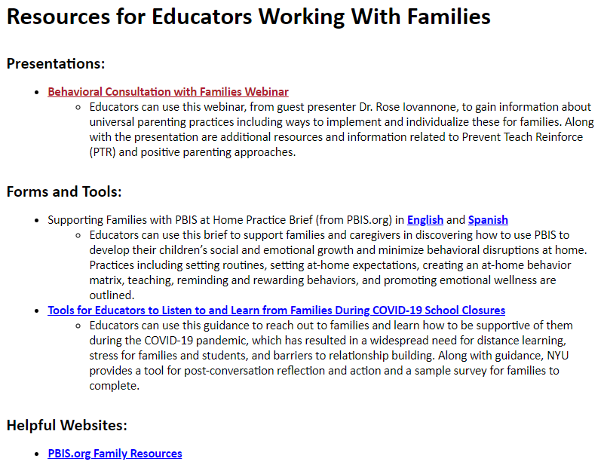
DE-PBS Resources for Educators Working With Families…
ongoing development!

Slide 33
District Critical Action #3: Establish an Evaluation Plan
Focus on developing a process to evaluate and respond to immediate student needs.
Focus on developing a process to evaluate and respond to immediate staff needs.
Establish expectations for universal screening that prioritize school-wide and other informal data sources.

Slide 34
What existing information do you have that would help you understand/define this concern?
Do you need additional information to understand the problem?
What concerns does your school community have at this time?
Who is impacted by the concern?
How can we most efficiently respond? All? Some? Few?
You just engaged in a universal screening problem solving process!

Slide 35
Information:
%age of students with fewer than 3 contacts per week (phone, text, zoom)
Informal wellness surveys collected by teachers
Collect more information (as needed):
No additional screener was recommended at this time
Next steps:
Work with Tier 1 team to plan wellness activities for all students upon return to school.
Work with Tier 2 team to consider students meeting at risk criteria and not already connected to supports for CICO
Problem: our team is worried about the stress level of our students returning to school
Problem analysis: Data indicates our teachers reported (on average for the first month of online instruction) less than 3 contacts per week were made for 20% of the students.
Wellness checks indicate a high percentage of students feeling more tired and less motivated than usual to complete schoolwork

Slide 36
Universal Screening
Involves the collection and review of multiple measures to assess the academic and SEB health of all students
Does not mean every student in a school or district is screened with every measure
Informs academic and SEB instructional decisions across all Tiers of support
Data uncovers a potential need with a student, class, grade or school

Slide 37
Schoolwide Data Sources:
DE School Climate Survey Update
Survey timeline will be adjusted for 2020-21 SY; more to come
CoVitality app will be utilized
2019-20 Home data (scan tron & online) reconciled
District summary reports now available
CoVitality Login - email Sarah (skhearn@udel.edu)

Slide 38
District Critical Action #4: Establish a Support Plan for Universal SEB Practices
Based on information collected through your evaluation identify universal expected practices for all district schools.
Based on identified needs of staff ensure a continuum of supports are available and communicated.
Ensure educators check in with all students and families before the school year begins.

Slide 40
Presentation Objectives
Enhance efforts to create safe, positive and predictable learning environments
Leverage your student behavior matrix to support learning and social emotional needs during COVID-specific context whether virtual, hybrid or in-person
Update your matrix to address physical and mental health safety needs
Expand supports and expectations for staff
Review an action plan for supporting and preparing for returning to school

Slide 41
Elementary Example | Classroom | Bathroom | Bus | Hallway | Playground | Lunchtime
Responsible | Use only your personal materials and label them Keep your personal materials in your own caddy Clean up your workspace everyday Tell an adult if you see a classmate having a hard time | Use one pump of soap to wash your hands and one paper towel to dry your hands | Stay in your assigned seat for the entire ride Let bus driver know if unsafe behavior seen | Follow 1-way direction arrows | Keep your toys and/or sports equipment for personal use only | Maintain distance from others while eating Wash your hands when you are done eating
Respectful | Wear your mask to respect others and yourself by keeping you all healthy Kindly remind others of rules, if needed Identify how to help others | Throw your paper towel in the trash can | Wait turn to board/exit Remind other of expectations kindly Keep hands and feet to yourself | Use kind language Smile with your eyes and wave to acknowledge adults & peers | Put any equipment used in the “dirty” bin to be sanitized Keep hands and feet to yourself | Stay at your own desk Throw your garbage away in the trash
Safe | Wear your mask over your nose and mouth to protect yourself and others Sneeze and cough into your elbow Keep hands and items out of your mouth Tell someone if you need help | Wash your hands with soap and water for at least 20 seconds | Sit in every other seat Wear your mask over your nose and mouth Keep windows open if possible | Maintain 6’ (big) personal space bubble Wear your mask over your nose and mouth to protect others in the hallway and yourself | Play games that allow for physical distancing | Wash your hands before eating Eat only your own food Keep your mask close to you when you aren’t wearing it
DRAFT: These are examples. DE-PBS Project is not recommending specific actions to prevent spread of COVID-19. Schools should develop/revise based on district/school-based guidelines.

Slide 42
Dstance Learning Behavior Matrix | Preparation How ready are you? | Respect How do you treat others? | Integrity Who are you when no one is looking? | Discipline Are you following the rules? | Effort Are you being your best you?
Distance Learning | I am: Have all the materials I need Attend Zoom/online Meetings on time. Completing and turning in assignments on time. | I am: Taking turns to comment during on-line/zoom lessons. Honoring one voice. Making respectful comments on-line/zoom Respectful facial expressions online/zoom. Valuing school property. Wash hands and maintain social distances. | I am: Turning in my own work. Helping younger siblings if needed. Using Zoom for school use only. Always THINKing before posting. (Is it True, is it Helpful, is it Inspiring, is it Necessary is it Kind?) Supportive of my classmates and opinions. | I am: Attending all my classes, every day. Following class procedures. Checking my calendar. Completing my homework each day. Spending time helping my family. | I am: Always persevering and trying my best. Asking for help when I need it. Actively participating. Creating thoughtful and neat work. Checking over my work. Helping others who might need assistance.
Technology | I am: Coming to class with Chromebook charged. Using technology appropriately. Taking good care of my Chromebook. | I am: Respectful of myself and others online. Keeping login, passwords, and private information private. Avoiding eating or drinking while using Chromebook. | I am: Always citing sources of pictures & information used. Always THINKing before posting. (Is it True, is it Helpful, is it Inspiring, is it Necessary is it Kind?) | I am: Staying on task when using technology. Avoiding and reporting inappropriate sites and unsafe use. | I am: Using Chromebooks for school use only. Taking PRIDE in completing my best work.
Courtesy of Grandview Middle School, Westonka Public Schools ISD 277, Minnesota
Report students and staff who are showing PRIDE during our Distance Learning! Click this link to the online form to report PRIDE!

Slide 43
Ensure Equity
MTSS (and your matrix) is for all students, families, and educators
A matrix needs to be representative of the population it is designed for
Development of expectations and matrix is done with stakeholders (students, family, community) - including input from them is culturally responsive
Having input from marginalized groups, not only easily reached groups, is especially important
Teams examine expectations and matrices for implicit bias and ensure that they are universal
Ongoing feedback is used to make improvements
Communication about your matrices is widespread and multi-modal
https://assets-global.website-files.com/5d3725188825e071f1670246/5d70468ef10ca28bb416e7b0_pbis%20cultural%20responsiveness%20field%20guide.pdf

Slide 44
Share Out!
Has your district supported used the behavior matrix as a key tool in returning to school this year?
As a coach, how have you supported your teams?

Slide 45
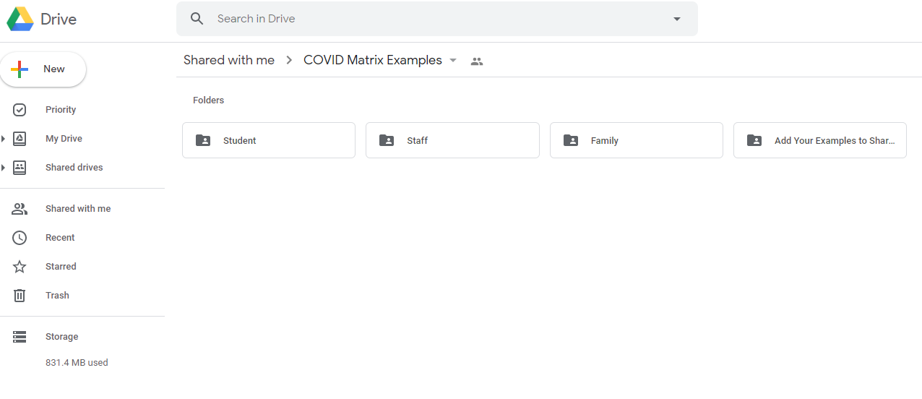
COVID Matrix Examples

Slide 46
Additional SEB Supports
Coming soon: Webinar series to support virtual/hybrid classroom practices
Resource: Tier 2 Virtual CICO guidance document

Slide 47
Based on identified needs of staff ensure a continuum of supports are available and communicated.

Slide 48
What is something that is important to you to know your safety (emotional or physical) is being addressed? Write in the chat box

Slide 49
Create a safe, positive, predictable environment for ALL
Be proactive
Empower teachers
Create clear expectations for staff in person and virtual
Build social and emotional supports for staff
Identify and respond to inequities

Slide 50
Design a System of Support for Staff
Focus on de-stressing staff
SYSTEMS
Clear, concrete health expectations, procedures and routines
Direct instruction
Opportunity to practice, plan and build fluency
Get feedback and input from staff, adjust, improve
5:1 feedback ratio

Slide 51
Staff Days – Preparing for In person
Check in
Expect to be emotional , exhausted
Track your “triggers”
Common experience will increase connection and sense of belonging, allow yourself to be vulnerable, honest and compassionate
Provide opportunity to practice new procedures
Walk the building in small groups, physically distanced
Learn new routines
Prepare to model calm when kids get back

Slide 52
Staff Example | Classroom | Bathroom | Outdoors | Staff Lounge | Staff Self-Care | Supporting Families
Responsible | Use only your personal materials, label them, and keep in your classroom/ workspace Provide a space for sharing and compassionate listening to process COVID experiences. | One person in the bathroom at a time | Remind students to put any used equipment in the “dirty” bin after use | Wipe down surfaces before and after eating Clean up any personal items/ food when leaving | “Tap out” with team teacher when needed Know your own calming strategies and use them when needed Complete health assessment every morning | Communicate with families 1:1 every week Keep a communication log Respond to caregiver requests within 48 hours
Respectful | Exercise patience with students who are still learning these new expectations Remind students of rules by pre-teaching them and using friendly reminders throughout the day | Leave the bathroom clear of personal items, paper towels, and shared items Limit use of time in the bathroom to allow time for others | Limit time on the playground to class time only to allow for the next group to transition in and out smoothly | Gently remind co-workers of rules when needed | Check in with others’ mental health Foster a culture of normalizing talking about mental health needs by talking about your own and respecting the needs of others | Use requested means of communication Recognize caregiver workload
Safe | Wear your mask over your nose and mouth unless eating lunch Remind students to wipe down computers, desks, shared materials before and after use Keep windows open as often as possible | Wash your hands with soap and water for at least 20 seconds | Maintain 6 feet distance from other staff even when outdoors | Sit staggered to maintain distance Wash hands before and after eating | Communicate to team, admin, and/or counselors if you are struggling | Stay informed of family food, shelter, and employment instability
DRAFT: These are examples. DE-PBS Project is not recommending specific actions to prevent spread of COVID-19. Schools should develop/revise based on district/school-based guidelines.

Slide 53
Breakout Room: Staff Supports
What are you doing at the district level to support staff?
What are your buildings doing to support staff?
Identify one practice you want to share with the whole group and select a reporter

Slide 54
District Critical Action #5: Local Implementation Demonstrations
Partner with schools to identify and highlight effective implementation of key practices.

Slide 55
Local Implementation Communication
Communication Check in -
As part of communication plan, do we have current points of contact for MTSS/PBS teams?
As a coach, do you have routine methods to connect & support buildings?

Slide 56
Routine Team Leader Meetings
Benefits:
•Chance to share unified district messaging & professional learning content
•Opportunity for team leader networking
•Creates group sharing of successes; structured and informal
•Promotes group problem solving
Sample Structures:
•Tier 1 team leaders
•Tier 2/3 team leaders
•MTSS team leaders (with or w/out administrators)
•New teams vs. veteran implementing schools
•Elementary vs. secondary team leaders

Slide 57
Thank you!
We appreciate and value your feedback!

