Slide 1
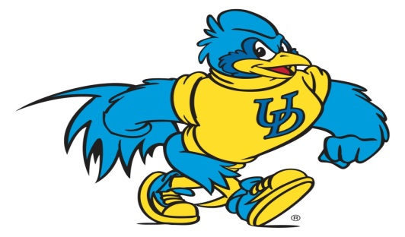
Linking School Climate Assessment to School Improvement
George Bear
Sarah Hearn
Fiona Lachman
Linda Smith
Angela Soltys
February 21, 2020
2:00-2:50
NASP Session PA027
Notes:
George
Session Description
Assessing school climate and linking results to school improvement strategies achieves positive student and school-wide outcomes. Learn about assessment tools, evidence-based strategies, and resources to improve school climate.

Slide 2
Learning Objectives
Learn about the Delaware School Surveys and how they might be used to assess school’s strengths and weaknesses in the areas of school climate and more.
The surveys are of particular value for schools that integrate the SWPBIS and SEL approaches, as recommended in Delaware.
See how to link the results of assessments to evidenced-based strategies through sharing of resources, such as worksheets for interpreting scores and training modules focused on improving school climate.
Learn of theory and research supporting the use of the surveys and training modules for assessing and improving school climate.
Notes:
George

Slide 3
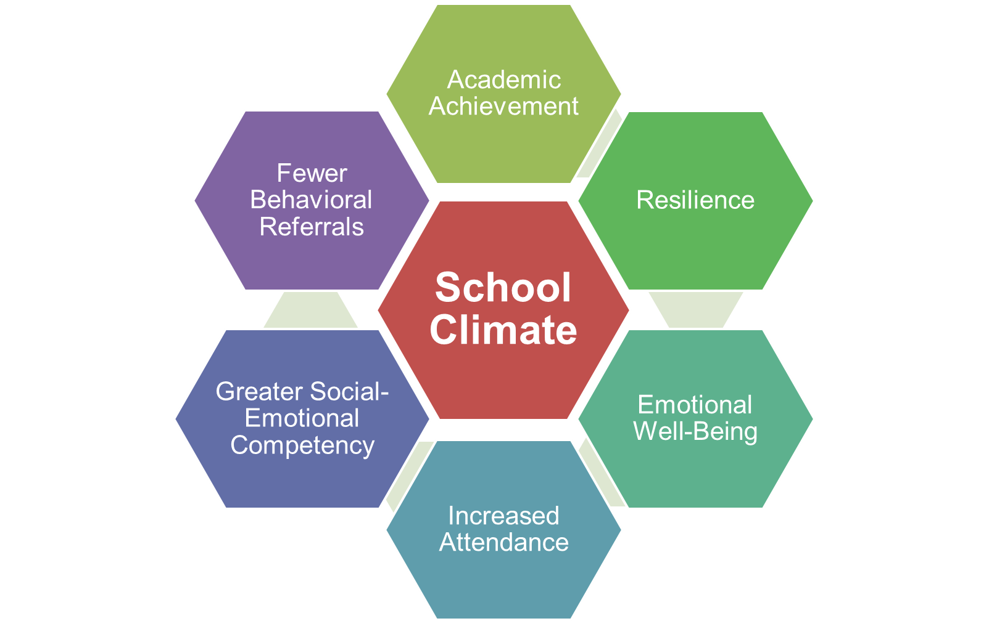
Why is school climate important?
School Climate is linked to a wide range of academic, behavioral, and socio-emotional outcomes for students and teachers:
Notes:
George
Content of original slide:
Academic achievement
Student academic, social, and personal attitudes and motives
Student attendance and school avoidance
Student behavior problems, delinquency, and victimization
Student and teacher emotional well-being
Teachers’ greater implementation fidelity
of new curriculum and interventions

Slide 4
Why is school climate important?
The Every Student Succeeds Act (ESSA) explicitly recognizes the strong relationship between positive school climate and student learning and success.
Law requires states to include data related to school climate and safety in annual school report cards
Notes:
Linda

Slide 5
School Climate in DE School Climate Transformation Grant (2014-2019)
Goals: Enhance state & district capacity to support the implementation of multi-tiered systems of support (MTSS) with fidelity, and to improve school climate along with behavioral and social-emotional outcomes of students in partnering districts.
Products:
Ongoing PD and TA provided to district level coaches
A variety of PD opportunities to meet the needs of districts/schools to implement MTSS
Access to multiple data tools and analysis support, data collection by the project, districts, and schools
Seven training modules for schools to use to improve areas of school climate
Development of an App (CoVitality) for all schools to use to administer, score, and generate school climate data reports
Notes:
Linda

Slide 6
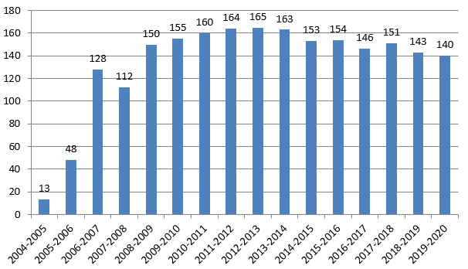
Participation in DE Continues To Be High
Number of Participating Schools
School Years
Notes:
Linda

Slide 7
DE School Surveys
Free to the public
Student, teacher/staff, and home versions (primarily grades 3-12)
Flexibility in choice of scales and subscales
Brevity: Each scale requires little time to complete
School Climate Scale: ~ 10 minutes for most students
4 supplemental scales: ~ 3–5 minutes each
The same or very similar items are found on all three versions and at all grade levels
Scales and subscales align with the goals commonly targeted in most programs for preventing behavior problems: promoting mental health and improving school climate
Completed via computer device (i.e., computer, tablet, or cellphone) or hard copy
An App that scores and reports the data is available from www.mosaic-network.com/Covitality
Detailed data reports and guidelines for interpreting the data
Staff development and training modules
Notes:
Linda

Slide 8
Delaware School Surveys Scales (Note: School Climate is 1 of the 5 Scales)
Student Scales
School Climate
Techniques (School Discipline)
Teacher/Staff Scales
School Climate
Home Scales
School Climate
Techniques (School Discipline)
Bullying Victimization
Student Engagement
Student Social and Emotional Competencies
Student Engagement
Bullying Victimization¹
¹ Grades 6-12 only for the printed version. Optional for grades 4-5 with computer version.
Notes:
Fiona
the Delaware School Surveys include five scales and a total of 23 subscales. The five scales are: Delaware School Climate Scale (DSCS), Delaware Bullying Victimization Scale, Delaware Student Engagement Scale, Delaware Positive, Punitive, and SEL Techniques Scale, and the Delaware Social and Emotional Competencies Scale. Only the student version includes all five scales. The home survey includes three scales and the teacher/staff survey includes two scales.

Slide 9
Delaware School Climate Scale and Subscales
Student | Teacher/Staff | Home
Teacher-Student Relations (5) | Teacher-Student Relations | Teacher-Student Relations
Student-Student Relations (5) | Student-Student Relations | Student-Student Relations
Clarity of Expectations (4) | Clarity of Expectations | Clarity of Expectations
Fairness of Rules (4) | Fairness of Rules | Fairness of Rules
School Safety (3) | School Safety | School Safety
Student Engagement School-wide (6) | Student Engagement School-wide
Bullying School-wide (3) | Bullying School-wide
 | Teacher-Home Communications (4) | Teacher-Home Communications
 | Staff Relations (4) | Satisfaction with School (4)
Total School Climate (30) | Total School Climate (38) | Total School Climate (25)
Notes:
Fiona
The school climate survey is one of the 5 scales of the Delaware school surveys. There are 25 items in common across the student, teacher/staff, and home versions. The subscale items across populations have the same items, which supports comparisons across populations. The number of items in the subscales are in parenthesis. The student and teacher/staff versions include two additional subscales not found on the home version: Student Engagement Schoolwide and Bullying Schoolwide. These two subscales were not included on the home version because it is thought that students and teachers/staff are better judges than parents of schoolwide student engagement and bullying victimization. Although parents are not asked to complete the Schoolwide Student Engagement and Bullying Victimization subscales of the DSCS, they are administered two other scales in which they are asked to rate the engagement and bullying victimization for their individual child. The teacher/staff version also includes two subscales not found on the student version: Teacher-Staff Relations and Teacher-Home Communications. The home version also includes the Teacher-Home Communications subscale. It also includes the Parent Satisfaction subscale.

Slide 10
Item Examples
Teacher-Student Relations
“Teachers care about their students.”
Student Engagement School-wide
“Most students try their best.”
Fairness of Rules
“The school rules are fair.”
Bullying School-wide
“Students threaten and bully others.”
(Note: A high score for this subscale is unfavorable)
Staff Relations
“Teachers, staff, and administrators work well together.”
Notes:
Fiona
Students respond to each item using a Likert scale of 1 = Disagree a Lot, 2 = Disagree, 3 = Agree, and 4 = Agree a Lot. A score for each subscale is derived by averaging responses across the subscale’s five items, with possible scores ranging from 1 to 4. Higher scores reflect more favorable perceptions, with the exception of scores on the Bullying Schoolwide subscale where lower scores are more favorable (i.e., there is less bullying). A total school climate score is derived by averaging all item scores (with scores for Bullying Schoolwide reverse scored). The same response and scoring formats are used for the teacher/staff and home versions.

Slide 11
Delaware Positive, Punitive, and SEL Techniques
Scale and Subscales
Student Survey | Teacher/Staff Survey | Home Survey
Positive Behavior Techniques (5) | Positive Behavior Techniques
Punitive Techniques (5) | Punitive Techniques
Social Emotional Learning Techniques (6) | Social Emotional Learning Techniques
Notes:
Fiona
Students and teachers receive the positive, punitive, and SEL techniques scale. This scale assesses perceptions among students and teachers/staff of the extent to which positive, punitive, and social-emotional techniques are used in their school to manage student behavior and develop self-discipline. The scale consists of three subscales: Positive Behavioral Techniques, Punitive Disciplinary Techniques, and Social Emotional Learning Techniques. The Positive Behavioral Techniques subscale consists of five items that assess the extent to which students, teachers, and staff recognize students’ behavior with praise and rewards. The Punitive Disciplinary Techniques subscale consists of five items that assess perceived use of harsh punitive consequences of behavior, as often associated with the zero tolerance approach to school discipline and with a negative school climate. The Social-Emotional Learning Techniques subscale is comprised of six items that assess perceived use of SEL techniques commonly associated with the Social and Emotional Learning approach and particularly for developing responsible decision making, self-management, social awareness, and relationship skills.

Slide 12
Item Examples
Use of Positive Techniques
“Students are praised often.”
Use of Punitive Techniques
“Students are punished a lot.”
(Note: A high score for this subscale is unfavorable)
Use of Social Emotional Learning (SEL) Techniques
“Students are taught to feel responsible for how they act.”
Notes:
Fiona
Students respond to each item using the same 4-point Likert scale used on the school climate scale, and subscale scores are derived in the same manner as on that scale. Whereas higher scores on Positive Behavioral Techniques and SEL techniques are favorable, high scores on the Punitive/Corrective Techniques subscale are unfavorable.

Slide 13
Bullying Victimization Scale and Subscales
Student |  | Teacher/Staff | Home
Bullying Victimization¹ | Verbal Bullying (4) |  | Verbal Bullying
 | Physical Bullying(4) |  | Physical Bullying
 | Social/Relational Bullying (4) |  | Social/Relational Bullying
 | Cyberbullying (4)² |  | Cyberbullying²
¹ Grades 6-12 only for the printed version. Optional for grades 4-5 with computer version. ² Grades 6-12 only.
Notes:
Fiona
The bullying victimization scale is included in the student and home surveys. is comprised of four subscales: Verbal Bullying, Physical Bullying, Social/Relational Bullying, and Cyberbullying. In Delaware, the cyberbullying items are administered to all students in grades 6-12, and are optional for grades 4-5 when completed via computer. Two separate total scores are calculated for the student version: one includes the cyberbullying subscale and the other excludes it. Computing a total score without cyberbullying allows schools to compare total scores across grade levels while using the same three subscales administered in all grades. If you recall, under the school climate survey, there is a subscale for bullying school-wide that students and teachers/staff receive. We can use this to look in comparison to individual-based response items.

Slide 14
Item Examples
Verbal Bullying
“A student said mean things to me.”
Physical Bullying
“I was pushed or shoved on purpose.”
Social/Relational Bullying
“A student told or got others to not like me.”
Cyberbullying (grades 6-12)
“A student sent me a mean or hurtful message about me using email, text messaging, instant messaging, or similar electronic messaging.”
Notes:
Fiona
Students respond on a 6-point Likert scale by indicating the degree to which they have been victims of the given bullying behavior in school since the beginning of the school year. On the home version, parents complete the same items while referring to their child’s bullying victimization. Scores for the item choices are: 1 = Never, 2 = Sometimes, 3 = Once or Twice a Month, 4 = Once a Week, 5 = Several Times a Week, and 6 = Every Day.

Slide 15
Student Engagement Scale and Subscales
Student |  | Teacher/Staff | Home
Student Engagement | Behavioral (4) |  | Behavioral
 | Cognitive (4) |  | Cognitive
 | Emotional (4) |  | Emotional
Notes:
Fiona
The Delaware Student Engagement Scale is included on the student and home versions of the surveys. It assesses three types of student engagement: cognitive, behavioral, and emotional. As with the bullying victimization scale, items target the individual student, either the student completing the scale or the child of the parent completing it.

Slide 16
Item Examples
Behavioral Engagement
“I follow the rules at school.”
Cognitive Engagement
“I try my best in school.”
Emotional Engagement
“I feel happy in school.”
Notes:
Fiona
Participants respond on the same 4-point Likert scale used with the school climate and classroom management techniques scales, and subscale and total scale scores are computed in the same manner as on those two scales.

Slide 17
Social and Emotional Competencies Scale
Student Survey | Teacher/Staff Survey | Home Survey
Responsible Decision-making/Responsibility (4)
Understanding how others Think and Feel/Social Awareness (4)
Self-management of Emotions and Behavior (4)
Relationship Skills (4)
Self-Awareness* (now field testing)
Notes:
Fiona
The social and emotional competencies is the newest scale. It is aligned with 4 of CASEL’s 5 social and emotional competencies, responsible decision-making, relationship skills, self-management, and social awareness. We are currently field testing self-awareness subscale items with this year’s survey. Once the pilot is finished, the scale will then capture all 5 of CASEL’s social and emotional competencies.

Slide 18
Item Examples
Responsible Decision-Making
“I am good at deciding right from wrong.”
Social Awareness
“I care about how others feel.”
Self-Management
“I think before I act.”
Relationship Skills
“I am good at solving conflicts with others.”
Self-Awareness*
“ I try to understand how I feel.”
Notes:
Fiona
Students respond to each of the 16 items item using a 4-point Likert scale, with 4 = Very much like me, 3 = Somewhat like me, 2 = Not much like me, and 1 = Not like me at all. Subscale scores are calculated by averaging scores across items for the respective subscale. A total scale score consists of the average scores across all 16 items.

Slide 19
Evidence of Reliability, Validity, and Research Support
Scales and subscales have good reliability
Alpha coefficients above .70
CAUTION: Some scores are not very reliable with 3rd graders
Validity of the surveys are supported by extensive studies on their psychometric properties
Including confirmatory factor analysis
Notes:
Angela
Reliability – scores consistent and stable
Have found that scores are not as reliable with 3rd graders – we caution using the survey with 3rd graders and interpretation of results. Schools are instructed to read questions aloud to 3rd graders or not survey them.

Slide 20
See Technical Manual on
Delaware PBS Website
Bear, G., Yang, C., Harris, A., Mantz, L., Hearn, S., & Boyer, D. (2019). Technical Manual for the Delaware School Survey: Scales of School Climate; Bullying Victimization; Student Engagement; Positive, Punitive, and Social Emotional Learning Techniques; and Social and Emotional Competencies. Newark, DE: Center for Disabilities Studies.
http://wh1.oet.udel.edu/pbs/technical-manual-for-school-climate surveys/
Notes:
Angela
Evidence of validity and extensive statistical analyses on the psychometric properties of the surveys can be found in the technical manual

Slide 21
Correlates of School Climate in Delaware Schools
 | Elementary School (n = 71) | Middle School (n = 26) | High School (n = 15)
Academics
English Language Arts | .69* | .75* | .22
Math | .64* | .74* | .39
Student Engagement | .77* | .90* | .83*
Behavior
Suspensions | -.60* | -.70* | -.75*
Bullying Victimization | -.47* | -.66* | -.15
Social and Emotional Competencies | .74* | .82* | .58*
Classroom Management Techniques
Punitive | -.87* | -.93* | -.54*
Positive | .46* | .43* | .22
SEL | .83* | .86* | .77*
* = Significant correlation
Notes:
angela

Slide 22
Side Note: Other Research Tidbits
Recent findings by UD/CDS researchers…
International Research:
Chinese students perceive school climate more favorably than American students and are more emotionally engaged, particularly beyond elementary school. However, among Chinese students (but not American students), perceptions of school climate are unrelated to their engagement in school (Bear, Yang, Chen, He, Xie, & Huang, 2018).
In Brazil, retained students in private schools report greater verbal and social/relational bullying, and bullying in general, than in public schools. There are no differences in bullying victimization between promoted, once-retained, and multiple-retained students in public schools (Harris, Bear, Chen, Lisboa, & Holst, 2018).
Notes:
Angela
Surveys have been used internationally; some highlights from studies that use the surveys in China and Brazil

Slide 23
Side Note: Other Research Tidbits
Delaware Schools:
Teaching SEL (more so in elementary school), Teacher-Student Relationships (more so in MS and HS), and Student-Student Relationships are strong predictors of student engagement (Yang, Bear, & May, 2018).
Effects of teaching social and emotional competencies are nearly twice that of the use of praise and rewards (Bear, Yang, Mantz, & Harris, 2017).
Frequent use of praise and rewards does not appear to harm intrinsic motivation (but is associated with greater extrinsic motivation) (Bear, Slaughter, Mantz, Farley-Ripple, 2017).
Notes:
Angela
Highlights from studies in Delaware Schools

Slide 24
Improvements in DE Continue! DE School Climate Longitudinal Study 2012-2019
Examined changes in students’ perceptions of school climate using the DE School Climate Scale -Student version
Guiding question:
Did students’ perceptions of school climate improve from 2012 to 2019 in elementary, middle, and high schools?
If so, were improvements found across all seven aspects of school climate measured by the Delaware School Climate Scale-Student?
Notes:
Angela
Highlights from a longitudinal study of school climate in DE
Focus just on the student version of the school climate scale

Slide 25
Major Findings
Total school climate score:
Students’ perceptions quite favorable; especially in elementary schools
Improved significantly from 2012 to 2019
All seven subscales:
Scores improved significantly (elementary, middle, and high schools)
Exception: Bullying School-wide subscale scores in middle schools.
Most impressive:
Improvements in School Safety and Bullying (elementary & high schools)
Notes:
Angela

Slide 26
Major Findings Cont.
Notes:
Angela

Slide 27
Major Findings Cont.
Notes:
Angela

Slide 28
Major Findings Cont.
Notes:
Angela

Slide 29
Major Findings Cont.
Notes:
Angela

Slide 30
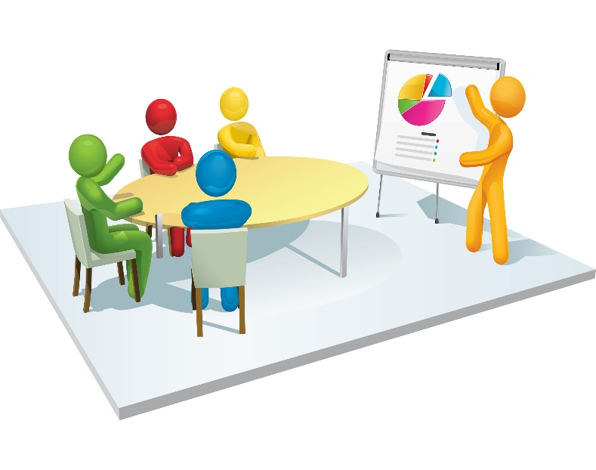
Data Reports and Supports Provided to Schools
Notes:
Sarah

Slide 31
Notes:
Sarah
Report orients to scales, types of scores and text/color coding
User’s go-to reference for:
the scales available for this population
The labeling codes used
What color coding means
Explanation of score types
Significant difference guidance

Slide 32
Sample Student Report: Average Item
Notes:
Sarah
Note color coding support

Slide 33
Sample Student Report: Percent Response per Item
Notes:
Sarah

Slide 34
Sample Student Report: Standard Score
Notes:
Sarah

Slide 35
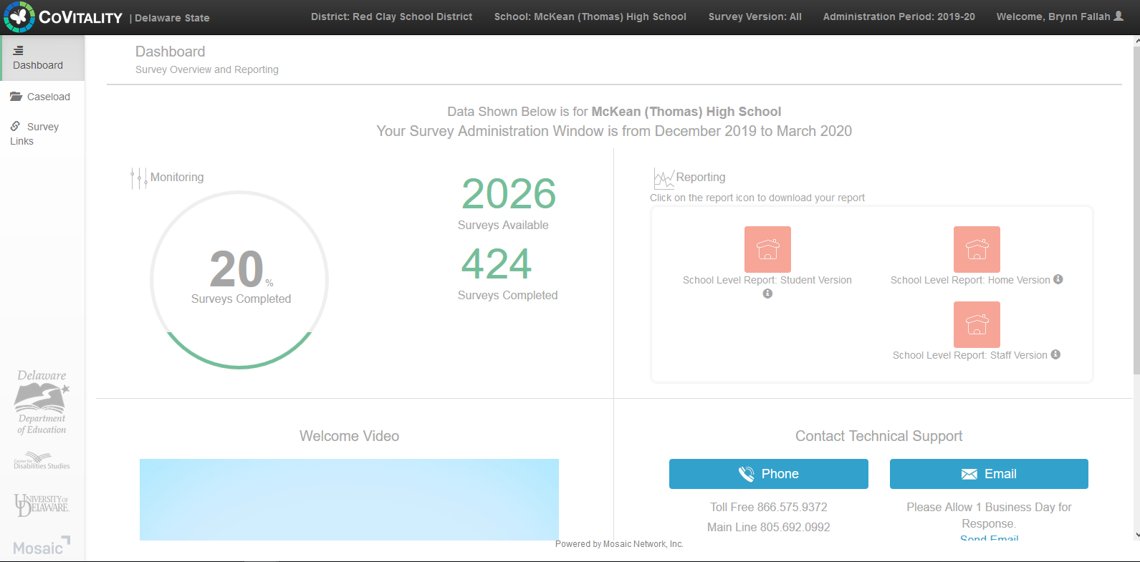
CoVitality App for DE School Surveys
Notes:
Sarah

Slide 36
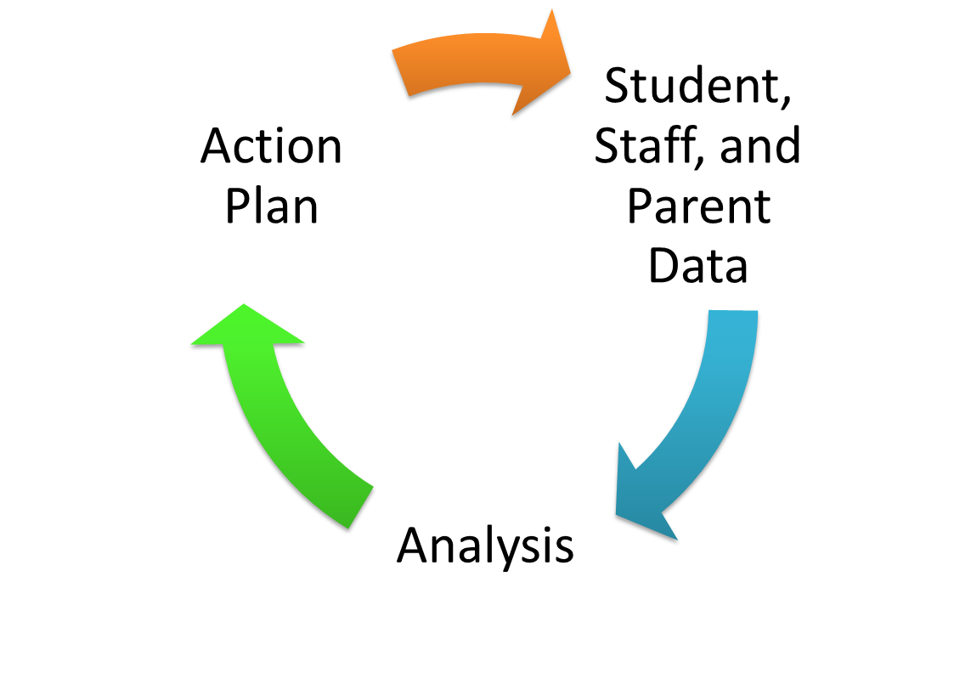
Interpretation Worksheets &
Action Plan Overview
Notes:
Sarah

Slide 37
Interpretation Worksheet Structure
Worksheet per survey population
Student, Staff, Home
Guides you through each survey scale
School Climate, Techniques, Bullying, Engagement, Social Emotional Competencies
Prompts review of graphs & 3 types of scores
Consider strengths, concerns, general notes such as significant differences
Information gathered then used to complete action planning template
Notes:
Sarah
Identify overall strengths & concerns by examining subscale scores
By Race
By Gender
By Grade
Identify specific items influencing high or low subscale scores
By Race
By Gender
By Grade

Slide 38
Action Plan Template Structure
Plan template per survey population
(Student, Staff, Home)
Prompts for data to share (strengths & concerns) with stakeholders
Captures identified areas of concerns & reminds schools to make a plan improve school climate while prioritizing areas of need and keeping plan manageable
Areas of concern
Additional data to review
Strategy Ideas
Who?
When?
School Climate Module Series Resource
Notes:
Sarah
Identify overall strengths & concerns by examining subscale scores
By Race
By Gender
By Grade
Identify specific items influencing high or low subscale scores
By Race
By Gender
By Grade
Scores are linked to school improvement (team) efforts, including training modules for:
Teacher-Student Relationships
Student-Student Relationships
Student Engagement
Bullying
School Safety

Slide 39
Resource: School Climate PD Online Module Series
Supported by the School Climate and Student Success Grant (SCSS)
Goal of the PD is to provide information to schools that can lead to improvements in school climate and behavioral outcomes
Each module is approximately an hour-long PowerPoint session with captioned audio
Potential uses:
In-house professional development
Materials can be accessed for use as:
A whole staff
In professional learning communities
Leadership teams
Individuals
Notes:
George

Slide 40
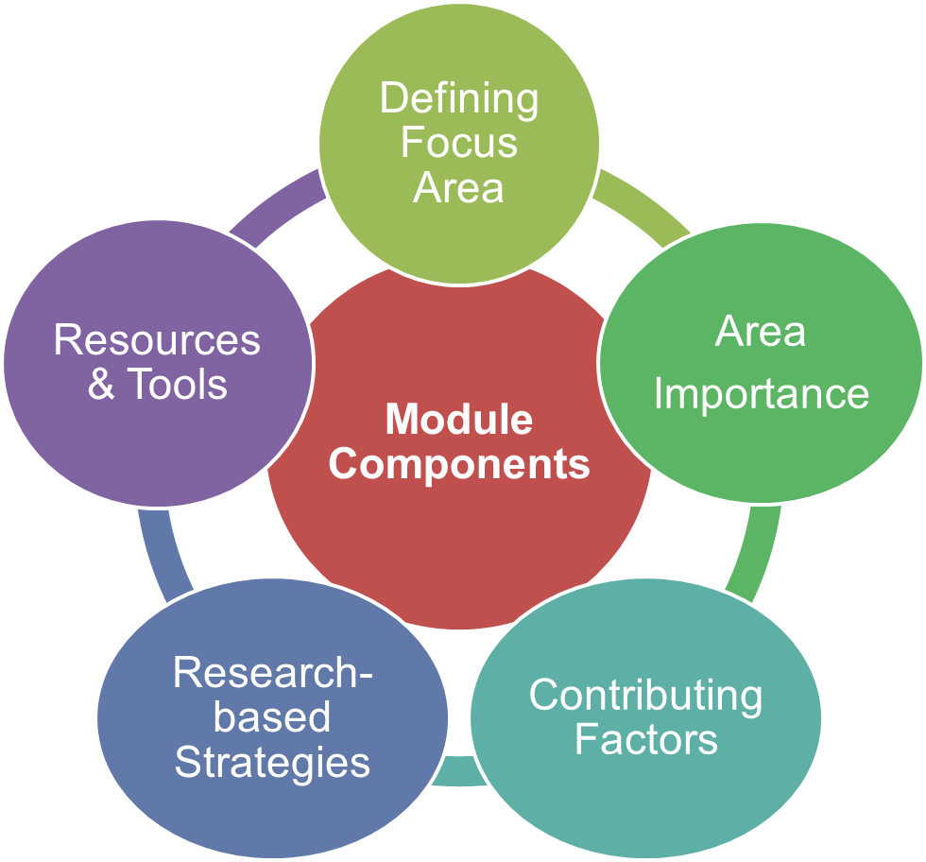
School Climate PD Series, cont.
Each module provides educators with:
An overview of the topic, its importance, and factors that contribute to both negative and positive aspects of the topic
Recommended research-based strategies to improve the topic
Resources and tools (available to download) to support the positive development of the topic
Research-based module in-depth narratives (that serve as the basis for the PowerPoint presentations) that focus on each topic in great detail
Notes:
George

Slide 41
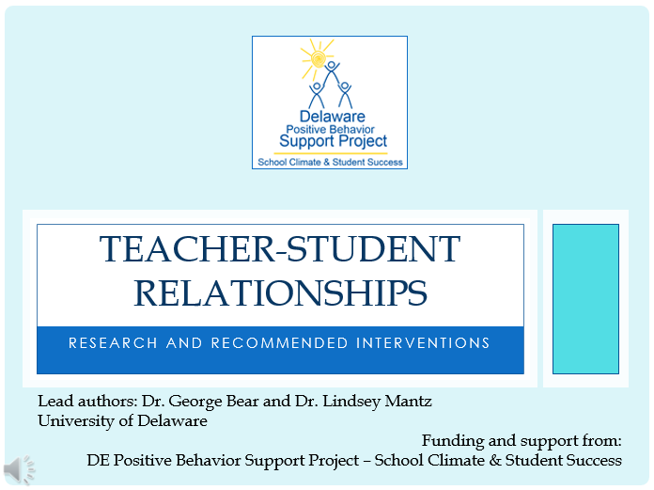
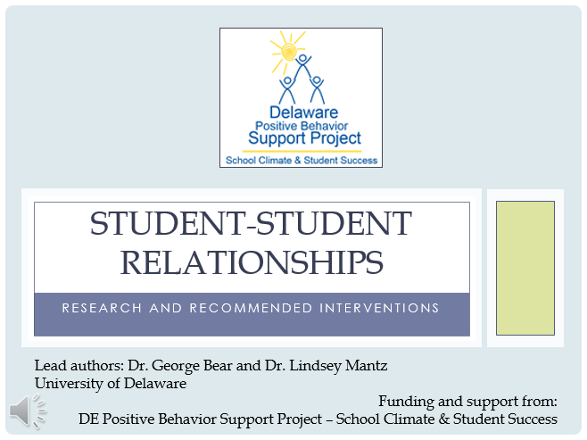
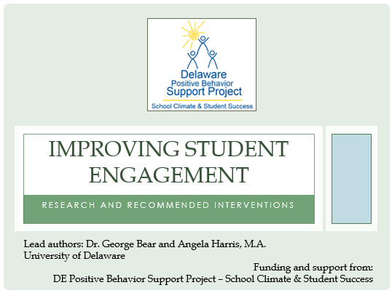
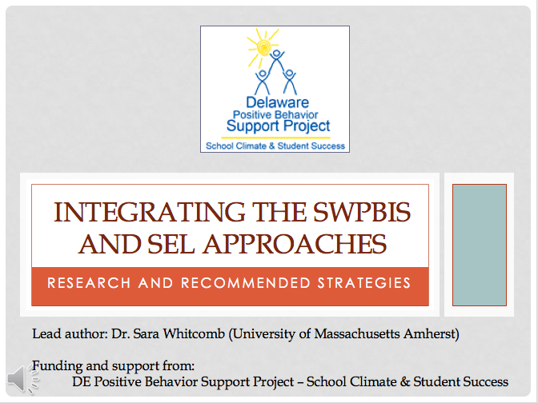
Available Modules
Notes:
‘
George

Slide 42
For Delaware School Surveys, worksheets, guides, and manual: http://wh1.oet.udel.edu/pbs/school-climate/de-school-climate-survey/
Notes:
George

Slide 43
Delaware Professional Training Modules (targeting areas of school climate): http://wh1.oet.udel.edu/pbs/school-climate-modules/
Notes:
George

Slide 44
If Interested is use of CoVitality App for use of DE School Climate survey, Please Contact:
Austin Ramsdell
Email: aramsdell@mosaic-network.com
Phone: 805-692-0992
Notes:
George

Slide 45
Questions?
Implications?
Discussion
delawarepbs.org
Name | Email
George Bear | gbear@udel.edu
Sarah Hearn | skhearn@udel.edu
Linda Smith | Linda.Smith@doe.k12.de.us
Notes:
George

