Slide 1
Agenda
Day 1
Day 2
Morning 9 – 12:15
Topics: Overview of MTSS, Teaming, Data-based Decision Making
Presentations, team time, break
Lunch – 12:15 – 1:15
Afternoon 1:15 – 3:30
Topic: Responding to Problem Behavior, Action Planning
Presentation, team time
Morning 9 – 12:15
Topics: Establishing & defining expectations and Teaching plan
Presentations, team time, break
Lunch – 12:15 – 1:15
Afternoon 1:15 – 3:30
Topic: Creating + reinforcement systems that foster + relationships, Action Planning
Presentation, team time

Slide 2
Let’s Talk about… Behavior
Inappropriate behavior
Misbehavior
Unwanted behaviors
Behavior infractions
Problem behaviors
Undesirable behavior
Behavioral missteps
Behaviors of concern

Slide 3
Thinking about the importance of language…
Commonly used words | Replacement word ideas
Attention seeking | Connection seeking
Inappropriate behavior
“Tier 3 kid”
Frequent flyer
Acting crazy
“Those kids”

Slide 4
Purpose and Outcomes
Develop/update your school-wide expectations
Consider how expectations reflect values of community and plan for gathering input
How does matrix connect with your why
Prioritize matrix development/updates for return to school

Slide 5
Why? … Consistency Matters and Language Matters
Common
Vision/Expectations
SCHOOL COMMUNITY
Common
Language
Common
Practices
(USDOE OSEP PBIS TA Center, 2010)

Slide 6
What Is Gained by Identifying Expectations & Rules?
Establishes common, unifying language for staff, students and families
Supports social behavioral curriculum design; supports alignment of varying initiatives
Promotes uniform instruction across multiple settings within the school (and outside)
Provides reassurance and predictability
Adapted from: www.pbis.org

Slide 7
Positive outcomes associated with clear expectations, fair rules, and positive consequences:
Greater prosocial behavior
Students feeling safer at school
Greater student engagement and academic achievement
Impact of perceptions of fairness on academic achievement is strongest among African American students. Grades tend to be worse in schools in which they perceive the rules as either too lenient or overly strict
More positive teacher-student relationships
Fewer behavior problems and disruptive behaviors
Fewer office disciplinary referrals, school suspensions, and expulsions
Less bullying and school violence
Less student delinquency and victimization
Fewer students bringing weapons to school
(Bear & Soltys, 2020)

Slide 8
Prevention First: Define, post, explicitly teach behaviors, provide on-going feedback

Slide 9
T H E DO NOTs
(A Non-Example)

Slide 10
School-wide Expectations Guidelines
Expectations are the umbrella for more specific rules:
Identify 3 – 5 positively stated expectations
Use data to determine expectations
Choose positive actions and terms
Keep them simple, broadly stated and easy to remember
Remember to be age appropriate
Overall goal to reflect values, promote positive social academic, behavioral, and mental health outcomes while being culturally responsive

Slide 11
Expectation Examples
If you already have, please type your school’s expectations in chat box
Examples:
Respectful
Cooperative
Safe
Kind

Slide 12
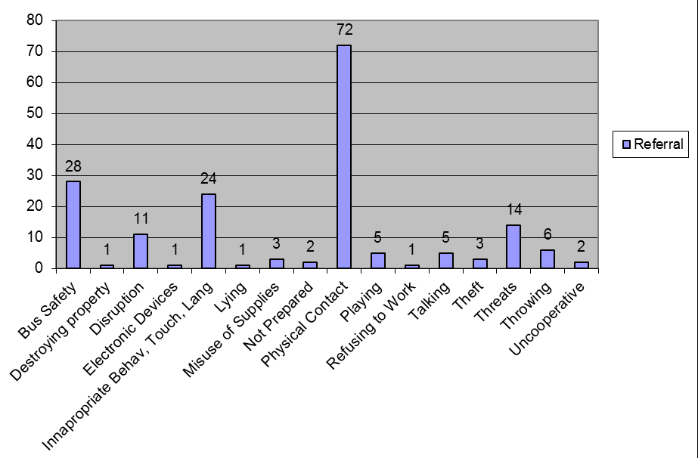
Use Data to Update or Develop Expectations

Slide 13
Enhancing Equity in School Discipline:
Expectations and Matrix (R)Examination Activity
How were your expectations developed and who provided input?
Do they reflect the values of the school community?
Do they represent “universal” core life skills beyond school?
Center on PBIS (PBIS.org)- Culturally Responsive Field Guide

Slide 14
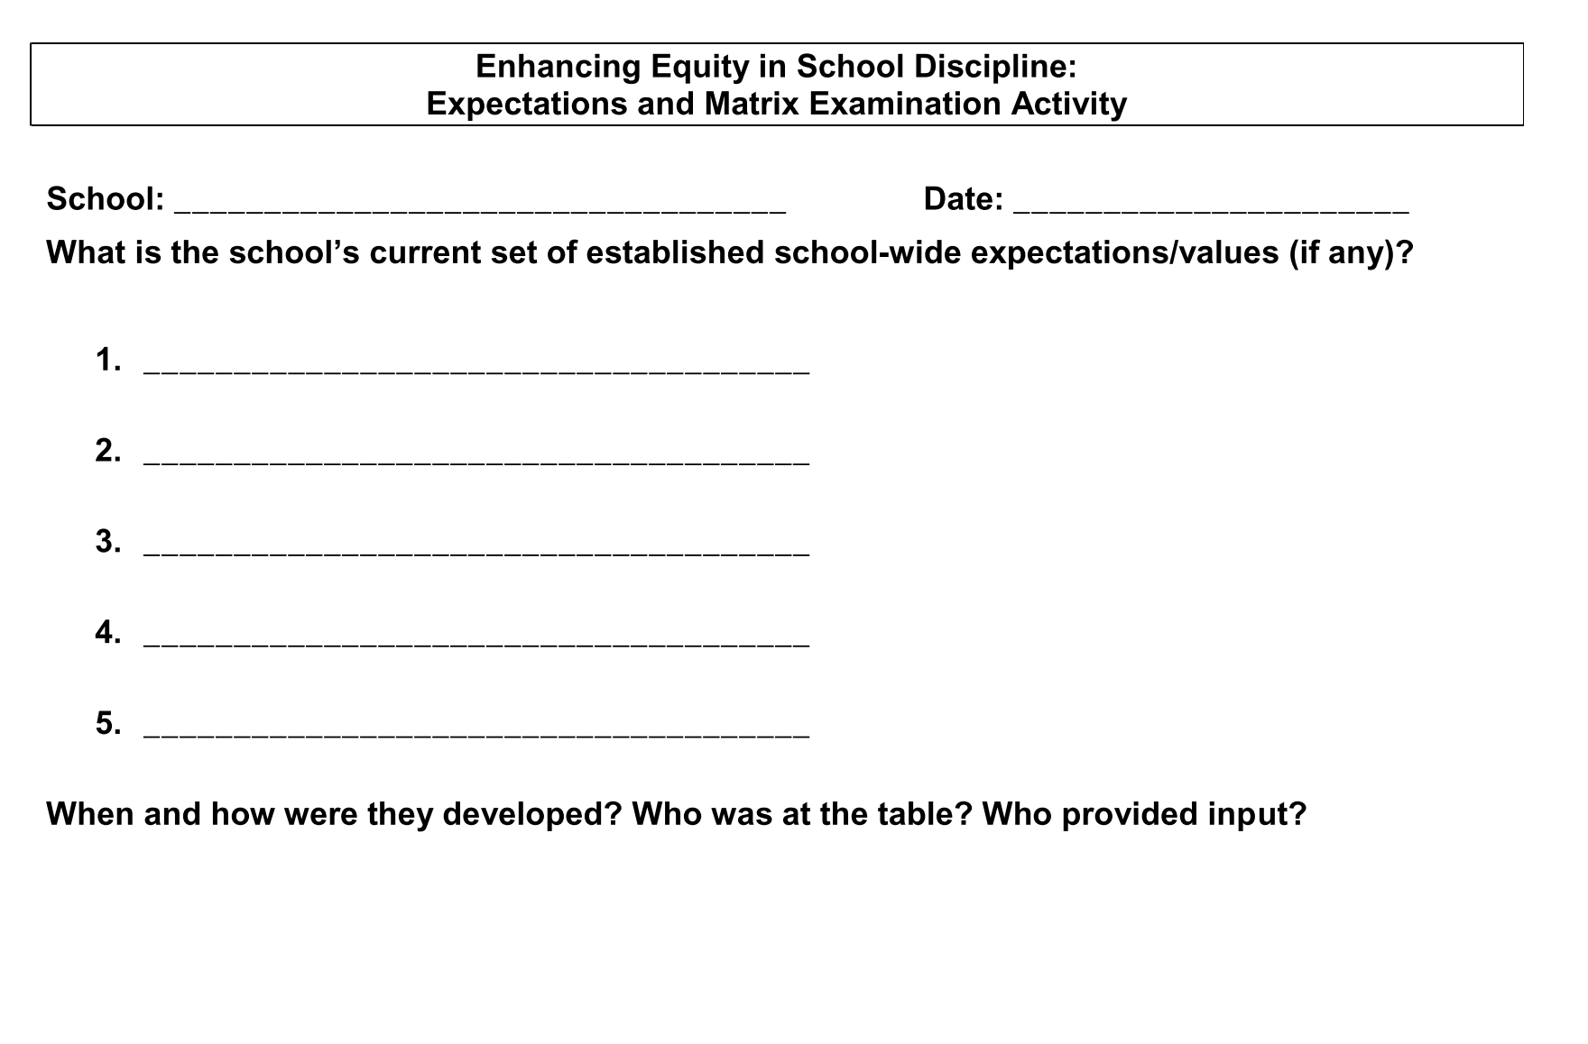

Slide 15
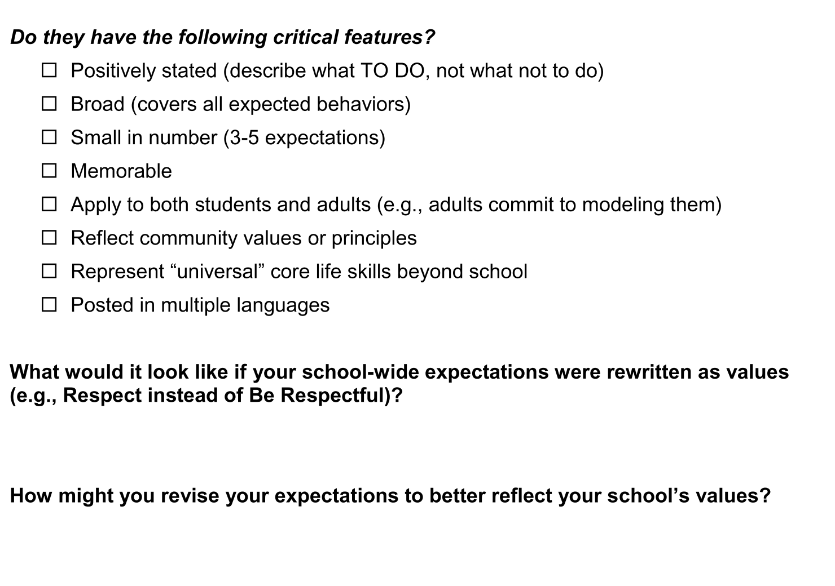

Slide 16
Build Your 3-5 School-wide Expectations
Can you also come up with a name for your school-wide expectations?
The Wilson Way
Tiger ROAR
SOAR Expectations
Panther Pride
Think about your data
Think school mission & vision statements
Think School Improvement Plan
Think about what you already have in your school
Think about core life skills
Get input from stakeholders
Reflect community values
Post in other languages

Slide 17
Why Develop a School-wide Teaching Matrix?
Defines the expected behaviors for specific settings:
hallways, classrooms, gym, cafeteria, bus loading, bathrooms, assemblies
State definitions positively
Use a few common words
Show what the behavior “looks like”
Creates the Tier 1 “Curriculum” that will guide the teaching of expected behaviors across settings & programs.
Enhances communication among staff, students and parents/community.

Slide 18
Customize to reflect student & staff needs
Staff & student input & feedback are critical
Specific examples (look-fors) are positively stated
Describe what TO DO, not what not to do
Active behaviors (not “Refrain from…”)
Student-friendly language
Examples are small in number (2 – 5 examples per box)
Memorable

Slide 19
Voices at the “Table”
Administrator
Teachers
School Nurse
School Counselor
School Psychologist
School-Based Wellness Center (when applicable)
Equity Leads
Student
Family
Community

Slide 20
Teaching Matrix Guidelines
Remember our behaviors/rules are specific tasks students are to do to demonstrate the schoolwide expectations
When defining specific behaviors/rules they should be:
Observable – behaviors that we can see,
Measurable – we could actually count the occurrence of the behavior,
Positively Stated – things to do to be successful,
Understandable – student-friendly language, and
Always Applicable.
http://pbismissouri.org

Slide 21
Example of Rules Following Guidelines
Guidelines | This Means | Example | Non-Example
Observable | I can see it. | Raise hand and wait to be called on. | Be your best.
Measurable | I can count it. | Bring materials. | Be ready to learn.
Positively Stated | I tell students what TO do. | Hands and feet to self. | No fighting.
Understandable | The vocabulary is age and grade appropriate. | Hands and feet to self. | Maintain personal space (K-1 rule)
Always Applicable | I am to consistently enforce. | Stay in assigned area. | Remain seated until given permission to leave.
http://www.midatlanticpbis.org

Slide 22
Behavior Matrix: Template
 |  | SETTING/ROUTINE
RULE/ EXPECTATION | Be Safe
 | Be Responsible
 | Be Respectful
http://pbismissouri.org

Slide 23
Teaching Matrix
Expectations | SETTINGS
?
?
?
Enter your expectations
3-5 positively stated behaviors
broadly stated

Slide 24
Teaching Matrix
 | Bus | Recess | Cafeteria | Classroom
Respectful
Responsible
Safe
Add locations/settings

Slide 25
Teaching Matrix |  | SETTING
 |  | Hallways | Cafeteria | Library/ Computer Lab | Bus | Classroom
 | Respectful | Keep hands feet and other objects to self | Eat only your food | Study, read, compute | Watch for your stop
 | Responsible | Use quiet voice | Replace trays & utensils | Push in chairs. Treat books carefully. | Wipe your feet Sit appropriately
 | Safe | Maintain your own physical space Stay to the right | Clean up your eating area | Whisper. Return books | Use a quiet voice Stay in your seat
Rules (specific behaviors) operationally define your expectations
Expectations

Slide 26
Virtual Behavior Matrix: Classroom Template
We are… | Entering Class | Teacher-led Whole Group Instruction | One-on-One Instruction | Small-Group Activities (Breakout Rooms)
Safe
Respectful
Responsible
https://www.pbis.org/resource/creating-a-pbis-behavior-teaching-matrix-for-remote-instruction

Slide 27
Including social emotional skills on your matrix
What modifications can be made to your matrix to increase the effectiveness of school-wide PBIS supports for students in your building who exhibit internalizing behaviors?
Not talking with other children
Being shy
Timid and/or unassertive
Avoiding or withdrawing from social situations
Not standing up for one’s self
Source: Walker and Severson, 1992

Slide 28
Specific Behaviors + Social-Emotional Skills
Expectation | Specific Behavior or Social Emotional Skill
Safe | Keep hands and feet to self
 | I tell an adult when I am worried about a friend.
Respectful | Use the signal to ask a public or private question.
 | Make sure everyone gets a turn.
Responsible | Turn in all work on time
 | Check in with my feelings during the day
http://www.midatlanticpbis.org

Slide 29
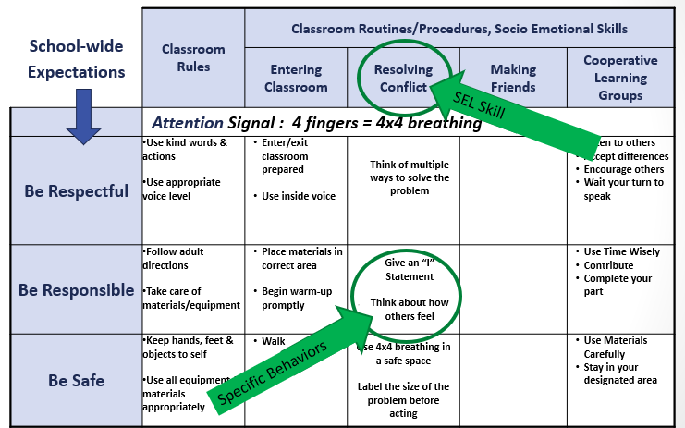

Slide 30
Secondary Example | Classroom | Bathroom | Lunchtime | Hallway | Sports | SEL/ Student Self-Care
Responsible | Use only your personal materials and label them Keep your personal materials in your backpack | Use one pump of soap to wash your hands and one paper towel to dry your hands | Maintain distance from others while eating Wash your hands when you are done eating | Follow one-way direction arrows | Keep personal items to yourself | Tell an adult if you observe someone struggling Stand up for others if you observe COVID stigmatization or inequities Avoid risky situations that could expose you to the virus
Respectful | Wipe down your desk and chair before/after use Wipe down any shared materials before/after use | Keep the bathroom tidy and clear of personal items | Stay at your own desk Throw your garbage away in the trash | Elbow bump friends to greet them | Put any equipment in the “dirty” bin to allow for sanitization | Give “air high fives” to encourage others Check in on friends Practice reflective listening when others are sharing their COVID experiences
Safe | Wear your mask over your nose and mouth | Wash your hands with soap and water for at least 20 seconds | Wash your hands before eating Eat only your own food Keep your mask close to your when you aren’t wearing it | Move to your next class quickly to reduce contact outside of the classroom | Limit activity to contact- minimum sports | Tell someone if you are struggling Share what you are going through and have gone through
DRAFT: These are examples. DE-PBS Project is not recommending specific actions to prevent spread of COVID-19. Schools should develop/revise based on district/school-based guidelines.

Slide 31
Create a safe, positive, predictable environment for ALL
Empower teachers
Create clear expectations for staff
Build social and emotional supports for staff
Identify and respond to inequities
https://www.nycleadershipacademy.org/wp-content/uploads/2020/04/Leading-for-Equity-and-Access-Amid-COVID-4.23.20-2.pdf

Slide 32
Staff Example | Classroom | Bathroom | Outdoors | Staff Lounge | Staff Self-Care | Supporting Families
Responsible | Use only your personal materials, label them, and keep in your classroom/ workspace Provide a space for sharing and compassionate listening to process COVID experiences. | One person in the bathroom at a time | Remind students to put any used equipment in the “dirty” bin after use | Wipe down surfaces before and after eating Clean up any personal items/ food when leaving | “Tap out” with team teacher when needed Know your own calming strategies and use them when needed Complete health assessment every morning | Communicate with families 1:1 every week Keep a communication log Respond to caregiver requests within 48 hours
Respectful | Exercise patience with students who are still learning these new expectations Remind students of rules by pre-teaching them and using friendly reminders throughout the day | Leave the bathroom clear of personal items, paper towels, and shared items Limit use of time in the bathroom to allow time for others | Limit time on the playground to class time only to allow for the next group to transition in and out smoothly | Gently remind co-workers of rules when needed | Check in with others’ mental health Foster a culture of normalizing talking about mental health needs by talking about your own and respecting the needs of others | Use requested means of communication Recognize caregiver workload
Safe | Wear your mask over your nose and mouth unless eating lunch Remind students to wipe down computers, desks, shared materials before and after use Keep windows open as often as possible | Wash your hands with soap and water for at least 20 seconds | Maintain 6 feet distance from other staff even when outdoors | Sit staggered to maintain distance Wash hands before and after eating | Communicate to team, admin, and/or counselors if you are struggling | Stay informed of family food, shelter, and employment instability
DRAFT: These are examples. DE-PBS Project is not recommending specific actions to prevent spread of COVID-19. Schools should develop/revise based on district/school-based guidelines.

Slide 33
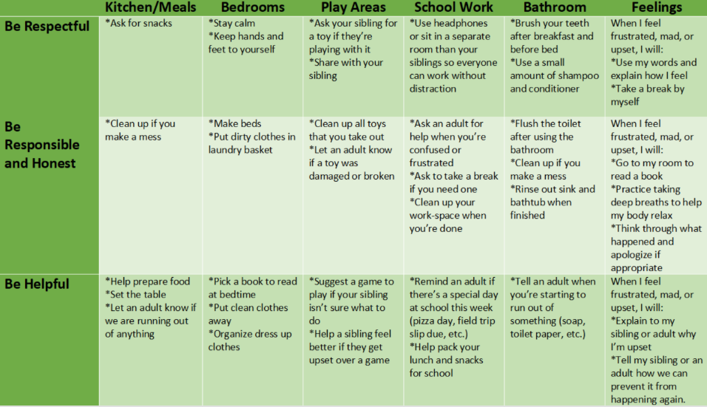
At-Home Behavior Support
Supporting Positive Behavior at Home
Supporting Learning at Home
Developing an At-Home Behavior Matrix

Slide 34
Considerations for Matrix Development/Review
Your Moral Imperative, Your Why (e.g. pro-social skills)
Relationship Building Behaviors
Predictable/anticipated problems
Data Informed
Stakeholder Feedback

Slide 35
Enhancing Equity in School Discipline:
Expectations and Matrix (R)Examination Continued
Examine critical features of your matrix
Consider possible actions
Periodic review of matrix with students, families and staff
Center on PBIS (PBIS.org)- Culturally Responsive Field Guide

Slide 36
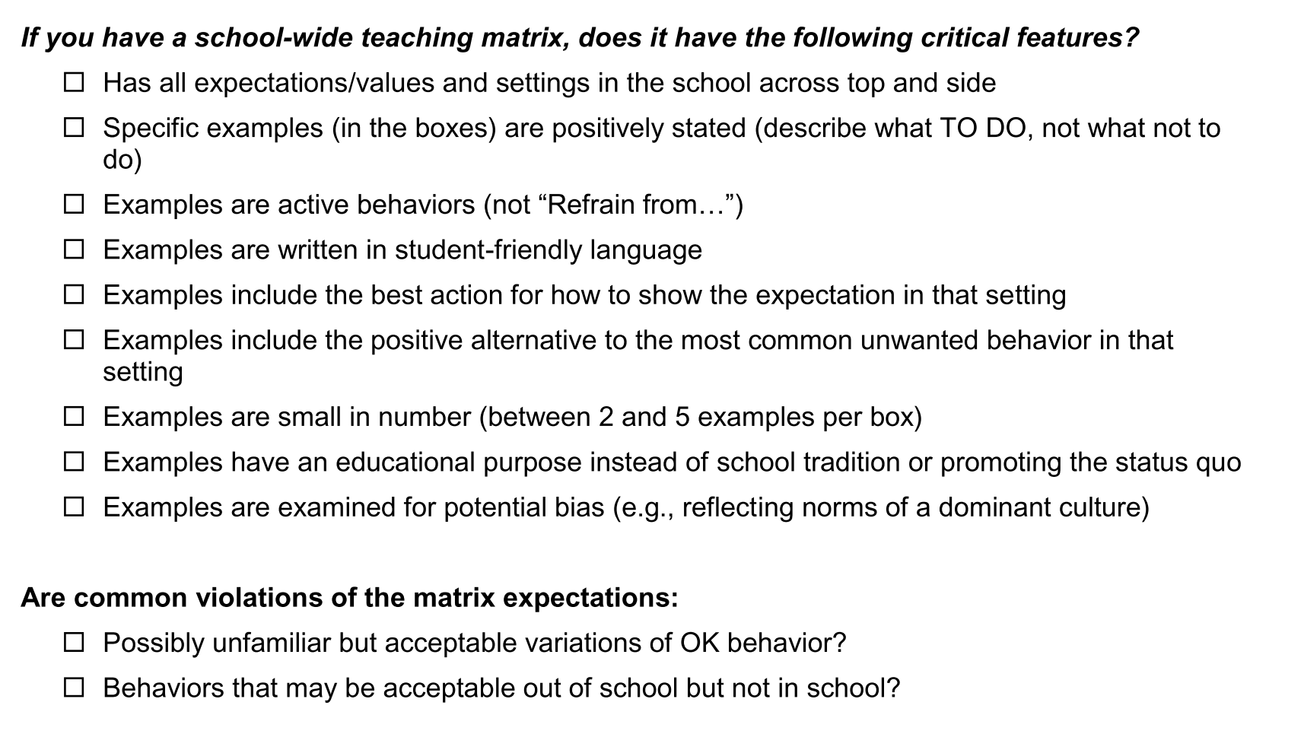

Slide 37
Team Planning Time
Revise, practice, draft a school-wide matrix
(start with “school-wide” as a setting)
Your Moral Imperative, Your Why (e.g. pro-social skills)
Relationship Building Behaviors
Data Informed, Predictable/anticipated problems
Consider social emotional skills
Plan for getting staff, student, and family input

Slide 38
Classroom Expectations Extend School-wide Expectation
Staff members should use the School-wide Expectations as the foundation for their classroom expectations.
It will be less confusing for the students and should be easy for the teachers to show the connection from the expected school-wide behavior to what is expected in the classroom at all times.

Slide 39
Class Procedures & Routines
Procedures explain the accepted process for carrying out a specific activity such as
walking in the hallway
using lockers
sharpening pencils
attending an assembly
setting up chemistry lab stations
going to the restroom
Classroom procedures are patterns for accomplishing classroom tasks
Procedures form routines when practiced and help students meet expectations stated in the rules

Slide 40
Research Studies Found…
Having Procedures and Routines in place will:
Increase instructional time by preventing problem behavior
Free teachers from correcting misbehavior
Improve classroom climate
Create shared ownership of the classroom
Develop self-discipline
Effective teaching includes teaching functional routines and procedures to students at the beginning of the year and using these routines to efficiently move through the school day.
(Leinhardt, Weidman, & Hammond, 1987)
As students become more familiar with classroom routines and procedures, additional instructional formats and more challenging work can be incorporated
(Evertson, Emmer, & Worsham, 2003; Good & Brophy, 2003)

Slide 41
Conversation: Can students engage in conversation during this activity? If yes, about what? With whom?
Help: How do students get your attention to ask a question? What do they do while they wait?
Movement: Can students get out of their seats for this activity? If so, for what reasons?
Participation: What does it look like and sound like?
Routines and Procedures
http://www.midatlanticpbis.org

Slide 42
Personal Matrix (Leverson, Smith, McIntosh, & Rose, 2016)
Aka “behavior dictionary”
Tool to assist in “code-switching” (time & place)
The tweak:
Take school expectations and…
Add differences at home
Add differences in community
Use after tailoring expectations to students, families, and community

Slide 43
Expectation | At SCHOOL it looks like… | At HOME it looks like… | For MYSELF, this looks like… | In my NEIGHBORHOOD it looks like…
Be Safe | Keep hands and feet to self Tell an adult if there is a problem
Be Respectful | Treat others how you want to be treated Include others Listen to adults
Be Responsible | Do my own work Personal best Follow directions Clean up messes

Slide 44
Expectation | At SCHOOL it looks like… | At HOME it looks like… | In my NEIGHBORHOOD it looks like…
Be Safe | Keep hands and feet to self Tell an adult if there is a problem | Protect your friends and family Don’t talk back | Stick up for your friends Don’t back down Look the other way
Be Respectful | Treat others how you want to be treated Include others Listen to adults | Do exactly what adults tell you to do Don’t stand out Don’t bring shame | Text back within 30 seconds Be nice to friends’ parents Share food
Be Responsible | Do my own work Personal best Follow directions Clean up messes | Help your family out first Own your mistakes Share credit for successes | Have each other’s backs Own your mistakes Check in about what to do

Slide 45
They’re Alive!
Think of your School-wide and Classroom Matrices as living, fluid documents. If being responsive to your data and needs of your school and community, then teams and schools need to be flexible and willing to revisit expectations and rules.

Slide 46
Invest in Building a Strong Foundation
The teaching matrix is foundation for
TEACHING behavior & social skills
ACKNOWLEDGING/REINFORCING skills
PRE-CORRECTING for desired behaviors, and
CORRECTING behavioral missteps through re-teaching.

