Slide 1
MTSS Tier 1: School-wide PBS Team Training
July 13 & 14, 2021
Team Based Problem Solving

Slide 2
How do you feel about data based problem solving?
I am confident I can use the tools provided by my district’s data technology system to retrieve charts, tables, or graphs for problem solving
I am confident in my ability to understand data reports
I am concerned that I will feel or look dumb when it comes to data informed decision making
I am intimidated by the process of connecting data analysis to our Tier 1 practices
I am confident I can use data to identify gaps in our Tier 1 practices
Adapted from the Decision-Making Efficacy and Anxiety Inventory (2018)

Slide 3
Why Use Data For Decision Making?
School teams who use data are more effective and efficient than teams who don’t include data in their process. Data informed teams:
Define problems with more precision
Solve rather than describe problems
Place problems in context rather than students or teachers
Increase the fidelity of their solutions
Increase the chances their solutions lead to positive outcomes

Slide 4
Your Team Data Analysts Should Be:
Fluent with data
Fluent with software (e.g., Excel)
Able to interpret and summarize data/graphs
Fluent with defining problems based on data
Able to access data, generate data summaries and identify potential problems to discuss prior to meetings
Who is this on your team? What support or coaching do they need?

Slide 5
Basic Understandings about Data:
Data are used to answer questions and create more questions
Error is always present in data (just expect it)
People, not data, make decisions
Know your why - decide what data you want to use (because there is so much)
Equity-check it.
Data helps identify problems NOT problematize students
Adapted from McCart, A. & Miller, D. (2020). Leading equity based mtss for all students. Corwin.

Slide 6
What is Data?
Data are the many sources of information we use to make decisions about how to allocate our resources of time and attention for teaching, redirecting, prompting, and reinforcing behaviors.
Data come in many forms such as office referrals, attendance records, school climate scores, universal screener results, fidelity scores, grades, surveys, verbal feedback, and observations.
Data must be documented, and shared to be most effective in action planning.

Slide 7
What data can/should our Tier 1 team use?
Examples:
Stakeholder survey data
Tier 2 and 3 enrollment data
Discipline data
Staff & Student attendance data
Grades
Universal screener data
Retention, dropout, graduation data
Supported through DE-PBS Project
School Climate Data (staff, student, families)
DE-PBS Key Feature Evaluation (KFE) /Tiered Fidelity Inventory (TFI)
Monitor MTSS PBIS fidelity data and develop/adjust school-wide procedures and processes.
Monitor impact data and develop/adjust school-wide (Tier 1) practices and supports.

Slide 8
All problem solving teams use multiple data sources to identify potential academic, externalizing and/or internalizing social, emotional and behavioral problems
Request for Assistance/Surveys
Schoolwide Data
Universal Screening Tool
This is your MTSS universal screening process!
Additional data is used to precisely define the problem
Solutions are developed in context (e.g., schoolwide, classroom, non-classroom, group or individual)

Slide 9
When and Who should review our data?
MONTHLY (at least):
Review data summaries with Tier 1 team to identify and define problems
Designate a data person to create data summaries ahead of time
Utilize a subgroup to review & present summary to team
3-4 TIMES A YEAR (at least):
Share data summaries with school staff
During: Staff Meetings, grade level meetings, PLCs
REGULARLY:
Share highlights and get feedback from community (e.g., students, parents, community)
Share via: school and district newsletters; community news

Slide 10
How do we use data for decision making?
Use data to:
Identify needs or problems
Describe the need or problem
Identify strengths to build upon for increasing success
Identify evidence-based practices or systems available to address the need or problem
Data helps place the “need” in the context rather than in the students or staff.

Slide 11
How do we use data for decision making?
Data raises questions: | I wonder why...? | Where can I find more information about this? | What is the problem (who, what, where, when, why)? | How does this inform team planning?
Data guides answers: | I noticed... | Let’s look at… Let’s gather... | Our definition of the problem is... | Our goal is… Our plan is...

Slide 12
I wonder why more than 20% of our 4th grade students have emotional concerns?
I wonder why our discipline referrals are up this month?
Use data to describe the need
Develop a Plan
I wonder why teacher reported fidelity with expectations lessons are low this month?
Let Data Raise Questions. Let Data Guide Answers.

Slide 13
Guiding Question to Create a Data Plan:
Do we have access to the data (e.g., fidelity of implementation and student outcome) we need?
For the data we can access, does it provided us the right information (e.g., what, where, when, who, why)?
Can/do our designated data analyst(s) prepare data summaries ahead of our meetings?
Are data used for decision making by all (e.g., data presented to all faculty at least 3-4 times per year)
See a Sample Data Plan in your Tier 1 Meeting Foundations Handout
Adapted from 2020 Midwest PBIS Tier 1 Team Workbook

Slide 14
Team Time (10 minutes)
Discuss who is interested in the data analyst role and how can we help this person access and run summaries of the data before team meetings?

Slide 15
Teams become more efficient and effective at solving problems with:
Meeting foundations (e.g. team vision, purpose/norms, authority, roles, agenda)
Data (timely, accurate, accessible)
Data informed decision making routines
defining problems with precision,
setting goals,
developing solutions
monitoring implementation)

Slide 16
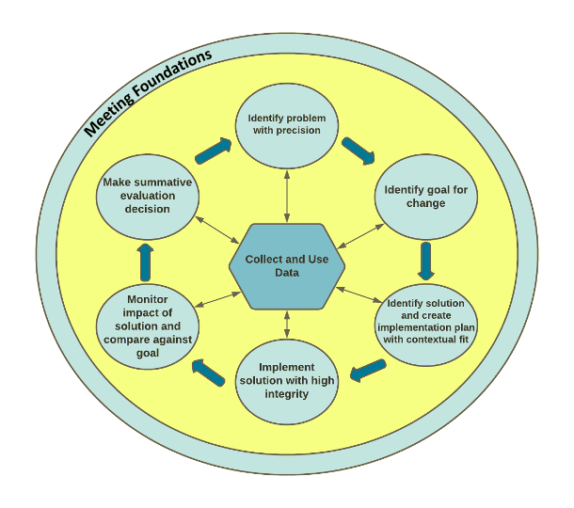
Team Based Problem Solving Model via...
Todd, A. W., Newton, J. S., Algozzine, K., Horner, R. H., Algozzine, B., Cusumano, D. L., & Preston, A. I. (2015). The Team-Initiated Problem Solving (TIPS II) Training Manual. Eugene, OR: University of Oregon, Educational and Community Supports.
Team Initiated Problem Solving (TIPS II)

Slide 17
Old vs. New Decision Making
Problem
Solution
Team Initiated Problem Solving (TIPS II)

Slide 18
Step 1: Identify problems with precision
The quality of decision making depends most on the first step—defining the problem to be solved.
When you hear these statements, what additional information do you want/need?
“Our students seem depressed”
“Our kindergarten is out of control”
“We have too many referrals”

Slide 19
Some questions your team will encounter when identifying problems with precision...
What concerning behaviors are most common?
Where are concerning behaviors most likely?
When are concerning behaviors most likely?
Who is engaged in the concerning behavior?
Why are concerning behaviors sustaining?
Why are concerning behaviors being reported?
What data can give us this information?

Slide 20
The Big 5 Office Discipline Data (ODR) Report:
Average Referral/Day/Month (what)
# of Referrals by Location (where)
# of Referrals by Behavior (what)
# of Referrals by Time of Day (when)
# of Referrals by Student (who)
# of Referrals by Demographic (who)
Can your data analyst get this information to run data summary reports?

Slide 21
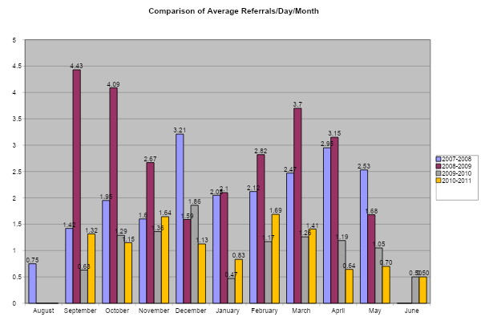
What do you notice?
In a given month, how many referrals on average do we have a day?
How does our school look behaviorally across the school year?
How are we doing this year, compared to last year?

Slide 22
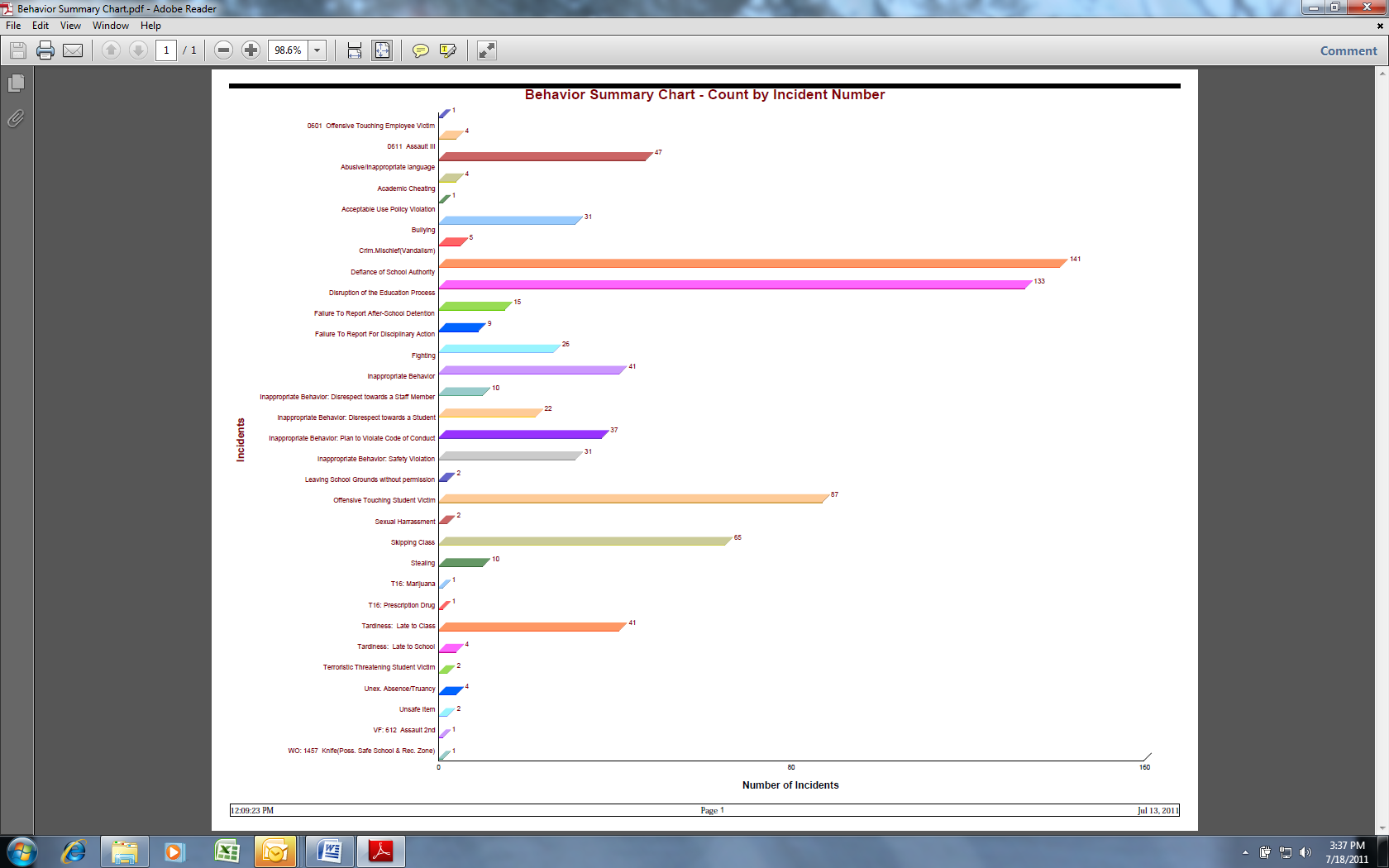
What concerning behaviors are most common?
Which problem behavior(s) has the least number of referrals?
Which problem behavior(s) has the highest number of referrals?

Slide 23
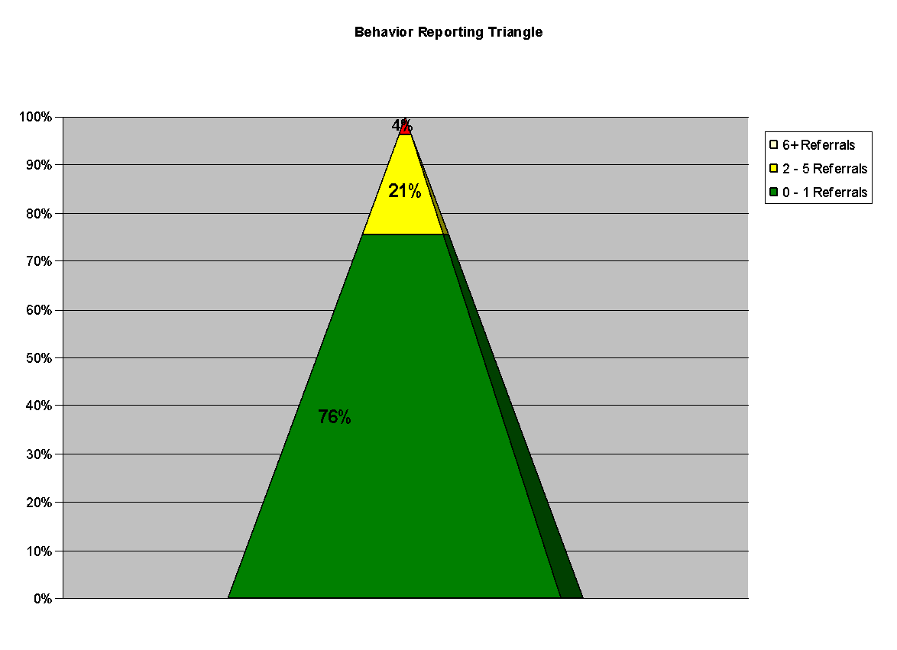
Who is receiving referrals for the concerning behavior?
What is the percentage of students with 0-1 referrals? In the green zone?
What is the percentage of students with 2-5 referrals? In the yellow zone?
What is the percentage of students with 6+ referrals? In the red zone?
Total Enrollment | 327
# of Students with 0-1 | 247 | 76%
# of Students with 2-4 | 68 | 21%
# of Students with 6+ | 12 | 4%

Slide 24
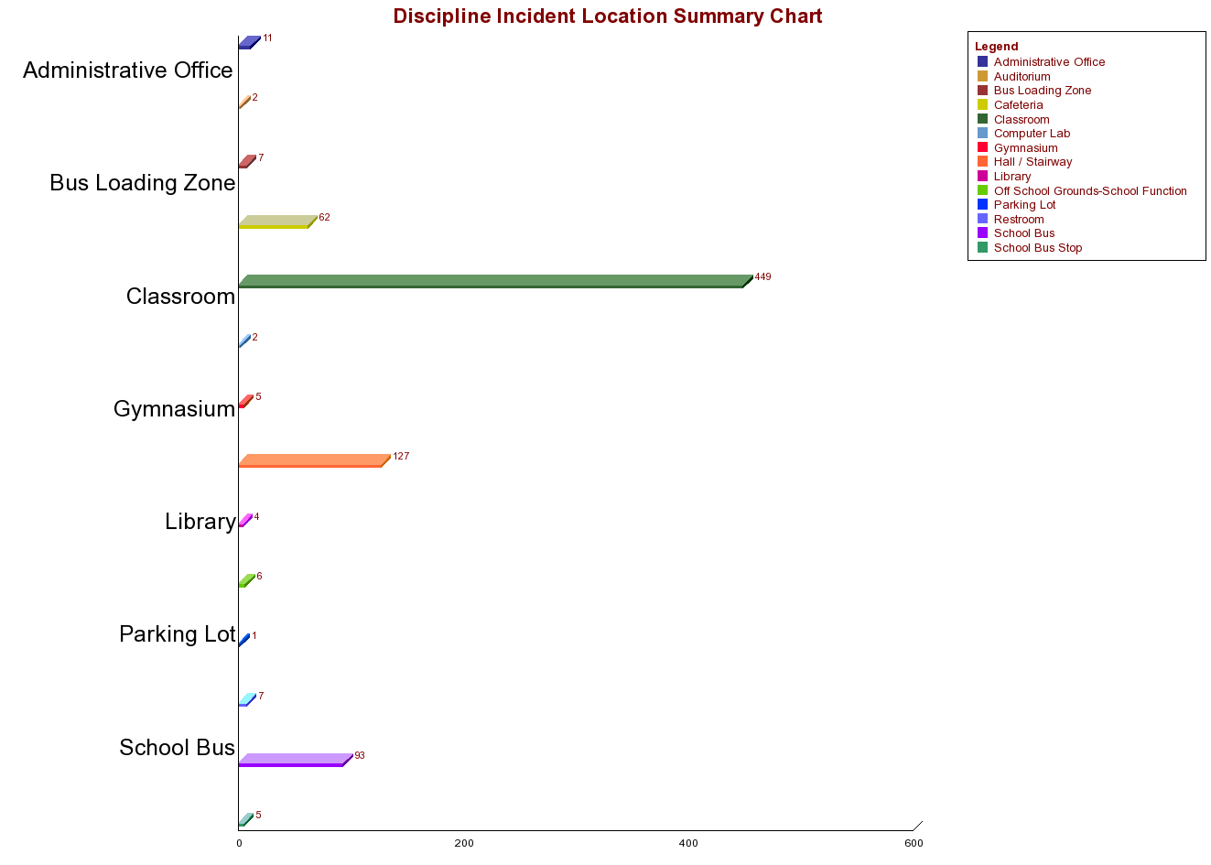
Where are concerning behaviors most likely?
Which location(s) has the least number of referrals?
Which location(s) has the highest number of referrals?
Are there specific locations where disproportionality is more likely to occur?

Slide 25
When are concerning behaviors most likely?
Which time interval(s) has the least number of referrals?
Which time interval(s) has the highest number of referrals?
Are there specific times of day when disproportionality is more likely to occur?

Slide 26
Why are the concerning behaviors being reported ?
Are there situational elements (e.g., subjectively defined behavior, location, time of day) that influence adult referral writing behavior for this student behavior?
Are there aspects of the adult decision maker’s internal state (e.g. hunger, fatigue) that influence adult referral writing behavior for this student behavior?
Why are the concerning behaviors sustaining ?
What elements of the situation trigger the behavior to occur?
What do students gain or escape as a result of the behavior/referral?
These require systems response)

Slide 27
Primary vs. Precision Statements
How do we go from here to here?
Primary Statements (I noticed..) | Precision Statement (Our problem is…)
Too many referrals | The 4th grade teachers report they have observed 25% of their students show risk for internalizing behavior problems. These behaviors occur equally across gender, race and disability. And are most likely related to students wanting to avoid stressful situations in the classroom.
September has more suspensions than last year
Our students seem depressed
The cafeteria is out of control
Student disrespect is rampant

Slide 28
Your Turn!
Write a precision problem statement with the following information:
What is the problem behavior? Physical altercations
How often is the problem happening? Every day. 24 referrals in the last month in this location.
Where is the problem happening? In the hallway outside of the cafeteria.
Who is engaged in the problem? Many students (about 40%)
When is the problem most likely to occur? During lunch, while entering and leaving.
Why is the problem sustaining? Students want to access the lunch line first, especially on chicken nugget day.
Data also showed that students were getting sent out of the class and placed in alternative setting (right outside cafeteria). They were the first dismissed for lunch.

Slide 29
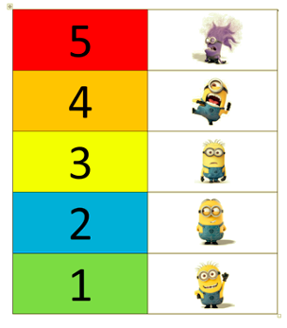
Poll Question:
How do you feel now about data-based decision making?

Slide 30
Primary vs. Precision Statements
How do we go from here to here?
Primary Statements | Precision Statement
Too many referrals | There are 25% more ODRs for aggression on the playground this month than last year. These are most likely to occur during first recess, with a large number of students, and the aggression is related to getting access to the new playground equipment.
September has more suspensions than last year
Our students seem depressed
The cafeteria is out of control
Student disrespect is rampant

Slide 31
Step 2: Set a Measurable Goal
Goals allow you to analyze, monitor, and adjust professional practice.
Example: By December 18 (school-wide PBIS team meeting), there will be a 5% decrease in minor disrespect and disruption behavior referrals for students in 7th & 8th grades as measured by ODR data.
Is it:
Specific?
Measurable?
Achievable?
Relevant?
Timely?

Slide 32
Step 3: Develop a Solution & Action Plan
Consider
Safety
Severity, Intensity, Frequency
Contextual Fit
Values, skills, resources, & Admin. support
Brainstorm all ideas for solving the problem
prevention, teaching, acknowledgment, correction & extinction, safety
Choose the least number of things to do that will support meeting the expected outcomes (meeting the goal)

Slide 33
Solution Action Elements | Possible Generic Solution Actions
Prevent What can we do to prevent the problem? | Adjust physical environment. Define & document expectations and routines. Assure consistent & clear communication with all staff.
Teach What do we need to teach to solve the problem? | Explicit instruction linked to school wide expectations. Teach what to do, how to do it and when to do it. Model respect .
Recognize What can we do to recognize appropriate behavior? | Strengthen existing school wide recognition systems. Include student preferences. Coach teachers to improve behavior specific praise practices
Extinguish What can we do to prevent the problem behavior from being recognized? | Use ‘signal’ for asking person to ‘stop’. Teach others to ignore (turn away/look down) problem behavior. Support teachers to use regulation strategies when frustrated by student behavior
Correct What will we do to provide corrective feedback? | Intervene early by using a neutral, respectful tone of voice. Label inappropriate behavior followed by what to do Follow SW discipline procedures
Safety Do we need additional safety precautions? | Separate student from others if he/she is unable to demonstrate self-control. Make sure adult supervision is available.

Slide 34
Solution Action Elements | Possible Solution Actions for Cafeteria Problem
Prevent What can we do to prevent the problem?
Teach What do we need to teach to solve the problem?
Recognize What can we do to recognize appropriate behavior?
Extinguish What can we do to prevent the problem behavior from being rewarded?
Correct What will we do to provide corrective feedback?
Safety Do we need additional safety precautions?

Slide 35
Step 4: Monitor Fidelity of Plan
How will you ensure the plan is being implemented as designed? Are you doing what you say you will do?
Examples:
School counselors will divide classrooms and do at least 4 brief observations to note if “Be Respectful” lessons are utilized.
Team members commit to ask 2 7th & 2 8th graders what was the focus of a given day’s advisory lesson (responses tracked on google survey).
Survey staff at weekly staff meeting (e.g., did you acknowledge 5 students not in your class/homeroom this week?)

Slide 36
Step 5: Monitor outcome data vs. goal
Was your problem-solving a success?
As a team, review data to see if the plan was successful.
Step 6: Make summative decisions
Do you need to change the precision problem statement, goal, action plan, or fidelity measure?

Slide 37
Team Time (10 minutes)
Practice the TIPS II problem solving process using the cafeteria example

Slide 38
Team Time (20 minutes) & Lunch Time (1 Hr)
Orient to and make notes on team action plan
Reflect on A.M. activities / resources
Wrap up discussions from A.M.
Explore Asset Mapping activity & note plan to complete
View & reflect on use of DE-MTSS Overview video to share with your team/coach

