Slide 1
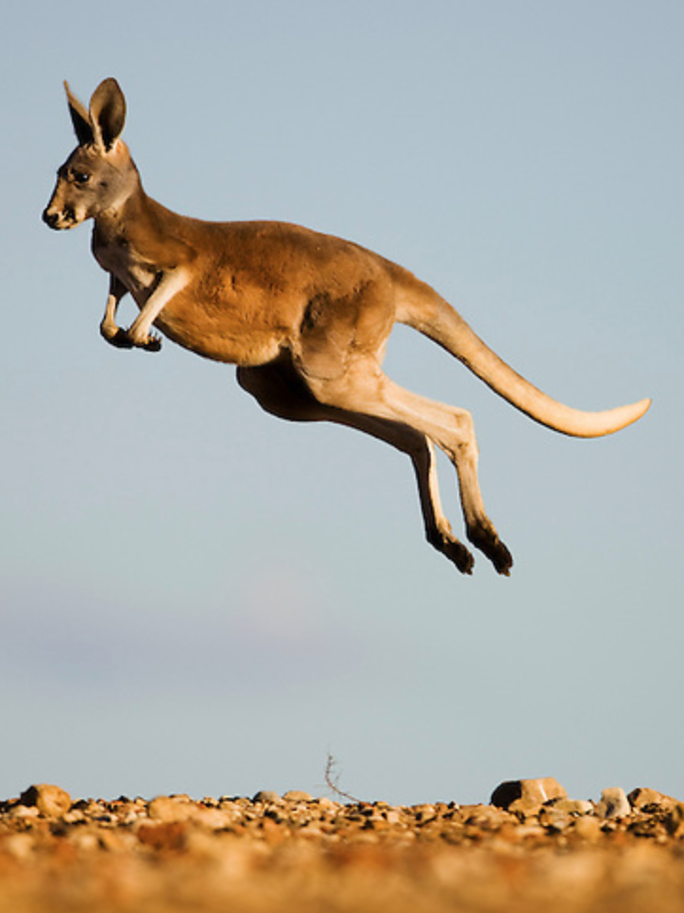
Our time together:
Keep Being Awesome
Staying engaged,reflective, and strategic
Planning your Tier 1 MTSS/PBS for the SY
Relationships & + Reinforcement in MTSS/PBS
The research
Creating + Reinforcement (R+) Systems that Foster + Relationships
Shared outcomes
Practices
Data

Slide 2
Keep Being Awesome
Continue to update your team notes & action plans
We welcome questions and sharing ideas via the chat box and hand-raising
Planning Question to Keep in Mind
How will we communicate the importance of intentional relationship-building and positive recognition systems to students, staff, family, and community partners?
What practices, tools, and data we will engage in to ensure that relationship-building & recognition is happening & happening for ALL?
We are...
ENGAGED
REFLECTIVE
STRATEGIC

Slide 3
Why might you be compelled
to make relationships
a priority for the upcoming school year?

Slide 4
Schools are
relationship hubs...
Staff-Student
Student-Student
School/Teacher - Home
Staff-Staff

Slide 5
...and + relationships help create + impacts!
Staff-Student
Student-Student
School/Teacher - Home
SEL, Academic & Behavior Outcomes
Staff-Staff

Slide 6
+ Well-being

Slide 7
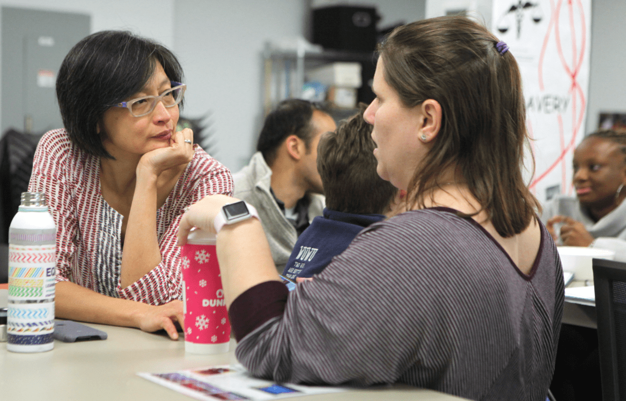
Staff-Student
Student-
Student
School/Teacher - Home
Staff-Staff

Slide 8
Staff School Climate Perceptions
job satisfaction
burnout and retention rates
perceptions of work conditions
their ﬁdelity in implementing new academic interventions and curricula
(Bear, Yang, Pell, 2014)

Slide 9
Updated Summer (2021) Professional Learning Resource List
Ways you might:
Prioritize building a culture of wellness
Cultivate wellness for ourselves
Scale support and strategies for collective wellness

Slide 10
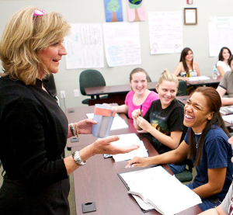
Where positive teacher-student relationships are found, students overall also show:
greater school completion, academic engagement, and academic achievement
greater peer acceptance
increased motivation to act responsibly and prosocially
less oppositional and antisocial behaviors, including bullying
better subjective well-being

Slide 11
Positive teacher-student relationships are particularly important for students at greater risk for negative outcomes:
Including those students who have:
Had previous school disengagement and problem behaviors (Balfanz, Herzog, & MacIver, 2007; Baker, 2006; Baker, Grant, & Morlock, 2008; Hamre et al., 2008; Meehan, Hughes, & Cavell, 2003; Silver et al., 2005; Wentzel & Wigfield, 2007)
lacked support from other sources, such as parents, peers, and close friends (Harter, 1999; Pianta, 1999)

Slide 12
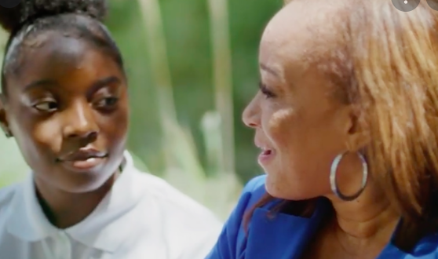
When positive relationships in your community exist...
Adult-Student
Student-student
Staff/teacher - home
Staff-Staff
... all systems can better grow to be even more positive, consistent, and equitable for all.

Slide 13
When systems provide positive, consistent, and equitable structures…
MTSS-SEB Data, systems, practices
Teaming roles
Preventing and Responding to Concerning Behavior
Expectations/matrix
Teaching
... positive relationships in our school communities grow.

Slide 14
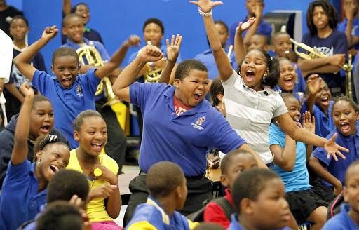
Recognition/ Positive Reinforcement (R+) Systems

Slide 15
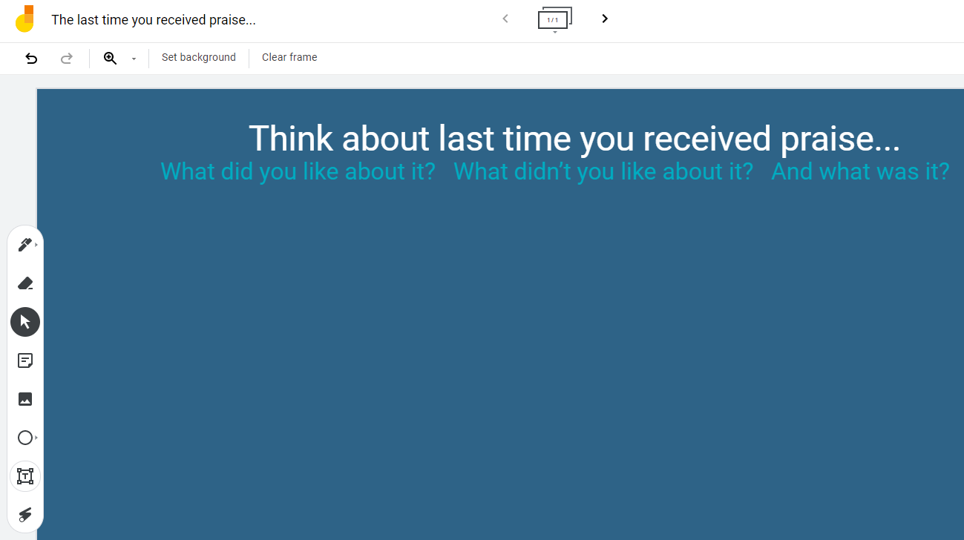
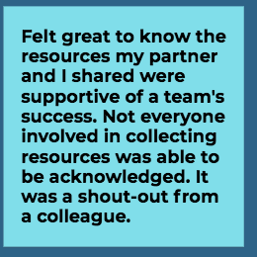
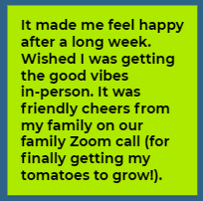
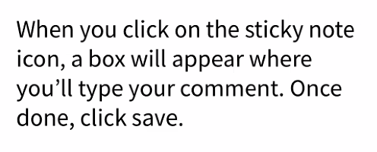
Jamboard Time!

Slide 16
If a child doesn’t know how to read...
WE TEACH and SUPPORT their success and fluency!
If a child doesn’t know how to swim...
WE TEACH and SUPPORT their success and fluency!
If a child doesn’t know how to multiply...
WE TEACH and SUPPORT their success and fluency!
If a child doesn’t know how to drive...
WE TEACH and SUPPORT their success and fluency!
If a child doesn’t know how to behave...
WE TEACH and SUPPORT their success and fluency!

Slide 17
The Purposes of Positive Reinforcement (R+)/ Recognition Systems
Create frequent positive interactions between staff and students
Teach new, positive and useful behaviors
Recognize desired behavior as a strategy to prevent new or escalating behavior problems.
Strengthen replacement behaviors that compete with any habitual behaviors of concern
Identify areas for improved, more equitable use of R+ and relationship-building between community members

Slide 18
DE-PBS Key Features
1. Recognize that a positive and safe school climate promotes not only positive behavior, but also academic, social, and emotional development.
2. Recognize that ALL students benefit from positive behavioral supports. This includes students with and without behavior problems or disabilities, and requires sensitivity to individual and cultural differences.
3. Recognize the critical importance of preventing behavior problems.This is evident throughout school policies and evidence-based practices, especially in preventive classroom management, clear school-wide expectations, and schoolwide teaching and recognition of positive behaviors. It also is seen in positive teacher-student, student-student, and school-family relations.

Slide 19
Evidence-based SW strategy:
Recognition/R+ Systems
OUTCOMES
Positive approaches to behaviors
and systems to support them provide
real, meaningful outcomes
for schools, teachers and students.
SYSTEMS
DATA
EQUITY
PRACTICES

Slide 20
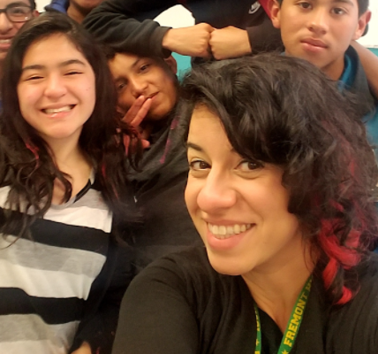
Staff-Student
Student-
Student
School/Teacher - Home
Staff-Staff

Slide 21
Evidence-based SW strategy: Positive Recognition/R+
Systematic positive approaches to behaviors have been found to:
Increase academic engagement
Decrease disruptive behavior
Increase intrinsic motivation
Increase peer social acceptance
(Rodgriguez & Sprick, n.d.)

Slide 22
Evidence-based SW strategy: Positive Recognition/R+
Group contingencies have been successfully used to:
improve academic and social behaviors and reduce disruptive behaviors
increase positive and decrease negative verbal interactions
decrease transition time
increase achievement, appropriate classroom behavior, and peer social acceptance
(Rodgriguez & Sprick, n.d.)

Slide 23
Effective Recognition/R+
Systems
Transparent & Non-Exclusionary Practices
On-Going, Data-Based Decision-Making
Appropriate and Meaningful Praise

Slide 24
Recognition/R+ systems
TO BUILD & REINFORCE
staff-student
relationships
Transparent & Non-Exclusionary Practices
On-Going, Data-Based Decision-Making
Appropriate and Meaningful Praise
Ensuring an equitable & engaging set of R+ practices
Creating that positive, predictable environment
Building & modeling positive relationship building

Slide 25
Tier 1 Teams lead and/or support efforts to advocate for the consistent and equitable use of positive recognition/R+ SW through contextualizing, teaching, and monitoring the implementation of R+ strategies.
How are we currently using positive recognition/R+ schoolwide?

Slide 26
Reflecting on Your Current Recognition/+R Activities
What recognition/R+ activities are currently in place for… |  | A brief description of current practices: | Additional reflection* notes:
Students Staff Family/ Caretakers | … learning and demonstrating of NEWLY TAUGHT/LEARNED prosocial behaviors?
 | … CONTINUING to engage in and demonstrate prosocial behaviors?
 | …cheering their peers in engaging in prosocial behaviors?

Slide 27
Reflecting on Our Current Recognition/+R Activities
What recognition/R+ activities are currently in place for… |  | A brief description of current practices: | Additional reflection* notes:
Students Staff Family/ Caretakers | … learning and demonstrating of NEWLY TAUGHT/LEARNED prosocial behaviors?
 | … CONTINUING to engage in and demonstrate prosocial behaviors?
 | …cheering their peers in engaging in prosocial behaviors?

Slide 28
Reflecting on Our Current Recognition/+R Activities
What recognition/R+ activities are currently in place for… |  | A brief description of current practices: | Additional reflection* notes:
Students Staff Family/ Caretakers | … learning and demonstrating of NEWLY TAUGHT/LEARNED prosocial behaviors?
 | … CONTINUING to engage in and demonstrate prosocial behaviors?
 | …cheering their peers in engaging in prosocial behaviors?

Slide 29
Recognizing the importance
of Adult Relationships
Relations with others (students, adults)
Relations about ourselves (how we feel about and take care of ourselves)
Cultivate self-compassion (Neff)
We cannot give what we do not have
(Thapa et al., 2013 as cited by Barrett, Herschfielt, and Yanek, 2020)

Slide 30
Tier 1 Teams lead and/or support efforts to advocate for the consistent and equitable use of positive recognition/R+ SW through teaching, contextualizing and monitoring the implementation of R+ strategies.
Anchor Tools
The PBIS School-Wide R+/Acknowledgement Matrix
Effective Ways to Praise & Acknowledge Worksheet
Your Data

Slide 31
Tier 1 Teams lead and/or support efforts to advocate for the consistent and equitable use of positive recognition/R+ SW through teaching, contextualizing and monitoring the implementation of R+ strategies.
Anchor Tools
The PBIS School-Wide R+/Acknowledgement Matrix
Effective Ways to Praise & Acknowledge Worksheet
Your Data

Slide 32
Keeping the Support, Care, & Love Flowing
ADJUST
For equity and context
DEFINE
your whys and your system
using data & feedback
BE
CONSISTENT &
INCLUSIVE
MODEL
as a team and utilize the research
MONITOR
fidelity and outcomes
PRACTICE
with staff, students and families

Slide 33
The PBIS School-Wide
R+/Recognition Matrix
Anchor Tool for:
Transparent & Non-Exclusionary R+ Practices
R+

Slide 34
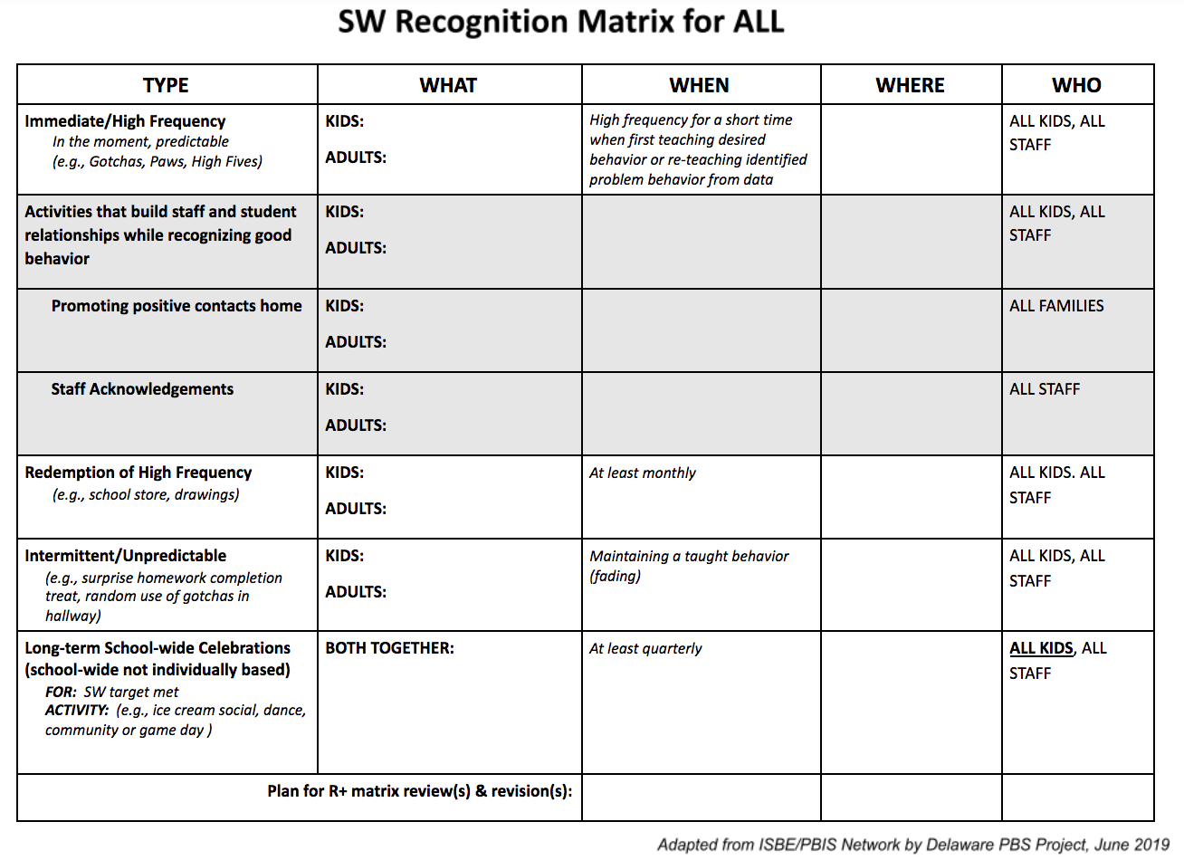

Slide 35
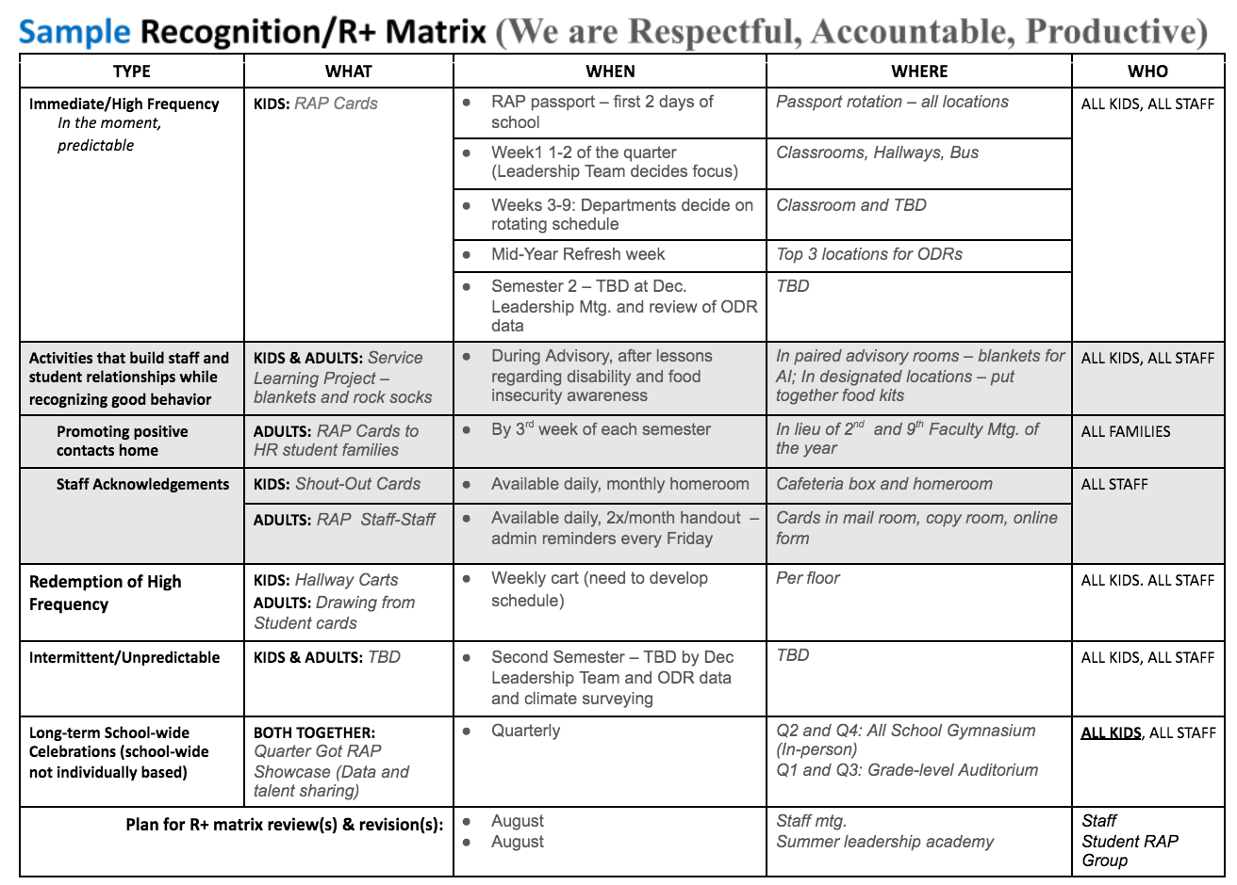

Slide 36
PBIS School-wide Acknowledgement Matrix
What
When
Where
Who
Outcomes
Types of Acknowledgement
Immediate/High Frequency In the moment, predictable (e.g., Gotchas, Paws, High Fives)
Redemption of High Frequency (e.g., school store, drawings)
Intermittent/Unpredictable (e.g., surprise HW completion treat, random use of gotchas in hallway)
Long-term School-wide Celebrations (school-wide not individually based) FOR: Ex: ODR reduction, school-wide target met for certain setting/behavior area (e.g., ice cream social, dance, game day)

Slide 37
PBIS School-wide Acknowledgement Matrix
Types of Acknowledgement
Immediate/High Frequency In the moment, predictable (e.g., Gotchas, Paws, High Fives)
Redemption of High Frequency (e.g., school store, drawings)
Intermittent/Unpredictable (e.g., surprise HW completion treat, random use of gotchas in hallway)
Long-term School-wide Celebrations FOR: Ex: ODR reduction, school-wide target met for certain setting/behavior area (e.g., ice cream social, dance, game day)

Slide 38
Develop a System/Schedule to Teach Lessons
When teaching will occur
First day/week/month
Who will do the teaching
Classroom teacher or other
Where to find materials
Shared computer drive or other organizational system
How much time to spend
Create a schedule
What products to create at the end of the lesson
Posters/ graphics
Staff need to be taught how to deliver the lesson plan!
Developing Plans for Teaching Schoolwide Expectations

Slide 39
Develop a System to Ensure Support, Care, & Love are a Habit & Are Given Equitably
When R+ will occur
Daily, weekly, monthly, annually
Who will do the recognition
Adults and students
Where to find materials
Shared drive of tools/directions
School shop/classroom
How much time to spend on related events
Create a schedule
What message to reinforce throughout
Your SW expectations
You are valued as a person and member of our community
Staff & students may need help to keep with it!

Slide 40
PBIS School-wide Acknowledgement Matrix
Types of Acknowledgement
Immediate/High Frequency In the moment, predictable (e.g., Gotchas, Paws, High Fives)
Redemption of High Frequency (e.g., school store, drawings)
Intermittent/Unpredictable (e.g., surprise HW completion treat, random use of gotchas in hallway)
Long-term School-wide Celebrations (school-wide not individually based) FOR: Ex: ODR reduction, school-wide target met for certain setting/behavior area (e.g., ice cream social, dance, game day)

Slide 41
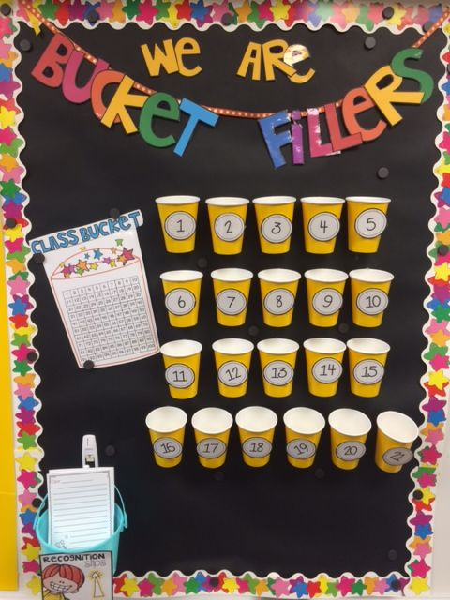
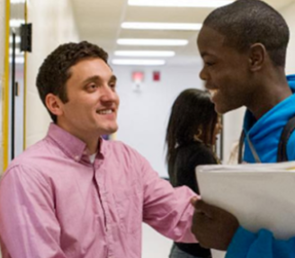
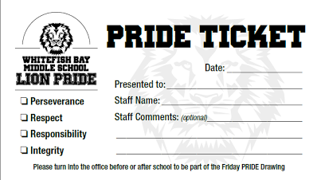
Immediate/High Frequency Acknowledgements
Quickly and easily reinforce when students meet the SW and CR expectations
Tangible
Visible
Verbal

Slide 42
Immediate/High Frequency Acknowledgements
Quickly and easily reinforce when students meet the SW and CR expectations
Delivery explicitly connects to SW expectation
Keep the system simple and start small
Build in opportunities for data collection
Use to reinforce 5:1 positivity ratios
Link behavior to techniques that encourage the internalizing of positive behavior and perception.

Slide 43
Best Practices for community building R+ systems
Use praise and rewards to provide positive feedback - not to control student behavior
Be sincere and credible when delivering praise and rewards
Encourage students to praise/reward themselves and each other
Highlight the student’s specific behaviors, skills and achievement and especially the effort and autonomous choice demonstrated
Reward/praise not only the students’ prosocial behavior, but also the thoughts, emotions, and dispositions that underlie the behavior
Provide praise/rewards across settings
Take developmental stage into consideration (some students, especially older students, prefer private praise)
(Excerpts from Bear (2020); Bear & Morales (2018))

Slide 44
Mix it up! use different types of praise and rewards
Use praise often and rewards occasionally - to demonstrate warmth, care, and support
Use frequent, immediate praise/rewards to teach a new behavior or to increase an infrequently occurring behavior
Provide less praise and fewer rewards when a behavior is more established
Use tangible rewards as little as necessary to teach and maintain the desired behavior
Plan for maintenance and generalization of the desired behavior
Emphasize the value or usefulness of the behavior, both presently and in the future
(Excerpts from Bear (2020); Bear & Morales (2018))

Slide 45
Ensuring Your Recognition System Benefits All
Keep in Mind:
Kids from different subgroups (race/ethnicity, gender, disability status) experience different levels empirically-supported classroom practices (praise vs. error corrections, for example).
Students experience “reinforcement” systems differently depending on their learning histories (which includes culture).
(McIntosh, Yanek and Simonson, 2021)

Slide 46
How to avoid
rewards negatively impacting interest & performance:
If reward is used as bribery
If rewards are delivered ambiguously (not clearly tied to performance of expectation)
If what we deliver is not a “reward” from the student’s perspective
If partial rewards are delivered when full reward is expected
If large rewards are delivered briefly and then withdrawn completely
Horner & Goodman
Using Rewards within School-wide PBIS, www.pbis.org
And for more information see: Cameron, Banko & Pierce, 2001

Slide 47
Set Up Reminders for Specific Behaviors
Create Alarms on Scheduled Days & Times
Count the # of Times Something Happens
Track Your Progress

Slide 48
Team Time

Slide 49
Tier 1 Teams lead and/or support efforts to advocate for the consistent and equitable use of positive recognition/R+ SW through contextualizing, teaching and monitoring the implementation of R+ strategies.
Anchor Tools
The PBIS School-Wide R+/Acknowledgement Matrix
Effective Ways to Praise & Acknowledge Worksheet
Your Data

Slide 50
Effective Ways to
Praise and Acknowledge
Worksheet
Anchor Tool for:
Appropriate and Meaningful Praise
R+

Slide 51
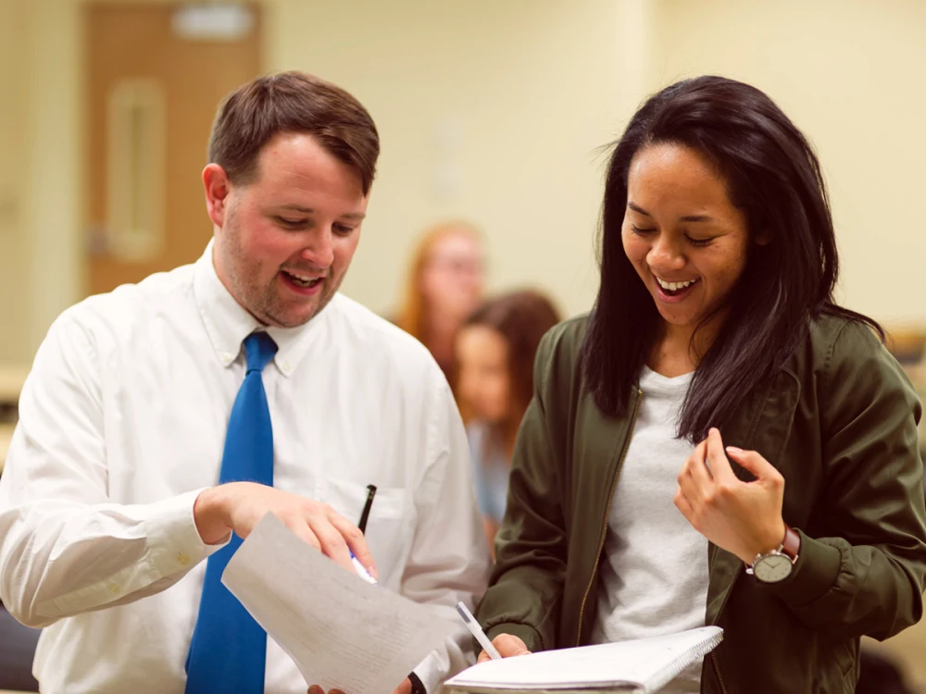
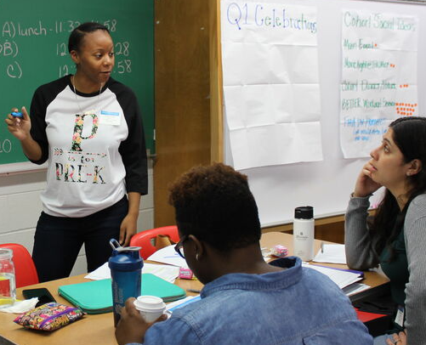
Practice the Best Practices
Highlight future usefulness of behavior.
Encourage the student to take pride in their own behavior and self-evaluate their prosocial behavior.
Link the behavior to underlying thoughts, emotions, and dispositions.
Focus on student’s specific achievement and effort demonstrated toward the achievement.
Link behaviors to underlying thoughts, emotions, and dispositions to support prosocial behavior.

Slide 52
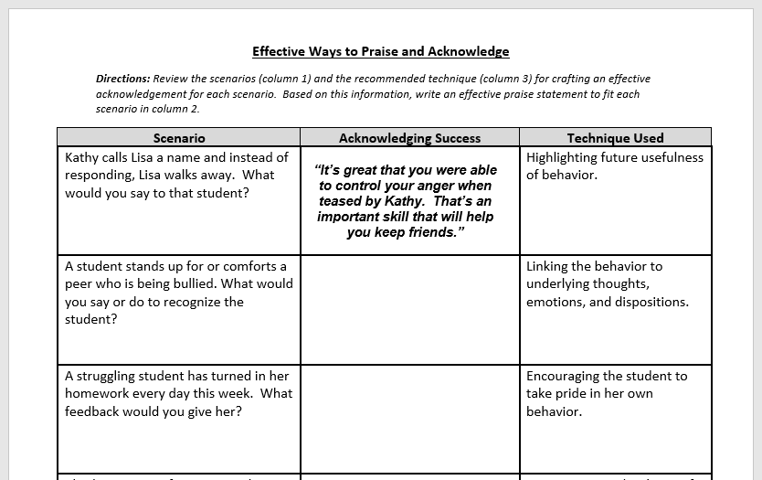
2
3
1

Slide 53
Tier 1 Teams lead and/or support efforts to advocate for the consistent and equitable use of positive recognition/R+ SW through contextualizing, teaching and monitoring the implementation of R+ strategies.
Anchor Tools
The PBIS School-Wide R+/Acknowledgement Matrix
Effective Ways to Praise & Acknowledge Worksheet
Your Data

Slide 54
On-Going, Data-Based Decision-Making with Voice & Preferences Matter:
Praise Preference Assessment
Delaware School Climate Surveys
DB
Your Data

Slide 55
On-Going, Data-Based Decision-Making with Voice & Preferences Matter:
Praise Preference Assessment
Delaware School Climate Surveys
DB
Your Data

Slide 56
Types of Acknowledgement
Immediate/High Frequency In the moment, predictable (e.g., Gotchas, Paws, High Fives)
Redemption of High Frequency (e.g., school store, drawings)
Intermittent/Unpredictable (e.g., surprise HW completion treat, random use of gotchas in hallway)
Long-term School-wide Celebrations (school-wide not individually based) FOR: Ex: ODR reduction, school-wide target met for certain setting/behavior area (e.g., ice cream social, dance, game day)
Developing a positive recognition/R+ system
that benefits ALL is KEY.

Slide 57
So...
Engage diverse stakeholders (i.e., students, families, community members with racial and cultural identities represented in the school) in the development, monitoring, and feedback process.
Instead of calling the Reinforcement System “rewards”, (which can be viewed negatively) use the term “community building”.
Discuss the use of group contingency drawings in place of token economies/using tangibles to purchase or get access to something.
Consider a praise preference assessment, as part of your system to acknowledge positive student behavior through positive reinforcement
(McIntosh, Yanek and Simonson, 2021)

Slide 58
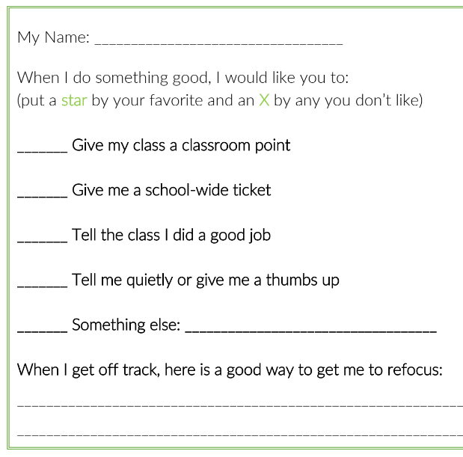
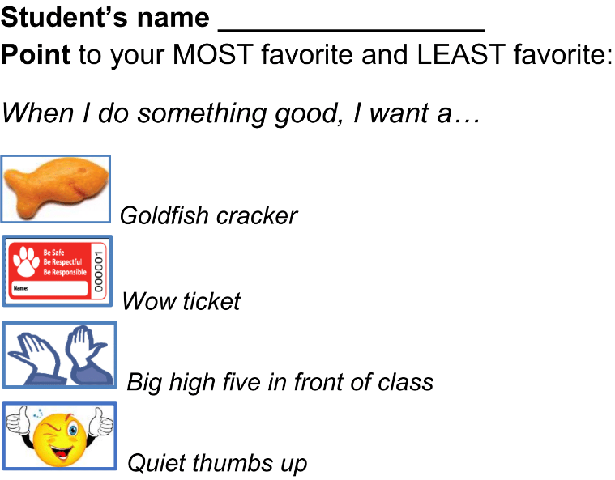
Praise preference assessments

Slide 59
Praise Preference Assessment:
1. Create assessment form
2. Ask students to rate the options
3. Review results to improve
REVIEW individual responses to tailor praise
REVIEW class-wide responses to adjust school-wide/classroom systems
(McIntosh, 2021)

Slide 60
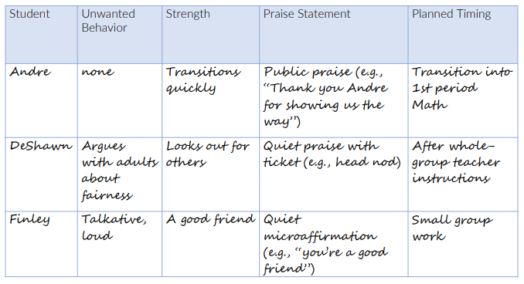
Planned Praise:

Slide 61
On-Going, Data-Based Decision-Making with Voice & Preferences Matter:
Praise Preference Assessment
Delaware School Climate Surveys
DB
Your Data

Slide 62
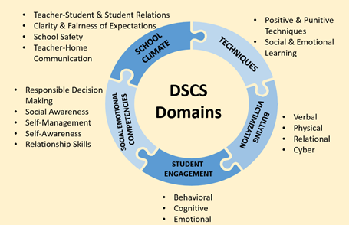
Delaware School Climate Survey

Slide 63
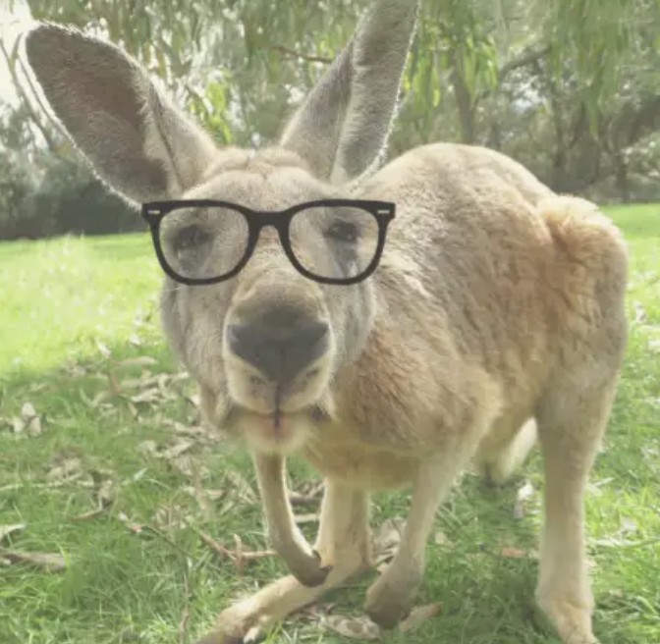
Hmm…
Now what?

Slide 64
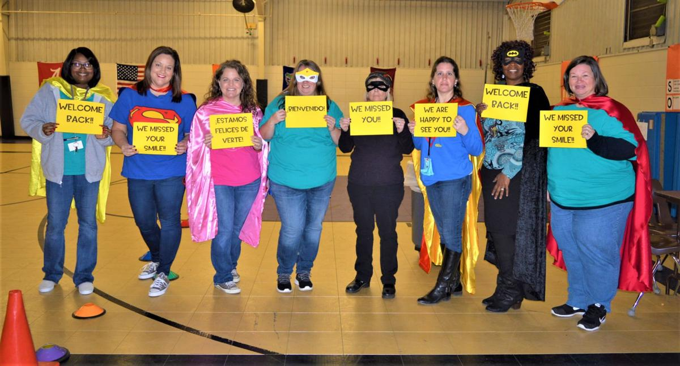
Prioritize the first two weeks: Big Picture
Focus on building community activities that:
Match your student, family and staff strengths, interests and needs
Provide opportunities for to engage and observe for action planning
Outline expectations around Positive Recognition/R+

Slide 65
Prioritize the first two weeks: Big Picture
Focus on building community through relationships and R+:
Across the school
Within the classroom
For All

Slide 66
Develop your R+ Matrix and engage staff in Recognition/R+ and relationship-building conversations
Other, initial relationship building strategies to consider:
Getting to Know Us...Lightening Round
My Name, My Identify
Door Greetings
R+
Tools for the first 2 weeks:
Creating Consistent & Equitable +Relationships & R+ Habits

Slide 67
Develop your R+ Matrix and engage staff in Recognition/R+ and relationship-building conversations
Other, initial relationship building strategies to consider:
Getting to Know Us...Lightening Round
My Name, My Identify
Door Greetings
R+
Tools for the first 2 weeks:
Creating Consistent & Equitable +Relationships & R+ Habits

Slide 68
Getting to Know Us… Lightning Round
A meaningful relationship looks like? Feels like? Sounds like? | You’re called to be brave, but you’re in some real fear. What’s the first thing you do?
What is something people often get wrong about you? | Last show you binged and loved
Favorite Movie | Favorite Meal
What’s on your night stand right now? | A snapshot of an ordinary moment in your life that brings you gratitude
What’s one thing you are deeply grateful for right now?

Slide 69
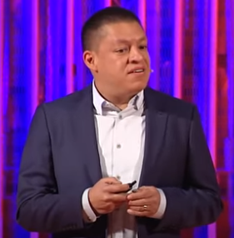
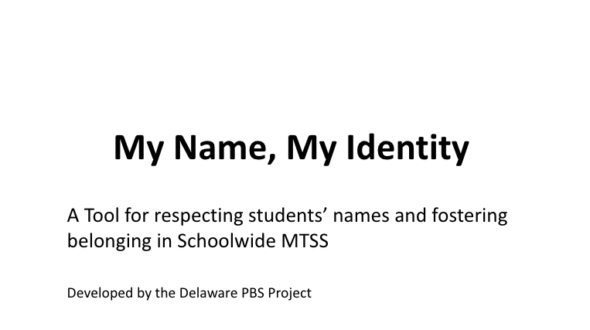
DE-PBS Mini-Module
Teaching Video: 13 min
Facilitation Guide: 1 pg
Resources Embedded:
Gerardo Ochoa Ted Talk
My Name, My Identity Website
PBIS Culturally Responsive Field Guide (ver.1)

Slide 70
PBIS
Practice Brief
Brief length: 1 pg
Resources Embedded:
Planning steps
Fidelity checklist
Tips for success

Slide 71
Tier 1 Teams lead and/or support efforts to advocate for the consistent and equitable use of R+ SW through contextualizing, teaching and monitoring the implementation of R+ strategies.
How are we currently using positive recognition/R+ schoolwide?
What will our 21-22 SY
schoolwide R+
practices be?
&
How will our R+ matrix
show that?

Slide 72
Tier 1 Teams lead and/or support efforts to advocate for the consistent and equitable use of R+ SW through contextualizing, teaching and monitoring the implementation of R+ strategies including systems of wellness and relationship-building.

Slide 73
MTSS Tier 1 - School-based Initial Action Plan
 |  | Who | When | Supports Needed
Acknowledgement | Develop staff PD messages regarding the SW use and tracking of wellness, relationship-building, & positive recognition/R+ in the 21-22 SY. Collect SW student and staff feedback about Positive Recognition/R+ preferences. Develop a draft SW Positive Recognition/R+ matrix for the 21-22 SY.

Slide 74
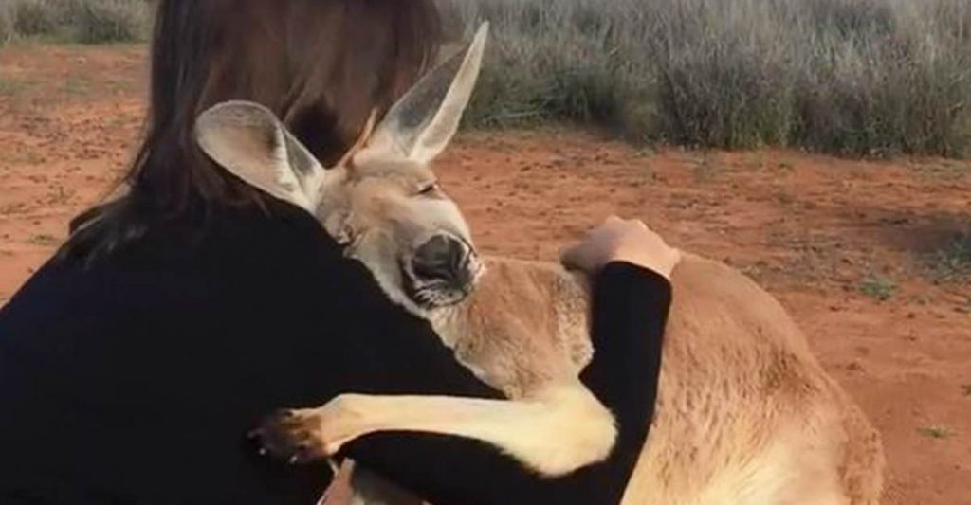
Thank you for sticking with us!

