Slide 2
Purpose & Outcomes
Purpose:
Prepare and plan for facilitating implementation of teaching the school-wide and classroom-wide expectations.
Outcomes and Fidelity:
Design a behavior lesson plan “cool tool”
Develop a system/schedule for teaching behavior lessons, with goals for ongoing fidelity
Create a sample big picture plan for teaching expectations
Academic and Behavior Expectations are taught:
Directly to all students in classrooms
Across all settings & locations

Slide 3
Why Develop a System for Teaching Behavior?
Behaviors are prerequisites for academics
Procedures and routines create structure
Repetition is key to learning new skills
For a youth to learn something new, it needs to be repeated an average of times
8
For youth to unlearn an old behavior and replace with a new behavior, the new behavior must be repeated an average of times
For an Adult to learn something new, it needs to be repeated an average
of times
25
28

Slide 4
If a child doesn’t know how to read...
WE TEACH!
How should we finish the last sentence?
If a child doesn’t know how to swim...
WE TEACH!
If a child doesn’t know how to multiply...
WE TEACH!
Punish?
Teach?
If a child doesn’t know how to drive...
WE TEACH!
If a child doesn’t know how to behave...
WE???

Slide 5
Once you have developed school-wide expectations, it is not enough to just post the words on the walls of the classroom, or simply tell students what they are…
YOU MUST TEACH THEM!
I taught the behaviors defined on my classroom matrix using explicit instruction
I went over the behaviors defined on my classroom matrix using explicit instruction

Slide 6
“Many teachers feel that they don't know how to teach
social and emotional skills.”
"I know how to teach math just fine," they might think, "but I don't know how to teach self-regulation.
That's a job for the counselor."
Actually, the same instructional practices we use to teach academic skills can be applied to teaching social and emotional skills.”
(Anderson, 2015)
We must demystify SEB instruction …

Slide 7
Teaching Academics
ADJUST
(RETEACH)
For Efficiency
DEFINE
(TELL)
Simplify
BE
CONSISTENT
MODEL
(SHOW)
Monitor
PRACTICE
In Setting

Slide 8
Teaching Behavior
ADJUST
(RETEACH)
For Efficiency
DEFINE
(TELL)
Simplify
BE
CONSISTENT
MODEL
(SHOW)
Monitor
PRACTICE
In Setting

Slide 9
Teach Social Behaviors Like Academics
Define Simply
“If someone won’t stop teasing your friend, you should look cool & walk away w/ your friend…”
Adjust for Efficiency
Model
“You got it. Tomorrow let’s figure out how to handle cyber-teasing.”
“Watch. This is how I would do it at a concert.”
Monitor & Acknowledge
Practice in Setting
“That was great. What would that look like if you were stuck on the bus? In the classroom?”
“Tell me how you would do it if you were in hallway...” “At school dance.”

Slide 10
How do you teach behavioral expectations?
Teach in the actual settings where behaviors are to occur
Teach the words by demonstrating the actions using examples and non-examples.
Model and practice to fluency
Build a social culture that is predictable and focused on student success.
Respect Ourselves
Respect Our Community
Respect Our Environment

Slide 11
Creating Behavior Lesson Plans
Tier 1 team members or classroom teachers should create unified lesson plans for each desired behavior from the matrix by incorporating the language and lessons from the SEL curriculum.
Students are taught the expectations, rules, and routines for both the school-wide system and the classroom-wide system as it aligns to the SEL curriculum.
Remember… If you are seeing problematic behavior, ask, “Have I taught the desired and acknowledged the behavior I want to see?”

Slide 12
Start Small...
Teaching Matrix |  | SETTING
 |  | All Settings | Hallways | Playgrounds | Cafeteria | Library/ Computer Lab | Assembly | Bus
 | Respect Ourselves | Be on task. Give your best effort. Be prepared. | Walk. | Have a plan. | Eat all your healthy food first. | Study, read, compute. | Sit in one spot. | Watch for your stop.
 | Respect Others | Be kind. Hands/feet to self. Help/share with others. | Use normal voice volume. Walk to right. | Play safe. Include others. Share equipment. | Invite those sitting alone to join you. | Whisper. Return books. | Listen/watch. Use appropriate applause. | Use a quiet voice. Stay in your seat.
 | Respect Property | Recycle. Clean up after self. | Pick up litter. Maintain physical space. | Use equipment properly. Put litter in garbage can. | Replace trays & utensils. Clean up eating area. | Push in chairs. Treat books carefully. | Pick up. Treat chairs appropriately. | Wipe your feet. Sit appropriately.
Teach in one location
Teach one expectation
Expectations

Slide 13
Behavior Lesson Plan Form
Expectation:
Location:
Establish/Define Expectation: Introduce the skill(s) and why is important. Be sure to list when the behavior is expected:
Teach: Teacher demonstrates or models the appropriate behavior. Discuss non-examples and examples.
Monitor and Reinforce: Increase the likelihood that students will demonstrate the skill. Provide examples if appropriate.
Pre-Correct/Remind: Provide anticipated time of day/activities to pre-correct.
Feedback: Observe student performance and give positive, specific feedback to students. Provide an example or specific praise and error correction.
Reteach: Provide examples of times throughout the day and school year to provide booster lessons.
Supervise: Don’t forget to move, scan and interact with students!

Slide 14
Expectation: Respect Others |  | Location: Cafeteria
Establish/Define Skill or Procedure: Define the behavior and why it is important. Be sure to list when the behavior is expected
Definition: we respect others in the cafeteria by making sure everyone feels comfortable and has someone to sit with. Why Important: Being respectful of others in the cafeteria helps everyone feel like they belong. When Expected: If you notice a student is sitting alone, you can ask a teacher to sit with them or invite them to sit with you and your friends.
Teach: Teacher demonstrates or models the appropriate behavior. Provide non-examples and examples.
Example: Debby notices that Niki, a student in her class is sitting alone. She notices because Niki is not talking to any of the other students sitting near her. She raises her hand to ask the teacher if she can invite Niki to sit at their table. If Niki agrees, the two sit together. Non-Example: Debby notices that Niki is not talking to anyone at her table. She whispers to her friend that it looks like Niki doesn’t have any friends, the two laugh.
Practice: Give students opportunities to role-play the appropriate behaviors across all relevant settings.
All students have the opportunity to role play inviting a student to join them in the cafeteria. Repeat several times so that everyone has different roles to role-play. Make sure all students understand the expectation and behavior.
Monitor and Reinforce: Increase the likelihood that students will demonstrate the skill. Provide examples if appropriate.
Pre-Correct/Remind: Provide anticipated time of day/activities to pre-correct. | Provide prompts right before lunch.
Feedback: Observe student performance and give positive, specific feedback to students. Provide an example or specific praise and error correction. | Privately (to Debby) say: “I noticed that you invited a new friend, Niki, to sit with you at lunch. Way to respect your classmate!”
Reteach: Provide examples of times throughout the day and school year to provide booster lessons. | In the beginning of the year when students are first getting to know each other
Supervise: Don’t forget to move, scan and interact with students!
Sample Behavior Lesson Plan

Slide 15
BREAKOUT SESSION:
Designing a Behavior Lesson Plan (Cool Tool)
Step one: Select a skill and location
Skill will come directly from the behavior matrix
Select skill based on the trends in your data
Step two: Write the lesson plan
Name the skill & align to school-wide expectation
Also align with SEL standards
Responsibility is the expectation
Name the expectation: Be Responsible
Name the location: Hallway
Name the skills: Students who are responsible:
Move quietly
Walk with hands at your sides
Stay to the right

Slide 16
Develop a Plan for Teaching Expectations
Once the behavior lesson plans are created it is important to take time to decide how and when the lessons will be taught
Provide initial lesson plans to begin teaching behavior
Build on what you have (i.e. SEL curriculum,character ed.)
Develop a system for expanding behavior lesson plan ideas throughout the year
Skill of the month, Booster Sessions
Determine the minimum requirements for teaching behavior (i.e. how often)
Remember to include a variety of teaching strategies

Slide 17
Develop a System/Schedule to Teach Lessons
When teaching will occur
First day/week/month
Who will do the teaching
Classroom teacher or other
Where to find materials
Shared computer drive or other organizational system
How much time to spend
Create a schedule
What products to create at the end of the lesson
Posters/ graphics
Staff need to be taught how to deliver the lesson plan!
Developing Plans for Teaching Schoolwide Expectations

Slide 18
Checking for Fidelity
Teaching Matrix |  | SETTING
 |  | All Settings | Hallways | Playgrounds | Cafeteria | Library/ Computer Lab | Assembly | Bus
 | Respect Ourselves | Be on task. Give your best effort. Be prepared. | Walk. | Have a plan. | Eat all your healthy food first. | Study, read, compute. | Sit in one spot. | Watch for your stop.
 | Respect Others | Be kind. Hands/feet to self. Help/share with others. | Use normal voice volume. Walk to right. | Play safe. Include others. Share equipment. | Invite those sitting alone to join you. | Whisper. Return books. | Listen/watch. Use appropriate applause. | Use a quiet voice. Stay in your seat.
 | Respect Property | Recycle. Clean up after self. | Pick up litter. Maintain physical space. | Use equipment properly. Put litter in garbage can. | Replace trays & utensils. Clean up eating area. | Push in chairs. Treat books carefully. | Pick up. Treat chairs appropriately. | Wipe your feet. Sit appropriately.
Lesson | Initial & Date
Respect Others - Hallway
Respect Others - Cafeteria
Respect Others - Bathroom
Respect Others - Playground

Slide 19
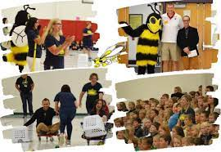
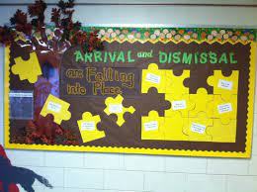
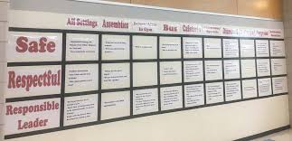
When and How will we teach behaviors?
Kick-off events
On-going Direct Instruction
Embedding into curriculum
Booster trainings
Continued visibility

Slide 20
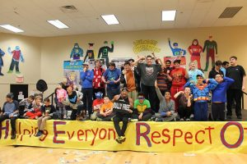
Kick-off Events
All faculty and students participate
Decide on method that will be most effective for your school
Consider Importance/Impact - Activity/event should be a high priority… not given a few minutes in some other activity
Teaching staff, students, and families the expectations and rules
Beginning and mid-year; more often as needed
Teach rules for all areas of school, including individual classrooms

Slide 21
Ongoing Direct Instruction
Daily or Weekly schedule?
Data-driven and scheduled designed lessons
Pre-correction
Re-teaching immediately after behavioral errors

Slide 22
Booster Trainings (Re-teach)
Data informed re-teaching (school-wide efforts led by Tier 1 Team)
Are there predictable times when we anticipate a need to revisit (holiday breaks, pivoting to remote/in-person/hybrid)?
Do we notice any problems within the data to address (e.g., increase in disrespectful behavior, disruption, aggression)?
Data informed re-teaching (classroom teachers)
Use morning meeting/advisory to
Re-teach & reinforce SEB taught during explicit instruction
Re-teach data-informed needs (e.g., formative assessment data indicate need to re-teach & practice calming strategies and routine to ask for help – anxiety with not knowing how to complete assignment)
Integrating Social Emotional Behavioral (SEB) and Academic Instruction Yanek, K.

Slide 23
Embedding into Curriculum
Coupling with academic objectives
Daily announcements
Newsletters
Staff memos
Social media updates

Slide 24
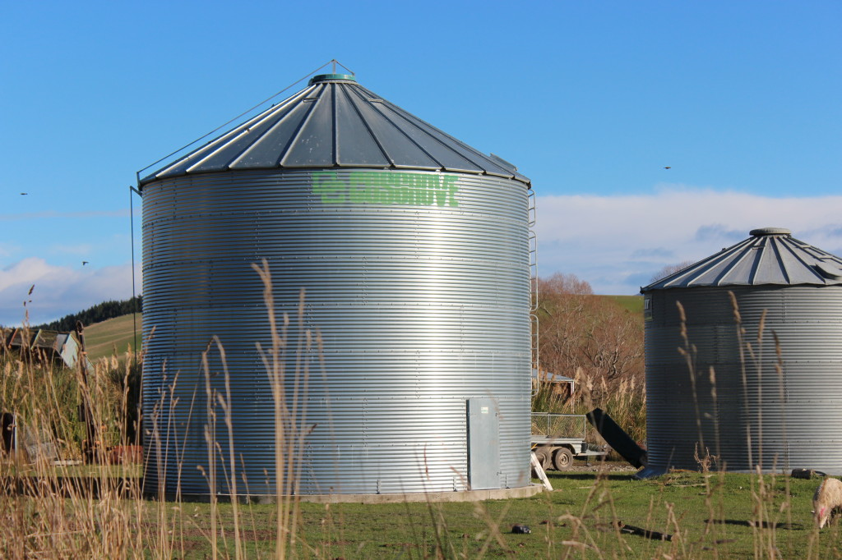
How do we set students up for success with SEB skills through their academic work?
Academics
SEB
Integrated Academics & SEB
Integrating Social Emotional Behavioral (SEB) and Academic Instruction Yanek, K.

Slide 25
Embed into Daily Curriculum
Objective for the Subject Matter Lesson
Objective for a paired Behavioral/Social/emotional skill (taken from the school’s teaching matrix)
Today’s
Wilson Way Be Responsible
* Focus on your own work

Slide 26
SEB Teaching & Learning Plan… Small, Frequent Doses
Instructional Strategies
Cooperative Learning Strategies/Groups
Project-based learning
Debate
Reflection on teamwork, collaboration
Reflective writing (e.g. what if, feelings experienced completing an assignment, during day)
Connect SEB to Academics
Integrating Social Emotional Behavioral (SEB) and Academic Instruction Yanek, K.

Slide 27
Expectations/ Values | What do we value as a class?
We are Responsible | We take care of our needs (biology, mental, emotional) (wellness) We consider, I am not here to be right, I am here to Get It Right (practice empathy)
We are Respectful | We listen to understand We assume best intentions We practice perspective-taking
We are Safe | We ask for clarity to understand and contribute We create a safe space that invites open dialogue and vulnerability – Pause & Consider: Is what I want to say Kind? True for me? Necessary?
(practice empathy)
Integrating Social Emotional Behavioral (SEB) and Academic Instruction Yanek, K.
Notes:
‹#›

Slide 28
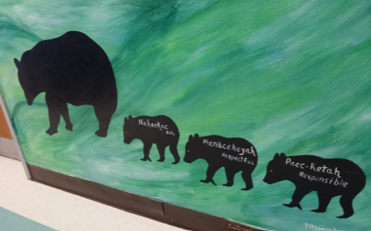
Continued Visibility
Promote joint ownership and responsibility for meeting expectations among staff, students and community
Posting expectations & matrix components per location provide reference tools for pre-correction & correction of misbehavior
Include expectation language in school-based materials: agenda books, code of conduct, school promotional items (pencils, t-shirts, etc.)
Represent expectations in various ways to support understanding (pictures/art, words)
Consider multiple languages to ensure understanding by all
Cultural considerations to ensure representation by all groups
Paula Fernandez, Wisconsin RtI Center, 2015.

Slide 29
Will you teach through Videos?
Important Considerations When Making Teaching Videos
Matching the climate of your building
Making sure they are data driven
Pairing them with follow up activities (Discussion, etc.)
Do not role-play non-examples. Videos should demonstrate the positive examples only.
Involve students in the process
Ensure students involved are representative of your student body

Slide 30
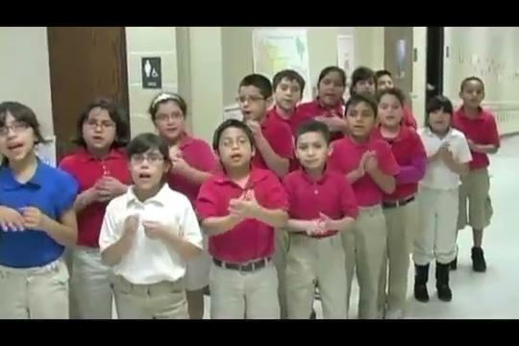
Using Instructional Videos- Bathroom Expectations

Slide 31
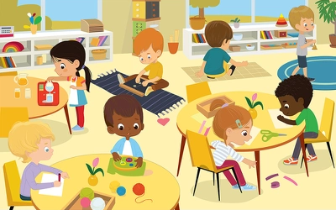
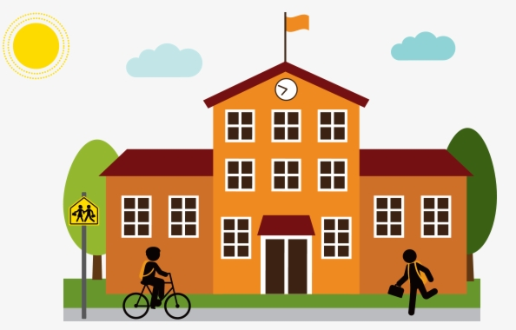
Involving Students
Classroom Teaching Plan
School-Wide Teaching Plan
Discussion of class values
Ask for preferences
Games
Role-play
Class roles
...The bonus is that involving students checks for understanding!
Arts Department
Drama club
Jingles by musical students
Photography/Videographer
Graphics by art students
Peer leaders

Slide 32
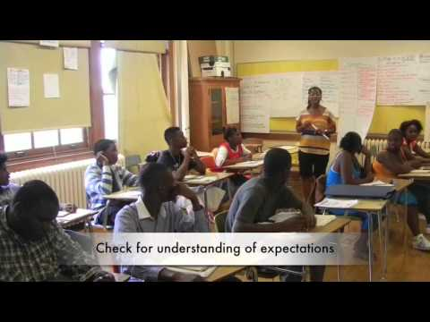
Example: Teaching high school students classroom expectations

Slide 33
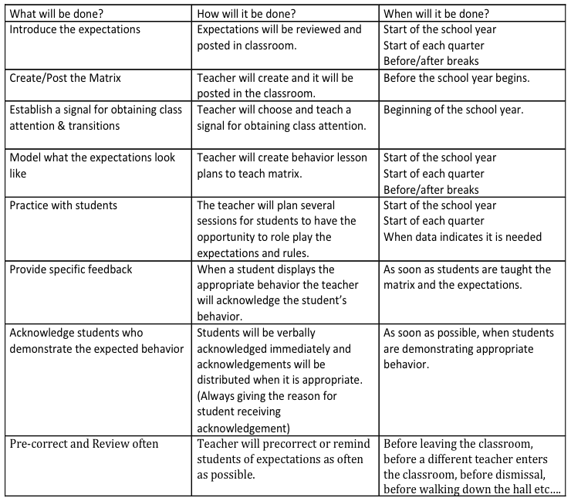
Sample Plan for Teaching Expectations
Breakout Session to brainstorm a school-wide plan!

Slide 34
Other DE-PBS Resources...
Building Habits of Effective Classroom Practice
Learn more about three highly effective classroom practices, including positively greeting students at the door/login, actively engaging students, and providing specific and corrective feedback.
PDMS Course # 29421

Slide 35
Remember…
Behavior change is an instructional process
We change STUDENT behavior
by changing
ADULT behavior
Interventions = changes in staff procedures & practices

