Slide 1
CICO: Check-In/Check-Out
An evidence-based Tier 2 intervention to help students reconnect with adults and school expectations

Slide 2
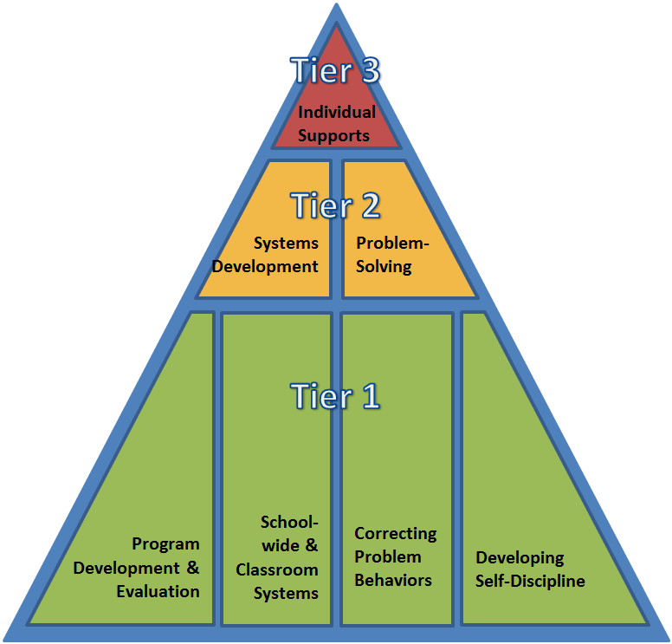
THE DELAWARE POSITIVE BEHAVIOR SUPPORT PROJECT (DE-PBS) IS AN ONGOING COLLABORATION BETWEEN THE DELAWARE DEPARTMENT OF EDUCATION AND THE UD CENTER FOR DISABILITIES STUDIES

Slide 3
Today’s Intended Audience
Educators who are looking to...
start a new Check-In/Check-Out (CICO) program
OR
improve an existing CICO program
...for students who can benefit
from additional positive adult support at the Tier 2 level.

Slide 4
Today’s Intended Audience
Educators may include:
District PBS Coaches who are support Tier 2 teams
School-Level Tier 2 Team Leads
New or Existing CICO Coordinators
Classroom Teachers, School Counselors, Support Staff, Parents

Slide 5
CICO aligns to the Multi-Tiered System of Supports (MTSS) Framework
Supporting culturally equitable Targets including SEL competence & academic achievement
OUTCOMES
Supporting culturally knowledgeable Staff Behavior
team-based leadership and coordination
professional development, coaching, and content expertise
Supporting culturally valid Data-based Decision Making
universal screening
progress monitoring
evaluation of fidelity
SYSTEMS
DATA
EQUITY
PRACTICES
Supporting Student Behavior
three-tiered continuum of culturally relevant evidence-based interventions
Adapted from
Midwest PBIS Network (2019)
Notes:
5

Slide 6
Today’s Content
What CICO Is and Is Not
The Evidence for CICO
Key Features of Tier 2 Interventions & Implementation Considerations
Key Features of CICO & Implementation Considerations
Data Tools
Conclusion and Recommended Next Steps

Slide 7
Intended Outcomes for Educators
You can more clearly identify who this intervention best works for and why.
You feel more comfortable advocating for the human resources, tools, and time needed to start and sustain a meaningful CICO program.
You can better locate, share, and use resources and tools for starting or improving CICO programming for your students.

Slide 8
Intended Outcomes for Our Students
Our students are enrolled in the best Tier 2 intervention for their interests, needs and time.
Their CICO programming is a culturally responsive, integrated, and positive intervention within their school’s MTSS framework for supporting students’ SEL and academic growth.
Our students receive even more clear and timely CICO instruction and opportunities to respond and receive positive feedback across the school day.

Slide 9
Intended Outcomes for Our Families
They receive even more explicit and timely CICO information and opportunities to see and share more positive and explicit feedback about their child.
Their child is enrolled in the best Tier 2 intervention for their interests, needs and time.
They can help make certain that their child’s CICO program is culturally responsive and reinforces their child’s SEL and academic growth.

Slide 10
Sources for Today’s Content
Center on Positive Behavior Interventions Support: Adding Check-in Check-out to MTSS (A School Climate Transformation Grant webinar, 1:03:36, Aug.2020)
CICO Initiative: Check In Check Out Video Tutorial: Educational Behavior Intervention (YouTube, 8:24, 2016)
Colorado Department of Education: CICO Self-Assessment (n.d.)
Crone, D. A., Hawken, L. S., & Horner, R. H. (2010). Responding to problem behavior in schools: The behavior education program. New York, NY: Guilford Press
Delaware PBS Project: District and school-level coaching and technical assistance
Missouri PBIS Project: Tier 2 Workbook Chapter 5 (2020)
PBISApps.org: 7 Dos and Don'ts to Ensure Your CICO Program is the Best (webpage with GIFS)

Slide 11
Manuals to Operationalize Today’s Content
Missouri Schoolwide Positive Behavior Support Project: Tier 2 Workbook - Chapter 5: Check-In, Check-Out (2017, 64 pg. manual)
Colorado Department of Education, Positive Behavioral Interventions and Supports Project’s CICO Self-Assessment and Action Plan (n.d., 10 pg. planning guide)

Slide 12
Next up...
What CICO Is and Is Not
The Evidence for CICO
Key Features of Tier 2 Interventions & Implementation Considerations
Key Features of CICO & Implementation Considerations
Data Tools
Conclusion and Recommended Next Steps

Slide 13
What CICO Is
It is a Tier 2 intervention:
for students who seek adult attention.
that uses and reinforces existing Tier 1 expectations.
to focus attention on building student strengths and confidence and reinforcing your school’s commitment to equitable supports and outcomes for students.
to help student to develop executive functioning & SEL skills they can successfully and independently use in the future.

Slide 14
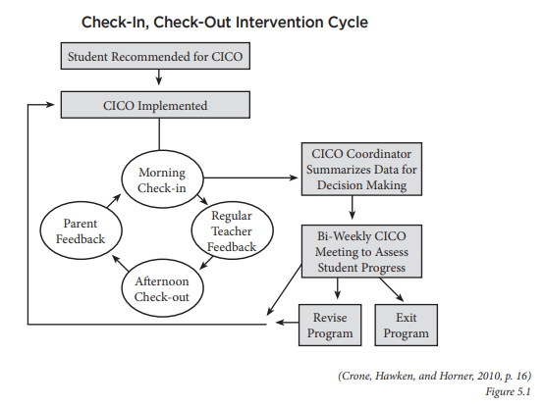
What CICO Is
Tier 2 Workbook Chapter 5
Pgs.53-54
(Missouri PBIS, 2020)
Crone, D. A., Hawken, L. S., & Horner, R. H. (2010). Responding to problem behavior in schools: The behavior education program. New York, NY: Guilford Press

Slide 15
What CICO Is Not
It is not a Tier 2 intervention:
for students who avoid adult attention.
to use in isolation of Tier 1 expectations.
to focus more attention on student concerns.
to keep a student dependent on adult supervision forever.

Slide 16
Student Engagement is a Tier 1 Intervention
Before adopting any Tier 2 intervention:
Look at Tier 1 programming areas to reinforce for students and staff
academic learning
SEL and relationship-building
prosocial behavior support
Consider updating Tier 1 tools
Universal Design for Learning strategies
Classroom & school-wide behavior matrices and lessons

Slide 17
Now...
What CICO Is and Is Not
The Evidence for CICO
Key Features of Tier 2 Interventions & Implementation Considerations
Key Features of CICO & Implementation Considerations
Data Tools
Conclusion and Recommended Next Steps

Slide 18
The Evidence Behind CICO
Daily Progress Report Program, Behavior Education Program (BEP), Hello, Update, & Goodbye (HUG program)
used in general and special education settings
resulted in changes in teacher ratings and office discipline referral changes
decreased frequency of problem behavior during academic routines
increased academic engagement
ranked as “acceptable and effective” by students and teachers
limited experimental design in research
some students may also need Tier 3 support while in CICO
(Campbell & Anderson (2011). MacLeod, Hawken, O’Neill, & Bundock,(2016). McIntosh, Campbell, Carter & Dickey (2009). Vanderbilt University. (2013).

Slide 19
The Evidence Behind CICO
Campbell, A., & Anderson, C. M. (2011). Check‐in/check‐out: A systematic evaluation and component analysis. Journal of applied behavior analysis, 44(2), 315-326.
MacLeod, K. S., Hawken, L. S., O’Neill, R. E., & Bundock, K. (2016). Combining Tier 2 and Tier 3 supports for students with disabilities in general education settings. Journal of Educational Issues, 2(2), 331–351.
McIntosh K, Campbell A, Carter D, & Dickey C. (2009). Differential effects of a tier two behavior intervention based on function of problem behavior. Journal of Positive Behavior Interventions, 11, 82–93.
Vanderbilt University. (2013). Tip Sheet: Check-In / Check-Out (CICO). https://my.vanderbilt.edu/specialeducationinduction/files/2013/07/Tip-Sheet-Check-In-Check-Out.pdf

Slide 20
Let’s Dive Deeper into the Details
Center for PBIS
Adding Check-in Check-out to MTSS (School Climate Transformation Grant webinar)
1 hr
Guidance on Adapting Check-in Check-out for Distance Learning
10 pg. practice brief

Slide 21
Now...
What CICO Is and Is Not
The Evidence for CICO
Key Features of Tier 2 Interventions & Implementation Considerations
Key Features of CICO & Implementation Considerations
Data Tools
Conclusion and Recommended Next Steps

Slide 22
Tier 2 Interventions
Key Features of Any Tier 2 intervention
Logistical Considerations
Ensuring fidelity

Slide 23
Key Features of Any Tier 2 intervention
(PBIS, 2020)
~ 3 mins

Slide 24
Logistical Considerations
(PBIS, 2020)
~ 6 mins

Slide 25
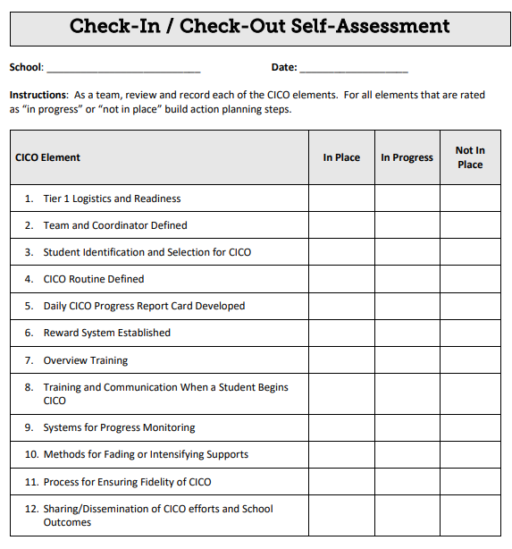
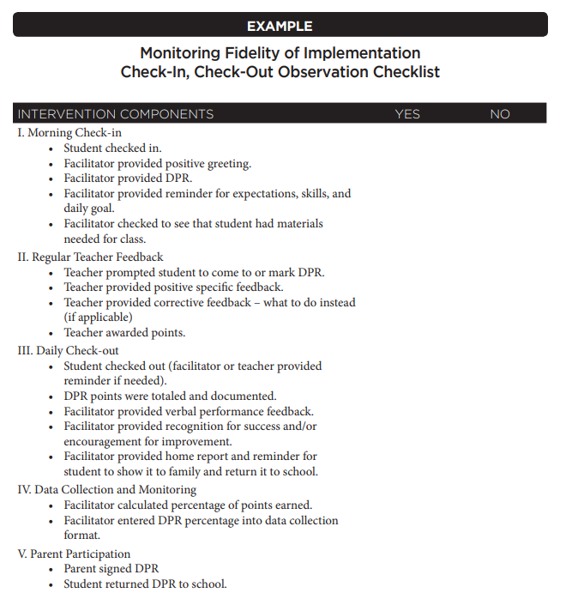
Ensuring fidelity
CICO Self-Assessment
Pgs.1
(Colorado Department of Education, n.d.)
Tier 2 Workbook Chapter 5
Pgs.53-54
(Missouri PBIS, 2020)

Slide 26
Now...
What CICO Is and Is Not
The Evidence for CICO
Key Features of Tier 2 Interventions & Implementation Considerations
Key Features of CICO & Implementation Considerations
Data Tools
Conclusion and Recommended Next Steps

Slide 27
CICO as a Tier 2 Intervention
How to determine if CICO is appropriate for your students
Key features of CICO
​Students to consider for CICO
Student and staff orientation to CICO

Slide 28
CICO: How to determine if it is appropriate for your school
(PBIS, 2020)
~ 3 mins

Slide 29
CICO: Key Features
(PBIS, 2020)
~ 5 mins

Slide 30
CICO: Students to Consider
(PBIS, 2020)
~ 3 mins

Slide 31
CICO: Staff and Student Orientation
(PBIS, 2020)
~ 5 mins

Slide 32
Now... Data Tools
What CICO Is and Is Not
The Evidence for CICO
Key Features of Tier 2 Interventions & Implementation Considerations
Key Features of CICO & Implementation Considerations
Data Tools
Conclusion and Recommended Next Steps

Slide 33
Data Sources & Tools
For the student, teachers, and family
PRIOR TO CICO/STUDENT MATCH: Request for Assistance form
DAILY: Daily Progress Report (DPR/HUG Card)
For the CICO Coordinating and supporting adults (including classroom teachers)
DAILY: Utilize a data-tracking system system for graphing, saving, and sharing DPR scores per student
DAILY/WEEKLY/FADED SCHEDULE: Utilize a data-tracking system to determine recognition schedule per student
MONTHLY: Utilize a data-tracking system to share an aggregate success percentages with Tier 2 team
For Tier 2 team:
AT LEAST MONTHLY: Review Requests for Assistance
AT LEAST MONTHLY: Review aggregate success percentages from CICO Facilitator
PERIODICALLY and/or AS NEEDED: Request CICO fidelity data

Slide 34
Data Sources & Tools
Daily Progress Report (DPR):
There are many great samples out there but you want a standardized one that fits your community - so it is based on existing Tier 1 (SW) expectations and includes easy-for-student-to-follow rating scales or visuals.
Requests for Assistance:
Make sure to include prompts related to identifying the function of behavior and student strengths and preferences.
Data-Tracking Systems:
PBS is committed to data-based decision-making to help ensure equitable and meaningful supports for students and effective use of student and staff time. 80% success at the student and aggregate level is recommended.
For the student, teachers, and family
AS NEEDED: Request for Assistance form
DAILY: Daily Progress/Points Report (DPR/HUG Card)
For Tier 2 team:
AT LEAST MONTHLY: Review Requests for Assistance
AT LEAST MONTHLY: Review aggregate success percentages from CICO Facilitator
PERIODICALLY and/or AS NEEDED: Request CICO fidelity data
For the CICO Facilitator and support staff:
DAILY: Utilize a data-tracking system system for graphing, saving, and sharing DPR scores per student
DAILY/WEEKLY/FADED SCHEDULE: Utilize a data-tracking system to determine recognition schedule per student
MONTHLY: Utilize a data-tracking system to share an aggregate success percentages with Tier 2 team

Slide 35
Ensuring equity throughout your CICO system
Consider how student voice, choice and outcomes are included throughout the intervention development and progress-monitoring process:
provide opportunities for students to determine logistical aspects of their CICO (e.g., the format of the data collection systems, who they prefer as their CICO facilitator(s), the reinforcement tools/resources)
collect and review social validity data from students and their support network
continue to collect and review aggregate outcome data trends to identify any populations of students for whom CICO is working particularly well or not and problem-solve accordingly
CICO Overview Training and Recognition
Pgs.6 & 7
(Colorado Department of Education, n.d.)
Tier 2 Workbook Chapter 5
Social Validity Scale
Pg.211
(Missouri PBIS, 2020)

Slide 36
Now... Data Tools
What CICO Is and Is Not
The Evidence for CICO
Key Features of Tier 2 Interventions & Implementation Considerations
Key Features of CICO & Implementation Considerations
Data Tools
Conclusion and Recommended Next Steps

Slide 37
Concluding Reminders:
It is a Tier 2 intervention:
for students who seek adult attention.
that uses and reinforces existing Tier 1 expectations
to focus attention on building student strengths and confidence and reinforcing your school’s commitment to equitable supports and outcomes for students.
to help student to develop executive functioning & SEL skills they can successfully use independently.

Slide 38
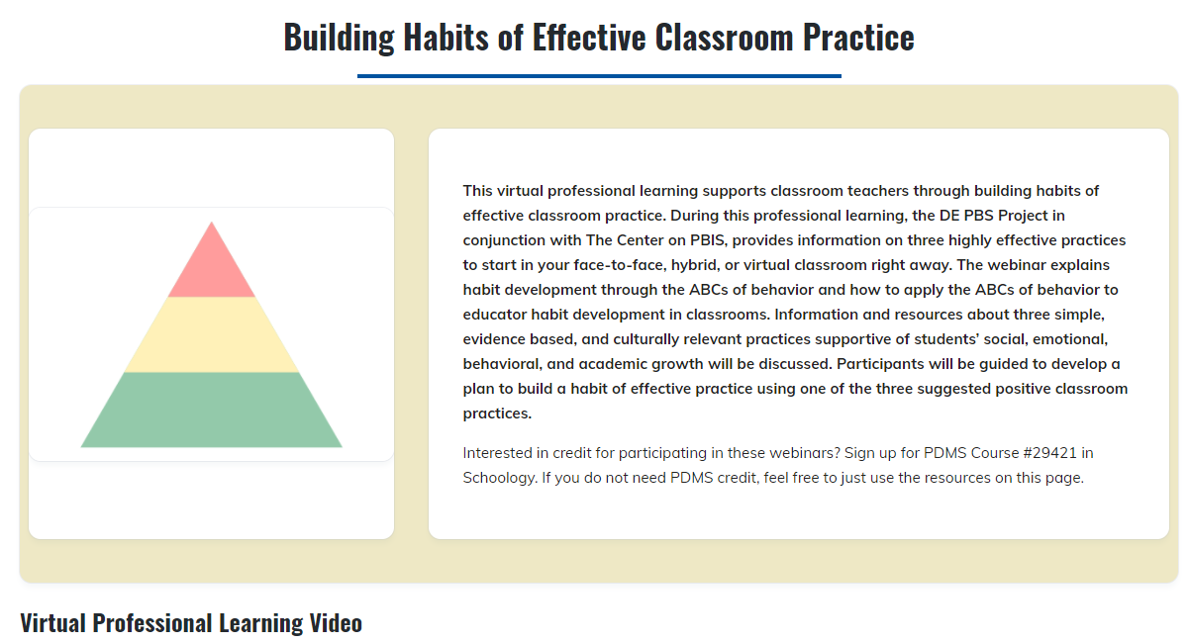
When Student Engagement is a Tier 1 Need

Slide 39
Sources for Today’s Content
Center on Positive Behavior Interventions Support: Adding Check-in Check-out to MTSS (A School Climate Transformation Grant webinar, 1:03:36, Aug.2020)
CICO Initiative: Check In Check Out Video Tutorial: Educational Behavior Intervention (YouTube, 8:24, 2016)
Colorado Department of Education: CICO Self-Assessment (n.d.)
Crone, D. A., Hawken, L. S., & Horner, R. H. (2010). Responding to problem behavior in schools: The behavior education program. New York, NY: Guilford Press
Delaware PBS Project: District and school-level coaching and technical assistance
Missouri PBIS Project: Tier 2 Workbook Chapter 5 (2020)
PBISApps.org: 7 Dos and Don'ts to Ensure Your CICO Program is the Best (webpage with GIFS)

Slide 40
Recommend Next steps:
Determine if CICO is a good match for your students and your adult resource by reviewing existing data.
Put together easy-to-follow documents, tools, videos, and/or emails to share the following with students, staff & families:
What the intervention is for and why your school is dedicated to using and using it consistently and with positive intent.
How the intervention works for everyone involved (including any related timelines).
The tools that will be used to help teach, monitor, and celebrate students enrolled in CICO.

Slide 41
You Got This & Thank you!
Delaware PBS Project
http://www.delawarepbs.org/
Fiona Lachman
Megan Pell

