Slide 1
Project DelAWARE & Interconnected Systems Framework (ISF)-Day 1
The Way Forward…
Presented by:
Kimberly Yanek, PhD

Slide 2
Learning Outcomes (Day 1)
Together we will
Share our collective celebrations & learn from our shared success
Ensure we have a shared understanding of Interconnected Systems Framework (ISF) to include our shared WHY
Explore how we (district) are organized to do this work WITH our stakeholders (teaming structures & communication loops)
Explore how we (school) are organized to do this work WITH our stakeholders (teaming structures & communication loops)

Slide 3
Learning Outcomes (Day 2)
Together we will
Explore what we are already doing & ways in which we might enhance Systems, Data, & Practices to reach identified outcomes
Explore routines for data-based decision making (universal screening process, impact & fidelity of supports provided)

Slide 4
Ensure we have a shared understanding of Interconnected Systems Framework (ISF) to include our shared WHY

Slide 5
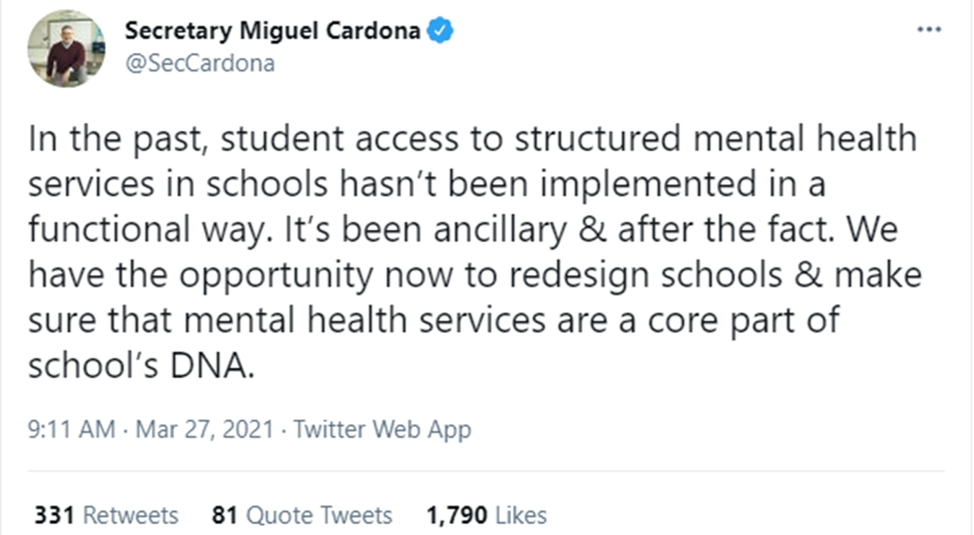

Slide 6
Addressing these needs…
Schools are front and center in this work
Traditional Approach
reach out to community or internal providers
proliferation of co-located school-based MH systems
disconnected from other school-based SEB efforts
(Eber, Perales, Hearn, 2021)

Slide 7
Addressing the needs
Through an Interconnected Systems Framework (ISF)
Creates more stream-lined, efficient approach to school mental health and wellness
Connects all SEB efforts through ONE system
Eliminates barriers inherent in systems that have previously operated separately
(Eber, Perales, Hearn, 2021)

Slide 8
So… what’s on your mind
Why do you want to use the ISF (outcomes for students, staff, families, community)?
What is the real challenge for you?
What do you want to do?
How can ISF help?
If you are saying YES to this, what are you saying NO to?
Note-taker in Google Drive
(Stanier, 2016)

Slide 9
In this present moment, it has never been more clear…
Mental health and SEL is a top priority for schools and communities
Systemically managing anxiety, depression, and the impact of trauma is necessary to ensure learning
Comprehensive systems need to have the agility to meet the needs of students, staff, and families in their current context
Data/science matters; direct resources to effective supports
Prevention & intervention at first sign of need pays off
People and relationships are key to all of the above

Slide 10
____________________________
____________________________
What do we know?
Any data specific to Delaware?

Slide 12
The Nurture Effect
We have the potential to reverse all trends and create a healthier way forward. We have a wealth of accumulated knowledge with one common theme across prevention science, behavioral and evolutionary science and that is to make people’s environments more nurturing.
(Biglan, 2015)

Slide 13
Getting to the heart of the matter

Slide 14
Let’s talk trauma…
“Trauma permeates all aspects of life- in very complex ways” (p.219)
If manifests in our biology, cognition, emotion, behavior…
It impacts our interactions with others (parenting, teaching, leading, coaching, creating, arresting, sentencing).
(Perry & Winfrey,2021)

Slide 15
An example…
We use exclusionary discipline practices at higher rates for pre-k than any other grade level
When children experience distress and trauma, there are disruptions in development (e.g., splintering development of specific skills)
May lead to overactive and overly reactive stress response
Mismatch between a child’s capabilities & unrealistic academic and SEB expectations = misunderstood behaviors
(Perry & Winfrey,2021)

Slide 16
An example…
We all know how this might play out… labels, vicious cycle of delays, engaging in predictable behaviors to support self-regulation (tapping, daydreaming, listening to music, gum chewing) that lead to exclusionary practices
Escape-motivated behavior (survival), labeled truant, troubled, …
Fight-flight-freeze response- lead to “assault” when they attempt to remove themselves from aversives
(Perry & Winfrey,2021)

Slide 17
Good intentions … missed opportunities
Education systems and mental health systems are typically
Under-resourced
Unaware of impact of trauma
Downstream efforts (system of reaction)

Slide 18
Upstream Solutions
Downstream Solutions
(A Public Health parable, credited to Irving Zola, and illustrated in Upstream by Dan Heath)

Slide 19
A big consideration for why we engage in Interconnected Systems Framework
A whole population need requires a whole population response…
We need more expertise in our schools and we need to re-position how we use our ‘experts’
What do we do to create opportunities for healing for all within our systems?
Opportunities to engage in both technical and adaptive change.
(Perry & Winfrey,2021)

Slide 20
Equitable Systems of Support…
Technical Change
Adaptive Change
Change or adaptations to practices or instruction
Involve learning new strategies or tools to use with students
Important, but may not reflect deeper change
Changes in Values, Beliefs, Roles, Relationships, Bias, & Approaches
More likely to occur after technical change as a result of experiencing successes and seeing the potential for equitable outcomes through the use of effective strategies (Guskey, 1986)
Change in Student Outcomes
(Leverson, Smith, Rose, McIntosh, Rose, & Pinkelman, 2021)

Slide 21
What’s on your mind? What other considerations do we want to raise?
Let’s Chat

Slide 22
Leveraging the Strengths of PBIS and SMH
PBIS offers a solid foundation
Research based public health prevention framework
Focus on prevention and solid universal practices
Data-informed decision-making routines, structures
Strong focus on implementation structure
Engages all stakeholders (voice, choice, agency)
but more is needed as schools struggle to implement effective interventions at Tiers 2 and 3.
Mental Health
More depth, options, & quality of advanced levels of intervention
Include focus on externalizing & internalizing behaviors
Focus on strong response system
(Splett et al., 2017)

Slide 23
Together, through ISF, we ...
Utilize the strengths of a multidisciplinary team to support implementation
Simplify process for accessing broader range & dose of supports, including school mental health services
Increase number of youth who need support, actually receiving treatment services
Decrease latency between need identification & intervention
Broader community and mental health data utilized to inform need
(Splett et al., 2017)

Slide 24
Need for Interconnected Systems
Ad hoc and weak connections of community mental health providers in schools
Need for community partners to be integrated into school teams;
Need for funding/support for partners to function at Tier 1 and 2 vs only “co-located” at Tier 3
Need for systematic MOUs to clarify roles and functions of integrated teams/work

Slide 25
ISF Applies MTSS Features to all SEB supports/interventions
Effective teams that include community mental health providers
Data-based decision making that include school data beyond ODRs
and community data
Formal processes for the selection & implementation of evidence-
based practices (EBP) across tiers with team decision making
Early access through use of comprehensive screening, which includes
internalizing and externalizing needs
Rigorous progress-monitoring for both fidelity & effectiveness of all
interventions regardless of who delivers
Ongoing coaching at both the systems & practices level for both
school and community employed professionals

Slide 26
Value Added through ISF (what will be different)
Move from co-located to single system of delivery for all SEB support
Deliberate application of PBIS for all SEB interventions
Aligning all related initiatives through one system at the district & school level
Moving from co-located mental health model to an integrated model
All SEB interventions are designed, delivered, and monitored through one set of teams
Clinicians actively participate in teams, share data and are part of system problem solving
District/community leadership team & identified coaches (from both education & mental health) support efforts within the school

Slide 27
Using Core Features to Improve the System
Sample Responses won’t be enough |  | Using ISF Logic
Hire social emotional experts |  | Participate in teams across tiers: Strengthen Tier 1 and focus on Tier 2 System. Adapt role to include building capacity of ALL staff.
Select Social Emotional Behavioral (SEB) curriculum |  | Formal process, team-based decision. Data used to prioritize skills. All instructional staff model, teach alongside academic content.
Train staff on trauma-informed practices |  | Team based training. Time to embed new learning. Time to develop evaluation plan.
Strengthen partnerships with families and community providers. |  | Expanded Team uses problem solving logic with school AND community data to inform efforts across all tiers.

Slide 28
What else looks different?
Clinicians no longer have separate meetings to select and monitor interventions but instead engage with teachers and other school staff to select and monitor interventions through one set of teams. (Note: Clinicians may want to repurpose their current ‘mental health’ meetings as a form of peer clinical supervision where fidelity and accuracy of different evidence-based practices are discussed.)
The integrated system moves from a referral (which implies a ‘hand off’ of a student from one team to another) to a request for assistance process, further delineating decision-making through a single set of teams that include both agency and school staff.
All interventions, including individualized supports provided by clinicians, are specifically described to include dosage, frequency and the assessment process; progress monitoring, fidelity and outcome measures are agreed upon by teams before initiating interventions.

Slide 29
Key Messages
Single System of Delivery
1
2
Access is NOT enough
Mental health is for ALL
3
4
MTSS is essential to install SEB MH, wellness

Slide 30
1. Single System of Delivery One set of teams
What Does it Look Like?
Invest in one set of school “behavioral health” teams organized around tiers.
Flexibility of funding to allow community employed staff to serve on teams and assist serving ALL students.
Role and function of staff are explicitly stated in MOU.
ALL Requests for Assistance managed within one set of teams.
ALL school and community employed staff take part in teaching Social/Emotional/Behavioral (SEB) necessary to navigate social situations, school, family and work environments.
Community and School MH staff serve on leadership team and make decisions as a TEAM
Symmetry of Process
State
County
District
School
A seamless system for accessing interventions
Both school and community based supports

Slide 31
2. Access is NOT Enough Success is defined by student impact
What Does it Look Like?
The District and School team includes community providers, families, students and persons who have authority to make structural changes within their organizations.
Teams works collaboratively with leaders to continuously assess student needs, implement programs, and eliminate, adjust, replace programs at all tiers to increase their impact on students.
Ineffective programs or practices are eliminated.
Interventions are evidenced based and matched to presenting problem using data
Interventions are progress monitored for fidelity and impact
Teams are explicit about intervention description (what, when, how long)
Skills taught in Tier 2/3 interventions are assessed across all tiers by ALL Staff across ALL settings linked to Tier 1 Social Emotional Behavioral (SEB) instruction
-

Slide 32
3. Mental Health is FOR ALL From Few to ALL
What Does it Look Like?
ALL staff are trained and supported through PD plan/coaching process.
MOU defines roles of all staff working in schools.
Clinician role includes support of systems and support of ALL adults as well as delivery of some interventions with students.
Teachers provide social emotional behavior (SEB) instruction along with academic content.
District Leadership prioritizes Staff Wellness
Integrate SEB competencies into PBIS Matrix
Vast majority of students will benefit from safe, predictable, positive nurturing environment, mentoring and academic support.
Universal Screening to identify ALL possible MH/Behavioral needs (externalizers and internalizers)
Need MH experts to triage and identify students with positive screen to determine next steps. However, not all interventions require clinical expertise
-

Slide 33
4. Use MTSS Framework Need implementation science to guide the work
What Does it Look Like?
The system models a Public Health Approach
All initiatives/programs are aligned and installed with core features of MTSS
The continuum of evidence-based interventions are linked across tiers, with dosage and specificity of interventions increasing from lowest to highest tiers.
Data-based decision making is used at all tiers with type of data matched to specifics and complexity of interventions.
A formal process for selecting and implementing evidence-based practices is established.
Comprehensive screening allows for early access to interventions.
Progress monitoring for both fidelity and effectiveness;
Skills taught in Tier 2/3 interventions are supported by ALL Staff across ALL settings linked to Tier 1 SEB instruction
Ongoing professional development and coaching to ensure fluency and to guide refinement of implementation.
-

Slide 34
Public Health Implementation Framework Social Emotional and Behavioral Mental Health
We organize our resources
Multi-Tier Mapping, Gap Analysis
So kids get help early
Actions based on outcomes (data!), not procedures
We do stuff that’s likely to work
Evidence-Based interventions
We provide supports to staff to do it right
Fidelity: Benchmarks of Quality
And make sure they’re successful
Coaching and Support
Progress monitoring and performance feedback
Problem-Solving process
Increasing levels of intensity

Slide 35
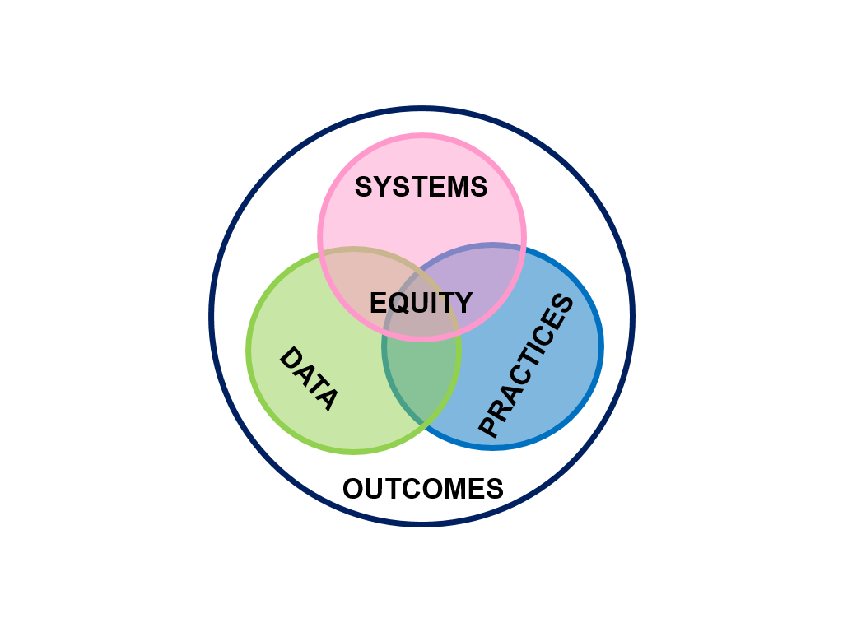
Core Features

Slide 36
Resources for a Deeper Dive
Delaware Team & Google Drive- Briefs, Resources have been made available.
An Introduction to PBIS 2.0 (An Interconnected Approach) https://www.pbis.org/video/an-introduction-to-the-interconnected-systems-framework

Slide 38
Step 1: Establish a District/Community Executive Leadership Team
Tasks | Installation Activities | Action Needed: | By Who? By When?
Representative DCLT team identified. Provide authority and problem solving needed to overcome organizational barriers and implement the efficiencies needed to functionally interconnect education, behavioral and mental health supports. Present concerning data and needs to those with authority and propose a way of working. | Assess current teaming structures. Identify need for new team or expansion of existing team
 | Review current partnerships and service agreements with community partners and/or in area. Executive level leadership from each organization are part of the team.
 | Establish team operating procedures (e.g.: time for team to meet at least quarterly, roles for team, process for forming agenda, etc.)
Guiding Questions:
Which voices with social-emotional-behavioral health expertise within school system could benefit this team? Which voices of mental health, juvenile justice, core service agency partners could benefit this team? In what ways are we ensuring that multiple stakeholders’ voices (i.e.: staff, MH agencies, parents/families, students, etc.) will stay at the table through the development of systems and overall implementation?

Slide 39
So… what’s on your mind?
Why do you want to use the ISF (outcomes for students, staff, families, community)?
What is the real challenge for you?
What do you want to do?
How can ISF help?
If you are saying YES to this, what are you saying NO to?
(Stanier, 2016)
Individual Reflection

Slide 40
A next step…What is your why? (in observable and measurable terms ☺)
Family
Student:
Academic Indicators:
Non-academic Indicators:
Student
Classroom
Community
School
District
State
Group Reflection Google Doc
(Attribution: Brandi Simonsen)

Slide 41
Explore how we (as a district) are organized to do this work WITH our stakeholders (teaming structures & communication loops)
Stakeholders include staff, students, families, communities

Slide 42
Intentions
Creating an effective MTSS District Community Leadership Team (DCLT) to drive the structures needed to support an ISF.
Reflect on membership to ensure the needed SEB/MH voices are on the team. Explore engaging & maintaining youth and family voice.

Slide 43
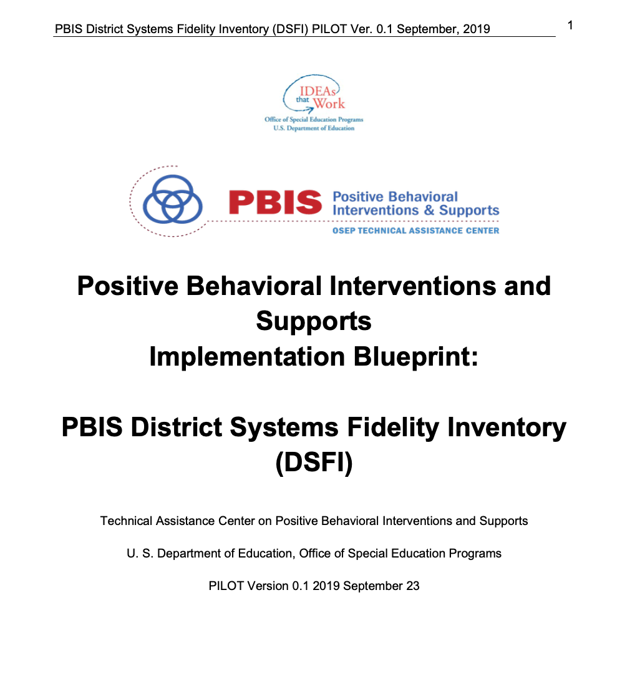
District System Fidelity Inventory & Installation Guide

Slide 44
ISF District Leadership Installation Guide
Step 1: Establish a District/Community Executive Leadership Team
Tasks | Installation Activities | Action Needed: | By Who? By When?
Representative DCLT team identified. Provide authority and problem solving needed to overcome organizational barriers and implement the efficiencies needed to functionally interconnect education, behavioral and mental health supports. Present concerning data and needs to those with authority and propose a way of working. | Assess current teaming structures. Identify need for new team or expansion of existing team
 | Review current partnerships and service agreements with community partners and/or in area. Executive level leadership from each organization are part of the team.
 | Establish team operating procedures (e.g.: time for team to meet at least quarterly, roles for team, process for forming agenda, etc.)
Guiding Questions:
Which voices with social-emotional-behavioral health expertise within school system could benefit this team? Which voices of mental health, juvenile justice, core service agency partners could benefit this team? In what ways are we ensuring that multiple stakeholders’ voices (i.e.: staff, MH agencies, parents/families, students, etc.) will stay at the table through the development of systems and overall implementation?

Slide 45
Core Features

Slide 46
A next step…What is your why? (in observable and measurable terms ☺)
Family
Student:
Academic Indicators:
Non-academic Indicators:
Student
Classroom
Community
School
District
State
Group Reflection Google Doc
(Attribution: Brandi Simonsen)

Slide 47
Foundational Component of MTSS ISF …
Interdisciplinary Collaboration & Teaming
…and diverse
District Community Leadership Team
Notes:
•

Slide 48
Why is teaming so important?
Mitigating the impact of trauma asks us to consider teaming as a strategy for technical & adaptive change
Technical Changes
Data informed decision-making routines
Alignment and/or integration of efforts/initiatives/funding/policies
Team initiated problem solving (TIPS) to build routines
Ensures diverse perspectives
Adaptive changes
Opportunities to engage in empathy (perspective-taking without judgment, acknowledging emotions, & honoring others’ truth)
Opportunities to heal (building trust, safety, productive dialogue)
(Perry & Winfrey,2021)
Notes:
.

Slide 49
A diverse interdisciplinary team…
Inclusion of multiple and diverse stakeholders and perspectives on teams ensures the likelihood of equity
Diverse in terms of both identities and roles
Which voices with social-emotional-behavioral health expertise (e.g., both those with credentials & and those with lived experiences) within school system could benefit this team
What makes this important to you and your district/school communities?

Slide 50
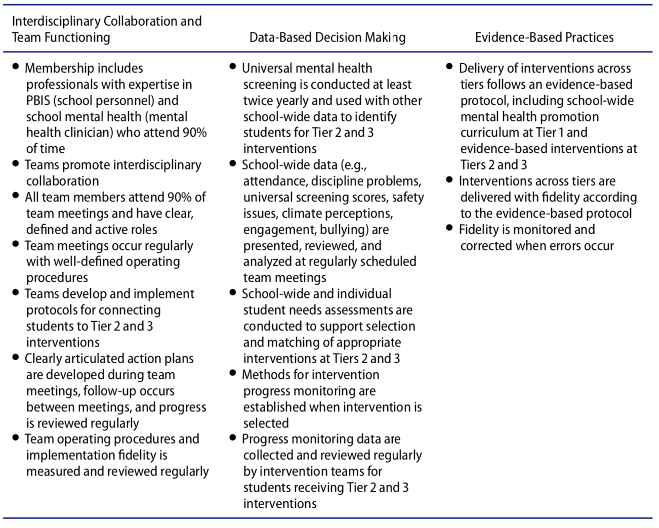
(Splett, et all, 2017)

Slide 51
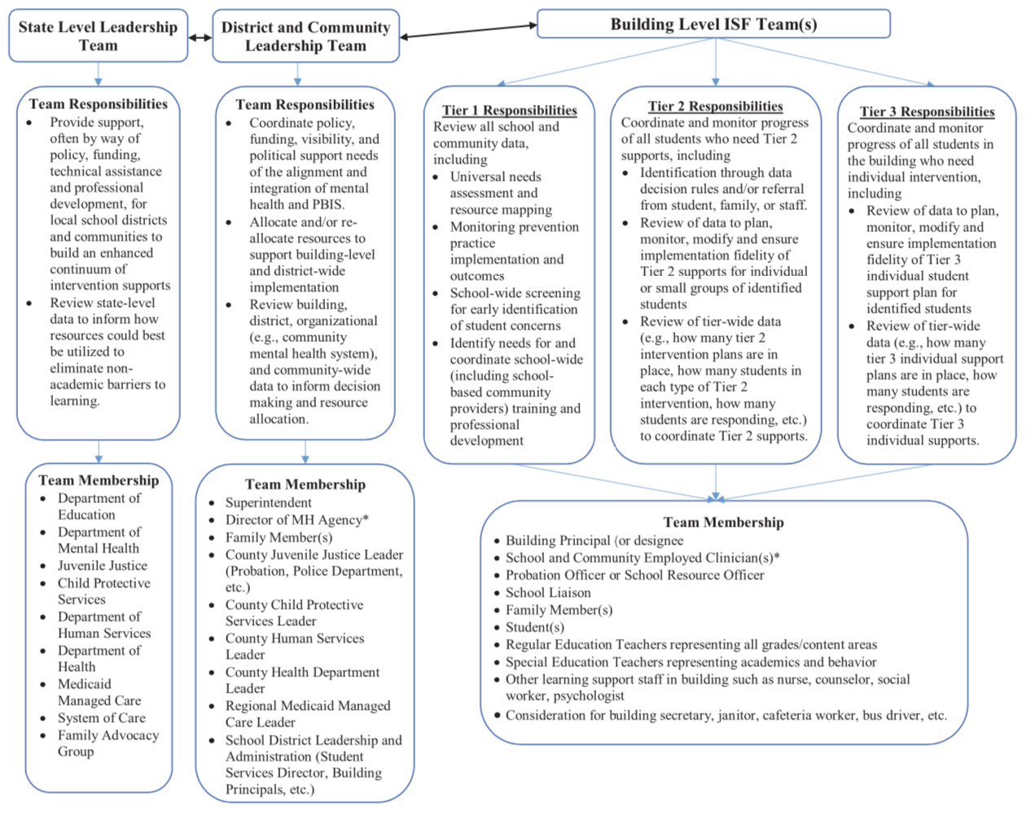
(Splett, et all, 2017)

Slide 52
District Role: support ISF implementation at school level
Coordinate policy, visibility, funding, & political support needs to align PBIS/MTSS and MH
Secure and allocate resources (fiscal, personnel)
Decision-making leadership (e.g., policy, MOUs to outline staff time utilization)
Administrative (e.g., supervision, communication routines/loops)
Address any issues around confidentiality
Ensure voice and agency from stakeholders (families, youth, educators, mental health providers, community)
Decisions around universal screening for SEB-W concerns
Ensure schools have enhanced continuum of supports
District level data-informed decisions across schools & communities (e.g., evaluation of fidelity impact, social validity; data informed PD)
SEB-W expertise (both those with credentials & those with lived experiences)

Slide 53
Possible example: Clinician potential change in role/partnership
Facilitation
Coordination
Consultation
Follow up conversation
Graphic Attribution: Midwest PBIS

Slide 54
What might Team Membership look like?
Superintendent
Director of MH Agency
Family members
Community leaders
County Juvenile Justice Leader (probation, police dept, etc.)
County Human Services Leader
County Health Dept Leader
Regional Medicaid Managed Care Leader
School District Leadership & Administration (students, services director, administrators, teachers, human resources)

Slide 55
Youth & Family Voice
How are we organized to do WITH and not do TO?
Notes:
.

Slide 56
Student Voice to Support Mental Wellness
Baltimore City youth
https://drive.google.com/file/d/1DCdYgZdR9Nvo72ZJPkl1fuB0cvgpt2Ct/view?usp=sharing

Slide 57
mindFull me
https://mindfullme.org/

Slide 58
Intergenerational
Attribution: Patti Hershfeldt

Slide 59
Guiding Questions
Which voices with social-emotional-behavioral health expertise (e.g., both those with credentials & and those with lived experiences) within school system could benefit this team?
Which voices of mental health, physical health, juvenile justice, and community partners could benefit this team?
In what ways are we ensuring that multiple stakeholders’ voices (staff, MH agencies, parents/families, students, community partners, etc.) will remain engaged through the development of systems and overall implementation?

Slide 60
How are you currently organized to achieve the outcomes you have identified (your why’s for doing this work)?
Teaming Structure Alignment/ Working Smarter, Not Harder

Slide 61
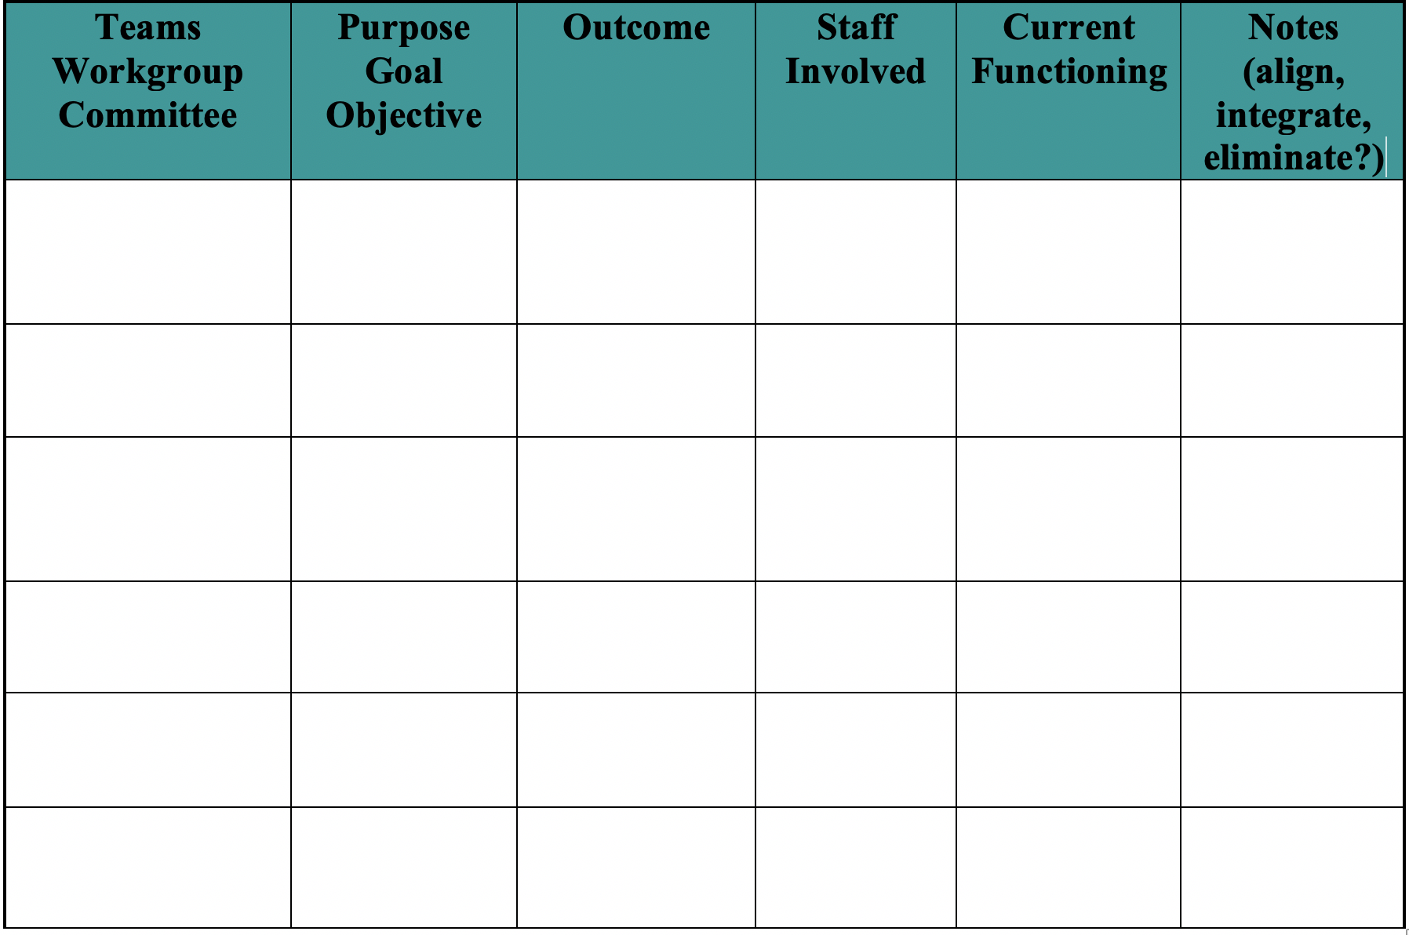

Slide 62
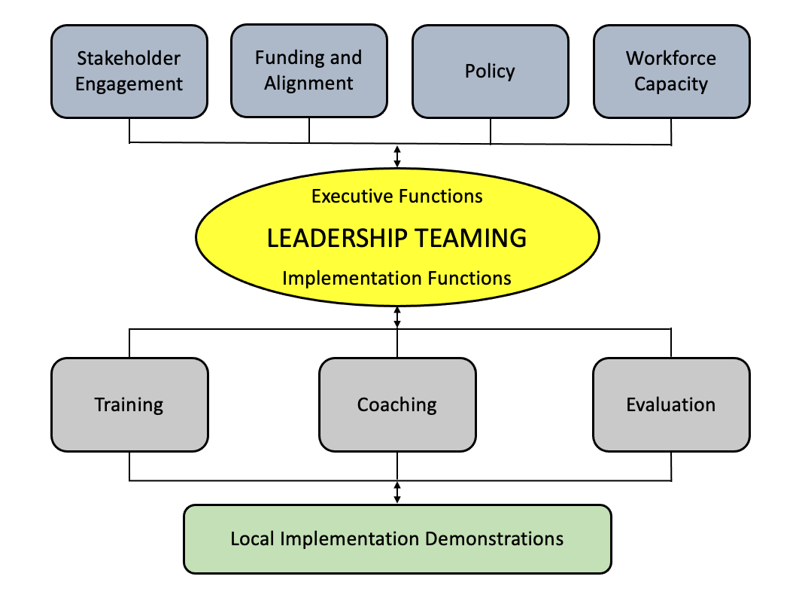
The District Community Leadership Team is a collection of personnel who serve two main functions, a) executive functions (e.g., creating policy, aligning resources) and b) implementation functions (e.g., supporting individual school teams).

Slide 63
Team Operating Procedures
Meets monthly
Standard Meeting Agenda & Problem-Solving Process (e.g., Team-Initiated Problem-Solving Process (TIPS)
Bi-directional communication plan
Team norms co-created by team members, revisiting whenever new team members join the team

Slide 64
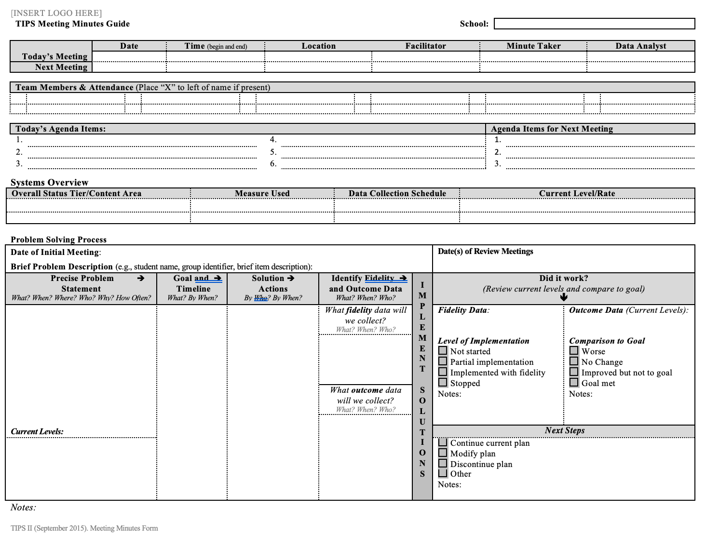
Team-Initiated Problem-Solving Process (TIPS, https://www.pbis.org/topics/data-based-decision-making

Slide 65
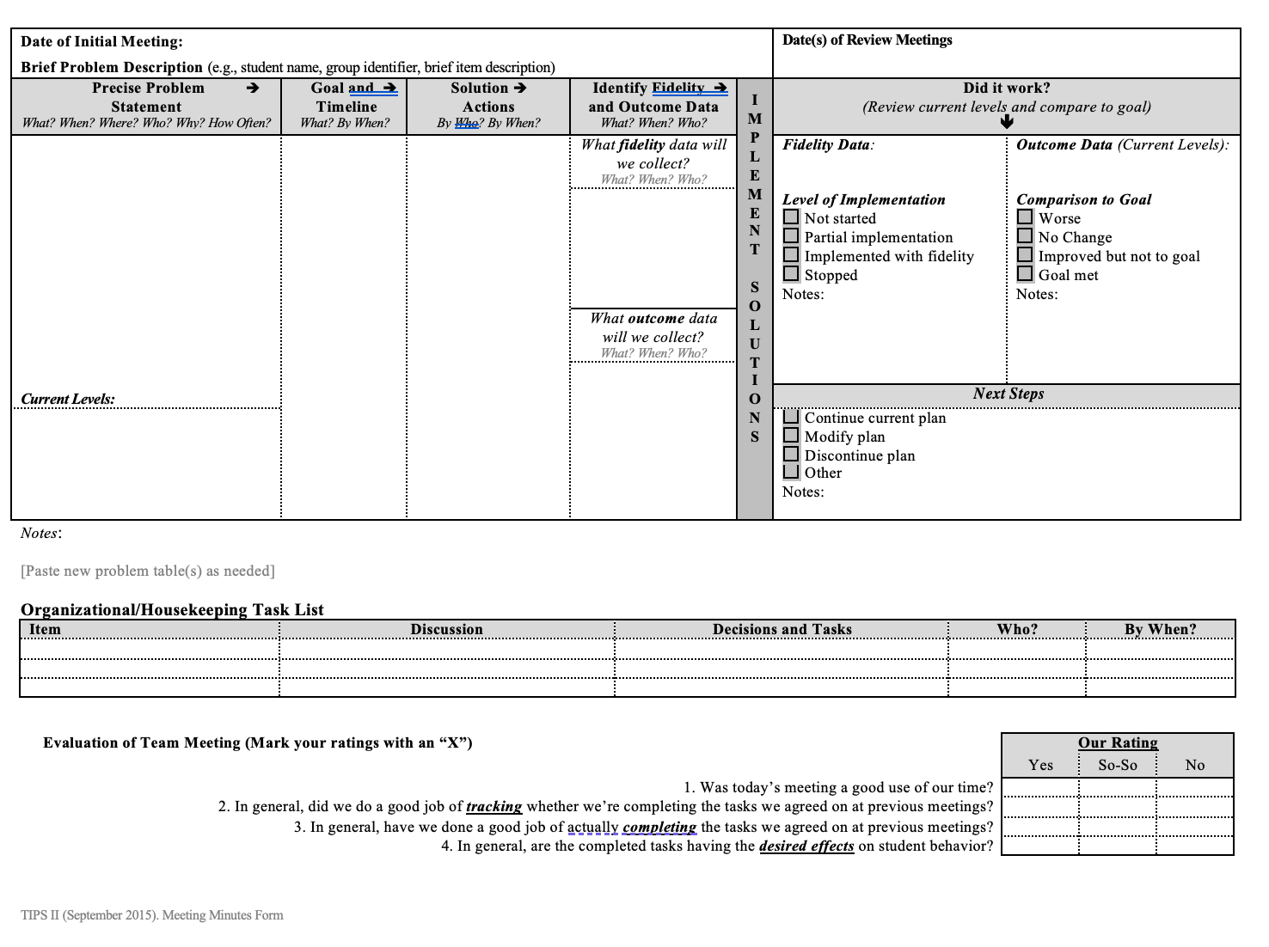
Team-Initiated Problem-Solving Process (TIPS, https://www.pbis.org/topics/data-based-decision-making

Slide 66
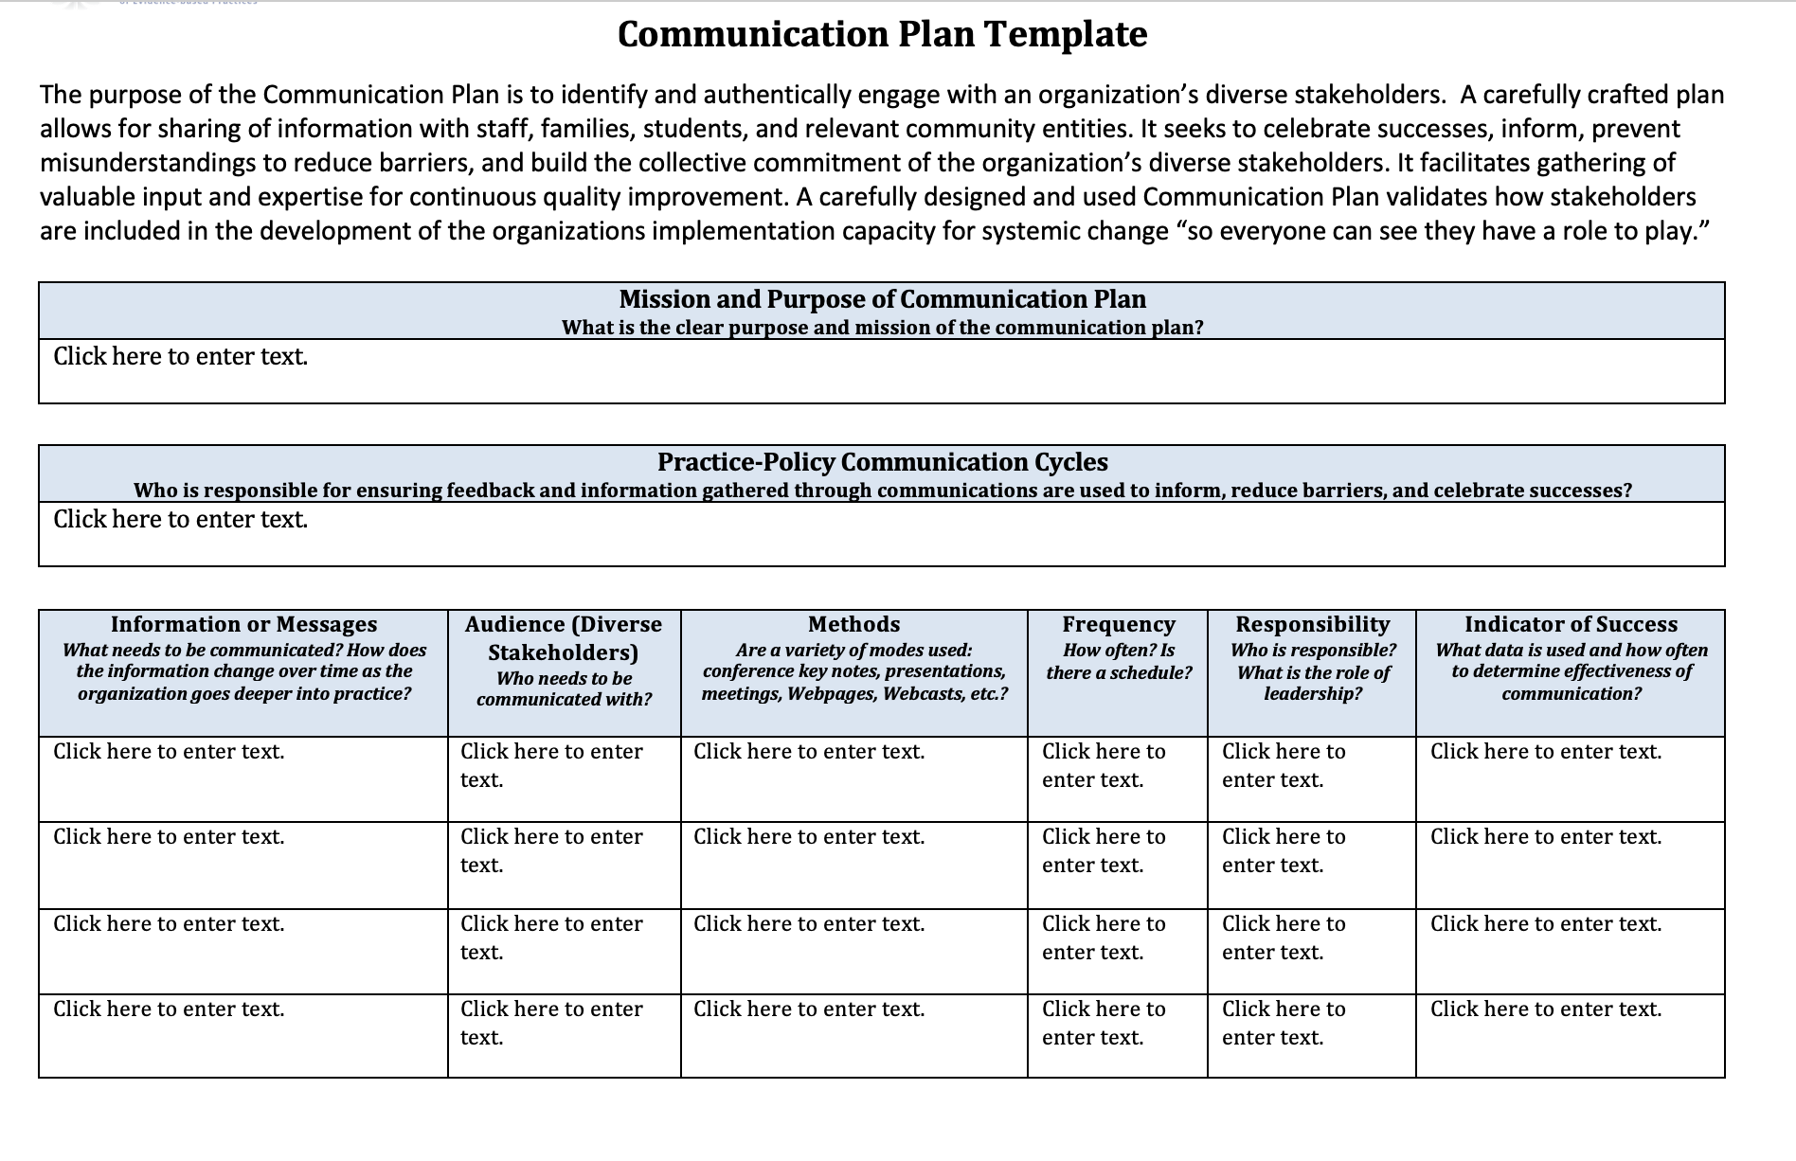

Slide 67
Expectations/ Values | Behaviors/Skills/Norms
We are Responsible | Make yourself comfortable (wellness) Take care of your needs (biology, mental, emotional) (wellness) Consider, I am not here to be right, I am here to Get It Right (practice empathy)
We are Respectful | Listen to understand Use “Oops” and “Ouch” Assume best intentions Practice perspective-taking
We are Safe | Ask for clarity to understand and contribute Create a safe space that invites open dialogue and vulnerability – Consider the 3 Gates of Speech: Is what you want to say Kind? True for you? Necessary?
(practice empathy)
Notes:
‹#›

Slide 68
Step 1: Establish a District/Community Executive Leadership Team
Tasks | Installation Activities | Action Needed: | By Who? By When?
Representative DCLT team identified. Provide authority and problem solving needed to overcome organizational barriers and implement the efficiencies needed to functionally interconnect education, behavioral and mental health supports. Present concerning data and needs to those with authority and propose a way of working. | Assess current teaming structures. Identify need for new team or expansion of existing team
 | Review current partnerships and service agreements with community partners and/or in area. Executive level leadership from each organization are part of the team.
 | Establish team operating procedures (e.g.: time for team to meet at least quarterly, roles for team, process for forming agenda, etc.)
Guiding Questions:
Which voices with social-emotional-behavioral health expertise within school system could benefit this team? Which voices of mental health, juvenile justice, core service agency partners could benefit this team? In what ways are we ensuring that multiple stakeholders’ voices (i.e.: staff, MH agencies, parents/families, students, etc.) will stay at the table through the development of systems and overall implementation?

Slide 69
Team Reflection & Planning Time
What are our shared outcomes (our reason for using ISF)?
How are you currently organized to do this work and what adjustments might enhance your ability to do this work (teaming structure alignment/working smarter)?
What other voices could contribute to the effectiveness of this team (see guiding questions)?
How do you already include youth & family voice and in what ways might you enhance your efforts (teaming, communication plan, leverage existing efforts)?
What team operating procedures do you currently include as part of the district way of work (WOW) and what practices might enhance your effectiveness & efficiency (TIPS, team norms)?

Slide 70
What are our shared take aways today?

Slide 71
Explore how we (as a school) are organized to do this work WITH our stakeholders (teaming structures & communication loops)
Stakeholders include staff, students, families, communities

Slide 72
Intentions (from agenda)
Utilize team and membership inventories to merge teams with similar goals to include needed voices.
Establish roles and functions of teams across tiers of support and explore changing roles of staff (e.g., school clinicians).

Slide 73
Core Features

Slide 74
A next step…What is your why? (in observable and measurable terms ☺)
Family
Student:
Academic Indicators:
Non-academic Indicators:
Student
Classroom
Community
School
District
State
(Attribution: Brandi Simonsen)

Slide 75
Foundational Component ISF …
Interdisciplinary Collaboration & Teaming
…and diverse
District Community Leadership Team
Notes:
•

Slide 76
A diverse interdisciplinary team…
Inclusion of multiple and diverse stakeholders and perspectives on teams ensures the likelihood of equity.
Diverse in terms of both identities and roles
What makes this important to you and your district/school communities?

Slide 77
Why is teaming so important?
Mitigating the impact of trauma asks us to consider teaming as a strategy for technical & adaptive change
Technical Changes
Data informed decision-making routines
Alignment and/or integration of efforts/initiatives/funding/policies
Team initiated problem solving (TIPS) to build routines
Ensures diverse perspectives
Adaptive changes
Opportunities to engage in empathy (perspective-taking without judgment, acknowledging emotions, & honoring others’ truth)
Opportunities to heal (building trust, safety, productive dialogue)
(Perry & Winfrey,2021)

Slide 78
A diverse interdisciplinary team…
Inclusion of multiple and diverse stakeholders and perspectives on teams ensures the likelihood of equity
Diverse in terms of both identities and roles
Which voices with social-emotional-behavioral health expertise (e.g., both those with credentials & and those with lived experiences) within school system could benefit this team
What makes this important to you and your district/school communities?

Slide 79
Systems Planning Tool for School-Based Teams
Multidisciplinary Tier 1 Team | Multidisciplinary Tier 2 Systems Team | Multidisciplinary Tier 3 Systems Team
Coordinates and monitors support for all students, all staff, and all settings Focuses on prevention and early identification of student needs across the school/community Monitors data to identify when and how to adjust system to meet the needs of whole school/community Develops decision rules for when a student receives additional interventions Reviews aggregate data from both school and community Identify data-informed PD & coaching Bi-directional Communication plan | Coordinates and monitors interventions for groups of students needing support beyond Tier 1 Ensures data-based selection of evidence-based practices for small groups of students Monitors and ensures timely access for students identified through data and/or request for assistance from student, family, or staff Reviews how many interventions are in place, how many students are supported through each intervention, and how many of those students are responding | Coordinates and monitors interventions for all students receiving individual interventions Ensures data-based selection of evidence-based practices for individual students Monitors the number of students receiving individual interventions Evaluates the number of students are responding to individual intervention Considers needs for additional staff PD and coaching as needed per aggregate data review of effectiveness
Notes:
This figure provides descriptions of the essential functions of the teams, illustrating the shift away from discussing individual students to monitoring and supporting the effectiveness of the multi-tiered systems.

Slide 80
What might Team Membership look like?
Principal or designee
School & community employed clinicians (across tiers)
Experience with applied behavioral expertise, coaching expertise
School Resource Officer (if utilized in school)
Family member(s)
Students
General education teachers across grade levels/departments
Special education teachers across academic & behavior
Learning support staff (nurse, counselor, social worker, psychologist, coaches)
Community members
Consider office administrative, custodians, cafeteria staff, bus driver, etc.
Multiple agency participation (Tier 3)
Notes:
Universal screening- identify instrument to be used, the process and timelines for roll out, how parents will be informed and what type of consent if any is needed.
Ensure school screen for seb concerns

Slide 81
Conversation… Changing Role of the Clinician

Slide 82
Possible example: Clinician potential change in role/partnership
Facilitation
Coordination
Consultation
Follow up conversation
Graphic Attribution: Midwest PBIS

Slide 83
Guiding Questions
Which voices with social-emotional-behavioral health expertise (e.g., both those with credentials & and those with lived experiences) within school system could benefit this team?
Which voices of mental health, physical health, juvenile justice, and community partners could benefit this team?
In what ways are we ensuring that multiple stakeholders’ voices (staff, MH agencies, parents/families, students, community partners, etc.) will remain engaged through the development of systems and overall implementation?

Slide 84
Guiding Questions
How will you recruit family representation for your building level teams?
What community partners already provide supports to students in your district or building?
What resources exist in your community that you might support the needs in your district or building?
What barriers might you have to move to expand your teams to include community partners?
Based on your building’s needs and priorities, what action steps might you need to take in developing teams?

Slide 85
How are you currently organized to achieve the outcomes you have identified (your why’s for doing this work)?
Teaming Structure Alignment/ Working Smarter, Not Harder

Slide 86
Alignment of Initiatives Related to PBIS is Guided by the Six MTSS Features
McIntosh, K.& Goodman, S. (2016). Integrated Multi-Tiered Systems of Support: Blending RTI and PBIS. New York: Guilford Press.
Academic RTI
Schoolwide PBIS
Focus on teaming
Scientifically based interventions
Instruction as prevention
Tiered continuum of supports with increasing intensity based on need
Regular screening for early intervention
Use of a problem-solving model and data-based decision rules
Emphasis on improving quality of implementation
Embedded into school improvement plan
Specific social behavior assessments and interventions
Use of free materials that are adapted to fit the school’s context
Use of indirect assessment of behavior
Continuous assessment of social behavior with existing data sources
Focus on schoolwide teaming
Described in IDEA as schoolwide prevention and individual intervention approach
Specific academic assessments and interventions
Use of published curricula selected by school or district
Use of direct assessment of skills
Periodic assessment through benchmarking periods
Focus on grade-level teaming
Described in IDEA as special education eligibility determination approach
Team based leadership and coordination
Evaluation of implementation fidelity
Three-Tiered Continuum of evidence-based practices
Continuous data-based progress monitoring and decision-making
Comprehensive universal screening
On-going professional development including coaching with local content expertise
Core Features of MTSS

Slide 87
Teaming at Tier 2
Problem-Solving ‘conversation’
Monitors effectiveness of CICO, S/AIG, Mentoring, and Brief FBA/BIP supports
Review data to make decisions on improvements to the interventions
Individual students are NOT discussed
Intervention Team ‘conversation’
Develops plans for one student at a time
Every school has this type of meeting
Teachers and family are typically invited

Slide 88
Necessary Team Conversations in a 3-Tiered System of Support
Tier 2 Systems Team
Uses data to progress monitor intervention fidelity and effectiveness. Addresses systems barriers to implementation.
Uses data to progress monitor intervention fidelity and effectiveness. Addresses systems barriers to implementation.
Tier 1 Team
Function Based Problem Solving Team
Tier 3 Systems Team
Plan School-wide & Class-wide supports for students and staff:
Data Systems
Teaching Systems
Acknowledgement Systems
Communication Systems
Creates individualized plans based on function for individual youth and/or Identifies appropriate intensified supports.
Members (functions) include: Administrator, Tier 2 Coach, clinician, intervention coordinators,
Members (functions) include: Administrator, Tier 2 Coach, FBA/BIP Coordinator, clinician, staff voice & teacher, caregiver, student of any individual plans generated
Members (functions) include: Administrator, Tier 3 Coach, clinician, intervention coordinators,
Members (functions) include: Administrator, Tier 1 Coach, staff, student, family,
Universal Support
CICO
Brief FBA-BIP Development
FBA-BIP
Modified CICO
Wraparound
Other Problem Solving Process
RENEW
SEB Instructional Groups
Rev 4/14/20 West-MWPBIS
Notes:
‹#›
‹#›
“At the top, pay attention to the word ‘Conversations’
You have these teams/conversations taking place for the difference components of your systems development and implementation and progress-monitoring of your practice
This team is talking about the system. How is that different than the FBA Problem-solving team?
Tier 3 team is also focused on building the interventions, not working on individual students. The individual student teams are the bottom boxes of “Complex FBA/BIP” and “Wrap/RENEW”

Slide 90
Team Operating Procedures
Meets monthly
Standard Meeting Agenda & Problem-Solving Process (e.g., Team-Initiated Problem-Solving Process (TIPS)
Bi-directional communication plan
Team norms co-created by team members, revisiting whenever new team members join the team
Roles (Coach/Facilitator/Team Leader, Recorder/Minute Taker, Time Keeper, Reporter, Data Analyst, Team Member, Team Administrator)
Notes:
DE roles list: https://docs.google.com/document/d/1ZcbwmTmtyQ-3qHMH6EyGvCtpsKudJaUUPvWHLRvKUX8/edit?usp=sharing

Slide 91
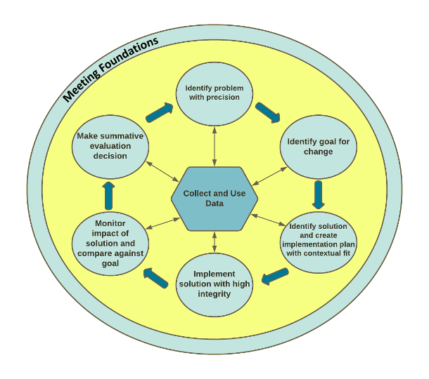
Old vs. New Decision Making
Problem
Solution
Team Initiated Problem Solving (TIPS II)
Notes:
just a reminder that our teams are newly familiar with the TIPS process and could benefit from a visual of the steps and reminder this process occurs across their Tiers through systems level and individual student level problem solving conversations

Slide 92
Team-Initiated Problem-Solving Process (TIPS, https://www.pbis.org/topics/data-based-decision-making

Slide 93
Team-Initiated Problem-Solving Process (TIPS, https://www.pbis.org/topics/data-based-decision-making

Slide 94
Expectations/ Values | Behaviors/Skills/Norms
We are Responsible | Make yourself comfortable (wellness) Take care of your needs (biology, mental, emotional) (wellness) Consider, I am not here to be right, I am here to Get It Right (practice empathy)
We are Respectful | Listen to understand Use “Oops” and “Ouch” Assume best intentions Practice perspective-taking
We are Safe | Ask for clarity to understand and contribute Create a safe space that invites open dialogue and vulnerability – Consider the 3 Gates of Speech: Is what you want to say Kind? True for you? Necessary?
(practice empathy)
Notes:
‹#›

Slide 96
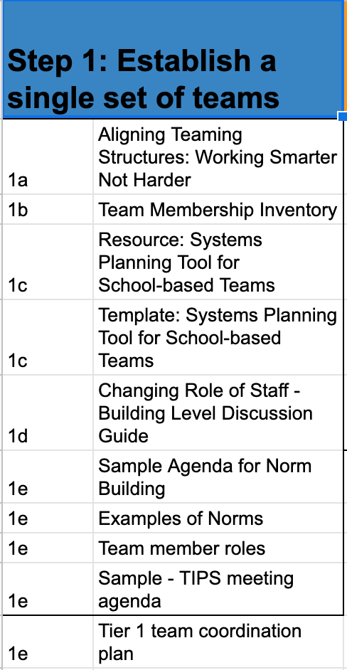
Resources

Slide 97
Team Reflection & Planning Time
How are you currently organized to do this work and what adjustments might enhance your ability to do this work (teaming structure alignment/working smarter)?
What other voices could contribute to the effectiveness of this team (see guiding questions)?
How do you already include youth & family voice and in what ways might you enhance your efforts (teaming, communication plan, leverage existing efforts)?
What team operating procedures do you currently include as part of the district way of work (WOW) and what practices might enhance your effectiveness & efficiency (TIPS, team norms)?

Slide 98
What are our shared take aways today?

