Slide 1
Project DelAWARE & ISF Overview - Day 2
The Way Forward…
Presented by:
Kimberly Yanek, PhD

Slide 2
Explore what we are already doing & ways in which we might enhance Systems, Data, & Practices to reach identified outcomes

Slide 3
Intentions (from agenda)
Assess core features of MTSS to plan for specific mental health enhancements.
Reflect on current needs and desired outcomes to determine if a current inventory of initiatives meets these needs/outcomes. Explore what’s needed.
Assess structures and data for identifying students who need access to support. Expand data sources to consider for integration of MTSS/Mental Health.

Slide 4
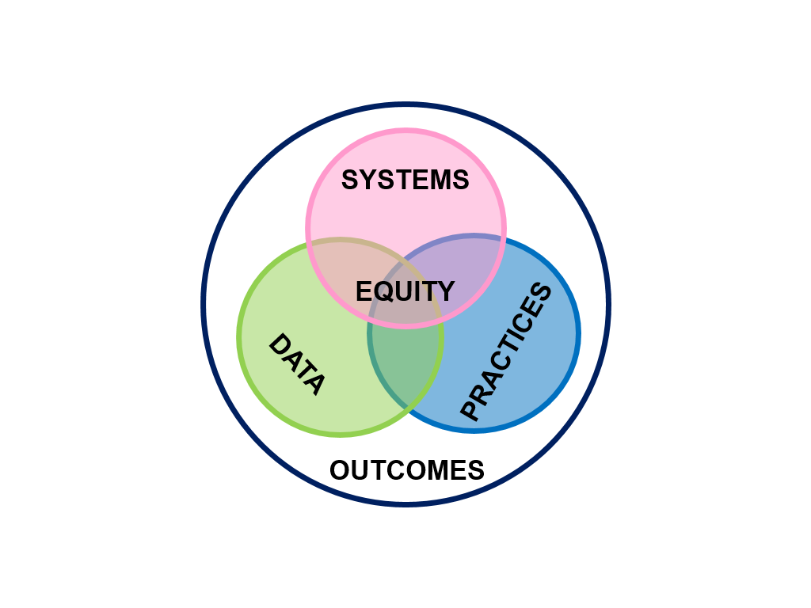

Core Features

Slide 5
ISF Applies MTSS Features to all SEB supports/interventions
Effective teams that include community mental health providers
Data-based decision making that include school data beyond ODRs
and community data
Formal processes for the selection & implementation of evidence-
based practices (EBP) across tiers with team decision making
Early access through use of comprehensive screening, which includes
internalizing and externalizing needs
Rigorous progress-monitoring for both fidelity & effectiveness of all
interventions regardless of who delivers
Ongoing coaching at both the systems & practices level for both
school and community employed professionals

Slide 6

Why Resource/Initiative Mapping for Schools?
Many youth, family, and school-based staff are not aware of and don’t know how to access resources
Community partners are often not aware of school-based resources and how to access them
School-community partnerships may exist, but real linkages often do not
(Anderson-Butcher, Stetler, & Midle, 2006)

Slide 7

Let’s take inventory of what you are already doing…

Slide 8
Revisit Resource Map
Do we have a continuum of interventions and supports?
Does our systems team include representatives from our community partners?
Are their gaps that we need filled?
Can we present needs to our district and community leadership team?

Slide 9
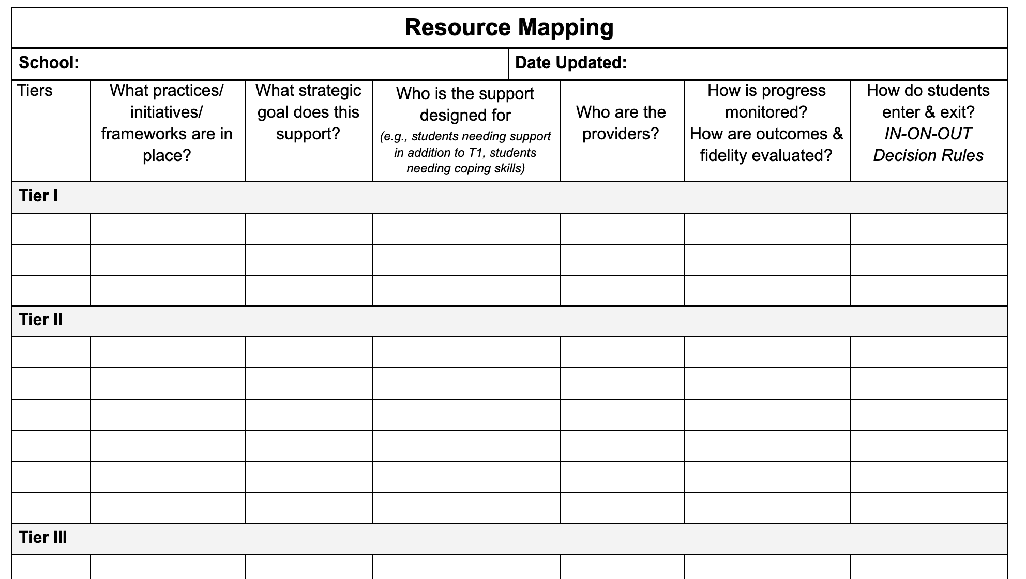

Slide 10

Unpacking data…
At a macro and micro level
Impact & Fidelity

Slide 11
School Examples of Analyzing Multiple Data Sources
Purpose: This table provides an example for how a merged mental health/behavioral team might organize their expanded school and community data sets for problem solving. Using more extensive data sources at a school-wide level can strengthen Tier 1 efforts and support design of Tier 2/3 continuum of interventions.

Slide 12
Data Sources to Consider for an Integrated PBIS/Mental Health System
Traditional School Data | Expanded School Data | Community Data
Office Referral Rates (by location, time, grade, problem behavior, race/ethnicity, students with IEP) Attendance rates for students and staff Academic data Graduation rates Minor incident reports and instructional time | Nursing /School Counselor logs Teacher ratings of student social emotional behavior/effort (Universal screening data) Student, staff, and family focus groups Family screener Climate data | Protective & risk factors Demographic data for the school/neighborhood, community and/or district Socio-economic status, free and reduced lunch rates Homelessness rates Incarceration rates Issues related to environmental changes and weather events Drug use/rate of drug overdoses Crisis center calls, suicide attempts School and workplace violent incidents Military deployment schedules Connected to other child serving systems

Slide 13
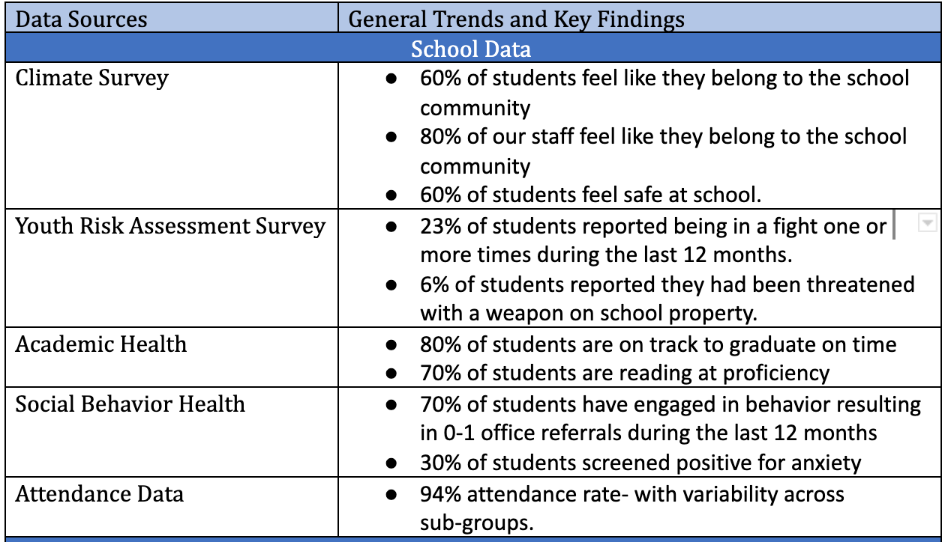
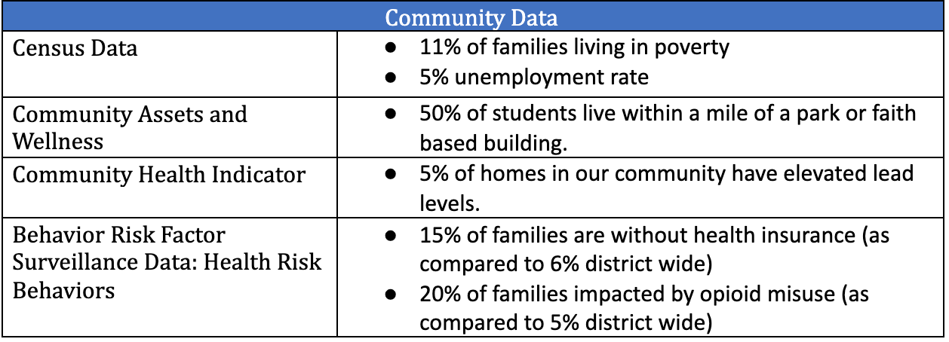
How do these inform decisions for organizing resources for All, Some, and a FEW?

Slide 14
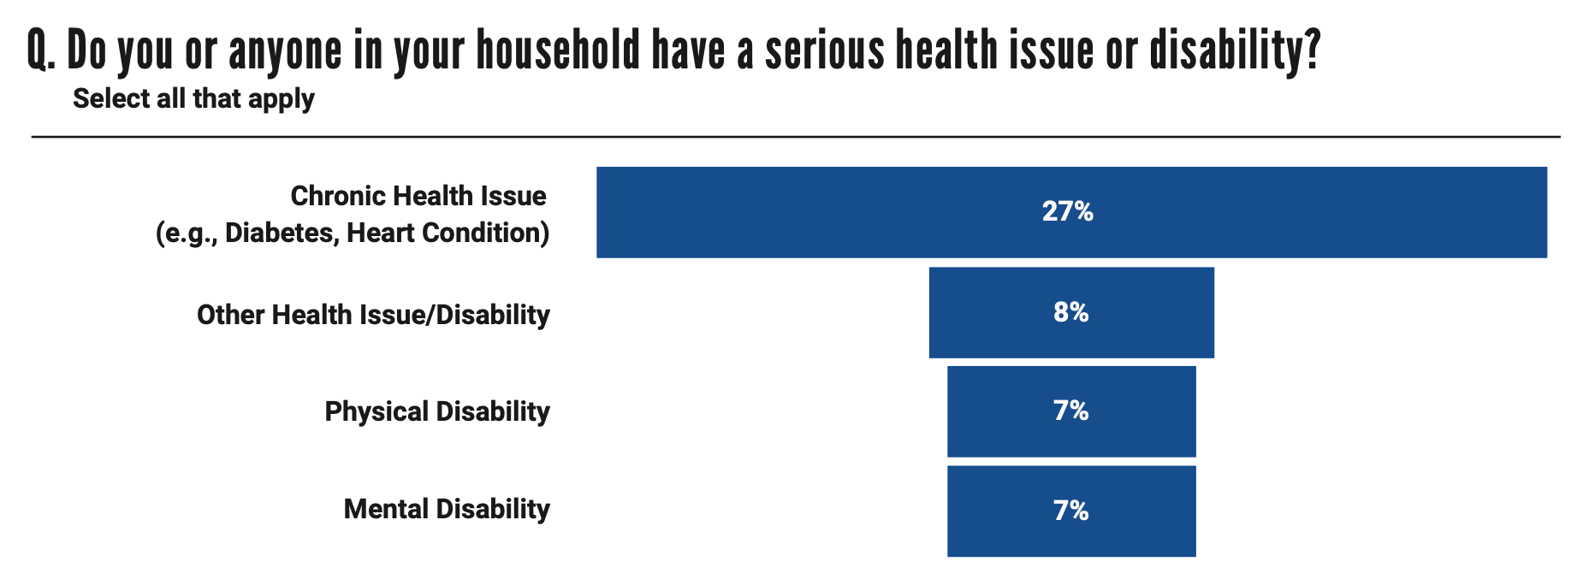
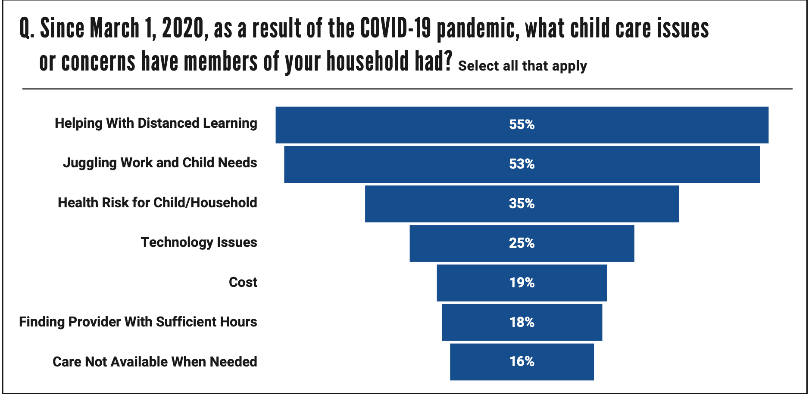
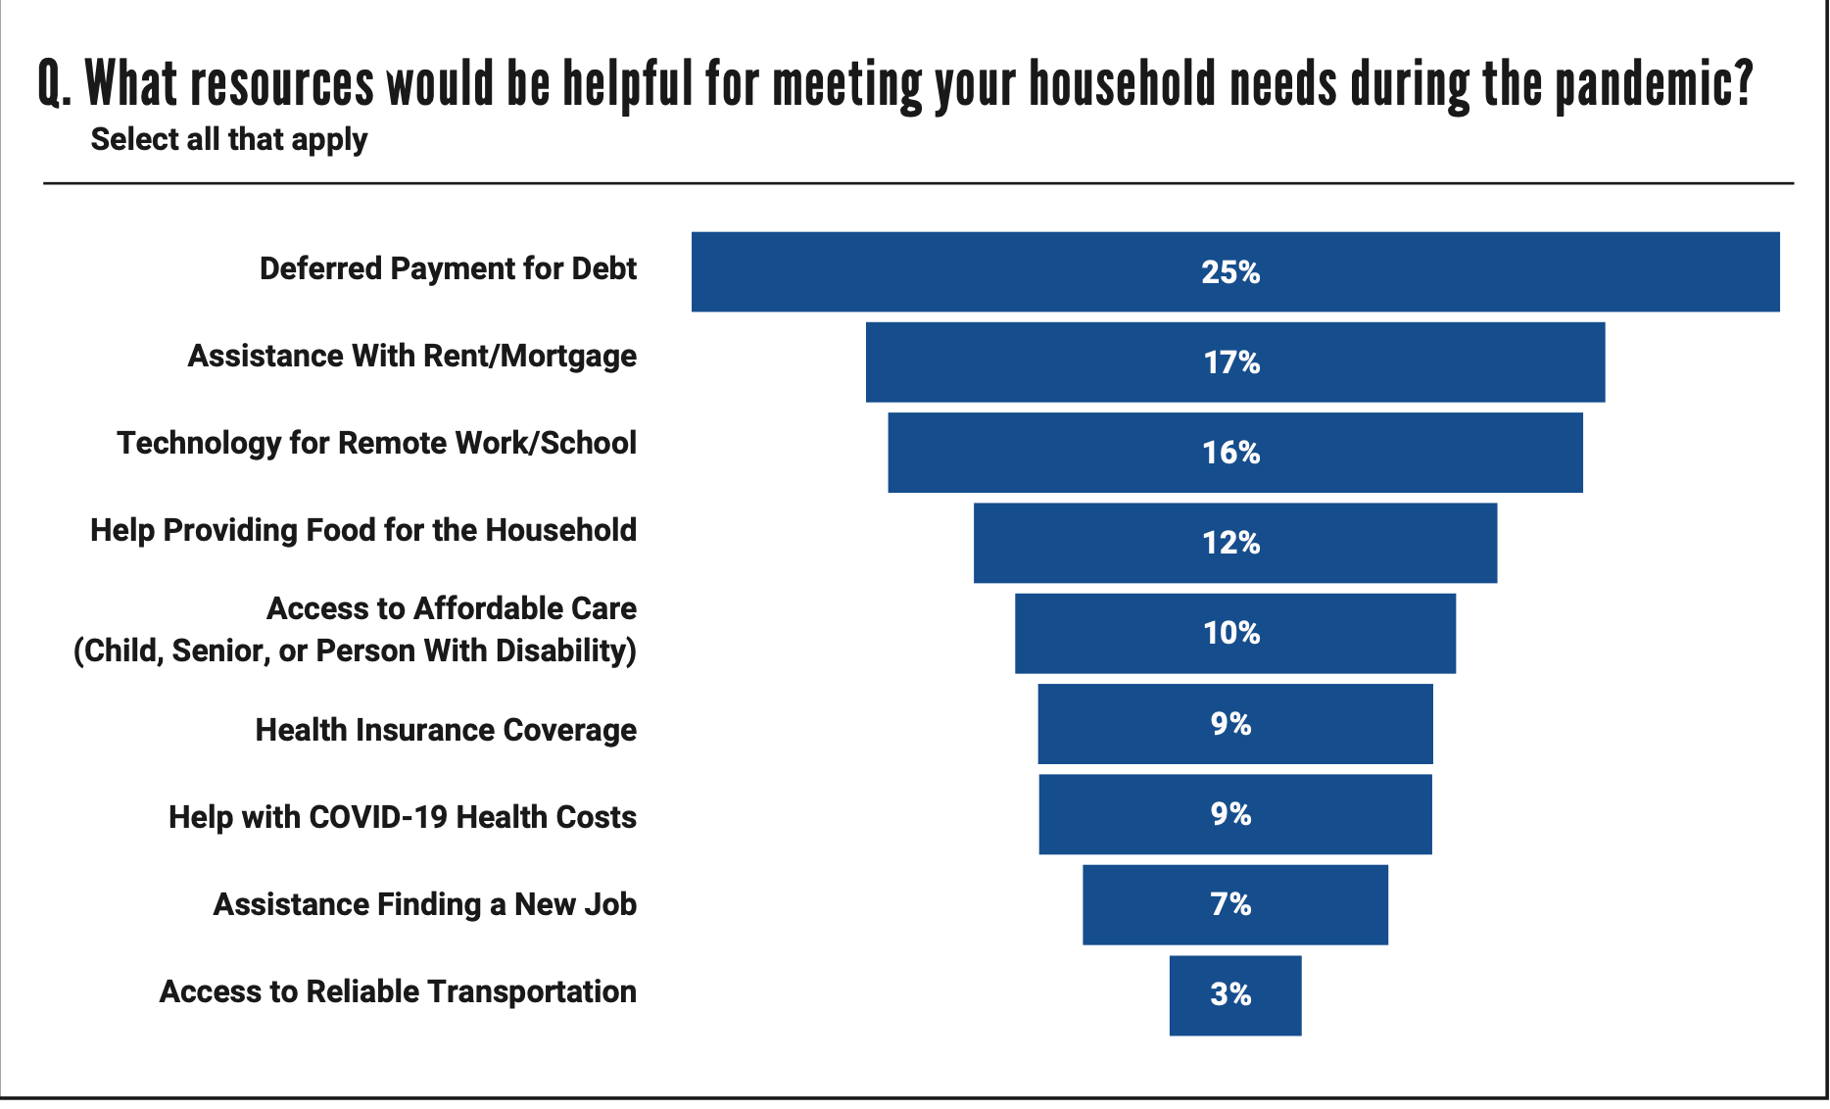
Climate, COVID Community, Health Index

Slide 15
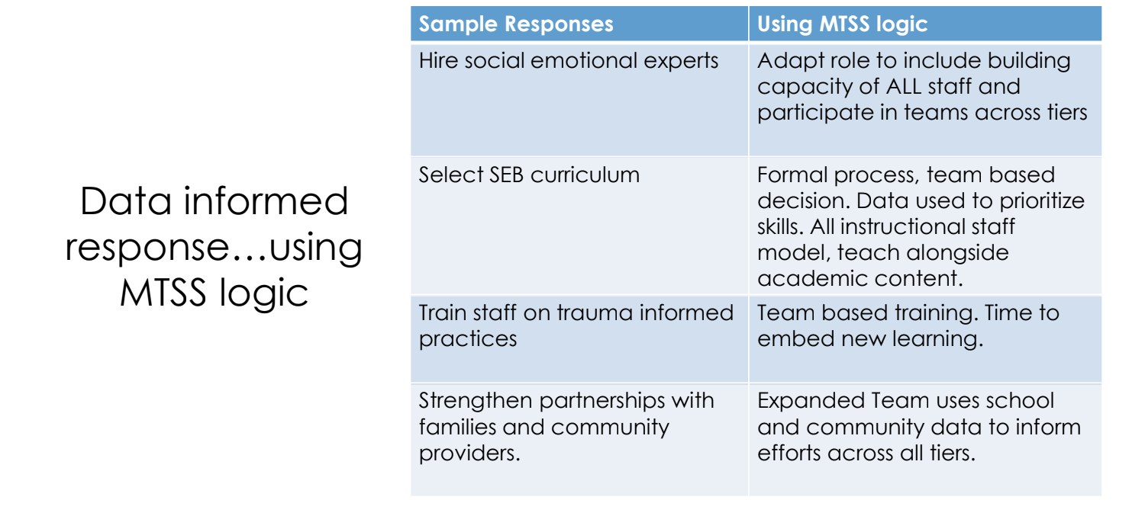

Slide 16

Progress Monitoring

Slide 17
Data-Based Decision-Rules:
Sample to Consider
a) Identification for Intervention (Decision Rules) (IN):
Youth is identified by Universal Screener, has 2 or more ODRs, 10% out of class time, open request for assistance
b) Progress-monitoring (ON):
DPR data is collected daily & reviewed every other week. Data is collected for 4-6 weeks (individual buildings decide whether 4 or 6 weeks will be better for their students)
c) Exiting/transitioning (OUT):
Youth received a total of 80% of DPR points averaged per day/week for 4 weeks and has had no new ODRs or attendance concerns. Youth will be transitioned into fading, self-management phase, possibly being a CICO student mentor being a CICO student mentor

Slide 18
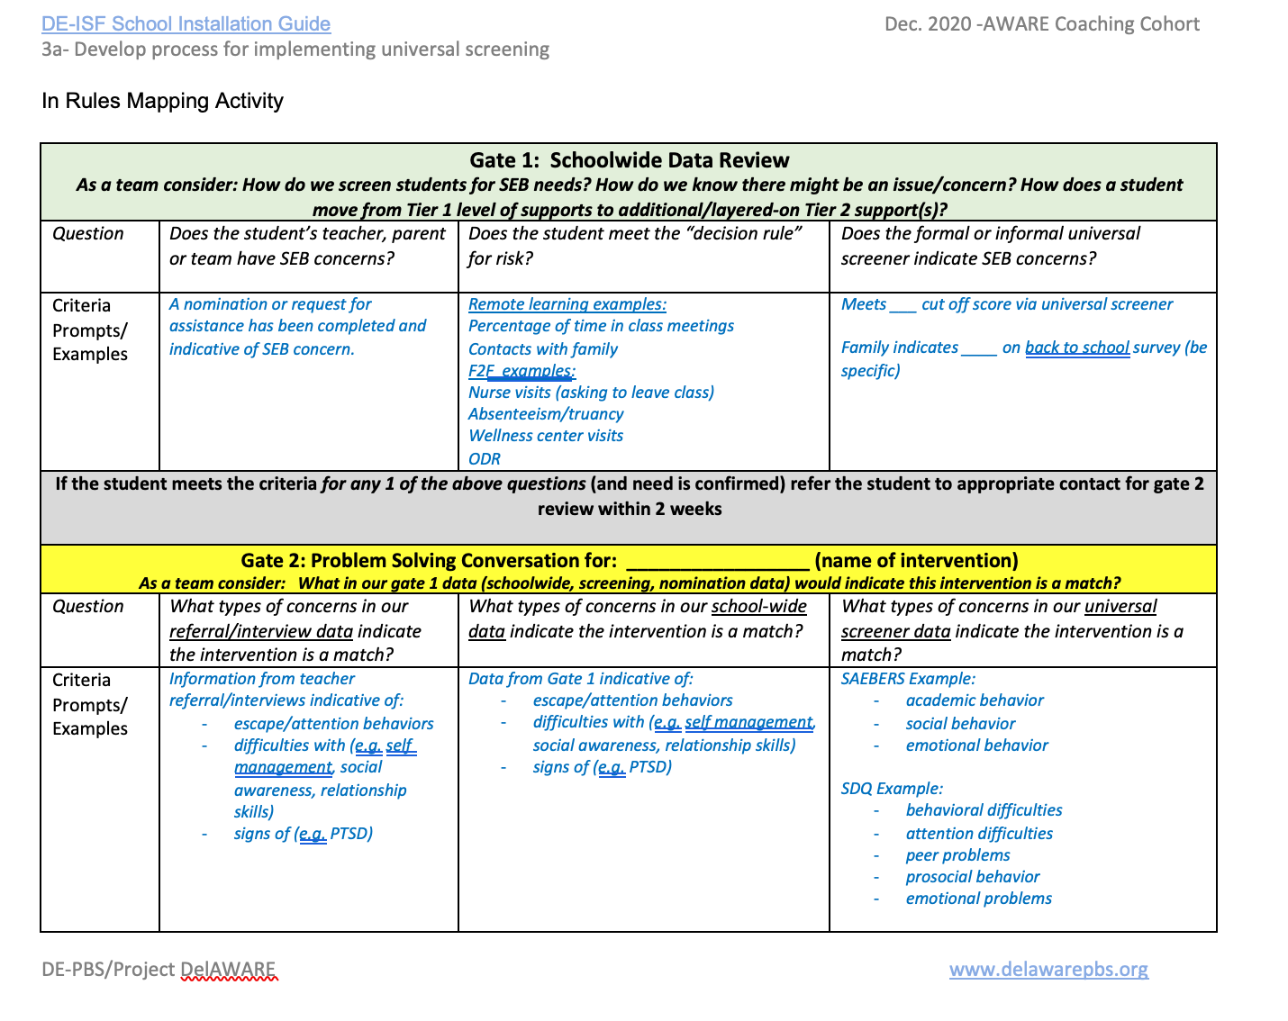
IN…

Slide 19
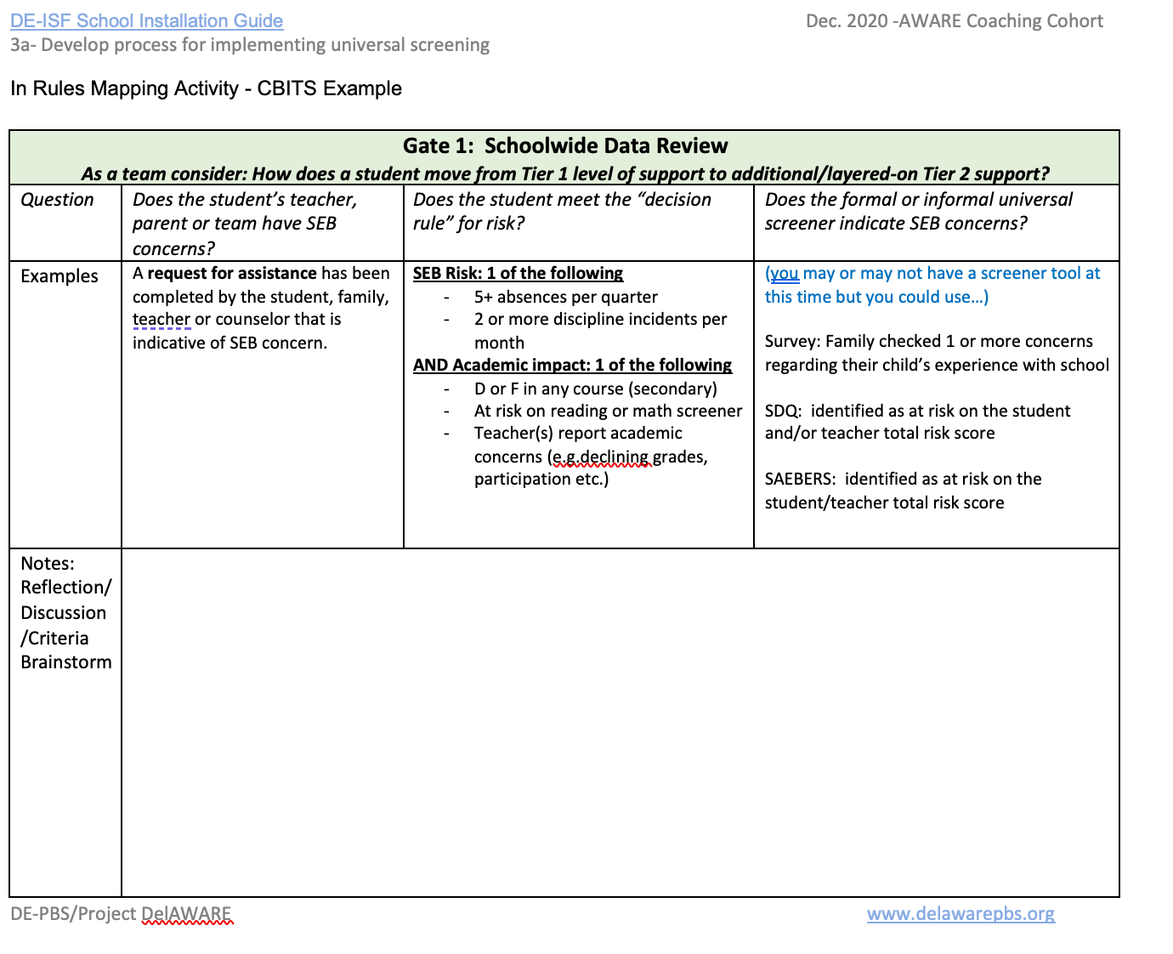
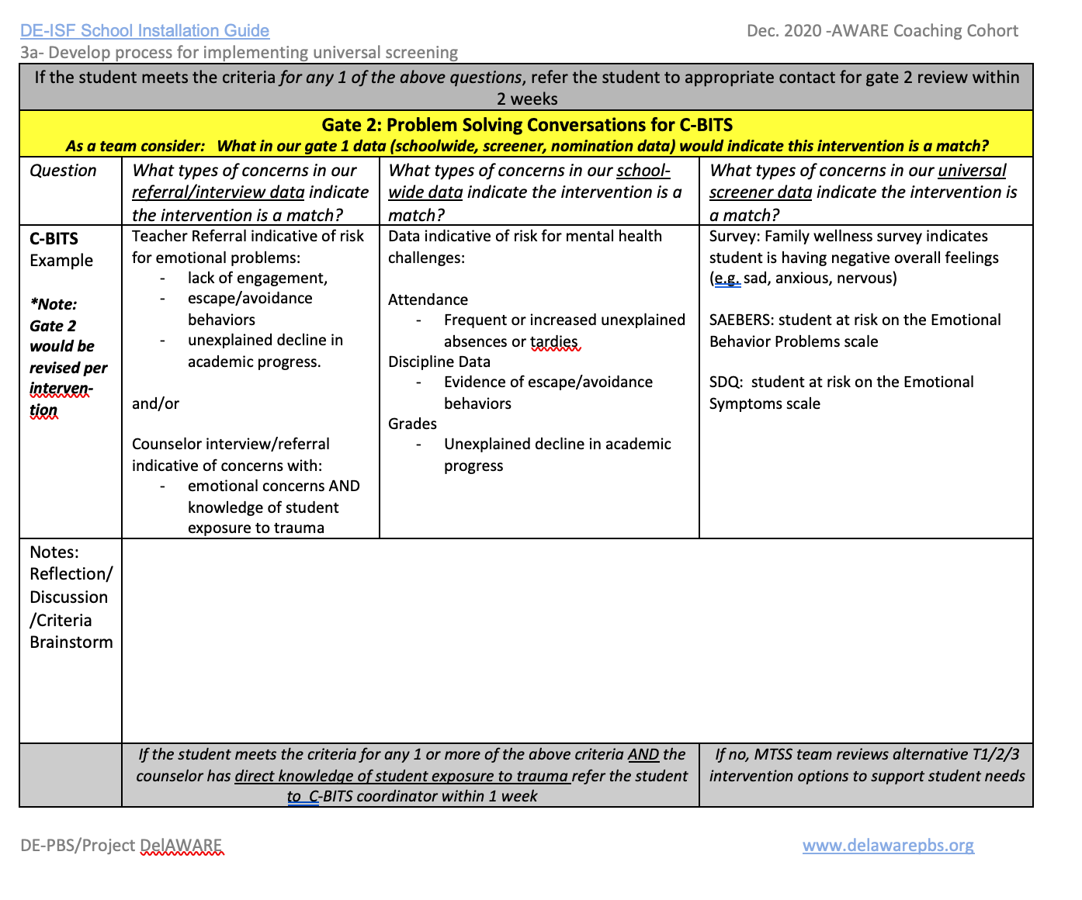
IN…

Slide 20
Data-Based Decision-Rules:
Sample to Consider
a) Identification for Intervention (Decision Rules) (IN):
Youth is identified by Universal Screener, has 2 or more ODRs, 10% out of class time, open referral
b) Progress-monitoring (ON):
DPR data is collected daily & reviewed every other week. Data is collected for 4-6 weeks (individual buildings decide whether 4 or 6 weeks will be better for their students). Sort progress into continue, modify, fade.
c) Exiting/transitioning (OUT):
Youth received a total of 80% of DPR points averaged per day/week for 4 weeks and has had no new ODRs or attendance concerns. Youth will be transitioned into fading, self-management phase, possibly being a CICO student mentor

Slide 21
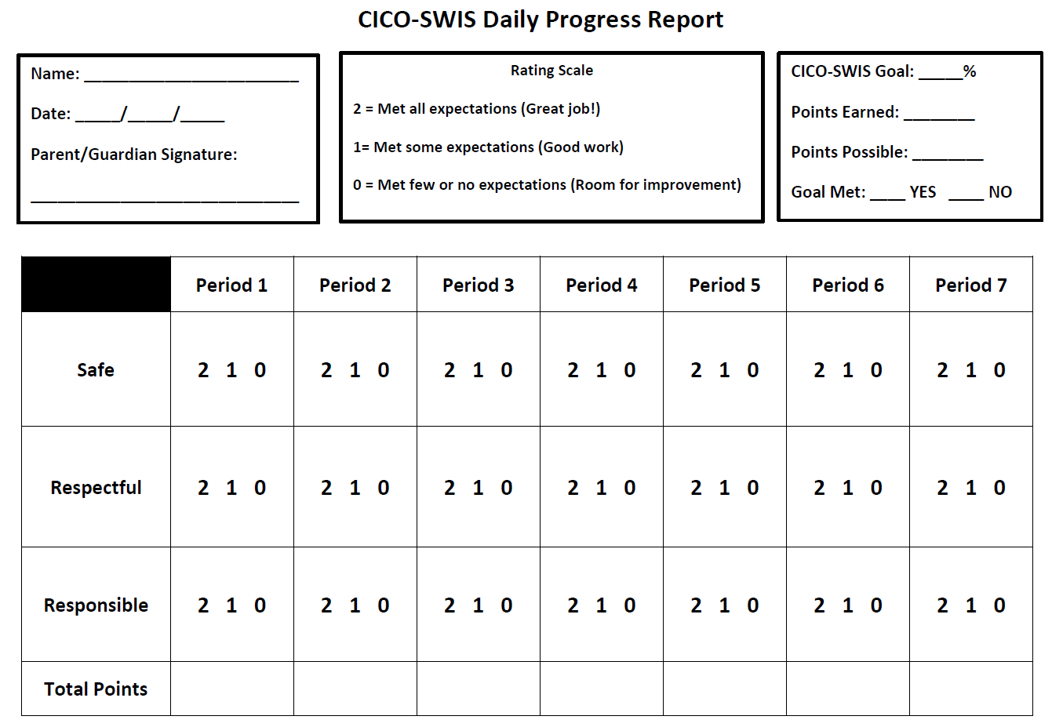
CICO Daily Progress Report
Built upon 3-5
school-wide expectations
Generalizable across student schedules
Three point rating scale
Defined number times for feedback (10 or less)

Slide 22
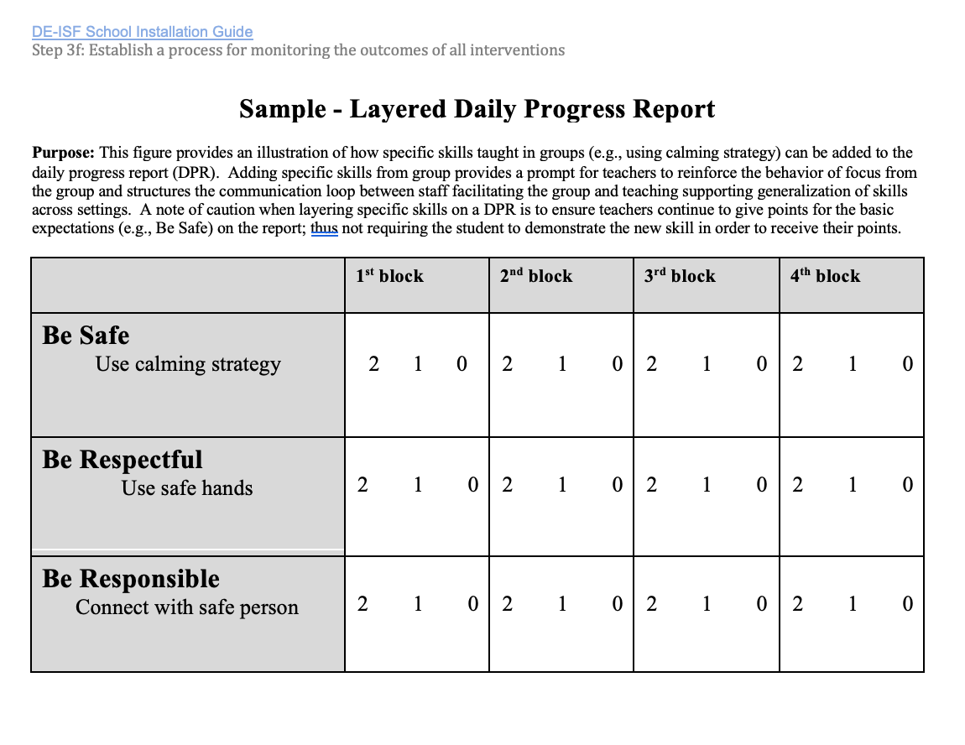
How would generalizing this progress monitoring tool across T2/T3 interventions support staff and students?

Slide 23
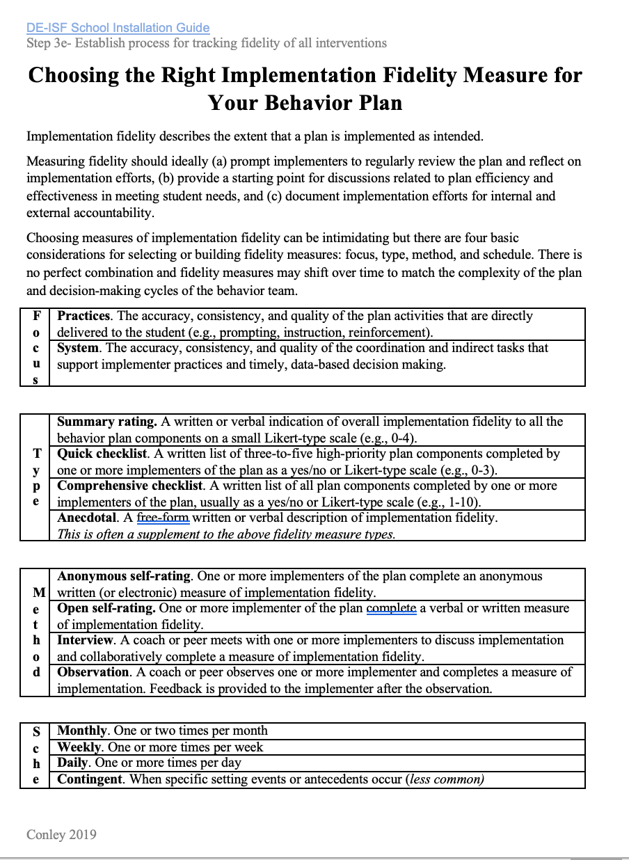
What about social validity?
How is what we are doing working for
staff? Students? Families?

Slide 24

Unpacking practices

Slide 26
Messages on Continuum of Interventions
Tier 1 enhancement is an on-going data-informed effort
At tier 2, start with 1 or 2 (CICO, CBITS, social skilles) and wrap them in data and systems DPR
  Small group instruction on specific skill sets
  Social, coping, problem solving etc. skills as low level generic, higher frequency dosage of teaching
Skills are layered into DPR
Use of screening, expanded data, referral
Systems support for adults

Slide 27
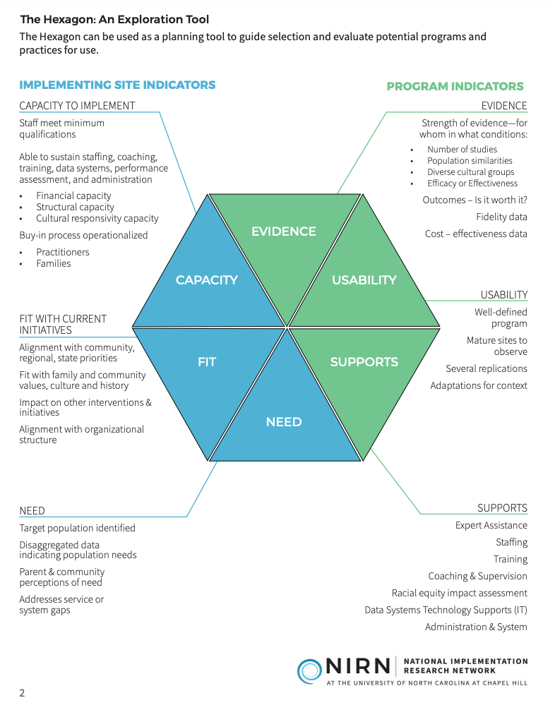
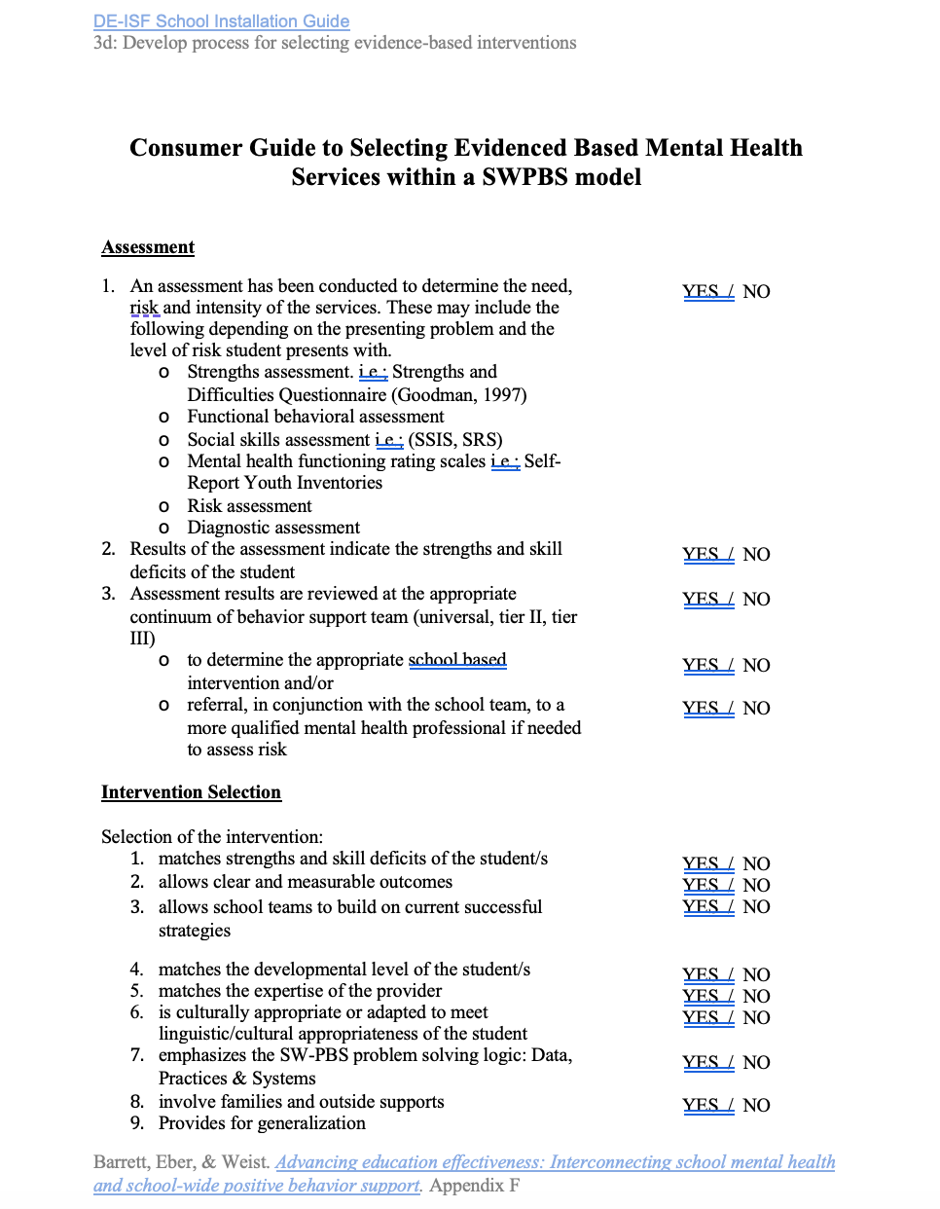

Slide 28
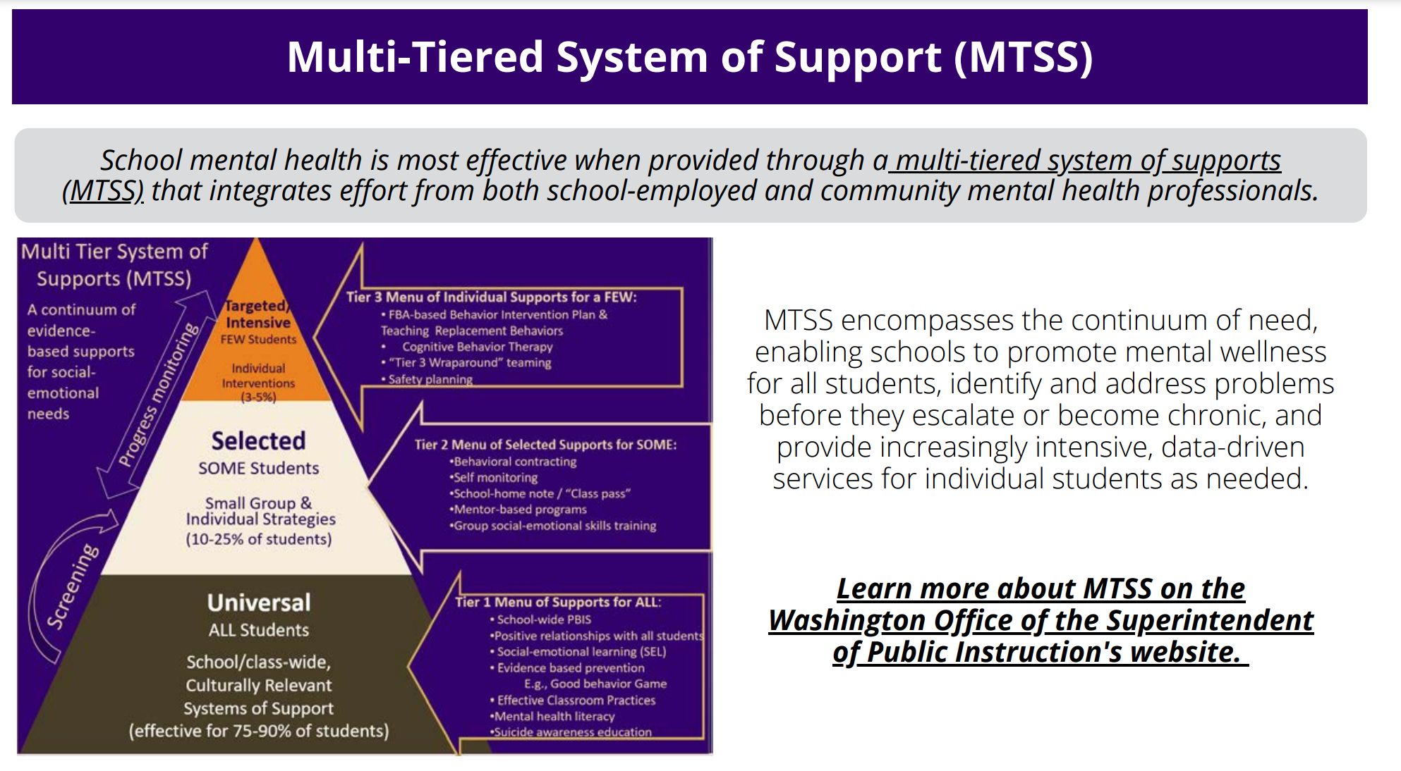

Slide 29

Unpacking systems

Slide 31

Cross Training and Planning

Slide 32

How do we invest in a culture of wellness?
Focus on building a Whole System response by building pro-social communities (Tier 1 PREVENTION)
  Use public health approach to organize.
  Bring community to school.
    23% students were receiving supports in schools (Duong et al., 2020)
    Youth 6 times more likely to complete evidence-based treatment when offered in schools than in other community settings (Jaycox et al., 2010)
Re-establish school as a safe, positive, predictable place. Priority for wellness shows up in budget, accountability system and messaging
  Academic success requires mental health skills and strategies (e.g., emotional regulation)
    Teaching social emotional behavior skills IS academic instructional time
  Mental health is everyone’s job
    Resilience can be intentionally taught, practiced and developed (all ages)
  Position Social Emotional leaders to build capacity
Focus on staff wellness and supporting staff to embed teaching wellness skills across all content areas.

Slide 33


Teaching & Learning for SEB
School-wide explicit instruction | Data informed re-teaching | Connect SEB to academics

Slide 34
Team Time
Examining your current system
•Are resources distributed equitably?
  -staffing, sports/clubs/activities/transportation/physical building
•Does your data system inform equitable decision making? (disaggregated by sub -groups including special education)
•Do your teams review community data and make adjustments based on specific community/neighborhood need?
•What are some unintended side effects from policy/procedure decisions?
•How does practice -> policy-> feedback loop benefit/harm disadvantaged youth, families?
•How does your professional development allow for time to apply new content? How do you track fidelity before assigning blame to students?
•Do you have a co-response model (discipline and mental health response) for supporting students who exhibit behaviors that are communicating to us that they are hurting and need us to do something different?

Slide 35

Applying the Logic to Families
Tier 3: Intensive, Individual Interventions
Family Liaison-matched with family, needs matched with community resources
Individual Skill Building Sessions-
1-5%
Tier 2: Targeted Group Interventions
Support Groups (Military Families, Newcomer Group)
Skill Building Sessions (Academic and Behavior)
5-10%
Tier 1: Universal Interventions
Self Assessments: Family Engagement Checklist, Surveys
Skill Building Series Guest Speaker (Topics Vary- Survey Families)
Newsletter, Resource Library , “Shout Outs”
Volunteer Opportunities (DOGS- Dads of Great Students)
Teacher Conferences- Goal Setting, Family Vision, Strengths Discovery
Family Fun Nights throughout the year
School Handbook (Description, Teaching Matrix – promote common language between school and home)
80-90%

Slide 37
Building Level Action Plan
UNIVERSAL SYSTEM
SECONDARY SYSTEM
TERTIARY SYSTEM
Universal Systems Team
Secondary Systems Team
Problem Solving Team (individual student)
Tertiary Systems Team
PRACTICES
PRACTICES
PRACTICES
PRACTICES
Data Decision Rule
Data Decision Rule
Data Decision Rule
Data Decision Rule
Notes:
‹#›
‹#›

Slide 38
Team Reflection & Planning Time
What needs have you identified as priorities for this school year? What data indicate these needs?
What is in your current continuum of supports within your school, district, and community to organize for All, Some, and a Few?
  Students? Staff? Families?
  Are there any gaps in your continuum? Look up first- district? Community?
  If gaps remain, what will you do to meet that need (e.g., utilize routine for identifying new practices such as Hexagon Tool)?
What systems of support are in place to support implementation of practices?
What data will be used to progress monitor fidelity, impact, social validity?

Slide 39
Explore routines for data-based decision making (universal screening process, impact & fidelity of supports provided)
Universal screening process
Progress Monitoring
Impact & Fidelity of supports provided

Slide 40
Data informed Decision Making…
At a macro and micro level

Slide 41
All problem solving teams use multiple data sources to identify potential academic, externalizing and/or internalizing social, emotional and behavioral problems
Request for Assistance/Surveys
Schoolwide Data
Universal Screening Tool
This is your MTSS universal screening process!
Additional data is used to precisely define the problem
Solutions are developed in context (e.g., schoolwide, classroom, non-classroom, group or individual)

Slide 42
Public Health Prevention Framework
A few 5%
Some 15%
All
80%
Walker et al. (1996). Integrated approaches to preventing antisocial behavior patterns among school-age children and youth. JEBD, 4, 194 – 209.

Slide 43
Circles & Triangles
Outcome:
Freshman Math

Slide 44
TIER II: Supplemental, Targeted
TIER III:
Intensive, Individualized
Current Reality: High School Freshman Math
Tier 3: Informal Teacher “see me before/after school”
Tier 2: Nothing in place
Tier 1: Core curriculum (responsive to 78% of freshman student math needs)
‹#›
Notes:
‹#›
‹#›

Slide 45
Continuum of Practices for Math Instruction & Support
Intensive Intervention Tier 3: Math
  One-to-one tutoring delivered during “skinny bell”
Universal Tier 1: Math
Evidence based curriculum
for ALL students
*with adequate planning & teaching time for progress monitoring, active Ss participation with frequent feedback, culturally responsive teaching & learning
Targeted Intervention Tier 2: Math
  Small group targeted math instruction with Core Teachers delivered during “skinny bell” *with adequate planning & teaching time for progress monitoring, active Ss participation with frequent feedback, culturally responsive teaching & learning
Continuum of Supports

Slide 46



High School Freshman Math Plan
Outcome data: 78% of freshman are meeting math academic benchmarks at end of 2nd qtr
Progress monitoring: Student Academic growth to benchmark; obs & feedback data; student engagement in small group intervention
Schedule arranged for: math dept to collaborate to strengthen core instruction w/ observation & feedback; strongest math teachers to work with students needing addtl support
SYSTEMS
DATA
EQUITY
PRACTICES
Strengthen Tier 1 math curriculum for freshman- increase engagement, practice with feedback, OTRs. Use data after strengthening T1 to identify Ss in need of addtl support.
Notes:
‹#›

Slide 47
Circles & Triangles
Outcomes:
Middle School Reading

Slide 48
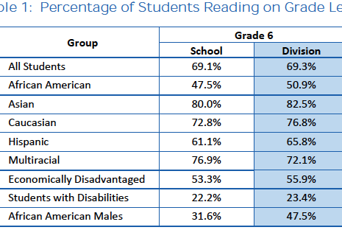
Current Reality for Middle School

Slide 49
Current Reality: Middle School Reading
Current Reality: 69% of all students are reading on grade level: 47.5% of AA students are reading on grade level; 22% of SWD are reading on grade level. No fidelity data available on instruction.
SYSTEMS
DATA
EQUITY
PRACTICES
Notes:
‹#›

Slide 50
Continuum of Practices for Reading Instruction & Support
  Intensive Intervention Tier 3:Reading
    Scott Foresman Early Reading Intervention
    Wilson Reading
    Corrective Reading
Universal Tier 1: Reading
Evidence based curriculum for ALL focused on:
  Fluency
  Vocabulary
  Comprehension
*With adequate planning & teaching time for progress monitoring, active Ss participation with frequent feedback, culturally responsive teaching & learning
Targeted Intervention Tier 2: Reading
  Small group Reading Instruction with Coach and Core Teachers
  Peer Assisted Learning Strategies
  *with adequate planning & teaching time for progress monitoring, active Ss participation with frequent feedback, culturally responsive teaching & learning
Continuum of Supports

Slide 51
Middle School Reading Plan
Current Reality: 69% of all students are reading on grade level: 47.5% of AA students are reading on grade level; 22% of SWD are reading on grade level. No fidelity data available.
Progress monitoring: Fidelity of Instruction (observations & performance feedback), lesson plans; reading assessment (aggregated & disaggregated)
PD for Core Teams to collaborate on T1 instruction with Instructional Coach; Instructional Coach works with small group of staff for T2 intervention for fluency & comprehension; T3 Wilson delivered by Coach and SPED T who uses Wilson Reading
SYSTEMS
DATA
EQUITY
PRACTICES
Tier 1 Academic Instruction for All focusing on fluency & comprehension; Data to inform Tier 2 Group targeting closing the gap with fluency; Data to informT3 Wilson Reading focusing on fluency
Notes:
‹#›

Slide 52
Circles & Triangles
Outcomes:
Elementary School
Social Emotional Behavioral

Slide 53
Student Outcome Data
Between September 15 and November 15, 22 staff members have observed and reported that 35% of students are not attending virtual classes, not submitting completed work, and or engaging in disruptive behavior during virtual class which looks like off-task comments in the chat box, un-muting to make off-task comments. These behaviors have been observed across grade levels and throughout the week. Staff report that students are engaging in these behaviors to either escape/avoid class and/or get attention from peers and staff.

Slide 54
Current Reality: Elementary Engagement
Current Reality: 35% of all students are not engaging in instruction which looks like not attending virtual classes, not completing assignments, and/or disruptive behavior during virtual lessons. 15 students have not attended or completed any assignments. No fidelity data on teacher practices available.
SYSTEMS
DATA
EQUITY
PRACTICES
Notes:
‹#›

Slide 55
Continuum of Practices for Social, Emotional, Behavior (SEB) Instruction & Support
Intensive Intervention Tier 3: SEB
  Individualized, functional assessment based behavior support plan
  Wrap around support for student & family
Universal Tier 1: SEB
Review school-wide/classroom teaching matrices for attendance, work completion, and on-task behavior
Re-teach expectations with on-going explicit instruction
Prompt & use performance feedback to reinforce expected behavior & correct problematic behavior
OTRs and engagement strategies
Cooperative Learning Groups
Adequate planning & teaching time for progress monitoring, active Ss participation with frequent feedback, culturally responsive teaching & learning
Targeted Intervention Tier 2: SEB
  Check-in, Check-out
  Small group, data informed SEB skills & academic instruction
  * with adequate planning & teaching time for progress monitoring, active Ss participation with frequent feedback, culturally responsive teaching & learning
Continuum of Supports

Slide 56
Current Reality: Elementary Engagement
Progress monitoring: Attendance & on-task behavior during virtual lessons; work completion; daily greeting roster. Self-monitoring and/or observation data in the aggregate.
Current Reality: 35% of all students are not engaging in instruction which looks like not attending virtual classes, not completing assignments, and/or disruptive behavior during virtual lessons. No fidelity data on teacher practices available.
PD & coaching for staff to focus on building fluency with the 4 practices- support for self-monitoring/obs.
T3: time for teams to meet with families & students to collaboratively develop a plan for support (15 Ss).
SYSTEMS
DATA
EQUITY
PRACTICES
Tier 1 Focus on Classroom Expectations/Matrix, OTRs/Engagement, Acknowledgement, Daily Intentional Greetings, Cooperative Learning Groups; Tier 2 –watch data to identify Ss needing addtl support; T3- a few students (15) an individual plan to include family collab
Notes:
‹#›

Slide 57
Current Reality:
Suicidal Ideation
Current Reality: Aggregated YRBS data exploration with students grade 9-12 discovered suicidal idealization rate twice that of state average, 25%.
DATA
SYSTEMS
EQUITY
PRACTICES
Notes:
‹#›

Slide 58
Continuum of Practices for Social, Emotional, Behavior (SEB) Instruction & Support
Intensive Intervention Tier 3: SEB
  Individualized, functional assessment based behavior support plan
  Wrap around support for student & family
Universal Tier 1: SEB
Review school-wide/classroom teaching matrices for attendance, work completion, and on-task behavior
Re-teach expectations with on-going explicit instruction
Prompt & use performance feedback to reinforce expected behavior & correct problematic behavior
OTRs and engagement strategies
Cooperative Learning Groups
Adequate planning & teaching time for progress monitoring, active Ss participation with frequent feedback, culturally responsive teaching & learning
Targeted Intervention Tier 2: SEB
  Check-in, Check-out
  Small group, data informed SEB skills & academic instruction
  * with adequate planning & teaching time for progress monitoring, active Ss participation with frequent feedback, culturally responsive teaching & learning
Continuum of Supports

Slide 59
Current Reality:
Suicidal Ideation
Current Reality: Aggregated YRBS data exploration with students grade 9-12 discovered suicidal ideation rate twice that of state average, 25%.
Progress monitoring: Attendance; Screener; Engagement & Connection Data; APP; YRBS.
PD & coaching for staff & students SOS, change to SW matrix; Engage staff in Engagement & Exercise w/ check 3x’s/yr
T3: time for teams to meet with families & students to collaboratively develop a plan for support.
SYSTEMS
DATA
EQUITY
PRACTICES
Tier 1 Focus on Prevention-adopt SOS; add suicide hotline and what to do when … to SW matrix; Implement Every Student Known; Connect every student to curricular enhancement; Tier 2 –watch data (RFA) to identify Ss needing addtl support (CICIO & Coping Skills); T3- Data (Gaggle) to inform crisis plan to wrap services around student/family
Notes:
‹#›

Slide 60

Let’s practice

Slide 61
Current Reality:
Pre-school SEB
Current Reality: Pre-school staff have observed & reported 40 behavioral incidents between Oct 1 and Nov 30 across classrooms & settings. Staff report “disruptive behavior” (making noises, moving around, playing with supplies, impulsive calling out). These behaviors are occurring across settings and days of the week and especially in the mornings between 8:00 and 11:00.
SYSTEMS
DATA
EQUITY
PRACTICES
Notes:
‹#›

Slide 62
Continuum of Practices for Social, Emotional, Behavior (SEB) Instruction & Support
Intensive Intervention Tier 3: SEB
  Individualized, functional assessment based behavior support plan
  Wrap around support for student & family
Universal Tier 1: SEB
Review school-wide/classroom teaching matrices for attendance, work completion, and on-task behavior
Re-teach expectations with on-going explicit instruction
Prompt & use performance feedback to reinforce expected behavior & correct problematic behavior
OTRs and engagement strategies
Cooperative Learning Groups
Adequate planning & teaching time for progress monitoring, active Ss participation with frequent feedback, culturally responsive teaching & learning
Targeted Intervention Tier 2: SEB
  Check-in, Check-out
  Small group, data informed SEB skills & academic instruction
  * with adequate planning & teaching time for progress monitoring, active Ss participation with frequent feedback, culturally responsive teaching & learning
Continuum of Supports

Slide 63
Outcome:
Pre-school SEB
Progress Monitor:
What would you do?
SYSTEMS
DATA
EQUITY
PRACTICES
What would you do?
Notes:
‹#›

Slide 64

Team Share Time

Slide 65
Let’s focus in on data-informed decision making at Tier 2 …

Slide 66
Universal Screening Process
Minimum of two data sources to accurately identify students with
Externalizing and/or internalizing social, emotional or behavioral risk factors
Request for Assistance
Schoolwide Data
Universal Screener
(what additional information do we need?)
Team Collects and Reviews Data
Student meets data based decision rules
Student matched to intervention

Slide 67
Supporting Tier 2 Needs
Observed Trends in Behavior(s) of Concerns and/or Transition-Related Event Occurring (Data-Based Discussion)
Request for Assistance to Tier 2 Team
Examine Function of Behavior, Level of Student Need and Related Contexts
ID Match Between Student Strengths and Interest, Function & Level of Behavior of Concern, and Context to Intervention Level and Practices
Targeted Intervention Tier 2: SEB
  Check-in, Check-out
  Small group, data informed SEB skills & academic instruction
  * with adequate planning & teaching time for progress monitoring, active Ss participation with frequent feedback, culturally responsive teaching & learning
Tier 1
Interventions/Practices
Tier 2
Interventions/ Practices
Tier 3
Interventions/ Practices
With student, family, & involved educators:
Introduction to and training of Intervention
Culturally responsive implementation of intervention, data-collection, & recognition
Review of data via IN/ON/OUT protocols & fading or problem-solving as needed
Celebrating and monitoring

Slide 68
Teaming For Tier 2 Success
(Main) Multidisciplinary Tier 2 or Tier 2/3 Team:
Coordinated by Tier 2 Team Leader, identifies targeted student needs, selects relevant interventions; implements & evaluates ALL interventions’ use. Meets at least monthly to cover these two conversations:
System Conversations
Uses process data; evaluates overall effectiveness; does NOT involve discussion of individual students
Problem Solving Conversations
Matches students to interventions and monitors progress, making adjustments as needed
Tier 2 Intervention (Sub-Committee) Teams:
Led by the Intervention Coordinator, works to implement ONE designated Tier 2 intervention for students with fidelity and engage in intervention-related data-based problem-solving and decision-making related to individual students. Coordinator regularly shares aggregate data with larger Multidisciplinary Tier 2 or Tier 2/3 Team. Also meets at least monthly.

Slide 69
Team Tools For Tier 2 Success
Team agenda
  monthly review of data
    requests for assistance
    existing school data
    Universal screening data
  includes system and problem solving conversations
Tier 2 (Aggregate) Tracker
  updated and reviewed monthly
  includes IN/ON/OUT protocols for each intervention
Tier 2 Student-Level data
  Daily progress reports or IBRST
  CBM and/or other surveying tools
Tier 2 school booklet
  updated continuously
  shared with staff annually
Tiered Fidelity Inventory - Tier 2
  teams self-assess every 6 and/or 12 mo.
System Conversations
Uses process data; evaluates overall effectiveness; does NOT involve discussion of individual students
Problem Solving Conversations
Matches students to interventions and monitors progress, making adjustments as needed
(are on-going)

Slide 70
Data-Based Decision-Rules:
Sample to Consider
a) Identification for CICO (IN):
  Student is identified by 2 or more ODRs, 4 or more classroom-managed incidents, attendance, work completion, referral from family, student, or school staff, etc.
b) Progress-monitoring (ON):
  DPR data is collected daily & reviewed every other week. Data is collected for 4-6 weeks (individual buildings decide whether 4 or 6 weeks will be better for their students).
c) Exiting/transitioning (OUT):
  Student received a total of 80% of DPR points averaged per day/week for 4 weeks and has had no new ODRs or attendance concerns. Student may be transitioned into being a CICO student mentor

Slide 71
TFI 2.11 Student Performance Data
Student data monitored & used at least monthly (usually every 2 weeks)
  % of students T2 is working for
Data decision rules established & used to
  Adjust support (fade, intensify, continue)
Aggregate data shared with stakeholders

Slide 72
Data-based problem solving
Progress monitoring data are necessary to answer important questions:
  Is the student making progress towards the goal?
  Is the intervention effective for most of the students receiving the intervention?
  Is the intervention being implemented with fidelity?

Slide 73
Data monitoring
Student level
  Daily percentage of points earned
  Use for decision making (continue, modify, intensify, fade) 80% = success

Slide 74
Before Team Meeting
T2 Group Intervention Coordinators summarize data for respective interventions

Slide 75
Progress Monitor Data Considerations
We have recommended as "success" or (ON) benchmark that schools consider an 80% success rate for an intervention (within a given time or incidence parameter). We also recommend that the intervention-specific (sub-committee) team members review the data at a minimum of every week and the (main) Tier 2 or Tier 2/3 team review aggregate data for an intervention at least 1x/month

Slide 76
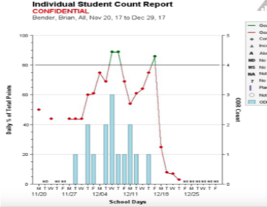

Slide 77
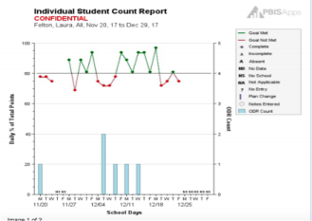

Slide 78
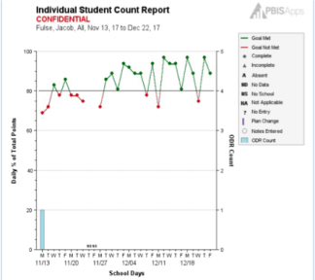

Slide 79
DATA-INFORMED TEAM DECISIONS:
FADE
CONTINUE
MODIFY

Slide 80
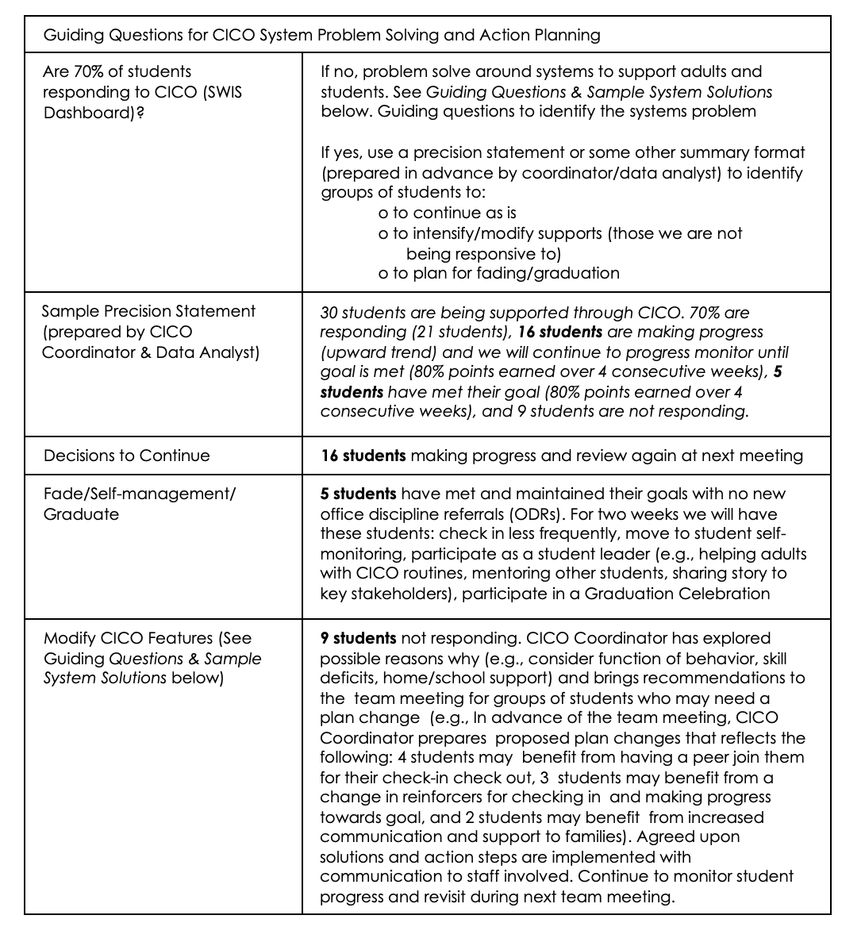
Progress Monitor Data Considerations

Slide 81
Tier 2 Systems Team Meeting
70% of students are responding
Coordinator comes with precision statement:
    30 students are being supported through CICO. 70% are responding (21 students), 16 students are making progress (upward trend) and we will continue to progress monitor until goal is met (80% points earned over 4 consecutive weeks), 5 students have met their goal (80% of points earned over 4 consecutive weeks), and 9 students are not responding.
Coordinator updates team on plan for continue, fade/graduate, and intensify/modify

Slide 82
Fade
If student has met graduation criteria consider:
  Graduation process …celebration! Then…
    Checking in less frequently (i.e. every other day, or less times throughout the day, etc.)
    Move to student self-monitoring
    Student Leader- help the adults check-in and check-out students
    Mentoring other students (student leader)
    Share story to key stakeholders

Slide 83
Self-Monitoring
Research supported practice
Goal is to shift from teacher ratings to accurate student rating of own behavior
Continue to use DPR and data collection
At any time in the fading process, if the student frails to continue to meet exit criteria, the student goes back on CICO.

Slide 84
Self-Monitoring
First Phase = Student learns to accurately self-assess
Teacher & student rate student’s behavior simultaneously
Compare ratings at end of each class period
Success = match in ratings (even if low rating)
If discrepancy in score, discuss
Teacher rating assumed accurate
Provide reinforcer for accuracy & honesty (optional)

Slide 85
The goal in the First Phase is for the student rating to get closer to the teacher rating until the students is reliable and accurate in rating his/her own behavior
(80% agreement between teacher and student for 5 consecutive days)
*Document % of agreement and continue to monitor daily progress scores

Slide 86
Self-Monitoring
Second Phase = Teacher Rating Removed
Begins once a student demonstrates consistency in accurately rating his/her own behavior for 5 consecutive days at 80%
Student continues to rate him/herself for 2 weeks, checking in and out with facilitator
*On days when the teacher does not rate, the student ratings are used for data collection and progress monitoring

Slide 87
Fading Out of Tier 2 Intervention:
Self-monitoring, Summarized
Phase 1: Teacher and student rate the behavior. Student meets criteria when his/her rating matches the teacher’s 80% of the time and he/she continues to earn an average of 80% on the daily progress report (DPR). Student is reinforced for accuracy.
Phase 2: Student has met accuracy criteria (5 consecutive days with 80% agreement) and maintains an average of 80% on his/her DPR. Student begins rating alone and teacher stops rating. Student’s scores are used for progress monitoring. Student continues to check in/out with the facilitator at the beginning and end of the day.
“OUT”/Exit: Use predetermined decision making rule. Example: Student rates self for 4 weeks, averages 80% on daily progress report and does not exhibit behavior that got them IN (e.g., no office referrals).

Slide 88
Gradual Fading Process
Decrease the number of times during the day/week that the student is rated and provided feedback on the DPR
  Number of times per day, e.g., if they have been rated 6 times a day, go to 3 times, then 2
  Number of days per week; e.g., begin providing feedback using he DPR every other day, then 2 days per week, then once a week
“OUT”/Exit: Use predetermined decision making rule. Example: Student continues to earn an average of 80% and does not exhibit behavior that got them IN (e.g., no office referrals)
  *At ANY time in the fading process, if the student fails to continue to meet exit criteria, the student goes back on CICO.

Slide 89
Ways to Increase Success During Fading
Talk with the student, parents & teachers about fading during the initial introduction to the program
Plan other opportunities & experiences that allow student to access adult attention
  Alumni assistant to the CICO Coordinator
    Help with checking in/out or organizing reinforcers
  Become an assistant to another adult in the building
Quarterly alumni party
  Establish criteria such as no ODRs during quarter
Weekly alumni check-outs
  Small reinforcer for continuing to be successful after CICO intervention

Slide 90
Continue
If student has NOT met graduation criteria (and further CICO could result in success), consider:
  Keeping the student in CICO
  Caution: Avoid leaving students in CICO without fading or intensifying for too long of a period of time

Slide 91
Intensify
If student has NOT met graduation criteria (and further CICO with no modifications would NOT result in success), consider:
  Adding an additional CICO time throughout the day
  Letting student bring a friend to check-in and check-out
  Student choosing specifically who he/she will check-in and check-out with
  Check in for a few more minutes (be careful here of getting too close to a mentoring model)

Slide 92
Fidelity of Implementation
Monitor for fidelity (70% of students responding)
Tools for measuring fidelity of implementation
  TFI, CICO-FIM
Using data to celebrate success and improve teacher buy-in

Slide 93
Let’s practice

Slide 94
Outcomes:
CICO Intervention
T2 Precision Statement:
30 students are being supported through CICO. 70% are responding (21 students), 16 students are making progress (upward trend) and we will continue to progress monitor until goal is met (80% points earned over 4 consecutive weeks), 5 students have met their goal (80% points earned over 4 consecutive weeks), and 9 students are not responding.
What would you do?
Which team/person is looking at 9 students?
Who is communicating with relevant staff about the data and any changes?
SYSTEMS
DATA
EQUITY
PRACTICES
What would you do?
5 students have met their goal (80% points earned over 4 consecutive weeks): Fading plan?
What would you do?
9 students we are not being responsive to with CICO?
Notes:
‹#›

Slide 95
Outcomes:
CICO Intervention
Progress Monitor:
What would you do?
SYSTEMS
DATA
EQUITY
PRACTICES
What would you do?
Notes:
‹#›

Slide 96
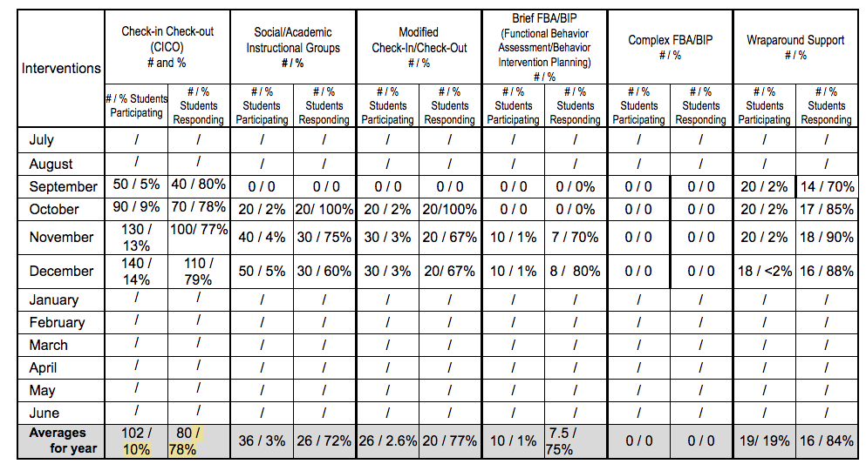
Intervention Receipt Form
Data supports:
Monitoring fidelity of interventions
Ensuring students are proportionate to total enrollment

Slide 97
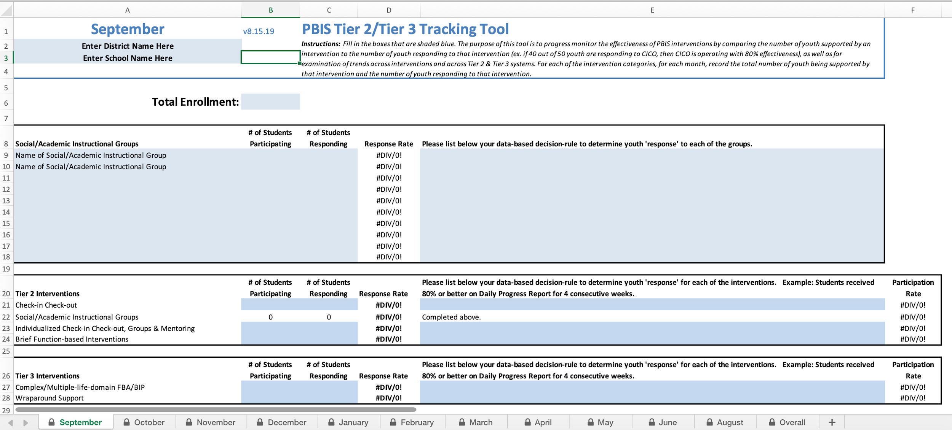

Slide 98
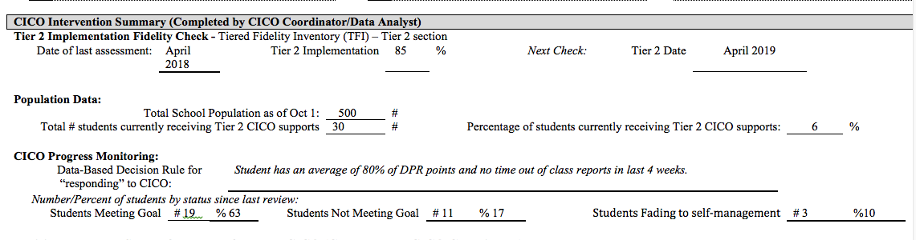
Bringing it Together:
Tier 2 TIPS Meeting Minutes
Recommended annually when at fidelity and 2-3 times/year until fidelity.
TFI Completion Date
Fidelity for Tier II is 70%
Population & Progress Monitoring Data comes from Tracking Tool. Want to include all interventions at Tier II.
Target is 10-15%. Need to consider students we are missing with our data decision rules.
Target is 70% of students responding. Need to problem solve this from systems perspective.

Slide 99
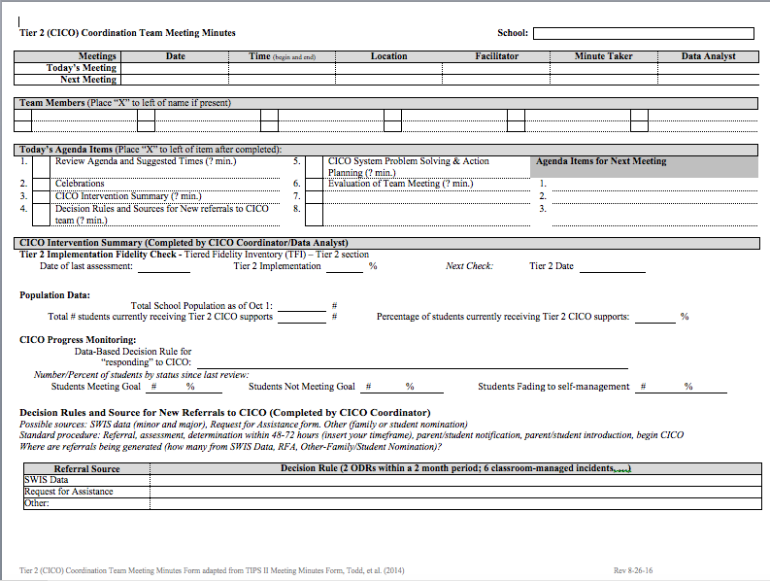

Slide 100
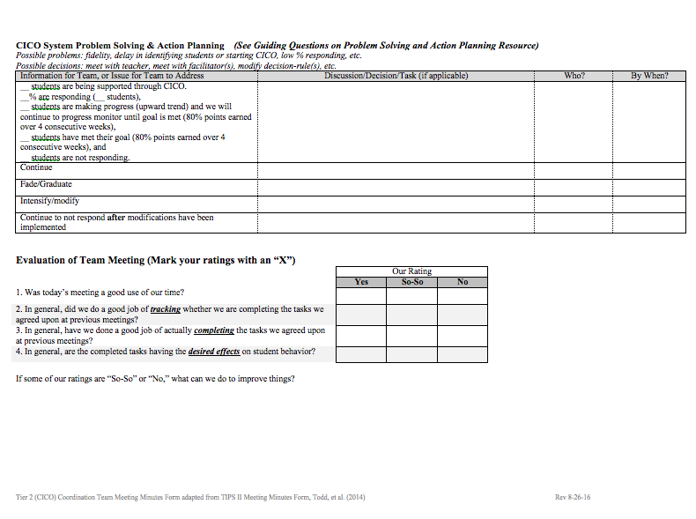

Slide 101

What questions can we answer for you?

Slide 102


Slide 103
Team Reflection & Planning
What routines are in place to build fluency with circles and triangles at Tier 1 (macro level)?
  If the T1 team is looking at school-/community-wide data and uncover a need for T2 support, how does that get communicated from T1 to T2 (communication plan)?
What routine is in place to monitor the health of the T2 system (how are our interventions working)?
What routines are in place to support progress monitoring?

