Slide 1
MTSS Tier 1: School-wide PBS Team Training
July 13 & 14, 2021
Teaming

Slide 2
Teams become more efficient and effective at solving problems with:
Meeting foundations (e.g. team vision, purpose/norms, authority, roles, agenda)
Data (timely, accurate, accessible)
Data informed decision making routines (e.g., defining problems with precision, building goals, monitoring implementation)
Teaming slides have been adapted from Rob Horner, available at Team Initiated Problem Solving (TIPS) Training

Slide 3
Efficient and effective teams….
Have a clear purpose, authority, efficient process, and defined roles
Transform data into clearly defined problems and solutions
Improve the likelihood their solutions are implemented
Improve the likelihood of improve in student outcomes (both academic and non-academic)
Inefficient and Ineffective teams....
Meet without establishing their purpose, process and roles
Meet without data or use data to describe rather than solve a problem
Define problems with limited precision (e.g., the kids are rude in the cafeteria) and adopt solutions that are a poor match with the problem (e.g., a packaged social skills program)
(Todd, Algozzine, Horner, Preston, Cusumano, Algozzine, 2019)
Notes:
Maybe ask a question in chat if people are restless and need engagement? Write down one meeting behavior that in your experience creates an effective or ineffective team

Slide 4
Critical Elements of Meeting Foundations
Team Purpose, Functions, Authority
Team Meeting Process (e.g., Agreements/Expectations)
Team Meeting Roles and Responsibilities
Team Organization (write it down!)
Flow of Team Meeting (develop an agenda!)

Slide 5
Purpose: Establish, monitor and improve a positive social culture for the school
Functions:
Select and teach school wide behavioral expectations
Establish a system to acknowledge positive behavior
Establish a system to respond constructively to problem behavior
Monitor and adapt to culture and context
Authority:
Advise administrators
Monthly report to faculty
Implement approved practices and systems
See the Tier 1 Meeting Foundations Tool in Your Handouts

Slide 6
Team Norms
Respect Before meeting: complete tasks, inform facilitator of absence/tardy, avoid side talk Start and end meeting on time During meeting: avoid side talk, stay focused Maintain confidentiality Relevance Question implementation fidelity Make data-based decisions to define precision statements (what, where, when, who, why & how often) Reality Think about feasibility, social acceptability, & contextual fit
See the Tier 1 Meeting Foundations Tool in Your Handouts
Notes:
Team meeting processes ensure you have efficient and predictable meetings. Here are some exampples

Slide 7
Core Roles
Facilitator Ensure the group moves smoothly through tasks! Minute Taker Write down the work of the group! Data Analyst Creates data summaries for the team Time Keeper Keep up with time! Active Team Member Stay engaged Administrator Provide support and authority Assign a back up for each role!
See the Tier 1 Meeting Roles Tool in Your Handouts
Notes:
Team meeting roles and defined responsibilities

Slide 8
Sample Tier 1 Team Meeting Flow:
Call meeting to order -- Who is present? Who is filling each role?
Update progress/problem solve previously defined problems Were solutions implemented? Based on data, is the problem getting better? Worse? Was goal reached? What is next?
Define and problem solve new problems What is the problem (who, what, where, when, why), identify goals, develop solutions and action plan
Discuss organizational/housekeeping items
Wrap up meeting - review data/time for next meeting and complete meeting assessment (how did it go)?
See a Sample Agenda in Your Handouts
Notes:
Team organization…. Develop an agenda and ensure you are writing things down!

Slide 9
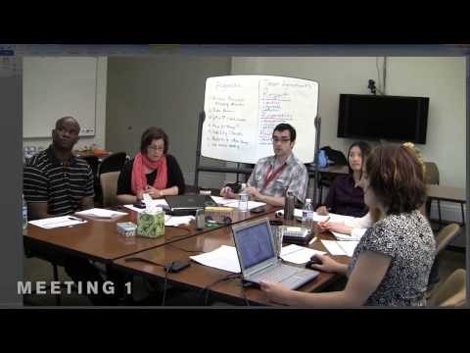
Tier 1 Team Meeting Demonstration using the TIPS II Model
Notes:
I have been referencing materials from the team initiated problem solving model (TIPS II) model of teaming and problem solving. TIPS-II is a research based process with associated tools for establishing and running effective and efficient problem solving team meetings. In this video, we will watch the beginning of a TIP-II meeting.
Play the first two minutes. Ask participants to type in the chat box elements of effective teaming noticed in the video

Slide 10
Team Time (10-15 minutes)
Reflecting on this morning’s MTSS/PBS overview, individually think what is one big idea you want to share with your larger school community and share with your team? Are there ideas that overlap? Capture team’s key messages to share.
Review and assign roles for training days (and think beyond training).
Reporters- Please rename with “R-”before name to support facilitation of ongoing share-out opportunities.
To prepare for our data discussion, please take a moment to answer a few questions via our shared survey.

