Slide 1
DE-PBS Cadre Meeting
Thursday, May 6, 2021

Slide 2
Meeting Expectations
 | Virtual Meetings
ENGAGED | Unmute yourself or use chat box to ask questions Participate in polls and breakout rooms Use video when possible, especially when speaking
REFLECTIVE | Share questions you have for full group Note follow up questions for PBS team and/or individuals Focus on problem solving around areas of concern
SUPPORTIVE | Share successes, ideas, useful resources Listen with openness and understanding Attend to your own needs

Slide 3
Welcome and Agenda
Cadre Goals:
Support district MTSS/PBS Coaches in their role
Project updates & resource sharing
Conduit between state to district to schools
Networking among districts
Feedback on Project activities/resources
Today’s Agenda:
Updates from DE-PBS Equity Committee
Extending the Mission Statement with Beliefs and Practices
DDOE Updates & Discussion with Susan Veenema
Indicator 4 & Significant Disproportionality
District Highlight: Kristi Peters, Appoquinimink SD
DE-PBS Project Notes

Slide 4
Equity

Slide 5
Equity Committee Update
Finalized Equity Mission, Beliefs, and Practices statements with Equity Committee
Plan to meet in summer to review action plan
Members:
Jocelyn Brown
Marqueia Davis
Tongela Ginyard
Yolanda McKinney
Adriane Simpson
Debby Boyer
Fiona Lachman
Megan Pell
Kittie Rehrig

Slide 6
Using the Courageous Conversations Agreements
Stay engaged.
Experience discomfort.
Speak your truth.
Expect and accept non­closure.
Singleton & Linton (2006) Courageous Conversations about Race: A Field Guide for Achieving Equity in Schools

Slide 7
Mission Statement
At the Delaware Positive Behavior Support Project, we are committed to improving outcomes for each student. Educational systems cannot be considered effective until they are effective for all students. A Multi-Tiered System of Support (MTSS) can be a force for dismantling systemic racism and promoting equity or serve to perpetuate oppression. In recognition that black lives matter and given centuries of oppression, violence, and segregation, we must increase our commitment to improving outcomes for Black, Indigenous, and other Students of Color. PBIS teams embed equity into their implementation of all aspects of MTSS.

Slide 8
Chat Box: What words or phrases resonate/stand out for you?
Mission Statement
At the Delaware Positive Behavior Support Project, we are committed to improving outcomes for each student. Educational systems cannot be considered effective until they are effective for all students. A Multi-Tiered System of Support (MTSS) can be a force for dismantling systemic racism and promoting equity or serve to perpetuate oppression. In recognition that black lives matter and given centuries of oppression, violence, and segregation, we must increase our commitment to improving outcomes for Black, Indigenous, and other Students of Color. PBIS teams embed equity into their implementation of all aspects of MTSS.

Slide 9
Share Out: How is this similar or different from your district statements?
Mission Statement
At the Delaware Positive Behavior Support Project, we are committed to improving outcomes for each student. Educational systems cannot be considered effective until they are effective for all students. A Multi-Tiered System of Support (MTSS) can be a force for dismantling systemic racism and promoting equity or serve to perpetuate oppression. In recognition that black lives matter and given centuries of oppression, violence, and segregation, we must increase our commitment to improving outcomes for Black, Indigenous, and other Students of Color. PBIS teams embed equity into their implementation of all aspects of MTSS.

Slide 10
Equity Beliefs
We believe…
Equity and culturally responsive practices must be ingrained into all aspects of MTSS/PBS at the state, district, and school levels.
Each student deserves to feel safe and to be welcomed as a valued member of the school community.
Listening to and learning from the educational experiences of Black, Indigenous, and other People of Color is essential to inform antiracist and culturally responsive work in schools.
Educational systems must amplify and prioritize the voices of students, staff and families who are Black, Indigenous and People of Color.
Representation matters in the curriculum and staffing and both should be representative of the communities and the students they serve.
Discipline policies and practices need to be equitable, preventive and restorative.
Decision-making in MTSS/PBS must be data-driven and all data needs to be examined for bias, from including what is collected, how it is collected, and how it gets interpreted and reported.
Educational systems need to prioritize, educate, and continuously monitor our school community around equity and culturally responsive practices in order to best serve our students.
Equity requires schools to support social emotional learning and promotion of mental wellbeing for each member of the school community.

Slide 11
Breakout Room Questions
What are your initial thoughts about the DE-PBS belief statements?
Choose the top beliefs (1-3) that are currently being prioritized in your districts? (or that you think should be a priority)

Slide 12
Poll
Select the top beliefs (1-3) that you noted as currently being prioritized in your districts

Slide 13
Equity in Practice
In translating these beliefs into practices...
1. Schools examine Tier 1 practices for bias including SW expectations and teaching matrices. The development and revision of expectations and teaching matrices includes representation of all members of community (staff, family and students).
2. LEAs and schools ensure students have equitable access to Tier 2 and 3 interventions and interventions are responsive to the needs of all students.
3. LEAs and schools engage in and provide professional learning about racism, bias, and privilege in order to build greater awareness, sensitivity, and opportunities for reflection.
4. Educators consider our biases about student behavior and replace deficit thinking with a strengths-based approach.
5. LEAs and schools examine and change policies that disproportionately harm students who are Black, Indigenous, and People of Color.
6. LEAs support educators in replacing exclusionary responses to problem behavior with restorative, culturally responsive approaches.
7. Disaggregated data is used to guide systems-level decision-making.

Slide 14
Breakout Room Questions
What glows and grows did you think about?
What is one area you would like to prioritize working on next year?

Slide 15
Share outs:
One glow or action from each group

Slide 16
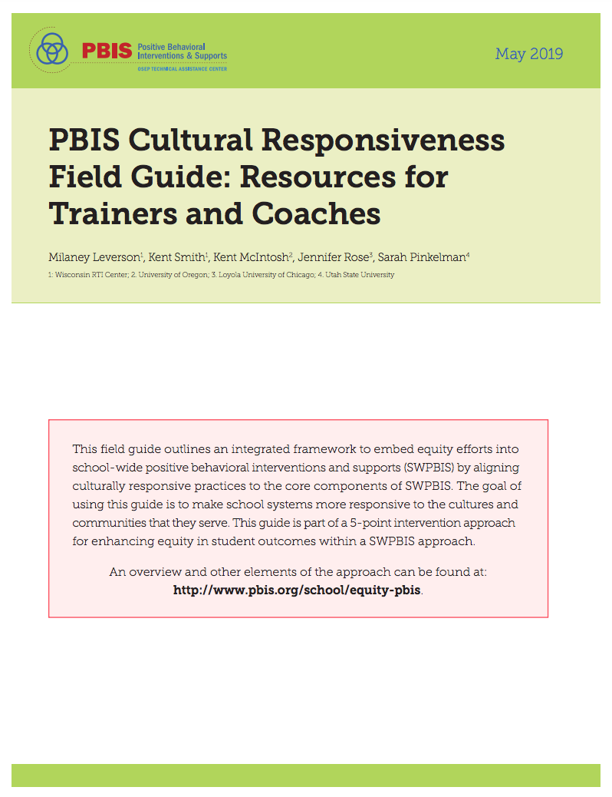
Equity Resource Reminders

Slide 17
Break Time

Slide 18
Reviewing Significant Discrepancy & Disproportionality and Exploring Reasonable Progress
Susan Veenema, Delaware Department of Education

Slide 34
DDOE Equity Summit
Friday October 8, 2021
At least 15 strands across all areas of education
How DDOE departments are addressing equitable practices

Slide 36
District Highlight
Kristine Peters, Appoquinimink School District

Slide 37
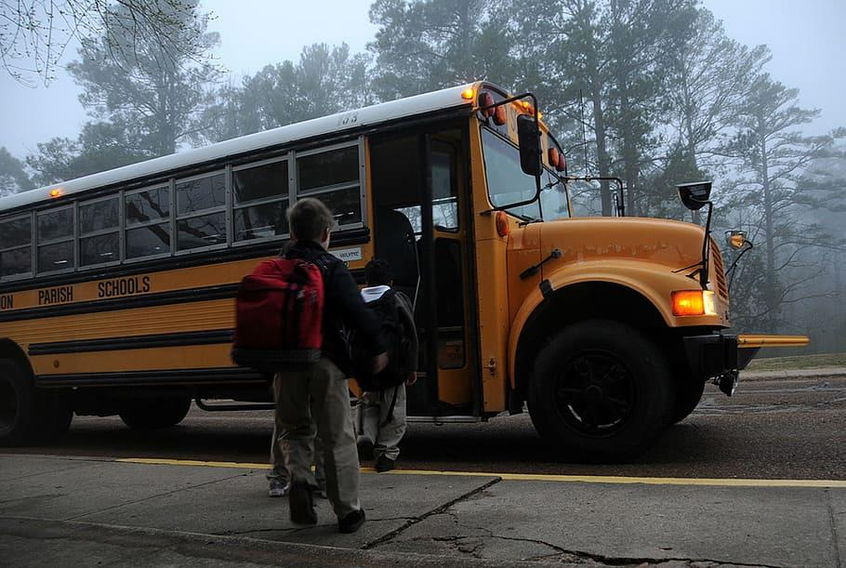
Appoquinimink School District
MTSS in Action

Slide 38
Appoquinimink’s Journey

Slide 39
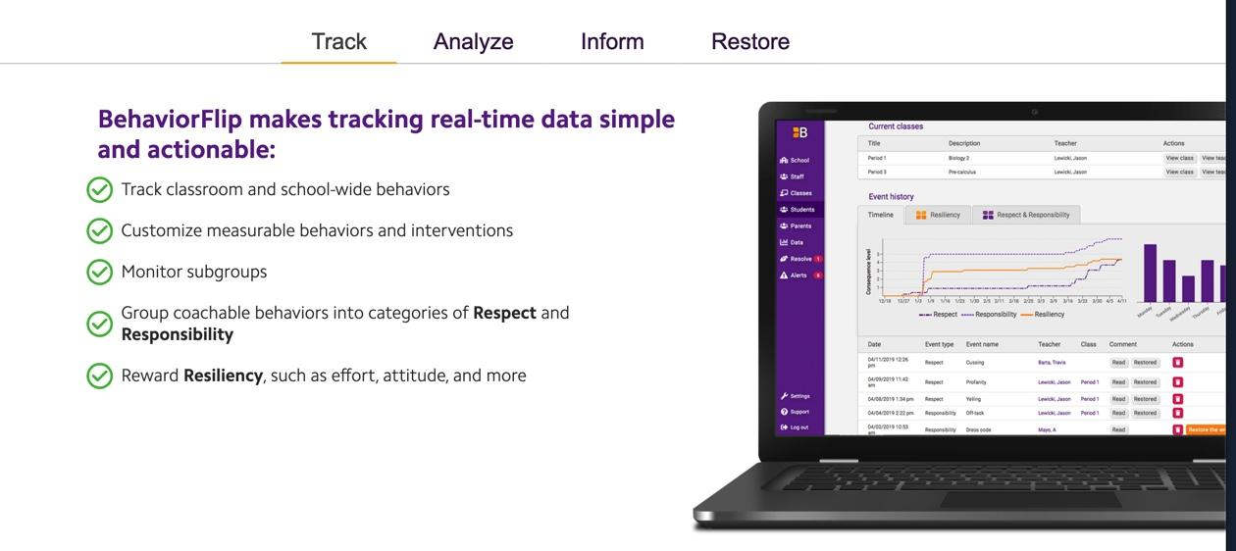
BehaviorFlip
Support open communication

Slide 40
2020-2021
Shift: to current social emotional needs
Opportunity: to pause and evaluate our WHY
Implementation: Cohort of champion schools

Slide 41
Where We Were
Restorative Practices & SEL
Reactive Code of Conduct
Exclusionary Practices
Siloed Initiatives

Slide 42
Where We are Going
Restorative Practices & SEL
Integrated Initiatives
Equitable Practices
Progressive Discipline Code

Slide 43
Appoquinimink Schools
Making CoC Changes Equity Centered
Focus on student learning and safety
Developmentally appropriate
Culturally responsive
Reinforcement of Social Emotional Learning
Support equitable outcomes/neutralize bias
Emphasis on collective commitments (shared ownership and responsibility)

Slide 44
Appoquinimink Schools
Minimize ineffective strategies and reduce disproportionality
Shift balance from:
punishment toward teaching strategies
external control (rule compliance) toward internal (intrinsic, self motivated)
exclusionary practices (removals)
Revised infractions (offense codes)

Slide 45
Appoquinimink Schools
Multi Tiered System of Support (MTSS) CoC Alignment
One size does not fit all
Strong Tier 1 Supports
Prevention and reinforcement of Social Emotional Learning (SEL)
Focus on skill gaps and teaching alternative skills
Progression of supports and consequences strategies in a Stepped Matrix

Slide 46
Appoquinimink Schools
CoC Focus on Effectiveness
Ensure consequence strategies are logical and repair the harm
Avoid inadvertently reinforcing behavior
Focus on developing Social Emotional Learning
Focus on the WHY for policies
What TO DO instead of what NOT to do
Staff and Student Ownership
Alignment with district core values and Board Policy 6109

Slide 47
Restorative practices take incidents that might otherwise result in punishment and in them recognize opportunities for kids/students/people to recognize the impact of their behavior, understand their obligation to take responsibility for their actions, and take steps towards making things right.
The Lawyers’ Committee for Civil Rights Under Law

Slide 48
Either we spend time meeting children’s emotional needs by filling their cup with love or we spend time dealing with the behaviors caused from their unmet needs. Either way, we spend the time.
Pam Leo

Slide 49
Appoquinimink Schools
Goals of CoC Revisions
Clear and concise language and policies
i.e. Bus expectations from 28 to 5
Student and Parent Friendly wording
Improved definitions to increase decision reliability (consistency)
Removed offense codes that were redundant, unclear, or unnecessary
i.e. dress code moved from infraction to policy
Visual format

Slide 50
Progressive Discipline Model, Approaches, and Responses: A Collective Model Encouraging Proactive Teaching
STEP 1: Classroom Interventions, Restorative Practices, and SEL Strategies/Supports
Teachers and Staff are encouraged to use culturally responsive, PBS, Restorative Practices, and SEL supports and classroom management strategies.
Establish positive relationships and rapport with students
Utilize calm down and coping strategies as needed
Emphasize teaching of positive SEL replacement strategies
Prevent negative behaviors from occurring and set students up for success
Establish meaningful and restorative responses to negative behavior
Ongoing communication between home and school for both positive and negative behavior

Slide 51
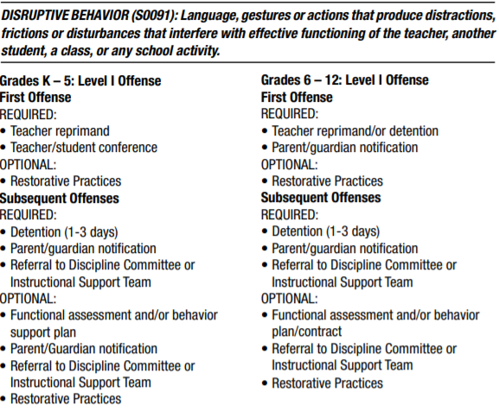
Old Chapter 3 Format - Student Facing

Slide 52
Revised Infractions/Code Violations (Collective)
https://docs.google.com/document/d/1J75UimdWYRR4beZ24z3I0Zvr8odzl38bpXbOfPUi83c/edit

Slide 53
One Vision
12,111+ reasons why

Slide 54
DE- PBS Project Notes
More info to come...
Professional Learning & Conference Opportunity
DE School Climate Survey
Phase Recognition

Slide 55
Professional Learning Opportunities
DE-PBS Online Professional Learning Materials
Webinars reflective of current context; e.g. return to school
School Climate focused modules
MTSS focused presentations
Building Habits of Effective Classroom Practice Module New!
Top Ten Questions Answered about Universal Screening New!
Identifying Virtual Professional Development for Staff
Tool to Identifying Virtual Professional Development for Staff, for administrators, district MTSS/PBS coaches, and others planning PD activities for their staff.
Identifying Virtual Professional Development for Staff
We need to hear from you!
Look for a questionnaire to come on new school team training interest & needs of existing teams.

Slide 56
Northeast PBIS Leadership Forum - Virtual Opportunity
Date: Thursday May 13 & Friday May 14
Time: 12-4:30 pm
Cost: $25/person
Link: https://nepbis.org/forum/
Local highlights: “Success for All: MTSS Through a Trauma-Invested Lens” Dr. Yolanda McKinney & Wendy Johns, Brandywine SD
“Using Climate Data: District and Middle School Level Planning for MTSS” Melinda Tartaglione, Talley MS & Dr. Yolanda McKinney
Strand topics:
PBIS Implementation & Sustainability
School-Wide PBIS & Class-Wide PBIS
Advanced Tiers of PBIS
Integration & Alignment

Slide 57
DE School Climate Survey Update
Spring 2021 - 131 DE Schools Enrolled; 8 Districts Fully Enrolled
Survey window open through end of May
Updated Dashboard to Support Coaching:
Completion stats per population and report to download
Login stats

Slide 58
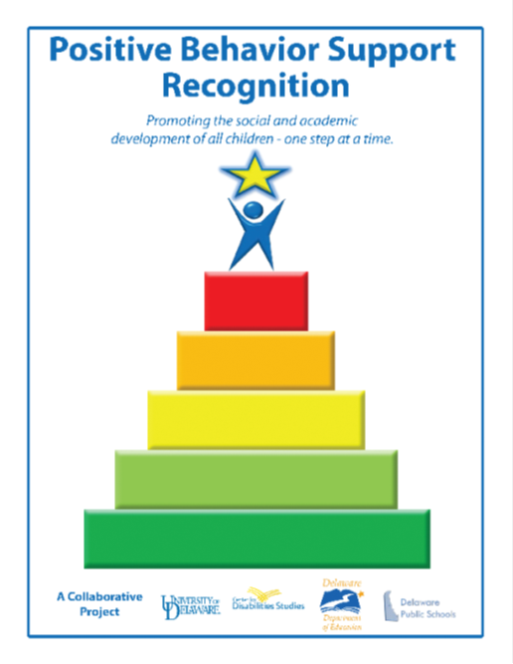
DE-PBS Phase Recognition
Maintaining for 2020-2021 School Year with modifications
Phases 1 & 2 – Focus on Tier 1: School-wide PBS
Phases 3 & 4 – Tier 2: Targeted PBS
Reminder: applications prompt reflection & planning; perfect for summer meetings
Extending deadline beyond end of June

Slide 59
DE-MTSS Resources Available-
Overview & Implementation Guides
DE-PBS Website currently under renovations! More to come.

Slide 60
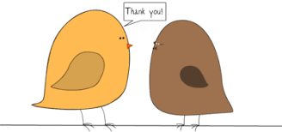
Thank you!
We appreciate and value your feedback!
Please take a moment to complete the survey for today’s meeting.
Please also look for an end of the year survey to help us inform plans for 2021-2022!
Reminder to follow us on Twitter & share the handle with your schools.
@Delawarepbs

