Slide 1
DE-PBS Cadre Meeting
October 21, 2021

Slide 2
The DE-PBS Project serves as a technical assistance center for the Delaware DOE to actualize the vision to create safe and caring learning environments that promote the social-emotional and academic development of all children.
The statewide initiative is designed to build the knowledge and skills of Delaware educators in the concepts and evidence-based practices of Positive Behavior Support (PBS) as a Multi-tiered System of Support (MTSS).

Slide 3
Meet our Team!
DE-PBS Project Co-Directors
Debby Boyer
Linda Smith

Slide 4
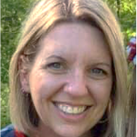
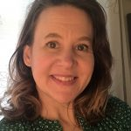
Meet our Team!
Full-Time Staff & Coaches
Brynn
Fallah
Sarah Hearn
Niki
Kendall
Megan Pell

Slide 5
Meet our Team!
Part-Time Coaches
Kitty Rehrig
Valerie Brown

Slide 6
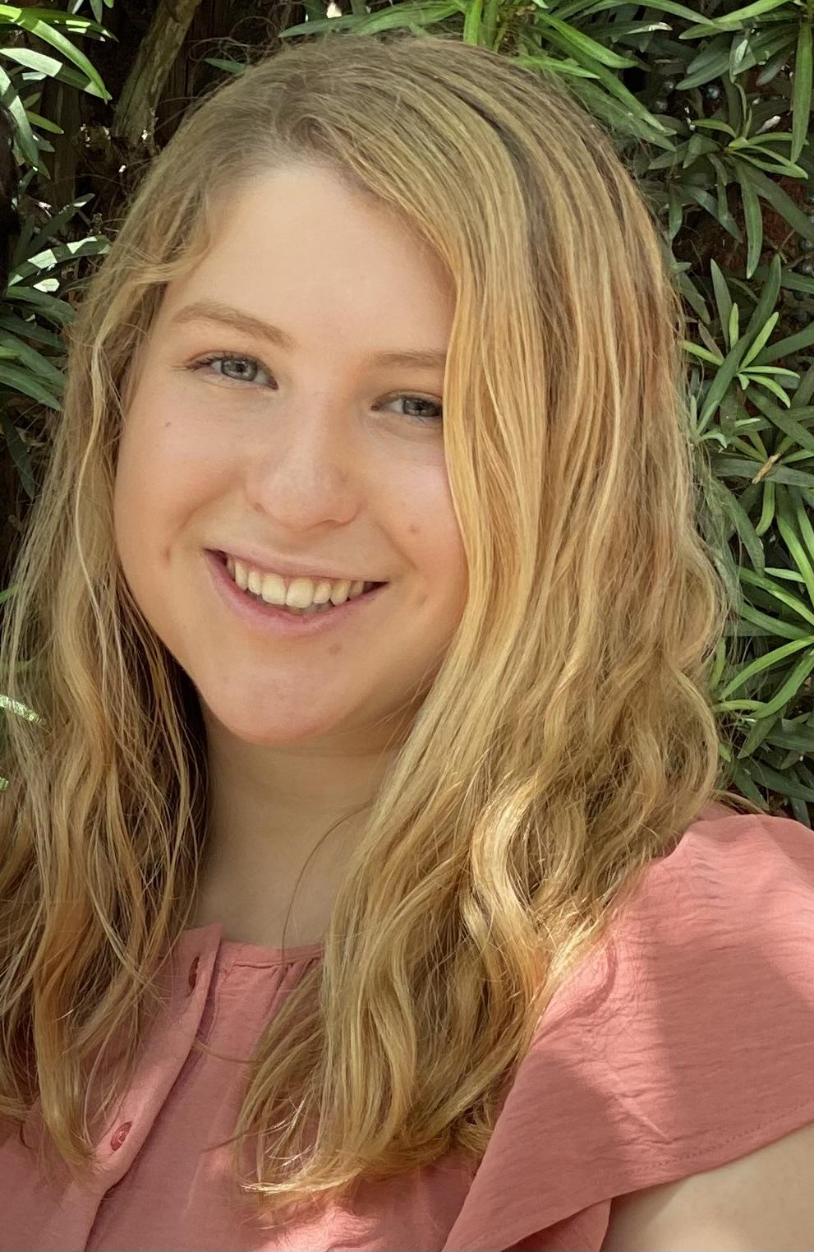
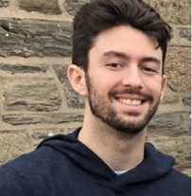
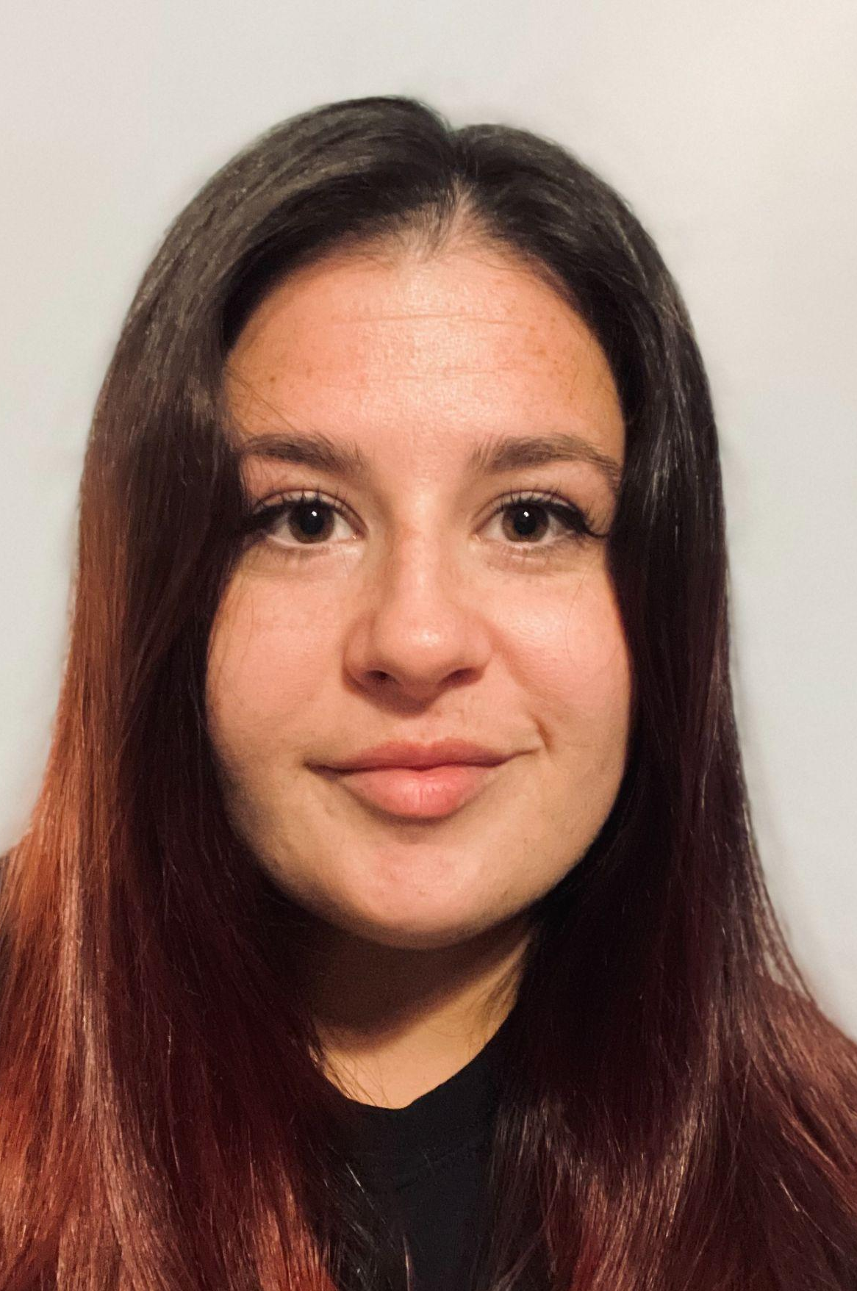
Meet our Team!
Graduate Assistants
Rebecca Silver
Mark Miller
Alex Miller

Slide 7
Meeting Expectations
We are... | Virtual Meetings
ENGAGED | Unmute yourself or use chat box to ask questions Participate in polls and breakout rooms Use video when possible, especially when speaking
REFLECTIVE | Share questions you have for full group Note follow up questions for PBS team and/or individuals Focus on problem solving around areas of concern
SUPPORTIVE | Share successes, ideas, useful resources Listen with openness and understanding Attend to your own needs

Slide 8
Cadre Goals & Agenda Topics
Cadre Goals:
Support district MTSS for SEB Coaches in their role
Project updates & resource sharing
Conduit between state to district to schools
Networking among districts
Feedback on Project activities/resources
Agenda:
DE-PBS 2020-21 Phase Recognition Celebrations
DDOE Indicator 4 - Significant Discrepancy & Equity Resource Updates
Social Emotional Behavioral Wellbeing Plan Overview
Project-based Professional Learning & Data Resource Updates

Slide 9
2020-21 SY Phase Recognition Recipients
Tier 1 School-wide Team
Implementation
Award Level | District | School
Phase 1 | Capital School District | Kent County Secondary Intensive Learning Center
Phase 1 | Indian River School District | Long Neck Elementary School
Phase 2 | Brandywine School District | Hanby Elementary School

Slide 10
2020-21 SY Phase Recognition Recipients
Tier 2 Targeted Team Implementation
Award Level | District | School
Phase 3 | Brandywine School District | Hanby Elementary School
Phase 3 | Brandywine School District | Talley Middle School
Phase 3 | Lake Forest School District | Lake Forest East Elementary School

Slide 11
2020-21 SY Phase Recognition Recipients
Tier 2 Targeted Team Systems
Implementation
Award Level | District | School
Phase 4 | Appoquinimink School District | Bunker Hill Elementary School
Phase 4 | Brandywine School District | Carrcroft Elementary School
Phase 4 | Christina School District | William B. Keene Elementary School
Phase 4 | Christina School District | Shue-Medill Middle School
Phase 4 | Milford School District | Lulu M. Ross Elementary School

Slide 12
2020-21 SY Phase Recognition Public Notices
School level messages
Website posting
Letters to district superintendents and board presidents
Twitter

Slide 13
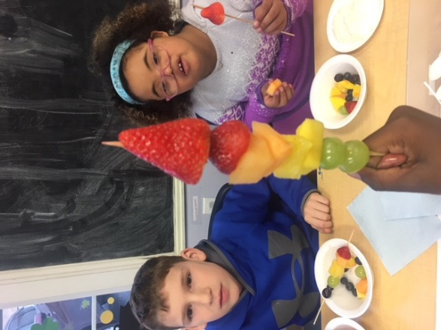
Significant Discrepancy Indicator 4A & 4B Equity in IDEA Statewide Stakeholder Group
Delaware Department of Education
Exceptional Children Resources

Slide 14
Agenda
What is Significant Discrepancy or Indicator 4?
Methodology of determining data
Review of Data
Target Setting
Strategies for Improvement, Feedback and Discussions

Slide 15
Definition of Significant Discrepancy/Indicator 4

Slide 16
SPP/APR: Compliance Indicators
SPP/APR: Compliance Indicators
INDICATOR 4B:
Suspension and Expulsion of Students with Disabilities as compared to students without disabilities by race and ethnicity.
aA
Significant discrepancy, by race or ethnicity, in the rate of suspensions and expulsions of more than 10 days in the school year that have policies, procedures, or practices that contribute to the significant discrepancy and that do not comply with requirements relating to the development and implementation of IEPs, use of positive behavior interventions and supports, and procedural safeguards.
Regulation: 20 U.S.C 1415(a)(3)(A); 1412(a)(22)

Slide 17
SPP/APR: Compliance Indicators
SPP/APR: Results Indicators
INDICATOR 4A:
Suspension and Expulsion of Students with Disabilities as compared to students without disabilities
Significant discrepancy in the rate of suspensions and expulsions of more than 10 days in the school year for students with IEPs.
Regulation: 20 U.S.C 1415(a)(3)(A); 1412(a)(22)

Slide 18
Calculation 4A
The DDOE defines “significant discrepancy” as those LEAs with a rate ratio which exceeds the “State bar,” and for which the number of students with disabilities suspended or expelled greater than 10 days equals or exceeds 15 students (state established n size). The DDOE calculates the LEAs’ rate ratio by dividing the percentage of students with disabilities suspended or expelled greater than 10 days by the district level percentage of general education students suspended or expelled greater than 10 days within each LEA.
The rate ratio or threshold is a static 2.0 for 3 consecutive years or 5.0 in one year
N size of 15
Percentage of students with disabilities
suspended or expelled greater than 10 days
District level Percentage of general education students
without disabilities suspended or expelled greater than 10 days

Slide 19
Calculation 4B
DDOE defines “significant discrepancy” as those LEAs with a rate ratio which exceeds the “State bar,” and for which the number of students with disabilities within a racial category are suspended or expelled greater than 10 days equals or exceeds 10 students (state established n size). The DDOE calculates the LEAs’ rate ratio by dividing the percentage of students with disabilities in each race or ethnicity, suspended or expelled greater than 10 days by the district level percentage of general education students suspended or expelled greater than 10 days within each LEA.
The rate ratio or threshold is a static 2.0 for 3 consecutive years or 5.0 in one year
N size of 10
Percentage of students with disabilities in each race or ethnicity
suspended or expelled greater than 10 days
District Level Percentage of general education students
in each race or ethnicity suspended or expelled greater than 10 days

Slide 20
Historical Data 4A
FFY | 2014 | 2015 | 2016 | 2017 | 2018 | 2019
Target <= | 0% | 0% | 0% | 50% | 50% | 40%
Data | 0% | 4.65% | 66.67% | 100% | 0% | 0%
Baseline Year | Baseline Data
FFY17 | 100
Number of Districts that met the states minimum n size of 15:
FFY 17: 6
FFY 18: 3
FFY 19: 3

Slide 21
Historical Data 4B
Number of Districts that met the states minimum n size of 10:
FFY 17: 6
FFY 18: 3
FFY 19: 3

Slide 22
Target Setting

Slide 23
Target Setting
Indicator 4B (Compliance Indicator) Target is set at 0%
4A (Results Indicator) Stakeholders met and set targets in 2018.
FFY17 - 50%
FFY18 - 50%
FFY 19 - 40%
FFY20 - 40%
FFY21 - 32%
FFY22 - 32%

Slide 24
Target Setting
What do we want to set for Indicator 4A FFY 23 & 24
FFY20 - 40%
FFY21 - 32%
FFY22 - 32%
FFY23 - ___
FFY24 - ___
FFY25 - ___

Slide 25
Questions/Discussion
We will collect your input on targets and potential strategies for improvement via a brief stakeholder survey after an activity.

Slide 26
Next Steps
Take this information back to your stakeholders
(Staff, parents, etc.)
Share resources
Check out DDOE website for parent friendly one-pagers
Provide feedback on targets and strategies for addressing
Significant Discrepancy to Susan.Veenema@doe.k12.de.us

Slide 27
Contact Information
Mary Ann Mieczkowski
Maryann.Mieczkowski@doe.k12.de.us
Susan Veenema
Susan.Veenema@doe.k12.de.us
Thank you!

Slide 28
Equity
DE-PBS Project Mission
At the Delaware Positive Behavior Support Project, we are committed to improving outcomes for each student. Educational systems cannot be considered effective until they are effective for all students. A Multi-Tiered System of Support (MTSS) can be a force for dismantling systemic racism and promoting equity or serve to perpetuate oppression. In recognition that black lives matter and given centuries of oppression, violence, and segregation, we must increase our commitment to improving outcomes for Black, Indigenous, and other Students of Color. PBIS teams embed equity into their implementation of all aspects of MTSS.

Slide 29
Disportionality, Equity, Discipline
Which PBIS features are most predictive of racial equity in school discipline?
Significant predictors of decreased disproportionality: Regular use of data for decision making (Tobin & Vincent, 2011)
Implementation of classroom PBIS systems (Tobin & Vincent, 2011)
Use of formal reward systems (Barclay, Castillo, & Kincaid, in press; Tobin & Vincent, 2011)
2021 Delaware
Equity Summit

Slide 30
Disportionality, Equity, Discipline
Center on PBIS
5-point Intervention Approach
Collect, use, and report disaggregated discipline data
Implement a behavior framework that is preventive, multi-tiered, and culturally responsive
Use engaging academic instruction to reduce the opportunity (achievement) gap
Develop policies with accountability for disciplinary equity
Teach strategies to neutralize implicit bias

Slide 31
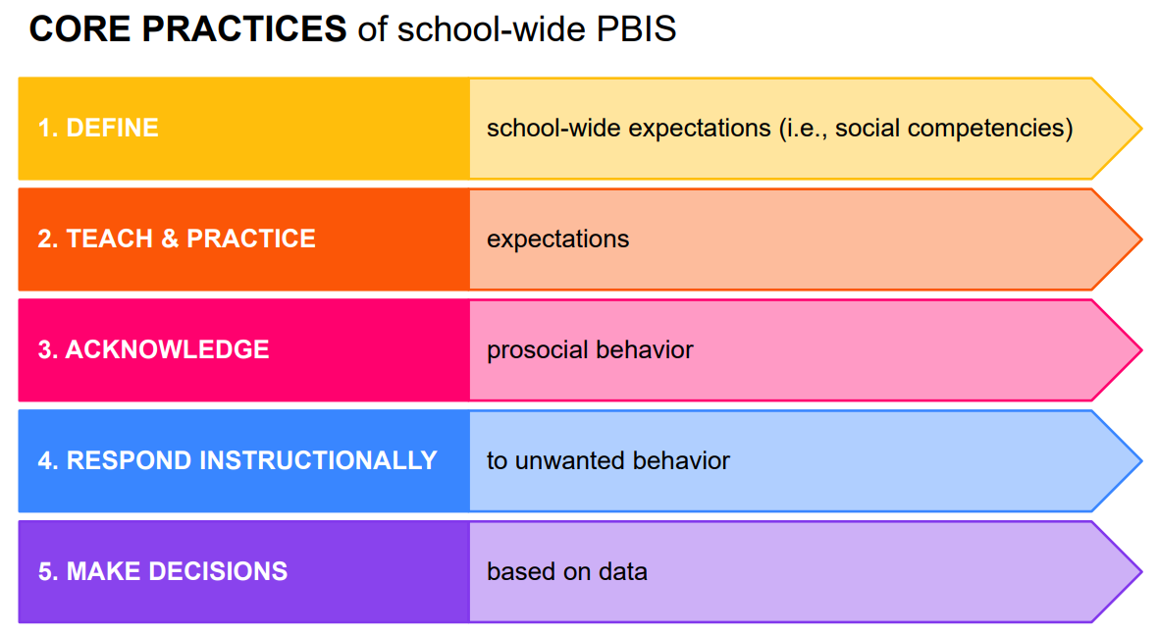
Disportionality, Equity, Discipline

Slide 32
Breakout
Room
Time

Slide 33
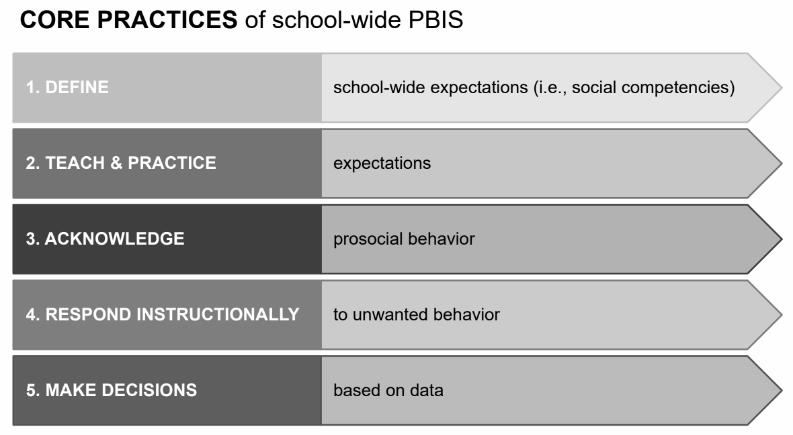
Big Picture Reflections
Thinking across these 5 core practices, please share the following:
How do you feel these practices proactively address disproportionality?
Are there ways in which they may be contributing to disproportionality?

Slide 34
Specific Examples
For the individual 5 core practices, please share:
What examples do you have from your schools or district of implementing these practices to address disproportionality?

Slide 35
...and...
When do you see teachers (or teams) needing coaching support to consider the equitable implementation (or outcomes) of any of these practices?

Slide 36
We are ENGAGED REFLECTIVE SUPPORTIVE

Slide 37
Share questions you have for full group
Note follow up questions for PBS team and/or individuals
Focus on problem solving around areas of concern
Unmute yourself or use chat box to ask questions
Participate in polls & breakout rooms
Use video when possible, especially when speaking
We are ENGAGED REFLECTIVE SUPPORTIVE
Share successes, ideas, useful resources
Listen with openness and understanding
Attend to your own needs

Slide 38
Breakout
Room
Debrief

Slide 39
Resource
Sharing
Coaching Teams to Implement Personal Matrix discussions SW
•15 min video
•Facilitator Guide
Based on:
PBIS Culturally Responsive Field Guide

Slide 40
DE-PBS Equity Committee
Reconvening for 2021-2022 SY
●Debby Boyer
●Jocelyn Brown
●Marqueia Davis
●Tongela Ginyard
●Yolanda McKinney
●Yolanda McKinney
●Mark Miller
●Megan Pell
●Kittie Rehrig
●Adriane Simpson

Slide 41
Survey & Stretch
Time for a wellbeing stretch
&
your feedback on 4B decision-making and the 5 core SWPBS practice.

Slide 42
Social, Emotional and Behavioral Wellbeing Plan
SEBW Plan

Slide 43
Social, Emotional and Behavioral Wellbeing (SEBW) Plan
The Social, Emotional and Behavioral Wellbeing plan is built on the logic that SEB practices are integral to learning and require multi-tiered systems to support implementation.
Partners: DOE, UD Center for Disabilities Studies - Delaware PBS Project, DSCYF, Project DelAWARE, and Project THRIVE
Coordinator contact: adriana.ignudo@doe.k12.de.us

Slide 44
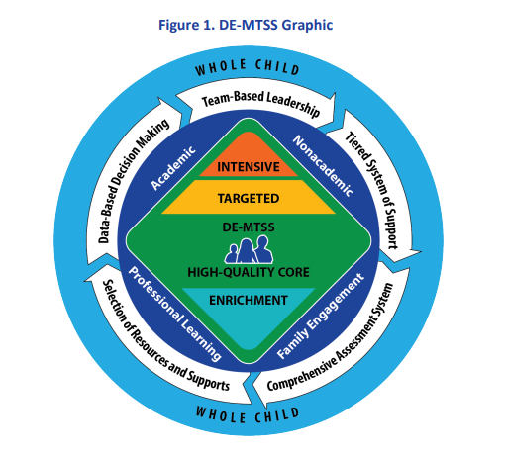
Delaware Developmental Framework
What are the main goals of the SEBW Plan?
Install and sustain effective multi-tiered systems that support the social, emotional, and behavioral wellbeing for all students
Align related SEB initiatives and resources for greater impact
Implement high-quality SEB instructional materials at each tier of support
Use multiple sources of data (e.g. universal screening data, progress monitoring data, implementation data) to identify and respond to SEB needs across the tiers of support
Ensure equitable access for each student

Slide 45
SEBW Plan Overview
Level 1: Exploration – Resources and online learning tools to use independently
Level 2: Installation – Guided Professional Learning opportunities for schools and districts
Level 3: Implementation – Ongoing coaching and professional learning for district/charter leadership teams at the readiness phase for full implementation or expansion

Slide 46
Community Resilience Model
Level 1 – Exploration
Designed to reach a broad audience from individual educators to building or district teams. It is recommended that district/schools begin with a needs assessment or data to identify which supports to explore based on prioritization activities and need
Appendix A outlines resources organized by:
Systems: Establishing MTSS
System Enhancements: Ensuring equity and integration of mental health supports within MTSS
Data: Building MTSS data practices
Practices: Building educator knowledge and skills

Slide 47
Community Resilience Model
Level 2 – Installation Stage
Designed to support teams through focused professional learning (PL) and technical assistance, develop support needed to install a new approach or practice as intended, create feedback loops between practice and leadership level to streamline communication, and gather feedback on implementation.
Appendix B outlines resources organized by:
LEA-Level MTSS for SEB Coaching
Level 2 LEA PL & coaching
Level 2 Professional Learning (PL) Opportunities
Foundational MTSS
System Enhancement
Data Enhancement
Tier 1-2-3 Practice Enhancements

Slide 48
Community Resilience Model
Level 3 – Implementation
Focuses on continuous improvement of new skills and practices and designed to support district/charter teams as they work to scale up the implementation. Resources and coaching to support the implementation of new skills and practices, gather data to assess fidelity and impact, and develop improvement strategies based on the data. Ongoing coaching opportunities are connected to identified needs and progress/ outcome data to determine if the coaching is leading to the improved use of skills and practices.
Appendix C outlines resources organized by:
LEA Level Coaching
Level 3 Professional Learning (PL) Opportunities

Slide 49
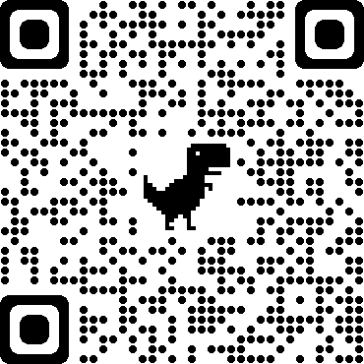
Community Resilience Model
SEBW Resources
Review the Delaware Strategy for Social, Emotional & Behavioral Wellbeing Plan
Visit the FAQ document
Checkout monthly SEBW newsletter
Reflect on current needs
Identify a contact to be lead for district/school
Initial SEBW Plan Entry Survey
Collaboration is Key!
Know that the State SEBW Team will coordinate with you as our district SEB coaches as we hear from schools and/or fellow district colleagues regarding SEBW resource interest.

Slide 50
Professional Learning
http://www.delawarepbs.org/pd/
Online PL
Building Habits of Effective Classroom Practice
Top Ten Questions Answered about Universal Screening
CICO: Check-In/Check-Out Module
DE-MTSS Module Series
Schoology Course (Course # 30130 Section # 57818)

Slide 51
Professional Learning
Tier 1 - School-wide
New team training held virtually in July
Looking ahead - New team training to be offered Summer 2022
What are current Tier 1 needs in your district?
New teams in need of training?
Booster training?
Overall tier 1? Specific core element?

Slide 52
Professional Learning
Tier 2
Teams, Interventions, and Evaluation
PL: Winter 2022 Tier 2 Fundamentals, Spring 2022 networking events
Self-Assessment Tool: Tiered Fidelity Inventory - Tier 2
DE-PBS Website:
School Resources, Tier 2

Slide 53
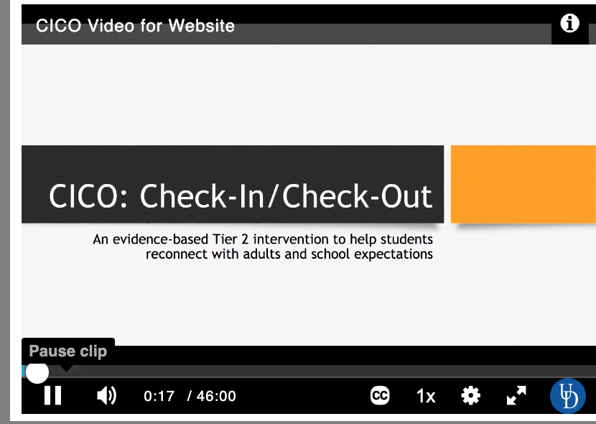
Tier 2: Check-in Check-out (CICO)
CICO is an evidence-based Tier 2 intervention to help students reconnect with adults and school expectations. This DE-PBS mini-learning module (46 mins total) walks viewers through the components and considerations of the Tier 2 Check-In/Check-Out intervention. The module presents key concepts and tools to help Tier 2 Teams to determine if this intervention is a good fit for their students, if they have appropriate resources, fidelity measures, and how the process works.
For credit: PDMS Course #30025 in Schoology.
Otherwise, you can use the resources on this page: http://www.delawarepbs.org/cico-check-in-check-out/

Slide 54
Tier 3: FBA and BIP for Educators
This session is for anyone interested in better understanding function based behavior support planning.
Dates:
Tuesday October 27, 2021 (5:00-7:00)
Wednesday November 9, 2021 (5:00-7:00)
To Register:
Please register in PDMS (course #30152). Participants should register for both sections (section 57918 and section 57919). A Zoom link will be provided via email a few days prior to each session.

Slide 55
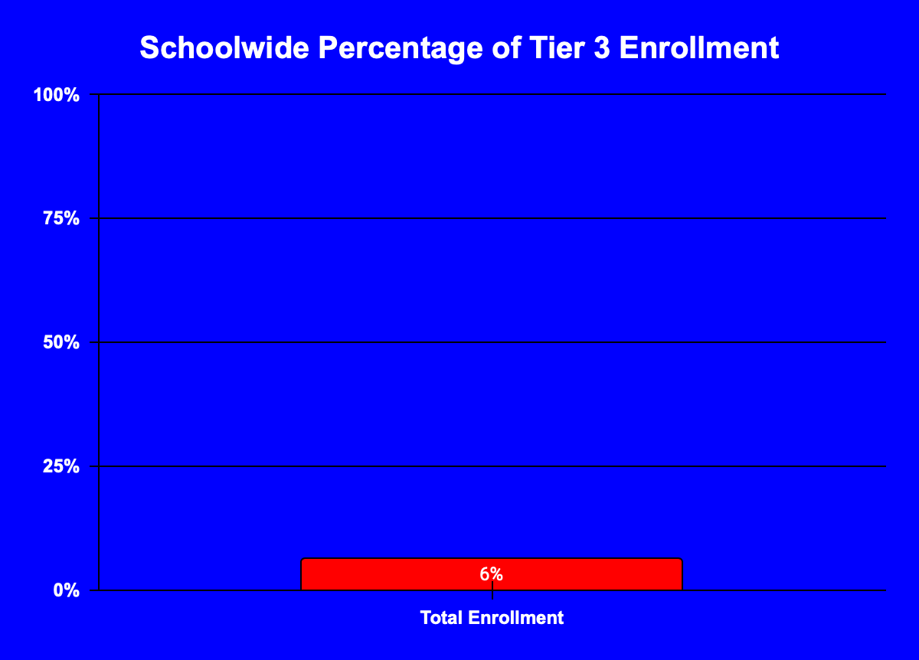
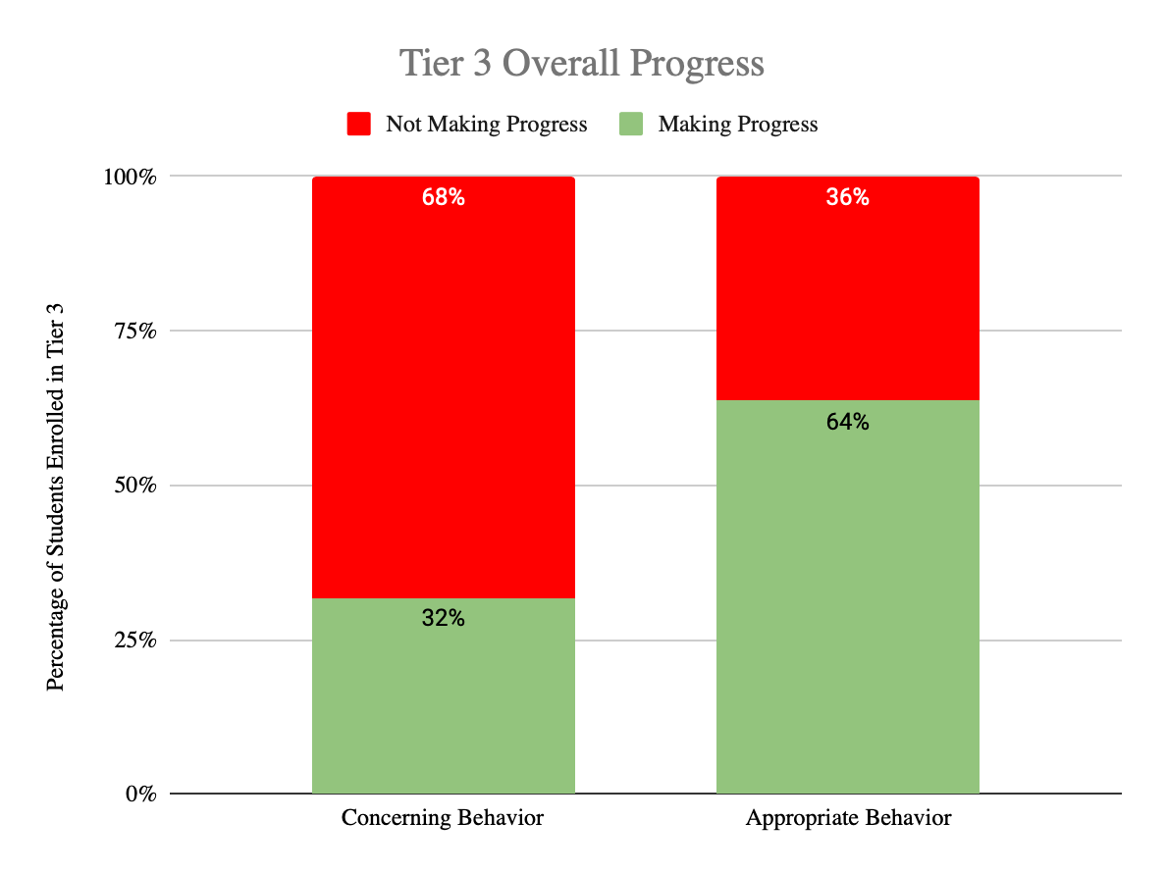
Tier 3: Systems Session
Have you ever wondered how to evaluate and respond to the overall effectiveness of your Tier 3 system?
This session is for you!
This spring we look forward to hosting a professional learning session for those focused on Intensive (T3) data, systems and practices.

Slide 56
Data Reminders & Updates
Discipline Data Reporting Tool (DDRT)
2021-22 Templates available on website & will also be shared via email
Submissions are 2x per year to district coach and project. January 14th and June 17th

Slide 57
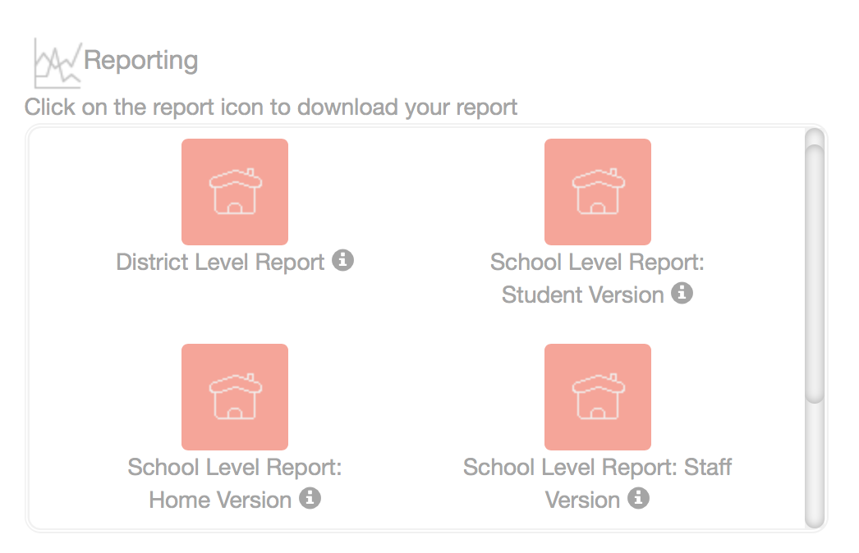
School Climate - 2020-2021 School Year
Reminder: School & District Level reports AVAILABLE once surveying is complete.
Reports downloaded as PDF files from the Dashboard in CoVitality.
Info forthcoming for new coaches!
2021-2022 DSC Survey Information Coming Soon

Slide 58
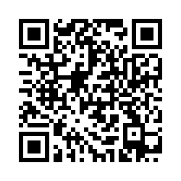
Next meetings:
Coach Networking
November 18 1-2:30
&
DE-PBS Cadre
December 16
Thank you for coming!
Please take a few minutes to fill out our participant survey!

Slide 59
Supporting Child and Student Social, Emotional, Behavioral and Mental Health
Information and resources to enhance the promotion of mental health and the social and emotional well-being among children and students.
Highlights seven key challenges to providing school-based mental health support across early childhood, K–12 schools, and higher education settings, and presents seven corresponding recommendations.
Includes real-world examples of how the recommendations are being put into action

