Slide 1
DE-PBS Cadre Meeting
Thursday, March 4, 2021

Slide 2
Meeting Expectations
 | Virtual Meetings
ENGAGED | Unmute yourself or use chat box to ask questions Participate in polls and breakout rooms Use video when possible, especially when speaking
REFLECTIVE | Share questions you have for full group Note follow up questions for PBS team and/or individuals Focus on problem solving around areas of concern
SUPPORTIVE | Share successes, ideas, useful resources Listen with openness and understanding Attend to your own needs

Slide 3
Welcome & Agenda
Cadre Goals:
Support district MTSS/PBS Coaches in their role
Project updates & resource sharing
Conduit between state to district to schools
Networking among districts
Feedback on Project activities/resources
Today’s Agenda:
DE-PBS Equity Committee Updates
DDOE Compliance Indicator 4
(Re)Grounding in Tier 1 & Building Coaching Toolbox
Updates/Reminders

Slide 4
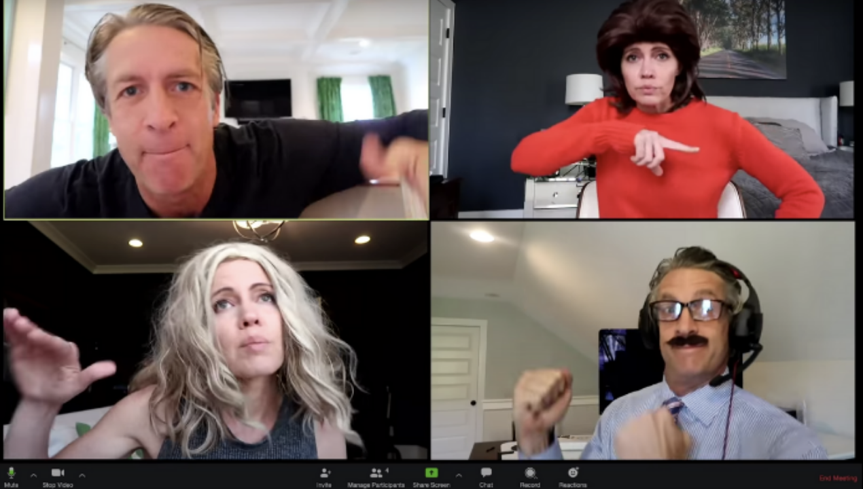
Icebreaker
What helps you stay engaged on Zoom or online learning platforms?

Slide 5
Equity Workgroup Update
Cadre meeting in December on CR Field Guide
Development of mini-modules
Formation of DE-PBS Equity Committee to create mission to guide the projects work for our community
Initiated critical review and revision of Professional Development content
“Educational systems cannot not be considered effective until they are effective for all student groups. PBIS provides an ideal framework for increasing equity in student outcomes.
- Center on PBIS

Slide 6
PBIS 5-Point Intervention Approach for Enhancing Equity in School Discipline:
Collect, Use, and Report Disaggregated Discipline Data
Implement a Preventative, Multi-Tiered, Culturally-Responsive Behavior Framework
Use Engaging Instruction to Reduce the Opportunity Gap
Develop Policies with Accountability for Disciplinary Equity
Teach Strategies for Neutralizing Implicit Bias in Discipline Decisions

Slide 7
Formation of
Equity Committee
Thanks!
Members
Jocelyn Brown
Marqueia Davis
Tongela Ginyard
Yolanda McKinney
Adriane Simpson
Debby Boyer
Fiona Lachman
Megan Pell
Kittie Rehrig
First meeting
Reviewed existing missions, visions and commitment
Discussed priorities and focus for our work
Second Meeting
Reviewed and edited draft mission statement
Initial work on commitments and actions

Slide 8
Key discussion points from first Equity Committee meeting:
Districts are addressing equity through a variety of lenses and priorities.
Expanding the voice of students and adopting an asset-centered lens in programming are fundamental to building equity in schools.
Data are important to ensure that equity is being experienced by all students and they help to identify and tackle bias in existing interventions.

Slide 9
Key discussion points from first Equity Committee meeting:
Organizations are stronger in their work to promote equity and address bias when they support each other to address this work.
Equity relates to many aspects of student lives (e.g., gender, race, religion, community, economic security).
Inequities are present in current education systems but current inequities represent a long-standing legacy of inequities that have differentially impacted different students, Black and Brown students in particular.

Slide 10
Equity Workgroup Update
“Educational systems cannot not be considered effective until they are effective for all student groups. PBIS provides an ideal framework for increasing equity in student outcomes.
Research shows that schools implementing PBIS with fidelity have greater equity in school discipline, specifically for African American students. However, PBIS teams may need to include equity-focused strategies in their action plans to achieve equitable outcomes for all student groups.”
- Center on PBIS

Slide 11
Draft mission
At the Delaware Positive Behavior Support Project, we are committed to improving outcomes for each student. Educational systems cannot not be considered effective until they are effective for all students. A Multi-Tiered System of Support (MTSS) can be a force for dismantling systemic racism and promoting equity or serve to perpetuate oppression. In recognition that Black lives matter and given centuries of oppression, violence, and segregation, we must increase our commitment to improving outcomes for Students of Color. PBIS teams embed equity into their implementation of all aspects of MTSS.

Slide 12
Breakout Groups
At this time…
What concerns do you see in your district in relationship to MTSS and equity?
Moving forward…
What would you like to see from us as a project to support your district with equity within MTSS?
Draft Mission and Commitments:
Independent Feedback
& Joint Discussion

Slide 13
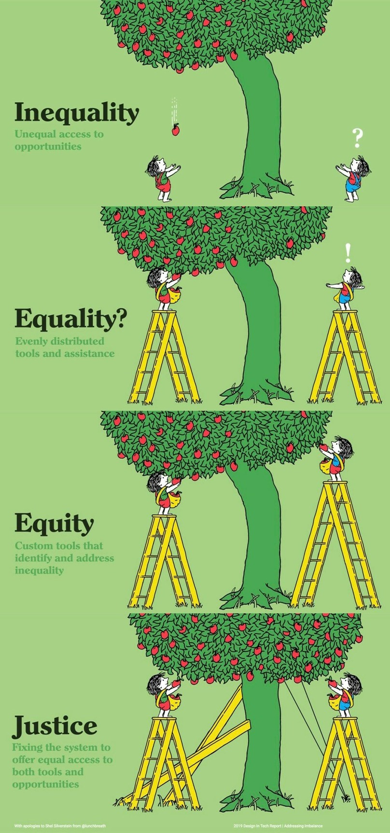
Equity Committee Next Steps
Finalize our commitments and actions
Develop plan for ongoing support and accountability
Share with DE-PBS cadre and other partners

Slide 14
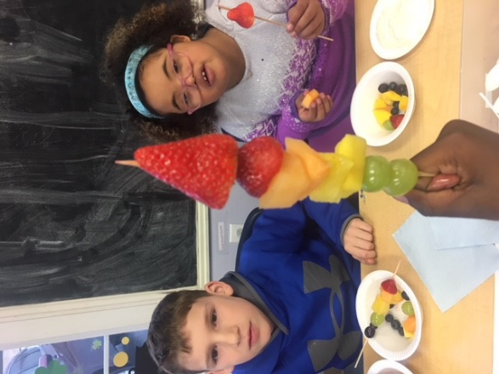
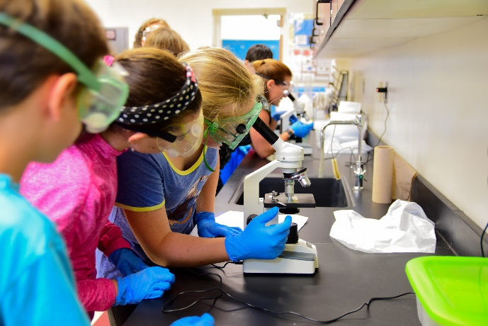
FFY19 APR Indicator 4a & 4b

Slide 15
Compliance Indicator
Indicator 4B:
Suspension and Expulsion of Students with Disabilities as compared to students without disabilities
Description:
Percent of districts that have: (a) a significant discrepancy, by race or ethnicity, in the rate of suspensions and expulsions of greater than 10 days in a school year for children with IEPs; and (b) policies, procedures or practices that contribute to the significant discrepancy and do not comply with requirements relating to the development and implementation of IEPs, the use of positive behavioral interventions and supports, and procedural safeguards.
FFY 2019 Target | FFY 2019 Data | Status
0% | 0% | Met Target

Slide 16
Results Indicators
Indicator 4A:
Suspension and Expulsion of Students with Disabilities as compared to students without disabilities
Description:
Percent of districts that have a significant discrepancy in the rate of suspensions and expulsions of greater than 10 days in a school year for children with IEPs
FFY 2019 Target | FFY 2019 Data | Status
40% | 0% | Met Target

Slide 17
Data
March - Indicator 4 Data will given to LEAs for review
May – Significant Disproportionality Data given to LEA for review

Slide 18
MTSS and Indicator 4
How does the MTSS work in your district connect to Indicator 4?
How does the MTSS work in your district help to address Indicator 4 now and what might be some areas for future discussion?

Slide 19
Questions
If you have any questions about your LEAs discipline data, Indicator 4, or Significant Disproportionality, please reach out to Susan.Veenema@doe.k12.de.us

Slide 20
Supporting PBIS Implementation Through Phases of Crisis Recovery
Ground in your PBIS framework and use as your road map
Prioritize Tier 1 basics
Focus on critical and impactful actions
Small, incremental steps that result in progress
https://www.pbis.org/resource/supporting-pbis-implementation-through-phases-of-crisis-recovery

Slide 21
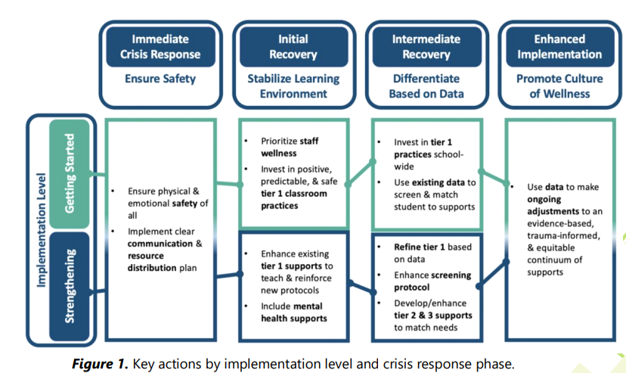
Phases of Crisis Recovery
Supporting PBIS Implementation Through Phases of Crisis Recovery

Slide 22
Implementation Level
Getting Started | Maintaining & Strengthening
There is an explicit commitment to implementation Schools were not implementing with fidelity prior to the crisis District or school teams are in training or action planning stages but have not yet begun school-wide implementation | Schools were implementing with at least tier 1 fidelity prior to the crisis Strong district commitment and infrastructure to support implementation at the school level exists
Supporting PBIS Implementation Through Phases of Crisis Recovery
https://nirn.fpg.unc.edu/module-4

Slide 23
Initial Recovery
Primary focus is on stabilizing the learning environment
Supporting PBIS Implementation Through Phases of Crisis Recovery
 | Actions | Resources
Getting Started | Prioritize staff wellness Invest in positive, predictable, safe & equitable tier 1 classroom practices | Staff Wellness webinar and brief (coming soon to PBIS.org) Supporting and Responding to Behavior Classroom Practices Building Habits for Classroom Practices Webinar and Brief DE-PBS Classroom Habits with Action Plan and Resources
Maintaining & Strengthening | Enhance existing tier 1 supports to teach & reinforce new protocols Include mental health supports | Supporting Schools During and After Crisis Teaching Social-Emotional Competencies through a PBIS Framework

Slide 24
Intermediate Recovery
Primary focus is on differentiating support based on data
Supporting PBIS Implementation Through Phases of Crisis Recovery
 | Actions | Resources
Getting Started | Invest in Tier 1 practices school-wide to establish a positive, predictable, and safe environment Use existing data to screen & match student to supports | Tier 1 Practices Data-Based Decision-Making Using outcome data to implement MTSS
Maintaining & Strengthening | Refine tier 1 based on data Enhance screening protocol Develop/enhance tier 2 & 3 supports to match identified needs | Data-Based Decision-Making Systematic Screening Top Ten Questions about Universal Screening Professional Learning Tools Tier 2 and Tier 3 Overviews

Slide 25
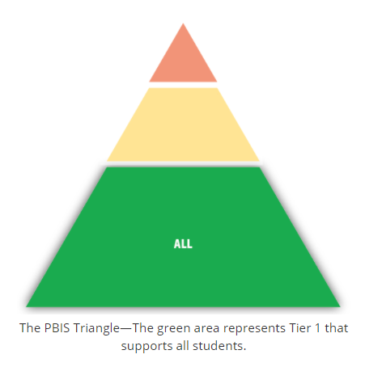
Tier 1 Key Practices
School-wide positive behavior expectations that are taught and defined
Procedures for establishing classroom expectations and routines that are consistent with SW expectations
Continuum of procedures for encouraging expected behavior
Continuum of procedures for discouraging problem behavior
Procedures for encouraging school-family partnerships
PBIS.org | Tier 1

Slide 26
Break

Slide 27
Highlighting Three Tier 1 Universal Tools
Updating the behavior matrix
Positive classroom habits
Universal screening

Slide 28
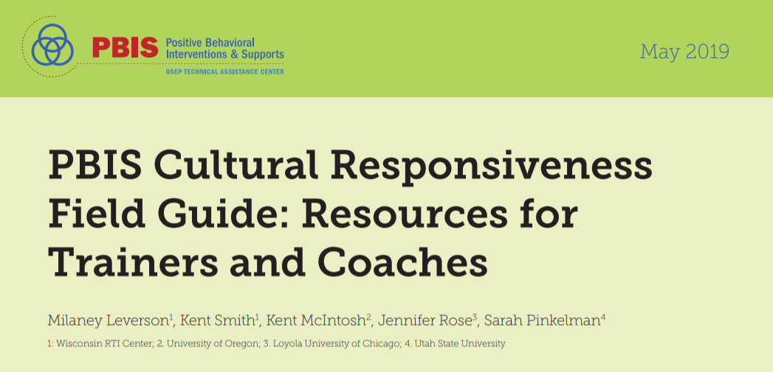
Examining the Matrix for Equity
Step 1: Identify Any Existing Expectations or Matrices
Step 2: Assess Existing Expectations Based on Fit with Values and Needs of Students, Families, and the Community (Revise As Needed)
Step 3: Revise Expectations and Matrix Based on Feedback
Step 4: Assess New Options for Expectations and Matrix Based on Critical Features of Effective Practices (Revise As Needed)
Step 5: Agree on New Expectations and Matrix
Step 6: (Re)Introduce, Teach, and Practice the New Expectations and Matrix with Students and Share with Families and Community Members

Slide 29
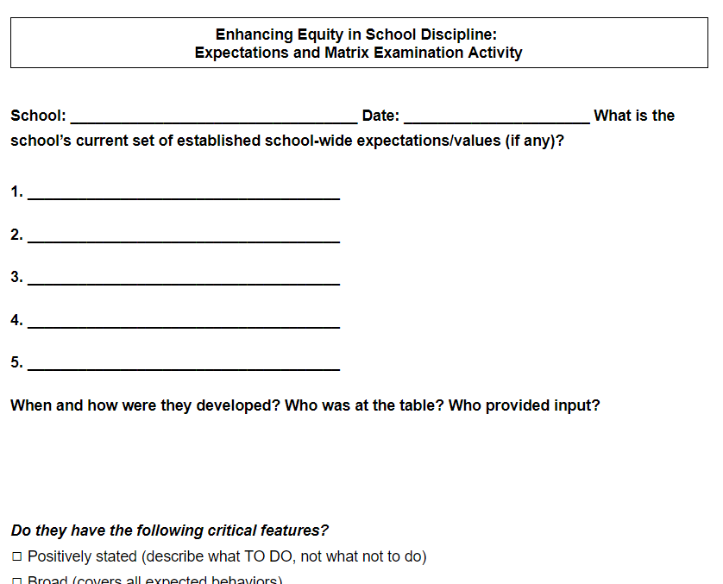
Enhancing Equity in School Discipline: Expectations and Matrix Examination Activity
How were your expectations developed and who provided input?
Do they reflect the values of the school community?
Do they represent “universal” core life skills beyond school?
Center on PBIS (PBIS.org)- Culturally Responsive Field Guide

Slide 30
Utilizing Your Matrix to Address Mental Health & Social Emotional Needs
Adaptable: the matrix can and should be updated regularly to reflect changing values and address identified needs!
Provides reassurance, consistency, and predictability
Establishes common, unifying language for staff, students and families to use new skills explicitly
Helps all staff connect to the prioritized social-emotional competencies by providing increased opportunities for students to practice across content areas and settings
Teaching Social-Emotional Competencies within a PBIS Framework

Slide 31
DE-PBS Example | All Settings | Classroom | Non- Instructional Time | Remote Learning | Mental Wellness
Responsible | Consider consequences before you act Label your feelings Think about how others feel Use “I” statements | Share openly and honestly during morning circle time Complete and turn in assignments on time Ask for help Identify solutions and strive to problem-solve | Report any issues to an adult Practice self-care with coping tools | Silence other electronics during class time Think before posting anything online Log in 5-10 min early to connect with teachers | Identify a trusted adult to report mental health concerns Recognize signs of stress and use calming techniques Ask for help when experiencing mental health challenges
Respectful | Accept and embrace your own and others’ differences Use positive self- talk and practice self-compassion Be an ally and treat others with kindness Strive to understand the root of behaviors | Listen to and follow instructions Use appropriate voice volume Use kind words and actions Be inclusive when working and playing | Use appropriate voice volume Use appropriate language Advocate for others | Keep video on or inform teacher if you need to turn it off Use chat to connect with classmates during identified opportunities Share your thoughts and ideas frequently | Use self-regulation tools like calming breathing techniques Listen to others nonjudgmentally
Safe | Check in with yourself and others mentally and emotionally frequently Use deep belly breathing | Stay at your desk during instructional time Keep hands, feets, objects to yourself Wear mask over nose and mouth Use personal materials or allowed shared materials only | Wash hands before and after eating Use non- instructional time to build relationships, check in with yourself, and support others | Report cyberbullying or tech abuse Keep passwords and other important information private | Know the warning signs of suicide, save crisis phone numbers, and call for help when needed Get regular exercise, eat healthily, and get fresh air daily

Slide 32
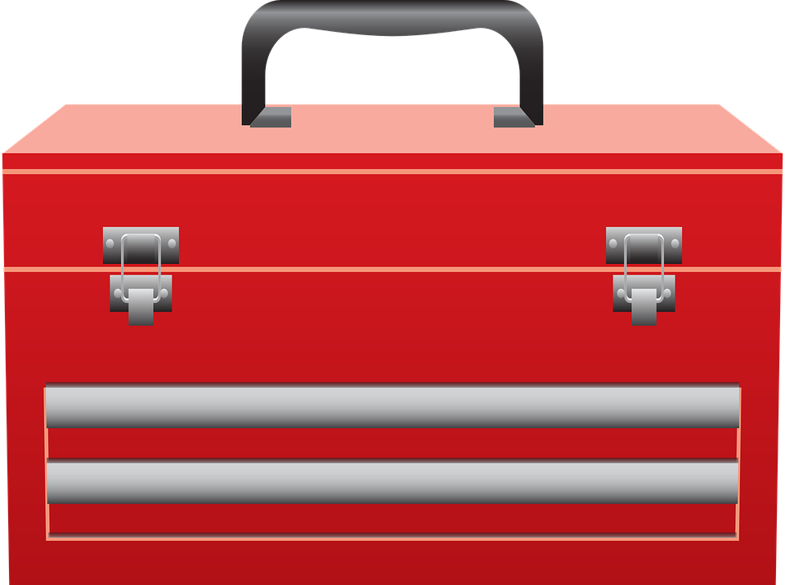
Building Habits of Effective Practice:
A Professional Learning Tool
Time: approximately 90 minutes
Intended audience: classroom teachers and/or those who support classroom teachers (e.g., PBIS coaches, TLs or administrators)
How: Register through PDMS and complete the Schoology course (Course #29421). Session materials are also available on our website
Key Objectives:
Understand habit development via the ABCs of behavior
Apply the ABCs of behavior to educator habit development of effective practices in classrooms
Gain access to information and resources about three simple, evidence based, and culturally relevant practices supportive of students’ social, emotional, behavioral and academic growth
Develop a plan to build a habit of effective practice (using one of the three suggested positive classroom practices)

Slide 33
DE-PBS Example | All Settings | Classroom | Non- Instructional Time | Remote Learning | Mental Wellness
Responsible | Consider consequences before you act Label your feelings Think about how others feel Use “I” statements | Share openly and honestly during morning circle time Complete and turn in assignments on time Ask for help Identify solutions and strive to problem-solve | Report any issues to an adult Practice self-care with coping tools | Silence other electronics during class time Think before posting anything online Log in 5-10 min early to connect with teachers | Identify a trusted adult to report mental health concerns Recognize signs of stress and use calming techniques Ask for help when experiencing mental health challenges
Respectful | Accept and embrace your own and others’ differences Use positive self- talk and practice self-compassion Be an ally and treat others with kindness Strive to understand the root of behaviors | Listen to and follow instructions Use appropriate voice volume Use kind words and actions Be inclusive when working and playing | Use appropriate voice volume Use appropriate language Advocate for others | Keep video on or inform teacher if you need to turn it off Use chat to connect with classmates during identified opportunities Share your thoughts and ideas frequently | Use self-regulation tools like calming breathing techniques Listen to others nonjudgmentally
Safe | Check in with yourself and others mentally and emotionally frequently Use deep belly breathing | Stay at your desk during instructional time Keep hands, feets, objects to yourself Wear mask over nose and mouth Use personal materials or allowed shared materials only | Wash hands before and after eating Use non- instructional time to build relationships, check in with yourself, and support others | Report cyberbullying or tech abuse Keep passwords and other important information private | Know the warning signs of suicide, save crisis phone numbers, and call for help when needed Get regular exercise, eat healthily, and get fresh air daily
How can you take your matrix from a poster on the wall to your SEB roadmap?

Slide 34
DE-PBS Example | All Settings | Classroom | Non- Instructional Time | Remote Learning | Mental Wellness
Responsible | Consider consequences before you act Label your feelings Think about how others feel Use “I” statements | Share openly and honestly during morning circle time Complete and turn in assignments on time Ask for help Identify solutions and strive to problem-solve | Report any issues to an adult Practice self-care with coping tools | Silence other electronics during class time Think before posting anything online Log in 5-10 min early to connect with teachers | Identify a trusted adult to report mental health concerns Recognize signs of stress and use calming techniques Ask for help when experiencing mental health challenges
Respectful | Accept and embrace your own and others’ differences Use positive self- talk and practice self-compassion Be an ally and treat others with kindness Strive to understand the root of behaviors | Listen to and follow instructions Use appropriate voice volume Use kind words and actions Be inclusive when working and playing | Use appropriate voice volume Use appropriate language Advocate for others | Keep video on or inform teacher if you need to turn it off Use chat to connect with classmates during identified opportunities Share your thoughts and ideas frequently | Use self-regulation tools like calming breathing techniques Listen to others nonjudgmentally
Safe | Check in with yourself and others mentally and emotionally frequently Use deep belly breathing | Stay at your desk during instructional time Keep hands, feets, objects to yourself Wear mask over nose and mouth Use personal materials or allowed shared materials only | Wash hands before and after eating Use non- instructional time to build relationships, check in with yourself, and support others | Report cyberbullying or tech abuse Keep passwords and other important information private | Know the warning signs of suicide, save crisis phone numbers, and call for help when needed Get regular exercise, eat healthily, and get fresh air daily
For students...define, post, and explicitly teach key behaviors until they become habits

Slide 35
DE-PBS Example | All Settings | Classroom | Non- Instructional Time | Remote Learning | Mental Wellness
Responsible | Consider consequences before you act Label your feelings Think about how others feel Use “I” statements | Share openly and honestly during morning circle time Complete and turn in assignments on time Ask for help Identify solutions and strive to problem-solve | Report any issues to an adult Practice self-care with coping tools | Silence other electronics during class time Think before posting anything online Log in 5-10 min early to connect with teachers | Identify a trusted adult to report mental health concerns Recognize signs of stress and use calming techniques Ask for help when experiencing mental health challenges
Respectful | Accept and embrace your own and others’ differences Use positive self- talk and practice self-compassion Be an ally and treat others with kindness Strive to understand the root of behaviors | Listen to and follow instructions Use appropriate voice volume Use kind words and actions Be inclusive when working and playing | Use appropriate voice volume Use appropriate language Advocate for others | Keep video on or inform teacher if you need to turn it off Use chat to connect with classmates during identified opportunities Share your thoughts and ideas frequently | Use self-regulation tools like calming breathing techniques Listen to others nonjudgmentally
Every educator in all settings and contexts: | Model and prompt our expected behaviors Provide positive & informative feedback when expected behavior observed Pre-teach expected behaviors behavior entering problem settings/contexts Re-teach when expected behavior not observed
For adults, define, post and explicitly teach key practices until they become habits

Slide 36
Habit Development Building Blocks of Behavior
A
Antecedent
B
Behavior
C
Consequence
Redesign environment (change cues)
Add prompts
Teach & practice to fluency
Monitor implementation
Celebrate success
Prevent reward for undesired behavior
Simonsen, B. & Yanek, K. (2020, December 18). Building Habits of Effective Practice in Today’s (Remote, Hybrid, and In-Person) Classrooms [Powerpoint slides]. https://www.pbis.org/video/building-habits-of-effective-practice-webinar.

Slide 37
Habit Development Example Specific Positive (& Corrective) Feedback
A
Antecedent
B
Behavior
C
Consequence
Redesign environment
script praise in matrix
look for desired behavior
Add reminder
Teach & practice specific praise until it become a habit
Track specific praise statements and error corrections and ensure 5:1 ratio
Tell yourself, “way to rock the ratio”
Celebrate positive environment with praise around
If your rates are low, revisit praise plan
Simonsen, B. & Yanek, K. (2020, December 18). Building Habits of Effective Practice in Today’s (Remote, Hybrid, and In-Person) Classrooms [Powerpoint slides]. https://www.pbis.org/video/building-habits-of-effective-practice-webinar.

Slide 38
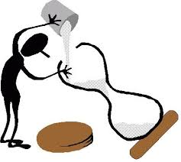
Habit Development Systems Building Blocks of Behavior
A
Antecedent
B
Behavior
C
Consequence
Greet Students!
S^{R+}
Train & Coach
Performance Feedback
Prompt & Remind
Celebrate Progress & Successes!
Provide Resources to Support
Monitor Fidelity & Outcomes
Simonsen, B. & Yanek, K. (2020, December 18). Building Habits of Effective Practice in Today’s (Remote, Hybrid, and In-Person) Classrooms [Powerpoint slides]. https://www.pbis.org/video/building-habits-of-effective-practice-webinar.

Slide 39
Top Ten Questions about Universal Screening:
A Professional Learning Tool
Time: 40 minutes
Intended audience: all educators looking to understand the key ideas of universal screening
How: Watch asynchronously or download and use the materials! Register via PDMS course # 29663 or visit: www.delawarepbs.org/universal-screening/
Key Topics:
Characteristics of effective screening tools
Similarities between academic and SEB tools
When, who and how often to screen
Data decision making strategies

Slide 40
District Coach Reflection & Planning
Reflect on topics & toolbox resources shared this morning.
Take a moment to reflect on where your district/schools are in the phases & implementation levels.
Make a plan! In your district coach role, what specific action(s) can you take to move forward in sharing & using the tools in your toolbox based on district/school-based needs?

Slide 41
Reminders & Updates

Slide 42
DDOE MTSS Book Study Facilitation Opportunity
Opportunity to facilitate MTSS book study in district or schools
Participants will receive books and resources for facilitation
All group members must complete participant survey
Contact Pam Alfaro pamala.alfaro@doe.k12.de.us

Slide 43
School Climate Survey 2021 Reminders
Enrollment now open until 3/10
Online Staff, Student & Home Window: Mid-March-May 2021
School selects window within this timeframe
School Survey Coordinator is lead for communication with DE-PBS Project and Mosaic
All coaches will have access to CoVitality application with district/school-based data

Slide 44
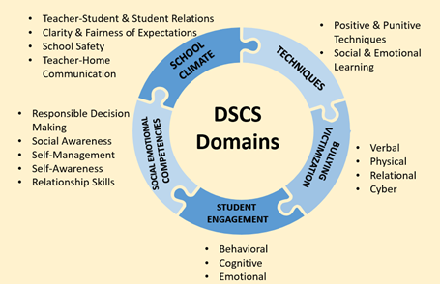
2021 Changes - DE School Climate Survey (DSCS)
Student Additions:
Social-Emotional Competencies - New Self-Awareness subscale
Learning context
Student/Staff/Home Removals:
School Safety
Punitive Techniques
Verbal, Physical, Social/Relational Bullying

Slide 45
Data Discipline Reporting Tool (DDRT)
Displays multi-yr school-level data + state & national trends comparisons
Submission to District Coach(es) & Project:
March 31st and June 18th
Mechanics for monthly updates:
COVID adaptations for 20-21 SY
Orange cells = majority days were online
Purple cells = majority days were hybrid
White cells = majority days were in-person

Slide 46
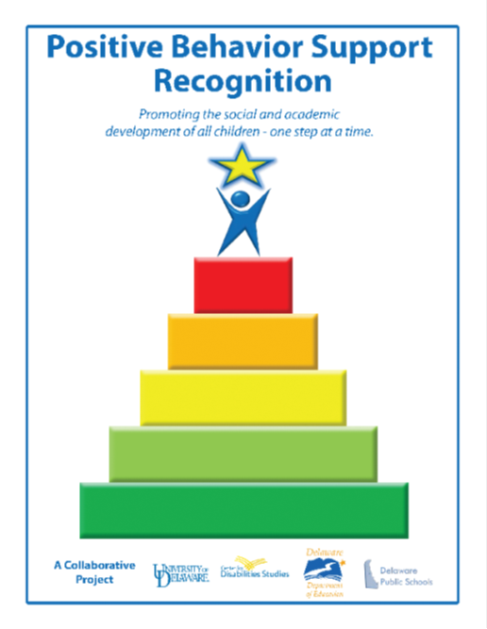
DE-PBS Phase Recognition
Maintaining for 2020-2021 School Year with modifications
Phases 1 & 2 – Focus on Tier 1: School-wide PBS
Phases 3 & 4 – Tier 2: Targeted PBS
More to come...

Slide 47
Thank you!
We appreciate and value your feedback!
Next Mtg: May 6, 2021
10 am - 12 pm

