Slide 1
FBA AND BIP FOR EDUCATORS
Niki Kendall and Rebecca Silver,
Delaware PBS Project

Slide 2
ACKNOWLEDGEMENTS
Dr. Rose Iovannone and FLPBiS Northeast PBIS National Center on Intensive Interventions Alberto & Troutman (9th ed) Applied Behavior Analysis for Teachers Dr. Al Cavalier, University of Delaware | Midwest PBIS Network Portland State University: www.basicfba.com CalTAC PBIS

Slide 3
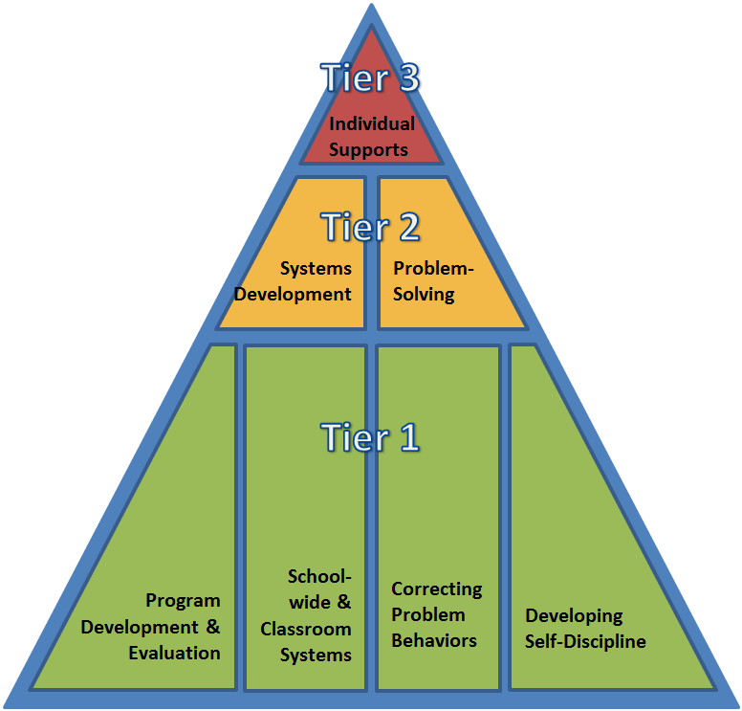
DE-PBS PROJECT IS ONGOING COLLABORATION BETWEEN THE DELAWARE DEPARTMENT OF EDUCATION AND THE UD CENTER FOR DISABILITIES STUDIES

Slide 4
OBJECTIVES
Learn about
Functional Behavior Assessment (FBA) and Function Based Behavior Support in language that understandable and applicable to classroom teachers
Part 1
Explore FBA as a process to uncover four essential components that predict, describe and maintain behavior
Part 2
Explore function based behavioral supports that prevent problem behavior and teach prosocial behavior.

Slide 5
GETTING THE MOST OUT OF OUR SESSIONS
Focus
Focus on moving from knowledge to practice
Goals
Set implementation goals and either self-monitor or ask for peer/coach feedback on your use of key skills
Apply
When a practice isn’t working, use your understanding of theory to help you modify or intensify a practice to improve outcomes

Slide 6
FBA Nuts and Bolts
A – B – C
In analyzing a concerning situation, we focus on:
the Antecedents that “set the occasion” for and initiate the occurrence (or nonoccurrence) of the behavior of concern,
the Behavior of concern, and
the Consequences that strengthen or weaken the future occurrence of that behavior when those antecedents are present.

Slide 7
Target Behaviors
Antecedents (when and where)
Consequences (why)
FBA Data
Functional Hypothesis
Functional Hypothesis

Slide 8
What do you want to decrease (in observable and measurable terms)?
 | Behavior
This is known as the Behavior.
Riffel, 2017

Slide 9
What prompts (triggers) the student to respond with the concerning behavior?
Antecedent
This is known as the Antecedent.
Riffel, 2017

Slide 10
What increases the likelihood, if an other specific antecedent occurs, the concerning behavior will occur?
Setting Event | Antecedent | Behavior | Consequence
This is known as the Setting Event
Riffel, 2017

Slide 11
What reinforces the behavior (increases its future probability) under similar circumstances?
Antecedent | Behavior | Consequence
This is known as the Consequence.
Riffel, 2017

Slide 12
As a result, what does the student escape/avoid or gain?
Antecedent | Behavior | Consequence
This is known as the Function.
Riffel, 2017

Slide 13
AND THIS IS A FUNCTIONAL HYPOTHESIS:
Setting Event | Antecedent | Behavior | Consequence
During synchronous whole group zoom sessions | When a student in the class asks a question to clarify directions in the chat | Niki Spams the chat box | As a result, other students respond and she avoids beginning the task.

Slide 14
In the chatbox write a functional hypothesis for a concerning behavior in your setting.
Setting Event | Antecedent | Behavior | Consequence
During synchronous whole group zoom sessions | When a student in the class asks a question to clarify directions in the chat | Niki Spams the chat box | As a result, she delays beginning the task (maintained by negative reinforcement) via off task time spent responding to peers in the chat box

Slide 15
In thinking about the FBA…
What questions are still circling?
What do you have squared away?
What was one good point made?

Slide 16
TRUE OR FALSE?
A BIP is a list of strategies to address problem behavior?

Slide 17
Energy Flows Where Attention Goes
FALSE!
A BIP defines how an educational setting will be changed to improve the behavioral success of one or more students based on information gathered through an FBA process.
Horner, Sugai, Tim Lewis (2008)

Slide 18
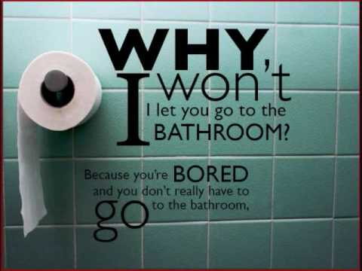
YOU MAKE A DIFFERENCE...

Slide 19
7 CORE FEATURES OF A BIP
Prevention strategies to minimize triggers
Strategies to teach and prompt replacement behaviors (defined in observable and measurable terms)
Consequence Strategies to Strengthen Replacement Behaviors
Consequence Strategies to weaken Problem Behaviors
Safety elements when needed
A systematic process for assessing fidelity and impact
An action plan for putting the support plan in place

Slide 20
The Three I’s
Function-Based Support Plans should
make the concerning behavior:
IRRELEVANT
by neutralizing setting events and removing triggers of the problem behavior.
INEFFICIENT
by selecting a replacement behavior that requires less effort to obtain the same reinforcers that maintain the problem behavior,
INEFFECTIVE
by removing the reinforcers of the problem behavior and by increasing the reinforcers of the replacement behavior

Slide 21
Connect and Prevent Interventions
Setting Event | Antecedent | Behavior | Consequences
Connect Interventions | Prevent Interventions | Teach Interventions | Respond to Increase | Respond to Decrease
Strengthen relationships & use noncontingent attention | Create and teach predictable routines, use transition supports Provide choices Increase opportunities to respond Modify instruction to student’s level Prompts | Functional Replacement Skills Alternative Skills --------------------------- Examples: Teach specific SEL Skills Teach general coping skills | Reinforce alternative behavior Behavior specific praise Token Economy Group contingencies | Praise around the misbehavior Reinforce lower rates Planned ignoring Error correction

Slide 22
How could you neutralize these setting events or triggers?
Examples include activities or circumstances that:
Result in frustration
Cause understimulation
Cause overstimulation
Provoke
Environmental Factors
classroom noise
temperature
movement
changes in the schedule
Social Factors,
hearing parents argue last night
encountering a bully on the morning school bus
Physiological Factors
side effects of medicine
not sleeping the night before

Slide 23
CONNECT
Intentionally build structures that promote supportive adult-student relationships and a sense of belonging.
Check in with the student more often! Some examples of “checking in”
Positively greet students at the door daily
Moodmeter app so students can describe how they are feeling visually and with words, explain why they are feeling that way, prompts whether the person wants to stay there or alter mood and then provides strategies, can set reminders to check in with self
Templates for daily check ins Provide the student with individualized questions on a class check in tool (or create one for your student)
5 minute chat with students

Slide 24
Noncontingent Attention
Examples | Nonexamples
Smiling at the student | Corrective instructions such as “stop distracting others”
Thumbs up at the student | Ignoring behavior
“How was your weekend?” | Shaking head or giving “teacher look” at the student

Slide 25
Predictable Classroom Routines & Transitions
We can’t eliminate all triggers, but we can create routines that minimize their impact on student behavior.
Make sure you have your kids’ FULL attention before giving directions
Keep instructions as brief as possible
Have students repeat multi-step directions back to you
Use a combination of visual and auditory cues to signal transitions
Spend time explaining, modeling, and practicing new routines
Prepare students for upcoming transitions with prompts and warnings

Slide 26
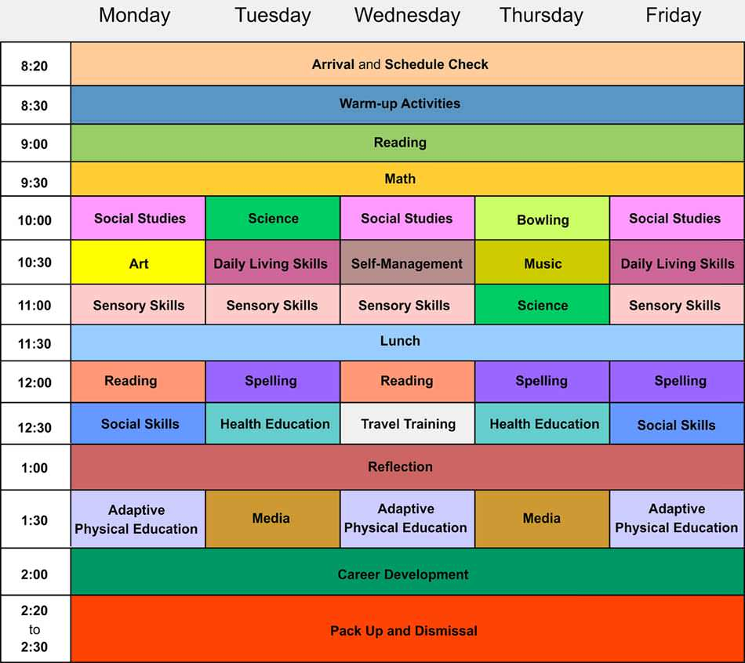
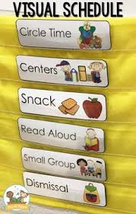
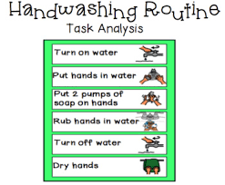
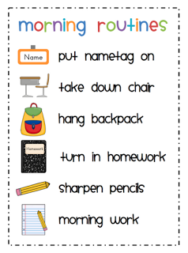

Slide 27
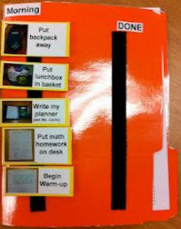
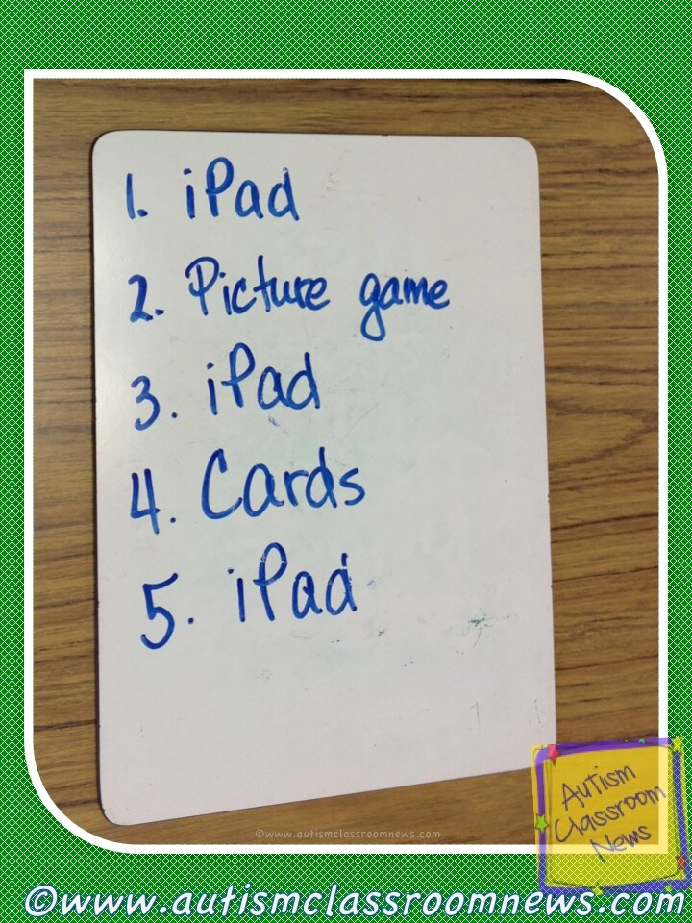
https://www.understood.org/articles/en/behavior-strategy-when-then#
https://educationandbehavior.com/visual-schedule-for-autism-and-adhd/

Slide 28
7 Types of Choices
“within-activities”
“between activities”
“refusal”
“who”
“where”
“when”
“terminate”
Choices offered need to be preferable and acceptable to both the teacher and the student.

Slide 29
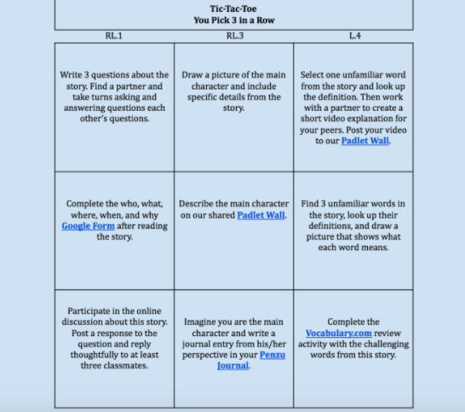
Offer multiple ways for students to show what they know: (e.g. Designing a digital choice board)

Slide 30
Increase Opportunities to Respond (OTRs)
Research shows that increasing OTRs leads to improved outcomes in reading and math, improved engagement, and decreased disruptive behaviors
Have the student respond and provide feedback/adjust lesson based on responses
Allow for a variety of ways to respond
Individual responding
Unison responding
Verbal responding
Nonverbal responding

Slide 31
Different Ways to Provide OTRs
Individual questioning
Choral responding
Think-pair-share or quartet quiz
Whip around
Guided notes
Response cards
White boards
Technology
socrative.com, polleverywhere.com, Kahoot.com, plickers.com/

Slide 32
Instructional Mismatch
Instructional material is too difficult for student (aversive situation)
Problem behavior to avoid the work
Example: Sarah is still working on mastering single-digit addition problems. Every time this week her teacher assigns a multiplication worksheet, Sarah starts screaming and banging on her desk until she is sent to the principal’s office.

Slide 33
Modifying the Task
Task difficulty
Reduce difficulty to match current skill level
Provide scaffolding/additional supports
Word bank or high frequency word list
Hundreds chart or multiplication chart
Guided notes or graphic organizers
Shorten task
Task preference
Incorporate student interests
Task meaningfulness
Make task relevant to the student

Slide 34
Behavioral Momentum
Simon Says...

Slide 35
Low probability task
Undesired behaviors reinforced, task remains low probability
Noncompliance/
Failure
High probability task
High probability task
Low probability task
Compliance/
success
Compliance/
success
Compliance/
success
Desired behaviors reinforced

Slide 36
DON’T FORGET: ADDRESS TRIGGERS FUNCTIONALLY
When participating in large group activities, Angela often interrupts the teacher to ask questions during instruction to gain adult attention.
Does the Intervention address the function of behavior?
Give the student a job to complete during large group instruction (e.g. write the answers on the board)
Allow the student to write comments on a post-it to share later
Let the student choose a preferred seat during large group instruction
Increase the ratio of positive to negative comments during large group instruction

Slide 37
DON’T FORGET: ADDRESS TRIGGERS FUNCTIONALLY
When participating in large group activities, (especially with unfamiliar peers) Angela often remains quiet or leaves to go to the bathroom to avoid participating with her peers.
Does the Intervention address the function of behavior?
Provide multiple options for participation during large group activities
Create assigned seating or groups with input from Angela about which group she’d work best
Give the student a job to complete during large group instruction (e.g. write the answers on the board)
Increase the ratio of positive to negative comments during large group instruction

Slide 38
WHICH PROCEDURE OR ROUTINE COULD YOU ADAPT TO PREVENT PROBLEM BEHAVIOR?
KEEP IT FUNCTIONAL!
A. During class, when it is almost time to transition, Megan asks for the homework to be repeated (despite postings in multiple places), which is positively reinforced by additional time with the teacher who keeps her after class.
B. During the day, whenever independent work is given, Niki leaves class to go to the bathroom or walks around the building, which is negatively reinforced via avoiding doing the assignment.

Slide 39
Teach Interventions
Setting Event | Antecedent | Behavior | Consequences
Connect Interventions | Prevent Interventions | Teach Interventions | Respond to Increase | Respond to Decrease
Strengthen relationships & use noncontingent attention | Create and teach predictable routines, use transition supports Provide choices Increase opportunities to respond Modify instruction to student’s level Prompts | Functional Replacement Behavior Alternative Skills --------------------------- Examples: Teach specific SEL Skills Teach general coping skills | Reinforce alternative behavior Behavior specific praise Token Economy Group contingencies | Praise around the misbehavior Reinforce lower rates Planned ignoring Error correction

Slide 40
let’s put this in context...
Antecedent (trigger) | Behavior | Consequences Did it work?
Present seat work task (writing) | 11:50; complained | no; task remained
 | 11:53; asked for an easier task | no; task remained
 | 12:04; worked for 5 minutes | no; task remained
 | 12:09; threw textbook down and ripped up papers | yes; sent to principal (task removed)
adapted from: Ennio Cipani, Ph.D. (2020)

Slide 41
let’s put this in context...
Antecedent (trigger) | Behavior | Consequences Did it work?
independent work tasks | 11:50; made a comment under his breath about the assignment | no; peers ignored
 | 11:53; tapped loudly with pencil on desk | no; peers ignored
 | 11:55; works on task for 5 minutes | no; peers ignored
 | 12:00; asks to work with a partner | no; teacher denies request
 | 12:03; made a fart noise | yes; peers laugh
adapted from Ennio Cipani, Ph.D. (2020)

Slide 42
by selecting a replacement behavior that requires less effort to obtain the same reinforcers that maintain the problem behavior,
Make it INEFFICIENT
Replacement Behaviors:
Provides the student with a skill to meet their own needs
Require less effort to obtain the same reinforcers that maintain the concerning behavior
Are socially acceptable

Slide 43
WHICH OF THE FOLLOWING ARE APPROPRIATE REPLACEMENT BEHAVIORS?
Jason is nine and cries when asked to write in his journal. The crying is maintained by avoiding or escaping difficult tasks.
Possible Replacement Behaviors:
Finish the writing task to earn a break
Ask for an easier task/ worksheet
Ask to play with his iPad
Appropriately request adult attention
1. Does it provide escape from difficult task (e.g., service the same function)?
2. Is behavior easier to do than problem behavior?
3. Is Behavior socially acceptable?
Basic FBA to BIP

Slide 44
WHICH OF THE FOLLOWING ARE APPROPRIATE REPLACEMENT BEHAVIORS?
Blake is in 9th grade and makes comments and jokes during work time when the teacher is attending to other students. The remarks are by maintained by peer (and adult) attention.
Possible Replacement Behaviors:
20 min on task behavior for free time
Ask to take a cell phone break
Ask to work with a partner
Appropriately request adult attention
1. Does it provide attention from peers?
2. Is behavior easier to do than problem behavior?
3. Is Behavior socially acceptable?
Basic FBA to BIP

Slide 45
There are 4 basic steps to follow when teaching a replacement behavior that is not currently in the student’s repertoire:
Modeling: demonstration of competent use of the replacement behavior
Role-Playing: student rehearsal of the replacement behavior
Performance Feedback: constructive feedback on the student’s performance
Maintenance and Generalization: use of the replacement behavior in new situations

Slide 46
After the behavior is taught...
Teach, re-teach, & teach some more
Provide prompts/visual supports

Slide 47
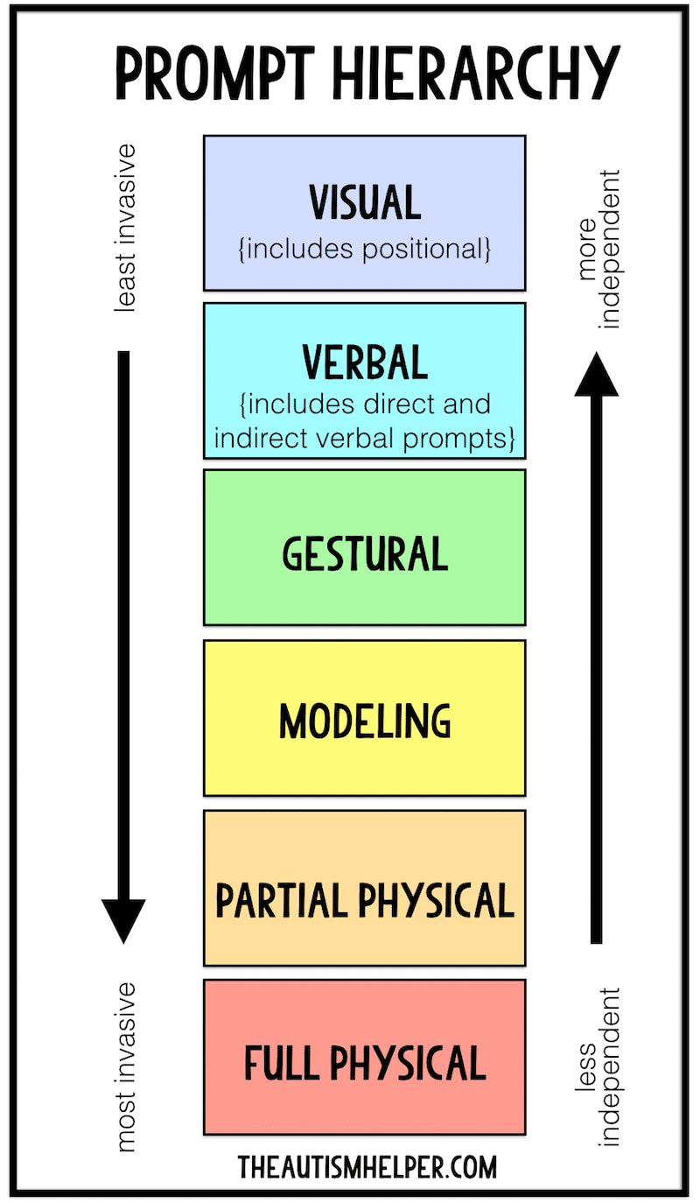
PROMPTS
Remind the student when/how to use replacement behaviors after they have been taught
Example:
Niki’s problem behavior is maintained by escape from difficult math assignments.
When handing out assignments, Niki’s teacher will remind her that she can ask for a break (Replacement behavior) if she gets frustrated.

Slide 48
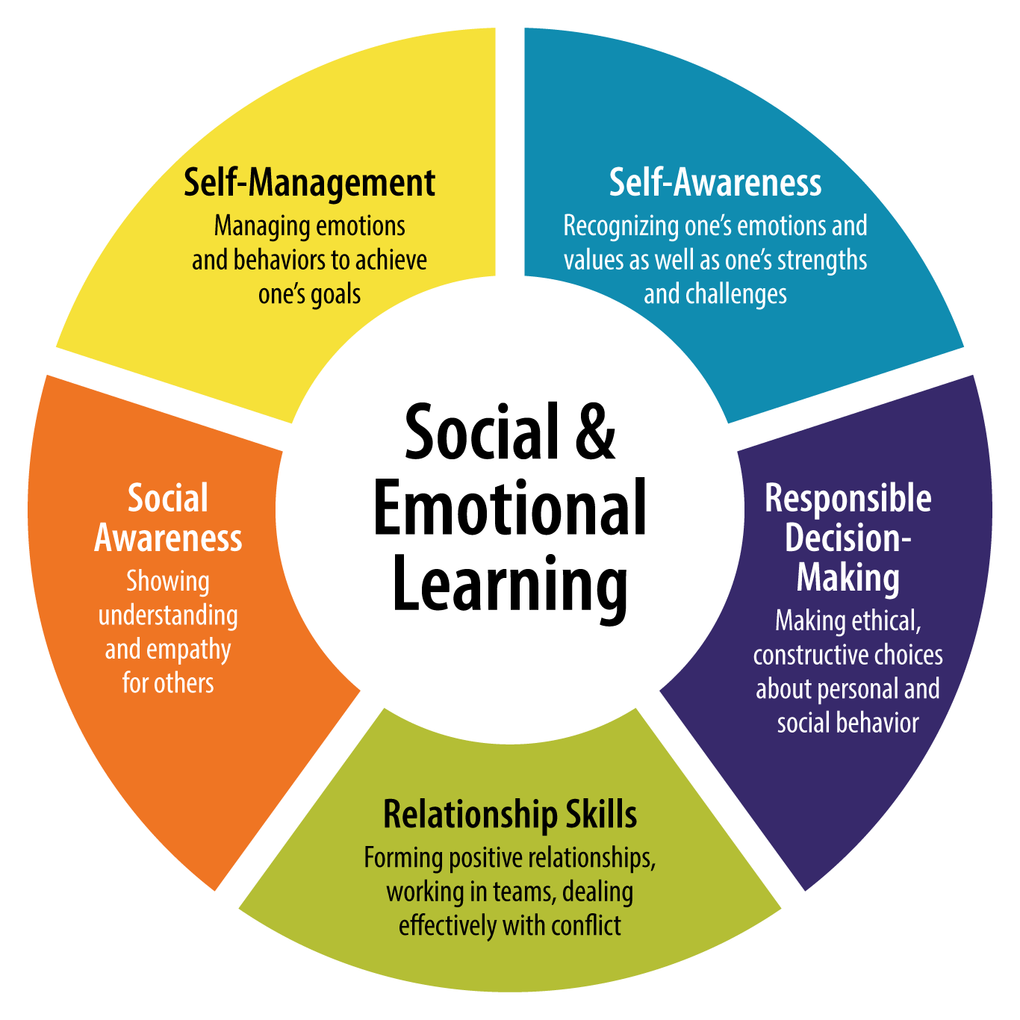
Specific
SEL
Skills

Slide 49
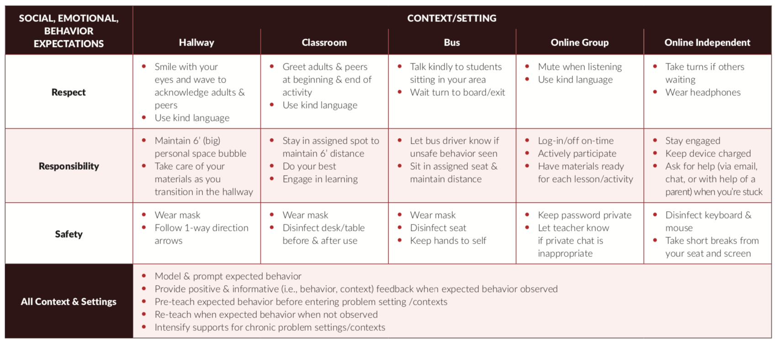
EXAMPLE OF SCHOOL TEACHING MATRIX UPDATED FOR HYBRID LEARNING
The teaching matrix is your social-emotional-behavioral curricular standards

Slide 50
Functional interventions for behaviors that provide the student with escape during a non-preferred routine or activity
Prevent:
Provide choices
Use transition supports
Changes task demands/ curriculum/mode of engaging
Increase OTRs
Teach Behaviors:
Ask for a different task to complete
Ask for help
Coping strategies

Slide 51
let’s put this in context...
Antecedent (trigger) | Behavior | Consequences Did it work?
Present seat work task (writing) | 11:50; complained | no; task remained and teacher reminded student to use coping tool if feeling frustrated
 | 11:53; asked for help | yes; teacher provided assistance and student avoided doing work independently
adapted from: Ennio Cipani, Ph.D. (2020)

Slide 52
General Coping Strategies
Skills and tools to use in stressful situations and solve conflicts
Need to be directly taught and practiced with the student
Most effective when the student learns to identify a potentially stressful situation prior to feeling stressed so that the coping strategy can be used to prevent more intense feelings.

Slide 53
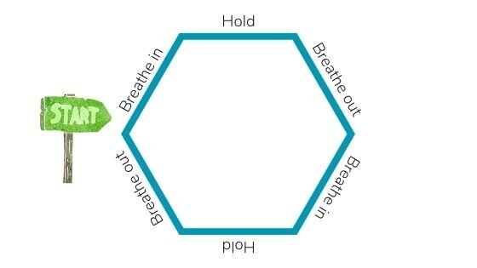
Relaxation Techniques - Coping Skills for Anxiety
https://www.youtube.com/watch?v=30VMIEmA114
https://copingskillsforkids.com/deep-breathing-exercises-for-kids
FREE for educators!
https://www.headspace.com/educators

Slide 54
Coping Strategies
Take a break
Make a fist and release it
Squeeze stress ball
Ask for help
Take a walk or other physical activity
Write in a journal
Listen to music
Talk about the problem

Slide 55
Functional interventions for behaviors that provide the student with attention from peers/adults
Prevent:
Provide noncontingent attention and positive comments
Increase OTRs
Use peer modeling or peer support
Teach:
Social skills
Increased academic engagement
Following SW expectations

Slide 56
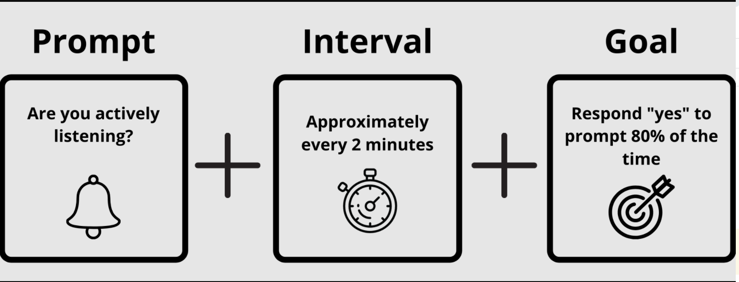
I-Connect for Self Management
What is self monitoring?
allows students to set and track goals and adjust their behavior to meet those goals
What is i-Connect?
a mobile app for students to self monitor a target behavior and track progress
What are the steps?
I am FREE!
https://iconnect.ku.edu/

Slide 57
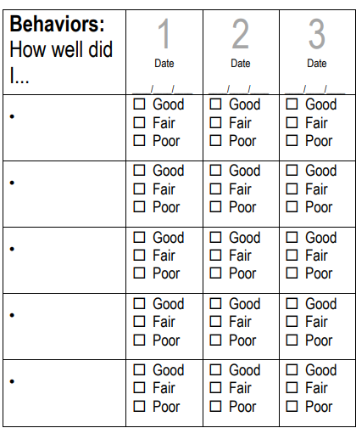
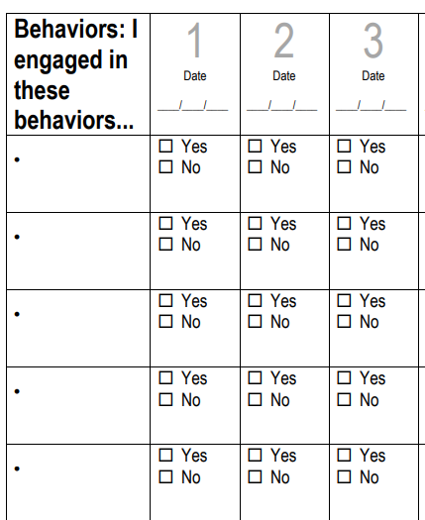
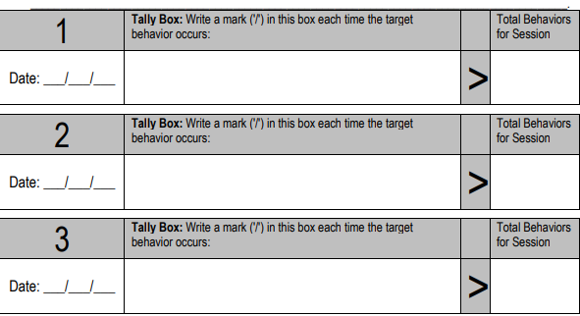
Rating Scale
Checklist
Frequency Count
https://www.interventioncentral.org/self_management_self_monitoring

Slide 58
let’s put this in context...
Antecedent (trigger) | Behavior | Consequences Did it work?
independent work tasks | 11:50; made a comment under his breath about the assignment | no; peers ignored
 | 11:53; worked for about 5 minutes | yes; self monitors for points
 | 11:55; worked for about 5 minutes | yes; self monitors for points
 | 12:00; worked for about 5 minutes | yes; self monitors for points
 | 12:03; conference with teacher | yes; met goal awarded points for free time
adapted from Ennio Cipani, Ph.D. (2020)

Slide 59
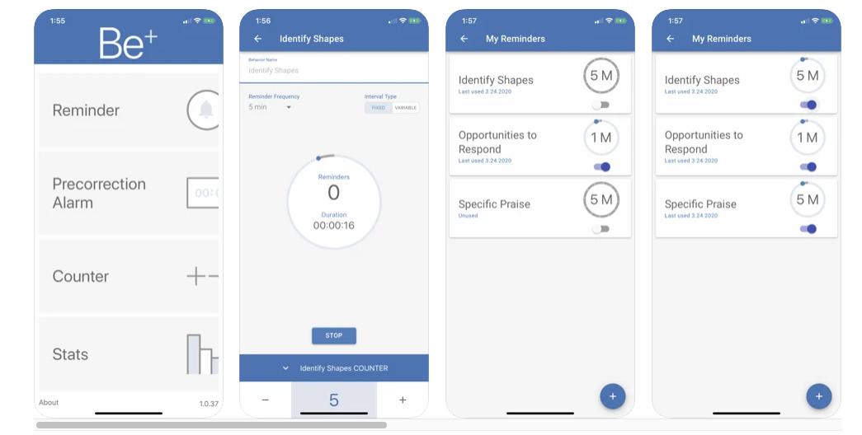
SELF MONITOR YOUR OWN BEHAVIOR

Slide 60
WHAT REPLACEMENT BEHAVIOR COULD YOU TEACH?
A. During class, when it is almost time to transition, Megan asks for the homework to be repeated (despite postings in multiple places), which is positively reinforced by additional time with the teacher who keeps her after class.
Remember Replacement Behaviors:
Require less effort to obtain the same reinforcers that maintain the concerning behavior
Are easier to do that the problem behavior
Are socially acceptable
B. During the day, when Niki transitions to lunch, she often leaves campus or walks around the building, which is negatively reinforced via avoiding social interaction with peers.

Slide 61
Respond to Increase Interventions
Setting Event | Antecedent | Behavior | Consequences
Connect Interventions | Prevent Interventions | Teach Interventions | Respond to Increase | Respond to Decrease
Strengthen relationships & use noncontingent attention | Create and teach predictable routines, use transition supports Provide choices Increase opportunities to respond Modify instruction to student’s level Prompts | Functional Replacement Skills Alternative Skills --------------------------- Examples: Teach specific SEL Skills Teach general coping skills | Premack principle Social reinforcers Token Economy Group contingencies | Reinforce Alternative Behavior Praise around the misbehavior Reinforce lower rates Error correction

Slide 62
What might follow this behavior to increase its future probability?
...This is known as Reinforcement

Slide 63
Fact or Fiction
Reinforcement is counterproductive and inhibits positive behavior.
Students with concerning behavior typically get LESS reinforcement for positive behavior than their peers
You can only call something reinforcement if it increases future rates of behavior
Artificial reinforcement should always be faded to more natural reinforcement

Slide 64
Assessing a Student’s Reinforcers
Individual factors that influence the effectiveness of a “stimulus” as a reinforcer:
the student’s reinforcement history
the student’s deprivation state
perceived value of the stimulus by the student
consistency of delivery of the reinforcer
age appropriateness of the stimulus
Some Tools:
Reinforcer menus
Reinforcer interviews

Slide 65
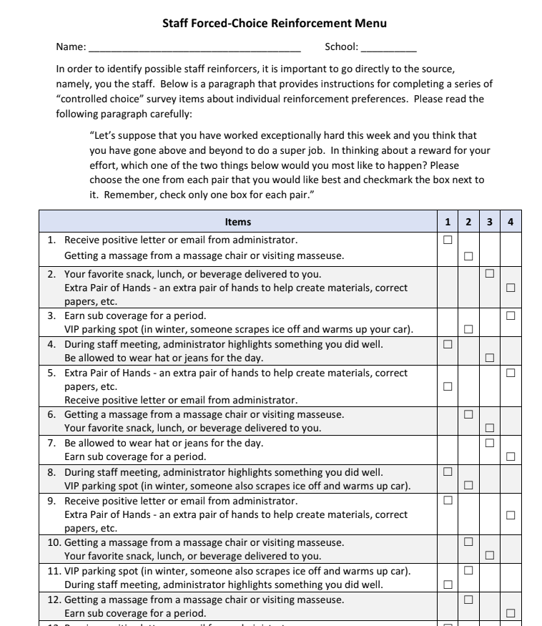
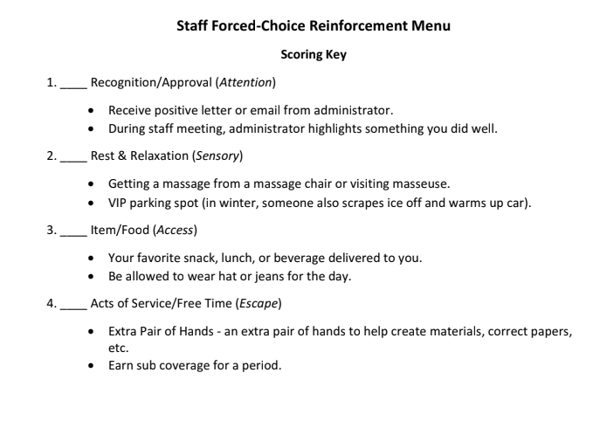
...or an adults preferences

Slide 66
Selecting a reinforcer… some tips!
select reinforcers that can be presented immediately following the behavior
select reinforcers that can be presented with minimal disruption to the behavior and on-going activity
select reinforcers that kids won’t “get sick of”
select reinforcers that are acceptable to you and the student’s family
select reinforcers that are reinforcing to the student!

Slide 67
by selecting a replacement behavior that requires less effort to obtain the same reinforcers that maintain the problem behavior,
Make it INEFFICIENT
Remember...

Slide 68
Types of Reinforcers
Tangible reinforcers
Activity and privilege reinforcers
premack principle
Token reinforcers
token economies
Social reinforcers (communicates acknowledgement and approval)
verbal feedback
nonverbal gestures
physical contact
proximity

Slide 69
Premack Principle
Focus on making the preferred activity contingent on completing a non-preferred task
“First complete 5 minutes of work independently (desired behavior) and then you can complete the rest with a partner.”

Slide 70
PRAISE SHOULD BE...
…contingent: occur immediately following desired behavior
…specific: tell learner exactly what they are doing correctly and continue to do in the future
“Good job” (not very specific)
“I like how you are showing me active listening by having quiet hands and feet and eyes on me” (specific)
“Thank you for reaching out to your students’ parents and establishing positive communication (works on adults too!)
From Positive Classroom Behavior Supports, presented by Kim Yanek from Mid-Atlantic PBIS Network

Slide 71
In the chatbox...
A student voluntarily helps another student in the hallway.
You say, “Nice”.
Change your response to a Behavior Specific Praise Statement.
___________________________________________
Example from Midwest PBIS

Slide 72
TOKEN ECONOMIES
Tokens are generalized reinforcers which means they are linked to a variety of other reinforcers
Always pair with behavior specific praise
Create a reinforcement menu that provides the student with ACCESS or ESCAPE based on the function of their problem behavior
Be aware of satiation (keep it fresh)!
Remember that students don’t learn without experiencing success… and the pay off should be easier to access with the replacement vs. problem behavior (don’t make it too hard)!
Move from artificial (e.g. access to toys) to more natural reinforcer options (e.g. access to class privileges)
BE AWARE OF RESPONSE COST

Slide 73
How could you reinforce the behavior you picked to teach in the last section?
A. During class, when it is almost time to transition, Megan asks for the homework to be repeated (despite postings in multiple places), which is positively reinforced by additional time with the teacher who keeps her after class.
Tangible
Activity
Social
Token Economy
B. During the day, when Niki transitions to lunch, she often leaves campus or walks around the building, which is negatively reinforced via avoiding social interaction with peers.
remember: your plan should provide easier access to the same reinforcers than maintain the concerning behavior

Slide 74
Respond to Decrease Interventions
Setting Event | Antecedent | Behavior | Consequences
Connect Interventions | Prevent Interventions | Teach Interventions | Respond to Increase | Respond to Decrease
Strengthen relationships & use noncontingent attention | Create and teach predictable routines, use transition supports Provide choices Increase opportunities to respond Modify instruction to student’s level Prompts | Functional Replacement Skills Alternative Skills --------------------------- Examples: Teach specific SEL Skills Teach general coping skills | Premack principle Social reinforcers Token Economy Group contingencies | Reinforce Alternative Behavior Praise around the misbehavior Reinforce lower rates Error correction

Slide 75
Make it INEFFECTIVE
by removing the reinforcers of the concerning behavior and by increasing the reinforcers of the replacement behavior
Minimize the pay-off the student has been receiving for the problem behavior.
and
Redirect the student to use their replacement behavior (do not reprimand) (ex: “The expectation is that you raise your hand to speak. Please raise your hand and wait if you have a question” rather than “Wait your turn to speak!”)

Slide 76
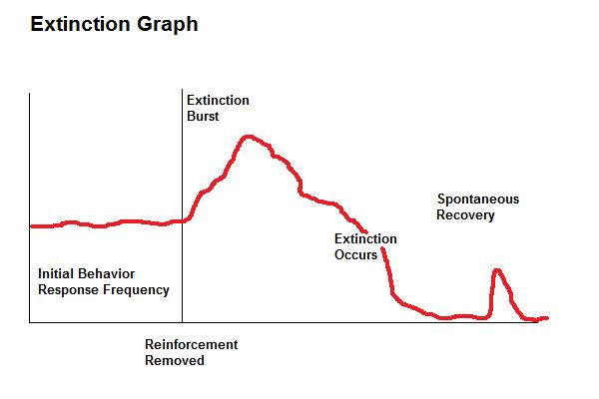
IGNORING ISN’T AN EASY STRATEGY
Applied Behavior Analysis for Teachers, 9th edition
Paul A. Alberto and Anne C. Troutman

Slide 77
How could you use reinforcement to decrease talking in class behavior?

Slide 78
REINFORCE ALTERNATIVE BEHAVIOR
When the student engages in the replacement behavior, quickly provide the student with an outcome that provides access to the same reinforcers that maintain the concerning behavior.
Start with high rates of reinforcement and find ways to fade as the student learns the skill

Slide 79
Jason is nine and cries when asked to write in his journal. The crying is maintained by avoiding or escaping difficult tasks.
Option 1: if the student’s alternative skill is: raises hand to request an easier task (in order to escape difficult tasks), then quickly provide the student with a similar/but easier task
Option 2: if the student’s alternative skills is: attempts difficult tasks, provide incentive to earn escape (e.g. use your token economy to skip writing tasks).

Slide 80
PRAISE AROUND MISBEHAVIOR
Example:
Ms. Linda wants to decrease Joe’s wandering behavior during circle time. She decides to ignore when he leaves circle and instead provides behavior specific praise and Linda Bucks to other students in the class when Joe leaves circle.

Slide 81
REINFORCE LOWER RATES
Example:
Mona moves her mask to take a quick drink 11 times on the average per class. Ms. Lisa tells Mona that if she moves her mask 7 or fewer times, then she will earn a classroom token. After Mona met this criterion for three consecutive classes, Ms. Lisa. lowered the reinforcer criterion to 4 or fewer times to move her mask.

Slide 82
REINFORCE ZERO OCCURRENCES
Example:
If Ben refrains from turning his camera off on Zoom for 30 minutes, then he will earn 10 Dojo Bonus points toward the class incentive.
Ms. Linda is frustrated that Tom is using the chat box for inappropriate conversation. She decides to set a random timer to go off several times throughout the class period and provides points to Joe if there were 0 incidents of inappropriate comments.

Slide 83
HOW WILL YOU USE CONSEQUENCES TO DECREASE USE OF PROBLEM BEHAVIOR?
A. During class, when it is almost time to transition, Megan asks for the homework to be repeated (despite postings in multiple places), which is positively reinforced by additional time with the teacher who keeps her after class.
Praise around the misbehavior
Reinforce lower rates
Error correction
Planned ignoring
B. During the day, when Niki transitions to lunch, she often leaves campus or walks around the building, which is negatively reinforced via avoiding social interaction with peers.

Slide 84
Plan for Fidelity: which one would be more likely to be implemented?
BIP-Prevention Strategies
OR
BIP-Prevention Strategies
Provide Choices: The teacher will provide Don with a choice prior to assigning him independent work in class. Choice options are: (a) materials to use for assignment; choice of leadership activities; (b) where to sit; (c) who to do the assignment with
Steps:
Immediately after giving the class the independent math assignment, go over to Don and present him with a choice option.
When presenting him with a choice, say “Don, where do you want to sit? X or X?”
After Don makes his choice, say, “Thanks for making a great choice” and release him to his choice.
Provide choices of where to sit
Teachers need to know exactly what to do or the intervention may not be implemented as intended.

Slide 85
Plan for safety
Safety Plan developed to implement here
You may need to develop a temporary safety plan prior to completing the FBA to ensure student/staff safety.
FBA identifies this; BIP developed to implement here!

Slide 86
Ways to Fade...
Teach a new skill
Change schedule of reinforcement
Change type of reinforcement
Increase expectations
Generalize to new settings
Teach self management

Slide 87
SOME FBA TOOLS
FUNCTIONAL ASSESSMENT CHECKLIST FOR TEACHERS
PTR BRIEF

Slide 88
INTERVENTION TOOLS
TOP TEN INTERVENTIONS:
FROM PBIS.ORG/OSEP
PTR INTERVENTIONS:
FROM PREVENT-TEACH-REINFORCE

Slide 89
Q/A

Slide 90
NEED MORE?
CHECK OUT OUR WEBSITE:
SEND US AN EMAIL!
Niki Kendall robertsn@udel.edu
Rebecca Silver rsilver@udel.edu

