Slide 1
DE-PBS CADRE
MEETING
December 16, 2021

Slide 2
Meeting Expectations
We are... | Virtual Meetings
ENGAGED | Unmute yourself or use chat box to ask questions Participate in polls and breakout rooms Use video when possible, especially when speaking
REFLECTIVE | Share questions you have for full group Note follow up questions for PBS team and/or individuals Focus on problem solving around areas of concern
SUPPORTIVE | Share successes, ideas, useful resources Listen with openness and understanding Attend to your own needs

Slide 3
Today’s Agenda Topics
Revisit: A Year at a Glance in Coaching Guidance for MTSS-SEB Coaches
Professional Learning Opportunities
Data
Universal Screening
Coach Networking Preview: Equity Focus

Slide 4
Positive Feedback & Gratitude
November Networking
Most helpful...
They (Kristi & Adriane) gave us items of consideration & encouragement to move forward at a steady pace.
The opportunity to hear from experienced coaches gave me valuable systems organization tools to keep in mind while "coaching for change.”
Focused on Coaching
via resource and experience sharing

Slide 5
A Year at a Glance in Coaching
Guidance for MTSS-SEB Coaches
This document is for you to use however best fits your needs.
The intent of this document is to help you organize all of the many parts of PBS/MTSS
It is organized by systems, practices and data. The front page is the overall picture and the second page is outlined by seasons.
You are doing amazing work - be kind to yourself.

Slide 6
Coaching Activities Guidance
Fall | Systems: | Hold scheduled Team Leader meetings (bi-monthly, quarterly, etc.) with agenda influenced by ongoing goals shared on page 1.
 | Practice: | Attend MTSS meetings and provide coaching feedback using Team Observation and/or ask Team Leaders to submit monthly agendas and minutes to preview & provide feedback Send reminder regarding DSCS enrollment based on DE-PBS Project timeline
 | Data: | Create and share a data collection plan for the year which includes the types of data (DDRT, DSCS, TFI) and collection schedule Send DDRT spreadsheet and instructions to Tier 1 PBS/MTSS Team Leaders Monitor DDRT submissions and identify trends to discuss at Team Leader Meetings; problem-solve with schools not yet utilizing DDRT.

Slide 7
Coaching Activities Guidance
Winter | Systems: | Hold scheduled Team Leader meetings (bi-monthly, quarterly, etc.)
 | Practice: | Send mid-year PBS/MTSS updates, success stories, and/or gratitude
 | Data: | Send reminder of school team’s DDRT to be submitted to DE-PBS Project by January 14, 2022

Slide 8
Professional Learning

Slide 9
PBIS Leadership Forum -
Recordings Available
Available topic strands include:
Getting Started with PBIS
District Leadership
Equity in School Discipline
Mental Health Integration
Family Partnerships
Youth Voice
Classroom PBIS
Tier 2 & 3 Systems & Practices
Juvenile Justice
National conference for school, district, regional, and state PBIS leadership teams
A place to learn about the latest PBIS research and strategies from leaders in field

Slide 10
Tier 2 PL Series Proposal (3-Part Series)
Teams | Interventions | Evaluation
Team Composition Team Operating Procedures Screening Request for Assistance | Option for Tier 2 Interventions Tier 2 Critical Features Practices Matched to Student Need Access to Tier 1 Supports Professional Development | Student Performance Data Fidelity Data Annual Evaluation

Slide 11
Tier 2 PL Series Proposal - Your Input
Thursday evening series
3-evening series: 2/24, 3/3, 3/10, 5-7pm each
2-evening series: 3/3, 3/10
Pre-, During-, Post-Series team participation & activities
Eg. attendance across the series, asset mapping, TFI draft scoring
District Coach Support
Recruit teams and familiarize yourself with the TFI-Tier 2
Attend series to provide live support
Support team submission of complete TFI scores/action plan

Slide 12
Sample Tier 2 Intervention

Slide 13
Tier 3 Professional Learning
FBA to BIP for Educators
What: This session is for anyone interested in better understanding function based behavior support planning.
When: Asynchronous
To Register: PDMS - Course #30118, Sections 57774 (part 1) and 57775 (part 2)
Standards Based IEP Combo Training
What: This training will focus on creating Standards-based IEPs. Participants will be given an introduction of the rationale for creating SBIEPs and the research-based best practices involved in creating IEP content in accordance with the Common Core State Standards, and compliance guidelines.
When:
2/15/2022 (PDMS Section #57893) 8:30am-3:30pm
3/16/2022 (PDMS Section #57894) 8:30am-3:30pm

Slide 14
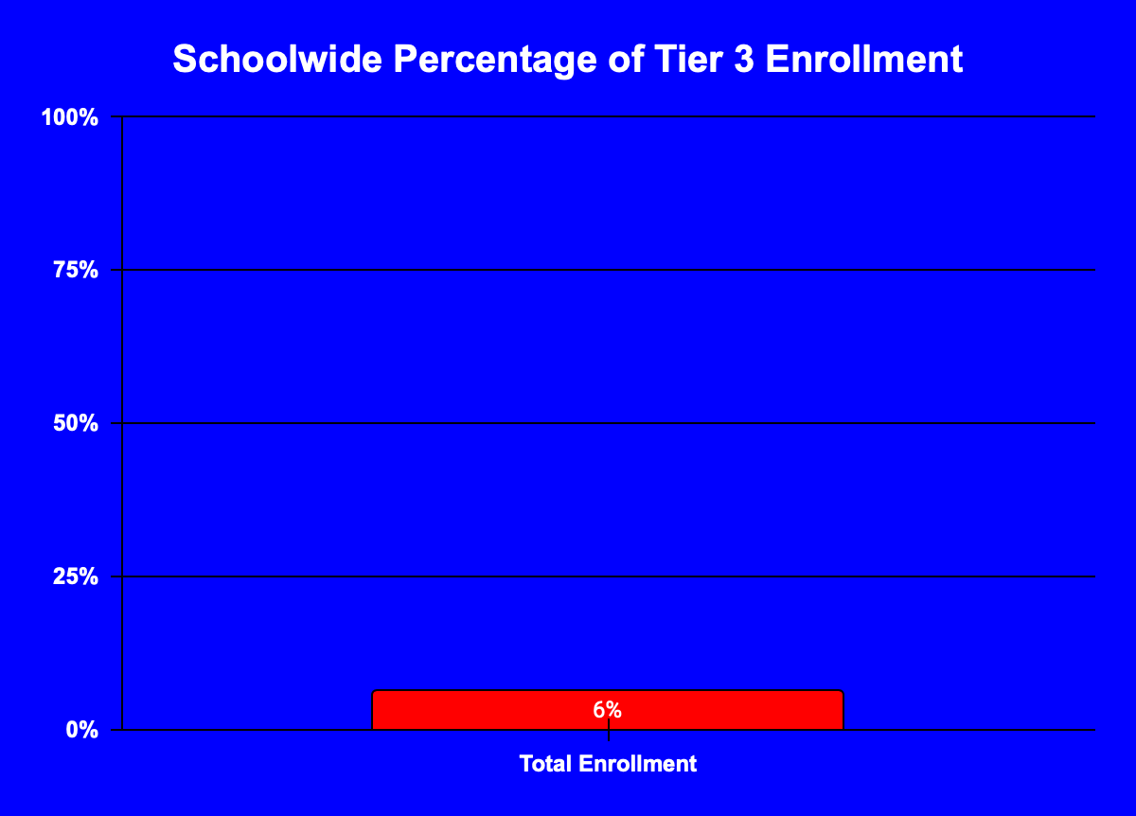
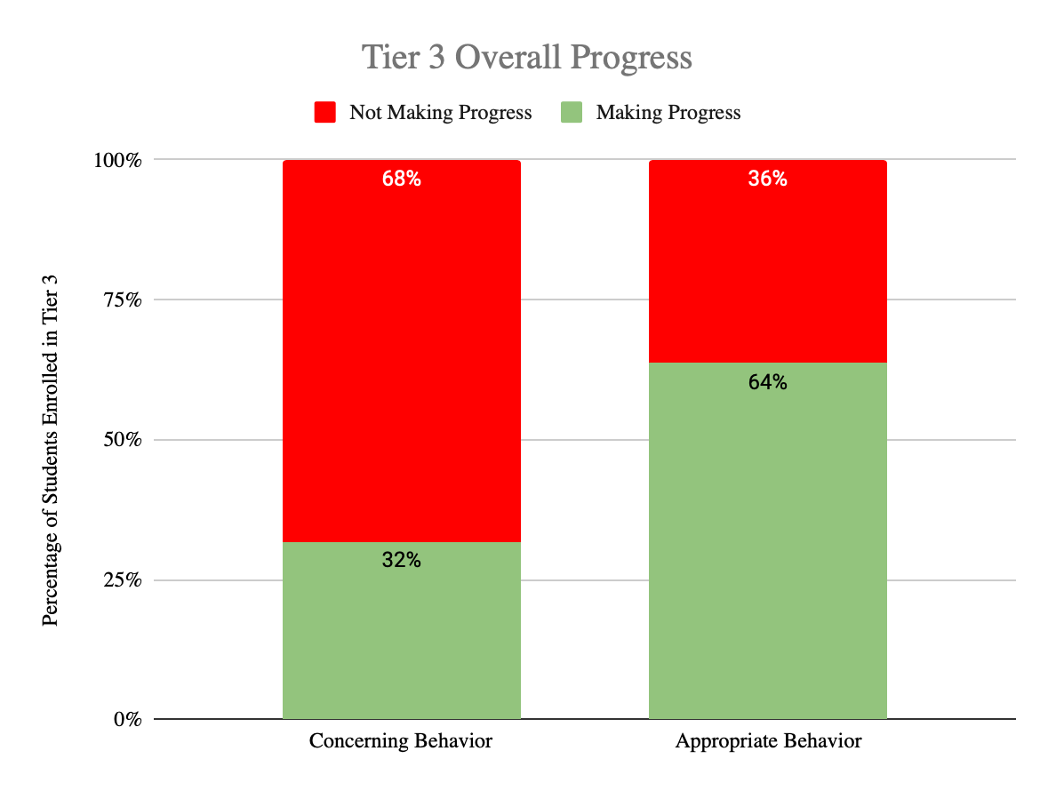
Spring 2022: Tier 3: Systems Session
Have you ever wondered how to evaluate and respond to the overall effectiveness of your Tier 3 system?
This session is for you!
This spring we look forward to hosting a professional learning session for those focused on Intensive (T3) data, systems and practices.

Slide 15
Data Reminders

Slide 16
Discipline Data Reporting Tool (DDRT)
2021-22 Excel templates shared via email for your distribution to active buildings
Templates available on website
Submissions are 2x per year to district coach and project.
January 14th and June 17th

Slide 17
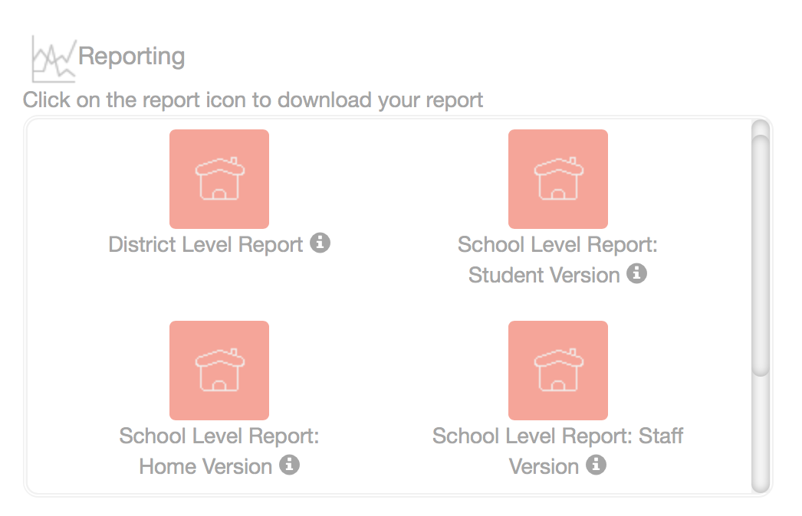
School Climate - 2020-2021 School Year
Reminder: School & District Level reports AVAILABLE once surveying is complete.
Reports downloaded as PDF files from the Dashboard in CoVitality.
Info forthcoming for new coaches!
2021-2022 DSC Survey - Updates to Come

Slide 18
The Behavioral Health Consortium
Needs YOUR Voice!
Current Response Rates
Superintendent
Assistant Superintendent | 1
Director of PPS | 1
Director of Special Education
Director of Curriculum
Director of Assessment and Accountability
Charter Lead | 1
Building Principal | 3
District Coach | 1
Other | 3
Total | 13
Who: School leaders (e.g. superintendents, charter leads, building principals, district coaches)
What: A survey to identify universal behavioral and mental health universal screening processes in schools.
Why: Survey results will help the BHC understand school leader beliefs and experiences with universal behavioral and mental health screening practices.
How: https://delawaredoe.iad1.qualtrics.com/jfe/form/SV_02sDHkSJbwfmTIi
When: Before end of January

Slide 19
Universal SEB Screening

Slide 20
Key Universal Screening Assumptions
Universal screening is a key component of your comprehensive MTSS assessment system (not a separate initiative).
Universal screening is a process to monitor student responsiveness to SEB supports not a tool.
Universal means ALL students are part of your process not ALL students are screened with every tool.

Slide 21
Sources of Data for a Comprehensive Assessment System
Screening/
Benchmarking
Diagnostic Data
Progress Monitoring
Fidelity
Helps identify students who might require additional support.
Helps identify students’ current skill level and needs.
Helps identify if students are making adequate progress.
Helps identify how consistently educators are implementing a practice.
21
Copyright © 2021 Center on Response to Intervention at American Institutes for Research and Delaware Department of Education. All rights reserved.

Slide 22
A summary of (14 DE Admin. Code § 508.6.1.1 - 508.6.1.1.4): MTSS Framework and Procedures
Tier 1 supports + multiple gating procedure
First stage is universal screening to identify students who may need additional supports
Second stage (within two weeks) is data analysis to confirm there are specific areas of need for Tier 2 supports
If 20% of students in a classroom are not meeting a benchmark consider the need for additional classroom, instructional and systems level supports and strategies
Based on results identified students matched to supports

Slide 23
Support families to engage in your MTSS Framework and Procedures
LEAs shall provide a description of the methods used to implement and evaluate the effectiveness of the program upon the request of the Department (14 DE Admin. Code § 508.7.0)
Be proactive and inform families about SEB screening data being collected and your response
LEAs shall have a process for providing parents with the MTSS intervention plan and data collected as part of the MTSS framework as described in Section 7.0. (14 DE Admin. Code § 508.5.6)
Actively involve families in the intervention planning process for identified students

Slide 24
Whom should we screen?
Few?
Some?
The response of every student should be captured in your universal screening process
All?

Slide 25
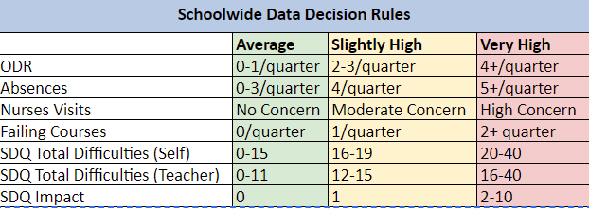
Data Response Protocols are KEY!
Student Level Decision Making Prompts:
Did the student meet your universal screener decision rule?
How is the need reflective of the student’s current circumstance?
Does the student meet additional schoolwide decision rules?
What additional information do we need to understand the need?
How can we best support the student’s specific need?

Slide 26
Universal Screening is a Process NOT a tool
What existing information do you have (e.g., schoolwide data) that could help you predict who may be impacted by this concern?
How are your students responding to your universal SEB supports?
Who is impacted? What is the impact?
How can we most efficiently respond? All? Some? Few?
What additional information do you need (e.g., universal screener) that could help you predict who may be impacted by this concern?

Slide 27
Existing information:
Office discipline referral data
Attendance data
Next steps:
Engage sample of girls to better understand need
Review schoolwide expectations and teaching plan with a focus on peer relations
Explore potential Tier 2 supports that address need (to layer with Tier 1)
How are your students responding to your continuum of SEB supports?
Tier 1 Problem analysis:
Data indicates only 65% of students self report average risk
Of the domains measured, peer relations was the biggest need
This trend impacts female students (50% average risk) more than male students (85% average risk)
Additional information:
6th grade self report SEB screener data

Slide 28
Indian River School District
Project DelAWARE Supported
Screening Pilot
Nika Reid

Slide 29
Screening Selection Process
Selection committee made up of various stakeholder groups. The committee reviewed four potential screening tools.
Essential Questions to keep in mind:
○What is the purpose of the universal screener?
○What tool will be most agreeable for our School Board and parent affinity groups?
○What do we hope to accomplish?
○How can we use the (Pilot) data to drive systemic change in supporting student needs?
Key Takeaways:
○Research the platform selected. ○How antiquated is the platform?
○ Training

Slide 30
Obtaining Parental Consent:
The District Team drafted our passive consent form, which was later reviewed by our Legal Team.
Point to keep in mind-How will the parent be notified when scores indicate support is needed? The District team agreed to include the following language in the passive consent letter…
(old language)...The (Insert name of school) School therapeutic team will review the results and communicate with you about strengths and areas of needed support for your student.
(new language)...a member of our counseling team will review the results and communicate with you if your student has any identifying concerns.
Must do: include Project DelAWARE Data Collection Language to the letter.

Slide 31
Strength and Difficulties Questionnaire
 | Sample Size
Psychological Attributes | LNE | MMS | SCHS
 | 119 out of 124 (Grade 4) | 48 (Grade 6)** | 224 out of 464* (Grade 9)
Prosocial Behavior (Skills) | Teacher-Report | Self-Report | Self-Report
Emotional Symptoms | Data Review: Identifying students for intervention
Conduct Problems | Coaching 101: What is the process for data review? ○Support school teams to ensure sample size is reflective of the school demographics. ○Work with team to identify problem(s) and gather more data about the problem. ○Time Management: is essential to ensure at-risk students are appropriately placed in tiered intervention in a timely manner. ○TAM method: Team approach to mastery of intervention development and implementation.
Hyperactivity/Inattention
Peer Relationship Problems
Total Difficulties (Stress or Impact Score)

Slide 32
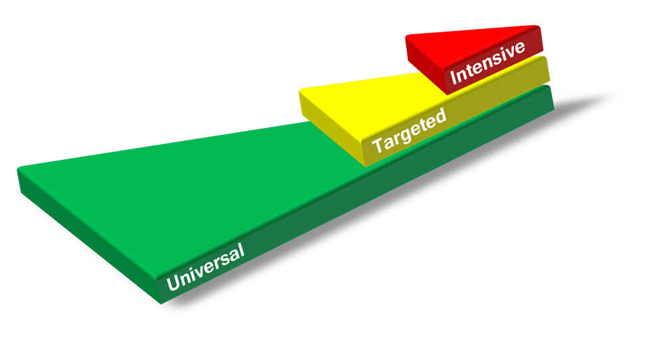
Action Steps
Continuum of Support
Using Data to Implement Systemic Changes:
Example: When your total impact score indicates significant concerns with Tier 1 School-wide Interventions.
○Tier 1 team met to review interventions matrix and design/develop areas of improvement
○Tier 1 team made modifications to PBIS rewards system (as some tangibles were not attainable).
○Administrator buy-in: review building data (Office Discipline Referrals, Attendance, and Achievement Data)
Referral to Service:
○Request for Assistance (modified process)
○Advocation of increased Tier 1 Interventions to support significant school-wide concerns.
Example: District Mandate-Counseling Teams must provide a minimum of 10 Small Groups (data-driven) each Cycle. District conversations to reduce district mandate in order to increase Tier 1 counseling team support.

Slide 33
Small Group Discussion
What data do you feel is missing in your current assessment system that you have concerns about? Start with screening and move on to the other types if you have time
Screening?
Diagnostic?
Progress monitoring?
Fidelity?
What are your takeaways from our conversation today?

Slide 34
DE-PBS/DelAWARE Project: Screening Resources
Top Ten Questions Answered about Universal Screening Webinar
Time: 40 minutes
Intended audience: all educators looking to understand the key ideas of universal screening
How: Watch asynchronously or download and use the materials! Register via PDMS course # 29663 or visit: www.delawarepbs.org/universal-screening/
DE-PBS Universal Screening Webpage
District Level Action Plan
School Level Action Plan

Slide 35
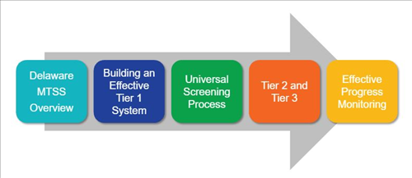
DE-MTSS: MTSS/Screening Resource
DE-MTSS Module Series
Schoology Course (Course # 30130 Section # 57818)

Slide 36
Coaches Networking
EQUITY

Slide 37
DE-PBS Deep Dive
Discussing Race, Racism, & Important Current Events

Slide 38
Introduction
In the midst of a global health pandemic, many students & educators witnessed the continual racial injustice occurring in our communities.
Many districts across the U.S. have been working to improve equity and inclusion, but caught off guard without a plan to respond to anti-Black racism, incorporate anti-racist work in schools, and give more voice to students.

Slide 39
Details of Guide:
-70 pages Total
-Sections:
*Introduction (3 pgs)
*Embed this Work within the Systems (4 pgs)
*Build Knowledge & Experience (5 pgs)
*Create Installation Plan (3 pgs)
*Implement & Monitor Progress (6 pgs)
*References (2 pgs)
*Numerous Appendixes of Resources (47 pgs)

Slide 40
Purpose of Guide
To increase the frequency and quality of conversations about race, racism, and current events regarding race in K-12 classrooms to support students and provide voice and self-reflection.
Center on Positive Behavioral Interventions and Supports (July 2021). Discussing Race, Racism, and Important Current Events with Students: A Guide with Lesson Plans and Resources. University of Oregon. www.pbis.org.

Slide 41
Purpose of the Guide Presentation
Although this guide is tailored for classroom teachers, our presentation focuses on supporting your role as a coach and provides you the opportunity to increase your understanding of this topic and resource, as well as build a capacity to turn this training around for your district or schools.

Slide 42
First Acknowledge Inequities
Ex: Resource-Student Focus Group Video p. 6
This short video (3:20 minutes) is an example of a student focus groups that highlights students talking about the importance of discussing race in school.

Slide 43
Polls re: Our Current Contexts
District guidance
Educator comfort
Educator use
District Board of Education

Slide 44
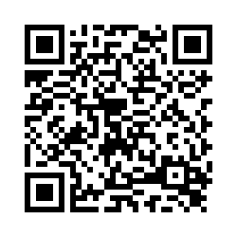
Coaches Networking
Thursday January 20th, 2022
1-2:30 pm
NEXT MEETING:
Please take a few minutes to fill out our participant survey!

Slide 45
HAVE A WONDERFUL HOLIDAY BREAK!
THANK YOU FOR ALL THAT YOU DO!

